Slide 1
Rising Risk and Global Opportunity
Musings on Mega Issues in Global Insurance & Growth Prospects
John Street Club
New York, NY
November 8, 2013
Download at www.iii.org/presentations
Robert P. Hartwig, Ph.D., CPCU, President & Economist
Insurance Information Institute ♦ 110 William Street ♦ New York, NY 10038
Tel: 212.346.5520 ♦ Cell: 917.453.1885 ♦ bobh@iii.org ♦ www.iii.org

Slide 2
Presentation Outline
Risk, Insurance and Opportunity: A Global Perspective
Old Risk, New Opportunity: Catastrophic Loss
The Old World: Money Left on the Table?
The Emerging Markets: Where (Most) of the Growth Is
Energy
Terrorism
Low Yields: Are They Forever?
Q&A

Slide 3
Risk, Insurance and Opportunity
U.S. and Global Perspective
Is the World Becoming a Riskier, More Uncertain Place?
Or Does It Just Seem that Way?
3

Slide 4

Uncertainty, Risk and Fear Abound: Insurance Can Help Mitigate Risk
US Debt and Budget Crisis
European Sovereign Debt & Eurozone Crises
Political Gridlock in the US, Europe, Japan
“Hard Landing” in China/Emerging Economies
Fiscal Imbalances
Monetary Policy/Tapering/Low Interest Rates
Unemployment
Political Upheaval in the Middle East
Resurgent Terrorism Risk
Diffusion of Weapons of Mass Destruction
Cyber Attacks
Record Natural Disaster Losses
Climate Change
Environmental Degradation
Income Inequality
(Over)Regulation
Are “Black Swans” everywhere or does it just seem that way?

Slide 5





5 Major Categories for Global Risks, Uncertainties and Fears: Insurance Solutions
Economic Risks
Geopolitical Risks
Environmental Risks
Technological Risks
Societal Risks
While risks can be broadly categorized, none are mutually exclusive
Source: Adapted from World Economic Forum, Global Risks 2013; Insurance Information Institute.

Slide 6
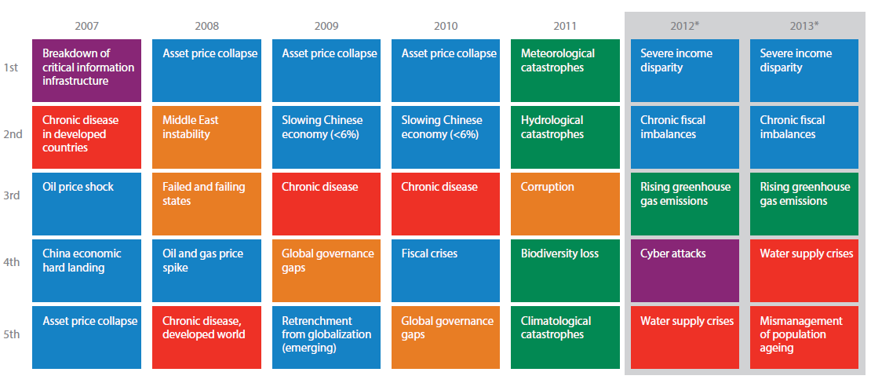
Top 5 Global Risks in Terms of Likelihood, 2007—2013: Insurance Can Help With Most
In 2013, economic and climate change concerns dominated frequency concerns
Concerns Shift Considerably Over Short Spans of Time. Shift in 2012 to Economic Risks and Away from Environmental Risks
Source: World Economic Forum, Global Risks 2013; Insurance Information Institute.
6
12/01/09 - 9pm
eSlide – P6466 – The Financial Crisis and the Future of the P/C
Notes:
6

Slide 7
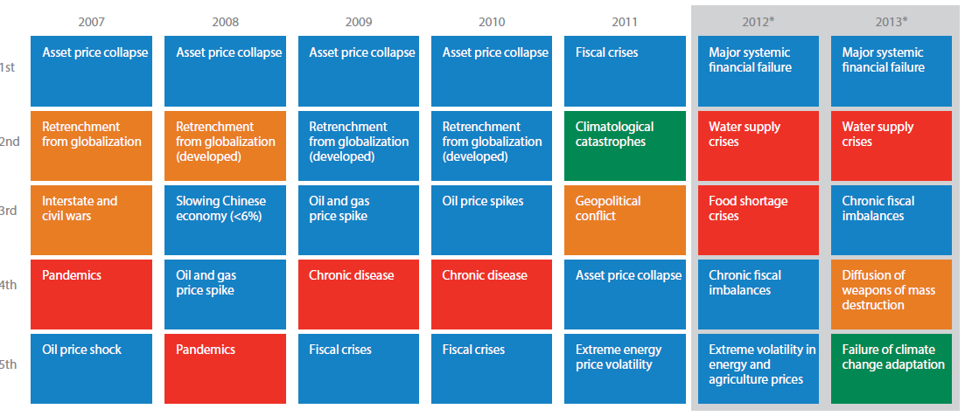
Top 5 Global Risks in Terms of Impact,
2007—2013: Insurance Can Help With Most
Impacts from economic, societal, geopolitical and environmental risks were all of great concern in 2013
Concerns Over the Impacts of Economics Risks Remained High in 2013, but Societal, Environment and Societal Risks Also Loom Large
Source: World Economic Forum, Global Risks 2013; Insurance Information Institute.
7
12/01/09 - 9pm
eSlide – P6466 – The Financial Crisis and the Future of the P/C
Notes:
7

Slide 8
Insured vs. Uninsured Catastrophe Losses
Do Insurers Leave Money on the Table Even With Risks We’ve Encountered for Centuries?
8

Slide 9
Top 16 Most Costly World Insurance Losses, 1970-2012*
(Insured Losses, 2012 Dollars, $ Billions)
5 of the top 14 most expensive catastrophes in world history have occurred within the past 3 years (2010-2012)
2012 insured CAT Losses totaled $60B; Economic losses totaled $140B, according to Swiss Re
Hurricane Sandy is now the 6th costliest event in global insurance history
*Figures do not include federally insured flood losses.
**Estimate based on PCS value of $18.75B as of 4/12/13.
Sources: Munich Re; Swiss Re; Insurance Information Institute research.

Slide 10
Natural Disasters in the United States, 1980 – June 2013*
Number of Events (Annual Totals 1980 – June 2013*)
There were 68 natural disaster events in the first half of 2013
Number
41
19
121
3
Geophysical
(earthquake, tsunami,
volcanic activity)
Meteorological (storm)
Climatological
(temperature extremes,
drought, wildfire)
Hydrological
(flood, mass movement)
*Through June 30, 2013.
Source: MR NatCatSERVICE
10

Slide 11
Losses Due to Natural Disasters in the US, 1980–2013*
(Overall and Insured Losses)
(2012 Dollars, $ Billions)
First Half 2013 losses were running below 2011 and 2012 but were consistent with the decade prior. Approximately 57% of the overall cost of catastrophes in the US was covered by insurance in 2013:H1
2013 First Half Losses
Overall : $13.8B
Insured: $7.9B
Indicates a great deal of losses are uninsured (~40%-50% in the US) = Growth Opportunity
*Through June 30, 2013.
Source: MR NatCatSERVICE
Insured losses (in 2012 values)
Overall losses (in 2012 values)
11

Slide 12
Natural Disasters Worldwide,
1980 – 2013* (Number of Events)
There were 460 natural disaster events globally in the first half of 2013 and 905 for full-year 2012
Number
41
19
121
3
Geophysical
(earthquake, tsunami,
volcanic activity)
Meteorological (storm)
Climatological
(temperature extremes,
drought, wildfire)
Hydrological
(flood, mass movement)
*Through June 30, 2013.
Source: MR NatCatSERVICE
12

Slide 13
Losses Due to Natural Disasters Worldwide, 1980–2013* (Overall & Insured Losses)
(Overall and Insured Losses)
(2012 Dollars, $ Billions)
2012 Losses
Overall : $101.1B
Insured: $57.9B
2013: 1st Half Losses
Overall : $45B
Insured: $13B
There is a clear upward trend in both insured and overall losses over the past 30+ years
Overall losses (in 2012 values)
Insured losses (in 2012 values)
*Through June 30, 2013.
Source: MR NatCatSERVICE
13

Slide 14
Total Value of Insured Coastal Exposure in 2012
(2012, $ Billions)
The value of insured coastal exposure in NY is now highest in the US for the first time.
In 2012, New York Ranked as the #1 Most
Exposed State to Hurricane Loss, Overtaking Florida with $2.862 Trillion. Texas is very exposed too, and ranked #3 with $1.175 Trillion
in insured coastal exposure
The Insured Value of All Coastal Property Was $10.6 Trillion in 2012 , Up 20% from $8.9 Trillion in 2007 and Up 48% from $7.2 Trillion in 2004
Source: AIR Worldwide

Slide 15
Total Potential Home Value Exposure to Storm Surge Risk in 2013*
($ Billions)
Florida is by far the state most vulnerable to storm surge.
The Value of Homes Exposed to Storm Surge was $1.147 Trillion in 2013.* Only a fraction of this is insured, hence the huge demand for federal aid following major coastal flooding events.
*Insured and uninsured property. Based on estimated property values as of April 2013.
Source: Storm Surge Report 2013, CoreLogic.

Slide 17
The combined ratios for both personal and commercial lines improved substantially in 2013:H1

Slide 18
I.I.I. Poll: Disaster Preparedness
Q. If you expect some relief from the government, do you purchase less insurance coverage against these natural disasters than you would have otherwise?
Don’t know
Yes
More than 20 percent cut back on insurance coverage in expectation of government disaster aid
No
Seventy-two percent of Americans would not purchase less insurance if they expect some relief from the government—but 22% would.
Source: Insurance Information Institute Annual Pulse Survey.

Slide 19
Near and Far:
The Global Economy Creates Opportunity, Transmits Risks
Globalization Is a Double Edged Sword—Creating Opportunity and Wealth But Potentially Creating and Amplifying Risk
Emerging vs. “Advanced” Economies
19

Slide 20
Close to Home: Sectors Likely to Generate Above Trend Growth
Into the 2020s, Certain Sectors Should Provide More Key Opportunities for Insurers in the US
20

Slide 21
US Real GDP Growth*
The Q4:2008 decline was the steepest since the Q1:1982 drop of 6.8%
Real GDP Growth (%)
Recession began in Dec. 2007. Economic toll of credit crunch, housing slump, labor market contraction was severe
2014 is expected to see a modest acceleration in growth
Demand for Insurance Continues To Be Impacted by Sluggish Economic Conditions, but the Benefits of Even Slow Growth Will Compound and Gradually Benefit the Economy Broadly
* Estimates/Forecasts from Blue Chip Economic Indicators.
Source: US Department of Commerce, Blue Economic Indicators 10/13; Insurance Information Institute.

Slide 22
Net Premium Growth: Annual Change,
1971—2013:H1
(Percent)
1975-78
1984-87
2000-03
Net Written Premiums Fell 0.7% in 2007 (First Decline Since 1943) by 2.0% in 2008, and 4.2% in 2009, the First 3-Year Decline Since 1930-33.
2013:H1 = 4.5%
2012 growth was +4.3%
Shaded areas denote “hard market” periods
Sources: A.M. Best (historical and forecast), ISO, Insurance Information Institute.

Slide 23
12 U.S. Industries for the Next 10 Years: Insurance Solutions Needed
Health Care
Health Sciences
Energy (Traditional)
Many industries are poised for growth, though insurers’ ability to capitalize on these industries varies widely
Alternative Energy
Petrochemical
Agriculture
Natural Resources
Technology (incl. Biotechnology)
Light Manufacturing
Insourced Manufacturing
Export-Oriented Industries
Shipping (Rail, Marine, Trucking, Pipelines)

Slide 24
Value of New Private Construction: Residential & Nonresidential, 2003-2013*
2013: Value of new pvt. construction hits $622.8B, up 24% from the 2010 trough but still 32% below 2006 peak
New Construction peaks at $911.8. in 2006
Billions of Dollars
Trough in 2010 at $500.6B, after plunging 55.1% ($411.2B)
$15.0
$613.7
$332.1
$298.1
$261.8
$238.8
$290.8
Private Construction Activity Is Moving in a Positive Direction though Remains Well Below Pre-Crisis Peak; Residential Dominates
*2013 figure is a seasonally adjusted annual rate as of June.
Sources: US Department of Commerce; Insurance Information Institute.
24
12/01/09 - 9pm
eSlide – P6466 – The Financial Crisis and the Future of the P/C
Notes:
24

Slide 25
New Private Housing Starts, 1990-2019F
Job growth, low inventories of existing homes, low mortgage rates and demographics are stimulating new home construction for the first time in years
(Millions of Units)
New home starts plunged 72% from 2005-2009; A net annual decline of 1.49 million units, lowest since records began in 1959
Insurers Are Starting to See Meaningful Exposure Growth for the First Time Since 2005 Associated with Home Construction: Construction Risk Exposure, Surety, Commercial Auto; Potent Driver of Workers Comp Exposure
Source: U.S. Department of Commerce; Blue Chip Economic Indicators (8/13 and 3/13); Insurance Information Institute.

Slide 26
Payroll vs. Workers Comp Net Written Premiums, 1990-2012E
Payroll Base* WC NWP
$Billions $Billions
7/90-3/91
3/01-11/01
12/07-6/09
WC premium volume dropped two years before the recession began
+9% in 2012E
WC net premiums written were down $14B or 29.3% to $33.8B in 2010 after peaking at $47.8B in 2005
Continued Payroll Growth and Rate Increases Suggest WC NWP Will Grow Again in 2012; +7.9% Growth in 2011 Was the First Gain Since 2005
*Private employment; Shaded areas indicate recessions. WC premiums for 2012 are I.I.I. estimate based YTD 2012 actuals.
Sources: NBER (recessions); Federal Reserve Bank of St. Louis at http://research.stlouisfed.org/fred2/series/WASCUR ; NCCI; I.I.I.

Slide 27
Far from Home: Growth Beyond US Borders Will Be Faster but Riskier
The Risk/Reward Tradeoff Is Rising and Will Continue to Rise
27

Slide 28
GDP Growth: Advanced & Emerging Economies vs. World, 1970-2014F
Emerging economies (led by China) are expected to grow by 5.0% in 2013 and 5.4% in 2014.
GDP Growth (%)
World output is forecast to grow by 3.1% in 2013 and 3.8% in 2014. The world economy shrank by 0.6% in 2009 amid the global financial crisis
Advanced economies are expected to grow at a sluggish pace of 1.2% in 2013 but accelerate to 2.1% in 2014.
Source: International Monetary Fund, World Economic Outlook , July 2013 WEO Update; Ins. Info. Institute.

Slide 29
Real GDP Growth Forecasts:
Major Economies: 2011 – 2014F
US growth should acceleratein 2014
Growth in China has outpaced the US and Europe
The Eurozone is ending
Growth Prospects Vary Widely by Region: Growth Returning in the US, Recession in the Eurozone, Some strengthening in Latin America
Sources: Blue Chip Economic Indicators (9/2013 issue); Insurance Information Institute.
29
Notes:
29

Slide 30
Real GDP Growth Forecasts:
Selected Economies: 2011 – 2014F
Strong economies in smaller industrialized nations will bolster demand for products, services, international trade and insure
Growth Outside the US, Europe and Japan is Relatively Strong
Sources: Blue Chip Economic Indicators (9/2013 issue); Insurance Information Institute.
30
Notes:
30

Slide 31
World Trade Volume: 1948—2013F
Global trade volume will approach $19 trillion in 2013, a 155% over the past decade
$ Billions
Insurance Regulation Will Necessarily Become More Transnational, Following Patterns of Global Economic Growth, the Creation of New Insurable Exposures and International Capital Flows
Sources: World Trade Organization data through 2011; Insurance Information Institute estimate for 2013 based on IMF forecasts as of July 2013.
31
12/01/09 - 9pm
eSlide – P6466 – The Financial Crisis and the Future of the P/C
Notes:
31

Slide 32
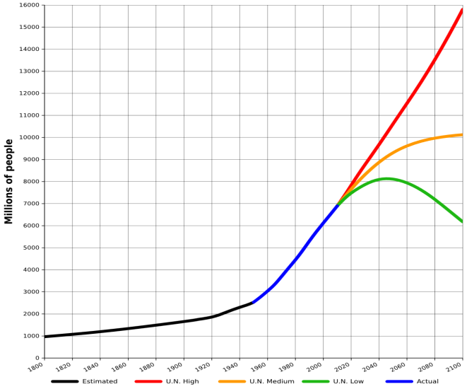
World Population Growth: 2010—2100F
The future of insurance will be tied global population growth—life insurance more closely than nonlife.
Mid-range scenarios suggest a massive slowdown in the number of available lives to insure. Growth will be increasing dependent on product penetration rates in emerging economies
Sources: United Nations, World Population Prospects, June 13, 2013; Insurance Information Institute .
32
12/01/09 - 9pm
eSlide – P6466 – The Financial Crisis and the Future of the P/C
Notes:
32

Slide 33
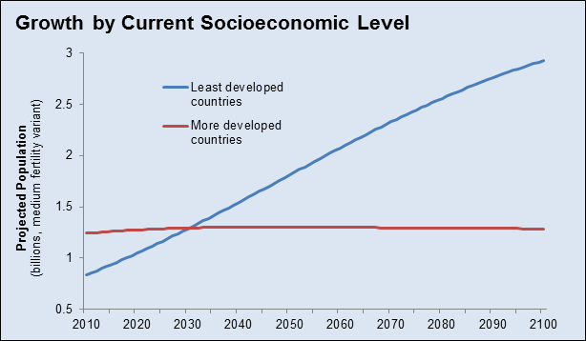
Population Growth: Developed vs. Less Developed Countries 2010—2100F
Virtually all of the world’s population growth through the end of the 21st century will occur in the developing world
Sources: United Nations, World Population Prospects, June 13, 2013; Insurance Information Institute .
33
12/01/09 - 9pm
eSlide – P6466 – The Financial Crisis and the Future of the P/C
Notes:
33

Slide 34
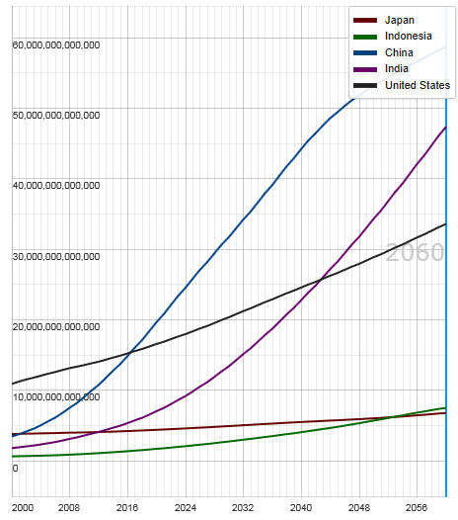
Potential Output of Total Economy: US, China, India, Indonesia and Japan, 2000-2060F
$ 2005 PPP
Growth in economic output will be concentrated in certain developing economies such as China and India
China will likely become the world’s largest economy between 2025 and 2030
Source: OECD; Insurance Information Institute .
34
12/01/09 - 9pm
eSlide – P6466 – The Financial Crisis and the Future of the P/C
Notes:
34

Slide 35
Global Insurance Premium Growth Trends:
Life and Non-Life
Growth Is Uneven Across Regions and Market Segments
35

Slide 36
Premium Growth by Region, 2012
Latin America growth was the strongest in 2012
Growth in Advanced Asia (incl. China) markets was third highest in 2012
Global Premium Volume Totaled $4.613 Trillion in 2012, up 2.4% from $4.566 Trillion in 2011. Global Growth Was Weighed Down by Slow Growth in N. America and W. Europe and Partially Offset by Emerging Markets
Source: Swiss Re, sigma, No. 3/2013.
36
Notes:
36

Slide 37
Distribution of Global Insurance Premiums, 2012 ($ Trillions)
Total Premium Volume = $4.613 Trillion*
Life insurance accounted for nearly 57% of global premium volume in 2012 vs. 43% for Non-Life
Source: Swiss Re, sigma, No. 3/2013; Insurance Information Institute.

Slide 38
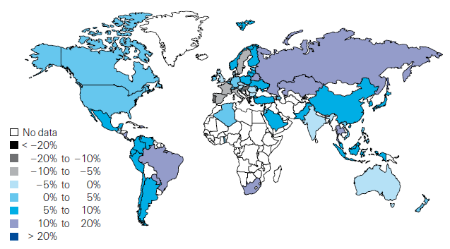
Global Real (Inflation Adjusted) Premium Growth (Life and Non-Life): 2012
Emerging markets in Asia, including China, showed faster growth an the US or Europe
Premium growth in emerging markets was 4 times that of advanced economies in 2012
Market | Life | Non-Life | Total
Advanced | 1.8 | 1.5 | 1.7
Emerging | 4.9 | 8.6 | 6.8
World | 2.3 | 2.6 | 2.4
Source: Swiss Re, sigma, No. 3/2013; Insurance Information Institute.
38
12/01/09 - 9pm
eSlide – P6466 – The Financial Crisis and the Future of the P/C
Notes:
38

Slide 39
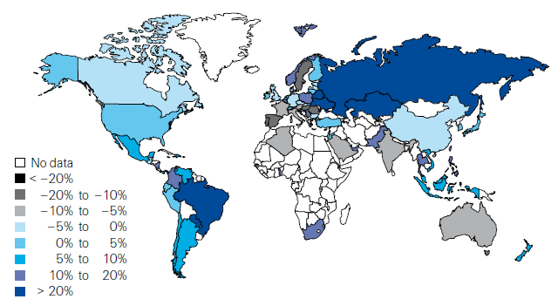
Life Insurance: Global Real (Inflation Adjusted) Premium Growth, 2012
Real growth in life insurance premiums was a bit slower in China than the US
Market | Life | Non-Life | Total
Advanced | 1.8 | 1.5 | 1.7
Emerging | 4.9 | 8.6 | 6.8
World | 2.3 | 2.6 | 2.4
Source: Swiss Re, sigma, No. 3/2013.
39
12/01/09 - 9pm
eSlide – P6466 – The Financial Crisis and the Future of the P/C
Notes:
39

Slide 40
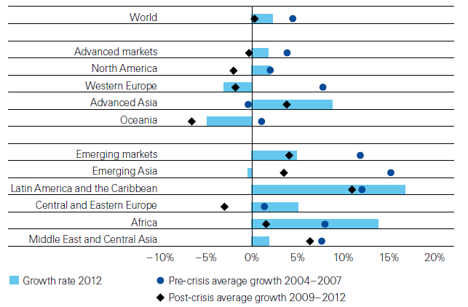
Life Insurance: Global Real (Inflation Adjusted) Premium Growth, 2012
Global Life Insurance growth in 2012 was lower than the pre-crisis average but above than the post-crisis average. Advanced Asia economies like China saw stronger growth on average than before or after the crisis.
Source: Swiss Re, sigma, No. 3/2013.
40
12/01/09 - 9pm
eSlide – P6466 – The Financial Crisis and the Future of the P/C
Notes:
40

Slide 41
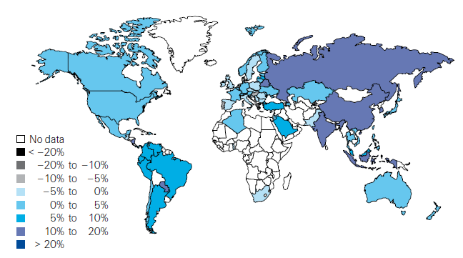
Non-Life Insurance: Global Real (Inflation Adjusted) Premium Growth, 2012
Real growth in non-life insurance premiums was faster in China than the US
Market | Life | Non-Life | Total
Advanced | 1.8 | 1.5 | 1.7
Emerging | 4.9 | 8.6 | 6.8
World | 2.3 | 2.6 | 2.4
Source: Swiss Re, sigma, No. 3/2013.
41
12/01/09 - 9pm
eSlide – P6466 – The Financial Crisis and the Future of the P/C
Notes:
41

Slide 42
Global Real (Inflation Adjusted) Nonlife
Premium Growth: 1980-2010
Average: 1980-2010
Industrialized Countries: 3.8%
Emerging Markets: 9.2%
Overall Total: 4.2%
Nonlife premium growth in emerging markets has exceeded that of industrialized countries in 27 of the past 31 years, including the entirety of the global financial crisis..
Real nonlife premium growth is very erratic in part to inflation volatility in emerging markets as well as a lack of consistent cyclicality
Source: Swiss Re, sigma, No. 2/2010.
42
12/01/09 - 9pm
eSlide – P6466 – The Financial Crisis and the Future of the P/C
Notes:
42

Slide 43
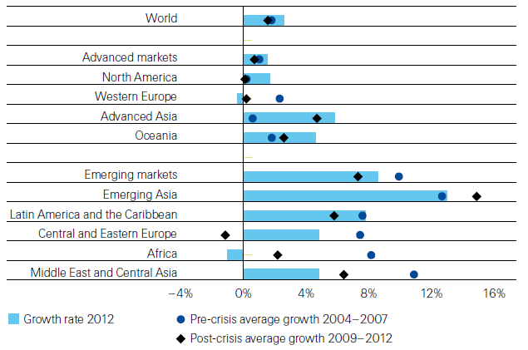
Non-Life Insurance: Global Real (Inflation Adjusted) Premium Growth, 2012
Global Non-Life growth in 2012 exceeded the pre-crisis and post-crisis average. The same is true for advanced Asia economies like China
Source: Swiss Re, sigma, No. 3/2013.
43
12/01/09 - 9pm
eSlide – P6466 – The Financial Crisis and the Future of the P/C
Notes:
43

Slide 44
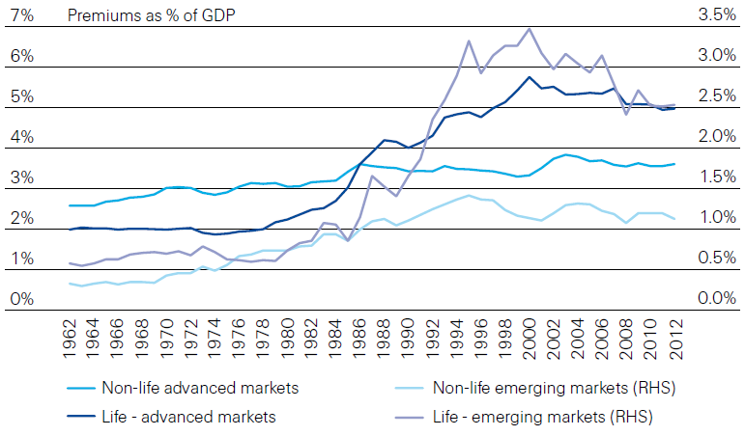
Life and Non-Life Insurance Penetration as a % of GDP: 1962-2012
Life insurance in emerging markets has experienced the fastest in recent decades
Advanced Markets
Emerging Markets
Non-life markets have been slower to grow than life
Source: Swiss Re, sigma, No. 3/2013.
44
12/01/09 - 9pm
eSlide – P6466 – The Financial Crisis and the Future of the P/C
Notes:
44

Slide 45
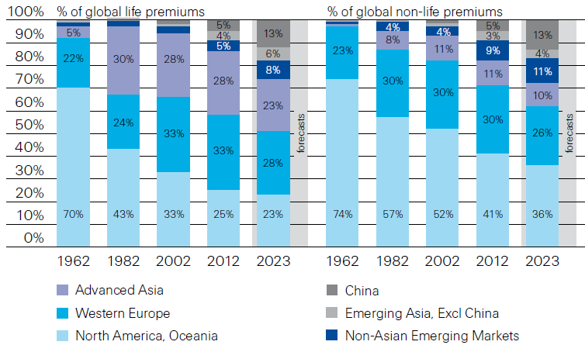
Premiums Written in Life and Non-Life, by Region: 1962-2012
Emerging market shares rose rapidly over the past 50 years
Source: Swiss Re, sigma, No. 3/2013.
45
12/01/09 - 9pm
eSlide – P6466 – The Financial Crisis and the Future of the P/C
Notes:
45

Slide 46
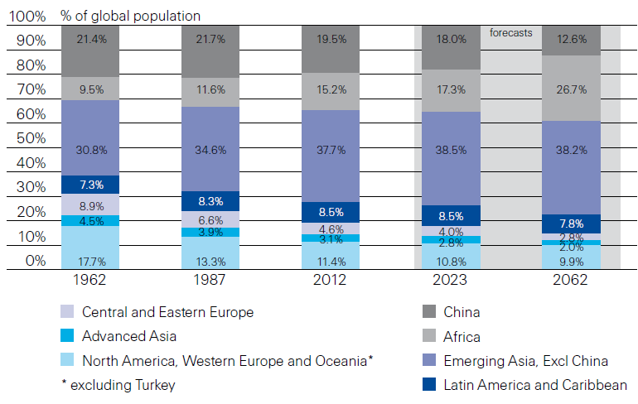
Population Distribution, by Region:
1962-2062F
Enormous population shifts will impact insurance demand over the next half century
Africa is expected to be the fastest population growth over the next 50 years, but no expectation now of Asia-like growth in economies or insurance demand
Source: Swiss Re, sigma, No. 3/2013 from United Nations Department of Economic and Sovial Affairs, Population Division.
46
12/01/09 - 9pm
eSlide – P6466 – The Financial Crisis and the Future of the P/C
Notes:
46

Slide 47
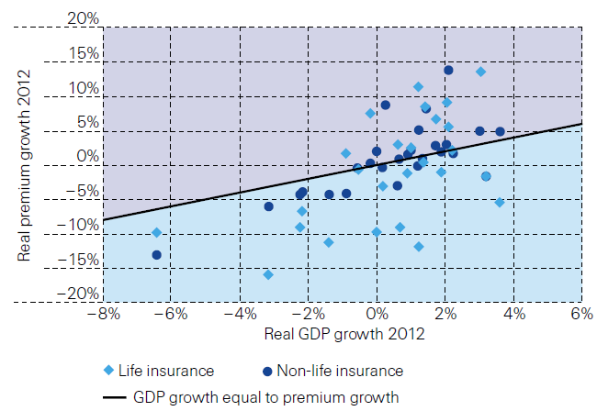
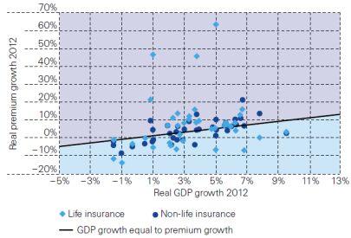
Relationship Between Real GDP and Real Life and Non-Life Premium Growth, 2012
Advanced Markets
Emerging Markets
The was a clear but highly relationship between real GDP growth and real premium growth in advance markets in 2012
The correlation between real GDP growth and real premium growth in emerging markets was much stronger than in advanced markets in 2012
Source: Swiss Re, sigma, No. 3/2013.
47
12/01/09 - 9pm
eSlide – P6466 – The Financial Crisis and the Future of the P/C
Notes:
47

Slide 48
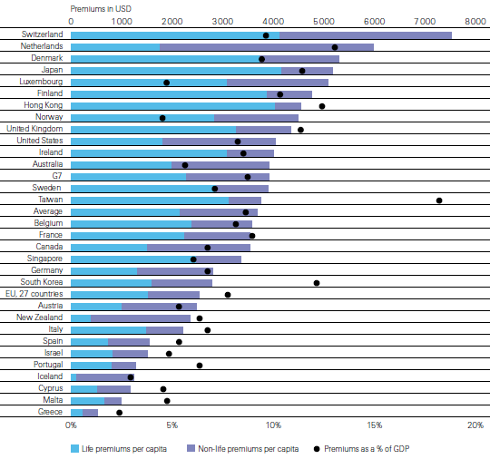
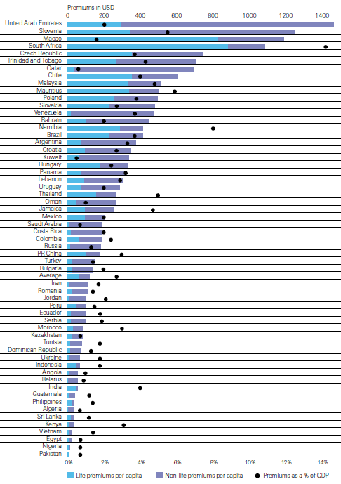
Insurance Density and Penetration for Advanced and Emerging Markets, 2012
Advanced Markets
Emerging Markets
Spending and penetration are highly variable in emerging markets
Spending and penetration are generally much higher in advanced markets, though growth is fastest in emerging markets
Chinese spending on insurance is very similar to Russia, but Russian spending is mostly non-life and in China the majority is life
Source: Swiss Re, sigma, No. 3/2013.
48
12/01/09 - 9pm
eSlide – P6466 – The Financial Crisis and the Future of the P/C
Notes:
48

Slide 49
The Unfortunate Nexus: Opportunity, Risk & Instability
Most of the Global Economy’s Future Gains Will be Fraught with Much Greater Risk and Uncertainty than in the Past
49

Slide 50
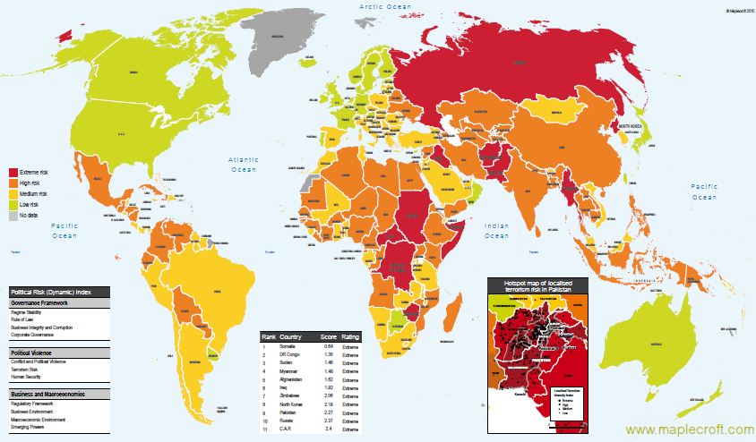
Political Risk in 2011/12: Greatest Business Opportunities Are Often in Risky Nations
The fastest growing markets are generally also among the politically riskiest, including East and South Asia
Heightened risk has economic and insurance implications
Australia and NZ rate well but most neighbors do not
Source: Maplecroft
50
12/01/09 - 9pm
eSlide – P6466 – The Financial Crisis and the Future of the P/C
Notes:
50

Slide 51
Energy is a Long-Term Global Growth Play for Insurers and Reinsurers
Extraction, Generation, Transmission All Provide Opportunities for Decades to Come in an Energy Hungry World
51

Slide 52
World Primary Energy Consumption, 1990-2030P
Quadrillion BTUs
Global energy consumption is expected to increase by 33.4% between 2010 and 2030 but by only 12% in the US
Between 2006 and 2030, energy consumption in projected to increase annually by 1.5% worldwide but only 0.5% in the US
Source: Energy Information Administration, 2009 International Energy Outlook, Insurance Information Institute.

Slide 53
Cumulative Projected Investment in Global Energy Infrastructure, 2011-2035 ($ Trill.)
Projected energy infrastructure investment through 2035 total $38 trillion; Implies substantial incurrence of risk.
Source: International Energy Agency, World Energy Outlook 2011.

Slide 54

US Oil & Gas Extraction Employment,
Jan. 2010—August 2013*
(Thousands)
Oil and gas extraction employment is up 25.5% since Jan. 2010 as the energy sector booms. Domestic energy production is essential to any robust economic recovery in the US.
*Seasonally adjusted
Sources: US Bureau of Labor Statistics at http://data.bls.gov; Insurance Information Institute.
54
12/01/09 - 9pm
eSlide – P6466 – The Financial Crisis and the Future of the P/C
Notes:
54

Slide 55
Is Terrorism an Insurable Risk or Not?
Issue of Critical Importance with Looming Expiration of TRIA
Download III’s Terrorism Insurance Report at: http://www.iii.org/white_papers/terrorism-risk-a-constant-threat-2013.html
55
Notes:
55

Slide 56
Loss Distribution by Type of Insurance from Sept. 11 Terrorist Attack ($ 2011)
($ Billions)
Total Insured Losses Estimate: $40.0B**
*Loss total does not include March 2010 New York City settlement of up to $657.5 million to compensate approximately 10,000 Ground Zero workers or any subsequent settlements.
**$32.5 billion in 2001 dollars.
Source: Insurance Information Institute.

Slide 57
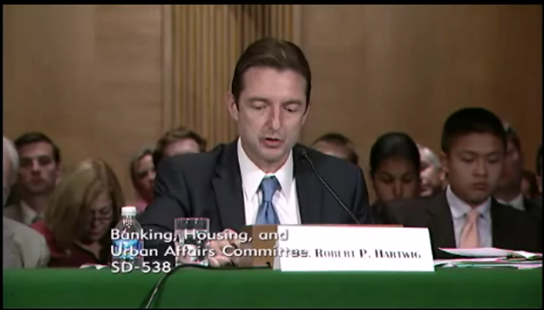
I.I.I. TRIA Testimony Before US Senate Banking Committee (Sept. 25, 2013)
Robert Hartwig, Future of TRIA Program, U.S. Senate Banking Committee

Slide 58
TRIA Outlook
Difficult Reauthorization Battle Ahead
  Very difficult to overcome antigovernment/small government, Tea Party forces in the House
  Most Committee members in both houses weren’t around in 2007
House Hearings in 2012; House and Senate in Sept. 2013
  Additional House hearing on Nov. 13
If Reauthorized, Insurer Participation Likely Increased
Some Have Attacked TRIA as “Corporate Welfare”
  In reality the taxpayer is 100% protected
  NFIP, Crop programs have led to miscomprehensions
Emphasizing Benefits to Employees Under WC is Key
Misperception by Some that Terrorism is Urban Issue
Standalone Market Opportunities? “Swiss Cheese” Market?

Slide 59
Terrorism Insurance Take-up Rates,
By Year, 2003-2012
Take-up rates for smaller commercial risks are lower—potentially very low in some areas and industries
In 2003, the first year TRIA was in effect, the terrorism take-up rate was 27 percent. Since then, it has increased steadily, remaining in the low 60 percent range since 2009.
Source: Marsh Global Analytics, 2013 Terrorism Risk Insurance Report, May 2013.
59
Notes:
59

Slide 60
Terrorism Violates Traditional Requirements for Insurability
Requirement | Definition | Violation
Estimable Frequency | Insurance requires large number of observations to develop predictive rate-making models (an actuarial concept known as credibility) | Very few data points Terror modeling still in infancy, untested. Inconsistent assessment of threat
Estimable Severity | Maximum possible/ probable loss must be at least estimable in order to minimize “risk of ruin” (insurer cannot run an unreasonable risk of insolvency though assumption of the risk) | Potential loss is virtually unbounded. Losses can easily exceed insurer capital resources for paying claims. Extreme risk in workers compensation and statute forbids exclusions.
Source: Insurance Information Institute

Slide 61
Terrorism Violates Traditional Requirements for Insurability (cont’d)
Requirement | Definition | Violation
Diversifiable Risk | Must be able to spread/distribute risk across large number of risks “Law of Large Numbers” helps makes losses manageable and less volatile | Losses likely highly concentrated geographically or by industry (e.g., WTC, power plants)
Random Loss Distribution/Fortuity | Probability of loss occurring must be purely random and fortuitous Events are individually unpredictable in terms of time, location and magnitude | Terrorism attacks are planned, coordinated and deliberate acts of destruction Dynamic target shifting from “hardened targets” to “soft targets” Terrorist adjust tactics to circumvent new security measures Actions of US and foreign govts. may affect likelihood, nature and timing of attack
Source: Insurance
Information Institute

Slide 62
Pyramid of Taxpayer Protection:
Strong, Stable, Sound and Secure
If TRIA is reauthorized, it is highly likely insurer retentions will be increased
Hard Cap
$100 Bill
Government Recoupment
Industry Aggregate
Retention: $27.5 Bill
Insurer Co-Payments
15% Above Retention
Individual Insurer Retention
20% of Premiums Earned
Program Dollar Threshold
$100 Million
Certification Dollar Threshold
$5 Million
Certification of Terrorist Act: Definition Must Be Met

Slide 63
Summary of Terrorism Risk Insurance Program Extension Bills Introduced in 2013
Bill | Summary
H.R. 508: “Terrorism Risk Insurance Act of 2002 Reauthorization Act of 2013” Introduced Feb. 5 by Rep. Michael Grimm (D-NY) | 5-Year Extension (through 2019) Extend recoupment period for any TRIA assistance from 2017 to 2019
H.R. 2146: “Terrorism Risk Insurance Program Reauthorization Act of 2013” Introduced May 23 by Rep. Michael Capuano (D-MA) | 10-Year Extension (through 2024) Extend recoupment period for any TRIA assistance from 2017 to 2024 Requires President’s Working Group on Financial Markets (PWGFM) to issue reports on long-term availability and affordability of terrorism insurance in 2017, 2020 and 2023 Reports to be drafted with consultation from NAIC and representatives of the insurance and securities industries and policyholders
H.R. 1945: “Fostering Resilience to Terrorism Act of 2013” Introduced May 9 by Rep. Benny Thompson (D-MS) | 10-Year Extension (through 2024) Recoupment period changed to 2024 Would transfer responsibility for certification of a “act of terrorism” to the Secretary of Homeland Security from Secretary of Treasury. PWGFM to issue reports in 2017, 2020 and 2023 Requires Sec. of DHS to provide insureds with “timely homeland security information, including terrorism risk information, at the appropriate level of classification and information on best practices to foster resilience to an act of terrorism.”
Source: Nelson, Levine, de Luca & Hamilton, FIO Focus, June 10, 2013; Insurance Information Institute.

Slide 64
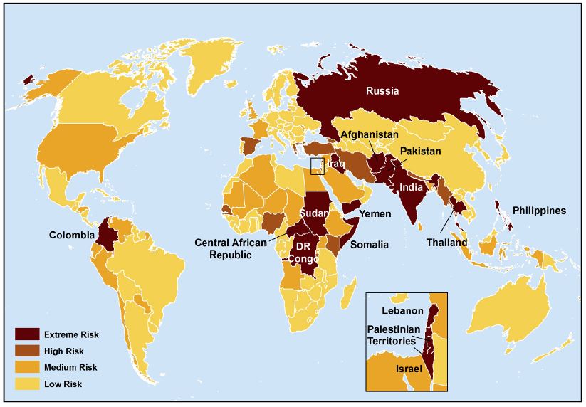
Terrorist Risk Index
The threat of terrorism is highest in South Asia, Russia, the Middle East and Central and East Africa
The US is still considered to be at “Medium Risk” for a terrorist attack
Sources: Maplecroft Terrorism Risk Index; (2011); Guy Carpenter; Insurance Information Institute.

Slide 65
CYBER RISK
Cyber Risk is a Rapidly Emerging Exposure for Businesses Large and Small in Every Industry
NEW III White Paper: http://www.iii.org/assets/docs/pdf/paper_CyberRisk_2013.pdf
65

Slide 66
Data Breaches 2005-2012, By Number of Breaches and Records Exposed
# Data Breaches/Millions of Records Exposed
Millions
The total number of data breaches and number of records exposed fluctuates from year to year and over time.
Source: Identity Theft Resource Center

Slide 67
2012 Data Breaches By Business Category, By Number of Breaches
The majority of the 447 data breaches in 2012 affected business and medical/healthcare organizations, according to the Identity Theft Resource Center.
Banking/Credit/Financial, 17 (3.8%)
Govt/Military, 50 (11.2%)
Business, 165 (36.9%)
Educational, 61 (13.6%)
Medical/Healthcare, 154 (34.5%)
Source: Identity Theft Resource Center, http://www.idtheftcenter.org/ITRC%20Breach%20Report%202012.pdf.

Slide 68
2012 Data Breaches By Category, By Number of Records Exposed
Government/Military and Business organizations accounted for the majority of records exposed by data breaches during 2012.
Banking/Credit/Financial, 470,048 (2.7%)
Medical/Healthcare, 2.2 million (12.9%)
Govt/Military, 7.7 million (44.4%)
Educational, 2.3 million (13.3%)
Business, 4.6 million (26.7%)
Source: Identity Theft Resource Center, http://www.idtheftcenter.org/ITRC%20Breach%20Report%202012.pdf.

Slide 69
AIG Survey: Cyber Attacks Top Concern Among Execs
While companies are focused on managing a variety of business risks, cyber attacks are a top concern. Some 85% of 258 executives surveyed said they were very or somewhat concerned about cyber attacks on their businesses.
Source: Penn Schoen Berland on behalf of American International Group.
69
Notes:
69

Slide 70
The Most Costly Cyber Crimes, Fiscal Year 2012
Malicious code, denial of service and web-based attacks account for more than 58 percent of the total annualized cost of cyber crime experienced by 56 companies.
Malware
Botnets
Malicious code
Viruses, Worms, Trojans
Phishing + social engineering
Malicious insiders
Stolen devices
Denial of service
Web-based attacks
Source: 2012 Cost of Cyber Crime: United States, Ponemon Institute.

Slide 71
External Cyber Crime Costs: Fiscal Year 2012
Information loss (44%) and business disruption or lost productivity (30%) account for the majority of external costs due to cyber crime.
Other costs*
Equipment damages
Information loss
Revenue loss
Business disruption
* Other costs include direct and indirect costs that could not be allocated to a main external cost category
Source: 2012 Cost of Cyber Crime: United States, Ponemon Institute.

Slide 72
High Profile Data Breaches, 2012-2013
Date | Company | Description of Breach
Mar 2013* | South Korean banks, media cos | Cyber attack causes computers to crash at South Korean banks and media companies, paralyzing bank machines across the country. No immediate reports of records compromised.
July 2012 | Yahoo | Security breach at Yahoo in which some 450,000 passwords lifted and posted to the Internet.
July 2012 | eHarmony | Online dating site eHarmony confirms security breach in which some 1.5 million user names and passwords compromised.
July 2012 | LinkedIn | Social networking site LinkedIn reportedly targeted in hacker attack that saw 6.5 million hashed passwords posted to the Internet.
April 2012 | Utah Dept of Technology Services | Utah Department of Technology notifies of a March 30 breach of a server containing personal data including social security numbers for about 780,000 Medicaid patient claims. Breach traced to Eastern Europe hackers.
Mar 2012 | Global Payments | Credit card processor Global Payments confirms hacker attack has compromised the payment card numbers of around 1.5 million cardholders.
Mar 2012 | CA Dept of Child Support Services | Officials announce that four computer storage devices containing personal information for about 800,000 adults and children in California’s child support system were lost by IBM and Iron Mountain Inc.
Jan 2012 | Zappos | Online shoe retailer Zappos announces that information, such as names, addresses and passwords on as many as 24 million customers illegally accessed.
Jan 2012 | NY State Electric + Gas Co | Security breach at NYSEG that allowed unauthorized access to NYSEG customer data, containing social security numbers, dates of birth and bank account numbers, exposing 1.8 million records.
*March 2013 attack is not part of ITRC research.
Sources: Identity Theft Resource Center, http://www.idtheftcenter.org/ITRC%20Breach%20Report%202012.pdf; Insurance Information Institute (I.I.I.) research.

Slide 73
Average Organizational Cost of a Data Breach, 2008-2011* ($ Millions)
The average organizational cost of a data breach in 2011 was $5.5 million, down 24% from $7.2 million in 2010. Companies have improved steps taken in both preparing for and responding to a data breach.
($ Millions)
*Findings of this benchmark study pertain to the actual data breach experiences of 49 U.S. companies from 14 different industry sectors, all of which participated in the 2011 study. Total breach costs include: lost business resulting from diminished trust or confidence of customers ;costs related to detection, escalation, and notification of the breach; and ex-post response activities, such as credit report monitoring.
Source: 2011 Annual Study: U.S. Cost of a Data Breach, the Ponemon Institute.
73
Notes:
73

Slide 74
Main Causes of Data Breach
Negligent employees and malicious attacks are most often the cause of the data breach. Some 39 percent of incidents involve a negligent employee or contractor, while 37 percent concern a malicious or criminal attack.
Negligence
System glitch
Malicious or criminal attack
Source: 2011 Cost of Data Breach Study: United States, Ponemon Institute, March 2012

Slide 75
Marsh: Increase in Purchase of Cyber Insurance Among U.S. Companies, 2012
Interest in cyber insurance continues to climb. The number of companies purchasing cyber insurance increased 33 percent from 2011 to 2012.
Source: Marsh Global Analytics, Marsh Risk Management Research Briefing, March 2013
75
Notes:
75

Slide 76
Marsh: Total Limits Purchased, By Industry – Cyber Liability, All Revenue Size
Cyber insurance limits purchased in 2012 averaged $16.8 million across all industries, an increase of nearly 20% over 2011.
($ Millions)
Source: Marsh Global Analytics, Marsh Risk Management Research Briefing, March 2013
76
Notes:
76

Slide 77
Marsh: Total Limits Purchased, By Industry – Cyber Liability, Revenue $1 Billion+
Among larger companies, average cyber insurance limits purchased in 2012 increased nearly 30% over 2011.
($ Millions)
Source: Marsh Global Analytics, Marsh Risk Management Research Briefing, March 2013
77
Notes:
77

Slide 78
INVESTMENTS:
THE NEW REALITY
Investment Performance is a Key Driver of Profitability
Depressed Yields Will Necessarily Influence Underwriting & Pricing
78

Slide 79
Property/Casualty Insurance Industry Investment Income: 2000–2013*¹
($ Billions)
Investment earnings are running below their 2007 pre-crisis peak
Investment Income Fell in 2012 and is Falling in 2013 Due to Persistently Low Interest Rates, Putting Additional Pressure on (Re) Insurance Pricing
¹ Investment gains consist primarily of interest and stock dividends..
*Estimate based on annualized actual H1:2013 investment income of $23.199B.
Sources: ISO; Insurance Information Institute.

Slide 80
U.S. Treasury Security Yields:
A Long Downward Trend, 1990–2013*
Yields on 10-Year U.S. Treasury Notes have been essentially below 5% for a full decade.
U.S. Treasury security yields recently plunged to record lows
Since roughly 80% of P/C bond/cash investments are in 10-year or shorter durations, most P/C insurer portfolios will have low-yielding bonds for years to come.
*Monthly, constant maturity, nominal rates, through October 2013.
Sources: Federal Reserve Bank at http://www.federalreserve.gov/releases/h15/data.htm.
National Bureau of Economic Research (recession dates); Insurance Information Institute.
80
12/01/09 - 9pm
eSlide – P6466 – The Financial Crisis and the Future of the P/C
Notes:
80

Slide 81
THE SEARCH FOR YIELD DISCOVERS REINSURANCE
Alternative (Convergence) Capital and Reinsurance Markets
81

Slide 82
Global Reinsurer Capital, 2007-2013:H1*
($ Billions)
+11%
+1%
+18%
-3%
+18%
-17%
Global Reinsurance Capital Has Been Trending Generally Upward Since the Global Financial Crisis, a Trend that Seems Likely to Continue
*Includes both traditional and non-traditional forms of reinsurance capital.
Source: Aon Benfield Aggregate study for the 6 months ending June 2013; Insurance Information Institute.

Slide 83
Long-Term Evolution of Shareholders’ Funds for the Guy Carpenter Global Reinsurance Composite
Source: Guy Carpenter

Slide 84
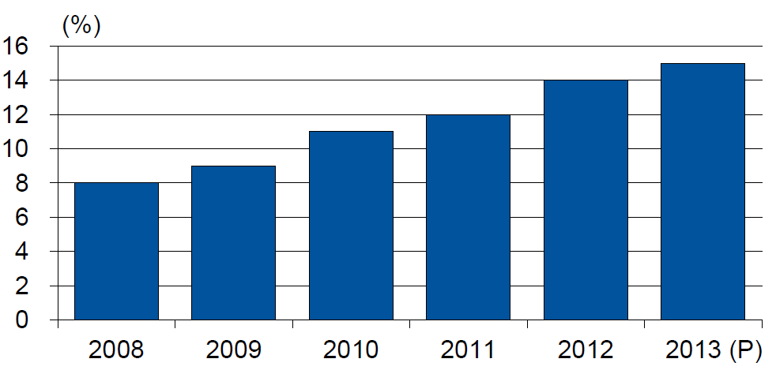
Alternative Capacity as a Percentage of Global Property Catastrophe Reinsurance Limit
(As of Year End)
Alternative Capacity accounted for approximately 14% or $45 billion of the $316 in global property catastrophe reinsurance capital as of mid-2013 (expected to rise to ~15% by year-end 2013)
Source: Guy Carpenter

Slide 85
Property Catastrophe Reinsurance Capacity by Source as of Mid-2013 ($ Bill)
Total = $316 Billion*
“Convergence Capital” accounted for an estimated $45B or 14% or total property catastrophe reinsurance capacity as of mid-2013, up $10B over the past 18 months (since 1/1/12). Penetration of this type of capacity is growing
Collateralized reinsurance (sidecars) is the fastest growing segment recently
Source: Guy Carpenter; Mid-Year Market Report, September 2013; Insurance Information Institute.

Slide 86
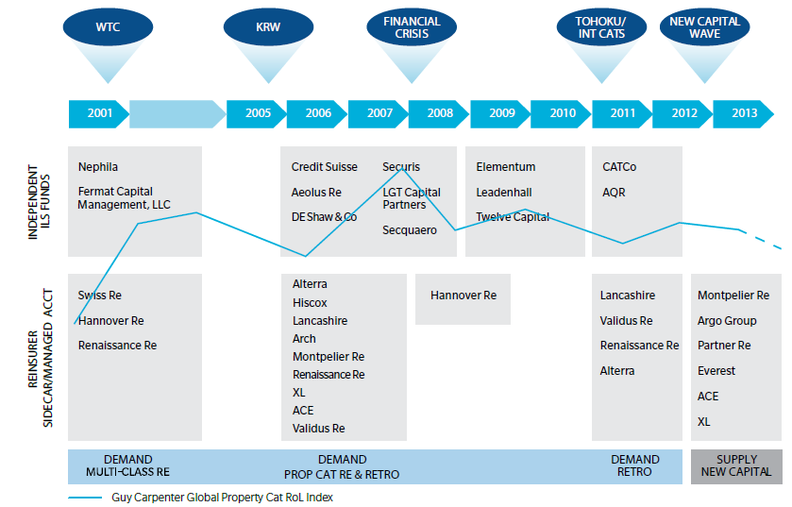
Alternative Capacity Development,
2001—2013:H1
Source: Guy Carpenter; Mid-Year Market Report, September 2013; Insurance Information Institute.

Slide 87
Non-Traditional Property Catastrophe
Limits by Type, YE 2012 vs. YE 2015E
Alternative capital is expected to rise by 30% by YE 2015 and will ultimately account for 20-30% of total reinsurance spend, according to Guy Carpenter
Source: Guy Carpenter; Reinsurance Association of America; Insurance Information Institute.

Slide 88
Catastrophe Bonds: Issuance and Outstanding, 1997- 2013*
Risk Capital Amount ($ Millions)
Risk capital outstanding reached a record high in 2013
Financial crisis depressed issuance
CAT bond issuance will likely reach a record high in 2013v
Catastrophe Bond Issuance Is Approaching Pre-Crisis Levels While Risk Capital Outstanding Stands at an All-Time Record
*Through July 2013.
Source: Guy Carpenter; Insurance Information Institute.

Slide 89
Insurance Information Institute Online:
www.iii.org
Thank you for your time
and your attention!
Twitter: twitter.com/bob_hartwig
Download at www.iii.org/presentations

