Slide 1
Partnership with the Lightning Protection Institute
An Overview of Communications Strategies
LPI/ULPA 2014 Annual Conference
Singer Island, Florida
February 28, 2014
Lynne McChristian, I.I.I. Florida Representative and Catastrophe Communications Expert
Insurance Information Institute ♦ 110 William Street ♦ New York, NY 10038
Tel: 212.346.5520 ♦ Fax: (212) 32-1916 ♦ www.iii.org

Slide 2
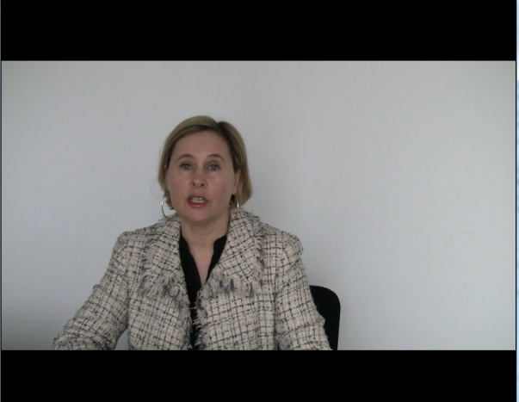
Greeting from I.I.I.’s Jeanne Salvatore
Notes:
I’ll email Lynne & you the video.

Slide 3
Presentation Outline
Overview of Communication Strategies
  Fully integrate lightning-related information into the I.I.I. website and its overall communications strategy, including:
    --- Facts and Statistics
    --- Consumer Articles
    --- Videos
Highlights of 2013 Accomplishments
  Ongoing Partnership Activities
What’s Ahead for 2014

Slide 4
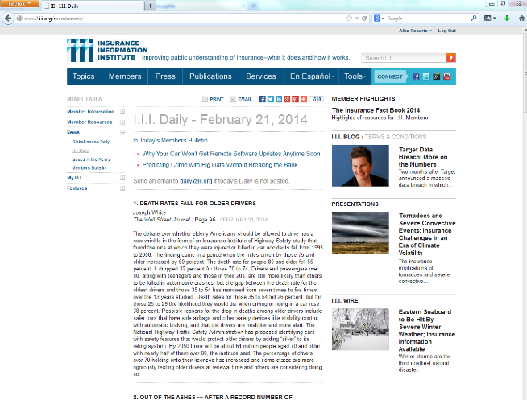
Strategy: Use I.I.I. website to promote LPI to insurance companies

Slide 5
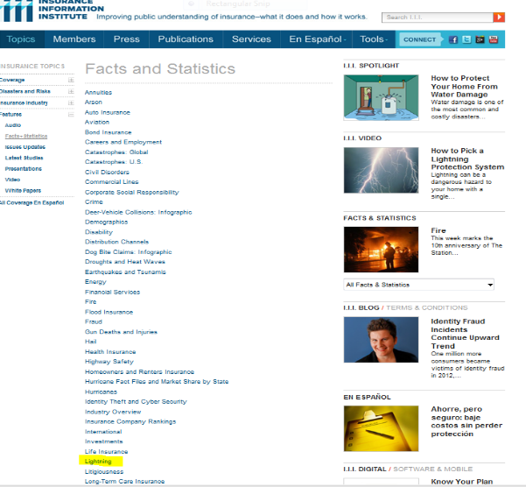
Strategy: Lightning information appears in many places on the I.I.I. Website
Lightning facts and statistics are updated and featured on the I.I.I. website with a link to the LPI.

Slide 6
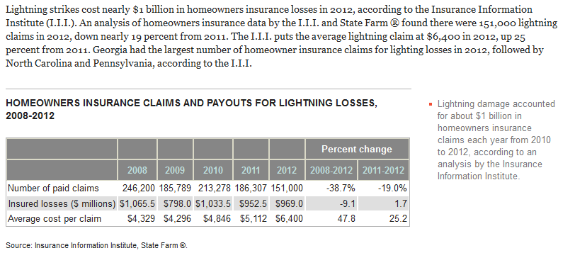
Strategy: Lightning data included in Facts & Statistics
NOTE: Statistics for 2013 will be updated when the NAIC issues market share data.
This is expected prior to the June press conference to promote
Lightning Safety Awareness Week

Slide 7
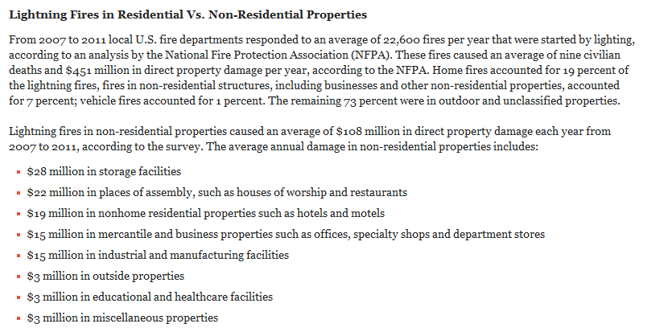
Data in Facts & Statistics
Feature Data from the National Fire Protection Association
Notes:
Add the updated chart here

Slide 8
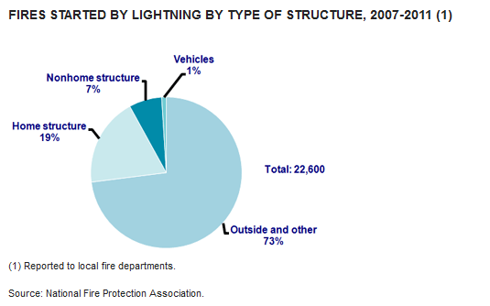
Data in Facts and Statistics
Link
Note: Archived data available back to 2002
Notes:
This is the most recent chart on the site.

Slide 9
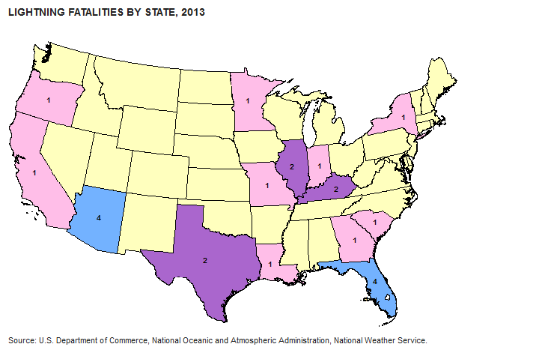
Data in Facts and Statistics

Slide 10
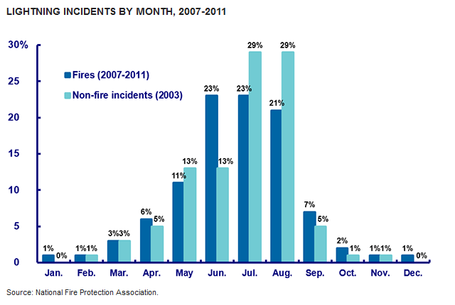
Data in Facts and Statistics
Notes:
This is the most recent chart on the site.

Slide 11
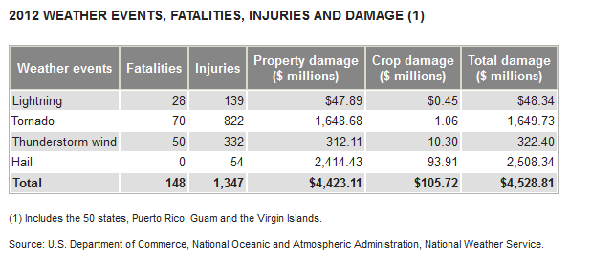
Data in Facts and Statistics
Strategy:
Encourage web users to contact LPI for additional information by linking to its website with all data sets.

Slide 12
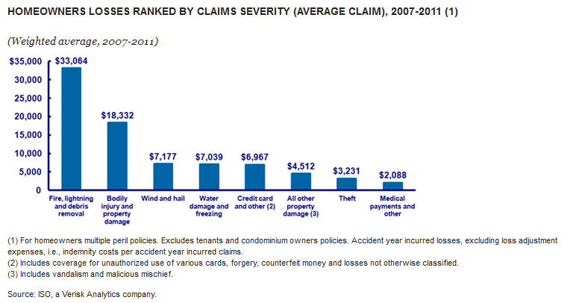
Data in Facts and Statistics – Homeowners Insurance
Notes:
This is the most updated chart on the site.

Slide 13
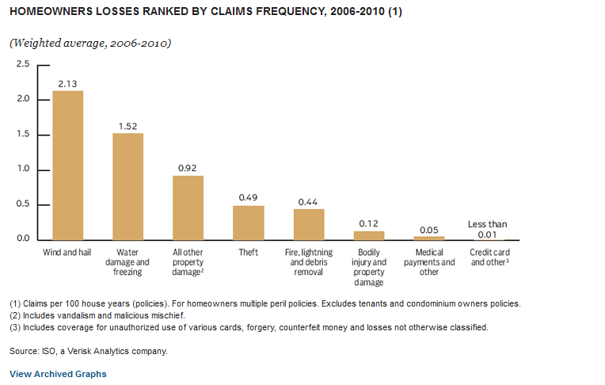
Data in Facts and Statistics – Homeowners Insurance
Notes:
This is the most updated chart on the site.

Slide 14
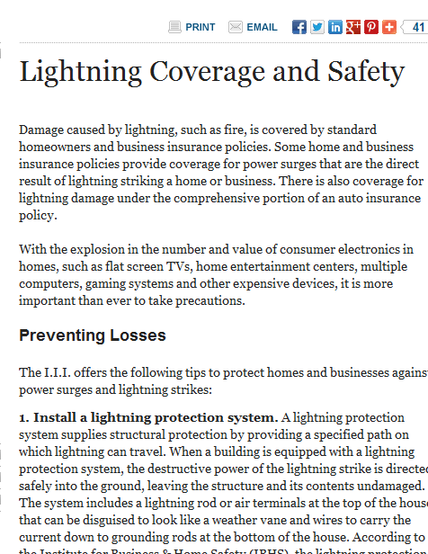
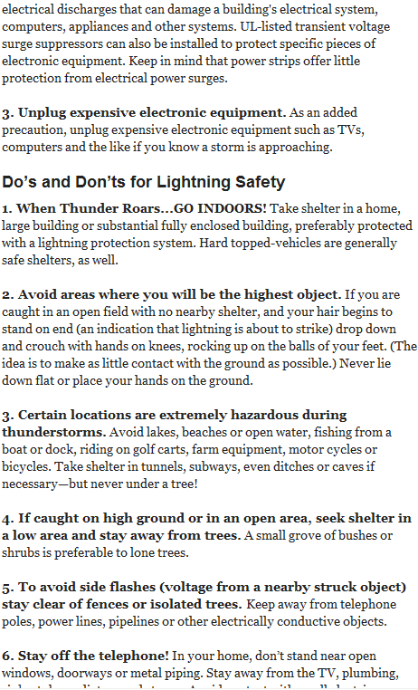
Consumer Articles

Slide 15
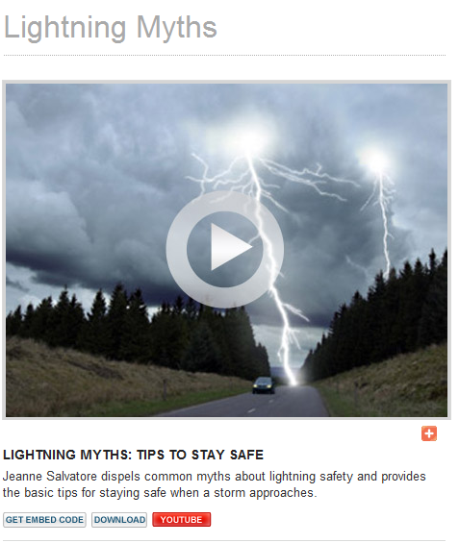
Web Video
Watch Video

Slide 16
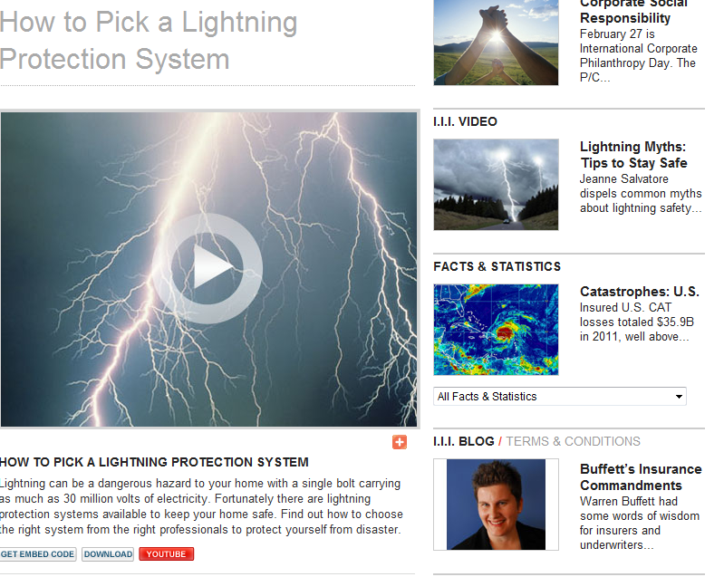
Podcasts and Video
Watch Video

Slide 17
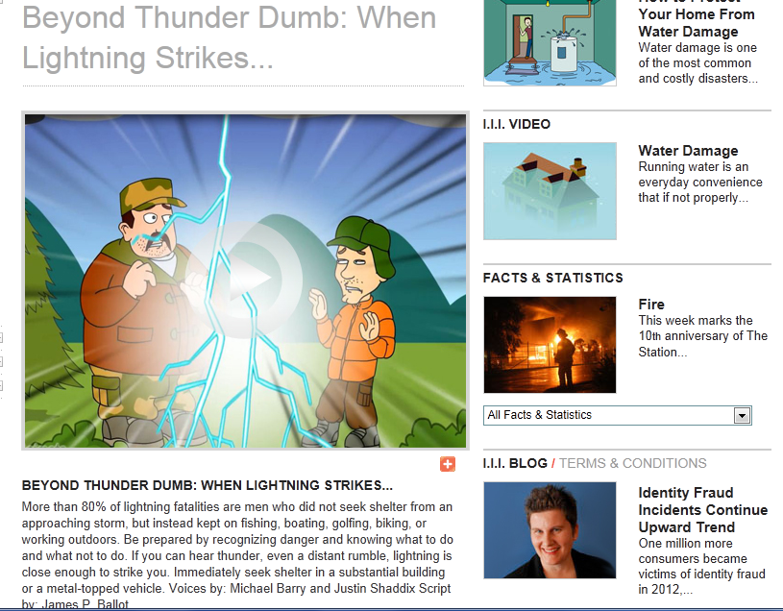
Fun and Entertaining Videos
http://www2.iii.org/video/beyond-thunder-dumb-when-lightning-strikes.html

Slide 18
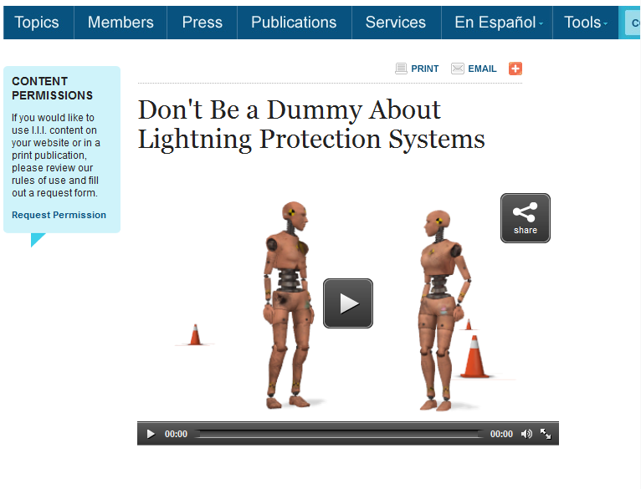
Web videos
Watch Video

Slide 19
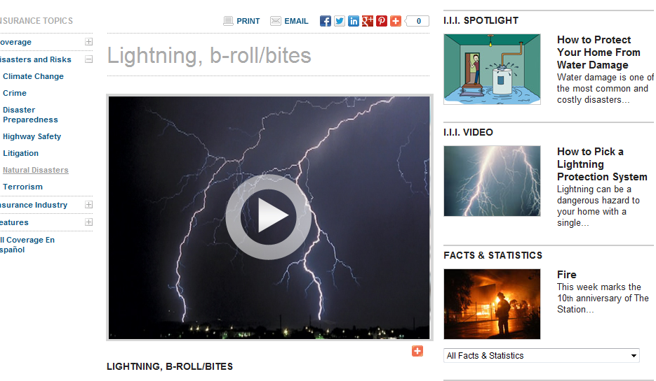
Video: b-roll/bites

Slide 20
Highlights
2013 Accomplishments and Ongoing Partnership Activities

Slide 21
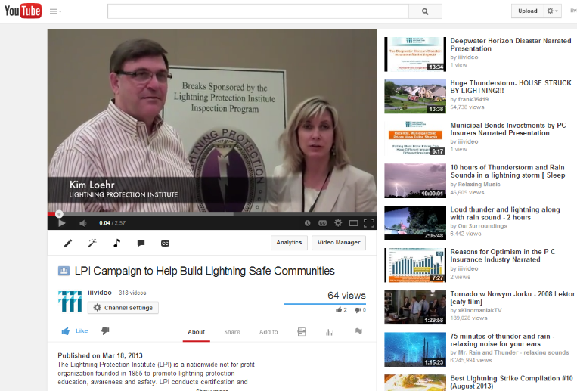
Recorded and edited a Web video at 2013 conference
Link: http://www.youtube.com/watch?v=zFxK6YEOR8A
Notes:
Add the video of Kim Lohr from last year

Slide 22
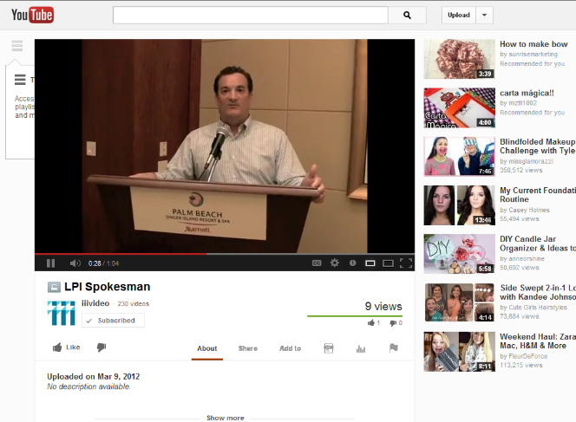
Recorded and edited a Web video at 2012 conference, too!
Notes:
Add the video of Kim Lohr from last year

Slide 23
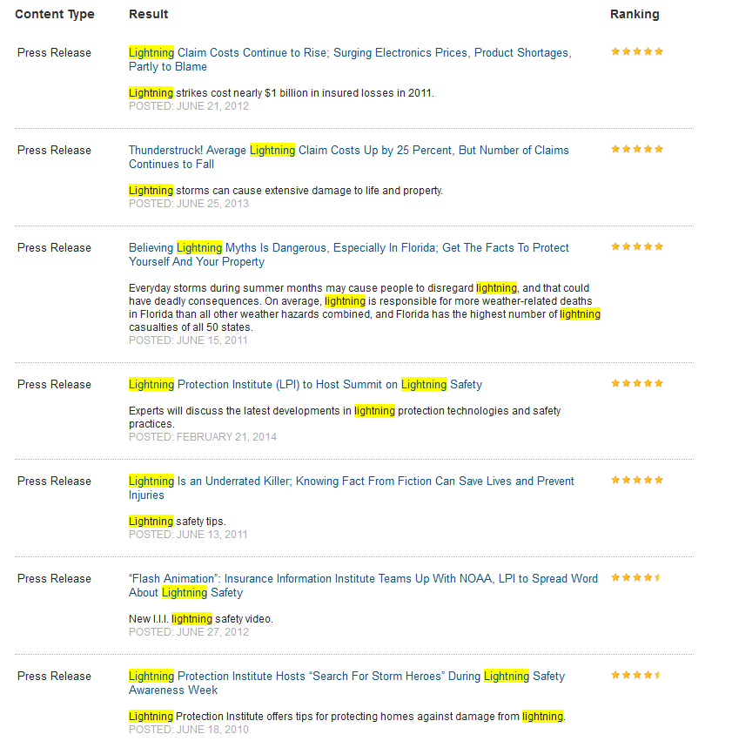
Issue News Releases – Since I.I.I. began partnering with the UPLA/LPI, 15 releases were issued and posted to our website -- with four issued in 2013.
Notes:
Can we have a new screen caption here? Please just go to news release and do a search with the word lightning. The latest news release should show up.

Slide 24
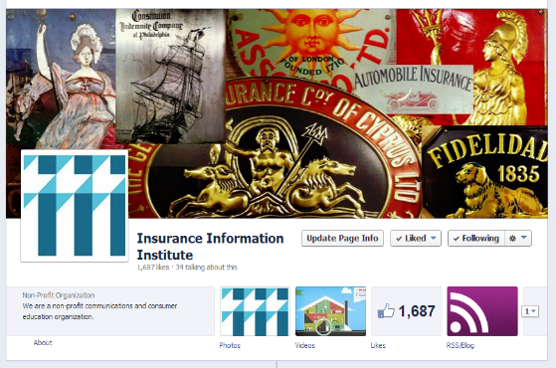
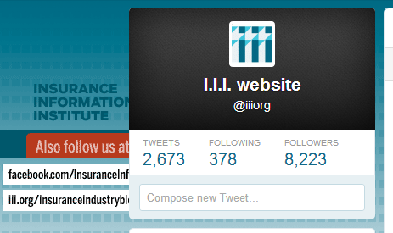
News releases issued in English and Spanish to announce new lightning claim data and promote Lightning Safety Awareness Week
Distributed information through I.I.I.’s social media network. On Facebook alone we reached 77,071 users
Notes:
Was the facebook number updated?

Slide 25
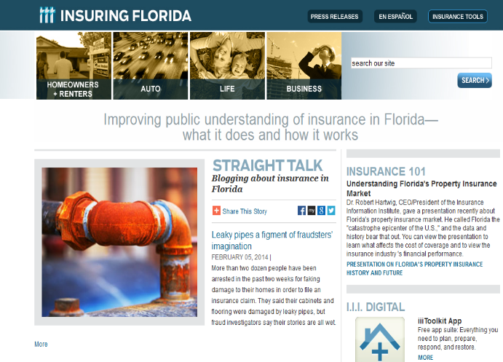
Lightning information, tailored to Florida audiences
Notes:
Is there something more up-to-date on the Florida site? Was there a news release in 2013? If not, let’s take the press release out. – No release in 2013.

Slide 26
Tracking of Media Coverage
Meltwater News reported 1,369 mentions of the LPI in 2013.
Some of these hits were generated by news releases issued by the LPI; others by the I.I.I. releases on behalf of the LPI.
Topics included: Promotion of lightning safe communities campaign, proposed disaster savings accounts, promotion of Thunderstruck video, release on the problems of unapproved lightning protection systems, new application for lightning protection and Lightning Safety Awareness Week.
There were 7 LPI mentions in social media.
  Full reports were provided to LPI.

Slide 27
Track Traditional Media Coverage of LPI
Source: Meltwater News.

Slide 28
Plans for 2014 – Outreach to Traditional
Media
Promote the 2014 conference in a media advisory, draft news releases at the event, promote conference via social media and tape a web video.
Promote Lightning Safety Awareness Week with updated insured lightning stats.
Make Kim Loehr available to speak to I.I.I. member companies, including attending the I.I.I. Communications meeting in June.
Ask about discounts for lightning protection systems during a planned survey of other home insurance discounts.
Incorporate lightning protection systems in the home buyers checklist.
Support Lightning Safe Communities campaign.

Slide 29
Plans for 2014 (continued)
Incorporate information on the value of lightning protection systems into post-disaster communication on rebuilding a home and when renovating or building a new structure.
Meet with fire safety organizations to develop more partnerships and encourage better data collection of lightning losses.
Reissue news releases promoting the three videos (How to Pick a Lightning Protection System, Lightning Myths and Lightning Safety).
Track both traditional and social media coverage to find out what works and identify promotion opportunities.
Lastly, a long shot idea: Pitch Richard Branson to do a public service announcement, as his home was struck by lightning and is being rebuilt with a lightning protection system.

Slide 30
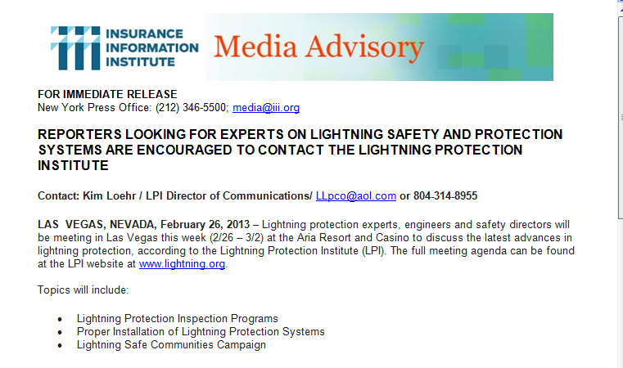
2014: Issued a Media Advisory
Distributed the advisory by PR Newswire. It appeared on over 300 websites of newspapers, radio and TV stations in the first 24 hours!
Notes:
Can we put the new media advisory here?

Slide 31
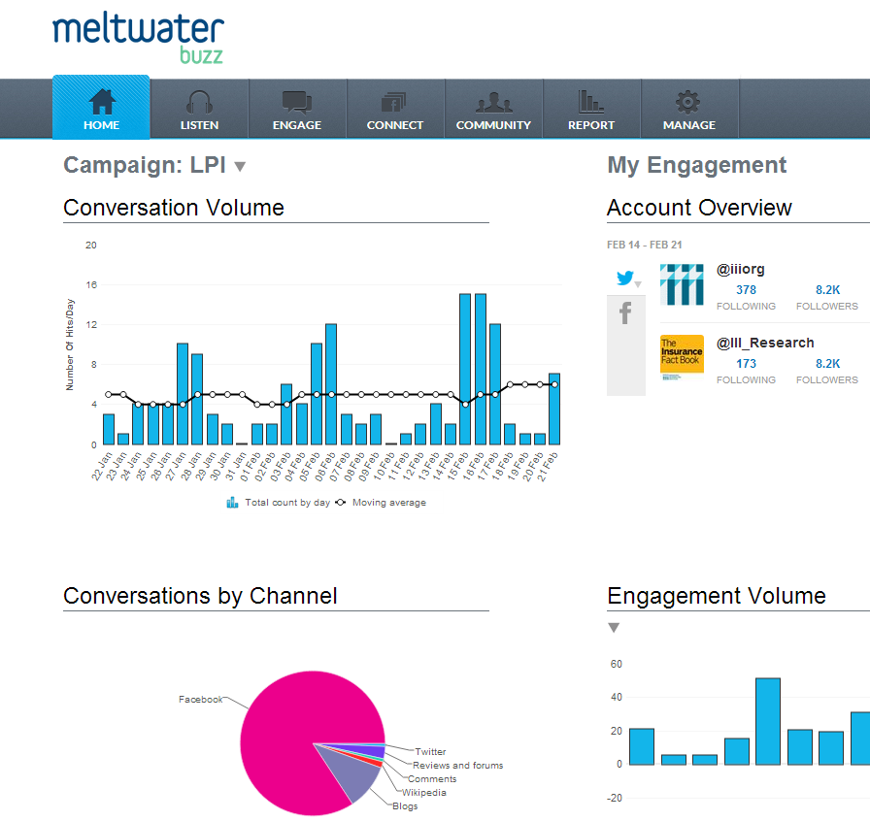
Tracking Lightning for Trends in Social Media in 2013
Notes:
Can we show a screen grab of what we are doing now?

Slide 32
Insurance Information Institute Website
www.iii.org
Notes:
32

