Slide 1
Overview and Outlook for the P/C Insurance Industry:
Focus on Lawyers’ Professional Liability Market and Tort Issues
Missoula, MT
July 25, 2013
Robert P. Hartwig, Ph.D., CPCU, President & Economist
Insurance Information Institute ♦ 110 William Street ♦ New York, NY 10038
Tel: 212.346.5520 ♦ Cell: 917.453.1885 ♦ bobh@iii.org ♦ www.iii.org

Slide 2
Presentation Outline
P/C Insurance Market Overview
  Where is the market today?
  Where is it headed?
  Market drivers
Performance by Segment
  Underwriting
  Growth
  Lawyer’s Professional Liability Market Overview
Tort System Update
Q&A

Slide 3
P/C Insurance Industry Financial Overview
Profit Recovery in Underway After High CAT Losses in 2011 and 2012
3

Slide 4
P/C Net Income After Taxes
1991–2013:Q1 ($ Millions)
2005 ROE*= 9.6%
2006 ROE = 12.7%
2007 ROE = 10.9%
2008 ROE = 0.1%
2009 ROE = 5.0%
2010 ROE = 6.6%
2011 ROAS¹ = 3.5%
2012 ROAS¹ = 5.9%
2013:Q1 ROAS¹ = 9.6%
2012:Q1 ROAS was 7.2%
Net income is up substantially (+40.9%) from 2012:Q1 $10.2B
ROE figures are GAAP; ¹Return on avg. surplus. Excluding Mortgage & Financial Guaranty insurers yields a 9.7% ROAS in 2013:Q1, 6.2% ROAS in 2012, 4.7% ROAS for 2011, 7.6% for 2010 and 7.4% for 2009.
Sources: A.M. Best, ISO, Insurance Information Institute

Slide 5
Profitability Peaks & Troughs in the P/C Insurance Industry, 1975 – 2013:Q1*
ROE
History suggests next ROE peak will be in 2016-2017
1977:19.0%
1987:17.3%
10 Years
2006:12.7%
1997:11.6%
2013:Q1 9.7%
10 Years
9 Years
2012: 5.9%
1975: 2.4%
1984: 1.8%
1992: 4.5%
2001: -1.2%
*Profitability = P/C insurer ROEs. 2011-13 figures are estimates based on ROAS data. Note: Data for 2008-2013 exclude mortgage and financial guaranty insurers.
Source: Insurance Information Institute; NAIC, ISO, A.M. Best.

Slide 6
A 100 Combined Ratio Isn’t What It
Once Was: Investment Impact on ROEs
A combined ratio of about 100 generates an ROE of ~7.0% in 2012, ~7.5% ROE in 2009/10,
10% in 2005 and 16% in 1979
Combined Ratio / ROE
Catastrophes and lower investment income pulled down ROE in 2012
Combined Ratios Must Be Lower in Today’s Depressed
Investment Environment to Generate Risk Appropriate ROEs
* 2008 -2012 figures are return on average surplus and exclude mortgage and financial guaranty insurers. 2012 combined ratio including M&FG insurers is 103.2, 2011 combined ratio including M&FG insurers is 108.1, ROAS = 3.5%.
Source: Insurance Information Institute from A.M. Best and ISO data.

Slide 7
UNDERWRITING
Underwriting Losses in 2011 and 2012 Were Elevated by High Catastrophe Losses
7

Slide 8
P/C Insurance Industry
Combined Ratio, 2001–2013:Q1*
Relatively Low CAT Losses, Reserve Releases
Higher CAT Losses, Shrinking Reserve Releases, Toll of Soft Market
As Recently as 2001, Insurers Paid Out Nearly $1.16 for Every $1 in Earned Premiums
Heavy Use of Reinsurance Lowered Net Losses
Relatively Low CAT Losses, Reserve Releases
Avg. CAT Losses, More Reserve Releases
Best Combined Ratio Since 1949 (87.6)
Lower CAT Losses Before Sandy
Cyclical Deterioration
* Excludes Mortgage & Financial Guaranty insurers 2008--2012. Including M&FG, 2008=105.1, 2009=100.7, 2010=102.4, 2011=108.1; 2012:=103.2.
Sources: A.M. Best, ISO.

Slide 9
Underwriting Gain (Loss)
1975–2013:Q1*
($ Billions)
Cumulative underwriting deficit from 1975 through 2012 is $510B
Underwriting profit in 2013:Q1 totaled $4.6B
High cat losses in 2011 led to the highest underwriting loss since 2002
Large Underwriting Losses Are NOT Sustainable
in Current Investment Environment
* Includes mortgage and financial guaranty insurers in all years.
Sources: A.M. Best, ISO; Insurance Information Institute.

Slide 10
P/C Reserve Development, 1992–2015E
Note: 2005 reserve development excludes a $6 billion loss portfolio transfer between American Re and Munich Re. Including this transaction, total prior year adverse development in 2005 was $7 billion. The data from 2000 and subsequent years excludes development from financial guaranty and mortgage insurance.
Sources: A.M. Best, ISO, Barclays Research (estimates).

Slide 11
Number of Years with Underwriting Profits by Decade, 1920s–2010s
Number of Years with Underwriting Profits
Underwriting Profits Were Common Before the 1980s
(40 of the 60 Years Before 1980 Had Combined Ratios Below 100) –
But Then They Vanished. Not a Single Underwriting Profit Was
Recorded in the 25 Years from 1979 Through 2003
* 2009 combined ratio excl. mort. and finl. guaranty insurers was 99.3, which would bring the 2000s total to 4 years with an u/w profit.
**Data for the 2010s includes 2010 through 2012.
Note: Data for 1920–1934 based on stock companies only.
Sources: Insurance Information Institute research from A.M. Best Data.
11
12/01/09 - 9pm
eSlide – P6466 – The Financial Crisis and the Future of the P/C
Notes:
11

Slide 12
Financial Strength & Underwriting
Cyclical Pattern is P-C Impairment History is Directly Tied to Underwriting, Reserving & Pricing
12

Slide 13
P/C Insurer Impairments, 1969–2012
Impairments among P/C insurers remain infrequent
The Number of Impairments Varies Significantly Over the P/C Insurance Cycle, With Peaks Occurring Well into Hard Markets
Source: A.M. Best Special Report “1969-2011 Impairment Review,” June 2012 and March 6, 2013 update; Insurance Info. Institute.

Slide 14
P/C Insurer Impairment Frequency vs. Combined Ratio, 1969-2011
2011 impairment rate was 0.91%, up from 0.67% in 2010; the rate is slightly higher than the 0.82% average since 1969
Impairment Rates Are Highly Correlated With Underwriting Performance and Reached Record Lows in 2007; Recent Increase Was Associated Primarily With Mortgage and Financial Guaranty Insurers and Not Representative of the Industry Overall
Source: A.M. Best; Insurance Information Institute

Slide 15
Reasons for US P/C Insurer Impairments, 1969–2010
Historically, Deficient Loss Reserves and Inadequate Pricing Are
By Far the Leading Cause of P-C Insurer Impairments.
Investment and Catastrophe Losses Play a Much Smaller Role
Reinsurance Failure
Sig. Change in Business
Misc.
Investment Problems (Overstatement of Assets)
Deficient Loss Reserves/
Inadequate Pricing
Affiliate Impairment
Catastrophe Losses
Alleged Fraud
Rapid Growth
Source: A.M. Best: 1969-2010 Impairment Review, Special Report, April 2011.

Slide 16
Top 10 Lines of Business for US P/C Impaired Insurers, 2000–2010
Workers Comp and Pvt. Passenger Auto Account for Nearly Half of the Premium Volume of Impaired Insurers Over the Past Decade
Title
Financial Guaranty
Surety
Med Mal
Workers Comp
Other Liability
Commercial Auto Liability
Pvt. Passenger Auto
Commercial Multiperil
Homeowners
Source: A.M. Best: 1969-2010 Impairment Review, Special Report, April 2011.

Slide 17
Performance by Segment
17
Notes:
17

Slide 18
Commercial Lines Combined Ratio, 1990-2015F*
Commercial lines underwriting performance is expected to improve as improvement in pricing environment persists
*2007-2012 figures exclude mortgage and financial guaranty segments.
Source: A.M. Best (1990-2011); Conning (2012-2015F) Insurance Information Institute

Slide 19
Commercial Auto Combined Ratio: 1993–2015F
Commercial Auto is Expected to Improve as Rate Gains Outpace Any Adverse Frequency and Severity Trends
Sources: A.M. Best (1990-2012E);Conning (2012-2015F); Insurance Information Institute.

Slide 20
Commercial Multi-Peril Combined Ratio: 1995–2015F
Commercial Multi-Peril Underwriting Performance is Expected to Improve in 2013 Assuming Normal Catastrophe Loss Activity
*2012-2013 figures are A.M. Best estimate/forecast for the combined liability and non-liability components. Same for Conning 2014-2015F figures.
Sources: A.M. Best; Conning; Insurance Information Institute.

Slide 21
General Liability Combined Ratio:
2005–2015F
Commercial General Liability Underwriting Performance Has Been Volatile in Recent Years
Source: Conning Research and Consulting.

Slide 22
Inland Marine Combined Ratio: 1999–2015F
Inland Marine is Expected to Remain Among the Most Profitable of All Lines
Sources: A.M. Best (1999-2011); Conning (2012-2015F)

Slide 23
Workers Compensation Combined Ratio: 1994–2012P
WC showed a better-than-expected improvement for private carriers in 2012
Workers Comp Results Began to Improve in 2012. Underwriting Results Deteriorated Markedly from 2007-2010/11 and Were the Worst They Had Been in a Decade.
Sources: A.M. Best (1994-2009); NCCI (2010-2012P) and are for private carriers only; Insurance Information Institute.

Slide 24
Other & Products Liability Combined Ratio: 1991–2013F
Liability Lines Have Performed Better in the Post-Tort Reform Era (~2005), but There Has Been Some Deterioration in Recent Years
Sources: A.M. Best ; Insurance Information Institute.

Slide 25
Medical Malpractice Combined Ratio vs. All Lines Combined Ratio, 1991-2015F
Med Mal Insurers in 2012 paid out $0.91 in loss and expense for every $1 they earned in premiums
The dramatic improvement over the past decade has restored med mal’s viability, though some deterioration is anticipated
In 2001, med mal insurers paid out $1.55 for every dollar earned
Source: AM Best (1991-2011); Conning (2012E-2015F) Insurance Information Institute

Slide 26
Lawyer’s Professional Liability Operating Environment
Operating Performance Has Been Quite Variable Over Time
26

Slide 27
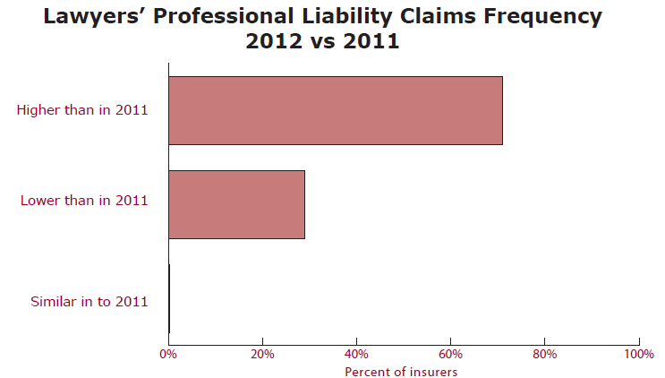
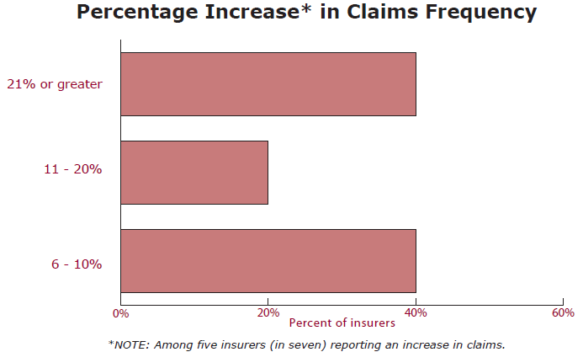
Lawyers’ Professional Liability Claims Frequency Trends
Claim frequency increased in 2012
The magnitude of claim frequency growth was fairly high
Source: Ames & Gough, Lawyers’ Professional Liability Claims Trends: 2013.

Slide 28
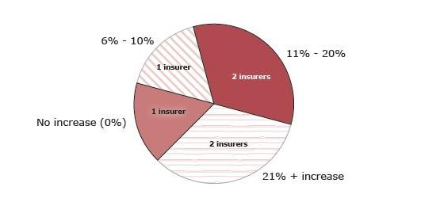
Estimated Year-Over-Year Percentage Increase in Large Claims (Combined Reserve Exceeding $500K)
Source: Ames & Gough, Lawyers’ Professional Liability Claims Trends: 2013.

Slide 29
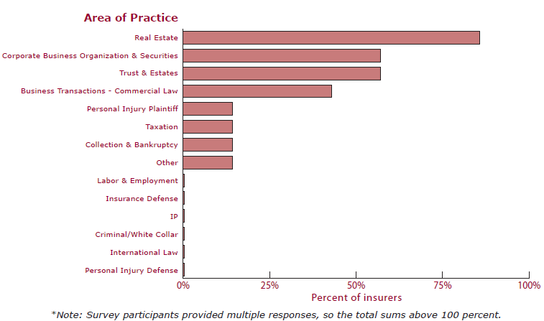
Practice Areas Generating Largest Number of Lawyers’ Professional Liability Claims*
Real Estate, followed by Corporate Business Organization & Securities and Trusts and Estates generated the largest number of LPL claims
Source: Ames & Gough, Lawyers’ Professional Liability Claims Trends: 2013.

Slide 30
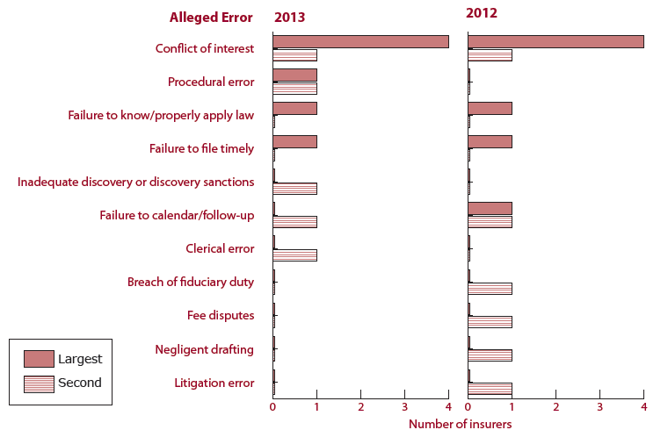
First and Second Most Frequently Alleged Malpractice Errors
Conflict of Interest remained the most commonly alleged malpractice error in 2013
Source: Ames & Gough, Lawyers’ Professional Liability Claims Trends: 2013.

Slide 31
Reported LPL Claim Frequency per
$1 Million of Gross Earned Premium
Frequency has increased since the “Great Recession”
Sources: Milliman, P&C Perspectives, May 2013.

Slide 32
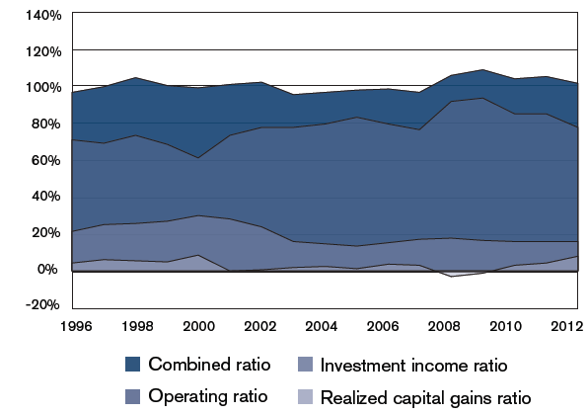
Aggregate Calendar-Year Operating Results for LPL Specialty Writers
Combined Ratio improved in 2012 but remains elevated
Investment Income Ratio is shrinking due to low interest rates
Sources: Milliman, P&C Perspectives, May 2013, compiled from SNL Financial data.

Slide 33
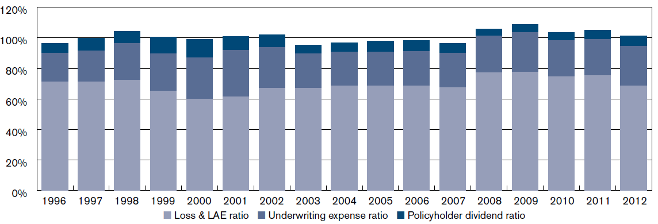
Breakdown of Aggregate Combined Ratio by Calendar Year for LPL Specialty Writers
Combined Ratio have shown volatility over the past 17 years (1996-2012, inclusive)
Sources: Milliman, P&C Perspectives, May 2013, compiled from SNL Financial data.

Slide 34
SURPLUS/CAPITAL/CAPACITY
How Will Large Catastrophe Losses Impact Capacity?
34

Slide 35
US Policyholder Surplus:
1975–2013*
($ Billions)
Surplus as of 3/31/13 was a record $607.7, up 3.6% from $586.9 of 12/31/12, and up 39.0% ($170.6B) from the crisis trough of $437.1B at 3/31/09. Pre-crisis peak was $521.8 as of 9/30/07. Surplus as of 3/31/13 was 16.5% above 2007 peak.
“Surplus” is a measure of underwriting capacity. It is analogous to “Owners Equity” or “Net Worth” in non-insurance organizations
The Premium-to-Surplus Ratio Stood at $0.77:$1 as of
3/31/13, A Near Record Low (at Least in Recent History)*
* As of 3/31/13.
Source: A.M. Best, ISO, Insurance Information Institute.

Slide 36
Policyholder Surplus,
2006:Q4–2013:Q1
Drop due to near-record 2011 CAT losses
2007:Q3
Pre-Crisis Peak
($ Billions)
The Industry now has $1 of surplus for every $0.80 of NPW, close to the strongest claims-paying status in its history.
Surplus as of 3/31/13 stood at a record high $607.7B
*Includes $22.5B of paid-in capital from a holding company parent for one insurer’s investment in a non-insurance business in early 2010.
The P/C Insurance Industry Both Entered and Emerged from the 2012 Hurricane Season Very Strong Financially.
Sources: ISO, A.M .Best.
36
12/01/09 - 9pm
eSlide – P6466 – The Financial Crisis and the Future of the P/C
Notes:
36

Slide 37
U.S. INSURANCE MERGERS AND ACQUISITIONS, 2002-2012 (1)
($ Millions)
M&A activity has returned to its pre-crisis levels.
(1) Includes transactions where a U.S. company was the acquirer and/or the target.
Source: Conning proprietary database.

Slide 38
REINSURANCE MARKET CONDITIONS
Capacity Has Recovered from the Effects of High Global Catastrophes Losses
38

Slide 39
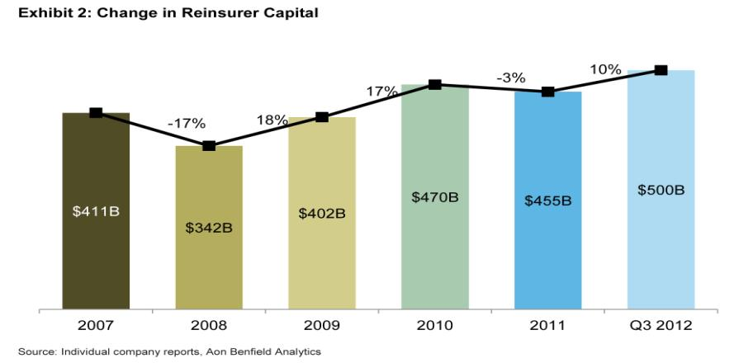
Reinsurance Capital Is at a Record High
Change in Global Reinsurer Capital
Source: Reinsurance Association of America from company reports and Aon Benfield Analytics.

Slide 40
Long-Term Evolution of Shareholders’ Funds for the Guy Carpenter Global Reinsurance Composite
Source: Guy Carpenter

Slide 41
RENEWED PRICING DISCIPLINE
Evidence of a Broad and Sustained Shift in Pricing
41

Slide 42
Net Premium Growth: Annual Change,
1971—2013:Q1
(Percent)
1975-78
1984-87
2000-03
Net Written Premiums Fell 0.7% in 2007 (First Decline Since 1943) by 2.0% in 2008, and 4.2% in 2009, the First 3-Year Decline Since 1930-33.
2013:Q1 = 4.1%
2012 growth was +4.3%
Shaded areas denote “hard market” periods
Sources: A.M. Best (historical and forecast), ISO, Insurance Information Institute.

Slide 43
P/C Net Premiums Written: % Change, Quarter vs. Year-Prior Quarter
Premium growth in Q1 2013 was up 4.1% over Q1 2012, marking the 12th consecutive quarter of growth
Sustained Growth in Written Premiums
(vs. the same quarter, prior year) Will Continue through 2013
Sources: ISO, Insurance Information Institute.
43
12/01/09 - 9pm
eSlide – P6466 – The Financial Crisis and the Future of the P/C
Notes:
43

Slide 44
Average Commercial Rate Change,
All Lines, (1Q:2004–2Q:2013)
Pricing as of Q2:2013 was positive for the89th consecutive quarter. Gains are likely to continue through 2013.
(Percent)
Q2 2011 marked the last of 30th consecutive quarter of price declines
KRW Effect
Note: CIAB data cited here are based on a survey. Rate changes earned by individual insurers can and do vary, potentially substantially.
Source: Council of Insurance Agents & Brokers; Insurance Information Institute

Slide 45
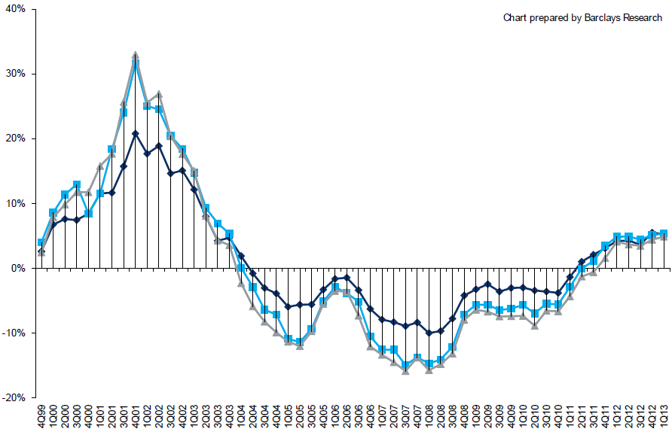
Change in Commercial Rate Renewals, by Account Size: 1999:Q4 to 2013:Q1
Percentage Change (%)
Peak = 2001:Q4 +28.5%
Pricing turned positive in Q3:2011, the first increase in nearly 8 years; Q1:2013 renewals were up 5.2%, the largest increase since late 2003; Some insurers posted stronger numbers.
Pricing Turned Negative in Early 2004 and Remained that way for 7 ½ years
KRW : No Lasting Impact
Trough = 2007:Q3 -13.6%
Source: Council of Insurance Agents and Brokers; Barclay’s Capital; Insurance Information Institute.
Note: CIAB data cited here are based on a survey. Rate changes earned by individual insurers can and do vary, potentially substantially.

Slide 46
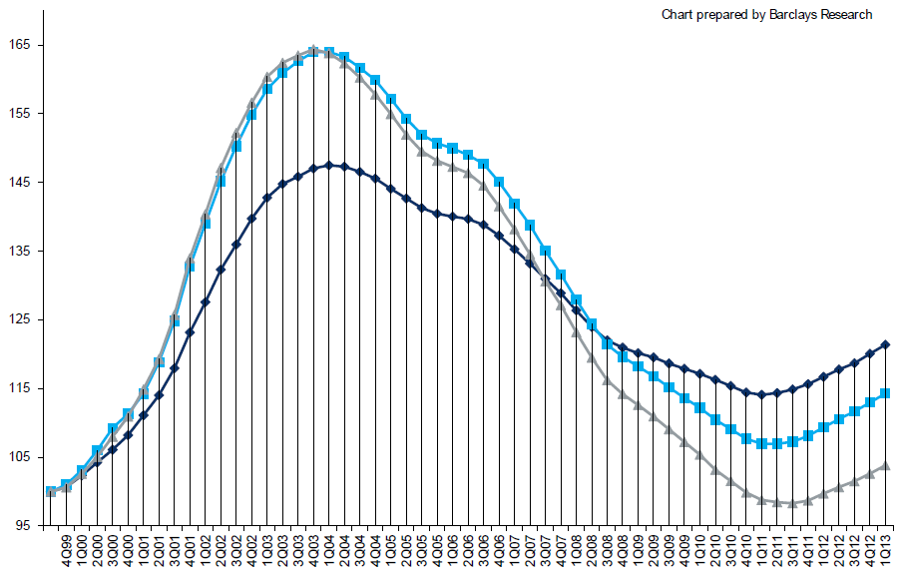
Cumulative Qtrly. Commercial Rate Changes, by Account Size: 1999:Q4 to 2013:Q1
1999:Q4 = 100
Despite 8 consecutive quarters of gains (Q4:2012 = 5.0%), pricing today is where is was in mid-2001 (pre-9/11), suggesting additional rate need going forward, esp. in light of record low interest rates
Note: CIAB data cited here are based on a survey. Rate changes earned by individual insurers can and do vary, potentially substantially.
Source: Council of Insurance Agents and Brokers; Barclay’s Capital; Insurance Information Institute.

Slide 47
Change in Commercial Rate Renewals, by Line: 2013:Q2
Workers Comp rate increases are large than any other line, followed by Property lines
Percentage Change (%)
Major Commercial Lines Renewed Uniformly Upward in Q2:2013 for the 8th Consecutive Quarter; Property Lines & Workers Comp Leading the Way; Cat Losses and Low Interest Rates Provide Momentum Going Forward
Note: CIAB data cited here are based on a survey. Rate changes earned by individual insurers can and do vary, potentially substantially.
Source: Council of Insurance Agents and Brokers; Insurance Information Institute.

Slide 48
Growth Analysis by State and Business Segment
Premium Growth Rates Vary Tremendously by State
48

Slide 49
Direct Premiums Written: Total P/C
Percent Change by State, 2007-2012*
Top 25 States
Montana was a growth leader over the past 5 years with premiums written expanding by 5.8% compared to 2.1% for the US overall
*Data are preliminary as of 5/1/13 and do not yet fully reflect the impact of state-run pools and plans.
Sources: SNL Financial LC.; Insurance Information Institute.

Slide 50
Direct Premiums Written: Total P/C
Percent Change by State, 2007-2012*
Bottom 25 States
*Data are preliminary as of 5/1/13 and do not yet fully reflect the impact of state-run pools and plans.
Sources: SNL Financial LC.; Insurance Information Institute.

Slide 51
The Strength of the Economy Will Influence P/C Insurer & Policyholder Growth Opportunities
Growth Will Expand Insurer Exposure Base Across Most Lines; Impacts on Loss Experience
51

Slide 52
US Real GDP Growth*
The Q4:2008 decline was the steepest since the Q1:1982 drop of 6.8%
Real GDP Growth (%)
Recession began in Dec. 2007. Economic toll of credit crunch, housing slump, labor market contraction was severe
2013 is expected to see uneven growth, then gradually accelerate throughout the year and into 2014
Demand for Insurance Continues To Be Impacted by Sluggish Economic Conditions, but the Benefits of Even Slow Growth Will Compound and Gradually Benefit the Economy Broadly
* Estimates/Forecasts from Blue Chip Economic Indicators.
Source: US Department of Commerce, Blue Economic Indicators 7/13; Insurance Information Institute.

Slide 53
Real GDP by State Percent Change, 2012:
Highest 25 States
North Dakota was the economic growth juggernaut of the US in 2012—by far
Only 10 states experienced growth in excess of 3%, which is what we would see nationally in a more typical recovery
Sources: US Bureau of Labor Statistics; Insurance Information Institute.

Slide 54
Real GDP by State Percent Change, 2012:
Lowest 25 States
Growth rates in 8 states (and DC) were still below 1% in 2012
Connecticut was the only state to shrink in 2012
Sources: US Bureau of Labor Statistics; Insurance Information Institute.

Slide 55
Consumer Sentiment Survey (1966 = 100)
January 2010 through June 2013
Optimism among consumers has remained fairly strong despite tax hikes, federal budget concerns. May’s reading was the highest since July 2007
Consumer confidence has been low for years amid high unemployment, falling home prices and other factors adversely impact consumers, but improved substantially over the past two years
Source: University of Michigan; Insurance Information Institute

Slide 56
New Private Housing Starts, 1990-2019F
Job growth, low inventories of existing homes, low mortgage rates and demographics are stimulating new home construction for the first time in years
(Millions of Units)
New home starts plunged 72% from 2005-2009; A net annual decline of 1.49 million units, lowest since records began in 1959
Insurers Are Starting to See Meaningful Exposure Growth for the First Time Since 2005 Associated with Home Construction: Construction Risk Exposure, Surety, Commercial Auto; Potent Driver of Workers Comp Exposure
Source: U.S. Department of Commerce; Blue Chip Economic Indicators (7/13 and 3/13); Insurance Information Institute.

Slide 57
Existing Home Sales and Months of Inventory, 2010-2013*
(Millions)
The number of real estate transactions continue to rise and inventories are falling
*Seasonally adjusted annualized figure for June 2013.
Source: Conning proprietary database.

Slide 58
30-Year Mortgages in 2013 Are Rising: What Will Be the Impact on Real Estate?
30-year mortgage rates are up more than 100 basis points since early May
Mortgage Interest Rates Will Rise as Expectations Over the Fed’s Tapering of QE3 Persist; Still Low by Historical Standards
*Weekly through July 18, 2013.
Sources: Federal Reserve Bank at http://www.federalreserve.gov/releases/h15/data.htm.; Insurance Information Institutes.
58
12/01/09 - 9pm
eSlide – P6466 – The Financial Crisis and the Future of the P/C
Notes:
58

Slide 59
Interest Rate on Conventional 30-Year Mortgages: Headed Back Up, 1990–2013*
Yields on 10-Year U.S. Treasury Notes plunged to all time record lows in early 2013 but are now rising as the Fed considers tapering its QE program
Yields on 30-Year mortgages have been below 6% for a five years
Since roughly 80% of P/C bond/cash investments are in 10-year or shorter durations, most P/C insurer portfolios will have low-yielding bonds for years to come.
*Monthly, through July 2013 (as of July 18). Note: Recessions indicated by gray shaded columns.
Sources: Federal Reserve Bank at http://www.federalreserve.gov/releases/h15/data.htm.
National Bureau of Economic Research (recession dates); Insurance Information Institutes.
59
12/01/09 - 9pm
eSlide – P6466 – The Financial Crisis and the Future of the P/C
Notes:
59

Slide 60
Construction Employment,
Jan. 2010—June 2013*
(Thousands)
Construction employment growth accelerated in the second half of 2012. Continued growth in this key sector is possible through 2013. Construction is a key driver of workers comp exposure growth.
*Seasonally adjusted
Sources: US Bureau of Labor Statistics at http://data.bls.gov; Insurance Information Institute.
60
12/01/09 - 9pm
eSlide – P6466 – The Financial Crisis and the Future of the P/C
Notes:
60

Slide 61
Commercial & Industrial Loans Outstanding at FDIC-Insured Banks, Quarterly, 2006-2013*
$Trillions
Recession
In nominal dollar terms, this is an all-time high.
Outstanding loan volume has been growing for over two years
and (as of year-end 2012) surpassed previous peak levels.
*Latest data as of 6/14/2013.
Source: FDIC at http://www2.fdic.gov/qbp/ (Loan Performance spreadsheet); Insurance Information Institute.

Slide 62
Percent of Non-current Commercial & Industrial Loans Outstanding at FDIC-Insured Banks,
Quarterly, 2006-2012:Q4*
Almost back to “normal” levels of noncurrent industrial & commercial loans
Recession
Non-current loans (those past due 90 days or more or in nonaccrual status) are back to early-recession levels, fueling bank willingness to lend.
*Latest data as of 3/18/2013.
Source: FDIC at http://www2.fdic.gov/qbp/ (Loan Performance spreadsheet); Insurance Information Institute.

Slide 63
Value of Construction Put in Place, May 2013 vs. May 2012*
Growth (%)
Private: +10.6%
Public: -4.7%
Public sector construction activity remains depressed
Private sector construction activity is up in the residential segment but down in nonresidential
Overall Construction Activity is Up, But Growth Is Entirely in the Private Sector as State/Local Government Budget Woes Continue
*seasonally adjusted
Source: U.S. Census Bureau, http://www.census.gov/construction/c30/c30index.html ; Insurance Information Institute.

Slide 64
Value of Private Construction Put in Place, by Segment, May 2013 vs. May 2012*
Growth (%)
Led by the Residential Construction, Lodging and Office segments, Private sector construction activity is remains mixed after plunging during the “Great Recession.” Most segments expanded in 2012 but weakened in early 2013.
Private Construction Activity is Up in Some Segments, Including the Key Residential Construction Sector, But Weakening in Early 2013
*seasonally adjusted
Source: U.S. Census Bureau, http://www.census.gov/construction/c30/c30index.html ; Insurance Information Institute.

Slide 65
Value of Public Construction Put in Place, by Segment, May 2013 vs. May 2012*
Growth (%)
Public sector construction activity is down substantially in most segments, a situation that will likely persist, dragging on public entity risk exposures
Transportation and Power projects lead public sector construction
Public Construction Activity is Down in Many Segments as State and Local Budgets Remain Under Stress; Improvement Possible in 2014.
*seasonally adjusted
Source: U.S. Census Bureau, http://www.census.gov/construction/c30/c30index.html ; Insurance Information Institute.

Slide 66
Manufacturing Growth for Selected Sectors, 2013 vs. 2013*
Growth (%)
Durables: +2.6%
Non-Durables: -0.2%
Manufacturing of durable goods was especially strong in 2012 but weakened in 2013
Manufacturing Is Expanding—Albeit More Slowly—Across a Number of Sectors that Will Contribute to Growth in Insurable Exposures Including: WC, Commercial Property, Commercial Auto and Many Liability Coverages
*Seasonally adjusted; Date are YTD comparing data through May 2013 to the same period in 2012.
Source: U.S. Census Bureau, Full Report on Manufacturers’ Shipments, Inventories, and Orders, http://www.census.gov/manufacturing/m3/

Slide 67
ISM Non-Manufacturing Index
(Values > 50 Indicate Expansion)
January 2010 through June 2013
Optimism among non-manufacturers is stable and remains expansionary in 2013
Non-manufacturing industries have been expanding and adding jobs. The question is whether this will continue.
Source: Institute for Supply Management at http://www.ism.ws/ismreport/nonmfgrob.cfm; Insurance Information Institute.

Slide 68
Business Bankruptcy Filings,
1980-2012:Q3
% Change Surrounding Recessions
1980-82 58.6%
1980-87 88.7%
1990-91 10.3%
2000-01 13.0%
2006-09 208.9%*
2011 bankruptcies totaled 47,806, down 15.1% from 56,282 in 2010—the second consecutive year of decline. Business bankruptcies more than tripled during the financial crisis. Through Q3:2012, filings were down 15.8% vs. Q3:2011
Significant Exposure Implications for All Commercial Lines as Business Bankruptcies Begin to Decline
Sources: American Bankruptcy Institute at http://www.abiworld.org/AM/AMTemplate.cfm?Section=Home&TEMPLATE=/CM/ContentDisplay.cfm&CONTENTID=61633; Insurance Information Institute
68
12/01/09 - 9pm
eSlide – P6466 – The Financial Crisis and the Future of the P/C
Notes:
68

Slide 69
Private Sector Business Starts,
1993:Q2 – 2012:Q3*
Business Starts
2006: 872,000
2007: 843,000
2008: 790,000
2009: 697,000 2010: 742,000 2011: 748,000 2012E: 769,000*
(Thousands)
Business starts were up an estimated 2.8% in 2012 to 769,000 following a 2.2% to 748,000 in 2011. Start-ups could accelerate in 2013.
Business Starts Were Down Nearly 20% in the Recession,
Holding Back Most Types of Commercial Insurance Exposure, But Are Recovering Slowly
* Data through Sep. 30, 2012 are the latest available as of June 21, 2013; Seasonally adjusted.
Source: Bureau of Labor Statistics, http://www.bls.gov/news.release/cewbd.t08.htm.
69
12/01/09 - 9pm
eSlide – P6466 – The Financial Crisis and the Future of the P/C
Notes:
69

Slide 70
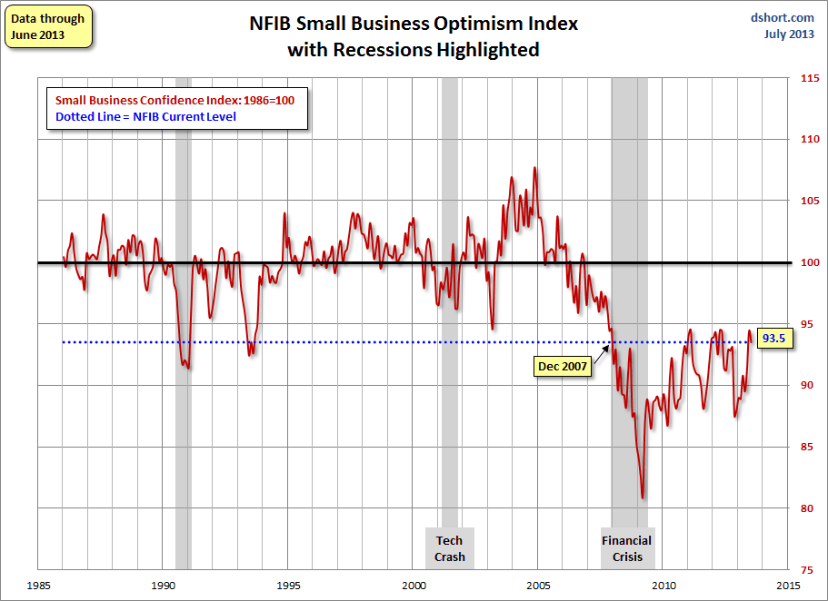
NFIB Small Business Optimism Index
January 1985 through June 2013
Small business optimism is off crisis lows but still suffering from economic and regulatory uncertainty. Confidence today is basically where it was when the crisis began in Dec. 2007.
Source: National Federation of Independent Business at http://www.advisorperspectives.com/dshort/charts/indicators/Sentiment.html?NFIB-optimism-index.gif ; Insurance Information Institute.

Slide 71
12 Industries for the Next 10 Years: Insurance (and Legal) Solutions Needed
Health Care
Health Sciences
Energy (Traditional)
Many industries are poised for growth, though insurers’ ability to capitalize on these industries varies widely
Alternative Energy
Petrochemical
Agriculture
Natural Resources
Technology (incl. Biotechnology)
Light Manufacturing
Insourced Manufacturing
Export-Oriented Industries
Shipping (Rail, Marine, Trucking, Pipelines)

Slide 72
U.S. Insured Catastrophe Loss Update
Catastrophe Losses in Recent Years Have Been Very High
72

Slide 73
U.S. Insured Catastrophe Losses
($ Billions, 2012 Dollars)
2012 was likely the third most expensive year ever for insured CAT losses
2012 Was the 3rd Highest Year on Record for Insured Losses in U.S. History on an Inflation-Adj. Basis. 2011 Losses Were the 6th Highest. YTD 2013 Running Below Average But Q3 Is Typically the Costliest Quarter.
Record tornado losses caused 2011 CAT losses to surge
*Through 6/2/13. Includes $2.6B for 2013:Q1 (PCS) and $5.32B for the period 4/1 – 6/2/13 (Aon Benfield Monthly Global Catastrophe Recap).
Note: 2001 figure includes $20.3B for 9/11 losses reported through 12/31/01 ($25.9B 2011 dollars). Includes only business and personal property claims, business interruption and auto claims. Non-prop/BI losses = $12.2B ($15.6B in 2011 dollars.)
Sources: Property Claims Service/ISO; Insurance Information Institute.
73
12/01/09 - 9pm
eSlide – P6466 – The Financial Crisis and the Future of the P/C
Notes:
73

Slide 74
Top 16 Most Costly Disasters in U.S. History
(Insured Losses, 2012 Dollars, $ Billions)
Hurricane Sandy could become the 4th or 5th costliest event in US insurance history
Includes Tuscaloosa, AL, tornado
Includes Joplin, MO, tornado
Hurricane Irene became the 12th most expense hurricane in US history in 2011
12 of the 16 Most Expensive Events in US History Have Occurred Over the Past Decade
*PCS estimate as of 4/12/13.
Sources: PCS; Insurance Information Institute inflation adjustments to 2012 dollars using the CPI.

Slide 75
Natural Disasters in the United States, 1980 – June 2013*
Number of Events (Annual Totals 1980 – June 2013*)
There were 68 natural disaster events in the first half of 2013
Number
41
19
121
3
Geophysical
(earthquake, tsunami,
volcanic activity)
Meteorological (storm)
Climatological
(temperature extremes,
drought, wildfire)
Hydrological
(flood, mass movement)
*Through June 30, 2013.
Source: MR NatCatSERVICE
75

Slide 76
Losses Due to Natural Disasters in the US, 1980–2012 (Overall & Insured Losses)
(Overall and Insured Losses)
(2012 Dollars, $ Billions)
2012 was the 2nd or 3rd most expensive year on record for insured catastrophe losses in the US.
Approximately 57% of the overall cost of catastrophes in the US was covered by insurance in 2012
2012 Losses
Overall : $101.1B
Insured: $57.9B
Overall losses (in 2012 values)
Insured losses (in 2012 values)
Source: MR NatCatSERVICE
76

Slide 77
Natural Disaster Losses in the United States: First Half 2013
As of July 1, 2013 | Number of Events | Fatalities | Estimated Overall Losses (US $m) | Estimated Insured Losses (US $m)
Severe Thunderstorm | 29 | 66 | 10,180 | 6,325
Winter Storm | 13 | 17 | 2,434 | 1,255
Flood | 10 | 9 | 500 | Minor
Earthquake & Geophysical | 5 | 0 | Minor | Minor
Tropical Cyclone | 1 | 1 | Minor | Minor
Wildfire, Heat, & Drought | 11 | 23 | 700 | 365
Totals | 68 | 116 | 13,814 | 7,945
Source: MR NatCatSERVICE
77

Slide 78
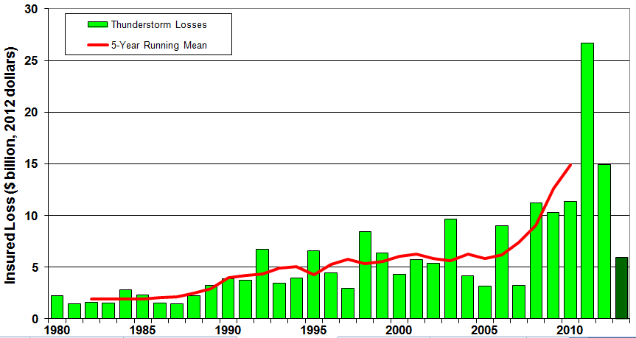
U.S. Thunderstorm Loss Trends, 1980 – June 30, 2013
Hurricanes get all the headlines, but thunderstorms are consistent producers of large scale loss. 2008-2012 are the most expensive years on record.
Average thunderstorm losses are up 7 fold since the early 1980s. The 5- year running average loss is up sharply.
1st Half 2013 thunderstorm losses total $6.325B; The system that included the EF-5 tornado in Moore, OK, accounted for $1.575B
Source: Property Claims Service, MR NatCatSERVICE
78

Slide 79
Inflation Adjusted U.S. Catastrophe Losses by Cause of Loss, 1992–2011¹
Wind/Hail/Flood (3), $14.8
Fires (4), $6.0
Other (5), $1.4
Insured cat losses from 1992-2011 totaled $384.3B, an average of $19.2B per year or $1.6B per month
Geological Events, $18.2
Terrorism, $24.4
Winter Storms, $28.2
Hurricanes & Tropical Storms, $161.3
Tornado share of CAT losses is rising
Wind losses are by far cause the most catastrophe losses, even if hurricanes/TS are excluded.
Tornadoes (2), $130.2
Catastrophes are defined as events causing direct insured losses to property of $25 million or more in 2009 dollars.
Excludes snow.
Does not include NFIP flood losses
Includes wildland fires
Includes civil disorders, water damage, utility disruptions and non-property losses such as those covered by workers compensation.
Source: ISO’s Property Claim Services Unit.

Slide 80
Combined Ratio Points Associated with Catastrophe Losses: 1960 – 2012*
Avg. CAT Loss Component of the Combined Ratio by Decade
1960s: 1.04 1970s: 0.85 1980s: 1.31 1990s: 3.39 2000s: 3.52 2010s: 7.20*
Catastrophe losses as a share of all losses reached a record high in 2012
Combined Ratio Points
The Catastrophe Loss Component of Private Insurer Losses Has Increased Sharply in Recent Decades
Notes: Private carrier losses only. Excludes loss adjustment expenses and reinsurance reinstatement premiums. Figures are adjusted for losses ultimately paid by foreign insurers and reinsurers.
Source: ISO (1960-2011); A.M. Best (2012E) Insurance Information Institute.

Slide 81
Federal Disaster Declarations Patterns: 1953-2013
Disaster Declarations Set New Records in Recent Years
81

Slide 82
Number of Federal Disaster Declarations, 1953-2013*
There have been 2,119 federal disaster declarations since 1953. The average number of declarations per year is 35 from 1953-2012, though there few haven’t been recorded since 1995.
The number of federal disaster declarations set a new record in 2011, with 99, shattering 2010’s record 81 declarations.
29 federal disasters were declared so far in 2013*
The Number of Federal Disaster Declarations Is Rising and Set New Records in 2010 and 2011. Hurricane Sandy Produced 13 Declarations in 2012/13.
*Through July 19, 2013.
Source: Federal Emergency Management Administration; http://www.fema.gov/disasters; Insurance Information Institute.

Slide 83
Federal Disasters Declarations by State,
1953 – 2013: Highest 25 States*
Over the past 60 years, Texas has had the highest number of Federal Disaster Declarations
*Through July 19, 2013. Includes Puerto Rico and the District of Columbia.
Source: FEMA: http://www.fema.gov/news/disaster_totals_annual.fema; Insurance Information Institute.

Slide 84
Federal Disasters Declarations by State,
1953 – 2013: Lowest 25 States*
Over the past 60 years, Wyoming and Rhode Island had the fewest number of Federal Disaster Declarations
Despite its size, Montana has relatively few disasters
*Through July 19, 2013. Includes Puerto Rico and the District of Columbia.
Source: FEMA: http://www.fema.gov/news/disaster_totals_annual.fema; Insurance Information Institute.

Slide 85
SEVERE WEATHER REPORT UPDATE: 2013
Damage from Tornadoes, Large Hail and High Winds Keep Insurers Busy
85

Slide 86
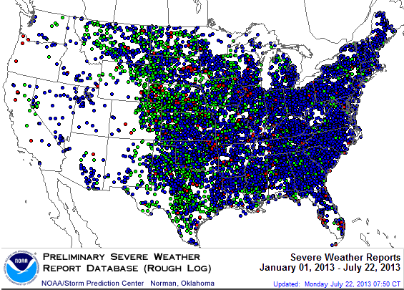
Severe Weather Reports:
Through July 22, 2013
More than 300 severe weather reports in MT
There were 13,667 severe weather reports through July 22; including 663 tornadoes; 4,111 “Large Hail” reports and 8,892 high wind events
Source: NOAA Storm Prediction Center; http://www.spc.noaa.gov/climo/online/monthly/2013_annual_summary.html#
86

Slide 87
Labor Market Trends
Massive Job Losses Sapped the Economy and Commercial/Personal Lines Exposure, But Trend is Improving
87

Slide 88
Unemployment and Underemployment Rates: Stubbornly High in 2012, But Falling
January 2000 through June 2013, Seasonally Adjusted (%)
U-6 went from 8.0% in March 2007 to 17.5% in
October 2009; Stood at 14.3% in June 2013
Recession ended in November 2001
Unemployment kept rising for 19 more months
Recession began in December 2007
Unemployment stood at 7.6% in June 2013—nearly its lowest level in 4 years.
Unemployment peaked at 10.1% in October 2009, highest monthly rate since 1983.
Peak rate in the last 30 years: 10.8% in November - December 1982
Stubbornly high unemployment and underemployment constrain overall economic growth, but the job market is now clearly improving
Source: US Bureau of Labor Statistics; Insurance Information Institute.
88
12/01/09 - 9pm
eSlide – P6466 – The Financial Crisis and the Future of the P/C
Notes:
88

Slide 89
Monthly Change in Private Employment
January 2007 through June 2013 (Thousands)
202,000 private sector jobs were created in June
Jobs Created
2012: 2.247 Mill
2011: 2.420 Mill
2010: 1.235 Mill
Monthly Losses in Dec. 08–Mar. 09 Were the Largest in the
Post-WW II Period
Private Employers Added 7.16 million Jobs Since Jan. 2010 After Having Shed 4.98 Million Jobs in 2009 and 3.80 Million in 2008 (State and Local Governments Have Shed Hundreds of Thousands of Jobs)
Source: US Bureau of Labor Statistics: http://www.bls.gov/ces/home.htm; Insurance Information Institute

Slide 90
Cumulative Change in Private Employment: Dec. 2007—May 2013
December 2007 through May 2013 (Millions)
Cumulative job losses as of June 2013 totaled 1.564 million
Cumulative job losses peaked at 8.765 million in February 2010
All of the jobs “lost” since President Obama took office in Jan. 2009 have been recouped
Private Employers Added 7.16 million Jobs Since Jan. 2010 After Having Shed 4.98 Million Jobs in 2009 and 3.80 Million in 2008 (State and Local Governments Have Shed Hundreds of Thousands of Jobs)
Source: US Bureau of Labor Statistics: http://www.bls.gov/ces/home.htm; Insurance Information Institute

Slide 91
Cumulative Change in Private Sector Employment: Jan. 2010—June 2013
January 2010 through June 2013* (Millions)
Job gains and pay increases have added more than $600 billion to payrolls since Jan. 2010
Cumulative job gains through June 2013 totaled 7.16 million
Private Employers Added 7.16 million Jobs Since Jan. 2010 After Having Shed 4.98 Million Jobs in 2009 and 3.80 Million in 2008 (State and Local Governments Have Shed Hundreds of Thousands of Jobs)
Source: US Bureau of Labor Statistics: http://www.bls.gov/ces/home.htm; Insurance Information Institute

Slide 92
Cumulative Change in Government Employment: Jan. 2010—June 2013
Government at all levels has shed more than 625,000 jobs since Jan. 2010 even as private employers created 7.16 million jobs, though losses may now be stabilizing.
January 2010 through June 2013* (Millions)
Cumulative job losses through June 2013 totaled 629,000
Temporary Census hiring distorted 2010 figures
Governments at All Levels are Under Severe Fiscal Strain As Tax Receipts Plunged and Pension Obligations Soared During the Financial Crisis: Sequestration Will Add to this Toll
Source: US Bureau of Labor Statistics http://www.bls.gov/data/#employment; Insurance Information Institute

Slide 93
Unemployment Rates by State, May 2013:
Highest 25 States*
In May, 25 states had over-the-month unemployment rate decreases, 17 had increases, and 8 and the District of Columbia had no change.
*Provisional figures for May 2013, seasonally adjusted.
Sources: US Bureau of Labor Statistics; Insurance Information Institute.

Slide 94
Unemployment Rates by State, May 2013:
Lowest 25 States*
In May, 25 states had over-the-month unemployment rate decreases, 17 had increases, and 8 and the District of Columbia had no change.
*Provisional figures for May 2013, seasonally adjusted.
Sources: US Bureau of Labor Statistics; Insurance Information Institute.

Slide 95

Oil & Gas Extraction Employment,
Jan. 2010—June 2013*
(Thousands)
Oil and gas extraction employment is up 22.8% since Jan. 2010 as the energy sector booms. Domestic energy production is essential to any robust economic recovery in the US.
*Seasonally adjusted
Sources: US Bureau of Labor Statistics at http://data.bls.gov; Insurance Information Institute.
95
12/01/09 - 9pm
eSlide – P6466 – The Financial Crisis and the Future of the P/C
Notes:
95

Slide 96
The BIG Question:
Where Is the Market Heading?
Catastrophes and Other Factors Are Pressuring Insurance Markets
New Factor: Record Low Interest Rates Are Contributing to Underwriting and Pricing Pressures
96
Notes:
96

Slide 97
INVESTMENTS:
THE NEW REALITY
Investment Performance is a Key Driver of Profitability
Depressed Yields Will Necessarily Influence Underwriting & Pricing
97

Slide 98
Property/Casualty Insurance Industry Investment Income: 2000–2013*¹
($ Billions)
Investment earnings are running below their 2007 pre-crisis peak
Investment Income Fell in 2012 and is Falling in 2013 Due to Persistently Low Interest Rates, Putting Additional Pressure on (Re) Insurance Pricing
¹ Investment gains consist primarily of interest and stock dividends..
*Estimate based on annualized actual Q1:2013 investment income of $11.385B.
Sources: ISO; Insurance Information Institute.

Slide 99
P/C Insurer Net Realized
Capital Gains/Losses, 1990-2013:Q1
Realized capital gains in 2012 were down 12% from 2011
($ Billions)
Insurers Posted Net Realized Capital Gains in 2010, 2011 and 2012 Following Two Years of Realized Losses During the Financial Crisis. Realized Capital Losses Were the Primary Cause of 2008/2009’s Large Drop in Profits and ROE
Sources: A.M. Best, ISO, Insurance Information Institute.
99
12/01/09 - 9pm
eSlide – P6466 – The Financial Crisis and the Future of the P/C
Notes:
99

Slide 100
Property/Casualty Insurance Industry Investment Gain: 1994–2013:Q1¹
($ Billions)
Investment gains in 2012 were approximately 16% below their pre-crisis peak
Investment Gains Are Slipping in 2012 as Low Interest Rates Reduce Investment Income and Lower Realized Investment Gains; The Financial Crisis Caused Investment Gains to Fall by 50% in 2008
¹ Investment gains consist primarily of interest, stock dividends and realized capital gains and losses.
* 2005 figure includes special one-time dividend of $3.2B;
Sources: ISO; Insurance Information Institute.

Slide 101
P/C Industry Investment Gains, Inflation-Adjusted: 1994–2012¹
($ Billions, 2012 dollars)
1994-2012 average yearly gain: $60.85B. We haven’t hit that average in the last 5 years.
Because the Federal Reserve Board aims to keep interest rates exceptionally low until the unemployment rate hits 6.5%—likely at least another year off—maturing bonds will be re-invested at even lower rates.
¹Investment gains consist primarily of interest, stock dividends and realized capital gains and losses.
*2005 figure includes special one-time dividend of $3.2B; 2013F figure is I.I.I. estimate for 2013:Q1, annualized.
Sources: ISO; Insurance Information Institute.

Slide 102
U.S. 10-Year Treasury Note Yields:
A Long Downward Trend, 1990–2013*
Yields on 10-Year U.S. Treasury Notes recently plunged to record modern-era lows and remain low by historical standards
Yields on 10-Year U.S. Treasury Notes have been essentially below 5% for a full decade.
Since roughly 80% of P/C bond/cash investments are in 10-year or shorter durations, most P/C insurer portfolios will have low-yielding bonds for years to come.
*Monthly, through June 2013. Note: Recessions indicated by gray shaded columns.
Sources: Federal Reserve Bank at http://www.federalreserve.gov/releases/h15/data.htm.
National Bureau of Economic Research (recession dates); Insurance Information Institutes.
102
12/01/09 - 9pm
eSlide – P6466 – The Financial Crisis and the Future of the P/C
Notes:
102

Slide 103
U.S. Treasury Security Yields:
A Long Downward Trend, 1990–2013*
Yields on 10-Year U.S. Treasury Notes have been essentially below 5% for a full decade.
U.S. Treasury security yields recently plunged to record lows
Since roughly 80% of P/C bond/cash investments are in 10-year or shorter durations, most P/C insurer portfolios will have low-yielding bonds for years to come.
*Monthly, constant maturity, nominal rates, through June 2013.
Sources: Federal Reserve Bank at http://www.federalreserve.gov/releases/h15/data.htm.
National Bureau of Economic Research (recession dates); Insurance Information Institute.
103
12/01/09 - 9pm
eSlide – P6466 – The Financial Crisis and the Future of the P/C
Notes:
103

Slide 104
Treasury Yield Curves:
Pre-Crisis (July 2007) vs. June 2013
Treasury yield curve remains near its most depressed level in at least 45 years. Investment income is falling as a result. If as Fed I “tapers” rates are unlikely to return to pre-crisis levels anytime soon
The Fed Is Actively Signaling that it Is Determined to Keep Rates Low Until Unemployment Drops Below 6.5% or Until Inflation Expectations Exceed 2.5%; Low Rates Add to Pricing Pressure for Insurers.
Source: Federal Reserve Board of Governors; Insurance Information Institute.

Slide 105
Average Maturity of Bonds Held by US P/C Insurers, 2006—2011*
Average Maturity (Years)
The average bond maturity is down by a full year between 2007 and 2011
Falling Average Maturity (and Duration) of the P/C Industry’s Bond Portfolio is Contributing to the Drop in Investment Income Along With Lower Yields
*Year-end figures. Latest available.
Sources: Insurance Information Institute calculations based on A.M. Best data.
105
12/01/09 - 9pm
eSlide – P6466 – The Financial Crisis and the Future of the P/C
Notes:
105

Slide 106
Distribution of Bond Maturities,
P/C Insurance Industry, 2003-2012
The main shift over these years has been from bonds with longer maturities to bonds with shorter maturities. The industry first trimmed its holdings of over-10-year bonds (from 24.6% in 2003 to 15.5% in 2012) and then trimmed bonds in the 5-10-year category (from 31.3% in 2003 to 27.6% in 2012) . Falling average maturity of the P/C industry’s bond portfolio is contributing to a drop in investment income along with lower yields.
Sources: SNL Financial; Insurance Information Institute.

Slide 107
Bonds Rated NAIC Quality Category 3-6 as a Percent of Total Bonds, 2003–2012
From 2006-07 to year-end 2012, the percentage of lower-quality bonds in P/C industry portfolios more than doubled
There are many ways to capture higher yields on bond portfolios.
One is to accept greater risk, as measured by NAIC bond ratings.
The ratings range from 1 to 6, with the highest quality rated 1.
Even in 2012, over 95% of the industry’s bonds were rated 1 or 2.
Sources: SNL Financial; Insurance Information Institute.

Slide 108
Reduction in Combined Ratio Necessary to Offset 1% Decline in Investment Yield to Maintain Constant ROE, by Line*
Lower Investment Earnings Place a Greater Burden on Underwriting and Pricing Discipline
*Based on 2008 Invested Assets and Earned Premiums
**US domestic reinsurance only
Source: A.M. Best; Insurance Information Institute.
108
12/01/09 - 9pm
eSlide – P6466 – The Financial Crisis and the Future of the P/C
Notes:
108
This shows the drop in Combined Ratio for each line of business that would be needed to maintain a constant ROE, given a 1-percentage-point drop in investment yield

Slide 109
Annual Inflation Rates, (CPI-U, %),
1990–2014F
Annual Inflation Rates (%)
Inflation peaked at 5.6% in August 2008 on high energy and commodity crisis. The recession and the collapse of the commodity bubble reduced inflationary pressures in 2009/10
Inflationary expectations remain quite low, allowing the Fed to continue its QE3 program
The slack in the U.S. economy suggests that inflationary pressures should remain subdued for an extended period of times. Energy, health care and commodity prices, plus U.S. debt burden, remain longer-run concerns
Sources: US Bureau of Labor Statistics; Blue Chip Economic Indicators, 5/13 (forecasts).

Slide 110
Shifting Legal Liability &
Tort Environment
Is the Tort Pendulum
Swinging Against Insurers?
110

Slide 111
Over the Last Three Decades, Total Tort Costs as a % of GDP Appear Somewhat Cyclical, 1980-2013E
($ Billions)
2.21% of GDP in 2003 = pre-tort reform peak
Deepwater Horizon Spike in 2010
Tort costs in dollar terms have remained high but relatively stable since the mid-2000s., but are down substantially as a share of GDP
1.68% of GDP in 2013
Sources: Towers Watson, 2011 Update on US Tort Cost Trends, Appendix 1A

Slide 112
Commercial Lines Tort Costs: Insured vs. Self-(Un)Insured Shares, 1973-2010
2005: $143.5B 66.4% insured, 33.6% self-(un)insured
Billions of Dollars
$15.0
1995: $83.6B 69.5% insured, 30.5% self-(un)insured
1973: Commercial Tort Costs Totaled $6.49B, 94% was insured, 6% self-(un)insured
1985: $46.6B 74.5% insured, 25.5% self-(un)insured
$9.5
$6.0
2009: $126.5B 64.4% insured, 35.6% self-(un)insured
Tort Costs and the Share Retained by Risks Both Grew Rapidly from the mid-1970s to mid-2000s, When Tort Costs Began to Fall But Self-Insurance Shares Continued to Rise
Sources: Towers Watson, 2011 Update on US Tort Cost Trends, III Calculations based on data from Appendix 4.
112
12/01/09 - 9pm
eSlide – P6466 – The Financial Crisis and the Future of the P/C
Notes:
112

Slide 113
Commercial Lines Tort Costs: Insured vs. Self-(Un)Insured Shares, 1973-2010
Percent
2010: $138.1B 56.6% insured, 44.4% self-(un)insured (distorted by Deepwater Horizon event with most losses retained by BP)
1973: 94% was insured, 6% self-(un)insured
1985:74.5% insured, 25.5% self-(un)insured
1995: 69.5% insured, 30.5% self-(un)insured
2005: 66.4% insured, 33.6% self-(un)insured
The Share of Tort Costs Retained by Risks Has Been Steadily Increasing for Nearly 40 Years. This Trend Contributes Has Left Insurers With Less Control Over Pricing.
Sources: Towers Watson, 2011 Update on US Tort Cost Trends, III Calculations based on data from Appendix 4.
113
12/01/09 - 9pm
eSlide – P6466 – The Financial Crisis and the Future of the P/C
Notes:
113

Slide 114
Business Leaders Ranking of Liability Systems in 2012
Best States
Delaware
Nebraska
Wyoming
Minnesota
Kansas
Idaho
Virginia
North Dakota
Utah
Iowa
Worst States
Florida
Oklahoma
Alabama
New Mexico
Montana
Illinois
California
Mississippi
Louisiana
West Virginia
New in 2012
Wyoming
Minnesota
Kansas
Idaho
Newly Notorious
Oklahoma
Drop-offs
Rising Above
Indiana
Colorado
Massachusetts
South Dakota
Arkansas
Source: US Chamber of Commerce 2012 State Liability Systems Ranking Study; Insurance Info. Institute.

Slide 115
The Nation’s Judicial Hellholes: 2011
Watch List
Illinois
Madison , St. Clair and McLean counties
West Virginia
Philadelphia
Eastern District of Texas
Cook County, IL
Southern NJ
Franklin County, AL
Smith County, MS
Louisiana
California
Dishonorable Mention
New York
Albany and NYC
MI Supreme Court
AK Supreme Court
MO Supreme Court
Nevada
Clark County
South Florida
Source: American Tort Reform Association; Insurance Information Institute

Slide 116
CYBER RISK
Cyber Risk is a Rapidly Emerging Exposure for Businesses Large and Small in Every Industry
NEW III White Paper: http://www.iii.org/assets/docs/pdf/paper_CyberRisk_2013.pdf
116

Slide 117
Data Breaches 2005-2013, By Number of Breaches and Records Exposed
# Data Breaches/Millions of Records Exposed
Millions
The total number of data breaches and number of records exposed fluctuates from year to year and over time.
* 2013 figures as of March 19, 2013.
Source: Identity Theft Resource Center

Slide 118
2012 Data Breaches By Business Category, By Number of Breaches
The majority of the 447 data breaches in 2012 affected business and medical/healthcare organizations, according to the Identity Theft Resource Center.
Banking/Credit/Financial, 17 (3.8%)
Govt/Military, 50 (11.2%)
Business, 165 (36.9%)
Educational, 61 (13.6%)
Medical/Healthcare, 154 (34.5%)
Source: Identity Theft Resource Center, http://www.idtheftcenter.org/ITRC%20Breach%20Report%202012.pdf.

Slide 119
2012 Data Breaches By Category, By Number of Records Exposed
Government/Military and Business organizations accounted for the majority of records exposed by data breaches during 2012.
Banking/Credit/Financial, 470,048 (2.7%)
Medical/Healthcare, 2.2 million (12.9%)
Govt/Military, 7.7 million (44.4%)
Educational, 2.3 million (13.3%)
Business, 4.6 million (26.7%)
Source: Identity Theft Resource Center, http://www.idtheftcenter.org/ITRC%20Breach%20Report%202012.pdf.

Slide 120
AIG Survey: Cyber Attacks Top Concern Among Execs
While companies are focused on managing a variety of business risks, cyber attacks are a top concern. Some 85% of 258 executives surveyed said they were very or somewhat concerned about cyber attacks on their businesses.
Source: Penn Schoen Berland on behalf of American International Group.
120
Notes:
120

Slide 121
The Most Costly Cyber Crimes, Fiscal Year 2012
Malicious code, denial of service and web-based attacks account for more than 58 percent of the total annualized cost of cyber crime experienced by 56 companies.
Malware
Botnets
Malicious code
Viruses, Worms, Trojans
Phishing + social engineering
Malicious insiders
Stolen devices
Denial of service
Web-based attacks
Source: 2012 Cost of Cyber Crime: United States, Ponemon Institute.

Slide 122
External Cyber Crime Costs: Fiscal Year 2012
Information loss (44%) and business disruption or lost productivity (30%) account for the majority of external costs due to cyber crime.
Other costs*
Equipment damages
Information loss
Revenue loss
Business disruption
* Other costs include direct and indirect costs that could not be allocated to a main external cost category
Source: 2012 Cost of Cyber Crime: United States, Ponemon Institute.

Slide 123
High Profile Data Breaches, 2012-2013
Date | Company | Description of Breach
Mar 2013* | South Korean banks, media cos | Cyber attack causes computers to crash at South Korean banks and media companies, paralyzing bank machines across the country. No immediate reports of records compromised.
July 2012 | Yahoo | Security breach at Yahoo in which some 450,000 passwords lifted and posted to the Internet.
July 2012 | eHarmony | Online dating site eHarmony confirms security breach in which some 1.5 million user names and passwords compromised.
July 2012 | LinkedIn | Social networking site LinkedIn reportedly targeted in hacker attack that saw 6.5 million hashed passwords posted to the Internet.
April 2012 | Utah Dept of Technology Services | Utah Department of Technology notifies of a March 30 breach of a server containing personal data including social security numbers for about 780,000 Medicaid patient claims. Breach traced to Eastern Europe hackers.
Mar 2012 | Global Payments | Credit card processor Global Payments confirms hacker attack has compromised the payment card numbers of around 1.5 million cardholders.
Mar 2012 | CA Dept of Child Support Services | Officials announce that four computer storage devices containing personal information for about 800,000 adults and children in California’s child support system were lost by IBM and Iron Mountain Inc.
Jan 2012 | Zappos | Online shoe retailer Zappos announces that information, such as names, addresses and passwords on as many as 24 million customers illegally accessed.
Jan 2012 | NY State Electric + Gas Co | Security breach at NYSEG that allowed unauthorized access to NYSEG customer data, containing social security numbers, dates of birth and bank account numbers, exposing 1.8 million records.
*March 2013 attack is not part of ITRC research.
Sources: Identity Theft Resource Center, http://www.idtheftcenter.org/ITRC%20Breach%20Report%202012.pdf; Insurance Information Institute (I.I.I.) research.

Slide 124
Average Organizational Cost of a Data Breach, 2008-2011* ($ Millions)
The average organizational cost of a data breach in 2011 was $5.5 million, down 24% from $7.2 million in 2010. Companies have improved steps taken in both preparing for and responding to a data breach.
($ Millions)
*Findings of this benchmark study pertain to the actual data breach experiences of 49 U.S. companies from 14 different industry sectors, all of which participated in the 2011 study. Total breach costs include: lost business resulting from diminished trust or confidence of customers ;costs related to detection, escalation, and notification of the breach; and ex-post response activities, such as credit report monitoring.
Source: 2011 Annual Study: U.S. Cost of a Data Breach, the Ponemon Institute.
124
Notes:
124

Slide 125
Main Causes of Data Breach
Negligent employees and malicious attacks are most often the cause of the data breach. Some 39 percent of incidents involve a negligent employee or contractor, while 37 percent concern a malicious or criminal attack.
Negligence
System glitch
Malicious or criminal attack
Source: 2011 Cost of Data Breach Study: United States, Ponemon Institute, March 2012

Slide 126
Marsh: Increase in Purchase of Cyber Insurance Among U.S. Companies, 2012
Interest in cyber insurance continues to climb. The number of companies purchasing cyber insurance increased 33 percent from 2011 to 2012.
Source: Marsh Global Analytics, Marsh Risk Management Research Briefing, March 2013
126
Notes:
126

Slide 127
Marsh: Total Limits Purchased, By Industry – Cyber Liability, All Revenue Size
Cyber insurance limits purchased in 2012 averaged $16.8 million across all industries, an increase of nearly 20% over 2011.
($ Millions)
Source: Marsh Global Analytics, Marsh Risk Management Research Briefing, March 2013
127
Notes:
127

Slide 128
Marsh: Total Limits Purchased, By Industry – Cyber Liability, Revenue $1 Billion+
Among larger companies, average cyber insurance limits purchased in 2012 increased nearly 30% over 2011.
($ Millions)
Source: Marsh Global Analytics, Marsh Risk Management Research Briefing, March 2013
128
Notes:
128

Slide 129
Cyber Liability: Historical Rate (price per million) Changes
Overall, rates for cyber insurance were essentially flat in the fourth quarter of 2012.
Source: Marsh Global Analytics, Marsh Risk Management Research Briefing, March 2013

Slide 130
Insurance Information Institute Online:
www.iii.org
Thank you for your time
and your attention!
Twitter: twitter.com/bob_hartwig

