Slide 1
The Never-Ending[?]
Era of Uncertainty:
Managing Global Risk in a Volatile World
Minnesota RIMS Chapter
Golden Valley, MN
May 21, 2013
Steven N. Weisbart, Ph.D., CLU, Senior Vice President & Chief Economist
Insurance Information Institute ♦ 110 William Street ♦ New York, NY 10038
Tel: 212.346.5540 ♦ Cell: 917.494.5945 ♦ stevenw@iii.org ♦ www.iii.org

Slide 2
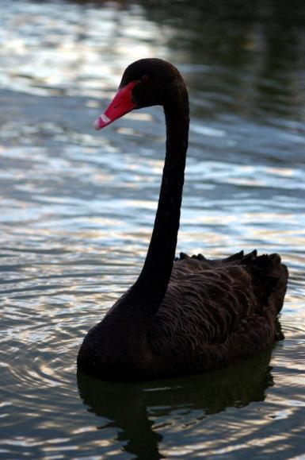
Global Risks:
What in the World is Going On?
Continuing Echoes of the Global Financial Crisis
European Sovereign Debt & Eurozone Crises
The US Debt and Budget Standoff
Unintended Consequences of (Over)Regulation
Persistent Global Austerity/
Slow Economic Growth
Housing and Unemployment Crises
Political Upheaval in the Middle East
Terrorism Risk Anywhere/Everywhere
Diffusion of Weapons of Mass Destruction
Cyber Attacks
Record Natural Disaster Losses
Climate Change/Environmental Degradation
Severe Income Disparity
Insomnia???
Are “Black Swans” everywhere or does it just seem that way?

Slide 3
Global Risks:
Their Importance in Risk Management
Global Risks are often diminished, or even ignored, in current enterprise risk management
  They don’t fit neatly into existing conceptual risk frameworks
  Kaplan and Mikes propose a framework of 3 types of global risks
    Natural & economic disasters with immediate impact
    Geopolitical and environmental changes with long-term impact
    Competitive risks (e.g., disruptive technologies) with medium-term impact
  To manage these risks, they recommend stress tests and scenario planning for the first two, and war gaming for the third
Sources: Kaplan and Mikes, “Managing Risks: A New Framework,” Harvard Business Review, June 2012; World Economic Forum, Global Risks 2013; Insurance Information Institute.

Slide 4
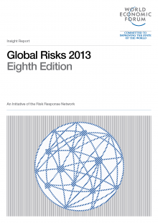
World Economic Forum:
The Global Risks Sourcebook
Source: World Economic Forum, Global Risks 2013, at http://www3.weforum.org/docs/WEF_GlobalRisks_Report_2013.pdf .

Slide 5
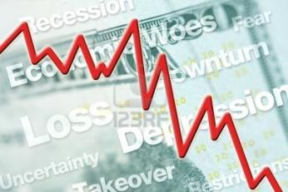
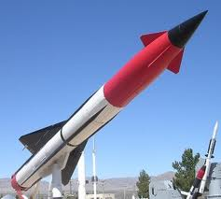
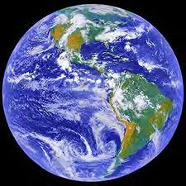

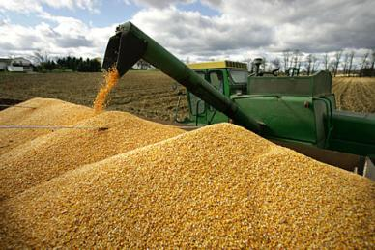
World Economic Forum
Global Risks: 5 Major Categories
Economic Risks
Environmental Risks
Geopolitical Risks
Technological Risks
Societal Risks
Risks can be broadly categorized, but no category is mutually exclusive
Sources: World Economic Forum, Global Risks 2013; Insurance Information Institute.

Slide 6
What Global Risks
Do the “Experts” See as
Most Significant
Over the Next 10 Years?
The Risks Tend to be Seen
in a “Rear View Mirror”
6

Slide 7
Top 3 Global Risks for the Next 10 Years, by Likelihood, 2007-2009
Information Infrastructure breakdown
Most likely
Asset price collapse
Asset price collapse
Slowing Chinese economy
Next most likely
Chronic disease
Middle East instability
3d most likely
Oil price shock
Failed &
Failing states
Chronic disease
The experts seem to simply read the headlines in assessing likelihood.
Key: blue = economic risks; green = environmental risks; red = societal risks; orange = geopolitical risks; purple = technological risks
Sources: World Economic Forum, Global Risks 2013; Insurance Information Institute.

Slide 8
Top 3 Global Risks for the Next 10 Years, by Impact, 2007-2009
Most likely
Asset price collapse
Asset price collapse
Asset price collapse
Next most likely
Retrenchment from globalization
Retrenchment from globalization
Retrenchment from globalization
3d most likely
Interstate and civil wars
Slowing Chinese economy
Oil and gas price spike
The experts seem to simply read the headlines in assessing likelihood.
Key: blue = economic risks; green = environmental risks; red = societal risks; orange = geopolitical risks
Sources: World Economic Forum, Global Risks 2013; Insurance Information Institute.

Slide 9
Top 3 Global Risks for the Next 10 Years, by Likelihood, 2010-2013
Asset price collapse
Meteorological catastrophes
Severe income disparity
Severe income disparity
Most likely
Slowing Chinese economy
Next most likely
Hydrological catastrophes
Chronic fiscal imbalances
Chronic fiscal imbalances
Rising greenhouse gas emissions
Rising greenhouse gas emissions
3d most likely
Chronic disease
Corruption
The experts seem to simply read the headlines in assessing likelihood.
Key: blue = economic risks; green = environmental risks; red = societal risks; orange = geopolitical risks
Sources: World Economic Forum, Global Risks 2013; Insurance Information Institute.

Slide 10
Top 3 Global Risks for the Next 10 Years, by Impact, 2010-2013
Major systemic financial failure
Major systemic financial failure
Asset price collapse
Fiscal crisis
Most likely
Retrenchment from globalization
Water supply crises
Water supply crises
Next most likely
Climatological catastrophes
3d most likely
Oil price spikes
Food shortage crises
Chronic fiscal imbalances
Geopolitical conflict
The experts seem to simply read the headlines in assessing likelihood.
Key: blue = economic risks; green = environmental risks; red = societal risks; orange = geopolitical risks
Sources: World Economic Forum, Global Risks 2013; Insurance Information Institute.

Slide 11
Global Economic Risks
Near Term: We Won’t Solve
“Chronic Fiscal Imbalances” Through Strong Economic Growth
We Won’t Solve “Severe Income Disparity” Through Strong Growth, Either
11

Slide 12
Economic Risk: Foremost on the Minds in “Advanced” Economies
Economic Risks
  Chronic fiscal imbalances
  Severe income disparity
  Extreme volatility in energy and food prices
  Recurring liquidity crises
  Major systemic failure
  Adverse unintended consequences of regulation
  Unmanageable inflation/deflation
  Chronic labor market imbalances
  Hard landing of emerging economy
Sources: World Economic Forum, Global Risks 2013; Insurance Information Institute.

Slide 13
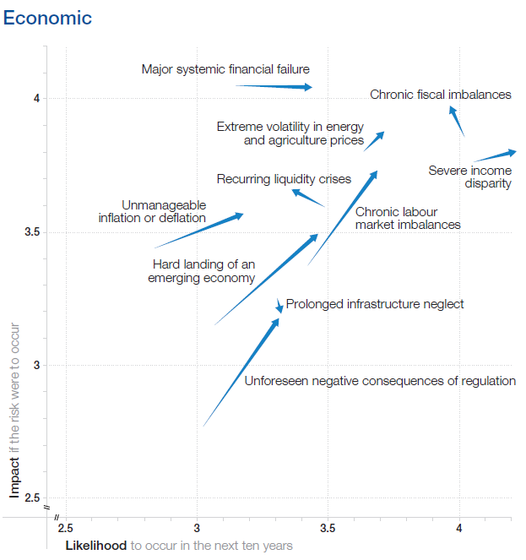
Changes in Assessment of Global Economic Risks, 2013 vs. 2012
Pressure to cut government spending?
Most impactful
Pressure to boost government spending?
Most likely

Slide 14
Real GDP Growth Forecasts, Major Economies: 2012 vs. 2013F & 2014F
Tepid US recovery continues, but stronger than in the UK or the Euro Zone
China growth remains strong in an expected “soft landing” scenario
Rebuilding, “Abenomics” is stimulating the Japanese economy
Except for China, growth forecasts for the largest economies are modest.
Sources: Blue Chip Economic Indicators (5/2013 issue); Insurance Information Institute.
14
Notes:
14

Slide 15
Real GDP Growth Forecasts, Emerging Economies: 2012 vs. 2013F & 2014F
Growth prospects in the major emerging economies
are expected to improve through 2014.
Sources: Blue Chip Economic Indicators (5/2013 issue); Insurance Information Institute.
15
Notes:
15

Slide 16

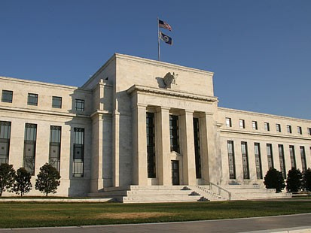
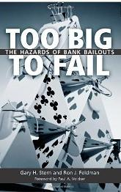
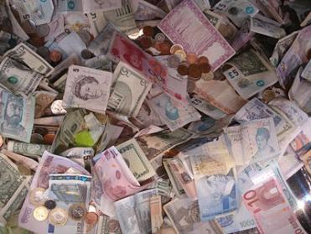
Regulatory Risk: Financial Sector in Consumed with Post-Crisis Concerns
Capital Adequacy, Quality, Liquidity,
  Leverage, Prudential Oversight
Dodd-Frank
Basel III
Solvency II
Systemic Importance
  US
  Global
Source: Insurance Information Institute.

Slide 17
Global Environmental Risks
Near Term: Can We Marshall the Resources (and the Determination) to Deal with the Coming Changes?
We Won’t Solve “Severe Income Disparity” Through Strong Growth, Either
17

Slide 18
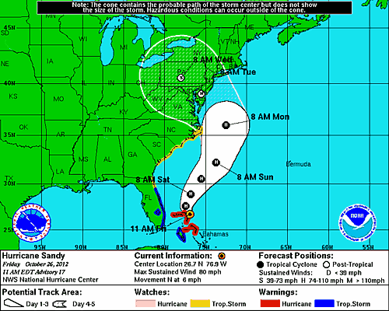
SuperStorm Sandy: Can other non-hurricanes do this much damage?
SuperStorm Sandy is just the latest in a long list of unusual and severe weather events. Can the risk of events like Sandy be managed?
Source: NOAA (as of 11 AM Oct. 26, 2012); Insurance Information Institute.
18
12/01/09 - 9pm
eSlide – P6466 – The Financial Crisis and the Future of the P/C
Notes:
18

Slide 19
Environmental Risk: Vulnerability and Susceptibility Vary Across the Globe
Environmental Risks
  Rising greenhouse gas emissions
  Failure of climate change adaptation
  Land/water use mismanagement
  Mismanaged urbanization
  Antibiotic-resistant bacteria
  Persistent extreme weather
  Species overexploitation
  Irremediable pollution
  Vulnerability to geomagnetic storms
Source: World Economic Forum, Global Risks 2013; Insurance Information Institute.

Slide 20
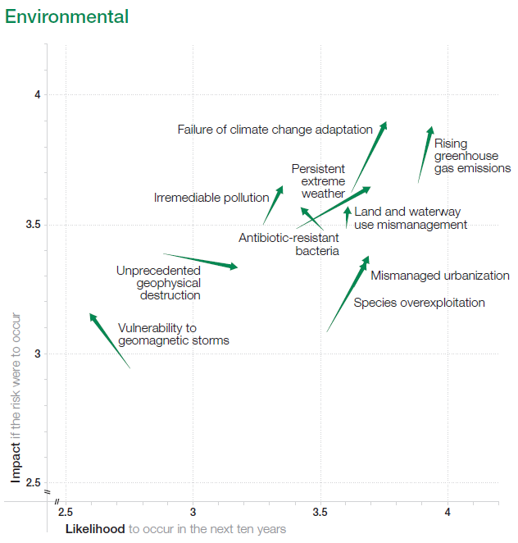
Changes in Assessment of Global Environmental Risks, 2013 vs. 2012
Pressure to boost government spending, regulation

Slide 21
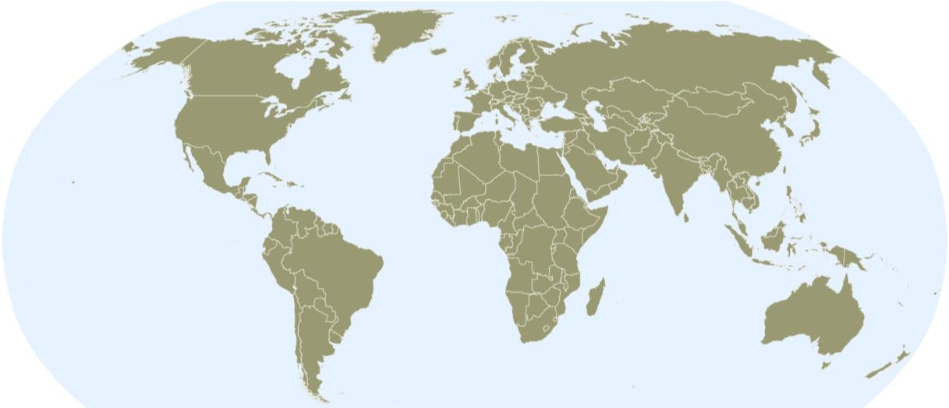
Natural Catastrophes Worldwide 2011
Insured losses US$ 105bn - Percentage distribution per continent
2%
44%
In 2011, just 37% of insured natural catastrophe losses were in the Americas, barely half the average of 66% over the prior 30 years (1981-2010)
37%
<1%
17%
Continent | Insured losses US$ m
America (North and South America) | 40,000
Europe | 2,000
Africa | Minor damages
Asia | 45,000
Australia/Oceania | 18,000
In 2011, 61% of insured natural catastrophe losses were in the Asia/Pacific region, nearly 3.5 times the average of 13% over the prior 30 years (1981-2010)
Source: MR NatCatSERVICE
21

Slide 22
Natural Catastrophes Worldwide 1980 – 2011
Insured losses US$ 870bn - Percentage distribution per continent
16%
13%
66%
<1%
5%
Continent | Insured losses US$ m
America (North and South America) | 566,000
Europe | 146,000
Africa | 2,000
Asia | 115,000
Australia/Oceania | 41,000
In 2011, 61% of natural catastrophe losses were in the Asia/Pacific region, nearly 3.5 times the average of 13% over the prior 30 years (1981-2010)
Source: MR NatCatSERVICE
22

Slide 23

Natural catastrophes worldwide 2012
Insured losses US$ 65bn - Percentage distribution per continent
5%
91%
<3%
<1%
<1%
Continent | Insured losses US$ m
America (North and South America) | 60,000
Europe | 3,200
Africa | 200
Asia | 1,700
Australia/Oceania | 300
© 2013 Munich Re
23
Source: Geo Risks Research, NatCatSERVICE – As at January 2013

Slide 24
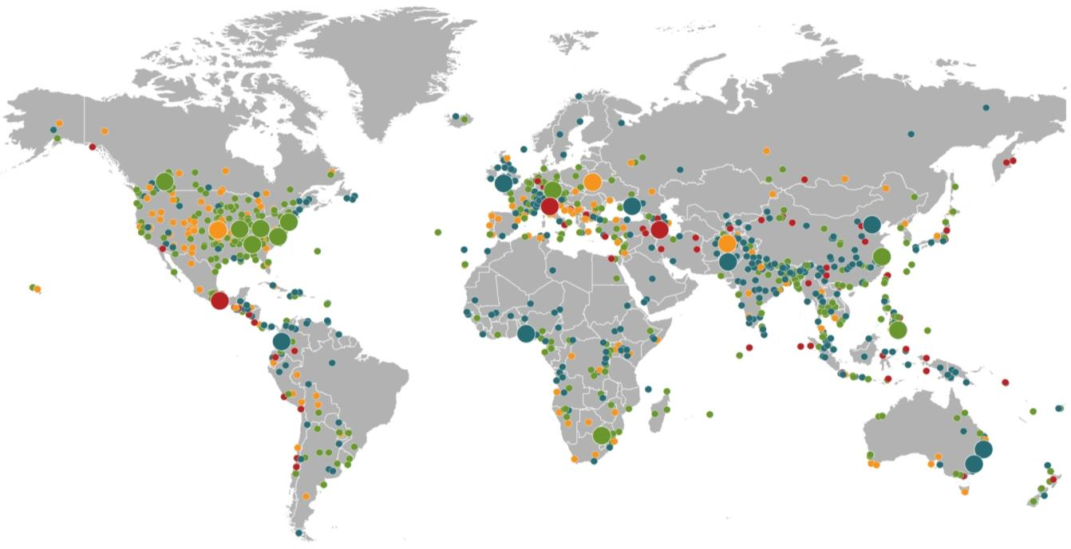
Natural Catastrophes 2012
Winter Storm Andrea
Europe, 5–6 January
Floods
United Kingdom,
21–27 November
Cold Wave
Eastern Europe, Jan – Feb
Cold Wave
Afghanistan, Jan – Mar
Severe Weather
USA, 28–29 April
Hailstorms, severe weather
Canada, 12–14 August
Severe storms
USA, 28 June –2 July
Flash Floods
Russia, 6–8 July
Floods
China, 21–24 July
Drought
USA, Summer
Hurricane Sandy
USA, Caribbean
24–31 October
Earthquake
Italy,
29 May/3 June
Typhoon Haikui China, 8–9 August
Severe Storms, tornadoes
USA, 2–4 March
Hurricane Isaac
USA, Caribbean
24–31 August
Earthquake
Iran, 11 August
Earthquake
Mexico, 20 March
Floods
Nigeria, Jul – Oct
Floods
Pakistan, 3 –27 September
Typhoon Bopha Philippines, 4–5 December
Floods
Columbia, Mar – Jun
Floods, flash floods
Australia, Jan – Feb
Number of events: 905
Floods, hailstorms
South Africa, 20 –21 October
Floods. flash floods
Australia, Feb – Mar
Natural catastrophes
Geophysical events
(earthquake, tsunami, volcanic activity)
Hydrological events
(flood, mass movement)
Selection of significant
Natural catastrophes
Meteorological events
(storm)
Climatological events
(extreme temperature, drought, wildfire)
© 2013 Munich Re
24
Source: Geo Risks Research, NatCatSERVICE – As at January 2013

Slide 25
Number of natural catastrophes worldwide, 1980 – 2012
Number
Geophysical events
(Earthquake, tsunami,
volcanic eruption)
Meteorological events
(Storm)
Hydrological events
(Flood, mass movement)
Climatological events
(Extreme temperature,
drought, forest fire)
© 2013 Munich Re
25
Source: Geo Risks Research, NatCatSERVICE – As at January 2013

Slide 26
Economic and Insured Losses, Natural Catastrophes worldwide 1980 – 2012
(bn US$)
Overall losses (in 2012 values)
Insured losses (in 2012 values)
© 2013 Munich Re
26
Source: Geo Risks Research, NatCatSERVICE – As at January 2013

Slide 27
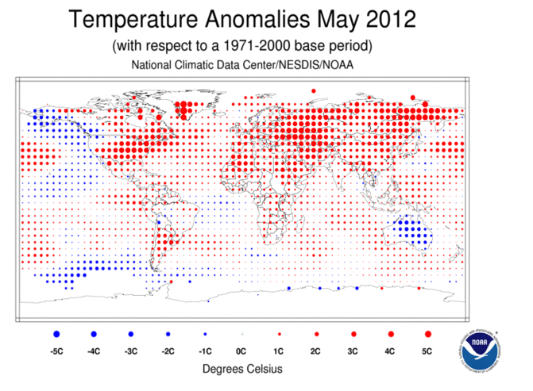
Global Temperature Anomolies, May 2012
Northern hemisphere land and ocean temperature for May 2012 was the all-time warmest on record, at 0.85 degrees C (1.53 degrees F) above average
Source: NOAA
27

Slide 28
U.S. Renewable Energy Net Summer Capacity & Avg. Ann. Change, by Source, 2010 – 2035P
Average annual change
(Gigawatts)
+0.2%
+2.3 %
Wind is expected to experience the greatest change in capacity but solar will experience the fastest growth
+8.6 %
+3.5 %
+4.0%
+0.1%
Source: US Energy Information Administration, Annual Energy Outlook 2012, Appendix A16; Insurance Information Institute.

Slide 29
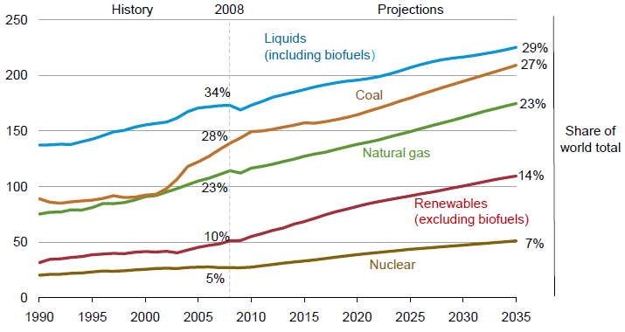
World Energy Consumption by Fuel,
1990—2035F
Renewables will account for 14% of global energy consumption by 2035, up from 10% in 2008
Source: US Energy Information Administration, International Energy Outlook 2011; Insurance Information Institute.
29
12/01/09 - 9pm
eSlide – P6466 – The Financial Crisis and the Future of the P/C
Notes:
29

Slide 30
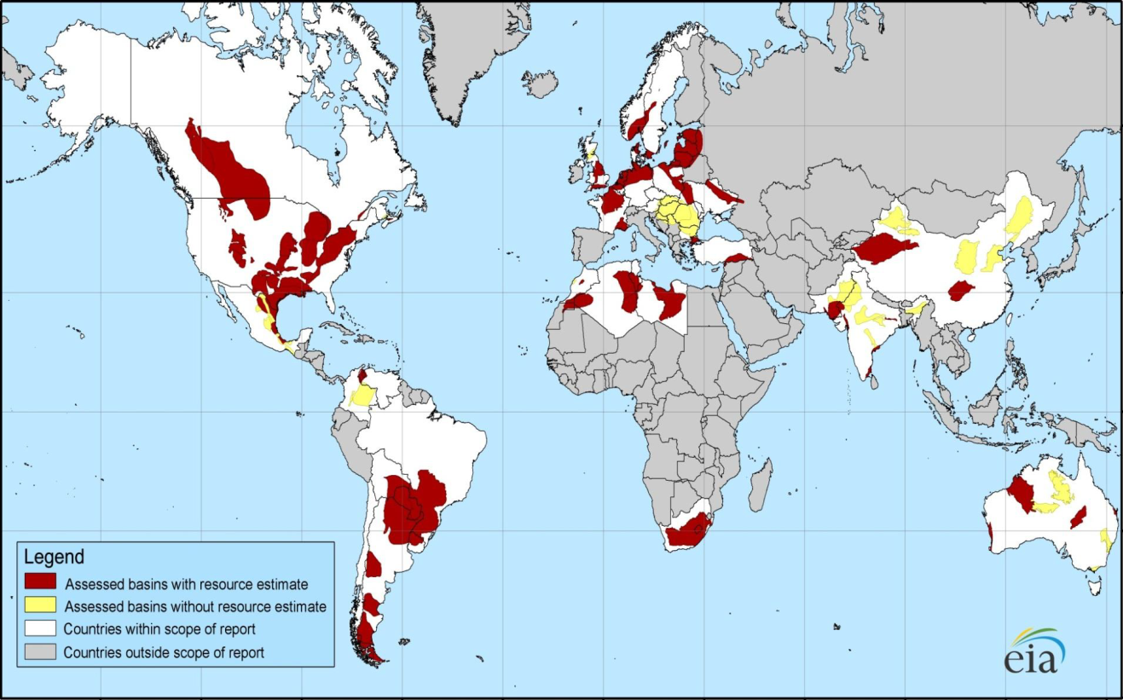
Distribution of Major Shale Deposits: 5.76 Tr. Cu. Ft. in 48 Shale Basins in 32 Countries
Europe and S. America also have large deposits
Initial assessments reveal 5.76 trillion cu. ft. of shale gas worldwide, including 1.069 trillion cu. Ft. in North America
Source: US Energy Information Administration; Insurance Information Institute.
30
12/01/09 - 9pm
eSlide – P6466 – The Financial Crisis and the Future of the P/C
Notes:
30

Slide 31
World Primary Energy Consumption, 2005-2035P
Quadrillion BTUs
Sources: Energy Information Administration, 2011 International Energy Outlook, at http://www.eia.gov/oiaf/aeo/tablebrowser/#release=IEO2011&subject=0-IEO2011&table=1-IEO2011&region=0-0&cases=Reference-0504a_1630 Insurance Information Institute.
The next report is due June 10, 2013.

Slide 32
Primary Energy Consumption, by Country, 2005–2035
Quadrillion BTUs
China passes the US in 2009
Already, China uses more energy than any other country. By 2035, China’s use (191.4) is projected to be only slightly less than the combined use of the US and the OECD-Europe countries (208.0).
Sources: Energy Information Administration, 2011 International Energy Outlook, at http://www.eia.gov/oiaf/aeo/tablebrowser/#release=IEO2011&subject=0-IEO2011&table=1-IEO2011&region=0-0&cases=Reference-0504a_1630 Insurance Information Institute.

Slide 33
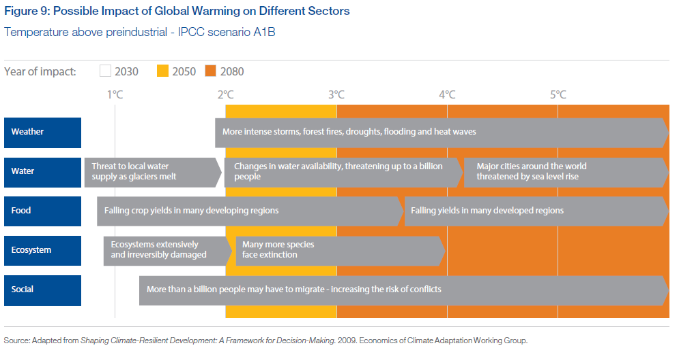
Global Warming Effects:
The Next 70 Years
Sources: World Economic Forum, Global Risks 2013; Insurance Information Institute.

Slide 34
Global Geopolitical Risks
Do We Have to Learn
to Live With These Risks?
34

Slide 35
Geopolitical Risk: Foremost on the Minds in “Emerging” Economies
Pervasive entrenched corruption
Critical fragile states
Terrorism
Failure of diplomatic conflict resolution
Global governance failure
Entrenched organized crime
Widespread illicit trade
Diffusion of WMD
Unilateral resource nationalization
Militarization of space
Source: World Economic Forum, Global Risks 2013; Insurance Information Institute.

Slide 36
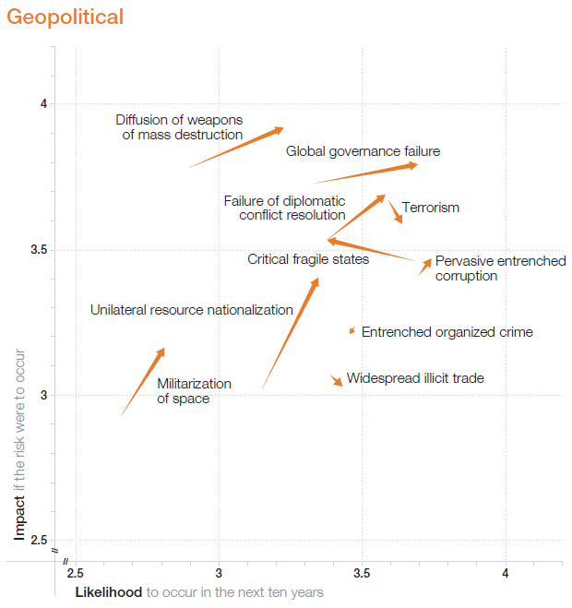
Changes in Assessment of Global Geopolitical Risks, 2013 vs. 2012

Slide 37
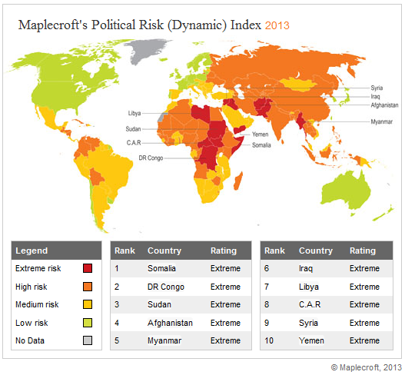
Some Great Business Opportunities
Are in Politically Risky Nations
Source: Maplecroft Terrorism Risk Index at http://maplecroft.com/about/news/pra_2013.html

Slide 38
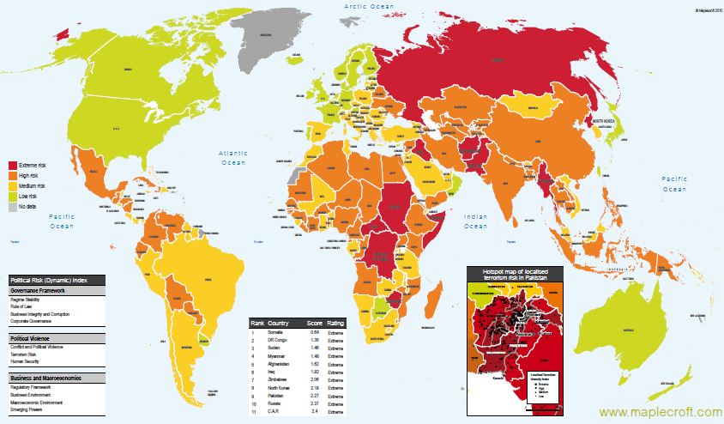
The Greatest Business Opportunities
Are Often in Politically Risky Nations
The fastest growing markets are generally also among the politically riskiest, including East and South Asia
Much of the middle East and North Africa have experienced and continue to experience political turmoil
Heightened risk has economic and insurance implications
Source: Maplecroft
38
12/01/09 - 9pm
eSlide – P6466 – The Financial Crisis and the Future of the P/C
Notes:
38

Slide 39
Top 20 Most At-Risk Countries, 2012
Rank | Country | Rating | Rank | Country | Rating
1 | Somalia | extreme | 11 | Nigeria | high
2 | Myanmar | extreme | 12 | Iran | high
3 | DR Congo | extreme | 13 | North Korea | high
4 | Afghanistan | extreme | 14 | Libya | high
5 | Sudan | extreme | 15 | Cote d’Ivoire | high
6 | South Sudan | extreme | 16 | Russia | high
7 | Iraq | extreme | 17 | Zimbabwe | high
8 | Yemen | extreme | 18 | P.O.T. | high
9 | Pakistan | extreme | 19 | Chad | high
10 | Central African Republic | extreme | 20 | Syria | high

Slide 40
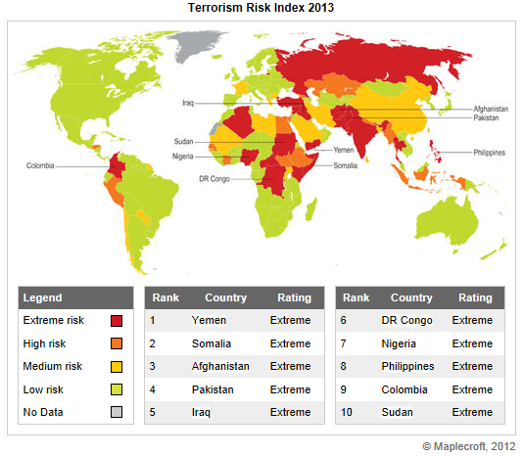
Terrorism Risk Around the Globe, 2013
Source: Maplecroft Terrorism Risk Index at http://maplecroft.com/about/news/pra_2013.html

Slide 41
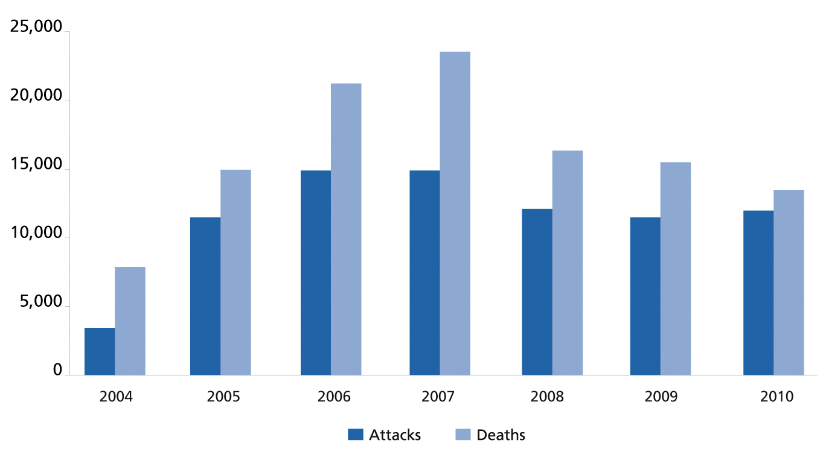
Global Terrorist Attacks and Deaths, 2004-2011
The number of terrorist attacks globally fell by 11.7% in 2011 while the number of deaths dropped by 5.0%
13,193
12,533
11,641
10,283
2011
Sources: National Counterterrorism Center, 2011 Report on Terrorism, released in June 2012; Guy Carpenter; Insurance Information Institute.

Slide 42
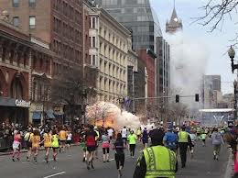
Terrorism Risk Insurance Program
Boston Marathon bombing
should help focus attention
in Congress on TRIA
  Act expires 12/31/14
  Numerous headwinds
Exclusionary language will
be inserted for renewals
occurring after 1/1/14
Boston Marathon Issues
  Property and BI losses not large but could breach $5 mill threshold for certification under TRIPRA
  Certification issue is generating press; No deadline to certify
  Disincentive to certify?
  Few of the impacted business had terror coverage
  Longer-term: Litigation issues (e.g., race organizers)
42
12/01/09 - 9pm
eSlide – P6466 – The Financial Crisis and the Future of the P/C
Notes:
42

Slide 43
Loss Distribution by Type of Insurance from Sept. 11 Terrorist Attack ($ 2011)
($ Billions)
Total Insured Losses Estimate: $40.0B**
*Loss total does not include March 2010 New York City settlement of up to $657.5 million to compensate approximately 10,000 Ground Zero workers or any subsequent settlements.
**$32.5 billion in 2001 dollars.
Source: Insurance Information Institute.

Slide 44
Terrorism Violates Traditional Requirements for Insurability
Requirement | Definition | Violation
Estimable Frequency | Insurance requires large number of observations to develop predictive rate-making models (an actuarial concept known as credibility) | Very few data points Terror modeling still in infancy, untested. Inconsistent assessment of threat
Estimable Severity | Maximum possible/ probable loss must be at least estimable in order to minimize “risk of ruin” (insurer cannot run an unreasonable risk of insolvency though assumption of the risk) | Potential loss is virtually unbounded. Losses can easily exceed insurer capital resources for paying claims. Extreme risk in workers compensation and statute forbids exclusions.
Source: Insurance Information Institute

Slide 45
Terrorism Violates Traditional Requirements for Insurability (cont’d)
Requirement | Definition | Violation
Diversifiable Risk | Must be able to spread/distribute risk across large number of risks “Law of Large Numbers” helps makes losses manageable and less volatile | Losses likely highly concentrated geographically or by industry (e.g., WTC, power plants)
Random Loss Distribution/Fortuity | Probability of loss occurring must be purely random and fortuitous Events are individually unpredictable in terms of time, location and magnitude | Terrorism attacks are planned, coordinated and deliberate acts of destruction Dynamic target shifting from “hardened targets” to “soft targets” Terrorist adjust tactics to circumvent new security measures Actions of US and foreign govts. may affect likelihood, nature and timing of attack
Source: Insurance
Information Institute

Slide 46
Global Technological Risks
Increasingly, Technology is What Makes Our Lives, Businesses,
and Risks Global
46

Slide 47
Technological Risks: Vulnerability and Susceptibility Vary Across the Globe
Technological Risks
  Cyber attacks
  Massive data fraud/theft
  Mineral resource supply vulnerability
  Massive digital misinformation
  Critical systems failure
  Unintended consequences of
    new life sciences technologies
    climate change mitigation
    nanotechnology
  Failure of intellectual property regime
  Proliferation of orbital debris
Sources: World Economic Forum, Global Risks 2013; Insurance Information Institute.

Slide 48
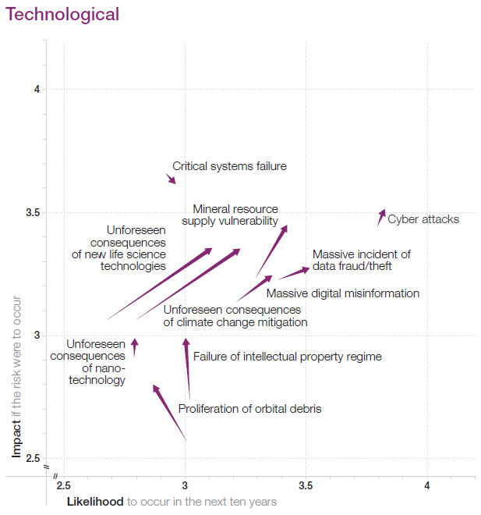
Changes in Assessment of Global Technological Risks, 2013 vs. 2012

Slide 49
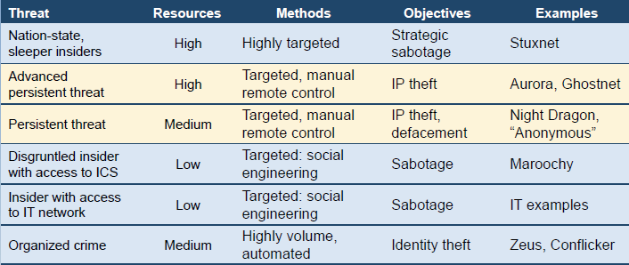
Cyber Risk Threat Spectrum:
Terrorism is a Concern
Combination of cyber attack with inside access
Highly targeted (low volume) attacks; Dedicated afford to do harm
Stuxnet: Autonomous Attack Sabotaging Iranian Uranium Enrichment Facilities
  Likely created by US and Israeli intelligence services
  Based on deep insider intelligence, planted deep inside perimeter using USB sticks
Advanced Persistent Threats (APT) = Manual Control
  Human-powered, but demonstrated ability to penetrate almost any defense
Sources: Waterfall Security Solutions.

Slide 50
Global Societal Risks
To Manage These Risks,
We Need Better Global Cooperation/Coordination
50

Slide 51
Societal Risks: Vulnerability and Susceptibility Vary Across the Globe
Societal Risks
  Water supply crisis
  Food shortage crisis
  Rising religious fanaticism
  Vulnerability to pandemics
  Unmanaged migration
  Mismanagement of population aging
  Unsustainable population growth
  Backlash against globalization
  Ineffective drug policies
Sources: World Economic Forum, Global Risks 2013; Insurance Information Institute.

Slide 52
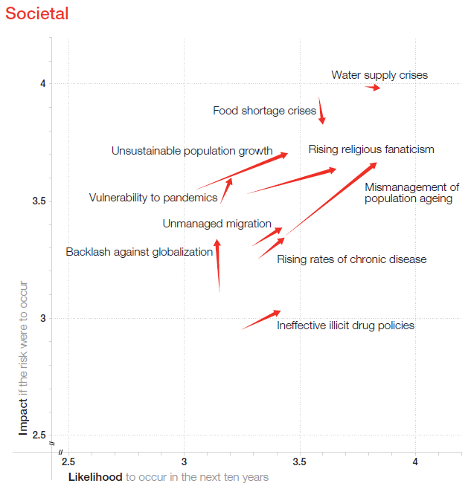
Changes in Assessment of Global Socetal Risks, 2013 vs. 2012

Slide 53
Summary & Conclusions
SO…
Is the World Really a Riskier Place?
53

Slide 54
Reasons for Optimism, Causes for Concern in the Insurance Industry
No Shortage of Local & Global Threats—Same Throughout Human History and the “Human Struggle” Will Never End
  Economic insecurity
  Geopolitical instability
  Natural and manmade disasters
But by Many Objective Measures Humans Are Much Better Off than at any Time in History
  Lifespan
  Standard of living
  Education
But Many of These Advances Are Fragile
  Many historical examples of societal collapses
Good News: World Will Likely Avoid Falling into Another Global Recession
But…It Is Still Unclear if Humans Can Successfully Manage Global Threats in a Cooperative Manner
  Interconnectedness through trade, finance, technology, intellectual exchange, natural resources and climate is unparalleled in human history

Slide 55
Strategies for Risk Managers in Dealing with Global Risks
In others who need to buy in, plan to recognize, and overcome, cognitive biases
  Complex systems such as global climate are non-linear: reactions throughout the system are unpredictable and not proportional to the triggers
  Limited data and computing power are strong impediments to clarity and granular forecasts
  Given uncertainty about future effects, is there anything we can/should do?
Sources: World Economic Forum, Global Risks 2013, p.20; Insurance Information Institute.

Slide 56
Will Attacking Environmental Problems Result in Slower Economic Growth?
“The narrative emerging from the [global risk] survey is clear: like a super storm, two major systems are on a collision course. The resulting interplay between stresses on the economic and environmental systems will present unprecedented challenges to global and national resilience.”
“Today’s massive socio-economic challenges demand immediate attention, yet availability of public resources is limited.”
Sources: World Economic Forum, Global Risks 2013; Insurance Information Institute.

Slide 57
Insurance Information Institute Online:
www.iii.org
Thank you for your time
and your attention!

