Slide 1
Overview & Outlook for the P/C Insurance Industry:
Focus on the Mining Sector
Lockton Mining Summit
St. Louis, MO
March 6, 2013
Download at www.iii.org/presentations
Robert P. Hartwig, Ph.D., CPCU, President & Economist
Insurance Information Institute ♦ 110 William Street ♦ New York, NY 10038
Tel: 212.346.5520 ♦ Cell: 917.453.1885 ♦ bobh@iii.org ♦ www.iii.org

Slide 2
Presentation Outline
P/C Insurance Market Overview
  Where is the market today?
  Where is it headed?
  Market drivers
Overview of Mining Industry
  Demand (Economic) Drivers
  Supply (price) Drivers
Catastrophe Loss Update
  History & drivers of loss
Tort System Update
Q&A

Slide 3
P/C Insurance Industry Financial Overview
The P/C Insurance Industry is Very Strong but Like Mining Can Be a Volatile & Cyclical Business
3

Slide 4
P/C Net Income After Taxes
1991–2012:Q3 ($ Millions)
2005 ROE*= 9.6%
2006 ROE = 12.7%
2007 ROE = 10.9%
2008 ROE = 0.1%
2009 ROE = 5.0%
2010 ROE = 6.6%
2011 ROAS¹ = 3.5%
2012:Q3 ROAS¹ = 6.3%
P-C Industry 2012:Q3 profits were up 222% from 2011:Q3, due primarily to lower catastrophe losses
* ROE figures are GAAP; ¹Return on avg. surplus. Excluding Mortgage & Financial Guaranty insurers yields a 6.6% ROAS through 2012:Q3, 4.6% ROAS for 2011, 7.6% for 2010 and 7.4% for 2009.
Sources: A.M. Best, ISO, Insurance Information Institute

Slide 5
A 100 Combined Ratio Isn’t What It
Once Was: Investment Impact on ROEs
A combined ratio of about 100 generates an ROE of ~6.6% in 2012, ~7.5% ROE in 2009/10,
10% in 2005 and 16% in 1979
Combined Ratio / ROE
Year Ago
2011:Q3 = 108.1, 3.1% ROE
Combined Ratios Must Be Lower in Today’s Depressed
Investment Environment to Generate Risk Appropriate ROEs
* 2008 -2012 figures are return on average surplus and exclude mortgage and financial guaranty insurers. 2012:Q3 combined ratio including M&FG insurers is 100.9, ROAS = 6.3%; 2011 combined ratio including M&FG insurers is 108.2, ROAS = 3.5%.
Source: Insurance Information Institute from A.M. Best and ISO data.

Slide 6
Profitability Peaks & Troughs in the P/C Insurance Industry, 1975 – 2012:Q3*
ROE
History suggests next ROE peak will be in 2016-2017
1977:19.0%
1987:17.3%
10 Years
2006:12.7%
1997:11.6%
10 Years
9 Years
2012:Q3: 6.6%
2011:4.6%*
1975: 2.4%
1984: 1.8%
1992: 4.5%
2001: -1.2%
*Profitability = P/C insurer ROEs. 2011 figure is an estimate based on ROAS data. Note: Data for 2008-2012 exclude mortgage and financial guaranty insurers. 2012:Q3 ROAS = 6.2% including M&FG.
Source: Insurance Information Institute; NAIC, ISO, A.M. Best.

Slide 7
Policyholder Surplus,
2006:Q4–2012:Q3
Drop due to near-record 2011 CAT losses
2007:Q3
Pre-Crisis Peak
($ Billions)
Surplus as of 9/30/12 was up $12.8B or 2.2% from the previous record high of $570.7B set as of 3/31/12.
The Industry now has $1 of surplus for every $0.80 of NPW, close to the strongest claims-paying status in its history.
*Includes $22.5B of paid-in capital from a holding company parent for one insurer’s investment in a non-insurance business in early 2010.
The P/C Insurance Industry Both Entered and Emerged from the 2012 Hurricane Season Very Strong Financially.
Sources: ISO, A.M .Best.
7
12/01/09 - 9pm
eSlide – P6466 – The Financial Crisis and the Future of the P/C
Notes:
7

Slide 8
The BIG Question:
Where Is the Market Heading?
Catastrophes and Other Factors Are Pressuring Insurance Markets
New Factor: Record Low Interest Rates Are Contributing to Underwriting and Pricing Pressures
8
Notes:
8

Slide 9
Historical Criteria for a “Market Turn”:
Low Interest Rates Add New Pressure
Criteria | Status | Comments
Sustained Period of Large Underwriting Losses | Large CAT Losses in 2011/12 Pushed Up Combineds | CAT Losses contributing to higher underwriting losses Apart from CAT losses, overall p/c underwriting losses remain modest Combined ratios (ex-CATs) still in low 100s (vs. 110+ at onset of last hard market); CR= 101.1 in H1:2012 (ex-M&FG) Prior-year reserve releases continue to reduce u/w losses, boost ROEs, though more modestly
Material Decline in Surplus/ Capacity | Small Decline Due to 2011 Cats; Could drop in 2012 | Fell 1.6% in 2011 due to CATs Surplus reached record as of 9/30/12 record $583.5B Likely drop as of 12/31/12 due to Sandy impact Modest growth in demand for insurance should begin to absorb some capacity
Tight Reinsurance Market | Somewhat in Place | Ample capacity Market is generally flat except up for cat-impacted accounts Lower prices in Europe
Renewed Underwriting & Pricing Discipline | Firming Broad, Sustained,esp. in Property, WC | Commercial lines pricing is consistently and uniformly across all major lines, esp. Property & WC; Markets remain competitive in most segments
Sources: Barclays Capital; Insurance Information Institute.

Slide 10
Net Premium Growth: Annual Change,
1971—2012:Q3
(Percent)
1975-78
1984-87
2000-03
Net Written Premiums Fell 0.7% in 2007 (First Decline Since 1943) by 2.0% in 2008, and 4.2% in 2009, the First 3-Year Decline Since 1930-33.
2012:Q3 growth was +4.2%
Shaded areas denote “hard market” periods
Sources: A.M. Best (historical and forecast), ISO, Insurance Information Institute.

Slide 11
P/C Net Premiums Written: % Change, Quarter vs. Year-Prior Quarter
Premium growth in Q3 2012 was up 5.1% over Q3 2011, the strongest growth since Q4 2006
Sustained Growth in Written Premiums
(vs. the same quarter, prior year) Will Continue into 2013
Sources: ISO, Insurance Information Institute.
11
12/01/09 - 9pm
eSlide – P6466 – The Financial Crisis and the Future of the P/C
Notes:
11

Slide 12
Growth in Net Written Premium by Segment, 2012:9 Mos. vs. 2011:9 Mos.*
(Percent)
*Excludes mortgage and financial guaranty insurers.
Source: ISO/PCI; Insurance Information Institute

Slide 13
Average Commercial Rate Change,
All Lines, (1Q:2004–4Q:2012)
Pricing as of Q4:2012 was positive for the 6th consecutive quarter. Gains are likely to continue through 2013.
(Percent)
Q2 2011 marked the last of 30th consecutive quarter of price declines
KRW Effect
Note: CIAB data cited here are based on a survey. Rate changes earned by individual insurers can and do vary, potentially substantially.
Source: Council of Insurance Agents & Brokers; Insurance Information Institute

Slide 14
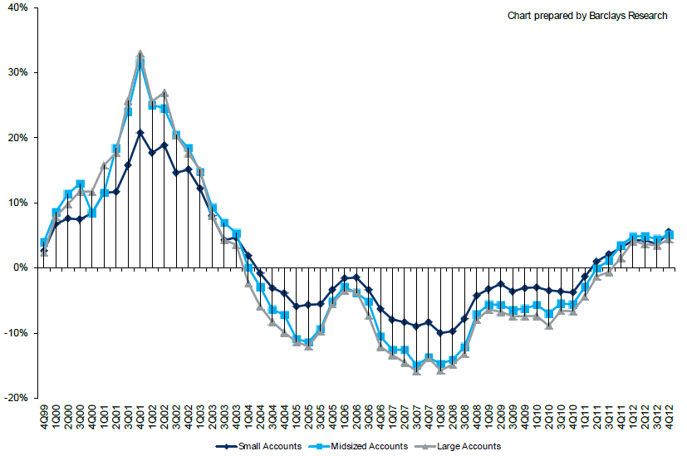
Change in Commercial Rate Renewals, by Account Size: 1999:Q4 to 2012:Q4
Percentage Change (%)
Peak = 2001:Q4 +28.5%
Pricing turned positive in Q3:2011, the first increase in nearly 8 years; Q4:2012 renewals were up 5.0%, the largest increase since late 2003; Some insurers posted stronger numbers.
Pricing Turned Negative in Early 2004 and Remained that way for 7 ½ years
KRW : No Lasting Impact
Trough = 2007:Q3 -13.6%
Source: Council of Insurance Agents and Brokers; Barclay’s Capital; Insurance Information Institute.
Note: CIAB data cited here are based on a survey. Rate changes earned by individual insurers can and do vary, potentially substantially.

Slide 15
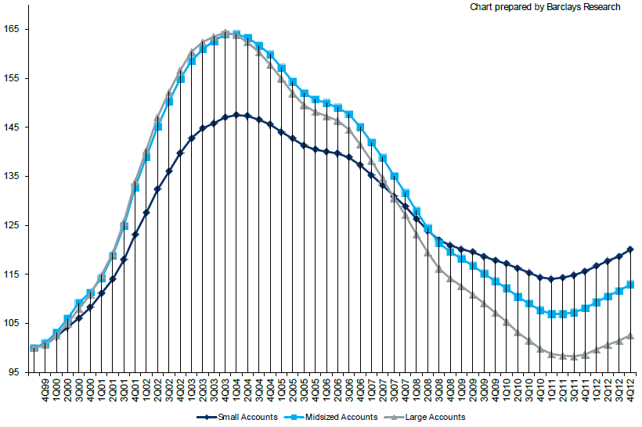
Cumulative Qtrly. Commercial Rate Changes, by Account Size: 1999:Q4 to 2012:Q4
1999:Q4 = 100
Despite 6 consecutive quarters of gains (Q4:2012 = 5.0%), pricing today is where is was in mid-2001 (pre-9/11), suggesting additional rate need going forward, esp. in light of record low interest rates
Note: CIAB data cited here are based on a survey. Rate changes earned by individual insurers can and do vary, potentially substantially.
Source: Council of Insurance Agents and Brokers; Barclay’s Capital; Insurance Information Institute.

Slide 16
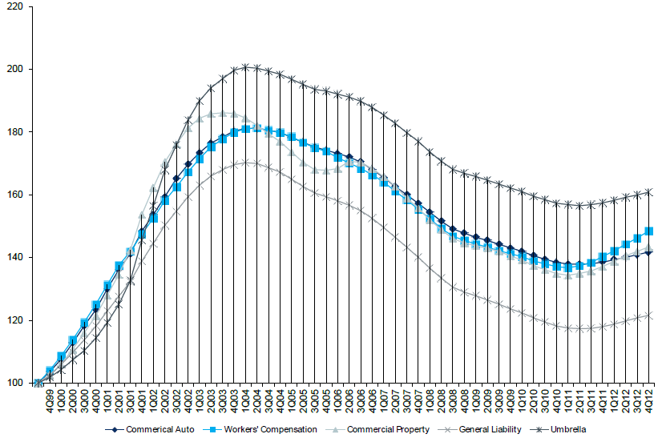
Cumulative Qtrly. Commercial Rate Changes, by Line: 1999:Q4 to 2012:Q4
1999:Q4 = 100
WC rate levels are rising and are now back to where they were in late 2008 and shortly after 9/11
Note: CIAB data cited here are based on a survey. Rate changes earned by individual insurers can and do vary, potentially substantially.
Source: Council of Insurance Agents and Brokers; Barclay’s Capital; Insurance Information Institute.

Slide 17
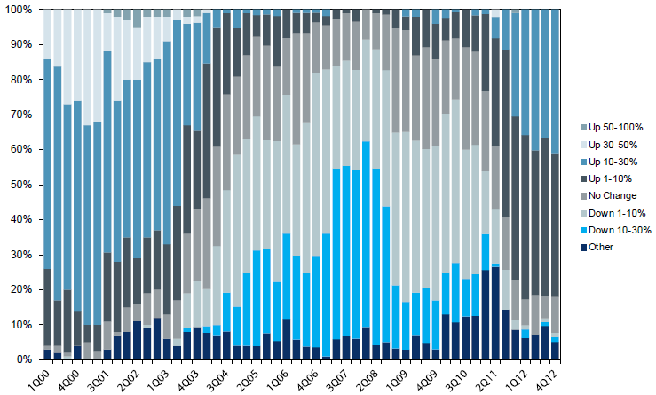
Workers Comp. Quarterly Rate Changes, by Line: 2000:Q1 to 2012:Q4
1999:Q4 = 100
Most accounts are now renewing upwards
Note: CIAB data cited here are based on a survey. Rate changes earned by individual insurers can and do vary, potentially substantially.
Source: Council of Insurance Agents and Brokers; Barclay’s Capital; Insurance Information Institute.

Slide 18
Change in Commercial Rate Renewals, by Line: 2012:Q4
Workers Comp rate increases are large than any other line, followed by Property lines
Percentage Change (%)
Major Commercial Lines Renewed Uniformly Upward in Q4:2012 for the Sixth Consecutive Quarter; Property Lines & Workers Comp Leading the Way; Cat Losses and Low Interest Rates Provide Momentum Going Forward
Note: CIAB data cited here are based on a survey. Rate changes earned by individual insurers can and do vary, potentially substantially.
Source: Council of Insurance Agents and Brokers; Insurance Information Institute.

Slide 19
Workers Comp Rate Changes,
2008:Q4 – 2012:Q4
WC rate changes have been positive for 7 consecutive quarters, longer than any other commercial line
(Percent Change)
Note: CIAB data cited here are based on a survey. Rate changes earned by individual insurers can and do vary, potentially substantially.
Source: Council of Insurance Agents and Brokers; Information Institute.

Slide 20
REINSURANCE MARKET CONDITIONS
Record Global Catastrophes Activity is Pressuring Pricing
20

Slide 21
Reinsurer Share of Recent Significant Market Losses
Billions of 2011 Dollars
40% Reinsurance share of total insured loss
$37.5
$15.0
73%
60%
95%
$13.0
44%
$10.0
$22.5
$8.3
$9.5
$6.0
$5.0
$7.9
$2.2
$3.5
$4.0
$2.8
$0.4
Reinsurers Paid a High Proportion of Insured Losses Arising from Major Catastrophic Events Around the World in Recent Years
Source: Insurance Information Institute from reinsurance share percentages provided in RAA, ABIR and CEA press release, Jan. 13, 2011.
21
12/01/09 - 9pm
eSlide – P6466 – The Financial Crisis and the Future of the P/C
Notes:
21

Slide 22
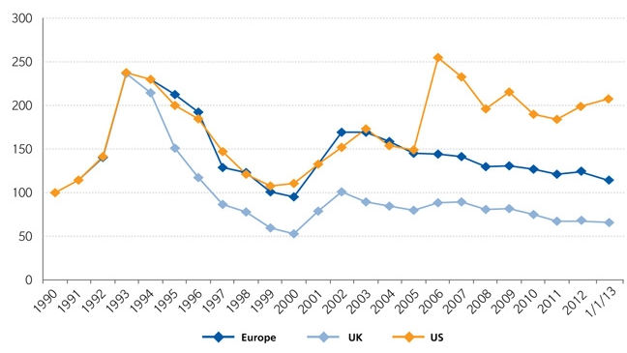
Regional Property Catastrophe Rate on Line Index, 1990—2013 (as of January 1)
Property-Cat reinsurance pricing was up in the US as of 1/1/13 but was down in Europe/UK
Sources: Guy Carpenter; Insurance Information Institute.

Slide 23
INVESTMENTS:
THE NEW REALITY
Investment Performance is a Key Driver of Profitability
Depressed Yields Will Necessarily Influence Underwriting & Pricing
23

Slide 24
Property/Casualty Insurance Industry Investment Income: 2000–2012E¹
($ Billions)
Investment earnings in 2012 were running 14% below their 2007 pre-crisis peak
Investment Income Fell in 2012 Due to Persistently Low Interest Rates, Putting Additional Pressure on (Re) Insurance Pricing
¹ Investment gains consist primarily of interest and stock dividends.
*2012F is based on annualized 9M:2012 actual figure of $35.131B.
Sources: ISO; Insurance Information Institute.

Slide 25
Property/Casualty Insurance Industry Investment Gain: 1994–2012F¹
($ Billions)
Investment gains in 2012 are running approximately 20% below their pre-crisis peak
Investment Gains Are Slipping in 2012 as Low Interest Rates Reduce Investment Income and Lower Realized Investment Gains; The Financial Crisis Caused Investment Gains to Fall by 50% in 2008
¹ Investment gains consist primarily of interest, stock dividends and realized capital gains and losses.
* 2005 figure includes special one-time dividend of $3.2B; 2012F figure is III estimate based on annualized actual 9M:2012 result of $38.089B.
Sources: ISO; Insurance Information Institute.

Slide 26
P/C Insurer Net Realized
Capital Gains/Losses, 1990-2012:Q3
Realized capital gains through 2012:9M are down 46% from $5.53B in 2011:9M
($ Billions)
Insurers Posted Net Realized Capital Gains in 2010, 2011 and 2012 Following Two Years of Realized Losses During the Financial Crisis. Realized Capital Losses Were the Primary Cause of 2008/2009’s Large Drop in Profits and ROE
Sources: A.M. Best, ISO, Insurance Information Institute.
26
12/01/09 - 9pm
eSlide – P6466 – The Financial Crisis and the Future of the P/C
Notes:
26

Slide 27
U.S. 10-Year Treasury Note Yields:
A Long Downward Trend, 1990–2013*
Yields on 10-Year U.S. Treasury Notes recently rose 48bp from its all time record lows to 1.91% in Jan. 2013
Yields on 10-Year U.S. Treasury Notes have been essentially below 5% for a full decade.
Since roughly 80% of P/C bond/cash investments are in 10-year or shorter durations, most P/C insurer portfolios will have low-yielding bonds for years to come.
*Monthly, through Jan. 2013. Note: Recessions indicated by gray shaded columns.
Sources: Federal Reserve Bank at http://www.federalreserve.gov/releases/h15/data.htm.
National Bureau of Economic Research (recession dates); Insurance Information Institutes.
27
12/01/09 - 9pm
eSlide – P6466 – The Financial Crisis and the Future of the P/C
Notes:
27

Slide 28
Treasury Yield Curves:
Pre-Crisis (July 2007) vs. Jan. 2013
Treasury yield curve remains near its most depressed level in at least 45 years. Investment income is falling as a result. Fed is unlikely to hike rates until well into 2014 at the earliest.
The Fed Is Actively Signaling that it Is Determined to Keep Rates Low Until Unemployment Drops Below 6.5% or Until Inflation Expectations Exceed 2.5%; Low Rates Add to Pricing Pressure for Insurers.
Source: Federal Reserve Board of Governors; Insurance Information Institute.

Slide 29
Annual Inflation Rates, (CPI-U, %),
1990–2014F
Annual Inflation Rates (%)
Inflation peaked at 5.6% in August 2008 on high energy and commodity crisis. The recession and the collapse of the commodity bubble reduced inflationary pressures in 2009/10
Higher energy, commodity and food prices pushed up inflation in 2011, but not longer term inflationary expectations.
The slack in the U.S. economy suggests that inflationary pressures should remain subdued for an extended period of times. Energy, health care and commodity prices, plus U.S. debt burden, remain longer-run concerns
Sources: US Bureau of Labor Statistics; Blue Chip Economic Indicators, 2/13 (forecasts).

Slide 30
Reduction in Combined Ratio Necessary to Offset 1% Decline in Investment Yield to Maintain Constant ROE, by Line*
Lower Investment Earnings Place a Greater Burden on Underwriting and Pricing Discipline
*Based on 2008 Invested Assets and Earned Premiums
**US domestic reinsurance only
Source: A.M. Best; Insurance Information Institute.
30
12/01/09 - 9pm
eSlide – P6466 – The Financial Crisis and the Future of the P/C
Notes:
30
This shows the drop in Combined Ratio for each line of business that would be needed to maintain a constant ROE, given a 1-percentage-point drop in investment yield

Slide 31
P/C Insurance Industry Underwriting Performance
31
Notes:
31

Slide 32
P/C Insurance Industry
Combined Ratio, 2001–2012*
Higher CAT Losses, Shrinking Reserve Releases, Toll of Soft Market
As Recently as 2001, Insurers Paid Out Nearly $1.16 for Every $1 in Earned Premiums
Heavy Use of Reinsurance Lowered Net Losses
Relatively Low CAT Losses, Reserve Releases
Relatively Low CAT Losses, Reserve Releases
Avg. CAT Losses, More Reserve Releases
High CAT Losses Due to Sandy
Best Combined Ratio Since 1949 (87.6)
Cyclical Deterioration
* Excludes Mortgage & Financial Guaranty insurers 2008--2012. Including M&FG, 2008=105.1, 2009=100.7, 2010=102.4, 2011=108.2; 2012:Q3=100.0.
Sources: A.M. Best, ISO.

Slide 33
Underwriting Gain (Loss)
1975–2012:Q3*
($ Billions)
Cumulative underwriting deficit from 1975 through 2011 is $479B
Underwriting losses through 2012:Q3 totaled $6.7B
High cat losses in 2011 led to the highest underwriting loss since 2002
Large Underwriting Losses Are NOT Sustainable
in Current Investment Environment
* Includes mortgage and financial guaranty insurers in all years.
Sources: A.M. Best, ISO; Insurance Information Institute.

Slide 34
P/C Reserve Development, 1992–2013F
Prior year reserve releases totaled $8.8 billion in the first half of 2010, up from $7.1 billion in the first half of 2009
Reserve Releases Remained Strong in 2010 But Tapered Off in 2011. Releases Are Expected to Further Diminish in 2012 and 2103
Note: 2005 reserve development excludes a $6 billion loss portfolio transfer between American Re and Munich Re. Including this transaction, total prior year adverse development in 2005 was $7 billion. The data from 2000 and subsequent years excludes development from financial guaranty and mortgage insurance.
Sources: Barclays Capital; A.M. Best.

Slide 35
Commercial Lines Combined Ratio, 1990-2013F*
Commercial lines underwriting performance in 2012 was the worst since 2002 due to heavy impact from Sandy
*2007-2013F figures exclude mortgage and financial guaranty segments.
Source: A.M. Best; Insurance Information Institute

Slide 36
Commercial Auto Combined Ratio: 1993–2014F
Commercial Auto is Expected to Improve as Rate Gains Outpace Any Adverse Frequency and Severity Trends
Sources: A.M. Best (1990-2013F);Conning (2014F); Insurance Information Institute.

Slide 37
Commercial Multi-Peril Combined Ratio: 1995–2013F
Commercial Multi-Peril Underwriting Performance is Expected to Improve in 2013 Assuming Normal Catastrophe Loss Activity
*2012-2013 figures are A.M. Best estimate/forecast for the combined liability and non-liability components.
Sources: A.M. Best; Insurance Information Institute.

Slide 38
General Liability Combined Ratio:
2005–2014F
Commercial General Liability Underwriting Performance Has Been Volatile in Recent Years
Source: Conning Research and Consulting.

Slide 39
Inland Marine Combined Ratio: 1999–2014F
Inland Marine is Expected to Remain Among the Most Profitable of All Lines
Sources: A.M. Best (1999-2011); Insurance Information Institute (2012F); Conning (2013F-2014F)

Slide 40
Other & Products Liability Combined Ratio: 1991–2013F
Liability Lines Have Performed Better in the Post-Tort Reform Era (~2005), but There Has Been Some Deterioration in Recent Years
Sources: A.M. Best ; Insurance Information Institute.

Slide 41
Workers Compensation Combined Ratio: 1994–2014F
Workers Comp Results Should Begin to Improve in 2013. Underwriting Results Deteriorated Markedly from 2007-2012 and Were the Worst They Had Been in a Decade.
Sources: A.M. Best (1994-2013F); Insurance Information Institute (2014F).

Slide 42
Workers Compensation Operating Environment
The Weak Economy and Soft Market Have Made the Workers Comp Operating Increasingly Challenging
42

Slide 43
Workers Compensation Medical Severity
Moderate Increase in 2011
Medical
Claim Cost ($000s)
Average Medical Cost per Lost-Time Claim
Annual Change 1991–1993: +1.9%
Annual Change 1994–2001: +8.9%
Annual Change 2002–2010: +6.0%
Cumulative Change = 245%
(1991-2011p)
Accident Year
2011p: Preliminary based on data valued as of 12/31/2011
1991-2010: Based on data through 12/31/2010, developed to ultimate
Based on the states where NCCI provides ratemaking services; Excludes high deductible policies

Slide 44
Workers Comp Indemnity Claim Costs: Modest Increase in 2011
Average Indemnity Cost per Lost-Time Claim
Indemnity
Claim Cost ($ 000s)
Average indemnity costs per claim resumed its upward climb in 2011
Annual Change 1991–1993: -1.7%
Annual Change 1994–2001: +7.3%
Annual Change 2002–2010: +3.4%
Accident Year
2010p: Preliminary based on data valued as of 12/31/2011
1991–2010: Based on data through 12/31/2010, developed to ultimate
Based on the states where NCCI provides ratemaking services
Excludes high deductible policies
Notes:
44
Exhibit 11 of Article

Slide 45
Workers Compensation Premium:
First Increase in Years
Net Written Premium
$ Billions
p Preliminary
Source: 1990–2010 Private Carriers, Best's Aggregates & Averages; 2011p, NCCI
1996–2011p State Funds: AZ, CA, CO, HI, ID, KY, LA, MD, MO, MT, NM, OK, OR, RI, TX, UT Annual Statements
State Funds available for 1996 and subsequent
Calendar Year

Slide 46
Nonfarm Payroll (Wages and Salaries):
Quarterly, 2005–2012:Q3
Billions
Latest (2012:Q2) was $6.88 trillion, a new peak--$663B above 2009 trough
Prior Peak was 2008:Q1 at $6.60 trillion
Pace of payroll growth is slowing in 2012
Recent trough (2009:Q3) was $6.25 trillion, down 5.3% from prior peak
Growth rates in 2012
Q1:12 over Q4:11: 1.8%
Q2 over Q1: 1.4% Q3 over Q2: 0.3%
Note: Recession indicated by gray shaded column. Data are seasonally adjusted annual rates.
Sources: http://research.stlouisfed.org/fred2/series/WASCUR; National Bureau of Economic Research (recession dates); Insurance Information Institute.
46
12/01/09 - 9pm
eSlide – P6466 – The Financial Crisis and the Future of the P/C
Notes:
46

Slide 47
Payroll vs. Workers Comp Net Written Premiums, 1990-2012E
Payroll Base* WC NWP
$Billions $Billions
7/90-3/91
3/01-11/01
12/07-6/09
WC premium volume dropped two years before the recession began
+9% in 2012E
WC net premiums written were down $14B or 29.3% to $33.8B in 2010 after peaking at $47.8B in 2005
Continued Payroll Growth and Rate Increases Suggest WC NWP Will Grow Again in 2012; +7.9% Growth in 2011 Was the First Gain Since 2005
*Private employment; Shaded areas indicate recessions. Payroll and WC premiums for 2012 is I.I.I. estimate based YTD 2012 actuals.
Sources: NBER (recessions); Federal Reserve Bank of St. Louis at http://research.stlouisfed.org/fred2/series/WASCUR ; NCCI; I.I.I.

Slide 48
Average Approved Bureau
Rates/Loss Costs
Percent
History of Average WC Bureau Rate/Loss Cost Level Changes
Cumulative 2000–2003
+17.1%
Approve rates/loss costs are seeing their first significant increase since 2003
Cumulative 1994–1999
-27.8%
Cumulative 2004–2011
-25.6%
Cumulative
1990–1993
+36.3%
Calendar Year
*States approved through 7/31/12.
Note: Countrywide approved changes in advisory rates, loss costs and assigned risk rates as filed by applicable rating organization.
Source: NCCI.

Slide 49
Current NCCI Voluntary Market
Filed Rate/Loss Cost Changes
(Excludes Law-Only Filings)
Ratio
IN and NC filed in cooperation with state rating bureau
Source: NCCI

Slide 50
Impact of Discounting on Workers Compensation Premium
NCCI States—Private Carriers
Percent
p Preliminary
Dividend ratios are based on calendar year statistics
NCCI benchmark level does not include an underwriting contingency provision
Based on data through 12/31/2011 for the states where NCCI provides ratemaking services
Source: NCCI.
Policy Year

Slide 51
Workers Comp Rate Changes,
2008:Q4 – 2012:Q4
WC rate changes have been positive for 7 consecutive quarters, longer than any other commercial line
(Percent Change)
Note: CIAB data cited here are based on a survey. Rate changes earned by individual insurers can and do vary, potentially substantially.
Source: Council of Insurance Agents and Brokers; Information Institute.

Slide 52
US Mining Drivers for Extractive Mining Operations
Natural Resources/Commodities Have Been Among the Strongest Sectors in Recent Years, Driving Insurance Demand
52

Slide 53
U.S. Mining Production,
Monthly, Jan 2005 – Jan. 2013*
Index: 2007=100
Jan. 2013 index 115.1
Growth as of Jan 2013 since June 2009 (end of recession)
= 22.5%
Sept 2005 index 88.4
June 2009 index 94.0
Sept 2008 index 91.8
*seasonally adjusted; Jan 2013 number is preliminary Note: Recession indicated by gray shaded column.
Sources: www.federalreserve.gov ; National Bureau of Economic Research (recession dates); Insurance Information Institutes.
53
12/01/09 - 9pm
eSlide – P6466 – The Financial Crisis and the Future of the P/C
Notes:
53

Slide 54
U.S. Mining Capacity Utilization,
Monthly, Jan 2005 – Jan 2013*
July 2008 93.4%
June 2009 78.5%
Jan. 2013 90.8%
Sept 2005 80.9%
Sept 2008 80.9%
Mining capacity utilization is back to pre-recession levels
*seasonally adjusted; Jan 2013 data is preliminary Note: Recession indicated by gray shaded column.
Sources: www.federalreserve.gov ; National Bureau of Economic Research (recession dates); Insurance Information Institutes.
54
12/01/09 - 9pm
eSlide – P6466 – The Financial Crisis and the Future of the P/C
Notes:
54

Slide 55
U.S. Mining Employment,
Monthly, Jan 2003 – Jan 2013*
Thousands
Sept. 2008 726,500
Jan. 2013 813,000
Apr 2003 498,000
Oct 2009 610,700
Mining employment is well above pre-recession levels,
and growing (up 33% from Oct 2009 trough)
*seasonally adjusted; Jan 2013 data is preliminary Note: Recession indicated by gray shaded column.
Sources: Bureau of Labor Statistics; National Bureau of Economic Research (recession dates); Insurance Information Institutes.
55
12/01/09 - 9pm
eSlide – P6466 – The Financial Crisis and the Future of the P/C
Notes:
55

Slide 56
Mining (except Oil & Gas) Employment,
Monthly, Jan 2003 – Jan 2013*
Thousands
Aug. 2008 and Oct 2008 228,400
Jan. 2013 223,900
Feb 2004 201,100
Oct 2009 199,200
Half of the mining jobs lost in the recession were in coal mining
*seasonally adjusted; Jan 2013 data is preliminary Note: Recession indicated by gray shaded column.
Sources: Bureau of Labor Statistics; National Bureau of Economic Research (recession dates); Insurance Information Institutes.
56
12/01/09 - 9pm
eSlide – P6466 – The Financial Crisis and the Future of the P/C
Notes:
56

Slide 57
U.S. Coal Mining Employment,
Monthly, Jan 2003 – Jan 2013*
Thousands
Jan. 2009 86,700
Sep 2003 68,600
Jan. 2013 82,000
Dec 2009 77,700
Coal mining employment appears to be cyclical;
lately in a down cycle, but growing over the long term
*seasonally adjusted; Jan 2013 data is preliminary Note: Recession indicated by gray shaded column.
Sources: Bureau of Labor Statistics; National Bureau of Economic Research (recession dates); Insurance Information Institutes.
57
12/01/09 - 9pm
eSlide – P6466 – The Financial Crisis and the Future of the P/C
Notes:
57

Slide 58
U.S. Metal Ore Mining Employment,
Monthly, Jan 2003 – Dec 2012*
Thousands
Oct. 2008 40,900
Dec. 2012 46,500
Nov 2003 26,300
Aug-Oct 2009 33,400
Strong employment growth in metal ore mining;
growth since Oct 2009 is over 13,000 jobs, up 39%
*seasonally adjusted; Dec 2012 data is preliminary Note: Recession indicated by gray shaded column.
Sources: Bureau of Labor Statistics; National Bureau of Economic Research (recession dates); Insurance Information Institutes.
58
12/01/09 - 9pm
eSlide – P6466 – The Financial Crisis and the Future of the P/C
Notes:
58

Slide 59
Price Drivers
Pricing Trends for Major Mined Resources
59

Slide 60
Commodity Metals Global Price Index,
1980—2013F* (2005 =100)
Index Value
Though down from their 2011 peak, metals/ore prices remain more than 3 times their levels in 2002
The global financial crisis had only a temporary impact on metal/ore prices
Metal/ore price moved rapidly higher after the 2001 recession
* Includes: Copper, Aluminum, Iron Ore, Tin, Nickel, Zinc, Lead and Uranium.
Sources: International Monetary Fund; Insurance Information Institute.

Slide 61
Global Price Index: Copper, Aluminum & Iron Ore vs. Full Metals Index,1980—2013F*
Index Value (2005 = 100)
Metals prices soared in the aftermath of the global financial crisis, especially for iron ore, which by 2011 was up nearly 500% from pre-crisis levels
Copper prices rose nearly six fold from 2003 through 2011
* Full Metals Index Includes: Copper, Aluminum, Iron Ore, Tin, Nickel, Zinc, Lead and Uranium.
Sources: International Monetary Fund; Insurance Information Institute.

Slide 62
Global Price Index: Tin, Nickel, Zinc, Lead & Uranium vs. Full Metals Index,1980—2013F*
Index Value (2005 = 100)
Uranium and tin prices have seen significant volatility in recent years. The uncertain future of nuclear power weighs on the price of uranium.
Prices for nickel and zinc have moderated
* Full Metals Index Includes: Copper, Aluminum, Iron Ore, Tin, Nickel, Zinc, Lead and Uranium.
Sources: International Monetary Fund; Insurance Information Institute.

Slide 63
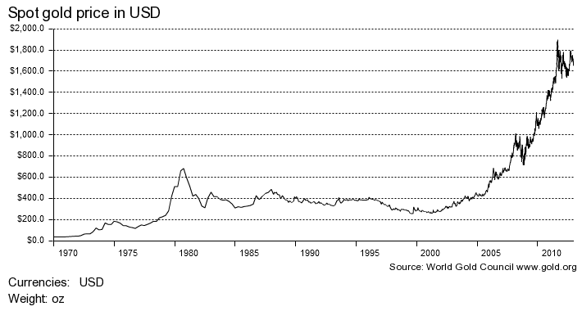
Spot Price for Gold, Jan. 1970—Feb. 2013
Dollars per Troy Ounce
Gold prices are up 500%+ over the past decade
Source: World Gold Council; Insurance Information Institute.

Slide 64
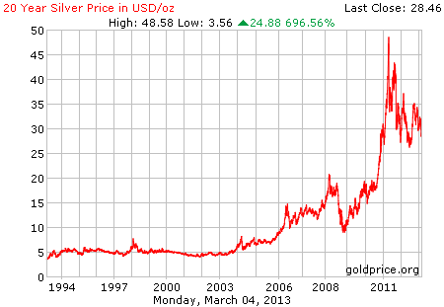
Spot Price for Silver:
Jan. 1994—Mar. 4, 2013
Dollars per Troy Ounce
Silver prices are well off their recent highs but are still triple what they were pre-crisis
Source: www.silverprice.org; Insurance Information Institute.

Slide 65
The Strength of the Global Economy Will Impact the Mining Industry and Demand for Insurance
Growth Will Expand Insurer Exposure Base Across Most Lines
65

Slide 66
US Real GDP Growth*
The Q4:2008 decline was the steepest since the Q1:1982 drop of 6.8%
Real GDP Growth (%)
Recession began in Dec. 2007. Economic toll of credit crunch, housing slump, labor market contraction was severe
2013 is expected to see initially slow growth, then gradually accelerate throughout the year and into 2014
Demand for Insurance Continues To Be Impacted by Sluggish Economic Conditions, but the Benefits of Even Slow Growth Will Compound and Gradually Benefit the Economy Broadly
* Estimates/Forecasts from Blue Chip Economic Indicators.
Source: US Department of Commerce, Blue Economic Indicators 2/13; Insurance Information Institute.

Slide 67
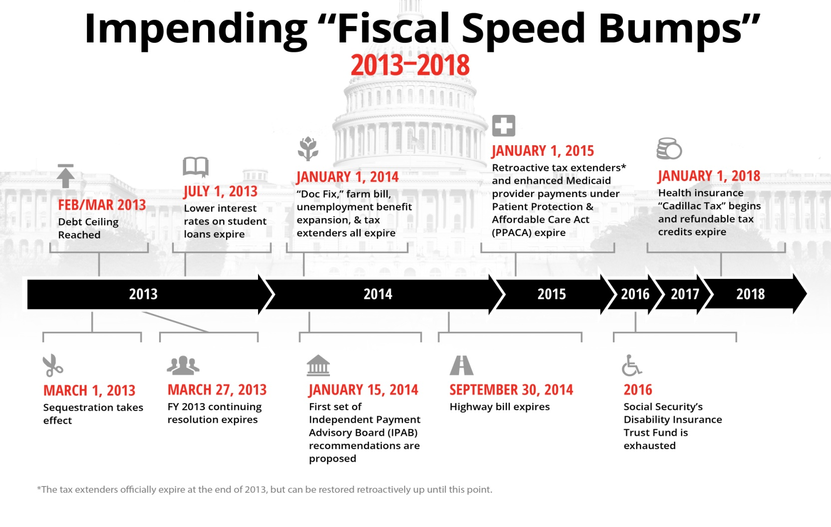
The Fiscal Cliff Was Just the Beginning: Budget Battles for Years to Come?
Poll: 94% of P/C insurance executives think looming budget battles
In Washington will hurt the economy.*
The “Fiscal Cliff” was just the beginning
There are 10+ “Fiscal Speed Bumps” over the next 5 years, setting up a potentially extended period of fiscal uncertainty
Creates long-term uncertainty around federal spending, tax policy, entitlements
Insurable exposures impacted
Cuts seem certain
Possible shutdown
*P/C Insurance Joint Industry Forum press release (www.iii.org/press_releases), January 15, 2013.
Source: Fix the Debt Coalition, January 18, 2013; Insurance Information Institute

Slide 68

Federal Spending as a Share of State GDP: Vulnerability to Sequestration Varies
Sources: Pew Center on the States (2012) Impact of the Fiscal Cliff on the States; Wells Fargo; Insurance Information Institute.

Slide 69
Defense and Non-Defense Federal Spending as a Share of State GDP: Top 10 States*
Defense Spending
Non-Defense Spending
Federal defense spending accounts for approximately 10%+ of GDP in 5 states
Federal non-defense spending accounts for 10%+ of GDP in 3 states
Sequestration Could Adversely Impact Commercial Insurance Exposures Directly at Defense Contractors and Indirectly in Impacted Communities
*As of 2010.
Sources: Pew Center on the States (2012) Impact of the Fiscal Cliff on the States; Wells Fargo Securities; Insurance Information Institute.

Slide 70
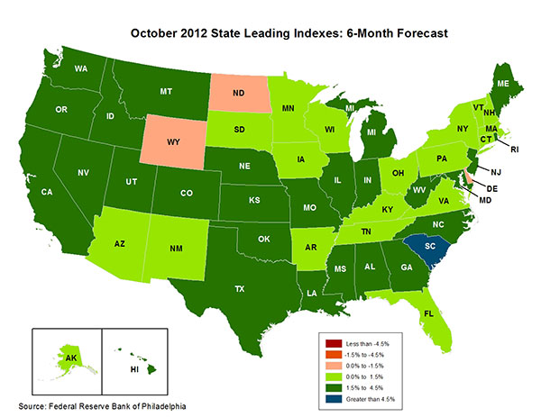
State-by-State Leading Indicators
through 2013:Q1
Near-term growth forecasts vary widely by state
5 Fastest Growing States
South Carolina 6.97%
Michigan 4.32%
West Virginia 3.59%
Idaho 3.14%
Georgia 3.04%
5 Slowest Growing States
Wyoming -1.09%
Delaware -0.24%
North Dakota -0.19%
Vermont 0.09%
Minnesota 0.18%
Sources: Federal Reserve Bank of Philadelphia at http://www.philadelphiafed.org/index.cfm ;Insurance Information Institute.

Slide 71
Global Demand Drivers for Extractive Mining Operations
Demand Can Be Volatile But in a Resource Hungry World the Overall Outlook is Good
71

Slide 72
GDP Growth: Advanced & Emerging Economies vs. World, 1970-2014F
Emerging economies (led by China) are expected to grow by 5.5% in 2013 and 5.9% in 2014.
GDP Growth (%)
World output is forecast to grow by 3.5% in 2013 and 4.1% in 2014. The world economy shrank by 0.6% in 2009 amid the global financial crisis
Advanced economies are expected to grow at a sluggish pace of 1.4% in 2013 but accelerate to 2.2% in 2014.
Source: International Monetary Fund, World Economic Outlook , Oct. 2012 and Jan. 2013 WEO Update; Ins. Info. Institute.

Slide 73
Real GDP Growth Forecasts:
Major Economies: 2011 – 2014F
The Eurozone is in recession, UK weak. Both should end by late 2013
China growth has slowed, but remains strong in an expected “soft landing” scenario
Rebuilding acts as a stimulus to Japanese economy
Tepid US recovery continues
Growth Prospects Vary Widely by Region: Growth Returning in the US, Mild Recession in the Eurozone, A “Soft Landing” in China, Sluggish Growth in Japan and Modest Growth in America’s Largest Trading Partners—Canada and Mexico.
Sources: Blue Chip Economic Indicators (2/2013 issue); Insurance Information Institute.
73
Notes:
73

Slide 74
Real GDP Growth Forecasts:
Emerging Economies: 2011 – 2014F
Strong economies in smaller industrialized nations will bolster demand for metals, energy
Growth Outside the US, Europe and Japans is Relatively Strong
Sources: Blue Chip Economic Indicators (2/2013 issue); Insurance Information Institute.
74
Notes:
74

Slide 75
World Trade Volume:
2010—2014F
Percentage Change (%)
After decelerating in 2011 and 2012, global trade growth is expected accelerate in 2013 and 2014
Growth in World Trade Volume (Imports + Exports) Has Slowed But Continues to Grow
Sources: IMF World Economic Outlook Update (Jan. 2013 ); Insurance Information Institute.

Slide 76
World Trade Volume: IMPORTS
2010 – 2014F
Growth (%)
Advanced Economies
Emerging Economies
Import growth in emerging economies outpaces Advanced Economies by a wide margin.
Sources: IMF World Economic Outlook Update (Jan. 2013 ); Insurance Information Institute.

Slide 77
World Trade Volume: EXPORTS
2010 – 2013F
Growth (%)
Advanced Economies
Emerging Economies
Export growth in emerging economies outpaces Advanced Economies by a much narrower margin than imports.
Sources: IMF World Economic Outlook Update (Jan. 2013 ); Insurance Information Institute.

Slide 78
Other Supply & Demand Drivers for Minerals
New Technologies
  Reduce the cost and increase the speed of processing
“Rare” Earths
  Chinese restricting supply; New sources will need to be found and developed
Miniaturization of Electronic Devices
  Increased demand for rare earths and other low-weight metals with special properties (conductivity, magnetism, strength, heat tolerance)
Low Energy Costs
  Should drive more operations to US and other areas with falling energy prices (shale gas) for manufacturing processes
  Catastrophe Losses
  Pricing
  Growth
  Capacity
  Investments

Slide 79
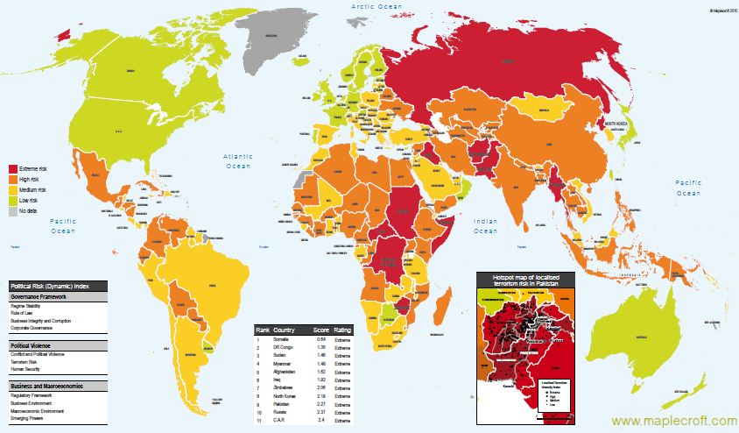
Political Risk in 2011/12: Greatest Business Opportunities Are Often in Risky Nations
The fastest growing markets are generally also among the politically riskiest, including East and South Asia
Much of the middle East and North Africa have experienced and continue to experience political turmoil
Heightened risk has economic and insurance implications
Source: Maplecroft
79
12/01/09 - 9pm
eSlide – P6466 – The Financial Crisis and the Future of the P/C
Notes:
79

Slide 80
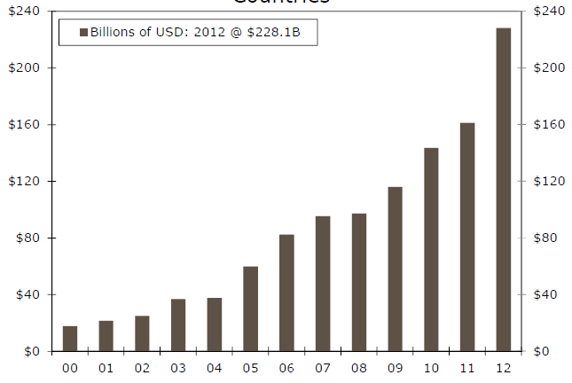
Sovereign Debt Issuance in Developing Countries, 2000-2012*
$ Billions
Bubble Trouble?
Issuance of debt by developing nations (often resource rich) has soared, raising concerns of (another) emerging market debt crisis
*Wells Fargo Securities estimate based on a sample of countries.
Source: Wells Fargo Securities; Insurance Information Institute.

Slide 81
US Demand for Metals, Energy Is Growing
Construction, Manufacturing Increase Demand for Mined Resources and Insurance
81

Slide 82
Consumer Sentiment Survey (1966 = 100)
January 2010 through February 2013
Optimism among consumers rose in February despite tax hike, federal budget concerns
Consumer confidence has been low for years amid high unemployment, falling home prices and other factors adversely impact consumers, but improved substantially in late 2011 and in 2012
Source: University of Michigan; Insurance Information Institute

Slide 83
Auto/Light Truck Sales, 1999-2014F
Job growth and improved credit market conditions will boost auto sales in 2013 and beyond
(Millions of Units)
New auto/light truck sales fell to the lowest level since the late 1960s. Forecast for 2013-14 is still far below 1999-2007 average of 17 million units, but a robust recovery is well underway.
Car/Light Truck Sales Will Continue to Recover from the 2009 Low Point, Bolstering the Auto Insurer Growth and the Manufacturing Sector.
Source: U.S. Department of Commerce; Blue Chip Economic Indicators (2/13); Insurance Information Institute.

Slide 84
New Private Housing Starts, 1990-2014F
Job growth, low inventories of existing homes, low mortgage rates and demographics are stimulating new home construction for the first time in years
(Millions of Units)
New home starts plunged 72% from 2005-2009; A net annual decline of 1.49 million units, lowest since records began in 1959
Homeowners Insurers Are Starting to See Meaningful Exposure Growth for the First Time Since 2005. Commercial Insurers with Construction Risk Exposure, Surety Also Benefit
Source: U.S. Department of Commerce; Blue Chip Economic Indicators (2/13); Insurance Information Institute.

Slide 85
Construction Employment,
Jan. 2010—January 2013*
(Thousands)
Construction employment growth accelerated in the second half of 2012. Stronger growth in this key sector is possible in 2013.
*Seasonally adjusted
Sources: US Bureau of Labor Statistics at http://data.bls.gov; Insurance Information Institute.
85
12/01/09 - 9pm
eSlide – P6466 – The Financial Crisis and the Future of the P/C
Notes:
85

Slide 86
Construction Employment,
Jan. 2003–Jan. 2013
(Thousands)
Construction employment as of Jan. 2013 totaled 5.731 million, an increase of 296,000 jobs or 5.4% from the Jan. 2011 trough
Construction employment peaked at 7.726 million in April 2006
Construction employment troughed at 5.435 million in Jan. 2011, after a loss of 2.291 million jobs, a 29.7% plunge from the April 2006 peak
The “Great Recession” and housing bust destroyed 2.3 million constructions jobs
The Construction Sector Could Be a Growth Leader in 2013 and 2014 as the Housing Market and Private Investment Recover. Commercial Insurers Will Benefit.
Note: Recession indicated by gray shaded column.
Sources: U.S. Bureau of Labor Statistics; Insurance Information Institute.
86
12/01/09 - 9pm
eSlide – P6466 – The Financial Crisis and the Future of the P/C
Notes:
86

Slide 87
Commercial & Industrial Loans Outstanding at FDIC-Insured Banks, Quarterly, 2006-2012:Q3*
$Trillions
Commercial lending activity is nearly back to pre-crisis levels (+24.9% or $290B)
Commercial lending plunged by 21.2% ($330B) during the financial crisis and ensuing period of tight credit
Outstanding Commercial Loan Volume Has Been Growing for Over Two Years and Is Now Nearly Back to Early Recession Levels. Bodes Very Well for the Creation of Current and Future Commercial Insurance Exposures
*Latest data as of 2/24/2013.
Source: FDIC at http://www2.fdic.gov/qbp/ (Loan Performance spreadsheet); Insurance Information Institute.

Slide 88
Value of Construction Put in Place, December 2012 vs. December 2011*
Growth (%)
Private: +15.0%
Public: -5.6%
Private sector construction activity is up in both the residential and nonresidential segments
Public sector construction activity remains depressed
Overall Construction Activity is Up, But Growth Is Entirely in the Private Sector as State/Local Government Budget Woes Continue
*seasonally adjusted
Source: U.S. Census Bureau, http://www.census.gov/construction/c30/c30index.html ; Insurance Information Institute.

Slide 89
Value of Private Construction Put in Place, by Segment, Dec. 2012 vs. Dec. 2011*
Led by the Residential Construction, Lodging, Office, Transportation and Power industries, Private sector construction activity is up across many segments after plunging during the “Great Recession”
Growth (%)
Private Construction Activity is Up in Most Segments, Including the Key Residential Construction Sector
*seasonally adjusted
Source: U.S. Census Bureau, http://www.census.gov/construction/c30/c30index.html ; Insurance Information Institute.

Slide 90
Value of Public Construction Put in Place, by Segment, Dec. 2012 vs. Dec. 2011*
Growth (%)
Public sector construction activity is down substantially in many segments, but is actually now up in some key segments
Transportation and Power projects lead public sector construction
Public Construction Activity is Down in Many Segments as State and Local Budgets Remain Under Stress; Improvement Possible in 2013.
*seasonally adjusted
Source: U.S. Census Bureau, http://www.census.gov/construction/c30/c30index.html ; Insurance Information Institute.

Slide 91
ISM Manufacturing Index
(Values > 50 Indicate Expansion)
January 2010 through January 2013
Manufacturing activity expanded in 3 of the past 4 months, but only slightly. The recent trend is basically flat.
The manufacturing sector expanded for 33 of the 37 months from Jan. 2010 through Jan. 2013. The question is whether this will continue.
Source: Institute for Supply Management at http://www.ism.ws/ismreport/mfgrob.cfm; Insurance Information Institute.

Slide 92
Dollar Value* of Manufacturers’ Shipments Monthly, Jan. 1992—Dec. 2012
$ Millions
ENERGY INTENSIVE
The value of Manufacturing Shipments in Nov. 2012 were up 36% to $484.9B from its May 2009 trough. June figure is only 0.1% below its previous record high in July 2008.
Monthly shipments are nearly back to peak (in July 2008, 8 months into the recession). Trough in May 2009. Growth from trough to Dec. 2012 was 36%. Manufacturing is an energy intensive activity and growth leads to gains in many commercial exposures: WC, Commercial Auto, Marine, Property and Various Liability Coverages
*seasonally adjusted
Source: U.S. Census Bureau, Full Report on Manufacturers’ Shipments, Inventories, and Orders, http://www.census.gov/manufacturing/m3/
92
12/01/09 - 9pm
eSlide – P6466 – The Financial Crisis and the Future of the P/C
Notes:
92

Slide 93
Manufacturing Growth for Selected Sectors, 2012 vs. 2011*
Growth (%)
Durables: +7.0%
Non-Durables: +2.2%
Manufacturing of durable goods was especially strong in 2012
Manufacturing Is Expanding Across a Wide Range of Sectors that Will Contribute to Growth in Insurable Exposures Including: WC, Commercial Property, Commercial Auto and Many Liability Coverages
*Seasonally adjusted; Date are YTD comparing data through December 2012 to the same period in 2011.
Source: U.S. Census Bureau, Full Report on Manufacturers’ Shipments, Inventories, and Orders, http://www.census.gov/manufacturing/m3/

Slide 94
Recovery in Capacity Utilization is a Positive Sign for Commercial Exposures
March 2001 through January 2013
“Full Capacity”
The US operated at 79.1% of industrial capacity in Jan. 2013, well above the June 2009 low of 68.3%
Percent of Industrial Capacity
Hurricane Katrina
The closer the economy is to operating at “full capacity,” the greater the inflationary pressure
March 2001-November 2001 recession
December 2007-
June 2009 Recession
94
Source: Federal Reserve Board statistical releases at http://www.federalreserve.gov/releases/g17/Current/default.htm.
Notes:
94

Slide 95
Manufacturing Employment,
Jan. 2010—January 2013*
Manufacturing employment is up by nearly 500,000 or 4.3% since Jan. 2010—a surprising source of strength in the economy. Employment in the sector is close to a multi-year high.
(Thousands)
*Seasonally adjusted
Sources: US Bureau of Labor Statistics at http://data.bls.gov; Insurance Information Institute.
95
12/01/09 - 9pm
eSlide – P6466 – The Financial Crisis and the Future of the P/C
Notes:
95

Slide 96
ISM Non-Manufacturing Index
(Values > 50 Indicate Expansion)
January 2010 through January 2013
Optimism among non-manufacturers is stable and remains expansionary in 2013
Non-manufacturing industries have been expanding and adding jobs. The question is whether this will continue.
Source: Institute for Supply Management at http://www.ism.ws/ismreport/nonmfgrob.cfm; Insurance Information Institute.

Slide 97
Business Bankruptcy Filings,
1980-2012:Q3
% Change Surrounding Recessions
1980-82 58.6%
1980-87 88.7%
1990-91 10.3%
2000-01 13.0%
2006-09 208.9%*
2011 bankruptcies totaled 47,806, down 15.1% from 56,282 in 2010—the second consecutive year of decline. Business bankruptcies more than tripled during the financial crisis. Through Q3:2012, filings were down 15.8% vs. Q3:2011
Significant Exposure Implications for All Commercial Lines as Business Bankruptcies Begin to Decline
Sources: American Bankruptcy Institute at http://www.abiworld.org/AM/AMTemplate.cfm?Section=Home&TEMPLATE=/CM/ContentDisplay.cfm&CONTENTID=61633; Insurance Information Institute
97
12/01/09 - 9pm
eSlide – P6466 – The Financial Crisis and the Future of the P/C
Notes:
97
Number of business bankruptcies still growing
Bankruptcy filings in 2010:Q1 were up 18% from 2009:Q1
Each bankruptcy costs commercial property, liability, WC, auto, life, health, pension, and other insurance exposures

Slide 98
Private Sector Business Starts,
1993:Q2 – 2012:Q2*
Business Starts
2006: 872,000
2007: 843,000
2008: 790,000
2009: 697,000 2010: 742,000 2011: 748,000 2012: 768,000*
(Thousands)
Business starts were up 2.2% to 748,000 in 2011 vs. 2010. In 2012, starts are likely to be up by about 2.7% over 2011 levels.
Business Starts Were Down Nearly 20% in the Recession, Holding Back Most Types of Commercial Insurance Exposure, But Are Recovering Slowly
* Annualized based on data through Jun. 30, 2012 (latest available as of Feb. 24, 2013); Seasonally adjusted.
Source: Bureau of Labor Statistics, http://www.bls.gov/news.release/cewbd.t08.htm.
98
12/01/09 - 9pm
eSlide – P6466 – The Financial Crisis and the Future of the P/C
Notes:
98

Slide 99
12 Industries for the Next 10 Years: Insurance Solutions Needed
Health Care
Health Sciences
Energy (Traditional)
Many industries are poised for growth, though insurers’ ability to capitalize on these industries varies widely
Alternative Energy
Petrochemical
Agriculture
Natural Resources
Technology (incl. Biotechnology)
Light Manufacturing
Insourced Manufacturing
Export-Oriented Industries
Shipping (Rail, Marine, Trucking)

Slide 100

Oil & Gas Extraction Employment,
Jan. 2010—January 2013*
(Thousands)
Oil and gas extraction employment is up 23.4% since Jan. 2010 as the energy sector booms. Domestic energy production is essential to any robust economic recovery in the US.
*Seasonally adjusted
Sources: US Bureau of Labor Statistics at http://data.bls.gov; Insurance Information Institute.
100
12/01/09 - 9pm
eSlide – P6466 – The Financial Crisis and the Future of the P/C
Notes:
100

Slide 101
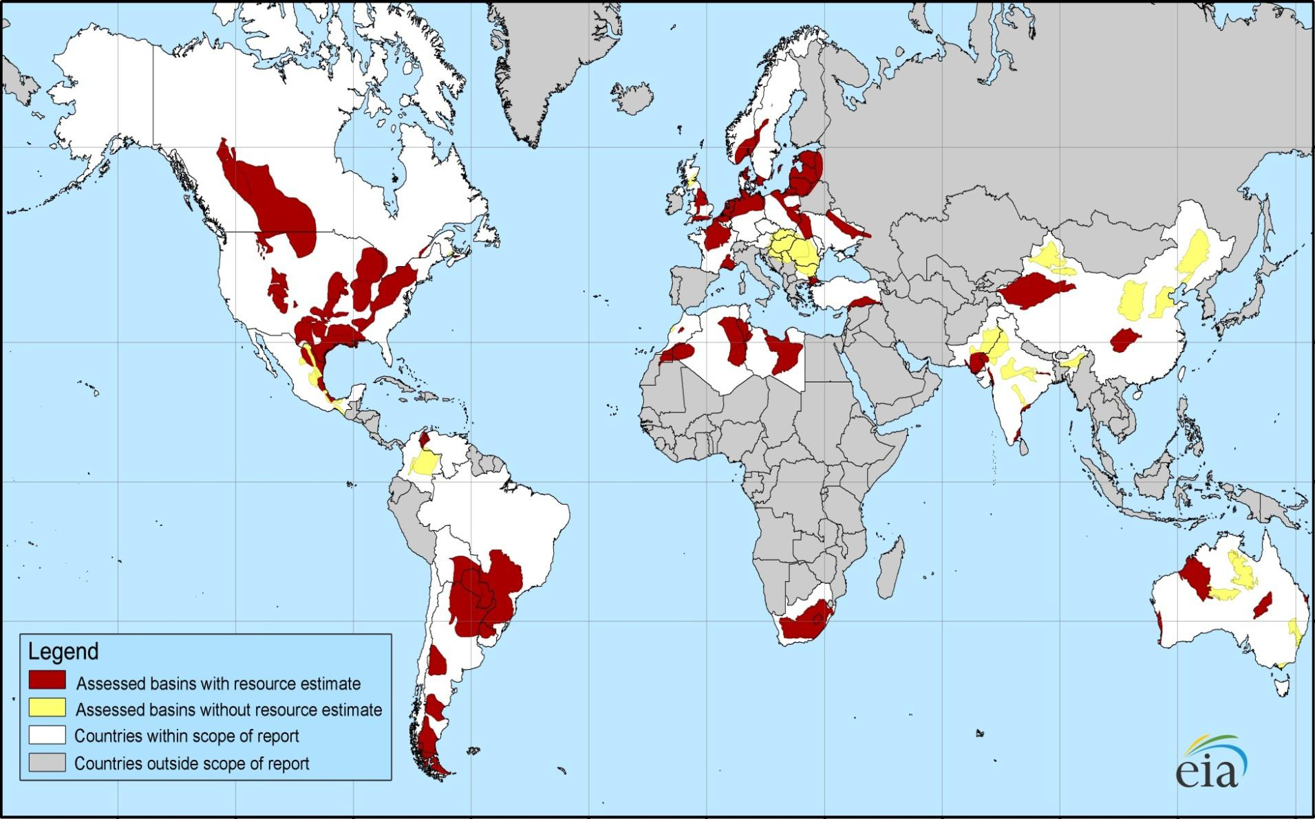
Distribution of Major Shale Deposits: 5.76 Tr. Cu. Ft. in 48 Shale Basins in 32 Countries
Europe and S. America also have large deposits
Initial assessments reveal 5.76 trillion cu. ft. of shale gas worldwide, including 1.069 trillion cu. Ft. in North America
Source: US Energy Information Administration; Insurance Information Institute.
101
12/01/09 - 9pm
eSlide – P6466 – The Financial Crisis and the Future of the P/C
Notes:
101

Slide 102
Technically Recoverable Shale Gas Deposits, by Region
North America has 1,069 trillion cu. ft. of technically recoverable shale gas recources—18.6% of the global total
Trillion Cubic Ft.tts
Source: US Energy Information Administration; Insurance Information Institute.

Slide 103
Much Uncertainty Exists in the World, But Energy Demand Grows Under All Scenarios
Energy is One of the Few Major Markets/Industries With Clear Growth Long-Term Trends
Coal Will Still Play a Big Role
103

Slide 104
World Primary Energy Consumption, 1990-2030P
Quadrillion BTUs
Global energy consumption is expected to increase by 33.4% between 2010 and 2030 but by only 12% in the US
Between 2006 and 2030, energy consumption in projected to increase annually by 1.5% worldwide but only 0.5% in the US
Source: Energy Information Administration, 2009 International Energy Outlook, Insurance Information Institute.

Slide 105
Avg. Annual Change in Total Energy Consumption by Country/Region:2006-2030P
US/Europe have the slowest growth rates for energy consumption through 2030, growing at less than 1/6 the rate in China and 1/5 that of India
Source: Energy Information Administration, 2009 International Energy Outlook, Ins. Info. Institute

Slide 106
World Net Effective Electric Power Generation, 1990-2030P
Trillions of Kilowatt Hours
Global electric power generation was dampened about 3% by the global financial crisis, but will still grow at 2.9% per year through 2030 compared to 1.9% for total energy consumption
Source: Energy Information Administration, International Energy Outlook, Insurance Information Institute.

Slide 107
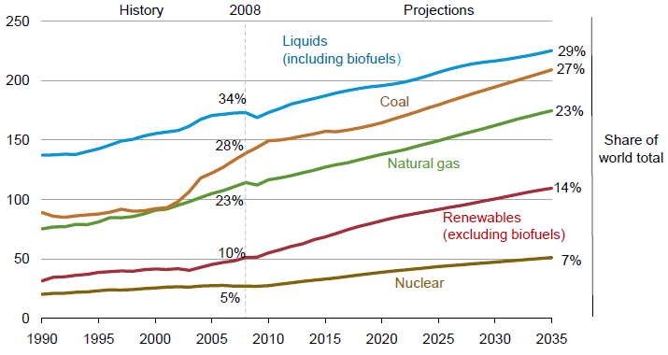
World Energy Consumption by Fuel,
1990—2035F
Global consumption of coal will rise
Renewables will account for 14% of global energy consumption by 2035, up from 20% in 2008
Source: US Energy Information Administration, International Energy Outlook 2011; Insurance Information Institute.
107
12/01/09 - 9pm
eSlide – P6466 – The Financial Crisis and the Future of the P/C
Notes:
107

Slide 108
US Electric Power Generation by Fuel Source, 2010-2035F (Billions of Kilowatt Hours)
4,279
4,427
3,937
4,118
3,806
3,796
Coal
Demand for Electricity Is Expected to Grow at a 0.6% Annual Rate Through 2035. Renewables and Natural Gas Will Account for an Increasing Share of Fuel Source
Source: US Energy Information Administration, Annual Energy Outlook 2012, Appendix A7.
108
12/01/09 - 9pm
eSlide – P6466 – The Financial Crisis and the Future of the P/C
Notes:
108

Slide 109
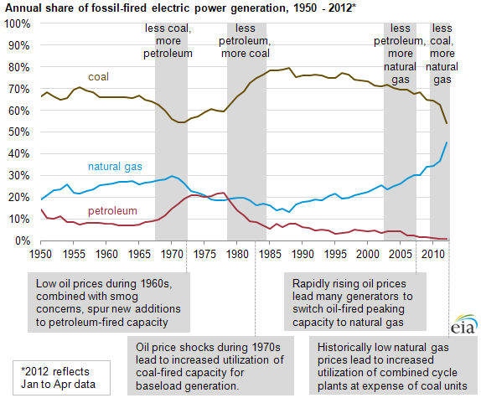
U.S. Annual Share of Fossil Fired Electric Power Generation, 1950-2012*
Natural gas share of fossil fired generation has more than tripled to 45% in 2012 from less than 15% in 1988. Coal’s share is down significantly and Petroleum’s share is approaching zero
Source: US Energy Information Administration, http://www.eia.gov/todayinenergy/detail.cfm?id=7090# ; Insurance Information Institute.
109
12/01/09 - 9pm
eSlide – P6466 – The Financial Crisis and the Future of the P/C
Notes:
109

Slide 110
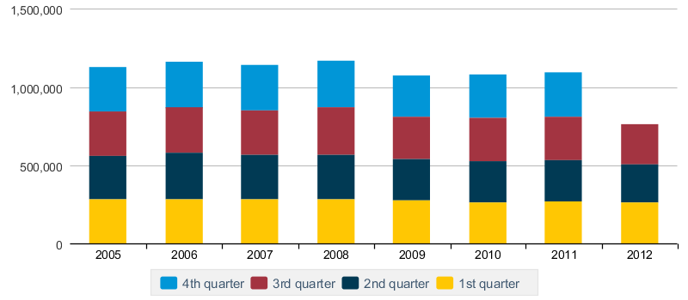
Quarterly Coal Production in the US, 2005:Q1—2012:Q3*
Thousands of Short Tons
Coal production has trended slightly downward in recent years
*Latest available as of 3/4/12.
Source: Energy Information Administration; Insurance Information Institute.

Slide 111
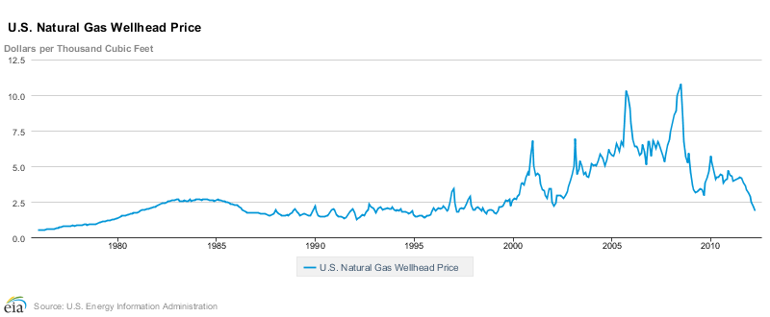
US Natural Gas Wellhead Price, Monthly,
1976-2012*
Dollars per 1,000 Cubic Ft.
Natural gas prices began a decade long rise in the late 1990s, before plunging amid the financial crisis and new discoveries and extraction technologies
*Through April 2012
Source: US Energy Information Administration, http://www.eia.gov/todayinenergy/detail.cfm?id=7090# ; Insurance Information Institute.
111
12/01/09 - 9pm
eSlide – P6466 – The Financial Crisis and the Future of the P/C
Notes:
111

Slide 112
U.S. Renewable Energy Net Summer Capacity, 2010 – 2035P
Electricity from renewable sources is expected to expand by 57% between 2010 and 2035—an annual growth rate of 2.3%
Gigawatts
Source: US Energy Information Administration, Annual Energy Outlook 2012, Appendix A16; Insurance Information Institute.

Slide 113
U.S. Renewable Energy Net Summer Capacity & Avg. Ann. Change, by Source, 2010 – 2035P
Average annual change
(Gigawatts)
+0.2%
+2.3 %
Wind is expected to experience the greatest change in capacity but solar will experience the fastest growth
+8.6 %
+3.5 %
+4.0%
+0.1%
Source: US Energy Information Administration, Annual Energy Outlook 2012, Appendix A16; Insurance Information Institute.

Slide 114
Global Insured Catastrophe Loss Update
2012 Catastrophe Losses in the US Were Close to “Average” Until Sandy Hit
Globally Losses Fell from 2011 Record Levels, But Still High
114

Slide 115
2012 Catastrophe Summary
Catastrophe Communications: US & Global
  U.S. Focus: ~$37-$42B = 2nd Most Costliest Year Ever for Insured Catastrophe Loss (Behind 2005)
    Economic Losses = $101B
    Crop = Additional ~$16B ($7B-$8B privately insured)
    NFIP Flood = Additional $9B+
    Flood losses/NFIP/FEMA has been the #1 communications “issue” in the wake of Sandy
  Global Focus: $65B in Insured Losses→Well Below $105B in 2011 but Above 10-Yr. Avg. of $50B
    Cats abroad did not drive media cycle in 2012, save ongoing Fukishima issues; Climate change
  Market Consequences: Primary & Reinsurance
    Impacts on price, availability
115
12/01/09 - 9pm
eSlide – P6466 – The Financial Crisis and the Future of the P/C
Notes:
115

Slide 116
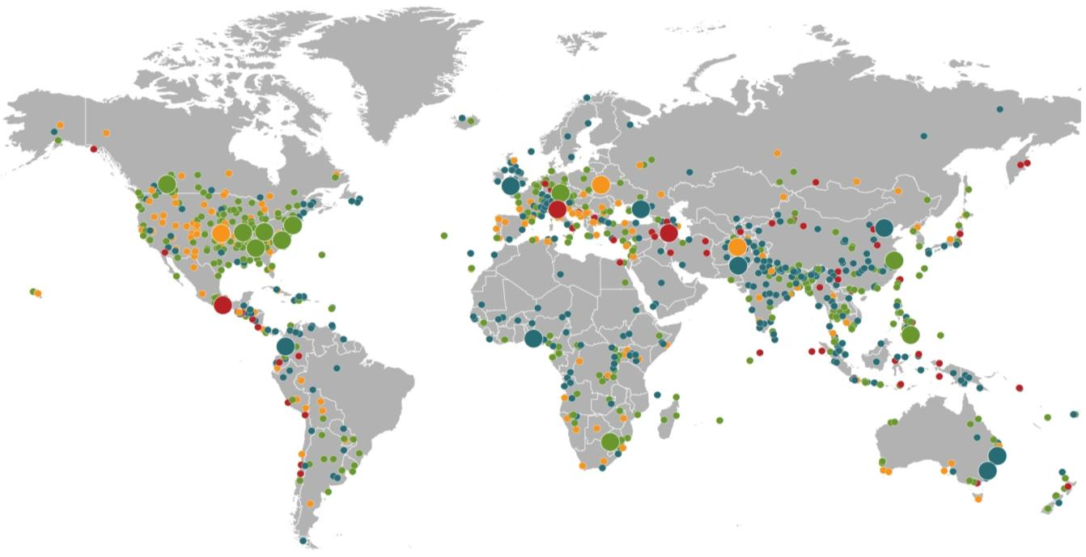
Natural Loss Events:
Full Year 2012
World Map
Winter Storm Andrea
Europe, 5–6 January
Floods
United Kingdom,
21–27 November
Cold Wave
Eastern Europe, Jan – Feb
Cold Wave
Afghanistan, Jan – Mar
Severe Weather
USA, 28–29 April
Hailstorms, severe weather
Canada, 12–14 August
Severe storms
USA, 28 June –2 July
Flash Floods
Russia, 6–8 July
Floods
China, 21–24 July
Drought
USA, Summer
Hurricane Sandy
USA, Caribbean
24–31 October
Earthquake
Italy,
29 May/3 June
Typhoon Haikui China, 8–9 August
Severe Storms, tornadoes
USA, 2–4 March
Hurricane Isaac
USA, Caribbean
24–31 August
Earthquake
Iran, 11 August
Earthquake
Mexico, 20 March
Floods
Nigeria, Jul – Oct
Floods
Pakistan, 3 –27 September
Typhoon Bopha Philippines, 4–5 December
Floods
Columbia, Mar – Jun
Floods, flash floods
Australia, Jan – Feb
Number of events: 905
Floods, hailstorms
South Africa, 20 –21 October
Floods. flash floods
Australia, Feb – Mar
Natural catastrophes
Geophysical events
(earthquake, tsunami, volcanic activity)
Hydrological events
(flood, mass movement)
Selection of significant
Natural catastrophes
Meteorological events
(storm)
Climatological events
(extreme temperature, drought, wildfire)
Source: Munich Re Geo Risks Research, NatCatSERVICE – As at January 2013.
116

Slide 117

Natural Catastrophes Worldwide 2012
Insured Losses = $65bn - % distribution per continent
91%
5%
2012: 91 %
65%
<3%
1980-2011: 65 %
Insured losses in the Americas were 91% of the global total in 2012, compared to an average of 65% from 1980-2011
<1%
<1%
Continent | Insured losses US$ m
America (North & South Am.) | 60,000
Europe | 3,200
Africa | 200
Asia | 1,700
Australia/Oceania | 300
© 2013 Munich Re
117
Source: Geo Risks Research, NatCatSERVICE – As at January 2013

Slide 118

Natural Catastrophes Worldwide 2012
Overall Losses = $160bn - % distribution per continent
69%
13%
16%
Overall losses (insured & uninsured) in the Americas totaled $110B or 69% of the $160B global total in 2012
<1%
<1%
<1%
Continent | Overall losses US$ m
America (North & South) | 110,000
Europe | 21,000
Africa | 1,000
Asia | 26,000
Australia/Oceania | 1,000
Source: Munich Re Geo Risks Research, NatCatSERVICE – As at January 2013
118

Slide 119
Natural Disaster Losses in the United States: 2012
As of January 1, 2013 | Number of Events | Fatalities | Estimated Overall Losses (US $m) | Estimated Insured Losses (US $m)
Tropical Cyclone | 4 | 143 | 52,240 | 26,360
Severe Thunderstorm | 115 | 118 | 27,688 | 14,914
Drought | 2 | 0 | 20,000 | 16,000†
Wildfire | 38 | 13 | 1,112 | 595
Winter Storm | 2 | 7 | 81 | 38
Flood | 19 | 3 | 13 | 0††
TOTALS | 184 | 284 | $101,134 | $57,907
Source: MR NatCatSERVICE
† - Includes Federal Crop Insurance Losses. † † - Excludes federal flood.
119
Notes:
All data from NatCat Service

Slide 120
Significant Natural Catastrophes, 2012
(Events with $1 billion economic loss and/or 50 fatalities)
Date | Event | Estimated Economic Losses (US $m) | Estimated Insured Losses (US $m)
June – Sept 2012 | Central US Drought | 20,000 | 16,000†
March 2 - 3 | Thunderstorms | 5,000 | 2,500
April 2 – 4 | Thunderstorms | 1,550 | 775
April 13- 15 | Thunderstorms | 1,800 | 910
April 28 – 29 | Thunderstorms | 4,500 | 2,500
May 25 – 30 | Thunderstorms | 3,400 | 1,700
June 6 – 7 | Thunderstorms | 1,400 | 1,000
June 11 – 13 | Thunderstorms | 1,900 | 950
June 28 – July 2 | Thunderstorms | 4,000 | 2,000
August 26 - 30 | Hurricane Isaac | 2,000 | 1,220
October 28 - 30 | Hurricane Sandy | 50,000 | 25,000††
Source: MR NatCatSERVICE
† - Includes Federal Crop Insurance Losses.; † † - Excludes NFIP losses.
120
120

Slide 121
Natural Disasters in the United States, 1980 – 2012
Number of Events (Annual Totals 1980 – 2012)
There were 184 natural disaster events in the US in 2012
Number
41
19
121
3
Geophysical
(earthquake, tsunami,
volcanic activity)
Meteorological (storm)
Climatological
(temperature extremes,
drought, wildfire)
Hydrological
(flood, mass movement)
Source: MR NatCatSERVICE
121

Slide 122
Losses Due to Natural Disasters in the US, 1980–2012 (Overall & Insured Losses)
(Overall and Insured Losses)
(2012 Dollars, $ Billions)
2012 was the 2nd or 3rd most expensive year on record for insured catastrophe losses in the US.
Approximately 57% of the overall cost of catastrophes in the US was covered by insurance in 2012
2012 Losses
Overall : $101.1B
Insured: $57.9B
Overall losses (in 2012 values)
Insured losses (in 2012 values)
Source: MR NatCatSERVICE
122

Slide 123
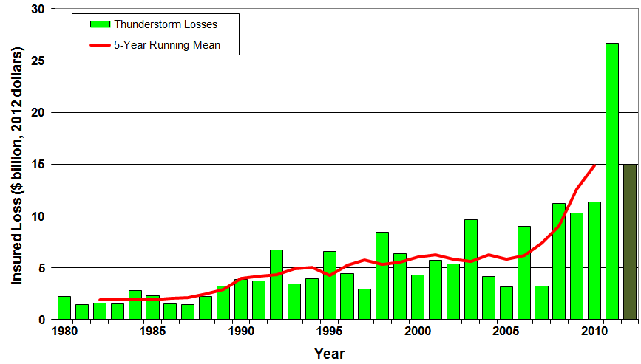
U.S. Thunderstorm Loss Trends, 1980 – 2012
Hurricanes get all the headlines, but thunderstorms are consistent producers of large scale loss. 2008-2012 are the most expensive years on record.
Average thunderstorm losses are up 7 fold since the early 1980s. The 5- year running average loss is up sharply.
Thunderstorm losses in 2012 totaled $14.9 billion, the 2nd highest on record
Source: Property Claims Service, MR NatCatSERVICE
123

Slide 124
Top 16 Most Costly Disasters in U.S. History
(Insured Losses, 2012 Dollars, $ Billions)
Hurricane Sandy could become the 4th or 5th costliest event in US insurance history
Includes Tuscaloosa, AL, tornado
Includes Joplin, MO, tornado
Hurricane Irene became the 12th most expense hurricane in US history in 2011
12 of the 16 Most Expensive Events in US History Have Occurred Over the Past Decade
*Estimate as of 12/09/12 based on estimates of catastrophe modeling firms and reported losses as of 1/12/13. Estimates range up to $25B.
Sources: PCS; Insurance Information Institute inflation adjustments to 2012 dollars using the CPI.

Slide 125
US Insured Catastrophe Losses
($ Billions, 2012 Dollars)
2012 CAT losses were down nearly 50% from 2011 until Sandy struck in late October
US CAT Losses in 2012 Will Likely Become the 2nd or 3rd Highest in US History on An Inflation-Adjusted Basis (Pvt Insured). 2011 Losses Were the 5th Highest
Record Tornado Losses Caused 2011 CAT Losses to Surge
*As of 1/2/13. Includes $20B gross loss estimate for Hurricane Sandy.
Note: 2001 figure includes $20.3B for 9/11 losses reported through 12/31/01 ($25.9B 2011 dollars). Includes only business and personal property claims, business interruption and auto claims. Non-prop/BI losses = $12.2B ($15.6B in 2011 dollars.)
Sources: Property Claims Service/ISO; Insurance Information Institute.
125
12/01/09 - 9pm
eSlide – P6466 – The Financial Crisis and the Future of the P/C
Notes:
125

Slide 126
Combined Ratio Points Associated with Catastrophe Losses: 1960 – 2012*
Avg. CAT Loss Component of the Combined Ratio by Decade
1960s: 1.04 1970s: 0.85 1980s: 1.31 1990s: 3.39 2000s: 3.52 2010s: 7.20*
Catastrophe losses as a share of all losses reached a record high in 2012
Combined Ratio Points
The Catastrophe Loss Component of Private Insurer Losses Has Increased Sharply in Recent Decades
Notes: Private carrier losses only. Excludes loss adjustment expenses and reinsurance reinstatement premiums. Figures are adjusted for losses ultimately paid by foreign insurers and reinsurers.
Source: ISO (1960-2011); A.M. Best (2012E) Insurance Information Institute.

Slide 127
Top 16 Most Costly World Insurance Losses, 1970-2012*
(Insured Losses, 2012 Dollars, $ Billions)
5 of the top 14 most expensive catastrophes in world history have occurred within the past 3 years
2012 insured CAT Losses totaled $60B; Economic losses totaled $140B, according to Swiss Re
Hurricane Sandy could become the 6th costliest event in global insurance history
*Figures do not include federally insured flood losses.
**Estimate based on PCS value of $18.75B as of 1/18/13 and assumption of upward development based on catastrophe modeler estimates ranging as high as $25B.
Sources: Swiss Re sigma 1/2011; Munich Re; Insurance Information Institute research.

Slide 128
Inflation Adjusted U.S. Catastrophe Losses by Cause of Loss, 1990–2011¹
Wind/Hail/Flood (3), $14.8
Fires (4), $6.0
Other (5), $1.4
Insured cat losses from 1992-2011 totaled $384.3B, an average of $19.2B per year or $1.6B per month
Geological Events, $18.2
Terrorism, $24.4
Winter Storms, $28.2
Hurricanes & Tropical Storms, $161.3
Tornado share of CAT losses is rising
Wind losses are by far cause the most catastrophe losses, even if hurricanes/TS are excluded.
Tornadoes (2), $130.2
Catastrophes are defined as events causing direct insured losses to property of $25 million or more in 2009 dollars.
Excludes snow.
Does not include NFIP flood losses
Includes wildland fires
Includes civil disorders, water damage, utility disruptions and non-property losses such as those covered by workers compensation.
Source: ISO’s Property Claim Services Unit.

Slide 129
Federal Disaster Declarations Patterns: 1953-2012
Despite 11 Sandy Declarations, Fewer Disasters Were Declared in 2012 than the Record Number of Declarations in 2010 and 2011
129

Slide 130
Number of Federal Disaster Declarations, 1953-2013*
There have been 2,101 federal disaster declarations since 1953. The average number of declarations per year is 35 from 1953-2012, though that few haven’t been recorded since 1995.
The number of federal disaster declarations set a new record in 2011, with 99, shattering 2010’s record 81 declarations.
47 federal disasters were declared in 2012
The Number of Federal Disaster Declarations Is Rising and Set New Records in 2010 and 2011. Hurricane Sandy Produced 13 Declarations in 2012/13.
*Through Feb. 24, 2013.
Source: Federal Emergency Management Administration; http://www.fema.gov/disasters; Insurance Information Institute.

Slide 131
Federal Disasters Declarations by State,
1953 – 2013: Highest 25 States*
Over the past 60 years, Texas has had the highest number of Federal Disaster Declarations
*Through Feb. 24, 2012. Includes Puerto Rico and the District of Columbia.
Source: FEMA: http://www.fema.gov/news/disaster_totals_annual.fema; Insurance Information Institute.

Slide 132
Federal Disasters Declarations by State,
1953 – 2013: Lowest 25 States*
Over the past 60 years, Wyoming and Rhode Island had the fewest number of Federal Disaster Declarations
*Through Feb. 24, 2013. Includes Puerto Rico and the District of Columbia.
Source: FEMA: http://www.fema.gov/news/disaster_totals_annual.fema; Insurance Information Institute.

Slide 133
Loss Distribution by Type of Insurance from Sept. 11 Terrorist Attack ($ 2011)
($ Billions)
Total Insured Losses Estimate: $40.0B**
*Loss total does not include March 2010 New York City settlement of up to $657.5 million to compensate approximately 10,000 Ground Zero workers or any subsequent settlements.
**$32.5 billion in 2001 dollars.
Source: Insurance Information Institute.

Slide 134
Top 12 Most Costly Hurricanes in U.S. History
(Insured Losses, 2012 Dollars, $ Billions)
10 of the 12 most costly hurricanes in insurance history occurred over the past 9 years (2004—2012)
Hurricane Sandy could become the 3rd costliest hurricane in US insurance history
Hurricane Irene became the 12th most expensive hurricane in US history in 2011
*Estimate as of 12/09/12 based on estimates of catastrophe modeling firms and reported losses as of 1/12/13. Estimates range up to $25B.
Sources: PCS; Insurance Information Institute inflation adjustments to 2012 dollars using the CPI.

Slide 135
Financial Strength & Underwriting
Cyclical Pattern is P-C Impairment History is Directly Tied to Underwriting, Reserving & Pricing
135

Slide 136
P/C Insurer Impairments, 1969–2011
3 small insurers in Missouri did encounter problems in 2011 following the May tornado in Joplin. They were absorbed by a larger insurer and all claims were paid.
The Number of Impairments Varies Significantly Over the P/C Insurance Cycle, With Peaks Occurring Well into Hard Markets
Source: A.M. Best Special Report “1969-2011 Impairment Review,” June 2012; Insurance Information Institute.

Slide 137
P/C Insurer Impairment Frequency vs. Combined Ratio, 1969-2011
2011 impairment rate was 0.91%, up from 0.67% in 2010; the rate is slightly higher than the 0.82% average since 1969
Impairment Rates Are Highly Correlated With Underwriting Performance and Reached Record Lows in 2007; Recent Increase Was Associated Primarily With Mortgage and Financial Guaranty Insurers and Not Representative of the Industry Overall
Source: A.M. Best; Insurance Information Institute

Slide 138
Reasons for US P/C Insurer Impairments, 1969–2010
Historically, Deficient Loss Reserves and Inadequate Pricing Are
By Far the Leading Cause of P-C Insurer Impairments.
Investment and Catastrophe Losses Play a Much Smaller Role
Reinsurance Failure
Sig. Change in Business
Misc.
Investment Problems (Overstatement of Assets)
Deficient Loss Reserves/
Inadequate Pricing
Affiliate Impairment
Catastrophe Losses
Alleged Fraud
Rapid Growth
Source: A.M. Best: 1969-2010 Impairment Review, Special Report, April 2011.

Slide 139
Top 10 Lines of Business for US P/C Impaired Insurers, 2000–2010
Workers Comp and Pvt. Passenger Auto Account for Nearly Half of the Premium Volume of Impaired Insurers Over the Past Decade
Title
Financial Guaranty
Surety
Med Mal
Workers Comp
Other Liability
Commercial Auto Liability
Pvt. Passenger Auto
Commercial Multiperil
Homeowners
Source: A.M. Best: 1969-2010 Impairment Review, Special Report, April 2011.

Slide 140
Number of Recessions Endured by P/C Insurers, by Number of Years in Operation
Number of Recessions Since 1860
Insurers are true survivors—not just of natural catastrophes but also economic ones
Number of Years in Operation
Many US Insurers Are Close to a Century Old or Older
Sources: Insurance Information Institute research from National Bureau of Economic Research data.
140
12/01/09 - 9pm
eSlide – P6466 – The Financial Crisis and the Future of the P/C
Notes:
140

Slide 141
Shifting Legal Liability &
Tort Environment
Is the Tort Pendulum
Swinging Against Insurers?
141

Slide 142
Over the Last Three Decades, Total Tort Costs as a % of GDP Appear Somewhat Cyclical, 1980-2013E
($ Billions)
2.21% of GDP in 2003 = pre-tort reform peak
Deepwater Horizon Spike in 2010
Tort costs in dollar terms have remained high but relatively stable since the mid-2000s., but are down substantially as a share of GDP
1.68% of GDP in 2013
Sources: Towers Watson, 2011 Update on US Tort Cost Trends, Appendix 1A

Slide 143
Commercial Lines Tort Costs: Insured vs. Self-(Un)Insured Shares, 1973-2010
2005: $143.5B 66.4% insured, 33.6% self-(un)insured
Billions of Dollars
$15.0
1995: $83.6B 69.5% insured, 30.5% self-(un)insured
1973: Commercial Tort Costs Totaled $6.49B, 94% was insured, 6% self-(un)insured
1985: $46.6B 74.5% insured, 25.5% self-(un)insured
$9.5
$6.0
2009: $126.5B 64.4% insured, 35.6% self-(un)insured
Tort Costs and the Share Retained by Risks Both Grew Rapidly from the mid-1970s to mid-2000s, When Tort Costs Began to Fall But Self-Insurance Shares Continued to Rise
Sources: Towers Watson, 2011 Update on US Tort Cost Trends, III Calculations based on data from Appendix 4.
143
12/01/09 - 9pm
eSlide – P6466 – The Financial Crisis and the Future of the P/C
Notes:
143

Slide 144
Commercial Lines Tort Costs: Insured vs. Self-(Un)Insured Shares, 1973-2010
Percent
2010: $138.1B 56.6% insured, 44.4% self-(un)insured (distorted by Deepwater Horizon event with most losses retained by BP)
1973: 94% was insured, 6% self-(un)insured
1985:74.5% insured, 25.5% self-(un)insured
1995: 69.5% insured, 30.5% self-(un)insured
2005: 66.4% insured, 33.6% self-(un)insured
The Share of Tort Costs Retained by Risks Has Been Steadily Increasing for Nearly 40 Years. This Trend Contributes Has Left Insurers With Less Control Over Pricing.
Sources: Towers Watson, 2011 Update on US Tort Cost Trends, III Calculations based on data from Appendix 4.
144
12/01/09 - 9pm
eSlide – P6466 – The Financial Crisis and the Future of the P/C
Notes:
144

Slide 145
Business Leaders Ranking of Liability Systems in 2012
Best States
Delaware
Nebraska
Wyoming
Minnesota
Kansas
Idaho
Virginia
North Dakota
Utah
Iowa
Worst States
Florida
Oklahoma
Alabama
New Mexico
Montana
Illinois
California
Mississippi
Louisiana
West Virginia
New in 2012
Wyoming
Minnesota
Kansas
Idaho
Newly Notorious
Oklahoma
Drop-offs
Rising Above
Indiana
Colorado
Massachusetts
South Dakota
Arkansas
Source: US Chamber of Commerce 2012 State Liability Systems Ranking Study; Insurance Info. Institute.

Slide 146
The Nation’s Judicial Hellholes: 2011
Watch List
Illinois
Madison , St. Clair and McLean counties
West Virginia
Philadelphia
Eastern District of Texas
Cook County, IL
Southern NJ
Franklin County, AL
Smith County, MS
Louisiana
California
Dishonorable Mention
New York
Albany and NYC
MI Supreme Court
AK Supreme Court
MO Supreme Court
Nevada
Clark County
South Florida
Source: American Tort Reform Association; Insurance Information Institute

Slide 147
Insurance Information Institute Online:
www.iii.org
Thank you for your time
and your attention!
Twitter: twitter.com/bob_hartwig
Download at www.iii.org/presentations

