Slide 1
2013 Half-Year Natural Catastrophe Review
July 9, 2013

Slide 2
Agenda
Welcome/Introduction
Terese Rosenthal
US/Global Natural Catastrophe Update
Carl Hedde
Special Topic: Convective Storms and Floods
Peter Höppe
Economic Implications of Natural Catastrophe Losses
Dr. Robert Hartwig
Questions and Answers
2

Slide 3
Webinar Interactivity
Questions and Answers
You will have an opportunity to ask questions at the conclusion of the presentation.
To ask a question, please dial 1 4 on your phone.
An operator will facilitate your participation.
Live Tweeting
@Munichre_US @lworters @iiiorg
#NATCAT2013
3

Slide 4
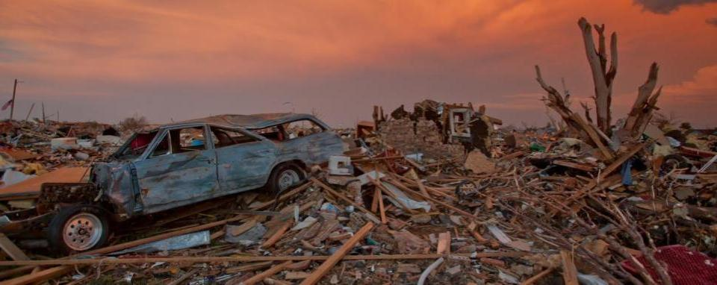
US/Global Natural Catastrophe Update
Carl Hedde, SVP, Head of Risk Accumulation
Munich Reinsurance America, Inc.
Source: FEMA

Slide 5

MR NatCatSERVICE
The world‘s largest database on natural catastrophes
The Loss Database Today
From 1980 until today all loss events; for USA and selected countries in Europe all loss events since 1970.
Retrospectively, all great disasters since 1950.
In addition, all major historical events starting from 79 AD – eruption of Mt. Vesuvio (3,000 historical data sets).
Currently more than 33,000 events
5

Slide 6
2013 Headlines
US Natural Catastrophe Update
Insured losses in the United States during the first half of 2012 totaled $7.9 billion – far below the 2000 to 2012 January – June average loss of $13.8 billion (in 2013 Dollars).
Despite a relatively quiet year for tornadoes, insured losses from thunderstorm events exceeded $6.0 billion.
Severe drought cripples agriculture over large section of central United States.
Dry conditions lead to the most damaging wildfire in Colorado history, breaking the previous record set in 2012.
6

Slide 7
Natural Disaster Losses in the United States, 2013
US Natural Catastrophe Update
As of July 1, 2013 | Number of Events | Fatalities | Estimated Overall Losses (US $m) | Estimated Insured Losses (US $m)
Severe Thunderstorm | 29 | 66 | 10,180 | 6,325
Winter Storm | 13 | 17 | 2,434 | 1,255
Flood | 10 | 9 | 500 | Minor
Earthquake & Geophysical | 5 | 0 | Minor | Minor
Tropical Cyclone | 1 | 1 | Minor | Minor
Wildfire, Heat, & Drought | 11 | 23 | 700 | 365
Totals | 68 | 116 | 13,814 | 7,945
Source: MR NatCatSERVICE
7

Slide 8
Natural Disasters in the United States, 1980 – 2013
Number of Events, January – June only
US Natural Catastrophe Update
First Six Months 2013
68 Events
11
10
42
5
Geophysical events
(Earthquake, tsunami,
volcanic eruption)
Meteorological events
(Storm)
Hydrological events
(Flood, mass movement)
Climatological events
(Extreme temperature,
drought, forest fire)
Source: MR NatCatSERVICE
8
Notes:
Included pcs 18&19 that natcat didn’t have yet

Slide 9
Natural Disasters in the United States, 1980 – 2013
Number of Events (Annual Totals 1980 – 2012 vs. First Six Months 2013)
US Natural Catastrophe Update
First Six Months 2013
68 Events
11
10
42
5
Geophysical events
(Earthquake, tsunami,
volcanic eruption)
Meteorological events
(Storm)
Hydrological events
(Flood, mass movement)
Climatological events
(Extreme temperature,
drought, forest fire)
Source: MR NatCatSERVICE
9

Slide 10
Losses Due to Natural Catastrophes in the United States
1980 – 2013 (Jan – June only)
US Natural Catastrophe Update
Insured losses in the US totaled US$ 7.9bn
Overall losses (in 2012 values)
Insured losses (in 2012 values)
Sources: MR NatCatSERVICE, Property Claims Services
10

Slide 11
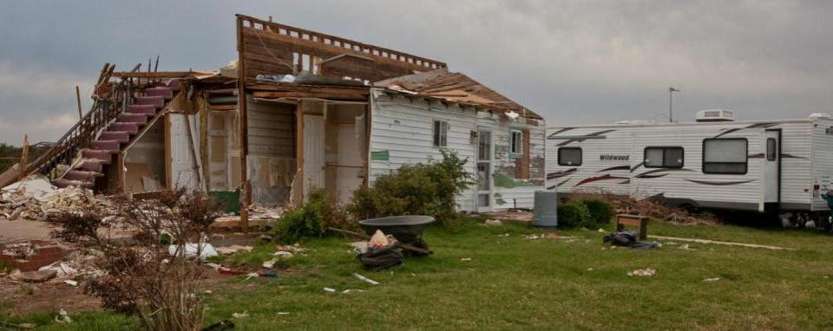
2013 US Thunderstorm Season

Slide 12
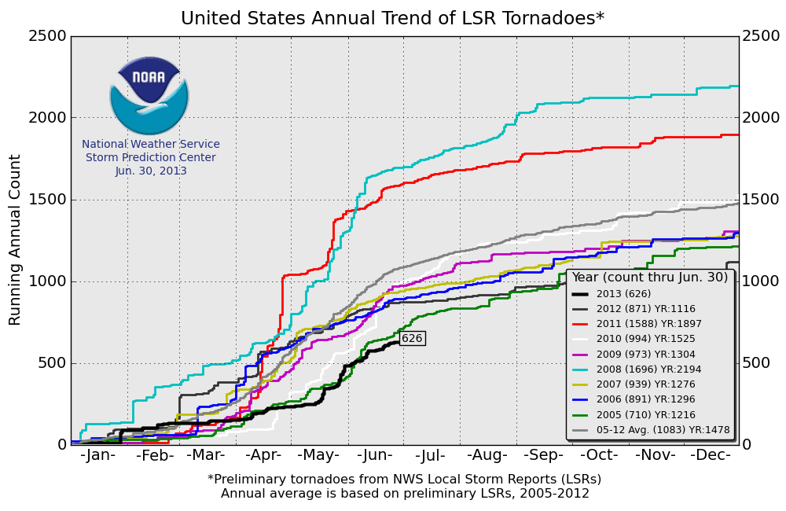
US Tornado Count
First Half 2013
US Natural Catastrophe Update
12

Slide 13
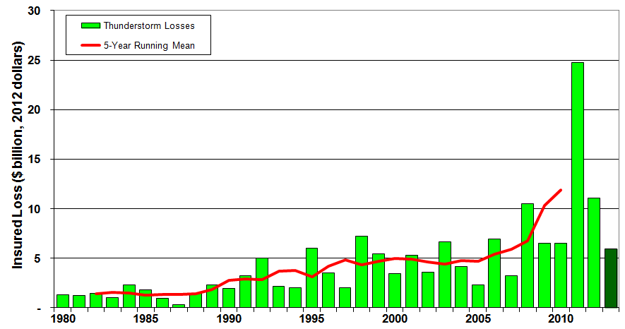
US Thunderstorm Loss Trends
January – June only, 1980 - 2012
US Natural Catastrophe Update
Thunderstorm losses for the period January – June in 2013 are lower than the past two years, but in line with experience over the past 10 years.
Source: Property Claims Service
MR NatCatSERVICE
13

Slide 14
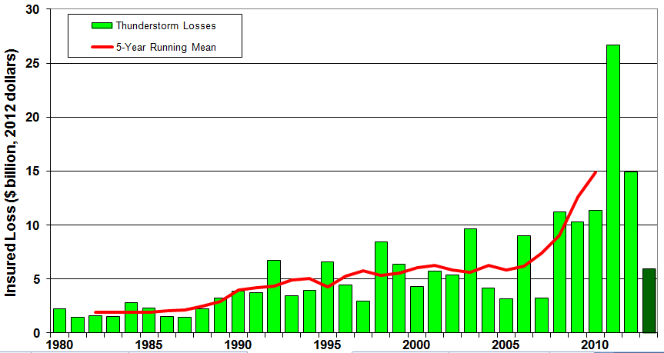
US Thunderstorm Loss Trends
Annual Totals 1980 – 2013 YTD
US Natural Catastrophe Update
Average thunderstorm losses have increased sevenfold since 1980.
Source: Property Claims Service
MR NatCatSERVICE
14

Slide 15
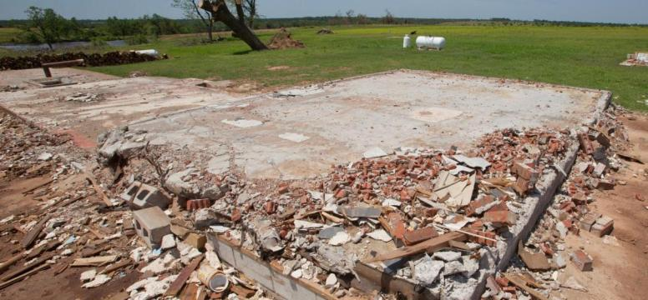
Notable Thunderstorm Events
First Half 2013
US Natural Catastrophe Update
May 18-20: Large outbreak of over 60 tornadoes across the midwest and southern Great Plains. Moore, Oklahoma, was hit by an EF5 tornado (5th tornado strike of EF2 or above in the town since 1998). Thousands of homes, 2 schools, and a hospital destroyed. Overall insured losses from the outbreak are estimated at US$ 1.6 billion.
Source: FEMA
Source: Property Claims Service
MR NatCatSERVICE
15

Slide 16
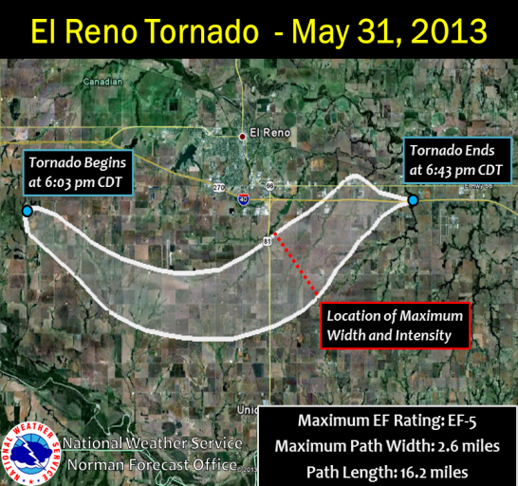
Notable Thunderstorm Events
First Half 2013
US Natural Catastrophe Update
May 28-31: Another large outbreak occurred over the southern Plains. The city of El Reno, Oklahoma, was hit by an EF5 tornado that possessed the largest diameter ever observed in a tornado, over 2 miles. Fortunately, downtown El Reno was not hit. Overall insured losses from the outbreak are estimated at US$ 815 million.
Source: NWS
16

Slide 17
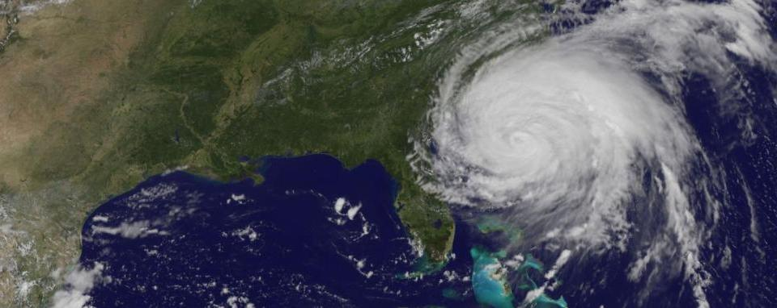
US Tropical Cyclones 2013

Slide 18
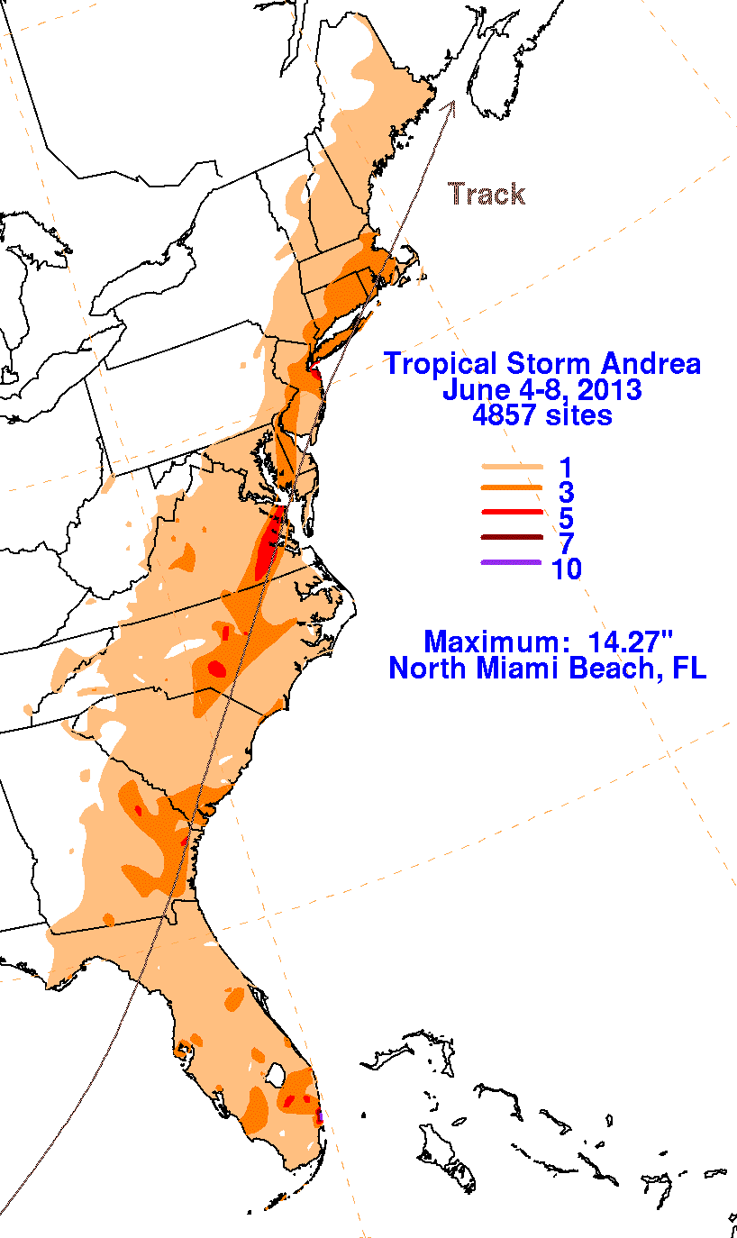
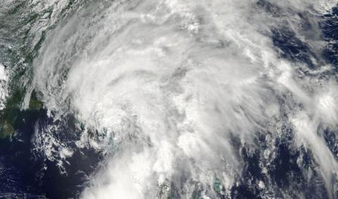
U.S. Tropical Cyclones in 2013
First Six Months 2013
US Natural Catastrophe Update
Tropical Storm Andrea
Landfall on June 6 near Cedar Key, Florida as a tropical storm with sustained winds of 65 mph.
Minor wind damage in Florida, storm and its remnants causes localized flooding along length of eastern seaboard.
Source: NOAA
Photo: FEMA
© 2012 Munich Re
18

Slide 19
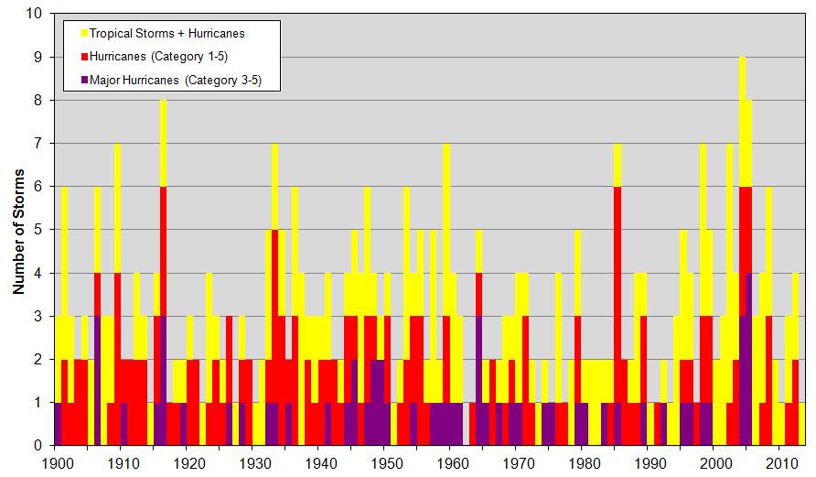
Number of US Landfalling Tropical Cyclones
1900 – 2013 YTD
US Natural Catastrophe Update
There has not been a major hurricane landfall in the US since Wilma in 2005.
Source: NOAA
19

Slide 20
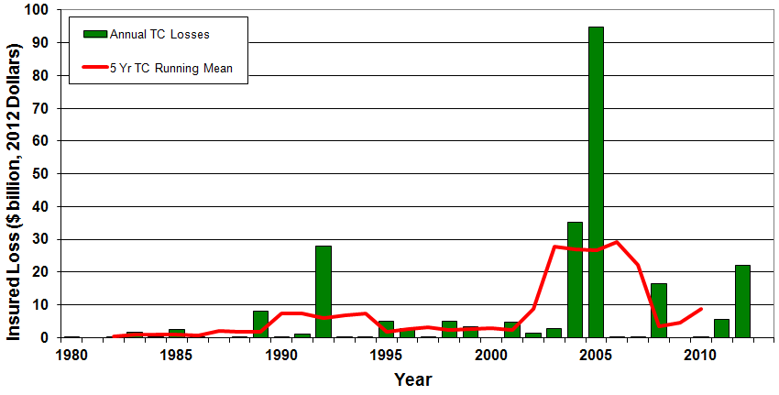
Insured US Tropical Cyclone Losses, 1980 - 2013
US Natural Catastrophe Update
The current 5-year average (2008-2012) for privately insured tropical cyclone losses are $8.8 billion per year.
Sources: Property Claims Service, MR NatCatSERVICE, NFIP
© 2013 Munich Re
20

Slide 21
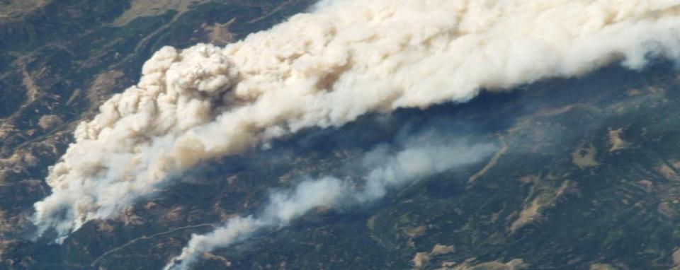
Other US Natural Catastrophes in 2013
Source: NASA

Slide 22
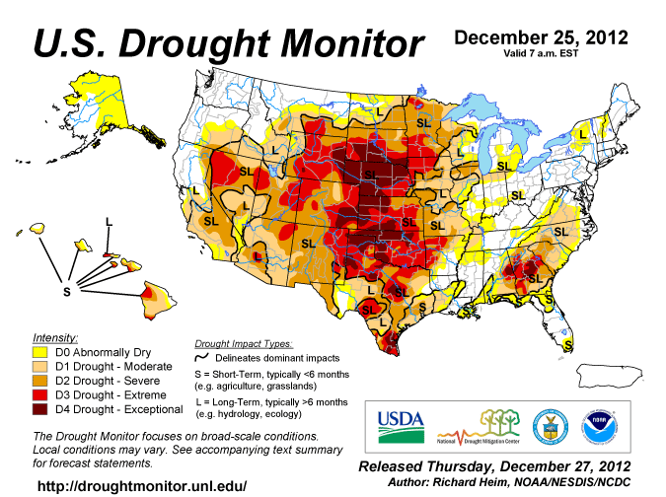
US Drought Conditions in December 2012
US Natural Catastrophe Update
22

Slide 23
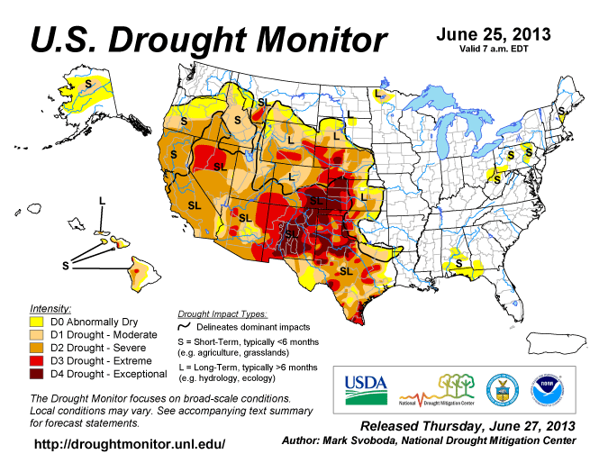
Current US Drought Conditions
US Natural Catastrophe Update
23

Slide 24
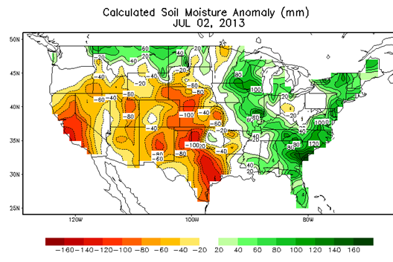
2013 Western US Drought Impacts
US Natural Catastrophe Update
Severe drought continues over large area of western United States, encompassing 15 states and almost of half of the area of the lower 48 states.
Severe damage to crops
(soybeans, sorghum) and
livestock
Record setting heat in the
desert southwest.
Ongoing economic losses
from the drought are
estimated at over $20 billion.
Source: NOAA/CPC
24

Slide 25
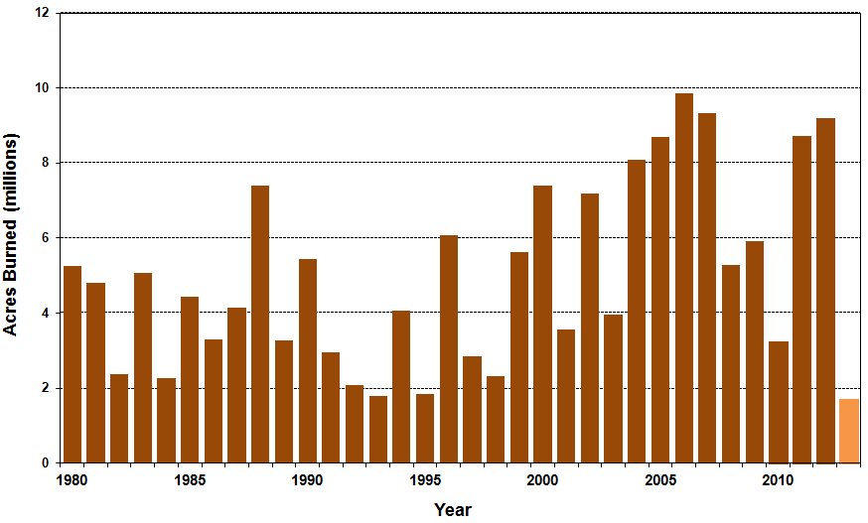
Number of Acres Burned in Wildfires,
1980 – 2013 YTD
US Natural Catastrophe Update
25
Source: National Interagency Fire Center
25

Slide 26
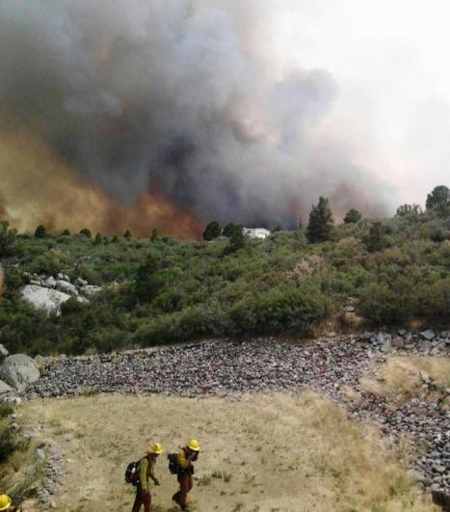
Notable Wildfires in 2013
US Natural Catastrophe Update
Colorado: “Black Forest” fire near Colorado Springs destroyed 511 homes, becoming the most damaging fire in state history, surpassing the losses from the “Waldo Canyon” fire in 2012. The insured loss estimate from this fire is US$ 365m.
Arizona: “Yarnell Hill” fire near Prescott consumes over 8,400 acres, destroys over 200 buildings, and claimed the lives of at least 19 firemen, the sixth-worst loss of firemen from a single event in U.S. history.
Source: USDA
26

Slide 27
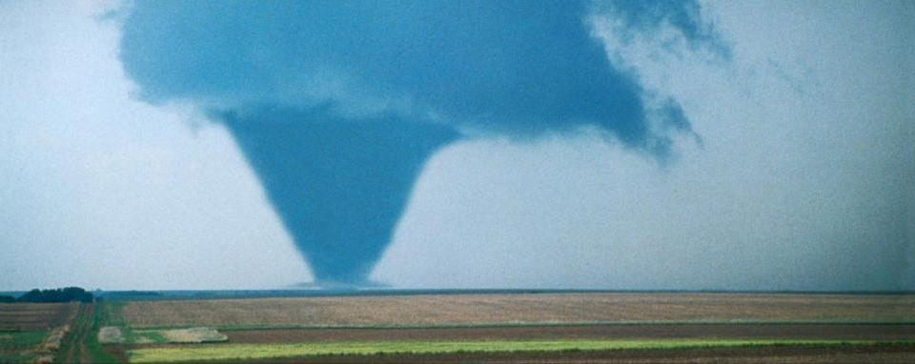
Global Natural Catastrophe Update

Slide 28
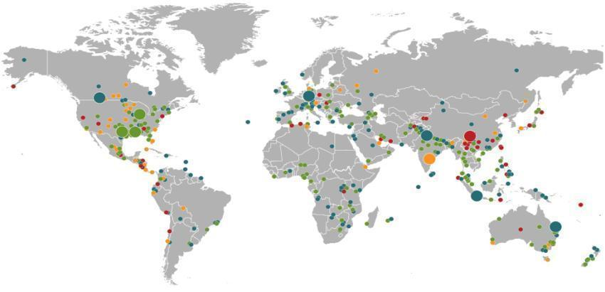
Natural Catastrophes January – June 2013
World map with significant events
Global Natural Catastrophe Update
Floods
Canada, June
Floods
Europe,
June
Winter storm
USA, 7–11 April
Earthquake
China,
20 April
Severe storms, tornadoes
USA, 18–20 March
Floods
India,
June
Severe storms, tornadoes
USA, 18–19 March
Heat wave
India, June
Number of events: 460
Floods
Indonesia,
15–22 January
Floods
Australia,
21–31 January
Natural catastrophes
Geophysical events
(earthquake, tsunami, volcanic activity)
Hydrological events
(flood, mass movement)
Selection of significant
loss events
Meteorological events
(storm)
Climatological events
(extreme temperature, drought, wildfire)
© 2013 Münchener Rückversicherungs-Gesellschaft, Geo Risks Research, NatCatSERVICE – as at June 2013
28

Slide 29
Natural Catastrophes Worldwide 2013
Overview and Comparison with Previous Years
Global Natural Catastrophe Update
 | 2013 (Jan – June)
Number of events | 460
Overall losses in US$m (original values) | 45,000
Insured losses in US$m (original values) | 13,000
Fatalities | 4,000
Source: MR NatCatSERVICE
© 2013 Munich Re
29

Slide 30
Natural Catastrophes Worldwide 2013
Overview and Comparison with Previous Years
Global Natural Catastrophe Update
 | 2013 (Jan – June) | 2012 (Jan – June)
Number of events | 460 | 520
Overall losses in US$m (original values) | 45,000 | 58,000
Insured losses in US$m (original values) | 13,000 | 19,000
Fatalities | 4,000 | 4,500
Source: MR NatCatSERVICE
30

Slide 31
Natural Catastrophes Worldwide 2013
Overview and Comparison with Previous Years
Global Natural Catastrophe Update
 | 2013 (Jan – June) | 2012 (Jan – June) | Average of the last 10 years 2003-2012 (Jan –June)
Number of events | 460 | 520 | 390
Overall losses in US$m (original values) | 45,000 | 58,000 | 85,000
Insured losses in US$m (original values) | 13,000 | 19,000 | 22,000
Fatalities | 4,000 | 4,500 | 53,000
Source: MR NatCatSERVICE
31

Slide 32
Natural Catastrophes Worldwide 2013
Overview and Comparison with Previous Years
Global Natural Catastrophe Update
 | 2013 (Jan – June) | 2012 (Jan – June) | Average of the last 10 years 2003-2012 (Jan –June) | Average of the last 30 years 1983-2012 (Jan –June)
Number of events | 460 | 520 | 390 | 300
Overall losses in US$m (original values) | 45,000 | 58,000 | 85,000 | 61,600
Insured losses in US$m (original values) | 13,000 | 19,000 | 22,000 | 13,500
Fatalities | 4,000 | 4,500 | 53,000 | 30,000
Source: MR NatCatSERVICE
32

Slide 33
Natural Catastrophes Worldwide 2013
Overview and Comparison with Previous Years
Global Natural Catastrophe Update
 | 2013 (Jan – June) | 2012 (Jan – June) | Average of the last 10 years 2003-2012 (Jan –June) | Average of the last 30 years 1983-2012 (Jan –June) | Top Year 1983 -2012 (Jan – June)
Number of events | 460 | 520 | 390 | 300 | 2012 620
Overall losses in US$m (original values) | 45,000 | 58,000 | 85,000 | 61,600 | 2011 (EQ Japan) 302,000
Insured losses in US$m (original values) | 13,000 | 19,000 | 22,000 | 13,500 | 2011 (EQ, Japan) 82,000
Fatalities | 4,000 | 4,500 | 53,000 | 30,000 | 2010 (EQ Haiti) 230,000
Source: MR NatCatSERVICE
33

Slide 34
Natural Catastrophes Worldwide 1980 – 2013
Number of Events (Annual Totals 1980 – 2012 vs. First Six Months 2013)
Global Natural Catastrophe Update
Number
First Six Months in 2013
460 Events
Geophysical events
(Earthquake, tsunami,
volcanic eruption)
Meteorological events
(Storm)
Hydrological events
(Flood, mass movement)
Climatological events
(Extreme temperature,
drought, forest fire)
Source: MR NatCatSERVICE
34

Slide 35
Natural Catastrophes Worldwide 1980 – 2013
Number of Events (January – June only)
Global Natural Catastrophe Update
Number
First Six Months in 2013
460 Events
Geophysical events
(Earthquake, tsunami,
volcanic eruption)
Meteorological events
(Storm)
Hydrological events
(Flood, mass movement)
Climatological events
(Extreme temperature,
drought, forest fire)
Source: MR NatCatSERVICE
35

Slide 36
Natural Catastrophes Worldwide 1980 – 2013
Overall and Insured Losses (Annual Totals 1980 – 2012 vs. First Six Months 2013)
Global Natural Catastrophe Update
Overall losses totaled US$ 45bn; Insured losses totaled US$ 13bn
(bn US$)
Overall losses (in 2012 values)
Insured losses (in 2012 values)
Source: MR NatCatSERVICE
36

Slide 37
Natural Catastrophes Worldwide 1980 – 2013
Overall and Insured Losses (January – June only)
Global Natural Catastrophe Update
Overall losses totaled US$ 45bn; Insured losses totaled US$ 13bn
(bn US$)
Overall losses (in 2012 values)
Insured losses (in 2012 values)
Source: MR NatCatSERVICE
37

Slide 38

Natural Catastrophes: Comparison of Insured Losses
Percentage Distribution – Annual Totals 1980 – 2012 vs. First Six Months 2013
Global Natural Catastrophe Update
65%
16%
14%
27%
4%
59%
<1%
<1%
5%
10%
Insured losses | US$
1980 – 2012 (annual totals): | 970bn* *losses in 2012 values
2013 (first six months): | 13bn
Source: MR NatCatSERVICE
38

Slide 39
Natural Catastrophes Worldwide 2013
The Five Costliest Natural Catastrophes for the Insurance Industry
Global Natural Catastrophe Update
Date | Region | Event | Fatalities | Overall losses US$ m | Insured losses US$ m
June 2013 | Europe | Floods | 22 | >16,000* | ~3,900*
18-20.5.2013 | USA | Thunderstorms, tornado | 26 | 3,100 | 1,575
18-19.3.2013 | USA | Thunderstorms | 2 | 2,000 | 1,415
June 2013 | Canada | Floods | 3 | >3,000* | >1,000*
21-31.1.2013 | Australia | Floods | 6 | 2,000 | 1,100
*Loss estimation in progress
Source: PCS - Property Claim Services
39

Slide 40
Costliest Natural Catastrophes Since 1950
Rank by Insured Losses
Global Natural Catastrophe Update
Year | Event | Region | Insured loss US$m (in original values)
2005 | Hurricane Katrina | USA | 62,200
2011 | EQ, tsunami | Japan | 40,000
2012 | Hurricane Sandy | USA, Caribbean | 30,150
2008 | Hurricane Ike | USA, Caribbean | 18,500
1992 | Hurricane Andrew | USA | 17,000
2011 | Floods | Thailand | 16,000
2012 | Drought | USA | 16,000
1994 | EQ Northridge | USA | 15,300
2004 | Hurricane Ivan | USA, Caribbean | 13,800
2011 | EQ Christchurch | New Zealand | 13,000
Source: MR NatCatSERVICE
40

Slide 41
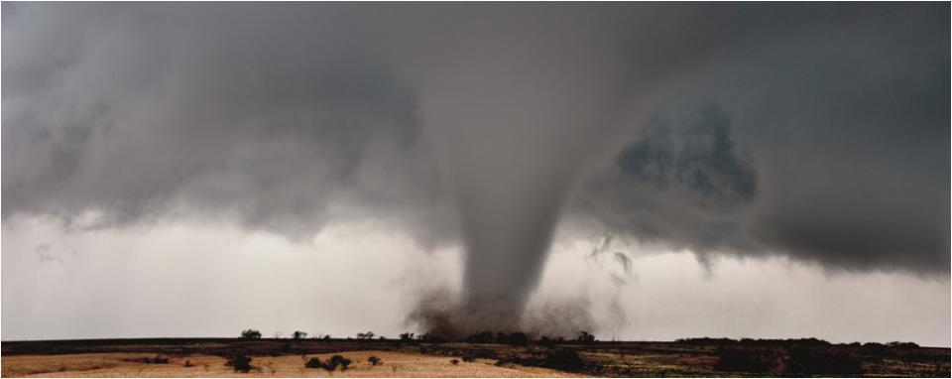
Special Topic:
Convective Storms and Floods
Prof. Dr. Peter Höppe,
Head Geo Risks Research/Corporate Climate Centre,

Slide 42
Convective loss events in the U.S.
Number of events 1980 – 2012 and the half year 2013
Special Topic: Convective Storms and Floods
Number
Loss events caused by straight-line winds, tornadoes, hail, heavy precipitation, flash floods, lightning
Source: Geo Risks Research, NatCatSERVICE – As at July 2013
42

Slide 43
Convective loss events in the U.S.
Overall and insured losses 1980 – 2012 and the half year 2013
Special Topic: Convective Storms and Floods
(bn US$)
Analysis contains: straight-line winds, tornadoes, hail, heavy precipitation, flash floods, lightning.
Overall losses (in 2012 values)
Insured losses (in 2012 values)
Source: Geo Risks Research, NatCatSERVICE – As at July 2013
43

Slide 44
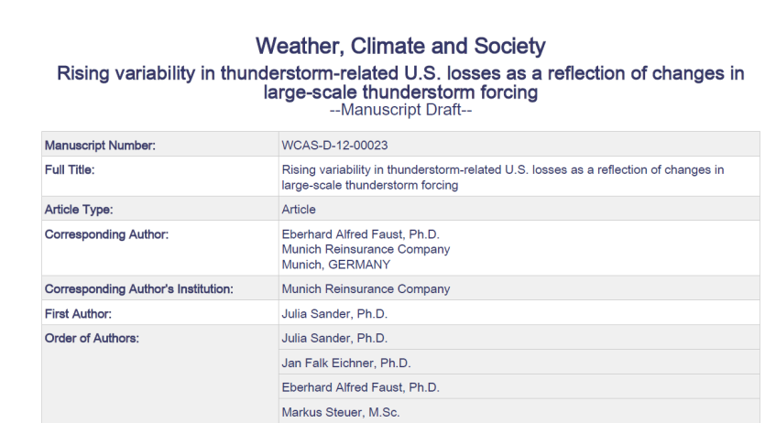
New Munich Re/DLR scientific paper on U.S. Thunderstorm Trends
Special Topic: Convective Storms and Floods
Published online on March 18, 2013
44

Slide 45
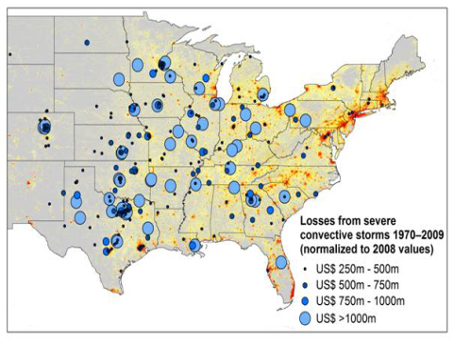
Major Results of New Munich Re Convective Storm Study
Special Topic: Convective Storms and Floods
Study examines convective (hail, tornado, thundersquall and heavy rainfall) events in
the US with losses exceeding US$ 250m in the period 1970–2009 (80% of all losses)
Past losses are normalized to currently exposed values
After normalization there are still increases of losses
Increases are correlated with
the increase in the meteorological
potential for severe thunderstorms
and its variability
For the first time it could be shown
that climatic changes have already
influenced US thunderstorm losses!
45

Slide 46
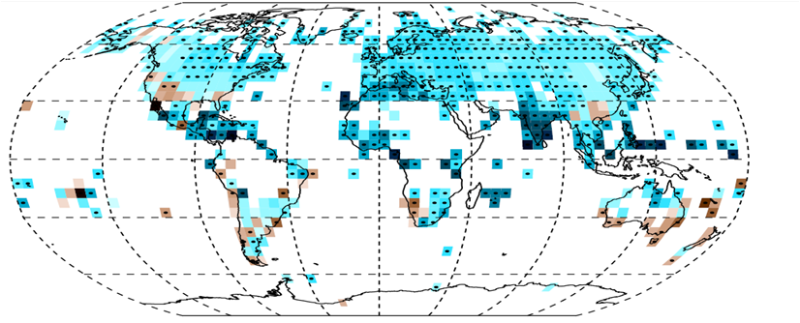
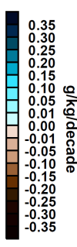
Specific humidity has risen in large parts of northern hemisphere
Special Topic: Convective Storms and Floods
Change in near-surface specific humidity over time in the northern hemisphere
1973–2012 (Source: Willett et. al. (2013), Clim. Past, 9, 657–677.)
Black dots: trends significant at the 95% level
Climate model based studies: Increase has to be expected from anthropogenic climate change
(Willet et al., 2010, Environ. Res. Letter, 5; Santer et al., 2007, PNAS, 104)
46

Slide 47
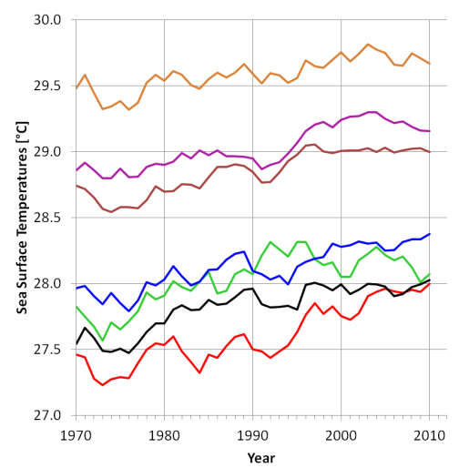
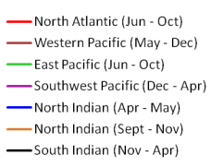
Observed changes in sea surface temperature in tropical ocean basins (1968-2012)
Special Topic: Convective Storms and Floods
Five-year running mean
Source: Munich Re, May 2013.
Data source: HadISST, MetOffice, 2013
47

Slide 48
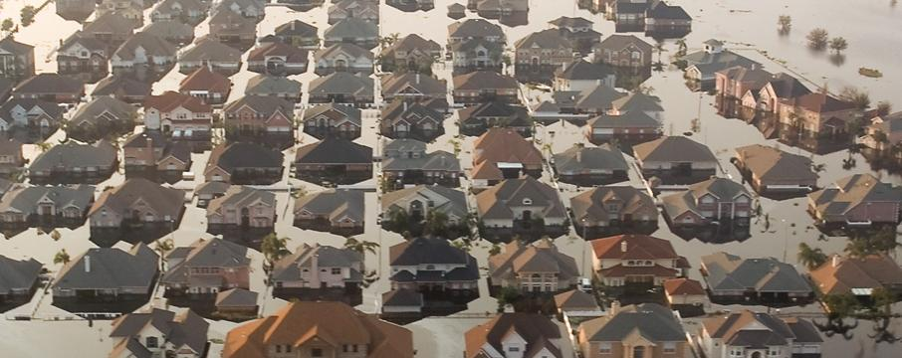
Floods

Slide 49
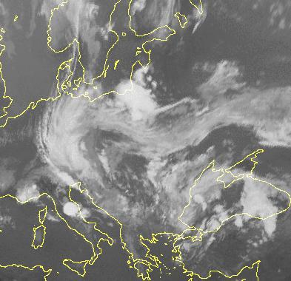
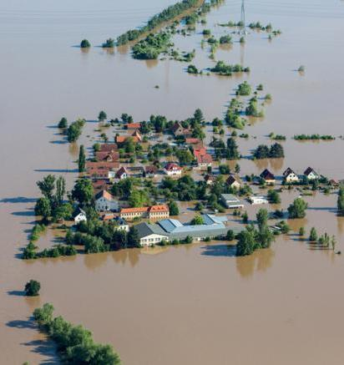
Floods in Europe in May/June 2013
Most probably the most expensive nat cat in Germany!
Special Topic: Convective Storms and Floods
Source: GDV
Region | Overall losses | Insured losses | Fatalities
Germany, Austria, Czech Republic | US$ > 16 bn* | US$ ~3.9 bn* | 22
Source: New York Times
* Loss estimation still ongoing
49

Slide 50
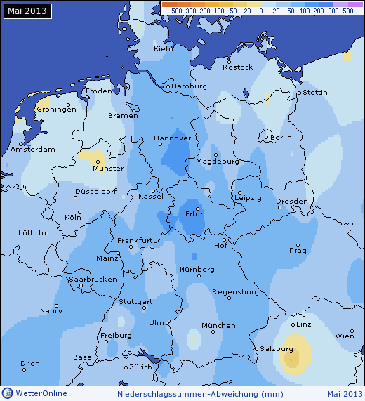
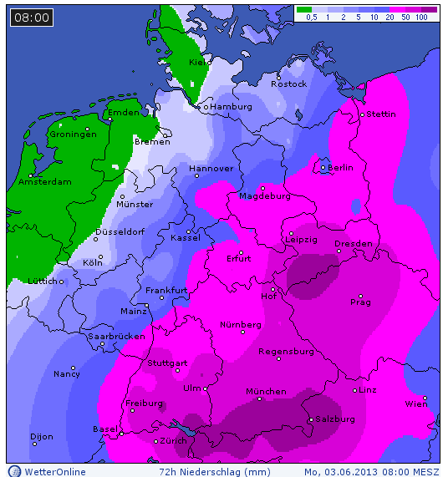
Historical Precipitation and River Gauge Records
Special Topic: Convective Storms and Floods
Precipitation anomalies in May 2013
72 h precipitation sums June1-3, 2013
50

Slide 51
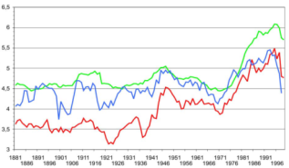
Weather pattern trough over central Europe
Special Topic: Convective Storms and Floods
Weather pattern trough over central Europe
in June - August
The number of days with the weather pattern trough over central Europe has increased (see upper graph)
One reason is that weather patterns in general move more slowly from west to east, leading to a longer persistence (see lower graph)
Scientific findings indicate that climate change driven arctic warming is responsible for the reduced propagation (Francis and Vavrus 2012)
[Days]
Number of days
per year
11-year running mean
Duration of weather patterns
(10-year running mean)
[Days]
year
summer
winter
Data source: Katalog der Grosswetterlagen Europas (1881-2009). PIK Report No. 119.
51

Slide 52
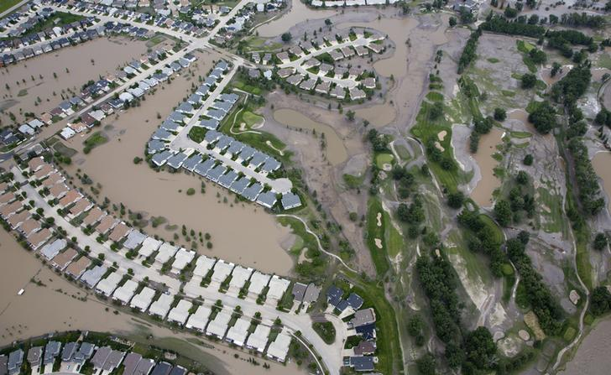
Floods in Calgary Region (Alberta, Canada) June 20-23
Worst flood in documented Canadian history
Special Topic: Convective Storms and Floods
220 mm precipitation
within 36 hours
(= average half year
precipitation),
75,000 people evacuated
Source: Rueters
Region | Overall losses | Insured losses | Fatalities
Canada, Alberta | US$ >3.0bn* | US$ > 1.0bn* | 3
Source: New York Times
* Loss estimation still ongoing
52

Slide 53
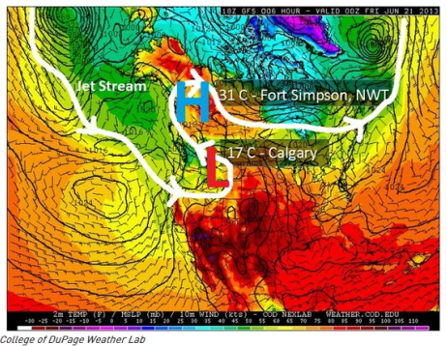
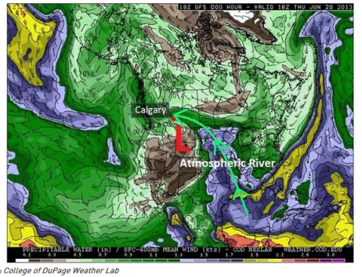
Floods in Calgary Region (Alberta, Canada) June 20-23
Worst flood in Alberta in documented history!
Special Topic: Convective Storms and Floods
A large ridge in the jet stream caused record warmth in Alaska and hot weather across parts of Canada’s north and blocked a strong dip in the jet stream from moving quickly from west to east.
Source: http://www.theweathernetwork.com/news/articles/alberta-floods-why-is-there-so-much-rain/8124/
53

Slide 54
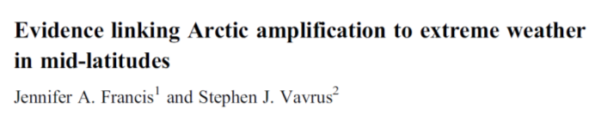
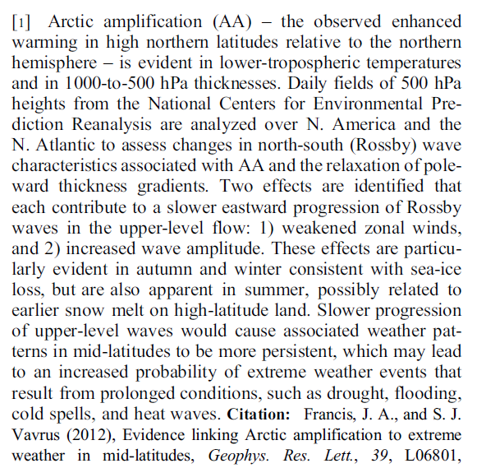
Article
Special Topic: Convective Storms and Floods
, 2012
54

Slide 55
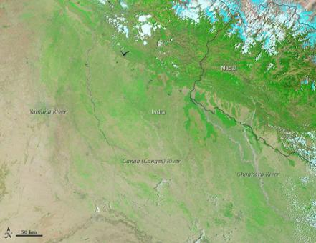
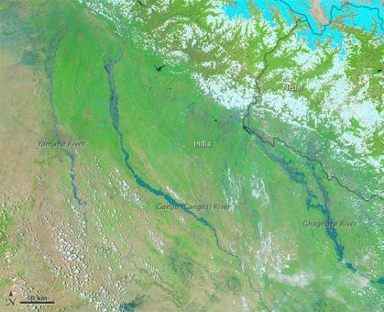
Floods in India June 2013
The deadliest natural catastrophe of first half of 2013!
Special Topic: Convective Storms and Floods
Source: NASA
Source: NASA
Region | Overall losses | Insured losses | Fatalities
India, Uttarakhand | Loss estimation in progress | Loss estimation in progress | 1,056
55

Slide 56
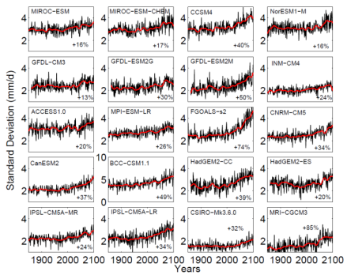
Enhanced future variability during India's rainy season
New climate model simulations
Special Topic: Convective Storms and Floods
Ensemble climate model simulations (for IPCC AR-5) projects significant increases from pre-industrial climate to 2100 in day-to-day rainfall variability
in all the 20 models (see graphic)
and under all four future warming scenarios
(Representative Concentration Pathways
RCP -2.6/-4.5/-6.0/-8.5)
Time series of intra seasonal standard deviation of all India summer monsoon rainfall (June-Sept.) for the strongest future warming scenario (RCP-8.5)
Menon A., et al. (2013): Enhanced future variability during India's rainy season. Geophys. Res. Lett.
56

Slide 57
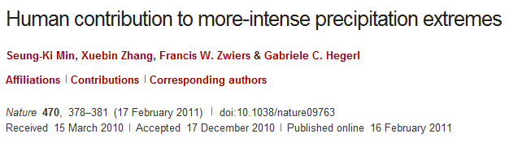
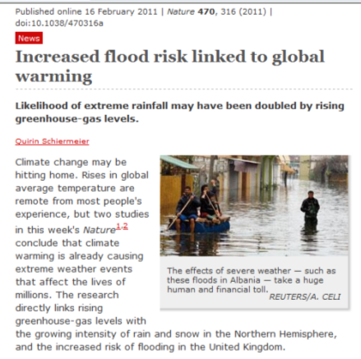
Study shows causal associations between climate change and weather extremes
Special Topic: Convective Storms and Floods
“… Here we show that human-induced increases in greenhouse gases have contributed to the observed intensification of heavy precipitation events found over approximately two-thirds of data-covered parts of Northern Hemisphere land areas. ..Changes in extreme precipitation projected by models and thus the impacts of future changes in extreme precipitation, may be underestimated because models seem to underestimate the observed increase in heavy precipitation with warming”.
57

Slide 58
Market & Financial Impact of Catastrophe Loss:
First Half 2013
Insurance Information Institute
July 9, 2013
Robert P. Hartwig, Ph.D., CPCU, President & Economist
Insurance Information Institute ♦ 110 William Street ♦ New York, NY 10038
Tel: 212.346.5520 ♦ Cell: 917.453.1885 ♦ bobh@iii.org ♦ www.iii.org

Slide 59
P/C Insurance Industry Financial Overview
Industry’s Financial Strength and Overall Performance Improved During the First Half of 2013 in Part Due to Lower Catastrophe Losses
59

Slide 60
P/C Net Income After Taxes
1991–2013:Q1 ($ Millions)
2005 ROE*= 9.6%
2006 ROE = 12.7%
2007 ROE = 10.9%
2008 ROE = 0.1%
2009 ROE = 5.0%
2010 ROE = 6.6%
2011 ROAS¹ = 3.5%
2012 ROAS¹ = 5.9%
2013:Q1 ROAS¹ = 9.6%
2012:Q1 ROAS was 7.2%
Net income is up substantially (+40.9%) from 2012:Q1 $10.2B
ROE figures are GAAP; ¹Return on avg. surplus. Excluding Mortgage & Financial Guaranty insurers yields a 9.7% ROAS in 2013:Q1, 6.2% ROAS in 2012, 4.7% ROAS for 2011, 7.6% for 2010 and 7.4% for 2009.
Sources: A.M. Best, ISO, Insurance Information Institute

Slide 61
Profitability Peaks & Troughs in the P/C Insurance Industry, 1975 – 2013:Q1*
ROE
History suggests next ROE peak will be in 2016-2017
1977:19.0%
1987:17.3%
10 Years
2006:12.7%
1997:11.6%
2013:Q1 9.7%
10 Years
9 Years
2012: 5.9%
1975: 2.4%
1984: 1.8%
1992: 4.5%
2001: -1.2%
*Profitability = P/C insurer ROEs. 2011-13 figures are estimates based on ROAS data. Note: Data for 2008-2013 exclude mortgage and financial guaranty insurers.
Source: Insurance Information Institute; NAIC, ISO, A.M. Best.

Slide 62
A 100 Combined Ratio Isn’t What It
Once Was: Investment Impact on ROEs
A combined ratio of about 100 generates an ROE of ~7.0% in 2012, ~7.5% ROE in 2009/10,
10% in 2005 and 16% in 1979
Combined Ratio / ROE
Catastrophes and lower investment income pulled down ROE in 2012
Combined Ratios Must Be Lower in Today’s Depressed
Investment Environment to Generate Risk Appropriate ROEs
* 2008 -2012 figures are return on average surplus and exclude mortgage and financial guaranty insurers. 2012 combined ratio including M&FG insurers is 103.2, 2011 combined ratio including M&FG insurers is 108.1, ROAS = 3.5%.
Source: Insurance Information Institute from A.M. Best and ISO data.

Slide 63
INVESTMENTS:
THE NEW REALITY
Depressed Yields Will Necessarily Influence Underwriting & Pricing
63

Slide 64
Property/Casualty Insurance Industry Investment Income: 2000–2013*¹
($ Billions)
Investment earnings are running below their 2007 pre-crisis peak
Investment Income Fell in 2012 and is Falling in 2013 Due to Persistently Low Interest Rates, Putting Additional Pressure on (Re) Insurance Pricing
¹ Investment gains consist primarily of interest and stock dividends..
*Estimate based on annualized actual Q1:2013 investment income of $11.385B.
Sources: ISO; Insurance Information Institute.

Slide 65
SURPLUS/CAPITAL/CAPACITY
Industry Claims Paying Capital Stands at or Near Record High as of Mid-2013;
Strength Despite Large Catastrophe Losses in 2011-2012, Including Sandy
65

Slide 66
Policyholder Surplus,
2006:Q4–2013:Q1
Drop due to near-record 2011 CAT losses
2007:Q3
Pre-Crisis Peak
($ Billions)
The Industry now has $1 of surplus for every $0.80 of NPW, close to the strongest claims-paying status in its history.
Surplus as of 3/31/13 stood at a record high $607.7B
*Includes $22.5B of paid-in capital from a holding company parent for one insurer’s investment in a non-insurance business in early 2010.
The P/C Insurance Industry Both Entered and Emerged from the 2012 Hurricane Season Very Strong Financially.
Sources: ISO, A.M .Best.
66
12/01/09 - 9pm
eSlide – P6466 – The Financial Crisis and the Future of the P/C
Notes:
66

Slide 67
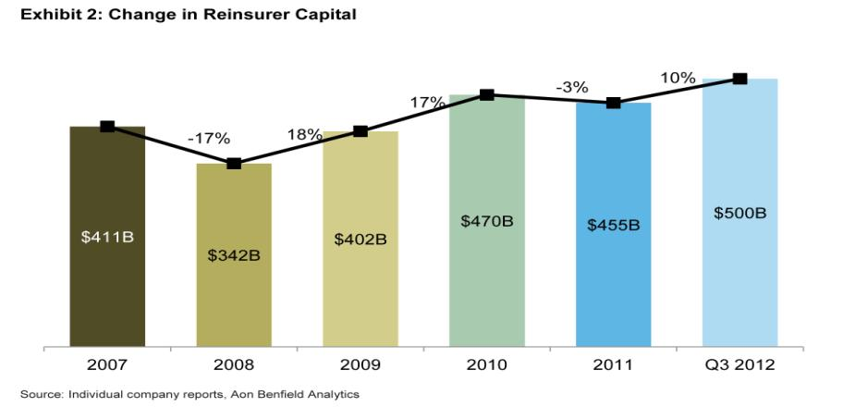
Reinsurance Capital Is at a Record High
Change in Global Reinsurer Capital
Source: Reinsurance Association of America from company reports and Aon Benfield Analytics.

Slide 68
Premium Growth
Catastrophe Losses Impact Trajectory of Premium Growth
68

Slide 69
Net Premium Growth: Annual Change,
1971—2013:Q1
(Percent)
1975-78
1984-87
2000-03
Net Written Premiums Fell 0.7% in 2007 (First Decline Since 1943) by 2.0% in 2008, and 4.2% in 2009, the First 3-Year Decline Since 1930-33.
2013:Q1 growth was +4.1%
Shaded areas denote “hard market” periods
Sources: A.M. Best (historical and forecast), ISO, Insurance Information Institute.

Slide 70
P/C Net Premiums Written: % Change, Quarter vs. Year-Prior Quarter
Premium growth in Q1 2013 was up 4.1% over Q1 2012, marking the 12th consecutive quarter of growth
Sustained Growth in Written Premiums
(vs. the same quarter, prior year) Will Continue through 2013
Sources: ISO, Insurance Information Institute.
70
12/01/09 - 9pm
eSlide – P6466 – The Financial Crisis and the Future of the P/C
Notes:
70

Slide 71
UNDERWRITING
Underwriting Losses in 2012 and 2011 Were Impacted by High Catastrophe Losses
Too Soon to Tell for 2013; Historically Q3 Has the Highest Losses for the US
71

Slide 72
P/C Insurance Industry
Combined Ratio, 2001–2013:Q1*
Relatively Low CAT Losses, Reserve Releases
Higher CAT Losses, Shrinking Reserve Releases, Toll of Soft Market
As Recently as 2001, Insurers Paid Out Nearly $1.16 for Every $1 in Earned Premiums
Heavy Use of Reinsurance Lowered Net Losses
Relatively Low CAT Losses, Reserve Releases
Avg. CAT Losses, More Reserve Releases
Best Combined Ratio Since 1949 (87.6)
Lower CAT Losses Before Sandy
Cyclical Deterioration
* Excludes Mortgage & Financial Guaranty insurers 2008--2012. Including M&FG, 2008=105.1, 2009=100.7, 2010=102.4, 2011=108.1; 2012:=103.2.
Sources: A.M. Best, ISO.

Slide 73
Underwriting Gain (Loss)
1975–2013:Q1*
($ Billions)
Cumulative underwriting deficit from 1975 through 2012 is $510B
Underwriting profit in 2013:Q1 totaled $4.6B
High cat losses in 2011 led to the highest underwriting loss since 2002
Large Underwriting Losses Are NOT Sustainable
in Current Investment Environment
* Includes mortgage and financial guaranty insurers in all years.
Sources: A.M. Best, ISO; Insurance Information Institute.

Slide 74
Combined Ratio Points Associated with Catastrophe Losses: 1960 – 2012*
Catastrophe losses as a share of all losses reached a record high in 2012
Combined Ratio Points
Avg. CAT Loss Component of the Combined Ratio by Decade
1960s: 1.04 1970s: 0.85 1980s: 1.31 1990s: 3.39 2000s: 3.52 2010s: 7.01*
The Catastrophe Loss Component of Private Insurer Losses Has Increased Sharply in Recent Decades
Notes: Private carrier losses only. Excludes loss adjustment expenses and reinsurance reinstatement premiums. Figures are adjusted for losses ultimately paid by foreign insurers and reinsurers.
Source: ISO (1960-2011); A.M. Best (2012E) Insurance Information Institute.

Slide 75
Severe Weather Events: First Half 2013
Natural Catastrophe Activity Has Down from Elevated Levels of First Half 2011-2012
75
Notes:
75

Slide 76

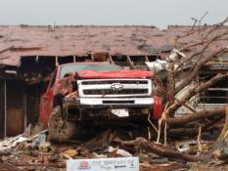
U.S. Tornado Count, 2005-2013*
There were 1,897 tornadoes in the U.S. in 2011 far above average, but well below 2008’s record
2013 count is running well below average
*Through July 6, 2013.
Source: http://www.spc.noaa.gov/wcm/.
76

Slide 77
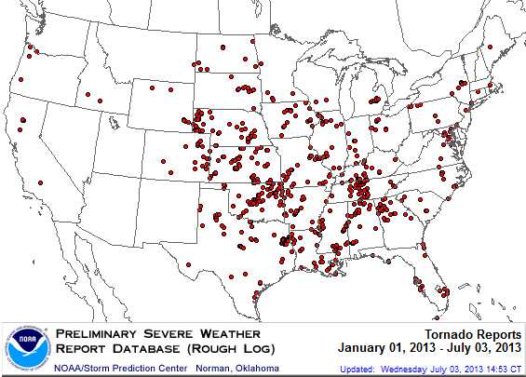
Location of Tornado Reports:
Through July 3, 2013
The storm system that spawned the deadly EF-5 tornado on May 19 in Moore, OK, produced insured losses of $1.575 billion
There were 630 tornadoes through July 3, causing extensive property damage in several states
Source: NOAA Storm Prediction Center; http://www.spc.noaa.gov/climo/online/monthly/2013_annual_summary.html#; PCS.
77

Slide 78
Number of Tornadoes and Related Deaths, 1990 – 2013*
Tornadoes claimed 553 lives in 2011, the most since 1925
628 tornadoes have been recorded so far this year, 44 deaths*
Insured Losses from Tornadoes and Thunderstorms in the First Half of Produced Insured Losses of Approximately $6B.
*Through July 3, 2013.
Source: U.S. Department of Commerce, Storm Prediction Center, National Weather Service at http://www.spc.noaa.gov/climo/online/monthly/newm.html

Slide 79
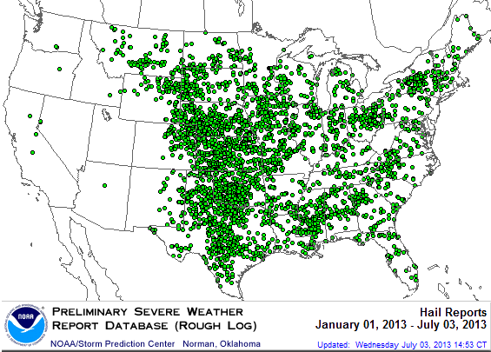
Location of Large Hail Reports:
Through July 3, 2013
Large hail reports were heavily concentrated in the Plains states
There were 3,716 “Large Hail” reports through July 3, causing extensive property and vehicle damage
Source: NOAA Storm Prediction Center; http://www.spc.noaa.gov/climo/online/monthly/2013_annual_summary.html#
79

Slide 80
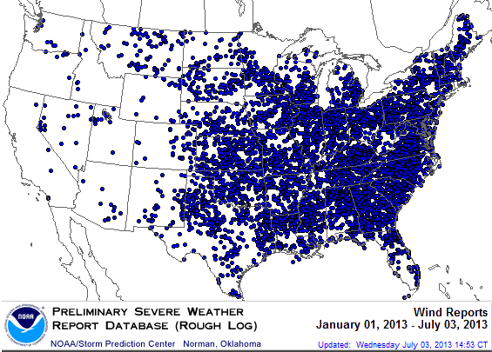
Location of High Wind Reports:
Through July 3, 2013
Wind damage reports were more heavily concentrated in the Southeast
There were 7,371 “Wind Damage” reports through July 3, causing extensive property damage
Source: NOAA Storm Prediction Center; http://www.spc.noaa.gov/climo/online/monthly/2013_annual_summary.html#
80

Slide 81
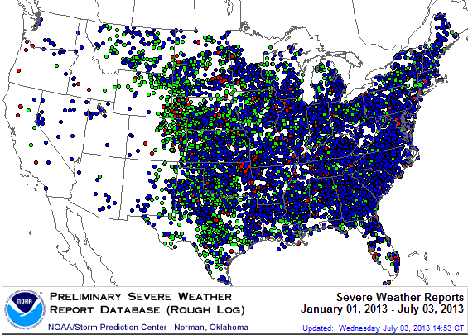
Severe Weather Reports:
Through July 3, 2013
There were 11,717 severe weather reports through July 3; including 630 tornadoes; 3,716 “Large Hail” reports and 7,371 high wind events
Source: NOAA Storm Prediction Center; http://www.spc.noaa.gov/climo/online/monthly/2013_annual_summary.html#
81

Slide 82
Number of Severe Weather Reports in US, by Type, 2013*
Tornadoes accounted for just 5% of all Severe Weather Reports so far in 2013. Tornado and Hail reports are running below average while Wind reports are close to average
*As of July 3, 2013
Source: NOAA Storm Prediction Center; http://www.spc.noaa.gov/climo/online/monthly/2013_annual_summary.html#

Slide 83
OUTLOOK FOR 2013 HURRICANE SEASON: ABOVE AVERAGE ACTIVITY EXPECTED
Hurricanes and Tropical Storms Frequently Drive Some of the Largest Losses Each Year as with Sandy in 2012
83

Slide 84
Outlook for 2013 Hurricane Season:
75% Worse Than Average
Forecast Parameter | Median (1981-2010) | 2013F
Named Storms | 12.0 | 18
Named Storm Days | 60.1 | 95
Hurricanes | 6.5 | 9
Hurricane Days | 21.3 | 40
Major Hurricanes | 2.0 | 4
Major Hurricane Days | 3.9 | 9
Accumulated Cyclone Energy | 92.0 | 165
Net Tropical Cyclone Activity | 103% | 175%
Source: Philip Klotzbach and Dr. William Gray, Colorado State University, June 2013, accessed at http://tropical.atmos.colostate.edu/forecasts/2013/jun2013/jun2013.pdf ; Insurance Information Institute..

Slide 85
Landfall Probabilities for 2013 Hurricane Season: Above Average
 | Average* | 2013F
Entire US East & Gulf Coasts | 52% | 72%
US East Coast Including Florida Peninsula | 31% | 48%
Gulf Coast from Florida Panhandle to Brownsville | 30% | 47%
Caribbean | 42% | 61%
*Average over the past century.
Source: Philip Klotzbach and Dr. William Gray, Colorado State University, June 2013.

Slide 86
Top 12 Most Costly Hurricanes in U.S. History
(Insured Losses, 2012 Dollars, $ Billions)
10 of the 12 most costly hurricanes in insurance history occurred over the past 9 years (2004—2012)
Hurricane Sandy became the 3rd costliest hurricane in US insurance history
Hurricane Irene became the 12th most expensive hurricane in US history in 2011
*PCS estimate as of 4/12/13.
Sources: PCS; Insurance Information Institute inflation adjustments to 2012 dollars using the CPI.

Slide 87
Hurricane Sandy: Claim Payments to Policyholders, by State
($ Thousands)
TOTAL = $18.75 BILLION
At $9.6B and $6.6B, respectively, NY and NJ suffered, by far, the largest losses from Hurricane Sandy
Insurers Will Pay at Least $18.75 Billion to 1.52 Million Policyholders Across 15 States and DC in the Wake of Hurricane Sandy
Sources: Catastrophe loss data is for Catastrophe Serial No. 90 (Oct. 28 – 31, 2012) from PCS as of Jan. 18, 2013; Insurance Information Institute .

Slide 88
Hurricane Sandy: Insured Loss by
Claim Type* ($ Millions)
Total Claim Value = $18.75 Billion*
Although Commercial Lines accounted for only 13% of total claims, they account for 48% of all claim dollars paid. In most hurricanes, Commercial Lines accounts for about 1/3 of insured losses.
*PCS insured loss estimates as of 1/18/13. Catastrophe modeler estimates range up to $25 billion. All figures exclude losses paid by the NFIP.
Source: PCS; Insurance Information Institute.

Slide 89
Hurricane Sandy: Average Claim Payment by Type of Claim
Commercial (i.e., business claims) are more expensive because the value of property is often higher as well as the impact of insured business interruption losses
The average insured flood loss was nearly 8 times larger than the average non-flood insured loss (mostly wind)
Commercial (Business) Claims Were Nearly Seven Times More Expensive than Homeowners Claims; Vehicle Claims Were Unusually Expensive Due to Extensive Flooding
*Includes rental and condo policies (excludes NFIP flood). **Preliminary as of May 14, 2013.
Sources: Catastrophe loss data is for Catastrophe Serial No. 90 (Oct. 28 – 31, 2012) from PCS as of March 2013; Insurance Information Institute.

Slide 90
Total Value of Insured Coastal Exposure in 2012
(2012, $ Billions)
$2.923 trillion insured coastal exposure in New York in 2012
In 2012, New York ranked as the #1 most
exposed state to hurricane loss, overtaking Florida with $2.862 trillion. Texas is very exposed too, and ranked #3 with $1.175 trillion
in insured coastal exposure
The insured value of all coastal property was $10.6 trillion in 2012 , up 20% from $8.9 trillion in 2007 and up 48% from $7.2 trillion in 2004
Source: AIR Worldwide.

Slide 91
Total Potential Home Value Exposure to Storm Surge Risk in 2013*
($ Billions)
Nearly $400 billion in home value is exposed to storm surge in FL
The Value of Homes Exposed to Storm Surge was $1.147 Trillion in 2013.* Only a fraction of this is insured, hence the huge demand for federal aid following major coastal flooding events.
*Insured and uninsured property. Based on estimated property values as of April 2013.
Source: Storm Surge Report 2013, CoreLogic.

Slide 92
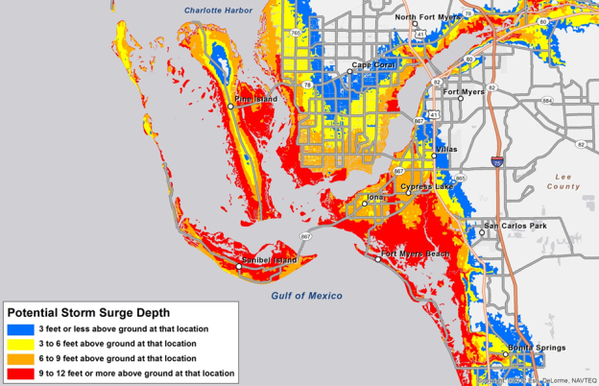


Storm Surge Inundation Graphic
NHC shooting for mid-season for deployment. First of many ways of distributing storm-surge forecasts.

Slide 93
Catastrophe Losses and Public Opinion:
First Half 2013 Poll
Many Americans Don’t Believe It’s Fair to Reflect Higher Catastrophe Losses in Rates; Government Aid Influences Insurance Purchase Decision
93
Notes:
93

Slide 94
I.I.I. Poll: Homeowners Insurance
Q. Do you think that it is fair that people who live in areas affected by record storms in 2011 and 2012 should pay more for their homeowners insurance in the future?
Don’t know
Public believes it is not fair to raise premiums of homeowners due to events they cannot control
No
Yes
Nearly 60 percent of Americans believe that homeowners insurance premiums should not be raised as a result of recent storms in their areas.
Source: Insurance Information Institute Annual Pulse Survey.

Slide 95
I.I.I. Poll: Disaster Preparedness
Q. If you expect some relief from the government, do you purchase less insurance coverage against these natural disasters than you would have otherwise?
Don’t know
Yes
More than 20 percent cut back on insurance coverage in expectation of government disaster aid
No
Seventy-two percent of Americans would not purchase less insurance if they expect some relief from the government—but 22% would.
Source: Insurance Information Institute Annual Pulse Survey.

Slide 96
I.I.I. Poll: Flood Insurance
Q. The federal government plans to raise the price of flood insurance so it reflects the costs of paying claims. Do you believe this is fair?
[% Responding “NO”]
Most people believe it is unfair for government to raise flood insurance premiums, even though they are subsidized by taxpayers
More than one-half of Americans do not think it is fair for the federal government to raise its flood insurance premiums to better reflect claims payouts.
Source: Insurance Information Institute Annual Pulse Survey.

Slide 97
I.I.I. Poll: Disaster Preparedness
Q. Have recent flooding events such as Hurricane Sandy or Hurricane Irene motivated you to buy flood coverage?¹
Despite recent major flood events, few people see the need to buy coverage
Recent storms have not motivated people to buy flood insurance coverag.e
¹Asked of those who have homeowners insurance but not flood insurance.
Source: Insurance Information Institute Annual Pulse Survey.

Slide 98
Insurance Information Institute Online:
www.iii.org
Thank you for your time
and your attention!
Twitter: twitter.com/bob_hartwig

Slide 99

Question and Answer

Slide 100

Press Question and Answer Process
To ask a question, please dial 1 4 on your phone.
An operator will facilitate your participation.
100

Slide 101
More Information
Press Inquiries
Terese Rosenthal
Phone: +1 (609) 243-4339
E-mail: trosenthal@munichreamerica.com
101

Slide 102


NatCatSERVICE Downloadcenter
for statistics and analyses on natural disasters
The downloadcenter provides free access:
Annual statistics
Long-term statistics
Information on significant natural disasters
Focus analyses
NatCatSERVICE methodology, info brochure
Publication Topics Geo
www.munichre.com/natcatservice/downloadcenter/en
102

Slide 103
More Information
 | Connect with Munich Re | Connect with I.I.I.
Twitter | @Munichre_US @Munichre | @iiiorg
LinkedIn | munich-reinsurance-america-inc. | Insurance Information Institute
Google+ | Munich Re (US) Munich Re | Insurance Information Institute
YouTube | MunichReUs MunichReVideo | iiivideo
Facebook | Munichreus1 Munichre | InsuranceInformationInstitute
Flickr |  | iiiorg
103

Slide 104
Thank you very much for attending
July 9, 2013

