Slide 1
Personal Lines P-C Insurance Markets: Trends, Challenges & Opportunities for 2014 & Beyond
NAMIC Personal Lines Seminar
Chicago, IL
March 19, 2014
Download at www.iii.org/presentations
Robert P. Hartwig, Ph.D., CPCU, President & Economist
Insurance Information Institute ♦ 110 William Street ♦ New York, NY 10038
Tel: 212.346.5520 ♦ Cell: 917.453.1885 ♦ bobh@iii.org ♦ www.iii.org

Slide 2
Presentation Outline
Personal Lines Growth Overview
Auto, Home: US and by State
Personal Lines Growth Drivers
Exposure, Pricing Factors
Personal Lines Profitability Analysis
Personal Auto Ad Spend Trends
Catastrophe Loss Trends: US & Local Impacts
Reinsurance Market Overview & Outlook
Cyclical Drivers in Personal Lines
Private Passenger Auto Performance
Distribution Trends
Telematics: Usage-Based Insurance —Trends & Challenges
P/C Financial Overview & Outlook: The Role of Cyclicality
Profitability
Premium Growth
Capital, Capacity and Financial Strength
Underwriting Performance
Low Interest Rates: Impact of Persistent Record Low Yields
Economic Overview: Exposure Drivers
Regulatory Environment “Report Card”
Q&A

Slide 3
Personal Lines Growth Analysis
Growth Trajectories Differ Substantially by Line, by State and Over Time
3

Slide 4
Distribution of Direct Premiums Written by Segment/Line, 2012
Personal/Commercial lines split has been about 50/50 for many years; Personal Lines overtook Commercial Lines in 2010
Pvt. Passenger Auto is by far the largest line of insurance and is currently the most important source of industry profits
Billions of additional dollars in homeowners insurance premiums are written by state-run residual market plans
Distribution Facts
2012
Commercial Lines
$215.9B/47%
Homeowners
$66.8B/15%
Pvt. Pass Auto
$167.9B/37%
Sources: A.M. Best; Insurance Information Institute research.

Slide 5
Auto & Home vs. All Lines, Net Written Premium Growth, 2000–2013P
While homeowners insurance has grown faster than auto over the past decade, auto is generally more profitable
Average 2000-2013P
Auto = 2.8%
Home = 6.2%
All Lines = 3.8%
Sources: A.M. Best (2000-2012); Conning (2013P-2015F); Insurance Information Institute.

Slide 6
Private Passenger Auto Insurance Net Written Premium, 2000–2015F
$ Billion
PP Auto premiums written are recovering from a period of flat growth attributable to the weak economy impacting new vehicle sales, car choice, and increased price sensitivity among consumers
Sources: A.M. Best; Insurance Information Institute.

Slide 7
Commercial Auto Insurance Net Written Premium, 2000–2013P
In contrast to positive PP Auto NPW growth, Commercial Auto premiums fell 21.3% between 2005 and 2011 due to soft market conditions in commercial lines and negative exposure trends, though growth resumed in 2012
$ Billion
Sources: A.M. Best; Insurance Information Institute.

Slide 8
Direct Premiums Written: Auto Percent Change by State, 2007-2012
Top 25 States & DC
ND was the fastest growing state between 2007 and 2012
Sources: SNL Financial LLC; Insurance Information Institute.

Slide 9
Direct Premiums Written: PP Auto Percent Change by State, 2007-2012*
Bottom 25 States
Arizona saw the biggest drop in premiums written between 2007 and 2012
Sources: SNL Financial LC.; Insurance Information Institute.

Slide 10
Homeowners Insurance Net Written Premium, 2000–2015F
$ Billions
Homeowners insurance NWP continues to rise (up 128% 2000-2013) despite very little unit growth during the wake of the real estate crash. Reasons include rate increases, especially in coastal zones, ITV endorsements (e.g., “inflation guards”), and inelastic demand
Sources: A.M. Best; Insurance Information Institute.

Slide 11
Average Premiums For Home Insurance By State, 2011* (1)
Top 25 States and DC
*Latest available.
(1) Based on the HO-3 homeowner package policy for owner-occupied dwellings, 1 to 4 family units. Provides “all risks” coverage (except those specifically excluded in the policy) on buildings and broad named-peril coverage on personal property, and is the most common package written.
Note: Average premium=Premiums/exposure per house years. A house year is equal to 365 days insured coverage for a single dwelling. Source: NAIC; Insurance Information Institute.

Slide 12
Average Premiums For Home Insurance By State, 2011* (1)
Bottom 25 States
Latest available
(1) Based on the HO-3 homeowner package policy for owner-occupied dwellings, 1 to 4 family units. Provides “all risks” coverage (except those specifically excluded in the policy) on buildings and broad named-peril coverage on personal property, and is the most common package written.
Note: Average premium=Premiums/exposure per house years. A house year is equal to 365 days insured coverage for a single dwelling. Source: © 2013 National Association of Insurance Commissioners (NAIC). Reprinted with permission. Further reprint or distribution strictly prohibited without written permission of NAIC.

Slide 13
Estimated Median Rate For Home Insurance By State, 2011* (1)
Top 25 States
Chart answers question: What is the rate to insure the average home in the state?
*Latest available.
(1) Based on the HO-3 homeowner package policy for owner-occupied dwellings, 1 to 4 family units. Provides “all risks” coverage (except those specifically excluded in the policy) on buildings and broad named-peril coverage on personal property, and is the most common package written.
Note: Estimated median = average premium in median insurance range/estimated average insurance value in that range. Source: Insurance Information Institute estimate from NAIC data.

Slide 14
Estimated Median Rate For Home Insurance By State, 2011* (1)
Bottom 25 States and DC
*Latest available.
(1) Based on the HO-3 homeowner package policy for owner-occupied dwellings, 1 to 4 family units. Provides “all risks” coverage (except those specifically excluded in the policy) on buildings and broad named-peril coverage on personal property, and is the most common package written.
Note: Estimated median = average premium in median insurance range/estimated average insurance value in that range. Source: Insurance Information Institute estimate from NAIC data.

Slide 15
Estimated Rate For Median U.S. Home Insurance By State, 2011* (1)
Top 25 States and DC
Answers the question: What rate would be paid to insure the typical U.S. home?
*Latest available.
(1) Based on the HO-3 homeowner package policy for owner-occupied dwellings, 1 to 4 family units. Provides “all risks” coverage (except those specifically excluded in the policy) on buildings and broad named-peril coverage on personal property, and is the most common package written.
Note: Estimated median = average premium in median U.S. insurance range/median U.S. insured value of homes in U.S. Source: Insurance Information Institute estimate from NAIC data.

Slide 16
Estimated Rate For Median U.S. Home Insurance By State, 2011* (1)
Bottom 25 States
*Latest available.
(1) Based on the HO-3 homeowner package policy for owner-occupied dwellings, 1 to 4 family units. Provides “all risks” coverage (except those specifically excluded in the policy) on buildings and broad named-peril coverage on personal property, and is the most common package written.
Note: Estimated median = average premium in median U.S. insurance range/median U.S. insured value of homes in U.S. Source: Insurance Information Institute estimate from NAIC data.

Slide 17
Ratio of Avg. Premium for Homeowners Insurance to Median Family Income, 2011
Top 25 States
(Percent)
*Average homeowners insurance expenditure as a percentage of the 2011 median income for a family of four
Source: Property Insurance Report, February 10, 2014.

Slide 18
Ratio of Avg. Premium for Homeowners Insurance to Median Family Income, 2011
(Percent)
Bottom 25 States
*Average homeowners insurance expenditure as a percentage of the 2011 median income for a family of four
Source: Property Insurance Report, February 10, 2014.

Slide 19
Ratio of Avg. Expenditure for Pvt. Passenger Auto Insurance to Median Family Income, 2011
Top 25 States
(Percent)
*Average auto insurance expenditure as a percentage of the 2011 median income for a family of four
Source: Auto Insurance Report, January 20, 2014.

Slide 20
Ratio of Avg. Expenditure for Pvt. Passenger Auto Insurance to Median Family Income, 2011
(Percent)
Bottom 25 States
*Average auto insurance expenditure as a percentage of the 2011 median income for a family of four
Source: Auto Insurance Report, January 20, 2014.

Slide 21
Personal Lines Growth Drivers: The Economy Is Creating Some Opportunities
Consumer Sentiment is Strong Enough to Propel Auto Sales and Insurable Exposures but Not Homes (Yet)
21

Slide 22
US Real GDP Growth*
The Q4:2008 decline was the steepest since the Q1:1982 drop of 6.8%
Real GDP Growth (%)
Recession began in Dec. 2007. Economic toll of credit crunch, housing slump, labor market contraction was severe
2014/15 are expected to see a modest acceleration in growth
Demand for Insurance Should Increase in 2014/15 as GDP Growth Accelerates Modestly and Gradually Benefits the Economy Broadly
* Estimates/Forecasts from Blue Chip Economic Indicators.
Source: US Department of Commerce, Blue Economic Indicators 3/14; Insurance Information Institute.

Slide 23
Real GDP by State Percent Change, 2012: Highest 25 States
North Dakota was the economic growth juggernaut of the US in 2012—by far
Only 10 states experienced growth in excess of 3%, which is what we would see nationally in a more typical recovery
Sources: US Bureau of Labor Statistics; Insurance Information Institute.

Slide 24
Real GDP by State Percent Change, 2012:
Lowest 25 States
Growth rates in 8 states (and DC) were still below 1% in 2012
Connecticut was the only state to shrink in 2012
Sources: US Bureau of Labor Statistics; Insurance Information Institute.

Slide 25
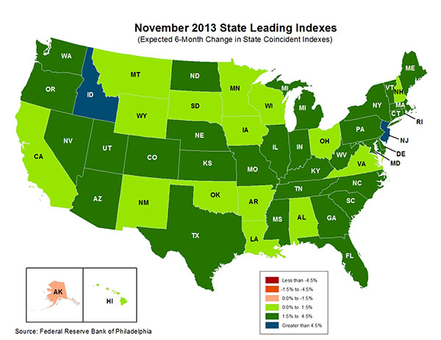
State-by-State Leading Indicators through 2014:Q2
The economic outlook for most of the US is positive for the first time in many years
Sources: Federal Reserve Bank of Philadelphia at http://www.philadelphiafed.org/index.cfm ;Insurance Information Institute.

Slide 26
Consumer Sentiment Survey (1966 = 100)
January 2010 through March 2014
Optimism among consumers dropped in Q3 2013 as the government shutdown created uncertainty, then rebounded though the harsh winter took a toll
Impact of 2011 budget impasse
Consumer confidence has been low for years amid high unemployment, falling home prices and other factors adversely impact consumers, but improved substantially over the past 2+ years, though uncertainty in Washington sometimes takes a toll.
Source: University of Michigan; Insurance Information Institute

Slide 27
Net Worth of Households* Recently Hit A Historic High
2008-09 recession: -15.7%
$ Trillions
Adjusted for population growth, net worth is slightly short of its prior peak
Housing “bubble”
2001 recession
1992 recession
1982 recession
Rising net worth fuels a “wealth affect” that helps fuel consumer spending, which accounts for 70% of spending in the U.S. economy
*and nonprofit organizations. Data are as of year-end, except in 2013:Q3 (data posted on Dec 9, 2013). Next release March 6, 2014. Data not seasonally adjusted or inflation-adjusted Source: Federal Reserve Board

Slide 28
Household Financial Obligations Ratio Recently Hit A Historic Low
Financial Obligations Ratio
Financial Obligations Ratio: debt service (mortgage and consumer debt), auto lease, residence rent, HO insurance, and property tax payments as % of personal disposable income.
Household balance sheets are stronger than they’ve been in many years, setting the stage for more consumer spending
Decline began in 2008:Q1.
15.23% in 2012:Q4 is lowest ratio since 1980:Q4 (15.09%).
*through 2013:Q3 (data posted on Dec 13, 2013) Source: Federal Reserve Board, at http://www.federalreserve.gov/releases/housedebt

Slide 29
Unemployment and Underemployment Rates: Still Too High, But Falling
January 2000 through February 2014, Seasonally Adjusted (%)
U-6 went from 8.0% in March 2007 to 17.5% in October 2009; Stood at 12.6% in Feb. 2014. 8% to 10% is “normal.”
As the unemployment rate approaches 6%, the Fed will begin signaling on short-term rates
“Headline” unemployment was 6.7% in February 2014. 4% to 6% is “normal.”
Stubbornly high unemployment and underemployment constrain overall economic growth, but the job market is now clearly improving.
Source: US Bureau of Labor Statistics; Insurance Information Institute.
29
12/01/09 - 9pm
eSlide – P6466 – The Financial Crisis and the Future of the P/C
Notes:
29

Slide 30
US Unemployment Rate Forecast
2007:Q1 to 2015:Q4F*
Rising unemployment eroded payrolls and WC’s exposure base.
Unemployment peaked at 10% in late 2009.
Jobless figures have been revised slightly downwards for 2014/15
Unemployment forecasts have been revised slightly downwards. Optimistic scenarios put the unemployment as low as 6.0% by Q4 of this year.
* = actual; = forecasts
Sources: US Bureau of Labor Statistics; Blue Chip Economic Indicators (3/14 edition); Insurance Information Institute.

Slide 31
Monthly Change in Private Employment
January 2007 through February 2014 (Thousands, Seasonally Adjusted)
162,000 private sector jobs were created in February
Jobs Created
2013: 2.368 Mill
2012: 2.294 Mill
2011: 2.400 Mill
2010: 1.277 Mill
Monthly losses in Dec. 08–Mar. 09 were the largest in the post-WW II period
Private Employers Added 8.34 million Jobs Since Jan. 2010 After Having Shed 5.01 Million Jobs in 2009 and 3.76 Million in 2008 (State and Local Governments Have Shed Hundreds of Thousands of Jobs)
Source: US Bureau of Labor Statistics: http://www.bls.gov/ces/home.htm; Insurance Information Institute

Slide 32
Cumulative Change in Private Employment: Dec. 2007—Dec. 2013
December 2007 through December 2013 (Millions)
Cumulative job losses as of Dec. 2013 totaled 587,000.
Cumulative job losses peaked at 8.765 million in February 2010
Private Employers Added 8.14 million Jobs Since Jan. 2010 After Having Shed 4.98 Million Jobs in 2009 and 3.80 Million in 2008 (State and Local Governments Have Shed Hundreds of Thousands of Jobs)
Source: US Bureau of Labor Statistics: http://www.bls.gov/ces/home.htm; Insurance Information Institute

Slide 33
Cumulative Change in Private Sector Employment: Jan. 2010—Feb. 2014
January 2010 through February 2014* (Millions)
Job gains and pay increases have added nearly $1 trillion to payrolls since Jan. 2010
Cumulative job gains through Feb. 2014 totaled 8.64 million
Private Employers Added 8.64 million Jobs Since Jan. 2010 After Having Shed 4.98 Million Jobs in 2009 and 3.80 Million in 2008 (State and Local Governments Have Shed Hundreds of Thousands of Jobs)
Source: US Bureau of Labor Statistics: http://www.bls.gov/ces/home.htm; Insurance Information Institute

Slide 34
Unemployment Rates by State, January 2014: Highest 25 States*
In January, 43 states and the District of Columbia had over-the-month unemployment rate decreases, 1 state had an increase, and 6 states had no change.
*Provisional figures for January 2014, seasonally adjusted.
Sources: US Bureau of Labor Statistics; Insurance Information Institute.

Slide 35
Unemployment Rates by State, January 2014:
Lowest 25 States*
In January, 43 states and the District of Columbia had over-the-month unemployment rate decreases, 1 state had an increase, and 6 states had no change.
*Provisional figures for January 2014, seasonally adjusted.
Sources: US Bureau of Labor Statistics; Insurance Information Institute.

Slide 36
Unemployment Rates by Age and Race: 2006, 2010 and 2013
Unemployment among younger workers remains a chronic problem
Unemployment among some minority groups remains far above pre-recession levels
Unemployment Rate (%)
Source: U.S. Bureau of Labor Statistics; Insurance Information Institute.

Slide 37
Personal Lines Growth Drivers
Rate is Presently a Bigger Driver than Exposure
37

Slide 38
Monthly Change* in Auto Insurance Prices, 1991–2014*
Cyclical peaks in PP Auto tend to occur approximately every 10 years (early 1990s, early 2000s and likely the early 2010s)
Pricing peak occurred in late 2010 at 5.3%, falling to 2.8% by Mar. 2012
“Hard” markets tend to occur during recessionary periods
The Jan. 2014 reading of 3.4% down from 4.9% a year earlier
*Percentage change from same month in prior year; through January 2014; seasonally adjusted
Note: Recessions indicated by gray shaded columns.
Sources: US Bureau of Labor Statistics; National Bureau of Economic Research (recession dates); Insurance Information Institutes.
38
12/01/09 - 9pm
eSlide – P6466 – The Financial Crisis and the Future of the P/C
Notes:
38

Slide 39
Monthly Change* in Auto Insurance Prices, January 2005 - December 2013
Pricing weakened in 2011, strengthened in 2012/early 2013 but has since moderated
(Percent Change from same month, prior year)
Auto Insurance Price Increases Averaged 5.1% in 2010 over 2009, After Averaging 4.5% in 2009 over 2008.
PPA Auto, like most p/c lines, exhibits strong cyclicality in pricing. Prices rose from 2000 to late 2005, were flat/falling in 2006 and 2007 before beginning to rise gain in 2008.
Underwriting performance remained strong even when prices were flat or falling due to improvements in underlying frequency and severity trends
* Percentage change from same month in prior year, seasonally adjusted.
Sources: US Bureau of Labor Statistics; Insurance Information Institute

Slide 40
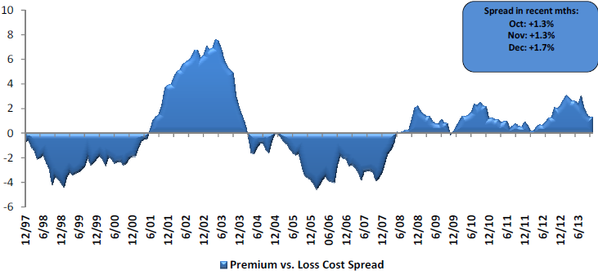
Private Passenger Auto: Premium Growth vs. Loss Cost Spread
Premium growth has generally exceeded underlying loss cost trends since mid-2008
Sources: Evercore Equity Research, Jan. 2014.

Slide 41
Average Expenditures* on Auto Insurance, 1994-2014F
Annual Pct Changes 2001: 5.2% 2002: 8.6% 2003: 5.6%
2004: 1.5% 2005: -1.3% 2006: -1.8% 2007: -2.1% 2008: -1.0% 2009: -0.5% 2010: 0.6% 2011: 0.6%
The average expenditure on auto insurance is lower today than it was in 2004
Across the U.S., auto insurance expenditures fell by 0.8% in 2008 and 0.5% in 2009 but rose 0.5% in 2010 and 0.8% in 2011. I.I.I. estimates for 2012-2014 are each +2.0%.
* The NAIC data are per-vehicle (actually, per car-year)
Sources: NAIC for 1994-2011; Insurance Information Institute estimates for 2012-2014 based on CPI and other data.

Slide 42
Annual Pct. Change in Avg. Expenditures on Auto Insurance, vs. Auto Insurance Prices, 1995-2011
Annual auto insurance price changes, as measured by the BLS, have been 2 to 4 percentage points higher than NAIC data since 2005
Annual auto insurance price changes, as measured by the BLS, roughly matched NAIC expenditure data from 1995-2004
The gap since 2005 between price changes and expenditures on auto insurance might be due to buyers increasing deductibles, obtaining discounts, and other premium-reducing behavior.
Sources: NAIC for 1994-2011; BLS for auto price changes; I.I.I.

Slide 43
Average Expenditures For Auto Insurance By State, 2011
Top 25 States
Note: Average expenditure=Total written premium/liability car years. A car year is equal to 365 days of insured coverage for a single vehicle.
Source: © 2012 National Association of Insurance Commissioners.

Slide 44
Average Expenditures For Auto Insurance By State, 2011
Bottom 25 States
Note: Average expenditure=Total written premium/liability car years. A car year is equal to 365 days of insured coverage for a single vehicle.
Source: © 2012 National Association of Insurance Commissioners.

Slide 45
Ratio of Avg. Expenditure for Pvt. Passenger Auto Insurance to Median Family Income, 2011
Top 25 States
(Percent)
*Average auto insurance expenditure as a percentage of the 2011 median income for a family of four
Source: Auto Insurance Report, January 20, 2014.

Slide 46
Ratio of Avg. Expenditure for Pvt. Passenger Auto Insurance to Median Family Income, 2011
(Percent)
Bottom 25 States
*Average auto insurance expenditure as a percentage of the 2011 median income for a family of four
Source: Auto Insurance Report, January 20, 2014.

Slide 47
Auto/Light Truck Sales, 1999-2019F
Job growth and improved credit market conditions will boost auto sales in 2014 and beyond
(Millions of Units)
New auto/light truck sales fell to the lowest level since the late 1960s. Forecast for 2013-14 is still below 1999-2007 average of 17 million units, but a robust recovery is well underway.
Truck purchases by contractors are especially strong
Car/Light Truck Sales Will Continue to Recover from the 2009 Low Point, Bolstering the Auto Insurer Growth and the Manufacturing Sector Along With Workers Comp Exposures
Source: U.S. Department of Commerce; Blue Chip Economic Indicators (1/14 and 3/13); Insurance Information Institute.

Slide 48
Advertising Expenditures by P/C Insurance Industry, 1999-2012
$ Billions
P/C ad spend hit an all time record high of $6.088 billion in 2012, up 3.5% over 2011. The pace of growth has slowed from 15.8% in 2011 and 23.8% in 2010
P/C ad spending has more than tripled since 2002 (up 256% from 2002-2012)
Source: Insurance Information Institute from consolidated P/C Annual Statement data, Insurance Expense Exhibit (Part I).

Slide 49
Number of Insured Vehicles in the US, 2000-2011*
The Number of Insured Passenger Vehicles Stopped Growing During the Economic Downturn. Growth Has Likely Returned.
*Note: Texas car years are not available
Source: Automobile Insurance Plans Service Office.

Slide 50
Do Changes in Miles Driven Affect Auto Collision Claim Frequency?
Paid Claim Frequency = (No. of paid claims)/(Earned Car Years) x 100
People drover 1.2% fewer miles in 2011 and collision frequency was relatively flat
Sources: Federal Highway Administration (http://www.fhwa.dot.gov/ohim/tvtw/tvtpage.cfm; ISO Fast Track Monitoring System, Private Passenger Automobile Fast Track Data: 1st Qtr. 2012 and earlier reports. *2011 ISO figure is for 12 months ending 12/31/2011; FHA data is for 12 months ending Dec. 2011.

Slide 51
New Private Housing Starts, 1990-2019F
Job growth, low inventories of existing homes, low mortgage rates and demographics should continue to stimulate new home construction for several more years
(Millions of Units)
New home starts plunged 72% from 2005-2009; A net annual decline of 1.49 million units, lowest since records began in 1959
Insurers Are Continue to See Meaningful Exposure Growth in the Wake of the “Great Recession” Associated with Home Construction: Construction Risk Exposure, Surety, Commercial Auto; Potent Driver of Workers Comp Exposure
Source: U.S. Department of Commerce; Blue Chip Economic Indicators (1/14 and 3/13); Insurance Information Institute.

Slide 52
Value of Construction Put in Place, January 2014 vs. January 2013*
Growth (%)
Private: +12.3%
Public: +2.5%
Private sector construction activity is now up in the residential and nonresidential segments
Public sector construction activity remains low but is no longer contracting
Overall Construction Activity is Up, But Growth Is Almost Entirely in the Private Sector as State/Local Government Budget Woes Continue
*seasonally adjusted Source: U.S. Census Bureau, http://www.census.gov/construction/c30/c30index.html ; Insurance Information Institute.

Slide 53
Average Square Footage of Completed New Homes in U.S., 1973-2012
Square Ft
The average size of completed new homes often falls in recessions (yellow bars), but historically bounces back in expansions
The trend toward building larger homes reversed from 2008 - 2010, affecting exposure growth beyond the decline in number of units built. Rising again in 2011-12 and could hit a new record in 2013 or 2014.
The average size of completed new homes fell by 147 square feet (5.75%) from 2008-2010. This was the largest recession-based drop in nearly four decades.
Source: U.S. Census Bureau: https://www.census.gov/construction/chars/completed.html; Insurance Information Institute.
53
Notes:
Typically, builders build smaller houses in recessions, to help make them more affordable
True again in 2009-2010
This means lower insurable values in new homes => lower exposure growth
53

Slide 54
State Population Growth Rate Projections, 2010-2020*
Projected Population Growth
Highest Growth Rate States
Lowest Growth Rate States
U.S. overall: +8.7%
The Mountain West region is projected to grow the most from now to 2020 (up 17.6%), followed by the South Atlantic (up 14.5%) and Pacific (up 11.2%). The Mid-Atlantic is projected to be the slowest-growing region (up 1.9%).
*based on 2000 census. Source: http://www.census.gov/population/www/projections/projectionsagesex.html Table 7
54
12/01/09 - 9pm
eSlide – P6466 – The Financial Crisis and the Future of the P/C
Notes:
54

Slide 55
Average Premium for Home Insurance Policies**
Annual Pct Changes 2001: 5.5% 2002: 10.6% 2003: 12.7%
2004: 9.1% 2005: 4.8% 2006: 5.2% 2007: 2.2% 2008: 1.0% 2009: 6.0% 2010: 3.3% 2011: 7.6%
Across the U.S., home insurance expenditures rose by an estimated 4.0% in 2012-2014
* Insurance Information Institute Estimates/Forecasts **Excludes state-run insurers.
Sources: NAIC; Insurance Information Institute estimates for 2012-2014 based on CPI data and other data.

Slide 56
Interest Rate on Convention 30-Year Mortgages: Headed Back Up, 1990–2014*
Yields on 30-Year Mortgages in the U.S. plunged to all time record lows in late 2012 and early 2013 but have risen as the Fed proceeds with tapering of its QE program
Yields on 30-Year mortgages have been below 6% for a five years
30-yr. mortgage rates are up 80 basis points over the past 12 months
High mortgage interest should have only a marginal impact on home buying
*Monthly, through February 2014. Note: Recessions indicated by gray shaded columns.
Sources: Federal Reserve Bank at http://www.federalreserve.gov/releases/h15/data.htm. National Bureau of Economic Research (recession dates); Insurance Information Institutes.
56
12/01/09 - 9pm
eSlide – P6466 – The Financial Crisis and the Future of the P/C
Notes:
56

Slide 57
Direct Premiums Written: Homeowners Percent Change by State, 2007-2012*
Top 25 States
Sources: SNL Financial LLC.; Insurance Information Institute.

Slide 58
Direct Premiums Written: Homeowners Percent Change by State, 2007-2012*
Bottom 25 States
Sources: SNL Financial LLC.; Insurance Information Institute.

Slide 59
The combined ratios for both personal and commercial lines improved substantially in 2013:H1

Slide 61
Personal Auto Ad Spend Trends
Growth in Ad Spend Remains Robust Among Many Top Auto Insurers
61

Slide 62
Advertising Expenditures by P/C Insurance Industry, 1999-2012
$ Billions
P/C ad spend hit an all time record high of $6.088 billion in 2012, up 3.5% over 2011. The pace of growth has slowed from 15.8% in 2011 and 23.8% in 2010
P/C ad spending has more than tripled since 2002 (up 256% from 2002-2012)
Source: Insurance Information Institute from consolidated P/C Annual Statement data, Insurance Expense Exhibit (Part I).

Slide 63
Advertising Spend Change by Select Personal Auto Writers: 2012 vs. 2011
Percentage Change (%)
Allstate led the industry in 2012 in terms of increase in personal auto ad spend
Overall these carriers spent nearly $4 billion on advertising, up 4% from 2011 and two-thirds the industry total.
Source: SNL Financial; Insurance Information Institute.

Slide 64
Personal Lines Profitability Analysis
Significant Variability and Volatility Over Time and Across States
64

Slide 65
Return on Net Worth: All P-C Lines vs. Homeowners & Pvt. Pass. Auto, 1990-2012*
(Percent)
Average RNW: 1990-2012*
All P-C Lines: 7.7% PP Auto: 8.4% Homeowners: 0.9%**
Hurricane Andrew
Pvt.Pass. Auto Has Consistently Outperformed the P-C Industry as a Whole. Homeowners Volatility is Associated Primarily With Coastal Exposure Issues
*Latest available.
**If 1992, the year of Hurricane Andrew is excluded, the resulting homeowners RNW is 3.4%.
Sources: NAIC; Insurance Information Institute.
65
Notes:
65

Slide 66
Return on Net Worth: All P-C Lines vs. Homeowners & Pvt. Pass. Auto, 1990-2012*
(Percent)
Average RNW: 1990-2012*
All P-C Lines: 7.7% PP Auto: 8.4% Homeowners: 3.4%**
Excluding 1992’s Hurricane Andrew
Pvt.Pass. Auto Has Consistently Outperformed the P-C Industry as a Whole. Homeowners Volatility is Associated Primarily With Coastal Exposure Issues
*Latest available.
**Excludes 1992, the year of Hurricane Andrew. If 1992 is included the resulting homeowners RNW is 0.9%
Sources: NAIC; Insurance Information Institute.
66
Notes:
66

Slide 67
Return on Net Worth: All P-C Lines vs. Pvt. Pass. Auto, 1990-2012*
(Percent)
Average RNW: 1990-2012*
All P-C Lines: 7.7% PP Auto: 8.4%
Pvt.Pass. Auto Profitability Has Exceeded the P-C Industry as a Whole in 13 of the 23 Years from 1990-2012 (Inclusive)
*Latest available.
Sources: NAIC.
67
Notes:
67

Slide 68
Return on Net Worth: All P-C Lines vs. Homeowners, 1990-2012*
(Percent)
Average RNW: 1990-2012*
All P-C Lines: 7.7% Homeowners: 3.4%**
Homeowners Insurance Is Considerably More Volatile than the Market Overall Due to Coastal Exposure and Interior Wind/Hail Events
*Latest available.
**Excluding Hurricane Andrew (1992); Including 1992 produces an average homeowners RNW of 0.9%.
Sources: NAIC.
68
Notes:
68

Slide 69
Return on Net Worth: Pvt. Passenger Auto,
10-Year Average (2003-2012*)
Top 25 States
(Percent)
Hawaii was the most profitable state for auto insurers from 2003-2012
*Latest available.
Sources: NAIC.

Slide 70
Return on Net Worth: Pvt. Passenger Auto,
10-Year Average (2003-2012*)
(Percent)
Bottom 25 States
Michigan was the least profitable state for auto insurers from 2003-2012
*Latest available.
Sources: NAIC

Slide 71
Return on Net Worth: Homeowners Insurance,
10-Year Average (2003-2012*)
Top 25 States
(Percent)
Hawaii was the most profitable state for home insurers from 2003-2012 due to the absence of hurricanes during this period
*Latest available.
Sources: NAIC.

Slide 72
Return on Net Worth: Homeowners Insurance,
10-Year Average (2003-2012*)
Bottom 25 States
(Percent)
Hurricanes Katrina and Rita made Louisiana and Mississippi the least profitable states for home insurers from 2003-2012
*Latest available.
Sources: NAIC

Slide 73
U.S. Insured Catastrophe Loss Update
2013 Was a Welcome Respite from the High Catastrophe Losses in Recent Years
73

Slide 74

U.S. Insured Catastrophe Losses
($ Billions, $ 2012)
2012 was the third most expensive year ever for insured CAT losses
2012 Was the 3rd Highest Year on Record for Insured Losses in U.S. History on an Inflation-Adj. Basis. 2011 Losses Were the 6th Highest. YTD 2013 Running Well Below 2011 and 2012 YTD Totals.
Record tornado losses caused 2011 CAT losses to surge
*Through 12/31/13.
Note: 2001 figure includes $20.3B for 9/11 losses reported through 12/31/01 ($25.9B 2011 dollars). Includes only business and personal property claims, business interruption and auto claims. Non-prop/BI losses = $12.2B ($15.6B in 2011 dollars.)
Sources: Property Claims Service/ISO; Insurance Information Institute.
74
12/01/09 - 9pm
eSlide – P6466 – The Financial Crisis and the Future of the P/C
Notes:
74

Slide 75
Combined Ratio Points Associated with Catastrophe Losses: 1960 – 2013*
Avg. CAT Loss Component of the Combined Ratio by Decade
1960s: 1.04 1970s: 0.85 1980s: 1.31 1990s: 3.39 2000s: 3.52 2010s: 6.1E*
Catastrophe losses as a share of all losses reached a record high in 2012
Combined Ratio Points
The Catastrophe Loss Component of Private Insurer Losses Has Increased Sharply in Recent Decades
*2010s represent 2010-2013.
Notes: Private carrier losses only. Excludes loss adjustment expenses and reinsurance reinstatement premiums. Figures are adjusted for losses ultimately paid by foreign insurers and reinsurers.
Source: ISO (1960-2011); A.M. Best (2012E) Insurance Information Institute.

Slide 76
Top 10 States for Insured Catastrophe Losses, 2013
$ Millions
Oklahoma let the country in insured CAT losses in 2013
Source: The Property Claim Services (PCS) unit of ISO, a Verisk Analytics company.

Slide 77
Top 5 States by Insured Catastrophe Losses in 2012*
(2012, $ Billions)
NY and NJ let the US in CAT losses in 2012 due Sandy
*Includes catastrophe losses of at least $25 million.
Sources: PCS unit of ISO; Insurance Information Institute.

Slide 78
Top States by Inflation-Adjusted Insured Catastrophe Losses, 1983–2012
Over the Past 30 Years Florida Has Accounted for the Largest Share of Catastrophe Losses in the U.S., Followed by Texas and Louisiana
FL is the most costly state for CATs, with nearly $67B in insured losses over the past 30 years
Louisiana
$42.0B
Texas
$48.8B
Rest of the U.S.
$309.9B
Florida
$66.7B
Total: $467.5 Billion, an average of $16.6B per year or $1.3B per month
Source: PCS unit of ISO, Verisk Company.; Insurance Information Institute.

Slide 79
Inflation Adjusted U.S. Catastrophe Losses by Cause of Loss, 1993–2012¹
Wind/Hail/Flood (3), $14.9
Fires (4), $6.5
Other (5), $0.2
Insured cat losses from 1993-2012 totaled $391.7B, an average of $19.6B per year or $1.6B per month
Geological Events, $18.4
Terrorism, $24.8
Winter Storms, $27.8
Hurricanes & Tropical Storms, $158.2
Tornado share of CAT losses is rising
Wind losses are by far cause the most catastrophe losses, even if hurricanes/TS are excluded.
Tornadoes (2), $140.9
Catastrophes are defined as events causing direct insured losses to property of $25 million or more in 2012 dollars.
Excludes snow.
Does not include NFIP flood losses
Includes wildland fires
Includes civil disorders, water damage, utility disruptions and non-property losses such as those covered by workers compensation.
Source: ISO’s Property Claim Services Unit.

Slide 80
Top 16 Most Costly Disasters in U.S. History
(Insured Losses, 2012 Dollars, $ Billions)
Hurricane Sandy became the 5th costliest event in US insurance history
Includes Tuscaloosa, AL, tornado
Includes Joplin, MO, tornado
Hurricane Irene became the 12th most expense hurricane in US history in 2011
12 of the 16 Most Expensive Events in US History Have Occurred Over the Past Decade
*PCS estimate as of 4/12/13.
Sources: PCS; Insurance Information Institute inflation adjustments to 2012 dollars using the CPI.

Slide 81
Top 16 Most Costly World Insurance Losses, 1970-2013*
(Insured Losses, 2012 Dollars, $ Billions)
5 of the top 14 most expensive catastrophes in world history have occurred within the past 3 years (2010-2012)
2012 insured CAT Losses totaled $60B; Economic losses totaled $140B, according to Swiss Re
Hurricane Sandy is now the 6th costliest event in global insurance history
*Figures do not include federally insured flood losses.
**Estimate based on PCS value of $18.75B as of 4/12/13.
Sources: Munich Re; Swiss Re; Insurance Information Institute research.

Slide 82
Top 12 Most Costly Hurricanes in U.S. History
(Insured Losses, 2012 Dollars, $ Billions)
10 of the 12 most costly hurricanes in insurance history occurred over the past 9 years (2004—2012)
Hurricane Sandy became the 3rd costliest hurricane in US insurance history
Hurricane Irene became the 12th most expensive hurricane in US history in 2011
*PCS estimate as of 4/12/13.
Sources: PCS; Insurance Information Institute inflation adjustments to 2012 dollars using the CPI.

Slide 83
Total Value of Insured Coastal Exposure in 2012
(2012, $ Billions)
NY and FL lead the US in the value of insured coastal exposure at $2.9 Trillion
In 2012, New York Ranked as the #1 Most Exposed State to Hurricane Loss, Overtaking Florida with $2.862 Trillion. Texas is very exposed too, and ranked #3 with $1.175 Trillion in insured coastal exposure
The Insured Value of All Coastal Property Was $10.6 Trillion in 2012 , Up 20% from $8.9 Trillion in 2007 and Up 48% from $7.2 Trillion in 2004
Source: AIR Worldwide

Slide 84
Total Value of Insured Coastal Exposure in 2007
(2007, $ Billions)
In 2007, Florida Still Ranked as the #1 Most Exposed State to Hurricane Loss, with $2.459 Trillion Exposure, but Texas is very exposed too, and ranked #3 with $895B in insured coastal exposure
The Insured Value of All Coastal Property Was $8.9 Trillion in 2007, Up 24% from $7.2 Trillion in 2004
Source: AIR Worldwide

Slide 85
Hurricane Sandy: Average Claim Payment by Type of Claim
Commercial (i.e., business claims) are more expensive because the value of property is often higher as well as the impact of insured business interruption losses
The average insured flood loss was nearly 9 times larger than the average non-flood insured loss (mostly wind)
Post-Sandy, the I.I.I. worked very hard to make help media, consumers and regulators understand the distinction between a flood claim and a standard homeowners claim. NFIP is $24B in debt.
*Includes rental and condo policies (excludes NFIP flood). **As of Oct. 31, 2013.
Sources: Catastrophe loss data is for Catastrophe Serial No. 90 (Oct. 28 – 31, 2012) from PCS as of March 2013; Insurance Information Institute.

Slide 86
Total Potential Home Value Exposure to Storm Surge Risk in 2013*
($ Billions)
Florida is by the state most vulnerable to storm surge.
The Value of Homes Exposed to Storm Surge was $1.147 Trillion in 2013.* Only a fraction of this is insured, hence the huge demand for federal aid following major coastal flooding events.
*Insured and uninsured property. Based on estimated property values as of April 2013.
Source: Storm Surge Report 2013, CoreLogic.

Slide 87
Top 10 Winter Storm and Winter Damage Events in the US and Canada, 1980-2013*
Ranked by Insured Loss, in Millions of $ 2013*
Period | Area | Economic Loss (in inflation-adjusted 2013 $US mill) | Insured Loss (in inflation-adjusted 2013 $US mill) | Fatalities
Mar. 11-14, 1993 | CAN, USA | 8,061 | 3,224 | 270
Dec. 17-30,1983 | USA | 2,339 | 2,058 | 500
Apr. 13-17, 2007 | CAN, USA | 2,247 | 1,775 | 23
Dec. 10-13, 1992 | USA | 4,981 | 1,660 | 19
Jan. 5-12, 1998 | CAN, USA | 4,145 | 1,644 | 45
Feb. 10-12, 1994 | USA | 4,716 | 1,258 | 9
Jan. 17-20, 1994 | USA | 1,572 | 1,258 | 70
Apr. 7-11, 2013 | USA | 1,600 | 1,200 | N/A
Jan. 1-4, 1999 | CAN, USA | 1,398 | 1,084 | 25
Jan. 31-Feb. 2, 2011 | USA | 1,346 | 1,010 | 36
*Top 10 events in original insured loss dollars were adjusted to and ranked by the Insurance Information Institute to 2013 inflation-adjusted values.
Sources: Munich Re NatCatSERVICE; Insurance Information Institute.

Slide 88
Winter Storm and Winter Damage Events in the US and Canada, 1980-2013 (2013 US$)
Three of the four most costly years ever for insured losses from winter storms and damage occurred in the 1990s, led by the “Storm of the Century” in 1993.
Insured Losses (Millions, $ 2013)
5-year running average
Insured losses from severe winter events totaled $2 billion in 2013.
Insured winter storm and damage losses in Jan. 2014 already totaled $1.5 billion. Continued severe weather since then makes it likely that 2014 will become one of the top 5 costliest winters since 1980.
Sources: Munich Re NatCatSERVICE; Insurance Information Institute.
88

Slide 89
Insured Homeowners Losses Due to Lightning, 2004-2012
$ Millions
Lightning claims cost insurers an estimated $969 million in 2012, 31.7% from $735.5 million in 2004
The Increased Number and Value of Expensive Electronic Devices in Homes is Pushing the Total Lightning Claim Costs Up Even as the Number of Lightning Claims Falls
Source: Insurance Information Institute.

Slide 90
Insured Homeowners Losses Due Dog Bite Liability Claims, 2003-2012
$ Millions
Dog bite liability claims cost insurers an estimated $489.7 million in 2012, up 51.0% from $324.2 million in 2003
The Increased Average Cost per Dog Bite Claim is Pushing Total Dog Bite Liabiity Claim Costs Higher Even as the Number of Claims Remains Relatively Flat
Source: Insurance Information Institute.

Slide 91
Natural Disaster Losses in the United States, by Type, 2013
As of December 31, 2013 | Number of Events | Fatalities | Estimated Overall Losses (US $m) | Estimated Insured Losses (US $m)
Severe Thunderstorm | 69 | 110 | 16,341 | 10,274
Winter Storm | 11 | 43 | 2,935 | 1,895
Flood | 19 | 23 | 1,929 | 240
Earthquake & Geophysical | 6 | 1 | Minor | Minor
Tropical Cyclone | 1 | 1 | Minor | Minor
Wildfire, Heat, & Drought | 22 | 29 | 620 | 385
Totals | 128 | 207 | 21,825 | 12,794
Source: Munich Re NatCatSERVICE
91
91

Slide 92
Significant Natural Catastrophes, 2013 (Events with $1 billion economic loss and/or 50 fatalities)
Date | Event | Estimated Economic Losses (US $m) | Estimated Insured Losses (US $m)
February 24 – 25 | Winter Storm | 1,300 | 690
March 18 – 19 | Thunderstorms | 2,200 | 1,600
April 7 – 11 | Winter Storm | 1,600 | 1,200
April 16 – 18 | Thunderstorms | 1,100 | 560
May 18 – 20 | Thunderstorms | 3,100 | 1,800
May 28 – 31 | Thunderstorms | 2,800 | 1,400
August 6 – 7 | Thunderstorms | 1,300 | 740
September 9 – 16 | Flooding | 1,500 | 160
November 17 - 18 | Thunderstorms | 1,300 | 931
Source: Munich Re NatCatSERVICE
92

Slide 93
Natural Disasters in the United States, 1980 – 2013 Number of Events (Annual Totals 1980 – 2013)
There were 128 natural disaster events in 2013
Number
22
19
81
6
Geophysical
(earthquake, tsunami,
volcanic activity)
Meteorological (storm)
Climatological
(temperature extremes,
drought, wildfire)
Hydrological
(flood, mass movement)
Source: MR NatCatSERVICE
93

Slide 94
Losses Due to Natural Disasters in the US, 1980–2013
(Overall and Insured Losses)
(2013 Dollars, $ Billions)
2013 CAT Losses
Overall : $21.8B
Insured: $12.8B
Indicates a great deal of losses are uninsured (~40%-50% in the US) = Growth Opportunity
2013 losses were far below 2011 and 2012 and were 44% lower than the average from 2000-2012
Overall losses (in 2012 values)
Insured losses (in 2013 values)
Source: MR NatCatSERVICE
94

Slide 95
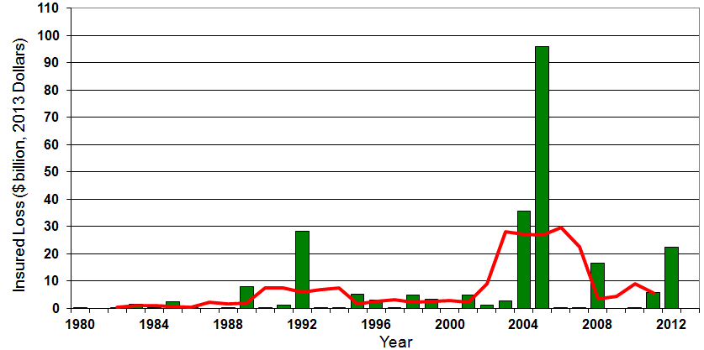

Insured US Tropical Cyclone Losses, 1980 - 2013
The current 5-year average (2008 - 2013) insured tropical cyclone loss is $5.6 billion per year.
Sources: Property Claims Service, Munich Re NatCatSERVICE, NFIP
95

Slide 96
The combined ratios for both personal and commercial lines improved substantially in 2013:H1

Slide 98
Hurricane Sandy: Average Claim Payment by Type of Claim
Commercial (i.e., business claims) are more expensive because the value of property is often higher as well as the impact of insured business interruption losses
The average insured flood loss was nearly 9 times larger than the average non-flood insured loss (mostly wind)
Post-Sandy, the I.I.I. worked very hard to make help media, consumers and regulators understand the distinction between a flood claim and a standard homeowners claim. NFIP is $24B in debt.
*Includes rental and condo policies (excludes NFIP flood). **As of Oct. 31, 2013.
Sources: Catastrophe loss data is for Catastrophe Serial No. 90 (Oct. 28 – 31, 2012) from PCS as of March 2013; Insurance Information Institute.

Slide 99
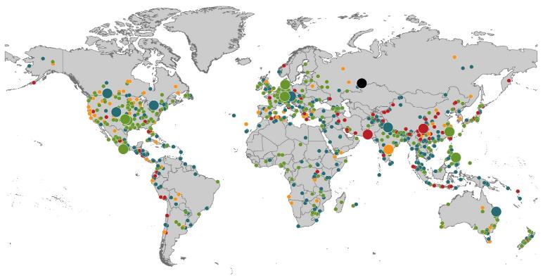
Natural Loss Events:
Full Year 2013 World Map
Winter Storm Christian (St. Jude)
Europe, 27–30 October
Floods
Europe,
30 May–19 June
Meteorite impact
Russian Federation, 15 February
Flash floods
Canada, 8–9 July
Floods
Canada, 19–24 June
Earthquake
China, 20 April
Hailstorms
Germany,
27–28 July
Floods
USA, 9–16 September
Typhoon Fitow
China, Japan,
5–9 October
Severe storms, tornadoes
USA, 18–22 May
Typhoon Haiyan
Philippines,
8–12 November
Severe storms, tornadoes
USA, 28–31 May
Floods
India, 14–30 June
Hurricanes Ingrid & Manuel
Mexico, 12–19 September
Floods
Australia,
21–31 January
880
Loss events
Earthquake (series)
Pakistan, 24–28 September
Heat wave
India, April–June
Geophysical events (earthquake, tsunami, volcanic activity)
Hydrological events (flood, mass movement)
Natural catastrophes
Geophysical events (earthquake, tsunami, volcanic activity)
Hydrological events (flood, mass movement)
Selection of significant
Natural catastrophes
Meteorological events (storm)
Climatological events (extreme temperature, drought, wildfire)
Meteorological events (storm)
Climatological events (extreme temperature, drought, wildfire)
Extraterrestrial events (Meteorite impact)
Source: Munich Re Geo Risks Research, NatCatSERVICE – as of January 2014.
99

Slide 100
Natural Disasters Worldwide, 1980 – 2013 (Number of Events)
There were 880 natural disaster events globally in 2013 compared to 905 in 2012
Number
Geophysical
(earthquake, tsunami,
volcanic activity)
Meteorological (storm)
Climatological
(temperature extremes,
drought, wildfire)
Hydrological
(flood, mass movement)
Source: MR NatCatSERVICE
100

Slide 101
Losses Due to Natural Disasters Worldwide, 1980–2013 (Overall & Insured Losses)
(Overall and Insured Losses)
(2013 Dollars, $ Billions)
10-Yr. Avg. Losses
Overall : $184B
Insured: $56B
2013 Losses
Overall : $125B
Insured: $34B
There is a clear upward trend in both insured and overall losses over the past 30+ years
Overall losses (in 2013 values)
Insured losses (in 2013 values)
Source: MR NatCatSERVICE
101

Slide 102
Federal Disaster Declarations Patterns: 1953-2014
Disaster Declarations Set New Records in Recent Years
102

Slide 103
Number of Federal Major Disaster Declarations, 1953-2014*
There have been 2,153 federal disaster declarations since 1953. The average number of declarations per year is 35 from 1953-2013, though there few haven’t been recorded since 1995.
The number of federal disaster declarations set a new record in 2011, with 99, shattering 2010’s record 81 declarations.
9 federal disasters were declared so far in 2014*
The Number of Federal Disaster Declarations Is Rising and Set New Records in 2010 and 2011 Before Dropping in 2012/13
*Through March 2, 2014.
Source: Federal Emergency Management Administration; http://www.fema.gov/disasters; Insurance Information Institute.

Slide 104
Federal Disasters Declarations by State, 1953 – 2014: Highest 25 States*
Over the past 60 years, Texas has had the highest number of Federal Disaster Declarations
*Through March 2, 2014. Includes Puerto Rico and the District of Columbia.
Source: FEMA: http://www.fema.gov/news/disaster_totals_annual.fema; Insurance Information Institute.

Slide 105
Federal Disasters Declarations by State, 1953 – 2014: Lowest 25 States*
Over the past 60 years, Wyoming and Rhode Island had the fewest number of Federal Disaster Declarations
*Through March 2, 2014. Includes Puerto Rico and the District of Columbia.
Source: FEMA: http://www.fema.gov/news/disaster_totals_annual.fema; Insurance Information Institute.

Slide 106
SEVERE WEATHER REPORT UPDATE: 2013
Damage from Tornadoes, Large Hail and High Winds Keep Insurers Busy
106

Slide 107
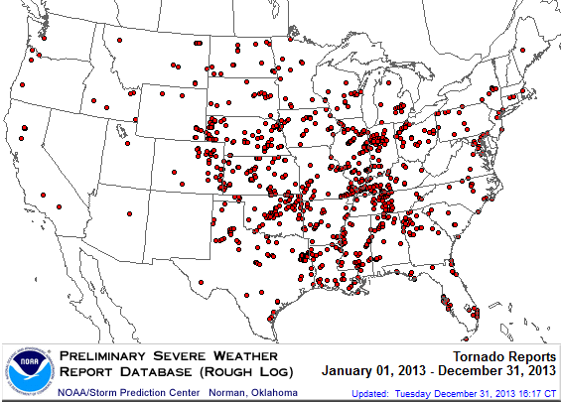
Location of Tornado Reports in 2013
A deadly EF-5 tornado in May in Moore, OK, produced insured losses of $1.575 billion. November tornadoes in the Midwest like produced $1B in insured losses.
There were 943 tornadoes through Dec. 31, causing extensive property damage in several states
Source: NOAA Storm Prediction Center; http://www.spc.noaa.gov/climo/online/monthly/2013_annual_summary.html#; PCS.
107

Slide 108
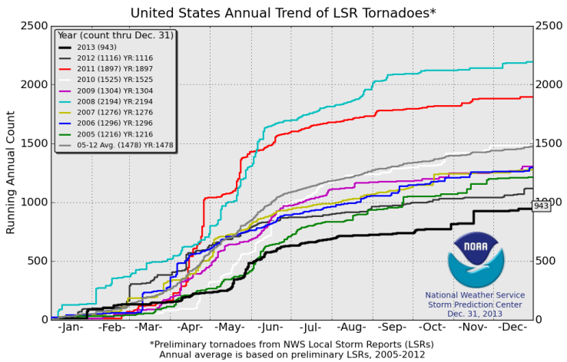
U.S. Tornado Count, 2005-2013*
There were 1,897 tornadoes in the U.S. in 2011 far above average, but well below 2008’s record
2013 count was the lowest in a decade
*Through Dec. 31, 2013.
Source: http://www.spc.noaa.gov/wcm/.
108

Slide 109
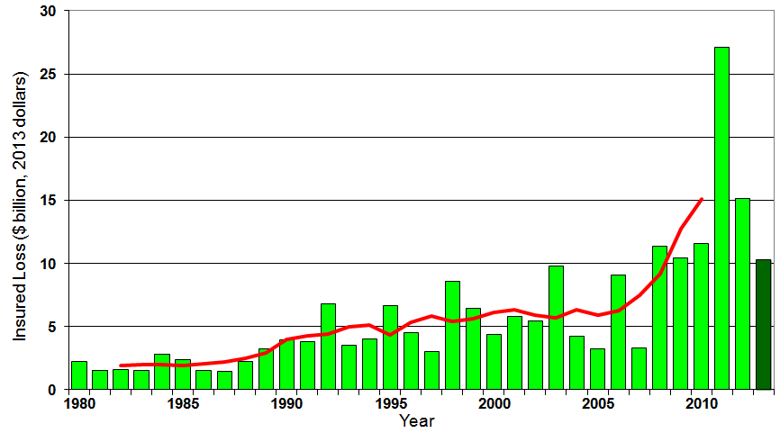
U.S. Thunderstorm Insured Loss Trends, 1980 – 2013
Hurricanes get all the headlines, but thunderstorms are consistent producers of large scale loss. 2008-2013 are the most expensive years on record.
Average thunderstorm losses are up 7 fold since the early 1980s. The 5-year running average loss is up sharply
Thunderstorm losses in 2013 totaled $10.3 billion, the 6th highest on record
Source: Property Claims Service, and MR NatCatSERVICE
109

Slide 110
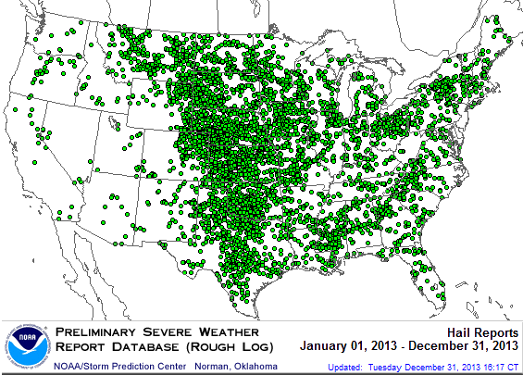
Location of Large Hail Reports: 2013
There were 5,457 “Large Hail” reports in 2013, causing extensive property and vehicle damage
Source: NOAA Storm Prediction Center; http://www.spc.noaa.gov/climo/online/monthly/2013_annual_summary.html#
110

Slide 111
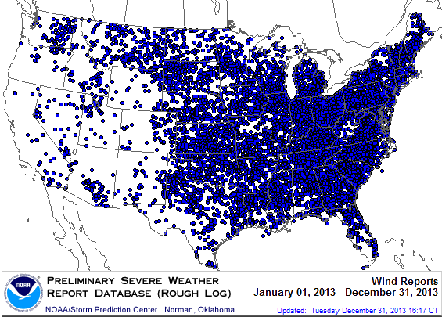
Location of High Wind Reports: 2013
There were 12,942 “Wind Damage” in 2013, causing extensive property damage
Source: NOAA Storm Prediction Center; http://www.spc.noaa.gov/climo/online/monthly/2013_annual_summary.html#
111

Slide 112
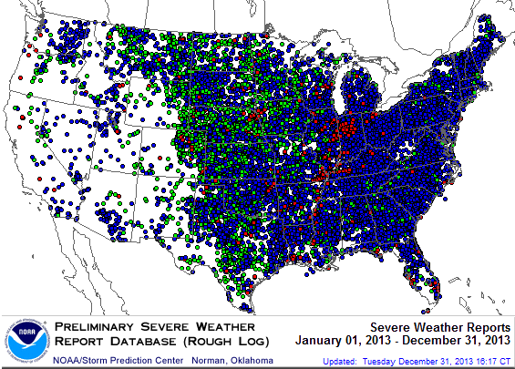
Severe Weather Reports: 2013
Severe weather reports are concentrated east of the Rockies
There were 19,342 severe weather reports in 2013; including 942 tornadoes; 5,457 “Large Hail” reports and 12,942 high wind events
Source: NOAA Storm Prediction Center; http://www.spc.noaa.gov/climo/online/monthly/2013_annual_summary.html#
112

Slide 113
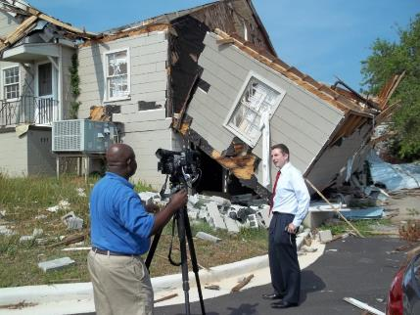
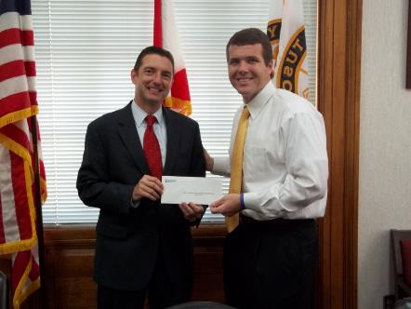

Insurers Making a Difference in Impacted Communities
Destroyed home in Tuscaloosa. Insurers will pay some 165,000 claims totaling $2 billion in the Tuscaloosa/ Birmingham areas alone.
Presentation of a check to Moore, OK, Public School Relief Fund
Presentation of a check to Tuscaloosa Mayor Walt Maddox to the Tuscaloosa Storm Recovery Fund
Source: Insurance Information Institute
113

Slide 114
Underwriting Trends: Lower Catastrophes Contributed Better Results in 2013
114

Slide 115
P/C Insurance Industry Combined Ratio, 2001–2013:Q3*
Relatively Low CAT Losses, Reserve Releases
Higher CAT Losses, Shrinking Reserve Releases, Toll of Soft Market
As Recently as 2001, Insurers Paid Out Nearly $1.16 for Every $1 in Earned Premiums
Heavy Use of Reinsurance Lowered Net Losses
Relatively Low CAT Losses, Reserve Releases
Avg. CAT Losses, More Reserve Releases
Best Combined Ratio Since 1949 (87.6)
Sandy Impacts
Cyclical Deterioration
Lower CAT Losses
* Excludes Mortgage & Financial Guaranty insurers 2008--2012. Including M&FG, 2008=105.1, 2009=100.7, 2010=102.4, 2011=108.1; 2012:=103.2; 2013:Q3 = 95.8.
Sources: A.M. Best, ISO.

Slide 116
Number of Years with Underwriting Profits by Decade, 1920s–2010s
Number of Years with Underwriting Profits
Underwriting Profits Were Common Before the 1980s (40 of the 60 Years Before 1980 Had Combined Ratios Below 100) – But Then They Vanished. Not a Single Underwriting Profit Was Recorded in the 25 Years from 1979 Through 2003
* 2009 combined ratio excl. mort. and finl. guaranty insurers was 99.3, which would bring the 2000s total to 4 years with an u/w profit.
**Data for the 2010s is for the period 2010 through 2013.
Note: Data for 1920–1934 based on stock companies only.
Sources: Insurance Information Institute research from A.M. Best Data.
116
12/01/09 - 9pm
eSlide – P6466 – The Financial Crisis and the Future of the P/C
Notes:
116

Slide 117
Underwriting Gain (Loss) 1975–2013:Q3*
Underwriting profit in 2013:Q3 totaled $10.5B
($ Billions)
Cumulative underwriting deficit from 1975 through 2012 is $510B
High cat losses in 2011 led to the highest underwriting loss since 2002
Large Underwriting Losses Are NOT Sustainable in Current Investment Environment
* Includes mortgage and financial guaranty insurers in all years.
Sources: A.M. Best, ISO; Insurance Information Institute.

Slide 118
Combined Ratios by Predominant Business Segment, 2013:9M vs. 2012:9M*
The combined ratios for both personal and commercial lines improved substantially through 2013:Q3
(Percent)
*Excludes mortgage and financial guaranty insurers.
Source: ISO/PCI; Insurance Information Institute

Slide 119
P/C Reserve Development, 1992–2015E
Note: 2005 reserve development excludes a $6 billion loss portfolio transfer between American Re and Munich Re. Including this transaction, total prior year adverse development in 2005 was $7 billion. The data from 2000 and subsequent years excludes development from financial guaranty and mortgage insurance.
Sources: A.M. Best, ISO, Barclays Research (estimates).

Slide 120
P/C Estimated Loss Reserve Deficiency/ (Redundancy), Excl. Statutory Discount
Line of Business | 2012
Personal Auto Liability | -$3.9B
Homeowners | -$0.4
Other Liab (incl. Prod Liab) | $7.5
Workers Compensation | $11.1
Commercial Multi Peril | $1.9
Commercial Auto Liability | $0.7
Medical Malpractice | -$3.5
Reinsurance—Nonprop Assumed | $1.0
All Other Lines* | -$4.6
Total Core Reserves | $9.8
Asbestos & Environmental | $11.2
Total P/C Industry | $21.0B
Source: A.M. Best, P/C Review/Preview 2014; Insurance Information Institute. *Excluding mortgage and financial guaranty segments.

Slide 121
SURPLUS/CAPITAL/CAPACITY
2013 Recorded Yet Another Record High
121

Slide 122
Policyholder Surplus, 2006:Q4–2013:Q3
Drop due to near-record 2011 CAT losses
($ Billions)
2007:Q3 Pre-Crisis Peak
Surplus as of 9/30/13 stood at a record high $624.4B
The industry now has $1 of surplus for every $0.78 of NPW, close to the strongest claims-paying status in its history.
2010:Q1 data includes $22.5B of paid-in capital from a holding company parent for one insurer’s investment in a non-insurance business .
The P/C insurance industry entered 2014 in very strong financial condition.
Sources: ISO, A.M .Best.
122
12/01/09 - 9pm
eSlide – P6466 – The Financial Crisis and the Future of the P/C
Notes:
122

Slide 123
US Policyholder Surplus: 1975–2013*
($ Billions)
Surplus as of 9/30/13 was a record $624.4, up 6.4% from $586.9 of 12/31/12, and up 42.9% ($187.3B) from the crisis trough of $437.1B at 3/31/09. Pre-crisis peak was $521.8 as of 9/30/07. Surplus as of 9/30/13 was 19.7% above 2007 peak.
“Surplus” is a measure of underwriting capacity. It is analogous to “Owners Equity” or “Net Worth” in non-insurance organizations
The Premium-to-Surplus Ratio Stood at $0.78:$1 as of 9/30/13, a Near Record Low (at Least in Recent History)*
* As of 9/30/13.
Source: A.M. Best, ISO, Insurance Information Institute.

Slide 124
Performance by Segment: Personal Lines
124
Notes:
124

Slide 125
Private Passenger Auto Combined Ratio: 1993–2015F
Private Passenger Auto Accounts for 34% of Industry Premiums and Remains the Profit Juggernaut of the P/C Insurance Industry
Sources: A.M. Best (1990-2014F);Conning (2015F); Insurance Information Institute.

Slide 126
Homeowners Insurance Combined Ratio: 1990–2015F
Hurricane Andrew
Record tornado activity
Hurricane Sandy
Hurricane Ike
Homeowners Performance in 2011/12 Impacted by Large Cat Losses. Extreme Regional Variation Can Be Expected Due to Local Catastrophe Loss Activity
Sources: A.M. Best (1990-2014F);Conning (2015F); Insurance Information Institute.

Slide 127
Homeowners Multi-Peril Loss & ALAE Ratio, 2012: Highest 25 States
KY hit by tornadoes in March and April and by ‘super derecho’ in June; Sandy struck NJ; wildfires ungulfed CO
Sources: SNL Financial; Insurance Information Institute.

Slide 128
Homeowners Multi-Peril Loss & ALAE Ratio, 2012: Lowest 25 States and DC
HI and ND had the best performances in 2012 due to the absence of catastrophes. Hail-fearing ND had best year since at least 1996.
Sources: SNL Financial; Insurance Information Institute.

Slide 129
Cycle Drivers
The Role of Losses and Reserves in the Underwriting Cycle
129

Slide 130
PP Auto Liability: Loss and LAE vs. Net Premiums Written, 1990-2012
Historically, losses drive premium growth (which is primarily driven by rate)
While Premium Growth Decelerated, the Driver Was Primarily Lower Losses, Allowing Auto Insurers to Maintain Strong Margins
Source: A.M. Best; Insurance Information Institute

Slide 131
REINSURANCE MARKET CONDITIONS
Ample Capacity as Alternative Capital is Transforming the Market
131

Slide 132
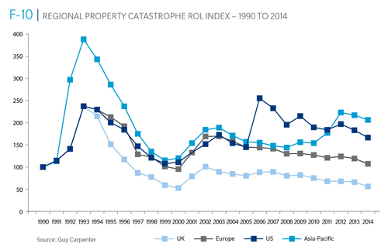
Reinsurance Pricing: Rate-on-Line Index by Region, 1990 – 2014*
Lower CATs and a flood of new capital has pushed reinsurance pricing down in most regions, including the US
*As of Jan. 1.
Source: Guy Carpenter

Slide 133
Global Reinsurer Capital, 2007-2013:H1*
($ Billions)
+11%
+1%
+18%
-3%
+18%
-17%
Global Reinsurance Capital Has Been Trending Generally Upward Since the Global Financial Crisis, a Trend that Seems Likely to Continue
*Includes both traditional and non-traditional forms of reinsurance capital.
Source: Aon Benfield Aggregate study for the 6 months ending June 2013; Insurance Information Institute.

Slide 134
Long-Term Evolution of Shareholders’ Funds for the Guy Carpenter Global Reinsurance Composite
Source: Guy Carpenter

Slide 135
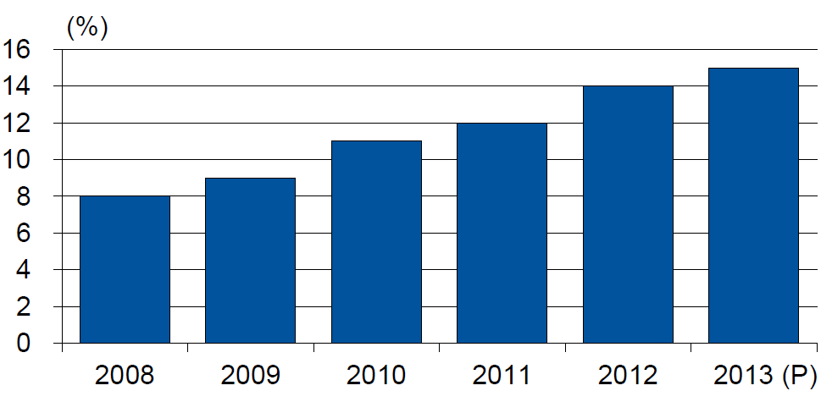
Alternative Capacity as a Percentage of Global Property Catastrophe Reinsurance Limit
(As of Year End)
Alternative Capacity accounted for approximately 14% or $45 billion of the $316 in global property catastrophe reinsurance capital as of mid-2013 (expected to rise to ~15% by year-end 2013)
Source: Guy Carpenter

Slide 136
Property Catastrophe Reinsurance Capacity by Source as of Mid-2013 ($ Bill)
Total = $316 Billion*
“Convergence Capital” accounted for an estimated $45B or 14% or total property catastrophe reinsurance capacity as of mid-2013, up $10B over the past 18 months (since 1/1/12). Penetration of this type of capacity is growing
Collateralized reinsurance (sidecars) is the fastest growing segment recently
Source: Guy Carpenter; Mid-Year Market Report, September 2013; Insurance Information Institute.

Slide 137
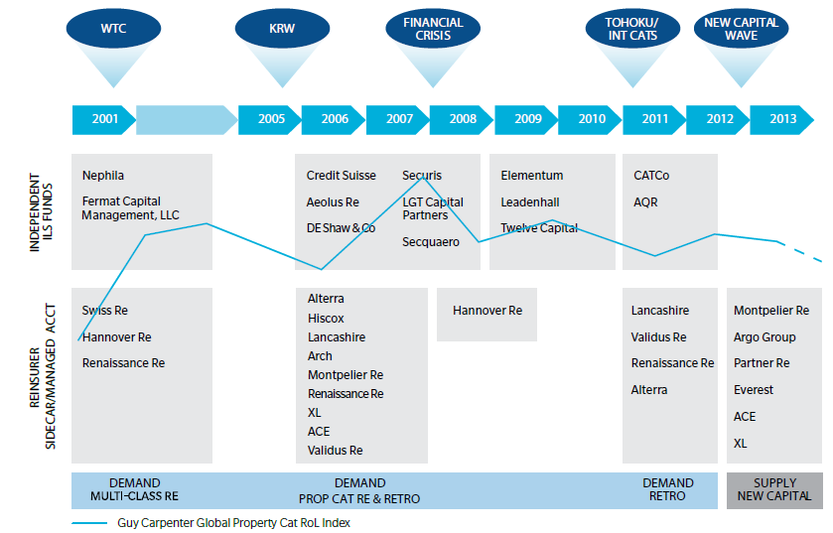
Alternative Capacity Development, 2001—2013:H1
Source: Guy Carpenter; Mid-Year Market Report, September 2013; Insurance Information Institute.

Slide 138
Non-Traditional Property Catastrophe Limits by Type, YE 2012 vs. YE 2015E
Alternative capital is expected to rise by 30% by YE 2015 and will ultimately account for 20-30% of total reinsurance spend, according to Guy Carpenter
Source: Guy Carpenter; Reinsurance Association of America; Insurance Information Institute.

Slide 139
Catastrophe Bonds: Issuance and Outstanding, 1997- 2013*
Risk Capital Amount ($ Millions)
Risk capital outstanding reached a record high in 2013
Financial crisis depressed issuance
CAT bond issuance reached a record high in 2013
Catastrophe Bond Issuance Is Approaching Pre-Crisis Levels While Risk Capital Outstanding Stands at an All-Time Record
*Through Dec. 31, 2013.
Source: Guy Carpenter; Insurance Information Institute.

Slide 140
Claim Trends in Auto Insurance
Rising Costs Held in Check by Falling Frequency:
Can That Pattern Be Sustained?
140

Slide 141
Bodily Injury: Severity Trend Is Up, Frequency Decline Ended and Is Now Flat
Annual Change, 2005 through 2013*
Cost Pressures Will Increase if BI Severity Increases Continue or Frequency Ticks Up
*2013 figure is for the 4 quarters ending with 2013:Q3.
Source: ISO/PCI Fast Track data; Insurance Information Institute

Slide 142
Property Damage Liability: Severity is Up, Frequency Nearly Flat Since 2008
Annual Change, 2005 through 2013*
Severity/Frequency Trends Have Been Volatile, But Rising Severity since 2011 Is a Concern
*2013 figure is for the 4 quarters ending with 2013:Q3.
Source: ISO/PCI Fast Track data; Insurance Information Institute

Slide 143
No-Fault (PIP) Liability: Adverse Trends May Be Moderating*
Annual Change, 2005 through 2013**
Multiple States Have Experienced Severe Fraud and Abuse Problems in their No-Fault Systems, Especially FL, MI, NY and NJ
*No-fault states included are: FL, HI, KS, KY, MA, MI, MN, NY, ND and UT.
**2013 figure is for the 4 quarters ending in 2013:Q3.
Source: ISO/PCI Fast Track data; Insurance Information Institute

Slide 144
Collision Coverage: Severity & Frequency Trends Are Both Higher in 2013*
Annual Change, 2005 through 2013*
The Recession, High Fuel Prices Helped Temper Frequency and Severity, But this Trend Will Likely Be Reversed Based on Evidence from Past Recoveries
*2013 figure is for the 4 quarters ending with 2013:Q3.
Source: ISO/PCI Fast Track data; Insurance Information Institute

Slide 145
Comprehensive Coverage: Severity Trends Are Unfavorable
Severe weather is a principal cause of the spike in both frequency and severity in 2011
Annual Change, 2005 through 2013*
Weather Creates Volatility for Comprehensive Coverage
*2013 figure is for the 4 quarters ending with 2013:Q3.
Source: ISO/PCI Fast Track data; Insurance Information Institute

Slide 146
Questionable Claims:
On the Rise
Fraud Concerns:
More Questionable Claims in Most State and Across Most Lines of Insurance
146

Slide 147
Questionable Claims, Top 10 Loss States, All Lines: 2010–2012
California had the largest number of Questionable Claims in 2012, but Maryland led the way in growth, with the number of QCs up by 72.9% from 2010 to 2012
(Number of Questionable Claims)
+28.3%
IL saw a 0.8% increase in questionable claims from 2010 to 2012, one of the slowest growing states
+22.6%
+37.9%
+29.1%
+72.9%
+39.3%
+37.1%
+0.8
+53.3
+50.0
Source: National Insurance Crime Bureau, ForeCAST Report, May 10, 2013; Insurance Information Institute

Slide 148
Total Number of Questionable Claims by State, 2012: Highest 25 States
California had the largest number of Questionable Claims in 2012
Sources: NICB; Insurance Information Institute.

Slide 149
Total Number of Questionable Claims by State, 2012: Highest 25 States
North Dakota had the fewest number of Questionable Claims in 2012
Sources: NICB; Insurance Information Institute.

Slide 150
Total Number of Questionable Claims by State, per 100K Persons, 2012: Highest 25 States
DC followed by Maryland California had the highest rate of Questionable Claims in 2012
Sources: NICB; Insurance Information Institute.

Slide 151
Total Number of Questionable Claims by State, per 100K Persons, 2012: Lowest 25 States
North and South Dakota had the lowest rate of Questionable Claims in 2012
Sources: NICB; Insurance Information Institute.

Slide 152
Questionable Claims, Top 10 Loss Cities, All Lines: 2010–2012
New York City had the largest number of Questionable Claims in 2012, but Miami and Baltimore led the way in growth, with the number of QCs nearly doubling from 2010 to 2012
(Number of Questionable Claims)
+28.5%
+55.1%
Philadelphia saw a 63.8% increase in questionable claims from 2010 to 2012, one of the fastest growing states
+93.2%
+18.7%
+99.0%
+19.8%
-27.7%
+63.8
+82.8
+1.2
Source: National Insurance Crime Bureau, ForeCAST Report, May 10, 2013; Insurance Information Institute

Slide 153
Questionable Claims, Top 10 Policy Types: 2010–2012
Private Passenger Auto had the largest number of Questionable Claims in 2012, but Personal Property (Other) led the way in growth, with the number of QCs more than tripling from 2010 to 2012
(Number of Questionable Claims)
+24.9%
+47.1%
+38.4%
+2.4%
+15.3%
+205.1%
+34.8%
+30.0%
-10.1%
+6.0%
Source: National Insurance Crime Bureau, ForeCAST Report, May 10, 2013; Insurance Information Institute

Slide 154
Distribution Trends
Distribution by Channel Type Continues to Evolve
154

Slide 155
All P/C Lines Distribution Channels, Direct vs. Independent Agents
Independent agents steadily lost market share from the early 1980s through the early 2000s across all P/C lines, but have gained or held generally steady in recent years. Direct channels include exclusive agency companies, direct marketers and direct sales (e.g., internet)
Source: Insurance Information Institute; based on data from Conning and A.M. Best.

Slide 156
Commercial P/C Distribution Channels, Direct vs. Independent Agents
Independent agents have seen only modest erosion in commercial lines market share in recent decades
Source: Insurance Information Institute; based on data from Conning and A.M. Best.

Slide 157
Personal Lines Distribution Channels, Direct vs. Independent Agents
Independent agents have lost significant personal lines market share since the early 1970s. Although the trend has slowed, it may be accelerating again.
Source: Insurance Information Institute; based on data from Conning and A.M. Best.

Slide 158
Usage-Based Insurance (UBI): Telematics
UBI Is Catching On Among Insurers and Consumers
158

Slide 159
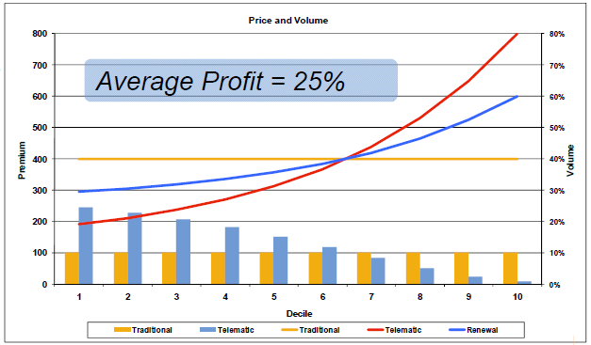
Driving Behavior Data Is Very Predictive
Provides significant lift above current rating plan
Early programs had discounts of up to 61% and surcharges of 9%, but most companies are not giving such significant rate variation
Difference between indication and selection can help fund technology while still providing marketing effect
Must be matched with policy and claims data to develop predictive models and define lift
Smart implementation helps justify the technology cost
Source: Towers Perrin.

Slide 160
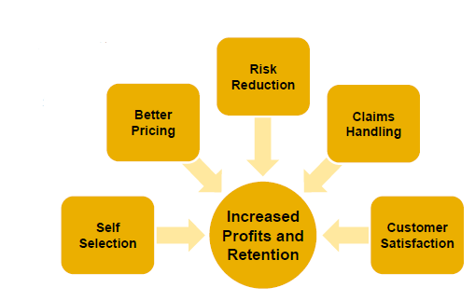
Why Is UBI Game-Changing?
Differentiates product offering by offering additional services
Significantly increases pricing accuracy
Appeals to consumers as it makes sense, is controllable and minimizes reliance on controversial proxies
Attracts lower-risk insureds via self-selection
Allows customers to understand and eliminate risky behaviors, actually reducing accident frequency
May improve claims handling
Can improve retention and profits
Source: Towers Perrin.

Slide 161
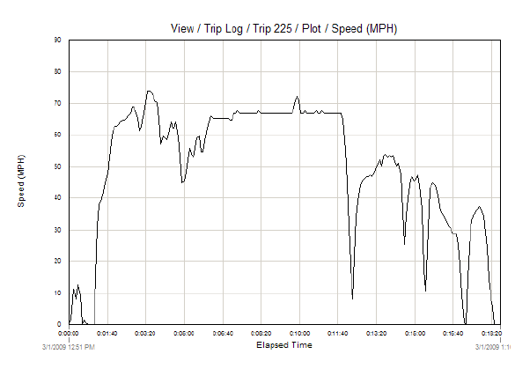
Appeals To The “Right” Consumers
Improves driving behavior
Controllable and enables potentially large premium savings
Makes sense and reduces reliance on proxies
Insurance credit scores
Driver assignment
Charges for relatively rare
accidents, convictions
Ancillary services
Source: Towers Perrin.

Slide 162
Current Market Landscape
162

Slide 163
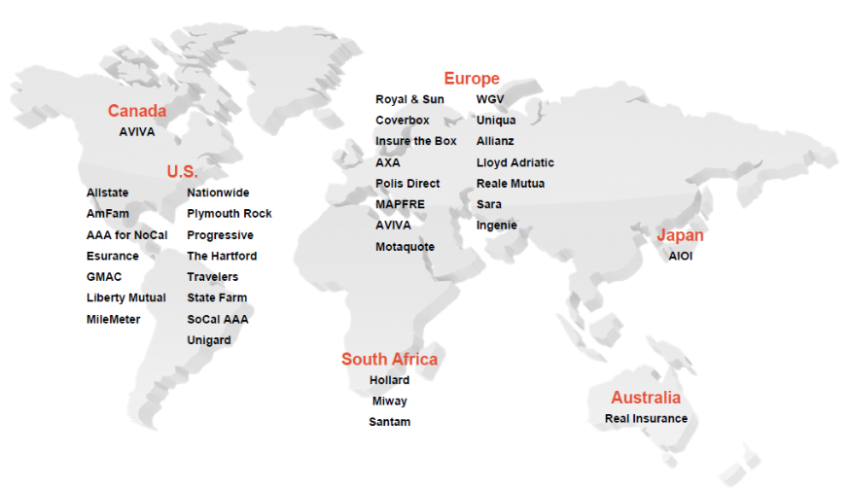
UBI In Personal Auto Around The Globe
Source: Towers Watson presentation at Casualty Actuarial Society PRM Conference, March 20, 2012: Usage-Based Insurance: Are You Ready?” by Robin Harbage, FCAS, MAAA.

Slide 164
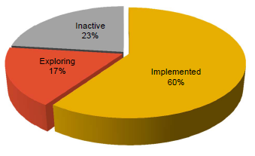
Top 50 U.S. Private Passenger Auto Companies
At least seven top 10 personal auto insurers have implemented programs to insureds in at least one state
U.S. companies representing over 75% of the market already have programs or are actively pursuing them
“UBI device sales rocketing from $50 million in 2011 to approximately $2.6 billion by 2015.” — FC Business Intelligence
Source: Towers Watson presentation at Casualty Actuarial Society PRM Conference, March 20, 2012: Usage-Based Insurance: Are You Ready?” by Robin Harbage, FCAS, MAAA.

Slide 165

Liberty Mutual
Inherited Safeco’s ‘Teensurance’ program for drivers up to age 25
15% discount
Participants pay $15 a month for a satellite-tracking service
Parents can track vehicle location and disable the car remotely if
driven outside set boundaries
exceeds a preset speed limit
drives past a curfew
Launched ‘OnBoard Advisor’ to provide driver coaching
‘Rewind’ introduced which provides forgiveness of violation surcharge with telematics monitoring
Teen programs were extremely popular for early adopters
Source: Towers Watson presentation at Casualty Actuarial Society PRM Conference, March 20, 2012: Usage-Based Insurance: Are You Ready?” by Robin Harbage, FCAS, MAAA.

Slide 166


Example Consumer Proposition – U.S.
Source: Towers Watson presentation at Casualty Actuarial Society PRM Conference, March 20, 2012: Usage-Based Insurance: Are You Ready?” by Robin Harbage, FCAS, MAAA.

Slide 167
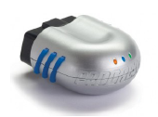
Progressive’s Snapshot SM
Optional program with customer selecting which vehicles to enroll
Wireless device plugged into OBD II port records time, speed and harsh braking
Discount calculated based on first 30 days, then applied for remainder of term
Device removed after first term and discount is fixed until significant endorsement
Maximum discount of 30% and no surcharge in most states
Approved in 39 states and Washington D.C.
40k to 50k new vehicles per month, quickly building market share
Source: Towers Watson presentation at Casualty Actuarial Society PRM Conference, March 20, 2012: Usage-Based Insurance: Are You Ready?” by Robin Harbage, FCAS, MAAA.

Slide 168
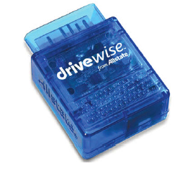
Allstate Drive Wise SM
Drive Wise launched in Illinois in January 2011 and followed with Ohio and Arizona
10% initial discount
Up to 36% at renewal
No surcharges
$10 technology fee semi-annually
Driver score based on driving behaviors
Mileage
Hard brakes
Speeding (80+ mph)
Time of day
Source: Towers Watson presentation at Casualty Actuarial Society PRM Conference, March 20, 2012: Usage-Based Insurance: Are You Ready?” by Robin Harbage, FCAS, MAAA.

Slide 169
State Farm In-Drive ®
Existing Drive Safe & Save Program with OnStar in five states
In-Drive® for IL in “September with more states to be added in 2012”
Discount up to 50% based on mileage, turns, acceleration, braking, speed and time of day
$10 initial fee with $5 to $14.99/month upgrade for additional features
Emergency response
Stolen vehicle location assistance
Vehicle diagnostic alerts and maintenance reminders
Speed alerts
Website and smartphone app for remote and mobile access
Building a comprehensive product offering with many consumer options
Source: Towers Watson presentation at Casualty Actuarial Society PRM Conference, March 20, 2012: Usage-Based Insurance: Are You Ready?” by Robin Harbage, FCAS, MAAA.

Slide 170
Data Availability
170

Slide 171
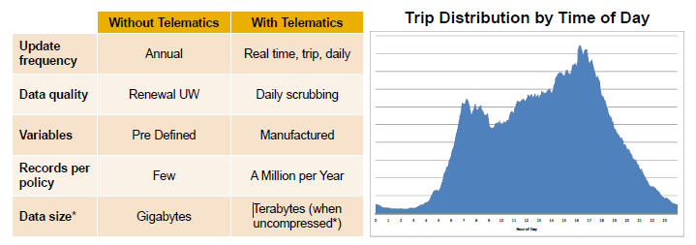
UBI Data Is Unlike Typical Insurance Data
Challenges
Defining data requirements and ensuring quality
Managing data size and transmission costs
Identifying and fixing data errors
Developing usable database of credible data
Source: Towers Watson presentation at Casualty Actuarial Society PRM Conference, March 20, 2012: Usage-Based Insurance: Are You Ready?” by Robin Harbage, FCAS, MAAA.

Slide 172
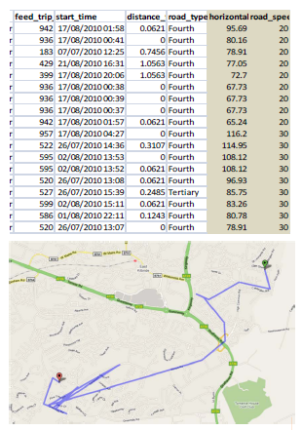
Data Must Be Scrubbed
Telematics data can have errors and must be checked
Granular data is critical to data scrubbing
Without it can get phantom events
With it can cross-check using several sources and/or external data to determine real versus phantom events
Imperative to automate as much of the validation as possible to facilitate ongoing scrubbing
Source: Towers Watson presentation at Casualty Actuarial Society PRM Conference, March 20, 2012: Usage-Based Insurance: Are You Ready?” by Robin Harbage, FCAS, MAAA.

Slide 173
Overcoming Challenges
173

Slide 174
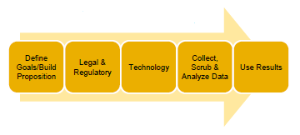
UBI Implementation Challenges
UBI projects are extremely complex and require cross-functional teams
Product must appeal to your market while still being profitable
Managing the legal and regulatory hurdles
Determining which of the multitude of devices available will best meet the needs of the program
Extensive IT infrastructure required to collect driving data, to integrate UBI scores with the current system and to give driving feedback
No publicly available data to jump-start a program
Danger of wasting time and money collecting the wrong data
Driving data is much different than traditional experience data and requires special data scrubbing and analysis techniques
Source: Towers Watson presentation at Casualty Actuarial Society PRM Conference, March 20, 2012: Usage-Based Insurance: Are You Ready?” by Robin Harbage, FCAS, MAAA.

Slide 175
P/C Insurance Industry Financial Overview
2013: Best Year in the Post-Crisis Era
Performance Improved with Lower CATs, Strong Markets
175

Slide 176
P/C Net Income After Taxes 1991–2013:Q3 ($ Millions)
2005 ROE*= 9.6%
2006 ROE = 12.7%
2007 ROE = 10.9%
2008 ROE = 0.1%
2009 ROE = 5.0%
2010 ROE = 6.6%
2011 ROAS¹ = 3.5%
2012 ROAS¹ = 5.9%
2013:9M ROAS¹ = 9.5%
Net income is up substantially (+54.7%) from 2012:Q3 $27.8B
2013:9M ROAS was 9.5%
ROE figures are GAAP; ¹Return on avg. surplus. Excluding Mortgage & Financial Guaranty insurers yields a 8.9% ROAS through 2013:Q3, 6.2% ROAS in 2012, 4.7% ROAS for 2011, 7.6% for 2010 and 7.4% for 2009.
Sources: A.M. Best, ISO, Insurance Information Institute

Slide 177
Profitability Peaks & Troughs in the P/C Insurance Industry, 1975 – 2013:Q3*
ROE
History suggests next ROE peak will be in 2016-2017
1977:19.0%
1987:17.3%
10 Years
2006:12.7%
1997:11.6%
2013:Q3 8.9%
10 Years
9 Years
2011: 4.7%
1975: 2.4%
1984: 1.8%
1992: 4.5%
2001: -1.2%
*Profitability = P/C insurer ROEs. 2011-13 figures are estimates based on ROAS data. Note: Data for 2008-2013 exclude mortgage and financial guaranty insurers.
Source: Insurance Information Institute; NAIC, ISO, A.M. Best.

Slide 178
A 100 Combined Ratio Isn’t What It Once Was: Investment Impact on ROEs
A combined ratio of about 100 generates an ROE of ~7.0% in 2012, ~7.5% ROE in 2009/10, 10% in 2005 and 16% in 1979
Combined Ratio / ROE
Lower CATs are improved ROEs in 2013
Combined Ratios Must Be Lower in Today’s Depressed Investment Environment to Generate Risk Appropriate ROEs
* 2008 -2013 figures are return on average surplus and exclude mortgage and financial guaranty insurers. 2013:9M combined ratio including M&FG insurers is 95.8; 2012 =103.2, 2011 = 108.1, ROAS = 3.5%.
Source: Insurance Information Institute from A.M. Best and ISO Verisk Analytics data.

Slide 179
ROE: Property/Casualty Insurance vs. Fortune 500, 1987–2013E*
(Percent)
P/C Profitability Is Both by Cyclicality and Ordinary Volatility
Katrina, Rita, Wilma
Sandy
Sept. 11
Hugo
Lowest CAT Losses in 15 Years
4 Hurricanes
Andrew
Record Tornado Losses
Northridge
Financial Crisis*
* Excludes Mortgage & Financial Guarantee in 2008 – 2013E. 2013 P/C ROE is through 2013:Q3.
Sources: ISO, Fortune; Insurance Information Institute.

Slide 180
ROE: ROEs by Industry vs. Fortune 500, 1987–2012*
Average: 1987-2012
Diversified Finl: 15.0% Commercial Banks: 13.1% All Industries (F500): 13.4% Life/Health Insurance: 8.8% P/C Insurance: 7.6%
(Percent)
* All figures are GAAP.
Sources: ISO, Fortune; Insurance Information Institute.

Slide 181
RNW All Lines by State, 2003-2012 Average: Highest 25 States
The most profitable states over the past decade are widely distributed geographically, though none are in the Gulf region
Source: NAIC.

Slide 182
RNW All Lines by State, 2003-2012 Average:
Lowest 25 States
Some of the least profitable states over the past decade were hit hard by catastrophes
Source: NAIC.

Slide 183
P/C Premium Growth Cycles
Cyclicality is Driven Primarily by the Industry’s Own Underwriting Cycle, Not the Economy
183

Slide 184
Net Premium Growth: Annual Change, 1971—2013:Q3
(Percent)
1975-78
1984-87
2000-03
Net Written Premiums Fell 0.7% in 2007 (First Decline Since 1943) by 2.0% in 2008, and 4.2% in 2009, the First 3-Year Decline Since 1930-33.
2013:9M = 4.2%
2012 growth was +4.3%
Shaded areas denote “hard market” periods
Sources: A.M. Best (historical and forecast), ISO, Insurance Information Institute.

Slide 185
Growth in Direct Written Premium by Line, 2013-2015F*
(Percent)
P/C growth is expected to remain fairly stable through 2015
Source: Conning.

Slide 186
P/C Net Premiums Written: % Change, Quarter vs. Year-Prior Quarter
Premium growth in Q3 2013 was up 3.8% over Q3 2012, marking the 14th consecutive quarter of growth
Sustained Growth in Written Premiums (vs. the same quarter, prior year) Will Continue into 2014
Sources: ISO, Insurance Information Institute.
186
12/01/09 - 9pm
eSlide – P6466 – The Financial Crisis and the Future of the P/C
Notes:
186

Slide 187
Growth in Net Written Premium by Segment, 2013:9M vs. 2012:9M*
(Percent)
*Excludes mortgage and financial guaranty insurers.
Source: ISO/PCI; Insurance Information Institute

Slide 188
INVESTMENTS: THE NEW REALITY
Investment Performance is a Key Driver of Profitability
Depressed Yields Will Necessarily Influence Underwriting & Pricing
188

Slide 189
Distribution of P/C Insurance Industry’s Investment Portfolio
Invested assets totaled $1.383 trillion as of 12/31/12
Insurers are generally conservatively invested, with nearly 2/3 of assets invested in bonds as of 12/31/12
Only about 18% of assets were invested in common stock as of 12/31/12
The portfolio is very conservative and returns are impacted by low interest rates.
Portfolio Facts
As of December 31, 2012
Bonds
Other
Preferred Stock
Common Stock
Real Estate
Cash and Short-term Investments
Sources: SNL Financial; Insurance Information Institute research.

Slide 190
Property/Casualty Insurance Industry Investment Income: 2000–2013*¹
($ Billions)
Investment earnings are running below their 2007 pre-crisis peak
Investment Income Fell in 2012 and is Falling in 2013 Due to Persistently Low Interest Rates, Putting Additional Pressure on (Re) Insurance Pricing
¹ Investment gains consist primarily of interest and stock dividends..
*Estimate based on annualized actual 9M:2013 investment income of $34.338B.
Sources: ISO; Insurance Information Institute.

Slide 191
Property/Casualty Insurance Industry Investment Income: 2000–2012F¹
($ Billions)
Investment earnings in 2011 were 10.3% below their 2007 pre-crisis peak
Investment Income in 2011 Was Surprisingly Strong, Though Investment Income Is Likely to Weaken in 2012 Due to Persistently Low Interest Rates
¹ Investment gains consist primarily of interest and stock dividends.
*2012F is based on annualized Q1:2012 actual figure of $11.656B.
Sources: ISO; Conning Research & Consulting; Insurance Information Institute.

Slide 192
P/C Insurer Net Realized Capital Gains/Losses, 1990-2013:Q3
Realized capital gains in 2013 will eclipse 2012 gains
($ Billions)
Insurers Posted Net Realized Capital Gains in 2010, 2011 and 2012 Following Two Years of Realized Losses During the Financial Crisis. Realized Capital Losses Were the Primary Cause of 2008/2009’s Large Drop in Profits and ROE
Sources: A.M. Best, ISO, Insurance Information Institute.
192
12/01/09 - 9pm
eSlide – P6466 – The Financial Crisis and the Future of the P/C
Notes:
192

Slide 193
Property/Casualty Insurance Industry Investment Gain: 1994–2013:Q3¹
($ Billions)
Investment gains through 2013:Q3 were approximately double those through 2012:Q3
Investment Income Continued to Fall in 2013 Due to Low Interest Rates but Realized Investment Gains Were Up Sharply; The Financial Crisis Caused Investment Gains to Fall by 50% in 2008
¹ Investment gains consist primarily of interest, stock dividends and realized capital gains and losses.
* 2005 figure includes special one-time dividend of $3.2B;
Sources: ISO; Insurance Information Institute.

Slide 194
U.S. 10-Year Treasury Note Yields: A Long Downward Trend, 1990–2014*
Yields on 10-Year U.S. Treasury Notes recently plunged to record modern-era lows in early 2013 but have since risen as the Fed begins “tapering” its QE program in 2014
Yields on 10-Year U.S. Treasury Notes have been essentially below 5% for a full decade.
Since roughly 80% of P/C bond/cash investments are in 10-year or shorter durations, most P/C insurer portfolios will have low-yielding bonds for years to come.
*Monthly, through January 2014. Note: Recessions indicated by gray shaded columns.
Sources: Federal Reserve Bank at http://www.federalreserve.gov/releases/h15/data.htm. National Bureau of Economic Research (recession dates); Insurance Information Institutes.
194
12/01/09 - 9pm
eSlide – P6466 – The Financial Crisis and the Future of the P/C
Notes:
194

Slide 195
U.S. Treasury Security Yields: A Long Downward Trend, 1990–2014*
Yields on 10-Year U.S. Treasury Notes have been essentially below 5% for a full decade.
U.S. Treasury yields plunged to historic lows in 2013. Only longer-term yields have rebounded.
Since roughly 80% of P/C bond/cash investments are in 10-year or shorter durations, most P/C insurer portfolios will have low-yielding bonds for years to come.
*Monthly, constant maturity, nominal rates, through February 2014.
Sources: Federal Reserve Bank at http://www.federalreserve.gov/releases/h15/data.htm. National Bureau of Economic Research (recession dates); Insurance Information Institute.
195
12/01/09 - 9pm
eSlide – P6466 – The Financial Crisis and the Future of the P/C
Notes:
195

Slide 196
Financial Strength & Underwriting
Cyclical Pattern is P-C Impairment History is Directly Tied to Underwriting, Reserving & Pricing
196

Slide 197
P/C Insurer Impairments, 1969–2012
Impairments among P/C insurers remain infrequent
The Number of Impairments Varies Significantly Over the P/C Insurance Cycle, With Peaks Occurring Well into Hard Markets
Source: A.M. Best Special Report “1969-2011 Impairment Review,” June 2012 and March 6, 2013 update; Insurance Info. Institute.

Slide 198
P/C Insurer Impairment Frequency vs. Combined Ratio, 1969-2011
2011 impairment rate was 0.91%, up from 0.67% in 2010; the rate is slightly higher than the 0.82% average since 1969
Impairment Rates Are Highly Correlated With Underwriting Performance and Reached Record Lows in 2007; Recent Increase Was Associated Primarily With Mortgage and Financial Guaranty Insurers and Not Representative of the Industry Overall
Source: A.M. Best; Insurance Information Institute

Slide 199
Reasons for US P/C Insurer Impairments, 1969–2010
Historically, Deficient Loss Reserves and Inadequate Pricing Are By Far the Leading Cause of P-C Insurer Impairments. Investment and Catastrophe Losses Play a Much Smaller Role
Reinsurance Failure
Sig. Change in Business
Misc.
Investment Problems (Overstatement of Assets)
Deficient Loss Reserves/ Inadequate Pricing
Affiliate Impairment
Catastrophe Losses
Alleged Fraud
Rapid Growth
Source: A.M. Best: 1969-2010 Impairment Review, Special Report, April 2011.

Slide 200
Top 10 Lines of Business for US P/C Impaired Insurers, 2000–2010
Workers Comp and Pvt. Passenger Auto Account for Nearly Half of the Premium Volume of Impaired Insurers Over the Past Decade
Title
Financial Guaranty
Surety
Med Mal
Workers Comp
Other Liability
Commercial Auto Liability
Pvt. Passenger Auto
Commercial Multiperil
Homeowners
Source: A.M. Best: 1969-2010 Impairment Review, Special Report, April 2011.

Slide 201
Number of Recessions Endured by P/C Insurers, by Number of Years in Operation
Number of Recessions Since 1860
Insurers are true survivors—not just of natural catastrophes but also economic ones
Number of Years in Operation
Many US Insurers Are Close to a Century Old or Older
Sources: Insurance Information Institute research from National Bureau of Economic Research data.
201
12/01/09 - 9pm
eSlide – P6466 – The Financial Crisis and the Future of the P/C
Notes:
201

Slide 202
Inflation
Is it a Threat to Claim Cost Severities?
202

Slide 203
Annual Inflation Rates, (CPI-U, %), 1990–2017F
Annual Inflation Rates (%)
Inflation peaked at 5.6% in August 2008 on high energy and commodity crisis. The recession, the collapse of the commodity bubble reduced inflationary pressures in 2009/10 and slow growth and slack in the economy have inflation low since then.
Inflationary expectations remain very modest. The Fed’s target inflation rate is 2%.
The slack in the U.S. economy suggests that inflationary pressures should remain subdued for an extended period of times.
Sources: US Bureau of Labor Statistics; Blue Chip Economic Indicators, 2/14 (forecasts).

Slide 204
Hospital-Related Personal Insurance Claim Cost Drivers Grow Faster Than CPI Suggests
Price Level Change: 2013 vs. 2012
Excludes Food and Energy
Healthcare costs are a major liability, med pay, and PIP claim cost driver. They are likely to grow faster than the CPI for the next few years, at least
Sources: Bureau of Labor Statistics; Insurance Information Institute.
204

Slide 205
P/C Commercial Property Insurance Claim Cost Drivers Climb at About Rate of CPI
Price Level Change: 2013 vs. 2012
Excludes Food and Energy
Copper prices spiked and retreated in 2011. In July its price was 33% higher than a year earlier; by November it cost 8% less than in November 2010.
Sources: Bureau of Labor Statistics; Insurance Information Institute.
205

Slide 206
Insurance Information Institute Online:
www.iii.org
Thank you for your time and your attention!
Twitter: twitter.com/bob_hartwig

