Slide 1
Insurance Regulatory Modernization and Industry Performance
Past, Present and Future
The Forum of Greater New York
New York, NY
March 13, 2014
Download at www.iii.org/presentations
Robert P. Hartwig, Ph.D., CPCU, President & Economist
Insurance Information Institute ♦ 110 William Street ♦ New York, NY 10038
Tel: 212.346.5520 ♦ Cell: 917.453.1885 ♦ bobh@iii.org ♦ www.iii.org

Slide 2
Presentation Outline
A History of Insurance and Insurance Regulation
The Eight Waves of Regulation in US Insurance History
  The institutionalization of insurance regulation
  Industrialization, progressive politics and federal power
  The genesis of rate regulation
  Reversing Course: A massive display of federal power
  A deregulatory pulse
  Crises and regulatory fury
  Global Crises, Global Responses
  Shadow Regulators
Future Shock: Waves of Risk Near and Far
  Health Insurance and the Affordable Care Act (“ObamaCare”)
  Emerging Markets, Emerging Risks
Thoughts on Significant Near-Term Risks
Summary
Q&A

Slide 3
A History of Insurance and the Rise of Regulation
The Roots of Insurance Extend Back Thousands of Years
Formal Regulation Came Much Later
3

Slide 4
In the Beginning…
Civilizations Long Ago Discovered the Benefits of Risk Pooling and Risk Transfer
4

Slide 5


Origins of Insurance…and Insurance Regulation
Earliest Forms of Insurance Date to 1800 BC in Babylon
  Code of Hammurabi
  282 clauses on the topic of “bottomery”
  Bottomery is a loan taken out by the owner of a ship to finance its voyage (no premium involved)
  If ship was lost, loan didn’t have to be repaid
Roman Emperor Claudius (10BC – 54AD)
  Eager to boost grain trade, Claudius became a 1-man, premium free insurance company by personally guaranteeing the storm losses of Roman merchants (also granted citizenship to sailors and exempted them from laws that penalized adultery and celibacy)
  Reduced taxes on communities impacted by drought or famine (form of ancient disaster aid)
Greek/Roman Occupational Guilds→Early Life Insurance
  Paid into pool that made payment to deceased member’s family
Sources: Elements drawn from Against the Gods: The Remarkable Story of Risk, Peter L. Bernstein; Insurance Information Institute.

Slide 6
Origins of Insurance…and Insurance Regulation
The Rise of Long Distance Trade: The Explosion of Risk and Reward
  14th Century: Italian city states of Venice, Florence, Genoa and Pisa became global epicenters for trade and are where the earliest written insurance contract originated
    The word “policy” is from the Italian “polizza” meaning promise or undertaking
  Bruges, Antwerp followed in the 15th century, Amsterdam by 17th century
  By 1600 England had become a major trading nation
From Expensive Cargo/Ships Arose Disputes and the Need for Certainty and the Foundations for Insurance Regulation Were Laid
  “For whom they insure, it is sweet to them to take the monies; but when disaster comes, it is otherwise, and each man draws his rump back and strives not to pay.”
    Franceso di Marco Datini, Florentine Merchant, 14th Century, complaining about insurers of his era (Datini left 400 marine insurance policies in his estate when he died)
  “For even though I were to live a thousand years, never again would I underwrite insurance.”
    Guiglielmo Barberi, 14th Century, lamenting the loss of a bale of cloth and a barrel of furs he had underwritten on a ship that had been plundered by pirates, but had no ability to pay
Sources: Elements drawn from Against the Gods: The Remarkable Story of Risk by Peter L. Bernstein, J. Wiley & Sons (1996); Insurance Perspectives, G. Gibbons, G. Rejda and M. Elliott., American Institutes for CPCU (1992); Insurance Information Institute.

Slide 7

Origins of Insurance…and Insurance Regulation
London and the Dawn of Insurance Regulation
  Italian forms of marine insurance contracts were used in London since at least the 15th century
  London merchants frequently acted as underwriters
  Contracts were negotiated by commodity brokers
  Notaries drafted/delivered policies and kept registers of policies written
  Chamber of Assurances established in 1576 and until 1690 all policies had to be registered in its office in the Royal Exchange
1601: Francis Bacon Introduces Bill to Regulate Insurance Policies
  Bacon recognized the ubiquity and of utility of insurance contracts which were “tyme out of mynde an usage amonste merchants, both of this realm and of forraine nacyons.”
  Led to 1601 Act of Parliament that formally recognized that the benefits of insurance justified legal sanction, with the government willing to enforce insurance contracts and resolve disputes
Sources: Elements drawn from Against the Gods: The Remarkable Story of Risk by Peter L. Bernstein, J. Wiley & Sons (1996); Insurance Perspectives, G. Gibbons, G. Rejda and M. Elliott., American Institutes for CPCU (1992); Insurance Information Institute.

Slide 8
The 8 Stages (Waves) of Insurance Regulation in the United States
Regulation in the U.S. Has Been Characterized by Periodic Pulses of Activity
8

Slide 9
Regulatory Wave #1
1850- 1900
The Institutionalization of State-Based Insurance Regulatory Schemes
9

Slide 10
Year of Establishment of Insurance Regulator Supervision
1854
1855 MA
RI 1856
VT, NH, IN 1852
1853
MS 1857
1858
1859
1850
1851
The half century from 1850-1900 bore witness to a massive wave of institutionalized regulation of the business of insurance
1850s
NV 1864
WV, CT 1865
VA 1866
1862
1863
WI, OH 1867
CA, IA, ME 1868
MO, GA, IL 1869
NY, AL 1860
1861
1860s
1874
NJ 1875
TX, SC 1876
FL, MD, MN 1872
AR, NE, PA, TN 1873
WY 1877
1878
DE 1879
KY 1870
KS, MI 1871
1870s
UT 1884
1885
1886
NM 1882
MT, CO 1883
AZ 1887
1888
ND, WA, SD 1889
1880
1881
1880s
1894
1895
1896
1892
1893
1897
LA 1898
AK 1900
OK 1890
ID 1891
1899
1901
DC 1902
1890-1902
Sources: Insurance Information Institute based on information in Appendix IV of The History of the National Board of Fire Underwriters: Fifty Years of a Civilizing Force, Harry Chase Brearly, published by Frederick A. Stokes Co. (1916).

Slide 11
Number of Recessions Endured by P/C Insurers, by Number of Years in Operation
Number of Recessions Since 1860
Insurers that have made it to the age of 150 have endured 32 recessions over the years
Number of Years in Operation
Longevity Requires an Insurer to Overcome Extreme Economic Adversity of Every Sort
Sources: Insurance Information Institute research from National Bureau of Economic Research data.
11
12/01/09 - 9pm
eSlide – P6466 – The Financial Crisis and the Future of the P/C
Notes:
11

Slide 12
The Supreme Court Reinforces (Establishes) the Primacy of State Regulation of Insurance
Paul vs. Virginia (1869)
Since its mid-18th century origins in the US, insurance had been regulated under the general laws governing commerce in the states in which the insurer had been granted a charter/license to operate
As the US economy expanded and insurers (based mostly in the Northeast) sought to expand along with the country, they wanted to avoid the cost and complexity of complying with the many and varied requirements promulgated by the states
Virginia in 1866 enacted legislation requiring a $30,000+ bond be deposited with the state treasurer as a condition of licensure for out-of-state insurers (the agents representing them needed a license as well)
Test Case: Insurers determined to challenge the law asserting that VA’s law interfered with the federal government’s constitutional power to regulate interstate commerce [Modern Historical Parallel: Pre-crisis push for OFC]
  States opposed since they generated significant revenues from the taxation of premiums
Several NY companies appointed as their agent in VA Samuel D. Paul, a Petersburg, VA, attorney.
Sources: Insurance Perspectives, G. Gibbons, G. Rejda and M. Elliott., American Institutes for CPCU (1992); Introduction to Risk Management and Insurance, Mark S. Dorfman, Pearson/Prentice Hall (2007); Insurance Information Institute.

Slide 13
The Supreme Court Reinforces (Establishes) the Primacy of State Regulation of Insurance
Paul vs. Virginia (1869)
Paul applied for a license which was denied because the bond had not been deposited but continued to sell insurance
Paul was indicted, convicted and fined ($50)
Case was eventually appealed to the US Supreme Court which ruled unanimously in VA’s favor
Chief Justice Stephen J. Field delivered the court’s opinion that:
  “Issuing a policy of insurance is not a transaction of commerce. The policies are simple contracts of indemnity against loss by fire…They are not commodities to be shipped from one state to another, and put up for sale. They are like personal contracts between parties which are completed by their signature and transfer of consideration…The policies do not take effect—are not executed contracts—until delivered by the agent in Virginia, They are, then, local transactions, governed by local law.”
This settled the law on the matter of state vs. federal regulation for the next 75 years
Sources: Insurance Perspectives, G. Gibbons, G. Rejda and M. Elliott., American Institutes for CPCU (1992); Introduction to Risk Management and Insurance, Mark S. Dorfman, Pearson/Prentice Hall (2007); Insurance Information Institute.

Slide 14
Regulatory Wave #2
1880- 1920
Industrialization, Progressive Politics and the Assertion of Federal Regulatory Might
14

Slide 15
Societal Changes Drive a Re-Evaluation of Insurance: Tidal Wave of Regulation
Historically, the determination of pricing (in any industry) was not viewed as a function of government, but the outcome of negotiation between parties
Societal views on this began to change in the period from 1887-1916 (roughly) with American industrialization and the rise of finance
  Munn v. Illinois (1877) [Supreme Ct. affirmed authority of states to regulate prices in businesses affected with the public interest]
  Interstate Commerce Act (1887)
  Sherman Antitrust Act (1890)
  Clayton Act (1914) [amended the Sherman Act]
  Federal Reserve Act (1913) [100 years later, the Fed has discovered insurance!]
  16th Amendment (1913) [permitted the establishment of a federal income tax]
Kansas Rate Law (1909, Upheld by US Supreme Court in 1914): Court said that insurance was “a business affected with the public interest” and that insurance rate regulation was an appropriate function of government
New York Rate Law of 1922: Required fire insurers to join approved rating bureau through which the NYID attempted to determine that rates were reasonable (neither inadequate nor excessive)
Sources: Insurance Perspectives, G. Gibbons, G. Rejda and M. Elliott., American Institutes for CPCU (1992); Insurance Information Institute.

Slide 16
Cumulative Number of WC Laws Passed, 1910-1920
Insurance was quickly becoming part of the nation’s economic infrastructure. Nearly every state adopted “modern” workers comp laws between 1910 and 1920
Source: http://eh.net/encyclopedia/article/fishback.workers.compensation; Insurance Information Institute.

Slide 17
Regulatory Wave #3
1910- 1943
The Genesis of Rate Regulation
17

Slide 18
Regulation Oversight Tightens,
Especially Over Rates
Armstrong Committee (1905) and Merritt Committee: NY investigations into alleged inappropriate practices of life and fire insurers, respectively
Investigations led to calls for federal regulation of the insurance industry coming both from the critics and from some in the industry itself.
  NJ Senator John Dryden (also President of Prudential Life) advocated for federal regulation in 1905 considering it “infinitely preferable to the intolerable regulation [of the states].” President Theodore Roosevelt that year even proposed that insurance be regulated and supervised by the Bureau of Corporation, but Congress did not act.
Southeastern Underwriters Case: After ~20 years of experience with rating bureaus some states—led by Missouri—came to view insurers’ actions through these bureaus as collusive.
  A federal investigation was launched and in 1942 the US Justice Department charged the Southeastern Underwriters Association and 9 of its member insurers with violations of the Sherman Antitrust Act. [The SEUA was owned by 200 private stock fire insurers that controlled 90%+ of the business in 6 southeastern states.]
Case was ultimately appealed to the Supreme Court which in 1944 stunned the industry by finding that the SEUA had violated antitrust law
Sources: Insurance Perspectives, G. Gibbons, G. Rejda and M. Elliott., American Institutes for CPCU (1992); Insurance Information Institute.

Slide 19
Regulatory Wave #4
1944- Present
Reversing Course: A Massive Display of Federal Power in Insurance Regulation
19

Slide 20
Out With the Old…In With Dual Regulation
1944 SEUA Supreme Court decision effectively overturned the 1869 Paul v. Virginia decision—after 75 years
State and Federal regulation of insurance were both constitutional
  This created an obvious dilemma with no obvious solution
  Congress stepped into the void
McCarran-Ferguson Act of 1945
  Crafted a partial exemption of the business of insurance from the Sherman, Clayton and FTC Acts to the extent it is regulated by the states
  Maintained that federal antitrust laws do apply in cases of boycott, coercion or intimidation
  Widely misunderstood by industry critics (including occasionally some members of Congress) as a blanket exemption from antitrust statutes
NAIC’s 1946 All Industry Bill became the model law establishing a framework for regulation in the wake of McCarran-Ferguson
Stringent rate regulation became the norm and by 1948 all states had enacted rate regulatory laws, usually in line with the All Industry Bill
Sources: Insurance Perspectives, G. Gibbons, G. Rejda and M. Elliott., American Institutes for CPCU (1992); Insurance Information Institute.

Slide 21
Regulatory Wave #5
1999- 2009
A Pulse of Deregulation
21

Slide 22
The Pendulum Swings: Financial Services Deregulation and Gramm-Leach-Bliley
By the late 1990s, years of bull markets and merger mania led to the view that Depression Era legislation such as Glass-Steagal (1933) prohibiting affiliations between commercial banks and securities firms were anachronistic
Gramm-Leach-Bliley Act of 1999
  Repealed Glass-Steagal
  Allowed the formation of Financial Service Holding Companies that permitted combinations of banks, securities firms and insurers
Preserved state-based regulation of insurance entities
Had little impact on insurance industry in the US
Only one major transaction involving an insurer took place—merger between Citi and Travelers in 1998
  Travelers was spun off in 2002
The idea of banks in insurance (“bancassurance”) never caught on in the US but was somewhat popular in Europe until the financial crisis
Sources: Insurance Information Institute research.

Slide 23
Regulatory Wave #6
2008 - Present
Crisis and Regulatory Fury
23

Slide 24
The Global Financial Crisis: The Pendulum Swings Again: Dodd-Frank & Systemic Risk
Dodd-Frank Act of 2010: The implosion of the housing bubble and virtual collapse of the US banking system, the seizure of credit markets and massive government bailouts of US financial institutions led to calls for sweeping regulatory reforms of the financial industry
Limiting Systemic Risk is at the Core of Dodd-Frank
Designation as a Systemically Important Financial Institutional (SIFI) Will Result in Greater Regulatory Scrutiny and Heightened Capital Requirements
Dodd-Frank Established Several Entities Impacting Insurers
  Federal Insurance Office
  Financial Stability Oversight Council
  Office of Financial Research
  Consumer Financial Protection Bureau

Slide 25
The Global Financial Crisis: The Pendulum Swings Again: Dodd-Frank & Systemic Risk
Insurers—as Non-Bank Financial Institutions—Have Escaped Some, though Not All of the Most Draconian Provision of Dodd-Frank
  In particular, small number of large insurers will (are) receiving a designations as Systemically Important Financial Institutions (SIFIs)
Insurers Generally Reject the Notion that Insurance Is Systemically Risky (or that any Individual Insurer is Systemically Important)
Such a Designation Makes the Fed the Penultimate Regulator
To Date: AIG, Prudential Have Been Designated as non-bank SIFIs by the FSOC
  MetLife is still under evaluation
Fed Reserve Seems Open to Developing a Tailored Capital Requirement Approach for Insurers
  Conflicting language in the DFA make this somewhat difficult
  SIFIs may need Fed approval to repurchase shares on increase dividend

Slide 26
Regulatory Wave #7
2010 - Present
Global Crises, Global Response
26

Slide 27
Global Financial Crises &
Global Systemic Risk
The Global Financial Crisis Prompted the G-20 Leaders to Request that the Financial Stability Board (FSB) Assess the Systemic Risks Associated with SIFIs, Global-SIFIs in Particular
In July 2013, the FSB Endorsed the International Association of Insurance Supervisors Methodology for Identifying Globally Systemically Important Insurers (G-SIIs)
For Each G-SII, the Following Will Be Required:
  (i) Recovery and resolution plans
  (ii) Enhanced group-wide supervision
  (iii) Higher loss absorbency (HLA) requirements
G-SIIs as Designated by the FSB as of July 2013:
  Allianz SE AIG Assicurazioni Generali
  Aviva Axa MetLife
  Ping An Prudential Financial Prudential plc

Slide 28
Global Financial Crises &
Global Systemic Risk: Key Dates
Implementation Date | Action
July 2013 | Designation of G-SIIs (annual updates thereafter beginning Nov. 2014)
July 2014 | FSB to make a decision on the G-SII status of, and appropriate risk mitigating measures for major reinsurers
By G-20 Summit 2014 | IAIS to develop backstop capital requirements to apply to all group activities, incl. non-ins. subs.
End 2015 | IAIS to develop HLA requirements that will apply to G-SIIs staring in 2019
January 2019 | G-SIIs to apply HLA requirements
Sources: Financial Stability Board, “Globally Systemically Important Insurers (G-SIIs) and the Policy Measures that Will Apply to Them,” July 18, 2013.

Slide 29
Global Financial Crises &
Global Systemic Risk…There’s More…
IAIS Also Plans to Develop the First-Ever Risk-Based Global Insurance Capital Standards by 2016
Would be Tested in 2017-2018; Implemented in 2019
Would Be Included as Part of ComFrame and Apply to Internationally Active Insurance Groups (IAIGs): ~50 IAIGs Designations Likely
While Flexibility May Exist within the Standards, Doubts in the US Are Likely to Be Strong
  Concern that the standards may be bank-centric
  Questions as to whether such standards are even needed:
  “Although US state insurance regulators continue to have doubts about the timing, necessity and complexity of developing a global capital standard given regulatory differences around the globe, we intend to remain fully engaged in the process to ensure that any development augments the strong legal entity capital requirements in the US that have provided proven and tested security for US policyholders and stable insurance markets for consumers and industry.” --NAIC President Ben Nelson (P/C 360, Oct. 16, 2013)

Slide 30
Regulatory Wave #8
Time Immemorial → End of Time
Shadow Regulators
30

Slide 31

Shadow Regulators—A New and Unpredictable Regulatory Concern?
How Many Insurance Regulators Are There?
50 State Departments of Insurance
50 State Attorneys General, 50 Governors
Thousands of State Legislators, Hundreds in Congress
New Federal Entities (FIO, FSOC) and Fed
Global Entities (IAIS, FSB)?
Eliot Spitzer and contingent commission issue
  Little substance to his accusations
MS AG Jim Hood—post-Katrina in wind vs. water dispute
Former Florida Governor Charlie Christ on rates, deductibles
Governors on hurricane deductibles post-Sandy
Shadow Regulators: A Source of Moral Hazard
Sources: Insuce Information Institute.

Slide 32

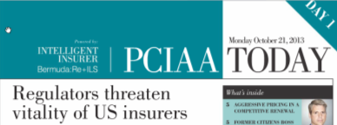
Insurance Regulation and the
Great Arc of the History
That Was Then… | This is Now…
“…misguided zealots, honest in intention but without knowledge of the special problems of underwriting present the greatest danger. They usually are the authors of the most revolutionary plans and their pride of authorship makes them the most impatient of correction.” | “Overzealous regulators are endangering the vigour, competitiveness and diversity of insurers in the US.”
“Public enjoyment of fair rates, sound protection, prompt adjustments, and freedom from discrimination is not due…to unwilling virtue under compulsion, but to the underwriters’ knowledge that any other course would be unprofitable—bad business.” | “If a policy is priced in a certain way on a certain basis, we cannot allow the terms and conditions simply to be overturned by political considerations.”
1916
2013 (Oct. 21)

Slide 33
Shadow Regulators—A New and Unpredictable Regulatory Concern?
Is the Phenomenon of Shadow Regulators Really a New One?
  “…one turns with a feeling of surprise, of bewilderment, to the intense activity of…state legislators fairly seething with legislation on fire insurance. Why should there be 2,500 bills in a single year unless the subject be one of immediate and overwhelming emergency…Many of the bills introduced are conceived in a spirit of indiscriminate hostility…from the time immemorial, politicians of a certain type have sought to pose as defenders of the people from the aggressions of capital…The politician has learned that popularity and applause may be most quickly attained by attacking largeness…’Big-game’ hunting…brings its political rewards. Fire insurance companies seem to be the most accessible of the larger fauna.”
    Harry Chase Stokes, The History of the National Board of Fire Underwriters: Fifty Years of a Civilizing Force, 1916.

Slide 34
Future Shock
Waves of Risk for the Immediate Future
34

Slide 35
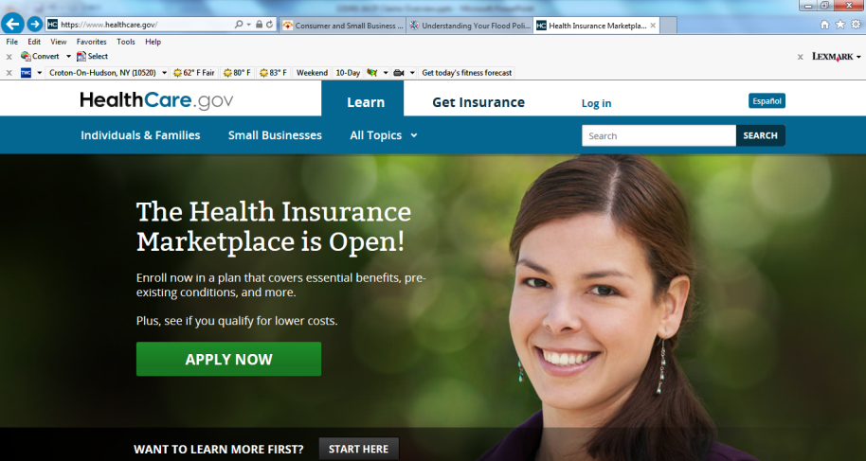
Affordable Care Act (“ObamaCare”): A Rocky Start
Health Insurance Marketplaces Are Open But Remain a Logistical and Political Nightmare
Sources: Screen capture on Oct. 1, 2013 from www.HealthCare.gov; Insurance Information Institute.

Slide 36
States of Play | Management of Health-Insurance Exchanges
Some states are running new health-insurance exchanges on their own. Other are leaving some or all of the task to the federal government.
WA
Federally Run
exchange
MT
ND
ME
OR
MN
VT
State-run
exchange
ID
WI
NY
NH
SD
MA
Federal and
state joint-run
exchange
WY
MI
RI
IA
PA
CT
NV
NE
OH
NJ
UT
IL
IN
DE
CA
CO
WV
VA
MD
KS
MO
KY
TN
NC
AZ
NM
OK
AR
SC
MS
AL
GA
RI
AK
CT
TX
LA
NJ
FL
DE
HI
MD
DC
Source: Wall Street Journal, September 20, 2013.

Slide 37
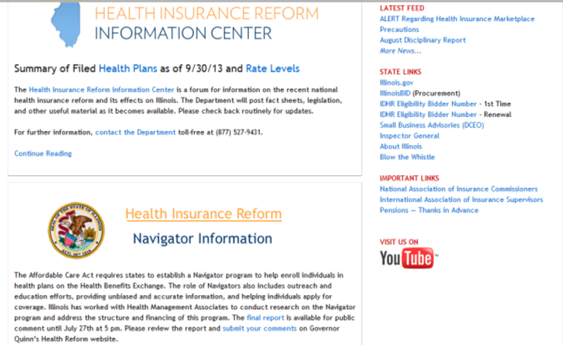
Affordable Care Act (“ObamaCare”): Grand Opening October 1
Health Insurance Marketplaces But Info About Health Insurance Is Much More Available on Some State’s Websites Than Others
Sources: Screen capture on Oct. 24, 2013 from Insurance.Illinois.gov; Insurance Information Institute.

Slide 38
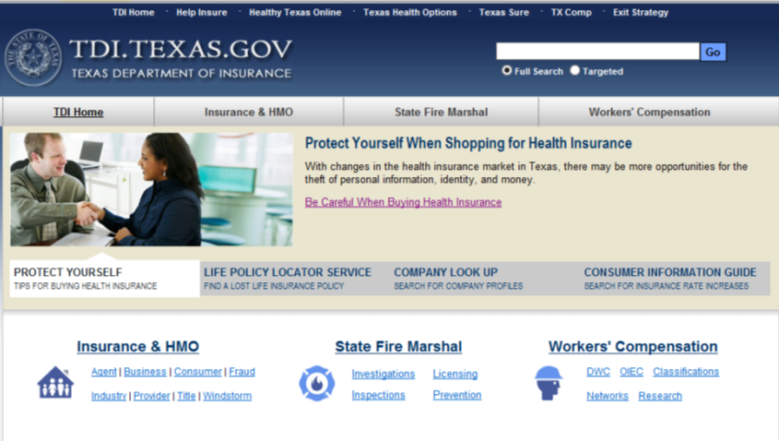
Affordable Care Act (“ObamaCare”): Grand Opening October 1
Health Insurance Marketplaces But Info About Health Insurance Is Much More Available on Some State’s Websites Than Others
Sources: Screen capture on Oct. 24, 2013 from TDI.Texas.gov ; Insurance Information Institute.

Slide 39
Risk & Insurance
U.S. and Global Perspective
Is the World Becoming a Riskier, More Uncertain Place?
39

Slide 40
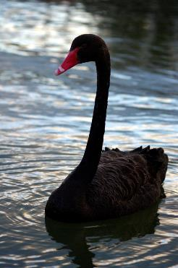
Uncertainty, Risk and Fear Abound: Insurance Can Help Mitigate Risk
Economic Issues in US, Europe
Weakness in China/Emerging Economies
Political Gridlock in the US, Europe, Japan
Fiscal Imbalances
Monetary Policy/Tapering/Low Interest Rates
Unemployment
Political Upheaval in the Ukraine, Middle East
  Argentina, Venezuela, Thailand
Resurgent Terrorism Risk
Diffusion of Weapons of Mass Destruction
Cyber Attacks
Record Natural Disaster Losses
Climate Change
Environmental Degradation
Income Inequality
(Over)Regulation
Are “Black Swans” everywhere or does it just seem that way?

Slide 41





5 Major Categories for Global Risks, Uncertainties and Fears: Insurance Solutions
Economic Risks
Geopolitical Risks
Environmental Risks
Technological Risks
Societal Risks
While risks can be broadly categorized, none are mutually exclusive
Source: Adapted from World Economic Forum, Global Risks 2014; Insurance Information Institute.

Slide 42
Top 5 Global Risks in Terms of Likelihood, 2007—2014: Insurance Can Help With Most
In 2014, societal and environ-mental issues dominated frequency concerns
Concerns Shift Considerably Over Short Spans of Time. 2014 Includes a Mix of Environmental Economic, Social and Environmental Risks
Source: World Economic Forum, Global Risks 2014; Insurance Information Institute.
42
12/01/09 - 9pm
eSlide – P6466 – The Financial Crisis and the Future of the P/C
Notes:
42

Slide 43
Top 5 Global Risks in Terms of Impact,
2007—2014: Insurance Can Help With Most
In 2014, economic and environ-mental issues dominated severity concerns
Concerns Over the Impacts of Economics Risks Remained High in 2014, but Societal, Environment and Technological Risks Also Loom Large
Source: World Economic Forum, Global Risks 2014; Insurance Information Institute.
43
12/01/09 - 9pm
eSlide – P6466 – The Financial Crisis and the Future of the P/C
Notes:
43

Slide 44





Data Breaches 2005-2013, by Number of Breaches and Records Exposed
# Data Breaches/Millions of Records Exposed
Millions
The Total Number of Data Breaches (+38%) and Number of Records Exposed (+408%) in 2013 Soared
* 2013 figures as of Jan. 1, 2014 from the ITRC updated to an additional 30 million records breached (Target) as disclosed in Jan. 2014.
Source: Identity Theft Resource Center.

Slide 45
Over the Last Three Decades, Total Tort Costs as a % of GDP Appear Somewhat Cyclical, 1980-2013E
($ Billions)
2.21% of GDP in 2003 = pre-tort reform peak
Deepwater Horizon Spike in 2010
Tort costs in dollar terms have remained high but relatively stable since the mid-2000s., but are down substantially as a share of GDP
1.68% of GDP in 2013
Sources: Towers Watson, 2011 Update on US Tort Cost Trends, Appendix 1A

Slide 46
Globalization:
The Global Economy Creates and Transmits Risks
Globalization Is a Double Edged Sword—Creating Opportunity and Wealth But Potentially Creating and Amplifying Risk
Emerging vs. “Advanced” Economies
46

Slide 47
US Real GDP Growth*
The Q4:2008 decline was the steepest since the Q1:1982 drop of 6.8%
Real GDP Growth (%)
Recession began in Dec. 2007. Economic toll of credit crunch, housing slump, labor market contraction was severe
2014/15 are expected to see a modest acceleration in growth
Demand for Insurance Should Increase in 2014/15 as GDP Growth Accelerates Modestly and Gradually Benefits the Economy Broadly
* Estimates/Forecasts from Blue Chip Economic Indicators.
Source: US Department of Commerce, Blue Economic Indicators 3/14; Insurance Information Institute.

Slide 48
GDP Growth: Advanced & Emerging Economies vs. World, 1970-2015F
Emerging economies (led by China) are expected to grow by 5.1% in 2014 and 5.4% in 2015.
GDP Growth (%)
World output is forecast to grow by 3.7% in 2014 and 3.9% in 2015. The world economy shrank by 0.6% in 2009 amid the global financial crisis
Advanced economies are expected to grow at a modest pace of 2.2% in 2014 and to 2.3% in 2015.
Source: International Monetary Fund, World Economic Outlook , January 2014 WEO Update; Ins. Info. Institute.

Slide 49
Real GDP Growth Forecasts:
Major Economies: 2011 – 2015F
US growth should acceleratein 2014
Growth in China has outpaced the US and Europe
The Eurozone is ending
Growth Prospects Vary Widely by Region: Growth Returning in the US, Recession in the Eurozone, Some strengthening in Latin America
Sources: Blue Chip Economic Indicators (2/2014 issue); IMF; Insurance Information Institute.
49
Notes:
49

Slide 50
Real GDP Growth Forecasts:
Selected Economies: 2011 – 2014F
Strong economies in smaller industrialized nations will bolster demand for products, services, international trade and insure
Growth Outside the US, Europe and Japan is Relatively Strong
Sources: Blue Chip Economic Indicators (9/2013 issue); Insurance Information Institute.
50
Notes:
50

Slide 51
Global GDP: 1948—2013F
Global trade volume will approach $19 trillion in 2013, a 155% over the past decade
$ Billions
Insurance Regulation Will Necessarily Become More Transnational, Following Patterns of Global Economic Growth, the Creation of New Insurable Exposures and International Capital Flows
Sources: World Trade Organization data through 2011; Insurance Information Institute estimate for 2013 based on IMF forecasts as of July 2013.
51
12/01/09 - 9pm
eSlide – P6466 – The Financial Crisis and the Future of the P/C
Notes:
51

Slide 52
World Trade Volume: 1948—2013F
Global trade volume will approach $19 trillion in 2013, a 155% over the past decade
$ Billions
Insurance Regulation Will Necessarily Become More Transnational, Following Patterns of Global Economic Growth, the Creation of New Insurable Exposures and International Capital Flows
Sources: World Trade Organization data through 2011; Insurance Information Institute estimate for 2013 based on IMF forecasts as of July 2013.
52
12/01/09 - 9pm
eSlide – P6466 – The Financial Crisis and the Future of the P/C
Notes:
52

Slide 53
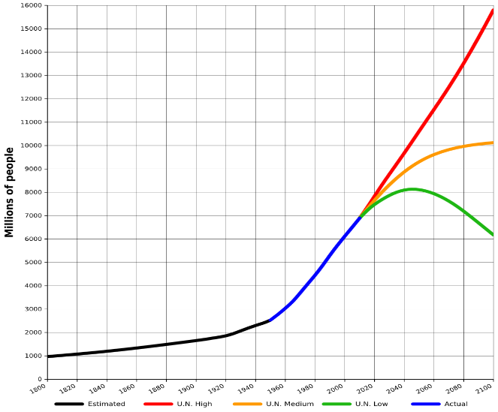
World Population Growth: 2010—2100F
The future of insurance will be tied global population growth—life insurance more closely than nonlife.
Mid-range scenarios suggest a massive slowdown in the number of available lives to insure. Growth will be increasing dependent on product penetration rates in emerging economies
Sources: United Nations, World Population Prospects, June 13, 2013; Insurance Information Institute .
53
12/01/09 - 9pm
eSlide – P6466 – The Financial Crisis and the Future of the P/C
Notes:
53

Slide 54
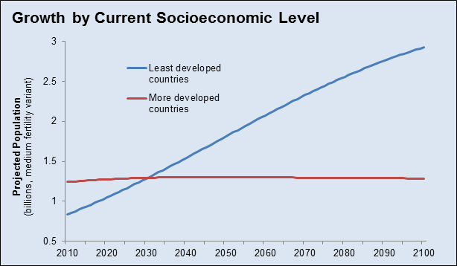
Population Growth: Developed vs. Less Developed Countries 2010—2100F
Virtually all of the world’s population growth through the end of the 21st century will occur in the developing world
Sources: United Nations, World Population Prospects, June 13, 2013; Insurance Information Institute .
54
12/01/09 - 9pm
eSlide – P6466 – The Financial Crisis and the Future of the P/C
Notes:
54

Slide 55
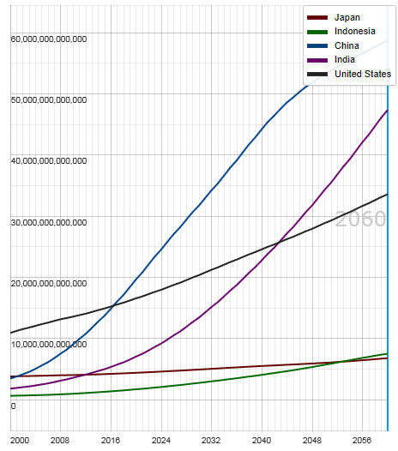
Potential Output of Total Economy: US, China, India, Indonesia and Japan, 2000-2060F
$ 2005 PPP
Growth in economic output will be concentrated in certain developing economies such as China and India
China will likely become the world’s largest economy between 2025 and 2030
Source: OECD; Insurance Information Institute .
55
12/01/09 - 9pm
eSlide – P6466 – The Financial Crisis and the Future of the P/C
Notes:
55

Slide 56
Global Insurance Premium Growth Trends:
Life and Non-Life
Growth Is Uneven Across Regions and Market Segments
56

Slide 57
Premium Growth by Region, 2012
Latin America growth was the strongest in 2012
Growth in Advanced Asia (incl. China) markets was third highest in 2012
Global Premium Volume Totaled $4.613 Trillion in 2012, up 2.4% from $4.566 Trillion in 2011. Global Growth Was Weighed Down by Slow Growth in N. America and W. Europe and Partially Offset by Emerging Markets
Source: Swiss Re, sigma, No. 3/2013.
57
Notes:
57

Slide 58
Distribution of Global Insurance Premiums, 2012 ($ Trillions)
Total Premium Volume = $4.613 Trillion*
Life insurance accounted for nearly 57% of global premium volume in 2012 vs. 43% for Non-Life
Source: Swiss Re, sigma, No. 3/2013; Insurance Information Institute.

Slide 59
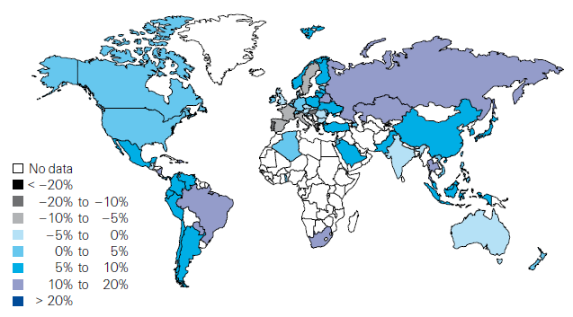
Global Real (Inflation Adjusted) Premium Growth (Life and Non-Life): 2012
Emerging markets in Asia, including China, showed faster growth an the US or Europe
Premium growth in emerging markets was 4 times that of advanced economies in 2012
Market | Life | Non-Life | Total
Advanced | 1.8 | 1.5 | 1.7
Emerging | 4.9 | 8.6 | 6.8
World | 2.3 | 2.6 | 2.4
Source: Swiss Re, sigma, No. 3/2013; Insurance Information Institute.
59
12/01/09 - 9pm
eSlide – P6466 – The Financial Crisis and the Future of the P/C
Notes:
59

Slide 60
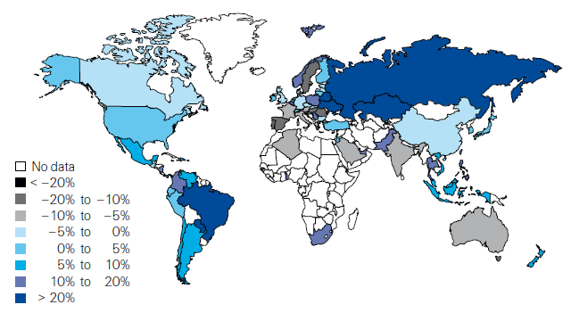
Life Insurance: Global Real (Inflation Adjusted) Premium Growth, 2012
Real growth in life insurance premiums was a bit slower in China than the US
Market | Life | Non-Life | Total
Advanced | 1.8 | 1.5 | 1.7
Emerging | 4.9 | 8.6 | 6.8
World | 2.3 | 2.6 | 2.4
Source: Swiss Re, sigma, No. 3/2013.
60
12/01/09 - 9pm
eSlide – P6466 – The Financial Crisis and the Future of the P/C
Notes:
60

Slide 61
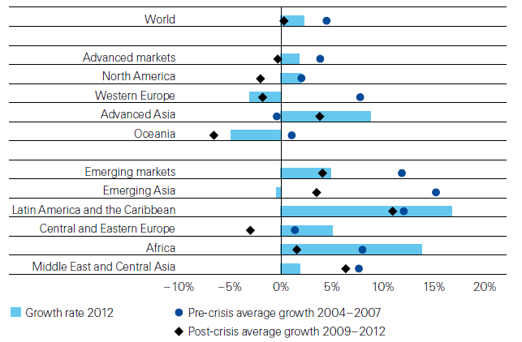
Life Insurance: Global Real (Inflation Adjusted) Premium Growth, 2012
Global Life Insurance growth in 2012 was lower than the pre-crisis average but above than the post-crisis average. Advanced Asia economies like China saw stronger growth on average than before or after the crisis.
Source: Swiss Re, sigma, No. 3/2013.
61
12/01/09 - 9pm
eSlide – P6466 – The Financial Crisis and the Future of the P/C
Notes:
61

Slide 62
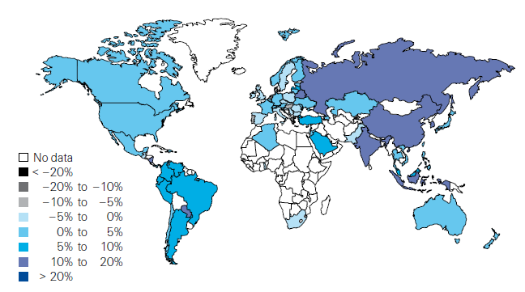
Non-Life Insurance: Global Real (Inflation Adjusted) Premium Growth, 2012
Real growth in non-life insurance premiums was faster in China than the US
Market | Life | Non-Life | Total
Advanced | 1.8 | 1.5 | 1.7
Emerging | 4.9 | 8.6 | 6.8
World | 2.3 | 2.6 | 2.4
Source: Swiss Re, sigma, No. 3/2013.
62
12/01/09 - 9pm
eSlide – P6466 – The Financial Crisis and the Future of the P/C
Notes:
62

Slide 63
Global Real (Inflation Adjusted) Nonlife
Premium Growth: 1980-2010
Average: 1980-2010
Industrialized Countries: 3.8%
Emerging Markets: 9.2%
Overall Total: 4.2%
Nonlife premium growth in emerging markets has exceeded that of industrialized countries in 27 of the past 31 years, including the entirety of the global financial crisis..
Real nonlife premium growth is very erratic in part to inflation volatility in emerging markets as well as a lack of consistent cyclicality
Source: Swiss Re, sigma, No. 2/2010.
63
12/01/09 - 9pm
eSlide – P6466 – The Financial Crisis and the Future of the P/C
Notes:
63

Slide 64
Net Premium Growth: Annual Change,
1971—2013:Q3
(Percent)
1975-78
1984-87
2000-03
Net Written Premiums Fell 0.7% in 2007 (First Decline Since 1943) by 2.0% in 2008, and 4.2% in 2009, the First 3-Year Decline Since 1930-33.
2013:9M = 4.2%
2012 growth was +4.3%
Shaded areas denote “hard market” periods
Sources: A.M. Best (historical and forecast), ISO, Insurance Information Institute.

Slide 65
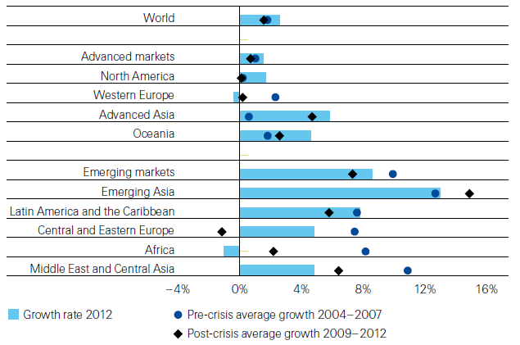
Non-Life Insurance: Global Real (Inflation Adjusted) Premium Growth, 2012
Global Non-Life growth in 2012 exceeded the pre-crisis and post-crisis average. The same is true for advanced Asia economies like China
Source: Swiss Re, sigma, No. 3/2013.
65
12/01/09 - 9pm
eSlide – P6466 – The Financial Crisis and the Future of the P/C
Notes:
65

Slide 66
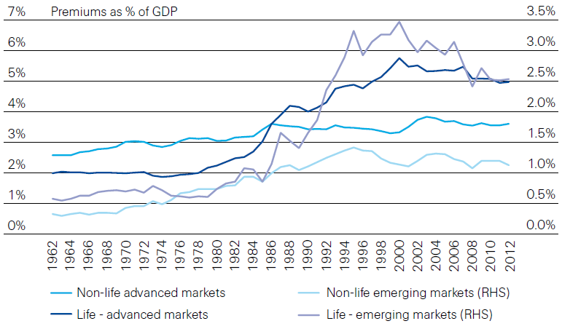
Life and Non-Life Insurance Penetration as a % of GDP: 1962-2012
Life insurance in emerging markets has experienced the fastest in recent decades
Advanced Markets
Emerging Markets
Non-life markets have been slower to grow than life
Source: Swiss Re, sigma, No. 3/2013.
66
12/01/09 - 9pm
eSlide – P6466 – The Financial Crisis and the Future of the P/C
Notes:
66

Slide 67
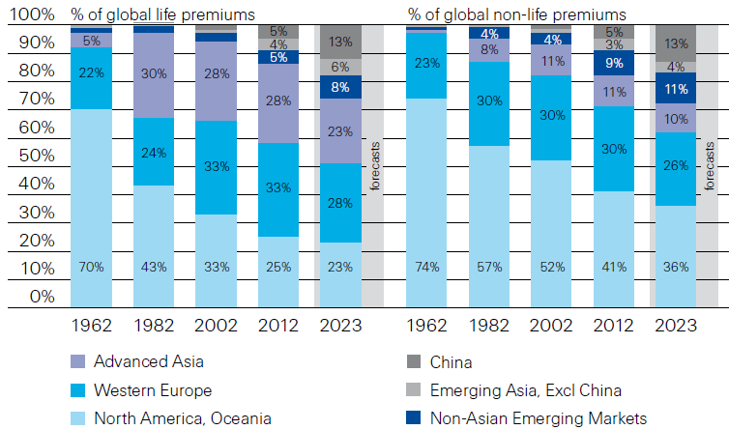
Premiums Written in Life and Non-Life, by Region: 1962-2012
Emerging market shares rose rapidly over the past 50 years
Source: Swiss Re, sigma, No. 3/2013.
67
12/01/09 - 9pm
eSlide – P6466 – The Financial Crisis and the Future of the P/C
Notes:
67

Slide 68
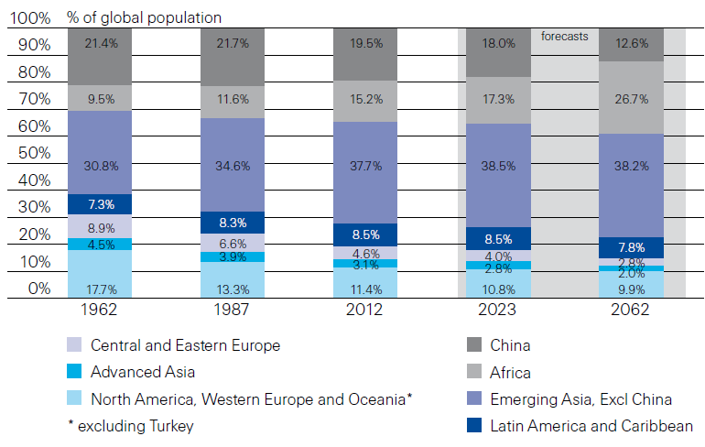
Population Distribution, by Region:
1962-2062F
Enormous population shifts will impact insurance demand over the next half century
Africa is expected to be the fastest population growth over the next 50 years, but no expectation now of Asia-like growth in economies or insurance demand
Source: Swiss Re, sigma, No. 3/2013 from United Nations Department of Economic and Sovial Affairs, Population Division.
68
12/01/09 - 9pm
eSlide – P6466 – The Financial Crisis and the Future of the P/C
Notes:
68

Slide 69
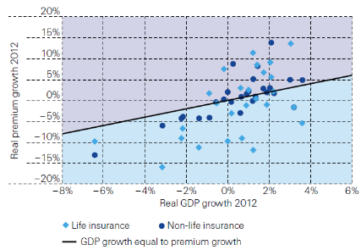
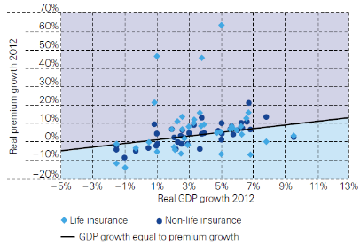
Relationship Between Real GDP and Real Life and Non-Life Premium Growth, 2012
Advanced Markets
Emerging Markets
The was a clear but highly relationship between real GDP growth and real premium growth in advance markets in 2012
The correlation between real GDP growth and real premium growth in emerging markets was much stronger than in advanced markets in 2012
Source: Swiss Re, sigma, No. 3/2013.
69
12/01/09 - 9pm
eSlide – P6466 – The Financial Crisis and the Future of the P/C
Notes:
69

Slide 70
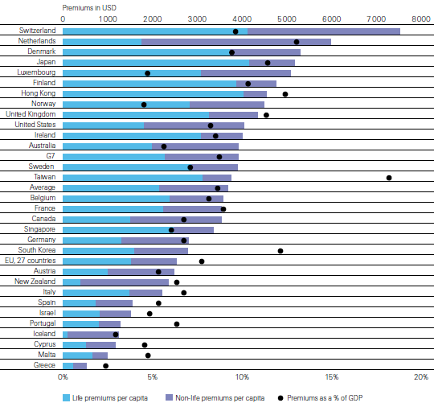
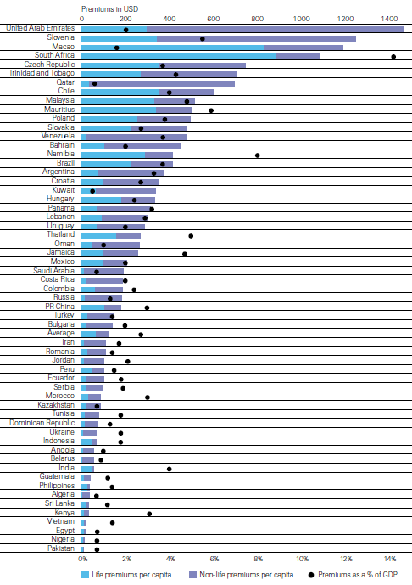
Insurance Density and Penetration for Advanced and Emerging Markets, 2012
Advanced Markets
Emerging Markets
Spending and penetration are highly variable in emerging markets
Spending and penetration are generally much higher in advanced markets, though growth is fastest in emerging markets
Chinese spending on insurance is very similar to Russia, but Russian spending is mostly non-life and in China the majority is life
Source: Swiss Re, sigma, No. 3/2013.
70
12/01/09 - 9pm
eSlide – P6466 – The Financial Crisis and the Future of the P/C
Notes:
70

Slide 71
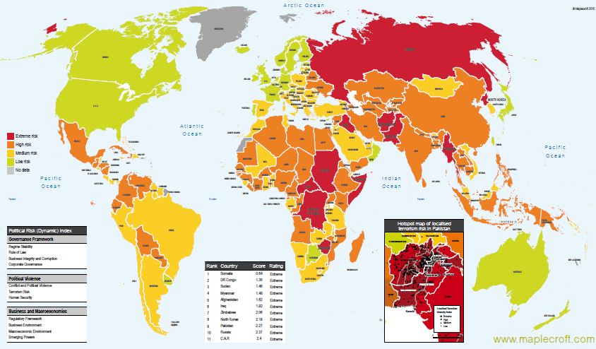
Political Risk in 2011/12: Greatest Business Opportunities Are Often in Risky Nations
The fastest growing markets are generally also among the politically riskiest, including East and South Asia
Heightened risk has economic and insurance implications
Australia and NZ rate well but most neighbors do not
Source: Maplecroft
71
12/01/09 - 9pm
eSlide – P6466 – The Financial Crisis and the Future of the P/C
Notes:
71

Slide 72
P/C Insurance Industry Financial Overview
2013: Best Year in the Post-Crisis Era
Performance Improved with Lower CATs, Strong Markets
72

Slide 73
P/C Net Income After Taxes
1991–2013:Q3 ($ Millions)
2005 ROE*= 9.6%
2006 ROE = 12.7%
2007 ROE = 10.9%
2008 ROE = 0.1%
2009 ROE = 5.0%
2010 ROE = 6.6%
2011 ROAS¹ = 3.5%
2012 ROAS¹ = 5.9%
2013:9M ROAS¹ = 9.5%
Net income is up substantially (+54.7%) from 2012:Q3 $27.8B
2013:9M ROAS was 9.5%
ROE figures are GAAP; ¹Return on avg. surplus. Excluding Mortgage & Financial Guaranty insurers yields a 8.9% ROAS through 2013:Q3, 6.2% ROAS in 2012, 4.7% ROAS for 2011, 7.6% for 2010 and 7.4% for 2009.
Sources: A.M. Best, ISO, Insurance Information Institute

Slide 74
Profitability Peaks & Troughs in the P/C Insurance Industry, 1975 – 2013:Q3*
ROE
History suggests next ROE peak will be in 2016-2017
1977:19.0%
1987:17.3%
10 Years
2006:12.7%
1997:11.6%
2013:Q3 8.9%
10 Years
9 Years
2011: 4.7%
1975: 2.4%
1984: 1.8%
1992: 4.5%
2001: -1.2%
*Profitability = P/C insurer ROEs. 2011-13 figures are estimates based on ROAS data. Note: Data for 2008-2013 exclude mortgage and financial guaranty insurers.
Source: Insurance Information Institute; NAIC, ISO, A.M. Best.

Slide 75
A 100 Combined Ratio Isn’t What It
Once Was: Investment Impact on ROEs
A combined ratio of about 100 generates an ROE of ~7.0% in 2012, ~7.5% ROE in 2009/10,
10% in 2005 and 16% in 1979
Combined Ratio / ROE
Lower CATs are improved ROEs in 2013
Combined Ratios Must Be Lower in Today’s Depressed
Investment Environment to Generate Risk Appropriate ROEs
* 2008 -2013 figures are return on average surplus and exclude mortgage and financial guaranty insurers. 2013:9M combined ratio including M&FG insurers is 95.8; 2012 =103.2, 2011 = 108.1, ROAS = 3.5%.
Source: Insurance Information Institute from A.M. Best and ISO Verisk Analytics data.

Slide 76
ROE: Property/Casualty Insurance vs. Fortune 500, 1987–2013E*
(Percent)
P/C Profitability Is Both by
Cyclicality and Ordinary Volatility
Katrina, Rita, Wilma
Sandy
Sept. 11
Hugo
Lowest CAT Losses in
15 Years
4 Hurricanes
Andrew
Record Tornado Losses
Northridge
Financial Crisis*
* Excludes Mortgage & Financial Guarantee in 2008 – 2013E. 2013 P/C ROE is through 2013:Q3.
Sources: ISO, Fortune; Insurance Information Institute.

Slide 77
ROE: ROEs by Industry vs. Fortune 500, 1987–2012*
Average: 1987-2012
Diversified Finl: 15.0% Commercial Banks: 13.1% All Industries (F500): 13.4% Life/Health Insurance: 8.8% P/C Insurance: 7.6%
(Percent)
* All figures are GAAP.
Sources: ISO, Fortune; Insurance Information Institute.

Slide 78
RNW All Lines by State, 2003-2012 Average:
Highest 25 States
The most profitable states over the past decade are widely distributed geographically, though none are in the Gulf region
Source: NAIC.

Slide 79
RNW All Lines by State, 2003-2012 Average:
Lowest 25 States
Some of the least profitable states over the past decade were hit hard by catastrophes
Source: NAIC.

Slide 80
Property/Casualty Insurance Industry Investment Income: 2000–2013*¹
($ Billions)
Investment earnings are running below their 2007 pre-crisis peak
Investment Income Fell in 2012 and is Falling in 2013 Due to Persistently Low Interest Rates, Putting Additional Pressure on (Re) Insurance Pricing
¹ Investment gains consist primarily of interest and stock dividends..
*Estimate based on annualized actual 9M:2013 investment income of $34.338B.
Sources: ISO; Insurance Information Institute.

Slide 81
Policyholder Surplus,
2006:Q4–2013:Q3
Drop due to near-record 2011 CAT losses
($ Billions)
2007:Q3
Pre-Crisis Peak
Surplus as of 9/30/13 stood at a record high $624.4B
The industry now has $1 of surplus for every $0.78 of NPW,
close to the strongest claims-paying status in its history.
2010:Q1 data includes $22.5B of paid-in capital from a holding company parent for one insurer’s investment in a non-insurance business .
The P/C insurance industry entered 2014
in very strong financial condition.
Sources: ISO, A.M .Best.
81
12/01/09 - 9pm
eSlide – P6466 – The Financial Crisis and the Future of the P/C
Notes:
81

Slide 82
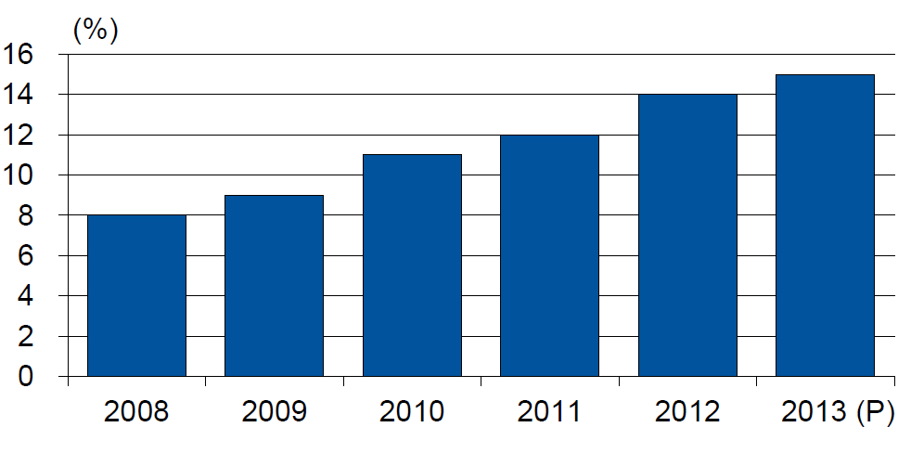
Alternative Capacity as a Percentage of Global Property Catastrophe Reinsurance Limit
(As of Year End)
Alternative Capacity accounted for approximately 14% or $45 billion of the $316 in global property catastrophe reinsurance capital as of mid-2013 (expected to rise to ~15% by year-end 2013)
Source: Guy Carpenter

Slide 83
Global Insured Catastrophe Loss Update
2013 Was a Welcome Respite from the High Catastrophe Losses in Recent Years
83

Slide 84
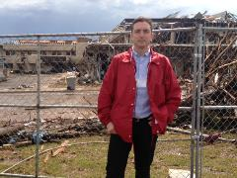
U.S. Insured Catastrophe Losses
($ Billions, $ 2012)
2012 was the third most expensive year ever for insured CAT losses
2012 Was the 3rd Highest Year on Record for Insured Losses in U.S. History on an Inflation-Adj. Basis. 2011 Losses Were the 6th Highest. YTD 2013 Running Well Below 2011 and 2012 YTD Totals.
Record tornado losses caused 2011 CAT losses to surge
*Through 12/31/13.
Note: 2001 figure includes $20.3B for 9/11 losses reported through 12/31/01 ($25.9B 2011 dollars). Includes only business and personal property claims, business interruption and auto claims. Non-prop/BI losses = $12.2B ($15.6B in 2011 dollars.)
Sources: Property Claims Service/ISO; Insurance Information Institute.
84
12/01/09 - 9pm
eSlide – P6466 – The Financial Crisis and the Future of the P/C
Notes:
84

Slide 85
Combined Ratio Points Associated with Catastrophe Losses: 1960 – 2013*
Avg. CAT Loss Component of the Combined Ratio by Decade
1960s: 1.04 1970s: 0.85 1980s: 1.31 1990s: 3.39 2000s: 3.52 2010s: 6.1E*
Catastrophe losses as a share of all losses reached a record high in 2012
Combined Ratio Points
The Catastrophe Loss Component of Private Insurer Losses Has Increased Sharply in Recent Decades
*2010s represent 2010-2013.
Notes: Private carrier losses only. Excludes loss adjustment expenses and reinsurance reinstatement premiums. Figures are adjusted for losses ultimately paid by foreign insurers and reinsurers.
Source: ISO (1960-2011); A.M. Best (2012E) Insurance Information Institute.

Slide 86
Top 10 States for Insured
Catastrophe Losses, 2013
$ Millions
Oklahoma let the country in insured CAT losses in 2013
Source: The Property Claim Services (PCS) unit of ISO, a Verisk Analytics company.

Slide 87
Top 5 States by Insured Catastrophe Losses in 2012*
(2012, $ Billions)
NY and NJ let the US in CAT losses in 2012 due Sandy
*Includes catastrophe losses of at least $25 million.
Sources: PCS unit of ISO; Insurance Information Institute.

Slide 88
Top States by Inflation-Adjusted Insured Catastrophe Losses, 1983–2012
Over the Past 30 Years Florida Has Accounted for the Largest Share of Catastrophe Losses in the U.S., Followed by Texas and Louisiana
FL is the most costly state for CATs, with nearly $67B in insured losses over the past 30 years
Louisiana
$42.0B
Texas
$48.8B
Rest of the U.S.
$309.9B
Florida
$66.7B
Total: $467.5 Billion, an average of $16.6B per year or $1.3B per month
Source: PCS unit of ISO, Verisk Company.; Insurance Information Institute.

Slide 89
Inflation Adjusted U.S. Catastrophe Losses by Cause of Loss, 1993–2012¹
Wind/Hail/Flood (3), $14.9
Fires (4), $6.5
Other (5), $0.2
Insured cat losses from 1993-2012 totaled $391.7B, an average of $19.6B per year or $1.6B per month
Geological Events, $18.4
Terrorism, $24.8
Winter Storms, $27.8
Hurricanes & Tropical Storms, $158.2
Tornado share of CAT losses is rising
Wind losses are by far cause the most catastrophe losses, even if hurricanes/TS are excluded.
Tornadoes (2), $140.9
Catastrophes are defined as events causing direct insured losses to property of $25 million or more in 2012 dollars.
Excludes snow.
Does not include NFIP flood losses
Includes wildland fires
Includes civil disorders, water damage, utility disruptions and non-property losses such as those covered by workers compensation.
Source: ISO’s Property Claim Services Unit.

Slide 90
Top 16 Most Costly Disasters in U.S. History
(Insured Losses, 2012 Dollars, $ Billions)
Hurricane Sandy became the 5th costliest event in US insurance history
Includes Tuscaloosa, AL, tornado
Includes Joplin, MO, tornado
Hurricane Irene became the 12th most expense hurricane in US history in 2011
12 of the 16 Most Expensive Events in US History Have Occurred Over the Past Decade
*PCS estimate as of 4/12/13.
Sources: PCS; Insurance Information Institute inflation adjustments to 2012 dollars using the CPI.

Slide 91
Top 16 Most Costly World Insurance Losses, 1970-2013*
(Insured Losses, 2012 Dollars, $ Billions)
5 of the top 14 most expensive catastrophes in world history have occurred within the past 3 years (2010-2012)
2012 insured CAT Losses totaled $60B; Economic losses totaled $140B, according to Swiss Re
Hurricane Sandy is now the 6th costliest event in global insurance history
*Figures do not include federally insured flood losses.
**Estimate based on PCS value of $18.75B as of 4/12/13.
Sources: Munich Re; Swiss Re; Insurance Information Institute research.

Slide 92
Natural Disasters in the United States, 1980 – 2013
Number of Events (Annual Totals 1980 – 2013)
There were 128 natural disaster events in 2013
Number
22
19
81
6
Geophysical
(earthquake, tsunami,
volcanic activity)
Meteorological (storm)
Climatological
(temperature extremes,
drought, wildfire)
Hydrological
(flood, mass movement)
Source: MR NatCatSERVICE
92

Slide 93
Losses Due to Natural Disasters in the US, 1980–2013
(Overall and Insured Losses)
(2013 Dollars, $ Billions)
2013 CAT Losses
Overall : $21.8B
Insured: $12.8B
Indicates a great deal of losses are uninsured (~40%-50% in the US) = Growth Opportunity
2013 losses were far below 2011 and 2012 and were 44% lower than the average from 2000-2012
Overall losses (in 2012 values)
Insured losses (in 2013 values)
Source: MR NatCatSERVICE
93

Slide 94
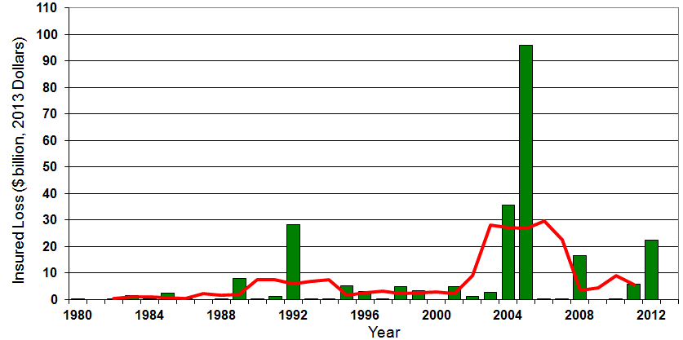

Insured US Tropical Cyclone Losses, 1980 - 2013
The current 5-year average (2008 - 2013) insured tropical cyclone loss is $5.6 billion per year.
Sources: Property Claims Service, Munich Re NatCatSERVICE, NFIP
94

Slide 95
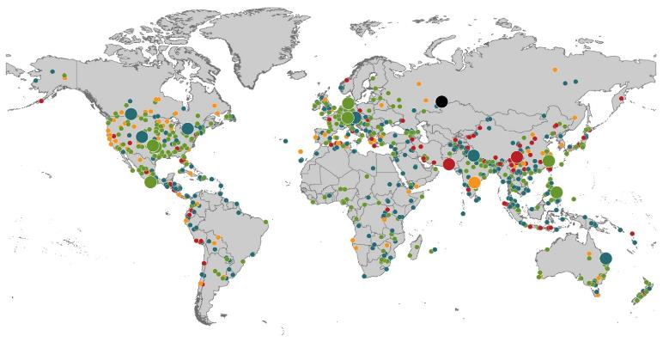
Natural Loss Events:
Full Year 2013
World Map
Winter Storm Christian (St. Jude)
Europe, 27–30 October
Floods
Europe,
30 May–19 June
Meteorite impact
Russian Federation, 15 February
Flash floods
Canada, 8–9 July
Floods
Canada, 19–24 June
Earthquake
China, 20 April
Hailstorms
Germany,
27–28 July
Floods
USA, 9–16 September
Typhoon Fitow
China, Japan,
5–9 October
Severe storms, tornadoes
USA, 18–22 May
Typhoon Haiyan
Philippines,
8–12 November
Severe storms, tornadoes
USA, 28–31 May
Floods
India, 14–30 June
Hurricanes Ingrid & Manuel
Mexico, 12–19 September
Floods
Australia,
21–31 January
880
Loss events
Earthquake (series)
Pakistan, 24–28 September
Heat wave
India, April–June
Geophysical events
(earthquake, tsunami, volcanic activity)
Hydrological events
(flood, mass movement)
Natural catastrophes
Geophysical events
(earthquake, tsunami, volcanic activity)
Hydrological events
(flood, mass movement)
Selection of significant
Natural catastrophes
Meteorological events
(storm)
Climatological events
(extreme temperature, drought, wildfire)
Meteorological events
(storm)
Climatological events
(extreme temperature, drought, wildfire)
Extraterrestrial events
(Meteorite impact)
Source: Munich Re Geo Risks Research, NatCatSERVICE – as of January 2014.
95

Slide 96
Natural Disasters Worldwide,
1980 – 2013 (Number of Events)
There were 880 natural disaster events globally in 2013 compared to 905 in 2012
Number
Geophysical
(earthquake, tsunami,
volcanic activity)
Meteorological (storm)
Climatological
(temperature extremes,
drought, wildfire)
Hydrological
(flood, mass movement)
Source: MR NatCatSERVICE
96

Slide 97
Losses Due to Natural Disasters Worldwide, 1980–2013 (Overall & Insured Losses)
(Overall and Insured Losses)
(2013 Dollars, $ Billions)
10-Yr. Avg. Losses
Overall : $184B
Insured: $56B
2013 Losses
Overall : $125B
Insured: $34B
There is a clear upward trend in both insured and overall losses over the past 30+ years
Overall losses (in 2013 values)
Insured losses (in 2013 values)
Source: MR NatCatSERVICE
97

Slide 98
Terrorism Update
Down to the Wire? Boston Bombings Underscore the Need for Extension of the Terrorism Risk Insurance Program
Download III’s Terrorism Insurance Report at: http://www.iii.org/white_papers/terrorism-risk-a-constant-threat-2013.html
98
Notes:
98

Slide 99
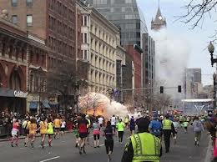
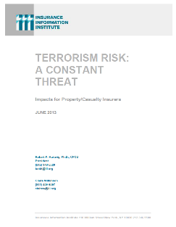
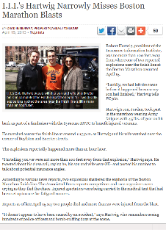
Terrorism Risk Insurance Program
Reauthorization Was a Major Industry Initiative for 2013 Even Before Boston
I.I.I. Testified at First Congressional Hearing on 9/11/12
  Provided testimony at NYC hearing on 6/17/13
I.I.I. Accelerated Planned Study on Terrorism Risk and Insurance in the Wake of Boston and Was Well Received
  Terrorism: A Constant Threat issued in June 2013
99
12/01/09 - 9pm
eSlide – P6466 – The Financial Crisis and the Future of the P/C
Notes:
99

Slide 100
Terrorism Risk Insurance Program
Boston Marathon Bombing Has Helped Focus Attention in Congress on TRIPRA and its Looming Expiration
  Act expires 12/31/14
  Exclusionary language will likely be inserted for post-1/1/2014 renewals and will likely lead to significant media interest (educational opportunity)
  Numerous headwinds; not a priority issue in 2013 in Congress
  3 extension bills introduced in 2013—2 since Boston
Media Interest Soared
  I.I.I. was conducting its first interviews within minutes after live-tweeting (nearly) from the scene; TV interest was high
  Local, national and international media focused on this topic for the first time in any significant way since TRIA’s inception in late 2002
  Inquiries revealed very little/no understanding (or even awareness) outside insurance industry and business owners
  Certification process caused confusion
100
12/01/09 - 9pm
eSlide – P6466 – The Financial Crisis and the Future of the P/C
Notes:
100

Slide 101
Loss Distribution by Type of Insurance from Sept. 11 Terrorist Attack ($ 2011)
($ Billions)
Total Insured Losses Estimate: $40.0B**
*Loss total does not include March 2010 New York City settlement of up to $657.5 million to compensate approximately 10,000 Ground Zero workers or any subsequent settlements.
**$32.5 billion in 2001 dollars.
Source: Insurance Information Institute.

Slide 102
TRIA Outlook
Difficult Reauthorization Battle Ahead
  Very difficult to overcome antigovernment/small government, Tea Party forces in the House
  Most Committee members in both houses weren’t around in 2007
House Hearings in 2012; House and Senate in Sept. 2013
If Reauthorized, Insurer Participation Likely Increased
Some Have Attacked TRIA as “Corporate Welfare”
  In reality the taxpayer is 100% protected
  NFIP, Crop programs have led to miscomprehensions
Emphasizing Benefits to Employees Under WC is Key
Misperception by Some that Terrorism is Urban Issue
Growth Opportunity: Standalone Cover if No Reauthorization
  Though limited capacity will not be sufficient to meet need

Slide 103
Terrorism Insurance Take-up Rates,
By Year, 2003-2012
Take-up rates for smaller commercial risks are lower—potentially very low in some areas and industries
In 2003, the first year TRIA was in effect, the terrorism take-up rate was 27 percent. Since then, it has increased steadily, remaining in the low 60 percent range since 2009.
Source: Marsh Global Analytics, 2013 Terrorism Risk Insurance Report, May 2013.
103
Notes:
103

Slide 104
TRIA Outlook
3 TRIA Reauthorization Bills Introduced in 2013
Bumpy Road to Reauthorization Ahead
  Senate: Generally supportive based on 9/25 hearing
  House: Democrats supportive; Republicans skeptical but some seem willing to support reauthorization based on 11/13 hearing
    Analogies to Affordable Care Act often mentioned by Republicans
House Committee Proposals Likely to Involve:
  Increase in trigger (from current $100 million)
  Increasing individual comp. retentions (from current 20% of DPE)
  Also possible: Simple industry aggregate or NBCR only proposal
I.I.I.: Success of Current Structure & Taxpayer Protections
Also Focused on Importance of Small/Medium Insurers
Limitations of Capacity in the Absence of TRIA
Media in 2014 Wants Stories of Economic Disruption

Slide 105
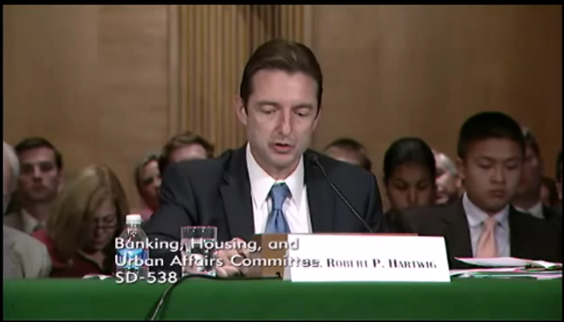
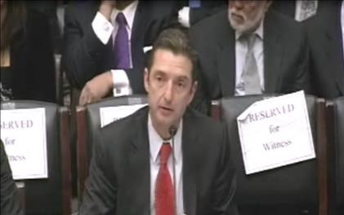
Terrorism Risk Insurance Program
Testified before Senate Banking Cmte. in Sept. 2013
Testified before House Financial Services Nov. 2013
Provided testimony at NYC hearing on June 2013
I.I.I. Accelerated Planned Study on Terrorism Risk and Insurance in the Wake of Boston and Hearings; Was Well Received and Widely Circulated
Working with Trades, Congressional Staff, GAO & Others
House Financial Services Subcommittee, 11/13/13
Senate Banking Committee, 9/25/13
105
12/01/09 - 9pm
eSlide – P6466 – The Financial Crisis and the Future of the P/C
Notes:
105

Slide 106
Pyramid of Taxpayer Protection:
Strong, Stable, Sound and Secure
If TRIA is reauthorized, it is highly likely insurer retentions will be increased
Hard Cap
$100 Bill
Government Recoupment
Industry Aggregate
Retention: $27.5 Bill
Insurer Co-Payments
15% Above Retention
Individual Insurer Retention
20% of Premiums Earned
Program Dollar Threshold
$100 Million
Certification Dollar Threshold
$5 Million
Certification of Terrorist Act: Definition Must Be Met

Slide 107
Summary of Terrorism Risk Insurance Program Extension Bills Introduced in 2013
Bill | Summary
H.R. 508: “Terrorism Risk Insurance Act of 2002 Reauthorization Act of 2013” Introduced Feb. 5 by Rep. Michael Grimm (D-NY) | 5-Year Extension (through 2019) Extend recoupment period for any TRIA assistance from 2017 to 2019
H.R. 2146: “Terrorism Risk Insurance Program Reauthorization Act of 2013” Introduced May 23 by Rep. Michael Capuano (D-MA) | 10-Year Extension (through 2024) Extend recoupment period for any TRIA assistance from 2017 to 2024 Requires President’s Working Group on Financial Markets (PWGFM) to issue reports on long-term availability and affordability of terrorism insurance in 2017, 2020 and 2023 Reports to be drafted with consultation from NAIC and representatives of the insurance and securities industries and policyholders
H.R. 1945: “Fostering Resilience to Terrorism Act of 2013” Introduced May 9 by Rep. Benny Thompson (D-MS) | 10-Year Extension (through 2024) Recoupment period changed to 2024 Would transfer responsibility for certification of a “act of terrorism” to the Secretary of Homeland Security from Secretary of Treasury. PWGFM to issue reports in 2017, 2020 and 2023 Requires Sec. of DHS to provide insureds with “timely homeland security information, including terrorism risk information, at the appropriate level of classification and information on best practices to foster resilience to an act of terrorism.”
Source: Nelson, Levine, de Luca & Hamilton, FIO Focus, June 10, 2013; Insurance Information Institute.

Slide 108
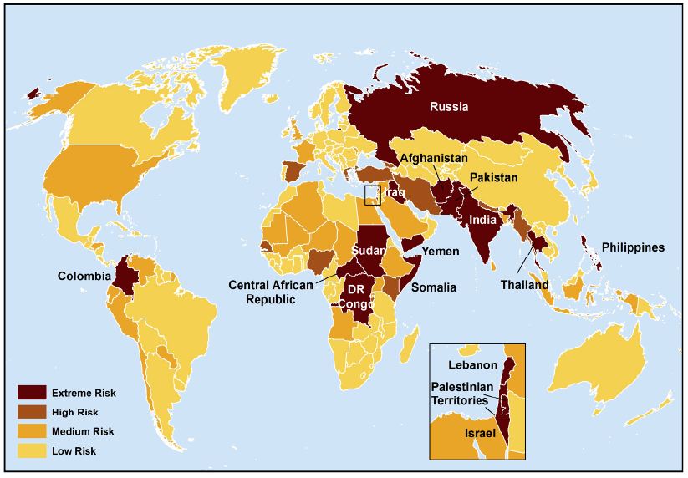
Terrorist Risk Index
The threat of terrorism is highest in South Asia, Russia, the Middle East and Central and East Africa
The US is still considered to be at “Medium Risk” for a terrorist attack
Sources: Maplecroft Terrorism Risk Index; (2011); Guy Carpenter; Insurance Information Institute.

Slide 109
Terrorism Violates Traditional Requirements for Insurability
Requirement | Definition | Violation
Estimable Frequency | Insurance requires large number of observations to develop predictive rate-making models (an actuarial concept known as credibility) | Very few data points Terror modeling still in infancy, untested. Inconsistent assessment of threat
Estimable Severity | Maximum possible/ probable loss must be at least estimable in order to minimize “risk of ruin” (insurer cannot run an unreasonable risk of insolvency though assumption of the risk) | Potential loss is virtually unbounded. Losses can easily exceed insurer capital resources for paying claims. Extreme risk in workers compensation and statute forbids exclusions.
Source: Insurance Information Institute

Slide 110
Terrorism Violates Traditional Requirements for Insurability (cont’d)
Requirement | Definition | Violation
Diversifiable Risk | Must be able to spread/distribute risk across large number of risks “Law of Large Numbers” helps makes losses manageable and less volatile | Losses likely highly concentrated geographically or by industry (e.g., WTC, power plants)
Random Loss Distribution/Fortuity | Probability of loss occurring must be purely random and fortuitous Events are individually unpredictable in terms of time, location and magnitude | Terrorism attacks are planned, coordinated and deliberate acts of destruction Dynamic target shifting from “hardened targets” to “soft targets” Terrorist adjust tactics to circumvent new security measures Actions of US and foreign govts. may affect likelihood, nature and timing of attack
Source: Insurance
Information Institute

Slide 111
Financial Strength & Underwriting
Cyclical Pattern is P-C Impairment History is Directly Tied to Underwriting, Reserving & Pricing
111

Slide 112
P/C Insurer Impairments, 1969–2012
Impairments among P/C insurers remain infrequent
The Number of Impairments Varies Significantly Over the P/C Insurance Cycle, With Peaks Occurring Well into Hard Markets
Source: A.M. Best Special Report “Pace of P/C Impairments Slowed in 2012; Auto Writers, RRGs Continued to Struggle,” June 2013; Insurance Information Institute.

Slide 113
P/C Insurer Impairment Frequency vs. Combined Ratio, 1969-2012
2012 impairment rate was 0.69%, down from 1.11% in 2011; the rate is lower than the 0.82% average since 1969
Impairment Rates Are Highly Correlated With Underwriting Performance and Reached Record Lows in 2007; Recent Increase Was Associated Primarily With Mortgage and Financial Guaranty Insurers and Not Representative of the Industry Overall
Source: A.M. Best; Insurance Information Institute

Slide 114
Reasons for US P/C Insurer Impairments, 1969–2012
Historically, Deficient Loss Reserves and Inadequate Pricing Are
By Far the Leading Cause of P-C Insurer Impairments.
Investment and Catastrophe Losses Play a Much Smaller Role
Reinsurance Failure
Sig. Change in Business
Misc.
Investment Problems (Overstatement of Assets)
Deficient Loss Reserves/
Inadequate Pricing
Affiliate Impairment
Catastrophe Losses
Alleged Fraud
Rapid Growth
Source: A.M. Best Special Report “Pace of P/C Impairments Slowed in 2012; Auto Writers, RRGs Continued to Struggle,” June 2013; Insurance Information Institute.

Slide 115
Rapid Growth ‘A Leading Cause’ of Impairment’
“The leading causes of impairment are deficient loss reserves (inadequate pricing) and rapid growth, together comprising more than 50 percent of annual impairments.”
- A.M. Best, 2013
Source: SNL Financial, Insurance Information Institute.

Slide 116
Top 10 Lines of Business for US P/C Impaired Insurers, 2000–2012
Workers Comp and Pvt. Passenger Auto Account for More Than 40 Percent of the Impaired Insurers Since 2000
Other
Title
Surety
Workers Comp
Med Mal
Other Liability
Pvt. Passenger Auto
Commercial Auto Liability
Commercial Multiperil
Homeowners
Source: A.M. Best Special Report “Pace of P/C Impairments Slowed in 2012; Auto Writers, RRGs Continued to Struggle,” June 2013; Insurance Information Institute.
.

Slide 117
Insurance Information Institute Online:
www.iii.org
Thank you for your time
and your attention!
Twitter: twitter.com/bob_hartwig
Download at www.iii.org/presentations

