Slide 1
The Historical Arc of Insurance Regulation and Modernization:
Convergence or Disharmony?
Past , Present and Future
St. John’s University
School of Risk Management, Insurance & Actuarial Science
New York, NY
October 24, 2013
Robert P. Hartwig, Ph.D., CPCU, President & Economist
Insurance Information Institute ♦ 110 William Street ♦ New York, NY 10038
Tel: 212.346.5520 ♦ Cell: 917.453.1885 ♦ bobh@iii.org ♦ www.iii.org

Slide 2
Presentation Outline
A History of Insurance and Insurance Regulation
The Eight Waves of Regulation in US Insurance History
  The institutionalization of insurance regulation
  Industrialization, progressive politics and federal power
  The genesis of rate regulation
  Reversing Course: A massive display of federal power
  A deregulatory pulse
  Crises and regulatory fury
  Global Crises, Global Responses
  Shadow Regulators
Future Shock: Waves of Risk Near and Far
  Health Insurance and the Affordable Care Act (“ObamaCare”)
  Emerging Markets, Emerging Risks
Thoughts on Significant Near-Term Risks
Summary
Q&A

Slide 3
A History of Insurance and the Rise of Regulation
The Roots of Insurance Extend Back Thousands of Years
Formal Regulation Came Much Later
3

Slide 4
In the Beginning…
Civilizations Long Ago Discovered the Benefits of Risk Pooling and Risk Transfer
4

Slide 5


Origins of Insurance…and Insurance Regulation
Earliest Forms of Insurance Date to 1800 BC in Babylon
  Code of Hammurabi
  282 clauses on the topic of “bottomery”
  Bottomery is a loan taken out by the owner of a ship to finance its voyage (no premium involved)
  If ship was lost, loan didn’t have to be repaid
Roman Emperor Claudius (10BC – 54AD)
  Eager to boost grain trade, Claudius became a 1-man, premium free insurance company by personally guaranteeing the storm losses of Roman merchants (also granted citizenship to sailors and exempted them from laws that penalized adultery and celibacy)
  Reduced taxes on communities impacted by drought or famine (form of ancient disaster aid)
Greek/Roman Occupational Guilds→Early Life Insurance
  Paid into pool that made payment to deceased member’s family
Sources: Elements drawn from Against the Gods: The Remarkable Story of Risk, Peter L. Bernstein; Insurance Information Institute.

Slide 6
Origins of Insurance…and Insurance Regulation
The Rise of Long Distance Trade: The Explosion of Risk and Reward
  14th Century: Italian city states of Venice, Florence, Genoa and Pisa became global epicenters for trade and are where the earliest written insurance contract originated
    The word “policy” is from the Italian “polizza” meaning promise or undertaking
  Bruges, Antwerp followed in the 15th century, Amsterdam by 17th century
  By 1600 England had become a major trading nation
From Expensive Cargo/Ships Arose Disputes and the Need for Certainty and the Foundations for Insurance Regulation Were Laid
  “For whom they insure, it is sweet to them to take the monies; but when disaster comes, it is otherwise, and each man draws his rump back and strives not to pay.”
    Franceso di Marco Datini, Florentine Merchant, 14th Century, complaining about insurers of his era (Datini left 400 marine insurance policies in his estate when he died)
  “For even though I were to live a thousand years, never again would I underwrite insurance.”
    Guiglielmo Barberi, 14th Century, lamenting the loss of a bale of cloth and a barrel of furs he had underwritten on a ship that had been plundered by pirates, but had no ability to pay
Sources: Elements drawn from Against the Gods: The Remarkable Story of Risk by Peter L. Bernstein, J. Wiley & Sons (1996); Insurance Perspectives, G. Gibbons, G. Rejda and M. Elliott., American Institutes for CPCU (1992); Insurance Information Institute.

Slide 7

Origins of Insurance…and Insurance Regulation
London and the Dawn of Insurance Regulation
  Italian forms of marine insurance contracts were used in London since at least the 15th century
  London merchants frequently acted as underwriters
  Contracts were negotiated by commodity brokers
  Notaries drafted/delivered policies and kept registers of policies written
  Chamber of Assurances established in 1576 and until 1690 all policies had to be registered in its office in the Royal Exchange
1601: Francis Bacon Introduces Bill to Regulate Insurance Policies
  Bacon recognized the ubiquity and of utility of insurance contracts which were “tyme out of mynde an usage amonste merchants, both of this realm and of forraine nacyons.”
  Led to 1601 Act of Parliament that formally recognized that the benefits of insurance justified legal sanction, with the government willing to enforce insurance contracts and resolve disputes
Sources: Elements drawn from Against the Gods: The Remarkable Story of Risk by Peter L. Bernstein, J. Wiley & Sons (1996); Insurance Perspectives, G. Gibbons, G. Rejda and M. Elliott., American Institutes for CPCU (1992); Insurance Information Institute.

Slide 8
The 8 Stages (Waves) of Insurance Regulation in the United States
Regulation in the U.S. Has Been Characterized by Periodic Pulses of Activity
8

Slide 9
Regulatory Wave #1
1850- 1900
The Institutionalization of State-Based Insurance Regulatory Schemes
9

Slide 10
Year of Establishment of Insurance Regulator Supervision
1854
1855 MA
RI 1856
VT, NH, IN 1852
1853
MS 1857
1858
1859
1850
1851
The half century from 1850-1900 bore witness to a massive wave of institutionalized regulation of the business of insurance
1850s
NV 1864
WV, CT 1865
VA 1866
1862
1863
WI, OH 1867
CA, IA, ME 1868
MO, GA, IL 1869
NY, AL 1860
1861
1860s
1874
NJ 1875
TX, SC 1876
FL, MD, MN 1872
AR, NE, PA, TN 1873
WY 1877
1878
DE 1879
KY 1870
KS, MI 1871
1870s
UT 1884
1885
1886
NM 1882
MT, CO 1883
AZ 1887
1888
ND, WA, SD 1889
1880
1881
1880s
1894
1895
1896
1892
1893
1897
LA 1898
AK 1900
OK 1890
ID 1891
1899
1901
DC 1902
1890-1902
Sources: Insurance Information Institute based on information in Appendix IV of The History of the National Board of Fire Underwriters: Fifty Years of a Civilizing Force, Harry Chase Brearly, published by Frederick A. Stokes Co. (1916).

Slide 11
Number of Recessions Endured by P/C Insurers, by Number of Years in Operation
Number of Recessions Since 1860
Insurers that have made it to the age of 150 have endured 32 recessions over the years
Number of Years in Operation
Longevity Requires an Insurer to Overcome Extreme Economic Adversity of Every Sort
Sources: Insurance Information Institute research from National Bureau of Economic Research data.
11
12/01/09 - 9pm
eSlide – P6466 – The Financial Crisis and the Future of the P/C
Notes:
11

Slide 12
The Supreme Court Reinforces (Establishes) the Primacy of State Regulation of Insurance
Paul vs. Virginia (1869)
Since its mid-18th century origins in the US, insurance had been regulated under the general laws governing commerce in the states in which the insurer had been granted a charter/license to operate
As the US economy expanded and insurers (based mostly in the Northeast) sought to expand along with the country, they wanted to avoid the cost and complexity of complying with the many and varied requirements promulgated by the states
Virginia in 1866 enacted legislation requiring a $30,000+ bond be deposited with the state treasurer as a condition of licensure for out-of-state insurers (the agents representing them needed a license as well)
Test Case: Insurers determined to challenge the law asserting that VA’s law interfered with the federal government’s constitutional power to regulate interstate commerce [Modern Historical Parallel: Pre-crisis push for OFC]
  States opposed since they generated significant revenues from the taxation of premiums
Several NY companies appointed as their agent in VA Samuel D. Paul, a Petersburg, VA, attorney.
Sources: Insurance Perspectives, G. Gibbons, G. Rejda and M. Elliott., American Institutes for CPCU (1992); Introduction to Risk Management and Insurance, Mark S. Dorfman, Pearson/Prentice Hall (2007); Insurance Information Institute.

Slide 13
The Supreme Court Reinforces (Establishes) the Primacy of State Regulation of Insurance
Paul vs. Virginia (1869)
Paul applied for a license which was denied because the bond had not been deposited but continued to sell insurance
Paul was indicted, convicted and fined ($50)
Case was eventually appealed to the US Supreme Court which ruled unanimously in VA’s favor
Chief Justice Stephen J. Field delivered the court’s opinion that:
  “Issuing a policy of insurance is not a transaction of commerce. The policies are simple contracts of indemnity against loss by fire…They are not commodities to be shipped from one state to another, and put up for sale. They are like personal contracts between parties which are completed by their signature and transfer of consideration…The policies do not take effect—are not executed contracts—until delivered by the agent in Virginia, They are, then, local transactions, governed by local law.”
This settled the law on the matter of state vs. federal regulation for the next 75 years
Sources: Insurance Perspectives, G. Gibbons, G. Rejda and M. Elliott., American Institutes for CPCU (1992); Introduction to Risk Management and Insurance, Mark S. Dorfman, Pearson/Prentice Hall (2007); Insurance Information Institute.

Slide 14
Regulatory Wave #2
1880- 1920
Industrialization, Progressive Politics and the Assertion of Federal Regulatory Might
14

Slide 15
Societal Changes Drive a Re-Evaluation of Insurance: Tidal Wave of Regulation
Historically, the determination of pricing (in any industry) was not viewed as a function of government, but the outcome of negotiation between parties
Societal views on this began to change in the period from 1887-1916 (roughly) with American industrialization and the rise of finance
  Munn v. Illinois (1877) [Supreme Ct. affirmed authority of states to regulate prices in businesses affected with the public interest]
  Interstate Commerce Act (1887)
  Sherman Antitrust Act (1890)
  Clayton Act (1914) [amended the Sherman Act]
  Federal Reserve Act (1913) [100 years later, the Fed has discovered insurance!]
  16th Amendment (1913) [permitted the establishment of a federal income tax]
Kansas Rate Law (1909, Upheld by US Supreme Court in 1914): Court said that insurance was “a business affected with the public interest” and that insurance rate regulation was an appropriate function of government
New York Rate Law of 1922: Required fire insurers to join approved rating bureau through which the NYID attempted to determine that rates were reasonable (neither inadequate nor excessive)
Sources: Insurance Perspectives, G. Gibbons, G. Rejda and M. Elliott., American Institutes for CPCU (1992); Insurance Information Institute.

Slide 16
Cumulative Number of WC Laws Passed, 1910-1920
Insurance was quickly becoming part of the nation’s economic infrastructure. Nearly every state adopted “modern” workers comp laws between 1910 and 1920
Source: http://eh.net/encyclopedia/article/fishback.workers.compensation; Insurance Information Institute.

Slide 17
Regulatory Wave #3
1910- 1943
The Genesis of Rate Regulation
17

Slide 18
Regulation Oversight Tightens,
Especially Over Rates
Armstrong Committee (1905) and Merritt Committee: NY investigations into alleged inappropriate practices of life and fire insurers, respectively
Investigations led to calls for federal regulation of the insurance industry coming both from the critics and from some in the industry itself.
  NJ Senator John Dryden (also President of Prudential Life) advocated for federal regulation in 1905 considering it “infinitely preferable to the intolerable regulation [of the states].” President Theodore Roosevelt that year even proposed that insurance be regulated and supervised by the Bureau of Corporation, but Congress did not act.
Southeastern Underwriters Case: After ~20 years of experience with rating bureaus some states—led by Missouri—came to view insurers’ actions through these bureaus as collusive.
  A federal investigation was launched and in 1942 the US Justice Department charged the Southeastern Underwriters Association and 9 of its member insurers with violations of the Sherman Antitrust Act. [The SEUA was owned by 200 private stock fire insurers that controlled 90%+ of the business in 6 southeastern states.]
Case was ultimately appealed to the Supreme Court which in 1944 stunned the industry by finding that the SEUA had violated antitrust law
Sources: Insurance Perspectives, G. Gibbons, G. Rejda and M. Elliott., American Institutes for CPCU (1992); Insurance Information Institute.

Slide 19
Regulatory Wave #4
1944- Present
Reversing Course: A Massive Display of Federal Power in Insurance Regulation
19

Slide 20
Out With the Old…In With Dual Regulation
1944 SEUA Supreme Court decision effectively overturned the 1869 Paul v. Virginia decision—after 75 years
State and Federal regulation of insurance were both constitutional
  This created an obvious dilemma with no obvious solution
  Congress stepped into the void
McCarran-Ferguson Act of 1945
  Crafted a partial exemption of the business of insurance from the Sherman, Clayton and FTC Acts to the extent it is regulated by the states
  Maintained that federal antitrust laws do apply in cases of boycott, coercion or intimidation
  Widely misunderstood by industry critics (including occasionally some members of Congress) as a blanket exemption from antitrust statutes
NAIC’s 1946 All Industry Bill became the model law establishing a framework for regulation in the wake of McCarran-Ferguson
Stringent rate regulation became the norm and by 1948 all states had enacted rate regulatory laws, usually in line with the All Industry Bill
Sources: Insurance Perspectives, G. Gibbons, G. Rejda and M. Elliott., American Institutes for CPCU (1992); Insurance Information Institute.

Slide 21
Regulatory Wave #5
1999- 2009
A Pulse of Deregulation
21

Slide 22
The Pendulum Swings: Financial Services Deregulation and Gramm-Leach-Bliley
By the late 1990s, years of bull markets and merger mania led to the view that Depression Era legislation such as Glass-Steagal (1933) prohibiting affiliations between commercial banks and securities firms were anachronistic
Gramm-Leach-Bliley Act of 1999
  Repealed Glass-Steagal
  Allowed the formation of Financial Service Holding Companies that permitted combinations of banks, securities firms and insurers
Preserved state-based regulation of insurance entities
Had little impact on insurance industry in the US
Only one major transaction involving an insurer took place—merger between Citi and Travelers in 1998
  Travelers was spun off in 2002
The idea of banks in insurance (“bancassurance”) never caught on in the US but was somewhat popular in Europe until the financial crisis
Sources: Insurance Information Institute research.

Slide 23
Regulatory Wave #6
2008 - Present
Crisis and Regulatory Fury
23

Slide 24
The Global Financial Crisis: The Pendulum Swings Again: Dodd-Frank & Systemic Risk
Dodd-Frank Act of 2010: The implosion of the housing bubble and virtual collapse of the US banking system, the seizure of credit markets and massive government bailouts of US financial institutions led to calls for sweeping regulatory reforms of the financial industry
Limiting Systemic Risk is at the Core of Dodd-Frank
Designation as a Systemically Important Financial Institutional (SIFI) Will Result in Greater Regulatory Scrutiny and Heightened Capital Requirements
Dodd-Frank Established Several Entities Impacting Insurers
  Federal Insurance Office
  Financial Stability Oversight Council
  Office of Financial Research
  Consumer Financial Protection Bureau

Slide 25
The Global Financial Crisis: The Pendulum Swings Again: Dodd-Frank & Systemic Risk
Insurers—as Non-Bank Financial Institutions—Have Escaped Some, though Not All of the Most Draconian Provision of Dodd-Frank
  In particular, small number of large insurers will (are) receiving a designations as Systemically Important Financial Institutions (SIFIs)
Insurers Generally Reject the Notion that Insurance Is Systemically Risky (or that any Individual Insurer is Systemically Important)
Such a Designation Makes the Fed the Penultimate Regulator
To Date: AIG, Prudential Have Been Designated as non-bank SIFIs by the FSOC
  MetLife is still under evaluation
Fed Reserve Seems Open to Developing a Tailored Capital Requirement Approach for Insurers
  Conflicting language in the DFA make this somewhat difficult
  SIFIs may need Fed approval to repurchase shares on increase dividend

Slide 26
Regulatory Wave #7
2010 - Present
Global Crises, Global Response
26

Slide 27
Global Financial Crises &
Global Systemic Risk
The Global Financial Crisis Prompted the G-20 Leaders to Request that the Financial Stability Board (FSB) Assess the Systemic Risks Associated with SIFIs, Global-SIFIs in Particular
In July 2013, the FSB Endorsed the International Association of Insurance Supervisors Methodology for Identifying Globally Systemically Important Insurers (G-SIIs)
For Each G-SII, the Following Will Be Required:
  (i) Recovery and resolution plans
  (ii) Enhanced group-wide supervision
  (iii) Higher loss absorbency (HLA) requirements
G-SIIs as Designated by the FSB as of July 2013:
  Allianz SE AIG Assicurazioni Generali
  Aviva Axa MetLife
  Ping An Prudential Financial Prudential plc

Slide 28
Global Financial Crises &
Global Systemic Risk: Key Dates
Implementation Date | Action
July 2013 | Designation of G-SIIs (annual updates thereafter beginning Nov. 2014)
July 2014 | FSB to make a decision on the G-SII status of, and appropriate risk mitigating measures for major reinsurers
By G-20 Summit 2014 | IAIS to develop backstop capital requirements to apply to all group activities, incl. non-ins. subs.
End 2015 | IAIS to develop HLA requirements that will apply to G-SIIs staring in 2019
January 2019 | G-SIIs to apply HLA requirements
Sources: Financial Stability Board, “Globally Systemically Important Insurers (G-SIIs) and the Policy Measures that Will Apply to Them,” July 18, 2013.

Slide 29
Global Financial Crises &
Global Systemic Risk…There’s More…
IAIS Also Plans to Develop the First-Ever Risk-Based Global Insurance Capital Standards by 2016
Would be Tested in 2017-2018; Implemented in 2019
Would Be Included as Part of ComFrame and Apply to Internationally Active Insurance Groups (IAIGs): ~50 IAIGs Designations Likely
While Flexibility May Exist within the Standards, Doubts in the US Are Likely to Be Strong
  Concern that the standards may be bank-centric
  Questions as to whether such standards are even needed:
  “Although US state insurance regulators continue to have doubts about the timing, necessity and complexity of developing a global capital standard given regulatory differences around the globe, we intend to remain fully engaged in the process to ensure that any development augments the strong legal entity capital requirements in the US that have provided proven and tested security for US policyholders and stable insurance markets for consumers and industry.” --NAIC President Ben Nelson (P/C 360, Oct. 16, 2013)

Slide 30
Regulatory Wave #8
Time Immemorial → End of Time
Shadow Regulators
30

Slide 31

Shadow Regulators—A New and Unpredictable Regulatory Concern?
How Many Insurance Regulators Are There?
50 State Departments of Insurance
50 State Attorneys General, 50 Governors
Thousands of State Legislators, Hundreds in Congress
New Federal Entities (FIO, FSOC) and Fed
Global Entities (IAIS, FSB)?
Eliot Spitzer and contingent commission issue
  Little substance to his accusations
MS AG Jim Hood—post-Katrina in wind vs. water dispute
Former Florida Governor Charlie Christ on rates, deductibles
Governors on hurricane deductibles post-Sandy
Shadow Regulators: A Source of Moral Hazard
Sources: Insuce Information Institute.

Slide 32

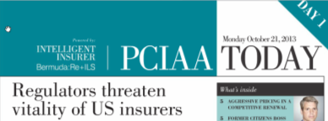
Insurance Regulation and the
Great Arc of the History
That Was Then… | This is Now…
“…misguided zealots, honest in intention but without knowledge of the special problems of underwriting present the greatest danger. They usually are the authors of the most revolutionary plans and their pride of authorship makes them the most impatient of correction.” | “Overzealous regulators are endangering the vigour, competitiveness and diversity of insurers in the US.”
“Public enjoyment of fair rates, sound protection, prompt adjustments, and freedom from discrimination is not due…to unwilling virtue under compulsion, but to the underwriters’ knowledge that any other course would be unprofitable—bad business.” | “If a policy is priced in a certain way on a certain basis, we cannot allow the terms and conditions simply to be overturned by political considerations.”
1916
2013 (Oct. 21)

Slide 33
Shadow Regulators—A New and Unpredictable Regulatory Concern?
Is the Phenomenon of Shadow Regulators Really a New One?
  “…one turns with a feeling of surprise, of bewilderment, to the intense activity of…state legislators fairly seething with legislation on fire insurance. Why should there be 2,500 bills in a single year unless the subject be one of immediate and overwhelming emergency…Many of the bills introduced are conceived in a spirit of indiscriminate hostility…from the time immemorial, politicians of a certain type have sought to pose as defenders of the people from the aggressions of capital…The politician has learned that popularity and applause may be most quickly attained by attacking largeness…’Big-game’ hunting…brings its political rewards. Fire insurance companies seem to be the most accessible of the larger fauna.”
    Harry Chase Stokes, The History of the National Board of Fire Underwriters: Fifty Years of a Civilizing Force, 1916.

Slide 34
Future Shock
Waves of Risk for the Immediate Future
34

Slide 35
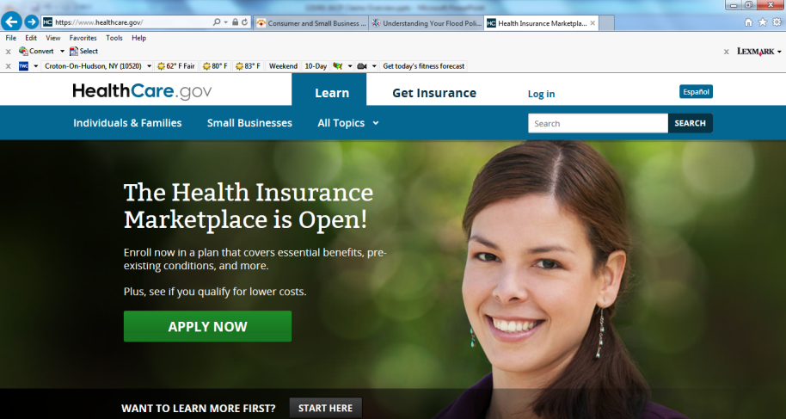
Affordable Care Act (“ObamaCare”): Grand Opening October 1
Health Insurance Marketplaces Are Open But Remain a Logistical and Political Nightmare
Sources: Screen capture on Oct. 1, 2013 from www.HealthCare.gov; Insurance Information Institute.

Slide 36
States of Play | Management of Health-Insurance Exchanges
Some states are running new health-insurance exchanges on their own. Other are leaving some or all of the task to the federal government.
WA
Federally Run
exchange
MT
ND
ME
OR
MN
VT
State-run
exchange
ID
WI
NY
NH
SD
MA
Federal and
state joint-run
exchange
WY
MI
RI
IA
PA
CT
NV
NE
OH
NJ
UT
IL
IN
DE
CA
CO
WV
VA
MD
KS
MO
KY
TN
NC
AZ
NM
OK
AR
SC
MS
AL
GA
RI
AK
CT
TX
LA
NJ
FL
DE
HI
MD
DC
Source: Wall Street Journal, September 20, 2013.

Slide 37
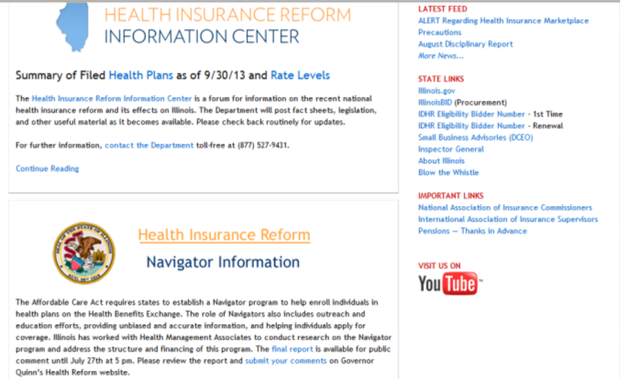
Affordable Care Act (“ObamaCare”): Grand Opening October 1
Health Insurance Marketplaces But Info About Health Insurance Is Much More Available on Some State’s Websites Than Others
Sources: Screen capture on Oct. 24, 2013 from Insurance.Illinois.gov; Insurance Information Institute.

Slide 38
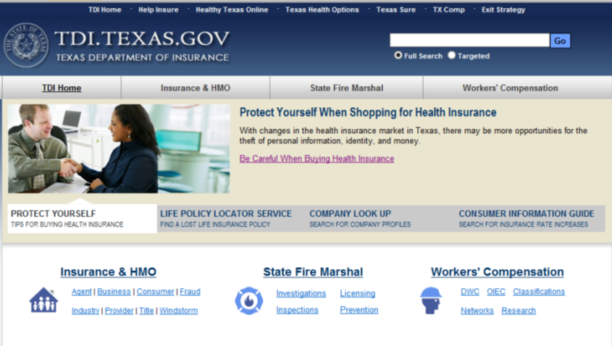
Affordable Care Act (“ObamaCare”): Grand Opening October 1
Health Insurance Marketplaces But Info About Health Insurance Is Much More Available on Some State’s Websites Than Others
Sources: Screen capture on Oct. 24, 2013 from TDI.Texas.gov ; Insurance Information Institute.

Slide 39
Risk, Insurance and Regulation
U.S. and Global Perspective
Is the World Becoming a Riskier, More Uncertain Place?
Is Insurance and Its Regulatory Framework Up to the Task?
39

Slide 40

Uncertainty, Risk and Fear Abound: Insurance Can Help Mitigate Risk
US Debt and Budget Crisis
European Sovereign Debt & Eurozone Crises
Political Gridlock in the US, Europe, Japan
“Hard Landing” in China/Emerging Economies
Fiscal Imbalances
Monetary Policy/Tapering/Low Interest Rates
Unemployment
Political Upheaval in the Middle East
Resurgent Terrorism Risk
Diffusion of Weapons of Mass Destruction
Cyber Attacks
Record Natural Disaster Losses
Climate Change
Environmental Degradation
Income Inequality
(Over)Regulation
Are “Black Swans” everywhere or does it just seem that way?

Slide 41





5 Major Categories for Global Risks, Uncertainties and Fears: Insurance Solutions
Economic Risks
Geopolitical Risks
Environmental Risks
Technological Risks
Societal Risks
While risks can be broadly categorized, none are mutually exclusive
Source: Adapted from World Economic Forum, Global Risks 2013; Insurance Information Institute.

Slide 42
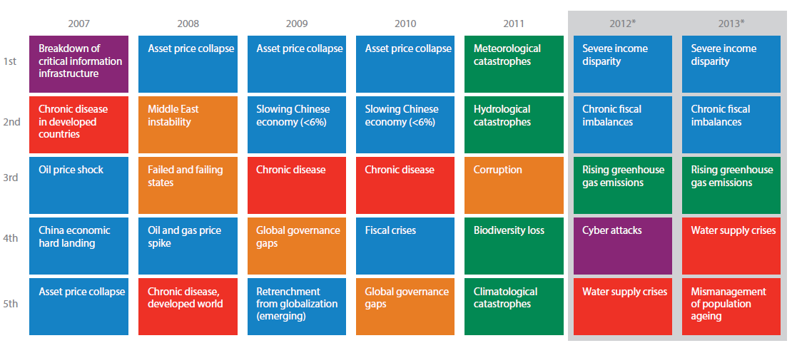
Top 5 Global Risks in Terms of Likelihood, 2007—2013: Insurance Can Help With Most
In 2013, economic and climate change concerns dominated frequency concerns
Concerns Shift Considerably Over Short Spans of Time. Shift in 2012 to Economic Risks and Away from Environmental Risks
Source: World Economic Forum, Global Risks 2013; Insurance Information Institute.
42
12/01/09 - 9pm
eSlide – P6466 – The Financial Crisis and the Future of the P/C
Notes:
42

Slide 43
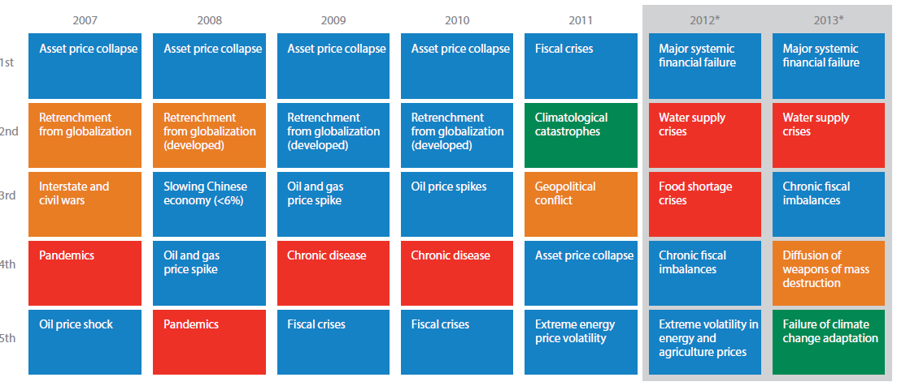
Top 5 Global Risks in Terms of Impact,
2007—2013: Insurance Can Help With Most
Impacts from economic, societal, geopolitical and environmental risks were all of great concern in 2013
Concerns Over the Impacts of Economics Risks Remained High in 2013, but Societal, Environment and Societal Risks Also Loom Large
Source: World Economic Forum, Global Risks 2013; Insurance Information Institute.
43
12/01/09 - 9pm
eSlide – P6466 – The Financial Crisis and the Future of the P/C
Notes:
43

Slide 44
Globalization:
Insurance Regulation Has Always Followed Economic Growth and New Risks RosTransmits Risks
Globalization Is a Double Edged Sword—Creating Opportunity and Wealth But Potentially Creating and Amplifying Risk
Emerging vs. “Advanced” Economies
44

Slide 45
US Real GDP Growth*
The Q4:2008 decline was the steepest since the Q1:1982 drop of 6.8%
Real GDP Growth (%)
Recession began in Dec. 2007. Economic toll of credit crunch, housing slump, labor market contraction was severe
2014 is expected to see a modest acceleration in growth
Demand for Insurance Continues To Be Impacted by Sluggish Economic Conditions, but the Benefits of Even Slow Growth Will Compound and Gradually Benefit the Economy Broadly
* Estimates/Forecasts from Blue Chip Economic Indicators.
Source: US Department of Commerce, Blue Economic Indicators 10/13; Insurance Information Institute.

Slide 46
GDP Growth: Advanced & Emerging Economies vs. World, 1970-2014F
Emerging economies (led by China) are expected to grow by 5.0% in 2013 and 5.4% in 2014.
GDP Growth (%)
World output is forecast to grow by 3.1% in 2013 and 3.8% in 2014. The world economy shrank by 0.6% in 2009 amid the global financial crisis
Advanced economies are expected to grow at a sluggish pace of 1.2% in 2013 but accelerate to 2.1% in 2014.
Source: International Monetary Fund, World Economic Outlook , July 2013 WEO Update; Ins. Info. Institute.

Slide 47
Real GDP Growth Forecasts:
Major Economies: 2011 – 2014F
US growth should acceleratein 2014
Growth in China has outpaced the US and Europe
The Eurozone is ending
Growth Prospects Vary Widely by Region: Growth Returning in the US, Recession in the Eurozone, Some strengthening in Latin America
Sources: Blue Chip Economic Indicators (9/2013 issue); Insurance Information Institute.
47
Notes:
47

Slide 48
Real GDP Growth Forecasts:
Selected Economies: 2011 – 2014F
Strong economies in smaller industrialized nations will bolster demand for products, services, international trade and insure
Growth Outside the US, Europe and Japan is Relatively Strong
Sources: Blue Chip Economic Indicators (9/2013 issue); Insurance Information Institute.
48
Notes:
48

Slide 49
World Trade Volume: 1948—2013F
Global trade volume will approach $19 trillion in 2013, a 155% over the past decade
$ Billions
Insurance Regulation Will Necessarily Become More Transnational, Following Patterns of Global Economic Growth, the Creation of New Insurable Exposures and International Capital Flows
Sources: World Trade Organization data through 2011; Insurance Information Institute estimate for 2013 based on IMF forecasts as of July 2013.
49
12/01/09 - 9pm
eSlide – P6466 – The Financial Crisis and the Future of the P/C
Notes:
49

Slide 50
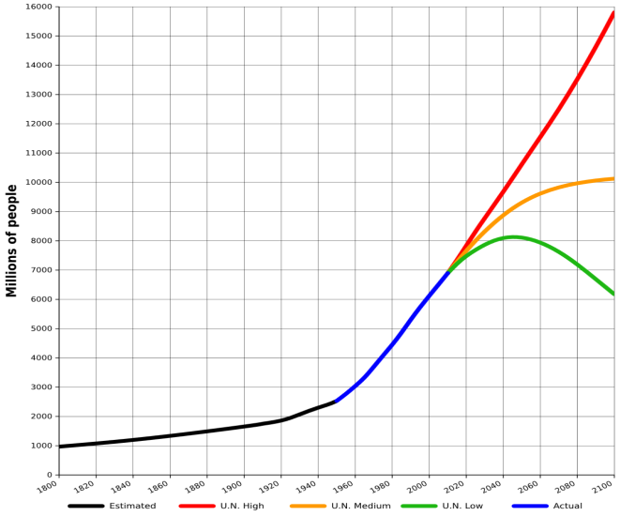
World Population Growth: 2010—2100F
The future of insurance will be tied global population growth—life insurance more closely than nonlife.
Mid-range scenarios suggest a massive slowdown in the number of available lives to insure. Growth will be increasing dependent on product penetration rates in emerging economies
Sources: United Nations, World Population Prospects, June 13, 2013; Insurance Information Institute .
50
12/01/09 - 9pm
eSlide – P6466 – The Financial Crisis and the Future of the P/C
Notes:
50

Slide 51
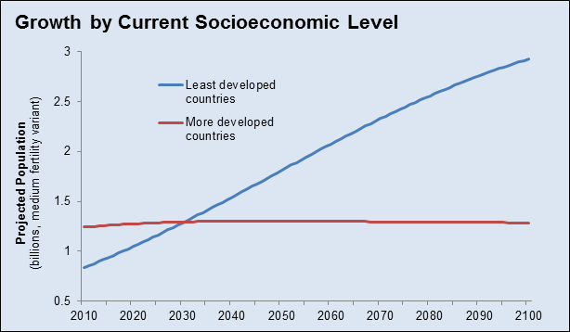
Population Growth: Developed vs. Less Developed Countries 2010—2100F
Virtually all of the world’s population growth through the end of the 21st century will occur in the developing world
Sources: United Nations, World Population Prospects, June 13, 2013; Insurance Information Institute .
51
12/01/09 - 9pm
eSlide – P6466 – The Financial Crisis and the Future of the P/C
Notes:
51

Slide 52
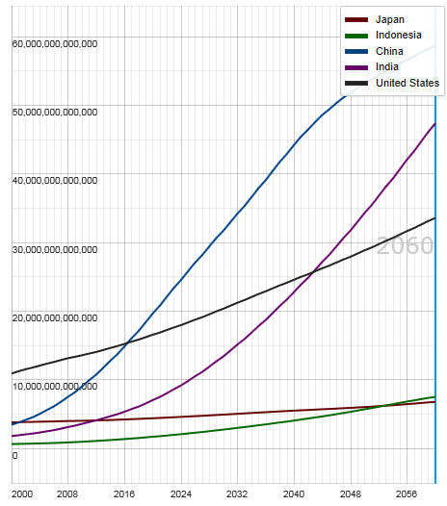
Potential Output of Total Economy: US, China, India, Indonesia and Japan, 2000-2060F
$ 2005 PPP
Growth in economic output will be concentrated in certain developing economies such as China and India
China will likely become the world’s largest economy between 2025 and 2030
Source: OECD; Insurance Information Institute .
52
12/01/09 - 9pm
eSlide – P6466 – The Financial Crisis and the Future of the P/C
Notes:
52

Slide 53
Global Insurance Premium Growth Trends:
Life and Non-Life
Growth Is Uneven Across Regions and Market Segments
53

Slide 54
Premium Growth by Region, 2012
Latin America growth was the strongest in 2012
Growth in Advanced Asia (incl. China) markets was third highest in 2012
Global Premium Volume Totaled $4.613 Trillion in 2012, up 2.4% from $4.566 Trillion in 2011. Global Growth Was Weighed Down by Slow Growth in N. America and W. Europe and Partially Offset by Emerging Markets
Source: Swiss Re, sigma, No. 3/2013.
54
Notes:
54

Slide 55
Distribution of Global Insurance Premiums, 2012 ($ Trillions)
Total Premium Volume = $4.613 Trillion*
Life insurance accounted for nearly 57% of global premium volume in 2012 vs. 43% for Non-Life
Source: Swiss Re, sigma, No. 3/2013; Insurance Information Institute.

Slide 56
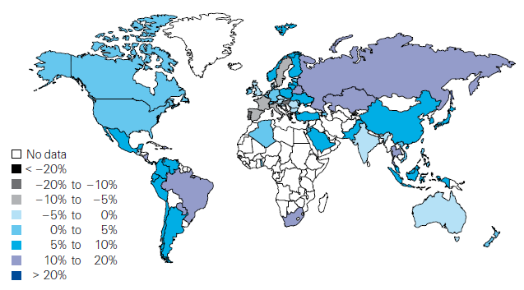
Global Real (Inflation Adjusted) Premium Growth (Life and Non-Life): 2012
Emerging markets in Asia, including China, showed faster growth an the US or Europe
Premium growth in emerging markets was 4 times that of advanced economies in 2012
Market | Life | Non-Life | Total
Advanced | 1.8 | 1.5 | 1.7
Emerging | 4.9 | 8.6 | 6.8
World | 2.3 | 2.6 | 2.4
Source: Swiss Re, sigma, No. 3/2013; Insurance Information Institute.
56
12/01/09 - 9pm
eSlide – P6466 – The Financial Crisis and the Future of the P/C
Notes:
56

Slide 57
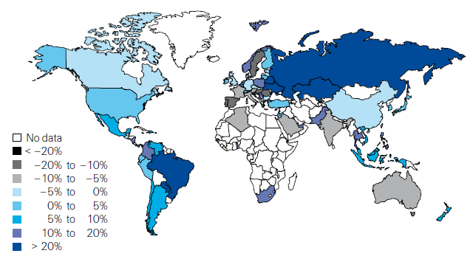
Life Insurance: Global Real (Inflation Adjusted) Premium Growth, 2012
Real growth in life insurance premiums was a bit slower in China than the US
Market | Life | Non-Life | Total
Advanced | 1.8 | 1.5 | 1.7
Emerging | 4.9 | 8.6 | 6.8
World | 2.3 | 2.6 | 2.4
Source: Swiss Re, sigma, No. 3/2013.
57
12/01/09 - 9pm
eSlide – P6466 – The Financial Crisis and the Future of the P/C
Notes:
57

Slide 58
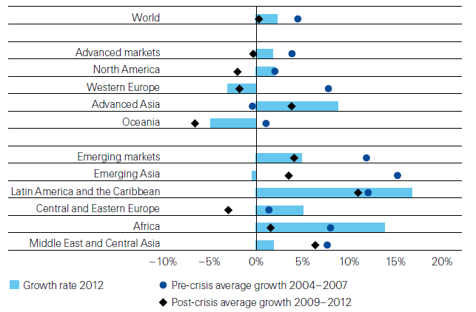
Life Insurance: Global Real (Inflation Adjusted) Premium Growth, 2012
Global Life Insurance growth in 2012 was lower than the pre-crisis average but above than the post-crisis average. Advanced Asia economies like China saw stronger growth on average than before or after the crisis.
Source: Swiss Re, sigma, No. 3/2013.
58
12/01/09 - 9pm
eSlide – P6466 – The Financial Crisis and the Future of the P/C
Notes:
58

Slide 59
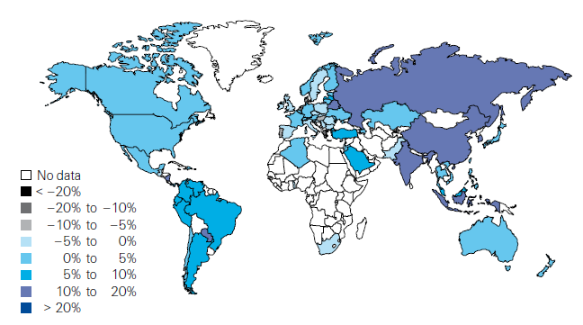
Non-Life Insurance: Global Real (Inflation Adjusted) Premium Growth, 2012
Real growth in non-life insurance premiums was faster in China than the US
Market | Life | Non-Life | Total
Advanced | 1.8 | 1.5 | 1.7
Emerging | 4.9 | 8.6 | 6.8
World | 2.3 | 2.6 | 2.4
Source: Swiss Re, sigma, No. 3/2013.
59
12/01/09 - 9pm
eSlide – P6466 – The Financial Crisis and the Future of the P/C
Notes:
59

Slide 60
Global Real (Inflation Adjusted) Nonlife
Premium Growth: 1980-2010
Average: 1980-2010
Industrialized Countries: 3.8%
Emerging Markets: 9.2%
Overall Total: 4.2%
Nonlife premium growth in emerging markets has exceeded that of industrialized countries in 27 of the past 31 years, including the entirety of the global financial crisis..
Real nonlife premium growth is very erratic in part to inflation volatility in emerging markets as well as a lack of consistent cyclicality
Source: Swiss Re, sigma, No. 2/2010.
60
12/01/09 - 9pm
eSlide – P6466 – The Financial Crisis and the Future of the P/C
Notes:
60

Slide 61
Net Premium Growth: Annual Change,
1971—2013:Q1
(Percent)
1975-78
1984-87
2000-03
Net Written Premiums Fell 0.7% in 2007 (First Decline Since 1943) by 2.0% in 2008, and 4.2% in 2009, the First 3-Year Decline Since 1930-33.
2013:Q1 = 4.1%
2012 growth was +4.3%
Shaded areas denote “hard market” periods
Sources: A.M. Best (historical and forecast), ISO, Insurance Information Institute.

Slide 62
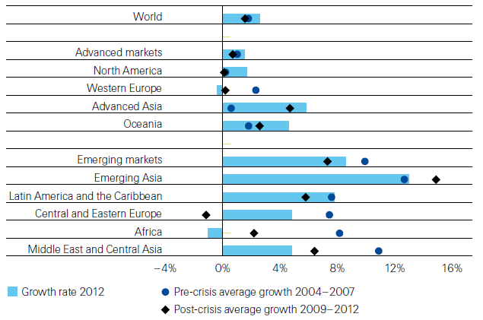
Non-Life Insurance: Global Real (Inflation Adjusted) Premium Growth, 2012
Global Non-Life growth in 2012 exceeded the pre-crisis and post-crisis average. The same is true for advanced Asia economies like China
Source: Swiss Re, sigma, No. 3/2013.
62
12/01/09 - 9pm
eSlide – P6466 – The Financial Crisis and the Future of the P/C
Notes:
62

Slide 63
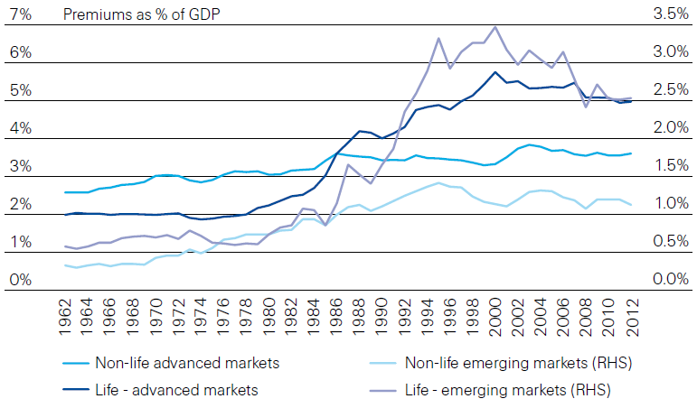
Life and Non-Life Insurance Penetration as a % of GDP: 1962-2012
Life insurance in emerging markets has experienced the fastest in recent decades
Advanced Markets
Emerging Markets
Non-life markets have been slower to grow than life
Source: Swiss Re, sigma, No. 3/2013.
63
12/01/09 - 9pm
eSlide – P6466 – The Financial Crisis and the Future of the P/C
Notes:
63

Slide 64
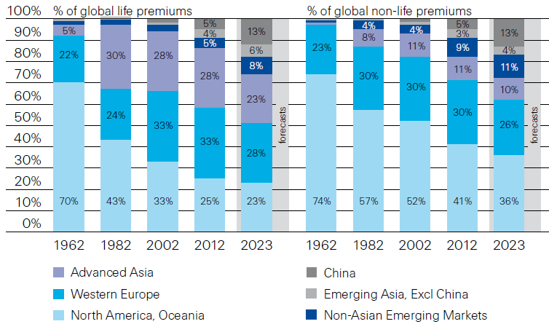
Premiums Written in Life and Non-Life, by Region: 1962-2012
Emerging market shares rose rapidly over the past 50 years
Source: Swiss Re, sigma, No. 3/2013.
64
12/01/09 - 9pm
eSlide – P6466 – The Financial Crisis and the Future of the P/C
Notes:
64

Slide 65
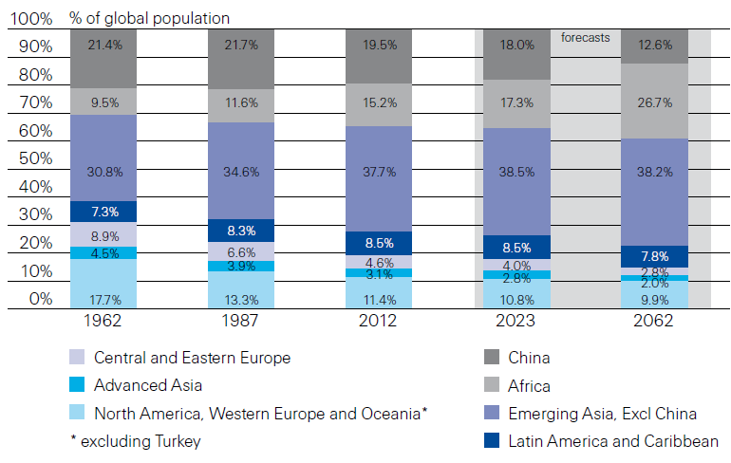
Population Distribution, by Region:
1962-2062F
Enormous population shifts will impact insurance demand over the next half century
Africa is expected to be the fastest population growth over the next 50 years, but no expectation now of Asia-like growth in economies or insurance demand
Source: Swiss Re, sigma, No. 3/2013 from United Nations Department of Economic and Sovial Affairs, Population Division.
65
12/01/09 - 9pm
eSlide – P6466 – The Financial Crisis and the Future of the P/C
Notes:
65

Slide 66
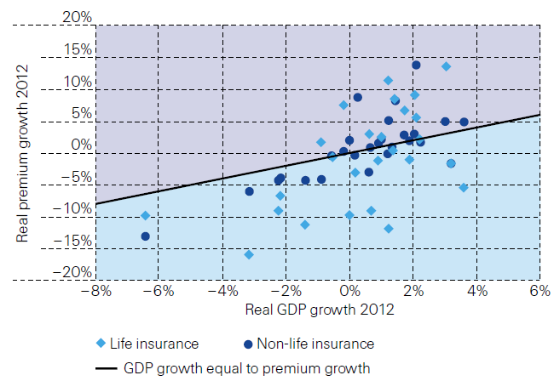
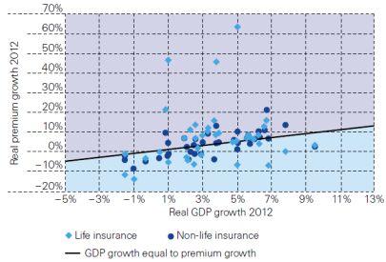
Relationship Between Real GDP and Real Life and Non-Life Premium Growth, 2012
Advanced Markets
Emerging Markets
The was a clear but highly relationship between real GDP growth and real premium growth in advance markets in 2012
The correlation between real GDP growth and real premium growth in emerging markets was much stronger than in advanced markets in 2012
Source: Swiss Re, sigma, No. 3/2013.
66
12/01/09 - 9pm
eSlide – P6466 – The Financial Crisis and the Future of the P/C
Notes:
66

Slide 67
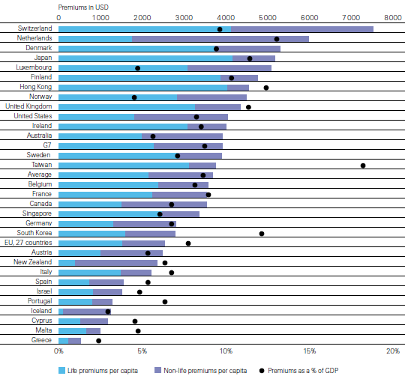
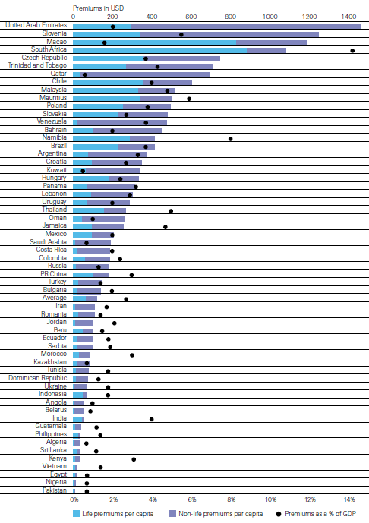
Insurance Density and Penetration for Advanced and Emerging Markets, 2012
Advanced Markets
Emerging Markets
Spending and penetration are highly variable in emerging markets
Spending and penetration are generally much higher in advanced markets, though growth is fastest in emerging markets
Chinese spending on insurance is very similar to Russia, but Russian spending is mostly non-life and in China the majority is life
Source: Swiss Re, sigma, No. 3/2013.
67
12/01/09 - 9pm
eSlide – P6466 – The Financial Crisis and the Future of the P/C
Notes:
67

Slide 68
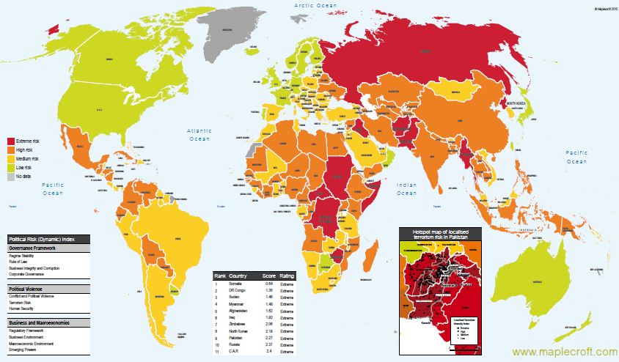
Political Risk in 2011/12: Greatest Business Opportunities Are Often in Risky Nations
The fastest growing markets are generally also among the politically riskiest, including East and South Asia
Heightened risk has economic and insurance implications
Australia and NZ rate well but most neighbors do not
Source: Maplecroft
68
12/01/09 - 9pm
eSlide – P6466 – The Financial Crisis and the Future of the P/C
Notes:
68

Slide 69
Thoughts on Near-Term Risks
New Risks Pose New
Regulatory Questions
69

Slide 70
Near-Term Risks—Can They Be Managed?
Dysfunction in Washington is Unquestionably a Systemic Risk
  Affects every industry
  Institutional investors concerned when dysfunction threatens default
Persistently Low Interest Rates
Rising Catastrophe Loss Trends/Climate Change
Terrorism (TRIA Reauthorization Debate)
Cyber Risk
Big Data/Advanced Data Analytics
Convergence/Alternative Capital in Reinsurance Markets
Proposed New FASB Accounting Rules for Insurance
Insurer Board of Director Governance Issues
Financial Services Regulatory “Black Holes”: China
Sources: Insurance Information Institute.

Slide 71
U.S. Treasury Security Yields:
A Long Downward Trend, 1990–2013*
Yields on 10-Year U.S. Treasury Notes have been essentially below 5% for a full decade.
U.S. Treasury security yields recently plunged to record lows
Since roughly 80% of P/C bond/cash investments are in 10-year or shorter durations, most P/C insurer portfolios will have low-yielding bonds for years to come.
*Monthly, constant maturity, nominal rates, through August 2013.
Sources: Federal Reserve Bank at http://www.federalreserve.gov/releases/h15/data.htm.
National Bureau of Economic Research (recession dates); Insurance Information Institute.
71
12/01/09 - 9pm
eSlide – P6466 – The Financial Crisis and the Future of the P/C
Notes:
71

Slide 72
Top 16 Most Costly Disasters in U.S. History
(Insured Losses, 2012 Dollars, $ Billions)
Hurricane Sandy could become the 4th or 5th costliest event in US insurance history
Includes Tuscaloosa, AL, tornado
Includes Joplin, MO, tornado
Hurricane Irene became the 12th most expense hurricane in US history in 2011
12 of the 16 Most Expensive Events in US History Have Occurred Over the Past Decade
*PCS estimate as of 4/12/13.
Sources: PCS; Insurance Information Institute inflation adjustments to 2012 dollars using the CPI.

Slide 73
Losses Due to Natural Disasters Worldwide, 1980–2013* (Overall & Insured Losses)
(Overall and Insured Losses)
(2012 Dollars, $ Billions)
2012 Losses
Overall : $101.1B
Insured: $57.9B
2013: 1st Half Losses
Overall : $45B
Insured: $13B
There is a clear upward trend in both insured and overall losses over the past 30+ years
Overall losses (in 2012 values)
Insured losses (in 2012 values)
*Through June 30, 2013.
Source: MR NatCatSERVICE
73

Slide 74
Loss Distribution by Type of Insurance from Sept. 11 Terrorist Attack ($ 2011)
($ Billions)
Total Insured Losses Estimate: $40.0B**
*Loss total does not include March 2010 New York City settlement of up to $657.5 million to compensate approximately 10,000 Ground Zero workers or any subsequent settlements.
**$32.5 billion in 2001 dollars.
Source: Insurance Information Institute.

Slide 75
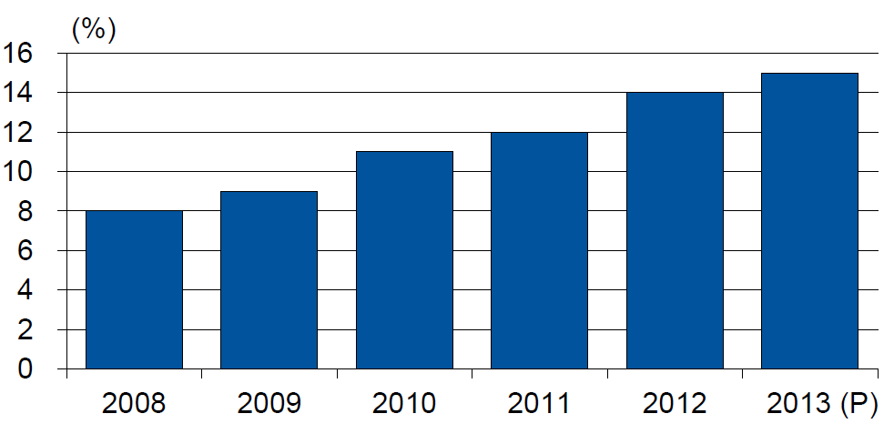
Alternative Capacity as a Percentage of Global Property Catastrophe Reinsurance Limit
(As of Year End)
Alternative Capacity accounted for approximately 14% or $45 billion of the $316 in global property catastrophe reinsurance capital as of mid-2013 (expected to rise to ~15% by year-end 2013)
Source: Guy Carpenter

Slide 76
Property Catastrophe Reinsurance Capacity by Source as of Mid-2013 ($ Bill)
Total = $316 Billion*
“Convergence Capital” accounted for an estimated $45B or 14% or total property catastrophe reinsurance capacity as of mid-2013, up $10B over the past 18 months (since 1/1/12). Penetration of this type of capacity is growing
Collateralized reinsurance (sidecars) is the fastest growing segment recently
Source: Guy Carpenter; Mid-Year Market Report, September 2013; Insurance Information Institute.

Slide 77
Non-Traditional Property Catastrophe
Limits by Type, YE 2012 vs. YE 2015E
Alternative capital is expected to rise by 30% by YE 2015 and will ultimately account for 20-30% of total reinsurance spend, according to Guy Carpenter
Source: Guy Carpenter; Reinsurance Association of America; Insurance Information Institute.

Slide 78
Summary
Insurance Markets Evolve Gradually Whereas Regulation Is Characterized by Waves or Pulses of Activity
These Quantum Changes Exacerbate What Is and Always Will Be an Inherent Tension Between the Regulator and the Regulated
We Have Experienced at Least 8 Regulatory Waves or Pulses Since 1850 in the US
The Next Decade’s Regulatory Thrust is a Confluence of Post-Crisis and Globalization Influences
Insurance and Insurance Regulation Must Both Change at an Accelerating Pace in the Decades Ahead to Remain Relevant in a World Where Economies, Technology, Society and Government Are Changing Rapidly

Slide 79
Insurance Information Institute Online:
www.iii.org
Thank you for your time
and your attention!
Twitter: twitter.com/bob_hartwig
Download at www.iii.org/presentations

Slide 80
I.I.I. Poll: Disaster Preparedness
Q. If you expect some relief from the government, do you purchase less insurance coverage against these natural disasters than you would have otherwise?
Don’t know
Yes
More than 20 percent cut back on insurance coverage in expectation of government disaster aid
No
Seventy-two percent of Americans would not purchase less insurance if they expect some relief from the government—but 22% would.
Source: Insurance Information Institute Annual Pulse Survey.

