Slide 1
State of the Florida Property Insurance Market Past, Present and Future
Willis Re Florida Insurance Summit
Orlando, FL
January 28, 2014
Download at www.iii.org/presentations
Robert P. Hartwig, Ph.D., CPCU, President & Economist
Insurance Information Institute ♦ 110 William Street ♦ New York, NY 10038
Tel: 212.346.5520 ♦ Cell: 917.453.1885 ♦ bobh@iii.org ♦ www.iii.org

Slide 2
Presentation Outline
P/C Performance & Historical Impacts of Florida
Florida Profitability & Growth Analyses
Florida Economic Outlook & Property Exposure Impacts
Catastrophe Loss Update: Florida’s Role in History
Florida: It’s Not Just Hurricanes Anymore!
Tornado
Flood/Surge—Key Issues in Flood Insurance; Biggert-Waters
Sinkholes
Catastrophe Loss Update: Florida’s Role in History
Reinsurance Markets: New Capital

Slide 3
P/C Insurance Industry Financial Overview
2013: Best Year in the Post-Crisis Era
Low CATs in Florida and Elsewhere Helped
Florida Impacts Performance
3

Slide 4
P/C Net Income After Taxes 1991–2013:Q3 ($ Millions)
2005 ROE*= 9.6%
2006 ROE = 12.7%
2007 ROE = 10.9%
2008 ROE = 0.1%
2009 ROE = 5.0%
2010 ROE = 6.6%
2011 ROAS¹ = 3.5%
2012 ROAS¹ = 5.9%
2013:9M ROAS¹ = 9.5%
Net income is up substantially (+54.7%) from 2012:Q3 $27.8B
2013:9M ROAS was 9.5%
Katrina, Rita, Wilma
4 Hurricanes
Andrew
ROE figures are GAAP; ¹Return on avg. surplus. Excluding Mortgage & Financial Guaranty insurers yields a 8.9% ROAS through 2013:Q3, 6.2% ROAS in 2012, 4.7% ROAS for 2011, 7.6% for 2010 and 7.4% for 2009.
Sources: A.M. Best, ISO, Insurance Information Institute

Slide 5
Profitability Peaks & Troughs in the P/C Insurance Industry, 1975 – 2013:Q3*
ROE
History suggests next ROE peak will be in 2016-2017
1977:19.0%
1987:17.3%
10 Years
2006:12.7%
1997:11.6%
2013:Q3 8.9%
10 Years
9 Years
2004/5 Storms
Andrew
2012: 5.9%
1975: 2.4%
1984: 1.8%
1992: 4.5%
2001: -1.2%
*Profitability = P/C insurer ROEs. 2011-13 figures are estimates based on ROAS data. Note: Data for 2008-2013 exclude mortgage and financial guaranty insurers.
Source: Insurance Information Institute; NAIC, ISO, A.M. Best.

Slide 6
A 100 Combined Ratio Isn’t What It Once Was: Investment Impact on ROEs
A combined ratio of about 100 generates an ROE of ~7.0% in 2012, ~7.5% ROE in 2009/10, 10% in 2005 and 16% in 1979
Combined Ratio / ROE
Lower CATs are improved ROEs in 2013
Combined Ratios Must Be Lower in Today’s Depressed Investment Environment to Generate Risk Appropriate ROEs
* 2008 -2013 figures are return on average surplus and exclude mortgage and financial guaranty insurers. 2013:9M combined ratio including M&FG insurers is 95.8; 2012 =103.2, 2011 = 108.1, ROAS = 3.5%.
Source: Insurance Information Institute from A.M. Best and ISO Verisk Analytics data.

Slide 7
ROE: Property/Casualty Insurance vs. Fortune 500, 1987–2013E*
(Percent)
P/C Profitability Is Both by Cyclicality and Ordinary Volatility
Katrina, Rita, Wilma
Sandy
Sept. 11
Hugo
Lowest CAT Losses in 15 Years
4 Hurricanes
Andrew
Record Tornado Losses
Northridge
Financial Crisis*
* Excludes Mortgage & Financial Guarantee in 2008 – 2013E. 2013 P/C ROE is through 2013:Q3.
Sources: ISO, Fortune; Insurance Information Institute.

Slide 8
RNW All Lines by State, 2003-2012 Average: Highest 25 States
The most profitable states over the past decade are widely distributed geographically, though none are in the Gulf region
Source: NAIC.

Slide 9
RNW All Lines by State, 2003-2012 Average:
Lowest 25 States
Florida All Lines profitability was slightly above the US on average from 2003-2012
Some of the least profitable states over the past decade were hit hard by catastrophes
Source: NAIC.

Slide 10
Profitability and Growth in Florida P/C Insurance Markets
Analysis by Line and Nearby State Comparisons
10

Slide 11
RNW All Lines: FL vs. U.S., 2003-2012
(Percent)
P/C Insurer profitability in FL is above that of the US overall over the past decade
US: 7.9%
FL: 8.6%
2004/2005 hurricanes
Sources: NAIC.
11
Notes:
11

Slide 12
RNW Homeowners: FL vs. U.S., 2003-2012
(Percent)
Average 2003-2012
US: 6.0%
FL: 0.0%
The average rate of return on the FL homeowners line is ZERO percent over the decade from 2003 - 2012
-53.4%
2004/2005 hurricanes
183.3%
Sources: NAIC.
12
Notes:
12

Slide 13
RNW Comm. Multi-Peril: FL vs. U.S., 2003-2012
(Percent)
Average 2003-2012
US: 9.0%
FL: 7.3%
-28.8%
2004/2005 hurricanes
-77.2%
Sources: NAIC.
13
Notes:
13

Slide 14
RNW PP Auto: FL vs. U.S., 2003-2012
Average 2003-2012
US: 7.6%
FL: 4.7%
Sources: NAIC.
14
Notes:
14

Slide 15
RNW Comm. Auto: FL vs. U.S., 2003-2012
(Percent)
Commercial Auto profitability in FL is generally below the US average
Average 2003-2012
US: 9.8%
FL: 5.2%
Sources: NAIC.
15
Notes:
15

Slide 16
RNW Workers Comp: FL vs. U.S., 2003-2012
(Percent)
Average 2003-2012
US: 7.1%
FL: 11.0%
Sources: NAIC.
16
Notes:
16

Slide 17
All Lines: 10-Year Average RNW FL & Nearby States
2003-2012
Florida All Lines profitability is above the US and the regional average
Source: NAIC, Insurance Information Institute

Slide 18
PP Auto: 10-Year Average RNW FL & Nearby States
2003-2012
Florida PP Auto profitability is below the US and regional average
Source: NAIC, Insurance Information Institute

Slide 19
Top Ten Most Expensive And Least Expensive States For Automobile Insurance, 2011 (1)
Rank | Most expensive states | Average expenditure | Rank | Least expensive states | Average expenditure
1 | New Jersey | $1,183.95 | 1 | Idaho | $525.15
2 | District of Columbia | 1,138.03 | 2 | South Dakota | 540.04
3 | Louisiana | 1,110.68 | 3 | North Dakota | 549.81
4 | New York | 1,108.64 | 4 | Iowa | 552.54
5 | Florida | 1,090.65 | 5 | Maine | 577.38
6 | Delaware | 1,052.28 | 6 | North Carolina | 600.33
7 | Rhode Island | 1,004.14 | 7 | Wisconsin | 601.40
8 | Michigan | 983.60 | 8 | Nebraska | 602.57
9 | Connecticut | 970.22 | 9 | Wyoming | 619.88
10 | Maryland | 956.17 | 10 | Ohio | 619.96
Florida ranked 5th as the most expensive state in 2011, with an average expenditure for auto insurance of $1,090.65.
Based on average automobile insurance expenditures.
Source: © 2013 National Association of Insurance Commissioners.

Slide 20
Homeowners: 10-Year Average RNW FL & Nearby States
At 0.0%, Florida Homeowners profitability is below the US average and above the regional average
2003-2012
Source: NAIC, Insurance Information Institute

Slide 21
Comm. M-P: 10-Year Average RNW FL & Nearby States
2003-2012
Florida Commercial Multi-Peril profitability is below the US average and above the regional average
Source: NAIC, Insurance Information Institute

Slide 22
Top Ten Most Expensive And Least Expensive States For Homeowners Insurance, 2011 (1)
Florida ranked as the most expensive state for homeowners insurance in 2011, with an average expenditure of $1,933.
Rank | Most expensive states | HO average premium | Rank | Least expensive states | HO average premium
1 | Florida | $1,933 | 1 | Idaho | $518
2 | Louisiana | 1,672 | 2 | Oregon | 559
3 | Texas (2) | 1,578 | 3 | Utah | 563
4 | Mississippi | 1,409 | 4 | Wisconsin | 592
5 | Oklahoma | 1,386 | 5 | Washington | 626
6 | Alabama | 1,163 | 6 | Ohio | 644
7 | Rhode Island | 1,139 | 7 | Delaware | 664
8 | Kansas | 1,103 | 8 | Arizona | 675
9 | New York | 1,097 | 9 | Nevada | 689
10 | Connecticut | 1,096 | 10 | Iowa | 713
Includes policies written by Citizens Property Insurance Corp. (Florida) and Citizens Property Insurance Corp. (Louisiana), Alabama Insurance Underwriting Association, Mississippi Windstorm Underwriting Association, North Carolina Joint Underwriting Association and South Carolina Wind and Hail Underwriting Association. Other southeastern states have wind pools in operation and their data may not be included in this chart. Based on the HO-3 homeowner package policy for owner-occupied dwellings, 1 to 4 family units. Provides “all risks” coverage (except those specifically excluded in the policy) on buildings and broad named-peril coverage on personal property, and is the most common package written.
The Texas Department of Insurance developed home insurance policy forms that are similar but not identical to the standard forms. In addition, due to the Texas Windstorm Association (which writes wind-only policies) classifying HO-1, 2 and 5 premiums as HO-3, the average premium for homeowners insurance is artificially high.
Note: Average premium=Premiums/exposure per house years. A house year is equal to 365 days of insured coverage for a single dwelling. The NAIC does not rank state average expenditures and does not endorse any conclusions drawn from this data.
Source: ©2013 National Association of Insurance Commissioners (NAIC). Reprinted with permission. Further reprint or distribution strictly prohibited without written permission of NAIC.

Slide 23
Comm. Auto: 10-Year Average RNW FL & Nearby States
2003-2012
Florida Commercial Auto profitability is below the US and regional average
Source: NAIC, Insurance Information Institute

Slide 24
Workers Comp: 10-Year Average RNW FL & Nearby States
2003-2012
Florida Workers Comp profitability is above the US average and regional average
Source: NAIC, Insurance Information Institute

Slide 25
Florida Premium Growth Analysis
Premium Growth in Florida Have Been Very Volatile
25

Slide 26
Direct Premiums Written: Total P/C Percent Change by State, 2007-2012*
Top 25 States
North Dakota was the country’s growth leader over the past 5 years with premiums written expanding by 58.4%
Sources: SNL Financial LC.; Insurance Information Institute.

Slide 27
Direct Premiums Written: Total P/C Percent Change by State, 2007-2012*
Bottom 25 States
Overall premium volume across all P/C lines declined by 5.6% between 2007 and 2012
Sources: SNL Financial LC.; Insurance Information Institute.

Slide 28
Direct Premiums Written: Homeowners Percent Change by State, 2007-2012*
Top 25 States
Sources: SNL Financial LLC.; Insurance Information Institute.

Slide 29
Direct Premiums Written: Homeowners Percent Change by State, 2007-2012*
Bottom 25 States
Sources: SNL Financial LLC.; Insurance Information Institute.

Slide 30
All Lines DWP Growth: FL vs. U.S., 2003-2012
(Percent)
Average 2003-2012
US: 2.6%
FL: 3.9%
FL’s home building boom helped fuel industry growth
The housing bubble burst, hurting industry growth
Source: SNL Financial.
30
Notes:
30

Slide 31
Comm. Lines DWP Growth: FL vs. U.S., 2003-2012
(Percent)
Average 2003-2012
US: 2.5%
FL: 2.6%
Source: SNL Financial.
31
Notes:
31

Slide 32
Personal Lines DWP Growth: FL vs. U.S., 2003-2012
(Percent)
Average 2003-2012
US: 3.0%
FL: 5.3%
Source: SNL Financial.
32
Notes:
32

Slide 33
Private Passenger Auto DWP Growth: FL vs. U.S., 2003-2012
(Percent)
Average 2003-2012
US: -1.8%
FL: 3.5%
Source: SNL Financial.
33
Notes:
33

Slide 34
Homeowner’s MP DWP Growth: FL vs. U.S., 2003-2012
(Percent)
The homeowners line grew rapidly during the housing boom then contracted during the crash
Average 2003-2012
US: 6.2%
FL: 9.4%
Source: SNL Financial.
34
Notes:
34

Slide 35
Florida Homeowners Direct Written Premium, 200-2013E*
Homeowners premium volume peaked at $8.59B prior to the housing collapse
($ Billions)
2007-09: -19% Growth
20090-13E: +21% Growth
2000-2007: +196% Growth
FL’s premium volume likely hit a new record high in 2013 as the economy continued to recover
Florida’s homeowners insurance market has been on a 15-year rollercoaster ride in terms of both volume and performance
*2013 is an I.I.I. estimate and assumes a 6.6% growth rate (same as in 2012).
Sources: SNL Financial; Insurance Information Institute.

Slide 36
Lender Placed Insurance Direct Earned Premiums, 2002-2011
By 2010, LPI volume had increased by 1,500%, from just $61 million in 2002 to nearly $1 billion in 2010, accounting for more than 10% of the residential mkt.
($ Millions)
Hundreds of thousands of FL homeowners defaulted on mortgages or stopped paying their home insurance premiums, triggering LPI coverage on these policies
Even Florida Citizens underwriting guidelines forbid it from underwriting properties on which LPI was triggered
Sources: Milliman, Inc., “Considerations When Developing Actuarially Sound Rates for Lender Placed Property Insurance,” NAIC Meeting, August 9, 2011; Insurance Information Institute.

Slide 37
The Strength of the Florida Economy Will Influence P/C Insurer Growth and Exposure
Growth Will Expand Insurer Property Exposures
37

Slide 38
Florida’ Economy: Primed for Growth; Hurricane Vulnerability Increases
Home Construction in FL Will Rise Sharply
110,000 new homes are expected to be built in FL in 2014
148,000 in 2015; 167,000 in 2016 and 168,000+ in 2017
Florida will account for 1-in-10 new homes built in the US
Real Economic Growth Average About 3% through 2017
Will fuel commercial property exposures
Population Growth Will Greatly Exceed the US Overall
1.3% to 1.4% per year, almost double ~0.75% for the US
In 2013, FL likely overtook NY as the 3rd most populace state
More than 1 million increase through 2017
Will drive demand for housing, infrastructure, commercial prop.
Increase of about 600,000 jobs through 2017

Slide 39
US Real GDP Growth*
The Q4:2008 decline was the steepest since the Q1:1982 drop of 6.8%
Real GDP Growth (%)
Recession began in Dec. 2007. Economic toll of credit crunch, housing slump, labor market contraction was severe
2014/15 are expected to see a modest acceleration in growth
Demand for Insurance Continues To Be Impacted by Sluggish Economic Conditions, but the Benefits of Even Slow Growth Will Compound and Gradually Benefit the Economy Broadly
* Estimates/Forecasts from Blue Chip Economic Indicators.
Source: US Department of Commerce, Blue Economic Indicators 1/14; Insurance Information Institute.

Slide 40
Real GDP by State Percent Change, 2012: Highest 25 States
North Dakota was the economic growth juggernaut of the US in 2012—by far
FL’s growth has been reasonably strong relative to most other states in recent years
Sources: US Bureau of Labor Statistics; Insurance Information Institute.

Slide 41
Real GDP by State Percent Change, 2012:
Lowest 25 States
Growth rates in 8 states (and DC) were still below 1% in 2012
Connecticut was the only state to shrink in 2012
Sources: US Bureau of Labor Statistics; Insurance Information Institute.

Slide 42
Florida vs. US Real GDP Growth
PRE-CRISIS: Florida grew much faster than the US economy before the financial crisis but contracted more sharply when the housing bubble collapsed
POST-CRISIS: Florida’s economy is now growing at a pace more consistent with the US overall
Housing bubble collapse
Source: US Department of Commerce; Blue Economic Indicators 1/14 (for US 2013-15 figures); University of Central Florida for 2013-2015 Florida figures: http://iec.ucf.edu/post/2014/01/07/Florida-Metro-Forecast-December-2013.aspx

Slide 43
Strong Florida Population Growth Will Drive Coastal Exposure Sharply Upward
(Millions)
At 1.3% to 1.4%, FL’s population growth will well above the US
Florida is expected to add 1.1 million new residents by 2017 relative to 2013
Source: US Census Bureau; University of Central Florida Institute for Economic Competitiveness: http://iec.ucf.edu/post/2014/01/07/Florida-Metro-Forecast-December-2013.aspx ; Insurance Information Institute.

Slide 44
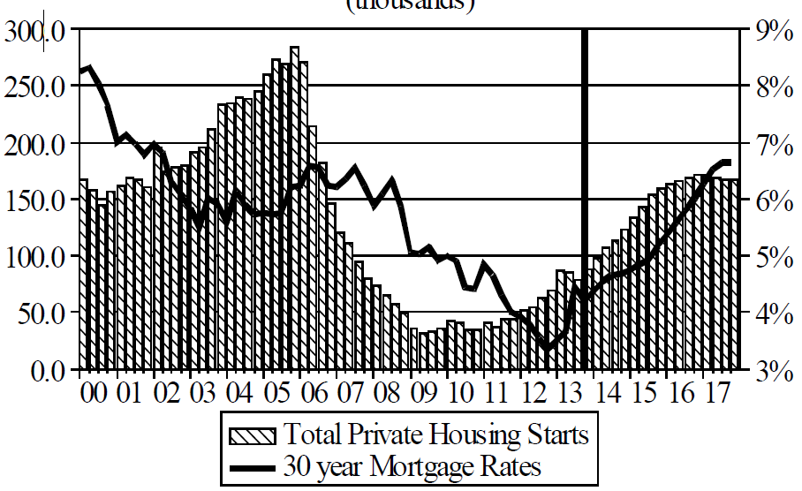
Florida Total Private Housing Starts, 2000 – 2017F
(Thousands of Units)
CRASH, CRATER, RECOVERY Homebuilding in FL continues to recover, adding substantially to coastal exposures.
The economic outlook for most of the US is positive for the first time in many years
Source: University of Central Florida Institute for Economic Competitiveness: http://iec.ucf.edu/post/2014/01/07/Florida-Metro-Forecast-December-2013.aspx

Slide 45
Interest Rate on Convention 30-Year Mortgages: Headed Back Up, 1990–2013*
Yields on 30-Year Mortgages in the U.S. plunged to all time record lows in late 2012 and early 2013 but are now rising as the Fed considers tapering its QE program
Yields on 30-Year mortgages have been below 6% for a five years
30-yr. mortgage rates are up 105 basis points since the beginning of the year
Since roughly 80% of P/C bond/cash investments are in 10-year or shorter durations, most P/C insurer portfolios will have low-yielding bonds for years to come.
*Monthly, through December 2013. Note: Recessions indicated by gray shaded columns.
Sources: Federal Reserve Bank at http://www.federalreserve.gov/releases/h15/data.htm. National Bureau of Economic Research (recession dates); Insurance Information Institutes.
45
12/01/09 - 9pm
eSlide – P6466 – The Financial Crisis and the Future of the P/C
Notes:
45

Slide 46
New Private Housing Starts, 1990-2019F
Job growth, low inventories of existing homes, low mortgage rates and demographics should continue to stimulate new home construction for several more years
(Millions of Units)
New home starts plunged 72% from 2005-2009; A net annual decline of 1.49 million units, lowest since records began in 1959
FL will account for 10% of all new homes built nationally in 2014
Insurers Are Continue to See Meaningful Exposure Growth in the Wake of the “Great Recession” Associated with Home Construction: Construction Risk Exposure, Surety, Commercial Auto; Potent Driver of Workers Comp Exposure
Source: U.S. Department of Commerce; Blue Chip Economic Indicators (1/14 and 3/13); Insurance Information Institute.

Slide 47
Net Worth of Households* Recently Hit A Historic High
2008-09 recession: -15.7%
$ Trillions
Adjusted for population growth, net worth is slightly short of its prior peak
Housing “bubble”
2001 recession
1992 recession
1982 recession
Rising net worth fuels a “wealth affect” that helps fuel consumer spending, which accounts for 70% of spending in the U.S. economy
*and nonprofit organizations. Data are as of year-end, except in 2013:Q3 (data posted on Dec 9, 2013). Next release March 6, 2014. Data not seasonally adjusted or inflation-adjusted Source: Federal Reserve Board

Slide 48
Household Financial Obligations Ratio Recently Hit A Historic Low
Financial Obligations Ratio
Financial Obligations Ratio: debt service (mortgage and consumer debt), auto lease, residence rent, HO insurance, and property tax payments as % of personal disposable income.
Household balance sheets are stronger than they’ve been in many years, setting the stage for more consumer spending
Decline began in 2008:Q1.
15.23% in 2012:Q4 is lowest ratio since 1980:Q4 (15.09%).
*through 2013:Q3 (data posted on Dec 13, 2013) Source: Federal Reserve Board, at http://www.federalreserve.gov/releases/housedebt

Slide 49
Unemployment Rates by State, November 2013: Highest 25 States*
In November 45 states and the District of Columbia had over-the-month unemployment rate decreases and 5 states had no change.
*Provisional figures for November 2013, seasonally adjusted.
Sources: US Bureau of Labor Statistics; Insurance Information Institute.

Slide 50
Unemployment Rates by State, November 2013:
Lowest 25 States*
Florida’s unemployment rate is now below the US overall
*Provisional figures for November 2013, seasonally adjusted.
Sources: US Bureau of Labor Statistics; Insurance Information Institute.

Slide 51
Insured Catastrophe Loss Update
Florida Has Played a Critical Role in the History of Catastrophe Losses in the U.S.
Relative Calm in Recent Years Is Unlikely to Endure
51

Slide 52
U.S. Insured Catastrophe Losses
($ Billions, $ 2012)
Storms of 2004/05
2012 was the third most expensive year ever for insured CAT losses
Andrew
2013 CATs Were Well Below Recent Years. 2012 Was the 3rd Highest Year on Record for Insured Losses in U.S. History on an Inflation-Adj. Basis. 2011 Losses Were the 6th Highest.
Record tornado losses caused 2011 CAT losses to surge
*Through 12/31/13.
Note: 2001 figure includes $20.3B for 9/11 losses reported through 12/31/01 ($25.9B 2011 dollars). Includes only business and personal property claims, business interruption and auto claims. Non-prop/BI losses = $12.2B ($15.6B in 2011 dollars.)
Sources: Property Claims Service/ISO; Insurance Information Institute.
52
12/01/09 - 9pm
eSlide – P6466 – The Financial Crisis and the Future of the P/C
Notes:
52

Slide 53
Combined Ratio Points Associated with Catastrophe Losses: 1960 – 2013*
Avg. CAT Loss Component of the Combined Ratio by Decade
1960s: 1.04 1970s: 0.85 1980s: 1.31 1990s: 3.39 2000s: 3.52 2010s: 6.1E*
Catastrophe losses as a share of all losses reached a record high in 2012
Combined Ratio Points
The Catastrophe Loss Component of Private Insurer Losses Has Increased Sharply in Recent Decades
*2010s represent 2010-2013.
Notes: Private carrier losses only. Excludes loss adjustment expenses and reinsurance reinstatement premiums. Figures are adjusted for losses ultimately paid by foreign insurers and reinsurers.
Source: ISO (1960-2011); A.M. Best (2012E) Insurance Information Institute.

Slide 54
Top 8 States for Insured Catastrophe Losses, 2013
$ Millions
Oklahoma let the country in insured CAT losses in 2013
Source: The Property Claim Services (PCS) unit of ISO, a Verisk Analytics company.

Slide 55
Top 5 States by Insured Catastrophe Losses in 2012*
(2012, $ Billions)
NY and NJ let the US in CAT losses in 2012 due Sandy
*Includes catastrophe losses of at least $25 million.
Sources: PCS unit of ISO; Insurance Information Institute.

Slide 56
Top States by Inflation-Adjusted Insured Catastrophe Losses, 1983–2012
Over the Past 30 Years Florida Has Accounted for the Largest Share of Catastrophe Losses in the U.S., Followed by Texas and Louisiana
FL is the most costly state for CATs, with nearly $67B in insured losses over the past 30 years
Louisiana
$42.0B
Texas
$48.8B
Rest of the U.S.
$309.9B
Florida
$66.7B
Total: $467.5 Billion, an average of $16.6B per year or $1.3B per month
Source: PCS unit of ISO, Verisk Company.; Insurance Information Institute.

Slide 57
Inflation Adjusted U.S. Catastrophe Losses by Cause of Loss, 1993–2012¹
Wind/Hail/Flood (3), $14.9
Fires (4), $6.5
Other (5), $0.2
Insured cat losses from 1993-2012 totaled $391.7B, an average of $19.6B per year or $1.6B per month
Geological Events, $18.4
Terrorism, $24.8
Winter Storms, $27.8
Hurricanes & Tropical Storms, $158.2
Tornado share of CAT losses is rising
Wind losses are by far cause the most catastrophe losses, even if hurricanes/TS are excluded.
Tornadoes (2), $140.9
Catastrophes are defined as events causing direct insured losses to property of $25 million or more in 2012 dollars.
Excludes snow.
Does not include NFIP flood losses
Includes wildland fires
Includes civil disorders, water damage, utility disruptions and non-property losses such as those covered by workers compensation.
Source: ISO’s Property Claim Services Unit.

Slide 58
Top 16 Most Costly Disasters in U.S. History
(Insured Losses, 2012 Dollars, $ Billions)
Hurricane Andrew remains the second most expensive natural disaster in US history
Includes Tuscaloosa, AL, tornado
Includes Joplin, MO, tornado
12 of the 16 Most Expensive Events in US History Have Occurred Over the Past Decade
*PCS estimate as of 4/12/13.
Sources: PCS; Insurance Information Institute inflation adjustments to 2012 dollars using the CPI.

Slide 59
Top 16 Most Costly World Insurance Losses, 1970-2013*
(Insured Losses, 2012 Dollars, $ Billions)
4 of the top 12 most expensive catastrophes in world history impacted Florida
Hurricane Sandy is now the 6th costliest event in global insurance history
*Figures do not include federally insured flood losses.
**Estimate based on PCS value of $18.75B as of 4/12/13.
Sources: Munich Re; Swiss Re; Insurance Information Institute research.

Slide 60
Top 12 Most Costly Hurricanes in U.S. History
(Insured Losses, 2012 Dollars, $ Billions)
6 of the 12 most costly hurricanes in insurance history impacted Florida
Hurricane Sandy is the costliest tropical event to not impact FL
*PCS estimate as of 4/12/13.
Sources: PCS; Insurance Information Institute inflation adjustments to 2012 dollars using the CPI.

Slide 61
Total Value of Insured Coastal Exposure in 2012
(2012, $ Billions)
The value of coastal exposure in FL was nearly $2.9 trillion in 2012, up 19% or $465 billion since 2007 despite the housing collapse
In 2012, New York Ranked as the #1 Most Exposed State to Hurricane Loss, Overtaking Florida with $2.862 Trillion. Texas is very exposed too, and ranked #3 with $1.175 Trillion in insured coastal exposure
The Insured Value of All Coastal Property Was $10.6 Trillion in 2012 , Up 20% from $8.9 Trillion in 2007 and Up 48% from $7.2 Trillion in 2004
Source: AIR Worldwide

Slide 62
Total Value of Insured Coastal Exposure in 2007
(2007, $ Billions)
In 2007, Florida Still Ranked as the #1 Most Exposed State to Hurricane Loss, with $2.459 Trillion Exposure, but Texas is very exposed too, and ranked #3 with $895B in insured coastal exposure
The Insured Value of All Coastal Property Was $8.9 Trillion in 2007, Up 24% from $7.2 Trillion in 2004
Source: AIR Worldwide

Slide 63
The combined ratios for both personal and commercial lines improved substantially in 2013:H1

Slide 65
Flood Insurance
Flood Exposure: Reforms in Danger?
Flood Should Reflect True Risk
Keep the Subsidies
Would Prefer to Purchase from Private Insurers
65

Slide 66
Total Potential Home Value Exposure to Storm Surge Risk in 2013*
($ Billions)
Florida is by the state most vulnerable to storm surge.
The Value of Homes Exposed to Storm Surge was $1.147 Trillion in 2013.* Only a fraction of this is insured, hence the huge demand for federal aid following major coastal flooding events.
*Insured and uninsured property. Based on estimated property values as of April 2013.
Source: Storm Surge Report 2013, CoreLogic.

Slide 67
Total NFIP Policies in Force, 2012
Florida has almost three times as much flood insurance in force as any other state, accounting for 37% of all policies in the US
Source: U.S. Department of Homeland Security, Federal Emergency Management Agency; Insurance Information Institute.

Slide 68
Growth of NFIP program
Policies in Force at Year-End
Number of policies has not changed significantly though more homes are in harm’s way
Despite the growth of the program, approximately half of all properties in a flood zone lack flood insurance.
Source: U.S. Department of Homeland Security, Federal Emergency Management Agency; Insurance Information Institute.

Slide 69
What kind of Buildings Does Flood Insurance Protect?
One-fourth of all flood policies are written on commercial (non-residential) risks or on secondary homes.
Sources: Congressional Budget Office (2007), Insurance Information Institute.

Slide 70
Median Value of Flood Properties
A CBO survey indicated the typical home with flood insurance is worth significantly more than the typical home. The typical subsidized coastal risk was worth more than unsubsidized risks.
Congressional Budget Office 2007 survey of coastal risks, with U.S. owner-occupied home median from Bureau of Census, 2005 American Housing Survey; Insurance Information Institute.

Slide 71
Hurricane Sandy: Average Claim Payment by Type of Claim
Commercial (i.e., business claims) are more expensive because the value of property is often higher as well as the impact of insured business interruption losses
The average insured flood loss was nearly 9 times larger than the average non-flood insured loss (mostly wind)
Post-Sandy, the I.I.I. worked very hard to make help media, consumers and regulators understand the distinction between a flood claim and a standard homeowners claim. NFIP is $24B in debt.
*Includes rental and condo policies (excludes NFIP flood). **As of Oct. 31, 2013.
Sources: Catastrophe loss data is for Catastrophe Serial No. 90 (Oct. 28 – 31, 2012) from PCS as of March 2013; Insurance Information Institute.

Slide 72
Top 12 Most Costly Flood Events by NFIP Payout*
(NFIP Insured Losses, $ Millions)
8 of the 10 most costly events in NFIP history occurred over the past decade (2004‒2013); NFIP deficit now totals $24 billion
Katrina and Sandy are by far the most costly events in NFIP history
*Expressed in original dollars (not inflation-adjusted).
Sources: PCS; Insurance Information Institute inflation adjustments to 2012 dollars using the CPI.

Slide 73
I.I.I. Poll: Disaster Preparedness
Q. Do you have a separate flood insurance policy?¹
Percentage of people with flood insurance is unchanged
Only 13 percent of American homeowners say they have a flood insurance policy; the percentage is lowest in the Northeast at 10 percent.
¹Asked of those who have homeowners insurance and who responded “yes”.
Source: Insurance Information Institute Annual Pulse Survey.

Slide 74
I.I.I. Poll: Disaster Preparedness
Q. Does your homeowners policy cover damage from flooding during a hurricane?¹
About 30 percent of homeowners in the South still believe flooding from a hurricane is covered
The proportion of homeowners who believe their homeowners policy covers damage from flooding during a hurricane stands at 21 percent. This proportion rises eight percentage points in the South, to 29 percent.
¹Asked of those who have homeowners insurance and who responded “yes”.
Source: Insurance Information Institute Annual Pulse Survey.

Slide 75
Biggert-Waters: Media and Congressional Maelstrom
BW-12 Rate Increases to Phase Out Subsidies Began in 2013
Note: Only 20% of NFIP policies are subsidized
Jan. 1, 2013: Non-Primary/Secondary Residences
Increases of 25% per year until full-risk rate achieved
Reaction: Very muted; Vacation homes/wealthier owners
Oct. 1, 2013: Subsidized Severe or Repetitive Loss Policies and Owners of Business/Non-Residential Properties
Increases of 25% per year until full-risk rate achieved
Reaction: Huge consumer backlash, intense media coverage leading to a Congressional effort to delay BW-12 by 4 years (effectively killing it). Even Maxine Waters supports delay…
Subsidy Lost if Policy Lapses, Severe Repeated, New Policy
I.I.I. Is Explaining the Risks Associated with BW-12 Delay
Future Pvt. Insurer Flood Participation Impacted by BW-12 Debate
I.I.I. Research Report on Issue Due Soon Under BW-12 Section 236 Study Requirement (National Academy of Sciences)
75
12/01/09 - 9pm
eSlide – P6466 – The Financial Crisis and the Future of the P/C
Notes:
75

Slide 76
Success of Write Your Own Program
Write Your Own Policies vs. Written Directly by NFIP
More than 80% of flood policies in the NFIP are written through the Write Your Own program, a public-private partnership.
Source: U.S. Department of Homeland Security, Federal Emergency Management Agency; Insurance Information Institute.

Slide 77
Extent of Flood Insurance Subsidy
The average subsidized policy pays about 40 percent of the full actuarial rate. Eliminating the subsidy would increase program premium by more than 50 percent.
Sources: NFIP 2011 Actuarial Rate Review, Insurance Information Institute.

Slide 78
Cost of Reinstituting Subsidies
Proposals to reduce rates will create a $2.1B shortfall in the NFIP over 10 years, would cause the NFIP to borrow more from the Treasury and could force a slowdown in claims payments.
Sources: Congressional Budget Office, Insurance Information Institute.

Slide 79
I.I.I. Poll: Flood Insurance
Q. Do you think it is fair that flood insurance premium increases are higher if people who live in high flood risk areas and rebuild their homes do not elevate them?
Don’t know
No
Yes
Almost two-thirds of Americans think that it is fair that flood insurance premiums be raised for people who live in high flood risk areas and rebuild their homes after a flood but do not elevate them.
Source: Insurance Information Institute Annual Pulse Survey.

Slide 80
I.I.I. Poll: Flood Insurance
Q. Do you think flood insurance premiums should reflect the risk of flooding no matter what the cost or do you think the government should subsidize the cost of flood insurance with taxpayers’ dollars?
Don’t know
Government should subsidize cost with taxpayers’ dollars
Premiums should reflect flood risk
Almost two-thirds of Americans think flood insurance premiums should be raised to reflect the risk of flooding.
Source: Insurance Information Institute Annual Pulse Survey (Nov. 2013).

Slide 81
I.I.I. Poll: Flood Insurance
Q. The federal government provides insurance coverage at taxpayer-subsidized rates for damage from floods through the National Flood Insurance Plan. A new law eliminates the subsidy and raises rates. Do you think the rate increase should be repealed?
It is inconsistent for the public to support full-risk rates but maintain subsidies, but this exactly mirrors Congressional sentiments, with supporters of BW-12 and even Tea Party conservatives supporting continuation of the subsidies
Don’t know
No
Yes
More than half of Americans polled for the November 2013 Pulse thought that hikes in National Flood Insurance premiums should be repealed.
Source: Insurance Information Institute Annual Pulse Survey.

Slide 82
I.I.I. Poll: Flood Insurance
Q. If the costs were similar, would you prefer to buy flood insurance from a private insurance company or from the federal government through the National Flood Insurance Program?
Don’t know
The federal government through the NFIP
Private insurance company
Six out of 10 Americans would prefer to buy flood insurance from a private insurance company as opposed to the federal government, if costs were similar.
Source: Insurance Information Institute Annual Pulse Survey.

Slide 83
Federal Disaster Declarations Patterns: 1953-2013
Disaster Declarations Set New Records in Recent Years
83

Slide 84
Number of Federal Major Disaster Declarations, 1953-2014*
There have been 2,147 federal disaster declarations since 1953. The average number of declarations per year is 35 from 1953-2013, though there few haven’t been recorded since 1995.
The number of federal disaster declarations set a new record in 2011, with 99, shattering 2010’s record 81 declarations.
3 federal disasters were declared so far in 2014*
The Number of Federal Disaster Declarations Is Rising and Set New Records in 2010 and 2011 Before Dropping in 2012/13
*Through January 25, 2014.
Source: Federal Emergency Management Administration; http://www.fema.gov/disasters; Insurance Information Institute.

Slide 85
Federal Disasters Declarations by State, 1953 – 2014: Highest 25 States*
Over the past 60 years, Florida has had the 5th highest number of Federal Disaster Declarations (32 were associated with tropical events)
Hurricanes Tornadoes Floods Freezes Wildfires Severe T-Storms High Winds Extreme Tides
*Through Jan. 25, 2014. Includes Puerto Rico and the District of Columbia.
Source: FEMA: http://www.fema.gov/news/disaster_totals_annual.fema; Insurance Information Institute.

Slide 86
Federal Disasters Declarations by State, 1953 – 2014: Lowest 25 States*
Over the past 60 years, Wyoming and Rhode Island had the fewest number of Federal Disaster Declarations
*Through Jan. 25, 2014. Includes Puerto Rico and the District of Columbia.
Source: FEMA: http://www.fema.gov/news/disaster_totals_annual.fema; Insurance Information Institute.

Slide 87
SEVERE WEATHER REPORT UPDATE: 2013
Damage from Tornadoes, Large Hail and High Winds Keep Insurers Busy in Every State—Including Florida
87

Slide 88
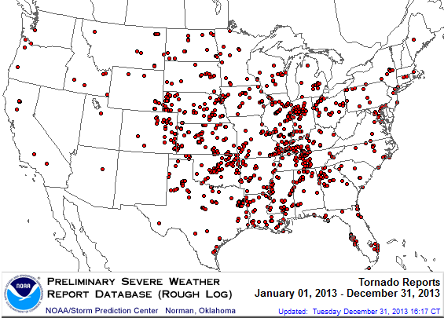
Location of Tornado Reports in 2013
A deadly EF-5 tornado in May in Moore, OK, produced insured losses of $1.575 billion
There were 943 tornadoes through Dec. 31, (37 of them in FL)causing extensive property damage in several states
Source: NOAA Storm Prediction Center; http://www.spc.noaa.gov/climo/online/monthly/2013_annual_summary.html#; PCS.
88

Slide 89
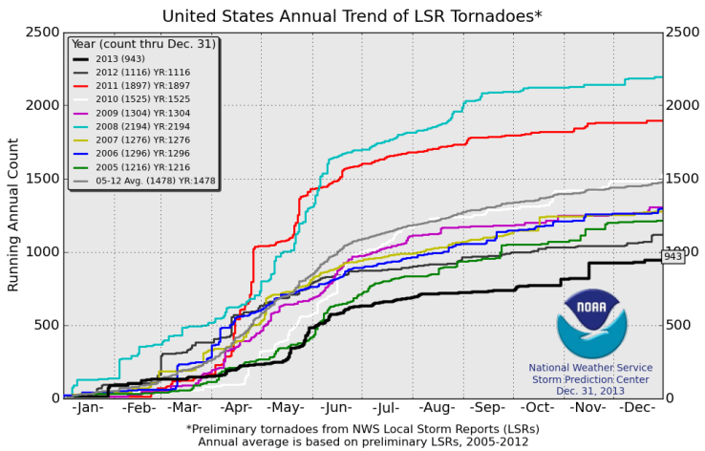
U.S. Tornado Count, 2005-2013*
There were 1,897 tornadoes in the U.S. in 2011 far above average, but well below 2008’s record
2013 count was the lowest in a decade
*Through Dec. 31, 2013.
Source: http://www.spc.noaa.gov/wcm/.
89

Slide 90
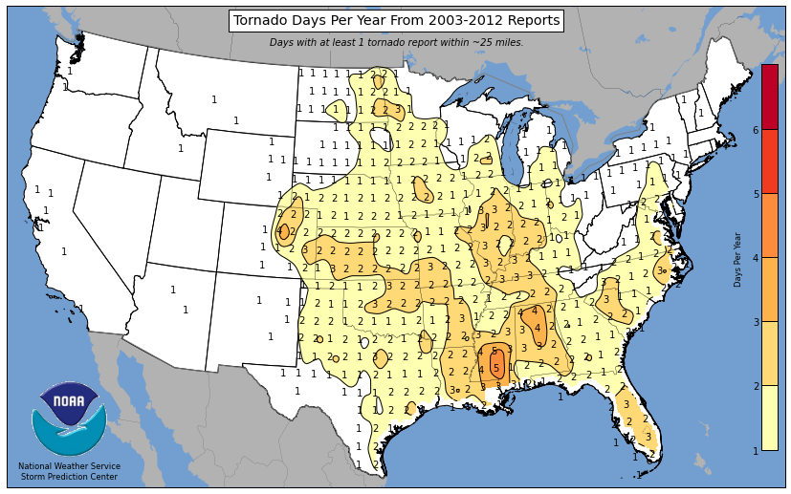
Tornado Days per Year, 2003-2012
Parts of inland FL have tornado frequencies that rival “Tornado Alley”
Source: http://www.spc.noaa.gov/wcm/.
90

Slide 91
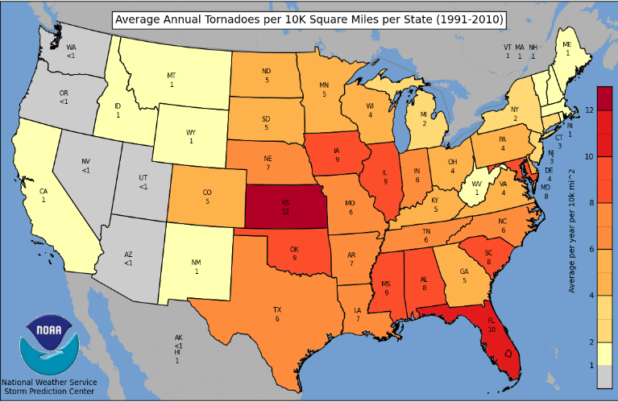
Severe Thunderstorm Wind Days per Year, 2003-2012
FL has among the highest frequency of tornadoes per kilometer in the U.S.
Source: http://www.spc.noaa.gov/wcm/.
91

Slide 92
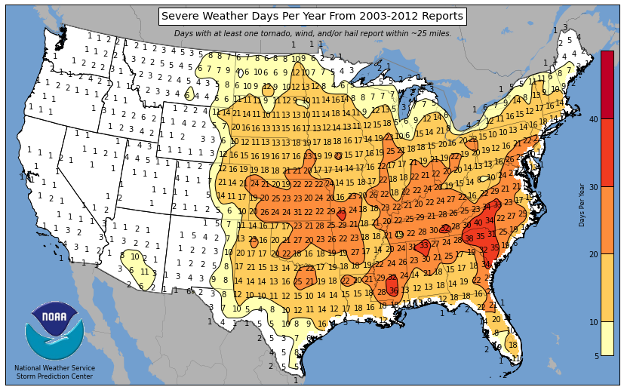
Severe Weather Days per Year, 2003-2012
North FL has more Severe Weather Days than south FL
Source: http://www.spc.noaa.gov/wcm/.
92

Slide 93
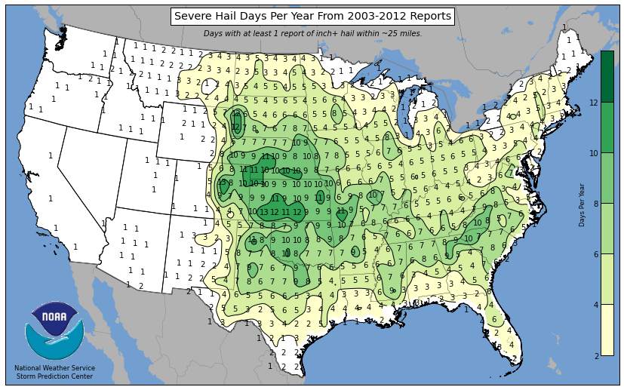
Severe Hail Days per Year, 2003-2012
Central and Northeast FL have elevated hail frequencies
Source: http://www.spc.noaa.gov/wcm/.
93

Slide 94
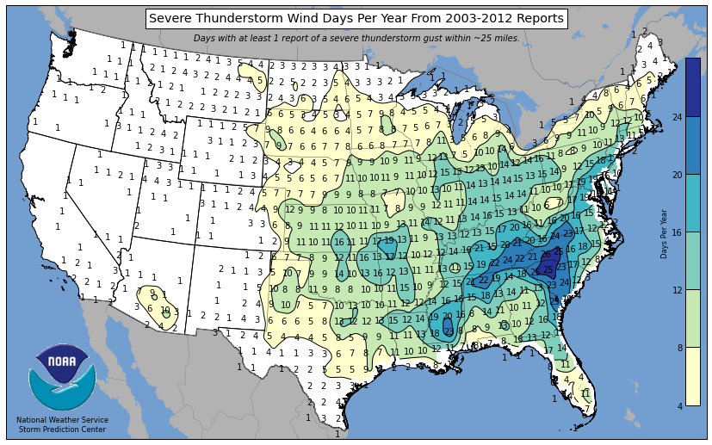
Severe Thunderstorm Wind Days per Year, 2003-2012
North FL experiences a high frequency of high winds from Severe T-Storms
Source: http://www.spc.noaa.gov/wcm/.
94

Slide 95
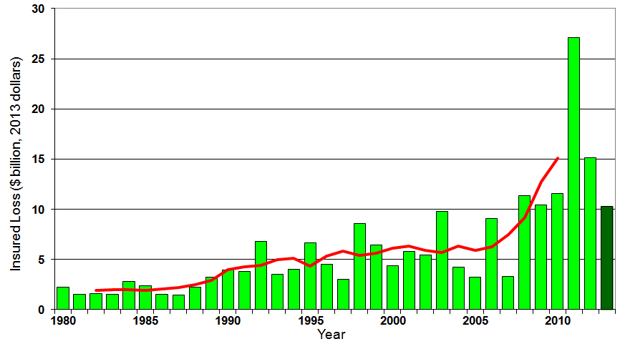
U.S. Thunderstorm Insured Loss Trends, 1980 – 2013
Hurricanes get all the headlines, but thunderstorms are consistent producers of large scale loss. 2008-2013 are the most expensive years on record.
Average thunderstorm losses are up 7 fold since the early 1980s. The 5-year running average loss is up sharply
Thunderstorm losses in 2013 totaled $10.3 billion, the 6th highest on record
Source: Property Claims Service, and MR NatCatSERVICE
95

Slide 96
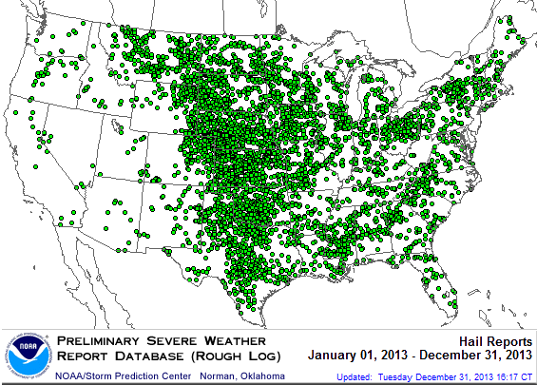
Location of Large Hail Reports: 2013
There were 5,457 “Large Hail” reports in 2013, causing extensive property and vehicle damage
Source: NOAA Storm Prediction Center; http://www.spc.noaa.gov/climo/online/monthly/2013_annual_summary.html#
96

Slide 97
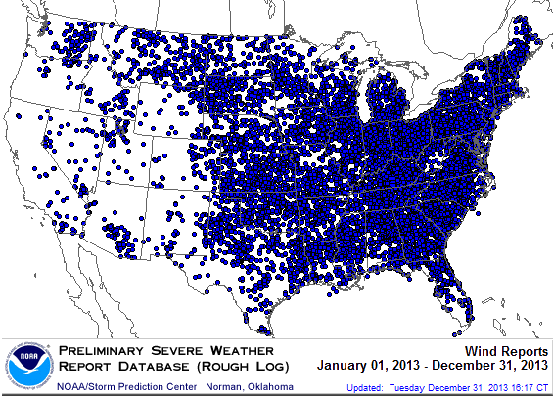
Location of High Wind Reports: 2013
There were 12,942 “Wind Damage” in 2013, causing extensive property damage
Source: NOAA Storm Prediction Center; http://www.spc.noaa.gov/climo/online/monthly/2013_annual_summary.html#
97

Slide 98
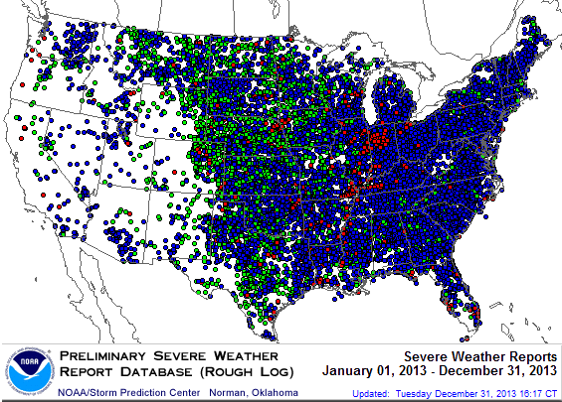
Severe Weather Reports: 2013
Severe weather reports are concentrated east of the Rockies
There were 19,342 severe weather reports in 2013; including 942 tornadoes; 5,457 “Large Hail” reports and 12,942 high wind events
Source: NOAA Storm Prediction Center; http://www.spc.noaa.gov/climo/online/monthly/2013_annual_summary.html#
98

Slide 99
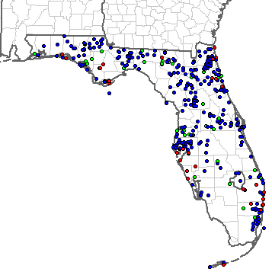
Severe Weather Reports in Florida: 2013
There were 400 severe weather reports in 2013
37 Tornadoes
47 Large Hail Reports
316 High Wind Events
Source: NOAA Storm Prediction Center; http://www.spc.noaa.gov/climo/online/monthly/2013_annual_summary.html#
99

Slide 100
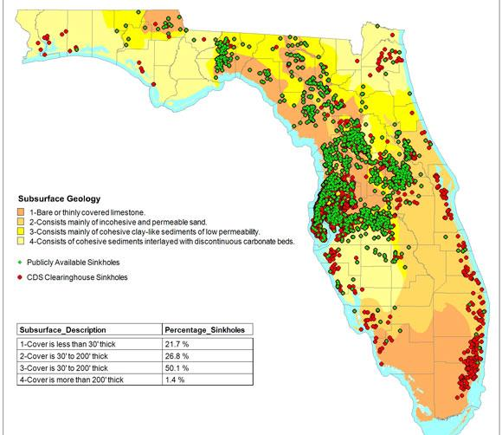
Sinkholes in FL Are Increasingly Common and Expensive
Florida has a huge sinkhole problem. FL is one of only 2 states where sinkhole coverage must be included in the standard HO policy
Sinkholes cost insurers $1.4B between 2006 and 2010
Top 10 Sinkhole Counties
Pasco
Hernando
Hillsborough
Marion
Pinellas
Citrus
Polk
Orange
Seminole
Lake
Source: Insurance Journal , March 30, 2011, from CDS Business Mapping at http://www.insurancejournal.com/news/southeast/2011/03/30/192278.htm
100

Slide 101
Financial Strength & Underwriting
Cyclical Pattern is P-C Impairment History is Directly Tied to Underwriting, Reserving & Pricing
101

Slide 102
P/C Insurer Impairments, 1969–2012
Impairments among P/C insurers remain infrequent
The Number of Impairments Varies Significantly Over the P/C Insurance Cycle, With Peaks Occurring Well into Hard Markets
Source: A.M. Best Special Report “1969-2011 Impairment Review,” June 2012 and March 6, 2013 update; Insurance Info. Institute.

Slide 103
P/C Insurer Impairment Frequency vs. Combined Ratio, 1969-2011
2011 impairment rate was 0.91%, up from 0.67% in 2010; the rate is slightly higher than the 0.82% average since 1969
Impairment Rates Are Highly Correlated With Underwriting Performance and Reached Record Lows in 2007; Recent Increase Was Associated Primarily With Mortgage and Financial Guaranty Insurers and Not Representative of the Industry Overall
Source: A.M. Best; Insurance Information Institute

Slide 104
Reasons for US P/C Insurer Impairments, 1969–2010
Historically, Deficient Loss Reserves and Inadequate Pricing Are By Far the Leading Cause of P-C Insurer Impairments. Investment and Catastrophe Losses Play a Much Smaller Role
Reinsurance Failure
Sig. Change in Business
Misc.
Investment Problems (Overstatement of Assets)
Deficient Loss Reserves/ Inadequate Pricing
Affiliate Impairment
Catastrophe Losses
Alleged Fraud
Rapid Growth
Source: A.M. Best: 1969-2010 Impairment Review, Special Report, April 2011.

Slide 105
Top 10 Lines of Business for US P/C Impaired Insurers, 2000–2010
Workers Comp and Pvt. Passenger Auto Account for Nearly Half of the Premium Volume of Impaired Insurers Over the Past Decade
Title
Financial Guaranty
Surety
Med Mal
Workers Comp
Other Liability
Commercial Auto Liability
Pvt. Passenger Auto
Commercial Multiperil
Homeowners
Source: A.M. Best: 1969-2010 Impairment Review, Special Report, April 2011.

Slide 106
SURPLUS/CAPITAL/CAPACITY
2013 Recorded Yet Another Record High
106

Slide 107
Policyholder Surplus, 2006:Q4–2013:Q3
Drop due to near-record 2011 CAT losses
($ Billions)
2007:Q3 Pre-Crisis Peak
Surplus as of 9/30/13 stood at a record high $624.4B
The industry now has $1 of surplus for every $0.78 of NPW, close to the strongest claims-paying status in its history.
2010:Q1 data includes $22.5B of paid-in capital from a holding company parent for one insurer’s investment in a non-insurance business .
The P/C insurance industry entered 2014 in very strong financial condition.
Sources: ISO, A.M .Best.
107
12/01/09 - 9pm
eSlide – P6466 – The Financial Crisis and the Future of the P/C
Notes:
107

Slide 108
US Policyholder Surplus: 1975–2013*
($ Billions)
Surplus as of 9/30/13 was a record $624.4, up 6.4% from $586.9 of 12/31/12, and up 42.9% ($187.3B) from the crisis trough of $437.1B at 3/31/09. Pre-crisis peak was $521.8 as of 9/30/07. Surplus as of 9/30/13 was 19.7% above 2007 peak.
“Surplus” is a measure of underwriting capacity. It is analogous to “Owners Equity” or “Net Worth” in non-insurance organizations
The Premium-to-Surplus Ratio Stood at $0.78:$1 as of 9/30/13, a Near Record Low (at Least in Recent History)*
* As of 9/30/13.
Source: A.M. Best, ISO, Insurance Information Institute.

Slide 109
3. REINSURANCE MARKET CONDITIONS
Ample Capacity as Alternative Capital is Transforming the Market
109

Slide 110
Catastrophe Bonds: Issuance and Outstanding, 1997- 2013*
Risk Capital Amount ($ Millions)
Risk capital outstanding reached a record high $18.6B in 2013
Financial crisis depressed issuance
CAT bond issuance reached a record $7.1B in 2013
Catastrophe Bond Issuance and Risk Capital Outstanding Reached All-Time Record Highs in 2013
*Through Dec. 31, 2013.
Source: Insurance Information Institute, 2014 Insurance Fact Book.

Slide 111
CATASTROPHE BONDS, ANNUAL RISK CAPITAL ISSUED, 2002-2013
($ Billions)
Catastrophe bond issuance hit a new record high in 2013
*Through Dec. 31, 2013.
Source: Insurance Information Institute, 2014 Insurance Fact Book.

Slide 112
CATASTROPHE BONDS, RISK CAPITAL OUTSTANDING, 2002-2013
($ Billions)
Catastrophe bond risk capital outstanding hit a new record high in 2013
*Through Dec. 31, 2013.
Source: Insurance Information Institute, 2014 Insurance Fact Book.

Slide 113
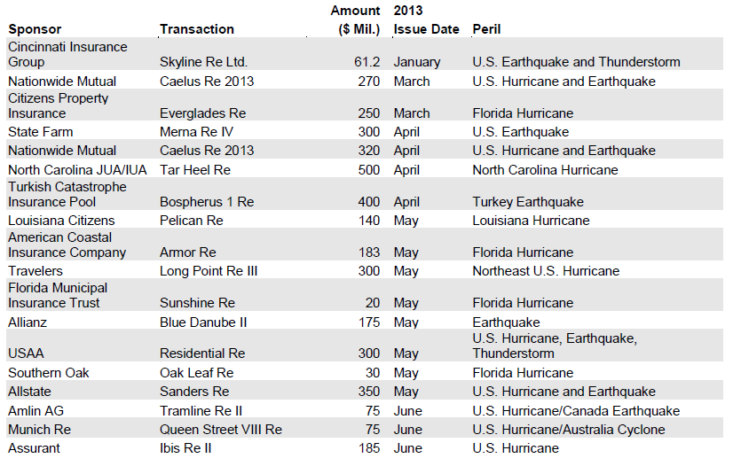
Catastrophe Bond Issuances, First Half 2013
Sources: Willis Capital Markets & Advisory, Fitch Ratings; Insurance Information Institute.

Slide 114
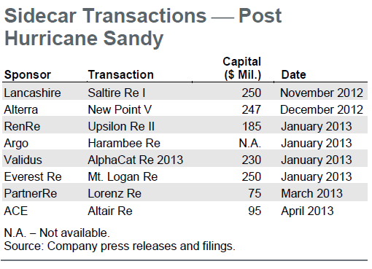
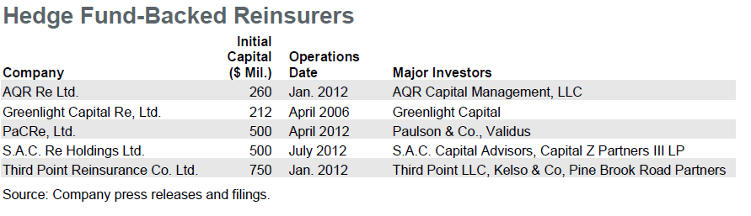
Sidecar Transactions (Post-Sandy) and Hedge Fund-Backed Reinsurers
Sidecars (collateralized reinsurance) are the fastest growing alternative capital segment, account for about 15% or $5 bill of total property catastrophe reinsurance capital
More hedge fund money is coming into the business
Sources: Willis Capital Markets & Advisory, Fitch Ratings; Insurance Information Institute.

Slide 115
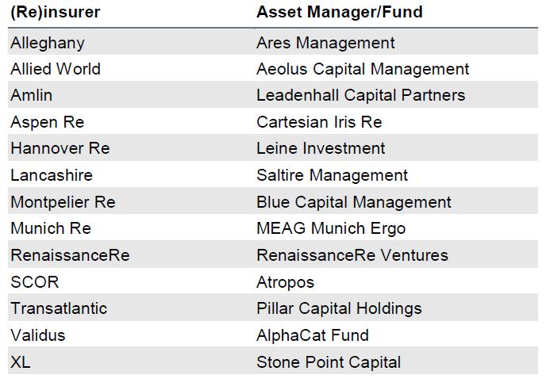
(Re) Insurers Investing in Insurance Linked Securities (ILS) Fund Managers
Several (re)insurers have formed asset managers or invested in independent asset managers that are focused on managing catastrophe/ILS funds for outside investors. These asset managers invest third party capital in instruments with returns linked to property catastrophe reinsurance retrocession and ILS contracts.
Sources: Willis Capital Markets & Advisory, Fitch Ratings; Insurance Information Institute.

Slide 116
Alternative Reinsurance Capital Summary
Alternative Reinsurance Here to Stay
Capital markets have effectively discovered reinsurance another “asset class,” in part due to Federal Reserve’s unprecedented actions since the financial crisis to keep interest rates low across the entire yield curve.
A convergence of the reinsurance and capital markets persists with many companies both providing and using alternative forms of risk transfer to supplement the traditional balance sheet, transforming several reinsurers into risk asset managers. These structures include catastrophe bonds (cat bonds), collateralized quota-share reinsurance vehicles (sidecars), industry loss warranties (ILWs), hedge fund-supported reinsurers and asset managers investing in insurance-linked securities (ILS).
Property Catastrophe Drives Market:
The nature of property catastrophe risk as being highly modeled and commoditized serves as an important economic force driving its transfer into the capital markets. Casualty (re)insurance lines have had limited movement into the alternative reinsurance market thus far, as the less standardized and more specialized nature of these longer term risks makes them better suited for more permanent traditional capacity providers.
Sources: Fitch Ratings, Alternative Reinsurance Market Update, September 5, 2013; Insurance Information Institute.

Slide 117
Alternative Reinsurance Capital Summary (continued)
Strong Investor Demand
Comparatively high potential returns of catastrophe risk through cat bonds and sidecar investments are particularly attractive to investors, although this spread has been shrinking due to increased investor demand. However, the lack of correlation between catastrophe losses and returns on other major asset classes should continue to contribute to strong demand from investors, which include hedge funds, private equity and institutional investors.
Shock (i.e., Large Loss) Event Could Alter Market
One area of uncertainty is how investors would react to an environment of less favorable catastrophe risk spreads or a large unexpected catastrophe loss, either of which could cause capital to retreat. This risk is likely higher for hedge fund capital, as pension fund capital tends to be more permanent, given their long-term investment outlook and more diversified risk exposure.
Mixed Impact to Reinsurers’ Ratings:
Fitch views the growth and acceptance of alternative reinsurance as a mixed impact for the credit quality of reinsurers’ ratings. Favorably, these products can be used to manage reinsurers’ exposure and capital and serve as a source of fee income. Negatively, alternative coverage represents competition for traditional reinsurers that, in conjunction with the strong overall capitalization of the reinsurance industry, have worked to notably dampen reinsurance pricing
Sources: Fitch Ratings, Alternative Reinsurance Market Update, September 5, 2013.

Slide 118
Alternative Reinsurance Capital Summary (continued)
Sponsors Benefit From New Issuance:
As investor demand has continued to grow for catastrophe bonds, sponsors have been able to offer deals at considerably lower coupon rates and with increasingly favorable structures that suit individual company needs. These market conditions are likely to drive further issuance of cat bonds in the near term if (re)insurers believe they can produce a cost-effective alternative to supplement their reinsurance program. As of midyear, 2013 is on track to produce a record amount of catastrophe bond issuance.
Sidecars Continue to Provide Capacity:
Several sidecars emerged late in 2012 and early into 2013 following Hurricane Sandy. These vehicles were opportunistically seeking to capitalize on any potential improvements in property catastrophe pricing. However, they also represented several newer entrants into the alternative reinsurance space looking to participate in what continues to be an important and growing segment of the reinsurance market.
Sources: Fitch Ratings, Alternative Reinsurance Market Update, September 5, 2013.

Slide 119
Questions Arising from Influence of Alternative Capital
Could Pension Fund Money Swamp Traditional Capacity?
US private pension funds hold ~$7 trillion in assets
2% allocation = $140 billion
Global property cat capital = ~$316 bill as of mid-2013
Do New Investors Have a Lower Cost of Capital?
New capacity expects 6-8% rate of return compared to 8-10% for traditional reinsurance, according to Dowling & Partners
Will Reinsurance Pricing Become More Closely Linked to Interest Rates?
Will the New Capital Exit if:
ILS sustain losses from major CAT events
Interest rates rise

Slide 120
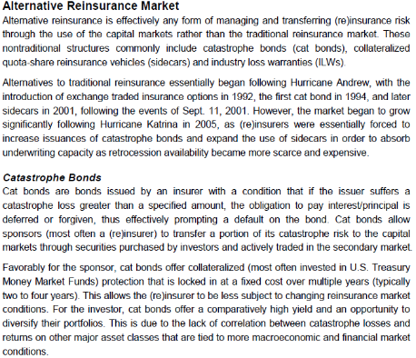
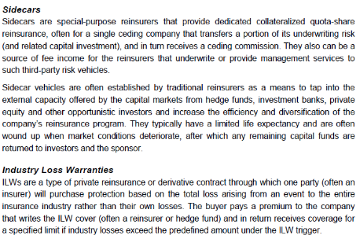
Alternative Capital: Important Definitions
Sources: Fitch Ratings; Insurance Information Institute.

Slide 121
Insurance Information Institute Online:
www.iii.org
Thank you for your time and your attention!
Twitter: twitter.com/bob_hartwig
Download at www.iii.org/presentations

