Slide 1
Mega Trends in Workers Compensation Past, Present and Future
16th Annual AMCOMP Conference
Las Vegas, NV
March 27, 2014
Download at www.iii.org/presentations
Robert P. Hartwig, Ph.D., CPCU, President & Economist
Insurance Information Institute ♦ 110 William Street ♦ New York, NY 10038
Tel: 212.346.5520 ♦ Cell: 917.453.1885 ♦ bobh@iii.org ♦ www.iii.org

Slide 2
Presentation Outline
The Post-Crisis Economy & Workers Compensation
The scars of the “Great Recession” are still visible on the WC line
The New American Labor Force
The Reindustrialization of America
The Future of Healthcare in the United States
WC’s future in inextricably linked to influences in this key sector
Workers Compensation Operating Result Update
Workers Compensation: The Next 100 Years
Q&A

Slide 3
The Slow and Uneven Nature of the Economic Recovery Is Changing the WC Playing Field
Despite a Still-Sluggish Economy, there Are Potent Growth Drivers for Workers Comp and Commercial Insurers in General
3

Slide 4
US Real GDP Growth*
The Q4:2008 decline was the steepest since the Q1:1982 drop of 6.8%
Real GDP Growth (%)
Recession began in Dec. 2007. Economic toll of credit crunch, housing slump, labor market contraction was severe
2014/15 are expected to see a modest acceleration in growth
Demand for Insurance Should Increase in 2014/15 as GDP Growth Accelerates Modestly and Gradually Benefits the Economy Broadly
* Estimates/Forecasts from Blue Chip Economic Indicators.
Source: US Department of Commerce, Blue Economic Indicators 3/14; Insurance Information Institute.

Slide 5
Real GDP by State Percent Change, 2012: Highest 25 States
North Dakota was the economic growth juggernaut of the US in 2012—by far
Only 10 states experienced growth in excess of 3%, which is what we would see nationally in a more typical recovery
Sources: US Bureau of Labor Statistics; Insurance Information Institute.

Slide 6
Real GDP by State Percent Change, 2012:
Lowest 25 States
Growth rates in 8 states (and DC) were still below 1% in 2012
Connecticut was the only state to shrink in 2012
Sources: US Bureau of Labor Statistics; Insurance Information Institute.

Slide 7
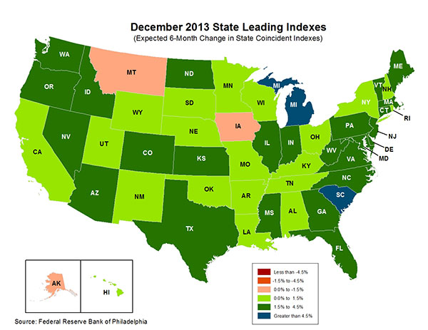
State-by-State Leading Indicators through 2014:Q2
The economic outlook for most of the US is positive for the first time in many years
Sources: Federal Reserve Bank of Philadelphia at http://www.philadelphiafed.org/index.cfm ;Insurance Information Institute.

Slide 8
Consumer Sentiment Survey (1966 = 100)
January 2010 through March 2014
Optimism among consumers dropped in Q3 2013 as the government shutdown created uncertainty, then rebounded though the harsh winter took a toll
Impact of 2011 budget impasse
Consumer confidence has been low for years amid high unemployment, falling home prices and other factors adversely impact consumers, but improved substantially over the past 2+ years, though uncertainty in Washington sometimes takes a toll.
Source: University of Michigan; Insurance Information Institute

Slide 9
New Private Housing Starts, 1990-2019F
Job growth, low inventories of existing homes, low mortgage rates and demographics should continue to stimulate new home construction for several more years
(Millions of Units)
New home starts plunged 72% from 2005-2009; A net annual decline of 1.49 million units, lowest since records began in 1959
Insurers Are Continue to See Meaningful Exposure Growth in the Wake of the “Great Recession” Associated with Home Construction: Construction Risk Exposure, Surety, Commercial Auto; Potent Driver of Workers Comp Exposure
Source: U.S. Department of Commerce; Blue Chip Economic Indicators (3/14 and 3/13); Insurance Information Institute.

Slide 10
Commercial & Industrial Loans Outstanding at FDIC-Insured Banks, Quarterly, 2006-2013*
$Trillions
Recession
In nominal dollar terms, this is an all-time high.
Outstanding loan volume has been growing for over two years and (as of year-end 2012) surpassed previous peak levels.
*Latest data as of 2/2/2014.
Source: FDIC at http://www2.fdic.gov/qbp/ (Loan Performance spreadsheet); Insurance Information Institute.

Slide 11
ISM Non-Manufacturing Index
(Values > 50 Indicate Expansion)
January 2010 through February 2014
Optimism among non-manufacturers was hurt by the uncertainty in Washington, but remains resilient
Non-manufacturing industries have been expanding and adding jobs. This trend is likely to continue through 2014.
Source: Institute for Supply Management at http://www.ism.ws/ismreport/nonmfgrob.cfm; Insurance Information Institute.

Slide 12
Business Bankruptcy Filings, 1980-2013
% Change Surrounding Recessions
1980-82 58.6%
1980-87 88.7%
1990-91 10.3%
2000-01 13.0%
2006-09 208.9%
2013 bankruptcies totaled 33,212, down 17.1% from 2012—the fourth consecutive year of decline. Business bankruptcies more than tripled during the financial crisis.
Significant Exposure Implications for All Commercial Lines as Business Bankruptcies Begin to Decline
Sources: American Bankruptcy Institute (1980-2012) at http://www.abiworld.org/AM/AMTemplate.cfm?Section=Home&TEMPLATE=/CM/ContentDisplay.cfm&CONTENTID=61633; 2013 data from United States Courts at http://news.uscourts.gov; Insurance Information Institute.
12
12/01/09 - 9pm
eSlide – P6466 – The Financial Crisis and the Future of the P/C
Notes:
12

Slide 13
Nonfarm Payroll (Wages and Salaries): Quarterly, 2005–2013:Q4
Billions
Latest (2013:Q4) was $7.23 trillion, a new peak--$980B above 2009 trough
Prior Peak was 2008:Q1 at $6.60 trillion
Payrolls are 15.7% above their 2009 trough and up 2.0% over the past year
Recent trough (2009:Q3) was $6.25 trillion, down 5.3% from prior peak
Note: Recession indicated by gray shaded column. Data are seasonally adjusted annual rates.
Sources: http://research.stlouisfed.org/fred2/series/WASCUR; National Bureau of Economic Research (recession dates); Insurance Information Institute.
13
12/01/09 - 9pm
eSlide – P6466 – The Financial Crisis and the Future of the P/C
Notes:
13

Slide 14
12 Industries for the Next 10 Years: Insurance Solutions Needed
Health Care
Health Sciences
Energy (Traditional)
Many industries are poised for growth, though insurers’ ability to capitalize on these industries varies widely
Alternative Energy
Petrochemical
Agriculture
Natural Resources
Technology (incl. Biotechnology)
Light Manufacturing
Insourced Manufacturing
Export-Oriented Industries
Shipping (Rail, Marine, Trucking, Pipelines)

Slide 15
CONSTRUCTION INDUSTRY OVERVIEW & OUTLOOK
The Construction Sector Is Critical to the Economy and the WC Insurers
15

Slide 16
Value of New Private Construction: Residential & Nonresidential, 2003-2013*
2013: Value of new pvt. construction hits $667.5B, up 33% from the 2010 trough but still 27% below 2006 peak
New Construction peaks at $911.8. in 2006
Billions of Dollars
Trough in 2010 at $500.6B, after plunging 55.1% ($411.2B)
$15.0
$613.7
$311.5
$298.1
$261.8
$238.8
$356.0
Private Construction Activity Is Moving in a Positive Direction though Remains Well Below Pre-Crisis Peak; Residential Dominates
*2013 figure is a seasonally adjusted annual rate as of December.
Sources: US Department of Commerce; Insurance Information Institute.
16
12/01/09 - 9pm
eSlide – P6466 – The Financial Crisis and the Future of the P/C
Notes:
16

Slide 17
Change from Peak in New Construction Expenditures to 2013*
Change (%)
Residential
Nonresidential
Govt.
Despite Recent Improvements, Construction Activity (and Employment) Remains Far Below Pre-Crisis Peaks
Note: Year in parentheses is the year of peak expenditure.
*2013 figure is a seasonally adjusted annual rate as of June.
Sources: US Department of Commerce; Insurance Information Institute.

Slide 18
Value of Construction Put in Place, January 2014 vs. January 2013*
Growth (%)
Private: +12.3%
Public: +2.5%
Private sector construction activity is now up in the residential and nonresidential segments
Public sector construction activity remains low but is no longer contracting
Overall Construction Activity is Up, But Growth Is Almost Entirely in the Private Sector as State/Local Government Budget Woes Continue
*seasonally adjusted Source: U.S. Census Bureau, http://www.census.gov/construction/c30/c30index.html ; Insurance Information Institute.

Slide 19
Value of Private Construction Put in Place, by Segment, Jan. 2014 vs. Jan. 2013*
Growth (%)
Led by the Residential Construction, Lodging, Communication and Office segments, Private sector construction activity is rising after plunging during the “Great Recession.”
Private Construction Activity is Up in Most Segments, Including the Key Residential Construction Sector; Bodes Well for Early 2014
*seasonally adjusted Source: U.S. Census Bureau, http://www.census.gov/construction/c30/c30index.html ; Insurance Information Institute.

Slide 20
Private Construction by Segment/Project Type, Jan. 2014 vs. Jan. 2013*
Shopping malls/centers and warehouse construction are among the strongest nonresidential segments
Growth (%)
Private Construction Activity is Up in Many Segments, Including the Key Residential Construction Sector, But Down in a Few
*seasonally adjusted Source: U.S. Census Bureau, http://www.census.gov/construction/c30/c30index.html ; Insurance Information Institute.

Slide 21
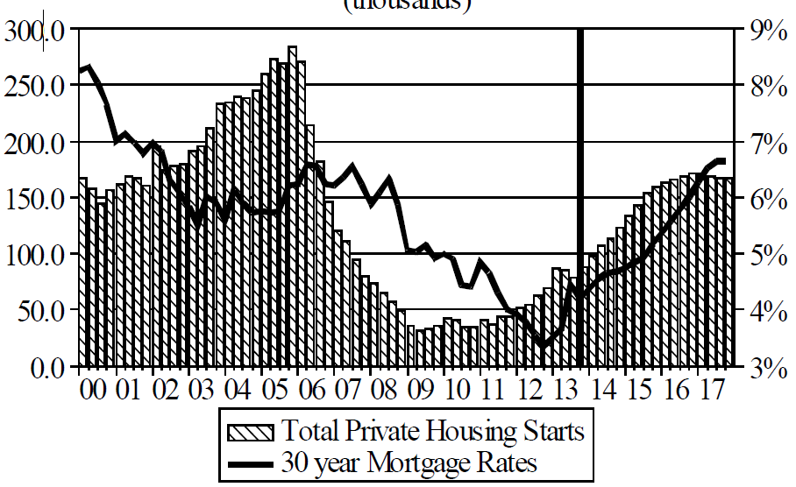
Florida Total Private Housing Starts, 2000 – 2017F
(Thousands of Units)
CRASH, CRATER, RECOVERY Homebuilding in FL continues to recover, but employment and WC exposures will take more than a decade to recover
The economic outlook for most of the US is positive for the first time in many years
Source: University of Central Florida Institute for Economic Competitiveness: http://iec.ucf.edu/post/2014/01/07/Florida-Metro-Forecast-December-2013.aspx

Slide 22
Value of New Federal, State and Local Government Construction: 2003-2013*
Construction across all levels of government peaked at $314.9B in 2009
Austerity Reigns
Govt. construction is still shrinking, down $40.5B or 12.9% since 2009 peak
($ Billions)
Government Construction Spending Peaked in 2009, Helped by Stimulus Spending, but Continues to Contract As State/Local Governments Grapple with Deficits and Federal Sequestration Takes Hold
*2013 figure is a seasonally adjusted annual rate as of December.
Sources: US Department of Commerce; Insurance Information Institute.

Slide 23
Value of Public Construction Put in Place, by Segment, Jan. 2014 vs. Jan. 2013*
Public sector construction activity is down substantially in most segments, a situation that will likely persist, dragging on public entity risk exposures
Highway, Transport, and Power projects lead public sector construction
Growth (%)
Public Construction Activity is Down in Many Segments as State and Local Budgets Remain Under Stress; Improvement Possible in 2014.
*seasonally adjusted Source: U.S. Census Bureau, http://www.census.gov/construction/c30/c30index.html ; Insurance Information Institute.

Slide 24
Public Construction by Segment/Project Type, Jan. 2014 vs. Jan. 2013*
Growth (%)
State and local public sector construction spending could begin a slow recovery in 2014; Federal spending will languish.
Public Construction Activity is Down in Most Segments as Governments Grapple with Budget Deficits and Pension Shortfalls
*seasonally adjusted Source: U.S. Census Bureau, http://www.census.gov/construction/c30/c30index.html ; Insurance Information Institute.

Slide 25
Construction Employment, Jan. 2010—February 2014*
(Thousands)
Construction employment is +506,000 above Jan. 2011 (+9.3%) trough
Construction and manufacturing employment constitute 1/3 of all payroll exposure.
*Seasonally adjusted.
Sources: US Bureau of Labor Statistics at http://data.bls.gov; Insurance Information Institute.
25
12/01/09 - 9pm
eSlide – P6466 – The Financial Crisis and the Future of the P/C
Notes:
25

Slide 26
Construction Employment, Jan. 2003–February 2014
(Thousands)
Construction employment as of Feb. 2014 totaled 5.941 million, an increase of 506,000 jobs or 9.3% from the Jan. 2011 trough
Construction employment peaked at 7.726 million in April 2006
Construction employment troughed at 5.435 million in Jan. 2011, after a loss of 2.291 million jobs, a 29.7% plunge from the April 2006 peak
The “Great Recession” and housing bust destroyed 2.3 million constructions jobs
The Construction Sector Could Be a Growth Leader in 2014 as the Housing Market, Private Investment and Govt. Spending Recover. WC Insurers Will Benefit.
Note: Recession indicated by gray shaded column.
Sources: U.S. Bureau of Labor Statistics; Insurance Information Institute.
26
12/01/09 - 9pm
eSlide – P6466 – The Financial Crisis and the Future of the P/C
Notes:
26

Slide 27
The New American Labor Force
The Recovery’s Winners and Losers Are Reshaping the Sources of WC’s Payroll Exposure Base
27

Slide 28
Unemployment and Underemployment Rates: Still Too High, But Falling
January 2000 through February 2014, Seasonally Adjusted (%)
U-6 went from 8.0% in March 2007 to 17.5% in October 2009; Stood at 12.6% in Feb. 2014. 8% to 10% is “normal.”
As the unemployment rate approaches 6%, the Fed will begin signaling on short-term rates
“Headline” unemployment was 6.7% in February 2014. 4% to 6% is “normal.”
Stubbornly high unemployment and underemployment constrain overall economic growth, but the job market is now clearly improving.
Source: US Bureau of Labor Statistics; Insurance Information Institute.
28
12/01/09 - 9pm
eSlide – P6466 – The Financial Crisis and the Future of the P/C
Notes:
28

Slide 29
US Unemployment Rate Forecast
2007:Q1 to 2015:Q4F*
Rising unemployment eroded payrolls and WC’s exposure base.
Unemployment peaked at 10% in late 2009.
Jobless figures have been revised slightly downwards for 2014/15
Unemployment forecasts have been revised slightly downwards. Optimistic scenarios put the unemployment as low as 6.0% by Q4 of this year.
* = actual; = forecasts
Sources: US Bureau of Labor Statistics; Blue Chip Economic Indicators (3/14 edition); Insurance Information Institute.

Slide 30
Monthly Change in Private Employment
January 2007 through February 2014 (Thousands, Seasonally Adjusted)
162,000 private sector jobs were created in February
Jobs Created
2013: 2.368 Mill
2012: 2.294 Mill
2011: 2.400 Mill
2010: 1.277 Mill
Monthly losses in Dec. 08–Mar. 09 were the largest in the post-WW II period
Private Employers Added 8.34 million Jobs Since Jan. 2010 After Having Shed 5.01 Million Jobs in 2009 and 3.76 Million in 2008 (State and Local Governments Have Shed Hundreds of Thousands of Jobs)
Source: US Bureau of Labor Statistics: http://www.bls.gov/ces/home.htm; Insurance Information Institute

Slide 31
Cumulative Change in Private Employment: Dec. 2007—Dec. 2013
December 2007 through December 2013 (Millions)
Cumulative job losses as of Dec. 2013 totaled 587,000.
Cumulative job losses peaked at 8.765 million in February 2010
Private Employers Added 8.14 million Jobs Since Jan. 2010 After Having Shed 4.98 Million Jobs in 2009 and 3.80 Million in 2008 (State and Local Governments Have Shed Hundreds of Thousands of Jobs)
Source: US Bureau of Labor Statistics: http://www.bls.gov/ces/home.htm; Insurance Information Institute

Slide 32
Cumulative Change in Private Sector Employment: Jan. 2010—Feb. 2014
January 2010 through February 2014* (Millions)
Job gains and pay increases have added nearly $1 trillion to payrolls since Jan. 2010
Cumulative job gains through Feb. 2014 totaled 8.64 million
Private Employers Added 8.64 million Jobs Since Jan. 2010 After Having Shed 4.98 Million Jobs in 2009 and 3.80 Million in 2008 (State and Local Governments Have Shed Hundreds of Thousands of Jobs)
Source: US Bureau of Labor Statistics: http://www.bls.gov/ces/home.htm; Insurance Information Institute

Slide 33
Cumulative Change in Government Employment: Jan. 2010—Dec. 2013
Government at all levels has shed more than 600,000 jobs since Jan. 2010 even as private employers created 8.14 million jobs, though losses may now be stabilizing.
January 2010 through Dec. 2013* (Millions)
Cumulative job losses through Dec. 2013 totaled 631,000
Temporary Census hiring distorted 2010 figures
Governments at All Levels are Under Severe Fiscal Strain As Tax Receipts Plunged and Pension Obligations Soared During the Financial Crisis: Sequestration Will Add to this Toll
Source: US Bureau of Labor Statistics http://www.bls.gov/data/#employment; Insurance Information Institute

Slide 34
Net Change in Government Employment: Jan. 2010—Dec. 2013*
State government employment fell by 1.9% since the end of 2009 but is recovering while Federal employment is down by 3.8% and deteriorating
(Thousands)
Local government employment shrank by 424,000 from Jan. 2010 through Dec. 2013, accounting for 67% of all government job losses, negatively impacting WC exposures for those cities and counties that insure privately
*Cumulative change from prior month; Base employment date is Dec. 2009.
Source: US Bureau of Labor Statistics http://www.bls.gov/data/#employment; Insurance Information Institute

Slide 35
Unemployment Rates by State, February 2014: Highest 25 States*
In February, 29 states had over-the-month unemployment rate decreases, 10 states had increases, and 11 states and the District of Columbia had no change.
*Provisional figures for February 2014, seasonally adjusted.
Sources: US Bureau of Labor Statistics; Insurance Information Institute.

Slide 36
Unemployment Rates by State, February 2014:
Lowest 25 States*
In February, 29 states had over-the-month unemployment rate decreases, 10 states had increases, and 11 states and the District of Columbia had no change.
*Provisional figures for February 2014, seasonally adjusted.
Sources: US Bureau of Labor Statistics; Insurance Information Institute.

Slide 37
US Unemployment Rate Forecasts
Quarterly, 2013:Q1 to 2014:Q4
Unemployment will remain high even under the most optimistic of scenarios, but forecasts are being revised downwards
Sources: Blue Chip Economic Indicators (May 2013); Insurance Information Institute

Slide 38
Nonfarm Payroll (Wages and Salaries): Quarterly, 2005–2013:Q4
Billions
Latest (2013:Q4) was $7.23 trillion, a new peak--$980B above 2009 trough
Prior Peak was 2008:Q1 at $6.60 trillion
Payrolls are 15.7% above their 2009 trough and up 2.0% over the past year
Recent trough (2009:Q3) was $6.25 trillion, down 5.3% from prior peak
Note: Recession indicated by gray shaded column. Data are seasonally adjusted annual rates.
Sources: http://research.stlouisfed.org/fred2/series/WASCUR; National Bureau of Economic Research (recession dates); Insurance Information Institute.
38
12/01/09 - 9pm
eSlide – P6466 – The Financial Crisis and the Future of the P/C
Notes:
38

Slide 39
Payroll vs. Workers Comp Net Written Premiums, 1990-2013E
Payroll Base* WC NWP
$Billions $Billions
7/90-3/91
3/01-11/01
12/07-6/09
WC premium volume dropped two years before the recession began
WC net premiums written were down $14B or 29.3% to $33.8B in 2010 after peaking at $47.8B in 2005
+8.5% in 2013E
Continued Payroll Growth and Rate Increases Suggest WC NWP Will Grow Again in 2014; +8.6% Growth Estimated for 2013
*Private employment; Shaded areas indicate recessions. WC premiums for 2012 are I.I.I. estimate based YTD 2013 actuals.
Sources: NBER (recessions); Federal Reserve Bank of St. Louis at http://research.stlouisfed.org/fred2/series/WASCUR ; NCCI; I.I.I.

Slide 40
Labor Force Participation Rate by Gender, 1948—2013
(Percent)
86.6% or working age men participated in the labor force in 1948 compared to 32.7% or women
By 2013, the labor force participation rate for men had declined to 69.7% while the participation rate for women had risen to 57.2%
By 2013, 57.2% of working age women participated in the labor force, up from 32.7% in 1948 but down from its all time high of 60.0% in 1999
Sources: U.S. Bureau of Labor Statistics; Insurance Information Institute.

Slide 41
Labor Force Participation by Sex and Education through the Crisis: 2006, 2010 and 2013
Men were hit harder and continue to do worse than women in the job market. Women are likely to do better than men for the indefinite future.
Workers lacking a college degree suffer from much higher rates of unemployment
Unemployment
Rate (%)
The composition and character of the U.S. labor force is changing rapidly. Winners and losers have clearly emerged. What does this mean for WC?
Sources: U.S. Bureau of Labor Statistics; Insurance Information Institute.

Slide 42
Unemployment Rates by Age and Race: 2006, 2010 and 2013
Unemployment among younger workers remains a chronic problem
Unemployment among some minority groups remains far above pre-recession levels
Unemployment Rate (%)
Source: U.S. Bureau of Labor Statistics; Insurance Information Institute.

Slide 43
Labor Force Participation Rate, Ages 65-69, Quarterly, 1998:Q1-2013:Q2
Labor Force participation rate
1 in 3 in this age group are working. Virtually none of them are “baby boomers”
The brown bars indicate recessions.
The labor force participation rate for workers 65-69 might grow even faster in the future as seniors find they can’t fully retire on their meager retirement savings.
Not seasonally adjusted. Sources: US Bureau of Labor Statistics, US Department of Labor; Insurance Information Institute.

Slide 44
Labor Force Participation Rate, Ages 70-74, Quarterly, 1998:Q1-2013:Q2
Labor Force participation rate
Nearly 1 in 5 in this age group is working. A dozen years ago it was 1 in 8.
The labor force participation rate for workers 70-74 grew by about 50% since 1998. Growth stalled during and after the Great Recession but has since resumed.
Source: US Bureau of Labor Statistics, US Department of Labor; Insurance Information Institute.

Slide 45
The Aging Workforce
45
Notes:
45

Slide 46
Fatality Rates Improved Slightly Since 2006 but Still Climb Sharply With Age
Fatal Work Injury Rate per 100,000 full-time-equivalent workers
No improvement in fatal work injury rate for this age group
The fatality rate for workers 65 and older was 5 times that of workers age 25-34. The workplace of the future will have to be completely redesigned to accommodate the surge in older workers.
Source: US Bureau of Labor Statistics, at http://www.bls.gov/iif/oshcfoi1.htm/#2010
46

Slide 47
Older Workers Lose More Days from Work Due to Injury or Illness
Median Days Away From Work
Youngest baby boomer is age 48 (in 2013)
Oldest baby boomer is age 67 (in 2013)
Median lost time of workers age 65+ is 2-3X that of workers age 25-34
Source: US Bureau of Labor Statistics, Nonfatal Occupational Injuries and Illnesses Requiring Days Away From Work, 2011 (Table 10), released November 8, 2012.
47

Slide 48
Older Workers Are Much More Likely to Break a Bone
Incidence Rate* (2011)
*per 10,000 full-time-equivalent workers Source: US Bureau of Labor Statistics, US Department of Labor at http://www.bls.gov/news.release/pdf/osh2.pdf Table 14
48

Slide 49
Older Workers Are More Likely to Slip When Walking, but Less Likely to Overexert Themselves
Incidence Rate (2011)
Source/Nature of Injury:
49
Source: US Bureau of Labor Statistics, US Department of Labor at http://www.bls.gov/news.release/pdf/osh2.pdf Table 14

Slide 50
The Reindustrialization of America
American Industrial Might Is Making a Comeback
A Golden Opportunity for Workers Comp Insurers?
50

Slide 51
Dollar Value* of Manufacturers’ Shipments Monthly, Jan. 1992—Dec. 2013
$ Millions
The value of Manufacturing Shipments in Dec. 2013 was $492.7B—a near record high.
Monthly shipments in Dec. 2013 exceeded the pre-crisis (July 2008) peak. Manufacturing is energy-intensive and growth leads to gains in many commercial exposures: WC, Commercial Auto, Marine, Property, and various Liability Coverages.
*seasonally adjusted; Dec. 2013 is preliminary; data published February 4, 2014. Source: U.S. Census Bureau, Full Report on Manufacturers’ Shipments, Inventories, and Orders, http://www.census.gov/manufacturing/m3/
51
12/01/09 - 9pm
eSlide – P6466 – The Financial Crisis and the Future of the P/C
Notes:
51

Slide 52
ISM Manufacturing Index
(Values > 50 Indicate Expansion)
January 2010 through February 2014
Manufacturing continued to expand in early 2014
The manufacturing sector expanded for 48 of the 50 months from Jan. 2010 through February 2014. Weakness in early 2014 stems largely from harsh winter weather and weakness in China.
Source: Institute for Supply Management at http://www.ism.ws/ismreport/mfgrob.cfm; Insurance Information Institute.

Slide 53
Manufacturing Growth for Selected Sectors, 2013 vs. 2012*
Growth (%)
Durables: +3.4%
Non-Durables: +0.2%
Manufacturing of durable goods was especially strong in 2012 but weakened in 2013
Manufacturing Is Expanding—Albeit Slowly—Across a Number of Sectors that Will Contribute to Growth in Insurable Exposures Including: WC, Commercial Property, Commercial Auto and Many Liability Coverages
*Seasonally adjusted; Date are YTD comparing data through November 2013 to the same period in 2012. Source: U.S. Census Bureau, Full Report on Manufacturers’ Shipments, Inventories, and Orders, http://www.census.gov/manufacturing/m3/

Slide 54
Durable Manufacturing: New Order Growth and Shipments, 2013
Most manufacturing sectors indicate order growth outstripping shipments, a favorable indicator for investment and expansion
Growth (%)
Manufacturing Is Expanding: New orders exceed shipments which suggests the industry is in an expansionary phase
*Seasonally adjusted; Date are advance report YTD data comparing data through December 2013 to the same period in 2012. Source: U.S. Census Bureau, Full Report on Manufacturers’ Shipments, Inventories, and Orders, http://www.census.gov/manufacturing/m3/

Slide 55
Recovery in Capacity Utilization is a Positive Sign for Commercial Exposures
March 2001 through December 2013
“Full Capacity”
The US operated at 79.2% of industrial capacity in Dec. 2013, well above the June 2009 low of 66.9% but is still below pre-recession levels.
Percent of Industrial Capacity
Hurricane Katrina
The closer the economy is to operating at “full capacity,” the greater the inflationary pressure
March 2001-November 2001 recession
December 2007- June 2009 Recession
55
Source: Federal Reserve Board statistical releases at http://www.federalreserve.gov/releases/g17/Current/default.htm.
Notes:
55

Slide 56
Manufacturing Employment, Jan. 2010—February 2014*
(Thousands)
Since Jan 2010, manufacturing employment is up (+605,000 or +5.3%) and still growing.
Manufacturing employment is a surprising source of strength in the economy. Employment in the sector is at a multi-year high.
*Seasonally adjusted; Jan. and Feb. 2014 are preliminary
Sources: US Bureau of Labor Statistics at http://data.bls.gov; Insurance Information Institute.
56
12/01/09 - 9pm
eSlide – P6466 – The Financial Crisis and the Future of the P/C
Notes:
56

Slide 57
Business Investment: Expected to Accelerate, Fueling Commercial Exposure Growth
Accelerating business investment will be a potent driver of commercial property and liability insurance exposures and should drive employment and WC payroll exposures as well (with a lag)
Source: IHS Global Insights as of Jan. 13, 2014; Insurance Information Institute.

Slide 58
U.S. Natural Has Imports and Exports, 1990 - 2040
Trillions of Cubic Feet
The US is now the largest gas producer in the world, though Russia is the largest exporter. The US needs to invest in its pipeline and LNG infrastructure and expedite regulatory approval to realize its full export potential
Sources: US Energy Information Administration, Annual Energy Outlook 2014 Early Release Overview; ;Insurance Information Institute.

Slide 59

Oil & Gas Extraction Employment, Jan. 2010—Feb. 2014*
Oil and gas extraction employment is up 32.9% since Jan. 2010 as the energy sector booms. Domestic energy production is essential to any robust economic recovery in the US.
Highest since Aug. 1986
(Thousands)
*Seasonally adjusted
Sources: US Bureau of Labor Statistics at http://data.bls.gov; Insurance Information Institute.
59
12/01/09 - 9pm
eSlide – P6466 – The Financial Crisis and the Future of the P/C
Notes:
59

Slide 60
Growth in Health Professions, 1991-2013
(Percent Annual Change)
Average Annual Growth Average
Healthcare: 2.5%
Total Nonfarm: 1.0%
The U.S. economy lost more than 8 million jobs during the Great Recession, but health sector employment expanded
Healthcare employment has continued to grow in good times and bad - including the Great Recession.
Sources: Bureau of Labor Statistics, Insurance Information Institute.
60
Notes:
60

Slide 61
Occupations Ranked by Projected Percentage Growth, 2012-2022F (Millions)
Healthcare professions are expected to grow at 2 to nearly 3 times employment growth overall
Source: Bureau of Labor Statistics, Insurance Information Institute.

Slide 62
The Future of Healthcare in America
Workers Comp Is Increasingly Along for the Ride in the American Health Care Saga
62

Slide 63
U.S. Health Care Expenditures, 1965–2022F
$ Billions
From 1965 through 2013, US health care expenditures had increased by 69 fold. Population growth over the same period increased by a factor of just 1.6. By 2022, health spending will have increased 119 fold.
U.S. health care expenditures have been on a relentless climb for most of the past half century, far outstripping population growth, inflation of GDP growth
Sources: Centers for Medicare & Medicaid Services, Office of the Actuary at http://www.cms.gov/Research-Statistics-Data-and-Systems/Statistics-Trends-and-Reports/NationalHealthExpendData/NationalHealthAccountsProjected.html accessed 3/14/14; Insurance Information Institute.

Slide 64
National Health Care Expenditures as a Share of GDP, 1965 – 2022F*
% of GDP
Health care expenditures as a share of GDP rose from 5.8% in 1965 to 18.0% in 2013 and are expected to reach 19.9% of GDP by 2022
2022 19.9%
2010: 17.9%
2000: 13.8%
1990: 12.5%
Since 2009, heath expenditures as a % of GDP have flattened out at about 18%--the question is why and will it last?
1980: 9.2%
1965 5.8%
Sources: Centers for Medicare & Medicaid Services, Office of the Actuary at http://www.cms.gov/Research-Statistics-Data-and-Systems/Statistics-Trends-and-Reports/NationalHealthExpendData/NationalHealthAccountsProjected.html accessed 3/14/14; Insurance Information Institute.

Slide 65
Rate of Health Care Expenditure Increase Compared to Population, CPI and GDP
Accelerating business investment will be a potent driver of commercial property and liability insurance exposures and should drive employment and WC payroll exposures as well (with a lag)
1965: $42.0 Bill
2013: $2,914.7 Bill
1965: $719.1 Bill
2013: $16,797.5 Bill
1965: 194.3 Mill
2013: 317.0 Mill
Source: Insurance Information Institute research.

Slide 66
Medical Cost Inflation vs. Overall CPI, 1995 - 2013
Though moderating, medical inflation will continue to exceed inflation in the overall economy
Average Annual Growth Average
Healthcare: 3.8%
Overall CPI: 2.4%
Sources: Med CPI from US Bureau of Labor Statistics, WC med severity from NCCI based on NCCI states.

Slide 67
Possible Effects of the Affordable Care Act (“ObamaCare”) on Workers Compensation
67

Slide 68
WC Medical Severity Generally Outpaces the Medical CPI Rate
Average annual increase in WC medical severity form 1995 through 2011 was well above the medical CPI (6.8% vs. 3.8%), but the gap is narrowing.
Sources: Med CPI from US Bureau of Labor Statistics, WC med severity from NCCI based on NCCI states.

Slide 69
A Few Potential Impacts of the ACA on Workers Compensation
Issue | Concern | Contravening Argument
Surge in People Covered by Health Insurance | System is overwhelmed MD shortage Patient care adversely impacted | Over time, people will have access to preventative care, improving the general health of the population Greater use of PA’s, etc.
Electronic Health Records | Cost | Computerization of patient data could help flag issues and improve risk management and improve patient outcomes
Claim Shifting | Provider/patient may prefer claim handled via WC system | Reduction in uninsured population reduces shifting
Source: Insurance Information Institute research; WCRI.
69

Slide 70
ACA Impact on WC May Occur via Changes in Rates Set by State Regulators
WC rates often tied to WC but can change for reasons independent of this link
There could be both positive and negative effects of a cut in Medicare rates on WC performance in states which tie reimbursement to Medicare
WC reimbursement rates would go down
Doctors may be unwilling to see WC patients:
64% of Dr.’s surveyed said they would stop accepting new Medicare patients if planned rate cuts go through; some of these same doctors may also refuse WC patients if WC rates also decrease
These effects would likely be short lived
All states which tie their fee schedules to Medicare already increase the Medicare rates to set WC rates, so any drop in the Medicare rates would likely be soon offset by a higher WC adjustment
WC Maximum Allowable Reimbursement Rates
as Percentage of Medicare
WC rates tied to Medicare
WC rates not tied to Medicare
SOURCE: NCCI Annual Issues Symposium 2009, Medicare’s Impact on Workers’ Compensation, AMA: “Physicians’ reactions to the Medicare physician payment cuts” from 3/13/13 presentation by Christopher Cunniff, FCAS, of Liberty Mutual.

Slide 71
PPACA May Have Distinct Impacts on WC Depending on Claim Frequency/Severity
Industry Portfolio by Claim Type
(Relative Volume by Claim Frequency & Paid Dollars)
Potential ACA Impact
Expanded coverage may shift some small claims to the health insurance system (+)
Physician access problems could lead to indemnity increases and may bleed into the complicated cases (-)
High Volume, Low Severity
Ex: med only, quick to settle, <25K
Preventative care and early record keeping decreases WC comorbidities (+)
Soft tissue treatments, a large portion of “slow burn claims,” may decrease in cost (+)
Complicated
Ex: back pain claims, very litigious
Catastrophic Injuries
Ex: spinal cord injury, multiple trauma claims
No significant impacts
SOURCE: Dr. Glenn Pransky, Liberty Mutual Research Institute for Health & Safety extracted from from 3/13/13 presentation by Christopher Cunniff, FCAS, of Liberty Mutual: Impacts of Healthcare Reform on Workers Compensation,

Slide 72
Possible Effects on Workers Comp
Could slow the growth in WC medical care costs
IPAB recommendations and PCORI reports, plus Medicare changes, could have beneficial effects on cost and treatment effectiveness
Could ACA be first step in federal regulation of insurance products and markets?
Will regulation like that requiring products to be priced to meet Medical Loss Ratios be applied to WC?
Will cost-control mechanisms such as the Independent Payment Advisory Board be developed for WC?
Will WC insurers lose their limited exemption from anti-trust laws that they have had under McCarran-Ferguson since 1945?

Slide 73
States of Play | Management of Health-Insurance Exchanges & ObamaCare
Some states are running new health-insurance exchanges on their own. Other are leaving some or all of the task to the federal government.
WA
Federally Run
exchange
MT
ND
ME
OR
MN
VT
State-run
exchange
ID
WI
NY
NH
SD
MA
Federal and
state joint-run
exchange
WY
MI
RI
IA
PA
CT
NV
NE
OH
NJ
UT
IL
IN
DE
CA
CO
WV
VA
MD
KS
MO
KY
TN
NC
AZ
NM
OK
AR
SC
MS
AL
GA
RI
AK
CT
TX
LA
NJ
FL
DE
HI
MD
DC
Source: Wall Street Journal, September 20, 2013.

Slide 74
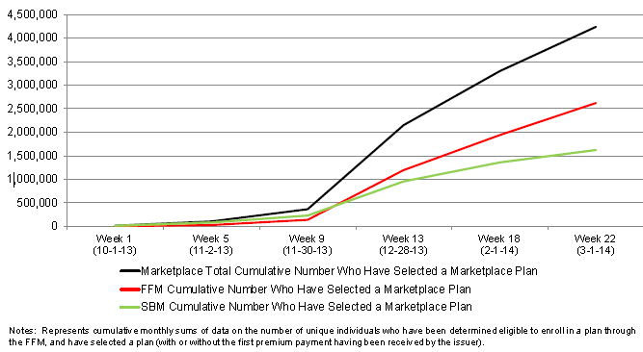
Number of People Signed Up for Health Care Under the ACA, Oct. 1 – March 1
UPDATE
HHS announced that enrollment as of 3/16 now exceeds 5 million
As of March 1, 4.2 million people have signed up for coverage under the ACA since enrollment opened on Oct. 1, 2013
759,800
Source: Centers for Medicare and Medicaid as of March 7, 2014: http://aspe.hhs.gov/health/reports/2014/MarketPlaceEnrollment/Mar2014/ib_2014mar_enrollment.pdf

Slide 75
Projected Number of People with No Health Insurance, 2013—2022*
By 2018 the number of people under age 65 without insurance is expected to drop by 25 million (~45%)
Millions
The projected decline in the uninsured population is very sensitive to the enrollment rate under the Affordable Care Act
*Under age 65.
Sources: Centers for Medicare & Medicaid Services, Office of the Actuary at http://www.cms.gov/Research-Statistics-Data-and-Systems/Statistics-Trends-and-Reports/NationalHealthExpendData/NationalHealthAccountsProjected.html accessed 3/14/14; Insurance Information Institute.
75
12/01/09 - 9pm
eSlide – P6466 – The Financial Crisis and the Future of the P/C
Notes:
75

Slide 76
Will Skill Shortages in the Medical Field Adversely Impact WC?
Concern that the ACA Will Overwhelm the Healthcare Delivery System, Harming Outcomes
76

Slide 77
Physician Supply and Demand, 2008–2020
A potential large and growing physician gap looms over the next decade, with potential for users of health care
Source: American Association of Medical Colleges https://www.aamc.org/advocacy/campaigns_and_coalitions/fixdocshortage/; Insurance Information Institute.

Slide 78
Projected Physician Supply and Demand, 2008–2020
A potential large and growing shortage of physicians looms. Estimates suggest a shortage of 91,500 physicians by 2020—a gap 12% gap.
Will this be a negative for MPL?
851,300
759,800
Source: American Association of Medical Colleges https://www.aamc.org/advocacy/campaigns_and_coalitions/fixdocshortage/; Insurance Information Institute.

Slide 79
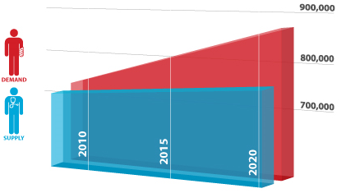
Physician Supply and Demand, 2008–2020
Demand for physicians is expected to outstrip supply through 2020 by a wide margin
Source: American Association of Medical Colleges https://www.aamc.org/advocacy/campaigns_and_coalitions/fixdocshortage/; Insurance Information Institute.

Slide 80
Growth in Healthcare Profession by Skill Level, 2012 – 2022F
(Thousands of Jobs)
+1.015 Mill +20.3%
+697,000 +24.1%
+750,000 +30.1%
+425,000 +24.0%
Source: Bureau of Labor Statistics, Insurance Information Institute.
80
Notes:
80

Slide 81
Workers Compensation Operating Environment
The Weak Economy and Soft Market Have Made the Workers Comp Operating Increasingly Challenging
81

Slide 82
Workers Compensation Combined Ratio: 1994–2014F
WC results have improved markedly since 2012
Workers Comp Results Began to Improve in 2012. Underwriting Results Deteriorated Markedly from 2007-2010/11 and Were the Worst They Had Been in a Decade.
Sources: A.M. Best (1994-2009); NCCI (2010-2012P) and are for private carriers only; Insurance Information Institute (2013-14).

Slide 83
Return on Net Worth, 2003-2012, Workers Comp vs. All P/C Lines
(Percent)
Average: 2003-2012
WC: 7.1%
All P/C Lines: 7.9%
WC Has Been Marginally Less Profitable than the P/C Insurance Industry Overall
Sources: NAIC, Report on Profitability by Line by State in 2012.
83
Notes:
83

Slide 84
Workers Comp Return on Net Worth, 2012
Percent
Top 25 States
9 states posted double-digit profits in WC in 2012
Sources: NAIC; Insurance Information Institute * Denotes results exclude state funds. Other state funds are included in results

Slide 85
Workers Comp Return on Net Worth, 2012
Percent
Bottom 25 States
In 2012, in 7 states the Return on Net Worth was under 4%
Sources: NAIC; Insurance Information Institute * Denotes results exclude state funds. Other state funds are included in results.

Slide 86
Change in Price Paid for Medical Professional Services in WC, 2002-2012*
%
Increases in WC med costs varied enormously over the past decade from a high of 56% in Wisconsin to a low of 2% in North Carolina
States in GOLD had no fee schedule in 2012. These generally saw larger increases in WC medical costs over the past decade.
*Data are preliminary as of 6/30/12.
Sources: Workers Compensation Research Institute, WCRI Medical Price Index for Workers Compensation, 5th Edition; Ins. Info. Institute.

Slide 87
Workers Compensation Medical Severity Moderate Increase in 2012
Medical
Claim Cost ($000s)
Average Medical Cost per Lost-Time Claim
Annual Change 1991–1993: +1.9%
Annual Change 1994–2001: +8.9%
Annual Change 2002–2010: +6.0%
Annual Change 1991–1993: +1.9%
Annual Change 1994–2001: +8.9%
Annual Change 2002–2011: +5.7%
Cumulative Change = 252%
(1991-2012p)
Accident Year
Accident Year
2012p: Preliminary based on data valued as of 12/31/2012.
1991-2011: Based on data through 12/31/2011, developed to ultimate
Based on the states where NCCI provides ratemaking services including state funds, excluding WV; Excludes high deductible policies.

Slide 88
Workers Comp Indemnity Claim Costs: Small Increase in 2012
Average Indemnity Cost per Lost-Time Claim
Indemnity
Claim Cost ($ 000s)
Average indemnity costs per claim were up 1% in 2012 to $22,400
Annual Change 1991–1993: -1.7%
Annual Change 1994–2001: +7.3%
Annual Change 2002–2011: +3.2%
Accident Year
2012p: Preliminary based on data valued as of 12/31/2012.
1991-2011: Based on data through 12/31/2011, developed to ultimate
Based on the states where NCCI provides ratemaking services including state funds, excluding WV; Excludes high deductible policies.
Notes:
88
Exhibit 11 of Article

Slide 89
Workers Compensation Lost-Time Claim Frequency Declined in 2012 Lost-Time Claims
Percent
Cumulative Change of –55.4%
(1991–2011 adj.)
Accident Year
*Adjustments primarily due to significant audit activity.
2012p: Preliminary based on data valued as of 12/31/2012
1991–2011: Based on data through 12/31/2011, developed to ultimate
Based on the states where NCCI provides ratemaking services, including state funds; excludes high deductible policies
Frequency is the number of lost-time claims per $1M pure premium at current wage and voluntary loss cost level
Source: NCCI.

Slide 90
WC Indemnity Severity vs. Wage Inflation, 1995 -2012p
Indemnity severities usually outpace wage gains
Annual Change 1991–1993: -1.7%
Annual Change 1994–2001: +7.3%
Annual Change 2002–2011: +3.2%
WC indemnity severity turned positive again in 2011
2011p: Preliminary based on data valued as of 12/31/2011; 1991-2010: Based on data through 12/31/2010, developed to ultimate. Based on the states where NCCI provides ratemaking services. Excludes the effects of deductible policies. CPS = Current Population Survey.
Source: NCCI

Slide 91
Questionable Claims, Top 10 Policy Types: 2010–2012
(Number of Questionable Claims)
According to the NICB, the number of “Questionable Claims” in WC and EL increased by 38.4% from 2010 through 2012
+24.9%
+47.1%
+38.4%
+2.4%
+15.3%
+205.1%
+34.8%
+30.0%
-10.1%
+6.0%
Source: National Insurance Crime Bureau, ForeCAST Report, May 10, 2013; Insurance Information Institute

Slide 92
Workers Compensation Premium: Second Consecutive Year of Increase Net Written Premium
$ Billions
p Preliminary
Source: 1990–20102p Private Carriers, Annual Statement Data, NCCI.
1996–2012p State Funds: AZ, CA, CO, HI, ID, KY, LA, MD, MO, MT, NM, OK, OR, RI, TX, UT Annual Statements
State Funds available for 1996 and subsequent
Calendar Year

Slide 93
Direct Premiums Written: Workers’ Comp Percent Change by State, 2007-2012*
Top 25 States
*Excludes monopolistic fund states: ND, OH, WA, WY as well as WV, which transitioned to a competitive structure during this period.
Sources: SNL Financial LC.; Insurance Information Institute.

Slide 94
Direct Premiums Written: Worker’s Comp Percent Change by State, 2007-2012*
Bottom 25 States
States with the poorest performing economies also produced the most negative net change in premiums of the past 5 years
*Excludes monopolistic fund states: ND, OH, WA, WY as well as WV, which transitioned to a competitive structure during this period.
Sources: SNL Financial LC.; Insurance Information Institute.

Slide 95
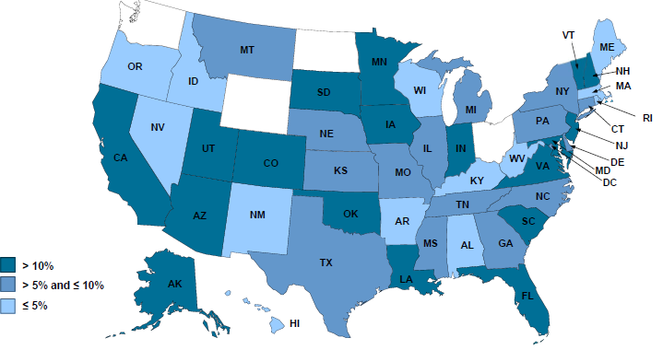
2012 Workers Compensation Direct Written Premium Growth, by State*
PRIVATE CARRIERS: Overall 2012 Growth = +9%
While growth rates varied widely, all states experienced growth in excess of 5% in 2012
*Excludes monopolistic fund states (in white): OH, ND, WA and WY.
Source: NCCI.

Slide 96
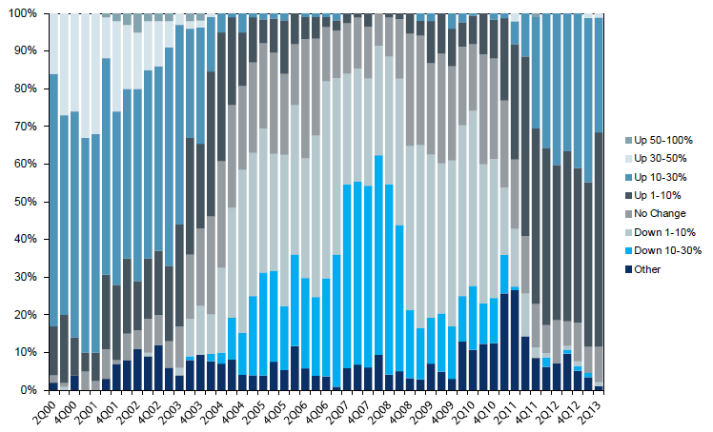
Workers Comp. Quarterly Rate Changes, by Line: 2000:Q1 to 2013:Q2
1999:Q4 = 100
Most accounts are now renewing upwards
Note: CIAB data cited here are based on a survey. Rate changes earned by individual insurers can and do vary, potentially substantially.
Source: Council of Insurance Agents and Brokers; Barclay’s Capital; Insurance Information Institute.

Slide 97
Change in Commercial Rate Renewals, by Line: 2013:Q3
Workers Comp rate increases are large than any other line, followed by Property lines
Percentage Change (%)
Major Commercial Lines Renewed Uniformly Upward in Q3:2013 for the 9th Consecutive Quarter; Property Lines & Workers Comp Leading the Way; Cat Losses and Low Interest Rates Provide Momentum Going Forward
Note: CIAB data cited here are based on a survey. Rate changes earned by individual insurers can and do vary, potentially substantially.
Source: Council of Insurance Agents and Brokers; Insurance Information Institute.

Slide 98
Workers Comp Rate Changes, 2008:Q4 – 2013:Q3
WC rate changes have been positive for 10 consecutive quarters, longer than any other commercial line
(Percent Change)
Note: CIAB data cited here are based on a survey. Rate changes earned by individual insurers can and do vary, potentially substantially.
Source: Council of Insurance Agents and Brokers; Information Institute.

Slide 99
Growth in Direct Written Premium by Line, 2013-2015F*
(Percent)
P/C growth is expected to remain fairly stable through 2015
Source: Conning.

Slide 100
Average Approved Bureau Rates/Loss Costs
Percent
History of Average WC Bureau Rate/Loss Cost Level Changes
Cumulative 2000–2003
+17.1%
Approve rates/loss costs are seeing their first significant increase since 2003
Cumulative 1994–1999
-27.8%
Cumulative 2004–2011
-25.6%
Cumulative
1990–1993
+36.3%
Calendar Year
*States approved through 7/31/12.
Note: Countrywide approved changes in advisory rates, loss costs and assigned risk rates as filed by applicable rating organization.
Source: NCCI.

Slide 101
Current NCCI Voluntary Market Filed Rate/Loss Cost Changes (Excludes Law-Only Filings)
Ratio
IN and NC filed in cooperation with state rating bureau
Source: NCCI

Slide 102
Impact of Discounting on Workers Compensation Premium NCCI States—Private Carriers
Percent
p Preliminary
Dividend ratios are based on calendar year statistics
NCCI benchmark level does not include an underwriting contingency provision
Based on data through 12/31/2011 for the states where NCCI provides ratemaking services
Source: NCCI.
Policy Year

Slide 103
INVESTMENTS: THE NEW REALITY
Investment Performance is a Key Driver of Profitability
Depressed Yields Will Necessarily Influence Underwriting & Pricing
103

Slide 104
Property/Casualty Insurance Industry Investment Income: 2000–2013*¹
($ Billions)
Investment earnings are running below their 2007 pre-crisis peak
Investment Income Fell in 2012 and is Falling in 2013 Due to Persistently Low Interest Rates, Putting Additional Pressure on (Re) Insurance Pricing
¹ Investment gains consist primarily of interest and stock dividends..
*Estimate based on annualized actual 9M:2013 investment income of $34.338B.
Sources: ISO; Insurance Information Institute.

Slide 105
P/C Insurer Net Realized Capital Gains/Losses, 1990-2013:Q3
Realized capital gains in 2013 will eclipse 2012 gains
($ Billions)
Insurers Posted Net Realized Capital Gains in 2010, 2011 and 2012 Following Two Years of Realized Losses During the Financial Crisis. Realized Capital Losses Were the Primary Cause of 2008/2009’s Large Drop in Profits and ROE
Sources: A.M. Best, ISO, Insurance Information Institute.
105
12/01/09 - 9pm
eSlide – P6466 – The Financial Crisis and the Future of the P/C
Notes:
105

Slide 106
Property/Casualty Insurance Industry Investment Gain: 1994–2013:Q3¹
($ Billions)
Investment gains through 2013:Q3 were approximately double those through 2012:Q3
Investment Income Continued to Fall in 2013 Due to Low Interest Rates but Realized Investment Gains Were Up Sharply; The Financial Crisis Caused Investment Gains to Fall by 50% in 2008
¹ Investment gains consist primarily of interest, stock dividends and realized capital gains and losses.
* 2005 figure includes special one-time dividend of $3.2B;
Sources: ISO; Insurance Information Institute.

Slide 107
Reduction in Combined Ratio Necessary to Offset 1% Decline in Investment Yield to Maintain Constant ROE, by Line*
Lower Investment Earnings Place a Greater Burden on Underwriting and Pricing Discipline
*Based on 2008 Invested Assets and Earned Premiums
**US domestic reinsurance only
Source: A.M. Best; Insurance Information Institute.
107
12/01/09 - 9pm
eSlide – P6466 – The Financial Crisis and the Future of the P/C
Notes:
107
This shows the drop in Combined Ratio for each line of business that would be needed to maintain a constant ROE, given a 1-percentage-point drop in investment yield

Slide 108
U.S. 10-Year Treasury Note Yields: A Long Downward Trend, 1990–2014*
Yields on 10-Year U.S. Treasury Notes recently plunged to record modern-era lows in early 2013 but have since risen as the Fed begins “tapering” its QE program in 2014
Yields on 10-Year U.S. Treasury Notes have been essentially below 5% for a full decade.
Since roughly 80% of P/C bond/cash investments are in 10-year or shorter durations, most P/C insurer portfolios will have low-yielding bonds for years to come.
*Monthly, through February 2014. Note: Recessions indicated by gray shaded columns.
Sources: Federal Reserve Bank at http://www.federalreserve.gov/releases/h15/data.htm. National Bureau of Economic Research (recession dates); Insurance Information Institutes.
108
12/01/09 - 9pm
eSlide – P6466 – The Financial Crisis and the Future of the P/C
Notes:
108

Slide 109
U.S. Treasury Security Yields: A Long Downward Trend, 1990–2014*
Yields on 10-Year U.S. Treasury Notes have been essentially below 5% for a full decade.
U.S. Treasury yields plunged to historic lows in 2013. Only longer-term yields have rebounded.
Since roughly 80% of P/C bond/cash investments are in 10-year or shorter durations, most P/C insurer portfolios will have low-yielding bonds for years to come.
*Monthly, constant maturity, nominal rates, through February 2014.
Sources: Federal Reserve Bank at http://www.federalreserve.gov/releases/h15/data.htm. National Bureau of Economic Research (recession dates); Insurance Information Institute.
109
12/01/09 - 9pm
eSlide – P6466 – The Financial Crisis and the Future of the P/C
Notes:
109

Slide 110
Treasury Yield Curves: Pre-Crisis (July 2007) vs. Feb. 2014
Treasury yield curve remains near its most depressed level in at least 45 years. Investment income is falling as a result. Even as the Fed “tapers” rates are unlikely to return to pre-crisis levels anytime soon
The Fed Is Actively Signaling that it Is Determined to Keep Rates Low Until Unemployment Drops Below 6.5% or Until Inflation Expectations Exceed 2.5%; Low Rates Add to Pricing Pressure for Insurers.
Source: Federal Reserve Board of Governors; Insurance Information Institute.

Slide 111
Treasury Yield Curves: Pre-Crisis (July 2007) vs. Feb. 2014
Longer term yields are expected to rise in 2014 and 2015 while short-term yields will not begin to normalize until 2015
Higher longer-term yields will help insurers but short term yields are expected to lag behind
Source: Federal Reserve Board of Governors (2006-2013), Swiss Re (2014-2015); Insurance Information Institute.

Slide 112
Outlook for U.S. Treasury Bond Yields Through 2015
Long-term yields should begin to normalize in 2014 but short-term yields will remain very low until 2015
% Yield
Longer-tail lines like MPL and workers comp will benefit the most from the normalization of yields
Source: Federal Reserve Board of Governors (2012-2013), Swiss Re (2014-2015); Insurance Information Institute.
112
12/01/09 - 9pm
eSlide – P6466 – The Financial Crisis and the Future of the P/C
Notes:
112

Slide 113
Financial Strength & Underwriting
History Suggests that WC, Like Other Long-Tailed Lines Is Much More Difficult to Underwrite
113

Slide 114
P/C Insurer Impairments, 1969–2012
Impairments among P/C insurers remain infrequent
The Number of Impairments Varies Significantly Over the P/C Insurance Cycle, With Peaks Occurring Well into Hard Markets
Source: A.M. Best Special Report “Pace of P/C Impairments Slowed in 2012; Auto Writers, RRGs Continued to Struggle,” June 2013; Insurance Information Institute.

Slide 115
P/C Insurer Impairment Frequency vs. Combined Ratio, 1969-2012
2012 impairment rate was 0.69%, down from 1.11% in 2011; the rate is lower than the 0.82% average since 1969
Impairment Rates Are Highly Correlated With Underwriting Performance and Reached Record Lows in 2007; Recent Increase Was Associated Primarily With Mortgage and Financial Guaranty Insurers and Not Representative of the Industry Overall
Source: A.M. Best; Insurance Information Institute

Slide 116
Number of Recessions Endured by P/C Insurers, by Number of Years in Operation
Number of Recessions Since 1860
Insurers are true survivors—not just of natural catastrophes but also economic ones
Number of Years in Operation
Many US Insurers Are Close to a Century Old or Older
Sources: Insurance Information Institute research from National Bureau of Economic Research data.
116
12/01/09 - 9pm
eSlide – P6466 – The Financial Crisis and the Future of the P/C
Notes:
116

Slide 117
Reasons for US P/C Insurer Impairments, 1969–2012
Historically, Deficient Loss Reserves and Inadequate Pricing Are By Far the Leading Cause of P-C Insurer Impairments. Investment and Catastrophe Losses Play a Much Smaller Role
Reinsurance Failure
Sig. Change in Business
Misc.
Investment Problems (Overstatement of Assets)
Deficient Loss Reserves/ Inadequate Pricing
Affiliate Impairment
Catastrophe Losses
Alleged Fraud
Rapid Growth
Source: A.M. Best Special Report “Pace of P/C Impairments Slowed in 2012; Auto Writers, RRGs Continued to Struggle,” June 2013; Insurance Information Institute.

Slide 118
Top 10 Lines of Business for US P/C Impaired Insurers, 2000–2012
Medical Professional Liability Accounts for Only About 2% of Industry DPW but 6.7% of Insurer Impairments
Other
Title
Surety
Workers Comp
Med Mal
Other Liability
Pvt. Passenger Auto
Commercial Auto Liability
Commercial Multiperil
Homeowners
Source: A.M. Best Special Report “Pace of P/C Impairments Slowed in 2012; Auto Writers, RRGs Continued to Struggle,” June 2013; Insurance Information Institute.
.

Slide 119
Workers Compensation
The NEXT 100 Years
119

Slide 120
Threats and Challenges
Will Advances in Workplace Safety Make WC Irrelevant?
Loss of Pricing Discipline
Persistently Low Interest Rates
Affordable Care Act (“ObamaCare”)
Probably a small net benefit for WC insurers
Less cost shifting possible
Potential downward pressure on drivers of med cost inflation; Wellness?
Obesity
Aging Workforce
Opioids
Regulatory Risk
Anti-Immigration Sentiment in Washington
Likely holding back growth in high and low skill jobs
Adoption of Employer Liability Laws? (e.g., TX, OK)
“Big Data” and Workers Comp
Proliferation of advanced analytics

Slide 121
Workers Compensation Timeline
Industrialization of US in the Late 19th/Early 20th Century Led to Increasing & Unacceptably High Number of Deaths and Injuries Among Workers
In 1912, an estimated 18,000 to 23,000 workers were killed on the job (compared to 5,071 in 2008) and approximately 4.7 million (12% or workforce) suffered a nonfatal illness or injury (compared to 3.7 million 2008)
The 1912 death/injury rates would imply 75,600 deaths and 17 million injuries today
More awareness of broader impacts on families of injured/killed workers
Workers Could Seek Redress Under Tort Law, But Seldom Prevailed
Employers usually won suits filed by injured workers by arguing:
Contributory Negligence: Employee was at least partially to blame for the accident
Assumed Risk: By taking the job, the employee understood the hazards involved
Fellow Servant Rule: A fellow worker caused the accident, so the employer was not at fault
European Countries Began to Implement Workers Compensation Programs
Germany (1884); England (1897)
Insurers Began to Sell Commercial Liability Coverage in the Late 1800s
Coverage for inadvertent errors became more commonplace
In the workforce, such policies became the first employer liability policies
Source: Insurance Information Institute.

Slide 122
Key Workers Compensation Developments in the 1910s
Source: Insurance Information Institute.

Slide 123
Cumulative Number of WC Laws Passed, 1910-1920
New York was the first state to pass a WC law in 1910, and Ohio was one of the first ten when its law passed in 1911. By 1920, 43 of the 48 states at that time had passed WC laws
Source: http://eh.net/encyclopedia/article/fishback.workers.compensation; Insurance Information Institute.

Slide 124
Workers Compensation: 4 Predictions for the Next 100 Years
The Workplace Will Become Safer
Continuation of a nearly century long trend
Deaths and injuries will continue to fall and perhaps plummet due to improvements in risk management, technology and medicine
Technologies such as autonomous (driverless vehicles) will likely be a reality within 20-25 years causing motor-vehicle related fatalities and injuries (including MSDs) to fall
The Footprint of Federal Regulation on Insurance Will Increase
TRIA: Workers comp is arguably the most TRIA-dependent line
Post-Dodd-Frank: One (and in the future perhaps more) Systemically Important Financial Institution (SIFI) is a big WC insurer; The Fed is the ultimate regulator of SIFIs
Other WC insurers and reinsurers could be designated as Internationally Active Insurance Group (IAIG); Impact of this in the US is still unclear; More capital?
Federal Insurance Office (FIO): Pushing for greater consistency in state regulation
Affordable Care Act and subsequent healthcare legislation
Will the federal government take direct interest in WC?
It already has (e.g., TRIA) but will not seek to completely usurp states
As WC medical loss share rises, WC will get pulled into a tighter federal orbit
Insurers could once again resurrect the Optional Federal Charter debate
Bottom Line: The federal regulatory camel’s nose is under the tent; The hump is next.
Source: Insurance Information Institute.

Slide 125
Workplace Fatalities, 1945-2012
Workplace deaths and injury rates have been falling for decades—trends that will likely continue for many years to come
Source: Bureau of Labor Statistics; National Safety Council; Insurance Information Institute

Slide 126
U.S. Workforce Injury & Illness Rates, 1973-2012
(Injuries and Illnesses per 100 Full-Time Workers)
Workplace injury rates have declined in all industries from 11.0 in 1973 to 3.4 in 2012; in the same period injury rates in manufacturing declined from 15.3 to 4.3 and in construction from 19.8 to 3.7.
Sources: Bureau of Labor Statistics; Insurance Information Institute

Slide 127
Frequency: 1926–2009 A Long-Term Drift Downward
Manufacturing – Total Recordable Cases Rate of Injury and Illness Cases per 100 Full-Time Workers
Note: Recessions indicated by gray bars.
Sources: NCCI from US Bureau of Labor Statistics; National Bureau of Economic Research.

Slide 128
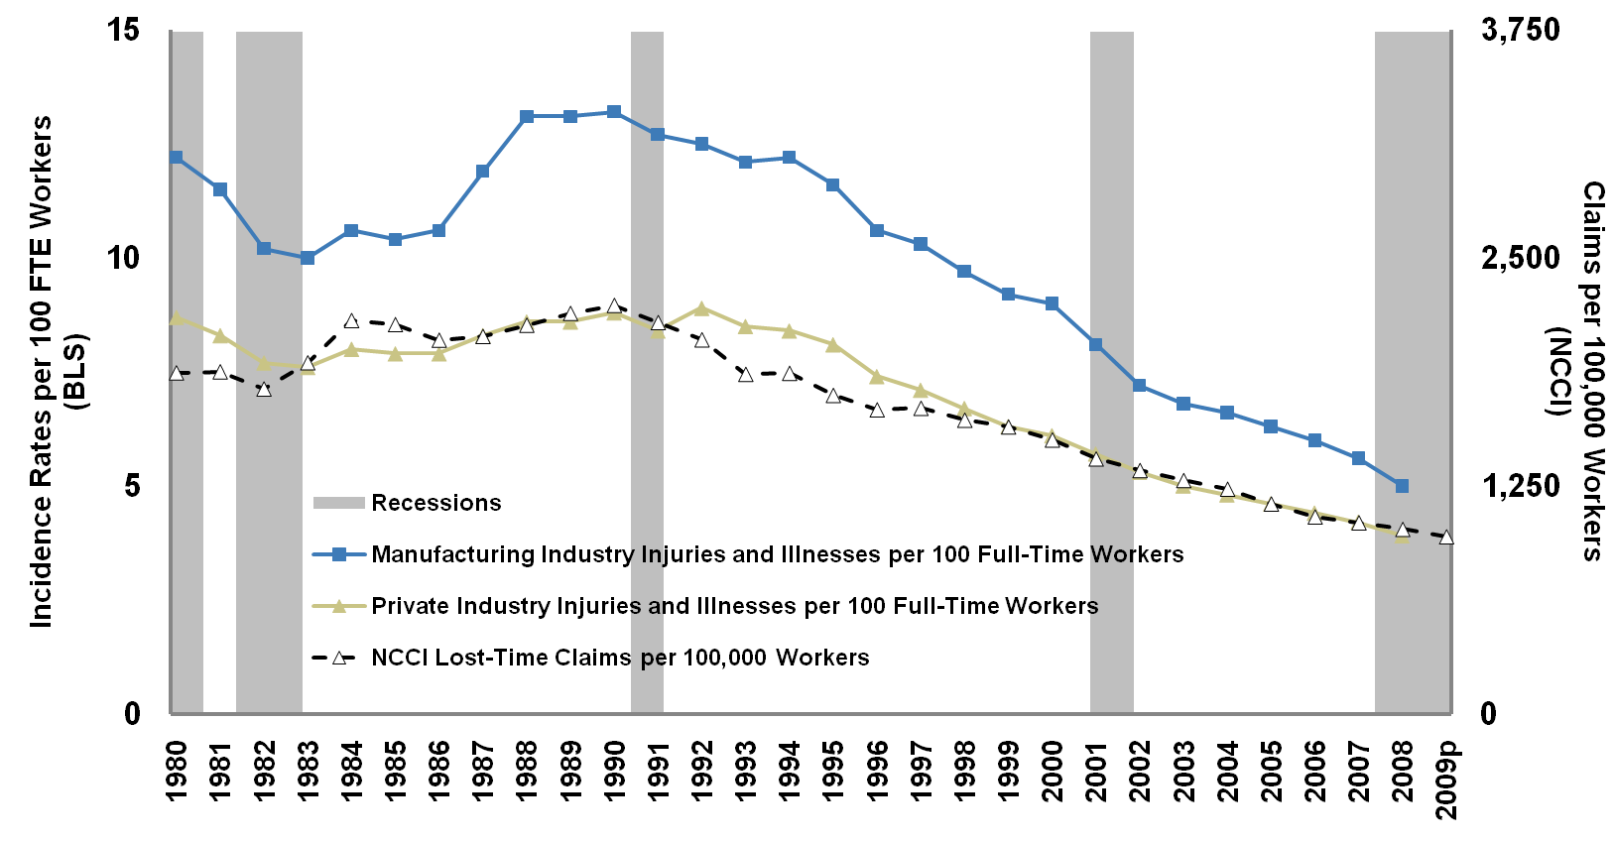
Workplace Injury Incidence Rates Declined
in Last Four Economic Downturns
Note: Recessions indicated by gray bars.
Sources: NCCI, US Bureau of Labor Statistics;

Slide 129
Workers Compensation: 5 Predictions for the Next 100 Years
Businesses Will Retain More Risk
Large deductible programs, self-insurance and use of captives will grow
Driven by more sophisticated risk management throughout corporate America and build-up of cash on corporate balance sheets (phenomenon of increased risk retention is occurring for most types of property and liability risks)
Some catastrophic WC exposures could be securitized
Medical Costs Will Continue to Rise
Technology, advancements in medicine will drive costs higher
Co-morbidities persist but may plateau; May improve over the span of decades
Supply/Demand imbalances for med services unlikely to persist beyond next 20 years
Consolidation in the healthcare space is likely; Net impact is upward price pressure
Digitization of patient med records per ACA is costly but ultimately should save money
BUT: “Big Data” drive should improve patient outcomes and lower costs
IF: Population projections are correct, aging will be less of an issue after 2030 or so
AND: People will live significantly longer but will not work that much longer
Source: Insurance Information Institute.

Slide 130
Insurance Information Institute Online:
www.iii.org
Thank you for your time and your attention!
Twitter: twitter.com/bob_hartwig
Download at www.iii.org/presentations

