Slide 1
Insurance: Vanguard of the Resilient
AAA Oregon/Idaho
Portland, OR
March 9, 2019
James Lynch, FCAS MAAA, Chief Actuary
Insurance Information Institute  110 William Street  New York, NY 10038
Tel: 212.346.5533  jamesl@iii.org  www.iii.org

Slide 2
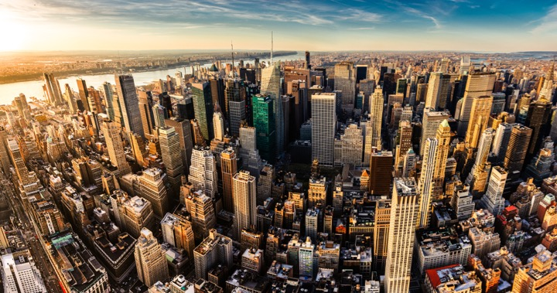
I.I.I. Mission Statement
Improving public understanding
of insurance...
…what it does and how it works.
2

Slide 3










How Insurance Drives Economic Growth
Safety/
Security
Economic/
Financial Stability
Development
Insurers are financial first responders
Insurers are capital protectors
Insurance is a partner in social policy
Insurers are community builders
Insurance enables infrastructure improvements
Insurers
are risk mitigators
Insurance sustains the supply chain
Insurers are capital infusers
Insurers are innovation catalysts
Insurers are credit facilitators
Notes:
3

Slide 4
Catastrophes
Extreme Weather Threatens Union

Slide 5
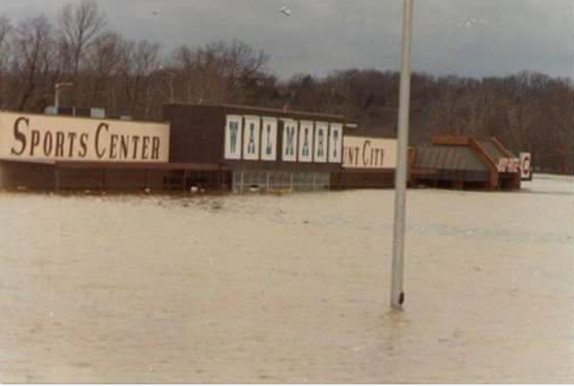
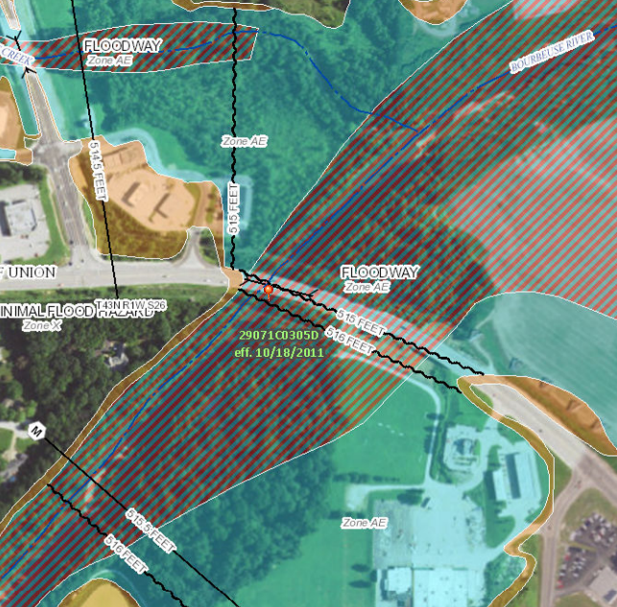
1982 Union, Missouri, Flood
A Storm for the Ages
Bourbeuse River
Record Crest
33.8 feet
12/5/1982
Source: Fox2News.com, @BoxxRadio.

Slide 6
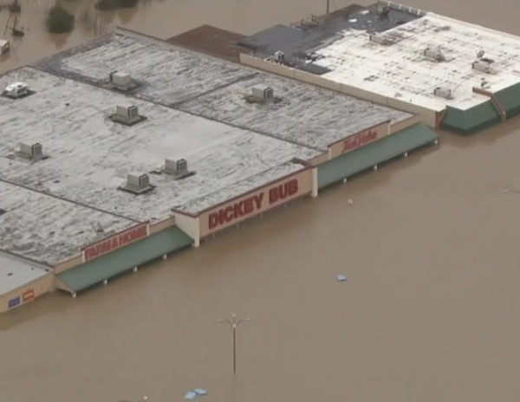
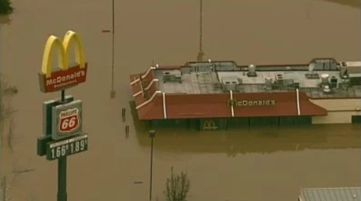
2015 Union, Missouri, Flood
A Storm for the Ages
Bourbeuse River
Record Crest
34.3 feet
12/29/2015
Sources: CBSnews.com; fox2news.com

Slide 7
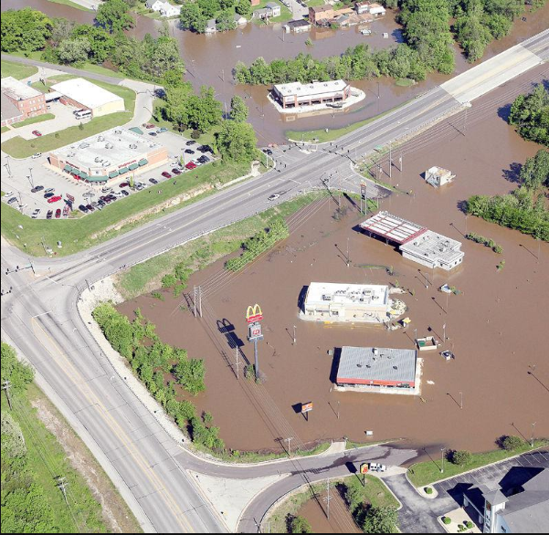
2017 Union, Missouri, Flood
“Unfortunately, it’s a river and Mother Nature.
And we can’t control her.”
Bourbeuse River
Crest
30.1 feet
May 2-3, 2017
Source: eMissourian.com

Slide 8
Extreme Events: A Troubling Trend
Rank | Date | Event | Cause
1 | Aug. 2005 | Hurricane Katrina | Hurricane
2 | Sep. 2017 | Hurricane Maria | Hurricane
3 | Sep. 2017 | Hurricane Irma | Hurricane
4 | Sep. 2001 | September 11 Events | Terrorism
5 | Oct. 2012 | Hurricane Sandy | Hurricane
6 | Aug. 2017 | Hurricane Harvey | Hurricane
7 | Aug. 1992 | Hurricane Andrew | Hurricane
8 | Jan. 1994 | Northridge, CA earthquake | Earthquake
9 | Sep. 2008 | Hurricane Ike | Hurricane
10 | Oct. 2005 | Hurricane Wilma | Hurricane
Three of 10 Worst US Catastrophes Occurred in 2017.
Source: The Property Claim Services® (PCS®) unit of ISO®, a Verisk Analytics® company.

Slide 9
U.S. Inflation-Adjusted Cat Losses
Harvey, Irma, Maria
2018 – Third worst year for U.S. Insured Catastrophe Losses. Average Insured Loss per Year for 1980-2018 is $19.3 B.
*2018: Inflation-adjusted estimate, subject to change. 2010s is average of 2010 to 2018.
Sources: Property Claims Service, a Verisk Analytics business; Insurance Information Institute.

Slide 10

Disruptive Forces in the World – The New Norm
Catastrophes
Economics
Geopolitical
Technology

Slide 11
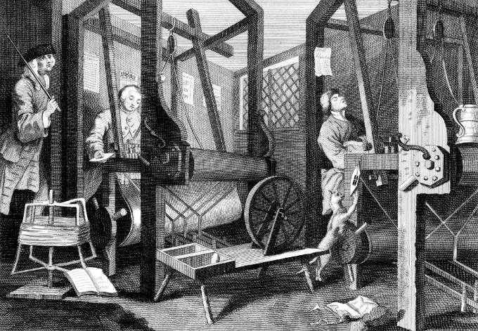
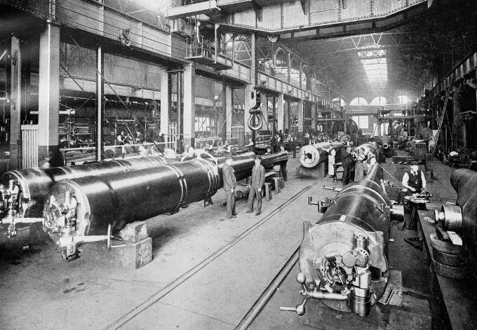
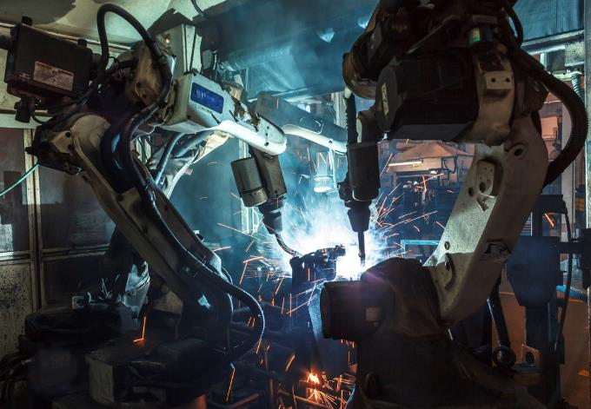

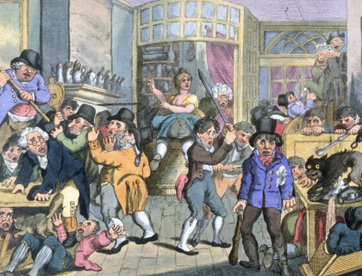
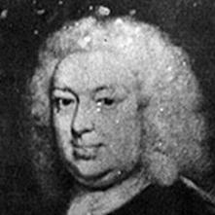
Insurance Leading Throughout History
???
1969
1870
1784
1648
Edward Lloyd’s Coffee House
Steam, Water, Mechanical Production
Division of Labor, Electricity, Mass Production
Electronics, IT, Automated Production
Cyber-Physical Systems

Slide 12
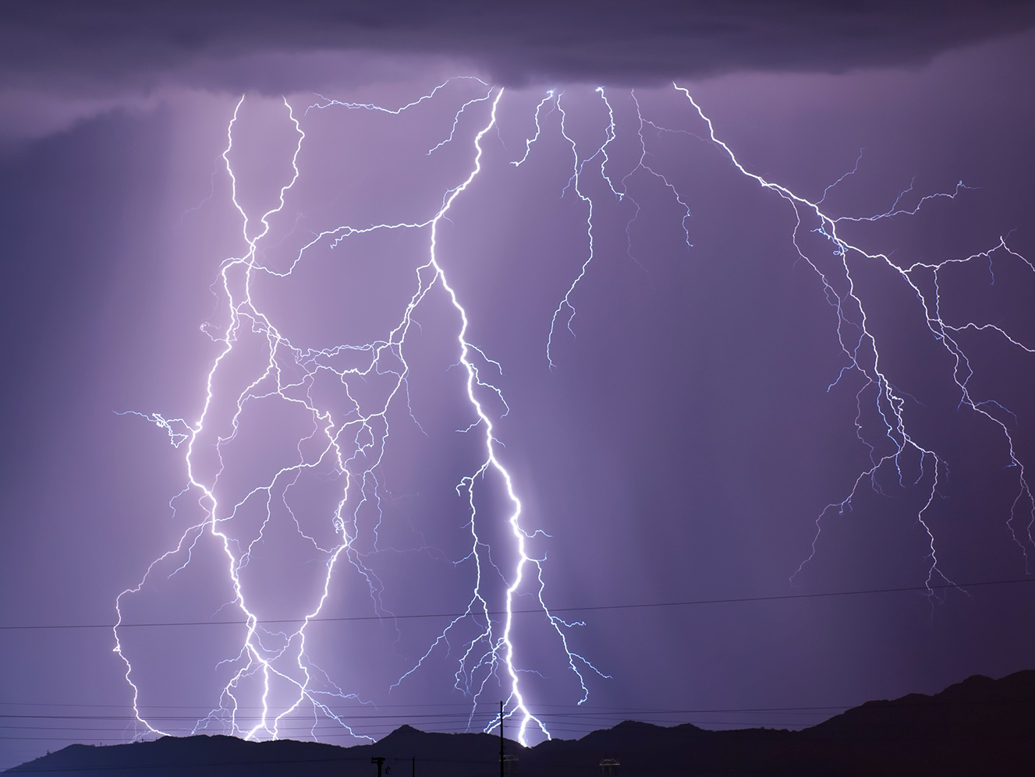
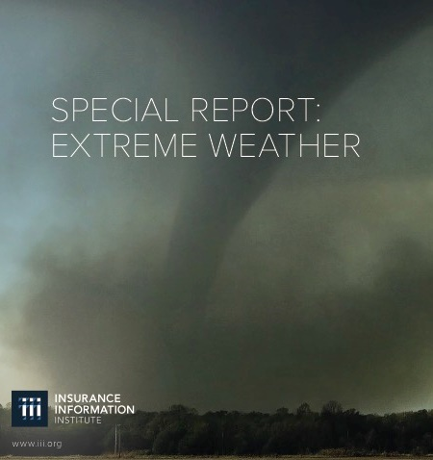
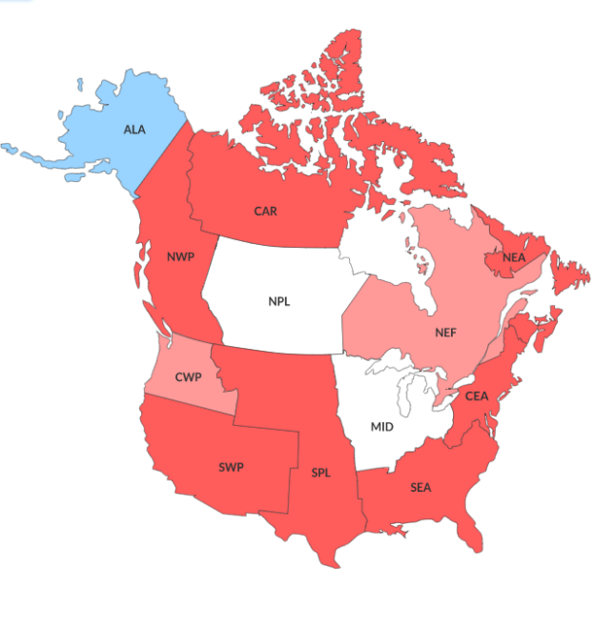
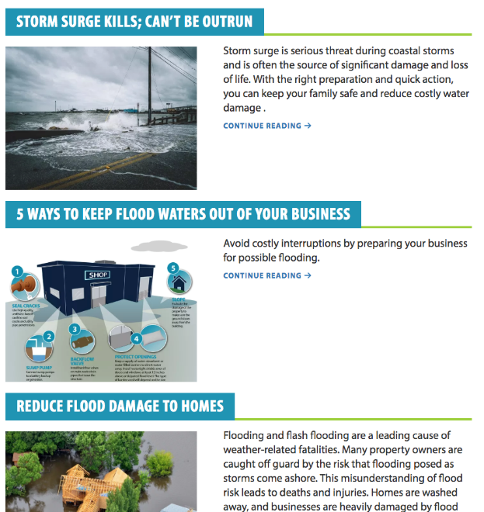
Insurers Studying Solutions to Extreme Weather
I.I.I., Actuaries, and IBHS offering resilience know-how to consumers on how to insure and protect themselves
Proposed I.I.I. white paper
The American Academy of Actuaries Climate Index
Insurance Institute for Business & Home Safety (IBHS) resources
Source: Insurance Information Institute, American Academy of Actuaries Climate Index, Insurance Institute for Business & Home Safety.

Slide 13
Education & Analysis
Actuaries Climate Index – Measuring Weather Extremes
Index Measures Frequency of Extreme Events (Heat, Cold, Drought, Wind, Rain, Sea Level) Vs. 1961-1990 Average
Source: Actuaries Climate Index, http://actuariesclimateindex.org/home/

Slide 14
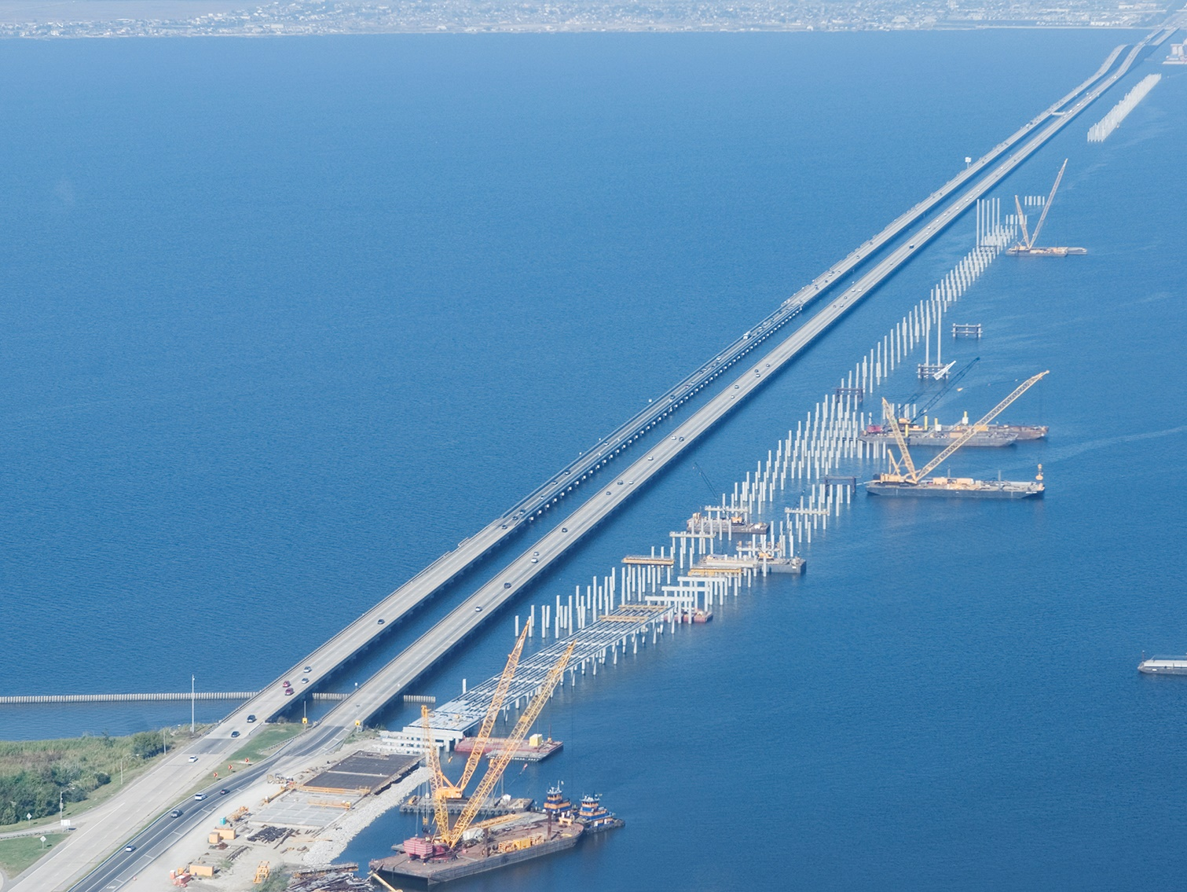

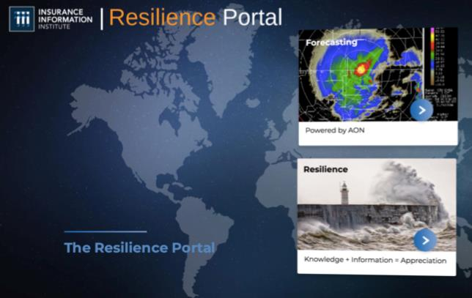

I.I.I. To Create Resilience Index
How prepared is each state for the natural and man-made disasters they are likely to see?
I.I.I. and Aon to share their findings with the industry policy-makers and the general public
Forecasting powered by:
Dr. Michel Leonard, CBE
Vice President and
Senior Economist, I.I.I.

Slide 15




(Re)insurance Products
Private Industry
Case Studies
FEMA Reinsurance
Through a $150 million purchase of private reinsurance products, FEMA was able to recover approximately $1 billion, or an eighth of its total 2017 loses.
40%
2018 FEMA Reinsurance
NFIP NatCat Bonds
By issuing new natural catastrophe bonds geared towards institutional investors, the NFIP can bring an estimated $500 million of additional reinsurance coverage.
Private Market Flood Products
During 2017, the private flood insurance market added 50 new carriers. Direct private flood insurance premiums written reached $630 million, an increase of $217 million over 2016.
Source: Insurance Journal; Houston Chronicle; Insurance Journal.

Slide 16
Who Is Buying Flood Insurance?
Who Has It Vs. Who Needs It
NFIP Takeup Rates
Oregon Counties
County | Major Floods | NFIP Takeup Rate
Benton | 1996 | 2%
Clackamas | 1862 | 1%
Linn | 1996 | 2%
Marion | 1996 | 1%
Morrow | 1903 | 1%
Multnomah | 1876, 1894, 1948, 1994, 1996 | 1%
Polk | 1996 | 2%
Source: National Flood Insurance Program, Insurance Information Institute.

Slide 17
FEMA Grant Vs. NFIP
Insurance Pays
Sources: National Flood Insurance Program, Reuters.

Slide 18
Private Flood Insurance
Significant Share of Flood Mkt
A $640 Million Market in 2017
Growing Faster Than Cyber
Growing No. Writers
Source: S&P Global Market Intelligence data, sourced from NAIC; Insurance Information Institute.

Slide 19
Insurance Industry Economic Trends

Slide 20
Direct Premium Growth, Annual Change
Direct Premiums Continue to Track Economic Growth
All data through second quarter.
SOURCES:NAIC data sourced through S&P Global Intelligence, Bureau of Economic Affairs, Insurance Information Institute.

Slide 21
P/C industry net income after taxes
Billions, 2018 dollars
Catastrophes Drove Earnings Down in 2017, Continuing a Four-Year Slide in Inflation-Adjusted Profits.
Through third quarter. Adjusted for inflation using the BLS CPI calculator, to 2018 dollars.
Sources: NAIC data, sourced from S&P Global Market Intelligence; Insurance Information Institute.

Slide 22
P/C Insurance Industry
Combined Ratio, 2000-2018*
3 Consecutive Years of U/W Profits; 1st time since 1971-73
Heavy Use of Reinsurance Lowered Net Losses.
Higher CAT Losses, Shrinking Reserve Releases, Toll of Soft Market
Hurricanes, Wildfires Drive CR Higher.
Best Combined Ratio Since 1949 (87.6)
Sandy
*Excludes Mortgage & Financial Guaranty insurers 2008-2014.
Including M&FG, 2008=105.1, 2009=100.7, 2010=102.4, 2011=108.1; 2012:=103.2; 2013: = 96.1; 2014: = 97.0.
Sources: A.M. Best; ISO, a Verisk Analytics company; I.I.I. estimate for 2018.

Slide 23
Key sources of P/C insurer profits
$ Billions
Data are before taxes and exclude extraordinary items.
Sources: NAIC data, sourced from S&P Global Market Intelligence; Insurance Information Institute.

Slide 24
Oregon Results
. . . And some Idaho . . .

Slide 25
RNW All Lines: OR vs. U.S.
P/C Insurer Profitability
in OR is Above That of the U.S. Overall Over the Past Decade
U.S.: 6.2%
OR: 8.9%
Source: NAIC.

Slide 26
RNW PP Auto: OR vs. U.S.
Average 2008–2017
U.S.: 3.7%
OR: 7.1%
Source: NAIC.

Slide 27
RNW Comm. Auto: OR vs. U.S.
Average 2008–2017
U.S.: 4.5%
OR: 11.3%
Source: NAIC.

Slide 28
All Lines: 10-Year Average RNW
OR and Nearby States, 2008–2017
Oregon All Lines Profitability is Above the U.S. Average (6.2%) and Regional Average (7.5%)
Sources: NAIC, Insurance Information Institute.

Slide 29
PP Auto: 10-Year Average RNW
OR and Nearby States, 2008–2017
Oregon PP Auto Profitability is Above the U.S. (3.7%) and Regional Average (6.1%)
Sources: NAIC, Insurance Information Institute.

Slide 30
Top Ten Most Expensive and Least Expensive States for Automobile Insurance, 2016¹
Rank | Most Expensive States | Average Expenditure | Rank | Least Expensive States | Average Expenditure
1 | New Jersey | $1,309.29 | 1 | Idaho | $599.77
2 | Louisiana | 1,302.11 | 2 | Iowa | 628.10
3 | New York | 1,301.64 | 3 | North Dakota | 639.10
4 | Michigan | 1,270.70 | 4 | South Dakota | 648.01
5 | Florida | 1,259.55 | 5 | Maine | 650.38
6 | District of Columbia | 1,246.80 | 6 | Wyoming | 677.53
7 | Rhode Island | 1,193.58 | 7 | Wisconsin | 688.32
8 | Delaware | 1,159.86 | 8 | Vermont | 691.56
9 | Massachusetts | 1,096.53 | 9 | Indiana | 692.29
10 | Connecticut | 1,086.17 | 10 | North Carolina | 699.91
Woot!
Oregon Ranked 21st in Average Expenditure for Auto Insurance
in 2016. The Average Expenditure was $877.09.
¹Based on average automobile insurance expenditures.
Source: © 2018 National Association of Insurance Commissioners.

Slide 31
Comm. Auto: 10-Year Average RNW
OR and Nearby States, 2008–2017
Oregon Comm. Auto Profitability is Above the U.S. (4.5%) and Regional Average (5.7%)
Sources: NAIC, Insurance Information Institute.

Slide 32
All Lines DWP Growth: OR vs. U.S.
Average 2008–2017
U.S.: 2.5%
OR: 2.2%
Source: NAIC data, sourced from S&P Global Market Intelligence, Insurance Information Institute.

Slide 33
Private Passenger Auto DWP Growth:
OR vs. U.S.
Average 2008–2017
U.S.: 3.6%
OR: 4.0%
Source: NAIC data, sourced from S&P Global Market Intelligence, Insurance Information Institute.

Slide 34
Commercial Auto DWP Growth: OR vs. U.S.
Average 2008–2017
U.S.: 2.4%
OR: 1.9%
Source: NAIC data, sourced from S&P Global Market Intelligence, Insurance Information Institute.

Slide 35
Auto Coverages
The Tide Has Turned.
But It Is Not Low Tide.

Slide 36
Auto Net Combined Ratio
Rate Actions Helped Personal Auto Results. Not So for Commercial Auto.
Source: National Association of Insurance Commissioners data, sourced from S&P Global Market Intelligence;
Insurance Information Institute.

Slide 37





Rising Accident Costs
All Coverages Affected
Increase in Loss Costs, 2016:Q3–2018:Q3
Bodily Injury
6.7%
Property
Damage
3.8%
Personal Injury Protection
4.8%
Collision
3.5%
Comprehensive
-4.0%
From 2016 to 2018, the cost of accidents
has risen dramatically. By contrast, consumer prices overall
rose 6.6 percent from 2016 to 2018.
Source: Fast Track Monitoring System.

Slide 38
Results by Line
Incurred Loss Ratios
LOB | 2018 | 2017 | Change From Year Earlier
Personal Auto Liab | 66 | 70
Homeowners | 63 | 70
PhysDam (PA, CA) | 60 | 67
GL (incl Products) | 57 | 55
WC | 48 | 54
Fire & Allied Lines | 66 | 118
CMP | 58 | 63
Comm Auto Liab | 70 | 69
Other | 44 | 50
Total | 59 | 67
Positive Number =
Bad News
Through Q3. Differences may not add up due to rounding.
Sources: NAIC data from S&P Global Intelligence, Insurance Information Institute.

Slide 39
Loss Ratio Trends
Liability and PhysDam Loss Ratios
Auto Loss Ratios Where They Were in 2014 – When the Combined Ratio Was 102.
Four Quarters Ending in September. Paid Losses, including all Loss Adjustment Expenses. Excludes commissions and other expenses.
Source: Fast Track Monitoring System.

Slide 40
Claim Trends by Coverage
Focus on Collision

Slide 41
Collision Claims Frequency
Annual % Change
Claim Frequency Has Been Flat Since 2014. But It Normally Falls.
*Four Quarters Ending in September.
Source: Fast Track Monitoring System.

Slide 42
Collision Claims: Severity Trending Higher
Annual % Change
The Size of Claims Keeps Growing.
*Four Quarters Ending in September.
Source: Fast Track Monitoring System

Slide 43
What’s Driving These Trends?
Frequency; Severity; Distraction?

Slide 44






Road Safety
Better Economy = More Drivers = More Accidents
14 Percent of Injury Crashes
Economic
well-being
Distracted driving
Safety Devices Can Be Expensive
Key Issues
Speed
Still
Kills
Expensive auto parts
Faster driving
Legalized marijuana
It’s Not Funny
Source: Insurance Information Institute research.

Slide 45
More People Working and Driving
=> More Collisions
Number Employed, Millions
Overall Collision Claims Per 100 Insured Vehicles
Recession
When People are Out of Work, They Drive Less. When They Get Jobs,
They Drive to Work, Helping Drive Claim Frequency Higher.
Sources: Seasonally Adjusted Employed from Bureau of Labor Statistics; Rolling four-quarter average frequency from Fast Track Monitoring System; Insurance Information Institute.
Notes:
45

Slide 46
Severity: Driving Fatalities are Rising
Annual Change in Motor Vehicle Deaths
Seatbelt Use Rose to 62% of Drivers, From 49% in ‘90
Big Drop-off Due to the Great Recession
Driving Has Been Getting Safer for Decades, But Recent Trend is Discouraging— over 40,000 Deaths in 2016
Sources: National Safety Council, Insurance Information Institute.
*2018 estimate of 40,000 deaths

Slide 47
Auto Repair: Complexity Grows
More Cool Stuff to Fix
More Parts, More Labor:
Higher Costs
Electronics Add to Cost, Complexity
150
22% Increase!
Electronics: 40-50% of cost of vehicle
  Pre-repair scan: $63
  Post-repair scan: $93
  Calibration labor: sublet at $150
  OEM: 98% of camera/sensors
* Property Damage Only.
SOURCES: CCC Information Services; Ford Motor Co.;

Slide 48
Fixing a Bumper
. . . On an Entry-Level Luxury Car (~$35K)
2014 Cost vs. 2016 Cost
What Has Changed?
 | 2014 | 2016
Grille: Distance Sensor | $0 | $2,818
Headlamp Assembly | 394 | 918
Mechanical Labor | 0 | 108
Fewer Accidents, Higher Costs
Parts: 130% Higher
Labor: 18% Higher
Total cost: $1,705 higher
2016 vehicle has LED headlights and adaptive cruise control.
SOURCE: Liberty Mutual Insurance.

Slide 49
What About Distractions?
It’s A Problem. Is It Growing?
What We Do Behind The Wheel
But Impact Is Not Clear
Talking Less . . .
Most Recent Year
* Property Damage Only.
SOURCES: State Farm, National Highway Transportation Safety Administration (distraction.gov)

Slide 50
Weed Spreads Like Wildfire. Insurers Caught in the Middle
Current marijuana laws by state
■ Fully legal ■ Medical use legal and recreational use decriminalized ■ Medical use legal ■ Recreational use decriminalized ■ Fully illegal
WA
MT
ND
VT
ME
OR
MN
ID
SD
WI
NY
NH
WY
MI
NV
NE
IA
PA
UT
IL
IN
OH
WV
CA
CO
KS
MO
VA
MA
KY
TN
NC
RI
AZ
NM
OK
AR
CT
SC
MS
AL
GA
NJ
AK
TX
LA
DE
FL
MD
DC
HI
Sources: – Map - National Journal; Ballotpedia, 2019
Collision Frequency – IIHS, LEGAL POT: Crashes are up in states with retail sales, October 18, 2018

Slide 51
Thank you for your time and your attention!
Read our auto White Paper on Rising Personal Auto Costs at
www.iii.org

