Slide 1
Alternative Capital: Impacts on Global Insurance and Reinsurance Markets
Annual Circle of Chief Economists
Paris, France
25 March 2015
Download at www.iii.org/presentations
Robert P. Hartwig, Ph.D., CPCU, President & Economist
Insurance Information Institute ♦ 110 William Street ♦ New York, NY 10038
Tel: 212.346.5520 ♦ Cell: 917.453.1885 ♦ bobh@iii.org ♦ www.iii.org

Slide 2
A World of Low Yields
Capital Will Seek Its Highest (Risk-Adjusted) Return
2

Slide 3
U.S. Treasury Security Yields: A Long Downward Trend, 1990–2015*
Yields on 10-Year U.S. Treasury Notes have been essentially below 5% for a full decade.
U.S. Treasury yields plunged to historic lows in 2013. Longer-term yields rebounded then sank fell again.
Since roughly 80% of P/C bond/cash investments are in 10-year or shorter durations, most P/C insurer portfolios will have low-yielding bonds for years to come.
*Monthly, constant maturity, nominal rates, through Feb. 2015.
Sources: Federal Reserve Bank at http://www.federalreserve.gov/releases/h15/data.htm. National Bureau of Economic Research (recession dates); Insurance Information Institute.
3
12/01/09 - 9pm
eSlide – P6466 – The Financial Crisis and the Future of the P/C
Notes:
3

Slide 4
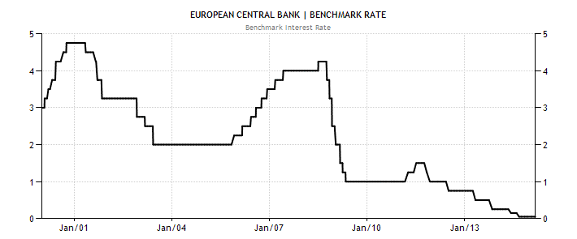
European Central Bank Benchmark Rate, 2000 – 2015*
ECB’s cut its key rate to 0.05% on 4 Sept. 2014 where it remains in March 2015
Interest Rates Have Been Slashed by Most Major Central Banks, Igniting a Global Quest for Yield. Reinsurance Is Just One of Many New Areas “Discovered” by Large Institutional Investors
*As of 20 March 2015.
Source: European Central Bank from www.tradingeconomics.com; Insurance Information Institute.

Slide 5
Book Yield on Property/Casualty Insurance Invested Assets, 2007–2016F
(Percent)
Book yield in 2014 is down 114 BP from pre-crisis levels
The yield on invested assets continues to decline as returns on maturing bonds generally still exceed new money yields. The end of the Fed’s QE program in Oct. 2014 should allow some increase in longer maturities while short term interest rate increases are unlikely until mid-to-late 2015
Sources: Conning.

Slide 6
A World Awash in Capital
Too Much of a Good Thing?
The Global Glut of Capital is Not Unique to (Re)Insurance
6

Slide 7
Hedge Fund Industry: Assets Under Management: 1997–2014:Q4¹
($ Billions)
Assets managed by hedge funds are up 70% or $1.02 trillion since 2008 to $2.48 trillion
Yield Hungry Pension Funds Have Grown Rapidly Since the Financial Crisis, Deploying Oceans of Capital in Industries Across the Globe—Including the Global Reinsurance Industry
¹ Figures for 2011-2014 are as of Q4 for each year.
Sources: BarclayHedge: http://www.barclayhedge.com/research/indices/ghs/mum/Hedge_Fund.html; Insurance Information Institute.

Slide 8
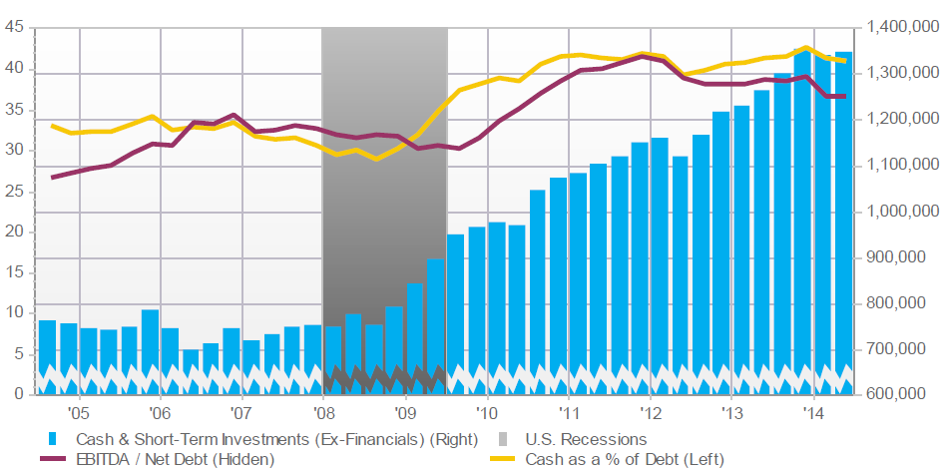
S&P 500 (Excl. Financials): Cash & Short-Term Investments
Cash and ST investments holdings have nearly doubled since 2007
Holdings of Cash and Liquid Asset Holdings Have Soared Across Virtually All Industries Since the Financial Crisis
Source: Fact Set Fundamentals.

Slide 9
Global Pension Assets Growth,
2008 – 2013*
Global pension assets for the top 13 pension markets reached $31.98 trillion in 2013 (+9.5% from 2012), an amount equal to 83.4% of these economies
Compound Annual Growth Rate (%)
CAGR of pension fund assets in most major pension markets has been quite strong since the financial crisis
*As of year-end.
Source: Towers Watson Global Pensions Asset Study 2014 at: http://www.towerswatson.com/en-US/Insights/IC-Types/Survey-Research-Results/2014/02/Global-Pensions-Asset-Study-2014
9
12/01/09 - 9pm
eSlide – P6466 – The Financial Crisis and the Future of the P/C
Notes:
9

Slide 10
Pension Asset Allocation (World’s 7 Largest Pension Markets)
Alternative investment’s share of assets is up +15 points since 2001 from 5% to 18%
Holdings of Cash and Liquid Asset Holdings Have Soared Across Virtually All Industries Since the Financial Crisis
*Australia, Canada, Japan, Netherlands, Switzerland, UK, US.
Source: Towers Watson Global Pensions Asset Study 2014 at: http://www.towerswatson.com/en-US/Insights/IC-Types/Survey-Research-Results/2014/02/Global-Pensions-Asset-Study-2014

Slide 11
Policyholder Surplus, 2006:Q4–2014:Q3
Drop due to near-record 2011 CAT losses
($ Billions)
2007:Q3 Pre-Crisis Peak
Surplus as of 9/30/14 stood at a record high $673.9B
The industry now has $1 of surplus for every $0.73 of NPW, close to the strongest claims-paying status in its history.
2010:Q1 data includes $22.5B of paid-in capital from a holding company parent for one insurer’s investment in a non-insurance business .
The P/C insurance industry entered 2015 in very strong financial condition.
Sources: ISO, A.M .Best.
11
12/01/09 - 9pm
eSlide – P6466 – The Financial Crisis and the Future of the P/C
Notes:
11

Slide 12
US Policyholder Surplus: 1975–2014*
($ Billions)
Surplus as of 9/30/14 was a record $673.9, up 3.2% from $653.3 of 12/31/13, and up 53.6% ($234.5B) from the crisis trough of $437.1B at 3/31/09
“Surplus” is a measure of underwriting capacity. It is analogous to “Owners Equity” or “Net Worth” in non-insurance organizations
The Premium-to-Surplus Ratio Stood at $0.73:$1 as of 9/30/14, a Near Record Low (at Least in Recent History)
* As of 9/30/14.
Source: A.M. Best, ISO, Insurance Information Institute.

Slide 13
Premium-to-Surplus Ratio: 1985–2014*
(Ratio of NWP to PHS)
The larger surplus is in relation to premiums—the lower the P:S ratio—and the great the industry’s capacity to handle the risk it has accepted
Surplus as of 9/30/14 was $0.75:$1, a near-record low (at least in modern history)
9/11, Recession & Hard Market
The Premium-to-Surplus Ratio Stood at $0.75:$1 as of 9/30/14, a Record Low (at Least in Recent History)
* As of 9/30/14.
Source: A.M. Best, ISO, Insurance Information Institute.

Slide 14
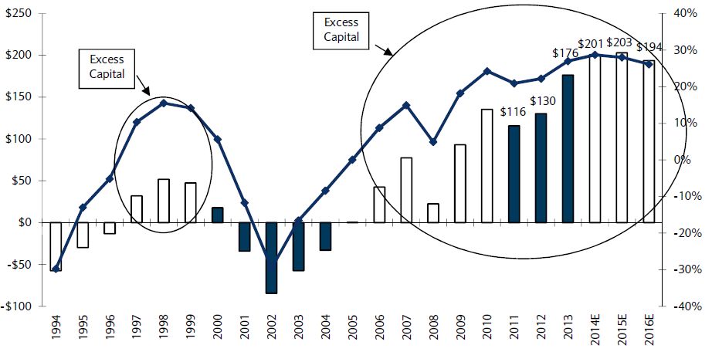
US P/C Insurance Industry Excess Capital Position: 1994–2016E
Barclay’s suggests that surplus is approximately $200B (~30%)
Surplus Redundancy (Deficiency)
Percent Redundancy (Deficiency)
The Industry’s Strong Capital Position Suggests Insurers Are in a Good Position to Increase Risk Appetite, Repurchase Shares and Pursue Acquisitions
Source: Barclays Research estimates.

Slide 15
Alternative Capital
New Investors Continue to Change the Reinsurance Landscape
First I.I.I. White Paper Released in
March 2015
15

Slide 16
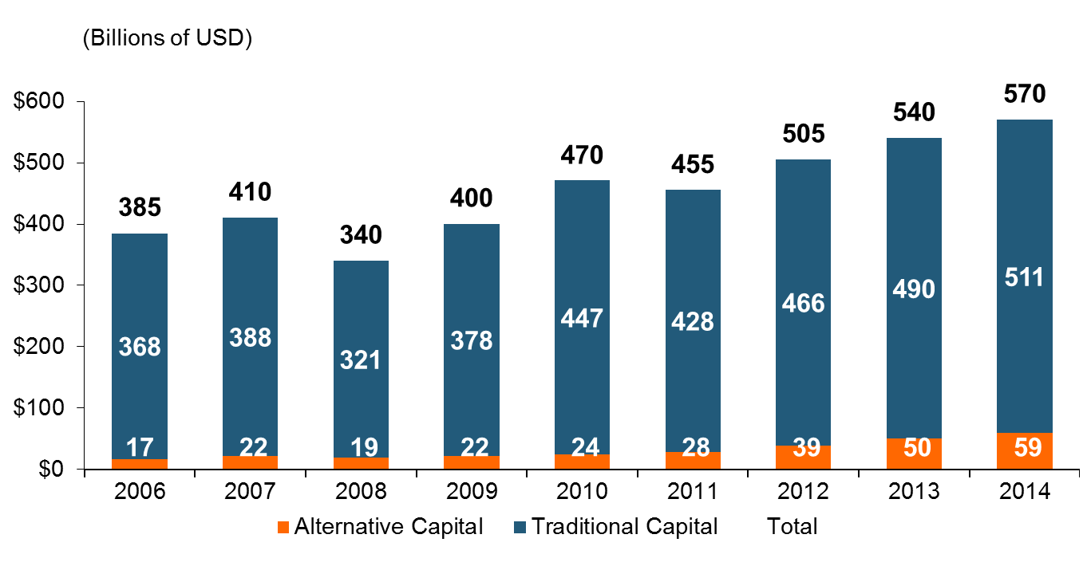
Global Reinsurance Capital (Traditional and Alternative), 2006 - 2014
Total reinsurance capital reached a record $570B in 2013, up 68% from 2008.
But alternative capacity has grown 210% since 2008, to $50B. It has more than doubled in the past three years.
2014 data is as of June 30, 2014.
Source: Aon Benfield Analytics; Insurance Information Institute.

Slide 17
Increase in Global Reinsurance Capital, 2008 – 2014:Q4
Alternative Capital Growth Facts
Reinsurance capital increased by ~$230 Bill. from 2008 - 2014
Alternative capital’s growth rate was 25% in 2014, 28% in 2013 and 39% in 2012.
Alternative capital’s share of global reinsurance capital has doubled, from 5.9% in 2008 to 12.0% in 2014
This growth has occurred during a period of falling and very low interest rates and, with the exception of 2011, relatively benign global cat activity.
2014, $Billions
All Other
$192 Bill
Alternative Capital
$40 Bill
Alternative Capital now accounts for about 17% of global reinsurance capital
Source: Insurance Information Institute based on data from Aon Benfield.

Slide 18
Alternative Capital as a Percentage of Traditional Global Reinsurance Capital
Alternative Capital’s Share of Global Reinsurance Capital Has More Than Doubled Since 2010.
2014 data is as of September 30, 2014.
Source: Aon Benfield Analytics; Insurance Information Institute.

Slide 19
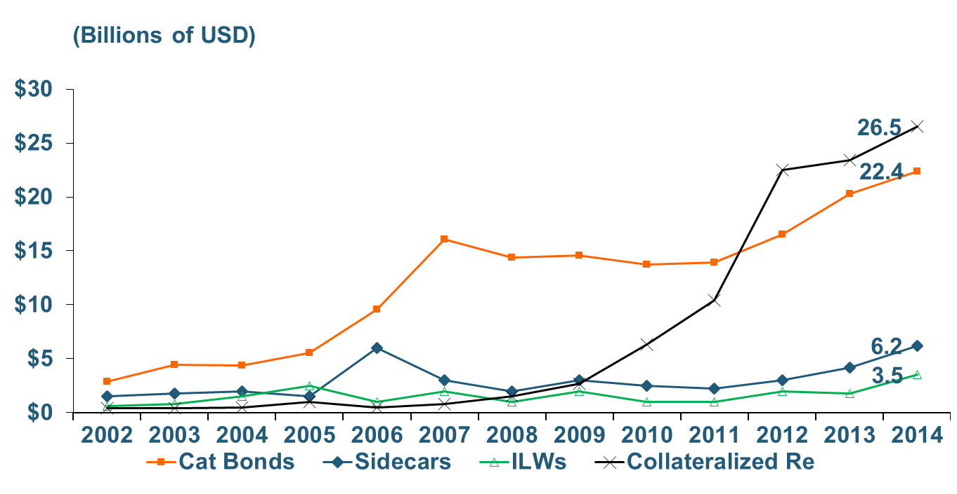
Growth of Alternative Capital Structures, 2002 - 2014
Collateralized Re’s Growth Has Accelerated in the Past Three Years.
Collateralized Reinsurance and Catastrophe Bonds Currently Dominate the Alternative Capital Market.
2014 data is as of June 30, 2014.
Source: Aon Benfield Analytics; Insurance Information Institute.

Slide 20
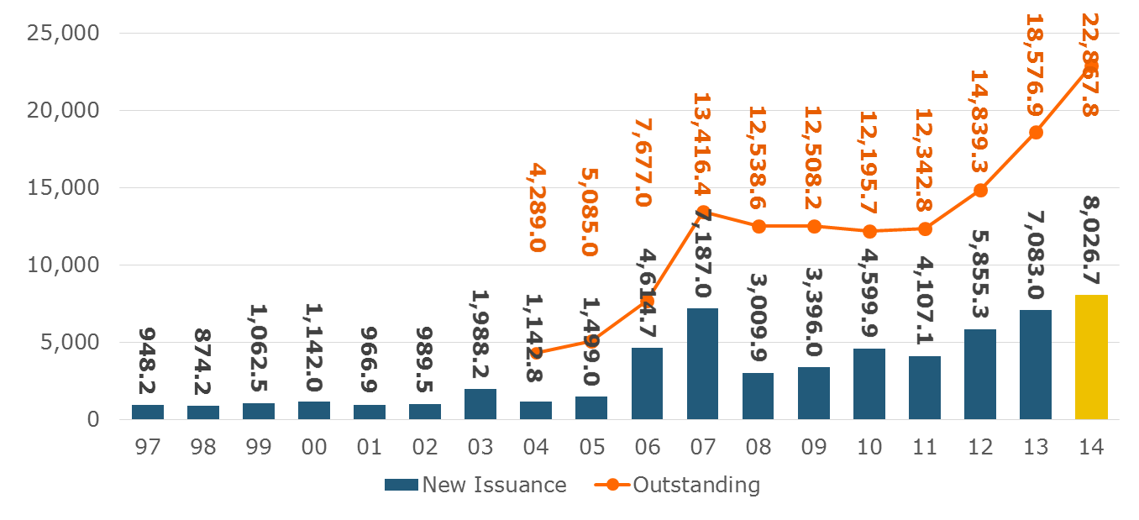
Catastrophe Bond Issuance and Outstanding: 1997-2014
Risk Capital Amount ($ Millions)
2014 Has Seen the Largest Cat Bond Ever - $1.5 Billion (Florida Citizens). Bond Issuance Set a Record.
Source: Guy Carpenter.

Slide 21
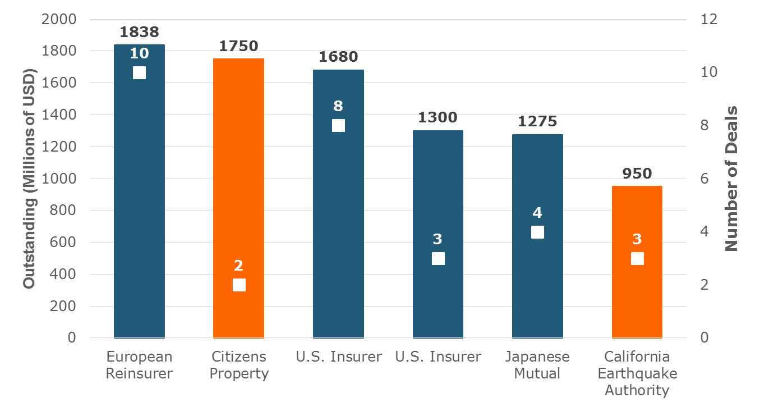
Largest Sponsors of ILS, Year-End 2014
Two of the Largest ILS Issuers Are Government-Sponsored Insurers. Nine Government-Related Insurers Have $4.6 Billion in Outstanding Securities.
Source: Artemis.bm; Insurance Information Institute.

Slide 22
Reinsurance Pricing: Change in Rate on Line for Cat Business
Alternative Capital, Low Levels of Catastrophe Drive Rates Down.
76%
Catastrophe Reinsurance Prices Fell 11 Percent on January 1 Renewals, Driven by Emergence of New Capital, Mild Catastrophe Losses.
2014 reflects change through June 30 from prior year end. 2015 is for January 1 renewals..
Source: Guy Carpenter; Insurance Information Institute.

Slide 23
U.S. Wind-Exposed Risk Premium* 2010:Q1 to 2014:Q4
Risk spreads rose in 2011-2012 from cat activity and changes to catastrophe models.
Risk spreads dropped to less than half their mid-2012 levels – equivalent to lower rates – low cat losses, capital entering market.
* Trailing 12-month average
SOURCE: Willis Capital Markets, Insurance Information Institute.

Slide 24
Non-U.S. Wind-Exposed Risk Premium* 2010:Q1-2014: Q1
Spreads are also falling in non-U.S. wind exposures, but less sharply and in line with expected losses
* Trailing 12-month average.
SOURCE: Willis Capital Markets, Insurance Information Institute.

Slide 25
Insurance-Linked Securities: Average Multiples, 1997 – 2014*
In Early Years, Investor Reluctance Kept Multiples High in Tiny Market
2014: Breaking 2013 Record for Lowest Multiple
Multiple is a Rough Estimate of Risk-Adjusted Return
Range Established
Cat Bond Terms Have Also Softened, With Indemnity Triggers (Favored by Insurers) Growing More Common.
*The ILS Multiple is computed as: (Bond Coupon – Risk Free Yield)/Expected Loss.
SOURCE: www.Artemis.bm Deal Directory, Insurance Information Institute.

Slide 26
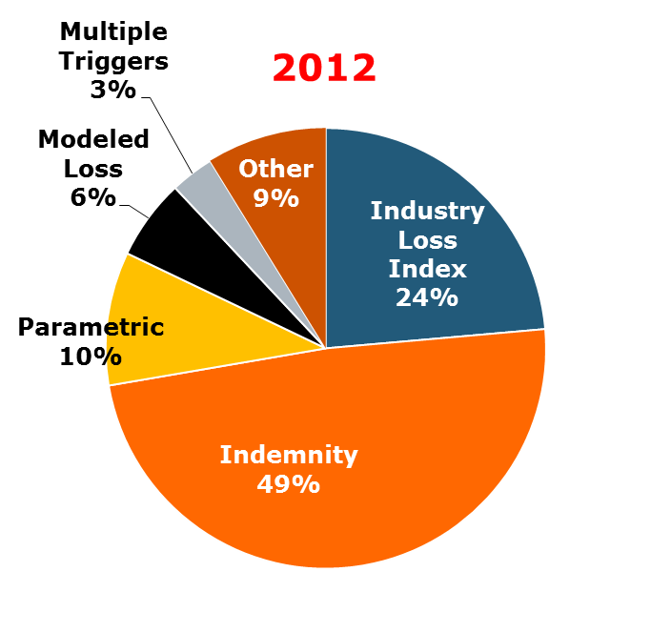
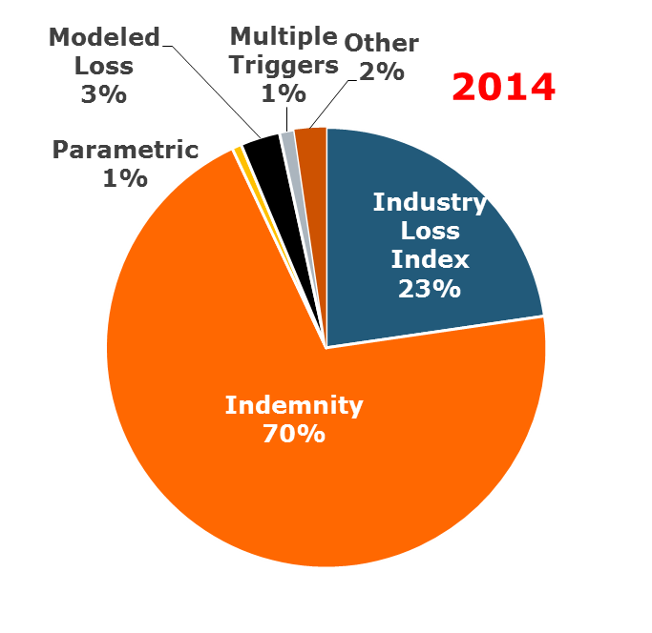
ILS Issuance by Trigger
Terms Are Shifting Away From ‘Objective’ Triggers (Favored by Investors) Toward Indemnity Trigger (Favored by Insurers).
Source: Artemis.bm; Insurance Information Institute.

Slide 27
Catastrophe Bonds Outstanding, Q4 2014
Catastrophe Bonds Are Heavily Concentrated in U.S. Hurricane Exposures. Two-thirds of Catastrophe Risks Outstanding Cover U.S. Wind Risks.
Source: Willis Capital Markets, Insurance Information Institute.

Slide 28
How a Catastrophe Bond Works
Investors supply capital.
Insurer cedes premium.
Investors
Insurer (Sponsor)
Reinsurer pays interest, returns principal at end of term.
Reinsurer (Special Purpose Vehicle)
Reinsurer pays losses.
Counterparty holds capital till needed, guarantees fixed return.
Reinsurer invests bond proceeds in swap.
Swap Counterparty

Slide 29
How a Catastrophe Bond Works
Investors supply capital.
Insurer cedes premium.
Investors
Insurer (Sponsor)
Reinsurer pays interest, returns principal at end of term.
Reinsurer (Special Purpose Vehicle)
Reinsurer pays losses.
Counterparty holds capital till needed, guarantees fixed return.
Reinsurer invests bond proceeds in swap.
Swap Counterparty

Slide 30
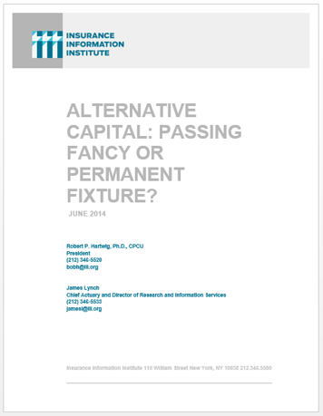
I.I.I. Will Release its First Report on Alternative Capital During Q1 2015
Issue of alternative capital in (re)insurance has received increased attention in recent years
Significant structural changes in property catastrophe reinsurance space
Questions addressed include:
Sources of new capital
Reasons/Drivers of growth
New structures
Impact of major triggering event(s)
Impacts of higher interest rates
Cat bond yield compression
Forthcoming: Q1 2015

Slide 31
Questions Arising from Influence of Alternative Capital
What Will Happen When Investors Face Large-Scale Losses?
What Happens When Interest Rates Rise?
Does ILS Have a Higher Propensity to Litigate?
How Much Lower Will Risk Premiums Shrink/ROLs Fall?
Will Investors Lose Interest as Risk Premia Shrink?
Will There Be Spillover Into Casualty Reinsurance?
Will Alternative Capital Drive Consolidation?
Has the Reinsurance Industry Been Fundamentally and Irrevocably Transformed?

Slide 32
Three Possible Scenarios for Alternative Capital (per McKinsey)
Peak At or Near Current Level: Alternative capital could peak at its current level, as spreads fall too low to keep investor interest, or until a major catastrophe drives them off. Insurers would still seek alternative arrangements but would prefer the security traditional reinsurers offer. Reinsurers would continue to partner with alternative investors, but these deals would remain a minor piece of overall capital.
Doubling to 30% of Catastrophe Capital: Alternative investors remain attracted to bonds where risk is uncorrelated with the overall economy and insurers continue to like spreading risk outside a few traditional reinsurers, particularly in structures in which losses are collateralized at the inception of the deal.
Grow Even Larger (>30%): Dislocating the current markets, as investors grow comfortable enough with the arrangements that they begin to offer terms that more closely resemble the traditional reinsurance contract.
SOURCE: Insurance Information Institute from McKinsey & Company, Could Third-Party Capital Transform the Reinsurance Markets?, Sept. 2013.

Slide 33
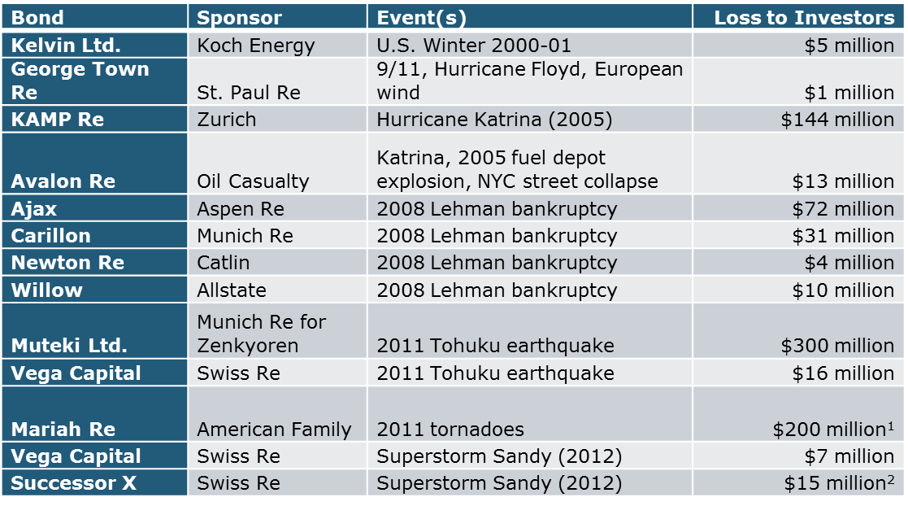
Notable Catastrophe Bond Events
*
*In litigation.
Source: Munich Re.

Slide 34
Potential Pros and Cons of Alternative Capital (per McKinsey)
PROs
Collateralized deals (in theory) reduce the risk (albeit quite small) that the reinsurer will be unable to fulfill its obligations
Insurers can diversify risk across more markets, rather than being concentrated with just a few reinsurers, many of whom reinsure each other via retrocessional arrangements
Insurers can lock in strictures for several years, which is particularly attractive when yields (rates) are low
CONs:
Capital may not be available over the long term. Investors can quickly exit if reinsurance (ILS) investments become less attractive than alternatives
Alternative agreements do not perfectly replicate traditional reinsurance treaties. Basis risk is one mismatch. Lack of reinstatement provisions in cat bonds is another.
Insurers also frequently benefit from reinsurers’ knowledge of the marketplace. Alternative capital providers often lack this expertise.
SOURCE: Insurance Information Institute from McKinsey & Company, Could Third-Party Capital Transform the Reinsurance Markets?, Sept. 2013.

Slide 35
Insurance Information Institute Online:
www.iii.org
Thank you for your time and your attention!
Twitter: twitter.com/bob_hartwig
Download at www.iii.org/presentations

