Slide 1
Things That Make You More Likely to Be in an Accident
Nevada Traffic Summit
Las Vegas – May 25, 2016
James Lynch, FCAS MAAA, Chief Actuary
Insurance Information Institute ♦ 110 William Street ♦ New York, NY 10038
Tel: 212.346.5533 ♦ Cell: 917.359.3908 ♦ jamesl@iii.org ♦ www.iii.org

Slide 2
Some Facts About Non-Driving Factors
Why Insurers Don’t Rely Solely on Driving Record
2
Notes:
2

Slide 3
Most People Don’t Know Their Risk Profile
Do You Consider Yourself a Better-Than-Average Driver?
SOURCE: “Auto Insurance Telematics: Consumer Expectations and Opinions,” Insurance Research Council, 2015.

Slide 4
Most Drivers Have Clean Driving Records
Three-year calculation makes conservative assumption that no ticketed driver in a year is in an accident that year.
SOURCES: Insurance Information Institute calculation using data for 2012 from ISO, a Verisk Analytics company, and Langton and Durose, Police Behavior During Traffic and Street Stops, 2011, Department of Justice, p. 7.

Slide 5

How to Differentiate Among Drivers?
Underwriting: ‘Gut’ vs. Data
Underwriters Got a Sense for Which Risks Were Better
Imperfect System
Subjective
Potential for Bias
Adverse Selection (I Know Something You Don’t)

Slide 6
How to Differentiate Among Drivers?
Actuarial Risk Classification
Uses Rating Variables to Create Risk Profile
Verifiable
Predictive
Age vs. Miles Driven
Fairer for Insurer and Policyholder
Objective – Uses Data to Predict
Rate Follows Risk

Slide 7
Early Factors Were Non-Driving
Age
Gender
Territory/State
SOURCES: U.S. Department of Transportation, National Highway Traffic Safety Administration, Federal Highway Administration.

Slide 8
Rating Plans Have Grown Complex
Year | Estimated Number of Rating Classifications | Estimated Rating Possibilities | Licensed Motor Vehicles in the US | Ratio of Rating Possibilities to Motor Vehicles
1960 | 9 | 2,688,000 | 74,000,000 | 0.04
1990 | 16 | 3,145,728,000 | 189,000,000 | 16.6
2013 | 20 | 2,264,924,160,000 | 250,000,000 | 9059
New Variables Include
Credit Scores
Payment Method
Tenure With Prior Company
Homeowners Losses
There Are No Two Identical Risks. Everybody Pays A Different Premium
Calculations by Jeffrey Kucera, FCAS

Slide 9
State of the Art: Credit Scores
Drivers With Low Scores Nearly 2x More Likely to Be in Accident
SOURCE: Arkansas State Insurance Department, Use and Impact of Credit in Personal Lines Insurance Premiums Pursuant to Ark. Code Ann. § 23-67-415, 2015, p. 4.
Common Variables
Payment History
Bankruptcy
Amt of Credit Used
Number, Type of Account
Length of Credit History
Relativity Controlled for Ethnicity, Neighborhood Income.
SOURCE: Federal Trade Commission, Credit-Based Insurance Scores: Impacts on Consumers of Automobile Insurance, July 2007, Table 6.

Slide 10
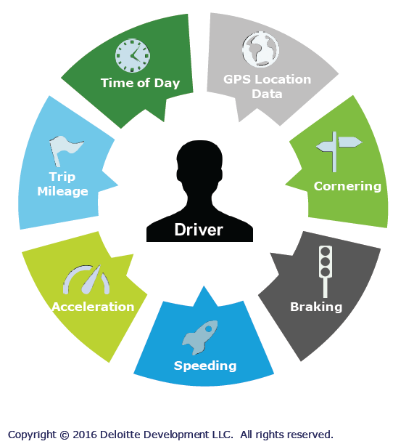
The Future: Telematics
Driver-Specific Information => Driver-Specific Premium
Monitor Drivers As They Drive
Snapshot ($2.6B in 2014 premium)
Many (most?) insurers offer
Not CA, NC
Monitoring Devices
‘Dongle’
Smartphone
OnStar etc.

Slide 11
Telematics: Growth Potential
Q. Would You Allow Insurer to Collect Driving Information to Set Premium?¹
Don’t know
Would not allow
Allow if premium went down
Allow whether or not premium went down
Source: IHS Automotive.
¹Asked of those who auto insurance.
Source: Insurance Information Institute Annual Pulse Survey, May 2016.
Market is Poised to Grow, But Some Reluctance Remains.

Slide 12
Summary
Some Drivers Are Better Than Others
Classify Drivers by Risk Profile is Important Insurance Job
Classification is Difficult, Sometimes Controversial
Telematics Allows Classification by Driving Skill That Has Never Been Seen Before

Slide 13
Insurance Information Institute Online:
www.iii.org
Thank you for your time and your attention!
Twitter: twitter.com/III_Research

