Slide 2
Sean Kevelighan
Insurance: Leading Through Disruption
Chief Executive Officer
Insurance Information Institute

Slide 3
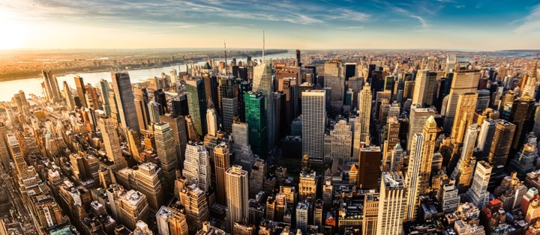
I.I.I. Mission Statement
Improving public understanding of insurance...
…what it does and how it works

Slide 4
Disruption is Everywhere

Slide 5
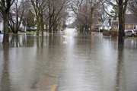
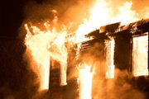

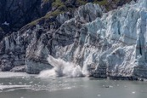
Disruption is Everywhere
Catastrophes – increases in frequency and severity
Natural Catastrophes
Water
Fire
2016 flood loss 6x greater
2015: record year
Wind
Climate Change
8 of 10 costliest since 2004
367 tornados Q1/17

Slide 6
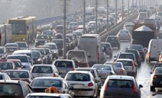

Disruption is Everywhere
Catastrophes – increases in frequency and severity
Man-Made Catastrophes
“Induced” Earthquakes
Autos
Cyber
More cars on road
Distracted driving
$445 million / year
~950 3.0+
60% in OK

Slide 7



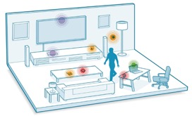

Technology / Digitalization
Sharing Economy
The Internet of Things
Big Data

Slide 8
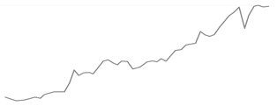
Economic Uncertainty
Global Growth...
US Growth...
*Since 2008 we've had the longest period of relative trade stagnation since World War II...
Investment Growth
GDP
1.6%
...Monetary vs. Fiscal Policy
Monetary: Low interest rates mean insurers are struggling to meet interest rate guarantees for life insurance and annuities must diversify their investment portfolios
Fiscal: Supply-side debate heating up, i.e., tax reform
* The Peterson Institute for International Economics
Notes:
GDP – Per Steve full year 2016 GDP is 1.6%

Slide 9




Globalization
Geopolitical Polarization
Rise of Nationalism
Regional Tensions
Global Trends Impacting Domestic Market
Regulatory Trends
"Conduct of Business"
TPP
Capital / Solvency
Dodd-Frank
* Mainland purchases of insurance and related investment policies in the nine months ended September 2016 surged to a record high.
Notes:
Elected Officials: "Rise of Nationalism" -- US, France, Germany
Neither US presidential candidate supports TPP
Regions: Europe (EU/Brexit/Russia), Asia (China/North-South Korea/Japan), Middle East (Syria/Iraq)
Global trends impacting domestic market
Regulatory trends:
"Conduct of Business"
Capital/Solvency
Climate Change

Slide 10
Geopolitics – US

Slide 11
P / C Insurance Industry ROE by Presidential Party Affiliation
1950 - 2016*
ROE
Truman
Eisenhower
Kennedy/ Johnson
Nixon/ Ford
Carter
Reagan/ Bush I
Clinton
Bush II
Obama
BLUE = Democratic President RED = Republican President
*2016 data is through Q3 Source: Insurance Information Institute

Slide 12
But State Politics Drives Insurance
And every state is different
C-
WA
D
MT
D+
ND
A
ME
B+
OR
B
MN
A
ID
A-
WI
D+
NY
NH A-
VT A+
MA D-
RI C+
CT C+
NJ B-
DE D
MD C+
B-
SD
B
WY
C+
MI
B
NE
B+
IA
B-
PA
D
CA
B+
NV
B
OH
A
UT
A
IL
B
IN
C
CO
C
WV
B
VA
C
KS
B
MO
A-
KY
B- TN
F NC
D-
AK
A
AZ
B
NM
C
OK
C+
AR
B
SC
= A
= B
= C
= D
= F
= NG
D
HI
D
MS
C-
AL
C
GA
B-
TX
D
LA
C
FL
Not Graded: District of Columbia
Source: R Street Insurance Regulation Report Card, December 2016

Slide 13
Insurance Industry Snapshot

Slide 14
State of Insurance
Top Issues
Catastrophe Costs
Consolidation / M&A
Insurance-related deals involving US firms²
Autonomous vehicles
P/C payouts / property losses¹
564
$101 billion
2015
2016
2015
P2P insurance
$15.4 billion
$21.6 billion
Cybersecurity
DEALS
VALUE
500 -11%
2016
$20 billion -80%
Sharing economy
US insured CAT losses
2016 loss up modestly compared with 10-year average $19.1 billion
Workers’ comp regulation
$6.3 billion
(Japan)
(Bermuda)
Politics
25
pending or completed M&As involving U.S. insurance companies (2017)³
Overcapitalization (reinsurance)
1. PCS; 2. Conning Research 3. S&P Financial
Notes:
According to the KPMG report called “The New Deal: Driving Insurance Transformation with Strategy-aligned M&A,” 84% of insurance companies plan to make between one and three acquisitions in 2017, while 94% plan at least one divestiture.
In 2015 Anthem’s announced purchase of Cigna, and Aetna’s planned purchase of Humana together totaled $83 billion, according to S&P Global Market Intelligence. The continued scrutiny of these two deals may have dampened merger activity in this sector in 2016.

Slide 15
P / C Insurance Industry Combined Ratio
2001 - 2016*
Heavy use of reinsurance lowered net losses
Best combined ratio since 1949 (87.6)
Higher CAT losses, shrinking reserve releases, toll of soft market
Three consecutive years of underwriting profits; first time since 1971-73
A return to more usual underwriting loss
Sandy
*Excludes mortgage & financial guaranty insurers 2008-2014. Including M&FG, 2008=105.1, 2009=100.7, 2010=102.4, 2011=108.1; 2012:=103.2; 2013: = 96.1; 2014: = 97.0 Sources: A.M. Best; ISO, a Verisk Analytics company; I.I.I.
Notes:
Drivers: Higher cats than older years
Development on Prior is trending the wrong way ($5B favorable is half what was posted last year; 2015 already trending higher)
2011 Tornados - Joplin Tuscaloosa
Joplin was biggest insurance event in Missouri history
2012 Super Storm Sandy
2001-2001 Interest Rates higher, but not the case since 2008/2009
99.5 – So close to 100 because earned and written premium

Slide 16
P / C Insurer Portfolio Yields
2002 - 2015
P/C carrier yields have been falling for over a decade, reflecting the long downtrend in prevailing interest rates
Even as prevailing rates rise in the next few years, portfolio yields are unlikely to rise quickly, since low yields of recent years are “baked in” to future returns
Sources: NAIC data, sourced from S&P Global Market Intelligence; Insurance Information Institute
Notes:
Likely to be some time before industry gets any relief – yields continue to be declining.
70’s – 80’s investment yields were in the double digits.
Seeing some – but not a lot – where they are looking for higher, but can only do so much because of the liability cover issue AND regulatory scrutiny
Hedge funds
Pension funds

Slide 17
Commercial & Personal Lines NPW Growth
1996 - 2016
Commercial lines are prone to far more cyclical volatility than personal lines
Note: Data include state funds beginning in 1998 Sources: A.M. Best; Insurance Information Institute

Slide 18
Rising Auto Costs
A force to be reckoned with…

Slide 19
Net Combined Ratio
1996 - 2016
Loss ratios have been rising for a decade 2015 return on net worth is likely close to zero or negative
Source: National Association of Insurance Commissioners data, sourced from S&P Global Market Intelligence; Insurance Information Institute

Slide 20





Double Digit Loss Costs
Auto insurance
Increase in loss costs, 2014:Q4–2016:Q4
Bodily injury
Property damage
Personal injury protection
Collision
Comprehensive
14.2%
15.3%
14.2%
13.6%
20.7%
From 2014 to 2016, the cost of accidents has risen dramatically By contrast, consumer prices overall rose 3.9 percent during 2014 and 2015
Source: Fast Track Monitoring System
Notes:
The amount of claim costs per vehicle insured - known as loss costs in the industry - is the primary cost in auto insurance rates. Those have been rising across all major coverages.

Slide 21
More People Working and Driving => More Collisions
2006 - 2016
Number employed, millions
Overall collision claims per 100 insured vehicles
Recession
When people are out of work, they drive less When they get jobs, they drive to work, helping drive claim frequency higher
Sources: Seasonally Adjusted Employed from Bureau of Labor Statistics; Rolling four-quarter average frequency from ISO, a Verisk Analytics company; Insurance Information Institute
Notes:
21
A lot of attention – WSJ, ABC
Nutshell: More people working, more people driving, more cars, more accidents
Costs are going up across the board – AAA numbers!
Manufacturing – Purchase – And depreciation
Repair & maintenance
Gas
Insurance – in that order!
Chart provides only frequency – seeing that level off
For reasons above, we still expect the severity will continue to

Slide 22
Fixing a Bumper
. . . On an entry-level luxury car (~$35,000)
2014 cost vs 2016 cost
What has changed?
Total Incurred | 2014 | 2016
Grille: distance sensor | $0 | $2,818
Headlamp assembly | 394 | 918
Mechanical labor | 0 | 108
Fewer accidents, higher costs
Parts: 130% higher
Labor: 18% higher
Total cost: $1,705 higher
2016 vehicle has LED headlights and adaptive cruise control Source: Liberty Mutual Insurance

Slide 23
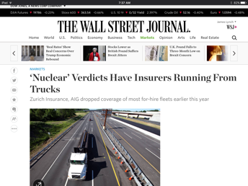
Trucking Trends
Driver Shortage
Laid-off Drivers Aren’t Returning
Older, Inexperienced Drivers Entering Force
High Turnover Exacerbates Problem

Slide 24
Commercial Auto Rates Since Late 2008
Rate index: December 2008 = 100
Commercial auto rates fell less in soft cycle and have risen more than overall property / casualty market
Sources: MarketScout, Insurance Information Institute

Slide 25
Energy
Mega Trends and Insurance Impact

Slide 26


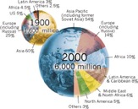

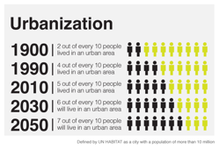
PwC’s Five Global Megatrends Challenging the Energy Sector
Technological breakthroughs
Demographic changes
Climate change
Shift in economic power
Source: PwC, The Forces of Transformation, 2014
Notes:
Technological breakthroughs - analytic capabilities will need to be a core strength if companies are to fend off competitors who already have these capabilities at the heart of their business
Climate change - resource scarcity or availability, and the associated geopolitics and economics of gas, oil and coal supply, are key factors shaping power market policy.
Demographic change - Africa’s population is projected to double by 2050 while Europe’s is expected to shrink. The growth prize for power companies of serving expanding populations is a big one.
Shift in economic power - Chinese state-owned power and utilities companies have been active in their search for suitable international power utility and grid investment opportunities. Europe, South America, Australia and other parts of Asia have all been targets for expansion
Accelerating Urbanization – power companies have the potential to be lead players at the heart of future city infrastructure but it will require a new mindset and the development of new partnerships.

Slide 27
Technology Breakthroughs

Slide 28

Blockchain (Internet 2.0)
Energy (oil & gas)
Enhanced cyber security
Improved regulatory compliance
Insurance / Risk Management
Improved customer experience: streamlining policyholder onboarding, policy administration, payments and claims
Source: Deloitte. Blockchain's future in oil and gas: Transformative or transient?; AM Best, Blockchain Reaction,
Notes:
https://www2.deloitte.com/us/en/pages/consulting/articles/blockchain-future-in-oil-and-gas.html

Slide 29
Cyber Attacks – No. 2 Global Risk
75% of oil and gas companies were hit by cyber attacks in 2016
Top ten global business risks
Source: Allianz Risk Barometer on Business Risks 2017; Source: Deloitte LLP, Protecting The Connected Barrels. June, 2017

Slide 30

Cyber: Protecting Directors and Officers From Liability
Risk manager to-do’s
Review D&O policies; present multiple threat scenarios and understand claims processes
Consider wrap-around coverage – adding cyber risks to an existing policy
Understand litigation risks – regulatory certifications, employee training, customer notifications, cyber insurance
Source: P/C 360. Sam Friedman. Directors, officers fear personal exposure to 'cyber nightmare.' June 28, 2017
Notes:
30

Slide 31
Catastrophe Change

Slide 32
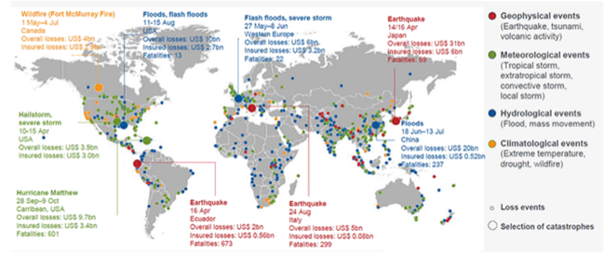
Overall Losses From Worldwide Natural Catastrophes in 2016 Totaled $175 Billion, Up From $103 Billion in 2015
World natural catastrophes, 2016
Source: © 2017 Munich Re, Geo Risks Research, NatCatSERVICE as of February 2017

Slide 33
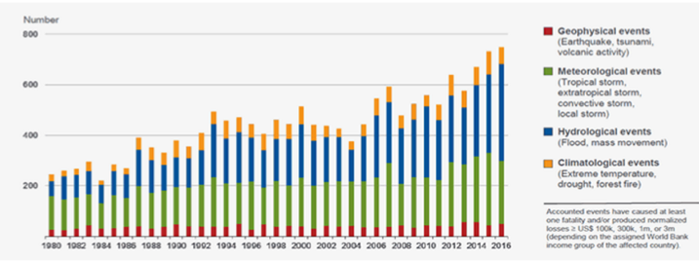
The Frequency of Extreme Weather Events is Rising
Number of world natural catastrophes, 1980 - 2016
Number of relevant events by peril
Source: © 2017 Munich Re, Geo Risks Research, NatCatSERVICE as of February 2017

Slide 34
Increased Heatwaves and Droughts May Lead to More Wildfires
Wildfire losses in the US, 2006 - 2015 (1)
2005 $ millions
2015
2014
2013
2012
2011
2010
2009
2008
2007
2006
The 2016 Ft. McMurray fire in Alberta, Canada cost $3.6 billion in insured losses
Insured losses Overall losses
0
$500
$1000
$1500
$2,000
$2,500
$3,000
$3,500
$4,000
(1) Adjusted for inflation Source: © 2016 Munich Re, Geo Risks Research, NatCatSERVICE

Slide 35
Induced Earthquakes
Oklahoma earthquakes magnitude 3.0 and greater
Number of earthquakes per year
Includes 30 quakes M4.0-4.7
Includes 15 quakes M4.0-4.4
Includes 20 quakes M4.0-5.1; 1 quake M5.8
~1.6 / year
Includes 3 quakes M4.0-4.8; 1 quake M5.6
Year
Earthquake insurance take-up rates increased by over 300 percent from 2006 to 2015 in Oklahoma
Source: USGS-NEIC ComCat & Oklahoma Geological Survey; Preliminary as of Dec. 31, 2016

Slide 36




Insurance Solutions on Risk Mitigation & Resilience
“The industry collaborates with a range of private and public organizations to research effective responses that reinforce financial, institutional and community resilience.”
Creating a Resilience Movement: The Time Is Right for Informed Policies, Platforms and Practices to Safeguard Our Communities, Sean Kevelighan, LinkedIn op-ed.

Slide 37
Insurance: Leading Through Disruption

Slide 38
Insurance Leadership
Sustainable Business Model
Strong Jobs Pool / Provider
Economic Growth Promoter / Facilitator
2010
$450.3 billion
2.6%
US GDP³
Bank failures: 157
2.5 million employed
Premium taxes paid⁴ $19.2
billion
Insurance impairments¹: 8
Bond investment⁵ $489
Policyholder surplus:
billion
$700.9 billion
Need to fill 400,000+ by 2022
End 2016
Charity / volunteerism⁶ 15%
Fundamentals strong – but still susceptible to disruption
1. Life/Health and P/C Insurance’ 2. PC 360 http://www.propertycasualty360.com/2013/04/17/insurance-industry-crisis-400000-positions-to-fill?slreturn=1476304299; 3. U.S. Bureau of Economic Analysis. 2014; 4. U.S. Department of Commerce, 2015; 5. Federal Reserve, 2015; 6. 2011–2014, Insurance Industry Charitable Foundation.

Slide 39
Insurance Disruption
Technology / digitalization
Fundamental changes
Opportunities
Challenges
New market entrants “Uber of insurance”?
Regulatory opportunities / threats
Future of auto
Future of reduced risk pools
Automation / efficiencies
New product lines (cyber)
Emerging technologies
Consumer trust – demonstrate the societal value
Big data vs. individual privacy
Lemonade
Offered in CA, IL, NY
Barrier to entry
US vs. other less regulated regions
Trust pull-back – the sandbox approach
Notes:
Insurance Disruption
Technology / Digitalization
Fundamental changes
Future of auto insurance
Autonomous vehicles -- reduction of accidents
Future of reduced risk pools
Disparate Impact
Opportunities
Automation and efficiencies -- claims, underwriting, filings (?)
New product lines -- cyber, sharing economy
Emerging technologies -- cognitive computing, predictive analytics
Challenges
Consumer trust will be key -- demonstrate the societal value
Big data vs. personal/information privacy
New market entrants -- "Uber of Insurance"
Lemonade: Approved in State of New York
Regulatory -- Opportunity / Threat
Barrier to entry (for potential disrupters)
US -- 50+ individual regulatory bodies
Taxi vs. Insurance Regulator: One can put you in jail…
Pull back / curb
Consumer trust will play key role
Sandbox approach
US vs. other global regions with less regulatory burden
[TBD] Audience Relevance Section

Slide 40
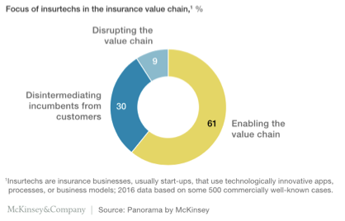
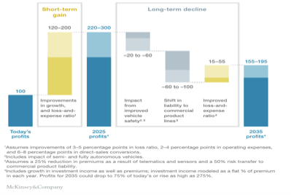
InsurTech Disruption: Threat or Opportunity?
Automation efficiencies can have powerful impact on industry
Only nine percent of insurtechs aim to oust incumbents
Future profits as a % of today’s profits, digitizing the business, auto insurance example

Slide 41






InsurTech Startups Have Broad Range… BUT…
Risk
Health
Insurance marketplace
Digital brokers
Peer to peer
Health navigators
Micro-duration coverage
Telematics
Notes:
Based on our most recent count we are tracking over 500+ InsurTech Companies. Just a year ago that number was about half that. We are tracking companies across Risk and Health in a variety of themes. For us its more about business concepts than it is about individual companies.

Slide 42









…With Broad Incumbent Support
$205 million
$57 million
$37 million
$21 million
$4 million
Note: Total funding
Notes:
Some examples of insurance company investments in InsurTech…. As you can see it is across a variety of themes or business concepts….
Metromile – Telematics
CoverHound and Policy Genius- Insurance Marketplaces
One Inc. – Cloud Based IT Platform and
Slice - Micro-Duration Coverage.
These investments create an opportunity to accelerate growth, improve efficiency, enhance the customer experience and “Speed to Market” for new products in emerging risk.

Slide 43







Successful Digital Transformation → Holistic Approach
Notes:
All industries being impacted

Slide 44
Insurance as an Economic Leader

Slide 45
The Insurance Industry’s Contribution to GDP Now Nearly Equals Banks
Sources: US Bureau of Economic Analysis; Insurance Information Institute

Slide 46
The Yearly Cash Flow to Rebuild Lives and Property is Substantial
Insurers annually pay over a trillion dollars in claims to rebuild lives, property, and businesses
In 2016 alone, the industry paid
$ 386.4 billion P/C incurred claims (L + LAE)
554.7 Life / annuity benefits
560.9 Health insurance benefits
= $1.502 trillion
This is equivalent to $125 billion per month
Notes:
46

Slide 47
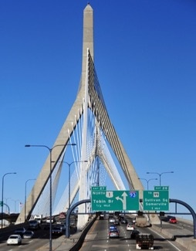
Major Construction Projects Don’t Start Without Insurance
Boston’s “Big Dig” – at $14 billion, the project was…
Larger than the original Panama Canal
More expensive than the “Chunnel” connecting France and England
Among the carriers who were winning bidders were AIG, Lexington, Zurich-American and Kemper Environmental
Workforce included 150 general contractors, 600 construction companies
Worst fear: that a building within 50 feet of the excavation would collapse
Notes:
47

Slide 48

As Financial Intermediaries, Insurers Expand the Funds Available to Grow the Economy
As financial intermediaries, insurers convert short-term funds into longer-term investments
In 2015, the industry converted $71 billion in premium income that was not needed for immediate claims payments into new long-term investments (bonds, mortgages, common and preferred stock, and owned real estate)

Slide 49
As Economies Grow Wealthier, Insurance Market Penetration (Premium as % of GDP) Also Grows
Some wealthy countries have penetration rates of 10% and higher
Source: A.M. Best.

Slide 50

Insurance Contributes to Growth by Speeding Recovery
Insurers are “financial first responders”
Insurance claims administration and payment is the most efficient way to achieve rapid recovery
Insurers perform this function more quickly and reliably than government or other aid organizations
This effect benefits not just those directly affected but also the wider community
After SuperStorm Sandy, 93% of claims were closed within six months
Notes:
50

Slide 51
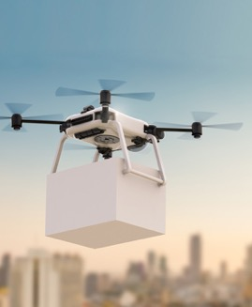
For the Economy, Insurance Is Growing in Importance
This is because economic activity is increasingly interdependent
This translates to an increase in the need for, and the cost of, activities that ensure the functioning of production and consumption (e.g., transportation, information)
With modern technology, the vulnerability of these systems and interdependencies increases
Notes:
51

Slide 52
Summary
Disruption causing insurance industry inflection point
Fundamentals are sound for industry leading through disruption
Opportunity / risk: define or be defined...

Slide 53
Insurance: Leading Through Disruption
Q&A
Notes:
Introduction
Preliminary work and observations since starting with III
Disruption is everywhere and insurance in right in the middle of it
Relevant anecdote for audience

