Slide 1
ROBERT P. HARTWIG,
PH.D., CPCU
insurance industry Financial Update & Outlook
President & Economist
Insurance Information Institute

Slide 2
p/c industry Net Income After Taxes
Net income in Q1:2016 was down 26.6% from Q1:2015 in part due to higher CATs
1991–2016:Q1
Millions
2005 ROE*= 9.6%  2011 ROAS1 = 3.5%
2006 ROE = 12.7%  2012 ROAS1 = 5.9%
2007 ROE = 10.9%  2013 ROAS1 = 10.2%
2008 ROE = 0.1%  2014 ROAS1 = 8.4%
2009 ROE = 5.0%  2015 ROAS = 8.4%
2010 ROE = 6.6%  2016:Q1 ROAS = 7.9%
ROE figures are GAAP; 1Return on avg. surplus. 2016 data are for Q1. Excluding Mortgage & Financial Guaranty insurers yields a 8.2% ROAS in 2014, 9.8% ROAS in 2013, 6.2% ROAS in 2012,
4.7% ROAS for 2011, 7.6% for 2010 and 7.4% for 2009; 2015E is annualized figure based actual figure through Q3 of $44.0
Sources: A.M. Best, ISO; Insurance Information Institute

Slide 3
profitability peaks & troughs in the P/C Insurance Industry
1975 – 2016*
ROE
History suggests next ROE peak should be in 2016-2017
1977: 19.0%
1987: 17.3%
10 Years
1997: 11.6%
2006: 12.7%
10 Years
2016:Q1 7.9%
2013 9.8%
9 Years
2014-15 8.4%
1975: 2.4%
1984: 1.8%
1992: 4.5%
2001: -1.2%
*2016 data through Q1. Profitability = P/C insurer ROEs. 2011-15 figures are estimates based on ROAS data. Note: Data for 2008-2014 exclude mortgage and financial guaranty insurers.
Source: Insurance Information Institute; NAIC, ISO, A.M. Best, Conning

Slide 4
roe Property/Casualty Insurance by Major Event
1987–2016:Q1
Percent
P/C profitability is both by
cyclicality and ordinary volatility
Modestly higher CATs
Katrina, Rita, Wilma
Low CATs
Sept. 11
Hugo
Lowest CAT losses in
15 years
4 hurricanes
Sandy
Andrew, Iniki
Record tornado losses
Northridge
Financial crisis*
* Data for 2016 through Q1. Excludes Mortgage & Financial Guarantee in 2008 – 2014
Sources: ISO, Fortune; Insurance Information Institute

Slide 5
p/c insurance industry roe Magnitude of Cyclicality, Volatility Changes Over Time
1950-2016:Q1
Percent
1950 - 1970
Low Volatility
1971 - 1992
Extreme Volatility
1993 - 2008
Moderate Volatility
2009 - Present
Modest Volatility
*Through Q1 2016.
Source: Insurance Information Institute

Slide 6
npw premium growth Peaks & Troughs in the P/C Insurance Industry
1926 – 2016:Q1
ROE
1970-90: Peak premium growth was much higher in this period while troughs were comparable. Rapid inflation, economic volatility, high interest rates, tort environment all played roles
Post WW II peak
1947: 26.2%
Start of WW II
1941: 15.8%
Economic shocks, inflation
1976: 22.0%
Tort crisis
1985/86: 22.2%
Post-9/11
2002:15.3%
1988-2000: Period of inter-cycle stability
2015 3.4%
1950-70: Extended period of stability in growth and profitability. Low interest rates, low inflation, “Bureau” rate regulation all played a role
2010-20XX? Post-recession period of stable growth?
Twin recessions; interest rate hikes
1987: 3.7%
Great Recession:2010: -4.9%
Great Depression
1932: -15.9% max drop
*Q1 data.
Note: Data through 1934 are based on stock companies only. Data include state funds beginning in 1998.
Source: A.M. Best; Insurance Information Institute

Slide 7
commercial lines NPW Premium Growth
1975 – 2015E
ROE
Commercial lines prone to more cyclical volatility that personal lines. Recently, growth has stabilized in the 4% to 5% range.
Economic Shocks, Inflation:
1976: 22.2%
Tort Crisis
1986: 30.5%
Post-9/11
2002: 22.4%
Post-Hurricane Andrew Bump:
1993: 6.3%
1988-2000: Period of inter-cycle stability
Post Katrina Bump:
2006: 7.7%
2015E 3.3%
2010-20XX? Post-recession period of stable growth?
Recessions:
1982: 1.1%
Great Recession:2009: -9.0%
Note: Data include state funds beginning in 1998.
Source: A.M. Best; Insurance Information Institute

Slide 8
p/c insurance industry Combined Ratio
2001–2016:Q1*
Millions
Relatively low CAT losses, reserve releases
Higher CAT losses, shrinking reserve releases, toll of soft market
Heavy use of reinsurance lowered net losses
As recently as 2001, insurers paid out nearly $1.16 for every $1 in earned premiums
Relatively low CAT losses, reserve releases
Average CAT losses, more reserve releases
3 consecutive years of U/W profits: first time since 1971-73
Sandy impacts
Best combined ratio since 1949 (87.6)
Cyclical deterioration
Lower CAT losses
Elevated CATs
* Excludes Mortgage & Financial Guaranty insurers 2008--2014. Including M&FG, 2008=105.1, 2009=100.7, 2010=102.4, 2011=108.1; 2012:=103.2; 2013: = 96.1; 2014: = 97.0.
Sources: 2016 figure from ISO/Verisk; A.M. Best, ISO (2014-2015); Figure for 2010-2013 is from A.M. Best P&C Review and Preview, Feb. 16, 2016.

Slide 9
CAPACITY/INDUSTRY CAPITAL REMAINS AT RECORD HIGHS BUT HAS STABILIZED
capital/capacity

Slide 10
policyholder surplus 2016
Q4–2016:Q1
Billions
2007:Q3
Pre-Crisis Peak
Drop due to near-record 2011 CAT losses
Surplus as of 3/31/16 stood at a record high of $676.3B
The industry now has $1 of surplus for every $0.77 of NPW,
close to the strongest claims-paying status in its history
2010:Q1 data includes $22.5B of paid-in capital from a holding company parent for one insurer’s investment in a non-insurance business .
The P/C insurance industry entered 2016
in very strong financial condition
Sources: ISO, A.M .Best

Slide 11
ARE CAPITAL ACCUMULATION,
DRIVE FOR GROWTH AND SCALE STIMULATING M&A ACTIVITY?
m&a update A Path to Growth

Slide 12
us insurance mergers and acquisitions P/C Sector
1994-2015 (1)
Millions
M&A activity in the P/C sector in 2015 totaled $39.6 billion, its highest level since 2000
(1) Includes transactions where a U.S. company was the acquirer and/or the target.
Source: Conning proprietary database

Slide 13
non-us insurance mergers and acquisitions P/C Sector
2007-2015 ⁽¹⁾
$ Millions
Non-US M&A activity in the P/C sector in 2015 totaled $18.9 billion, its highest level since 2011 but still less than half the $39.6 billion involving US companies
(1) Includes transactions where a non-U.S. company was the acquirer and the target.
Source: Conning proprietary database

Slide 14
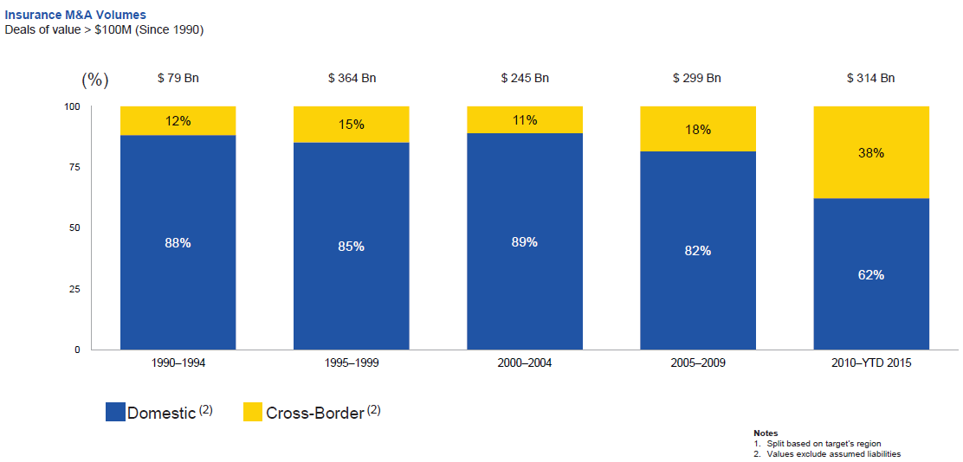
huge shift from domestic m&a activity to cross-border
The share of M&A deal volume that was cross-border more than doubled in 2015
Source: Thomson Reuters as of Oct. 2015 from Geneva Association Newsletter Insurance and Finance,
Jan. 2016, presentation “Facts vs. Sentiment: Deals in the Insurance Sector,” by Aviva CEO Mark Wilson.
.

Slide 15
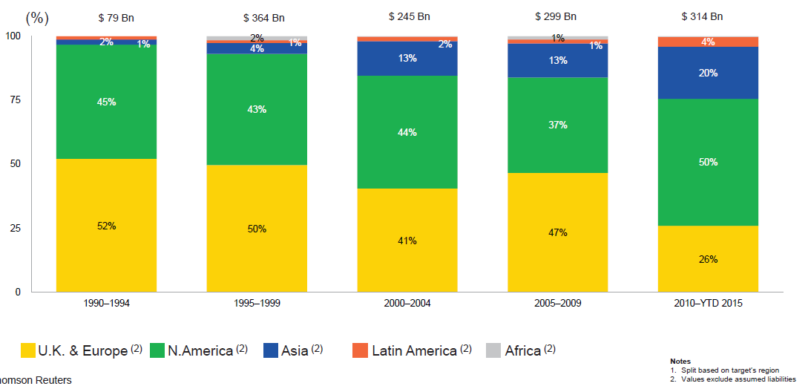
m&a activity has shifted away from europe and towards asia and north america
Asian, North American deal volumes were up sharply in 2015
Source: Thomson Reuters as of Oct. 2015 from Geneva Association Newsletter Insurance and Finance,
Jan. 2016, presentation “Facts vs. Sentiment: Deals in the Insurance Sector,” by Aviva CEO Mark Wilson.
.

Slide 16
INVESTMENT PERFORMANCE IS A KEY DRIVER OF PROFITABILITY
DEPRESSED YIELDS WILL NECESSARILY INFLUENCE UNDERWRITING & PRICING
investments The New Reality

Slide 17
p/c insurance industry Investment Income
2000–2016:Q1
Billions
Investment earnings are still below their 2007 pre-crisis peak
Due to persistently low interest rates, investment income fell in 2012, 2013 and 2014 but showed a small (1.9%) increase in 2015—another drop in 2016 seems likely
1 Investment gains consist primarily of interest and stock dividends.
*2014 figure is estimated based on annualized data through Q3.
Sources: ISO; Insurance Information Institute

Slide 18
us treasury security yields A Long Downward Trend
1990–2016*
Yields on 10-year US Treasury Notes have been essentially below 5% for more than a decade
Despite the Fed’s December 2015 rate hike, yields remain low though short-term yields have seen some gains; yield curve is flattening
Since roughly 80% of P/C bond/cash investments are in 10-year or shorter durations,
most P/C insurer portfolios will have low-yielding bonds for years to come
*Monthly, constant maturity, nominal rates, through June 2016.
Sources: Federal Reserve Bank at http://www.federalreserve.gov/releases/h15/data.htm. National Bureau of Economic Research (recession dates); Insurance Information Institute

Slide 19
net investment yield on p/c insurance Invested Assets
2007–2016P*
Percent
Estimated book yield in 2016 is down about 140 BP from pre-crisis levels
The yield on invested assets remains low relative to pre-crisis yields. The Fed’s plan to raise interest rates in late 2015 has pushed up some yields, albeit quite modestly.
*2015 figure is the average of the four quarters ending in 2015:Q1.
Sources: SNL Financial; Insurance Information Institute

Slide 20
interest rate forecasts
2016–2021
Yield %
3-Month Treasury
10-Year Treasury
Concerns about global growth, low yields aborad, Brexit, have pushed yields lower in 2016
A full normalization of interest rates is unlikely until 2019, more than a decade
after the onset of the financial crisis
Sources: Blue Chip Economic Indicators (6/16 for 2016 and 2017; for 2018-2021 3/16 issue); Insurance Information Institute.

Slide 21
HOW IS PROFITABILITY AFFECTED BY THE PRESIDENT’S POLITICAL PARTY?
profitability & politics

Slide 22
p/c insurance industry ROE by Presidential Administration
1950-2015*
Overall record: 1950-2015*
Democrats 7.72%
Republicans 7.85%
Party of President has marginal bearing on profitability of P/C insurance industry
*Truman administration ROE of 6.97% based on 3 years only, 1950-52;.
Source: Insurance Information Institute

Slide 23
p/c insurance industry ROE by Presidential Party Affiliation
1950-2015*
Eisenhower
Kennedy/Johnson
Nixon/Ford
Carter
Reagan/Bush I
Clinton
Bush II
Obama
Truman
BLUE = Democratic President RED = Republican President
*2015 data is through Q3.
Source: Insurance Information Institute

Slide 24
trump vs. clinton
Issues that Matter to P/C Insurers
Issue | Trump | Clinton
Economy | Supply Side-Like Philosophy: Lower taxes→faster real GDP growth; deficits likely grow as tax cuts are combined with targeted increased spending on Homeland Security, defense, etc. | Keynesian Philosophy: More government spending on infrastructure, education, social services; deficits likely increase as tax increases likely difficult to pass
Interest Rates | May trend higher with larger deficits; shift from monetary policy to fiscal focus (tax cuts, government spending) | Status quo at the Fed; net impact on interest rates unclear
Taxes | Favors lower tax rates for corporate and personal income tax rates; tax code overhaul? | Unlikely to reduce taxes or embark on major overhaul of tax code
International Trade | Protectionist tendencies (appeal primarily to manufacturing sector) | Has criticized Trans-Pacific Partnership but is a realist on international matters
Tort System | Doesn’t like trial lawyers but seems to like filing lawsuits | Status quo
Energy | Laissez-faire; less “green” | Status quo

Slide 25
trump vs. clinton Differences on Energy Policy Are Large, but Energy Is Not a Major Issue this Election Cycle
TRUMP
CLINTON
“America First” energy plan: “American energy dominance will be declared a strategic economic and foreign policy goal of the United States.”
Supports fracking, coal, nuclear, XL / Keystone pipeline
Not a big supporter of “green” energy…but renewables are okay so long as they’re not to the exclusion of other forms of energy
Climate change not one of our “big problems”
Views green / renewable energy investment as job stimulus
Staunch supporter of Obama climate change initiatives
“Utilities should not be allowed to penalize consumers with retroactive rule changes that cause financial hardship and slow the transition to a clean energy economy” − Feb. 12, 2016
Speaks frequently about a “bridge” to clean energy
  Suggests a pragmatic, gradual approach

Slide 26
UNDERWRITING PERFORMANCE
commercial lines

Slide 27
commercial lines Combined Ratio
1990-2017F*
Figures exclude mortgage and financial guaranty segments
Source: A.M. Best (1990-2014); Conning (2015E-17F) Insurance Information Institute
*2007-2012 figures exclude mortgage and financial guaranty segments.
Source: A.M. Best (1990-2014); Conning (2015E-17F) Insurance Information Institute.

Slide 28
commercial property Combined Ratio
2007–2017F
Commercial property underwriting performance has improved
in recent years, largely due to diminished CAT activity
Source: Conning Research and Consulting

Slide 29
general liability Combined Ratio
2005–2017F
Commercial general liability underwriting performance has been volatile in recent years
Source: Conning Research and Consulting

Slide 30
commercial auto Combined Ratio
1993–2017F
Commercial auto results are challenged as rate gains barely have yet
to offset adverse frequency and severity trends
Sources: A.M. Best (1990-2014);Conning (2015E-2017F); Insurance Information Institute

Slide 31
workers compensation Combined Ratio
1994–2015P
WC results have improved markedly since 2011
Workers’ comp results began to improve in 2012. Underwriting results deteriorated markedly from 2007-2010/11 and were the worst they had been in a decade.
Sources: A.M. Best (1994-2009); NCCI (2010-2015P) and are for private carriers only; Insurance Information Institute

Slide 32
PRICING TRENDS
SURVEY RESULTS SUGGEST COMMERCIAL PRICING HAS FLATTENED OUT
commercial lines

Slide 33
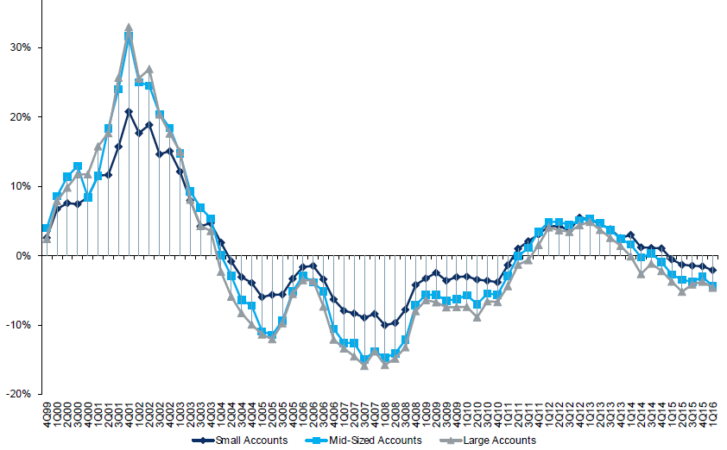
change in commercial rate renewals by Account Size
1999:Q4 to 2016:Q1
Percentage Change %
Peak = 2001:Q4 +28.5%
Pricing turned positive in Q3:2011, the first inrease in nearly 8 years; Q1:2015 renewals were down 2.8%; Some insurers posted stronger numbers
Pricing turned negative in early 2004 and remained that way for 7 ½ years
Trough = 2007:Q3 -13.6%
KRW : no lasting impact
Note: CIAB data cited here are based on a survey. Rate changes earned by individual insurers can and do vary, potentially substantially.
Source: Council of Insurance Agents and Brokers; Barclay’s Capital; Insurance Information Institute

Slide 34
ciab Average Commercial Rate Change, All Lines
1Q:2004–1Q:2016
Percent
Q2 2011 marked the last of 30th consecutive quarter of price declines
Pricing as of Q1:2016 remained somewhat negative
KRW effect
Note: CIAB data cited here are based on a survey. Rate changes earned by individual insurers can and do vary, potentially substantially.
Source: Council of Insurance Agents & Brokers; Insurance Information Institute

Slide 35
change in commercial rate renewals by Line
2016:Q1
Percentage Change (%)
Commercial Auto rate increases are larger than any other line, followed by EPL and D&O
Note: CIAB data cited here are based on a survey. Rate changes earned by individual insurers can and do vary, potentially substantially
Source: Council of Insurance Agents and Brokers; Insurance Information Institute

Slide 36
2013/14/15 EXPERIENCED BELOW AVERAGE CAT ACTIVITY AFTER VERY HIGH CAT LOSSES IN 2011/12
2016 CAT LOSSES YTD RUNNING HIGHER
insured catastrophe losses

Slide 37
us insured catastrophe losses
1989–2016
$ Billions, $2015
2012 was the
third most expensive year ever for insured CAT losses
$11.0B in insured CAT losses through 6/30/16
2013/14/15 were welcome respites from 2011/12, among the costliest years for insured disaster losses in us history. 2016 is off to a costlier start.
*Through 6/30/16. 2016 figure stated in 2016 dollars.
Note: 2001 figure includes $20.3B for 9/11 losses reported through 12/31/01 ($25.9B 2011 dollars). Includes only business and personal property claims, business interruption and auto claims.
Non-prop/BI losses = $12.2B ($15.6B in 2011 dollars.)
Sources: Property Claims Service/ISO; Insurance Information Institute

Slide 38
combined ratio points associated with catastrophe losses
1960 – 2016F*
Catastrophe losses as a share of all losses reached a record high in 2011
Combined Ratio Points
Average CAT loss component
of the combined ratio by decade
1960s: 1.04 1970s: 0.85
1980s: 1.31 1990s: 3.39
2000s: 3.52 2010s: 5.46*
The catastrophe loss component of private insurer losses
has increased sharply in recent decades
*2010s represent 2010-2015E.
Notes: Private carrier losses only. Excludes loss adjustment expenses and reinsurance reinstatement premiums. Figures are adjusted for losses ultimately paid by foreign insurers and reinsurers.
Source: ISO (1960-2009); A.M. Best (2010-15E) Insurance Information Institute (2016F).

Slide 39
top 16 most costly disasters in us history Katrina Still Ranks #1
Insured Losses
$ Billions, 2014 Dollars
Storm Sandy in 2012 was the last mega-CAT to hit the US
Includes Tuscaloosa, AL, tornado
Includes Joplin, MO, tornado
12 of the 16 Most expensive events in US history have occurred since 2004
Sources: PCS; Insurance Information Institute inflation adjustments to 2014 dollars using the CPI.

Slide 40
inflation adjusted us catastrophe losses by Cause of Loss
1995–2014¹
Wind/Hail/Flood
5.4%
Fires
1.5%
Other
0.1%
Winter storm losses were much above average in 2014/15 and will push this share up
Geological
0.1%
Insured CAT losses from 1995-2014 totaled $395.6 billion, an average of $19.8 billion per year or $1.65 billion per month
Terrorism
6.2%
Hurricane &
Tropical Storms
40.7%
Winter Storm
6.8%
Tornado share of CAT losses is rising
Catastrophes are defined as events causing direct insured losses to property of $25 million or more in 2014 dollars.
Excludes snow.
Does not include NFIP flood losses
Includes wildland fires
Includes civil disorders, water damage, utility disruptions and non-property losses such as those covered by workers compensation.
Source: ISO’s Property Claim Services Unit.
Wind losses by far cause the most catastrophe losses, even if hurricanes/TS are excluded
Events Involving Tornado
39.2%

Slide 41
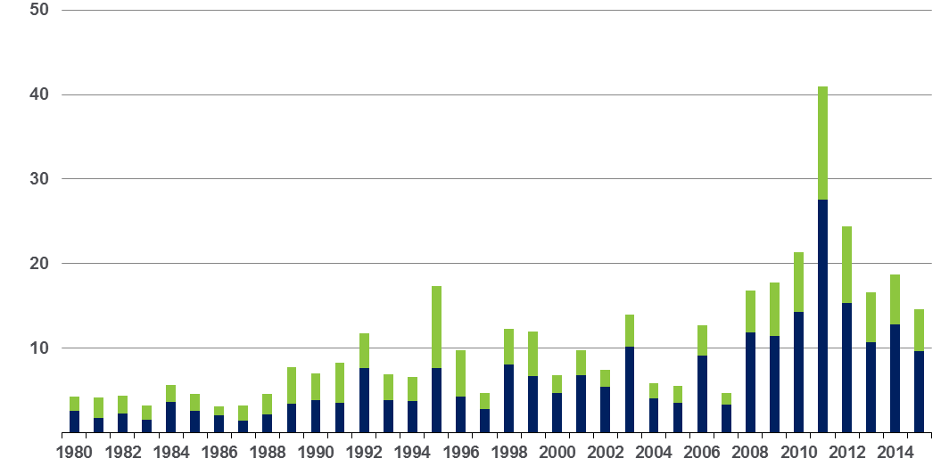
convective loss events in the us Overall and Insured Losses
1980–2015
$ Billions
The period from 2008-2015 has been the most expensive on record for insured losses from “convective events” (severe thunderstorms, tornado, hail, lightning and flash flood)
Overall losses
(in 2015 values)*
Insured losses
(in 2015 values)*
Analysis contains:
severe storm, tornado, hail, flash flood and lightning
*Losses adjusted to inflation based on CPI
Source: Geo Risks Research, NatCatSERVICE

Slide 42
insured homeowners losses Due to Lightning
Insurers paid $790 million in lightning claims in 2015, a 6.9% increase over 2014
2004 - 2015
$ Millions
The increased number and value of expensive electronic devices in homes
has pushed total lightning claim costs to about $1 billion in many years even
as the number of lightning claims falls
Sources: Insurance Information Institute

Slide 43
selected large outages associated with tropical systems by State
Millions of Customers
Hurricanes and tropical storms have produced significant losses for insurers in recent years, including with Sandy in 2012
Sources: US Dept. of Energy, Vertyx, AP analysis; Insurance Information Institute

Slide 44
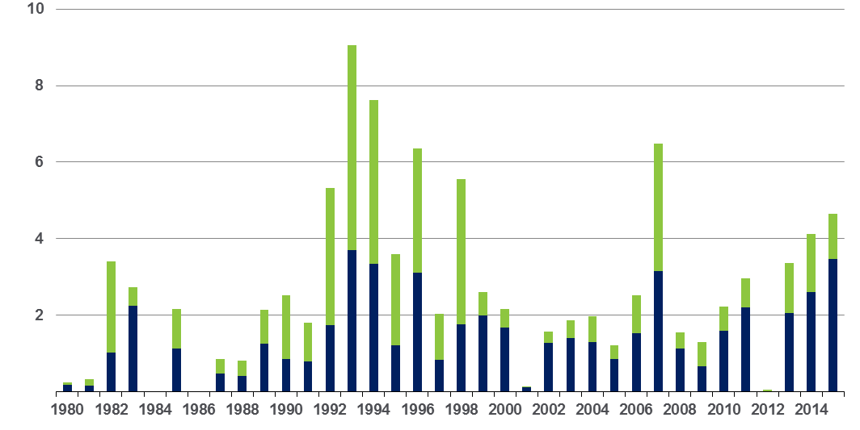
winter storm losses in the us Overall and Insured Losses*
1980–2015
$ Billions
Winter storm losses have been increasing rapidly in recent years
Overall losses
(in 2015 values)*
Insured losses
(in 2015 values)*
*Winter storms include also winter damages, blizzards and cold waves
*Losses adjusted to inflation based on CPI.
Source: Property Claim Services, MR NatCatSERVICE

Slide 45
first half 2016 cat losses by Type
Severe thunderstorms and hail drove up losses in the first half of 2016
Severe Thunderstorms Lead the Way
As of July 12, 2016 | Number of Events | Fatalities | Estimated Overall Losses (US $million) | Estimated Insured Losses (US $million)*
Severe Thunderstorm | 21 | 25 | 11,600 | 8,500
Winter Storms & Cold Waves | 8 | 55 | 2,300 | 1,500
Flood, Flash Flood | 60 | 3,300 | 3,300 | 1,000
Earthquake & Geophysical | - | - | - | -
Tropical Cyclone | - | - | - | -
Wildfire, Heat Waves & Drought (ongoing drought conditions without loss estimation for half the year) | 5 | 10 | 200 | Minor Losses
Totals | 40 | 150 | 17,4000 | 11,000
Source: ISO’s Property Claims Services (PCS) Unit

Slide 46
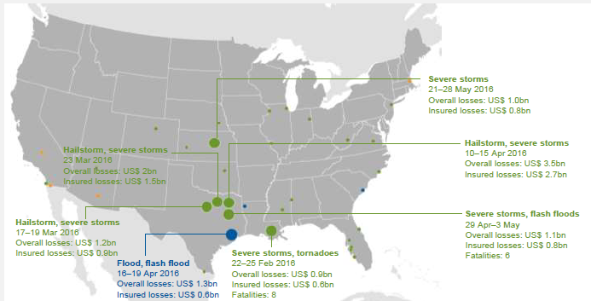
first half 2016 cat losses
Everything Is Bigger in Texas
Insured CAT losses in Texas in 2016 H1 totaled $6.6 billion
Geophysical events
(Earthquake, tsunami,
volcanic activity)
Meteorological events
(Tropical storm, extratropical storm, convective storm,
local storm)
Hydrological events
(Flood, mass movement)
Climatological events
(Extreme temperature,
drought, forest fire)
Source: Munich Re

Slide 47
us property cat rate on Line Index & Global Reinsurance ROE
US Property CAT ROL
Global Reinsurance ROE
Record traditional capacity, alternative capital and low CAT activity have pressured reinsurance prices; ROEs are down only very modestly
Source: Barclays PLC from Guy Carpenter; Insurance Information Institute

Slide 48
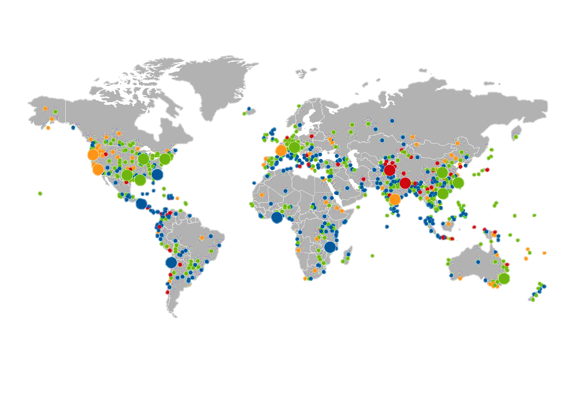
loss events Worldwide
Global insured CAT losses totaled $27 billion in 2015, 21% below the $31 billion average over the past 30 years (1985-2014, adj. for inflation)
2015
Severe storms
USA,
7–10 Apr
Winter storm
USA, Canada,
16–25 Feb
Winter Storm Niklas
Europe,
30 Mar–1 Apr
Earthquake
Pakistan, Afghanistan,
26 Oct
Tornado
China,
1 Jun
Geophysical events
(Earthquake, tsunami,
volcanic activity)
Severe storms
USA,
23–28 May
Meteorological events
(Tropical storm, extratropical storm, convective storm,
local storm)
Wildfires
USA,
12 Sep–8 Oct
Heat wave
Europe,
Jun–Aug
Typhoon Soudelor
China, Taiwan,
2–13 Aug
Hydrological events
(Flood, mass movement)
Drought
USA,
Jan–Oct
Flash floods
USA,
2–6 Oct
Typhoon Mujigae
China,
1–5 Oct
Climatological events
(Extreme temperature,
drought, forest fire)
Severe storms
USA,
18–21 Apr
Heat wave
India, Pakistan
May–Jun
Winter storm
Australia,
19–24 Apr
Flash floods
Ghana,
2–5 Jun
Landslide
Guatemala,
1 Oct
1,060
Loss events
Earthquake
Nepal,
25 Apr
Flash floods
Chile,
23–26 Mar
Floods
Malawi, Mozambique
Jan–Mar
Source: Munich Re, NatCatSERVICE, 2016
Source: Munich Re.

Slide 49
CYBER RISK IS A RAPIDLY EMERGING EXPOSURE FOR BUSINESSES LARGE AND SMALL IN EVERY INDUSTRY
cyber risk & cyber insurance

Slide 50






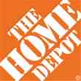

data breaches by Number of Breaches and Records Exposed
2005 ̶ 2015
# Data Breaches
Millions of Records Exposed
The total number of data breaches (+27.5%) hit a record high of 783 in 2014, exposing 85.6 million record through June 30; this year has seen 117.6 million records exposed in 400 breaches*
Source: Identity Theft Resource Center,
http://www.idtheftcenter.org/images/breach/ITRCBreachReport2015.pdf
*2007-2012 figures exclude mortgage and financial guaranty segments.

Slide 51
marsh Percentage of US Companies Purchasing Cyber Insurance Increased in 2014
Ever larger numbers of insureds seek financial protection via cyber insurance. The percentage of US companies buying cyber insurance rose to 16 percent in 2014.
*Take-up rate refers to the overall percentage of clients that purchased standalone cyber insurance.
Source: Benchmarking Trends: As Cyber Concerns Broaden, Insurance Purchases Rise, Marsh Risk Management Research Briefing, March 2015

Slide 52
cyber insurance Growth Rates by Industry
2015
Ever larger numbers of insureds seek financial protection via cyber insurance.
The growth rate in cyber premiums written was 27% percent in 2015.*
*Marsh clients.
Source: Benchmarking Trends: As Cyber Concerns Broaden, Insurance Purchases Rise, Marsh Risk Management Research Briefing, March 2015

Slide 53
marsh Total Limits Purchased, by Industry – Cyber Liability
All Revenue Size
Limits purchased for the power & utility sector were up 22.1% in 2015
$ Millions
Average limits purchased for cyber risk rose 15% to $16.9 million for all industries
and all company sizes in 2015. Power and utility companies witnessed a sharper percentage increase in average limits, at 22 percent.
Source: Benchmarking Trends: As Cyber Concerns Broaden, Insurance Purchases Rise, Marsh Risk Management Research Briefing, March 2015

Slide 54
marsh Total Limits Purchased, by Industry – Cyber Liability
Revenue > $1 Billion
$ Millions
Among larger companies, average cyber insurance limits purchased increased
by 14.6 percent to $39.2 million in 2015, from $34.2 million in 2014; Power and Utility purchases were up 21.8%
Source: Benchmarking Trends: Operational Risks Drive Cyber Insurance Purchases, Marsh Management Research Briefing, March 2016.

Slide 55
cyber liability Historical Rate Changes
Price per Million
Cyber insurance premiums trended lower in 2015 despite increased frequency and severity of losses in some sectors
Source: Benchmarking Trends: Operational Risks Drive Cyber Insurance Purchases, Marsh Management Research Briefing, March 2016.

Slide 56
THE STRENGTH OF THE ECONOMY WILL GREATLY INFLUENCE INSURER EXPOSURE BASE AND DRIVE ENERGY DEMAND
the economy

Slide 57
us real gdp growth*
The Q4:2008 decline was the steepest since the Q1:1982 drop of 6.8%
Percent
Recession began in Dec. 2007
Q1 2014/15 GDP data were hit hard by the “Polar Vortex” and harsh winter
Demand for energy should increase in 2016-17 as GDP growth continues at a steady,
albeit moderate pace and gradually benefits the economy broadly
* Estimates/Forecasts from Blue Chip Economic Indicators.
Source: US Department of Commerce, Blue Economic Indicators 7/16; Insurance Information Institute

Slide 58
us unemployment rate forecast
Rising unemployment
eroded payrolls and WC’s
exposure base
Unemployment peaked at 10% in late 2009
2007:Q1 to 2017:Q4F*
Percent
Jobless figures have been revised downwards for 2016
* = actual; = forecasts
Sources: US Bureau of Labor Statistics; Blue Chip Economic Indicators (7/16 edition); Insurance Information Institute

Slide 59
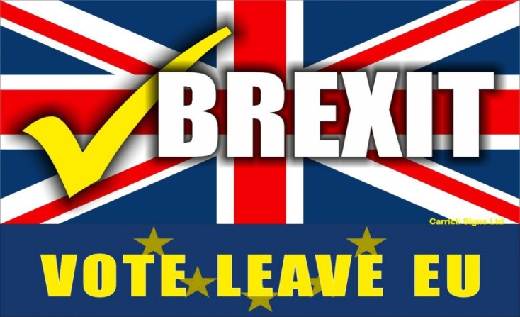
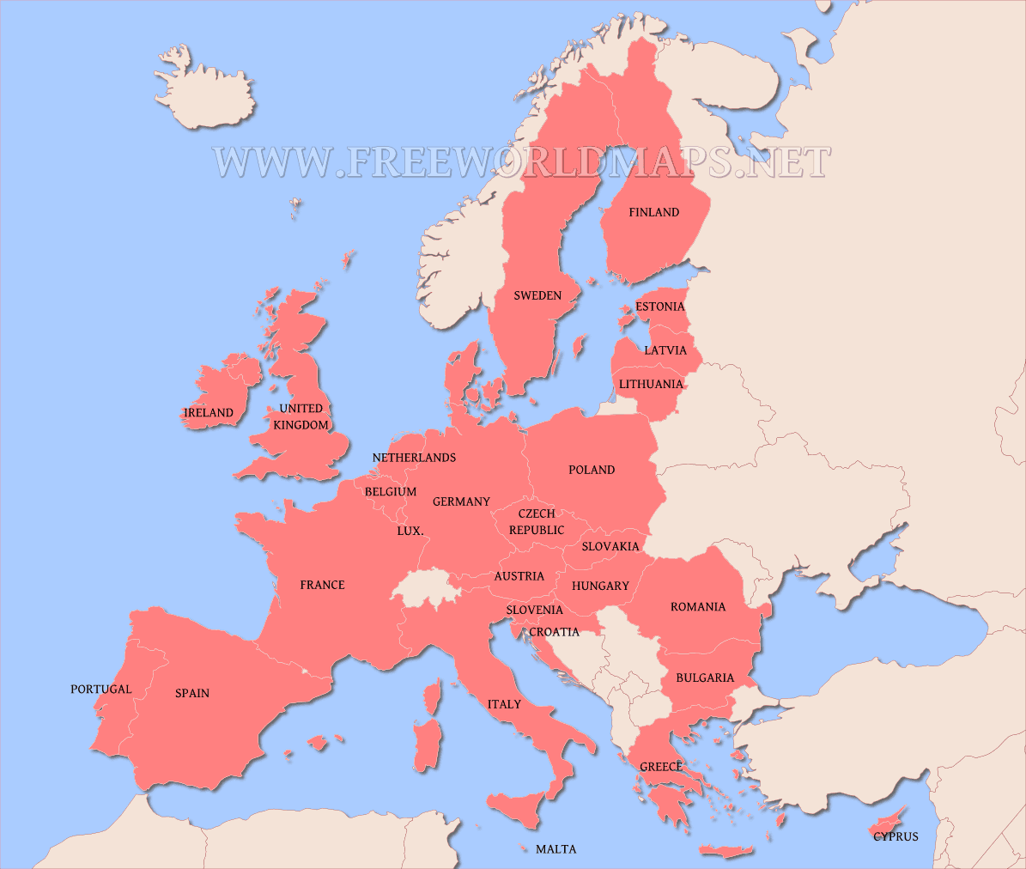
brexit Potential Impacts on the Global (Re)insurance Industry
Brexit is a net negative for the global (re)insurance industry
Fundamentally, Brexit is a protectionist measure and antithetical to free trade; economic negatives:
    Dollar appreciates weakening US exports
    Delays Fed rate hikes
    Uncertainty
Free flow of financial capital, human capital and coordinated regulatory policy
across EU states is on net good for Europe’s economy
Concern that UK’s action could initiate a domino effect
Economic integration is the cornerstone of keeping (most of) Europe free of war
Does Brexit weaken Solvency II and efforts to implement European-like regulations in the US?
59
Notes:
59

Slide 60
WWW.III.ORG
THANK YOU FOR YOUR TIME
AND YOUR ATTENTION!
TWITTER: TWITTER.COM/BOB_HARTWIG
DOWNLOAD AT WWW.III.ORG/PRESENTATIONS
insurance information institute online

Slide 61


