Slide 1
Overview of US P&C and Marine Market
Marine Insurance Issues Seminar
American Institute of Marine Underwriters, New York, NY
May 7, 2019
James Lynch, FCAS MAAA, Chief Actuary
Insurance Information Institute  110 William Street  New York, NY 10038 Tel: 212.346.5533  jamesl@iii.org  www.iii.org

Slide 2

What is the Insurance Information Institute?
Improving public understanding of insurance...
…what it does and how it works
2

Slide 3
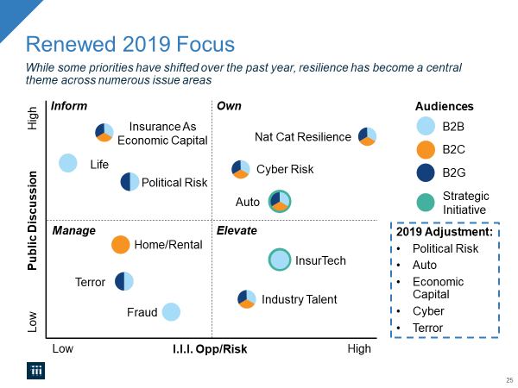

Slide 4
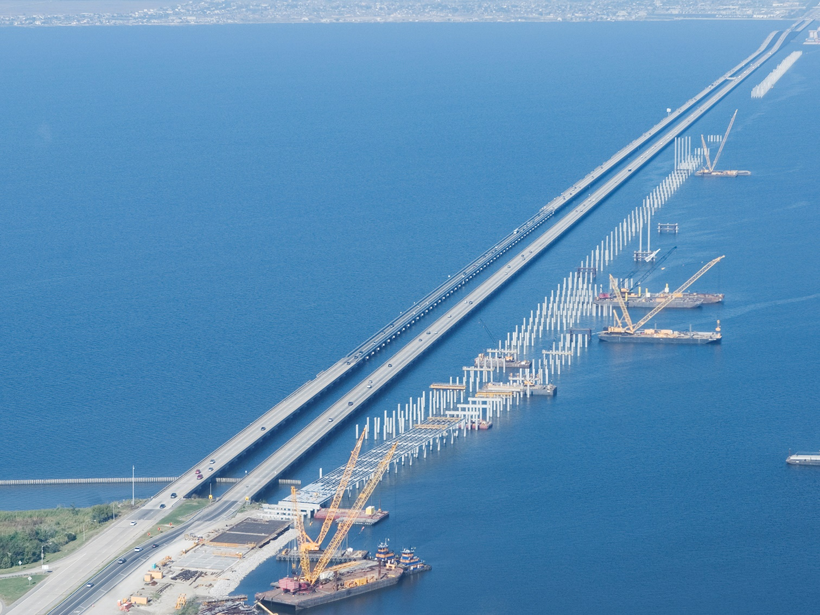
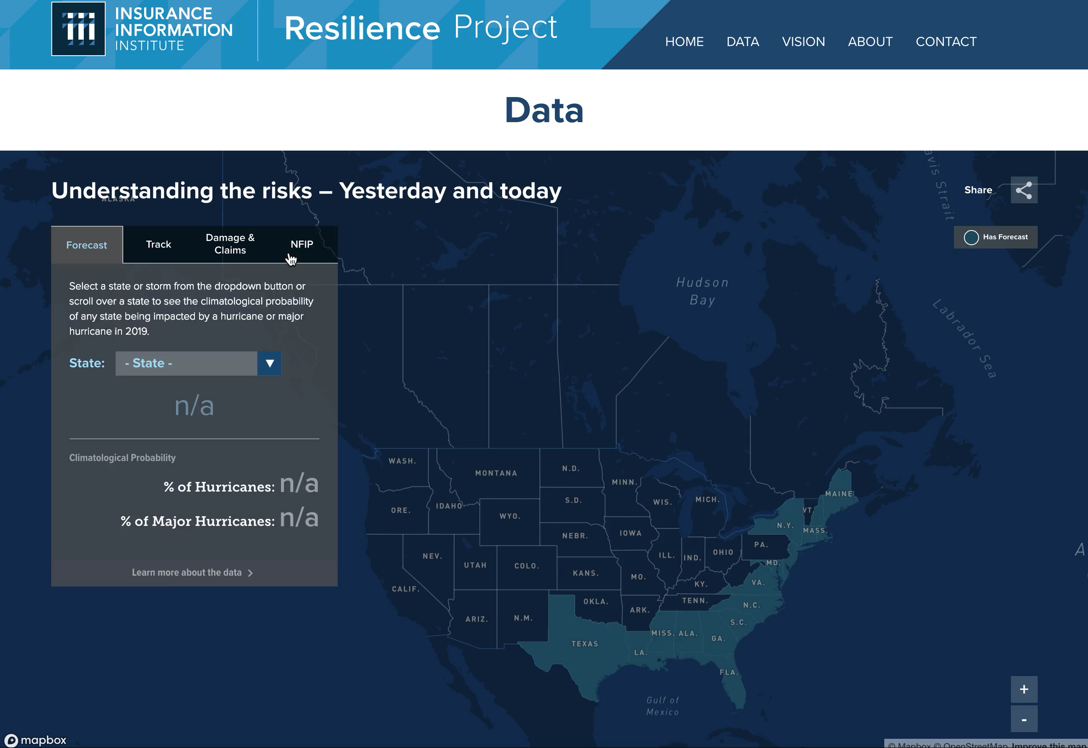

The Power of Visualization
Data transformed to show the power of resilience.
Powered by:

Slide 5










How Insurance Drives Economic Growth
Safety/
Security
Economic/ Financial Stability
Development
Insurers are financial first responders
Insurers are capital protectors
Insurance is a partner in social policy
Insurers are community builders
Insurance enables infrastructure improvements
Insurers are risk mitigators
Insurance sustains the supply chain
Insurers are capital infusers
Insurers are innovation catalysts
Insurers are credit facilitators
Notes:
5

Slide 6
Financial Results Q4 2018

Slide 7
Policyholder Surplus By Quarter
Amount of Surplus
Change from Prior Quarter
($ Billions)
Tax Law Increased Surplus at Year-End 2017 and Makes Surplus Growth a Bit More Volatile. $0.83 Premium per $1 Surplus.
7
Sources: ISO, A.M .Best.
Notes:
7

Slide 8
Direct Premium Growth, Annual Change
Direct Premiums Continue to Track Economic Growth
SOURCES:NAIC data sourced through S&P Global Intelligence, Bureau of Economic Affairs, Insurance Information Institute.

Slide 9
P/C industry net income after taxes
Billions, 2018 dollars
Catastrophes Let Up After Awful ‘17; Auto Turned a Corner.
Through fourth quarter. Adjusted for inflation using the BLS CPI calculator, to 2018 dollars. Sources: NAIC data, sourced from S&P Global Market Intelligence; Insurance Information Institute.

Slide 10
P/C Insurance Industry Combined Ratio, 2000-2018*
3 Consecutive Years of U/W Profits; 1st time since 1971-73
Heavy Use of Reinsurance Lowered Net Losses.
Hurricanes, Wildfires Drive CR Higher.
Higher CAT Losses, Shrinking Reserve Releases, Toll of Soft Market
Best Combined Ratio Since 1949 (87.6)
Sandy
*Excludes Mortgage & Financial Guaranty insurers 2008-2014. Including M&FG, 2008=105.1, 2009=100.7, 2010=102.4, 2011=108.1; 2012:=103.2; 2013: = 96.1; 2014: = 97.0.
Sources: A.M. Best; ISO, a Verisk Analytics company; I.I.I. estimate for 2018.

Slide 11
U.S. Inflation-Adjusted Cat Losses
Harvey, Irma, Maria
2018 – Third worst year for U.S. Insured Catastrophe Losses. Average Insured Loss per Year for 1980-2018 is $19.3 B.
*2018: Estimate, subject to change. 2010s is average of 2010 to 2018.
Sources: 1980-2017 Property Claims Service, a Verisk Analytics business; 2018 Insurance Information Institute.

Slide 12
Key sources of P/C insurer profits, 2008-2018
$ Billions
Data are before taxes and exclude extraordinary items.
Source: NAIC data, sourced from S&P Global Market Intelligence.

Slide 13
P/C Insurer Portfolio Yields
Yields Have Been Falling for Over a Decade, Reflecting the Long Downward Trend in Prevailing Interest Rates.
Sources: NAIC data, sourced from S&P Global Market Intelligence.

Slide 14
Marine Results Underwriting is Historically Volatile; Has the Market Turned?

Slide 15
U.S. Ocean Marine Direct Written Premiums
($ Billions)
Ocean Marine Premium Volume Fell During the Global Financial Crisis.
Source: NAIC data, sourced from S&P Global Market Intelligence. Note: U.S. and territories
Notes:
15

Slide 16
Has the Market Bottomed Out?
(U.S. Ocean Marine DWP as % of GDP)
Economy Grows Faster Than Premium – Sign of Soft Market (30% Decline Since 2006 Peak)
Sources: Federal Reserve Economic Data; NAIC data, sourced from S&P Global Market Intelligence

Slide 17
Total losses by type of vessel 2008 vs. 2017
(Vessels Lost)
While Exposures Grow, the Number of Vessels Lost Has Declined.
Source: Source: Lloyd’s List Intelligence Casualty Statistics; Allianz Global Safety & Shipping Review 2018
Notes:
17

Slide 18
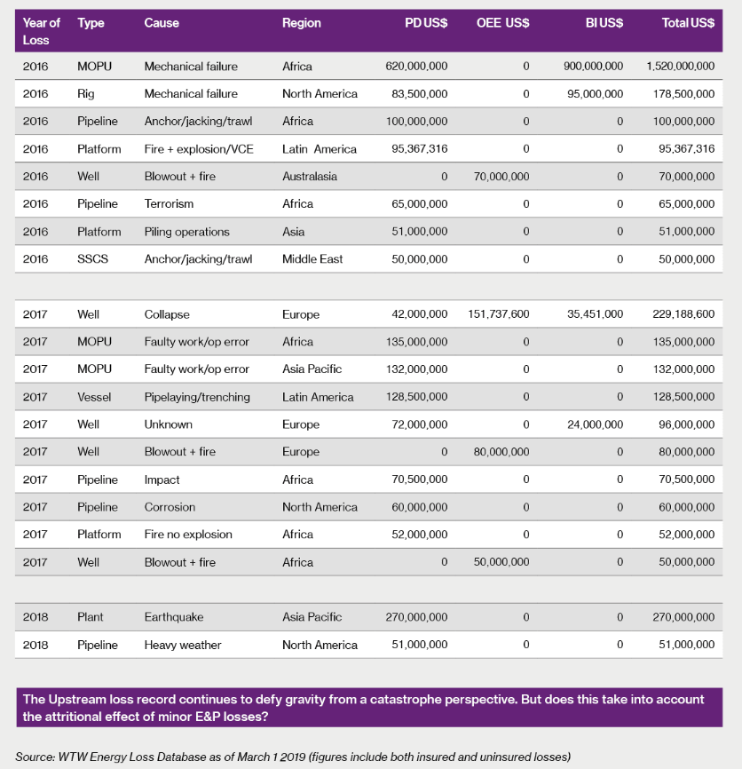
Major Energy Losses
Heaviest Upstream 2018 Losses Were Outside USA.
Source: Willis Towers Watson Energy Loss Database (February 12, 2018).

Slide 19
U.S. Marine Results, 2007-2017
Combined Ratio After Dividends
Results Deteriorated in 2018.
Source: Ocean and Inland Marine combined. A.M. Best’s Aggregates and Averages, 2017
Notes:
19
2012 Sandy – cargo losses
http://www3.ambest.com/bestweekpdfs/sr577057119015afull.pdf (inland marine from 2013)

Slide 20
Economic Factors

Slide 21
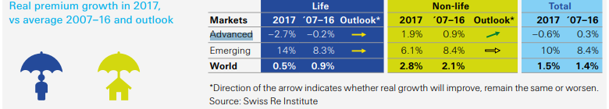
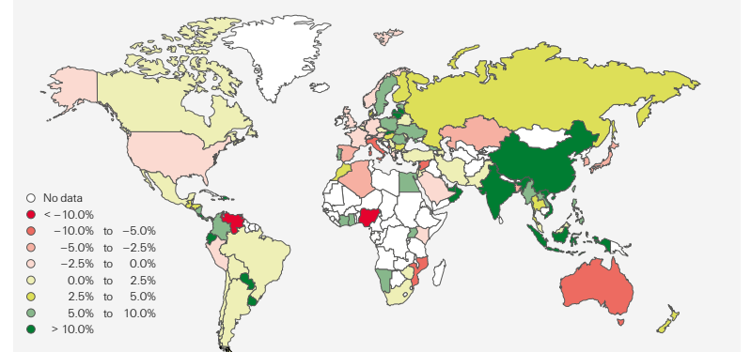
Global Premium Growth, 2017
Life Sector’s Growth Cooled
P/C Looking Good
Watch China, India
Source: Swiss Re sigma, 3/2018

Slide 22
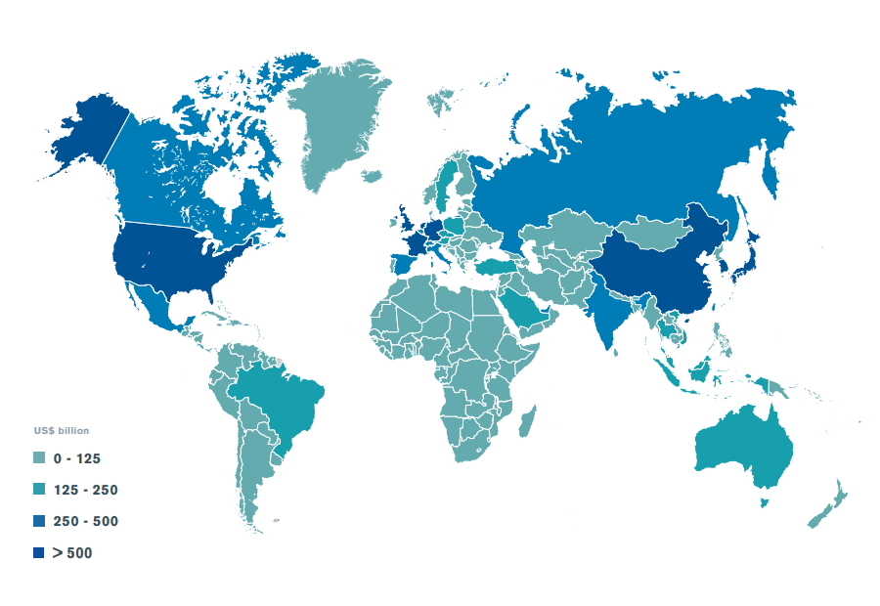
Economies by size of merchandise trade, 2017
Merchandise exports of WTO members totaled US$ 17.43 trillion in 2017
Source: World Trade Statistical Review 2018

Slide 23
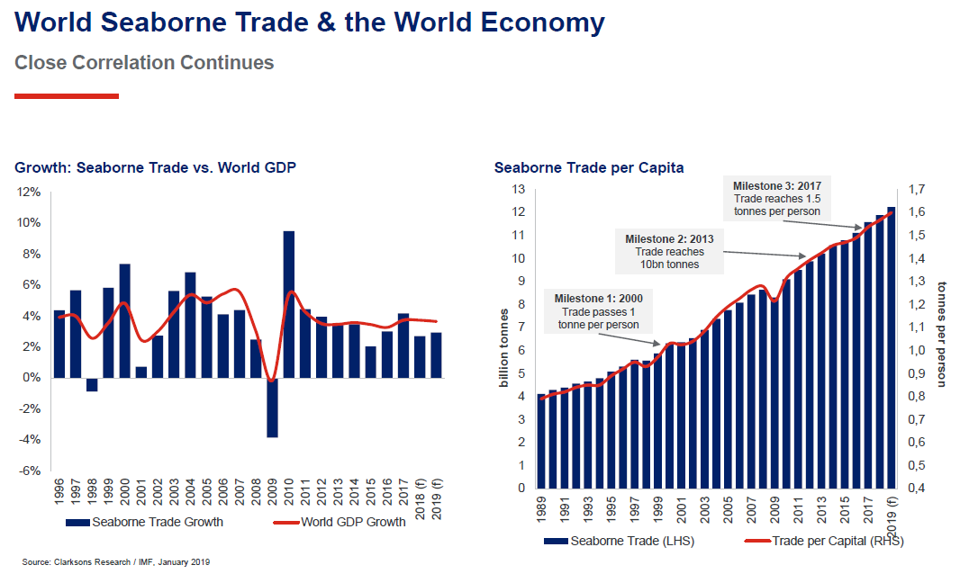
World Trade and the Economy
Source: Clarksons Research / IMF, January 2019

Slide 24
World Trade Volume Growth* 2012-2020P
Global trade growth has slowed sharply.
Sources: International Monetary Fund, World Economic Outlook, April 2019 Statistical Appendix * Goods and services
Notes:
24

Slide 25
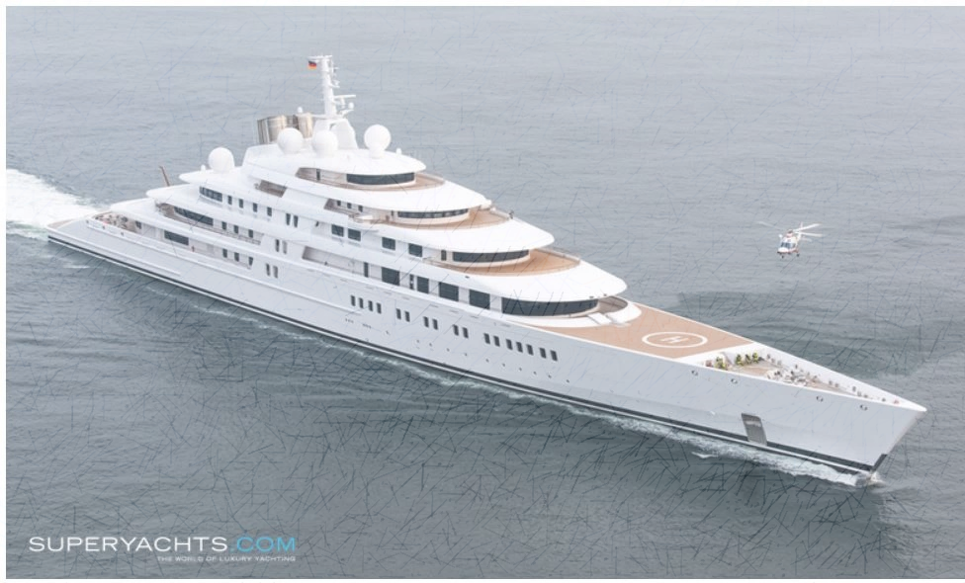
Total value of recreational boats sold in the U.S.
($ Millions in Sales)
5%
*National Marine Manufacturers Association.
SOURCE: Statista, 2018.
Notes:
Latest figures - https://www.nmma.org/press/article/22428

Slide 26
Global Risk

Slide 27
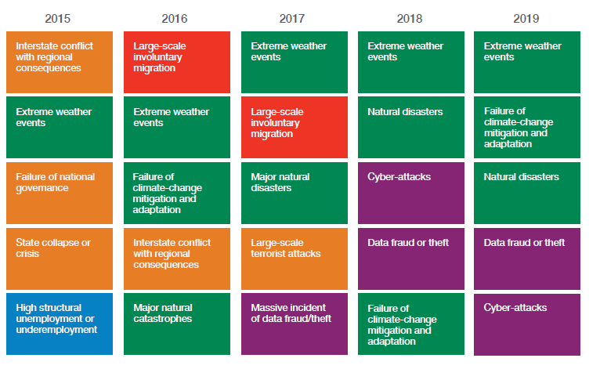

Top 5 Global Risks in Terms of Likelihood, 2015—2019: Insurance Can Help With Most
Environmental & Tech Issues Dominate
Concerns Shift Considerably Over Short Spans of Time.
Sources: World Economic Forum, Global Risks 2019; Insurance Information Institute.

Slide 28
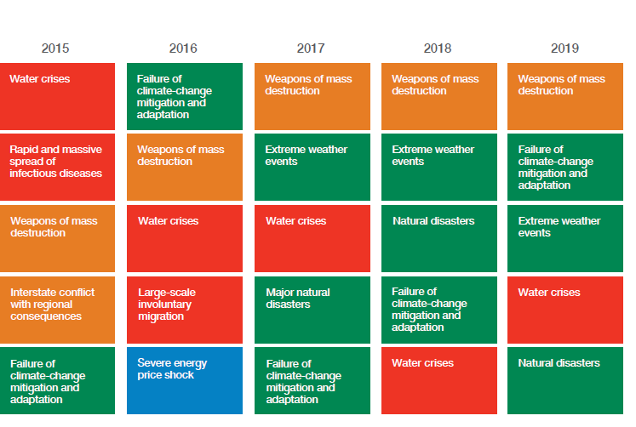
Top 5 Global Risks in Terms of Impact, 2015—2019: Insurance Can Help With Most
Marine Underwriters Have a Lot to Worry About.
Sources: World Economic Forum, Global Risks 2019; Insurance Information Institute.
Notes:
http://www3.weforum.org/docs/WEF_Global_Risks_Report_2019.pdf

Slide 29
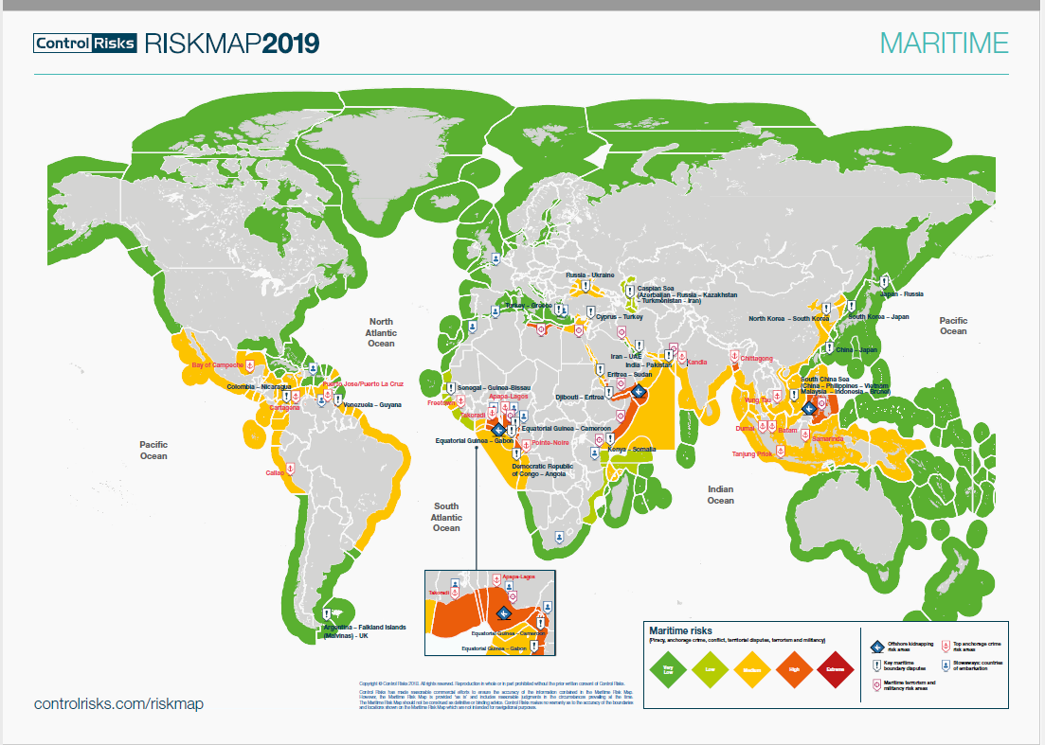
Maritime Risk
Source: ControlRisks, 2019 Risk Map
Notes:
https://www.controlrisks.com/-/media/corporate/files/riskmap/maps/2018-11-29-riskmap-2019-map-maritime-a3.pdf
Changes from 2018
Border dispute between Senegal and Guinea-Bissau is complicating development of billion-barrel oilfield: https://www.upi.com/Energy-News/2018/08/22/First-oil-well-in-40-years-scheduled-for-offshore-Gambia/5821534931594/
Border dispute Gibraltar (UK, Spain) is it a colony or part of UK. With Brexit this is a big deal: https://www.reuters.com/article/us-britain-eu-visas/spain-claims-success-in-gibraltar-row-with-britain-idUSKCN1RG199
East Timor – Australia boundary – treaty signed, not ratified (disputed oil fields) https://www.abc.net.au/news/2019-04-22/australia-expected-to-pay-back-24100-million-to-timor-leste/11035232
Bangladesh emerging as center of kidnapping
Anchorage Crime
Bay of Campeche (Mexico) – theft of fuel, oil equipment: https://www.argusmedia.com/en/news/1830861-mexico-city-fuel-supply-improves-on-pipeline-flows?backToResults=true
Shifting of risks around Nigeria (Gulf of Guinea)
Threat slightly less in Nigeria but higher in Ghana, Cote d’Ivoire – 22 kidnappings in Q1: https://iccwbo.org/media-wall/news-speeches/maritime-piracy-incidents-q1-2019-kidnapping-risk-gulf-guinea-persists/

Slide 30
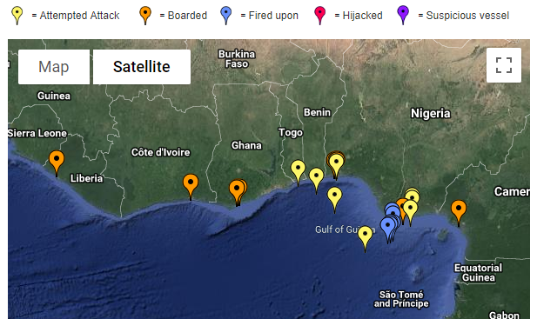
Piracy 2019 (so far)
Gulf of Guinea remains a hotspot: 22 kidnappings in Q1
SOURCE: ICC Commercial Crime Services, accessed May 3, 2019.
Notes:
Other areas of concern:
Southeast Asia, Indian subcontinent
Ecuador, Peru
Somalia (where fishermen defend their nets with semiautomatic weapons, so don’t get confused)
https://www.icc-ccs.org/index.php/piracy-reporting-centre/prone-areas-and-warnings

Slide 31
The Risk Report
The Latest in the World of Property/Casualty
The Economy
The World of Insurance
How Long Can It Last?
The Jobs Engine Powers Along
Trade Wars
Mondelez/NotPetya: It’s War!
Rating Variables
Product Liability
Roundup - $158M
J&J talc - $142M
Burger King’s $9,026 claim
Marine Issues
Lloyd’s: 10th Decile
Psst . . . Rates are Rising
Notes:
BK: https://www.foxnews.com/food-drink/burger-king-settles-with-customer-who-sued-restaurant-for-reneging-on-free-food-offer

Slide 32
Wind Power

Slide 33
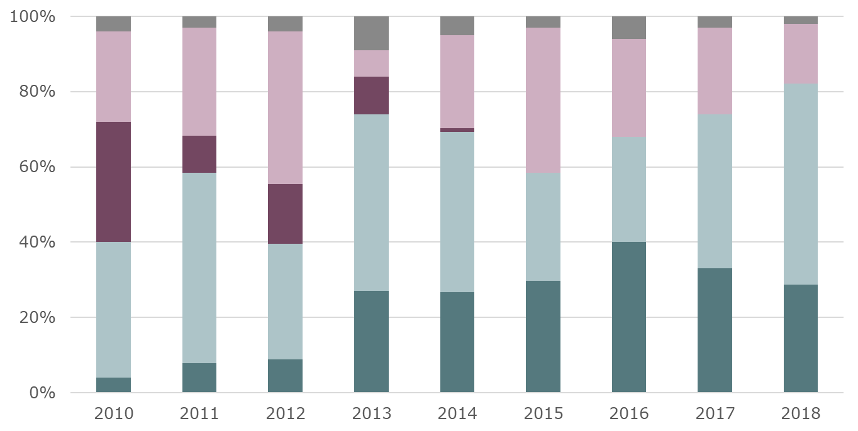
New U.S. electricity generation by source
■ Solar ■ Natural gas ■ Coal ■ Wind ■ Other
Coal is Out. Solar, Gas and Wind Are In.
Sources: “Solar Market Insight Report 2018 Year in Review,” SEIA and Wood Mackenzie Power & Renewables, March 2019.
Notes:
33

Slide 34
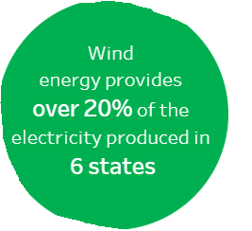
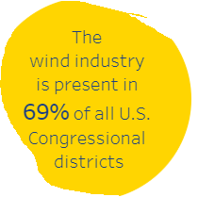
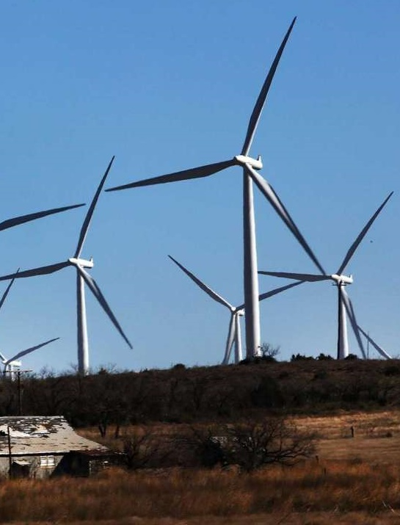
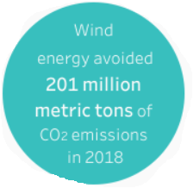
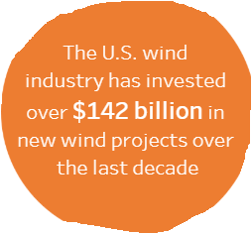
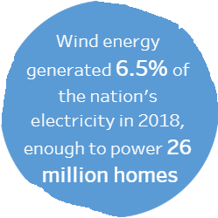
Upside of wind energy
Source: American Wind Energy Association, all figures are as of 2018
Notes:
34

Slide 35
Growth of Wind Power Capacity in the U.S.
Gigawatts
By 2050 total wind power capacity across 48 states will be 404.25 gigawatts, an increase of 180.15 gigawatts from 2030
Source: Energy.gov
Notes:
35
1 gigawatt = 100 million LEDs = 700K homes
So 400 gigawatts =

Slide 36
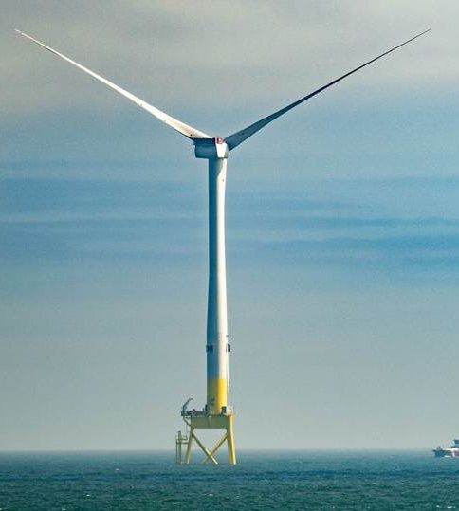
Offshore wind farms pros and cons
Pros
Offshore wind speeds are faster and steadier than on land
Meet energy needs of high-density coastal areas
Renewable energy with no pollution
Domestic energy source
Jobs
Cons
Expensive and difficult to build and maintain
Effects on marine animals and birds are not fully understood
May be unpopular with residents
Source American Geosciences Institute
Notes:
36

Slide 37
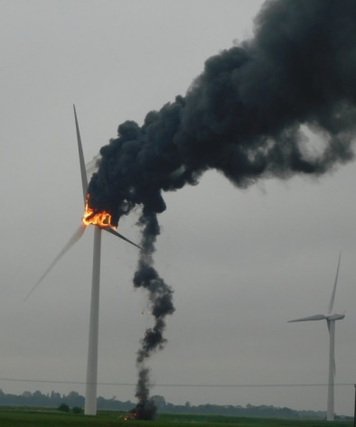
Key risks faced by wind farms
Natural disasters
Underperformance aka “wind drought”
Mechanical issues
Cable issues
Start-up delays
Lightning damage
Prototype technology
Substations and power delivery
Source: Willis Towers Watson, WindPower
Notes:
37

Slide 38
Thank You!

