Slide 1
Overview & Outlook for the P/C Insurance Industry:
Behind the Numbers
Alabama I-Day
Tuscaloosa, AL
October 8, 2014
Steven N. Weisbart, Ph.D., CLU, Senior Vice President & Chief Economist
Insurance Information Institute ♦ 110 William Street ♦ New York, NY 10038
Tel: 212.346.5540 ♦ Cell: 917.494.5945 ♦ stevenw@iii.org ♦ www.iii.org

Slide 2
2013: Best Year (So Far)
in the Post-Crisis Era
Performance Improved with Lower CATs, Firming Markets
2

Slide 3
P/C Net Premiums Written: % Change, Quarter vs. Year-Prior Quarter
2014:Q1 marked the 16th consecutive quarter of y-o-y growth
Sustained growth in written premiums
(vs. the same quarter, prior year) should continue through 2014.
Sources: ISO, Insurance Information Institute.
3
12/01/09 - 9pm
eSlide – P6466 – The Financial Crisis and the Future of the P/C
Notes:
3

Slide 4
Underwriting Gain (Loss)
All Lines Combined, 1975–2014*
Underwriting profit in 2013 was $15.5B
($ Billions)
$1.22B 2014:1H profit
High CAT losses in 2011 led to the highest underwriting loss since 2001. Lower CAT losses in 2013
led to the highest underwriting profit since 2007.
* Includes mortgage and financial guaranty insurers in all years. 2014:1H is estimated.
Sources: A.M. Best, ISO, Insurance Information Institute.

Slide 5
P/C Insurance Industry
Combined Ratio, 2001–2014:1H
As Recently as 2001, Insurers Paid Out Nearly $1.16 for Every $1 in Earned Premiums
Relatively Low CAT Losses, Reserve Releases
Relatively Low CAT Losses, Reserve Releases
Higher CAT Losses, Shrinking Reserve Releases, Toll of Soft Market
Heavy Use of Reinsurance Lowered Net Losses
Avg. CAT Losses, More Reserve Releases
Best Combined Ratio Since 1949 (87.6)
Sandy Impacts
Cyclical Deterioration
Lower CAT Losses
* Excludes Mortgage & Financial Guaranty insurers 2008--2012. Including M&FG, 2008=105.1, 2009=100.7, 2010=102.4, 2011=108.1; 2012:=103.2; 2013: = 96.1; 2014.1H: 98.9
Sources: A.M. Best, ISO.

Slide 6
P/C Industry Net Income After Taxes
1991–2014:1H
2005 ROE*= 9.6%
2006 ROE = 12.7%
2007 ROE = 10.9%
2008 ROE = 0.1%
2009 ROE = 5.0%
2010 ROE = 6.6%
2011 ROAS¹ = 3.5%
2012 ROAS¹ = 5.9%
2013 ROAS¹ = 10.3%
Net income rose strongly (+81.9%) vs. 2012
$ Millions
ROE figures are GAAP; ¹Return on avg. surplus. Excluding Mortgage & Financial Guaranty insurers yields a 8.9% ROAS through 2013:Q3, 6.2% ROAS in 2012, 4.7% ROAS for 2011, 7.6% for 2010 and 7.4% for 2009.
Sources: A.M. Best, ISO; Insurance Information Institute

Slide 7
Profitability Peaks & Troughs in the P/C Insurance Industry, 1975 – 2014:1H*
ROE
1977:19.0%
History suggests next ROE peak will be in 2016-2017
1987:17.3%
10 Years
2006:12.7%
1997:11.6%
10 Years
2013 10.4%
9 Years
1975: 2.4%
1984: 1.8%
1992: 4.5%
2001: -1.2%
*Profitability = P/C insurer ROEs. 2011-13 figures are estimates based on ROAS data. Note: Data for 2008-2013 exclude mortgage and financial guaranty insurers.
Source: Insurance Information Institute; NAIC, ISO, A.M. Best.

Slide 8
Policyholder Surplus,
2006:Q4–2014:1H
Drop due to near-record 2011 CAT losses
($ Billions)
2007:Q3
Pre-Crisis Peak
The industry now has $1 of surplus for every $0.73 of NPW,
the strongest claims-paying status in its history.
2010:Q1 data includes $22.5B of paid-in capital from a holding company parent for one insurer’s investment in a non-insurance business .
The P/C insurance industry entered
the second half of 2014
in very strong financial shape.
Sources: ISO, A.M .Best.
8
12/01/09 - 9pm
eSlide – P6466 – The Financial Crisis and the Future of the P/C
Notes:
8

Slide 9
Profitability in P/C Markets
in Alabama
and Neighboring States
Analysis by Line and State
9

Slide 10
Return on Net Worth, All Lines:
2002-2012
Source: NAIC.
10
Notes:
10

Slide 11
Return on Net Worth, All Lines:
2002-2012
Sources: NAIC.
11
Notes:
11

Slide 12
Return on Net Worth, All Lines:
2003-2012 Average, by State
Sources: NAIC.
12
Notes:
12

Slide 13
RNW PP Auto: Alabama and Neighboring States, 2003-2012, 10-year average
Sources: NAIC.
13
Notes:
13

Slide 14
RNW HO: Alabama and Neighboring
States, 2003-2012, 10-year average
Sources: NAIC.
14
Notes:
14

Slide 15
RNW CMP: Alabama and Neighboring
States, 2003-2012, 10-year average
Sources: NAIC.
15
Notes:
15

Slide 16
RNW WC: Alabama and Neighboring
States, 2003-2012, 10-year average
Sources: NAIC.
16
Notes:
16

Slide 17
The Strength of the Economy Will Influence P/C Insurer Growth Opportunities
Growth Will Expand Insurer Exposure Base Across Most Lines
17

Slide 18
Real Quarterly GDP Growth Since the “Great Recession, and Forecast
Additional growth forecast by average of 10 most optimistic models
0.1%
Growth forecast by average of 10 least optimistic models
Since the Great Recession ended, even 3% real growth in a quarter has been unusual (only 6 times in 20 quarters)
Demand for insurance continues to be affected by sluggish economic conditions, but the benefits of even slow growth will compound and gradually benefit the economy broadly.
Forecasts from Blue Chip Economic Indicators; data are quarterly changes at annualized rates.
Sources: (history) US Department of Commerce,at http://www.bea.gov/national/index.htm#gdp ; (forecasts) Blue Chip Economic Indicators 9/14; Insurance Information Institute.

Slide 19
Real Quarterly GDP Growth by State, 2013
Economic growth varied widely among Alabama and its neighbors in 2013. Not only were the rates of growth different from state to state,
but even the direction of growth differed.
Data are seasonally-adjusted quarterly changes at annualized rates
Source: US Department of Commerce,at http://www.bea.gov/newsreleases/regional/gdp_state/2014/pdf/qgsp0814.pdf

Slide 20
Monthly Change in Nonfarm Employment, 2011 - 2014
Average Monthly Gain
2011: 173,600 2012: 186,300 2013: 194,250 2014*: 226,700
Thousands
The pace of job growth varies considerably from month to month.
*Seasonally adjusted. Aug 2014 and Sept 2014 are preliminary data. Monthly gain for 2014 is average for January-August
Sources: US Bureau of Labor Statistics; Insurance Information Institute

Slide 21
AL Change in Nonfarm Employment: Quarterly, 2009:Q3—2014:Q3*
(Thousands)
Nonfarm employment growth in Alabama since the end of the “Great Recession” is still very variable, quarter to quarter; still, there are now 36,000 more people working in Alabama than in June 2009.
*seasonally-adjusted
Source: US Bureau of Labor Statistics http://www.bls.gov/data/#employment; Insurance Information Institute

Slide 22
Nonfarm Employment, Birmingham vs. Montgomery, Mobile, & Tuscaloosa: Quarterly, 2008:Q1—2014:Q2*
Index 2008:Q1=100
Employment in Alabama’s major urban areas slumped sharply in the “Great Recession,” and all but Tuscaloosa are still down vs. 2008:Q1
*seasonally adjusted. Sources: US Bureau of Labor Statistics, US Department of Labor; Insurance Information Institute.

Slide 23
Full-time vs. Part-time Employment,
Quarterly, 2003-2014: WC Implications
Millions
Recession shifted employment growth from full-time to part-time
Millions
Recession
Pre-recession, most new jobs were full-time
The Great Recession shifted employment from full-time to part-time, and the recovery to date hasn’t changed that. Full-time employment is still 3.2 million below its pre-recession peak, but part-time recently reached a new peak.
Data are seasonally-adjusted. Sources: US Bureau of Labor Statistics, US Department of Labor; Insurance Information Institute.

Slide 24
Forces Affecting Personal Lines
24

Slide 25
Private Housing Unit Starts, 1990-2015F
Millions of Units
Still well below the levels reached in 1998-2002, before the bubble began
Housing unit starts plunged 72% from 2005-2009, down 1.5 million, to lowest level since records began in 1959
Housing starts are rising, but this could be retarded by rising mortgage interest rates. Recently, the fastest growth is in multi-unit residences. Personal lines exposure will grow, and commercial insurers with Workers Comp, Construction risk exposure, and Surety also benefit.
Sources: U.S. Department of Commerce; Blue Chip Economic Indicators (8/14); Insurance Information Institute.

Slide 26
US: Pct. Of Private Housing Unit Starts
In Multi-Unit Projects, 1990-2014*
Units in Multiple-Unit Projects
as Percent of Total
A NEW NORMAL?
In 4 of the last 6 years, over 30% of housing unit starts were in multi-unit projects
For the U.S. as a whole, the trend toward multi-unit housing projects (vs. single-unit homes) is recent. Commercial insurers with Workers Comp, Construction risk exposure, and Surety benefit.
*through July 2014 Sources: U.S. Census Bureau; Insurance Information Institute.

Slide 27
Rental Vacancy Rates, Quarterly, 1990-2014
Percent vacant
Peak vacancy rate 11.1% in 2009:Q3
Vacancy rate 10.4% in 2004:Q1
Latest vacancy rate was 7.5% in 2014:Q2
Before the 2001 recession, rental vacancy rates were 8% or less.
We’re close to those levels again. => More multi-unit construction?
Sources: US Census Bureau, Residential Vacancies & Home Ownership in the Second Quarter of 2014 (released July 29, 2014) and earlier issues; Insurance Information Institute. Next Census Bureau report to be released on October 28, 2014.
27
12/01/09 - 9pm
eSlide – P6466 – The Financial Crisis and the Future of the P/C
Notes:
27

Slide 28
Auto/Light Truck Sales, 1999-2015F
(Millions of Units)
It seems likely that we’re back to new vehicle sales levels last seen pre-recession
Yearly car/light truck sales will keep rising, in part replacing cars that were held onto in 2008-12. New vehicles will generate more physical damage insurance coverage but will be more expensive to repair.
PP Auto premium might grow by 6%.
Sources: U.S. Department of Commerce; Blue Chip Economic Indicators, 8/14 issue (forecasts); Insurance Information Institute.

Slide 29
Auto Loans and other Nonrevolving
Credit Outstanding, 1990–2014*
$ Billions
Outstanding nonrevolving credit grew by 7.8% in 2013
No growth in outstanding nonrevolving credit for three years
Spurt began in Dec. 2010
Note: Recessions indicated by gray shaded columns. *Seasonally adjusted; Latest data is for June 2014, preliminary
Sources: Federal Reserve at http://www.federalreserve.gov/datadownload/Download.aspx?rel=G19&series=8ee7aa36107a130bcc862d44824a3b86&lastObs=&from=&to=&filetype=csv&label=include&layout=seriescolumn&type=package
National Bureau of Economic Research (recession dates); Insurance Information Institutes.
29
12/01/09 - 9pm
eSlide – P6466 – The Financial Crisis and the Future of the P/C
Notes:
29

Slide 30
Something Unusual is Happening:
Miles Driven*, 1990–2014
Billions
Miles Driven Growth per 5-Yr Span
1997 vs. 1992: 13.9%
2002 vs. 1997: 11.5%
2007 vs. 2002: 6.1%
2012 vs. 2007: -3.0%
Some of the growth in miles driven is due to population growth:
1997 vs. 1992: +5.1%
2002 vs. 1997: +7.4%
2007 vs. 2002: +4.7%
2012 vs. 2007: +3.4%
A record: miles driven has been below the prior peak for 80 straight months (through June 2014). Previous record was in the early 1980s (39 months)
*Moving 12-month total. The latest data is for July 2014. Note: Recessions indicated by gray shaded columns..
Sources: Federal Highway Administration (http://www.fhwa.dot.gov/ohim/tvtw/tvtpage.cfm );
National Bureau of Economic Research (recession dates); Insurance Information Institute.
30
12/01/09 - 9pm
eSlide – P6466 – The Financial Crisis and the Future of the P/C
Notes:
30

Slide 31
Forces Affecting Commercial Lines
31

Slide 32
Index of Total Industrial Production:*
A New Peak in July 2014
Many economists expect business investment to rise in 2014, 2015, and 2016
July 2014 Index at 103.9,
a new peak
Peak at 100.82 in December 2007 (officially the 1st month of the Great Recession)
Insurance exposures for industrial production will continue growing in 2014, and commercial insurance premium volume with them.
*Monthly, seasonally adjusted, through July 2014 (which is preliminary). Index based on year 2007 = 100
Sources: Federal Reserve Board at http://www.federalreserve.gov/releases/g17/ipdisk/ip_sa.txt .
National Bureau of Economic Research (recession dates); Insurance Information Institute.
32
12/01/09 - 9pm
eSlide – P6466 – The Financial Crisis and the Future of the P/C
Notes:
32

Slide 33
Private Sector Business Starts:
1993:Q2 – 2013:Q4* As Strong as Ever?
Business Starts
2006: 861,000
2007: 844,000
2008: 787,000
2009: 701,000 2010: 742,000 2011: 781,000
2012: 800,000
2013: 870,000**
Recessions in orange
2013:Q1 578,000 business starts*
Thousands
*Data posted Jul 30, 2014, the latest available; a classification change in 2013:Q1 resulted in a report of 578,000 businesses started in that quarter. Seasonally adjusted. **2013 number assumes 1st quarter equals average of second-through-fourth quarters
Sources: Bureau of Labor Statistics, http://www.bls.gov/news.release/cewbd.t08.htm. NBER (recession dates)
33
12/01/09 - 9pm
eSlide – P6466 – The Financial Crisis and the Future of the P/C
Notes:
33

Slide 34
Dollar Value* of Manufacturers’ Shipments Monthly, January 1992—June 2014
$ Millions
The value of Manufacturing Shipments in June 2014 was $499.8B—a new record high.
Monthly shipments in November 2013 exceeded the pre-crisis (July 2008) peak; December 2013, January 2014, and February 2014 slipped a bit.
March 2014, then April, then May, then June 2014 (prelim.) set new record highs.
*seasonally adjusted; June 2014 is preliminary; data published July 25, 2014.
Source: U.S. Census Bureau, Full Report on Manufacturers’ Shipments, Inventories, and Orders, http://www.census.gov/manufacturing/m3/
34
12/01/09 - 9pm
eSlide – P6466 – The Financial Crisis and the Future of the P/C
Notes:
34

Slide 35
Nonfarm Payroll (Wages and Salaries):
Quarterly, 2005–2014:Q2
Billions
Latest (2014:Q2) was $7.46 trillion, a new peak--$1T above 2009 trough
Prior Peak was 2008:Q3 at $6.54 trillion
Recent trough (2009:Q1) was $6.23 trillion, down 5.3% from prior peak
Note: Recession indicated by gray shaded column. Data are seasonally adjusted annual rates.
Sources: http://research.stlouisfed.org/fred2/series/WASCUR; National Bureau of Economic Research (recession dates); Insurance Information Institute.
35
12/01/09 - 9pm
eSlide – P6466 – The Financial Crisis and the Future of the P/C
Notes:
35

Slide 36
Commercial & Industrial Loans Outstanding at FDIC-Insured Banks, Quarterly, 2006-2014:Q1
$Trillions
Commercial lending activity exceeds pre-crisis levels (+36.75% or $430B above mid-2010 trough)
Commercial lending plunged by 21.2% ($330B) during the financial crisis and ensuing period of tight credit
Outstanding Commercial Loan Volume Has Been Growing for Over Two Years and Is Now Nearly Back to Early Recession Levels. Bodes Very Well for the Creation of Current and Future Commercial Insurance Exposures
Source: FDIC at http://www2.fdic.gov/qbp/ (Loan Performance spreadsheet); Insurance Information Institute.

Slide 37
Percent of Non-current Commercial & Industrial Loans Outstanding at FDIC-Insured Banks,
Quarterly, 2006-2014:Q1
Recession
Back to “normal” levels of noncurrent industrial & commercial loans
Non-current loans (those past due 90 days or more or in nonaccrual status) are below even pre-recession levels, fueling bank willingness to lend.
Source: FDIC at http://www2.fdic.gov/qbp/ (Loan Performance spreadsheet); Insurance Information Institute.

Slide 38
Tornados and
Other Natural Catastrophes
2013 Was a Welcome Respite from the High Catastrophe Losses in Recent Years
2014 Winter Storm Losses Manageable
38

Slide 39
Natural Disasters in the United States Number of Events (Annual Totals 1980 – 2013)
2013 was the first year since 2005 with fewer than 150 natural disaster events (it had 128)
Number
22
19
81
6
Geophysical
(earthquake, tsunami,
volcanic activity)
Meteorological (storm)
Climatological
(temperature extremes,
drought, wildfire)
Hydrological
(flood, mass movement)
Source: MR NatCatSERVICE
39

Slide 40
U.S. Insured Catastrophe Losses
($ Billions, $ 2013)
In 6 of the last 13 years, CAT claims exceeded $29 billion (in 2012 dollars)
Longer-term trend is for more costly years.
$9.1 billion in insured CAT losses through June 30
*Through 6/30/14.
Note: 2001 figure includes $20.3B for 9/11 losses reported through 12/31/01 ($25.9B 2011 dollars). Includes only business and personal property claims, business interruption and auto claims. Non-prop/BI losses = $12.2B ($15.6B in 2011 dollars.)
Sources: Property Claims Service/ISO; Insurance Information Institute.
40
12/01/09 - 9pm
eSlide – P6466 – The Financial Crisis and the Future of the P/C
Notes:
40

Slide 41
Combined Ratio Points Associated with Catastrophe Losses: 1960 – 2013*
Combined Ratio Points
Avg. CAT Loss Component of the Combined Ratio by Decade
1960s: 1.04 1970s: 0.85 1980s: 1.31 1990s: 3.39 2000s: 3.52 2010s: 6.1E*
Catastrophe losses as a share of all losses reached a record high in 2012
The catastrophe loss component of private insurer losses
has increased sharply in the last 20 years.
*2010s represent 2010-2013.
Notes: Private carrier losses only. Excludes loss adjustment expenses and reinsurance reinstatement premiums. Figures are adjusted for losses ultimately paid by foreign insurers and reinsurers.
Source: ISO (1960-2011); A.M. Best (2012E) Insurance Information Institute.

Slide 42
States with Most Inflation-Adjusted Insured Catastrophe Losses, 1983–2012
Over the past 30 years, just three states—Florida, Texas, and Louisiana—accounted for one-third of all catastrophe claims in the U.S.
Total: $467.5 billion, an average of $16.6B per year
Louisiana
$42.0B
Texas
$48.8B
Rest of the U.S.
$309.9B
Florida
$66.7B
FL is the most costly state for CATs, with nearly $67B in insured losses over the past 30 years
Source: PCS unit of ISO, a Verisk Company.; Insurance Information Institute.

Slide 43
Five States with the Most Insured Catastrophe Claims* in 2012 & 2013
2012, $ Millions
Texas was the only state to be in the top 5 in both years
Texas was the only state to be in the top 5 in both years
2013
2012
*Includes catastrophe losses of at least $25 million.
Sources: PCS unit of ISO; Insurance Information Institute.

Slide 44
12 States with Most Growth in Total Value of Insured Coastal Exposure, 2012 vs. 2007
$ Billions
Texas added $280 billion after Hurricanes Gustav and Ike in 2008
Alabama added $36 billion in insured value after Hurricanes Katrina and Rita
The insured value of all coastal property was $10.6 trillion in 2012,
up 20% from $8.9 trillion in 2007, and up 48% from $7.2 trillion in 2004
Source: AIR Worldwide; I.I.I.

Slide 45
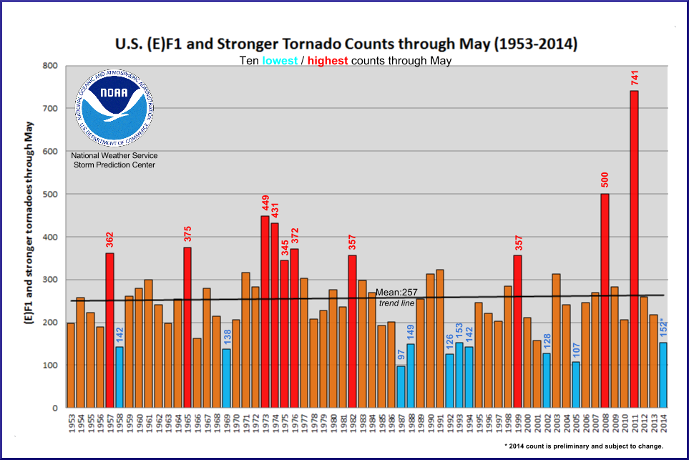
U.S. Tornado Count, EF-1 and Stronger,
(through May each year), 1953-2014
Tornado occurrence is very variable
2014 count was 152, lowest since 2005
Source: http://www.spc.noaa.gov/wcm/

Slide 46
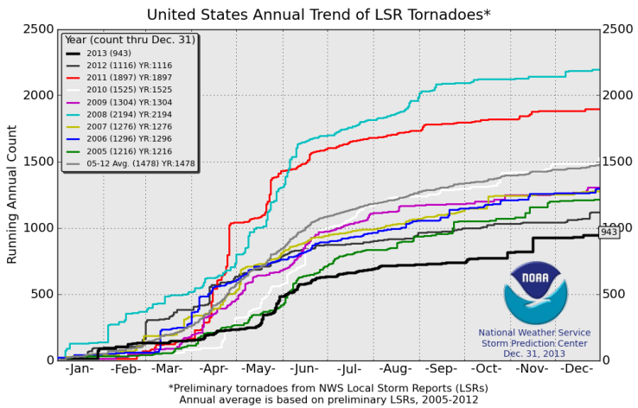
U.S. Tornado Count, 2005-2013
There were 1,897 tornadoes in the U.S. in 2011—far above average, but well below 2008’s record
2013 count was the lowest in a decade
Source: http://www.spc.noaa.gov/wcm/.
46

Slide 47
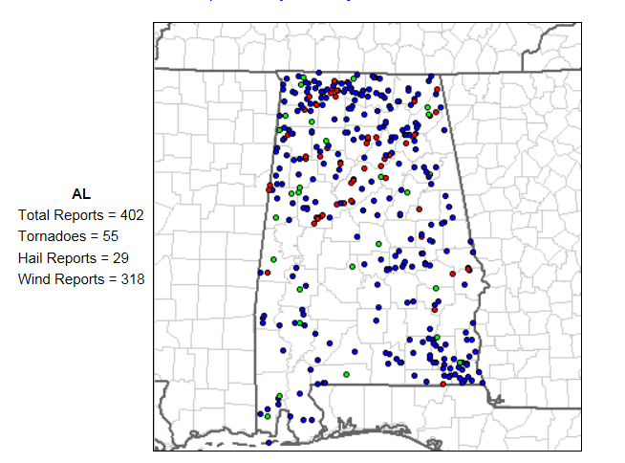
Reports of Severe Weather* in AL through Sept 2, 2014
Almost all of the tornados are in the northern half of the state
*excluding floods, wildfires, droughts
Source: NOAA Storm Prediction Center; http://www.spc.noaa.gov/climo/online/monthly/2014_annual_summary.html#
47

Slide 48
Investment Performance: a Key Driver of Profitability
Depressed Yields Influence Underwriting & Pricing
48

Slide 49
Net Yield on Insurer Invested Assets, 2007-2014:1H
P/C Insurer net yields to date dropped by 106 basis points
since year-end 2007.
Sources: NAIC, via SNL Financial; I.I.I.

Slide 50
U.S. Treasury 2- and 10-Year Note Yields*: 1990–2014
Yields on 10-Year U.S. Treasury Notes have been essentially below 5% for a full decade.
U.S. Treasury 10-year note yields recently “spiked” up
Since roughly 80% of P/C bond/cash investments are in 10-year or shorter durations, most P/C insurer portfolios will have low-yielding bonds for years to come.
*Monthly, constant maturity, nominal rates, through August 2014.
Sources: Federal Reserve Bank at http://www.federalreserve.gov/releases/h15/data.htm.
National Bureau of Economic Research (recession dates); Insurance Information Institutes.
50
12/01/09 - 9pm
eSlide – P6466 – The Financial Crisis and the Future of the P/C
Notes:
50

Slide 51
Bonds Rated NAIC Quality Category 3-6 as a Percent of Total Bonds, 2003–2013
From 2006-07 to year-end 2012, the percentage of lower-quality bonds in P/C industry portfolios doubled
There are many ways to capture higher yields on bond portfolios.
One is to accept greater risk, as measured by NAIC bond ratings.
The ratings range from 1 to 6, with the highest quality rated 1.
Even in 2012-13, over 95% of the industry’s bonds were rated 1 or 2.
Sources: SNL Financial; Insurance Information Institute.

Slide 52
Property/Casualty Insurance Industry Investment Gain: 1994–2014:Q1¹
$ Billions
Investment gains in 2013 were the highest in the post-crisis era
Low interest rates in 2013 caused investment income to keep falling
but realized investment gains were up sharply.
The financial crisis caused investment gains to fall by 50% in 2008.
¹ Investment gains consist primarily of interest, stock dividends and realized capital gains and losses.
* 2005 figure includes special one-time dividend of $3.2B;
Sources: ISO; Insurance Information Institute.

Slide 53
Insurance Information Institute Online:
www.iii.org
Thank you for your time
and your attention!

