Slide 1
Insurance Industry and Business Landscape Post Election
James Lynch, Chief Actuary
Insurance Information Institute  110 William Street  New York, NY 10038
212.346.5533  jamesl@iii.org  www.iii.org
Notes:
Introduction

Slide 2
Disruption is Everywhere

Slide 3
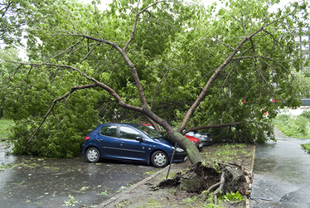
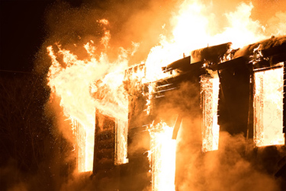

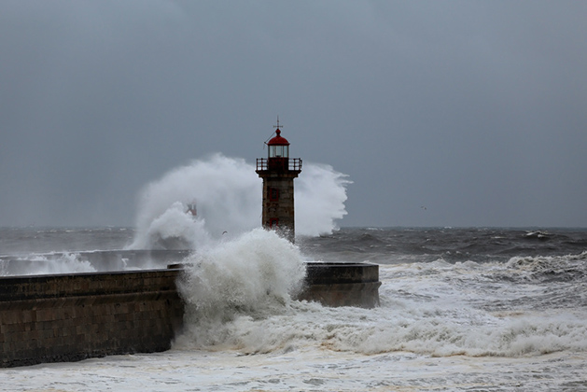
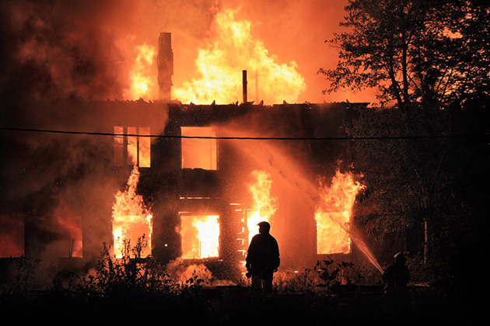
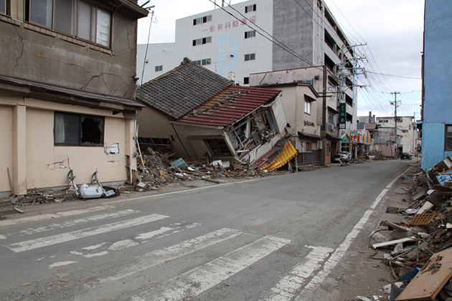
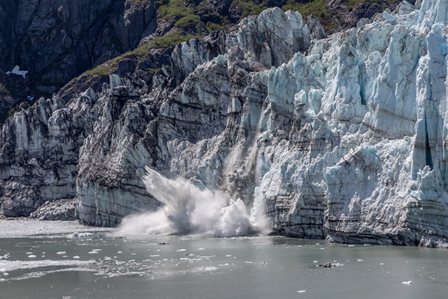
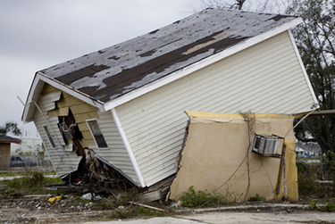
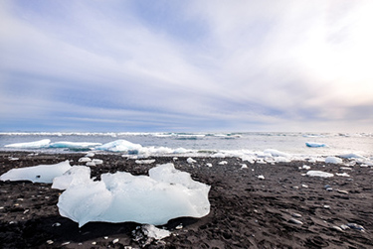
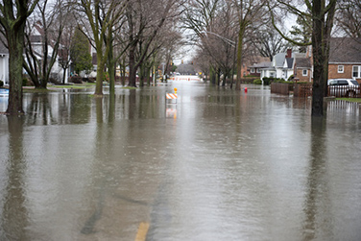
Disruption is Everywhere
Catastrophes – Increases in frequency and severity
Natural Catastrophes
Climate
Change
Wind
Fire
Earthquake
Water

Slide 4
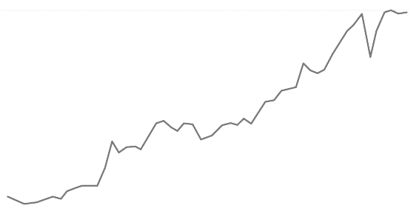
Economic Uncertainty
Global Growth...
US Growth...
  *Since 2008 we've had the longest period of relative trade stagnation since World War II...
  Investment
  Growth
  GDP
  1.6
...Monetary vs. Fiscal Policy
  Monetary: Low interest rates mean insurers are struggling to meet interest rate guarantees for life insurance and annuities must diversify their investment portfolios
  Fiscal: Supply-side debate heating up, i.e., tax reform
* The Peterson Institute for International Economics

Slide 5




Globalization
Geopolitical Polarization
Rise of Nationalism
Regional
Tensions
Global Trends Impacting
Domestic Market
Regulatory Trends
"Conduct of Business"
TPP
Capital/Solvency
Dodd-Frank
* Mainland purchases of insurance and related investment policies in the nine months ended September 2016 surged to a record high.
Notes:
Elected Officials: "Rise of Nationalism" -- US, France, Germany
Neither US presidential candidate supports TPP
Regions: Europe (EU/Brexit/Russia), Asia (China/North-South Korea/Japan), Middle East (Syria/Iraq)
Global trends impacting domestic market
Regulatory trends:
"Conduct of Business“ (Fiduciary Rule)
Capital/Solvency
Climate Change

Slide 6
Geopolitics – US

Slide 7
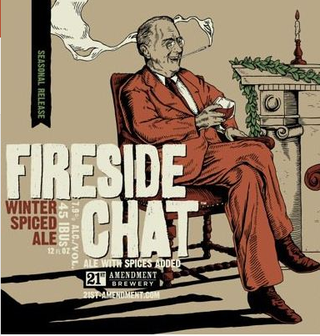
The ‘Bully Pulpit’ Evolution
Trump has potential to change the game…
@USTreasSec where is #TaxReform? Get R done!
@USAG #Waterboarding will #MakeAmericaGreat!
Notes:
Social media has been changing politics for the last several years.
Halls of legislatures and Congress – "Follow, Like!"
When I started – answering phones – messages, weekly reviews
Members are voting by their facebook and twitter accounts
Corporate advocacy sites – Crowd finding = grassroots.
Media is following as well vs. primary driver.

Slide 8
Does It Matter?

Slide 9
P/C Insurance Industry ROE by Presidential Party Affiliation
1950-2016*
Truman
Eisenhower
Kennedy/ Johnson
Nixon/
Ford
Carter
Reagan/
Bush I
Clinton
Bush II
Obama
BLUE = Democratic President RED = Republican President
.
*2016 data is through Q3.
Source: Insurance Information Institute

Slide 10
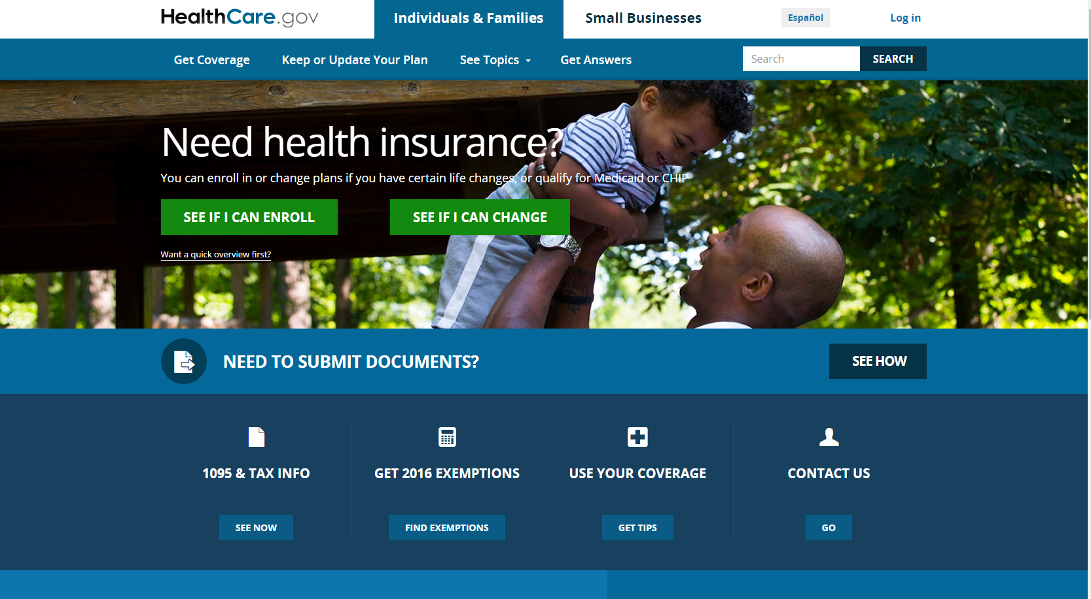
Affordable Care Act
Going …. Going ….. Maybe Not Going Anywhere
?
Notes:
One WC issue that might depend on federal control: health care
Does ACA affect comp
New enrollees raise prices all around
New enrollees mean doctors stop accepting WC patients
Doctors have incentives to push claims into WC

Slide 11
Workers Comp Private Carrier
Combined Ratio, 2001-2016*
3 Consecutive Years of U/W Profits; 1st Time in At Least 30 Years.
I.I.I. Estimate
*Projected.
SOURCES: NCCI, Insurance Information Institute (2016 projection).

Slide 12
Rates by Line & Account Size, Q4 2016
By Account Size
This Survey is Based on Agent Estimates.
 | Down > 10% | Down 1-10% | No Change | Up 1-10% | Up > 10% | N/A
Small (<25K) | 4.49% | 38.20% | 29.22% | 21.35% | 1.12% | 5.62%
Medium (25-100K) | 6.74% | 62.92% | 21.35% | 7.87% | 0.00% | 1.12%
Large (100K+) | 15.73% | 55.06% | 19.10% | 4.49% | 0.00% | 5.62%
By Line of Business
Rate Changes Can Vary Significantly Within States, Lines of Business or Individual Markets.
SOURCE: Council of Insurance Agents & Brokers, Insurance Information Institute.

Slide 13
P/C Insurer Portfolio Yields,
2002-2016
(Yield on Invested Assets)
P/C Carrier Yields Have Been Falling for Over a Decade, Reflecting the Long Downtrend in Prevailing Interest Rates.
Sources: NAIC data, sourced from S&P Global Market Intelligence; ISO, a Verisk Analytics company; Insurance Information Institute.

Slide 14
10-Year Treasury Forecast
Yield (%)
On March 13 the yield was 2.61%.
Virtually all of the 53 forecasts in the Blue Chip survey expect
continual increases in the yield of long-term bonds in 2017-18.
Sources: Blue Chip Economic Indicators (3/13); Insurance Information Institute

Slide 15
New Money vs. Embedded Yields,
U.S. Insurers, 1985-2016
Falling yields means less investment income, putting upward pressure on rates.
As long as new money rates are below the rates of maturing bonds,
the portfolio yield will continue to sink.
p: Preliminary
Sources: NCCI, ISO, a Verisk Analytics company, U.S. Treasury (5-year note as proxy for new money yield);
Insurance Information Institute.
15
12/01/09 - 9pm
eSlide – P6466 – The Financial Crisis and the Future of the P/C
Notes:
15

Slide 16
But State Politics Drives Insurance
And Every State is Different
C-
WA
D
MT
D+
ND
A
ME
B+
OR
B
MN
A
ID
A-
WI
D+
NY
NH A-
VT A+
MA D-
RI C+
CT C+
NJ B-
DE D
MD C+
B-
SD
B
WY
C+
MI
B
NE
B+
IA
B-
PA
D
CA
B+
NV
B
OH
A
UT
A
IL
B
IN
C
CO
C
WV
B
VA
C
KS
B
MO
A-
KY
B- TN
F NC
A
AZ
B
NM
C
OK
C+
AR
B
SC
D
MS
C-
AL
C
GA
B-
TX
D
LA
= A
= B
= C
= D
= F
= NG
D-
AK
C
FL
D
HI
Not Graded: District of Columbia
Source: R Street Insurance Regulation Report Card, December 2016

Slide 17
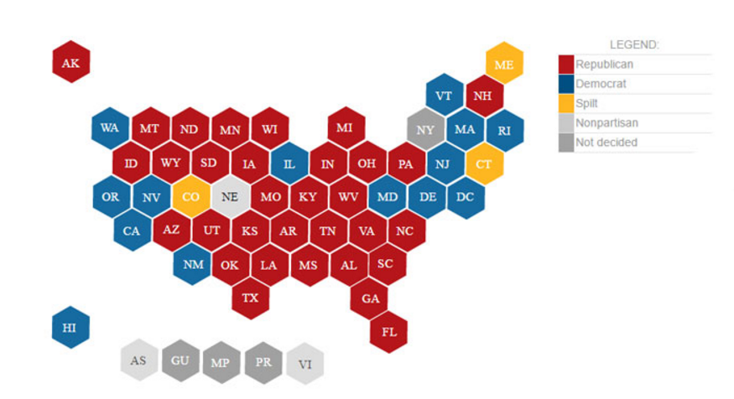
Republicans Control Most States . . .
In The November Election They Lost One Legislature Overall
Makeup Today
Seven chambers flipped control after the November 2016 elections.
* Nebraska: Unicameral, nonpartisan, Republican dominated. New York: not decided.
Source: National Conference of State Legislatures, Ballotpedia, Insurance Information Institute.
Notes:
Republicans controlled 69. They now control 68.
The Iowa Senate switched D to R; Kentucky House switched from D to R; Minnesota Senate switched D to R. The Nevada Senate switched R to D; Nevada Assembly switched R to D; New Mexico House switched R to D; and Alaska House switched R to D.

Slide 18
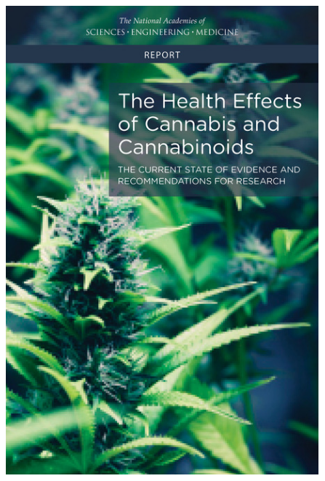
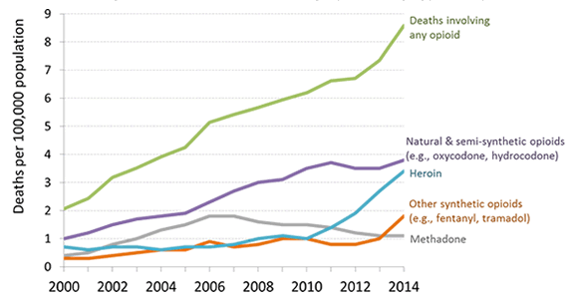
Medical Marijuana
Comp Caught in the Middle
Opioid Alternative?
https://www.nap.edu/catalog/24625/the-health-effects-of-cannabis-and-cannabinoids-the-current-state
Notes:
There is conclusive evidence or substantial evidence that marijuana:
Improves the lot of adults in chronic pain.
Increases the risk of motor vehicle crashes.
Increases the risk of developing schizophrenia and other psychoses.
There is moderate support suggesting that marijuana:
Improves short-term sleep outcomes for people with fibromyalgia or chronic pain.
Increases impairment of learning, memory and attention span.
Increases dependence on alcohol, tobacco and illicit drugs.
It is not possible to determine whether marijuana use is statistically correlated with occupational injuries.
47,000 drug deaths in USA in 2015

Slide 19
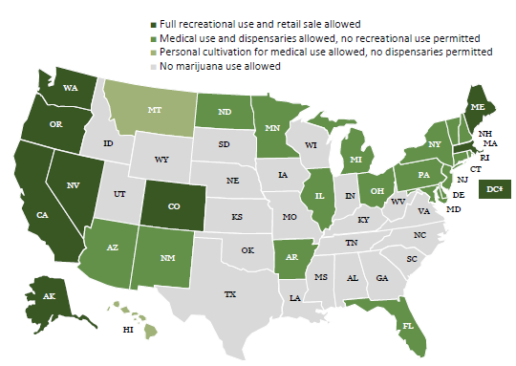
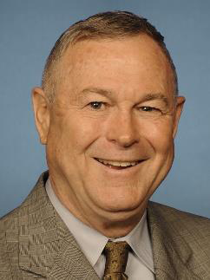
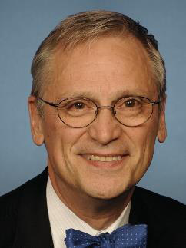
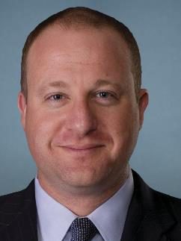
Medical Marijuana
Comp Caught in the Middle
Congressional Cannabis Caucus
Rohrbacher (CA)
Bluemenauer (OR)
Young
(AK)
Polis
(CO)
SOURCE: National Journal.
Notes:
There were 9 referenda on marijuana legalization. Only one failed – recreational use in Arizona.
Six states require use of medical marijuana in WC claims – CT, ME, MA, MN, NJ, NM
Six states forbid use of medical marijuana in WC claims – AZ, CO, MI, MT, OR, VT
It is illegal to use the banking system to purchase marijuana. So an insurer can’t write a check against to pay for the drug. They use cash.
Trump OK with med mare. Sessions, not so much. We wind up with one more conflict, Trump vs. his Cabinet.

Slide 20
Summary
Political leaders face a complex disruptive environment.
Monetary and fiscal forces, though at odds, are likely to drive interest rates higher, affecting workers comp and other long-tailed lines.
Comp finds itself in the crosshairs in important issues, especially the federal-state divide on marijuana use.

Slide 21
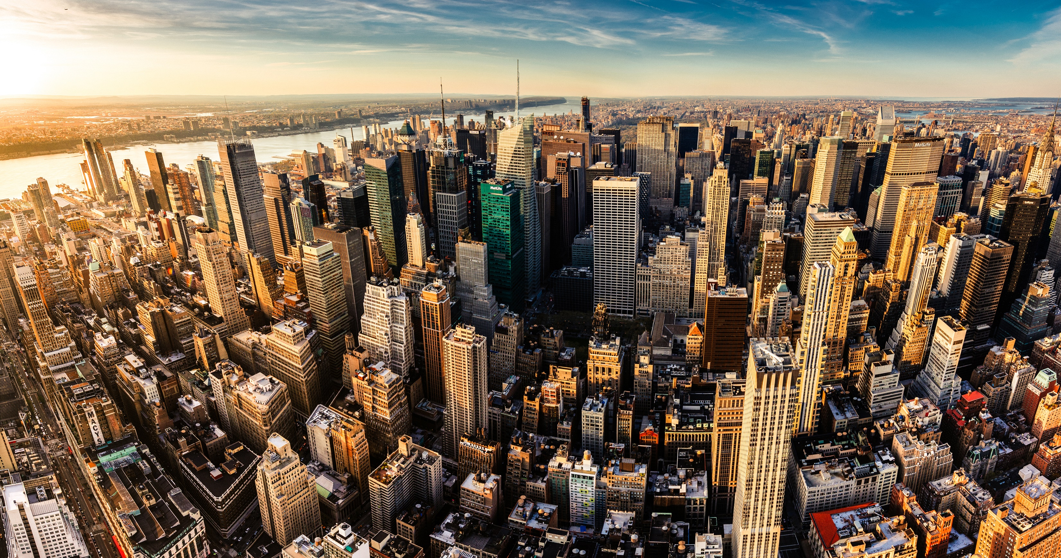
I.I.I. Mission Statement
Improving public understanding
of insurance...
…what it does and how it works
21

Slide 22

Notes:
Mission: Improving public understanding of insurance -- what it is and how it works
Key stakeholders: industry (businesses/trades), consumers, government, media)

Slide 23
Thank You!

