Slide 1
Private Passenger Auto Insurance Trends in Georgia
Frequency & Severity on the Rise
Georgia House Insurance Committee
Atlanta, GA
January 11, 2017
Download at www.iii.org/presentations
Robert P. Hartwig, Ph.D., CPCU ♦ Special Consultant
Insurance Information Institute and
Clinical Associate Professor of Finance ♦ Darla Moore School of Business University of South Carolina
Tel: 917.453.1885 ♦ bobh@iii.org ♦ www.iii.org

Slide 2
A Few Factors Driving Adverse Private Passenger Auto Loss Trends
More Jobs, Better Economy, More People Driving, Lower Gas Prices, Higher Speed Limits…
2

Slide 3
America is Driving More Again: 2000-2016
Percent Change, Miles Driven*
Fastest Growth Since 2000
Tremendous Growth In Miles Driven. The More People Drive, The More Frequently They Get Into Accidents.
*2000-2015: Moving 12-month total vs. prior year. 2016 data through Oct. 2016, the latest available, vs. Oct. 2015.
Sources: Federal Highway Administration; National Bureau of Economic Research (recession dates); Insurance Information Institute.
Notes:
3

Slide 4
Why Are People Driving More Miles?
Is it Jobs? 2006-2016:Q2
Billions of Miles Driven in Prior Year
Millions Employed
Recession
People Drive to and from Work and Drive to Entertainment.
Out of Work, They Curtail Their Movement.
Sources: Federal Highway Administration; Seasonally Adjusted Employed from Bureau of Labor Statistics (Series ID CES0000000001); Insurance Institute for Highway Safety; Insurance Information Institute.
Notes:
4

Slide 5
More People Working and Driving
=> More Collisions, 2006-2016
Overall Collision Claims Per 100 Insured Vehicles
Number Employed,
Millions
There are not only more accidents, but accidents per 100 insured vehicles is up too. This is what matters to insurers.
Recession
When people are out of work, they drive less. When they get jobs,
they drive to work, helping drive claim frequency higher.
Sources: Seasonally Adjusted Employed from Bureau of Labor Statistics; Rolling Four-Qtr Avg. Frequency from Insurance Services Office; Insurance Information Institute.
5
12/01/09 - 9pm
eSlide – P6466 – The Financial Crisis and the Future of the P/C
Notes:
5

Slide 6
More Miles Driven
→ More Collisions, 2006-2016:Q2
Billions of Miles Driven in Prior Year
Overall Collision Claims Per 100 Insured Vehicles
Recession
The More Miles People Drive, the More Likely They are to
Get in an Accident, Helping Drive Claim Frequency Higher.
Sources: Federal Highway Administration; Rolling four-quarter average frequency from ISO, a Verisk Analytics company; Insurance Institute for Highway Safety; Insurance Information Institute.
Notes:
6

Slide 7
More Miles Driven
=> More Collisions, 2006–2015:Q4
Billions of Miles Driven in Prior Year
Overall Collision Claims Per 100 Insured Vehicles
Recession
The more miles people drive, the more likely they are to get in an accident, helping drive claim frequency higher.
Sources: Federal Highway Administration (http://www.fhwa.dot.gov/policyinformation/travel_monitoring/tvt.cfm ); Rolling Four-Qtr Avg. Frequency from Insurance Services Office; Insurance Institute for Highway Safety; Insurance Information Institute.
7
12/01/09 - 9pm
eSlide – P6466 – The Financial Crisis and the Future of the P/C
Notes:
7

Slide 8
Why Are People
Driving More Miles? Cheap Gas?
Billions of Miles Driven in Prior Year
Avg. Price Per Gallon
Recession
15:Q4
Gas Prices Don’t Seem Correlated With Miles Driven.
Sources: Federal Highway Administration (http://www.fhwa.dot.gov/policyinformation/travel_monitoring/tvt.cfm ); Energy Information Administration; Insurance Institute for Highway Safety; Insurance Information Institute.
8
12/01/09 - 9pm
eSlide – P6466 – The Financial Crisis and the Future of the P/C
Notes:
8

Slide 9
Comparing Gas Prices, Employment on Collision Frequency
Gas Price/Gal.
Employment Level
Sources: Seasonally Adjusted Employed from Bureau of Labor Statistics; Energy Information Administration; Rolling Four-Qtr Avg. Frequency from Insurance Services Office; Insurance Information Institute.

Slide 10
US Pvt. Passenger Auto Net Combined Ratio, 2005-2015
Loss Ratios Have Been Rising for A Decade. 2015 Return on Net Worth Is Likely Close to Zero or Negative.
SOURCE: National Association of Insurance Commissioners data, sourced from S&P Global Market Intelligence; Insurance Information Institute.

Slide 11
Return on Net Worth: Personal Auto, 2005-2015*
Auto Insurance Profitability Remains Well Below Pre-Crisis Levels (12% vs. ~4%)
*2016 Personal Auto figure is estimated.
SOURCE: National Association of Insurance Commissioners.

Slide 12
Auto Fatalities Are Rising
Fatal Auto Accidents Are Rising Faster in Georgia at Nearly 3 Times the Rate Nationally
12

Slide 13
U.S. Annual Change in Automobile Deaths, 1991- 2016*
Steep drop due to less driving during the Great Recession
Motor vehicle deaths saw their largest increase in 50 years in 2016
Annual Change (%)
Sharp increase in use of seatbelts
Driving Has Been Getting Safer For Decades, But Recent Trend Is Discouraging—38,300 Deaths in 2015—and Likely More in 2016
*2016 data are though June 30.
Source: National Safety Council.

Slide 14
Georgia Highway Fatalities, 2007–2016
Highway deaths in Georgia are now at their highest level since 2007
+262 Deaths =
+22.4% in 2015
+104 Deaths =
+7.3% in 2016
Highway fatalities are surging in Georgia, with no end in sight
Sources: Georgia Department of Transportation accessed 1/9/17 at http://www.dot.ga.gov/BuildSmart/performance/Pages/Fatalities.aspx

Slide 15
Change in Auto Fatalities by State: Especially Severe in Georgia
GA’s auto fatality rate has increased at a pace nearly 3 times that of the US overall and far in excess of any other state in the region
2015 vs. 2014
Fatalities in Southeast Rising Faster than USA as a Whole
SOURCE: Estimates from National Safety Council.

Slide 16
Change in Auto Fatalities by State: Especially Severe in Georgia
GA’s auto fatality rate has increased at a pace nearly double that of the US overall
First 6 Months 2016 vs. First 6 Month 2014
Fatalities in Southeast Rising Faster Than USA as a Whole
SOURCE: Estimates from National Safety Council.

Slide 17
Private Passenger Auto Profitability in Southeast States vs. US
Georgia is a Profitability Laggard in the Region and Among the 50 States
17

Slide 18
RNW PP Auto: NC, SC and GA vs. U.S., 2005-2014
Average 2005-2014
US: 6.2%
NC: 6.4%
SC: 5.8%
GA: 4.7%
Source: NAIC.
18
Notes:
18

Slide 19
RNW PP Auto: TN, FL, MS, AL vs. U.S., 2005-2014
Average 2005-2014
US: 6.2%
AL: 6.7% TN:5.8%
GA: 4.7% FL: 3.9%
MS: 3.6%
GA’s pvt. Passenger auto market is the least profitable in the region
Source: NAIC.
19
Notes:
19

Slide 20
Private Passenger Auto Frequency & Severity Trends in Georgia vs. Southeast States and US
Frequency, Severity and Loss Ratios Are Up in Georgia
20

Slide 21
Georgia Coverage: BI Severity & Frequency Trends Are Both Higher in Recent Years*
Annual Change, 2005 through 2016
The Recession, High Fuel Prices Helped Temper Frequency and Severity, But this Trend Has Clearly Reversed, Consistent with Experience from Past Recoveries
*2016 data are for the 4 quarters ending June 30, 2016.
Source: ISO/PCI Fast Track data; Insurance Information Institute

Slide 22
Georgia Coverage: PD Frequency Trends Are Higher in 2014-2016*
Annual Change, 2005 through 2016*
The Recession, High Fuel Prices Helped Temper Frequency and Severity, But this Trend Has Clearly Reversed, Consistent with Experience from Past Recoveries
*2016 data are for the 4 quarters ending June 30, 2016.
Source: ISO/PCI Fast Track data; Insurance Information Institute

Slide 23
Georgia Coverage: Collision Frequency Trends Are Higher in 2014-2016*
Annual Change, 2005 through 2016*
GA’s Collision claim frequency is up sharply over the past 3 years
The Recession, High Fuel Prices Helped Temper Frequency and Severity, But this Trend Has Clearly Reversed, Consistent with Experience from Past Recoveries
*2016 data are for the 4 quarters ending June 30, 2016.
Source: ISO/PCI Fast Track data; Insurance Information Institute

Slide 24
Collision Loss Ratio Trending Upward:
Pvt. Passenger Auto, GA vs. US, 2010 – 2016*
GA’s Collision loss ratio is up 23.7 percentage points since 2010, rising far more rapidly than in the US overall. For the first time in recent history, GA’s collision loss ratio is above the US average.
Loss Ratio
Collision Loss Ratios are Rising Much Faster in Georgia than the US Overall
*2016 data are for the 4 quarters ending June 30, 2016.
Source: ISO/PCI Fast Track data; Insurance Information Institute

Slide 25
Georgia Coverage: Comprehensive Frequency, Severity Typically Tied to Weather Events
Annual Change, 2005 through 2016*
Weather Events Drive Volatility in Comprehensive Coverage
*2016 data are for the 4 quarters ending June 30, 2016.
Source: ISO/PCI Fast Track data; Insurance Information Institute

Slide 26
Speed Limits Are Up All Over Metro Atlanta
Force = Mass x Acceleration*
The Laws of Physics Apply Everywhere, including Georgia
*Newton’s Second Law of Motion
26

Slide 27
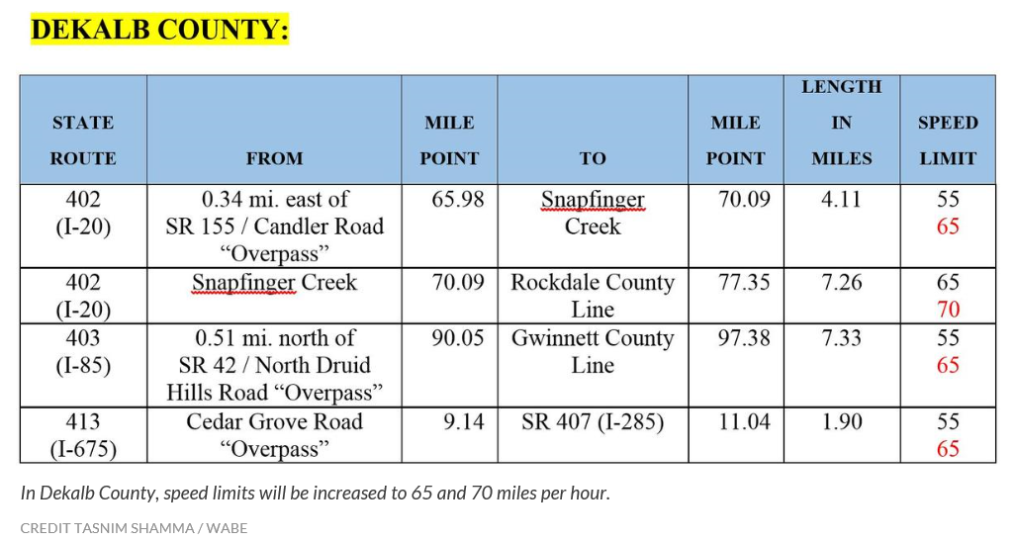
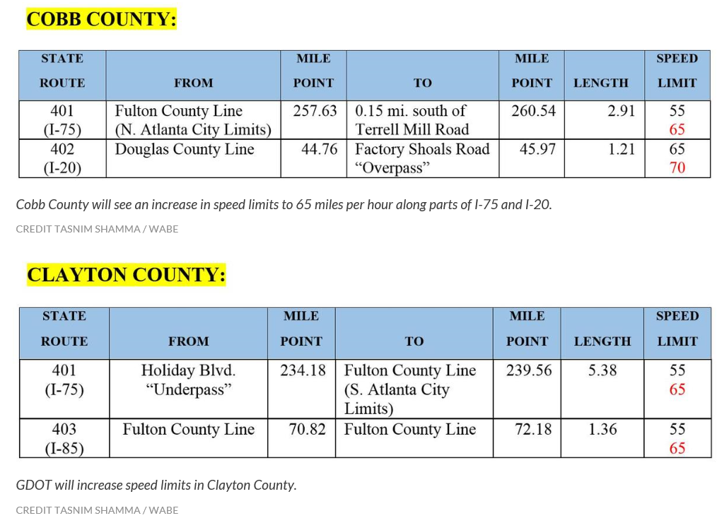
Higher Speed Limits in Many Parts of Georgia
Speed limits are up all around the densely populated metro Atlanta area—to as high as 70 mph in some areas
Source: WABE at http://news.wabe.org/post/65-too-slow-try-70-miles-hour-gdot-increases-speed-limits-metro-atlanta Insurance Information Institute research.
27
12/01/09 - 9pm
eSlide – P6466 – The Financial Crisis and the Future of the P/C
Notes:
27

Slide 28
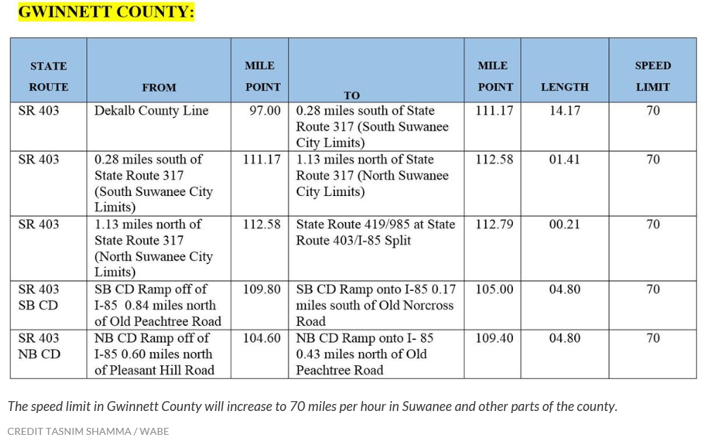
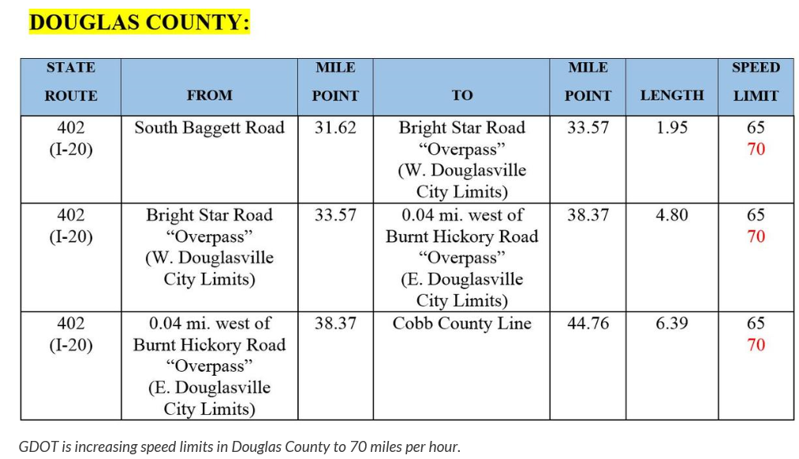
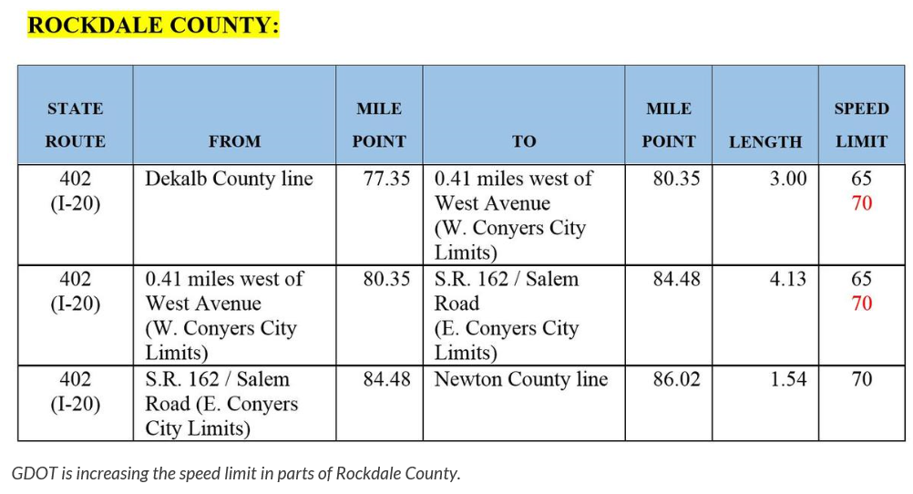
Higher Speed Limits in Many Parts of Georgia
Speed limits are up all around the densely populated metro Atlanta area—to as high as 70 mph in some areas
Source: WABE at http://news.wabe.org/post/65-too-slow-try-70-miles-hour-gdot-increases-speed-limits-metro-atlanta Insurance Information Institute research.
28
12/01/09 - 9pm
eSlide – P6466 – The Financial Crisis and the Future of the P/C
Notes:
28

Slide 29
Rising Highway Fatalities:
Georgia’s #1 Public Health Crisis?
Is Society Too Complacent About Highway Deaths and Injuries?
29

Slide 30
Summary of Georgia’s Rapid Rise in Auto Accident Frequency, Severity & Fatalities
Many Factors Are Contributing to the Mounting Death Toll on Georgia’s Highways
  Recovering Economy
  More Jobs→ More Miles Driven
  Increased Vehicle Density
  Favorable Demographics→Results in More Drivers
  Lack of Highway Infrastructure Investment
  Lower Gas Prices
More Accidents, More Severe Accidents Impacting Insurance Rates
Can’t Rely Solely on New “Autonomous” Technologies
30
12/01/09 - 9pm
eSlide – P6466 – The Financial Crisis and the Future of the P/C
Notes:
30

Slide 31
Insurance Information Institute Online:
www.iii.org
Thank you for your time
and your attention!
Twitter: twitter.com/bob_Hartwig
Download at www.iii.org/presentations

