Slide 1
Private Passenger Auto Insurance Trends in Georgia Frequency & Severity on the Rise
Insurance Information Institute
Atlanta, GA
May 17, 2016
Download at www.iii.org/presentations
Robert P. Hartwig, Ph.D., CPCU, President & Economist
Insurance Information Institute ♦ 110 William Street ♦ New York, NY 10038
Tel: 212.346.5520 ♦ Cell: 917.453.1885 ♦ bobh@iii.org ♦ www.iii.org

Slide 2
A Few Factors Driving Adverse Private Passenger Auto Loss Trends
More People Driving, Lower Gas Prices, Higher Speed Limits…
2

Slide 3
Return on Net Worth: Personal Auto, 2005-2014
Auto Insurance Profitability Has Been Falling for A Decade.
SOURCE: National Association of Insurance Commissioners.

Slide 4
Net Combined Ratio, 2005-2015
Loss Ratios Have Been Rising for A Decade. 2015 Return on Net Worth Is Likely Close to Zero or Negative.
SOURCE: National Association of Insurance Commissioners data, sourced from S&P Global Market Intelligence; Insurance Information Institute.

Slide 5
More Miles Driven => More Collisions, 2006–2015:Q4
Billions of Miles Driven in Prior Year
Overall Collision Claims Per 100 Insured Vehicles
Recession
The more miles people drive, the more likely they are to get in an accident, helping drive claim frequency higher.
Sources: Federal Highway Administration (http://www.fhwa.dot.gov/policyinformation/travel_monitoring/tvt.cfm ); Rolling Four-Qtr Avg. Frequency from Insurance Services Office; Insurance Institute for Highway Safety; Insurance Information Institute.
5
12/01/09 - 9pm
eSlide – P6466 – The Financial Crisis and the Future of the P/C
Notes:
5

Slide 6
More People Working and Driving => More Collisions, 2006-2016
Overall Collision Claims Per 100 Insured Vehicles
Number Employed, Millions
Recession
When people are out of work, they drive less. When they get jobs, they drive to work, helping drive claim frequency higher.
Sources: Seasonally Adjusted Employed from Bureau of Labor Statistics; Rolling Four-Qtr Avg. Frequency from Insurance Services Office; Insurance Information Institute.
6
12/01/09 - 9pm
eSlide – P6466 – The Financial Crisis and the Future of the P/C
Notes:
6

Slide 7
Why Are People Driving More Miles? Cheap Gas?
Billions of Miles Driven in Prior Year
Avg. Price Per Gallon
Recession
Gas Prices Don’t Seem Correlated With Miles Driven.
Sources: Federal Highway Administration (http://www.fhwa.dot.gov/policyinformation/travel_monitoring/tvt.cfm ); Energy Information Administration; Insurance Institute for Highway Safety; Insurance Information Institute.
7
12/01/09 - 9pm
eSlide – P6466 – The Financial Crisis and the Future of the P/C
Notes:
7

Slide 8
Why Are People Driving More Miles? Jobs?
Billions of Miles Driven in Prior Year
Millions Employed
Recession
People Drive To and From Work and Drive to Entertainment. Out of Work, They Curtail Their Movement.
Sources: Federal Highway Administration (http://www.fhwa.dot.gov/policyinformation/travel_monitoring/tvt.cfm ); Seasonally Adjusted Employed from Bureau of Labor Statistics; Insurance Institute for Highway Safety; Insurance Information Institute.
8
12/01/09 - 9pm
eSlide – P6466 – The Financial Crisis and the Future of the P/C
Notes:
8

Slide 9
Comparing Gas Prices, Employment on Collision Frequency
Gas Price/Gal.
Employment Level
Sources: Seasonally Adjusted Employed from Bureau of Labor Statistics; Energy Information Administration; Rolling Four-Qtr Avg. Frequency from Insurance Services Office; Insurance Information Institute.

Slide 10
Auto Fatalities Are Rising
Fatal Auto Accidents Are Rising Faster in Georgia at Nearly 3 Times the Rate Nationally
10

Slide 11
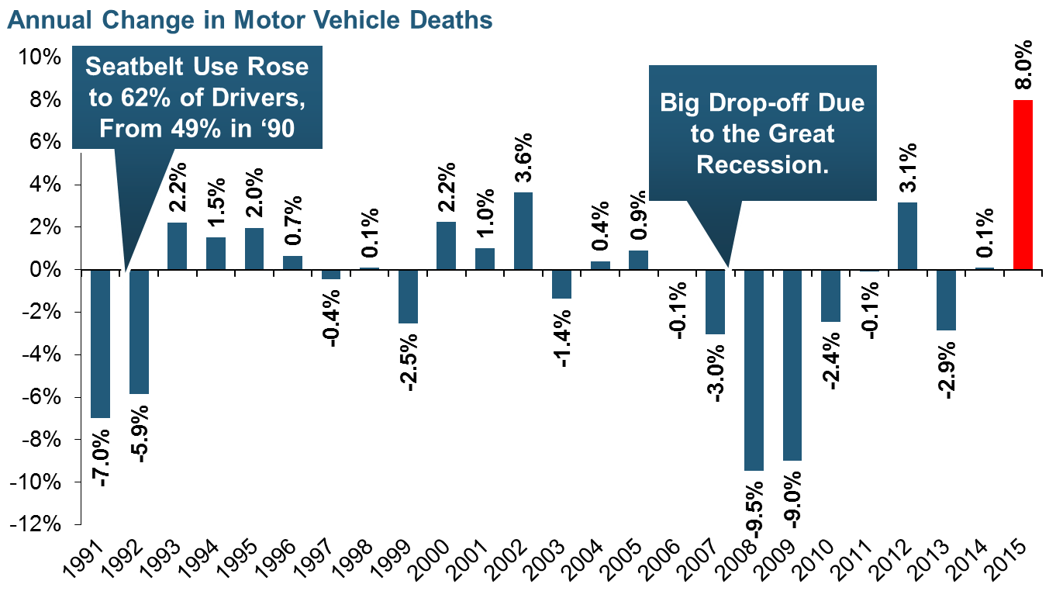
Severity: Driving Fatalities Are Rising
Driving Has Been Getting Safer For Decades, But Recent Trend Is Discouraging—38,300 Deaths in 2015
Sources: National Safety Council, Insurance Information Institute.

Slide 12
Change in Auto Fatalities by State: Especially Severe in Georgia
GA’s auto fatality rate has increased at a pace nearly 3 times that of the US overall and far in excess of any other state in the region
2015 vs. 2014
Fatalities in Southeast Rising Faster Than USA as a Whole
SOURCE: Estimates from National Safety Council.

Slide 13
Private Passenger Auto Profitability in Southeast States vs. US
Georgia is Profitability Laggard in the Region and Among the 50 States
13

Slide 14
RNW PP Auto: NC, SC and GA vs. U.S., 2005-2014
Average 2005-2014
US: 6.2% NC: 6.4% SC: 5.8% GA: 4.7%
Source: NAIC.
14
Notes:
14

Slide 15
RNW PP Auto: TN, FL, MS, AL vs. U.S., 2005-2014
Average 2005-2014
US: 6.2% AL: 6.7% TN:5.8% GA: 4.7% FL: 3.9% MS: 3.6%
Source: NAIC.
15
Notes:
15

Slide 16
Private Passenger Auto Frequency & Severity Trends in Georgia vs. Southeast States and US
Frequency, Severity and Loss Ratios Are Up in Georgia
16

Slide 17
Georgia Coverage: BI Severity & Frequency Trends Are Both Higher in 2015
Annual Change, 2005 through 2015
The Recession, High Fuel Prices Helped Temper Frequency and Severity, But this Trend Has Clearly Reversed, Consistent with Experience from Past Recoveries
Source: ISO/PCI Fast Track data; Insurance Information Institute

Slide 18
Georgia Coverage: PD Frequency Trends Are Higher in 2014-2015
Annual Change, 2005 through 2015
The Recession, High Fuel Prices Helped Temper Frequency and Severity, But this Trend Has Clearly Reversed, Consistent with Experience from Past Recoveries
Source: ISO/PCI Fast Track data; Insurance Information Institute

Slide 19
Georgia Coverage: Collision Frequency Trends Are Higher in 2014-2015
Annual Change, 2005 through 2015
GA’s Collision claim frequency is up sharply over the past two years
The Recession, High Fuel Prices Helped Temper Frequency and Severity, But this Trend Has Clearly Reversed, Consistent with Experience from Past Recoveries
Source: ISO/PCI Fast Track data; Insurance Information Institute

Slide 20
Collision Loss Ratio Trending Upward: Pvt. Passenger Auto, GA vs. US, 2010 – 2015
GA’s Collision loss ratio is up 23.7 percentage points since 2010, more than double the 11.2 percentage point increase nationally. For the first time in recent history, GA’s collision loss ratio is above the US average.
Loss Ratio
Collision Loss Ratios are Rising Much Faster in Georgia than the US Overall
Source: ISO/PCI Fast Track data; Insurance Information Institute.

Slide 21
Georgia Coverage: Comp Frequency, Severity Typically Tied to Weather Events
Annual Change, 2005 through 2015
Weather Events Drive Volatility in Comprehensive Coverage
Source: ISO/PCI Fast Track data; Insurance Information Institute

Slide 22
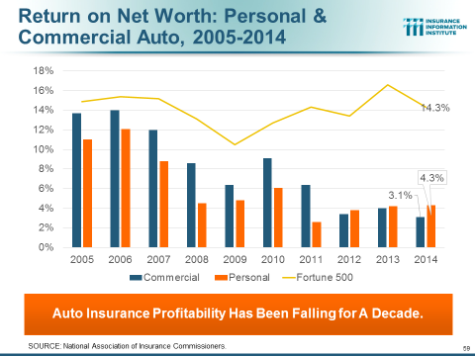
Georgia Coverage: Comp Frequency, Severity Typically Tied to Weather Events
Annual Change, 2005 through 2015
The Recession, High Fuel Prices Helped Temper Frequency and Severity, But this Trend Has Clearly Reversed, Consistent with Experience from Past Recoveries
Source: ISO/PCI Fast Track data; Insurance Information Institute

Slide 23
Speed Limits Are Up All Over Metro Atlanta
Force = Mass x Acceleration*
The Laws of Physics Apply Everywhere, including Georgia
*Newton’s Second Law of Motion
23

Slide 24
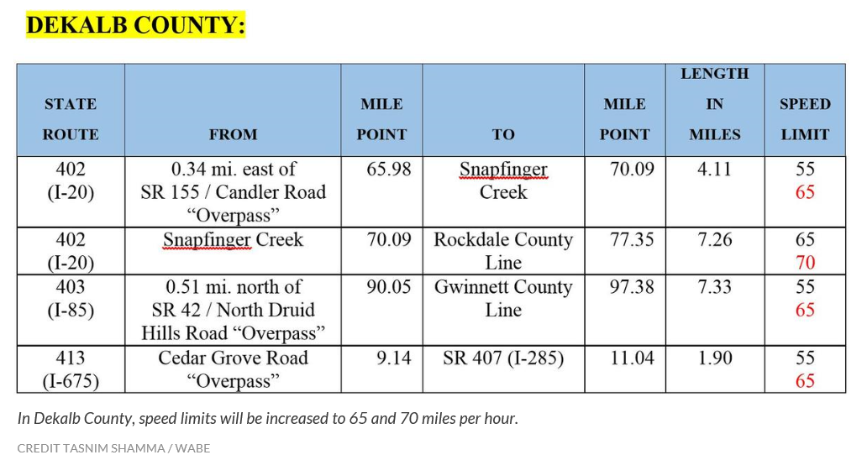
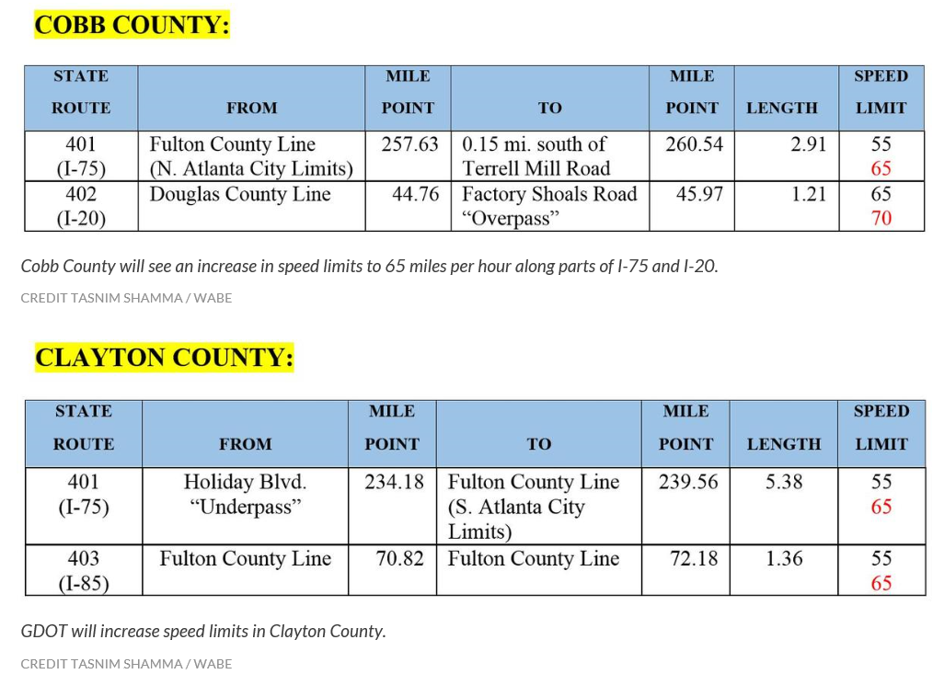
Partnerships with Insurers: Selling Safety and Savings Simultaneously
Speed limits are up all around the densely populated metro Atlanta area—to as high as 70 mph in some areas
Source: WABE at http://news.wabe.org/post/65-too-slow-try-70-miles-hour-gdot-increases-speed-limits-metro-atlanta Insurance Information Institute research.
24
12/01/09 - 9pm
eSlide – P6466 – The Financial Crisis and the Future of the P/C
Notes:
24

Slide 25
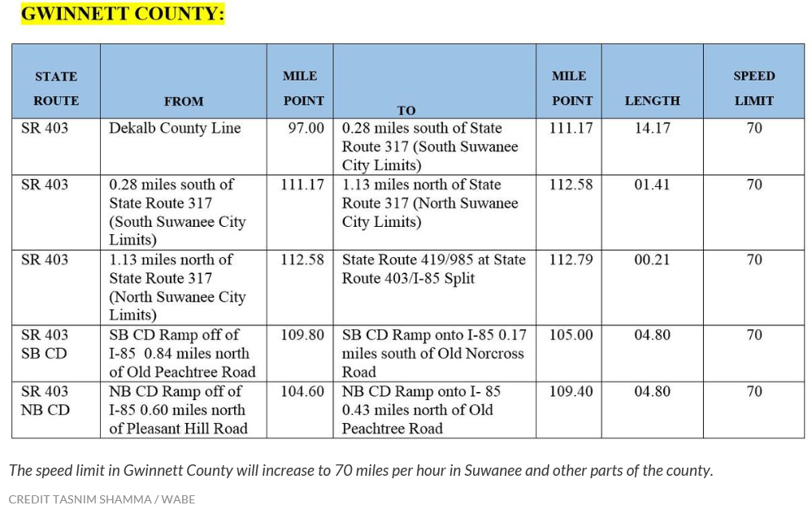
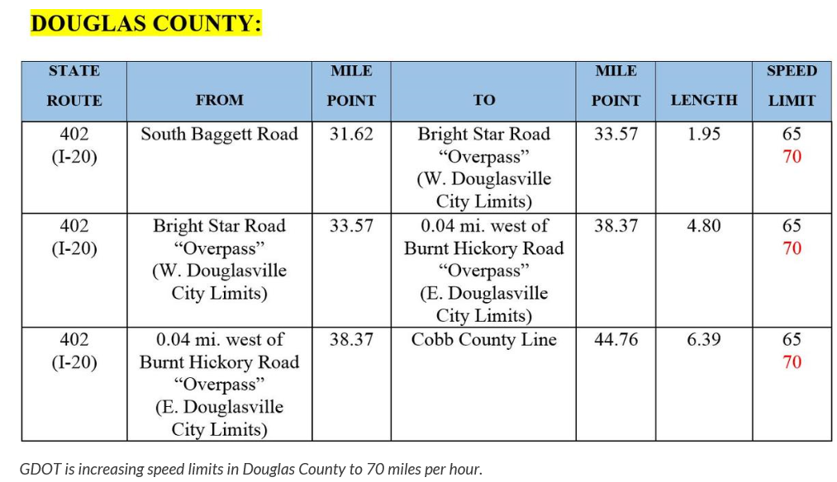
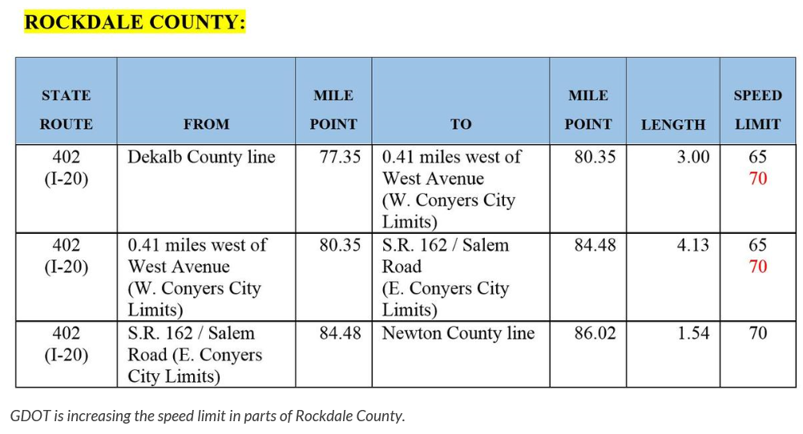
Partnerships with Insurers: Selling Safety and Savings Simultaneously
Speed limits are up all around the densely populated metro Atlanta area—to as high as 70 mph in some areas
Source: WABE at http://news.wabe.org/post/65-too-slow-try-70-miles-hour-gdot-increases-speed-limits-metro-atlanta Insurance Information Institute research.
25
12/01/09 - 9pm
eSlide – P6466 – The Financial Crisis and the Future of the P/C
Notes:
25

Slide 26
Insurance Information Institute Online:
www.iii.org
Thank you for your time and your attention!
Twitter: twitter.com/bob_Hartwig
Download at www.iii.org/presentations

