Slide 1
The Future in Transportation: Autonomous Vehicles
They’ll Change Insurance - Slowly
Nevada Driving Summit
May 25, 2016
James P. Lynch, FCAS MAAA, chief actuary
Insurance Information Institute ♦ 110 William Street ♦ New York, NY 10038
Tel: 212.346.5533 ♦ Cell: 917.359.3908 ♦ jamesl@iii.org ♦ www.iii.org

Slide 2

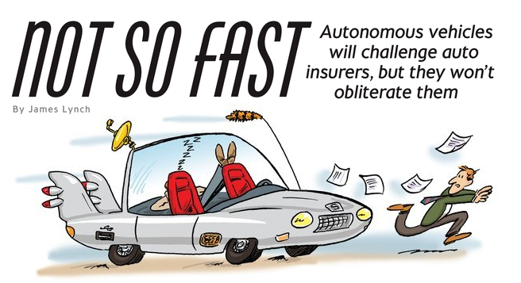
When Computers Take the Wheel . . .

Slide 3
Step 1: Co-pilot
In Theory
Crashes Avoided Per Year | All | Injury | Fatal
Forward Collision Warning | 1,165,000 | 66,000 | 879
Lane Departure Warning | 179,000 | 37,000 | 7,529
Side Assist View (Blind Spots) | 395,000 | 20,000 | 393
Adaptive Headlights | 142,000 | 29,000 | 2,484
Total Unique Crashes | 1,866,000 | 149,000 | 10,238
In Practice
Forward Collision Warning Working
Adaptive Headlights Working
Others: Benefits ‘Less Clear’
6% of Injuries
30% of Fatalities
Some of These Features Are Already on Vehicles. Others Are On Their Way Soon.
Source: Highway Loss Data Institute, Insurance Institute for Highway Safety, National Highway Traffic Safety Administration.

Slide 4
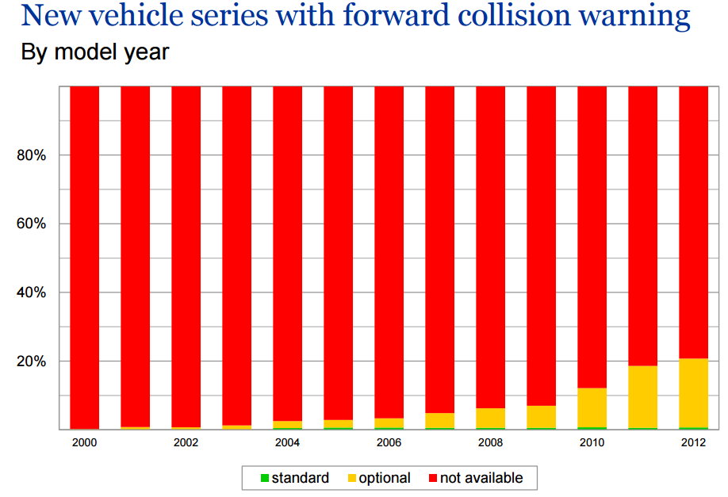
Step 1: Co-pilot
Technology Emerges Slowly.
Source: Highway Loss Data Institute, Insurance Institute for Highway Safety.

Slide 5
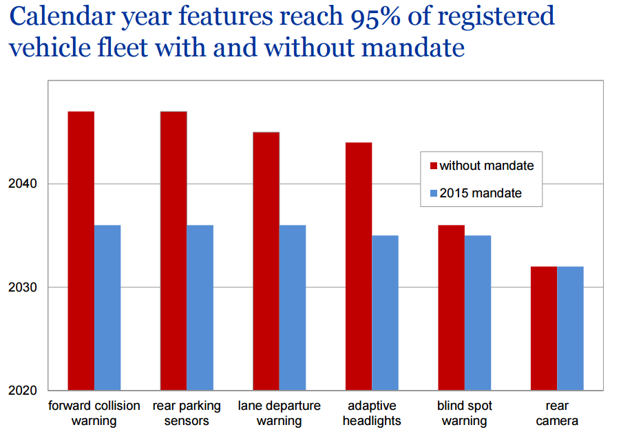
Step 1: Co-pilot
20 Years With Mandate, Longer Without.
Source: Highway Loss Data Institute, Insurance Institute for Highway Safety.

Slide 6
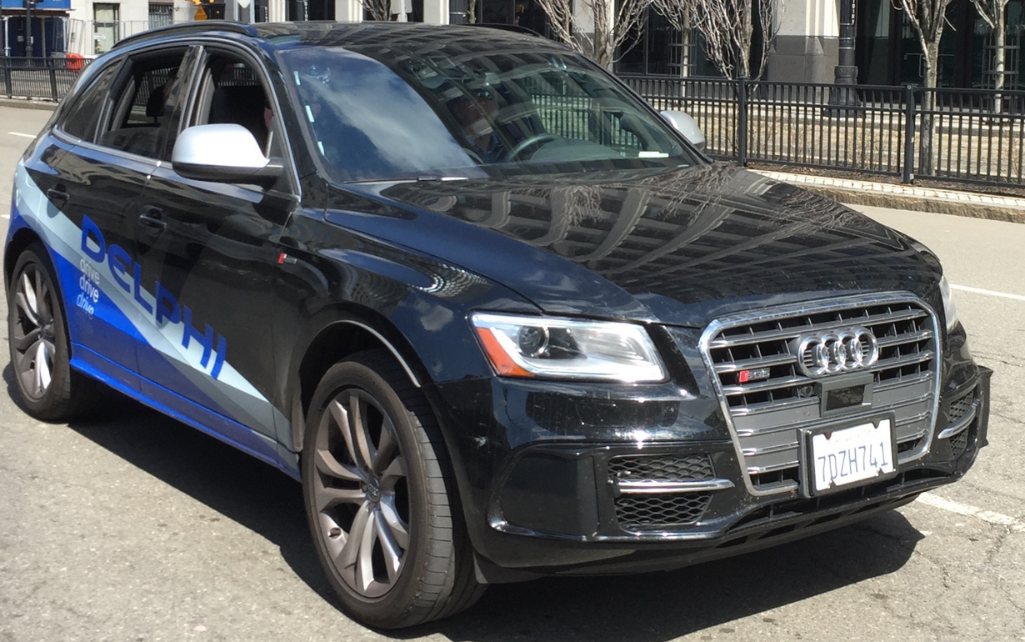
Step 2: The ‘Dream Vehicle’
Delphi prototype “Roadrunner”
SF to NYC in Nine Days (4/2015)
3,400 Miles – All but 50 Autonomous
Issues: ‘Unmarked Lanes, Heavy Roadworks,’ When Sun Was Low in Sky
These Are on the Drawing Boards of Almost All Automakers. But the Dream Vehicle Is a Long Ways Away.

Slide 7
When Will This Happen?
Standard Equipment
Minimal Price
Moderate
Expensive
SOURCE: Autonomous Vehicle Implementation Predictions, Victoria Transport Policy Institute, 2015.

Slide 8
Why Will It Take So Long?
Average Vehicle
Age (Years)
Recession Hangover – People Struggling to Afford Major Purchase; Cars Are Built Better, Last Longer.
Sources: Polk, August 2013 Survey, IHS Automotive July 2015; Insurance Information Institute.
8
12/01/09 - 9pm
eSlide – P6466 – The Financial Crisis and the Future of the P/C
Notes:
8

Slide 9
Why Will It Take So Long?
Q. Would You Be Willing to Ride in a Driverless Car?
Don’t Know
No
Yes
Most People Say They Would Not Ride in a Driverless Car.
Source: Insurance Information Institute annual Pulse Survey, May 2016.

Slide 10
Enhanced Vehicle and Road Safety Have Made Driving Much Safer
Motor Vehicle Crash Deaths and Crash Death Rate, 1994-2015
Crash deaths are down 40% since the early 1970s, 14% in past 20
Fatal crash rates have fallen by 85% over the past 60 years, 35% in past 20
Source: National Highway Transportation Safety Administration, Federal Highway Administration, National Safety Council; 2015 Estimates by Insurance Information Institute.
10

Slide 11
Fatalities per Hundred
Million Miles Driven
32,719 Traffic Deaths in 2013, 2.1% Less Than 2012.
Auto Fatality/Injury Rates Have Been Falling for Decades.
Sources: National Highway Traffic Safety Administration.

Slide 12
But Auto Insurance Expenditures Rise
For Past 20 Years, Expenditures Rising About 1.5% Annually
If Cars Are Safer, Why Are Insurance Costs Rising?
Insurance Information Institute Estimates/Forecasts
Source: NAIC, Insurance Information Institute estimate for 2014-2015 based on Motor Insurance CPI.

Slide 13
Auto Insurance: Frequency vs. Severity
Down 55%! (1.6%/Year)
Sources: Insurance Institute for Highway Safety, Insurance Services Office, Insurance Information Institute.

Slide 14
Auto Claims Have Grown Faster Than Inflation for 50 Years
Percentage Change, 1963-2013

Slide 15
Impact by Coverage
Type of Coverage | Examples | Frequency | Severity
Damage | PD, Collision | Decrease | Increase
Injury | BI, PIP, MedPay | Decrease | Unclear
Uninsured | UM/UIM | None | None
Miscellaneous | Comprehensive | None | Increase
Coverages on 21% of Premium Will Be Unaffected for Decades
Autonomous Vehicles Will Have Different Impacts on Different Coverages and Will Not All Happen At Once.

Slide 16
I.I.I. Poll: Who Is Responsible?
Q. Who should be responsible if an accident occurred involving a driverless car?
Don’t Know
Car’s Occupant
Car’s Insurer
Car’s Manufacturer
Car’s Owner
Half of Respondents Think a Driverless Car’s Manufacturer Should Bear Responsibility in Case of an Accident.
Source: Insurance Information Institute Annual Pulse Survey.

Slide 17
I.I.I. Poll: Who Is Responsible?
Q. Would you be willing to pay more for your car to cover the manufacturer’s liability in case of an accident?
Don’t Know
Yes
No
Only a Quarter of Americans Would Be Willing to Pay More for a Driverless Car to Cover the Manufacturer’s Liability in Case of an Accident.
Source: Insurance Information Institute Annual Pulse Survey.

Slide 18
The Future of the Car of the Future
Technology Has Been Making Cars Safer for Decades.
It Takes a Long Time for Technology to Penetrate the Marketplace.
The Size of Claims Has Grown Faster Than the Frequency of Claims Has Shrunk.
Auto Insurers Should Be Up to the Challenge.

Slide 19
Insurance Information Institute Online:
www.iii.org
Thank you for your time
and your attention!
Twitter: twitter.com/@III_Research

