Slide 1
Price Optimization and Professionalism
Casualty Actuaries of Desert States
December 2, 2016
Download at www.iii.org/presentations
James Lynch, FCAS MAAA, Chief Actuary
Insurance Information Institute  110 William Street  New York, NY 10038 Tel: 212.346.5533  Cell: 917.359.3908  jamesl@iii.org  www.iii.org

Slide 2
Before We Start…
Oh, Boy, is This Controversial

Slide 3
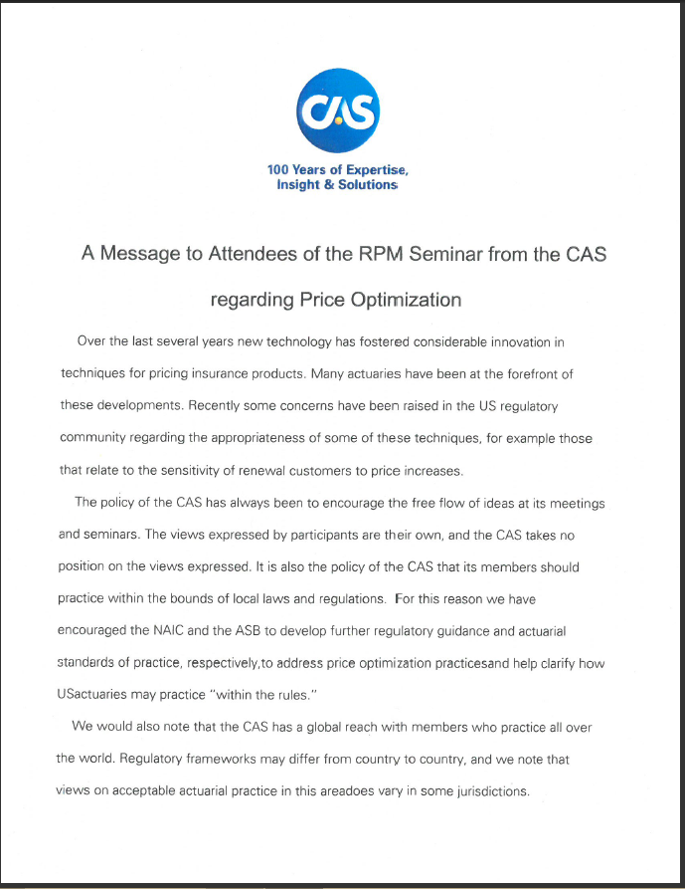
How Controversial?
Banned/Challenged/ Questioned in 19 States
NAIC Studied, Issued White Paper
CAS, AAA, ASB All Approach Topic Carefully
“The Views Expressed by Participants Are Their Own, and the CAS Takes No Position on the Views Expressed. It Is Also the Policy of the CAS that Its Members Should Practice Within the Bounds of Local Laws and Regulations”

Slide 4
Disclaimer
The Insurance Information Institute Does Not Take Partisan Stances on Issues of Public Policy. Its Goal is to Improve Public Understanding of Insurance – What It Does and How It Works.
The Opinions Expressed in This Discussion Are My Own and Should Not Be Considered the View of the Insurance Information Institute or Any of its Members or Subscriber Organizations, Including the Casualty Actuarial Society.

Slide 5
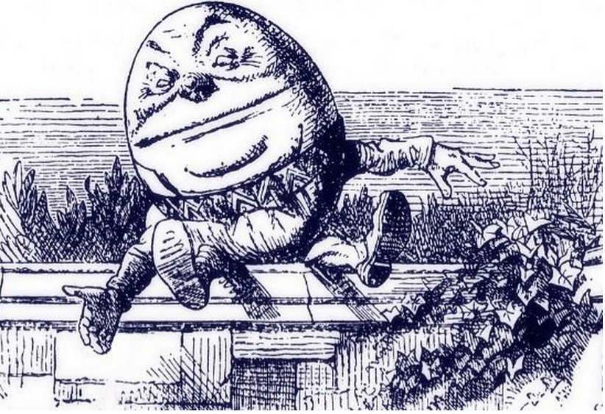
What is Price Optimization?
Price Optimization Defined
Earnix (P.O. Vendor):
“Systematic and statistical method to help an insurer estimate a rating plan factoring in a competitive environment”
“Using mathematical algorithms to determine optimal values of rating factors to meet business goals and constraints”
“When I use a word,’ Humpty Dumpty said in rather a scornful tone, ‘it means just what I choose it to mean — neither more nor less.’
’The question is,’ said Alice, ‘whether you can make words mean so many different things.’
’The question is,’ said Humpty Dumpty, ‘which is to be master — that’s all.”

Slide 6
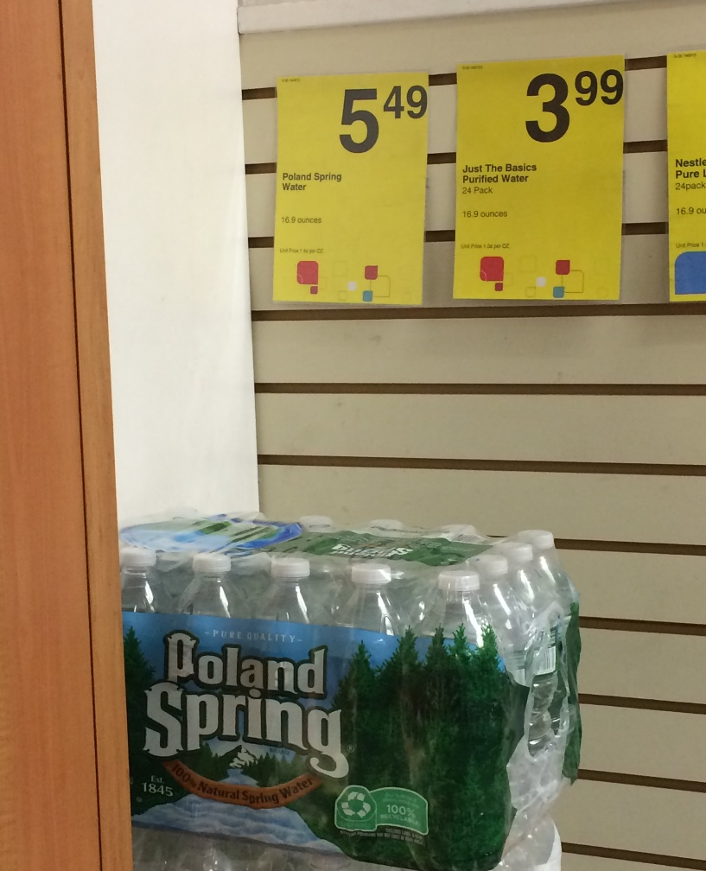
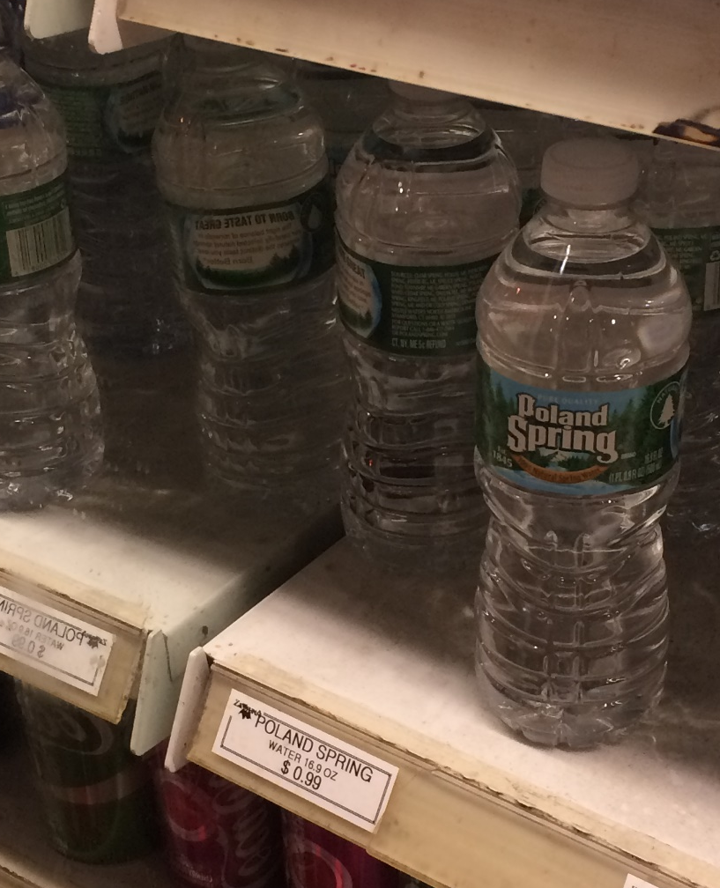
Shopping for Water
Insurers Don’t Do This!!!
1.4 Cents Per Ounce ($5.49 for 24 Bottles)
5.9 Cents Per Ounce ($23.76 for 24 Bottles)
320% Price Difference! Does It Cost $18.25 to Unpack the Bottles and Keep Them Cold?

Slide 7
Pricing Water vs. Pricing Insurance
Pricing H₂0
Pricing Insurance
It’s cold – charge more
It’s near the front of the store – charge more
It’s easy to carry – charge more
It’s Memorial Day – charge less
“What the market will bear”
Price = Loss + Exp + Profit
Expected value of future costs*
Provides for all costs of risk transfer*
Provides for all costs of individual risk transfer*
Reasonable rate estimates all future costs of risk transfer*
Value Based: None of These are Related to Projected Expenses
Cost Based: All of These Are Related to Projected Expenses
For Most Products, Supply and Demand Set Price – But Not In Insurance
*Source: CAS Statement of Ratemaking Principles (1988).

Slide 8
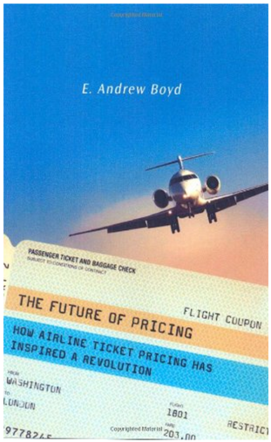
Not Just Water…
Computer-Driven Dynamic Pricing Sets Rates for:
Hotels
Airline Tickets
Uber Rides
Prices Change
Weekly
Daily
Instantaneously
Not Surprised Are You? We Are Used to Seeing Price Optimization in Other Products – but Not Insurance

Slide 9
Predicting Supply and Demand
Elasticity of Demand
Econ 101: How Much Will Sales Fall if Price Rises?
Steep Demand Curve → Consumer Doesn’t Care Much if Prices Rise
Companies That Know the Slope Can Price Smarter
This is Normal in Other Industries – But Not Insurance
Inelastic Demand
Elastic Demand
D
S₁
S₂
S₁
S₂
Price
Price
D
P₂
P₂
P₁
P₁
Q₂
Q₁
Quantity
Q₂
Q₁
Quantity
Example: Gasoline
Example: Shell Gasoline
Now Computers Can Model Elasticity of Demand

Slide 10
Have Insurers Always Optimized Prices?

Slide 11
Do Rates Adhere to the Actuarial Model?
Regulators are Generally OK With That.
REDACTED
Companies Temper Increases Based on ‘Market Judgment’
Indication (Technical Price) vs. Charged (Street Price)
Sources: System for Electronic Rate and Form Filing (SERFF) via S&P Global Market Intelligence; Insurance Information Institute.

Slide 12
The Triple-I Players Present
Do Actuaries Make Rates?

Slide 13
Actuary
“My Analysis Shows We Need to Raise Rates 5%”

Slide 14
Underwriter
“We Might As Well Close Up Shop Right Now”

Slide 15
Agent
“You’re Killing Me”

Slide 16
Senior Management
“I Think Maybe You Should Sharpen Your Pencil”

Slide 17
Repeat as Needed Until… The End
Moral: Ratemaking is a Collaboration

Slide 18
Traditional Adjustments (Optimizations?)
By the Insurer
Young Drivers Undercharged – Don’t Want to Lose the Parents (Class Plan)
Implementation of New Class Plan – Minimize Rate Shock (Individual)
Post-Merger Rate Stabilization Factor (Individual)
Insurers Have Been Adjusting Rates for Reasons Unrelated to Loss for Decades. Was That Wrong?

Slide 19
Other Adjustments (Optimizations?)
By Government
Proposition 103 (20% Rate Rollback) – 1988
Flood Insurance (18% Cap on Rate Increases) – 2014
Limit/Ban on Age/Gender As Rating Variable (~Seven States) – Ongoing
All Adjustments Unrelated to Expected Loss (but Mandated)

Slide 20
Are Rates Unfair?
An Example
Traditional practice
Used ‘seat-of-the-pants’ judgment to discount off indication
What’s new
Software informs the judgment
Always within actuarial indications
Current Rate
Selected: +3%
Indicated: +6%
If Today’s Rate is Fair, and The Indication is Fair, Can Anything in Between Be Unfair?

Slide 21
At the Class Plan Level
Example (cont’d): There Are Many Reasonable Ways to Achieve Reasonable Rates.
As practiced in U.S.
Remains true to cost-based price.
Applied to classes, not individuals.
Innovations are usually encouraged, with appropriate restraint.

Slide 22
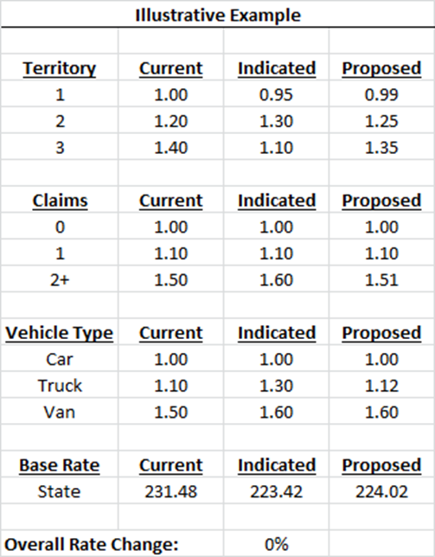
Avoiding The Reversal (1)
3 Territories
3 Vehicle Types
3 Claim Bands
1 Vehicle in Each Territory/Vehicle/Claim
All Proposed Factors Between Current & Indicated
It Is. You’ll See.

Slide 23
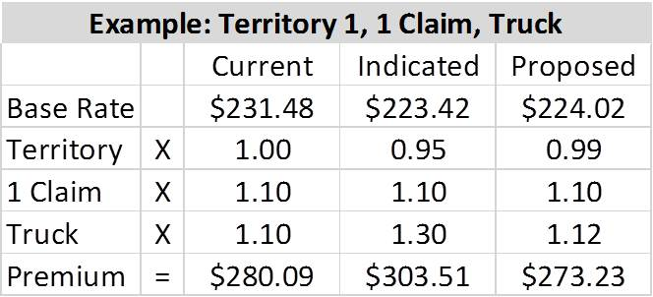
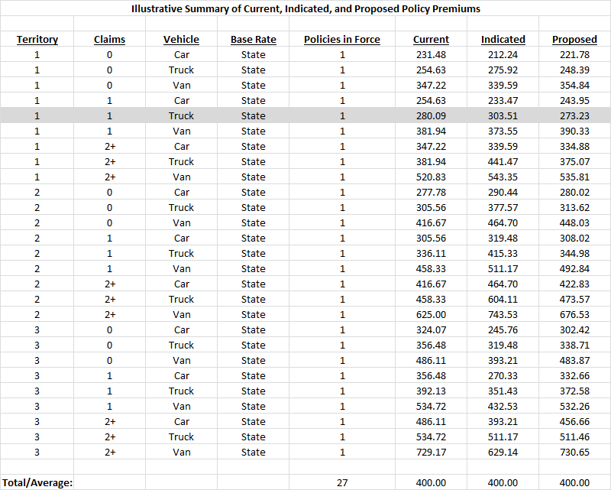
Avoiding The Reversal (2)
See? No Overall Rate Change

Slide 24
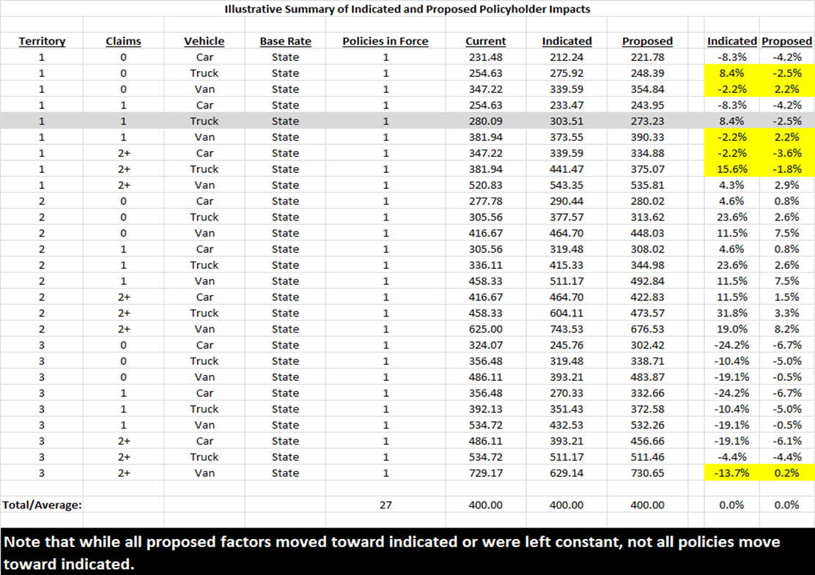
Avoiding The Reversal (3)
Reversals
Another Reversal
Reversal: Rating Factors are Reasonable, but Individual Premiums Do Not Appear to Be

Slide 25
How is P.O. Different From the Past?
Proponents
Opponents
It’s Not, Except Software Replaces Subjective Process
Allowed Under Current Actuarial Standards of Practice [Statement of Principles?]
It Isn’t Price Optimization – Not Maximizing Profits
Gouges Customers, Particularly Those Who Shop Less
Renewals and the Poor
Conflicts With State Rating Laws
‘Not to Be Excessive, Inadequate, Unfairly Discriminatory’
Each Side Has Counterarguments, of Course

Slide 26
What is the Issue?
The practice of charging something other than the technical price?
The software that insurers can use to move from technical price to street price?
The variables that insurers use to move from technical price to street price?
Debate is Here
Debate Should Be Here

Slide 27
Professionalism Break
Does Statement of Principles Allow Price Optimization?
The principles in this Statement are limited to that portion of the ratemaking process involving the estimation of costs associated with the transfer of risk
“Ratemaking should provide for the costs of an individual risk transfer so that equity among insureds is maintained.” (Reasonable, not excessive, not inadequate, not unfairly discriminatory)
Justification Via Considerations?
Mix of Business – “…distributional changes in deductibles, coverage limitations or type of risks that may affect the frequency or severity of claims”
What I’m Looking At. (You Might Disagree)
Source: CAS Statement of Ratemaking Principles (1988).

Slide 28
Professionalism Break
Justification Via Considerations?
Operational Changes – “Changes in the underwriting process, claim handling, case reserving and marketing practices that affect the continuity of the experience”
Other Influences – “The impact of external influences on the expected future experience should be considered… (seems to focus on residual markets, etc.)
Actuarial Judgment – “…may be applied throughout the ratemaking process…”

Slide 29
Professionalism Break
Foreshadowing Alert
§ IV. Conclusion
“The actuary, by applying the ratemaking principles in the Statement, will derive an estimation of the future costs associated with the transfer of risk. Other business considerations are also a part of ratemaking.” [U/W, Marketing, Law, Claims, etc.]
Reality Alert: It’s a Static Model
Of Course, These Are the Old Principles…

Slide 30
Professionalism Break
Statement of Ratemaking Principles Is Changing
Distinguish Between Principles (Worldwide) and Practices (Country-specific)
Separate Estimation of Rate From Setting of Rate
ASB Developing U.S. Standard of Practice
CAS (Constitution) vs. ASB (Local Law)
Images: Ten Commandments photo By Ji-Elle (Own work) [GFDL (http://www.gnu.org/copyleft/fdl.html) or CC BY-SA 3.0 (http://creativecommons.org/licenses/by-sa/3.0)], via Wikimedia Commons; U.S. Code photo By Tony Webster (Own work) [CC BY-SA 3.0 (http://creativecommons.org/licenses/by-sa/3.0)], via Wikimedia Commons.
Source: Notes from “The Standards and Principles: ‘They are a Changin,’’” 2015 Ratemaking and Product Management Seminar.

Slide 31
Professionalism Break
CURRENT: Ratemaking is the process of establishing rates used in insurance or other risk transfer mechanisms
PROPOSED: Ratemaking is the process of establishing future costs associated with the transfer of risk in insurance or other risk transfer mechanisms.
Distinguishes Between Technical Price, “Street Price”
Current Principles
Proposed Principles
4 Sections – Definitions, Principles, Considerations, Conclusion
3 Sections (Considerations Moved to Standards of Practice)

Slide 32
Professionalism Break
CURRENT/PROPOSED: The actuary, by applying informed actuarial judgment and the ratemaking principles in this Statement, will derive an estimation of the future costs associated with the transfer of risk. Other business considerations are also a part of ratemaking insurance pricing.
Replaces ‘Ratemaking’ with ‘Insurance Pricing’
Some are dismayed
“…dismantling the cost-based standard as the bedrock of the actuarial profession …
“It is shocking to me as a Fellow of the CAS that the Society would propose a set of principles that [implies actuaries] not only have no impact on the prices that policyholders will pay, but acts to remove the actuary from the central role she has in ratemaking today.”
– J. Robert Hunter, Consumer Federation of America
But For Reserving Actuaries, the Distinction May Sound Familiar

Slide 33
New Reserving Standard
Statement of Principles
Regarding
Property and Casualty
Loss and Loss Adjustment
Expense Reserves
1988-2014
Statement of Principles Regarding Property and Casualty Unpaid Claims Estimates
Born May 6, 2015
Images from Cliparts.com. and Clipart Panda.

Slide 34
The Triple-I Players Present
Do Actuaries Set Reserves?

Slide 35
Actuary
“My Analysis Shows We Need to Raise Reserves 5%”

Slide 36
CFO
“There Goes My Bonus”

Slide 37
Underwriter
“There Goes My Bonus – And I’ll Be Fired”

Slide 38
Senior Management
“No One Wants to Lose Their Bonus or Their Job”

Slide 39
Repeat as Needed Until… The End
Moral: Loss Reserving is a Collaboration

Slide 40
Professionalism Break
Old Principles
New Principles
4 Sections – Definitions, Principles, Considerations, Conclusion
3 Sections (Considerations Moved to Standards of Practice)
OLD: A loss reserve is a provision for its related liability
NEW: Unpaid Claims Estimate: An actuary’s estimate of the unpaid amount required to make the future loss and/or loss adjustment expense payments related to a defined group of claims
Implicit Is the Difference Between Estimate and Booked

Slide 41
Professionalism Break
CAS on Unpaid Claims Estimates
“The principal objective of revising the original Principles was to update them and to revise them where necessary to contain principles only, not standards of practice.
“This newly adopted Statement is not intended to provide prescriptive practice guidance to actuaries. Such practice guidance for actuaries has been developed in the U.S., for example, by the Actuarial Standards Board (U.S.) in the form of Actuarial Standards of Practice.”
The Same Sort of Reasoning Applies to Ratemaking

Slide 42
Homework
Ratemaking Principles (On Hold, Awaiting ASB)
Current http://casact.org/professionalism/standards/princip/sppcrate.pdf
Proposed http://www.casact.org/professionalism/SoP-Ratemaking-Discussion-Draft_October2014.pdf
Ratemaking Standards (2nd Exposure Draft) http://www.actuarialstandardsboard.org/asops/propertycasualty-ratemaking-2/
Reserve Principles
Old http://casact.org/professionalism/standards/princip/sppcloss.pdf
New http://www.casact.org/professionalism/standards/princip/SOP-Regarding-Property-and-Casualty-Unpaid-Claims-Estimates_Final%204-22-2015.pdf

Slide 43
Homework
Carrier Management Articles
By James Lynch: About Those Rates: Why Allstate’s Rating Program May Not Be What It Seems
Part 1
Part 2
Part 3
By Robert Hunter: CFA’s Hunter Reacts in Actuarial Battle: Allstate’s Plan Is Price Optimization

Slide 44
Summary
Price Optimization Is A Controversial Activity
Much Depends on How Term Is Defined
Ratemaking Principles Are Changing. Reserving Principles Changed
Removing Nation-Specific Guidance
Bedrock CAS Principles Apply Everywhere
Practice Guidelines Tend to Be Nation-Specific (ASB in US)
Don’t Break the Law
Even if the CAS Principle Changes, the Old Principle is Still the Law in Many (Most?) States

Slide 45
www.iii.org
Thank You for Your Time and Your Attention!
Twitter: twitter.com/@III_Research

