Slide 1
Actuarial Professionalism: Considerations Regarding Price Optimization
June 2015
Download at www.iii.org/presentations
James Lynch, FCAS MAAA, chief actuary
Insurance Information Institute ♦ 110 William Street ♦ New York, NY 10038
Tel: 212.346.5533 ♦ Cell: 917.359.3908 ♦ jamesl@iii.org ♦ www.iii.org

Slide 2
What Is the Controversy?
2

Slide 3

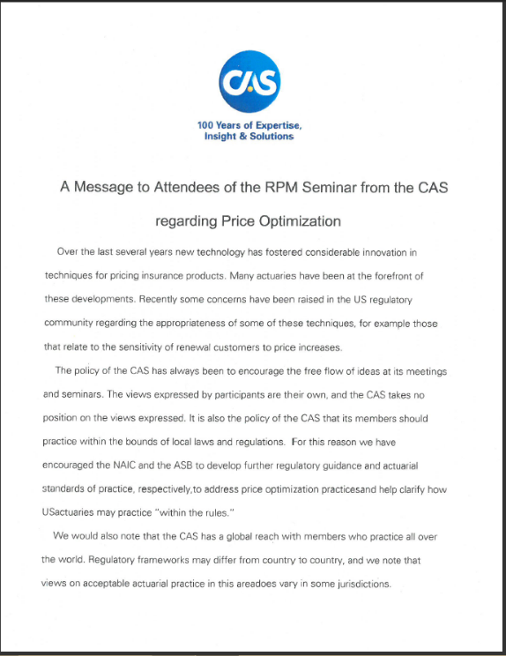
How Controversial?
Banned in Four States (MD, OH, CA, FL)
One De Facto Ban (WA)
NY Gathering Information
NAIC Studying
CAS, AAA, ASB
“The Views Expressed by Participants Are Their Own, and the CAS Takes No Position on the Views Expressed. It Is Also the Policy of the CAS that Its Members Should Practice Within the Bounds of Local Laws and Regulations.”

Slide 4
What Is Price Optimization?
Definitions Vary Substantially With Respect to Its Use in Insurance
4

Slide 5
Price Optimization Defined
NAIC (Draft)–“…the advent of sophisticated data mining tools and pricing models have allowed actuaries to provide more objective, quantitative information about the judgmental aspects of the rate-setting process instead of relying primarily on anecdotal evidence as has been the case in the past. This process is now referred to as “price optimization.”

Slide 6
Price Optimization Defined…
Earnix (P.O. Vendor):
  “systematic and statistical method to help an insurer estimate a rating plan factoring in a competitive environment.”
  “using mathematical algorithms to determine optimal values of rating factors to meet business goals and constraints.”
Maryland:
  “…[V]arying rates based on factors other than risk of loss, including, but not limited to:
    a) The likelihood that a policyholder will engage in activities that result in policy turnover; and
    b) The willingness of a policyholder to pay a higher premium compared to other policyholders.”

Slide 7
Price Optimization Defined…
Ohio:
  “While price optimization has no absolute definition, it generally refers to an insurer’s practice of varying premiums based upon factors that are unrelated to risk of loss in order to charge each insured the highest price that the market will bear.”
Florida:
  “…a process for modifying the insurance premium that would otherwise be charged to an insured or class of insureds in order to maximize insurer retention, profitability, written premium, market share, or any combination of these while remaining within real world constraints.”

Slide 8
Price Optimization Defined…
California:
  “…any method of taking into account an individual’s or class’s willingness to pay a higher premium relative to other individuals or classes.”
New York:
  “…the practice of varying rates based on factors other than those directly related to risk of loss, for example, setting rates or factors based on an insured’s likelihood to renew a policy or on an individual’s or class of individuals’ perceived willingness to pay a higher premium relative to other individuals or classes”

Slide 9
Do Other Industries Use
Price Optimization?
Yes, Consistent with Basic Microeconomic Principles Related to Supply and Demand
9

Slide 10
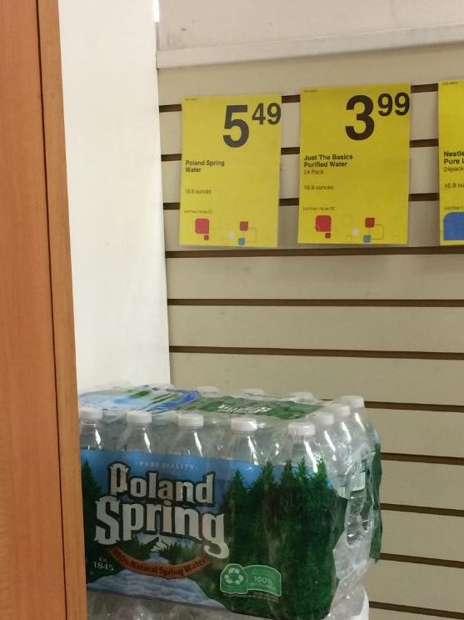
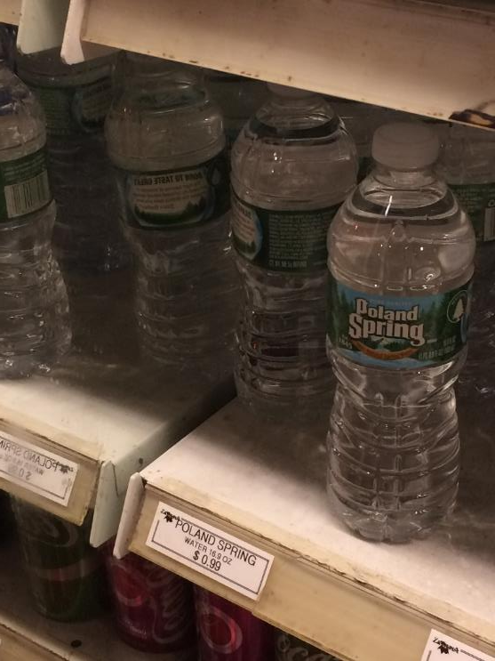
Insurance Is Not Priced Like Water
– Or Most Consumer Products
1.4 Cents Per Ounce ($5.49 for 24 Bottles)
5.9 Cents Per Ounce ($23.76 for 24 Bottles)
Insurers Don’t Do This
320% Price Difference. Does It Cost $18.25 to Unpack the Bottles and Keep Them Cold? Insurers Do Not Price Like This.

Slide 11
Differences Between Pricing
Insurance, Other Products
Pricing Water (for example)
Pricing Insurance
It’s cold – charge more.
It’s near the front of the store – charge more.
It’s easy to carry – charge more.
It’s Memorial Day – charge less.
“What the market will bear.”
Expected value of future costs
Provides for all costs of risk transfer
Provides for all costs of individual risk transfer
Reasonable rate estimates all future costs of risk transfer
SOURCE: CAS Statement of Ratemaking Principles (1988).
None of These Are Related to Projected Expenses
All of These Are Related to Projected Expenses
For Most Products, Supply and Demand Set Price–But Not In Insurance. Insurance Rates Are Tied to Loss, Expense.

Slide 12
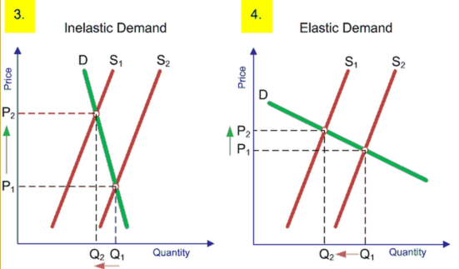
Elasticity of Demand
Econ 101: Determination
of Supply and Demand
Econ 101: How Much Will Sales Fall If Price Rises?
Steep Demand Curve → Consumer Doesn’t Care Much If Prices Rise
Companies that Understand Demand for their Products Have a Competitive Advantage
Many industries are characterized by rapid and frequent price changes over time and/or across consumer segments; …But Not Insurers
Example: Gasoline
Example: Shell Gasoline
Now Many Non-Insurance Companies Use Very Sophisticated Computer Algorithms to Model Elasticity of Demand.

Slide 13

Other Industries Routinely Change Prices on a Near Continuous Basis
Computer-Driven Dynamic Pricing Sets Rates for:
  Hotels
  Airline Tickets
  Uber Rides
Prices Change
  Weekly
  Daily
  Instantaneously
Outside Insurance, Companies Often Vary Prices Tremendously – Across Customers and Over Time

Slide 14
Have Insurers Always Optimized Prices?
14

Slide 15
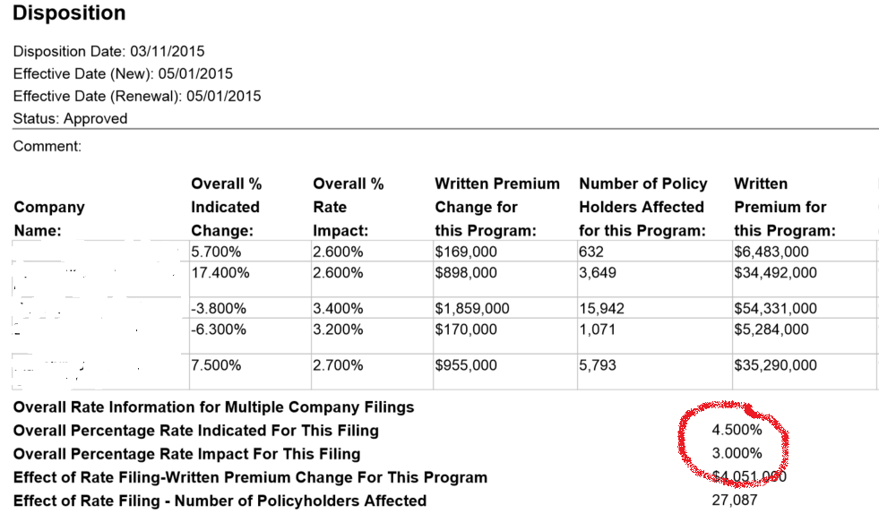
Do Rates Always Adhere to Projected Loss?
Companies Rarely Take the Indicated Rate, Often Charging Less
Regulators Are Generally OK With That.
REDACTED
Sources: System for Electronic Rate and Form Filing (SERFF) via SNL Financial; Insurance Information Institute.
Is That Acceptable in the Actuarial Profession? Does Current Practice Conform to Ratemaking Principles?

Slide 16
Other Adjustments (Optimizations?)
By the Insurer
  Young Drivers Undercharged – Don’t Want to Lose the Parents (Class Plan)
  Implementation of New Class Plan – Minimize Rate Shock (Individual)
  Post-Merger Rate Stabilization Factor (Individual)
Insurers Have. . .
  Infrequent (Annual) Rate Changes
  Traditionally Optimized in Tiny Adjustments Compared to Many Other Industries
  Charged Less Than Indicated in Vast Majority of Cases
Insurers Have Been Adjusting Rates for Reasons Unrelated to Loss for Decades – Usually Charging Less Than Indicated. Was That Wrong? Regulators Generally Approved of It.

Slide 17
Other Adjustments (Optimizations?)
By Government
  Proposition 103 (20% Rate Rollback) - 1988
  Flood Insurance (18% Cap on Rate Increases) - 2014
  Limit/Ban on Age/Gender As Rating Variable (~Seven States) – Ongoing
  Caps on Rate Changes in State-Run Pools and Plans
Government Mandated Adjustments Often Unrelated to Expected Loss – Generally Charging Less than Actuarially Indicated Rates.

Slide 18
How Is P.O. Different From the Past?
Proponents
Opponents
It’s Not, Except Software Replaces Subjective Process
  May Make Rates More Stable
Allowed Under Current Actuarial Standards of Practice [Statement of Principles?]
Harms Customers, Particularly Those Who Shop Less
  Renewals and the Poor
Conflicts With State Rating Laws
  ‘Not to Be Excessive, Inadequate, Unfairly Discriminatory’
Each Side Has Counterarguments, of Course.

Slide 19
Professionalism Issues
The principles in this Statement are limited to that portion of the ratemaking process involving the estimation of costs associated with the transfer of risk.
“Ratemaking should provide for the costs of an individual risk transfer so that equity among insureds is maintained.” (Reasonable, not excessive, not inadequate, not unfairly discriminatory)
Justification Via Considerations?
  Mix of Business – “…distributional changes in deductibles, coverage limitations or type of risks that may affect the frequency or severity of claims.”
SOURCE: CAS Statement of Ratemaking Principles (1988).

Slide 20
Professionalism Issues
Justification Via Considerations?
  Operational Changes – “Changes in the underwriting process, claim handling, case reserving and marketing practices that affect the continuity of the experience.”
  Other Influences – “The impact of external influences on the expected future experience should be considered. . .” (seems to focus on residual markets, etc.)
  Actuarial Judgment – “…may be applied throughout the ratemaking process…”
SOURCE: CAS Statement of Ratemaking Principles (1988).

Slide 21
Professionalism Issues
§ IV. Conclusion
  “The actuary, by applying the ratemaking principles in the Statement, will derive an estimation of the future costs associated with the transfer of risk. Other business considerations are also a part of ratemaking.” [U/W, Marketing, Law, Claims, Etc.]
Reality: It’s A Static Model.
Of Course, These Are the Old Principles . . .
SOURCE: CAS Statement of Ratemaking Principles (1988).

Slide 22
Professionalism Issues
Statement of Ratemaking Principles Is Changing
  Distinguish Between Principles (Worldwide) and Practices (Country-specific)
  Separate Estimation of Rate From Setting of Rate
ASB Developing U.S. Standard of Practice
SOURCE: Notes from “The Standards and Principles: ‘They are a Changin,’’” 2015 Ratemaking and Product Management Seminar.

Slide 23
Professionalism Issues
CURRENT: Ratemaking is the process of establishing rates used in insurance or other risk transfer mechanisms.
PROPOSED: Ratemaking is the process of establishing future costs associated with the transfer of risk in insurance or other risk transfer mechanisms.
Distinguishes Between Technical Price, “Street Price”
Current Principles
Proposed Principles
4 Sections – Definitions, Principles, Considerations, Conclusion
3 Sections (Considerations Moved to Standards of Practice)

Slide 24
Professionalism Issues
CURRENT/PROPOSED: The actuary, by applying informed actuarial judgment and the ratemaking principles in this Statement, will derive an estimation of the future costs associated with the transfer of risk. Other business considerations are also a part of ratemaking insurance pricing.
Replaces ‘Ratemaking’ With ‘Insurance Pricing’
Some are dismayed
“…dismantling the cost-based standard as the bedrock of the actuarial profession . . .
“It is shocking to me as a Fellow of the CAS that the Society would propose a set of principles that [implies actuaries] not only have no impact on the prices that policyholders will pay, but acts to remove the actuary from the central role she has in ratemaking today.”
- J. Robert Hunter, Consumer Federation of America
But For Reserving Actuaries, The Distinction May Sound Familiar.

Slide 25
Reserving Principles Have Already Undergone a Similar Change
Old Statement
(1988-2014)
Statement of Principles Regarding Property and Casualty Loss and Loss Adjustment Expense Reserves
New Statement
(May 2015 – Present)
Statement of Principles
Regarding Property and Casualty Unpaid Claims Estimates

Slide 26
Professionalism Issues
Old Principles
New Principles
4 Sections – Definitions, Principles, Considerations, Conclusion
3 Sections (Considerations Moved to Standards of Practice)
Implicit Is the Difference Between Estimate and Booked
OLD: A loss reserve is a provision for its related liability.
NEW: Unpaid Claims Estimate: An actuary’s estimate of the unpaid amount required to make the future loss and/or loss adjustment expense payments related to a defined group of claims

Slide 27
Professionalism Issues
CAS on Unpaid Claims Estimates
“The principal objective of revising the original Principles was to update them and to revise them where necessary to contain principles only, not standards of practice.
“This newly adopted Statement is not intended to provide prescriptive practice guidance to actuaries. Such practice guidance for actuaries has been developed in the U.S., for example, by the Actuarial Standards Board (U.S.) in the form of Actuarial Standards of Practice.”
The Same Reasoning Applies to Ratemaking in the Draft Principles.
Source: Casualty Actuarial Society, Statement of Principles Regarding Property and Casualty Unpaid Claims Estimates, May 2015.

Slide 28
Homework
Ratemaking Principles
  Current http://casact.org/professionalism/standards/princip/sppcrate.pdf
  Proposed http://www.casact.org/professionalism/SoP-Ratemaking-Discussion-Draft_October2014.pdf
Ratemaking Standards (Exposure Draft) http://www.actuarialstandardsboard.org/wp-content/uploads/2014/12/Ratemaking_expsoure_draft_sept2014.pdf
Reserve Principles
  Old http://casact.org/professionalism/standards/princip/sppcloss.pdf
  New
  http://www.casact.org/professionalism/standards/princip/SOP-Regarding-Property-and-Casualty-Unpaid-Claims-Estimates_Final%204-22-2015.pdf

Slide 29
Summary
Price Optimization Is A Controversial Activity.
  Much Depends on How Term Is Defined.
Ratemaking Principles Are Changing. Reserving Principles Changed.
  Removing Nation-Specific Guidance.
  Bedrock CAS Principles Apply Everywhere
  Practice Guidelines Tend to Be Nation-Specific (ASB in US)
Don’t Break the Law
If the CAS Principle Changes, It’s Still the Law in Many (Most?) States.

Slide 30
Insurance Information Institute Online:
www.iii.org
Thank you for your time
and your attention!
Twitter: twitter.com/@III_Research

