Slide 1
What’s Driving the P/C Industry?
CAS Webinar, July 27, 2017
Download at www.iii.org/presentations
Steven Weisbart, PhD., CLU, Chief Economist; James Lynch, FCAS MAAA, Chief Actuary
Insurance Information Institute  110 William Street  New York, NY 10038
Tel: 212.346.5500  stevenw@iii.org  jamesl@iii.org  www.iii.org

Slide 2
What’s Driving It?
The Economy, for one thing.

Slide 3
The Economy Drives P/C Insurance Industry Premiums:
Direct Premium Growth (All P/C Lines) vs. Nominal GDP: Quarterly Y-o-Y Pct. Change
Direct Written Premiums track Nominal GDP—not quarter by quarter but overall fairly well.
Sources: SNL Financial; U.S. Commerce Dept., Bureau of Economic Analysis; I.I.I.

Slide 4
ISM Manufacturing Index (Values > 50 Indicate Expansion), January 2010-June 2017
Latest 6 months: strengthening
The manufacturing sector expanded in 67 of the 70 months from January 2010 through October 2015. It contracted in November 2015 through February 2016 and again in August 2016 but is expanding again.
Sources: Institute for Supply Management; Insurance Information Institute.

Slide 5
ISM Non-Manufacturing Index (Values > 50
Indicate Expansion), January 2010-June 2017
The non-manufacturing sector expanded in every month after January 2010. The pace of expansion roared ahead in 2014-15, slowed a bit in 2016,
but ended 2016 and is starting 2017 strong.
Sources: Institute for Supply Management via https://research.stlouisfed.org/fred2/data/NMFCI.txt; Insurance Information Institute.

Slide 6
Nonfarm Payroll (Wages and Salaries):
Quarterly, 2005–2017:Q1
Billions
Latest (2017:Q1) was $8.32 trillion, a new peak--$2.09T above 2009 trough
Prior Peak was 2008:Q3 at $6.54 trillion
Y-o-Y Growth rates
2012:Q1 over 2011:Q1: 3.9%
2013:Q1 over 2012:Q1: 2.3%
2014:Q1 over 2013:Q1: 5.0%
2015:Q1 over 2014:Q1: 4.6%
2016:Q1 over 2015:Q1: 4.2%
2017:Q1 over 2016:Q1: 3.8%
Recent trough (2009:Q1) was $6.23 trillion, down 5.3% from prior peak
Note: Recession indicated by gray shaded column. Data are seasonally adjusted annual rates.
Sources: http://research.stlouisfed.org/fred2/series/WASCUR; National Bureau of Economic Research (recession dates); Insurance Information Institute.
6
eSlide – P6466 – The Financial Crisis and the Future of the P/C
Notes:
6

Slide 7
Nonresidential Fixed Investment: Implications for Commercial Insurance
Percent Change from same quarter, prior year
Sources: bea.gov, news release “Gross Domestic Product: First Quarter 2017 (Second Estimate) and prior releases, Table 8; Insurance Information Institute.

Slide 8
So How is the P/C Industry Doing?

Slide 9
Net Premium Growth (All P/C Lines):
Annual Change, 2007-2016
Premium Growth Has Followed Economic Growth, Inflation.
SOURCES: A.M. Best (2007-2013), ISO (2014-16), Federal Reserve Bank of St. Louis (FRED), Insurance Information Institute.

Slide 10
Commercial & Personal Lines Direct Premiums Written Growth, Quarterly Y-o-Y
Percent Change from same quarter, prior year
.
Sources: NAIC via SNL Financial; Insurance Information Institute calculations.

Slide 11
P/C Insurance Industry
Combined Ratio, 2000-2017*
3 Consecutive Years of U/W Profits; 1st time since 1971-73
Heavy Use of Reinsurance Lowered Net Losses.
Higher CAT Losses, Shrinking Reserve Releases, Toll of Soft Market
A return to more usual underwriting loss.
Best Combined Ratio Since 1949 (87.6)
Sandy
*Excludes Mortgage & Financial Guaranty insurers 2008-2014.
Including M&FG, 2008=105.1, 2009=100.7, 2010=102.4, 2011=108.1; 2012:=103.2; 2013: = 96.1; 2014: = 97.0.
Sources: A.M. Best; ISO, a Verisk Analytics company; I.I.I.

Slide 12
Net Underwriting Gains & Losses,
1st Quarter of Each Year, 2007-2017
$ Millions
In the first quarter of the year,
net underwriting results have been quite variable.
Sources: ISO/PCI; Insurance Information Institute.

Slide 13
CAT Claims as a Percent of Total Claims,* 1st Quarter, 2011-2017
CAT claims are normally a small part of total claims in the first quarter,
but that wasn’t true in 2017. Moreover, although it’s a small sample,
the trend seems to be rising.
*Net of reinsurance and include Loss Adjustment Expenses
Sources: ISO PCS; Insurance Information Institute calculations.

Slide 14
Auto Net Combined Ratio, 2005-2016
Loss Ratios Have Been Rising for a Decade.
2016 Return on Net Worth is Likely Close to Zero or Negative.
Source: National Association of Insurance Commissioners data, sourced from S&P Global Market Intelligence;
Insurance Information Institute.

Slide 15





State Issues
Auto Insurance
Increase in Loss Costs, 2015:Q1–2017:Q1
Bodily Injury
15.3%
Property
Damage
15.0%
Personal Injury Protection
14.1%
Collision
13.2%
Comprehensive
22.5%
From 2015 to 2017, the cost of accidents
has risen dramatically. By contrast, consumer prices overall
rose 3.9 percent during 2014 and 2015.
Source: Fast Track Monitoring System.
Notes:
The amount of claim costs per vehicle insured - known as loss costs in the industry - is the primary cost in auto insurance rates. Those have been rising across all major coverages.

Slide 16
P/C Industry Loss and Loss Adjustment Expenses as Percent of NPE, 1997-2016
The industry tends to make an underwriting profit
when this ratio is under 70 percent.
Sources: SNL Financial; Insurance Information Institute. NPE=Net Premiums Earned

Slide 17
Reserve Development
Has the Well Run Dry?

Slide 18
AY vs. CY Combined Ratio,
(Excl. Guaranty Lines) 2004-2016
Higher AY → Favorable DOP
10 Consecutive Years of Favorable Loss Development.
Sources: NAIC data from S&P Global Intelligence, Insurance Information Institute.
18

Slide 19
Personal Lines Combined Ratio,
2004-2016
Higher AY → Favorable DOP
Catastrophes (Matthew, Hail) Drove HO C.R. Higher. Frequency, Severity Dogged Auto Results. 14 Years of Favorable Development.
Sources: NAIC data from S&P Global Intelligence, Insurance Information Institute.
19

Slide 20
Commercial Lines Combined Ratio, 2004-2016
After 10 Years, Has the Well Run Dry?
Sources: NAIC data from S&P Global Intelligence, Insurance Information Institute.
20

Slide 21
Development on Prior, 1996-2016
DoP (% of NEP)
Reserve Releases Keep Getting Smaller.
Sources: NAIC data from S&P Global Intelligence, Insurance Information Institute.
21

Slide 22
CY Development on Prior by LOB
Reserve Deterioration in Auto Liability Lines, Improvement in Workers Compensation.
Sources: NAIC data from S&P Global Intelligence, Insurance Information Institute.
22

Slide 23
And the Investment Results?

Slide 24
US Treasury Note 10-Year Yields:
A Long Downward Trend, 2000–2017*
Yields on 10-Year US Treasury Notes have been below 3% for over 6 years: 10-year bonds bought in 2007 at 5% will be reinvested at 2.5% for 10 more years
The end of the downtrend?
Since nearly 50% of P/C bond/cash investments are in 5-year or longer maturities, most P/C insurer portfolios will have low-yielding bonds for years to come.
*Monthly, constant maturity, nominal rates, through June 2017.
Sources: Federal Reserve Bank at http://www.federalreserve.gov/releases/h15/data.htm; National Bureau of Economic Research (recession dates); Insurance Information Institute.
24
12/01/09 - 9pm
eSlide – P6466 – The Financial Crisis and the Future of the P/C
Notes:
24

Slide 25
P/C Insurer Portfolio Yields,
2002-2015
P/C Carrier Yields Have Been Falling for Over a Decade, Reflecting the Long Downtrend in Prevailing Interest Rates.
Even as Prevailing Rates Rise in the Next Few Years,
Portfolio Yields Are Unlikely to Rise Quickly,
Since Low Yields of Recent Years Are “Baked In” to Future Returns.
Sources: NAIC data, sourced from S&P Global Market Intelligence; Insurance Information Institute.

Slide 26
Net Investment Gains Vary Mainly With Realized Capital Gains/Losses, 1st Quarters, 2007-2017
$ Billions
In the first quarter of the year, net investment income has been steady but realized capital gains/losses have been quite variable.
Sources: ISO/PCI; Insurance Information Institute.

Slide 27
June 2017: Quarterly Yield Forecasts for 10-Year US Treasury Bonds in 2017-18
Yield (%)
Virtually all of the 53 forecasts in the Blue Chip survey expect
continual increases in the yield of 10-year T-bonds in 2017-18.
Sources: Blue Chip Economic Indicators (6/17); Insurance Information Institute

Slide 28
The “Bottom Line”?

Slide 29
P/C Industry Net Income After Taxes*,
1st Quarters, 2007-2017
$ Billions, 2017 dollars
In the first quarters of the year, net income varied.
2017 was the second-lowest profit in the last 11 years.
*adjusted for inflation using the BLS CPI calculator, to 2016 dollars
Sources: A.M. Best; ISO, a Verisk Analytics company; Insurance Information Institute.

Slide 30
Policyholder Surplus, Quarterly,
2006:Q4–2017:Q1
Surplus as of 3/31/17 stood at $709.0B
($ Billions)
2007:Q3
Pre-Crisis Peak
Drop due to near- record 2011 CAT losses
Surplus grew by 4.8% over 3/31/2016
The industry now has $1 of surplus for every $0.75 of NPW,
the strongest claims-paying status in its history.
2010:Q1 data includes $22.5B of paid-in capital from a holding company parent for one insurer’s investment in a non-insurance business.
The P/C insurance industry is, in 2017,
in very strong financial condition.
Sources: ISO, A.M .Best.
30
12/01/09 - 9pm
eSlide – P6466 – The Financial Crisis and the Future of the P/C
Notes:
30

Slide 31
Commercial Rates*
Softening Ahead?
*These Publicly Available Estimates May Differ Substantially
From Events In Individual States and Markets

Slide 32
Rate Changes Worldwide
Rates Soft/Flat, Especially in Reinsurance
Global Insurance Rates Through Q1 2017
Global Reinsurance
January Renewals
Rates Have Been Flat/Declining Slightly for Several Years
Sources: Marsh Insurance Market Index, JLT Re.
Notes:
32

Slide 33
Commercial Lines Rate Change
We’re in a Long Period of Flat Rates Overall.
Sources: Willis Towers Watson, MarketScout.

Slide 34
Liability Rate Changes
Slight Softening, Though Local Markets Vary
U.S. Casualty
U.S. Financial and Prof Liab
SOURCE: Marsh Insurance Market Index.

Slide 35
Property/Cyber Rate Changes
Slight Softening, Though Local Markets Vary
U.S. Property
U.S. Cyber
SOURCE: Marsh Insurance Market Index.

Slide 36
On the Horizon
Sharing Economy and Disruption

Slide 37
Greatest Threats, Opportunities
Whither Silicon Valley?
Greatest Opportunity
Greatest Threat
SOURCE: A.M. Best Winter 2016-17 Insurance Industry Survey.

Slide 38
Insurance Technology Financing – Change Is Coming
More Than Half This Funding Was in Two Deals (Zenefits/ Zhong An)
Investment ($ Millions)
Deals
Investment In Insurance Tech Is Rising. Number of Deals Set A Record Last Year. P/C Insurance is Increasingly the Focus.
SOURCES: CB Insights, Insurance Information Institute.

Slide 39
The (Re)Insurance Value Chain
Where Could Disruption Lie?
Create Policy/ Treaty
Brains + Bank Account
Write Risk
Perform Loss Control
Settle Claims
Market Policy/ Treaty
Improve World
Price Risk
Protecting People & Organizations
Most Links in the Value Chain Have the Potential
to Be Disrupted in Next 10 Years.

Slide 40
Alternative Capital
Potentially Disrupting the Bank Account
Alternative capacity has grown 350% since 2006. It has more than tripled in the past six years.
Source: Aon Benfield Analytics; Insurance Information Institute.

Slide 41
The Internet
Will It Disrupt Marketing?
Lead Generators
  InsWeb, NetQuote, Insurance.com
  Site allows comparison shopping, sells lead to insurer
Call Center Agencies
  SelectQuote, Goji
  Call center employs agents
Digital agencies
  Esurance, Policy Genius
  Quote and buy online
But Customers Still Like Agents
Did You Compare Prices When Your Auto Policy Was Up for Renewal?
SOURCES: The New Age of Insurance Aggregators, http://insurancethoughtleadership.com/the-new-age-of-insurance-aggregators/; Insurance Information Institute November 2015 Pulse Survey.

Slide 42






Pricing Disruptor: The Fragmented Risk
42
12/01/09 - 9pm
eSlide – P6466 – The Financial Crisis and the Future of the P/C
Notes:
42
The Insurance Contract Is Being Split into Tiny Pieces.
The Sharing/“On-Demand” Economy – Personal → Commercial → Personal
By-peril HO insurance
Ride-sharing insurance
Pay By Mile Insurance
Expect More As
Computers Get Stronger
Data Storage Gets Cheaper
Information Collection Grows
Workers comp – adjust rates for travel?

Slide 43
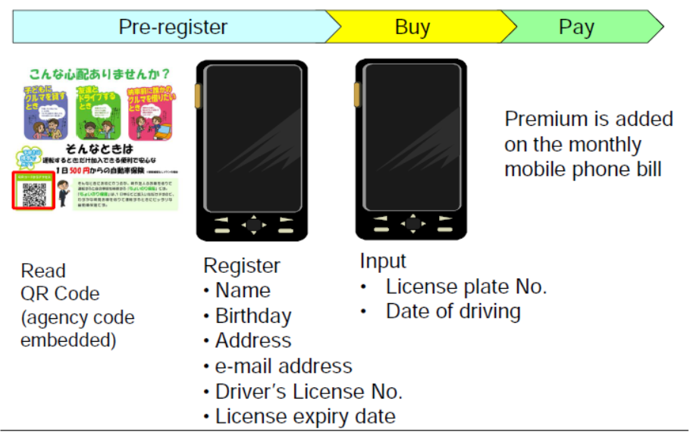
One-Day Auto Insurance
Source: Tokio Marine & Nichido Fire Insurance, NTT Docomo.

Slide 44




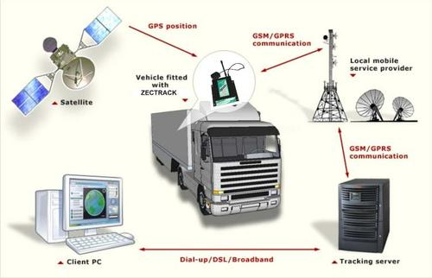

Loss Control Disruptor
The Internet of Things
Telematics Today
Telematics Tomorrow
44
12/01/09 - 9pm
eSlide – P6466 – The Financial Crisis and the Future of the P/C
Notes:
44
Gathering Big Data Affects
Underwriting
Pricing
Monitoring Could Affect
Loss Control
Pricing?

Slide 45
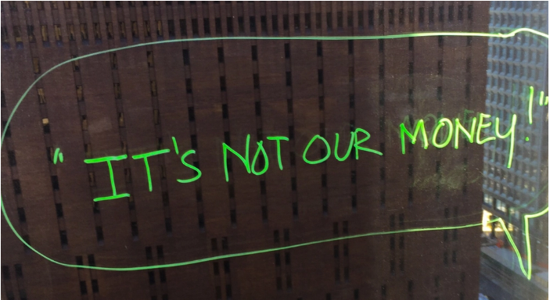


Claims Disruptor
Artificial Intelligence + Behavioral Economics
Notes:
AI Jim
IDs suspicious activity
Marries Artificial Intelligence, Behavioral Economics (file via video)
Bot handles simplest claims

Slide 46
How Insurance Contributes to Economic Growth

Slide 47




Insurance Industry Snapshot:
By the Numbers
2.8 million
People in the U.S. employed, in a wide variety of careers, from human resource administrators to public relations managers to financial analysts
$5.8 trillion
Assets under management
at year-end 2016, including
$1.5 trillion for the property/
casualty sector and $3.7 trillion
for the life sector
$508 billion
Contributed to the U.S. gross domestic product in 2016,
roughly 2.7%
of the whole
$40.0 billion
Federal and foreign income taxes paid
in 2016, plus U.S. premium taxes paid
Source: A Firm Foundation, Insurance Information Institute.

Slide 48
The Insurance Industry’s Contribution to GDP Now Nearly Equals Banks
Sources: US Bureau of Economic Analysis; Insurance Information Institute.

Slide 49

The Yearly Cash Flow to Rebuild Lives and Property is Substantial
Insurers annually pay over a trillion dollars in claims to rebuild lives, property, and businesses.
In 2016 alone, the industry paid
$ 386.4 billion P/C incurred claims (L + LAE)
554.7 Life/Annuity benefits
560.9 Health Insurance benefits
= $1.502 trillion
This is equivalent to $125 billion per month.
Notes:
49

Slide 50
Insurance and Economic Growth: Macroeconomic Perspectives

Slide 51

Major Construction Projects Don’t Start Without Insurance
An example: Boston’s “Big Dig.” At $14 billion, the project was…
  Larger than the original Panama Canal,
  More expensive than the “Chunnel” connecting France and England
  Among the carriers who were winning bidders were AIG, Lexington, Zurich-American and Kemper Environmental.
  Workforce included 150 general contractors, 600 construction companies
  Worst fear: that a building within 50 feet of the excavation would collapse
Source: Mark Hollmer, “The Big Risk: Insuring the Big Dig,” Insurance Times, Sept. 17, 2002.
Notes:
51

Slide 52




Insurers Contribute to the Savings Rate by Lessening the Need for “a Rainy Day Fund”
Insurance is a major contributor to the economy’s savings/investment function
  Funds that, in the absence of insurance, would have to be kept liquid to cope with disasters, can be invested
  => enhanced growth capacity
  This is especially important for small- and medium-sized businesses, which often have no “rainy day” fund and cannot borrow sufficiently to recover after a disaster
Source: Benjamin Collier, “Small and Young Businesses Are Especially Vulnerable to Extreme Weather,” Harvard Business Review, November 23, 2016.
Notes:
52

Slide 53

As Financial Intermediaries, Insurers Expand the Funds Available to Grow the Economy
  As financial intermediaries, insurers convert short-term funds into longer-term investments
In 2015, the industry converted $71 billion in premium income that was not needed for immediate claims payments into new long-term investments (bonds, mortgages, common and preferred stock, and owned real estate)
Notes:
53

Slide 54
Insurers are Major Investors, 2015
Categories of investments ($billions)
Categories of bonds ($billions)
Total invested assets: $5.8 trillion 22% of corporate bonds outstanding
15% of municipal bonds outstanding
Sources: NAIC (the Center for Insurance Policy and Research, June 6, 2016) via SNL Financial; I.I.I.

Slide 55
Insurers Are a Stabilizing Force in the Economy
Unlike Banks,
Insurers Rarely Fail
For the financial system as a whole, insurers are stabilizers
  Much less likely than banks to get into financial trouble
  Even when insurers are in financial trouble, problems are not urgent but are resolved over time, making them more manageable than bank crises
  Unlike banks, we can’t have a “run” on insurers because…
    Claims are paid when they occur, not when policyholders demand payment
    Insurers maintain unearned premium reserves
2010
Bank Failures: 157
Insurance Impairments¹: 8
P/C Industry policyholder surplus as of year-end 2016: $700 billion
¹Life/Health and P/C Insurance
Notes:
55

Slide 56
As Economies Grow Wealthier, Insurance Market Penetration (Premium as % of GDP) Also Grows
Some wealthy countries have penetration rates of 10% and higher
Source: A.M. Best.

Slide 57

Insurance Contributes to Growth by Speeding Recovery
Insurers are “financial first responders”
  Insurance claims administration and payment is the most efficient way to achieve rapid recovery
  Insurers perform this function more quickly and reliably than government or other aid organizations
  This effect benefits not just those directly affected but also the wider community
  After SuperStorm Sandy, 93% of claims were closed within 6 months
Notes:
57

Slide 58



Insurers Sponsor and Promote Knowledge and Activities That Save Lives and Property
Insurers collect and disseminate both financial and
non-financial knowledge; for example:
Life insurers
Major longevity influencers
WC insurers
Injury and fatality avoidance and
rehabilitation
Property insurers
Research and certification of
fire-resistant materials
Notes:
58

Slide 59

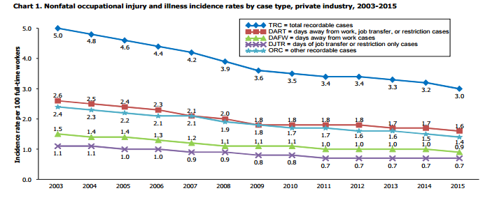
Insurance is an Instrument of Social Policy
Mandated
auto liability insurance
Workers compensation insurance
  In just the last dozen years, Workers Comp insurers have continued to help reduce injury and illness rates in the workplace.
Since 1959 (when IIHS was founded), over half a million deaths in auto crashes avoided
Source for chart: U.S. Dept. of Labor, Bureau of Labor Statistics, “Employer-Reported Workplace Injuries and Illnesses—2015,” released October 27, 2016. Source for IIHS calculation: Robert Hartwig speech at IIHS 50th Anniversary, Sept 9, 2009.
Notes:
59

Slide 60



Insurance Supports New Ventures
Insurance enables individuals and organizations to take new risks, such as venturing into outer space.
In the case of the Falcon 9 launches, insurance is needed for potential damages to
--the launch pad
--nearby government property
--nongovernment property
--the rocket and [$200 million] satellite
Sources: Art: Cover of Contingencies magazine, May-June 2017 issue; headline: http://www.nbcnews.com/science/space/spacex-explains-september-explosion-says-it-ll-try-again-sunday-n702421
Notes:
60

Slide 61
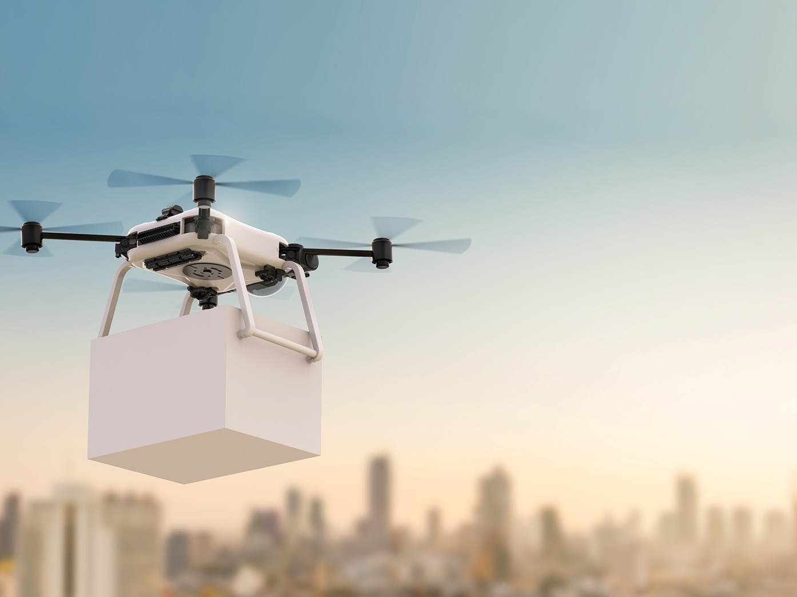
For the Economy, Insurance Is Growing in Importance
This is because economic activity is increasingly interdependent
  This translates to an increase in the need for, and the cost of, activities that ensure the functioning of production and consumption (e.g., transportation, information)
  With modern technology, the vulnerability of these systems and interdependencies increases
Notes:
61

Slide 62
Final Thoughts

Slide 63
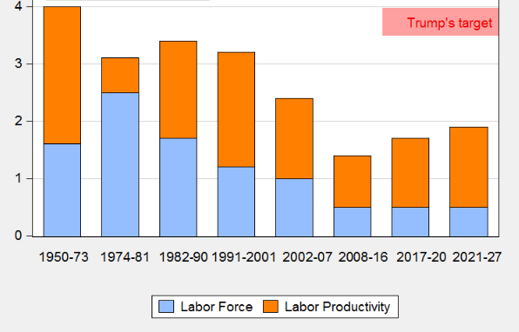
Where Would Economic Growth Come From?
President Trump’s goal of a sustained 4% real annual growth rate will be hard to achieve, even if labor productivity reverses its 21st century slide, because the labor force isn’t growing as rapidly as before, especially if immigration is curtailed.
Source: http://econbrowser.com/archives/2017/05/president-trumps-gdp-forecast

Slide 64
Length of US Business Cycles, 1960–Present*
Duration (Months)
Average Duration*
Recession = 11.75 Mos
Expansion = 72.50 Mos
The length of the expansions greatly exceeds
the length of contractions (recessions).
*Through July 2017; June 2009 was the “official” end of the recession that started in Dec 2007.
Sources: National Bureau of Economic Research; Insurance Information Institute.
64
12/01/09 - 9pm
eSlide – P6466 – The Financial Crisis and the Future of the P/C
Notes:
64

Slide 65
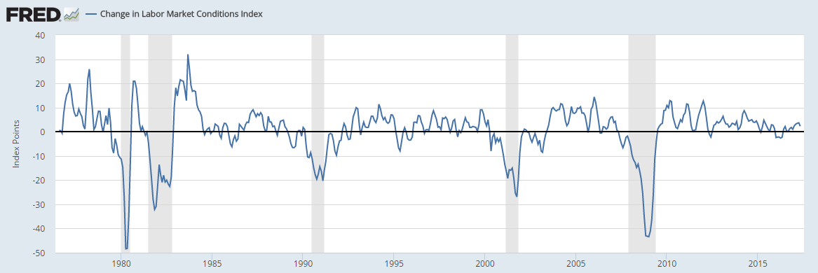

Recession Ahead? The Fed’s “Change in Labor Market Conditions Index” is a Good Indicator
Latest value: 1.5 in June 2017.
Since 1976, we’ve had a recession whenever the Index drops below -15.
Source: https://fred.stlouisfed.org/series/FRBLMCI#0 , last updated May 8, 2017

Slide 66
Summary
The economy seems likely to grow at a modest rate, and property/casualty premiums will grow with them.
Catastrophes are an increasing drag on underwriting results.
Commercial rates may be entering a soft period.
Investment returns continue to be meager; don’t expect changes soon.
Insurance is a cornerstone of the U.S. economy.

Slide 67
Thank you for your time and your attention!
www.iii.org
Download at www.iii.org/presentations

