Slide 1
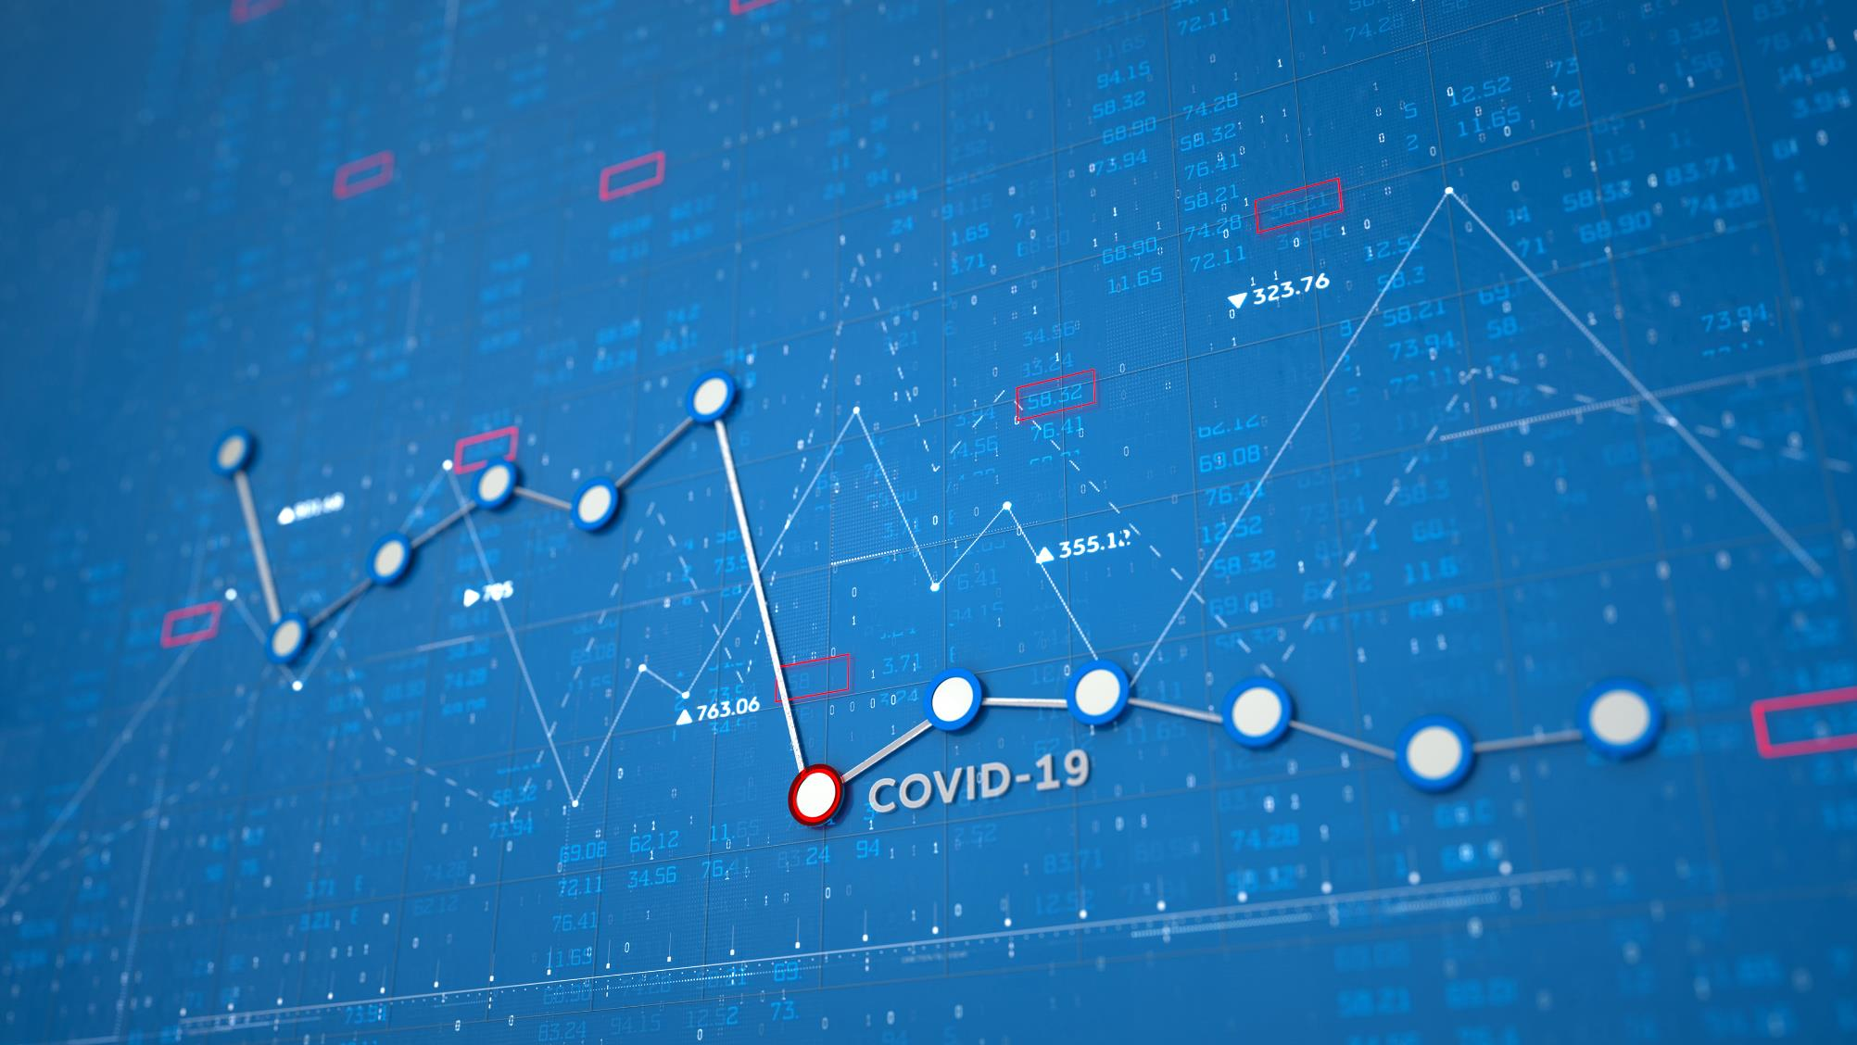
COVID-19 – The Good, the Bad and the Ugly
Tuesday, November 10, 2020
James Lynch, FCAS MAAA, Chief Actuary
Insurance Information Institute
jamesl@iii.org | www.iii.org

Slide 2

COVID-19
Economic and Cultural Impacts: An Industry’s Response

Slide 3
The insurance value chain
How insurance contributes to society
Protecting People & Organizations
Brains + Bank Account
Create Policy/ Treaty
Market Policy/ Treaty
Write Risk
Price Risk
Perform Loss Control
Settle Claims
Improve World
How did the value chain weather the pandemic?

Slide 4
Brains: Industry is preserving its human capital
Steady employment among all four insurance sectors despite the recession
Thousands
2020 Employment Change Through August
2,319.5
2,238.9
Data are seasonally adjusted.
Sources: BLS; Insurance Information Institute.

Slide 5
The bank account – Damage, then recovery
Amount of Surplus ($ Billions)
Change from Prior Quarter
Surplus has rebounded from Q1 decline caused by unrealized capital losses (stock declines).
Sources: ISO, AM Best, Insurance Information Institute.
Notes:
5

Slide 6
Monthly costs of retroactive changes to SME BI policies
Regardless of scenario, retroactive attempts to include pandemics in BI causes bankruptcy
Retroactive BI Scenarios
Higher
Median
Lower
Higher
Median
Lower
1
Virus / Bacteria Exclusion Removal
2
Expanded BI to All SMEs
Key Assumptions
Scenario 1: 40% take-up rate
Scenario 2: 100% take-up rate
Loss basis: Compensation, profits, adjustment costs 7 days waiting period
Retained loss of 10% of total loss
Median estimates are model-driven. The higher and lower estimates assume a standard distribution for BI losses anchored in the mode-driven median loss estimates.

Slide 7
Policy wording: Insurers minimized risk
Insurers understood threat of pandemics well before most
Cumulative Filings
Who Is Suing?
Insurer Defenses
No physical damage
Exclusion for loss due to virus or bacteria (2006)
Source: COVID Coverage Litigation Tracker, cclt.law.upenn.edu

Slide 8
Pricing: Adjusting on the fly
Insurers reacted nimbly to fulfill regulatory needs
$14B in Personal Auto Givebacks
Consumer Price Index – Personal Auto
Sources: Insurance Information Institute, Bureau of Labor Statistics.
Notes:
In first half, most carriers gave direct credits and could be tracked in quarterly statement filings. In second half, much of the reduction will be made via lower rate filings so will be more difficult to track.
Other lines were equally nimble. Workers Compensation created a new class code – 0012 – to cover people who were furloughed but remained on a company’s payroll thanks to the Paycheck Protection Program of the CARES Act. It had to be filed in virtually every state.
The changes also show that insurers were ready to respond, thanks to telematics programs that have been in place at most insurers for a few years. They were able to track real-time driving patterns.
Fewer miles driven overall, but some people had significant increases – presumably delivery people
High risk drivers were more likely to stay on the road
But people drove safer – less frequent braking for example
But drivers were faster – one element of safety they just couldn’t embrace
And a lot of consumers started to see the value of telematics. 40 percent of people who think their driving rates will remain low are interested in telematics-driven insurance products.

Slide 9
Marketing opportunities
Too few knew industry gave back billions, but telematics shone
Did you receive either refund or credit?
Growing embrace of telematics
Percent comfortable with use in pricing
Did insurer tell you it…
Source: Insurance Information Institute, Arity.com

Slide 10
Market challenge: A surge in business interruption media coverage
Count of Stories Mentioning Business Interruption Insurance & COVID-19
Source: Meltwater.

Slide 11
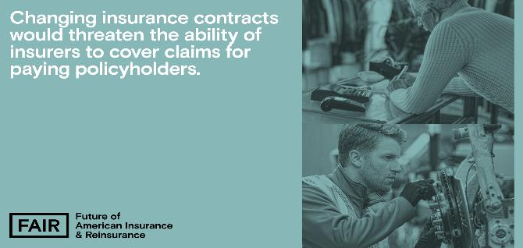
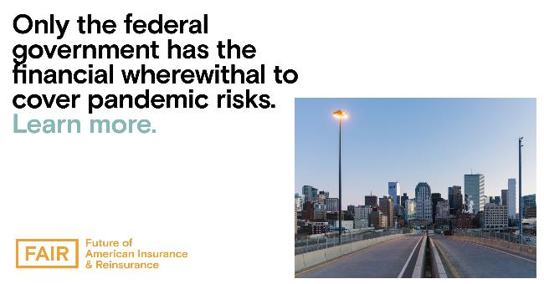
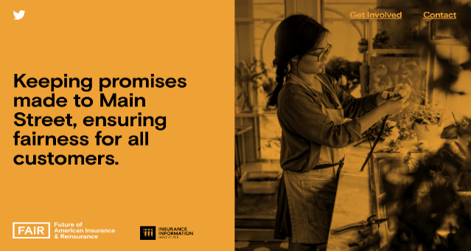

Market challenge: An industry campaign
The Future of American Insurance & Reinsurance (FAIR) campaign launched in May and has served as a source of education surrounding pivotal industry activity, including Congressional hearings, White House roundtables, state legislation, and media stories.
With a separate website, valuable explanatory assets, stakeholder outreach, and digital promotions, this integrated campaign provides the Triple-I with a separate platform and voice to present information in a digestible, influential manner to key audiences.
The campaign takes on overarching industry issues (i.e. business interruption) and emphasizes its essential role in supporting and rebuilding communities in these uncertain times.
www.fairinsure.org

Slide 12
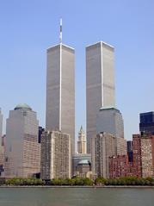
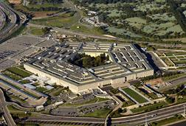
Communications: Global pandemics are uninsurable
Economic Impact of 9/11

Slide 13
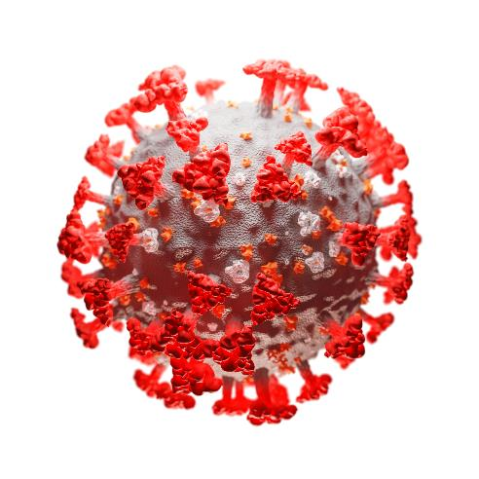
Communications: Global pandemics are uninsurable
Economic Impact of Coronavirus

Slide 14
Settling claims: COVID-19’s claims impact
Losses spread across many lines, but amount is uncertain
Potential Loss Impact
Industrywide Toll
Lloyd’s estimate (May, worldwide) $107B
Reported (through September 12, worldwide): $22.4B
Triple-I estimate: equivalent in US to a significant hurricane ($10B - $50B)
Loss estimates range from $30B (≈ bad hurricane) to $140B (2-3 Katrinas)
Source: Willis Towers Watson, www.Lloyds.com, Reinsurance News, Insurance Information Institute.

Slide 15
A better place: Industry outlook
Commercial Lines Rate Change
Calendar Year Written Premium and Net Combined Ratio Projections
Growth in Nominal GDP (Real GDP + Inflation)
2020 Commentary
Overall premium projected to be flat. Underwriting result deteriorates.
Pandemic and recession reduce exposure in personal auto, several commercial lines.
Rate increases make up for lower exposures somewhat.
Tremendous uncertainty due to pandemic’s impact on several lines.
We assume normal cat year, despite bleak hurricane forecast.
Data sources: NAIC data sourced through S&P Global Market Intelligence, MarketScout, Blue Chip Economic Indicators, Congressional Budget Office, PCS, Aon, Munich Re, Energy Information Agency, FRED (Federal Reserve Bank of St. Louis).
Analysis: Insurance Information Institute, Milliman.

Slide 16
A better place: Six months into COVID-19, news coverage discusses federal policy solution
Number of Stories
Source: Meltwater.

Slide 17
A better place: FAIR guiding principles: A defined perspective on potential policy solutions
Given their universal scope, pandemics are largely uninsurable. Therefore, only the government has the financial capacity to provide the relief small and large businesses need to weather this crisis.
Proposed solutions must:
Maintain the federal government as a primary provider of relief, reflecting the reality that pandemic risks are not privately insurable.
Provide widely accessible relief payments to businesses in a fast and efficient manner once a pandemic is declared by the government, with minimal chance of abuse.
Protect businesses from losses, and incentivize businesses to retain employees, without jeopardizing insurers' existing commitments.

Slide 18
Stepping Up
America's Insurers:
for Customers, Communities, and Employees
The insurance industry is applying forward-thinking solutions to take care of its customers, communities, and employees during the COVID-19 crisis
Customers
Community
Employees
Industry
Auto insurers have returned $14 billion so far to customers' pockets around the country through premium relief
Insurers have pledged more than an estimated $280 million (according to III/Insurance Industry Charitable Foundation) in donations to the national and local organizations fighting this pandemic on the frontlines
Employing more than 2.8 million Americans, Insurers are taking care of their employees–many pledging no layoffs during the ongoing crisis
Insurers are implementing innovative solutions to carrying out daily operations while respecting social distancing

