Slide 1
Insurance 2020
Casualty Actuaries of Greater New York
December 9, 2020
James Lynch, FCAS MAAA, Chief Actuary and Senior Vice President, Research and Education
Insurance Information Institute  110 William Street  New York, NY 10038 Tel: 212.346.5533  jamesl@iii.org  www.iii.org

Slide 2
The Financial Picture
2020: COVID and Cats

Slide 3
P/C Insurance Industry Combined Ratio*
Hurricanes Harvey, Irma, Maria
3 Consecutive Years of U/W Profits; 1st time since 1971-73
*Excludes Mortgage & Financial Guaranty insurers before 2014. Including M&FG, 2008=105.1, 2009=100.7, 2010=102.4, 2011=108.1; 2012:=103.2; 2013: = 96.1; 2014: = 97.0.
Sources: A.M. Best; APCIA/ISO, a Verisk Analytics® business; I.I.I/Milliman.

Slide 4
P/C Industry Net Income After Taxes 2002-Present
$ Billions
Sources: NAIC data, sourced from S&P Global Market Intelligence.

Slide 5
Industry Outlook
Commercial Lines Rate Change
Calendar Year Written Premium Net Combined Ratio Projections
Growth in Nominal GDP (Real GDP + Inflation)
2020 Commentary
Slight rise in premium. Underwriting result deteriorates.
Pandemic and recession reduce exposure in personal auto, several commercial lines.
Rate increases make up for lower exposures somewhat.
Tremendous uncertainty due to pandemic’s impact on several lines.
Above-average cat year.
Data sources: NAIC data sourced through S&P Global Market Intelligence, MarketScout, Blue Chip Economic Indicators, Congressional Budget Office, PCS, Aon, Munich Re, Energy Information Agency, FRED (Federal Reserve Bank of St. Louis).
Analysis: Insurance Information Institute, Milliman.

Slide 6
The Personal Lines Picture

Slide 7
Direct Written Premium Growth By Year
HO growth more stable than auto, which grew in response to rising costs till recently.
Through Q2. Personal auto liability only.
Sources: NAIC data, sourced from S&P Global Market Intelligence.

Slide 8
Personal Lines Results
Personal auto has returned to underwriting profitability. Homeowners results depend on catastrophe season.
Source: NAIC data, sourced from S&P Global Market Intelligence.

Slide 9
HO Trend: Catastrophe Losses
Harvey, Irma, Maria
2019 was a relatively mild year; 2020 hit by multiple hurricanes, widespread wildfires – mostly in second half
*Aon estimate through June. 2010s is average of 2010 to 2019. All losses are Direct.
Sources: Property Claims Service, a Verisk Analytics business; Aon; Insurance Information Institute.

Slide 10
Auto Trends
Americans stopped driving
Frequency, severity trends
Source: Federal Highway Administration, Fast Track Monitoring System.

Slide 11
The Commercial Lines Picture
2020 Was Looking Good

Slide 12
Commercial Lines Results
Excellent workers comp results have more than made up for problems in auto, general liability.
Source: NAIC data, sourced from S&P Global Market Intelligence.

Slide 13
Commercial Direct Loss Ratios by Line
Allied Lines, Mortgage and Inland Marine results deteriorated in first half; note Auto, GL deteriorated (slightly), even in hard market.
Through Q2.
Source: NAIC data, sourced from S&P Global Market Intelligence.

Slide 14
Commercial Lines Rate Changes
Fastest rate increases in almost 20 years.
Sources: Willis Towers Watson, MarketScout, Marsh.

Slide 15
Commercial Rate Changes
By Line, 2020:Q3
All of these are larger than previous quarter. Overall, largest rate increases in almost 20 years.
Source: MarketScout.

Slide 16
Reserving Trends
Is the cupboard getting bare?
CY2019 Loss Development
CY Development on Older* Claims as of Mid-Year
* Older claims are more than 42 months old, e.g. 2017 and prior as of Q22020.
Source: NAIC data, sourced from S&P Global Market Intelligence.

Slide 17
2021 Forecast
Social inflation, uncertainty drive the hard market
Rate Projections
Market Influences
Line | 2021 Forecast
Property | Up 15 to 25%
GL | Up 7.5% to 15%
Umbrella/XS | Up 30% to 150%
WC | Flat
Comm Auto | Up 8% to 15%
D&O | Up to 70%
Cyber | Up 10% to 30%
Line | Trend
Property | Cats, COVID
GL | Social inflation
Umbrella/XS | Social inflation
WC | COVID
Comm Auto | Social inflation
D&O | COVID, IE&D
Cyber | COVID
These are all higher than spring projections.
Source: Willis Insurance Marketplace Realities, November 2020.

Slide 18
Social Inflation
An Actuarial Examination

Slide 19
Social Inflation
Coming to Terms
A Good Definition
“a fancy term to describe rising litigation costs and their impact on insurers’ claim payouts, loss ratios, and, ultimately, how much policyholders pay for coverage.”
Actuarial Interpretation
“Excessive inflation in claims.”
Occurs when development defies key assumption: Loss Development is RV about stable mean

Slide 20
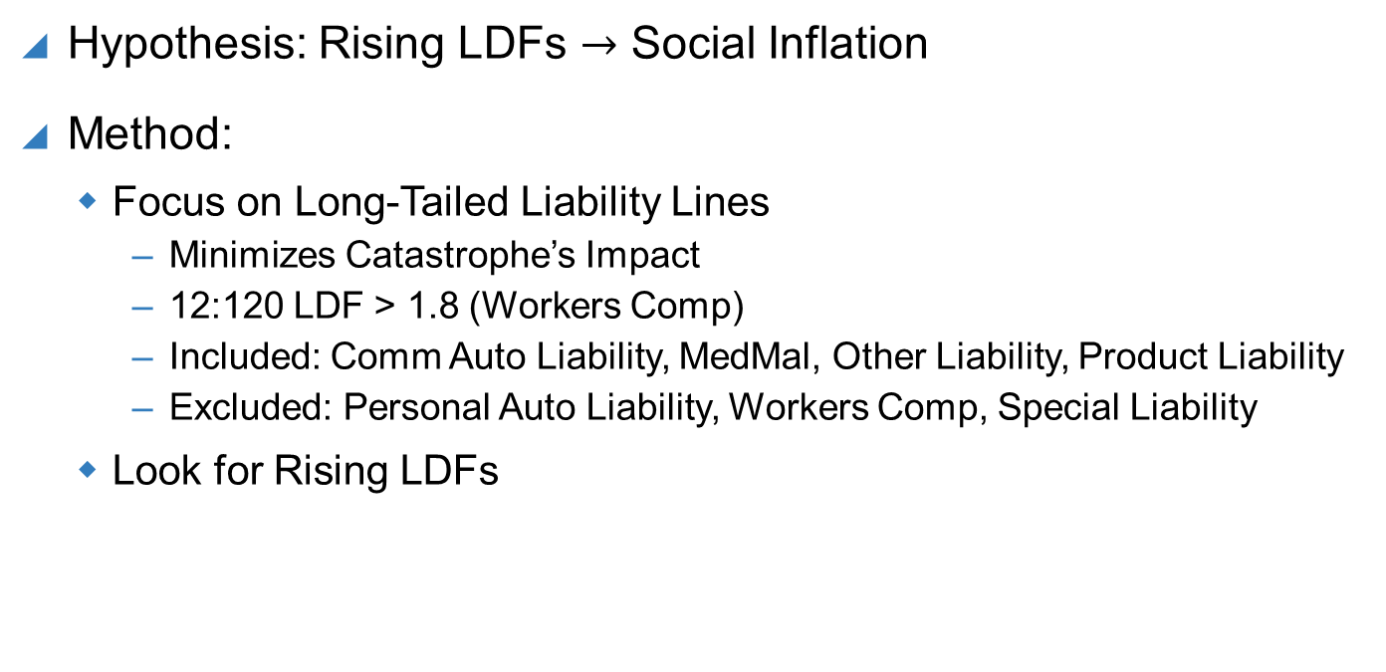
Triple-I Analysis
What We Studied and Why
Hypothesis: Rising LDFs $→$ Social Inflation
Method:
Focus on Long-Tailed Liability Lines
Minimizes Catastrophe’s Impact
12:120 LDF > 1.8 (Workers Comp)
Included: Comm Auto Liability, MedMal, Other Liability, Product Liability
Excluded: Personal Auto Liability, Workers Comp, Special Liability
Look for Rising LDFs

Slide 21
Upward Creep in Loss Development
Key Assumption: LDF is RV about mean + inflation
Comm Auto LDFs
2-Year Expected vs. Actual
 | 12 | 24 | 36 | 48
2009 | 1.34 | 1.14 | 1.08 | 1.03
2010 | 1.36 | 1.16 | 1.08 | 1.04
2011 | 1.40 | 1.16 | 1.08 | 1.04
2012 | 1.40 | 1.16 | 1.09 | 1.04
2013 | 1.41 | 1.18 | 1.10 | 1.04
2014 | 1.42 | 1.19 | 1.10 | 1.05
2015 | 1.45 | 1.18 | 1.11
2016 | 1.43 | 1.20
2017 | 1.44
12-36 Development ($ Millions)
Source: NAIC data, sourced from S&P Global Intelligence; Insurance Information Institute. Expected: 3-yr Straight Average.

Slide 22
Social Inflation: The Toll
Reserve Development, Commercial Auto Liability
Millions
Additions to Claim Reserves
Reductions from Claim Reserves
Sources: NAIC data sourced from S&P Market Intelligence; Insurance Information Institute.

Slide 23
It’s Not Just Auto
12:36 Loss Development Factors by Year, Long-Tailed Lines
Commercial Auto
MedMal Claims-Made
Other Liability Occurrence
Other Long-Tailed Lines*
Medical Malpractice Occurrence, Other Liability Claims-Made, Products Liability Occurrence, Products Liability Claims-Made.
Estimate assumes 24:36 Factor is straight average of previous three years.
Source: NAIC data, sourced from S&P Global Market Intelligence; Insurance Information Institute.

Slide 24
Why It Is Happening
Why Social Inflation Hits Insurance
Overall Inflation Remains Steady
Who Solves Problems?
Sources: Bureau of Labor Statistics (via FRED), Gallup.

Slide 25
Why Is It Happening?
Dystopian Days
Social Trends Set the Stage
Big Payout Expectations
Sources: Wikipedia, Economic Policy Institute, Centers for Disease Control, Google Trends.

Slide 26
Why Is It Happening?
The Changing Legal Environment
“Jackpot Justice”
Litigation Financing
Litigation is a financeable asset.
- 68% of US Law Firms
Sources: Swiss Re Economic Insights, Burford Capital.

Slide 27
COVID-19 and Insurance

Slide 28
The insurance value chain
How insurance contributes to society
Protecting People & Organizations
Brains + Bank Account
Create Policy/ Treaty
Market Policy/ Treaty
Write Risk
Price Risk
Perform Loss Control
Settle Claims
Improve World
How did the value chain weather the pandemic?

Slide 29
Brains: Industry is preserving its human capital
Steady employment among all four insurance sectors despite the recession
Thousands
2020 Employment Change (Through August)
2,319.5
2,238.9
Data are seasonally adjusted.
Sources: BLS; Insurance Information Institute.

Slide 30
The bank account – Damage, then recovery
Amount of Surplus ($ Billions)
Change from Prior Quarter
Surplus has rebounded from Q1 decline caused by unrealized capital losses (stock declines).
Sources: ISO, AM Best, Insurance Information Institute.
Notes:
30

Slide 31
Monthly costs of retroactive changes to SME BI policies
Regardless of scenario, retroactive attempts to include pandemics in BI causes bankruptcy
Retroactive BI Scenarios
Higher
Median
Lower
Higher
Median
Lower
1
Virus / Bacteria Exclusion Removal
2
Expanded BI to All SMEs
Key Assumptions
Scenario 1: 40% take-up rate
Scenario 2: 100% take-up rate
Loss basis: Compensation, profits, adjustment costs 7 days waiting period
Retained loss of 10% of total loss
Median estimates are model-driven. The higher and lower estimates assume a standard distribution for BI losses anchored in the mode-driven median loss estimates.
Source: Insurance Information Institute.

Slide 32
Policy wording: Insurers minimized risk
Insurers understood threat of pandemics well before most
Cumulative Filings
Who Is Suing?
Insurer Defenses
No physical damage
Exclusion for loss due to virus or bacteria (2006)
Source: COVID Coverage Litigation Tracker, cclt.law.upenn.edu

Slide 33
Pricing: Adjusting on the fly
Insurers reacted nimbly to fulfill regulatory needs
$14B in Personal Auto Givebacks
Consumer Price Index – Personal Auto
Sources: Insurance Information Institute, Bureau of Labor Statistics.

Slide 34
Marketing opportunities
Too few knew industry gave back billions, but telematics shone
Did you receive either refund or credit?
Growing embrace of telematics
Percent comfortable with use in pricing
Did insurer tell you it…
Source: Insurance Information Institute, Arity.com

Slide 35
Market challenge: A surge in business interruption media coverage
Count of Stories Mentioning Business Interruption Insurance & COVID-19
Source: Meltwater.

Slide 36
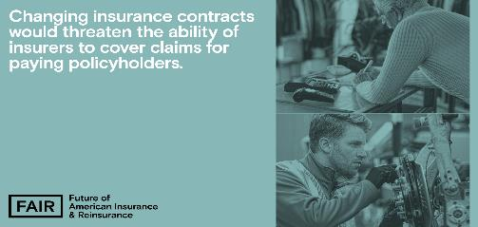
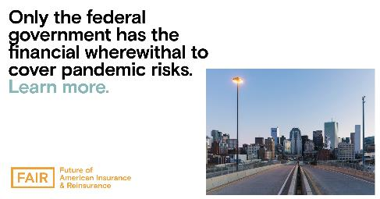
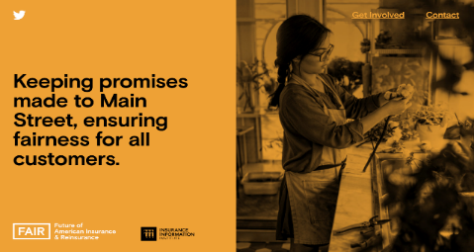

Market challenge: An industry campaign
The Future of American Insurance & Reinsurance (FAIR) campaign launched in May and has served as a source of education surrounding pivotal industry activity, including Congressional hearings, White House roundtables, state legislation, and media stories.
With a separate website, valuable explanatory assets, stakeholder outreach, and digital promotions, this integrated campaign provides the Triple-I with a separate platform and voice to present information in a digestible, influential manner to key audiences.
The campaign takes on overarching industry issues (i.e. business interruption) and emphasizes its essential role in supporting and rebuilding communities in these uncertain times.
www.fairinsure.org

Slide 37
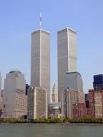

Communications: Global pandemics are uninsurable
Economic Impact of 9/11

Slide 38
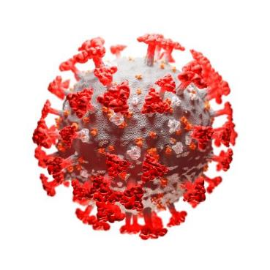
Communications: Global pandemics are uninsurable
Economic Impact of Coronavirus

Slide 39
Settling claims: COVID-19’s claims impact
Losses spread across many lines, but amount is uncertain
Potential Loss Impact
Industrywide Toll
Lloyd’s estimate (May, worldwide) $107B
Reported (through September 12, worldwide): $22.4B
Triple-I estimate: equivalent in US to a significant hurricane ($10B - $50B)
Loss estimates range from $30B (≈ bad hurricane) to $140B (2-3 Katrinas)
Source: Willis Towers Watson, www.Lloyds.com, Reinsurance News, Insurance Information Institute.

Slide 40
A better place: Six months into COVID-19, news coverage discusses federal policy solution
Number of Stories
Source: Meltwater.

Slide 41
A better place: FAIR guiding principles: A defined perspective on potential policy solutions
Given their universal scope, pandemics are largely uninsurable. Therefore, only the government has the financial capacity to provide the relief small and large businesses need to weather this crisis.
Proposed solutions must:
Maintain the federal government as a primary provider of relief, reflecting the reality that pandemic risks are not privately insurable.
Provide widely accessible relief payments to businesses in a fast and efficient manner once a pandemic is declared by the government, with minimal chance of abuse.
Protect businesses from losses, and incentivize businesses to retain employees, without jeopardizing insurers' existing commitments.

Slide 42
Stepping Up
America's Insurers:
for Customers, Communities, and Employees
The insurance industry is applying forward-thinking solutions to take care of its customers, communities, and employees during the COVID-19 crisis
Customers
Community
Employees
Industry
Auto insurers have returned $14 billion so far to customers' pockets around the country through premium relief
Insurers have pledged more than an estimated $280 million (according to III/Insurance Industry Charitable Foundation) in donations to the national and local organizations fighting this pandemic on the frontlines
Employing more than 2.8 million Americans, Insurers are taking care of their employees–many pledging no layoffs during the ongoing crisis
Insurers are implementing innovative solutions to carrying out daily operations while respecting social distancing

Slide 43
Thank you for your time and your attention!

