Slide 1
The Age of Extreme Weather
Casualty Actuarial Society Spring Meeting
May 21, 2019
New Orleans, Louisiana
James Lynch, FCAS MAAA, Chief Actuary
Insurance Information Institute  110 William Street  New York, NY 10038
Tel: 212.346.5533  jamesl@iii.org  www.iii.org

Slide 2

I.I.I. Mission Statement
Improving public understanding
of insurance...
…what it does and how it works.
2

Slide 3
Catastrophes
Extreme Weather Threatens Union

Slide 4
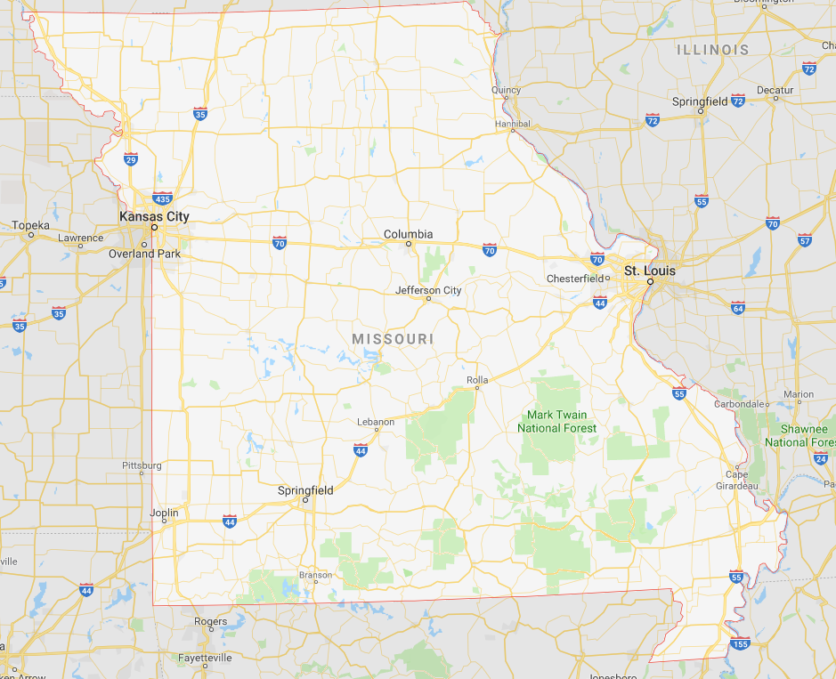
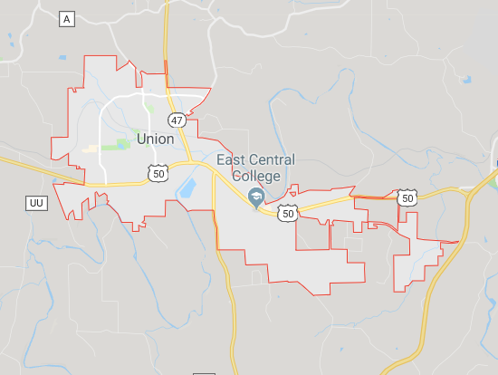
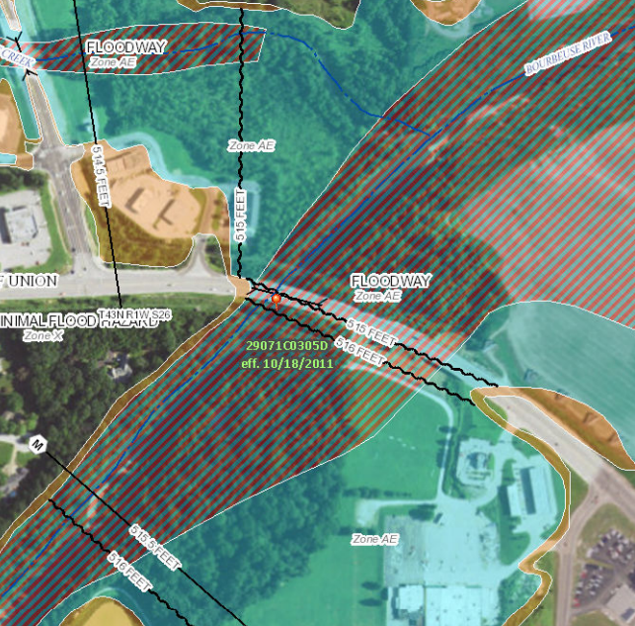
A Small Town in Missouri

Slide 5
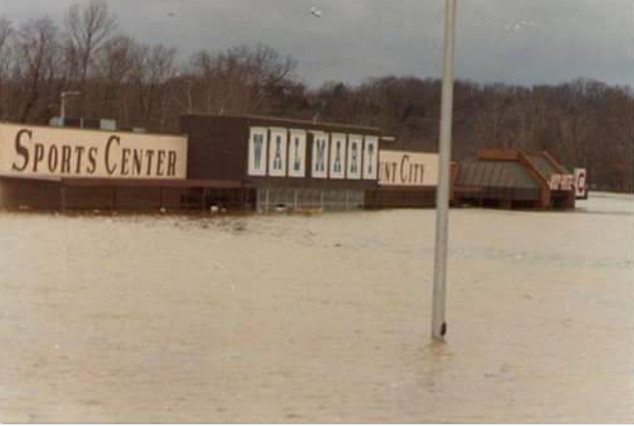
1982 Union, Missouri, Flood
A Storm for the Ages
Bourbeuse River
Record Crest
33.8 feet
12/5/1982
Source: Fox2News.com, @BoxxRadio.

Slide 6
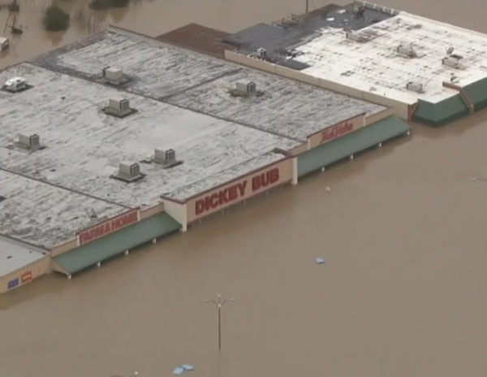
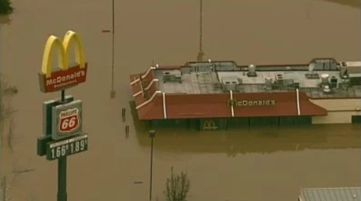
2015 Union, Missouri, Flood
A Storm for the Ages
Bourbeuse River
Record Crest
34.3 feet
12/29/2015
Sources: CBSnews.com; fox2news.com

Slide 7
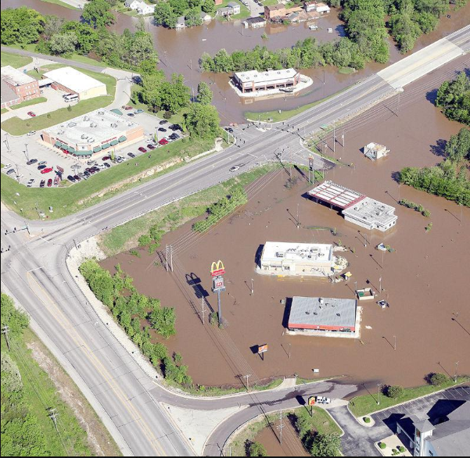
2017 Union, Missouri, Flood
Bourbeuse River
Crest
29.4 feet
May 2-3, 2017
“Unfortunately, it’s a river and Mother Nature.
And we can’t control her.”
 | Crest (feet) | Year
1 | 34.31 | 2015
2 | 33.80 | 1982
3 | 29.38 | 2017
4 | 28.50 | 1915
5 | 27.77 | 1994
6 | 26.37 | 1993
7 | 25.89 | 2008
8 | 24.53 | 2000
9 | 24.44 | 1957
10 | 23.89 | 2005
 | Crest (feet) | Year
1 | 0.40 | 1936
2 | 0.40 | 1948
3 | 0.40 | 1948
4 | 0.50 | 1976
5 | 0.55 | 2014
6 | 0.64 | 2012
7 | 0.68 | 2000
8 | 0.78 | 2001
9 | 0.80 | 1996
10 | 1.14 | 2007
Source: eMissourian.com, National Weather Service.

Slide 8
Extreme Events: A Troubling Trend
Rank | Date | Event | Cause | Insured Loss (1) ($ millions)
1 | Aug. 2005 | Hurricane Katrina | Hurricane | $41,100
2 | Sep. 2017 | Hurricane Maria (2) | Hurricane | 25,000-30,000
3 | Sep. 2017 | Hurricane Irma (2) | Hurricane | 20,000-25,000
4 | Sep. 2001 | September 11 Events | Terrorism | 18,779
5 | Oct. 2012 | Hurricane Sandy | Hurricane | 18,750
6 | Aug. 2017 | Hurricane Harvey (2) | Hurricane | 16,000-19,000
7 | Aug. 1992 | Hurricane Andrew | Hurricane | 15,500
8 | Jan. 1994 | Northridge, CA earthquake | Earthquake | 12,500
9 | Sep. 2008 | Hurricane Ike | Hurricane | 12,500
10 | Oct. 2005 | Hurricane Wilma | Hurricane | 10,300
(1) Dollars when occurred.
(2) Insurance Information Institute estimate based on data from catastrophe risk modelers, the Property Claims Services unit of Verisk Analytics, et al.
Source: Insurance Information Institute, catastrophe risk modelers, The Property Claim Services® (PCS®) unit of ISO®, a Verisk Analytics® company, et al.

Slide 9
U.S. Inflation-Adjusted Insured Cat Losses
Harvey, Irma, Maria
2018 – Third worst year for U.S. Insured Catastrophe Losses. Average Insured Loss per Year for 1980-2018 is $19.3 B.
*2018: Inflation-adjusted estimate, subject to change. 2010s is average of 2010 to 2018. All losses are Direct.
Sources: Property Claims Service, a Verisk Analytics business; Insurance Information Institute.

Slide 10










How Insurance Drives Economic Growth
Safety/
Security
Economic/
Financial Stability
Development
Insurers are financial first responders
Insurers are capital protectors
Insurance is a partner in social policy
Insurers are community builders
Insurance enables infrastructure improvements
Insurers
are risk mitigators
Insurance sustains the supply chain
Insurers are capital infusers
Insurers are innovation catalysts
Insurers are credit facilitators
Notes:
10

Slide 11
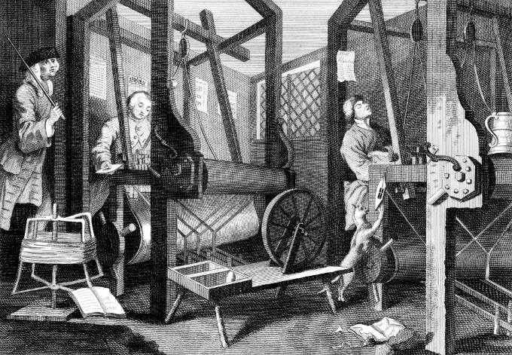
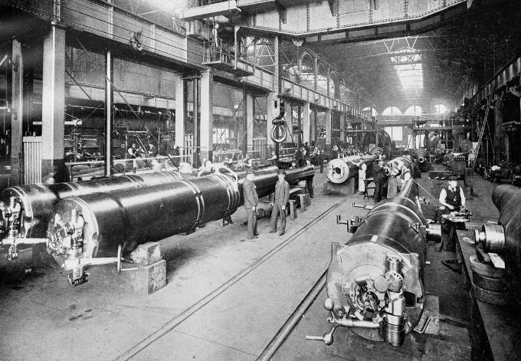


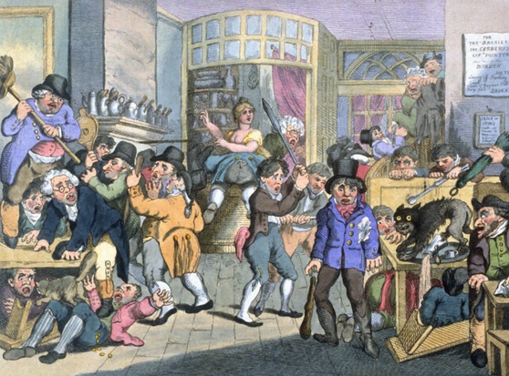
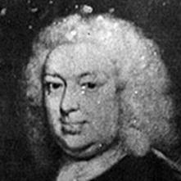
Insurance Leading Throughout History
???
1969
1870
1784
1648
Edward Lloyd’s Coffee House
Steam, Water, Mechanical Production
Division of Labor, Electricity, Mass Production
Electronics, IT, Automated Production
Cyber-Physical Systems

Slide 12
Underwriting Solutions

Slide 13




(Re)insurance Products
Private Industry
Case Studies
FEMA Reinsurance
Through a $150 million purchase of private reinsurance products, FEMA was able to recover approximately $1 billion, or an eighth of its total 2017 loses.
40%
2018 FEMA Reinsurance
NFIP NatCat Bonds
By issuing new natural catastrophe bonds geared towards institutional investors, the NFIP can bring an estimated $500 million of additional reinsurance coverage.
Private Market Flood Products
During 2017, the private flood insurance market added 50 new carriers. Direct private flood insurance premiums written reached $630 million, an increase of $217 million over 2016.
Source: Insurance Journal; Houston Chronicle; Insurance Journal.

Slide 14
Case Study: Offshore Wind Power

Slide 15
Growth of Wind Power Capacity in the U.S.
Gigawatts
By 2050 total wind power capacity across 48 states will be 404.25 gigawatts, an increase of 180.15 gigawatts from 2030
Source: Energy.gov
Notes:
15

Slide 16
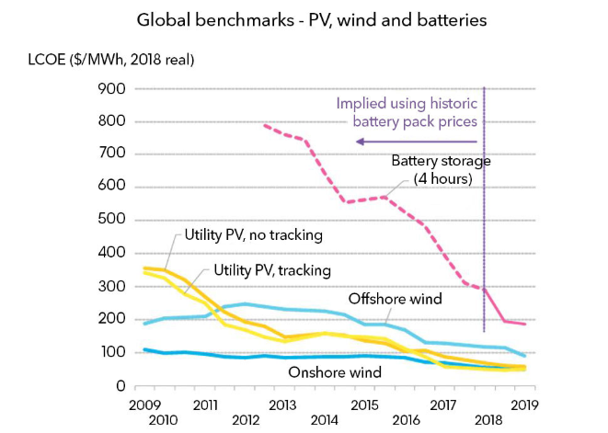
Cost of Alternative Energies is Falling
LOCO: Levelized cost of energy – cost of producing MWh of electricity, accounting for cost of development, construction and equipment, financing, feedstock, operation and maintenatnce
Source: BloombergNEF.

Slide 17
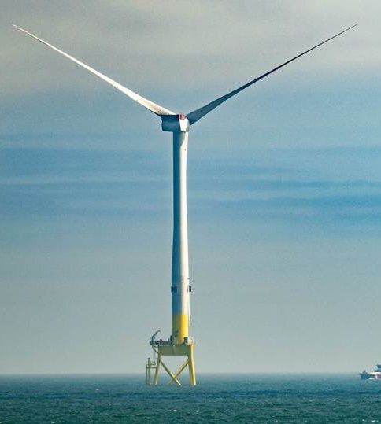
Offshore wind farms pros and cons
Pros
Offshore wind speeds are faster and steadier than on land
Meet energy needs of high-density coastal areas
Renewable energy with no pollution
Domestic energy source
Jobs
Cons
Expensive and difficult to build
and maintain
Effects on marine animals and
birds are not fully understood
May be unpopular with residents
Source American Geosciences Institute
Notes:
17

Slide 18
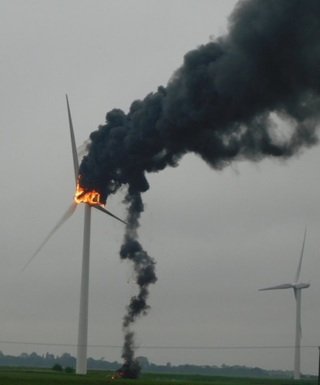
Key risks faced by wind farms
Risk | Insurance
Cargo in transit | Marine
Construction problems | Construction delay cover
Mechanical, cable issues | Property damage cover
Lightning strike | Business interruption
Terrorism | Political risk
‘Wind drought’ | Weather hedge
Source: Willis Towers Watson, WindPower, JLT Group.
Notes:
18

Slide 19
Education Solutions

Slide 20
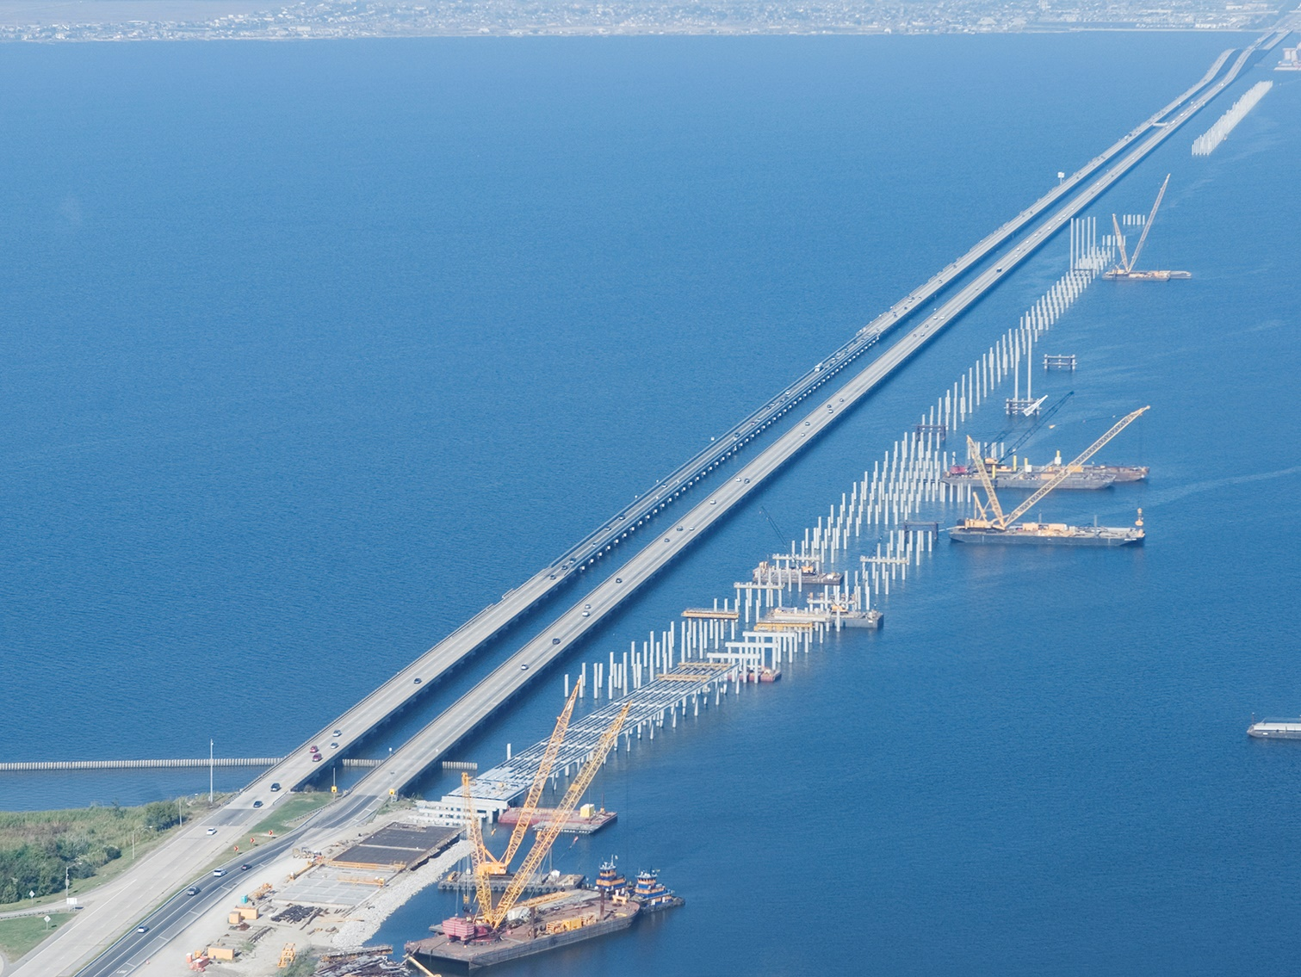
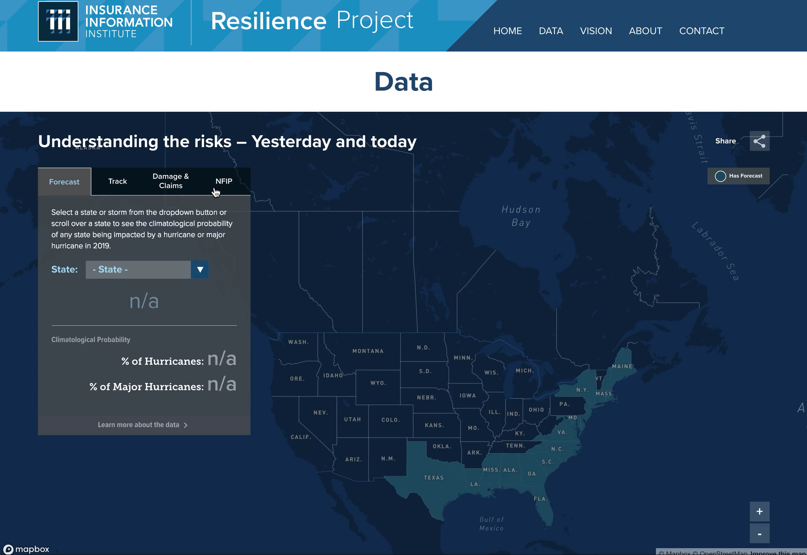

I.I.I. Resilience Project
Data transformed to show
the power of resilience.
Powered by:

Slide 21
Education & Analysis
Actuaries Climate Index – Measuring Weather Extremes
Index Measures Frequency of Extreme Events (Heat, Cold, Drought, Wind, Rain, Sea Level) Vs. 1961-1990 Average
Source: Actuaries Climate Index, http://actuariesclimateindex.org/home/

Slide 22
Summary
Extreme Weather is a Growing Problem Worldwide
Insurance Traditionally Manages Emerging Risks
Insurers Are Taking an Educational Role

Slide 23
Thank you for your time and your attention!

