Slide 1
Catastrophe Models: What Can Go Worng
Casualty Actuarial Society Annual Meeting
Honolulu, HI
November 11 & 13, 2019
James Lynch, FCAS MAAA, Chief Actuary
Insurance Information Institute  110 William Street  New York, NY 10038 Tel: 212.346.5533  jamesl@iii.org  www.iii.org

Slide 2
I.I.I. Mission Statement
The trusted source of unique, data-driven insights on insurance. . .
…to inform and empower consumers.
2

Slide 3
What is a Model?
A Definition
Components
“A simplified representation of relationships among real world variables, entities or events using statistical, financial, economic, mathematical or scientific concepts and equations.”
Information (Input)
Processing Component (turns input into estimate)
Output Component (translates estimates into useful business information)
Source: Actuarial Standards Board (proposed standard).

Slide 4
A Simple Model
It’s in the Bible!
Red Sky in the Morning . . .
Issues
“When in evening, ye say, it will be fair weather: For the sky is red. And in the morning, it will be foul weather today; for the sky is red and lowering.”
- Matthew 16:2-3
Pros
Easy to Understand, Use
Time-tested
Cons
Not Mutually Exclusive and Exhaustive
Insufficiently Quantitative for Actuarial Analysis
Red Sky at Night . . .
Source: Photos from Wikimedia Commons.

Slide 5
The Traditional Actuarial Model
Nonwind vs. Nonexcess Wind vs. Excess Wind
Source: Mark Homan, “Homeowners Insurance Pricing.”

Slide 6
The Traditional Actuarial Model
An Assessment
Not Too Bad for Pricing
The System Worked . . .
Leveraged Internal Data
Worked Fairly Well – Property Lines Were Profitable Across Time
Still in Syllabus, Still in Use
No Projection for Individual Events (PCS Did That)
Didn’t Really Work for Capital Management
. . . Until It Didn’t
Source: New York Times, Insurance Information Institute.

Slide 7
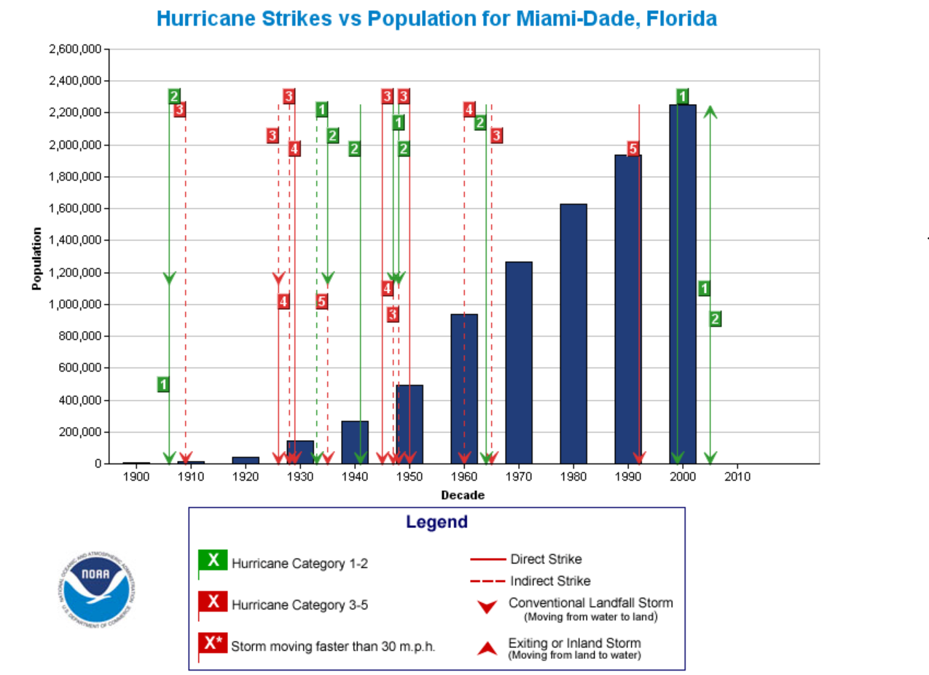
Hurricane Andrew: What Happened?
Why Did the Models Fail?
Hurricanes w/in 75 Miles of Miami, 1964-1990
Lots of People, Few Storms
Isbell, 1964, Cat 3
David, 1979, Cat 1
Floyd, 1987, Cat 1
Inez, 1966, Cat 1
Betsy, 1965, Cat 3
Cleo, 1964, Cat 2
Source: National Oceanic and Atmospheric Administration.

Slide 8
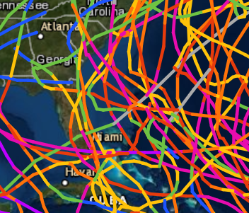
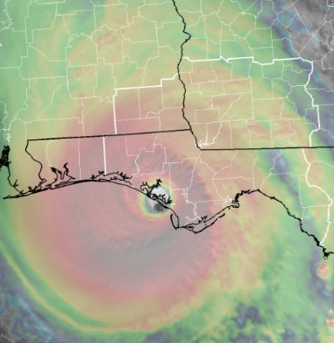
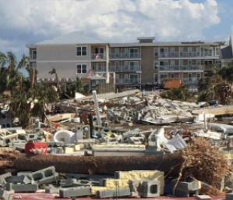
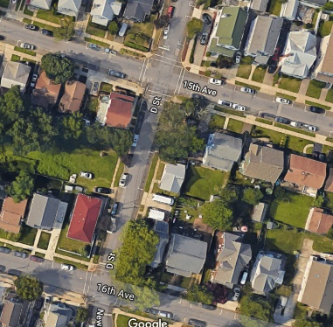
Anatomy of a Cat Model
One Model . . . Or Six?
Event Generation
Intensity Calculation
$
Damage Estimation
Financial Calculation
Exposure Information
Policy Conditions

Slide 9
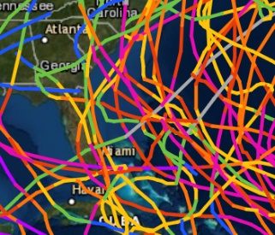
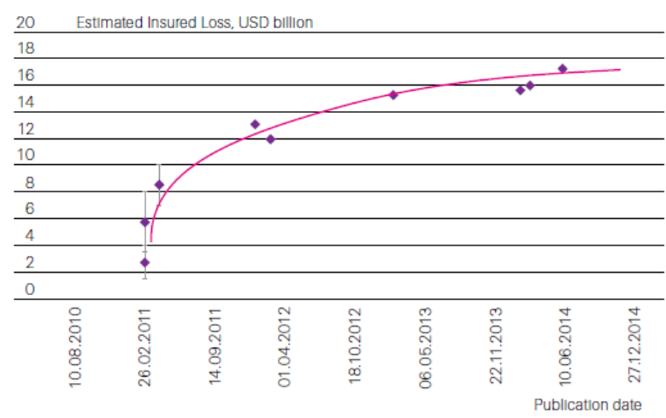
Event Generation
Finding Fault
NZ Active Faults
Who Knew?
Major Faults in NZ Are Far From Christchurch
Faults That Ruptured Were Unknown
NZ EQC Claims Staff: 49 to 1,000 One Month
Source: Te Ara, the Encyclopedia of New Zealand, Swiss Re.

Slide 10
Intensity Calculation
We Learn From Every Event … For a Long Time
A Silly Little Millibar
Andrew: the Great Validator
Ambient (Far Field) Atmospheric Pressure Lowered to 1012 From 1013 MBs
Impact of 1 MB Change
20% Reduction
Sources: Image from National Oceanic and Atmospheric
Administration; BAMS (Bulletin of the American Meteorological
Society).

Slide 11
Exposures
When Is a Barge a Building?
When It’s a Casino.

Slide 12
Damages, Insurance & Money
Lots of Lessons
Demand Surge
Business Interruption
Lessons from Andrew
Lessons from 2004-2005
Policy Terms
Christchurch: Uncapped Replacement Cost (Bring Up to Code)
RC > Insured Sum
Source: Swiss Re, Insurance Information Institute.

Slide 13
Summary
Catastrophe Models Aren’t Perfect (What Is?)
The Industry is Young
It is Improving
It is Much Better Than What Preceded It

Slide 14
Thank you for your time and your attention!

