Slide 1
What’s Driving the P/C Industry?
CAS Webinar
October 11, 2018
Steven Weisbart, chief economist
James Lynch, FCAS MAAA, chief actuary
Insurance Information Institute  110 William Street  New York, NY 10038
212.346.5520  jenniferh@iii.org  www.iii.org

Slide 2
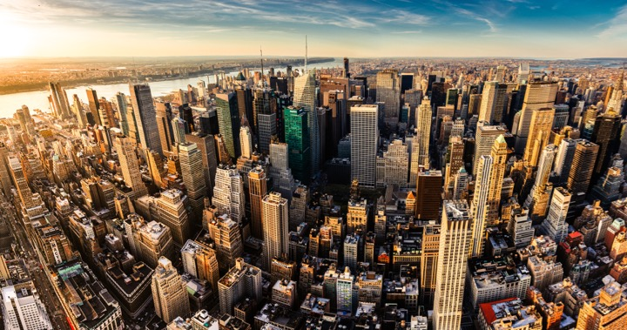
I.I.I. Mission Statement
Improving public understanding
of insurance...
…what it does and how it works
2

Slide 3










10 Key Ways Insurance Drives Economic Growth
Safety/
Security
Economic/
Financial Stability
Development
Insurers are financial first responders
Insurers are capital protectors
Insurance is a partner in social policy
Insurers are community builders
Insurance enables infrastructure improvements
Insurers
are risk mitigators
Insurance sustains the supply chain
Insurers are capital infusers
Insurers are innovation catalysts
Insurers are credit facilitators
Notes:
At III one of the jobs we’ve been doing this year is telling everybody how important insurance is. We have a white paper and a video that talk about this. We all know how we provide safety, but we also make the entire financial system more stable – and we are keys to development.

Slide 4
The State of Resilience
A Case Study: Flood Risk

Slide 5
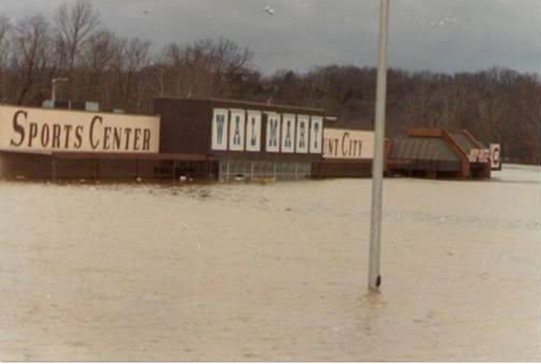
1982 Union, Missouri, Flood
A Storm for the Ages
Bourbeuse River
Record Crest
33.8 feet
12/5/1982
Source: Fox2News.com, @BoxxRadio.

Slide 6
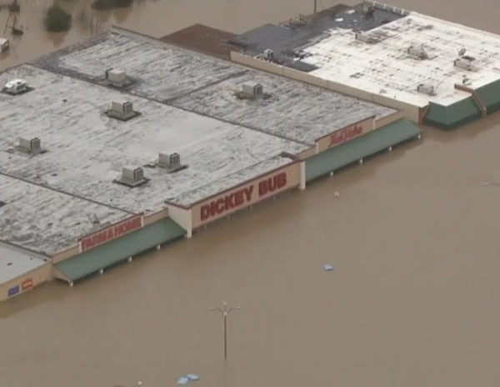
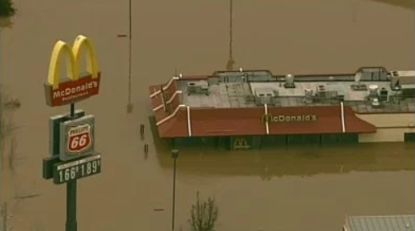
2015 Union, Missouri, Flood
A Storm for the Ages
Bourbeuse River
Record Crest
34.3 feet
12/29/2019
Sources: CBSnews.com; fox2news.com

Slide 7
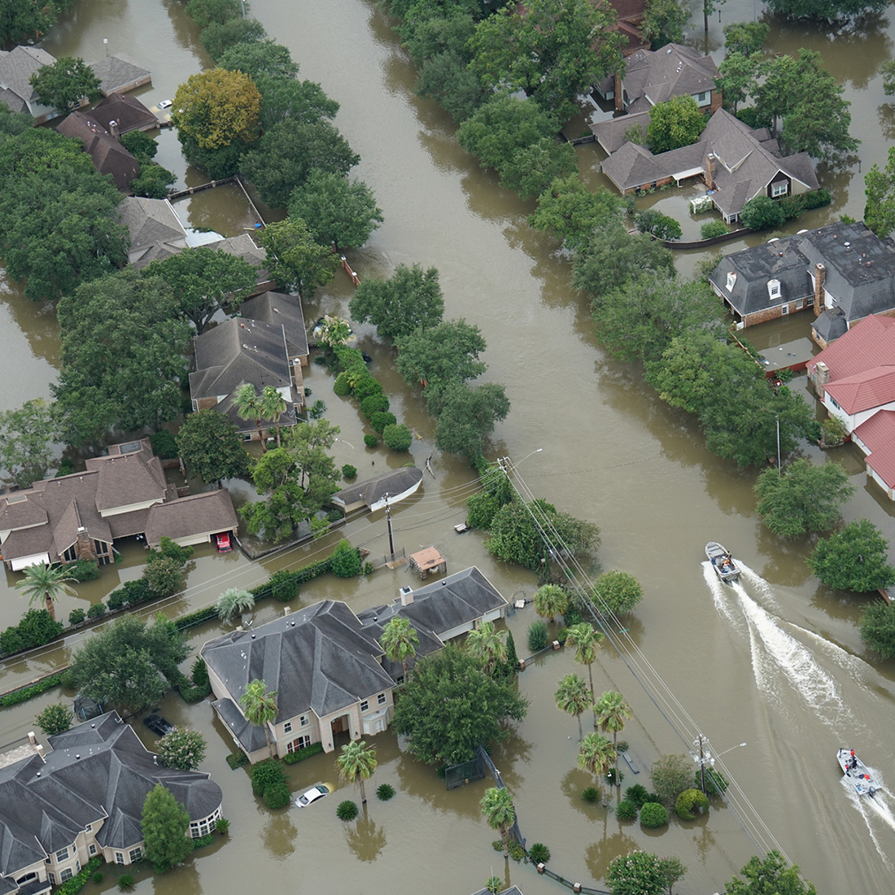
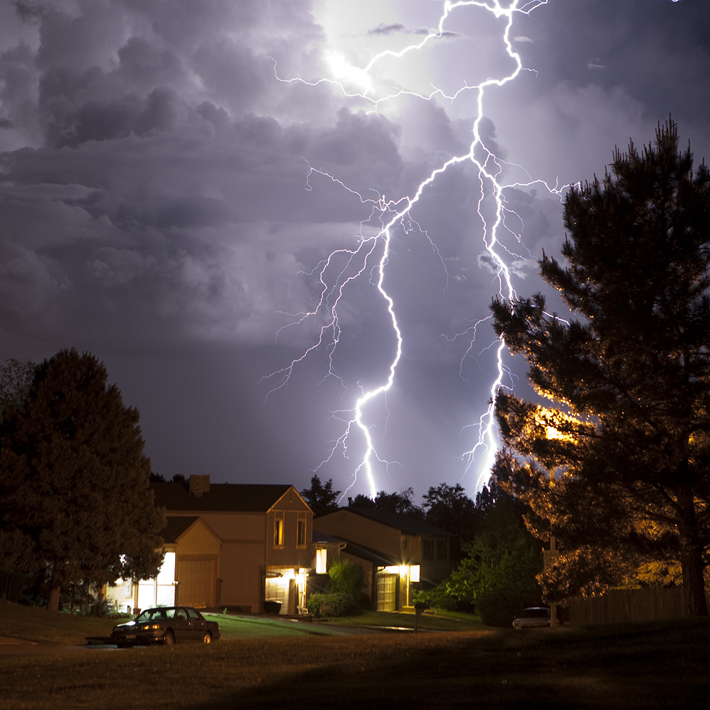

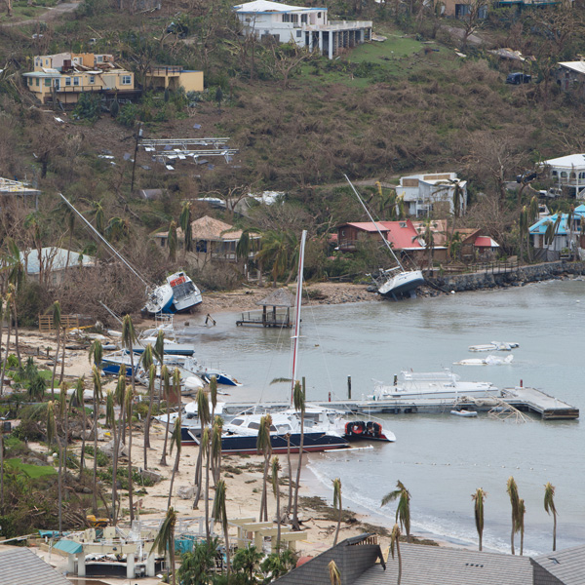

2017: A Record Year Of Catastrophe Losses
Flooding events spurred 73% of federal disaster declarations
Thunderstorm related losses 2nd highest ever in U.S.
$14 billion insured wildfire losses; California damage estimated ~$11 billion
N.A. hurricane season record-breaking insured & economic losses; disasters affected >25 million Americans
Cyber: Risk continuing to increase
Auto: Reaching epidemic proportions

Slide 8
Education & Analysis
Actuaries Climate Index – Measuring Weather Extremes
Index Measures Frequency of Extreme Events (Heat, Drought, Wind, Rain, Sea Level) Vs. 1961-1990 Average
Source: Actuaries Climate Index, http://actuariesclimateindex.org/home/
Notes:
Created 9/30/18 - lynch

Slide 9
NFIP Payouts To The Small Group Of Americans With Flood Insurance Have Skyrocketed
78% Of NFIP's Payouts Have Occurred In The Last 13 Years
Cost of Paid NFIP Claims
Aug 2005:
Hurricane Katrina
$18,000,000
$16,000,000
$14,000,000
$12,000,000
Oct 2012:
Superstorm
Sandy
$10,000,000
Aug 2017: Hurricane Harvey
$8,000,000
$6,000,000
$4,000,000
1979:
FEMA Created
$2,000,000
0
Source: FEMA NFIP
Year

Slide 10
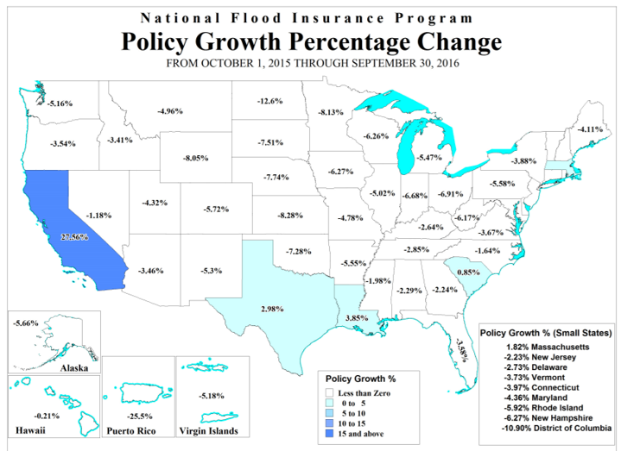
Coverage Gaps Have Serious Consequences For American Families And Businesses
88% Of American Households Lack Flood Insurance
Major Populations Without Flood Insurance (%):
Texas
  80%
Florida
  60%
Puerto Rico
  99%
Source: McKinsey; FEMA NFIP
Notes:
73% of all federally declared disasters were a result of flooding from 2008-2017, according to Pew Charitable Trust.

Slide 11

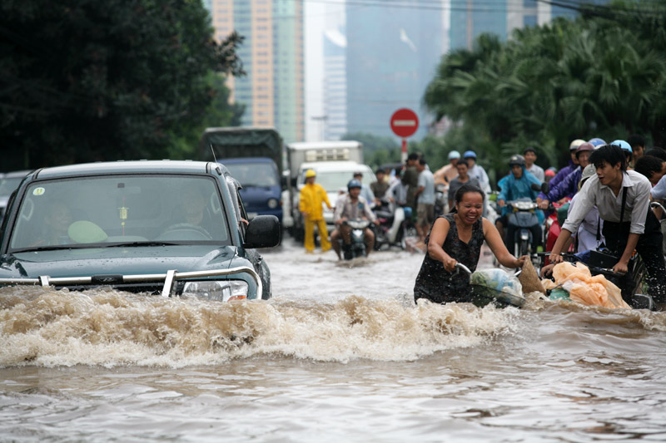
The Insurance Coverage Gap Cost Consumers An Estimated $1.3 Trillion From 2005-2015
Over the last decade, more than 70 percent of all catastrophes losses worldwide were uninsured.
Flooding is not covered by standard homeowners insurance or commercial insurance policies, making it one of the largest uninsured risks for consumers.
Source: Swiss Re; Wikimedia Commons; DOD

Slide 12




(Re)insurance Products
Private Industry
Case Studies
FEMA Reinsurance
Through a $150 million purchase of private reinsurance products, FEMA was able to recover approximately $1 billion, or an eighth of its total 2017 loses.
40%
2018 FEMA Reinsurance
NFIP NatCat Bonds
By issuing new natural catastrophe bonds geared towards institutional investors, the NFIP can bring an estimated $500 million of additional reinsurance coverage.
Private Market Flood Products
During 2017, the private flood insurance market added 50 new carriers. Direct private flood insurance premiums written reached $630 million, an increase of $217 million over 2016.
Source: Insurance Journal; Houston Chronicle; Insurance Journal.

Slide 13
Financial Results
Light, Favorable Winds Buoy Results

Slide 14
Commercial & Personal Lines Direct Premiums Written Growth, Quarterly Y-o-Y, 2012:Q1-2017:Q2
Percent Change from same quarter, prior year
.
Sources: NAIC via SNL Financial; Insurance Information Institute calculations.

Slide 15
Net Premium Growth, Annual Change
The tax reform act at the end of 2017 led to the spike in net written premium in 2018 - $314B at Second Quarter.
As a general rule, net written premium growth tracks nominal GDP growth.
All data through second quarter.
SOURCES: NAIC data sourced through S&P Global Intelligence, Bureau of Economic Affairs, Insurance Information Institute.
Notes:
Updated 6/25 – lynch
Updated 9/13 lynch

Slide 16
Direct Premium Growth, Annual Change
Rising Auto Rates Driving Premium Growth - $337B at Second Quarter.
All data through second quarter.
SOURCES:NAIC data sourced through S&P Global Intelligence, Bureau of Economic Affairs, Insurance Information Institute.
Notes:
Created 6/25/18 – lynch
Updated 9/13 lynch

Slide 17
Net Underwriting Gains & Losses,
1st Halves of Each Year, 2007-2018
$ Millions
Second-highest first-half U/W gains in last dozen years
Net underwriting results in the first half of the year
have been quite variable, but mostly losses.
Sources: ISO/PCI; Insurance Information Institute.

Slide 18
P/C Insurer Portfolio Yields,
2002-2017
Net Yield on Invested Assets for 2018:
1st quarter: 2.93%
2nd quarter: 3.66%
Even as Prevailing Rates Rise in the Next Few Years,
Portfolio Yields Are Unlikely to Rise Quickly,
Since Low Yields of Recent Years Are “Baked In” to Future Returns.
Sources: NAIC data, sourced from S&P Global Market Intelligence; Insurance Information Institute.

Slide 19
Net Investment Gains Vary Mainly With Realized Capital Gains/Losses, 1st Halves, 2007-2018
$ Billions
In the first half of the year, net investment income has been steady but realized capital gains/losses have been variable.
Sources: ISO/PCI; Insurance Information Institute.

Slide 20
P/C Industry Net Income After Taxes*,
1st Halves, 2007-2018
$ Billions, 2018 dollars
2018:1H was the second-highest first-half profit in the last dozen years.
In the first half of the year, net income varied considerably.
*adjusted for inflation using the BLS CPI calculator, to 2018 dollars
Sources: ISO, a Verisk Analytics company; Insurance Information Institute.

Slide 21
Policyholder Surplus By Quarter
Amount of Surplus
Change from Prior Quarter
($ Billions)
Tax Law Increased Surplus at Year-End 2017 and Makes Surplus Growth a Bit More Volatile. $1.30 Surplus per $1 Premium.
21
Sources: ISO, A.M .Best.
12/01/09 - 9pm
eSlide – P6466 – The Financial Crisis and the Future of the P/C
Notes:
21
As of Q1 2018, $1.30 of surplus for every dollar of premium written in US
Added 9/13 – jim lynch

Slide 22
2017:Q4 Scuttlebutt
Is a hard market coming?
Notes:
Antitrust disclaimer – no one should express their individual plans or situation
With three major hurricanes, an earthquake and record wildfires in the third quarter of the year, following an above-average catastrophe first-half, there is talk about a “hard market” emerging.
How is a hard market defined?
A hard market occurs when insurance premiums grow substantially faster than the economy.
Premiums are measured by Net Written Premiums
The economy is measured by nominal GDP
The last hard market was 15 years ago. Are we due for another one?

Slide 23
Three Hard Markets in the Last 45 Years
Net Premium Growth (All P/C Lines) Minus Nominal GDP, Annual Change
16.6%
12.0%
10.7%
The three “hard markets” in this 45-year span were in 1976–77, 1985–86, and 2001–03.
Sources: A.M. Best (1971-2017), ISO (2014-16), A.M. Best, Insurance Information Institute (1986-1994); U.S. Commerce Dept., Bureau of Economic Analysis;
Insurance Information Institute calculations.
Notes:
Except for the three “hard markets,” over the last 45 years net written premiums grew at, or more often, below, the growth of the U.S. economy, as measured by nominal GDP. The rising trend since 2005 suggests the possibility of another hard market in coming years, if the trend continues.
HARD MARKET HISTORY
9/11
80’s liability cases – asbestos
90’s medical liability
Looking at the trends of hard markets — when rates grow/rise faster than economy — it would appear we are due…

Slide 24
Two Hard Markets in the Last 21 Years
Net Premium Growth (All P/C Lines) Minus Nominal GDP, Annual Change
16.6%
12.0%
The two “hard markets” in this 21-year span were in 1985–86, and 2001–03.
Sources: A.M. Best (1986-2016), ISO (2014-16), A.M. Best, Insurance Information Institute (1986-1994); U.S. Commerce Dept., Bureau of Economic Analysis;
Insurance Information Institute calculations.
Notes:
Except for the three “hard markets,” over the last 45 years net written premiums grew at, or more often, below, the growth of the U.S. economy, as measured by nominal GDP. The rising trend since 2005 suggests the possibility of another hard market in coming years, if the trend continues.
HARD MARKET HISTORY
9/11
80’s liability cases – asbestos
90’s medical liability
Looking at the trends of hard markets — when rates grow/rise faster than economy — it would appear we are due…

Slide 25
I.I.I. Hypothesis
What causes a hard market?
Return on equity falls to 4% or below?
Surplus drops due to financial market declines and/or significant underwriting losses?
Unusually large losses due to catastrophes?

Slide 26
P/C Industry ROE and Hard Markets
Year | ROE | NWP-GDP Growth in Following Year | Hard Market?
1975 | 2.4% | 10.7% | Yes
1984 | 1.8% | 14.6% | Yes
2001 | -1.2% | 12.0% | Yes
2002 | 2.1% | 5.1% | Yes
2017 | 5.0% | 0.4%* | No
* Direct Written Premium – GDP Growth through Second Quarter

Slide 27
Policyholder Surplus and Hard Markets
Year | Surplus Decline | NWP-GDP Growth in Following Year | Hard Market?
1984 | -2.7% | 14.6% | Yes
1999 | -0.9% | -1.5% | No
2000 | -4.7% | 5.1% | Yes
2001 | -8.0% | 12.0% | Yes
2008 | -12.5% | -2.2% | No
2011 | -0.8% | 0.2% | No
2017 | +7.4% | 0.4% | No
* Direct Written Premium – GDP Growth through Second Quarter
Notes:
Decline is unlikely by year-end because surplus had risen by $20 billion at mid-year vs. 2016 year-end and also is driven by strong stock market appreciation in the second half of 2017.

Slide 28
CAT Claims and Hard Markets
Year | CAT Claims Over $25 billion (2016 Adjusted) | NWP-GDP Growth in Following Year | Hard Market?
1992 | $39.6 | 0.9% | No
1994 | $27.7 | -1.2% | No
2001 | $36.4 | 12.0% | Yes
2004 | $36.4 | -6.2% | No
2005 | $77.1 | -3.1% | No
2008 | $30.7 | -2.2% | No
2011 | $35.2 | 0.2% | No
2012 | $36.8 | 1.3% | No
2017 | $90.5 | 0.4% | No
Notes:
Even though it is commonly believed that large CAT years bring hard markets, the data doesn’t seem to support that belief.

Slide 29
Hard Market in 2018?
Strong indicator: ≤ 4% ROE
  Consistent hard markets in years comparisons.
Indifferent indicator: Surplus Increase/Decrease
  Inconsistent hard/soft markets in years comparisons.
Weak indicator: Large Cat Losses
  Consistent non-movement; even with 2017 potentially being one of the worst years on record.

Slide 30
Commercial Rate Changes
Commercial Auto . . . And Everything Else

Slide 31
Rate Changes Worldwide
Rates Soft/Flat, Especially in Reinsurance
Global Insurance Rates Through Q2 2018
Global Reinsurance
January Renewals
Rates Worldwide Increasing a Bit (Australia)
1%
Sources: Marsh Insurance Market Index, JLT Re.
Notes:
31
JLT https://www.jltre.com/media-centre/press-releases/2018/january/reinsurance-renewal-outcomes-2018

Slide 32
Liability Rate Changes
Slight Softening, Though Local Markets Vary
U.S. Casualty
U.S. Financial and Prof Liab
SOURCE: Marsh Insurance Market Index.

Slide 33
Property/Cyber Rate Changes
A Flat Market, Though Local Markets Vary
U.S. Property
U.S. Cyber
SOURCE: Marsh Insurance Market Index.

Slide 34
Commercial Lines Rate Change
‘Material’ Increases in Auto, Property, Umbrella; Q2 Increases > Q1 Increases
Sources: Willis Towers Watson, MarketScout.

Slide 35
Commercial Property Rate Change
(vs. Year Earlier)
Sep-12
6%
4 Years of Rates ≥ 0%
Mar-09
-8%
Property Rates Closely Following Loss Experience, Especially in Catastrophe Prone Areas.
Sources: MarketScout, Insurance Information Institute..

Slide 36
Business Interruption Rate Change
(vs. Year Earlier)
Sources: MarketScout, Insurance Information Institute..

Slide 37
BOP Rate Change
(vs. Year Earlier)
Rate Change on Business Owners Policies Can Be Bellwether for
Small Commercial Risks
Sources: MarketScout, Insurance Information Institute.
Interpolated Commercial Property Estimates for May, August, September 2010.

Slide 38
Inland Marine Rate Change
(vs. Year Earlier)
Sources: MarketScout, Insurance Information Institute..

Slide 39
General Liability Rate Change
(vs. Year Earlier)
Sources: MarketScout, Insurance Information Institute..

Slide 40
Umbrella/Excess Rate Change
(vs. Year Earlier)
Sources: MarketScout, Insurance Information Institute..

Slide 41
Commercial Auto Rate Change
(vs. Year Earlier)
Sources: MarketScout, Insurance Information Institute.

Slide 42
Workers Comp Rate Change
(vs. Year Earlier)
Stellar Results Have Created a Soft Market.
Sources: MarketScout, Insurance Information Institute.

Slide 43
Professional Liability Rate Change
(vs. Year Earlier)
Sources: MarketScout, Insurance Information Institute.

Slide 44
D&O Liability Rate Change
(vs. Year Earlier)
Sources: MarketScout, Insurance Information Institute.

Slide 45
EPLI Rate Change
(vs. Year Earlier)
Sources: MarketScout, Insurance Information Institute..

Slide 46
Fiduciary Liability Rate Change
(vs. Year Earlier)
Sources: MarketScout, Insurance Information Institute..

Slide 47
Crime Rate Change
(vs. Year Earlier)
Sources: MarketScout, Insurance Information Institute..

Slide 48
Surety Rate Change
(vs. Year Earlier)
Sources: MarketScout, Insurance Information Institute..

Slide 49
Economic Outlook
The Strength of the Economy
Will Influence the Insurance Environment
Notes:
Antitrust disclaimer – no one should express their individual plans or situation
With three major hurricanes, an earthquake and record wildfires in the third quarter of the year, following an above-average catastrophe first-half, there is talk about a “hard market” emerging.
How is a hard market defined?
A hard market occurs when insurance premiums grow substantially faster than the economy.
Premiums are measured by Net Written Premiums
The economy is measured by nominal GDP
The last hard market was 15 years ago. Are we due for another one?

Slide 50
The Economy Drives P/C Insurance Industry Premiums:
Net Premium Growth (All P/C Lines) vs. Nominal GDP: Annual Change, 1971-2017
Except for the three “hard markets” in this 47-year period,
Net Written Premiums track Nominal GDP—not year by year but fairly well.
Sources: A.M. Best (1971-2013), ISO (2014-17); U.S. Commerce Dept., Bureau of Economic Analysis; I.I.I.

Slide 51
U.S. Post-Recession Real GDP Growth,** Quarterly
The start of sustained 3+% growth?
Since the start of 2012, the economy (as measured by real GDP)
grew 3% or faster (at an annual rate) in a calendar quarter
only 10 times in 22 quarters. But twice in the last 5.
*GDPnow estimate **Percent change from previous quarter, seasonally-adjusted at an annual rate
Sources: U.S. Department of Commerce; Insurance Information Institute.

Slide 52
Quarterly U.S. Real GDP Growth:
Range of Forecasts
Tough times ahead? With interest rates rising, most forecasts expect U.S. growth to slow by 2020; some foresee a sharp slowdown.
Sources: Blue Chip Economic Indicators, September 2018 issue; Insurance Information Institute.

Slide 53
Length of US Business Cycles, 1960–Present*
Duration (Months)
The length of the expansions greatly exceeds
the length of contractions (recessions).
*Through October 2018; June 2009 was the “official” end of recession.
Sources: National Bureau of Economic Research; Insurance Information Institute.
53
12/01/09 - 9pm
eSlide – P6466 – The Financial Crisis and the Future of the P/C
Notes:
53

Slide 54
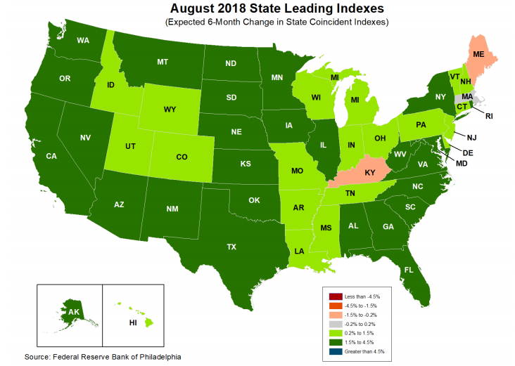
State-by-State Leading Indicators
through February 2019
Near-term growth forecasts vary widely by state.
Strongest
growth
= dark green
(1.5%-4.5%);
then light green;
then gray;
weakest = beige (-1.5% to -4.5%)
1.77
1.69
3.89
1.90
1.50
2.24
2.62
1.55
4.36
3.08
1.58
1.54
3.57
2.15
2.20
4.28
3.90
3.52
2.68
2.47
3.25
1.72
1.60
2.81
3.41
3.55
3.43
2.40
1.87
2.47
Sources: Federal Reserve Bank of Philadelphia at www.philadelphiafed.org/index.cfm , released October 4, 2018; Next release is November 5, 2018; Insurance Information Institute.

Slide 55
Growth of Nonresidential Fixed Investment: Implications for Commercial Insurance
Percent Change from same quarter, prior year
Rising exposure base bodes well for commercial premium growth
Sources: bea.gov, news release “Gross Domestic Product: Second Quarter 2018 (Second Estimate), Table 6; Insurance Information Institute.

Slide 56
US Treasury Note 10-Year Yields*:
Is the long downward trend over?
Yields on 10-Year US Treasury Notes have been below 3% for over 7 years: 10-year bonds bought in 2008 at over 3% will be reinvested today at 2.9% for 10 more years
Since nearly 50% of P/C bond/cash investments are in 5-year or longer maturities, most P/C insurer portfolios will have low-yielding bonds for years to come.
*Monthly, constant maturity, nominal rates, through August 2018.
Sources: Federal Reserve Bank at http://www.federalreserve.gov/releases/h15/data.htm; National Bureau of Economic Research (recession dates); Insurance Information Institute.
56
12/01/09 - 9pm
eSlide – P6466 – The Financial Crisis and the Future of the P/C
Notes:
56

Slide 57
September 2018: Quarterly Yield Forecasts for 10-Year US Treasury Bonds in 2018-19
Yield (%)
Yield as of 10/5: 3.19%
Many of the 53 forecasts in the Blue Chip survey expect
continual increases in the yield of 10-year T-bonds in 2018-19.
Sources: Blue Chip Economic Indicators (9/18); Insurance Information Institute

Slide 58
Cannabis and Insurance
A Sensitive Issue

Slide 59
Support for Legalization Grows
% Saying Yes
“Do You Think the Use of Marijuana Should Be Made Legal, Or Not?”
No survey in years where no data appears.
SOURCES: Gallup Poll Social Series, http://news.gallup.com/file/poll/221027/171025Marijuana.pdf.

Slide 60
Support for Legalization Grows
% Saying Yes
“Do You Think the Use of Marijuana Should Be Made Legal, Or Not?”
SOURCES: Gallup Poll Social Series, http://news.gallup.com/poll/221018/record-high-support-legalizing-marijuana.aspx

Slide 61
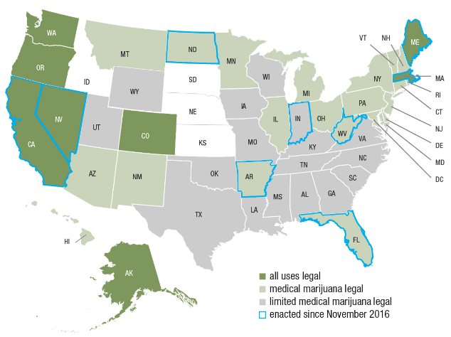
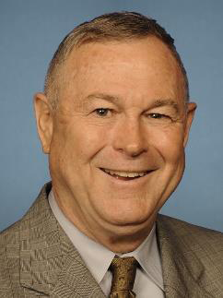
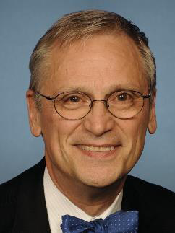
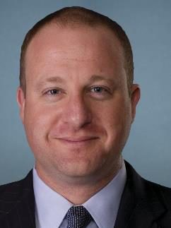
Cannabis in the USA
Legalization is Accelerating
Congressional Cannabis Caucus
Rohrbacher (CA)
Bluemenauer (OR)
Young
(AK)
Polis
(CO)
SOURCE: National Journal.
Notes:
There were 9 referenda on marijuana legalization. Only one failed – recreational use in Arizona.
Six states require use of medical marijuana in WC claims – CT, ME, MA, MN, NJ, NM
Six states forbid use of medical marijuana in WC claims – AZ, CO, MI, MT, OR, VT
It is illegal to use the banking system to purchase marijuana. So an insurer can’t write a check against to pay for the drug. They use cash.
Trump OK with med mare. Sessions, not so much. We wind up with one more conflict, Trump vs. his Cabinet.
Missouri has passed a medical CBD law allowing for the use of cannabis extracts that are high in CBD and low in THC in instances where a physician has recommended such treatment to a patient with a state-qualifying condition
Rohrabacher-Blumenauer amendment) prohibiting the use of federal funds to prevent the implementation of state medical marijuana laws.

Slide 62
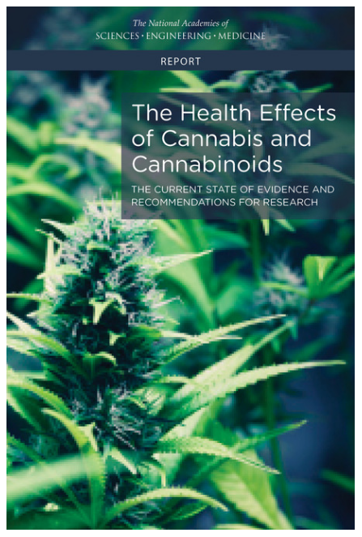
The Science of Weed
What the Experts Say
Conclusive evidence
  Improves the lot of adults in chronic pain.
Substantial evidence
  Increases the risk of motor vehicle crashes.
SOURCE: National Academy of Sciences, https://www.nap.edu/catalog/24625/the-health-effects-of-cannabis-and-cannabinoids-the-current-state
Notes:
There is conclusive evidence or substantial evidence that marijuana:
Improves the lot of adults in chronic pain.
Increases the risk of motor vehicle crashes.
Increases the risk of developing schizophrenia and other psychoses.
There is moderate support suggesting that marijuana:
Improves short-term sleep outcomes for people with fibromyalgia or chronic pain.
Increases impairment of learning, memory and attention span.
Increases dependence on alcohol, tobacco and illicit drugs.
It is not possible to determine whether marijuana use is statistically correlated with occupational injuries.
47,000 drug deaths in USA in 2015

Slide 63
Cannabis as Medicine
Treatments for Occupational-Related Conditions
Work-Related Conditions
Cannabis vs. Opioids
Chronic Pain
Anxiety and Depression
PTSD
Traumatic Brain Injury
Spasticity Following Spinal Cord Injury
‘Highly suggestive studies’
  Death Certificate Study
  Dispensaries Study
  Medicare/Medicaid Study
  Auto Fatality Study
Not conclusive – Further Study Needed
Source: David Dietz, “Medical Marijuana, Occupational Injuries, and the Workplace: 2017 Status Update,” https://www.ncci.com/Articles/Pages/II_Insights_MedMarijuana-OccupInjuries.aspx
Notes:
State death certificate data from 1999–2010 from the Centers for Disease Control and Prevention shows a significantly slower rise in opioid-related deaths in states with medical marijuana laws.²³
National Bureau of Economic Research reported in 2015 that states with medical marijuana dispensaries had relatively fewer treatment admissions for opioid addiction and fewer opioid deaths than states without such laws.²⁴
Medicare and Medicaid data indicate lower prescribed quantities of opioids in states where cannabis could be legally used. There are many confounders, and it is impossible to say whether an opioid-sparing effect, if it truly exists, would carry over to WC claims.
Probability of fatally injured drivers aged 21–40 testing positive for opioids was reduced in states with laws allowing the use of cannabis for medical conditions.

Slide 64






Road Safety
Better Economy = More Drivers = More Accidents
14 Percent of Injury Crashes
Economic
well-being
Distracted driving
Safety Devices Can Be Expensive
Why rates go up
Speed
Still
Kills
Expensive auto parts
Faster driving
Legalized marijuana
It’s Not Funny
Source: Insurance Information Institute research.
Notes:
More recently the problem has been claim severity rather than frequency.
Fatalities in H117 fell 1 percent, to 18,680. They remain 8% higher than in 2015.

Slide 65
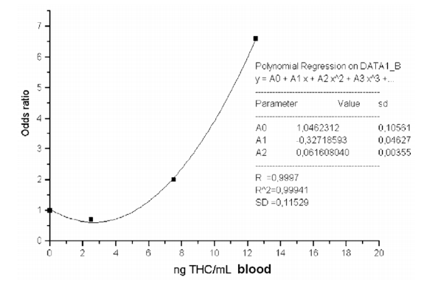
Accident Probability
Chance of Accident Rises Sharply As Consumption Rises.
SOURCE: Sewell, Poling, Sofuoglu, “The Effect of Cannabis Compared with Alcohol on Driving,” American Journal on Addictions, 2009.

Slide 66
Legal Sales Lead to More Accidents
Look at ‘Real World’ Crashes
All Measures Statistically Significant
‘Overall’ Measure a Good Proxy for What Will Happen in Any State
Auto Accidents are 6% of WC claims; 12% of Losses
SOURCE: Highway Loss Data Institute.

Slide 67
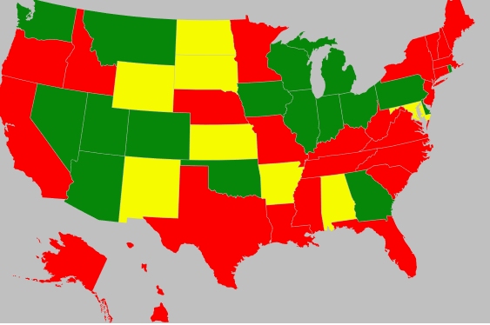
Driving While High – the Legal Framework
Illegal Everywhere, but What Makes You High?
● Under the Influence
● Per Se
● Incapacitated
RI: ‘Zero Tolerance (Medical Exception).’ Rest of NE: ‘Incapable of Driving Safely.’
SOURCE: National Conference of State Legislators, National Organization for Reform of Marijuana Laws (NORML),
Notes:
http://www.ncsl.org/research/transportation/drugged-driving-overview.aspx
http://norml.org/legal/item/rhode-island-drugged-driving
Increasing use of DREs (Drug Recognition Experts) – something like 8000 in US (certified by International Association of Chiefs of Police)
Per se DUID makes it an offense for a driver to have marijuana in their body while operating a motor vehicle.
Under the influence DUID standard requires the driver to be under the influence of or affected by marijuana.
Incapacity DUID standard requires the marijuana in a driver's system make the driver incapable of driving safely. The prosecutor must show a connection between drug ingestion and the incapacity of the driver.

Slide 68
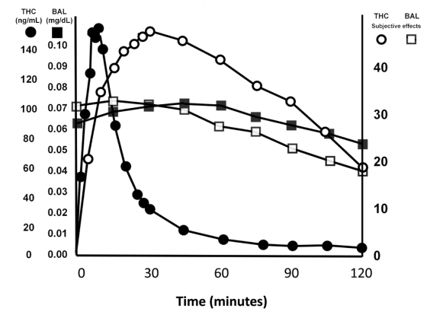
Blood Levels vs. Intoxication
BAC and ‘feeling drunk’ rise and fall in lockstep
THC levels in blood and ‘feeling high’ rise and fall at different rates
It Is Difficult to Use Blood Test to Measure Whether Someone is High.
SOURCE: Sewell, Poling, Sofuoglu, “The Effect of Cannabis Compared with Alcohol on Driving,” American Journal on Addictions, 2009.
Notes:
18 mg is one joint

Slide 69
State of the Debate
Lots of Questions
Insurers Are Asking
Employers Are Asking
Will Schedule I Status Change?
Is Medical Marijuana Covered?
Does WC Cover a High Worker?
Is Drug-Free Workplace Affected?
Regulators Are Asking
Legislators Are Asking
How Can Reimbursement Be Handled?
Can Worker Rights, Employer Needs Be Balanced?
What Are the Key Issues in the Debate?
If We Legalize, What Will Feds Do?
Source: NCCI, “The Marijuana Conversation: Questions Workers Compensation Insurers Are Asking; Questions Employers Are Asking; Questions Legislators and Regulators Are Asking,”
Notes:
Insurer Questions
Schedule I - DEA has said policy won’t change; Justice Department remains reluctant to enforce law
Covered?
CT ME MN NJ NM – reimbursement required
FL, ND – reimbursement prohibited
Employer Questions
High workers covered?
Most states address the issue.
40 allow complete denial of claim
Some allow denial of indemnity
Drug Free Workplace – Case is emerging but appears that presence of federal statute means a worker can be fired for using marijuana
Regualtors/Legislators
NM has a fee schedule that includes cannabis
Reimbursement Issues
Does insurer pay dispensary or the worker?
How do you determine reimbursement rate?
Key issues
Popular support for legalization
Cole memo – Justice department puts low priority on enforcement, focuses on gang-related trafficking and sales to youth

Slide 70
Employment Trends in Insurance
We’re Doing More With No More People
Notes:
Antitrust disclaimer – no one should express their individual plans or situation
With three major hurricanes, an earthquake and record wildfires in the third quarter of the year, following an above-average catastrophe first-half, there is talk about a “hard market” emerging.
How is a hard market defined?
A hard market occurs when insurance premiums grow substantially faster than the economy.
Premiums are measured by Net Written Premiums
The economy is measured by nominal GDP
The last hard market was 15 years ago. Are we due for another one?

Slide 71
U.S. Employment in the Direct
P/C Insurance Industry: 1990–2018*
Sometimes the BLS Reclassifies Employment Within Industries.
When This Happens, the Change is Spread Evenly Over a 12-month Period (in This Case March 2010–March 2011)
*As of July 2018; not seasonally adjusted; Does not include agents & brokers.
Note: Recessions indicated by gray shaded columns.
Sources: U.S. Bureau of Labor Statistics; National Bureau of Economic Research (recession dates); Insurance Information Institute.
Notes:
71

Slide 72
U.S. Employment in the
Reinsurance Industry: 1990–2018*
*As of July 2018; not seasonally adjusted; Does not include agents & brokers.
Note: Recessions indicated by gray shaded columns.
Sources: U.S. Bureau of Labor Statistics; National Bureau of Economic Research (recession dates); Insurance Information Institute.
Notes:
72

Slide 73
U.S. Employment in Insurance
Agencies & Brokerages: 1990–2018*
*As of July 2018; not seasonally adjusted. Includes all types of insurance.
Note: Recessions indicated by gray shaded columns.
Sources: U.S. Bureau of Labor Statistics; National Bureau of Economic Research (recession dates); Insurance Information Institute.
Notes:
73

Slide 74
U.S. Employment in Independent
Claims Adjusting: 1990–2018*
*As of July 2018; not seasonally adjusted.
Note: Recessions indicated by gray shaded columns.
Sources: U.S. Bureau of Labor Statistics; National Bureau of Economic Research (recession dates); Insurance Information Institute.
Notes:
74

Slide 75
Questions?
Notes:
Antitrust disclaimer – no one should express their individual plans or situation
With three major hurricanes, an earthquake and record wildfires in the third quarter of the year, following an above-average catastrophe first-half, there is talk about a “hard market” emerging.
How is a hard market defined?
A hard market occurs when insurance premiums grow substantially faster than the economy.
Premiums are measured by Net Written Premiums
The economy is measured by nominal GDP
The last hard market was 15 years ago. Are we due for another one?

Slide 76
Thank you!
www.iii.org

