Slide 1
The Property/Casualty Landscape Profitability, Growth – Disruption?
Casualty Actuaries of the Southeast, Atlanta, September 26, 2016
Download at www.iii.org/presentations
James Lynch, FCAS MAAA, Chief Actuary
Insurance Information Institute  110 William Street  New York, NY 10038 Tel: 212.346.5533  jamesl@iii.org  www.iii.org

Slide 2
Insurance Industry: Financial Update & Outlook
2015 Was a Reasonably Good Year and Similar to 2014
2016: Smarting from Catastrophes

Slide 3
P/C Industry Net Income After Taxes 1991-2016:Q2 (preliminary)
Profits Are 28 Percent Below Last Year Through Two Quarters. Little Cats, Weak Auto Results
2005 ROE*= 9.6%
2006 ROE = 12.7%
2007 ROE = 10.9%
2008 ROE = 0.1%
2009 ROE = 5.0%
2010 ROE = 6.6%
2011 ROAS¹ = 3.5%
2012 ROAS¹ = 5.9%
2013 ROAS¹ = 10.2%
2014 ROAS¹ = 8.4%
2015 ROAS¹ = 8.4%
*ROE figures are GAAP; ¹Return on avg. surplus. Excluding Mortgage & Financial Guaranty insurers yields a 8.2% ROAS in 2014, 9.8% ROAS in 2013, 6.2% ROAS in 2012, 4.7% ROAS for 2011, 7.6% for 2010 and 7.4% for 2009. 2016:Q2 is annualized
Sources: A.M. Best; ISO, a Verisk Analytics company; Insurance Information Institute.

Slide 4
Return on Equity by Financial Services Sector vs. Fortune 500, 2004-2015*
Average: 2004–2014
Fortune 500: 13.9% Commercial Banks: 9.8%
Life: 8.2%
P/C: 7.1%
Banks and Insurers Have Substantially Underperformed the Fortune 500 Since the Financial Crisis.
*GAAP basis.
Sources: ISO, a Verisk Analytics company; Fortune; Insurance Information Institute.

Slide 5
Profitability Peaks & Troughs in the P/C Insurance Industry, 1975-2015
History Suggests Next ROE Peak Will Be in 2016–2017, But Looks Like 2013 Was Most Recent Peak.
10 Years
10 Years
9 Years
*Profitability = P/C insurer ROEs. 2011-14 figures are estimates based on ROAS data. Note: Data for 2008-2014 exclude mortgage and financial guaranty insurers.
Sources: Insurance Information Institute; Natl. Assoc. of Insurance Comm.; ISO, a Verisk Analytics company; A.M. Best, Conning.

Slide 6
Policyholder Surplus, 2006:Q4-2016:Q1
Surplus has not grown significantly in the last 7 quarters
Drop Due to Near-Record 2011 CAT Losses
2007:Q3 Pre-Crisis Peak
The Industry Now Has $1 of Surplus for Every $0.75 of NPW, Close to the Strongest Claims-paying Status in its History.
The P/C Insurance Industry Entered 2016 in Very Strong Financial Condition.
2010:Q1 data includes $22.5B of paid-in capital from a holding company parent for one insurer’s investment in a non-insurance business.
Sources: ISO, a Verisk Analytics company; A.M. Best.

Slide 7
Investments: The New [Grim] Reality
Investment Performance is a Key Driver of Profitability
Depressed Yields Will Necessarily Influence Underwriting & Pricing

Slide 8
Property/Casualty Insurance Industry Investment Income: 2000–2016¹
(Billions)
Investment income is still below its 2007 pre-crisis peak
Due to persistently low interest rates, investment income continues to fall.
¹ Investment gains consist primarily of interest and stock dividends. 2016 is I.I.I. estimate based on A.M. Best data. Sources: ISO. A.M. Best, Insurance Information Institute.

Slide 9
P/C Insurer Portfolio Yields, 2002-2015
P/C Carrier Yields Have Been Falling for Over a Decade, Reflecting the Long Downtrend in Prevailing Interest Rates.
Even as Prevailing Rates Rise in the Next Few Years, Portfolio Yields Are Unlikely to Rise Quickly, Since Low Yields of Recent Years Are “Baked In” to Future Returns.
Sources: NAIC data, sourced from S&P Global Market Intelligence; Insurance Information Institute.

Slide 10
U.S. Treasury Security Yields: A Long Downward Trend, 1990-2016*
Yields on 10-year U.S. Treasury Notes Have Been Essentially Below 5% for a Full Decade.
Despite the Fed’s December 2015 Rate Hike, Yields Remain Low Though Short-term Yields Have Seen Some Gains.
Recession
Bonds Constitute Slightly More Than 2/3 of P/C Industry Investments. Roughly 36% of P/C Bonds Are in 1-5-Year Durations, So They Will Respond to Rising Interest Rates in Just a Few Years. But Nearly Half of the Bond Portfolio is in 5-Year or Longer Durations, Which Will Take Longer to Rise.
*Monthly, constant maturity, nominal rates, through April 2016.
Sources: Federal Reserve Bank at federalreserve.gov/releases/h15/data.htm; National Bureau of Economic Research (recession dates); Insurance Information Institute.

Slide 11
Distribution of Bond Maturities, P/C Insurance Industry, 2005-2015
<1 yr 1 – 5 years 5 – 10 years 10-20 20>
Two main shifts over these years: From 2007 to 2011-12, from bonds with longer maturities to bonds with shorter maturities. But beginning in 2013, the reverse. Note, however, that the percentages in bonds with maturities over 10 years continues to drop.
Sources: National Association of Insurance Commissioners’ data, sourced from S&P Global Market Intelligence; Insurance Information Institute.

Slide 12
New Money vs. Embedded Yields, U.S. Insurers, 1983-2012
As long as new money rates are below the rates of maturing bonds, the portfolio yield will continue to sink.
p: Preliminary Estimate
Sources: NCCI, Insurance Information Institute.
12
12/01/09 - 9pm
eSlide – P6466 – The Financial Crisis and the Future of the P/C
Notes:
12

Slide 13
Interest Rate Forecasts: 2016-2021
3-Month Treasury
10-Year Treasury
The End of the Fed’s QE Program in 2014 and its First Rate Increase in Dec. 2015 Have Yet to Push Longer-term Yields Much Higher
A “Normalization” of Interest Rates is Unlikely Until 2019, More than a Decade After the Onset of the Financial Crisis. Note how flat the Yield Curve is Expected to be.
Sources: Blue Chip Economic Indicators (8/10 for 2016 and 2017; for 2018-2021 3/16 issue); Insurance Information Institute.

Slide 14
Underwriting Performance

Slide 15
Net Premium Growth (All P/C Lines): Annual Change, 1971-2016
1975–78
1984–87
2000–03
Outlook
2016F: 4.0%
2017F: 3.8%
2016: 2.6%
2015: 3.4%
2014: 4.1%
2013: 4.4%
2012: 4.2%
Net Written Premiums Fell 0.7% in 2007 (First Decline Since 1943) by 2.0% in 2008, and 4.2% in 2009, the First 3-Year Decline Since 1930–33.
Shaded areas denote “hard market” periods
Sources: FRED Economic Data for GDP; A.M. Best (1971-2013), ISO (2014-15); NAIC data sourced from S&P Global Market Intelligence for 2016:Q2, Insurance Information Institute calculations.

Slide 16
P/C Direct Written Premium by Line
(Billions of Dollars)
LOB | 2016 | 2015 | % Chg From Year Earlier
Personal Auto Liab | 62.5 | 59.1
Homeowners | 46.4 | 45.3
PhysDam (PA, CA) | 46.4 | 43.4
GL (incl Products) | 32.9 | 32.1
WC | 29.5 | 28.8
Fire & Allied Lines | 17.3 | 18.3
CMP | 20.2 | 20.1
Comm Auto Liab | 12.8 | 12.3
Other | 32.9 | 32.4
Total | 300.9 | 291.8
Through Q2
Sources: NAIC data from S&P Global Intelligence, Insurance Information Institute.

Slide 17
P/C Insurance Industry Combined Ratio, 2001-2016:Q2*
3 Consecutive Years of U/W Profits; 1st time since 1971-73
As Recently as 2002, Insurers Paid Out Nearly $1.08 for Every $1 in Earned Premium.
Lotsa Small CATs, Auto
Best Combined Ratio Since 1949 (87.6)
Lower CAT Losses
Q2 2016 Estimate is Preliminary
*Excludes Mortgage & Financial Guaranty insurers 2008-2014. Including M&FG, 2008=105.1, 2009=100.7, 2010=102.4, 2011=108.1; 2012:=103.2; 2013: = 96.1; 2014: = 97.0.
Sources: A.M. Best; ISO, a Verisk Analytics company; 2010-2014 is from A.M. Best P&C Review and Preview, February 16, 2016; 2015 from I.I.I/PCI/ISO; 2016 Estimate from I.I.I. based on S&P Global Market Intelligence data.

Slide 18
AY vs. CY Combined Ratio, (Excl. Guaranty Lines) 1996-2015
Higher AY → Favorable DOP
Hurricane Ike
Tuscaloosa, Joplin Tornadoes
Three Consecutive Years of Deteriorating Combined Ratios, Despite Light Cat Losses. AY2015 Above 100.
2015 Figures Preliminary. Sources: NAIC data from S&P Global Intelligence, Insurance Information Institute.

Slide 19
Personal Lines Combined Ratio, 1996-2015
Higher AY → Favorable DOP
2005: Last Year of Adverse Development
Tuscaloosa, Joplin Tornadoes
Lack of Catastrophes Let Personal Lines Writers Post Underwriting Profit Two Years In a Row. CY15>100, Despite Lack of Cats.
2015 Figures Preliminary. Sources: NAIC data from S&P Global Intelligence, Insurance Information Institute.

Slide 20
Commercial Lines Combined Ratio, 1996-2015
10 Consecutive Years of Favorable Development.
Low Cat Losses Contribute to Favorable Combined Ratios.
2015 Figures Preliminary. Sources: NAIC data from S&P Global Intelligence, Insurance Information Institute.

Slide 21
Development on Prior, 1996-2015
10 Consecutive Years of Favorable Development.
Reserve Releases Keep Getting Smaller.
2015 Affected by a Single Company’s $3B Reserve Hit.
2015 Figures Preliminary. Sources: NAIC data from S&P Global Intelligence, Insurance Information Institute.

Slide 22
CY Development on Prior by LOB
Several Liability Lines (Auto, GL, Products) Had Reserve Spikes. WC Was an Exception.
2015 Figures Preliminary. Sources: NAIC data from S&P Global Intelligence, Insurance Information Institute.

Slide 23
U.S. Real GDP Growth,* Quarterly
Recession Began in Dec. 2007 and Ended in June 2009
For Some (Currently Unknown) Reason, in the Post-recession Period, Frequently Q1 has Been a Weak Quarter
The Q4:2008 Decline was the Steepest Since the Q1:1982 Drop of 6.8%.
Demand for Insurance Should Increase Slowly in 2016 as GDP Growth Continues at a Steady, Albeit Moderate Pace and Gradually Benefits the Economy Broadly
*Estimates/Forecasts (gold bars) from Blue Chip Economic Indicators.
Sources: U.S. Department of Commerce, Blue Chip Economic Indicators 8/10; Insurance Information Institute.

Slide 24
P/C Direct Incurred Loss Ratio by LOB
LOB | 2016 | 2015 | Chg From Year Earlier
Personal Auto Liab | 72 | 68
Homeowners | 56 | 55
PhysDam (PA, CA) | 67 | 64
GL (incl Products) | 52 | 51
WC | 54 | 59
Fire & Allied Lines | 56 | 55
CMP | 51 | 48
Comm Auto Liab | 64 | 62
Other | 44 | 42
Total | 59 | 57
Positive Number = Bad News
Through Q2
Sources: NAIC data from S&P Global Intelligence, Insurance Information Institute.

Slide 25
Commercial Rates*
Steady Going
*These Publicly Available Estimates May Differ Substantially From Events In Individual States and Markets

Slide 26
Commercial Lines Rate Change by Quarter (vs. Year Earlier)
22 Consecutive Quarters of Rate Increases
Second Quarter: <1% Decreases: WC, Property, D&O. ‘Meaningful’
Increases: Commercial Auto – similar to prior two quarters
Sources: Willis Towers Watson Commercial Lines Insurance Pricing Survey, Insurance Information Institute.
Notes:
26

Slide 27
Commercial Lines Rate Change by Month (vs. Year Earlier)
Jul-02 33%
3 Straight Months: -4%; Recent Months -1%
Not Much of a Hard Market, by Historic Standards
Feb-05 0%
Sep-13 5%
79 Months of Rates < 0%
37 Months of Rates > 0%
Dec-07 -16%
Rates Are as Stable as They’ve Been in 15 Years. Modest Declines This Year but That May Be Ebbing. August: -1%
Sources: MarketScout, Insurance Information Institute.

Slide 28
Catastrophes

Slide 29
U.S. Insured Catastrophe Losses
2012 was the 3rd Most Expensive Year Ever for Insured Cat Losses.
2013/14/15 Were Welcome Respites from 2011/12, Which Were Among the Costliest Years for Insured Disaster Losses in U.S. History. Longer-term Trend is for More – Not Fewer – Costly Events.
*Estimate through first quarter.
Note: 2001 figure includes $20.3B for 9/11 losses reported through 12/31/01 ($25.9B 2011 dollars). Includes only business and personal property claims, business interruption and auto claims. Non-prop/BI losses = $12.2B ($15.6B in 2011 dollars).
Sources: Property Claims Service, a Verisk Analytics business; Insurance Information Institute.

Slide 30
Combined Ratio Points Associated with Catastrophe Losses: 1960 – 2015
Avg. CAT Loss Component of the Combined Ratio by Decade
1960s: 1.04 1970s: 0.85 1980s: 1.31 1990s: 3.39 2000s: 3.52 2010s: 5.46*
Catastrophe losses as a share of premium reached a record high in 2011
Combined Ratio Points
The Catastrophe Loss Component of Private Insurer Losses Has Increased Sharply in Recent Decades
*2010s represent 2010-2015.
Notes: Private carrier losses only. Excludes loss adjustment expenses and reinsurance reinstatement premiums. Figures are adjusted for losses ultimately paid by foreign insurers and reinsurers.
Source: ISO (1960-2009); A.M. Best (2010-16:Q2); Insurance Information Institute.

Slide 31
States Hit by Cats, First Half 2016
(Millions of Dollars)
Source: Property Claim Services.

Slide 32
Auto Insurance
Rising Frequency, Severity Pinching the Largest P/C Line

Slide 33
Net Combined Ratio, 2005-2015
Loss Ratios Have Been Rising for a Decade. 2015 Return on Net Worth is Likely Close to Zero or Negative.
Source: National Association of Insurance Commissioners data, sourced from S&P Global Market Intelligence; Insurance Information Institute.

Slide 34
Why Personal Auto Loss Ratios are Rising: Severity & Frequency by Coverage, 2016 vs. 2015
Annual Change, 2016 Over 2015*
Across All Personal Coverage Types (Except Comprehensive) in 2015, Frequency and Severity Rose. This Pattern is Continuing in 2016.
*Four quarters ending in March.
Source: ISO, a Verisk Analytics company; Insurance Information Institute.

Slide 35
Claim Trends by Coverage
Focus on Collision

Slide 36
Collision Claims: Frequency Trending Higher in 2015
Annual Change, 2005 through 2015
For a Long Time, Claim Frequency Was Falling, But Since 2010 This Trend Seems to Have Reversed.
Source: ISO, a Verisk Analytics company; Insurance Information Institute.

Slide 37
Collision Claims: Severity Trending Higher in 2009-2015
Annual Change, 2005 through 2015
The Great Recession and High Fuel Prices Helped to Temper Claim Severity, But These forces Have Clearly Reversed, Consistent with Experience from Past Recoveries.
Source: ISO, a Verisk Analytics company; Insurance Information Institute.

Slide 38
What’s Driving These Trends?
Frequency; Severity

Slide 39
America is Driving More Again: 2000-2016
Percent Change, Miles Driven*
Fastest Growth Since Late 1990s
Tremendous Growth In Miles Driven. The More People Drive, The More Frequently They Get Into Accidents.
*2000-2015: Moving 12-month total vs. prior year. 2016 data through May 2016, the latest available, vs. May 2015. Sources: Federal Highway Administration; National Bureau of Economic Research (recession dates); Insurance Information Institute.
Notes:
39

Slide 40
More Miles Driven => More Collisions, 2006-2016
Billions of Miles Driven in Prior Year
Overall Collision Claims Per 100 Insured Vehicles
Recession
The More Miles People Drive, the More Likely They are to
Get in an Accident, Helping Drive Claim Frequency Higher.
Sources: Federal Highway Administration; Rolling four-quarter average frequency from ISO, a Verisk Analytics company; Insurance Institute for Highway Safety; Insurance Information Institute.
Notes:
40

Slide 41
Why Are People Driving More Miles? Cheap Gas?
Billions of Miles Driven in Prior Year
Average Price Per Gallon
Recession
Gas Prices Don’t Seem Correlated With Miles Driven.
Sources: Federal Highway Administration; Energy Information Administration; Insurance Institute for Highway Safety; Insurance Information Institute.
Notes:
41

Slide 42
Why Are People Driving More Miles? Jobs?
Billions of Miles Driven in Prior Year
Millions Employed
Recession
People Drive to and from Work and Drive to Entertainment.
Out of Work, They Curtail Their Movement.
Sources: Federal Highway Administration; Seasonally Adjusted Employed from Bureau of Labor Statistics; Insurance Institute for Highway Safety; Insurance Information Institute.
Notes:
42

Slide 43
Comparing Gas Prices, Employment on Collision Frequency Through 2015
Gas Price vs. Collision Frequency
Number Employed vs. Collision Frequency
Sources: Seasonally Adjusted Employed from Bureau of Labor Statistics; Energy Information Administration; Rolling Four-Qtr Avg. Frequency from Insurance Services Office; Insurance Information Institute.

Slide 44
More People Working and Driving => More Collisions, 2006-2016
Number Employed, Millions
Overall Collision Claims Per 100 Insured Vehicles
Recession
When People are Out of Work, They Drive Less. When They Get Jobs, They Drive to Work, Helping Drive Claim Frequency Higher.
Sources: Seasonally Adjusted Employed from Bureau of Labor Statistics; Rolling four-quarter average frequency from ISO, a Verisk Analytics company; Insurance Information Institute.
Notes:
44

Slide 45
Severity: Driving Fatalities are Rising
Annual Change in Motor Vehicle Deaths
Seatbelt Use Rose to 62% of Drivers, From 49% in ‘90
Big Drop-off Due to the Great Recession
Driving Has Been Getting Safer for Decades, But Recent Trend is Discouraging—38,300 Deaths in 2015.
Sources: National Safety Council, Insurance Information Institute.

Slide 46
On the Horizon
Sharing Economy and Disruption

Slide 47
What Is A Value Chain?
Example: Local Newspapers
Create Product (Publish the Newspaper)
Gather Information (News, Ads)
Distribute Product (Deliver the Newspaper)
Improve World
Printing Press
Provide Information to Local Audience
This Industry Was Radically Disrupted by the Internet. Its Barriers to Entry Were Destroyed. Is Insurance Next?

Slide 48
Insurance Technology Financing – Change Is Coming
Investment ($ Millions)
Deals
Investment In Insurance Tech Is Rising. Number of Deals Reached A Record in First Quarter.
SOURCES: CB Insights, Insurance Information Institute.

Slide 49
Insurance Tech Activity by Area of Interest, 2013 – 2016:Q1
With the ACA in the rear view window, non-health insurance tech accounts for the majority of investment
(Percent)
Silicon Valley, Venture Capitalists Have Insurance Industry in Their Sights. Most Will Fail. Some Will Succeed.
Source: CB Insights at https://www.cbinsights.com/blog/insurance-tech-overview-q1-2016/; Insurance Information Institute.

Slide 50
The (Re)Insurance Value Chain
Where Could Disruption Lie?
Create Policy/ Treaty
Brains + Bank Account
Write Risk
Perform Loss Control
Settle Claims
Market Policy/ Treaty
Improve World
Price Risk
Protecting People & Organizations
Most Links in the Value Chain Have the Potential
to Be Disrupted in Next 10 Years.

Slide 51
Alternative Capital Potentially Disrupting the Bank Account
Alternative capacity has grown 263% since 2008. It has more than tripled in the past six years.
Source: Aon Benfield Analytics; Insurance Information Institute.

Slide 52
Alternative Capital Potentially Disrupting the Bank Account
Collateralized Reinsurance and Catastrophe Bonds Currently Dominate the Alternative Capital Market.
Source: Aon Benfield Analytics; Insurance Information Institute.

Slide 53
The Internet
Will It Disrupt Marketing?
Lead Generators
InsWeb, NetQuote, Insurance.com
Site allows comparison shopping, sells lead to insurer
Call Center Agencies
SelectQuote, Goji
Call center employs agents
Digital agencies
Esurance, Policy Genius
Quote and buy online
But Customers Still Like Agents
Did You Compare Prices When Your Auto Policy Was Up for Renewal?
SOURCES: The New Age of Insurance Aggregators, http://insurancethoughtleadership.com/the-new-age-of-insurance-aggregators/; Insurance Information Institute November 2015 Pulse Survey.

Slide 54




Pricing Disruptor: The Fragmented Risk
The Insurance Contract Is Being Split into Tiny Pieces.
By-peril HO insurance – Rate Water, Theft, Liability Risk Separately
The Sharing/“On-Demand” Economy – Personal Exposures Become Commercial Exposures, Then Switch Back
Pay By Mile Insurance – Exposure Basis for Auto – Vehicle-Mile Replaces Vehicle-Year
Expect More As
Computers Get Stronger
Data Storage Gets Cheaper
Information Collection Grows
54
12/01/09 - 9pm
eSlide – P6466 – The Financial Crisis and the Future of the P/C
Notes:
54

Slide 55
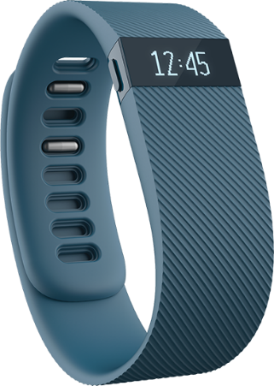

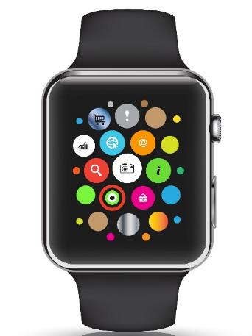

The Internet of Things
Gathering Big Data Affects
Underwriting
Pricing
Monitoring Could Affect
Loss Control
Pricing?
55
12/01/09 - 9pm
eSlide – P6466 – The Financial Crisis and the Future of the P/C
Notes:
55

Slide 56


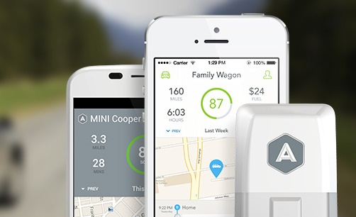
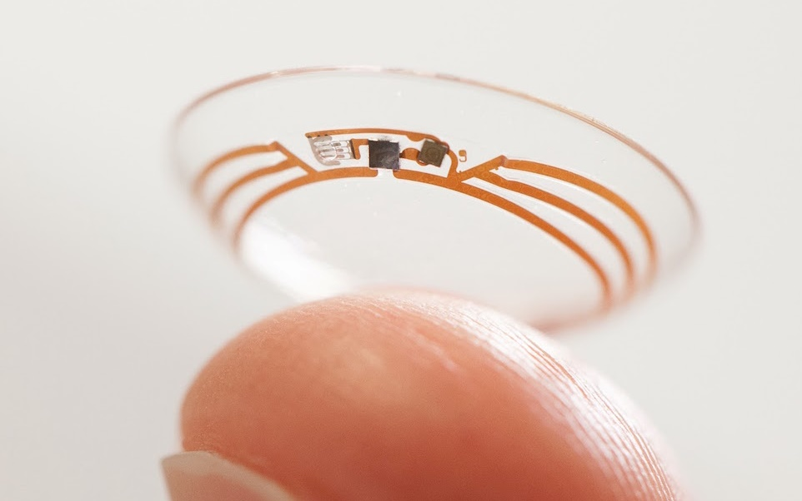
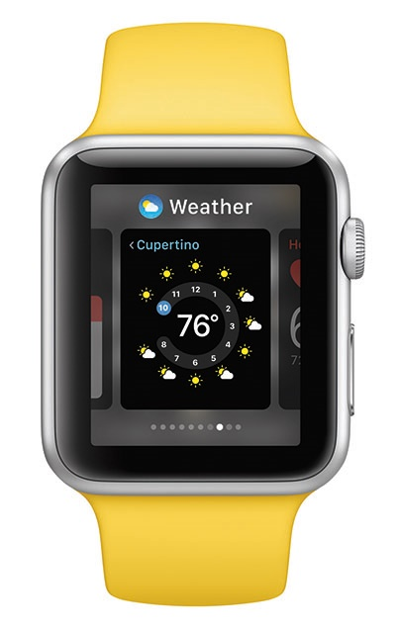
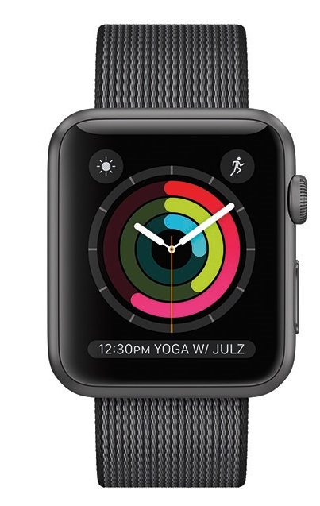
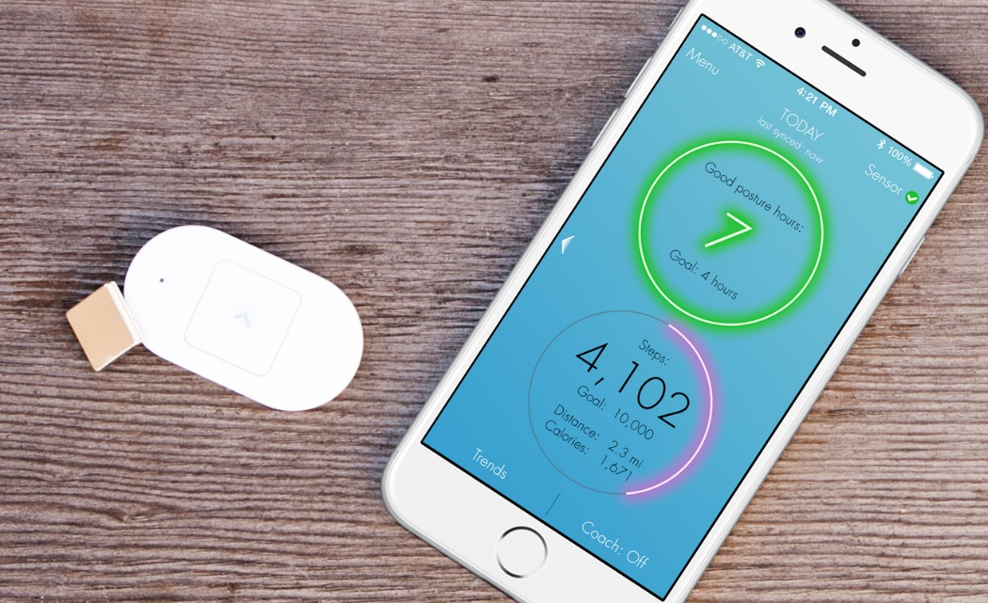
As For The Future…
IoT Could Disrupt UW, Claims, Loss Control
Image sources, clockwise: Nest, Jawbone, Automatic, Lumo, Apple, PSFK

Slide 57
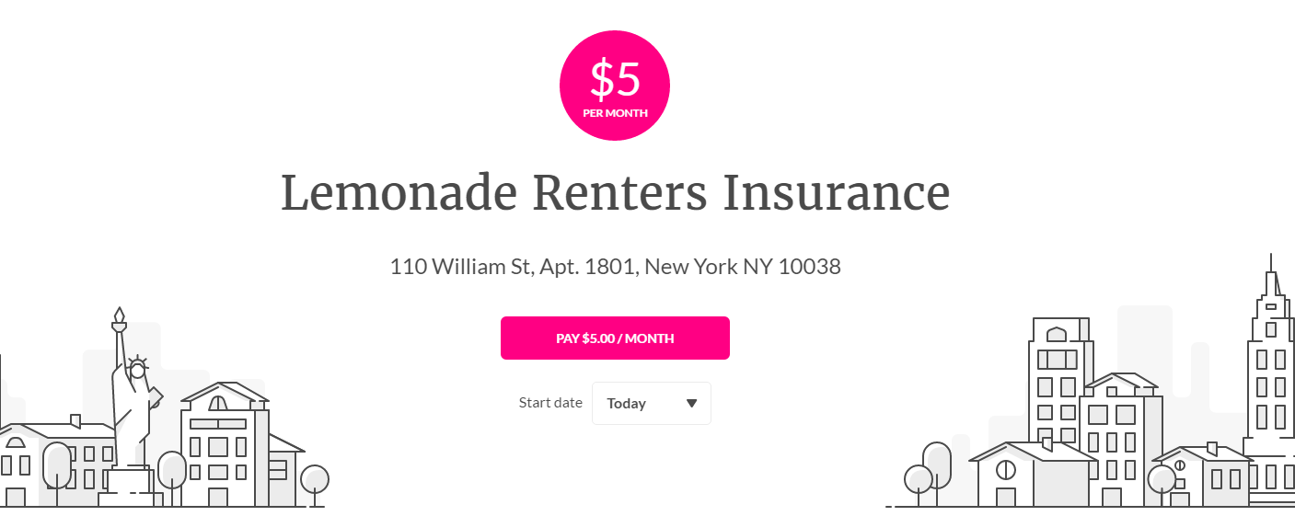
Peer-to-Peer (P2P) Insurance
Taking on the Entire Value Chain
The Business Model
Resembles Mutuals/ Reciprocals
20% of Premium to Expenses, 80% to Cover Risk.
Risk Pool for Each Charity
Leftover Pool Money Goes to Charity.
May Deter Fraud – You Wouldn’t Cheat Your Favorite Charity!
CEO Daniel Schreiber
Our Chief Behavioral Officer, Professor Dan Ariely, says that “If you tried to create a system to bring out the worst in humans, it would look a lot like the insurance of today.”
Source: “UberX-ing Insurance : Is Peer-to-Peer Insurance Viable?”, presentation by Jay Sarzen, Aite Group at Drinker Biddle Insurance Conference, June 21, 2016; Financial Times; www.lemonade.com.

Slide 58
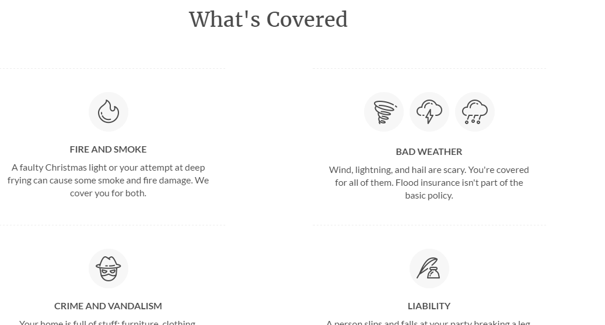
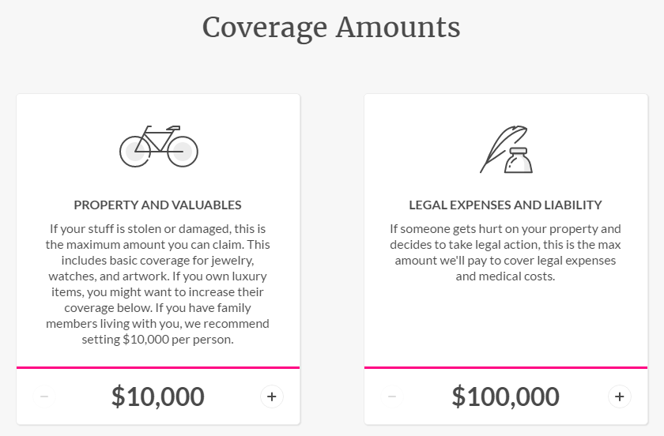
Lemonade’s P2P Model
Example: Renters’ Insurance (HO-4)

Slide 59
Lemonade’s P2P Model
Questions
Who Holds the Risk?
Captive? Front?
How Are Charitable Pools Separated?
Segregated Cell Captive?
Who Gets the Float?
Insurer, Reinsurer or Charity?
Who Gets the Tax Deduction (Worth More Than the Float)?

Slide 60
Summary
The industry is in good financial shape with several years of modest profits.
Interest rates look like they’ll stay low
Recent years have had modest cats; U.S. This year hurt by severe weather
Auto costs are rising (both frequency and severity)
Disruption provides opportunities and challenges throughout the value chain

Slide 61
Thank you for your time and your attention!
www.iii.org
Download at www.iii.org/presentations

