Slide 1
Casualty Market Overview & Outlook
Trends, Challenges & Opportunities
Insurance Information Institute
October 8, 2015
Robert P. Hartwig, Ph.D., CPCU, President & Economist
Insurance Information Institute ♦ 110 William Street ♦ New York, NY 10038
Tel: 212.346.5520 ♦ Cell: 917.453.1885 ♦ bobh@iii.org ♦ www.iii.org

Slide 2
P/C Insurance Industry Financial Performance
2015 is Shaping Up to Be a Reasonably Good Year
A Repeat of 2014?
2

Slide 3
P/C Industry Net Income After Taxes
1991–2015:H1
$ Millions
2005 ROE*= 9.6%
2006 ROE = 12.7%
2007 ROE = 10.9%
2008 ROE = 0.1%
2009 ROE = 5.0%
2010 ROE = 6.6%
2011 ROAS¹ = 3.5%
2012 ROAS¹ = 5.9%
2013 ROAS¹ = 10.2%
2014 ROAS¹ = 8.4%
2015:H1 ROAS = 9.2%
Net income fell modestly (-12.5%) in 2014 vs. 2013
ROE figures are GAAP; ¹Return on avg. surplus. Excluding Mortgage & Financial Guaranty insurers yields a 8.2% ROAS in 2014, 9.8% ROAS in 2013, 6.2% ROAS in 2012, 4.7% ROAS for 2011, 7.6% for 2010 and 7.4% for 2009.
Sources: A.M. Best, ISO; Insurance Information Institute

Slide 4
Profitability Peaks & Troughs in the P/C Insurance Industry, 1975 – 2015E
ROE
1977:19.0%
History suggests next ROE peak will be in 2016-2017
1987:17.3%
10 Years
1997:11.6%
2006:12.7%
10 Years
2015E: 8.8%
2013 9.8%
9 Years
2014 8.2%
1975: 2.4%
1984: 1.8%
1992: 4.5%
2001: -1.2%
*Profitability = P/C insurer ROEs. 2011-14 figures are estimates based on ROAS data. Note: Data for 2008-2014 exclude mortgage and financial guaranty insurers.
Source: Insurance Information Institute; NAIC, ISO, A.M. Best, Conning

Slide 5
ROE: Property/Casualty Insurance by Major Event, 1987–2015E
(Percent)
P/C Profitability Is Both by
Cyclicality and Ordinary Volatility
Modestly higher CATs
Katrina, Rita, Wilma
Low CATs
Sept. 11
Hugo
Lowest CAT Losses in
15 Years
4 Hurricanes
Sandy
Andrew
Record Tornado Losses
Northridge
Financial Crisis*
* Excludes Mortgage & Financial Guarantee in 2008 – 2014.
Sources: ISO, Fortune; Insurance Information Institute.

Slide 6
Commercial Lines NPW Premium Growth:
1975 – 2014
ROE
Commercial lines is prone to more cyclical volatility that personal lines. Recently, growth has stabilized in the 4% to 5% range.
Economic Shocks, Inflation:
1976: 22.2%
Tort Crisis
1986: 30.5%
Post-9/11
2002: 22.4%
Post-Hurricane Andrew Bump:
1993: 6.3%
1988-2000: Period of inter-cycle stability
Post Katrina Bump:
2006: 7.7%
2014 3.2%
2010-20XX? Post-recession period of stable growth?
Recessions:
1982: 1.1%
Great Recession:2009: -9.0%
Note: Data include state funds beginning in 1998.
Source: A.M. Best; Insurance Information Institute.

Slide 7
P/C Insurance Industry
Combined Ratio, 2001–2015:H1*
Heavy Use of Reinsurance Lowered Net Losses
Relatively Low CAT Losses, Reserve Releases
Higher CAT Losses, Shrinking Reserve Releases, Toll of Soft Market
As Recently as 2001, Insurers Paid Out Nearly $1.16 for Every $1 in Earned Premiums
Relatively Low CAT Losses, Reserve Releases
Avg. CAT Losses, More Reserve Releases
Sandy Impacts
Best Combined Ratio Since 1949 (87.6)
Cyclical Deterioration
Lower CAT Losses
* Excludes Mortgage & Financial Guaranty insurers 2008--2014. Including M&FG, 2008=105.1, 2009=100.7, 2010=102.4, 2011=108.1; 2012:=103.2; 2013: = 96.1; 2014: = 97.0.
Sources: A.M. Best, ISO.

Slide 8
A 100 Combined Ratio Isn’t What It
Once Was: Investment Impact on ROEs
A combined ratio of about 100 generates an ROE of ~7.0% in 2012/13, ~7.5% ROE in 2009/10,
10% in 2005 and 16% in 1979
Combined Ratio / ROE
Lower CATs helped ROEs in 2013-15:Q2
Combined Ratios Must Be Lower in Today’s Depressed
Investment Environment to Generate Risk Appropriate ROEs
* 2008 -2014 figures are return on average surplus and exclude mortgage and financial guaranty insurers. 2014 combined ratio including M&FG insurers is 97.0; 2013 = 96.1; 2012 =103.2, 2011 = 108.1, ROAS = 3.5%.
Source: Insurance Information Institute from A.M. Best and ISO Verisk Analytics data.

Slide 9
Return on Net Worth (RNW) All Lines:
2004-2013 Average
Commercial lines have tended to be more profitable than personal lines over the past decade
Source: NAIC; Insurance Information Institute.

Slide 10
Back to the Future: Profitability Peaks & Troughs in the P/C Insurance Industry, 1950 – 2015E*
ROE
1970-90: Peak ROEs were much higher in this period while troughs were comparable. High interest rates, rapid inflation, economic volatility all played roles
1950-70: ROEs were lower in this period. Low interest rates, low inflation, “Bureau” rate regulation all played a role
1990-2010s: Déjà vu. Excluding mega-CATs, this period is very similar to the 1950-1970 period
1977:19.0%
1987:17.3%
2006:12.7%
1972:13.7%
1997:11.6%
2013 9.8%
1950:8.0%
1966-67: 5.5%
1959:6.8%
2015E 8.8%
1969: 3.9%
1992: 4.5%
1957: 1.8%
1965: 2.2%
1975: 2.4%
1984: 1.8%
2001: -1.2%
*Profitability = P/C insurer ROEs. 2011-14 figures are estimates based on ROAS data. Note: Data for 2008-2014 exclude mortgage and financial guaranty insurers.
Source: Insurance Information Institute; NAIC, ISO, A.M. Best.

Slide 11
NPW Premium Growth: Peaks & Troughs in the P/C Insurance Industry, 1926 – 2015E
ROE
Post WW II Peak:
1947: 26.2%
1970-90: Peak premium growth was much higher in this period while troughs were comparable. Rapid inflation, economic volatility, high interest rates, tort environment all played roles
Start of WW II
1941: 15.8%
Economic Shocks, Inflation:
1976: 22.0%
Tort Crisis
1985/86: 22.2%
Post-9/11
2002:15.3%
1988-2000: Period of inter-cycle stability
2015E 4.1%
1950-70: Extended period of stability in growth and profitability. Low interest rates, low inflation, “Bureau” rate regulation all played a role
2010-20XX? Post-recession period of stable growth?
Twin Recessions; Interest Rate Hikes
1987: 3.7%
Great Recession:2010: -4.9%
Great Depression
1932: -15.9% max drop
Note: Data through 1934 are based on stock companies only. Data include state funds beginning in 1998.
Source: A.M. Best; Insurance Information Institute.

Slide 12
Distribution of Direct Premiums Written by Segment/Line, 2013
Personal/Commercial lines split has been about 50/50 for many years
Pvt. Passenger Auto is by far the largest line of insurance and is currently the most important source of industry profits
Billions of additional dollars in homeowners insurance premiums are written by state-run residual market plans
Distribution Facts
2013
Commercial Lines
$269.2B/51%
Homeowners
$80.7B/15%
Pvt. Pass Auto
$180.8B/34%
Sources: A.M. Best; Insurance Information Institute research.

Slide 13
RNW All Lines by State, 2004-2013 Average:
Highest 25 States
The most profitable states over the past decade are widely distributed geographically, though none are in the Gulf region
Profitability Benchmark: All P/C
US: 7.9%
Source: NAIC; Insurance Information Institute.

Slide 14
RNW All Lines by State, 2004-2013 Average:
Lowest 25 States
Some of the least profitable states over the past decade were hit hard by catastrophes
Source: NAIC; Insurance Information Institute.

Slide 15
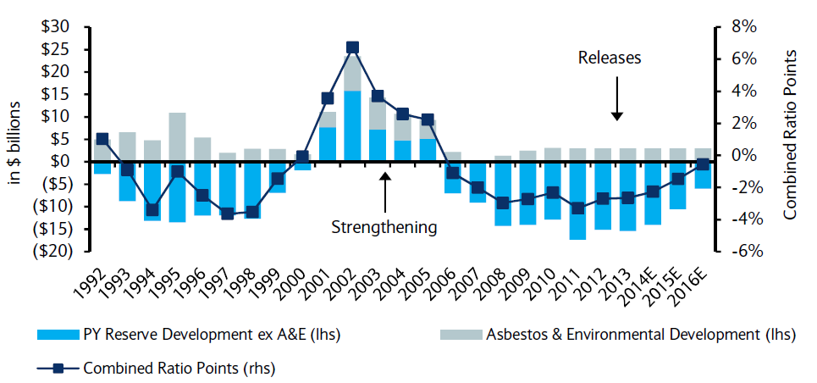
P/C Insurance Loss Reserve Development, 1992 – 2016E*
Reserve releases are expected to gradually taper off, but will continue to benefit the bottom line and combined ratio through at least 2016
Reserve Change
Source: A.M. Best; Barclays research for estimates.

Slide 16
INVESTMENTS:
THE NEW REALITY
Investment Performance is a Key Driver of Profitability
Depressed Yields Will Necessarily Influence Underwriting & Pricing
16

Slide 17
Property/Casualty Insurance Industry Investment Income: 2000–2015E¹
Investment earnings are still below their 2007 pre-crisis peak
($ Billions)
Due to persistently low interest rates,
investment income fell in 2012, 2013 and 2014.
¹ Investment gains consist primarily of interest and stock dividends. *2015 figure is estimated based on annualized data through Q2.
Sources: ISO; Insurance Information Institute.

Slide 18
Distribution of Invested Assets: P/C Insurance Industry, 2013
$ Billions
Total Invested Assets = $1.5 Trillion
Source: Insurance Information Institute Fact Book 2015, A.M. Best.

Slide 19
U.S. Treasury Security Yields:
A Long Downward Trend, 1990–2015*
Yields on 10-Year U.S. Treasury Notes have been essentially below 5% for a full decade.
U.S. Treasury yields plunged to historic lows in 2013. Longer-term yields rebounded then sank fell again.
Since roughly 80% of P/C bond/cash investments are in 10-year or shorter durations, most P/C insurer portfolios will have low-yielding bonds for years to come.
*Monthly, constant maturity, nominal rates, through September 2015.
Sources: Federal Reserve Bank at http://www.federalreserve.gov/releases/h15/data.htm. National Bureau of Economic Research (recession dates); Insurance Information Institute.
19
12/01/09 - 9pm
eSlide – P6466 – The Financial Crisis and the Future of the P/C
Notes:
19

Slide 20
Treasury Yield Curves:
Pre-Crisis (July 2007) vs. June 2015
Treasury yield curve remains near its most depressed level in at least 45 years. Investment income is falling as a result. Even when the Fed begins to raise rates, yields unlikely to return to pre-crisis levels anytime soon
The Fed Is Actively is Signaling that it Is Likely to Begin Raising Rates Later in 2015 but Only Very Gradually
Source: Federal Reserve Board of Governors; Insurance Information Institute.

Slide 21
Net Yield on Property/Casualty Insurance Invested Assets, 2007–2015*
(Percent)
Book yield in 2015 is down 77 BP from pre-crisis levels
The yield on invested assets remains low relative to pre-crisis yields. The Fed’s plan to raise interest rates in late 2015 has already pushed up some yields, albeit quite modestly.
*2015 figure is the average of the four quarters ending in 2015:Q2.
Sources: SNL Financial; Insurance Information Institute

Slide 22
Interest Rate Forecasts: 2015 – 2021
Yield (%)
3-Month Treasury
10-Year Treasury
The end of the Fed’s QE program in 2014 and a stronger economy have yet to push longer-term yields much higher
A full normalization of interest rates is unlikely until 2018, more than a decade after the onset of the financial crisis.
Sources: Blue Chip Economic Indicators (9/15 for 2015 and 2016; for 2017-2021 3/15 issue); Insurance Info. Institute.

Slide 23
Annual Inflation Rates, (CPI-U, %),
1990–2016F
Annual Inflation Rates (%)
Inflation peaked at 5.6% in August 2008 on high energy and commodity crisis. The recession and the collapse of the commodity bubble reduced inflationary pressures in 2009/10
Inflationary expectations have slipped (due in part to falling energy costs) allowing the Fed to maintain low interest rates
Slack in the U.S. economy and falling energy prices suggests that inflationary pressures should remain subdued for an extended period of times
Sources: US Bureau of Labor Statistics; Blue Chip Economic Indicators, 9/15 (forecasts).

Slide 24
Reduction in Combined Ratio Necessary to Offset 1% Decline in Investment Yield to Maintain Constant ROE, by Line*
Lower Investment Earnings Place a Greater Burden on Underwriting and Pricing Discipline
*Based on 2008 Invested Assets and Earned Premiums
**US domestic reinsurance only
Source: A.M. Best; Insurance Information Institute.
24
12/01/09 - 9pm
eSlide – P6466 – The Financial Crisis and the Future of the P/C
Notes:
24
This shows the drop in Combined Ratio for each line of business that would be needed to maintain a constant ROE, given a 1-percentage-point drop in investment yield

Slide 25
P/C Insurer Net Realized
Capital Gains/Losses, 1990-2015:Q2
Realized capital gains rose sharply as equity markets rallied in 2013-14
($ Billions)
Insurers Posted Net Realized Capital Gains in 2010 - 2014 Following Two Years of Realized Losses During the Financial Crisis. Realized Capital Losses Were a Primary Cause of 2008/2009’s Large Drop in Profits and ROE.
*Through Q2 2015.
Sources: A.M. Best, ISO, SNL, Insurance Information Institute.
25
12/01/09 - 9pm
eSlide – P6466 – The Financial Crisis and the Future of the P/C
Notes:
25

Slide 26
Property/Casualty Insurance Industry Investment Gain: 1994–2015:Q2¹
($ Billions)
Investment gains in 2014 will rival the post-crisis high reached in 2013
Total Investment Gains Were Down Slightly in 2014 as Low Interest Rates Pressured Investment Income but Realized Capital Gains Remained Robust
¹ Investment gains consist primarily of interest, stock dividends and realized capital gains and losses.
* 2005 figure includes special one-time dividend of $3.2B; 2015 figure is through Q2 2015.
Sources: ISO, SNL; Insurance Information Institute.

Slide 27
S&P 500 Index Returns, 1950 – 2015*
Annual Return
Volatility is endemic to stock markets—and may be increasing—but there is no persistent downward trend over long periods of time
Fed Raises Rate
Tech Bubble Implosion
2015*:
-3.8%
Energy Crisis
Financial Crisis
*Through Oct. 6, 2015.
Source: NYU Stern School of Business: http://pages.stern.nyu.edu/~adamodar/New_Home_Page/datafile/histretSP.html Ins. Info. Inst.

Slide 28
Distribution of Bond Maturities,
P/C Insurance Industry, 2003-2013
The main shift over these years has been from bonds with longer maturities to bonds with shorter maturities. The industry first trimmed its holdings of over-10-year bonds (from 24.6% in 2003 to 15.5% in 2012) and then trimmed bonds in the 5-10-year category (from 31.3% in 2003 to 27.6% in 2012) . Falling average maturity of the P/C industry’s bond portfolio is contributing to a drop in investment income along with lower yields.
Sources: SNL Financial; Insurance Information Institute.

Slide 29
CAPITAL/CAPACITY
Capital Accumulation Has Multiple Impacts
29

Slide 30
Policyholder Surplus,
2006:Q4–2015:Q2
($ Billions)
2007:Q3
Pre-Crisis Peak
Drop due to near-record 2011 CAT losses
Surplus as of 6/30/15 stood at a near-record high $672.4B
The industry now has $1 of surplus for every $0.73 of NPW,
close to the strongest claims-paying status in its history.
2010:Q1 data includes $22.5B of paid-in capital from a holding company parent for one insurer’s investment in a non-insurance business .
The P/C insurance industry entered 2015
in very strong financial condition.
Sources: ISO, A.M .Best.
30
12/01/09 - 9pm
eSlide – P6466 – The Financial Crisis and the Future of the P/C
Notes:
30

Slide 31
US Policyholder Surplus:
1975–2015:Q2*
($ Billions)
Surplus as of 6/30/15 was a near-record $672.4, down 0.3% from the record $674.7 of 12/31/14 but up 53.8% ($235.3B) from the crisis trough of $437.1B at 3/31/09
“Surplus” is a measure of underwriting capacity. It is analogous to “Owners Equity” or “Net Worth” in non-insurance organizations
The Premium-to-Surplus Ratio Stood at $0.76:$1 as of
6/30/15, a Near Record Low (at Least in Recent History)
* As of 6
*As of 6/30/15.
Source: A.M. Best, ISO, Insurance Information Institute.

Slide 32
Premium-to-Surplus Ratio:
1985–2014*
(Ratio of NWP to PHS)
The larger surplus is in relation to premiums—the lower the P:S ratio—and the great the industry’s capacity to handle the risk it has accepted
Surplus as of 12/31/14 was $0.73:$1, a near-record low (at least in modern history)
9/11, Recession & Hard Market
The Premium-to-Surplus Ratio Stood at $0.73:$1 as of
12/31/14, a Record Low (at Least in Recent History)
* As of 12/31/14.
Source: A.M. Best, ISO, Insurance Information Institute.

Slide 33
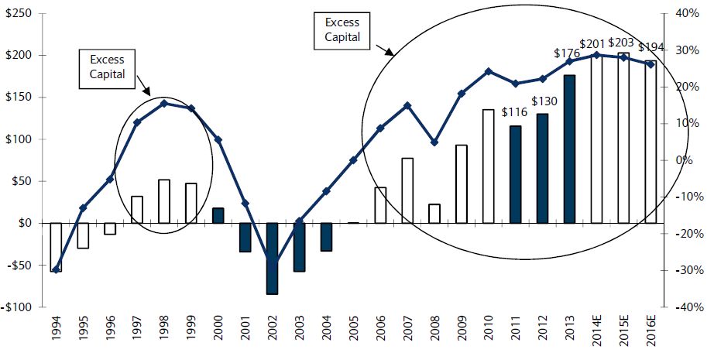
US P/C Insurance Industry Excess Capital Position: 1994–2016E
Barclay’s suggests that surplus is approximately $200B (~30%)
Surplus Redundancy (Deficiency)
Percent Redundancy (Deficiency)
The Industry’s Strong Capital Position Suggests Insurers Are in a Good Position to Increase Risk Appetite, Repurchase Shares and Pursue Acquisitions
Source: Barclays Research estimates.

Slide 34
P/C Industry: Loss Reserve-to-Surplus Ratio, 1971-2014
Inflation, Liability Crisis Increased Reserves, Plunging Stock Prices Depleted Surplus
The Property/Casualty Industry Adjusted Its Risk Portfolio in Response to Risk-Based Capital Requirements Implemented in 1994.
Source: Calculations from A.M. Best and ISO data by Insurance Information Institute.

Slide 35
Alternative Capital
New Investors Continue to Change the Reinsurance Landscape
Trickle Down Into Casualty Lines?
35

Slide 36
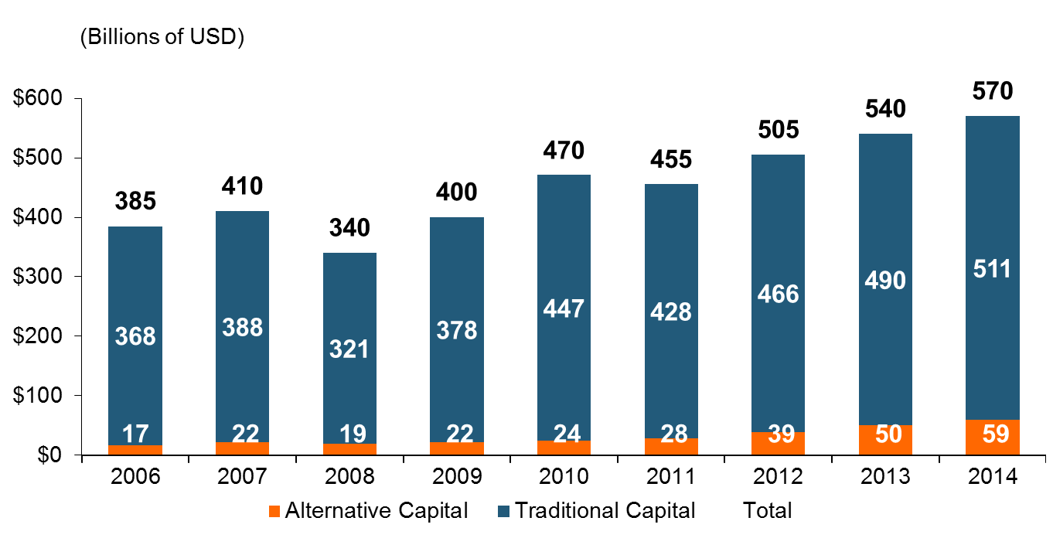
Global Reinsurance Capital (Traditional and Alternative), 2006 - 2014
Total reinsurance capital reached a record $570B in 2013, up 68% from 2008.
But alternative capacity has grown 210% since 2008, to $50B. It has more than doubled in the past three years.
2014 data is as of June 30, 2014.
Source: Aon Benfield Analytics; Insurance Information Institute.

Slide 37
Alternative Capital as a Percentage of Traditional Global Reinsurance Capital
Alternative Capital’s Share of Global Reinsurance Capital Has More Than Doubled Since 2010.
2014 data is as of June 30, 2014.
Source: Aon Benfield Analytics; Insurance Information Institute.

Slide 38
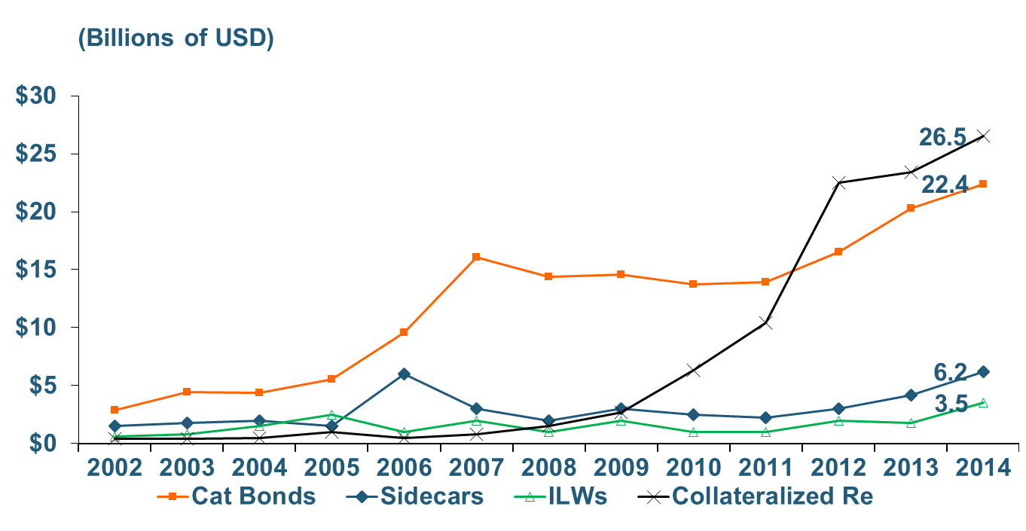
Growth of Alternative Capital Structures, 2002 - 2014
Collateralized Re’s Growth Has Accelerated in the Past Three Years.
Collateralized Reinsurance and Catastrophe Bonds Currently Dominate the Alternative Capital Market.
2014 data is as of June 30, 2014.
Source: Aon Benfield Analytics; Insurance Information Institute.

Slide 39
Catastrophe Bond Issuance and Outstanding: 1997-2015:Q1
Risk Capital Amount ($ Millions)
2014 Has Seen the Largest Cat Bond Ever - $1.5 Billion (Florida Citizens). Bond Issuance Set a Record.
Source: Guy Carpenter.

Slide 40
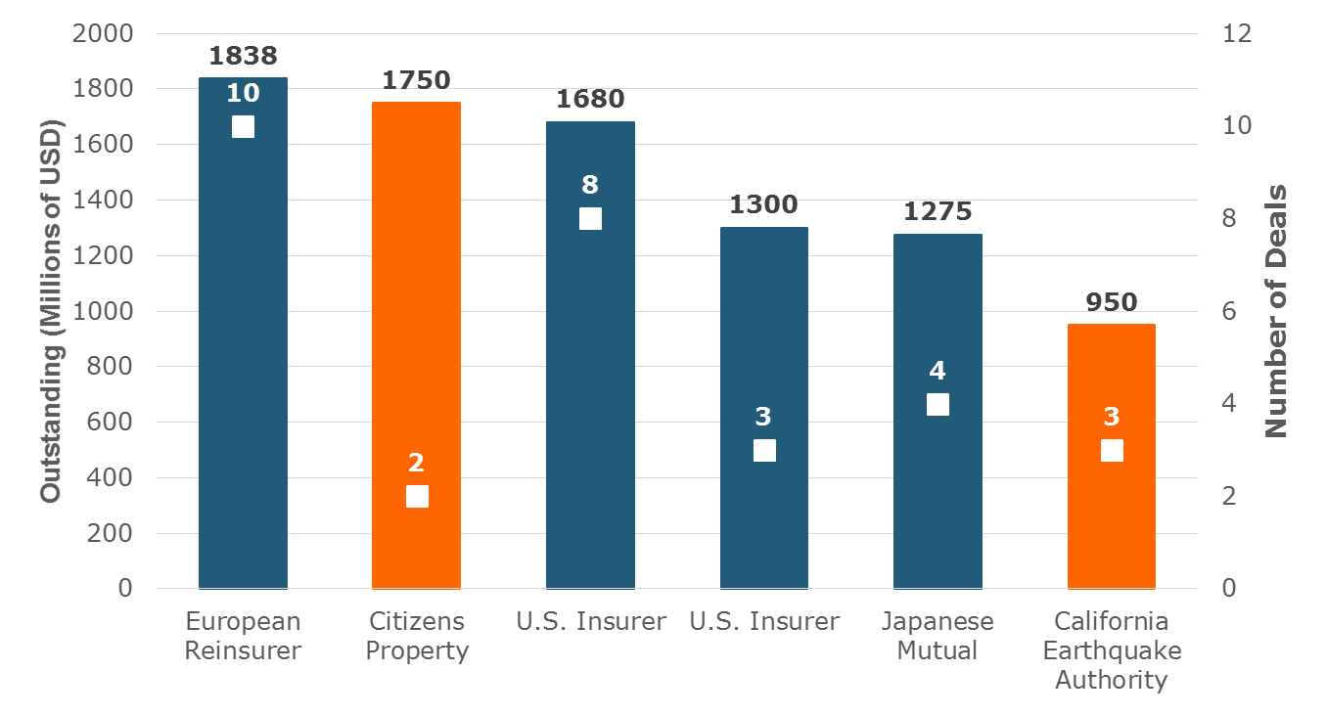
Largest Sponsors of ILS, Year-End 2014
Two of the Largest ILS Issuers Are Government-Sponsored Insurers. Nine Government-Related Insurers Have $4.6 Billion in Outstanding Securities.
Source: Artemis.bm; Insurance Information Institute.

Slide 41
Questions Arising from Influence of Alternative Capital
What Will Happen When Investors Face Large-Scale Losses?
What Happens When Interest Rates Rise?
Does ILS Have a Higher Propensity to Litigate?
How Much Lower Will Risk Premiums Shrink/ROLs Fall?
Will There Be Spillover Into Casualty Reinsurance?
Will Alternative Capital Drive Consolidation?

Slide 42
M&A UPDATE:
A PATH TO GROWTH?
Are Capital Accumulation, Drive for Growth and Scale Stimulating M&A Activity?
42

Slide 43
U.S. INSURANCE MERGERS AND ACQUISITIONS,
P/C SECTOR, 1994-2014 (1)
M&A activity in 2015 will likely reach its highest level since 1998
M&A activity in the P/C sector was up sharply in 2014 but remains well below pre-crisis or late 1990s levels.
($ Millions)
(1) Includes transactions where a U.S. company was the acquirer and/or the target.
Source: Conning proprietary database.

Slide 44
Top Global P&C M&As in 2014 - YTD 2015
Acquirer | Target | Transaction Value
ACE (Switzerland) | Chubb (US) | $28,300
Exor (Italy) | PartnerRe Ltd. (Bermuda) | $6,900
Zurich (Switzerland) | RSA (UK) | 8,000
XL Group plc (Ireland) | Catlin Group Ltd. (Bermuda) | 4,200
RenaissanceRe Holdings Ltd. (Bermuda) | Platinum Underwriters Holdings Ltd. (Bermuda) | 1,900
Fairfax Financial Holdings Ltd. (Canada) | Brit Insurance Holdings NV (Netherlands) | 1,880
Desjardins Financial Corp. (Canada) | State Farm's property/casualty and life insurance operations in Canada (Canada) | 1,500
TPG Capital LP | The Warranty Group, Inc. (Canada) | 1,500
Fosun International Ltd. (China) | Caixa Seguros e Saude SGPA SA (Portugal) | 1,360
Progressive Corp. | ARX Holding Corp. | 875
Assured Guaranty Ltd. (Bermuda) | Radian Asset Assurance, Inc. | 810
Mapfre S.A. (Spain) | German and Italina operations of Direct Line Insurance Group plc (Germany/Italy) | 701
Validus Holdings Ltd. (Bermuda) | Western World Insurance Group, Inc. | 690
ACE Ltd. (Switzerland) | P&C business from Itau Seguros S.A. (Brazil) | 685
Update: Alleghany Corp. announced in May 2015 that it is considering the sale of TransAtlantic Holding Co. (TransRe).
*Source: Conning; Insurance information Institute.

Slide 45
Recent M&A Transactions Involving
Lloyd's and Bermuda Re/Insurers
Date | Acquirer | Target | Deal Value $ Billion
Dec 2012 | Aquiline | Equity Redstar | 0.1
Jun 2013 | Enstar/Stone Point | Atrium | 0.2
Jul 2013 | Enstar/Stone Point | Torus | 0.7
Aug 2013 | Ian Beaton and Management | Ark Syndicate Management | 0.4
Aug 2013 | Lancashire | Cathedral | 0.4
Aug 2013 | AmTrust | Sagicor | 0.1
Sep 2013 | ANV | Jubilee Managing Agency | N/A
Dec 2013 | Sompo | Canopius | 1.0
Feb 2014 | Qatar Insurance Company | Antares | 0.2
Jul 2014 | BTG Pactual | Ariel Re | 0.4
Nov 2014 | RenaissanceRe | Platinum Underwriters | 1.9
Dec 2014 | XL Group | Catlin | 4.1
Jan 2015 | PartnerRe | AXIS | 11.0*
Feb 2015 | Fairfax Financial Holdings | Brit | 1.9
*Deal was not complete as of 6/4/15 and a rival bid from Italian investment firm Exor was still under consideration.
Source: Swiss Re sigma 3/2015; Insurance information Institute.

Slide 46
What’s Driving Global Insurance M&A Activity and Will It Continue?
Excess Capital in Global Reinsurance and Primary Commercial Insurance in US
  (Re)Insurers, like corporations in many industry, are sitting are large amounts of cash accumulated since the Global Financial Crisis that earns very little
Alternative Capital
Slow Top Line (Premium) Growth
Slowdown in Pace of Earnings Growth/ROE
Low Interest Rates Make Debt Financing for Acquisitions Attractive
  Concern that interest rates in US may soon rise so best to act now
Desire to Achieve Economies of Scale
Peer Pressure/Momentum
  Management concerns about being “left out”

Slide 47
Performance by Segment
Key Casualty Lines
47
Notes:
47

Slide 48
Commercial Lines Combined Ratio, 1990-2016F*
Commercial lines underwriting performance improved in 2013/14 but higher cats, diminishing prior year reserves and rising loss cost trends in some lines could push combined ratios higher
*2007-2012 figures exclude mortgage and financial guaranty segments.
Source: A.M. Best (1990-2014); Conning (2015-16F) Insurance Information Institute.

Slide 49
Commercial Property Combined Ratio:
2007–2016F
Commercial Property Underwriting Performance Has Been Volatile in Recent Years, Largely Due to Fluctuations in CAT Activity
Source: Conning Research and Consulting.

Slide 50
Direct Premiums Written: Comm. Lines
Percent Change by State, 2007-2014
Top 25 States
43 states showed commercial lines growth from 2007 through 2014
Growth Benchmarks: Commercial
US: 5.9%
Sources: SNL Financial LLC.; Insurance Information Institute.

Slide 51
Direct Premiums Written: Comm. Lines
Percent Change by State, 2007-2014
Bottom 25 States
Nearly half the states have yet to see commercial lines premium volume return to pre-crisis levels
States with the poorest performing economies also produced the most negative net change in premiums of the past 6 years
Sources: SNL Financial LLC.; Insurance Information Institute.

Slide 52
How the Risk Dollar is Spent
(U.S. Firms with Revenues Under $1 Bill)
Source: 2015 RIMS Benchmark Survey; Insurance Information Institute.
52
Notes:
52

Slide 53
How the Risk Dollar is Spent
(U.S. Firms with Revenues Over $1 Bill)
Source: 2015 RIMS Benchmark Survey; Insurance Information Institute.
53
Notes:
53

Slide 54
General Liability
Operating Environment
General Liability Results Are Mixed
54

Slide 55
General Liability Combined Ratio:
2005–2017F
Commercial General Liability Underwriting Performance Was Volatile but May Be Stabilizing
Source: Conning Research and Consulting.

Slide 56
General Liability: DWP Volume and Growth, 2008 – 2017F
DPW ($ Bill) % Change
GL DPW is up an estimated 35.9% ($17.2B) from its crisis low
GL Premium Volumes Continue to Grow Albeit at a Slower Pace
Source: Conning Research & Consulting; Insurance Information Institute.

Slide 57
General Liability: Return on GAAP Equity: 2008–2017F
General Liability Profitability Is Stable but Below Its 2011 Peak
Source: Conning Research and Consulting.

Slide 58
General Liability: Incurred Loss Trends and Outlook
FREQUENCY
  Decreasing low single digit in 2015-2017
  Reported occurrence form other liability claim counts down by 11.8% and up 10.0% for claims-made form
  Some reports of rising loss frequency, esp. EPLI and non-profit D&O
SEVERITY
  Up low-to-mid single digits in 2015-2017
  Analysis of paid losses to claim counts suggests trend of rising average loss severity
  Inflation in hospital and medical costs continues to outpace overall CPI, contributing to loss severity
Source: Conning Research and Consulting.

Slide 59
Commercial Auto
Operating Environment
Commercial Auto Outlook Is Cloudy
59

Slide 60
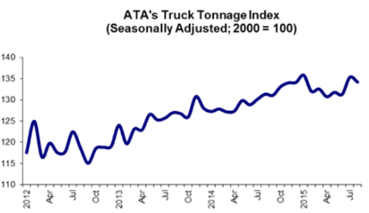
Commercial Auto: Outlook
EXPOSURE
  Heavy and light truck sales expected to rise 4% - 5% in 2015
  Truck tonnage (ATA) is up 3.3% YTD (August)
  Transportation Network Companies (TNCs)
    TNCs such as Uber, Lyft will need to seek solutions
    Regulatory environment for TNCs uncertain
FREQUENCY
  Overall frequency flat to +1% for 2015-2017 (Conning)
  Miles driven is up in commercial fleets
  Non-fatal injuries for truck drivers appears to be increasing
  ATA: Trucker shortage; Need 89,000 new trucks each year for next decade (10% of current 890,000 employed truckers)
Sources: Conning Research and Consulting; American Trucking Association (ATA); Insurance Information Institute.

Slide 61
Commercial Auto Combined Ratio: 1993–2017F
Commercial Auto is Expected to Improve Only Slowly as Rate Gains Barely Offset Adverse Frequency and Severity Trends
Sources: A.M. Best (1990-2014);Conning (2015F); Insurance Information Institute.

Slide 62
Private Passenger Auto Combined Ratio: 1993–2017F
Private Passenger Auto Underwriitng Performance Is Exhibiting Remarkable Stability
Sources: A.M. Best (1990-2014); Conning (2015F – 2017F); Insurance Information Institute.

Slide 63
Commercial Auto: Return on GAAP Equity: 2008–2017F
Commercial Auto Margins Could Shrink if Underwriting Deteriorates
Source: Conning Research and Consulting.

Slide 64
Commercial Auto: DWP Volume and Growth, 2008 – 2017F
DPW ($ Bill) % Change
Commercial Auto DPW is up an estimated 34.9% ($8.2B) from its crisis low
Commercial Auto Premium Volumes Continue to Grow Albeit at a Slower but Still-Healthy Pace
Source: Conning Research & Consulting; Insurance Information Institute.

Slide 65
Collision Coverage: Severity & Frequency Trends Are Both Higher in 2015*
Annual Change, 2005 through 2015*
The Recession, High Fuel Prices Helped Temper Frequency and Severity, But this Trend Will Likely Be Reversed Based on Evidence from Past Recoveries
*2015 figure is for the 4 quarters ending with 2015:Q1.
Source: ISO/PCI Fast Track data; Insurance Information Institute

Slide 66
Bodily Injury: Severity Trend Is Up, Frequency Decline Has Ended—Rising?
Annual Change, 2005 through 2015:Q1*
Cost Pressures Will Increase if BI Frequency and Severity Trends Persist
*2015 figure is for Q1 2015 over Q1 2014.
Source: ISO/PCI Fast Track data; Insurance Information Institute

Slide 67
Death Rates per 100,000,000 Vehicle miles, 1990-2015*
The recession and high gas prices reduced miles driven, accelerating the drop in death rates
Motor vehicle fatality rates appear to be ticking up in 2015
Vehicle death rates fell by nearly half between 1990 and 2010
*Projected rate for 2015 based on date through June 2015.
Source: National Safety Council; Insurance Information Institute.
67
Notes:
67

Slide 68
Driving Trends, Gas Prices
Back Behind the Wheel…
68

Slide 69
America is Driving More Again:
Total Miles Driven*, 1990–2015
Billions
Some of the 1990-2007 growth in miles driven (+43.9%) is due to population growth (+20.7%)…
…but the population grew by 6.6% from 2007-2015 and miles driven didn’t grow at all.
New records in 2015
From November 2007 until January 2015, miles driven was below the prior peak for 87 straight months—
over 7 years! Previous record was in the early 1980s (39 months).
*Moving 12-month total. The 2015 data are through May 2015, the latest available.
Note: Recessions indicated by gray shaded columns.
Sources: Federal Highway Administration (http://www.fhwa.dot.gov/policyinformation/travel_monitoring/tvt.cfm );
National Bureau of Economic Research (recession dates); Insurance Information Institute.
69
12/01/09 - 9pm
eSlide – P6466 – The Financial Crisis and the Future of the P/C
Notes:
69

Slide 70
Do Changes in Miles Driven Affect
Auto Collision Claim Frequency?
Paid Claim Frequency = (No. of paid claims)/(Earned Car Years) x 100
People drove 2.8% more miles through May 2015 than through May 2014.
Sources: Federal Highway Administration (http://www.fhwa.dot.gov/ohim/tvtw/tvtpage.cfm; ISO Fast Track Monitoring System, Private Passenger Automobile Fast Track Data: 1st Qtr. 2015 and earlier reports. *2015 ISO figure is for 12 months ending 2015 Q1. FHA data for 2015 is 12-month moving average ending May 2015.

Slide 71
% Change in Real US GDP vs. % Change in Total Miles Driven
Percent Change in Total Miles Driven
% Change in Real US GDP*
The percent change in miles driven tracked the growth of the national economy fairly well. If this holds, miles driven will continue to rise.
*Data are annual rates
Sources: Federal Highway Administration (http://www.fhwa.dot.gov/policyinformation/travel_monitoring/tvt.cfm ); www.bea.gov (real GDP); l I.I.

Slide 72
The Price of Gas, Weekly, 2014-2015
Avg. Price /Gallon
Even after the rebound, prices remain 30% below the July 2014 peak.
Until July 2014, gas prices were persistently high
From July through December, gas prices fell virtually every week
Gas Prices Fell 34% Over the Second Half of the 2014
Price is U.S. All Grades All Formulations Retail Gasoline Prices, through August 10, 2015
Sources: Federal Energy Administration (http://www.eia.gov/petroleum/gasdiesel/ ); I.I.I.

Slide 73
Workers Compensation Operating Environment
Workers Comp Results Have Improved Substantially in Recent Years
73

Slide 74
Workers Compensation Combined Ratio: 1994–2014P
WC results have improved markedly since 2011
Workers Comp Results Began to Improve in 2012. Underwriting Results Deteriorated Markedly from 2007-2010/11 and Were the Worst They Had Been in a Decade.
Sources: A.M. Best (1994-2009); NCCI (2010-2014P) and are for private carriers only; Insurance Information Institute.

Slide 75
Nonfarm Payroll (Wages and Salaries):
Quarterly, 2005–2015:Q1
Billions
Latest (2015:Q1) was $7.66 trillion, a new peak--$1.34 trillion above 2009 trough
Prior Peak was 2008:Q3 at $6.54 trillion
Growth rates
2011:Q1 over 2010:Q1: 5.5%
2012:Q1 over 2011:Q1: 4.2%
2013:Q1 over 2012:Q1: 2.5%
2014:Q1 over 2013:Q1: 4.3%
2015:Q1 over 2014:Q1: 4.4%
Recent trough (2009:Q1) was $6.23 trillion, down 5.3% from prior peak
Note: Recession indicated by gray shaded column. Data are seasonally adjusted annual rates.
Sources: http://research.stlouisfed.org/fred2/series/WASCUR; National Bureau of Economic Research (recession dates); Insurance Information Institute.
75
12/01/09 - 9pm
eSlide – P6466 – The Financial Crisis and the Future of the P/C
Notes:
75

Slide 76
Payroll vs. Workers Comp Net Written Premiums, 1990-2014P
Payroll Base* WC NWP
$Billions $Billions
7/90-3/91
3/01-11/01
12/07-6/09
WC premium volume dropped two years before the recession began
WC net premiums written were down $14B or 29.3% to $33.8B in 2010 after peaking at $47.8B in 2005
Continued Payroll Growth and Rate Gains Suggest WC NWP Will Grow Again in 2015
*Private employment; Shaded areas indicate recessions. WC premiums for 2014 are from NCCI.
Sources: NBER (recessions); Federal Reserve Bank of St. Louis at http://research.stlouisfed.org/fred2/series/WASCUR ; NCCI; I.I.I.

Slide 77
Workers Compensation Premium:
Fourth Consecutive Year of Increase
Net Written Premium
$ Billions
p Preliminary
Source: NCCI from Annual Statement Data.
Includes state insurance fund data for the following states: AZ, CA, CO, HI, ID, KY, LA, MD, MO, MT, NM, OK, OR, RI, TX, UT.
Each calendar year total for State Funds includes all funds operating as a state fund that year.
Calendar Year

Slide 78
Direct Premiums Written: Workers’ Comp
Percent Change by State, 2007-2014*
Top 25 States
Only 21 states have seen works comp premium volume return to pre-crisis levels
*Excludes monopolistic fund states: ND, OH, WA, WY as well as WV, which transitioned to a competitive structure during this period.
Sources: SNL Financial LC.; Insurance Information Institute.

Slide 79
Direct Premiums Written: Worker’s Comp
Percent Change by State, 2007-2014*
Bottom 25 States
States with the poorest performing economies also produced some of the most negative net change in premiums of the past 7 years
*Excludes monopolistic fund states: ND, OH, WA, WY as well as WV, which transitioned to a competitive structure during this period.
Sources: SNL Financial LC.; Insurance Information Institute.

Slide 80
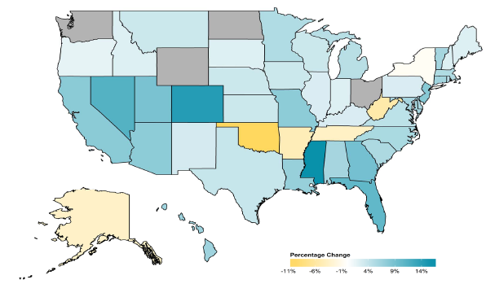
2014 Workers Compensation Direct Written Premium Growth, by State*
PRIVATE CARRIERS: Overall 2014 Growth = +4.6%
While growth rates varied widely, most states experienced positive growth in 2014
*Excludes monopolistic fund states (in gray): OH, ND, WA and WY.
Source: NCCI.

Slide 81
Workers Compensation Components of Written Premium Change, 2013 to 2014
Written Premium Change from 2013 to 2014
Net Written Premium—Countrywide | +4.6%
Direct Written Premium—Countrywide | +4.6%
Direct Written Premium—NCCI States | +4.5%
Components of DWP Change for NCCI States
Change in Carrier Estimated Payroll | +4.7%
Change in Bureau Loss Costs and Mix | -1.4%
Change in Carrier Discounting | +0.4%
Change in Other Factors | +0.8%
Combined Effect | +4.5%
Growth is now almost entirely payroll driven
Sources: Countrywide: Annual Statement data.
NCCI States: Annual Statement Statutory Page 14 for all states where NCCI provides ratemaking services.
Components: NCCI Policy data.

Slide 82
Monthly Change in Private Employment
3,042,000 jobs were created in 2014, the most since 1997
January 2007 through Sept. 2015 (000s, Seasonally Adj.)
Jobs Created
2014: 3.042 Mill
2013: 2.452 Mill
2012: 2.315 Mill
2011: 2.396 Mill
2010: 1.282 Mill
118,000 private sector jobs were created in Sept.
Monthly losses in Dec. 08–Mar. 09 were the largest in the
post-WW II period
Private Employers Added 13.03 Million Jobs Since Jan. 2010 After Having Shed 5.01 Million Jobs in 2009 and 3.76 Million in 2008 (State and Local Governments Have Shed Hundreds of Thousands of Jobs)
Source: US Bureau of Labor Statistics: http://www.bls.gov/ces/home.htm; Insurance Information Institute

Slide 83
US Unemployment Rate Forecast
Rising unemployment
eroded payrolls
and WC’s
exposure base.
Unemployment peaked at 10% in late 2009.
2007:Q1 to 2016:Q4F*
Jobless figures have been revised downwards for 2015/16
Unemployment forecasts have been revised modestly downwards. Optimistic scenarios put the unemployment as low as 5.0% by Q4 of 2015.
* = actual; = forecasts
Sources: US Bureau of Labor Statistics; Blue Chip Economic Indicators (9/15 edition); Insurance Information Institute.

Slide 84
Unemployment Rates by State, July 2015:
Highest 25 States*
In July, 24 states and the District of Columbia had over-the-month unemployment rate decreases, 14 states had increases, and 12 states had no change.
*Provisional figures for July 2015, seasonally adjusted.
Sources: US Bureau of Labor Statistics; Insurance Information Institute.

Slide 85
Unemployment Rates by State, July 2015:
Lowest 25 States*
In July, 24 states and the District of Columbia had over-the-month unemployment rate decreases, 14 states had increases, and 12 states had no change.
*Provisional figures for July 2015, seasonally adjusted.
Sources: US Bureau of Labor Statistics; Insurance Information Institute.

Slide 86
2013 Workers Compensation Direct Written Premium Growth, by State*
PRIVATE CARRIERS: Overall 2013 Growth = +5.4%
While growth rates varied widely, all states experienced positive growth in 2013
*Excludes monopolistic fund states (in white): OH, ND, WA and WY.
Source: NCCI.

Slide 87
WC Approved Changes in Bureau Premium Level (Rates/Loss Costs)
Percent
By Effective Date for Total Market
Cumulative 2000–2003
+17.1%
Cumulative 2011–2014
+11.8%
Cumulative 1994–1999
-27.8%
Cumulative 2004–2011
-30.8%
Cumulative
1990–1993
+36.3%
Approved rates/loss costs are down for the first time since 2010
Calendar Year
*States approved through 4/24/15.
Note: Bureau premium level changes are countrywide approved changes in advisory rates, loss costs and assigned risk rates as filed by applicable rating organization, relative to those previously approved.
Source: NCCI.

Slide 88
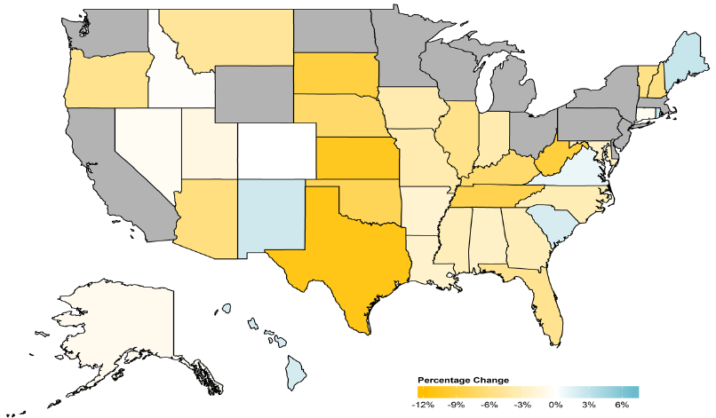
WC Approved or Filed and Pending Change in NCCI Premium Level by State
Latest Change for Voluntary Market
While growth rates varied widely, most states experienced positive growth in 2014
*Excludes monopolistic fund states (in gray): OH, ND, WA and WY.
Source: NCCI.

Slide 89
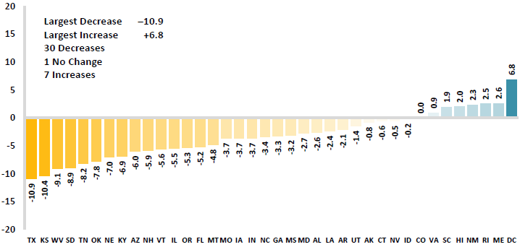
WC Approved or Filed and Pending Change in NCCI Premium Level by State
Latest Change for Voluntary Market
Excludes Law-Only Filings
The majority of states experienced decreases in rates/loss costs over
Note: Premium level changes are approved changes are approved or filed and pending changes in advisory rates, loss costs and rating values as of 4/24/15 as filed by applicable rating organization, relative to those previously approved. SC is filed and pending. IN and NC are in cooperation with state rating bureaus.
Source: NCCI.

Slide 90
Workers Compensation Lost-Time
Claim Frequency Declined in 2014
Percent
Cumulative Change of –51.1%
(1994–2013 adj.)
*Adjustments primarily due to significant audit activity.
2014p: Preliminary based on data valued as of 12/31/2014.
Source: NCCI Financial Call data, developed to ultimate and adjusted to current wage an voluntary loss cost level; Excludes high deductible policies; 1994-2013: Based on data through 12/31/13. Data for all states where NCCI provides ratemaking services, excluding WV.
Frequency is the number of lost-time claims per $1M pure premium at current wage and voluntary loss cost level
Accident Year

Slide 91
Workers Comp Indemnity Claim Costs: Modest Increase in 2014
Average Indemnity Cost per Lost-Time Claim
Indemnity
Claim Cost ($ 000s)
Average indemnity costs per claim were up 4% in 2014 to $23,600, the largest increase since 2008
+1.9%
+4%
Cumulative Change = 141%
(1991-2014p)
Accident Year
2014p: Preliminary based on data valued as of 12/31/2014.
1991-2013: Based on data through 12/31/2013, developed to ultimate
Based on the states where NCCI provides ratemaking services including state funds, excluding WV; Excludes high deductible policies.
Notes:
91
Exhibit 11 of Article

Slide 92
WC Indemnity Severity vs. Wage Inflation, 1995 -2014p
Indemnity severities usually outpace wage gains
Annual Change 1994–2014
Indemnity Claim Sev.: +4.6
US Avg. Weekly Wage: +3.4%
WC indemnity severity turned positive again in 2011
2014p: Preliminary based on data valued as of 12/31/2014; 1991-2010: Based on data through 12/31/2010, developed to ultimate. Based on the states where NCCI provides ratemaking services. Excludes the effects of deductible policies. CPS = Current Population Survey.
Source: NCCI

Slide 93
Workers Compensation Medical Severity:
Moderate Increase in 2014
Medical
Claim Cost ($000s)
Average Medical Cost per Lost-Time Claim
Medical severity for lost time claims was up 4% in 2014, the largest increase since 2009
Annual Change 1991–1993: +1.9%
Annual Change 1994–2001: +8.9%
Annual Change 2002–2010: +6.0%
Cumulative Change = 263%
(1991-2014p)
Accident Year
Accident Year
2014p: Preliminary based on data valued as of 12/31/2014.
1991-2013: Based on data through 12/31/2013, developed to ultimate
Based on the states where NCCI provides ratemaking services including state funds, excluding WV; Excludes high deductible policies.

Slide 94
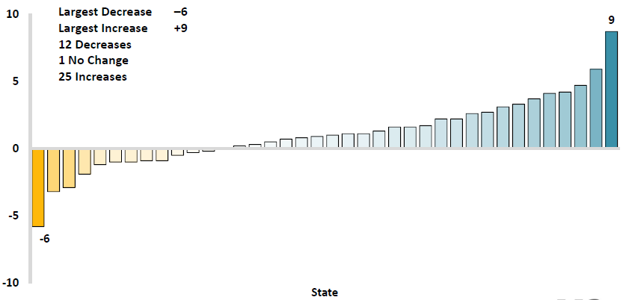
Workers Comp Change in Medical Severity by State, Avg. Annual Change, 2009-2013
Percent
The change in lost-time medical severities from 2009-2013 ranged from a low of -6% to a high of 9%
While growth rates varied widely, most states experienced positive growth in 2014
Source: NCCI’s Analysis of Frequency and Severity of Claims Across the Country as of 12/31/13 on ncci.com.
Values reflect methodology and state data underlying the most recent rate/lost cost filing.
TX changes are for the years 2010-2013.

Slide 95
Annual Inflation Rates, (CPI-U, %),
1990–2016F
Annual Inflation Rates (%)
Inflation peaked at 5.6% in August 2008 on high energy and commodity crisis. The recession and the collapse of the commodity bubble reduced inflationary pressures in 2009/10
Inflationary expectations have slipped (due in part to falling energy costs) allowing the Fed to maintain low interest rates
Slack in the U.S. economy and falling energy prices suggests that inflationary pressures should remain subdued for an extended period of times
Sources: US Bureau of Labor Statistics; Blue Chip Economic Indicators, 5/15 (forecasts).

Slide 96
Workers Compensation
Change in Medical Severity
Comparison to Change in Medical Consumer Price Index (CPI)
Percent Change
Average Annual Change: 1994—2014
Lost-Time Medical Severity: +6.4%
US Medical CPI: +3.7%
Year
2014p: Preliminary based on data valued as of 12/31/2014.
Sources: Severity: 995-2013: Based on data through 12/31/2013, developed to ultimate
Based on the states where NCCI provides ratemaking services including state funds, excluding WV; Excludes high deductible policies.
US Medical CPI: US Bureau of Labor Statistics.

Slide 97
WC Medical Severity Generally Outpaces the Medical CPI Rate
Average annual increase in WC medical severity from 1995 through 2014 was well above the medical CPI (6.4% vs. 3.7%), but the gap has narrowing. Lost-time medical severities appear to on the rise again.
Sources: Med CPI from US Bureau of Labor Statistics, WC med severity from NCCI based on NCCI states.

Slide 98
Medical Cost Inflation vs. Overall CPI, 1995 – 2014*
Though moderating, medical inflation will continue to exceed inflation in the overall economy
Average Annual Growth Average 1995 – 2013
Healthcare: 3.8%
Total Nonfarm: 2.4%
*July 2014 compared to July 2013.
Sources: Med CPI from US Bureau of Labor Statistics, WC med severity from NCCI based on NCCI states.

Slide 99
U.S. Health Care Expenditures,
1965–2022F
$ Billions
From 1965 through 2013, US health care expenditures had increased by 69 fold. Population growth over the same period increased by a factor of just 1.6. By 2022, health spending will have increased 119 fold.
U.S. health care expenditures have been on a relentless climb for most of the past half century, far outstripping population growth, inflation of GDP growth
Sources: Centers for Medicare & Medicaid Services, Office of the Actuary at http://www.cms.gov/Research-Statistics-Data-and-Systems/Statistics-Trends-and-Reports/NationalHealthExpendData/NationalHealthAccountsProjected.html accessed 3/14/14; Insurance Information Institute.

Slide 100
National Health Care Expenditures as a Share of GDP, 1965 – 2022F*
% of GDP
Health care expenditures as a share of GDP rose from 5.8% in 1965 to 18.0% in 2013 and are expected to reach 19.9% of GDP by 2022
2022 19.9%
2010: 17.9%
2000: 13.8%
1990: 12.5%
Since 2009, heath expenditures as a % of GDP have flattened out at about 18%--the question is why and will it last?
1980: 9.2%
1965 5.8%
Sources: Centers for Medicare & Medicaid Services, Office of the Actuary at http://www.cms.gov/Research-Statistics-Data-and-Systems/Statistics-Trends-and-Reports/NationalHealthExpendData/NationalHealthAccountsProjected.html accessed 3/14/14; Insurance Information Institute.

Slide 101
Commercial Multi-Peril Combined Ratio: 1995–2016F
Commercial Multi-Peril Underwriting Performance is Expected to Remains Stable in 2015 Assuming Normal Catastrophe Loss Activity
*2015F-2016F figures are Conning figures for the combined liability and non-liability components.
Sources: A.M. Best; Conning; Insurance Information Institute.

Slide 102
Umbrella/Excess
Are Risks Purchasing Enough Coverage?
102

Slide 103
Over the Last Three Decades, Total Tort Costs as a % of GDP Appear Somewhat Cyclical, 1980-2013E
($ Billions)
2.21% of GDP in 2003 = pre-tort reform peak
Deepwater Horizon Spike in 2010
Tort costs in dollar terms have remained high but relatively stable since the mid-2000s., but are down substantially as a share of GDP
1.68% of GDP in 2013
Sources: Towers Watson, 2011 Update on US Tort Cost Trends, Appendix 1A

Slide 104
Average Personal Injury Jury Award,
2009 – 2013
Average awards in Personal Injury cases have increased by more than 1/3 in recent years
Source: Current Award Trends in Personal Injury, 54th Edition; Insurance Information Institute.

Slide 105
Percent of Personal Injury Jury Awards Over $1 Million, 2003 – 2013*
The share of $1MM+ jury awards has returned ot its pre-crisis high
*Latest available.
Source: Current Award Trends in Personal Injury, 53rd and 54th Editions; Insurance Information Institute.

Slide 106
Dollar Value of Top 100 Verdicts in 2013 by Cause of Action, 2013
($ Millions)
Many causes of action can give rise to catastrophic casualty claims
Source: VerdictSearch as cited in Reevaluating Excess Casualty Protection as Liability Losses Increase,
Marsh Risk Management Research Briefing, Oct. 2014.

Slide 107
Median and Average Personal Injury Jury Award by Type of Liability, 2013
Porducts Liability and Medical Malpractice cases tend to have among the highest jury awards
Source: Current Award Trends in Personal Injury, 54th Edition; Insurance Information Institute.
107
Notes:
107

Slide 108
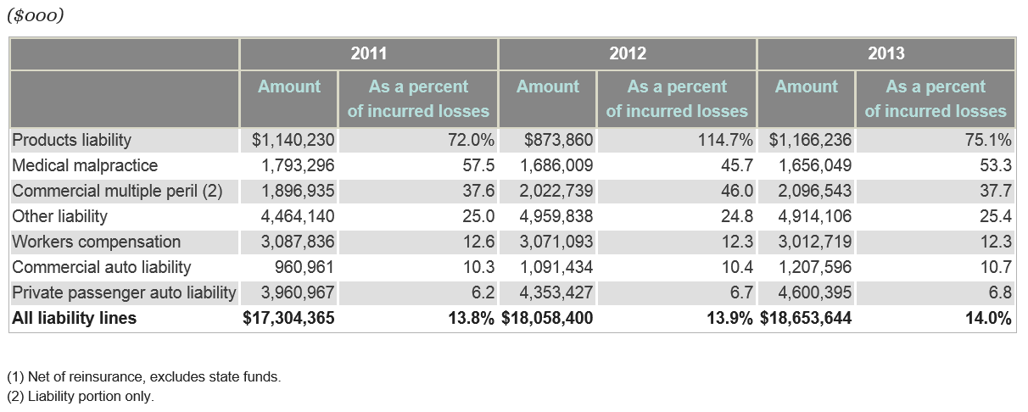
Defense Costs and Cost Containment Expenses as a Percent of Incurred Losses, 2011 – 2013*
Defense and Cost Containment expenses have edged up slightly in recent years
*Latest available.
Source: SNL Financial; Insurance Information Institute.

Slide 109
Average Total Excess/Umbrella Limits Purchased, By Revenue Size
Average excess/umbrella limits purchased are flat
($ Millions)
Source: Reevaluating Excess Casualty Protection as Liability Losses Increase, Marsh Risk Management Research Briefing, Oct. 2014.
109
Notes:
109

Slide 110
Commercial Lines Tort Costs: Insured vs. Self-(Un)Insured Shares, 1973-2010
2005: $143.5B 66.4% insured, 33.6% self-(un)insured
Billions of Dollars
$15.0
1995: $83.6B 69.5% insured, 30.5% self-(un)insured
1973: Commercial Tort Costs Totaled $6.49B, 94% was insured, 6% self-(un)insured
1985: $46.6B 74.5% insured, 25.5% self-(un)insured
$9.5
$6.0
2009: $126.5B 64.4% insured, 35.6% self-(un)insured
Tort Costs and the Share Retained by Risks Both Grew Rapidly from the mid-1970s to mid-2000s, When Tort Costs Began to Fall But Self-Insurance Shares Continued to Rise
Sources: Towers Watson, 2011 Update on US Tort Cost Trends, III Calculations based on data from Appendix 4.
110
12/01/09 - 9pm
eSlide – P6466 – The Financial Crisis and the Future of the P/C
Notes:
110

Slide 111
Commercial Lines Tort Costs: Insured vs. Self-(Un)Insured Shares, 1973-2010
Percent
2010: $138.1B 56.6% insured, 44.4% self-(un)insured (distorted by Deepwater Horizon event with most losses retained by BP)
1973: 94% was insured, 6% self-(un)insured
1985:74.5% insured, 25.5% self-(un)insured
1995: 69.5% insured, 30.5% self-(un)insured
2005: 66.4% insured, 33.6% self-(un)insured
The Share of Tort Costs Retained by Risks Has Been Steadily Increasing for Nearly 40 Years. This Trend Contributes Has Left Insurers With Less Control Over Pricing.
Sources: Towers Watson, 2011 Update on US Tort Cost Trends, III Calculations based on data from Appendix 4.
111
12/01/09 - 9pm
eSlide – P6466 – The Financial Crisis and the Future of the P/C
Notes:
111

Slide 112
Business Leaders Ranking of Liability Systems in 2015
Best States
Delaware
Vermont
Nebraska
Iowa
New Hampshire
Idaho
North Carolina
Wyoming
South Dakota
Utah
Worst States
Arkansas
Missouri
Mississippi
Florida
New Mexico
Alabama
California
Illinois
Louisiana
West Virginia
New in 2015
Vermont
New Hampshire
North Carolina
South Dakota
Newly Notorious
Arkansas
Missouri
Drop-offs
Rising Above
Minnesota
Kansas
Virginia
North Dakota
Oklahoma
Montana
Source: US Chamber of Commerce 2015 State Liability Systems Ranking Study; Insurance Info. Institute.

Slide 113
The Nation’s Judicial “Hellholes”: 2014/2015
Watch List
Illinois
Madison County
West Virginia
Atlantic County, New Jersey
Mississippi Delta
Montana
Nevada
Newport News, Virginia
Philadelphia, Pennsylvania
California
Dishonorable Mention
New York City Asbestos Litigation
AL Supreme Court
PA Supreme Court
Volkswagen: Massive tort actions, fines, penalties certain. Are others vulnerable? Issue of cheating on environmental standards and liability looms large.
Florida
Source: American Tort Reform Association; Insurance Information Institute

Slide 114
Pricing Trends
Survey Results Suggest Commercial Pricing Has Flattened
114

Slide 115
CIAB: Average Commercial Rate Change, All Lines, (1Q:2004–2Q:2015)
(Percent)
Q2 2011 marked the last of 30th consecutive quarter of price declines
Pricing as of Q2:2015 had remained (slightly) negative
KRW Effect
Note: CIAB data cited here are based on a survey. Rate changes earned by individual insurers can and do vary, potentially substantially.
Source: Council of Insurance Agents & Brokers; Insurance Information Institute

Slide 116
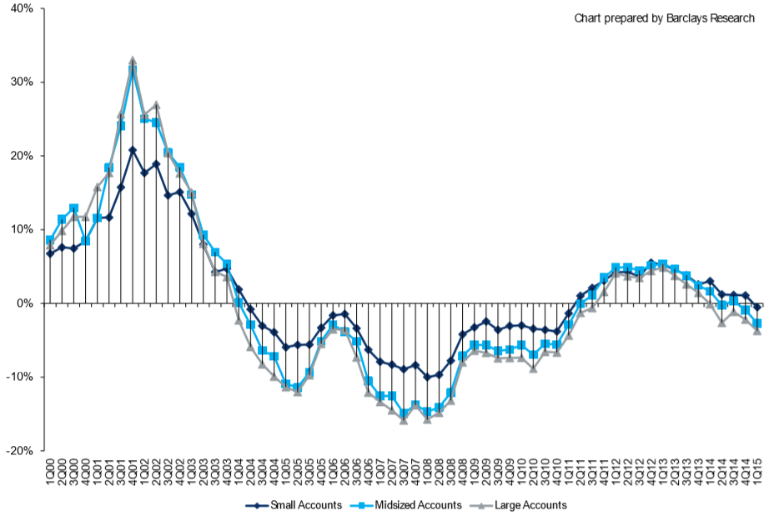
Change in Commercial Rate Renewals, by Account Size: 1999:Q4 to 2015:Q1
Percentage Change (%)
Peak = 2001:Q4 +28.5%
Pricing turned positive in Q3:2011, the first increase in nearly 8 years
Pricing Turned Negative in Early 2004 and Remained that way for 7 ½ years
KRW : No Lasting Impact
Rate trends are roughly flat, some carriers reporting small gains, others flat, others small declines
Trough = 2007:Q3 -13.6%
Source: Council of Insurance Agents and Brokers; Barclay’s Capital; Insurance Information Institute.
Note: CIAB data cited here are based on a survey. Rate changes earned by individual insurers can and do vary, potentially substantially.

Slide 117
Change in Commercial Rate Renewals, by Line: 2015:Q2
Employment Practices rate increases are large than any other line, followed by D&O and Commercial Auto
Percentage Change (%)
Major Commercial Lines Renewals Were Mixed to Flat in Q2:2015; EPL, D&O and Commercial Auto Led the Way
Note: CIAB data cited here are based on a survey. Rate changes earned by individual insurers can and do vary, potentially substantially.
Source: Council of Insurance Agents and Brokers; Insurance Information Institute.

Slide 118
Towers Watson: Commercial Lines Rate Change by Qtr (vs. Year Earlier)
18 consecutive quarters of rate increases
Hard Market (Such As It Is) Appears to Have Passed Its Peak.
Sources: Towers Watson Commercial Lines Insurance Pricing Survey, Insurance Information Institute.
118
12/01/09 - 9pm
eSlide – P6466 – The Financial Crisis and the Future of the P/C
Notes:
118

Slide 119
MarketScout: Commercial Lines Rate Change by Month (vs. Yr. Earlier) Since 6/09
Rate Change Has Been 0% or 1% Since October 2014.
SOURCE: MarketScout, Insurance Information Institute.

Slide 120
Commercial Lines Rate Change by Month (vs. Year Earlier)
Not Much of A Hard Market, By Historic Standards
Sept. 2015: -1.5%
Rates Are As Stable As They’ve Been in 15 Years.
SOURCE: MarketScout, Insurance Information Institute.

Slide 121
Commercial Property Rate Change by Month (vs. Year Earlier)
Commercial Property Rates Track Closely With Commercial Rates Overall.
SOURCE: MarketScout, Insurance Information Institute.
Interpolated Commercial Property Estimates for May, August, September 2010.

Slide 122
BOP Rate Change by Month
(vs. Year Earlier)

Slide 123
Inland Marine Rate Change by Month
(vs. Year Earlier)

Slide 124
General Liability Rate Change by Month
(vs. Year Earlier)

Slide 125
Commercial Auto Rate Change by Month (vs. Year Earlier)

Slide 126
Umbrella/Excess Rate Change by Month
(vs. Year Earlier)

Slide 127
Workers Comp Rate Change by Month (vs. Year Earlier)
Sources: MarketScout, Insurance Information Institute.

Slide 128
Professional Liability Rate Change by Month (vs. Year Earlier)

Slide 129
D&O Liability Rate Change by Month (vs. Year Earlier)

Slide 130
EPLI Rate Change by Month (vs. Year Earlier)

Slide 131
Fiduciary Liability Rate Change by Month (vs. Year Earlier)

Slide 132
Crime Rate Change by Month (vs. Year Earlier)

Slide 133
Surety Rate Change by Month (vs. Year Earlier)

Slide 134
The Strength of the Economy Will Influence P/C Insurer Growth Opportunities
Growth Will Expand Insurer Exposure Base Across Most Lines
134

Slide 135
US Real GDP Growth*
The Q4:2008 decline was the steepest since the Q1:1982 drop of 6.8%
Real GDP Growth (%)
Recession began in in June 2009
Q1 2014/15 GDP data were hit hard by this year’s “Polar Vortex” and harsh winter
Demand for Insurance Should Increase in 2015 as GDP Growth Accelerates Modestly and Gradually Benefits the Economy Broadly
* Estimates/Forecasts from Blue Chip Economic Indicators.
Source: US Department of Commerce, Blue Economic Indicators 9/15; Insurance Information Institute.

Slide 136
Profitability & Politics
How Is Profitability Affected by the President’s Political Party?
136

Slide 137
P/C Insurance Industry ROE by Presidential Administration, 1950-2014*
OVERALL RECORD: 1950-2014*
Democrats 7.72%
Republicans 7.85%
Party of President has marginal bearing on profitability of P/C insurance industry
*Truman administration ROE of 6.97% based on 3 years only, 1950-52;.
Source: Insurance Information Institute

Slide 138
P/C insurance Industry ROE by Presidential Party Affiliation, 1950- 2014
BLUE = Democratic President RED = Republican President
Nixon/Ford
Carter
Reagan/Bush I
Clinton
Bush II
Obama
Truman
Eisenhower
Kennedy/ Johnson
.
Source: Insurance Information Institute

Slide 139
CYBER RISK & CYBER INSURANCE
Cyber Risk is a Rapidly Emerging Exposure for Businesses Large and Small in Every Industry
Nonprofits Including Religious Institutions Are Vulnerable
139

Slide 140






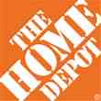

Data Breaches 2005-2015, by Number of Breaches and Records Exposed
# Data Breaches/Millions of Records Exposed
Millions
The total number of data breaches (+27.5%) hit a record high of 783 in 2014, exposing 85.6 million records. Through June 30, this year has seen 117.6 million records exposed in 400 breaches.*
*Figures as of June 30, 2015, from the Identity Theft Resource Center,
http://www.idtheftcenter.org/images/breach/ITRCBreachReport2015.pdf

Slide 141
High Profile Data Breaches, 2014-2015
Date | Company | Description of Breach
May 2015 | OPM | Hackers broke into U.S. Government Personnel Office stealing personal identifying information of as many as 14 million civilian U.S. government employees.
Mar 2015 | Premera Blue Cross | Data breach compromises financial and medical records of 11 million customers.
Feb 2015 | Anthem, Inc | Massive data breach after hackers gained access to corporate data base containing personal information of as many as 80 million current and former U.S. customers and employees.
Dec 2014 | Sony Pictures Entertainment | Hacker break-in involving theft of unreleased motion pictures, and theft of more than 25 gigabytes of sensitive data on tens of thousands of Sony employees, including social security numbers, medical and salary information.
Nov 2014 | Staples | Point-of-sale (POS) malware attack and breach exposing customer data, and resulting in compromise of 1.2 million records.
Sept 2014 | Home Depot | Huge data breach exposes 56 million credit and debit cards and 53 million email addresses.
Aug 2014 | Community Health Systems | Cyber attack originating in China resulted in data breach, compromising 4.5 million patient records. Hackers broke into company’s computer system by exploiting Heartbleed bug.
June/July 2014 | JP Morgan Chase | Massive data breach compromised data associated with 76 million household and 7 million small business accounts. Hackers obtained personal identifying nformation.
June 2014 | PF Changs | Security breach affected customers at 33 restaurants located in 16 states, with potential credit and debit card data stolen.
May 2014 | eBay | Massive data breach exposed records of site’s 233 million customers, including names, email addresses, physical addresses, phone numbers and birthdates.
Feb 2014 | Michaels Stores | Possible fraudulent activity on some U.S. payment cards used at Michaels stores suggests it may have experienced data security attack, exposing 2.6 million records.
Jan 2014 | Snapchat | Security breach compromises phone numbers and usernames for 4.6 million accounts.
Jan 2014 | Neiman Marcus | Hacker break-in exposed unknown no. of customer cards, compromising est. 1.1 million records.
Nov/Dec 2013 | Target | Malware stored on Target’s checkout registers led to theft of data from about 40 million credit and debit card accounts and the personal information of up to 70 million customers.
Sources: Identity Theft Resource Center; Insurance Information Institute (I.I.I.) research.

Slide 142
Worldwide Cybersecurity Spending, 2011- 2016F
($ Billions)
Cybersecurity spending increased by an estimated $5.2B in 2014, $5.8B in 2015 and $6.3B in 2016
Cybersecurity Spending Is Rising Sharply, Up by About 8%+ Annually through 2016—a Projected Increase of $12.1 Billion from 2014 to 2016
142
Source: Gartner Group; Insurance Information Institute; Adapted from Wall Street Journal: “Financial Firms Boost Cybersecurity Funds,” Nov. 17, 2014.

Slide 143
Top 10 Global Business Risks for 2015
Cyber is one of the most significant movers in this year’s Risk Barometer rankings, gaining five percentage points to move into the top 5 global business risks for the first time.
Source: Allianz Risk Barometer on Business Risks 2015
143
Notes:
143

Slide 144
2014 Data Breaches By Business Category, By Number of Breaches
The majority of the 783 data breaches in 2014 affected business and medical/healthcare organizations, according to the Identity Theft Resource Center.
Banking/Credit/Financial, 43 (5.5%)
Govt/Military, 92 (11.7%)
Business, 258 (33.3%)
Educational, 57 (7.3%)
Medical/Healthcare, 333 (42.5%)
Source: Identity Theft Resource Center, http://www.idtheftcenter.org/ITRC-Surveys-Studies/2014databreaches.html

Slide 145
Evolving Threats: Cyber Crime and Cyber Terrorism
State sponsored groups:
Foreign government sponsored
Sophisticated and well-funded
Organized cyber criminals:
Traditional organized crime groups
Loosely organized global hacker crews
Hacktivists:
Politically-motivated hackers
Increasing capabilities
Insiders:
Easy access to sensitive information
Difficult to detect
Terrorists:
Destruction of physical and digital assets
Source: Lewis Brisbois, Practical Strategies to Address Cyber Risk in Your Business, November 2014

Slide 146
Main Causes of Data Breach Globally
Malicious or criminal attacks are most often the cause of data breach globally. Some 42 percent of incidents concern a malicious or criminal attack, while 30 percent concern a negligent employee or contractor (human factor).
Malicious or criminal attack*
Human error
System glitch
*The most common types of malicious or criminal attacks include malware infections, criminal insiders, phishing/social engineering and SQL injection.
Source: 2014 Cost of a Data Breach Study: Global Analysis, the Ponemon Institute, sponsored by IBM, May 2014

Slide 147
US: Most Costly Types of Cyber Crimes, Fiscal Year 2014
Malicious code, denial of service and web-based attacks account for more than 55 percent of the total annualized cost of cyber crime experienced by 59 U.S. companies.
Viruses, Worms, Trojans
Botnets
Malicious code
Malware
Malicious insiders
Stolen devices
Denial of service
Phishing + social engineering
Web-based attacks
Source: 2014 Cost of Cyber Crime: United States, Ponemon Institute.

Slide 148
US: External Cyber Crime Costs: Fiscal Year 2014
Information theft (40%) and business disruption or lost productivity (38%) account for the majority of external costs due to cyber crime.
Equipment damages
Other costs*
Information theft
Revenue loss
Business disruption
* Other costs include direct and indirect costs that could not be allocated to a main external cost category
Source: 2014 Cost of Cyber Crime: United States, Ponemon Institute.

Slide 149
PWC Survey: Cybercrime Costs Greater for U.S. Companies
U.S. organizations are more at risk of suffering financial losses in excess of $1 million due to cybercrime.
Source: 2014 Global Economic Crime Survey, PWC.
149
Notes:
149

Slide 150
Marsh: Percentage of U.S. Companies Purchasing Cyber Insurance Increased in 2014
Ever larger numbers of insureds seek financial protection via cyber insurance. The percentage of U.S. companies buying cyber insurance rose to 16 percent in 2014.
*Take-up rate refers to the overall percentage of clients that purchased standalone cyber insurance.
Source: Benchmarking Trends: As Cyber Concerns Broaden, Insurance Purchases Rise, Marsh Risk Management Research Briefing, March 2015
150
Notes:
150

Slide 151
Marsh: Total Limits Purchased, By Industry – Cyber Liability, All Revenue Size
Average limits purchased for cyber risk rose to $12.8 million for all industries and all company sizes in 2014. Power and utility companies witnessed the sharpest percentage increase in average limits, at 59 percent.
($ Millions)
Source: Benchmarking Trends: As Cyber Concerns Broaden, Insurance Purchases Rise, Marsh Risk Management Research Briefing, March 2015
151
Notes:
151

Slide 152
Marsh: Total Limits Purchased, By Industry – Cyber Liability, Revenue $1 Billion+
Among larger companies, average cyber insurance limits purchased increased by 22 percent to $34.1 million in 2014, from $27.8 million in 2013.
($ Millions)
Source: Benchmarking Trends: As Cyber Concerns Broaden, Insurance Purchases Rise, Marsh Risk Management Research Briefing, March 2015
152
Notes:
152

Slide 153
Cyber Liability: Historical Rate (price per million) Changes
Cyber insurance premiums were generally volatile in 2014 due to increased frequency and severity of losses. Average rate increases at renewal for both primary layers and total programs were lower in Q4 2014 than in Q1.
Source: Benchmarking Trends: As Cyber Concerns Broaden, Insurance Purchases Rise, Marsh Risk Management Research Briefing, March 2015

Slide 154
Data/Privacy Breach:
Many Potential Costs Can Be Insured
Data Breach Event
Costs of notifying affecting individuals
Defense and settlement costs
Lost customers and damaged reputation
Cyber extortion payments
Costs of notifying regulatory authorities
Regulatory fines at home & abroad
Business Income Loss
Forensic costs to discover cause
Source: Zurich Insurance; Insurance Information Institute
154

Slide 155
The Three Basic Elements of Cyber Coverage: Prevention, Transfer, Response
Loss Prevention
Post-Breach Response
(Insurable)
Loss Transfer (Insurance)
Cyber risk management today involves three essential components, each designed to reduce, mitigate or avoid loss. An increasing number of cyber risk products offered by insurers today provide all three.
Source: Insurance Information Institute research.
155

Slide 156
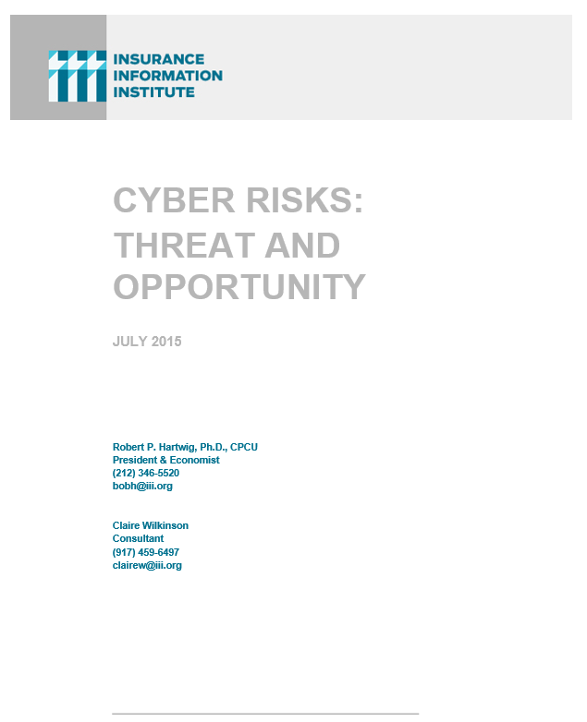
I.I.I. Will Release its Third Cyber Report in 2015: Cyber Risks Threat and Opportunity
I.I.I.’s 3rd report on cyber risk scheduled for Q3 2015
Provides information on cyber threats and insurance market solutions
Global cyber risk overview
  Quantification of threats by type and industry
Cyber security and cost of attacks
Cyber terrorism
Cyber liability
Insurance market for cyber risk

Slide 157
INDUSTRY DISRUPTORS
Technology, Society and the Economy Are All Changing at a Rapid Pace
Thoughts on the Future
157

Slide 158

Technology and Insurance
Rapid Technological Innovations Are Impacting Many Segments of the P/C Insurance Industry
158

Slide 159

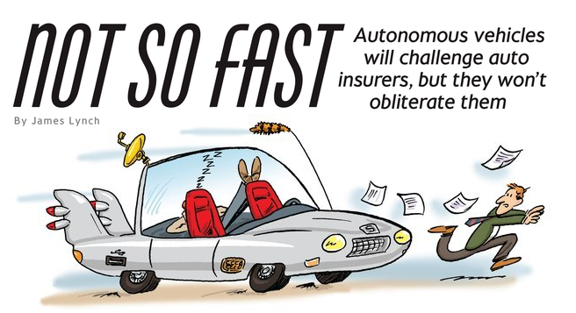
Media is Obsessed with Driverless Vehicles: Often Predicting the Demise of Auto Insurance
By 2035, it is estimated that 25% of new vehicle sales could be fully autonomous models
Questions
Are auto insurers monitoring these trends?
How are they reacting?
Will Google take over the industry?
Will the number of auto insurers shrink?
How will liability shift?
Source: Boston Consulting Group.

Slide 160




On-Demand/Sharing/Peer-to-Peer Economy Impacts Many Lines of Insurance
The “On-Demand” Economy is or will impact many segments of the economy important to P/C insurers
  Auto (personal and commercial)
  Homeowners/Renters
  Many Liability Coverages
  Professional Liability
  Workers Comp
Many unanswered insurance questions
Insurance solutions are increasingly available to fill the many insurance gaps that arise
160
12/01/09 - 9pm
eSlide – P6466 – The Financial Crisis and the Future of the P/C
Notes:
160

Slide 161
A Few Thoughts on the Future of Auto Insurance
Global auto insurance premiums written total about $600B
  ~80% personal, 20% commercial
  US accounts for more than 1/3 of this total (about $210B in 2014)
Innovations in automobile safety will, over time, reduced claim frequency but severities could still rise as repair costs escalate
  Claim activity clearly not immune to economy
Frequency declines could lead price declines, aiding profitability
More cars, not fewer will be on highways in the US, world
  Exposure (insured car years) grows even as frequency declines
Timeline for large numbers of mass produced autonomous vehicles on American highways is wildly optimistic
  Mid-2030s is more likely timeframe; Transition occurring through mid-century
  Tech media is enamored with anything involving Google, Apple
Auto insurance will be the largest, most important of all P/C lines for many years to come

Slide 162



Labor on Demand: Huge Implications for the US Economy, Workers & Insurers
Will YOUR job be reduced to an app?

Slide 163


Send in the Drones: Potential Rapid
Adoption in Industry; Media Loves It
Drones or Unmanned Aerial Vehicle (UAV) technology is seeing rapid adoption rate in many industries, including insurance
FAA granting Section 333 exemptions for commercial use and testing of UAS
At least 5 insurers have received permission to test
Wide variety of applications: claims, pre-event property inspections…
Insurers partnering with construction industry to guide R&D and regulation of UAV use via Property Drone Consortium: www.propertydrone.org

Slide 164
Insurance Information Institute Online:
www.iii.org
Thank you for your time
and your attention!
Twitter: twitter.com/bob_Hartwig
Download at www.iii.org/presentations

