Slide 1
How the Growing Use of Non-Driving Factors in Auto Insurance Pricing Affects Consumers
Consumer Federation of America’s
28th annual Financial Services Conference
Washington, DC - December 3, 2015
James Lynch, FCAS MAAA, Chief Actuary
Insurance Information Institute ♦ 110 William Street ♦ New York, NY 10038
Tel: 212.346.5533 ♦ Cell: 917.359.3908 ♦ jamesl@iii.org ♦ www.iii.org

Slide 2
Three Facts About Non-Driving Factors
2
Notes:
2

Slide 3
1. Most Factors Are Non-Driving Factors
Age
Gender
Territory/State
SOURCES: U.S. Department of Transportation, National Highway Traffic Safety Administration, Federal Highway Administration.

Slide 4
No. 2: Most Drivers Have Clean Driving Records
Three-year calculation makes conservative assumption that no ticketed driver in a year is in an accident that year.
SOURCES: Insurance Information Institute calculation using data for 2012 from ISO, a Verisk Analytics company, and Langton and Durose, Police Behavior During Traffic and Street Stops, 2011, Department of Justice, p. 7.

Slide 5
No. 3: Insurance Scores Are Effective
Confirming Studies Include
NAIC (1996)
Virginia (1999)
Michigan (2002)
Texas (2003)
Texas (2004)
FTC (2007)
New Jersey (2008)
Georgetown U (2015)
Relativity Controlled for Ethnicity, Neighborhood Income.
SOURCE: Federal Trade Commission, Credit-Based Insurance Scores: Impacts on Consumers of Automobile Insurance, July 2007, Table 6.

Slide 6
No. 4: Insurance Scores Lower Rates for Most Drivers
Safer Drivers Save
Straight Average: Two-thirds Save $754 (33%)
Weighted Average: 95% Save $106 (5%)
Drivers Most Likely to Be in Accident Pay More.
SOURCE: Arkansas State Insurance Department, Use and Impact of Credit in Personal Lines Insurance Premiums Pursuant to Ark. Code Ann. § 23-67-415, 2015, p. 4.
SOURCE: Insurance Information Institute calculation based on Consumer Reports data.

Slide 7
Three Facts About Price Optimization
7
Notes:
7

Slide 8
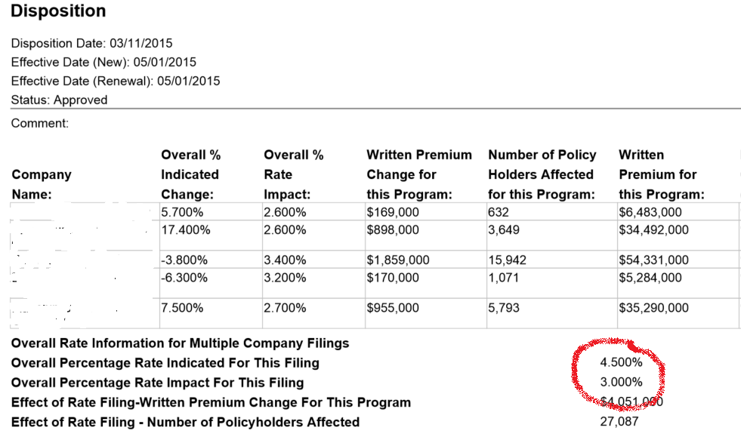
1. Insurers Have Always ‘Optimized’ – With Regulator Knowledge & Approval
Companies Temper Increases Based on ‘Market Judgment’
Regulators Are Generally OK With That.
REDACTED
Sources: System for Electronic Rate and Form Filing (SERFF) via SNL Financial; Insurance Information Institute.
Other Examples: Rate Capping, Teen Drivers

Slide 9
2. Optimization Is Not Price Gouging
Traditional Practice
Used ‘Seat-of-the-Pants’ Judgment to Discount Off Indication
What’s New
Software Informs the Judgment
Never Exceeds Actuarial Indication
Indicated: +6%
Selected: +3%

Slide 10
3. Optimization Doesn’t Raise Rates; It Distributes the Rate Change
As Practiced in U.S.
Remains True to Cost-Based Price
Applied to Classes, Not Individuals
Innovations Are Usually Encouraged, With Appropriate Restraint
Example (cont’d): There Are Many Reasonable Ways to Achieve Reasonable Rates.
Indication
Doesn’t
Exceed
By Class

Slide 11
Insurance Information Institute Online:
www.iii.org
Thank you for your time and your attention!
Twitter: twitter.com/III_Research

