Slide 1
Presentation to the Cincinnati CPCU – I Day
Jack Casino, Cincinnati, Ohio
Thursday, October 26, 2017
Consumer Understanding and Perceptions About Insurance
Jeanne M. Salvatore, Senior Vice President, Chief Engagement Officer and Sr. Spokesperson
Insurance Information Institute  110 William Street  New York, NY 10038
Tel: 212.346.5555  Cell: 917.612.4088  Jeannes@iii.org  www.iii.org

Slide 2
Presentation Overview
What is the Insurance Information Institute?
Public Attitude Toward the Insurance Industry.
What do Consumers Know About Insurance?
What Should We Be Communicating?
How Should We Communicate?
Resources: I.I.I. and Other Industry Sponsored Organizations!
Questions

Slide 3

I.I.I. Mission Statement
Simple and succinct; and should stay that way…
Improving public understanding
of insurance...
…what it does and how it works
3

Slide 4
Public Attitudes Toward Insurance
2016 I.I.I. Insurance Pulse

Slide 5
I.I.I. Poll: Favorability
Percent of Public Rating Industry as Very or Mostly Favorable, 2016
Auto/Home Insurers Tie with Banks as Highest Rated of Industries Surveyed
Source: Insurance Information Institute Pulse survey, November 2016.
Notes:
What it is: We asked respondents to rate on a scale of 1 to 5, with 5 being the high, how favorable their opinion was for auto and home insurance vs. various other industries.
What it says: Auto and home insurers have the highest ratings, tied with banking, of all the industries we included in the survey.
Note: We ask this question regularly, and auto and home insurers inevitably come in first or second.

Slide 6
Perception of the Insurance Industry
Related to Interest in Working in the Industry!
Almost half of Americans (48 percent) would not like to see someone close to them choose the insurance field for their career.
Less than half of Americans (44 percent) would like to see someone close to them choose the insurance field for their career.
Of the 44 percent of Americans who said they would like to see someone close to them choose insurance for their career, about three-quarters (74 percent) said it was because they had a good opinion of the insurance professionals with whom they are familiar
About three out of five of favorable respondents think that insurance is a field where there are jobs available or employees are well paid.
.Source: 2016 I.I.I. Insurance Pulse

Slide 7
Growing Interest in Viewing Policies Online
Majority Would like Option to Read Policy Before Purchase!
Almost eight out of 10 respondents would now like to be able to view all the policies available to them on a single website.
In November 2015, 79 percent of policyholders said they wanted to see their policies on one website, up from about seven out of 10 in May 2013 and May 2014.
Younger policyholders were most likely to say they would like to see policies on a single site. Nine out of 10 policyholders between the ages of 35 and 44 wanted to view policies online, followed by 89 percent of policyholders age 18 to 34 and 85 percent of those between the ages of 45 and 54.
Significantly fewer older policyholders wanted to see policies online, only 56 percent of those age 65 and over, and 72 percent of those between the ages of 55 and 64.

Slide 8
What do Consumers Know About Insurance?
And what don’t they understand about:
- Homeowners Insurance
- Natural Disasters
- Liability Coverage
- Cost of Auto Insurance
- Telematics
- Commercial Insurance

Slide 9
Homeowners and Renters Insurance
Most Homeowners Purchase Coverage and Growing Number of Renters do too!
A 2016 Insurance Information Institute poll conducted by ORC International found that 93 percent of homeowners had homeowners insurance.
And 41 percent of renters had renters insurance. This number has been growing over the last decade.
But only 12 percent had a flood insurance policy, despite the fact that flooding is the most common natural disaster in the U.S.
And, although earthquakes have caused damage in all 50 states, only 8 percent of American homeowners purchase separate earthquake insurance or add an earthquake endorsement to their homeowners policy.

Slide 10
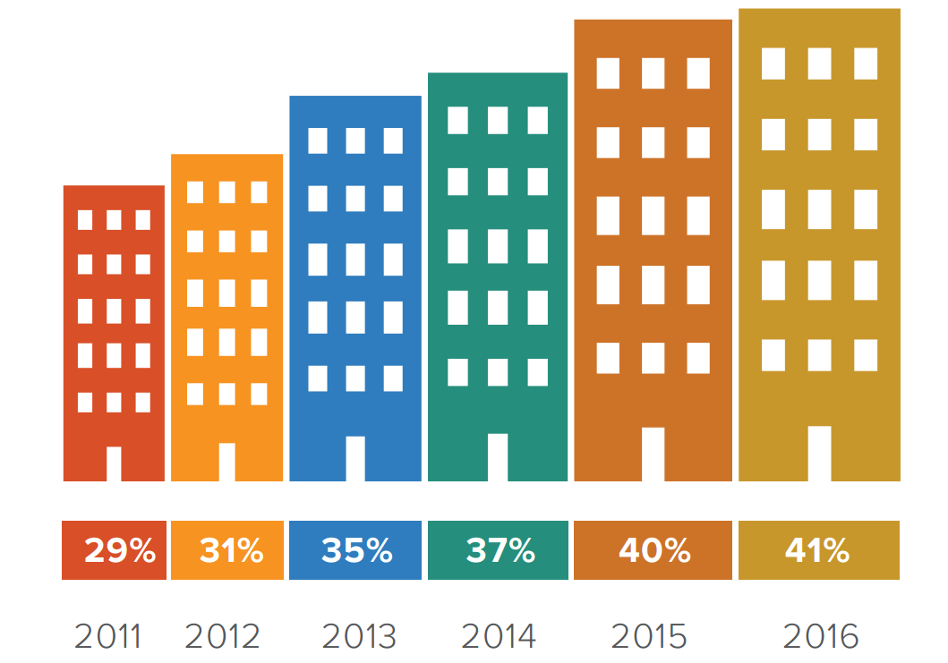
Growing Number of Renters Insure Their Home

Slide 11
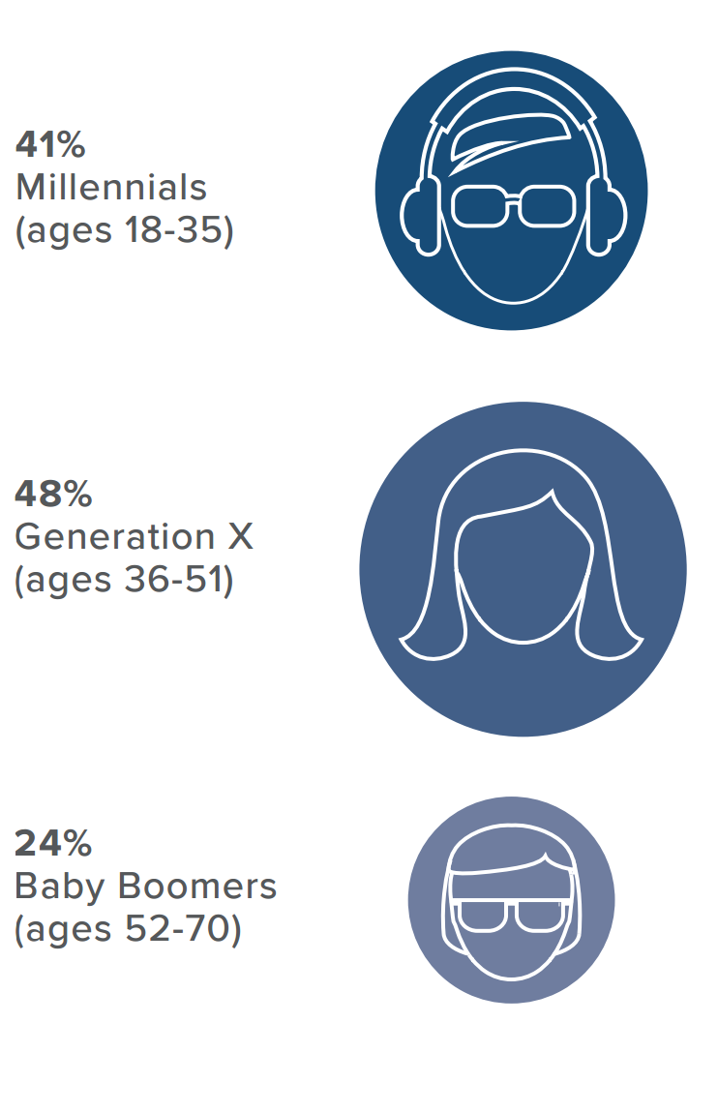
Renters Insurance - Age Matters
In one surprising twist, the I.I.I. found that younger generations are more likely to purchase renters insurance than older Americans.
A greater percentage of both Millennials and Generation Xers purchase renters insurance than Baby Boomers.

Slide 12
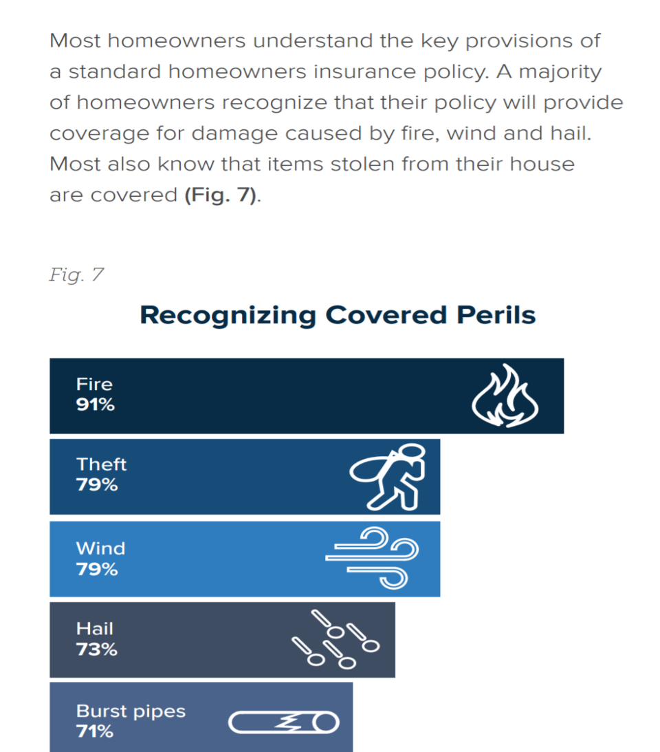
Homeowners Understand the Key Provisions in A Policy
Most consumers understand that
Fire
Theft
Wind
Hail
Burst Pipes
ARE covered by standard home policies

Slide 13
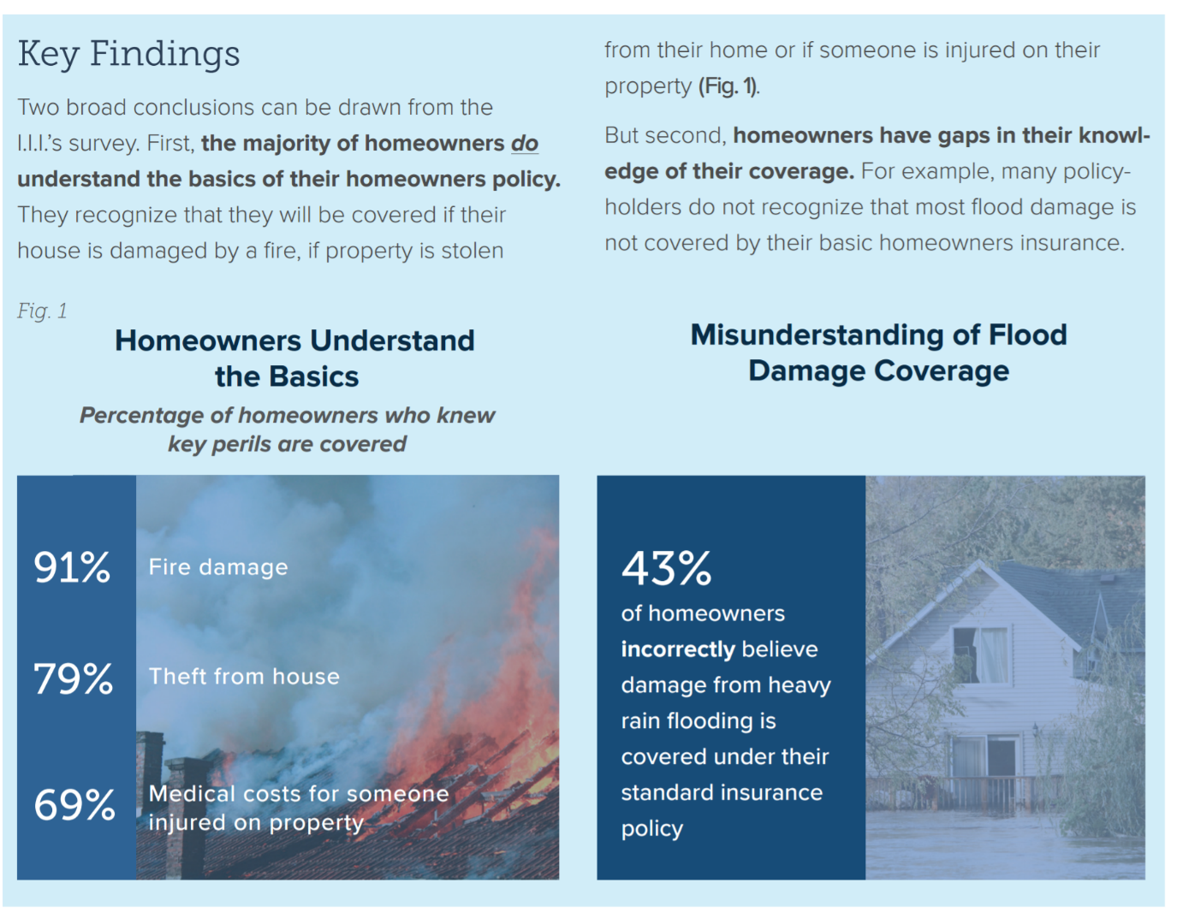
Confusion about water damage
Most homeowners understand the basics in a home insurance policy but don’t understand water damage and flooding
Insurance Information Institute, 2016 Consumer Insurance Survey, Homeowners Insurance: Understanding, Attitudes, and Shopping Practices, February 2017, p. 2.

Slide 14
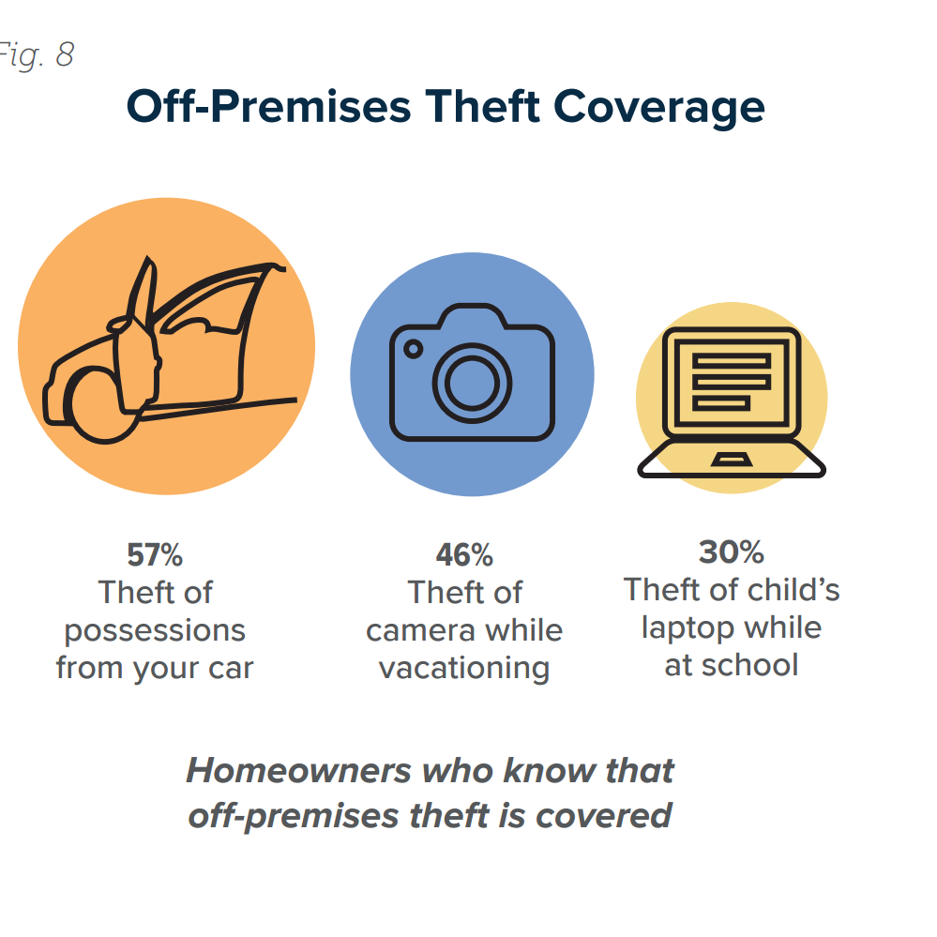
Consumers are Fuzzy on the Details
While homeowners understand the basics, the I.I.I. found that many were not aware of some additional coverages included in their policy.
For example, 79 percent recognize that homeowners insurance provides coverage for stolen possessions in their home, but don’t always know that they are covered away from home too.

Slide 15
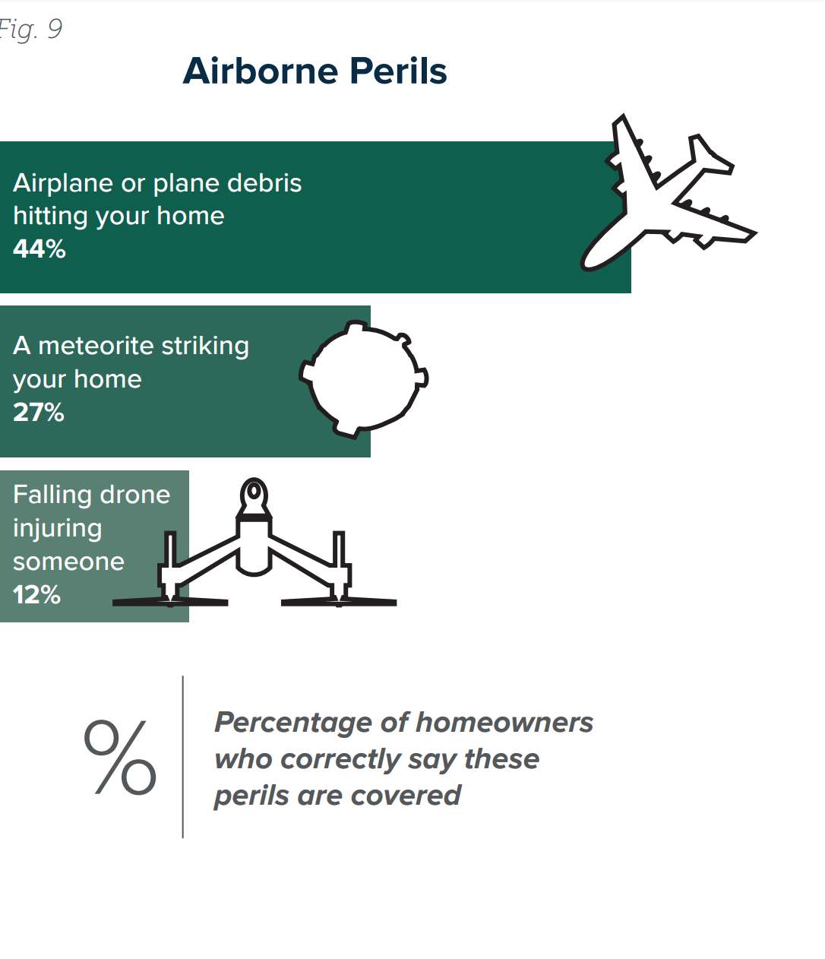
Consumers are Unaware that Fallen Objects are Covered!
Only 27 percent of homeowners said their policy covered a meteorite striking their home.
They also don’t know they are covered against falling airplane debris or if their drone falls and injures someone.

Slide 16
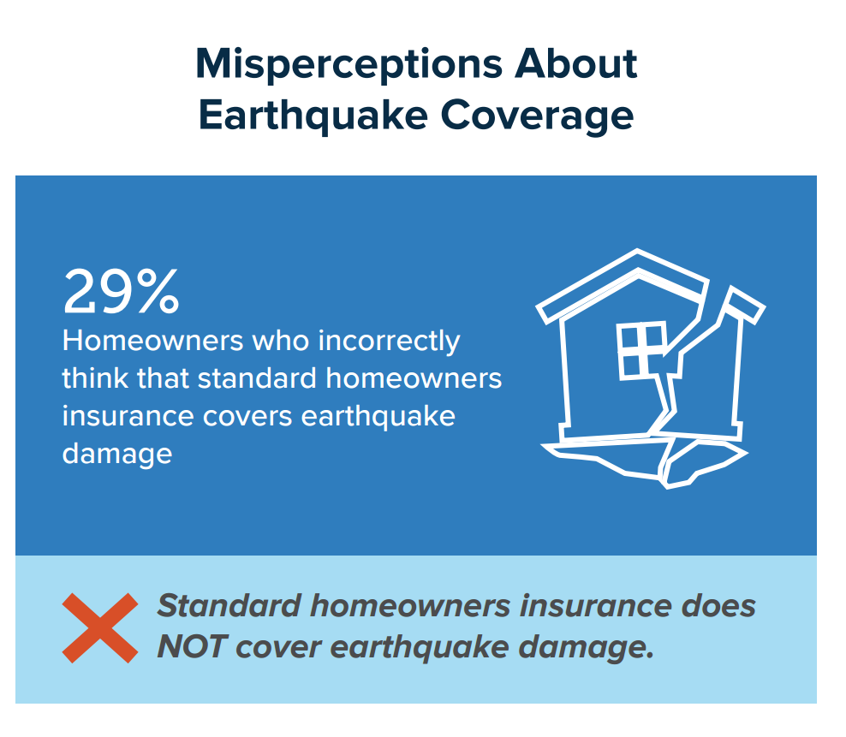
Lack of Knowledge about Earthquake Coverage
Property damage caused by earthquakes is also not covered by a standard homeowners policy, though fire damage following an earthquake will usually be covered.

Slide 17
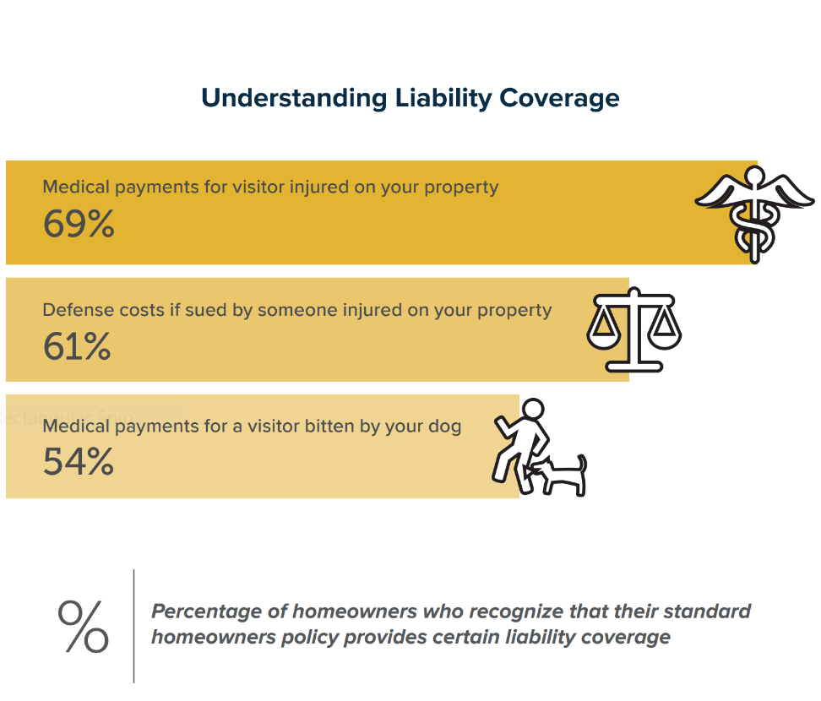
Consumer Understanding of Liability Coverage
Most policyholders recognize that standard homeowners insurance provides liability coverage.

Slide 18
I.I.I. Poll: Telematics
Q. Would You Allow Your Auto Insurer to Collect Information
About How and When You Drive?¹
1% – Don’t know
Allow if premium went down
Would not allow
Allow whether or not premium went down
More Than Half of Americans Would Not Allow Their Auto Insurer
to Collect Information About How They Drive
1. Asked of those who own or lease a car.
Source: Insurance Information Institute Pulse survey, November 2016.
Notes:
What it is: We asked whether respondents would share information from a telematics device with their insurer.
What it says: More than half of respondents would not allow information sharing.

Slide 19
I.I.I. Poll: Telematics
Q. Would You Agree to Share Information from a
Home Monitor Like Nest with Your Insurer…
1% – Don’t know
Allow if premium went down
Would not allow
Allow whether or not premium went down
Half of Americans Would Not Share Information
from a Home Monitor with Their Insurer
Source: Insurance Information Institute Pulse survey, November 2016.
Notes:
What it is: We asked whether respondents would share information from a home monitoring service with their insurer.
What it says: More than half of respondents would not allow information sharing.

Slide 20
What has the Industry Learned from the Hurricanes and Wildfires in 2017
Every Disaster is a Teacher
Flood insurance is available to those who do not live in a flood zone
There is still a lot of confusion about the very basics of insurance
Continued Widespread Confusion About Hurricane/Wind Deductibles
Evacuation planning is important no matter where you live… but even more important if you live in a wildfire area.

Slide 21
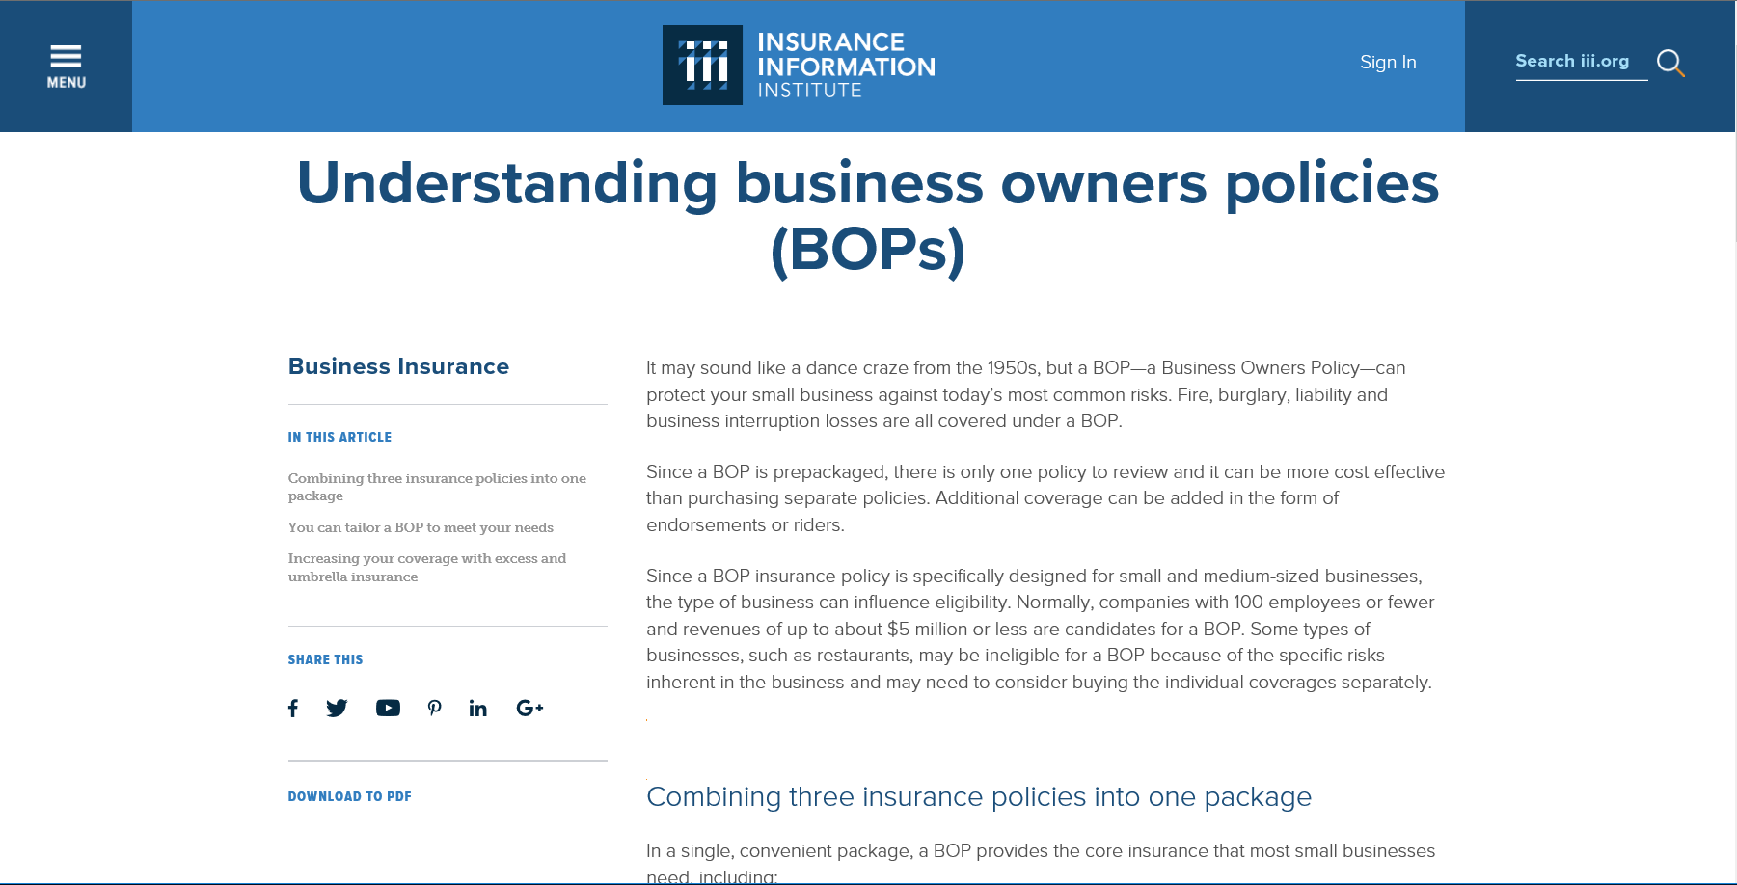
Critical Need for Small Business Owners to Understand their Options
Too Often, they ask about coverage….after a disaster!

Slide 22
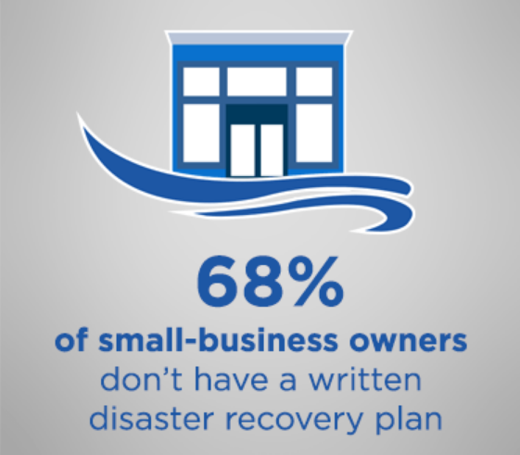
Business are Not Prepared for a Disaster
Nationwide has seen a 26 percent increase in the average severity of commercial catastrophe claims
The company has also seen a 14 percent increase in unique commercial catastrophe events that impact a business when comparing those same time periods.
Most small-business owners (68 percent) still don’t have a written disaster recovery plan — even though about half (49 percent) said it would take their business at least three months to recover from a natural disaster.
hose findings stem from Nationwide’s second annual Small Business Indicator, which was conducted online by Harris Poll on behalf of Nationwide from June 10-23 among 502 U.S. small-business owners with fewer than 300 employees.

Slide 23
Home Based Business Do Not Have Proper Coverage, According to the IIABA Survey
Most of the 11 Million Home-based Business are at Risk!
The survey, conducted by International Communications Research, reveals that one in 10 U.S. households operates some type of full or part-time home-based business. However, nearly 60 percent of these businesses do not have insurance coverage.
Nearly 40 percent of home-based business owners say they thought they were protected by some other type of coverage, while almost 30 percent say their businesses are too small to insure.
Additionally, home-based businesses that do not have insurance are slightly more likely (11 percent) to have experienced a financial loss than are those that do have insurance (9 percent).

Slide 24
Millennials and Business Insurance Coverage
Good News for the Future….a Nationwide Insurance Poll Reveals
Millennial small-business owners are seemingly the most concerned generation in recent history. They are more likely than Gen X or Baby Boomers to have plans for natural disasters, retirement benefits, cyberattacks and even business succession.
Disaster recovery: Millennials are most likely to have a disaster recovery plan in place (51 percent), versus Gen X (30 percent) or Baby Boomers (29 percent)
Cyber security: More Millennials have a written cyberattack response plan in place (42 percent), versus Gen X (17 percent) or Baby Boomers (12 percent)
Business succession: Millennials are most likely to currently have a business succession plan in place (61 percent), versus Gen X (32 percent) or Baby Boomers (32 percent)

Slide 25
Millennial Business Owners and Employee Benefits
More Generous Than Other Generations
Retirement planning: Millennials are most likely to offer retirement benefits (59 percent)
  They are also most likely to offer their employees the following benefits (84 percent), versus Gen X (60 percent) or Baby Boomers (46 percent):
    medical insurance,
    paid time off, retirement benefits (e.g., 401(k)),
    workers' compensation,
    dental insurance,
    vision insurance,
    life insurance, short-term disability,
    long-term disability and domestic partner benefits

Slide 26
What Should We Be Communicating?

Slide 27
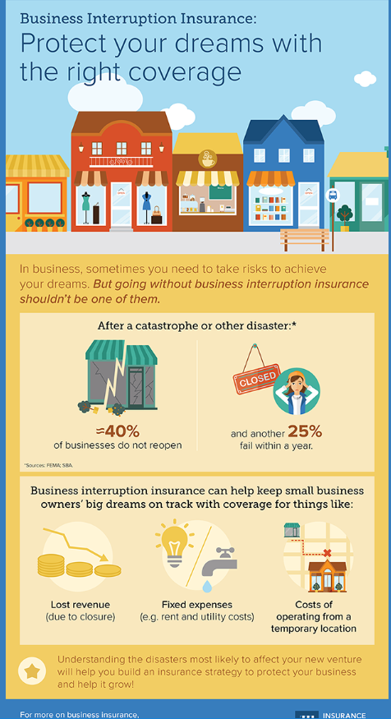
Need to Educate Business Owners
About all their options…so they can make sound financial decisions!
40 Percent Don’t Open After a Disaster
Another 25% Fail Within a Year!
Property insurance
Liability insurance
Business interruption insurance
And, Coverages such as Professional liability, Employee practices liability, Workers compensation, Health and disability, Flood and sewer back-up, Cyber risk insurance, Terrorism insurance and others…

Slide 28
Need to Communicate the Basics As Often as Possible
Key Messages Include:
Standard home, renters and business insurance policies clearly list the disasters that are covered and the disasters that are not.
Everyone needs to get enough insurance to rebuild their home, replace their possession and protect their assets.
The two biggest disasters that are not covered are floods and earthquakes.
Flood coverage is available from the National Flood Insurance Program (NFIP) and a few private insurance companies. Excess flood insurance is available from private insurers.
Flood damage to an auto is covered under the optional comprehensive portion of an auto insurance policy.
Earthquake insurance is available from private insurance companies and through the CEA in California.

Slide 29
Encourage to get both a Renters Insurance Policy and a Flood Insurance Policy
We are increasingly becoming a Nation that Eschews
Home Ownership at Every Demographic!
The U.S. homeownership rate was 63 percent in second-quarter 2016, the lowest rate since the third quarter of 1965, according to data from the U.S. Census Bureau.
Renters account for a majority of households in NYC (69 percent), LA (62 percent), Chicago and Houston (55 percent).

Slide 30
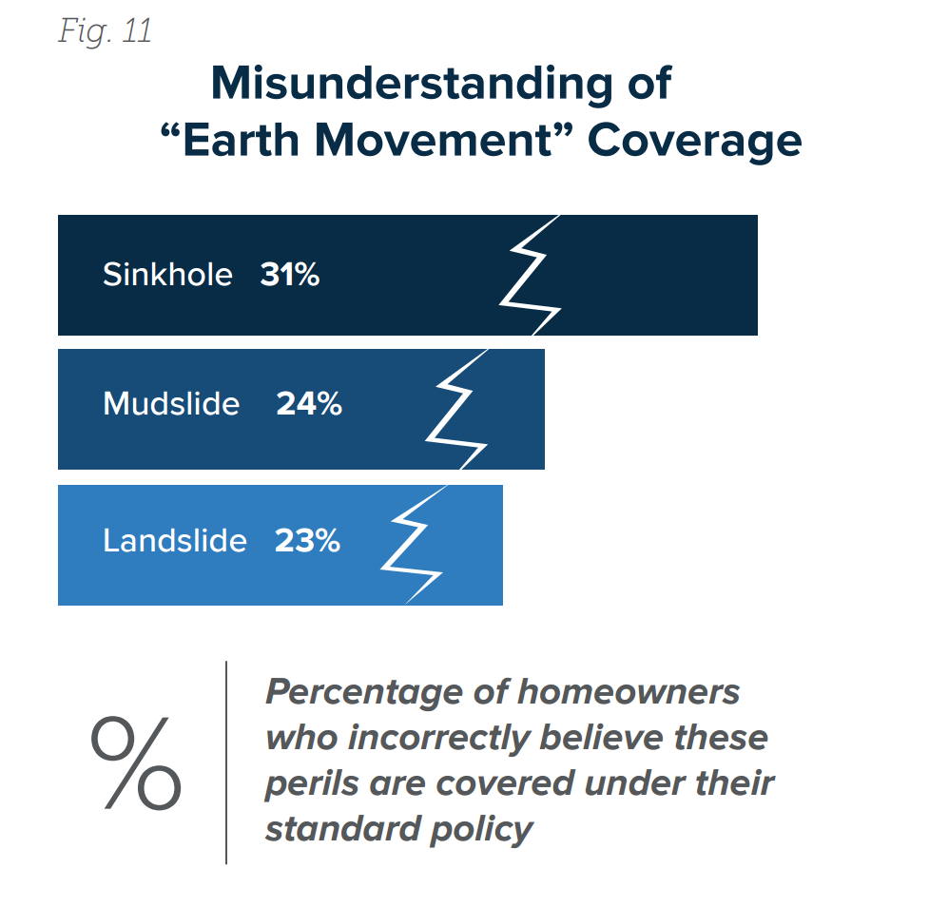
Need to Clear Up Confusion About Coverage
For example, the industry needs to do a better job of explaining water damage coverage.
Need to communicate that homeowners insurance includes coverage for damage caused by wind-driven rain, burst pipes and water leaking into a house because of an ice dam.
Also need to clearly explain coverage for mudslides, landslides and back-up of sewers and drains, as well as “law and ordinance” coverage.

Slide 31
Need to Point out Limitations of the Flood Insurance Policy
Important to Not Sugar Coat it!
Stress the following:
There is no ALE coverage.
Coverage for Basements is limited.
There are limits on the amount and type of coverage under an NFIP flood insurance policy. Homes are covered for up to $250,000 on a replacement cost basis and the contents for up to $100,000 on an actual cash value basis.
Coverage limits for commercial property are $500,000 for the structure and another $500,000 for its contents.

Slide 32
How Should We Communicate?

Slide 33

“Surround Sound” Approach to Consumer Communications
Consumers
Consumers
Industry
Policymakers
Media
Relevant
Experts
Relevant
Experts
Industry
Media
Policymakers

Slide 34
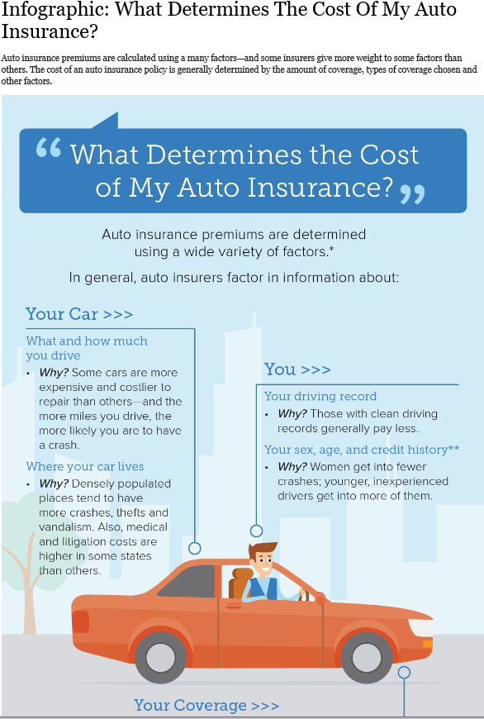
Approaches as Different As Individuals
Apps
Blogs
Checklists
Consumer Articles
Infographics
Media Interviews
Social Engagement
Videos

Slide 35
I.I.I. and Industry Resources

Slide 36
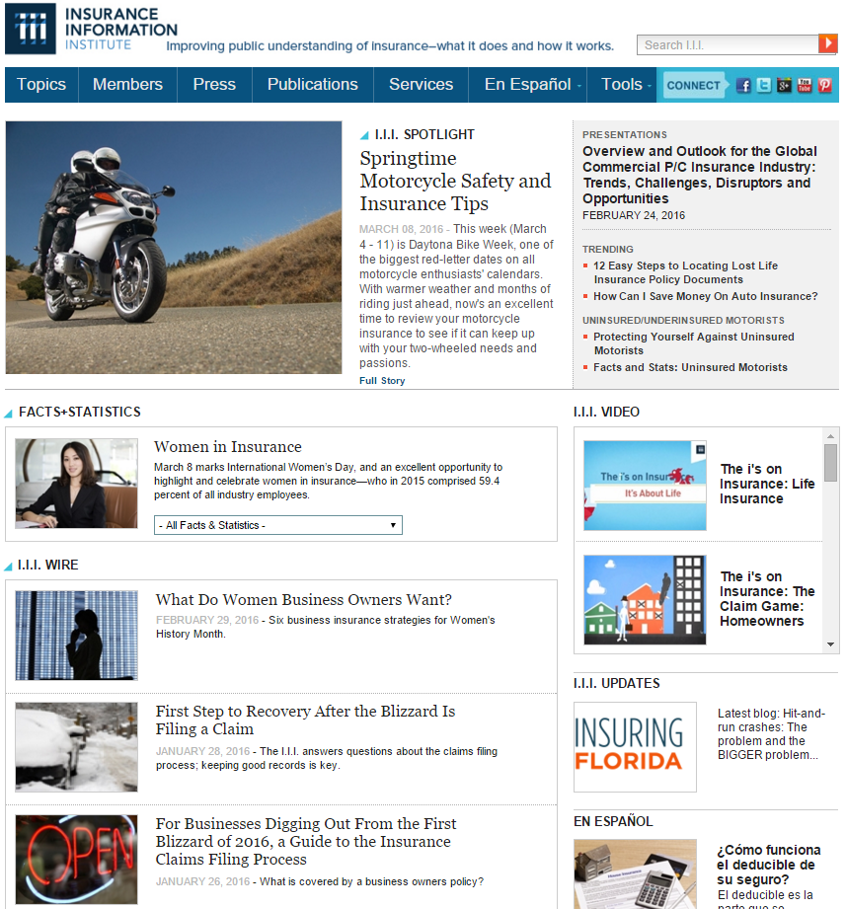
I.I.I. Website
The I.I.I. homepage is updated regularly with content relevant to consumers.

Slide 37
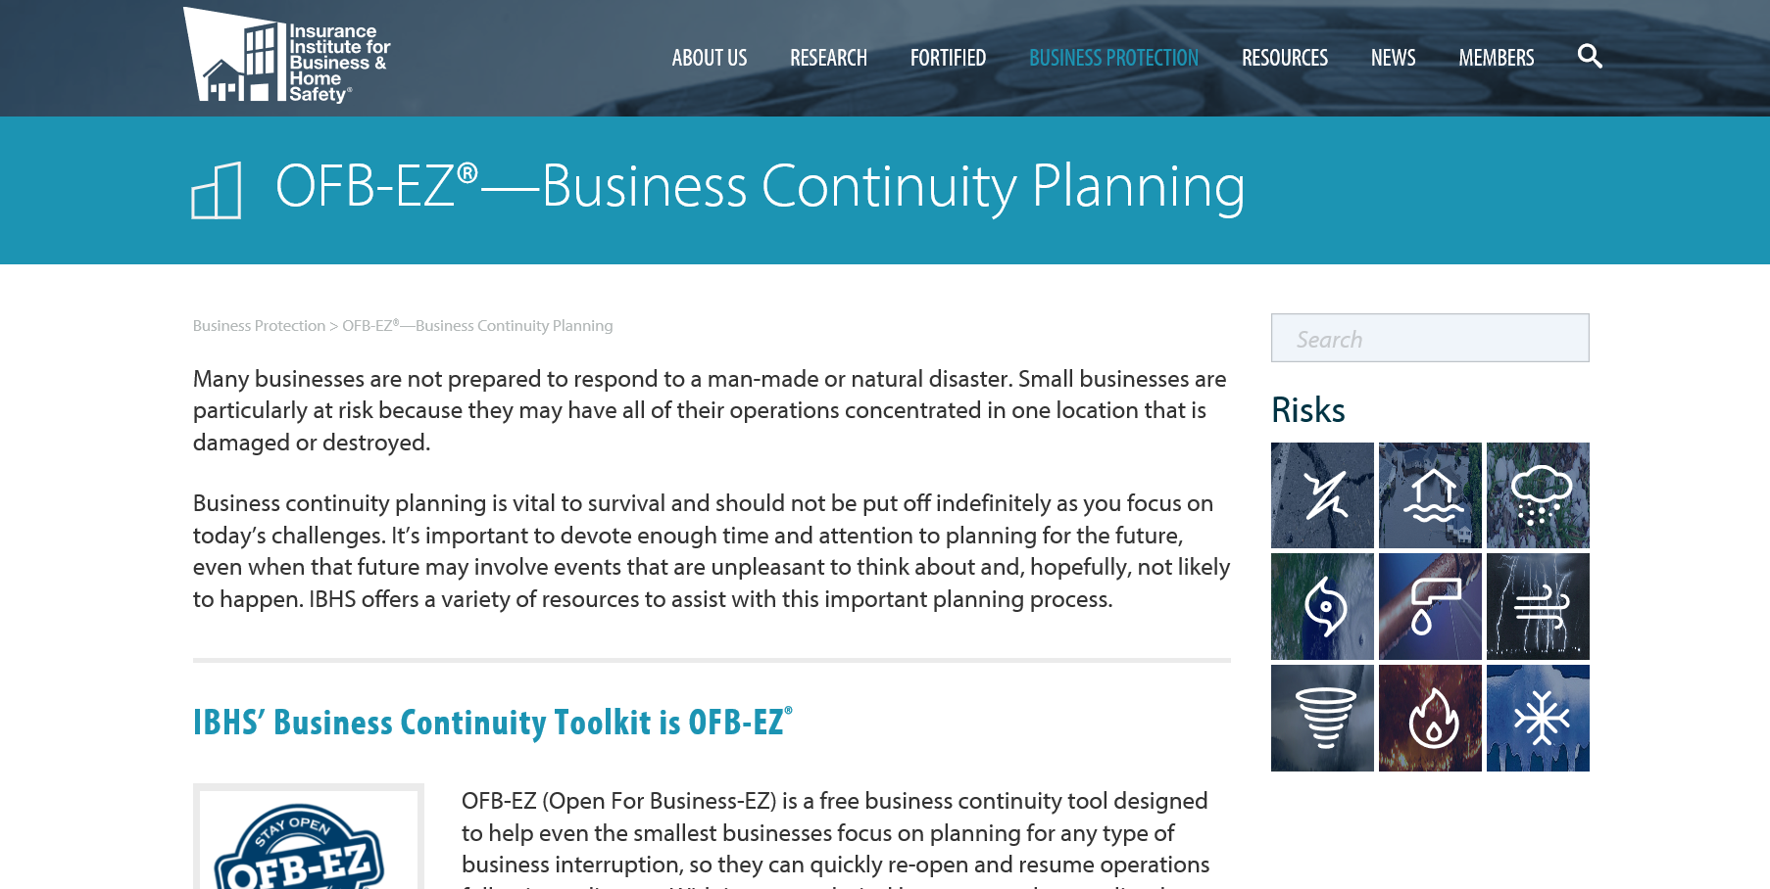
IBHS – Great Resources for a Small Business

Slide 38
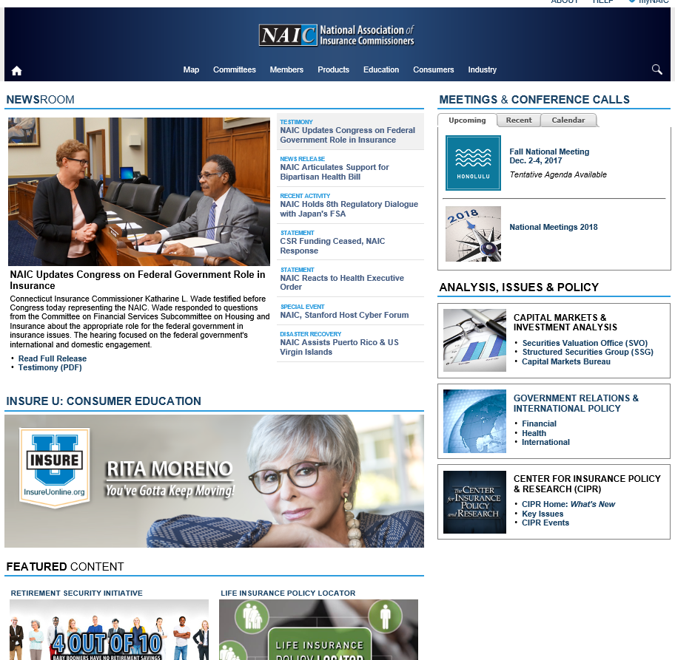
NAIC Resources for the Industry and Consumers

Slide 39
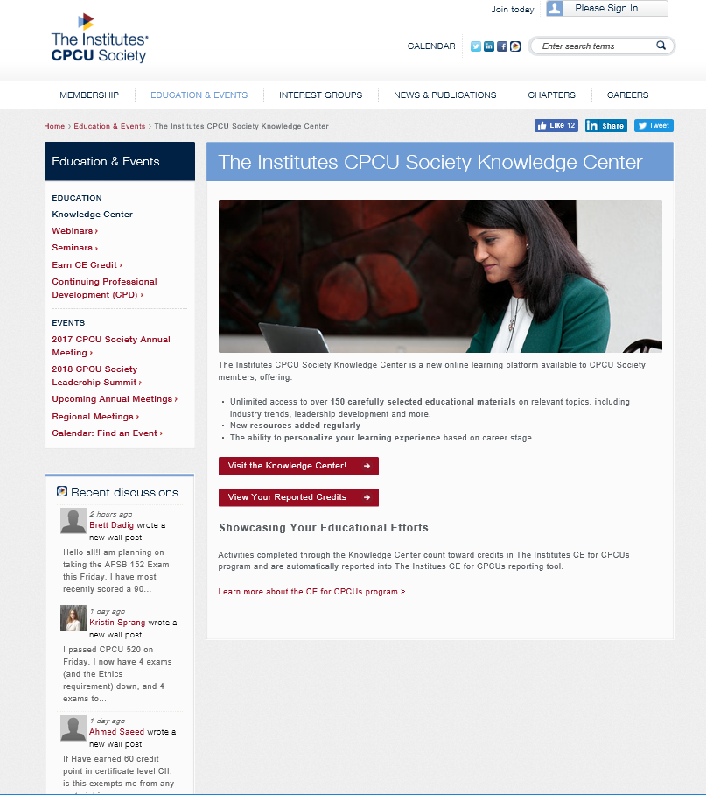
CPCU Society/The Institutes Great Source of Information

Slide 40
Questions?
And, Thank You!
@JeanneSalvatore
212-346-5555
917-612-4088
Jeannes@iii.org
jeannes@iii.org

