Slide 1


Insurance Leading Through Disruption
Litigation Management Symposium October 21 | Virtual
#CLMSymposium

Slide 2
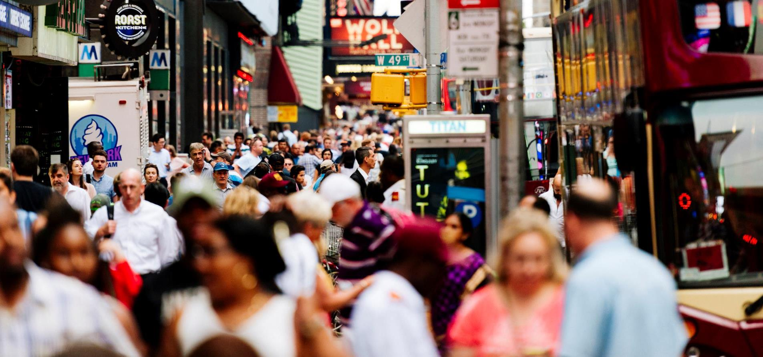
The Triple-I & Its Mission
A world with MORE insurance
We are the trusted source of unique, data-driven insights on insurance…
……to inform and empower consumers.
2
2

Slide 3
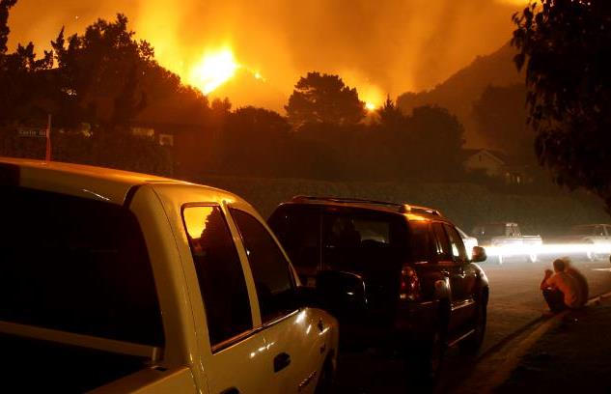

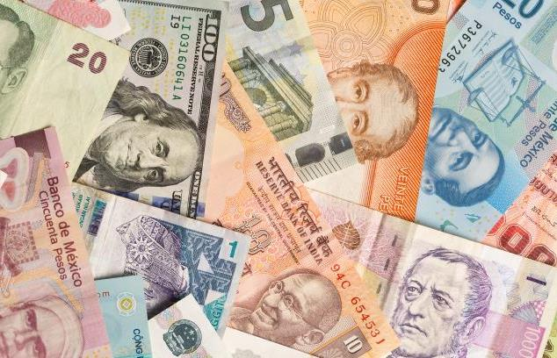



The Disruption Continuum
Catastrophes
COVID
Economics
INSURANCE
Geopolitical
Social Unrest
Technology

Slide 4
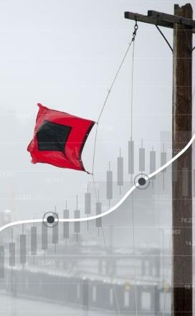

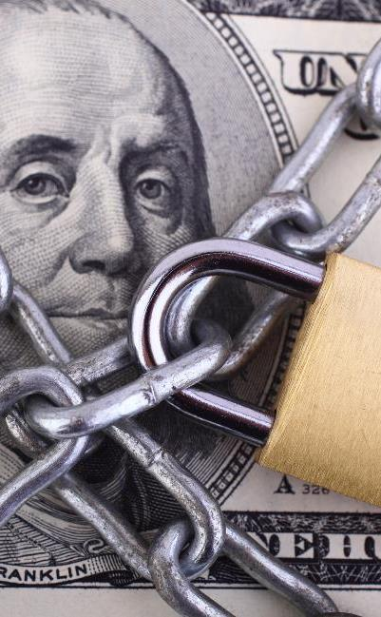





A New Milestone for Measuring Success
Economic Growth
Community
Well-being
Capital Protections
Resilience
Fairness & Equality

Slide 5
Stepping Up
America's Insurers:
for Customers, Communities, and Employees
The insurance Industry is Applying Forward-thinking Solutions to Take Care of Its Customers, Communities, and Employees During the COVID-19 Crisis
Customers
Community
Employees
Industry
Auto insurers have returned $14 billion so far to customers' pockets around the country through premium relief
Insurers have pledged more than an estimated $280 million (according to III/Insurance Industry Charitable Foundation) in donations to the national and local organizations fighting this pandemic on the frontlines
Employing more than 2.8 million Americans, Insurers are taking care of their employees–many pledging no layoffs during the ongoing crisis
Insurers are implementing innovative solutions to carrying out daily operations while respecting social distancing
Notes:
This is a great example of us as economic and first responders
News: 10.5B premium returned to auto customers
Significant charity dollars
Claims will be paid
Innovative solutions…. 4th industrial revolution

Slide 6

Underwriting Trends
Notes:
Will circle to this later, but first thought I would go through some of macro economic trends we are seeing for the industry at I.I.I.
Part of new product we are putting out quarterly at I.I.I.

Slide 7
COVID-19’s Impact
Unprecedented Spread of Loss, Deterioration of Exposure
Potential Loss Impact
Exposure Impact
$14B auto premium
Employment related exposures (GL, WC)
Loss estimates range from $30B
(≈ bad hurricane) to $140B (2-3 Katrinas)
Investment
Volatile stocks, bond yields plunging
Lloyd’s estimate: $96B in investment losses
Source: Willis Towers Watson, Insurance Information Institute..
Notes:
The pandemic and recession are driving results in three ways:
Exposures are falling because of the recession caused by the pandemic
Losses are rising because of pandemic related claims – currently most of those are falling in property, commercial multiperil and workers comp – but most observers expect a spike in liability claims as well.
Bond income is drying up because of the sharp decrease in interest rates, and the stock market has been on a remarkable roller coaster.

Slide 8
Industry Outlook
Commercial Lines Rate Change
Calendar Year Written Premium and Net Combined Ratio Projections
Growth in Nominal GDP (Real GDP + Inflation)
2020 Commentary
Overall premium projected to be flat. Underwriting result deteriorates.
Pandemic and recession reduce exposure in personal auto, several commercial lines.
Rate increases make up for lower exposures somewhat.
Tremendous uncertainty due to pandemic’s impact on several lines.
We assume normal cat year, despite bleak hurricane forecast.
Data sources: NAIC data sourced through S&P Global Market Intelligence, MarketScout, Blue Chip Economic Indicators, Congressional Budget Office, PCS, Aon, Munich Re, Energy Information Agency, FRED (Federal Reserve Bank of St. Louis).
Analysis: Insurance Information Institute, Milliman.

Slide 9
U.S. Inflation-Adjusted Insured Cat Losses
Harvey, Irma, Maria
Katrina, Rita, Wilma
WTC
2019 Was a Relatively Mild Year; 2020 Faces Pandemic, Above-average Hurricane Forecast
*Aon estimate through April. 2010s is average of 2010 to 2019. All losses are Direct.
Sources: Property Claims Service, a Verisk Analytics business; Aon; Insurance Information Institute.

Slide 10

Financial Trends
Notes:
Will circle to this later, but first thought I would go through some of macro economic trends we are seeing for the industry at I.I.I.
Part of new product we are putting out quarterly at I.I.I.

Slide 11
Key Sources of P/C Insurer Profits
$ Billions
Steady Investment Gains, Good Underwriting Results Lifted Profits in Most Years
Through first quarter.
Data are before taxes and exclude extraordinary items.
Source: NAIC data, sourced from S&P Global Market Intelligence.
Notes:
Chart shows results through first quarters since 2009. Underwriting profits were strong, with little in the way of Q1 catastrophes. Investment gains (income from bonds and dividends plus realized capital gains).

Slide 12
Policyholder Surplus by Quarter
Amount of Surplus ($ Billions)
Change from Prior Quarter
Surplus Has Rebounded from Q1 Decline Caused by Unrealized Capital Losses (Stock Declines).
78 Cents of Premium per Dollar of Surplus.
Sources: ISO, A.M. Best, Insurance Information Institute.
12
Notes:
While the industry booked significant income, surplus fell by more than $70 billion because of unrealized capital losses. Fortunately that has bounced back in the second quarter, Triple-I economists estimate.
12

Slide 13
Employment in Major Subsectors of the Insurance Industry:
A Surprise
Over the Last Two Years, All Four Major Insurance Industry Subsectors Have Grown Employment Despite the Recession That Began in February 2020
Thousands
2,319.5
2,238.9
Data are seasonally adjusted
Sources: BLS; Triple-I

Slide 14

COVID-19
Economic and Cultural Impacts:
An Industry’s Response
Notes:
Will circle to this later, but first thought I would go through some of macro economic trends we are seeing for the industry at I.I.I.
Part of new product we are putting out quarterly at I.I.I.

Slide 15

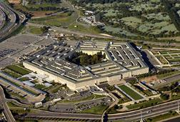
Global Pandemics Are Uninsurable
Economic Impact of 9/11

Slide 16

Global Pandemics Are Uninsurable
Economic Impact of Coronavirus

Slide 17
Monthly Costs of Retroactive Changes to SME BI Policies
Regardless of Scenario, Retroactive Attempts to Include Pandemics in BI Causes Bankruptcy
Retroactive BI Scenarios
Higher
Median
Lower
Higher
Median
Lower
1
Virus / Bacteria Exclusion Removal
2
Expanded BI to
All SMEs
Key Assumptions
Scenario 1: 40% take-up rate
Scenario 2: 100% take-up rate
Loss basis: Compensation, profits, adjustment costs 7 days waiting period
Retained loss of 10% of total loss
Median estimates are model-driven. The higher and lower estimates assume a standard distribution for BI losses anchored in the mode-driven median loss estimates.
Notes:
-One of the things we’re concerned about
….BI policies always excluded pandemics
-compare to 911 when it was DC/NYC, the rest of the US was facing some stress but now it’s the whole economy
-we simply cannot produce such a widely available product
-there are some exceptions, Wimbledon, not the norm
-if you go retroactive first thing to understand is: unconstitutional
second thing: from an econ perspective, 40%, charge to the surplus upward 100b per month
even more extremely to all BI policies cld go upward of 250b a month
It would
Estimated BI Costs
Retroactive changes could cost industry from roughly ~$150B to nearly as high as ~$380B
Scenario 1: Retroactive removal of virus exclusion on existing SME BI policies (est. cost ~B50 to ~B150)
Scenario 2: Retroactive exclusion removal, AND expanded BI coverage to all SME property policies (est. cost ~125 to ~380)
Either scenario would imperil industry’s financial stability and ability to pay claims on existing valid policies
Lower and higher range to the scenarios are standard distribution based not model based. They assume that the possible total losses from retroactive BI are normally-distributed and the two tails are one standard deviation in each direction around the mean. This means the 50-to-150 spread covers only 2/3 of the possibilities. Going another standard deviation would cover a total of 95 percent of the possibilities.

Slide 18
The Surge in Business Interruption Media Coverage Created an Opportunity for Triple-I to Serve as Industry Voice and Educator
Count of Stories Mentioning Business Interruption Insurance & COVID-19
Source: Meltwater

Slide 19
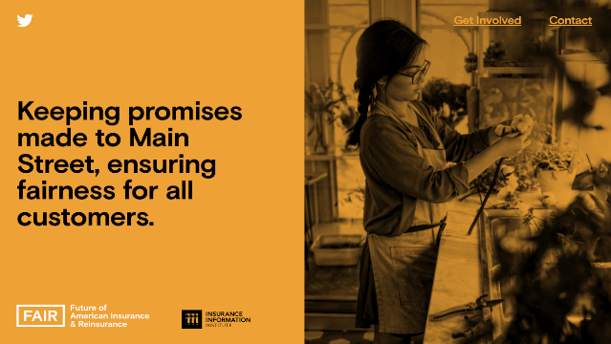


With Increased Attention and Scrutiny on Industry, Triple-I Identified the Need to Launch an Industry Campaign
The ‘Future of American Insurance & Reinsurance’ campaign launched in May and has served as a source of education and information surrounding pivotal industry activity, including Congressional hearings, White House roundtables, state legislation, and media stories.
With a separate website and public presences, this campaign provides the Triple-I with a separate platform and voice.
The campaign will take on overarching industry issues and emphasize its essential role in supporting and rebuilding communities in these uncertain times.
www.fairinsure.org

Slide 20
FAIR Guiding Principles:
A Defined Perspective on Potential Policy Solutions
Given their universal scope, pandemics are largely uninsurable.
Therefore, only the government has the financial capacity to provide the relief
small and large businesses need to weather this crisis.
Proposed solutions must:
Maintain the federal government as a primary provider of relief, reflecting the reality that pandemic risks are not privately insurable.
Provide widely accessible relief payments to businesses in a fast and efficient manner once a pandemic is declared by the government, with minimal chance of abuse.
Protect businesses from losses, and incentivize businesses to retain employees, without jeopardizing insurers' existing commitments.

Slide 21



Summer 2020
An initiative of the

Slide 22





Objective
Drive behavioral change to help people and communities better manage risk and become more resilient

Slide 23
Strategies
Create a resilience movement giving households and communities a stake in risk mitigation
Educate and empower stakeholders about protection gaps and their impact on their recovery
Fast-track the use of cost effective tools to drive risk mitigation, transfer and retention

Slide 24


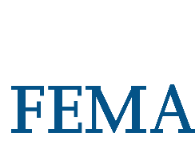









Action Partners
Triple-I Members
Carriers, Reinsurers and Brokers
Insurance Trade Associations
Non-Profits and Foundations
Regulators
Academia

Slide 25

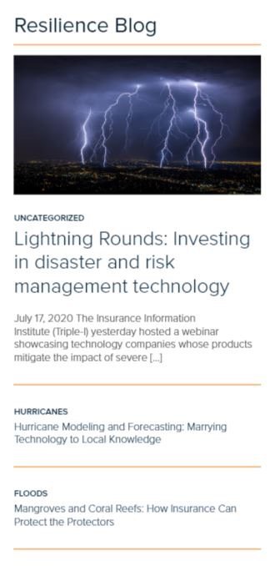
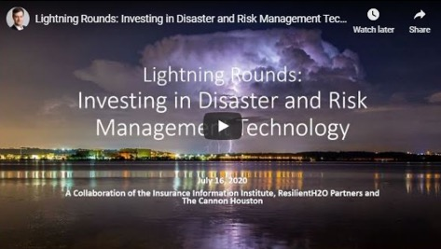
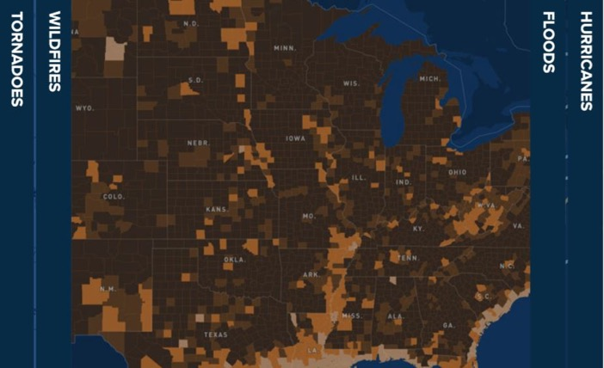
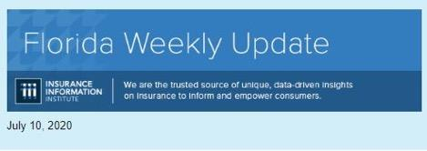
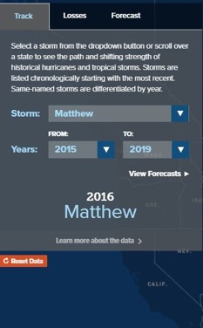
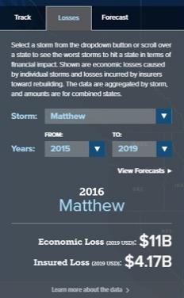
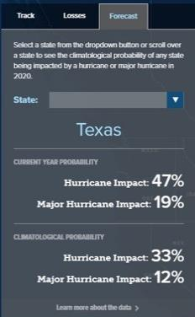


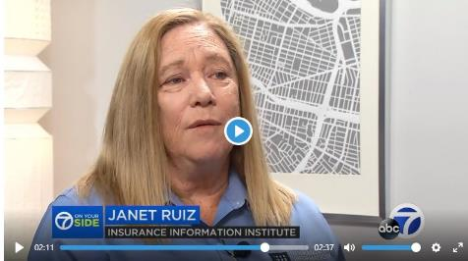

Slide 26

Fairness and Equality
Notes:
Will circle to this later, but first thought I would go through some of macro economic trends we are seeing for the industry at I.I.I.
Part of new product we are putting out quarterly at I.I.I.

Slide 27
Employed Persons by Occupation, Sex, Race, and
Hispanic or Latino Ethnicity, 2019
Occupation | Total Employed (in 000s) | % of Total Employed
 |  | Women | Black or African American | Asian | Hispanic or Latino
Total, 16 Years and Over | 157,538 | 47.0% | 12.3% | 6.5% | 17.6%
Business and Financial Operations Occupations | 7,996 | 54.0% | 9.9% | 9.0% | 9.5%
Insurance Sales Agents | 595 | 50.6% | 10.1% | 5.6% | 13.4%
Claims Adjusters, Appraisers, Examiners, and Investigators | 318 | 62.1% | 19.5% | 4.4% | 9.5%
Insurance Claims and Policy Processing Clerks | 269 | 81.7% | 21.8% | 2.4% | 15.5%
Insurance Underwriters | 105 | 51.1% | 5.9% | 5.4% | 6.2%
Actuaries | 33 | N/A | N/A | N/A | N/A
The Industry is More Diverse and Inclusive Than It Was 20 Years Ago, But Women, People of Color and Other Minority Groups Are Still Significantly Underrepresented at Senior Levels
Source: Bureau of Labor Statistics

Slide 28

Solutions?
The NAIC's newly formed committee on race and insurance will address practices that potentially disadvantage minorities – the industry will engage with the NAIC to review the recommended steps
SOLUTION

Slide 29

Working in Tandem to Overcome Unprecedented Challenges
The insurance industry is proud of its continued success in these areas—in large part because this success is built on a foundation of working in close partnership with consumers and regulators

