Slide 1
Overview & Outlook for the Commercial P/C Insurance Industry:
Focus on Southeast States
Insurance Information Institute
April 27, 2016
Download at www.iii.org/presentations
Robert P. Hartwig, Ph.D., CPCU, President & Economist
Insurance Information Institute ♦ 110 William Street ♦ New York, NY 10038
Tel: 212.346.5520 ♦ Cell: 917.453.1885 ♦ bobh@iii.org ♦ www.iii.org

Slide 2
Insurance Industry:
Financial Update & Outlook
2015 Was a Reasonably Good Year and Similar to 2014
2016: Could Be Similar to 2015
2

Slide 3
Commercial Lines Outlook: 2016
Flat to modest deceleration in premium growth in 2016
Rate environment suggests flat-to-slightly negative renewals in 2016
Economic growth continues at a modest pace but unevenly across industries and regions; Nearly full employment and tighter labor market conditions are pluses and should drive new exposures
Construction, Service sectors are positives but manufacturing, energy, commodities face headwinds
Loss costs driven by modest frequency and severity trends, but helped by reserve releases, low cats, low infl.
Property cat reinsurance costs continue to fall
Investment income still under pressure from low yields

Slide 4
P/C Industry Net Income After Taxes
1991–2015
$ Millions
2005 ROE*= 9.6%
2006 ROE = 12.7%
2007 ROE = 10.9%
2008 ROE = 0.1%
2009 ROE = 5.0%
2010 ROE = 6.6%
2011 ROAS¹ = 3.5%
2012 ROAS¹ = 5.9%
2013 ROAS¹ = 10.2%
2014 ROAS¹ = 8.4%
2015 ROAS = 8.4%
Net income in 2015 was on par with 2014; ROE unchanged at 8.4%
ROE figures are GAAP; ¹Return on avg. surplus. Excluding Mortgage & Financial Guaranty insurers yields a 8.2% ROAS in 2014, 9.8% ROAS in 2013, 6.2% ROAS in 2012, 4.7% ROAS for 2011, 7.6% for 2010 and 7.4% for 2009; 2015E is annualized figure based actual figure through Q3 of $44.0
Sources: A.M. Best, ISO; Insurance Information Institute

Slide 5
Profitability Peaks & Troughs in the P/C Insurance Industry, 1975 – 2015
ROE
1977:19.0%
History suggests next ROE peak will be in 2016-2017
1987:17.3%
10 Years
1997:11.6%
2006:12.7%
10 Years
2015: 8.4%
2013 9.8%
9 Years
2014 8.4%
1975: 2.4%
1984: 1.8%
1992: 4.5%
2001: -1.2%
*Profitability = P/C insurer ROEs. 2011-15 figures are estimates based on ROAS data. Note: Data for 2008-2014 exclude mortgage and financial guaranty insurers.
Source: Insurance Information Institute; NAIC, ISO, A.M. Best, Conning

Slide 6
ROE: Property/Casualty Insurance by Major Event, 1987–2015
(Percent)
P/C Profitability Is Both by
Cyclicality and Ordinary Volatility
Modestly higher CATs
Katrina, Rita, Wilma
Low CATs
Sept. 11
Hugo
Lowest CAT Losses in
15 Years
4 Hurricanes
Sandy
Andrew, Iniki
Record Tornado Losses
Northridge
Financial Crisis*
* Excludes Mortgage & Financial Guarantee in 2008 – 2014.
Sources: ISO, Fortune; Insurance Information Institute.

Slide 7
Commercial Lines NPW Premium Growth:
1975 – 2015E
ROE
Commercial lines is prone to more cyclical volatility that personal lines. Recently, growth has stabilized in the 4% to 5% range.
Economic Shocks, Inflation:
1976: 22.2%
Tort Crisis
1986: 30.5%
Post-9/11
2002: 22.4%
Post-Hurricane Andrew Bump:
1993: 6.3%
1988-2000: Period of inter-cycle stability
Post Katrina Bump:
2006: 7.7%
2015E 3.3%
2010-20XX? Post-recession period of stable growth?
Recessions:
1982: 1.1%
Great Recession:2009: -9.0%
Note: Data include state funds beginning in 1998.
Source: A.M. Best; Insurance Information Institute.

Slide 8
P/C Insurance Industry
Combined Ratio, 2001–2015*
Heavy Use of Reinsurance Lowered Net Losses
Relatively Low CAT Losses, Reserve Releases
Higher CAT Losses, Shrinking Reserve Releases, Toll of Soft Market
As Recently as 2001, Insurers Paid Out Nearly $1.16 for Every $1 in Earned Premiums
Relatively Low CAT Losses, Reserve Releases
Avg. CAT Losses, More Reserve Releases
3 Consecutive Years of U/W Profits: First Time Since 1971-73
Best Combined Ratio Since 1949 (87.6)
Sandy Impacts
Cyclical Deterioration
Lower CAT Losses
* Excludes Mortgage & Financial Guaranty insurers 2008--2014. Including M&FG, 2008=105.1, 2009=100.7, 2010=102.4, 2011=108.1; 2012:=103.2; 2013: = 96.1; 2014: = 97.0.
Sources: A.M. Best, ISO (2014-2015); Figure for 2010-2013 is from A.M. Best P&C Review and Preview, Feb. 16, 2016.

Slide 9
Distribution of Direct Premiums Written by Segment/Line, 2014
Personal/Commercial lines split has been about 50/50 for many years
Pvt. Passenger Auto is by far the largest line of insurance and is currently the most important source of industry profits
Billions of additional dollars in homeowners insurance premiums are written by state-run residual market plans
Distribution Facts
2014
Commercial Lines
$282.5B/51%
Homeowners
$86.1B/15%
Pvt. Pass Auto
$190.3B/34%
Sources: A.M. Best; Insurance Information Institute research.

Slide 10
RNW All Lines, 2005-2014 Average:
Highest 25 States
(Percent)
The most profitable states over the past decade are widely distributed geographically, though none are in the Gulf region
Profitability Benchmark: All P/C
US: 7.7%
Source: NAIC; Insurance Information Institute.

Slide 11
RNW All Lines, 2005-2014 Average:
Lowest 25 States
(Percent)
Some of the least profitable states over the past decade were hit hard by catastrophes
Source: NAIC; Insurance Information Institute.

Slide 12
Return on Equity by Financial Services Sector vs. Fortune 500, 2004-2015*
(Percent)
Average: 2004 - 2014
Fortune 500: 13.9% Commercial Banks: 9.8% Life: 8.2% P/C: 7.1%
Banks and Insurers Have Substantially Underperformed the Fortune 500 Since the Financial Crisis
*GAAP basis.
Sources: ISO, Fortune; Insurance Information Institute.
12
Notes:
12

Slide 13
Top 25 US P/C Insurers by Direct Premiums Written, 2014
The ACE/Chubb deal will create a much larger commercial presence for the combined entity
Commercial Lines
$269.2B/51%
Homeowners
$80.7B/15%
Pvt. Pass Auto
$180.8B/34%
Sources: Barclays PLC; Insurance Information Institute.

Slide 14
RNW Commercial Auto,
2005-2014 Average: Highest 25 States
(Percent)
Sources: NAIC; Insurance Information Institute

Slide 15
RNW Commercial Auto,
2005-2014 Average: Lowest 25 States
(Percent)
Sources: NAIC; Insurance Information Institute

Slide 16
RNW Workers Compensation,
2005-2014 Average: Highest 25 States
(Percent)
Sources: NAIC; Insurance Information Institute

Slide 17
RNW Workers Compensation,
2005-2014 Average: Lowest 25 States
(Percent)
Sources: NAIC; Insurance Information Institute

Slide 18
P/C Insurance Loss Reserve Development, 1992 – 2017E*
Reserve releases are expected to gradually taper off slowly, but will continue to benefit the bottom line and combined ratio through at least 2017
Reserve Change
Source: A.M. Best; Barclays research for estimates.

Slide 19
Profitability & Politics
How Is Profitability Affected by the President’s Political Party?
19

Slide 20
P/C Insurance Industry ROE by Presidential Administration, 1950-2015*
OVERALL RECORD: 1950-2015*
Democrats 7.72%
Republicans 7.85%
Party of President has marginal bearing on profitability of P/C insurance industry
*Truman administration ROE of 6.97% based on 3 years only, 1950-52;.
Source: Insurance Information Institute

Slide 21
P/C insurance Industry ROE by Presidential Party Affiliation, 1950- 2015
BLUE = Democratic President RED = Republican President
Nixon/Ford
Carter
Reagan/Bush I
Clinton
Bush II
Obama
Truman
Eisenhower
Kennedy/ Johnson
.
Source: Insurance Information Institute

Slide 22
2015 Property and Casualty Insurance
Regulatory Report Card
C
AK
AL
A
WA
ME
C
MT
B
ND
C
VT
D
MN
D
NH
B
OR
ID
C+
C
NY
MA
= A
= B
= C
= D
= F
= NG
B
SD
B+
WI
MI
CT
RI C+
B
B
NJ
WY
PA
C
B
B+
IA
B
C-
A
C+
OH
MD
NV
NE
A-
IL
IN
DE
B+
WV
B
UT
B
C
VA
CO
C+
A
B
A
B
KS
MO
KY
CA
B
A
F
D
A-
TN
NC
C
AZ
NM
OK
C
AR
C
SC
Source: James Madison Institute, February 2008.
A-
D
HI
B
B
AL
B
MS
C
GA
LA
D+
TX
D
Not Graded: District of Columbia
FL
D
D
Source: R Street Insurance Regulation Report Card, December 2015

Slide 23
Trump vs. Clinton:
Issues that Matter to P/C Insurers
Issue | Trump | Clinton
Economy | Supply Side-Like Philosophy: Lower taxes→Faster real GDP growth; Deficits likely grow as tax cuts are combined with targeted increased spending on Homeland Security, Defense, etc. | Keynesian Philosophy: More government spending on infrastructure, education, social services; Deficits likely increase as tax increases likely difficult to pass
Interest Rates | May trend higher with larger deficits; Shift from monetary policy to fiscal focus (tax cuts, government spending) | Status quo at the Fed; Net impact on interest rates unclear
Taxes | Favors lower tax rates for corporate and personal income tax rates; Tax code overhaul? | Unlikely to reduce taxes or embark on major overhaul of tax code
International Trade | Protectionist Tendencies | Has criticized Trans-Pacific Partnership but is a realist on international matters
Tort System | Doesn’t like trial lawyers but seems to like filing lawsuits | Status Quo

Slide 24
Profitability and Growth in Georgia, Florida, the Carolinas, Tennessee, Mississippi and Alabama’s P/C Insurance Markets
Analysis by Line and State Comparisons
24

Slide 25
RNW All Lines: NC, SC and GA vs. U.S., 2005-2014
P/C Insurer profitability in NC and SC is above that of the US overall over the past decade. In GA profitability is below that of the US.
US: 7.7%
NC: 11.1%
SC: 10.8%
GA: 5.1%
(Percent)
Source: NAIC.
25
Notes:
25

Slide 26
RNW All Lines: TN, FL, MS and AL vs. U.S., 2005-2014
(Percent)
P/C Insurer profitability in FL is above that of the US overall over the past decade. In TN, MS and AL profitability is below that of the US.
US: 7.7%
TN: 6.2%
FL: 13.0%
MS: -7.4
AL: 4.1
Source: NAIC.
26
Notes:
26

Slide 27
RNW All Lines: TN, FL, MS and AL vs. U.S., 2005-2014
(Percent)
P/C Insurer profitability in FL is above that of the US overall over the past decade. In TN, MS and AL profitability is below that of the US.
US: 7.7%
TN: 6.2%
FL: 13.0%
MS: -7.4
AL: 4.1
Source: NAIC.
27
Notes:
27

Slide 28
RNW PP Auto: NC, SC and GA vs. U.S., 2005-2014
Average 2005-2014
US: 6.2%
NC: 6.4%
SC: 5.8%
GA: 4.7%
Source: NAIC.
28
Notes:
28

Slide 29
RNW PP Auto: TN, FL, MS, AL vs. U.S., 2005-2014
Average 2005-2014
US: 6.2%
TN:5.8%
FL: 3.9%
MS: 3.6%
AL: 6.7%
Source: NAIC.
29
Notes:
29

Slide 30
RNW Comm. Auto: NC, SC and GA vs. U.S., 2005-2014
(Percent)
Average 2005-2014
US: 8.1%
NC: 11.4%
SC: 8.8%
GA: 5.2%
Sources: NAIC.
30
Notes:
30

Slide 31
RNW Comm. Auto: TN, FL, MS and AL vs. U.S., 2005-2014
(Percent)
Average 2005-2014
US: 8.1%
TN: 8.3%
FL: 3.9%
MS: 4.9%
AL: 3.3%
Source: NAIC.
31
Notes:
31

Slide 32
RNW Comm. Multi-Peril: NC, SC and GA vs. U.S., 2005-2014
Average 2005-2014
US: 8.9%
NC: 15.4%
SC: 10.8%
GA: 4.7%
(Percent)
Sources: NAIC.
32
Notes:
32

Slide 33
RNW Comm. Multi-Peril: TN, FL, MS, AL vs. U.S., 2005-2014
(Percent)
Average 2005-2014
US: 8.9%
TN: 5.5%
FL: 17.6%
MS: -7.5%
AL: 1.4%
Source: NAIC.
33
Notes:
33

Slide 34
RNW Homeowners: NC, SC and GA vs. U.S., 2005-2014
(Percent)
Average 2005-2014
US: 7.6%
NC: 11.5%
SC: 18.4%
GA: -8.4%
Source: NAIC.
34
Notes:
34

Slide 35
RNW Homeowners: TN, FL, MS and AL vs. U.S., 2005-2014
(Percent)
Average 2005-2014
US: 7.6%
TN: -11.2%
FL: 20.9%
MS: -26.8%
AL: -4.8%
Sources: NAIC.
35
Notes:
35

Slide 36
RNW Workers Comp: NC, SC and GA vs. U.S., 2005-2014
(Percent)
Average 2005-2014
US: 6.8%
NC: 5.1%
SC: 4.1%
GA: 4.7%
Source: NAIC.
36
Notes:
36

Slide 37
RNW Workers Comp: TN, FL, MS and AL vs. U.S., 2005-2014
(Percent)
Average 2005-2014
US: 6.8%
TN: 7.2%
FL: 9.7%
MS: 7.7%
AL: 7.9%
Sources: NAIC.
37
Notes:
37

Slide 38
All Lines: 10-Year Average RNW
2005-2014
Source: NAIC

Slide 39
PP Auto: 10-Year Average RNW
2005-2014
Source: NAIC

Slide 40
Top Ten Most Expensive And Least Expensive States For Automobile Insurance, 2013 (1)
Rank | Most expensive states | Average expenditure | Rank | Least expensive states | Average expenditure
1 | New Jersey | $1,254.10 | 1 | Idaho | $553.38
2 | D.C. | 1,187.49 | 2 | Iowa | 572.14
3 | New York | 1,181.86 | 3 | South Dakota | 580.99
4 | Louisiana | 1,146.29 | 4 | Maine | 592.82
5 | Florida | 1,143.83 | 5 | North Dakota | 604.58
6 | Michigan | 1,131.40 | 6 | Wisconsin | 621.05
7 | Delaware | 1,101.12 | 7 | Indiana | 621.71
8 | Rhode Island | 1,066.25 | 8 | North Carolina | 624.76
9 | Connecticut | 1,011.27 | 9 | Nebraska | 638.74
10 | Massachusetts | 1,007.98 | 10 | Wyoming | 639.71
North Carolina ranked 8th as the least expensive state in 2013, with an average expenditure for auto insurance of $624.76 while Florida ranked as the 5th most expensive state with an $1,143.83 average expenditure
Based on average automobile insurance expenditures.
Source: © 2016 National Association of Insurance Commissioners.

Slide 41
Commercial Auto: 10-Year Average RNW
2005-2014
Source: NAIC

Slide 42
Commercial M-P: 10-Year Average RNW
2005-2014
Source: NAIC

Slide 43
Homeowners: 10-Year Average RNW
2005-2014
Source: NAIC

Slide 44
Top Ten Most Expensive And Least Expensive States For Homeowners Insurance, 2013 (1)
Florida ranked as the most expensive state for homeowners insurance in 2013, with an average expenditure of $2,115. Mississippi was 5th ($1,395). Alabama was 8th ($1,323).
Rank | Most expensive states | HO average premium | Rank | Least expensive states | HO average premium
1 | Florida | $2,115 | 1 | Idaho | 561
2 | Texas (2) | 1,837 | 2 | Oregon | 568
3 | Louisiana | 1,822 | 3 | Utah | 609
4 | Oklahoma | 1,654 | 4 | Wisconsin | 665
5 | Mississippi | 1,395 | 5 | Washington | 676
6 | Kansas | 1,343 | 6 | Nevada | 687
7 | Rhode Island | 1,334 | 7 | Delaware | 709
8 | Alabama | 1,323 | 8 | Arizona | 724
9 | Connecticut | 1,274 | 9 | Ohio | 763
10 | Massachusetts | 1,263 | 10 | Maine | 776
Includes policies written by Citizens Property Insurance Corp. (Florida) and Citizens Property Insurance Corp. (Louisiana), Alabama Insurance Underwriting Association, Mississippi Windstorm Underwriting Association, North Carolina Joint Underwriting Association and South Carolina Wind and Hail Underwriting Association. Other southeastern states have wind pools in operation and their data may not be included in this chart. Based on the HO-3 homeowner package policy for owner-occupied dwellings, 1 to 4 family units. Provides “all risks” coverage (except those specifically excluded in the policy) on buildings and broad named-peril coverage on personal property, and is the most common package written.
The Texas Department of Insurance developed home insurance policy forms that are similar but not identical to the standard forms. In addition, due to the Texas Windstorm Association (which writes wind-only policies) classifying HO-1, 2 and 5 premiums as HO-3, the average premium for homeowners insurance is artificially high.
Note: Average premium=Premiums/exposure per house years. A house year is equal to 365 days of insured coverage for a single dwelling. The NAIC does not rank state average expenditures and does not endorse any conclusions drawn from this data.
Source: ©2016 National Association of Insurance Commissioners (NAIC). Reprinted with permission. Further reprint or distribution strictly prohibited without written permission of NAIC.

Slide 45
Workers Comp: 10-Year Average RNW
2005-2014
Source: NAIC, Insurance Information Institute

Slide 46
All Lines DWP Growth: NC, SC and GA vs. U.S., 2006-2015
(Percent)
Average 2006-2015
US: 1.8%
NC: 2.2%
SC: 2.9%
GA: 2.3%
Source: NAIC via SNL Financial.
46
Notes:
46

Slide 47
All Lines DWP Growth: TN, FL, MS and Al vs. U.S., 2006-2015
(Percent)
Average 2006-2015
US: 1.8%
TN: 2.5%
FL: 1.8%
MS: 2.8%
AL: 2.1%
Source: NAIC via SNL Financial.
47
Notes:
47

Slide 48
Comm. Lines DWP Growth: NC, SC and GA vs. U.S., 2006-2015
(Percent)
Average 2006-2015
US: 1.2%
NC: 1.5%
SC: 1.9%
GA: 0.9%
Source: NAIC via SNL Financial.
48
Notes:
48

Slide 49
Comm. Lines DWP Growth: vs. U.S., 2006-2015
(Percent)
Average 2006-2015
US: 1.2%
TN: 1.2%
FL: 0.8%
MS: 2.5%
AL: 0.8%
Source: NAIC via SNL Financial.
49
Notes:
49

Slide 50
Personal Lines DWP Growth: NC, SC and GA vs. U.S., 2006-2015
(Percent)
Average 2006-2015
US: 2.6%
NC: 2.9%
SC: 3.8%
GA: 3.5%
Source: NAIC via SNL Financial.
50
Notes:
50

Slide 51
Personal Lines DWP Growth: TN, FL, MS and AL vs. U.S., 2006-2015
(Percent)
Average 2006-2015
US: 2.6%
TN: 3.7%
FL: 2.8%
MS: 3.2%
AL: 3.3%
Source: NAIC via SNL Financial.
51
Notes:
51

Slide 52
Private Passenger Auto DWP Growth: NC, SC and GA vs. U.S., 2006-2015
(Percent)
Average 2006-2015
US: 1.8%
NC:1.9%
SC:2.9%
GA:2.4%
Source: NAIC via SNL Financial.
52
Notes:
52

Slide 53
Private Passenger Auto DWP Growth: TN, FL, MS and AL vs. U.S., 2006-2015
(Percent)
Average 2006-2015
US: 1.8%
TN: 2.5%
FL: 2.0%
MS: 2.1%
AL: 2.1%
Source: NAIC via SNL Financial.
53
Notes:
53

Slide 54
Homeowner’s MP DWP Growth: NC, SC and GA vs. U.S., 2006-2015
(Percent)
Average 2006-2015
US: 4.5%
NC: 5.4%
SC: 5.8%
GA:6.4%
Source: NAIC via SNL Financial.
54
Notes:
54

Slide 55
Homeowner’s MP DWP Growth: TN, FL, MS and AL vs. U.S., 2006-2015
Average 2006-2015
US: 4.5%
TN: 6.2%
FL: 0.8%
MS: 6.2%
AL: 5.4%
(Percent)
Source: NAIC via SNL Financial.
55
Notes:
55

Slide 56
INVESTMENTS:
THE NEW REALITY
Investment Performance is a Key Driver of Profitability
Depressed Yields Will Necessarily Influence Underwriting & Pricing
56

Slide 57
Property/Casualty Insurance Industry Investment Income: 2000–2015¹
Investment earnings are still below their 2007 pre-crisis peak
($ Billions)
Due to persistently low interest rates,
investment income fell in 2012, 2013 and 2014 but showed a small (1.9%) increase in 2015—a trend that may continue
¹ Investment gains consist primarily of interest and stock dividends. Sources: ISO; Insurance Information Institute.

Slide 58
U.S. Treasury Security Yields:
A Long Downward Trend, 1990–2016*
Yields on 10-Year U.S. Treasury Notes have been essentially below 5% for more than a decade.
Despite the Fed’s December 2015 rate hike, yield remain low though short-term yields have seen some gains
Since roughly 80% of P/C bond/cash investments are in 10-year or shorter durations, most P/C insurer portfolios will have low-yielding bonds for years to come.
*Monthly, constant maturity, nominal rates, through March 2016.
Sources: Federal Reserve Bank at http://www.federalreserve.gov/releases/h15/data.htm. National Bureau of Economic Research (recession dates); Insurance Information Institute.
58
12/01/09 - 9pm
eSlide – P6466 – The Financial Crisis and the Future of the P/C
Notes:
58

Slide 59
Distribution of Invested Assets: P/C Insurance Industry, 2014
$ Billions
Total Invested Assets = $1.533 Trillion
Source: Insurance Information Institute Fact Book 2016, A.M. Best.

Slide 60
Net Investment Yield on Property/ Casualty Insurance Invested Assets, 2007–2016P*
(Percent)
Estimated book yield in 2016 is down about 140 BP from pre-crisis levels
The yield on invested assets remains low relative to pre-crisis yields. The Fed’s plan to raise interest rates in late 2015 has pushed up some yields, albeit quite modestly.
Sources: A.M. Best; 2015E-2016P figures from A.M. Best P/C Review and Preview, Feb. 2016; Insurance Information Institute

Slide 61
Interest Rate Forecasts: 2016 – 2021
Yield (%)
3-Month Treasury
10-Year Treasury
The end of the Fed’s QE program in 2014 and a stronger economy have yet to push longer-term yields much higher
A full normalization of interest rates is unlikely until 2019, more than a decade after the onset of the financial crisis.
Sources: Blue Chip Economic Indicators (4/16 for 2016 and 2017; for 2018-2021 3/16 issue); Insurance Info. Institute.

Slide 62
Treasury Yield Curves:
Pre-Crisis (July 2007) vs. April 2016*
Treasury yield curve remains near its most depressed level in at least 45 years. Investment income is depressed as a result. Fed began to raise rates in Dec. 2015, but yields unlikely to return to pre-crisis levels anytime soon
The Fed Began to Raise Rates in Dec. 2015 but Market Volatility and Weakness Abroad Have Made Additional Hikes Difficult
*As of April 22, 2016.
Source: Federal Reserve Board of Governors: http://www.federalreserve.gov/releases/h15/data.htm; Insurance Information Institute.

Slide 63
Annual Inflation Rates, (CPI-U, %),
1990–2017F
Annual Inflation Rates (%)
Inflation peaked at 5.6% in August 2008 on high energy and commodity crisis. The recession and the collapse of the commodity bubble reduced inflationary pressures in 2009/10
Inflationary expectations have slipped (due in part to falling energy costs) allowing the Fed to maintain low interest rates
Slack in the U.S. economy and falling energy prices suggests that inflationary pressures should remain subdued for an extended period of times
Sources: US Bureau of Labor Statistics; Blue Chip Economic Indicators, 4/16 (forecasts).

Slide 64
P/C Insurer Net Realized
Capital Gains/Losses, 1990-2015
Realized capital gains rose sharply as equity markets rallied in 2013-14
($ Billions)
Insurers Posted Net Realized Capital Gains in 2010 - 2015 Following Two Years of Realized Losses During the Financial Crisis. Realized Capital Losses Were a Primary Cause of 2008/2009’s Large Drop in Profits and ROE.
Sources: A.M. Best, ISO; Insurance Information Institute.
64
12/01/09 - 9pm
eSlide – P6466 – The Financial Crisis and the Future of the P/C
Notes:
64

Slide 65
Property/Casualty Insurance Industry Investment Gain: 1994–2015¹
($ Billions)
Investment gains in 2015 were unchanged from 2014 and still well below the pre-crisis highs
Total Investment Gains Were Flat in 2015 as Investment Income Rose Marginally and Realized Capital Gains Fell Slightly
¹ Investment gains consist primarily of interest, stock dividends and realized capital gains and losses.
* 2005 figure includes special one-time dividend of $3.2B; 2015 figure is through Q3 2015.
Sources: ISO, SNL; Insurance Information Institute.

Slide 66
Reduction in Combined Ratio Necessary to Offset 1% Decline in Investment Yield to Maintain Constant ROE, by Line*
Lower Investment Earnings Place a Greater Burden on Underwriting and Pricing Discipline
*Based on 2008 Invested Assets and Earned Premiums
**US domestic reinsurance only
Source: A.M. Best; Insurance Information Institute.
66
12/01/09 - 9pm
eSlide – P6466 – The Financial Crisis and the Future of the P/C
Notes:
66
This shows the drop in Combined Ratio for each line of business that would be needed to maintain a constant ROE, given a 1-percentage-point drop in investment yield

Slide 67
CAPITAL/CAPACITY
Capital Accumulation Has Multiple Impacts
Alternative Capital Impacts?
67

Slide 68
Policyholder Surplus,
2006:Q4–2015:Q4
($ Billions)
2007:Q3
Pre-Crisis Peak
Drop due to near-record 2011 CAT losses
Surplus as of 12/31/15 stood at a near-record high $673.7B
The industry now has $1 of surplus for every $0.76 of NPW,
close to the strongest claims-paying status in its history.
2010:Q1 data includes $22.5B of paid-in capital from a holding company parent for one insurer’s investment in a non-insurance business .
The P/C insurance industry entered 2016
in very strong financial condition.
Sources: ISO, A.M .Best.
68
12/01/09 - 9pm
eSlide – P6466 – The Financial Crisis and the Future of the P/C
Notes:
68

Slide 69
US Policyholder Surplus:
1975–2015*
($ Billions)
Surplus as of 12/31/15 was a near-record $673.7, down 0.2% from $675.2 of 12/31/14, and up 54.1% ($236.6B) from the crisis trough of $437.1B at 3/31/09
“Surplus” is a measure of underwriting capacity. It is analogous to “Owners Equity” or “Net Worth” in non-insurance organizations
The Premium-to-Surplus Ratio Stood at $0.76:$1 as of
12/31/15, a Near Record Low (at Least in Recent History)
* As of 12/31/15.
Source: A.M. Best, ISO, Insurance Information Institute.

Slide 70
Alternative Capital
New Investors Continue to Change the Reinsurance Landscape
First I.I.I. White Paper on Issue Was Released in March 2015
70

Slide 71
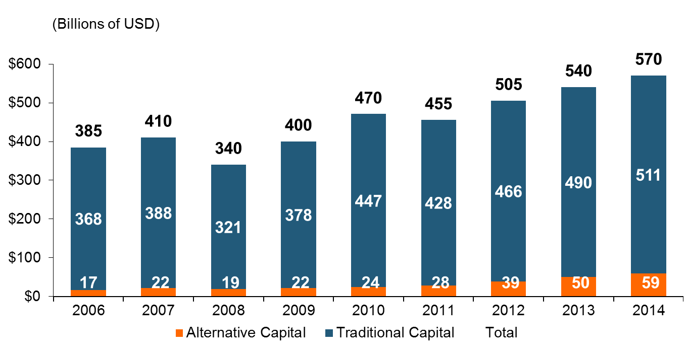
Global Reinsurance Capital (Traditional and Alternative), 2006 - 2014
Total reinsurance capital reached a record $570B in 2013, up 68% from 2008.
But alternative capacity has grown 210% since 2008, to $50B. It has more than doubled in the past three years.
2014 data is as of June 30, 2014.
Source: Aon Benfield Analytics; Insurance Information Institute.

Slide 72
Alternative Capital as a Percentage of Traditional Global Reinsurance Capital
Alternative Capital’s Share of Global Reinsurance Capital Has More Than Doubled Since 2010.
2014 data is as of June 30, 2014.
Source: Aon Benfield Analytics; Insurance Information Institute.

Slide 73
Catastrophe Bond Issuance and Outstanding: 1997-2015
Risk Capital Amount ($ Millions)
Cat Bond Issuance Declined Slightly in 2015 from 2014’s Record Pace. Lower Yields on Bonds Explain Some of the Contraction.
Source: Guy Carpenter, Artemis accessed at http://www.artemis.bm/deal_directory/cat_bonds_ils_issued_outstanding.html .

Slide 74
US Property CAT Rate on Line Index & Global Reinsurance ROE
US Property CAT ROL
Global Reinsurance ROE
Record traditional capacity, alternative capital and low CAT activity have pressured reinsurance prices; ROEs are own only very modestly
Source: Barclays PLC from Guy Carpenter; Insurance Information Institute.

Slide 75
GLOBAL M&A UPDATE:
A PATH TO GROWTH?
Are Capital Accumulation, Drive for Growth and Scale Stimulating M&A Activity?
75

Slide 76
U.S. INSURANCE MERGERS AND ACQUISITIONS,
P/C SECTOR, 1994-2015E (1)
M&A activity in 2015 will likely reach its highest level since 1998. Globally, across all sectors, M&A activity exceeded $200B
($ Millions)
M&A activity in the P/C sector was up sharply in 2015
(1) Includes transactions where a U.S. company was the acquirer and/or the target.
Source: Conning proprietary database; 2015 I.I.I. estimate.

Slide 77
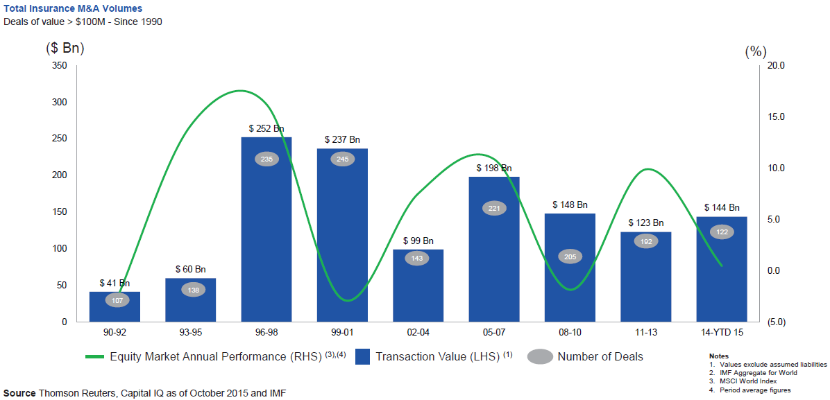
Global M&A Activity Tends to Follow Equity Market Performance
The number and volume of insurance M&A deals was up globally in 2015
.
Source: Thomson Reuters, Capital IQ as of Oct. 2015 and IMF from Geneva Association Newsletter Insurance and Finance, Jan. 2016, presentation “Facts vs. Sentiment: Deals in the Insurance Sector,” by Aviva CEO Mark Wilson.

Slide 78
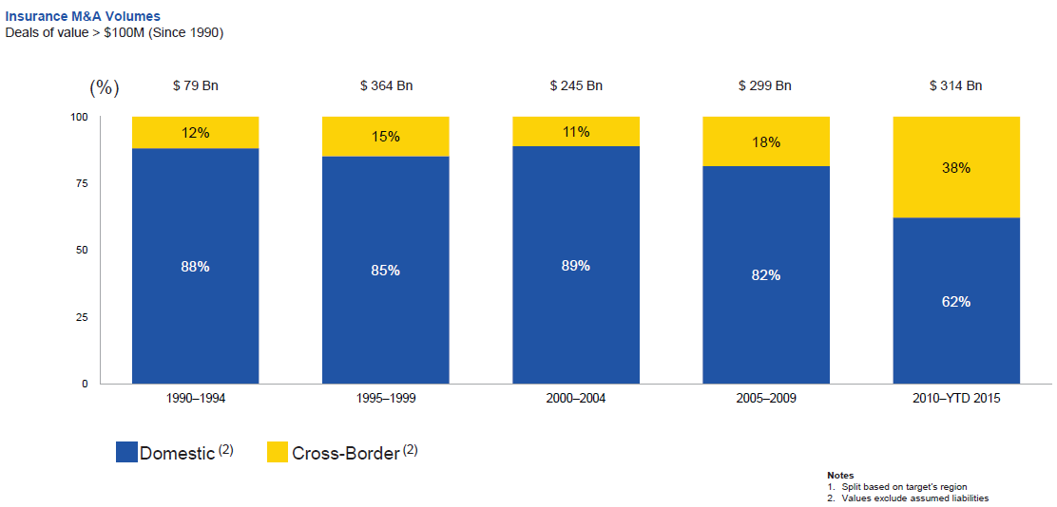
Huge Shift from Domestic M&A Activity to Cross-Border
The share of M&A deal volume that was cross-border more than doubled in 2015
.
Source: Thomson Reuters as of Oct. 2015 from Geneva Association Newsletter Insurance and Finance, Jan. 2016, presentation “Facts vs. Sentiment: Deals in the Insurance Sector,” by Aviva CEO Mark Wilson.

Slide 79
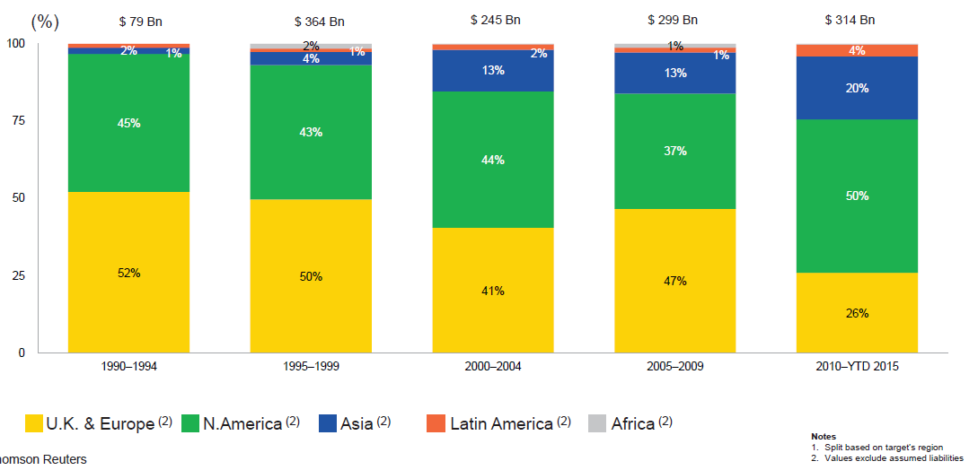
M&A Activity Has Shifted Away from Europe and Towards Asia and N. America
Asian, N. American deal volumes were up sharply in 2015
.
Source: Thomson Reuters as of Oct. 2015 from Geneva Association Newsletter Insurance and Finance, Jan. 2016, presentation “Facts vs. Sentiment: Deals in the Insurance Sector,” by Aviva CEO Mark Wilson.

Slide 80
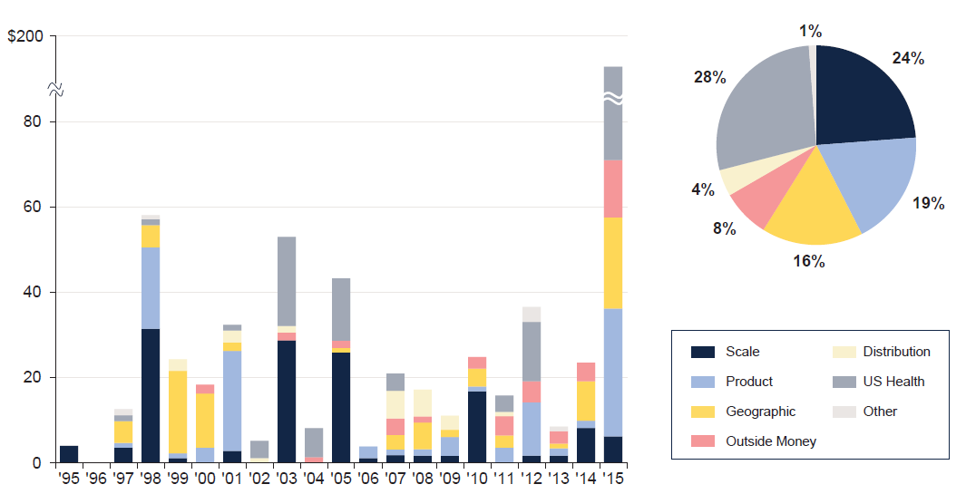
M&A: Deal Rationale by Dollar Amount
Scale drives most deals (excluding health sector)
Source: SNL Financial and WCMA estimates from Geneva Association Newsletter Insurance and Finance, Jan. 2016, presentation “What is the Logic Behind Consolidation? And Does It Create Value? A View from Outside,” by Brian Shea, Head of Willis Capital Markets & Advisory Europe (WCMA).
.

Slide 81
Growth
Premium Growth Rates Vary Tremendously by State and Over Time, But…
81

Slide 82
Net Premium Growth (All P/C Lines): Annual Change, 1971—2015:Q3P
(Percent)
1975-78
1984-87
2000-03
Net Written Premiums Fell 0.7% in 2007 (First Decline Since 1943) by 2.0% in 2008, and 4.2% in 2009, the First 3-Year Decline Since 1930-33.
Outlook
2016F: 4.0%
2017F: 3.8%
2015:Q3: 4.1%
2014: 4.1%
2013: 4.4%
2012: +4.2%
Shaded areas denote “hard market” periods
Sources: A.M. Best (1971-2013), ISO (2014-15).

Slide 83
NPW Premium Growth: Peaks & Troughs in the P/C Insurance Industry, 1926 – 2015E
ROE
Post WW II Peak:
1947: 26.2%
1970-90: Peak premium growth was much higher in this period while troughs were comparable. Rapid inflation, economic volatility, high interest rates, tort environment all played roles
Start of WW II
1941: 15.8%
Economic Shocks, Inflation:
1976: 22.0%
Tort Crisis
1985/86: 22.2%
Post-9/11
2002:15.3%
1988-2000: Period of inter-cycle stability
2015E 4.1%
1950-70: Extended period of stability in growth and profitability. Low interest rates, low inflation, “Bureau” rate regulation all played a role
2010-20XX? Post-recession period of stable growth?
Twin Recessions; Interest Rate Hikes
1987: 3.7%
Great Recession:2010: -4.9%
Great Depression
1932: -15.9% max drop
Note: Data through 1934 are based on stock companies only. Data include state funds beginning in 1998.
Source: A.M. Best; Insurance Information Institute.

Slide 84
Direct Premiums Written: Total P/C
Percent Change by State, 2007-2014
Top 25 States
North Dakota was the country’s growth leader over the past 7 years with premiums written expanding by 70.7%, fueled by the state’s energy boom
Growth Benchmarks: Total P/C
US: 13.0%
Sources: SNL Financial LC.; Insurance Information Institute.

Slide 85
Direct Premiums Written: Total P/C
Percent Change by State, 2007-2014
Bottom 25 States
Growth was negative in 4 states and DC between 2007 and 2014
Sources: SNL Financial LC.; Insurance Information Institute.

Slide 86
Direct Premiums Written: Comm. Lines
Percent Change by State, 2007-2015
Top 25 States
44 states showed commercial lines growth from 2007 through 2015
Growth Benchmarks: Commercial
US: 9.0%
Sources: NAIC via SNL Financial; Insurance Information Institute.

Slide 87
Direct Premiums Written: Comm. Lines
Percent Change by State, 2007-2015
Bottom 25 States
Eight states write less commercial business than they did in 2007
Sources: NAIC via SNL Financial; Insurance Information Institute.

Slide 88
Pricing Trends
Personal Lines Pricing Is Up
Survey Results Suggest Commercial Pricing Has Flattened Out
88

Slide 89
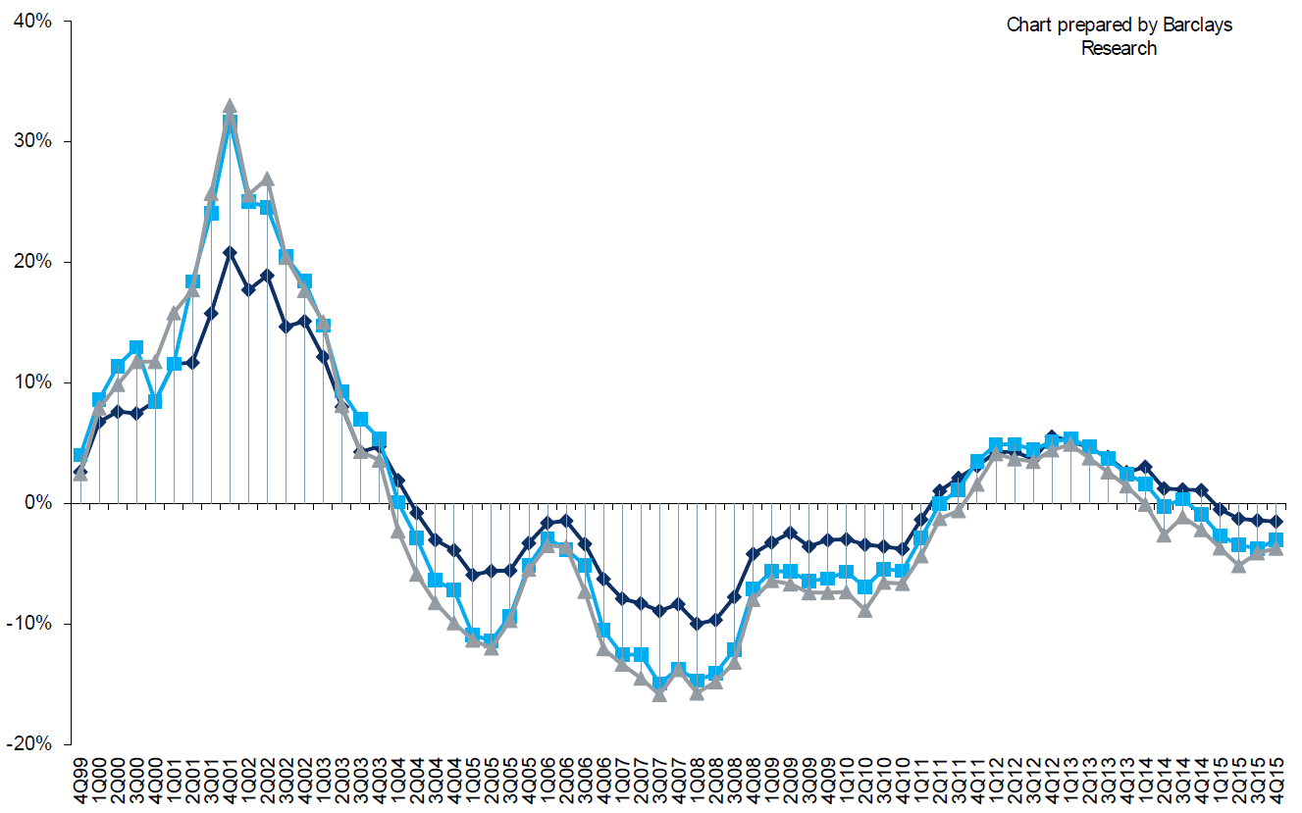
Change in Commercial Rate Renewals, by Account Size: 1999:Q4 to 2015:Q4
Percentage Change (%)
Peak = 2001:Q4 +28.5%
Pricing turned positive in Q3:2011, the first increase in nearly 8 years; Q4:2015 renewals were down 2.8%; Some insurers posted stronger numbers.
Pricing Turned Negative in Early 2004 and Remained that way for 7 ½ years
KRW : No Lasting Impact
Trough = 2007:Q3 -13.6%
Source: Council of Insurance Agents and Brokers; Barclay’s Capital; Insurance Information Institute.
Note: CIAB data cited here are based on a survey. Rate changes earned by individual insurers can and do vary, potentially substantially.

Slide 90
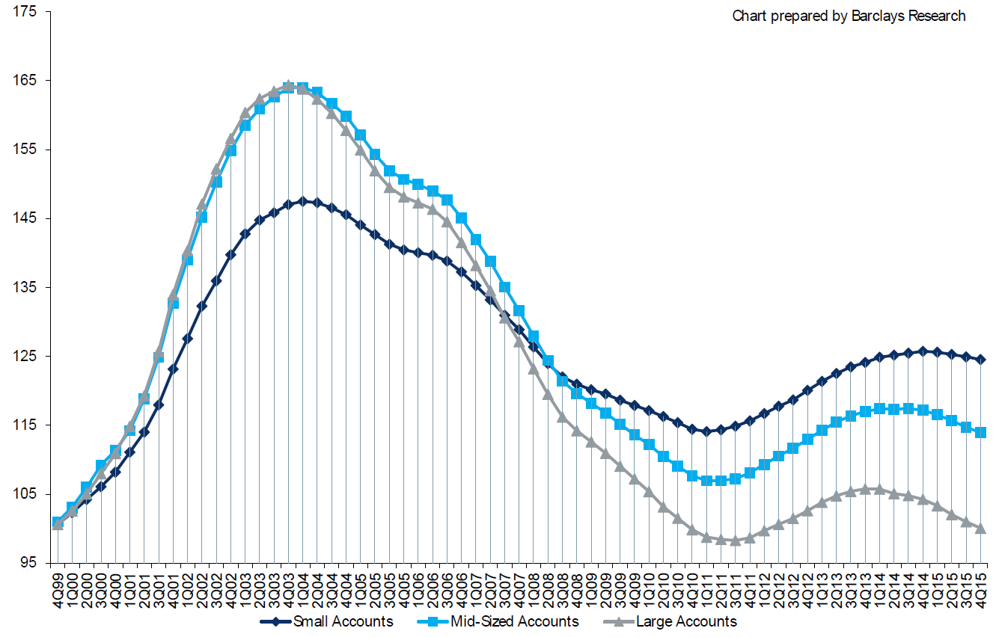
Cumulative Qtrly. Commercial Rate Changes, by Account Size: 1999:Q4 to 2015:Q4
1999:Q4 = 100
Pricing for smaller accounts has more stable than for larger accounts
Note: CIAB data cited here are based on a survey. Rate changes earned by individual insurers can and do vary, potentially substantially.
Source: Council of Insurance Agents and Brokers; Barclay’s Capital; Insurance Information Institute.

Slide 91
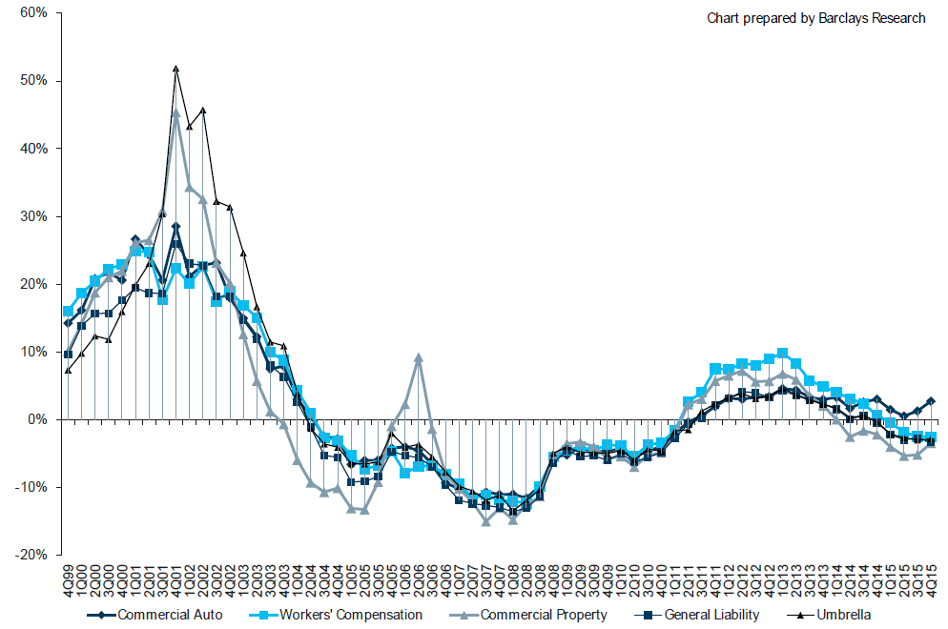
Change in Commercial Rate Renewals, by Line: 1999:Q4 to 2015:Q4
Percentage Change (%)
Peak = 2001:Q4
Commercial Auto is currently experiencing the strongest rate trend, supplanting WC
Source: Council of Insurance Agents and Brokers; Barclay’s Capital; Insurance Information Institute.
Note: CIAB data cited here are based on a survey. Rate changes earned by individual insurers can and do vary, potentially substantially.

Slide 92
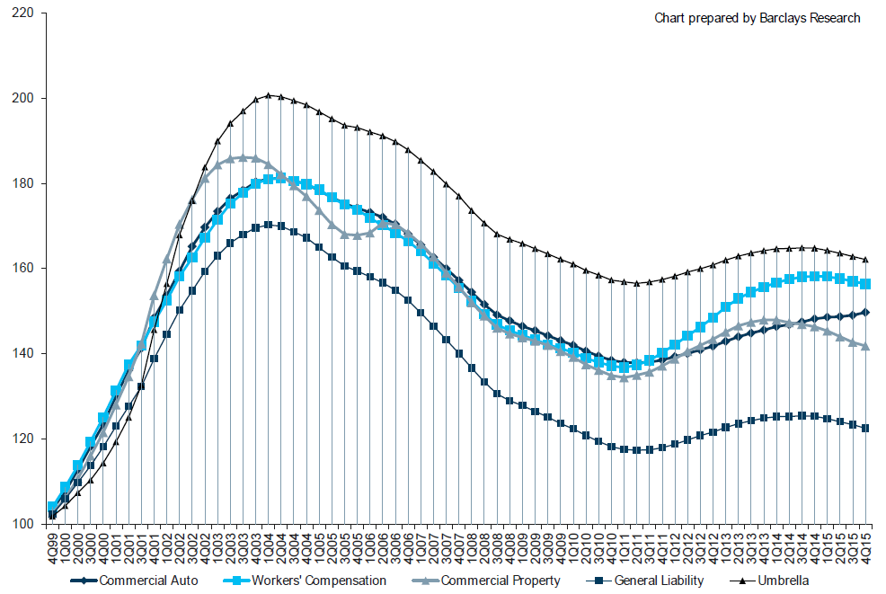
Cumulative Qtrly. Rate Changes, by Line: 1999:Q4 to 2015:Q4
1999:Q4 = 100
Commercial Auto is currently experiencing the strongest rate trend, supplanting WC
Note: CIAB data cited here are based on a survey. Rate changes earned by individual insurers can and do vary, potentially substantially.
Source: Council of Insurance Agents and Brokers; Barclay’s Capital; Insurance Information Institute.

Slide 93
CIAB: Average Commercial Rate Change, All Lines, (1Q:2004–4Q:2015)
(Percent)
Q2 2011 marked the last of 30th consecutive quarter of price declines
Pricing as of Q4:2015 remained somewhat negative
KRW Effect
Note: CIAB data cited here are based on a survey. Rate changes earned by individual insurers can and do vary, potentially substantially.
Source: Council of Insurance Agents & Brokers; Insurance Information Institute

Slide 94
Change in Commercial Rate Renewals, by Line: 2015:Q4
Commercial Auto rate increases are larger than any other line, followed by D&O and EPL
Percentage Change (%)
Major Commercial Lines Renewals Were Mixed to Down in Q4:2015; EPL, D&O and Commercial Auto Saw Gains
Note: CIAB data cited here are based on a survey. Rate changes earned by individual insurers can and do vary, potentially substantially.
Source: Council of Insurance Agents and Brokers; Insurance Information Institute.

Slide 95
How the Risk Dollar is Spent
(U.S. Firms with Revenues Under $1 Bill)
Source: 2015 RIMS Benchmark Survey; Insurance Information Institute.
95
Notes:
95

Slide 96
Underwriting Performance
96
Notes:
96

Slide 97
Florida Citizens Policy Count, 2003 – 2015* (Thousands)
Florida Citizen’s policy count is down by nearly 900,000 (61%) from its 2011 peak
A lack of major hurricanes, ample private sector/reinsurer capital and capital market interest—combined with structural changes to Citizens—have combined to take Citizens policy count and exposure to their lowest levels in many years
*As of October 6, 2015. All other figures are as of Dec. 31.
Source: Florida Citizens https://www.citizensfla.com/about/bookofbusiness/; Insurance Information Institute (I.I.I.).
Notes:
97

Slide 98
Commercial Lines Combined Ratio, 1990-2017F*
Commercial lines underwriting performance improved in 2013/14 but higher cats, diminishing prior year reserves and rising loss cost trends in some lines could push combined ratios higher
*2007-2012 figures exclude mortgage and financial guaranty segments.
Source: A.M. Best (1990-2014); Conning (2015E-17F) Insurance Information Institute.

Slide 99
Commercial Auto Combined Ratio: 1993–2017F
Commercial Auto Results Are Challenged as Rate Gains Barely Have Yet to Offset Adverse Frequency and Severity Trends
Sources: A.M. Best (1990-2014);Conning (2015E-2017F); Insurance Information Institute.

Slide 100
Collision Coverage: Severity & Frequency Trends Are Both Higher in 2015*
Annual Change, 2005 through 2015*
The Recession, High Fuel Prices Helped Temper Frequency and Severity, But this Trend Has Clearly Reversed, Consistent with Experience from Past Recoveries
*2015 figure is for the 4 quarters ending with 2015:Q3.
Source: ISO/PCI Fast Track data; Insurance Information Institute

Slide 101
Commercial Property Combined Ratio:
2007–2017F
Commercial Property Underwriting Performance Has Improved in Recent Years, Largely Due to Diminished CAT Activity
Source: Conning Research and Consulting.

Slide 102
General Liability Combined Ratio:
2005–2017F
Commercial General Liability Underwriting Performance Has Been Volatile in Recent Years
Source: Conning Research and Consulting.

Slide 103
Commercial Multi-Peril Combined Ratio: 1995–2017F
Commercial Multi-Peril Underwriting Performance is Expected to Deteriorate Slightly in the 2015 - 2017 Period Assuming Normal Catastrophe Loss Activity
*2015E-2017F figures are Conning figures for the combined liability and non-liability components.
Sources: A.M. Best; Conning; Insurance Information Institute.

Slide 104
Inland Marine Combined Ratio:
2004–2017F
Inland Marine Underwriting Performance Has Been Consistently Strong for Many Years
Source: A.M. Best (2004-2014); Conning Research and Consulting (2015F-2017F).

Slide 105
Medical Malpractice Combined Ratio vs. All Lines Combined Ratio, 1991-2017F
MPL insurers in 2015 paid out an estimated $1.04 in loss and expense for every $1 they earned in premiums
The dramatic improvement over the past decade has restored MPL’s viability, though some deterioration has occurred and is expected to continue
In 2001, med mal insurers paid out $1.55 for every dollar earned
Source: AM Best (1991-2014); Conning (2015-17F) Insurance Information Institute.

Slide 106
Workers Compensation Combined Ratio: 1994–2016F
WC results have improved markedly since 2011
Workers Comp Results Began to Improve in 2012. Underwriting Results Deteriorated Markedly from 2007-2010/11 and Were the Worst They Had Been in a Decade.
Sources: A.M. Best (1994-2009); NCCI (2010-2014P) and are for private carriers only; Insurance Information Institute (2015-16F).

Slide 107
Workers Compensation Operating Environment
Workers Comp Results Have Improved Substantially in Recent Years
107

Slide 108
Workers Compensation Combined Ratio: 1994–2016F
WC results have improved markedly since 2011
Workers Comp Results Began to Improve in 2012. Underwriting Results Deteriorated Markedly from 2007-2010/11 and Were the Worst They Had Been in a Decade.
Sources: A.M. Best (1994-2009); NCCI (2010-2014P) and are for private carriers only; Insurance Information Institute (2015-16F).

Slide 109
Unemployment and Underemployment Rates: Still Falling
January 2000 through December 2015, Seasonally Adjusted (%)
For U-6, 8% to 10% is “normal.”
U-6 went from 8.0% in March 2007 to 17.5% in
October 2009
U-6 was 9.9% in Dec. 2015.
“Headline” unemployment was 5.0% in December 2015. 4% to 6% is “normal.”
High unemployment and underemployment still constrain overall economic growth, but the job market is now clearly improving.
Source: US Bureau of Labor Statistics; Insurance Information Institute.
109
12/01/09 - 9pm
eSlide – P6466 – The Financial Crisis and the Future of the P/C
Notes:
109

Slide 110
Nonfarm Payroll (Wages and Salaries):
Quarterly, 2005–2015:Q3
Billions
Latest (2015:Q3) was $7.90 trillion, a new peak--$1.34 trillion above 2009 trough
Prior Peak was 2008:Q3 at $6.54 trillion
Growth rates
2011:Q1 over 2010:Q1: 5.5%
2012:Q1 over 2011:Q1: 4.2%
2013:Q1 over 2012:Q1: 2.5%
2014:Q1 over 2013:Q1: 4.3%
2015:Q3 over 2014:Q3: 5.1%
Recent trough (2009:Q1) was $6.23 trillion, down 5.3% from prior peak
Note: Recession indicated by gray shaded column. Data are seasonally adjusted annual rates.
Sources: http://research.stlouisfed.org/fred2/series/WASCUR; National Bureau of Economic Research (recession dates); Insurance Information Institute.
110
12/01/09 - 9pm
eSlide – P6466 – The Financial Crisis and the Future of the P/C
Notes:
110

Slide 111
Payroll vs. Workers Comp Net Written Premiums, 1990-2015E
Payroll Base* WC NWP
$Billions $Billions
7/90-3/91
3/01-11/01
12/07-6/09
WC premium volume dropped two years before the recession began
WC net premiums written were down $14B or 29.3% to $33.8B in 2010 after peaking at $47.8B in 2005
Continued Payroll Growth and Rate Gains Suggest WC NWP Will Grow Again in 2016
*Private employment; Shaded areas indicate recessions. WC premiums are from NCCI through 2014; I.I.I. estimate for 2015.
Sources: NBER (recessions); Federal Reserve Bank of St. Louis at http://research.stlouisfed.org/fred2/series/WASCUR (annualized as of Q3 2015); NCCI; I.I.I.

Slide 112
Workers Compensation Premium:
Fourth Consecutive Year of Increase
Net Written Premium
$ Billions
p Preliminary
Source: NCCI from Annual Statement Data.
Includes state insurance fund data for the following states: AZ, CA, CO, HI, ID, KY, LA, MD, MO, MT, NM, OK, OR, RI, TX, UT.
Each calendar year total for State Funds includes all funds operating as a state fund that year.
Calendar Year

Slide 113
Direct Premiums Written: Workers’ Comp
Percent Change by State, 2007-2015*
Top 25 States
27 states showed positive growth in the workers comp line from 2007 – 2015 (up from 13 through 2013 and 5 through 2012).
*Excludes monopolistic fund states: ND, OH, WA, WY as well as WV, which transitioned to a competitive structure during this period.
Sources: NAIC data, sourced from S&P Global Market Intelligence; Insurance Information Institute.

Slide 114
Direct Premiums Written: Worker’s Comp
Percent Change by State, 2007-2015*
Bottom 25 States
States with the poorest performing economies also produced some of the most negative net change in premiums of the past 8 years
*Excludes monopolistic fund states: ND, OH, WA, WY as well as WV, which transitioned to a competitive structure during this period.
Sources: NAIC data, sourced from S&P Global Market Intelligence; Insurance Information Institute.

Slide 115
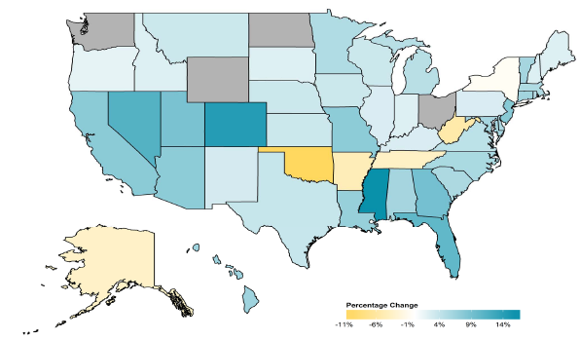
2014 Workers Compensation Direct Written Premium Growth, by State*
PRIVATE CARRIERS: Overall 2014 Growth = +4.6%
While growth rates varied widely, most states experienced positive growth in 2014
*Excludes monopolistic fund states (in gray): OH, ND, WA and WY.
Source: NCCI.

Slide 116
2013 Workers Compensation Direct Written Premium Growth, by State*
PRIVATE CARRIERS: Overall 2013 Growth = +5.4%
While growth rates varied widely, all states experienced positive growth in 2013
*Excludes monopolistic fund states (in white): OH, ND, WA and WY.
Source: NCCI.

Slide 117
Workers Compensation Components of Written Premium Change, 2013 to 2014
Written Premium Change from 2013 to 2014
Net Written Premium—Countrywide | +4.6%
Direct Written Premium—Countrywide | +4.6%
Direct Written Premium—NCCI States | +4.5%
Components of DWP Change for NCCI States
Change in Carrier Estimated Payroll | +4.7%
Change in Bureau Loss Costs and Mix | -1.4%
Change in Carrier Discounting | +0.4%
Change in Other Factors | +0.8%
Combined Effect | +4.5%
Growth is now almost entirely payroll driven
Sources: Countrywide: Annual Statement data.
NCCI States: Annual Statement Statutory Page 14 for all states where NCCI provides ratemaking services.
Components: NCCI Policy data.

Slide 118
WC Approved Changes in Bureau Premium Level (Rates/Loss Costs)
Percent
By Effective Date for Total Market
Cumulative 2000–2003
+17.1%
Cumulative 2011–2014
+11.8%
Cumulative 1994–1999
-27.8%
Cumulative 2004–2011
-30.8%
Cumulative
1990–1993
+36.3%
Approved rates/loss costs are down for the first time since 2010
Calendar Year
*States approved through 4/24/15.
Note: Bureau premium level changes are countrywide approved changes in advisory rates, loss costs and assigned risk rates as filed by applicable rating organization, relative to those previously approved.
Source: NCCI.

Slide 119
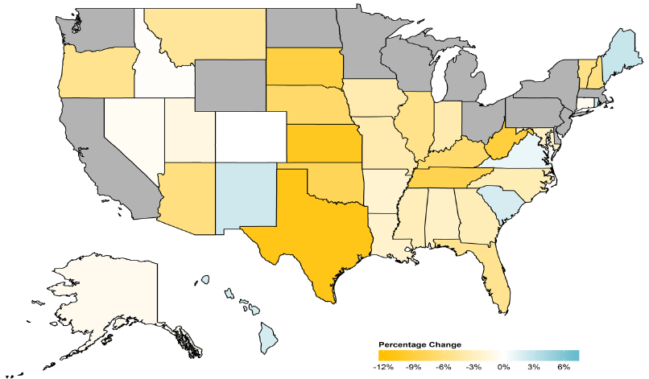
WC Approved or Filed and Pending Change in NCCI Premium Level by State
Latest Change for Voluntary Market
While growth rates varied widely, most states experienced positive growth in 2014
*Excludes monopolistic fund states (in gray): OH, ND, WA and WY.
Source: NCCI.

Slide 120
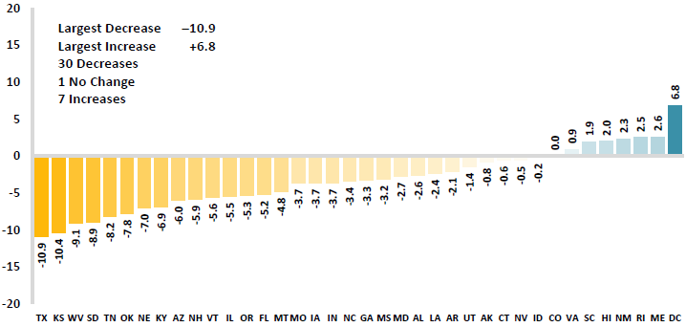
WC Approved or Filed and Pending Change in NCCI Premium Level by State
Latest Change for Voluntary Market
Excludes Law-Only Filings
The majority of states experienced decreases in rates/loss costs over
Note: Premium level changes are approved changes are approved or filed and pending changes in advisory rates, loss costs and rating values as of 4/24/15 as filed by applicable rating organization, relative to those previously approved. SC is filed and pending. IN and NC are in cooperation with state rating bureaus.
Source: NCCI.

Slide 121
Workers Compensation Lost-Time
Claim Frequency Declined in 2014
Percent
Cumulative Change of –51.1%
(1994–2013 adj.)
*Adjustments primarily due to significant audit activity.
2014p: Preliminary based on data valued as of 12/31/2014.
Source: NCCI Financial Call data, developed to ultimate and adjusted to current wage an voluntary loss cost level; Excludes high deductible policies; 1994-2013: Based on data through 12/31/13. Data for all states where NCCI provides ratemaking services, excluding WV.
Frequency is the number of lost-time claims per $1M pure premium at current wage and voluntary loss cost level
Accident Year

Slide 122
Workers Comp Indemnity Claim Costs: Modest Increase in 2014
Average Indemnity Cost per Lost-Time Claim
Indemnity
Claim Cost ($ 000s)
Average indemnity costs per claim were up 4% in 2014 to $23,600, the largest increase since 2008
+1.9%
+4%
Cumulative Change = 141%
(1991-2014p)
Accident Year
2014p: Preliminary based on data valued as of 12/31/2014.
1991-2013: Based on data through 12/31/2013, developed to ultimate
Based on the states where NCCI provides ratemaking services including state funds, excluding WV; Excludes high deductible policies.
Notes:
122
Exhibit 11 of Article

Slide 123
WC Indemnity Severity vs. Wage Inflation, 1995 -2014p
Indemnity severities usually outpace wage gains
Annual Change 1994–2014
Indemnity Claim Sev.: +4.6
US Avg. Weekly Wage: +3.4%
WC indemnity severity turned positive again in 2011
2014p: Preliminary based on data valued as of 12/31/2014; 1991-2010: Based on data through 12/31/2010, developed to ultimate. Based on the states where NCCI provides ratemaking services. Excludes the effects of deductible policies. CPS = Current Population Survey.
Source: NCCI

Slide 124
Workers Compensation Medical Severity:
Moderate Increase in 2014
Medical
Claim Cost ($000s)
Average Medical Cost per Lost-Time Claim
Medical severity for lost time claims was up 4% in 2014, the largest increase since 2009
Annual Change 1991–1993: +1.9%
Annual Change 1994–2001: +8.9%
Annual Change 2002–2010: +6.0%
Cumulative Change = 263%
(1991-2014p)
Accident Year
Accident Year
2014p: Preliminary based on data valued as of 12/31/2014.
1991-2013: Based on data through 12/31/2013, developed to ultimate
Based on the states where NCCI provides ratemaking services including state funds, excluding WV; Excludes high deductible policies.

Slide 125
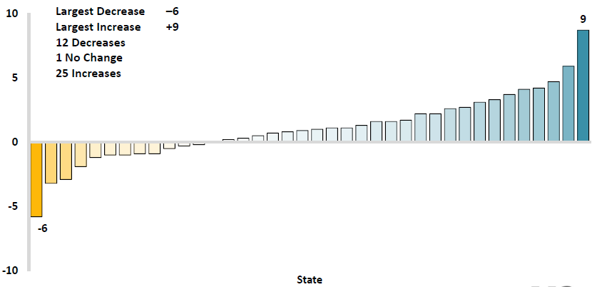
Workers Comp Change in Medical Severity by State, Avg. Annual Change, 2009-2013
Percent
The change in lost-time medical severities from 2009-2013 ranged from a low of -6% to a high of 9%
While growth rates varied widely, most states experienced positive growth in 2014
Source: NCCI’s Analysis of Frequency and Severity of Claims Across the Country as of 12/31/13 on ncci.com.
Values reflect methodology and state data underlying the most recent rate/lost cost filing.
TX changes are for the years 2010-2013.

Slide 126
Annual Inflation Rates, (CPI-U, %),
1990–2016F
Annual Inflation Rates (%)
Inflation peaked at 5.6% in August 2008 on high energy and commodity crisis. The recession and the collapse of the commodity bubble reduced inflationary pressures in 2009/10
Inflationary expectations have slipped (due in part to falling energy costs) allowing the Fed to maintain low interest rates
Slack in the U.S. economy and falling energy prices suggests that inflationary pressures should remain subdued for an extended period of times
Sources: US Bureau of Labor Statistics; Blue Chip Economic Indicators, 5/15 (forecasts).

Slide 127
Workers Compensation
Change in Medical Severity
Comparison to Change in Medical Consumer Price Index (CPI)
Percent Change
Average Annual Change: 1994—2014
Lost-Time Medical Severity: +6.4%
US Medical CPI: +3.7%
Year
2014p: Preliminary based on data valued as of 12/31/2014.
Sources: Severity: 995-2013: Based on data through 12/31/2013, developed to ultimate
Based on the states where NCCI provides ratemaking services including state funds, excluding WV; Excludes high deductible policies.
US Medical CPI: US Bureau of Labor Statistics.

Slide 128
WC Medical Severity Generally Outpaces the Medical CPI Rate
Average annual increase in WC medical severity from 1995 through 2014 was well above the medical CPI (6.4% vs. 3.7%), but the gap has narrowing. Lost-time medical severities appear to on the rise again.
Sources: Med CPI from US Bureau of Labor Statistics, WC med severity from NCCI based on NCCI states.

Slide 129
Medical Cost Inflation vs. Overall CPI, 1995 – 2014*
Though moderating, medical inflation will continue to exceed inflation in the overall economy
Average Annual Growth Average 1995 – 2013
Healthcare: 3.8%
Total Nonfarm: 2.4%
*July 2014 compared to July 2013.
Sources: Med CPI from US Bureau of Labor Statistics, WC med severity from NCCI based on NCCI states.

Slide 130
U.S. Health Care Expenditures,
1965–2022F
$ Billions
From 1965 through 2013, US health care expenditures had increased by 69 fold. Population growth over the same period increased by a factor of just 1.6. By 2022, health spending will have increased 119 fold.
U.S. health care expenditures have been on a relentless climb for most of the past half century, far outstripping population growth, inflation of GDP growth
Sources: Centers for Medicare & Medicaid Services, Office of the Actuary at http://www.cms.gov/Research-Statistics-Data-and-Systems/Statistics-Trends-and-Reports/NationalHealthExpendData/NationalHealthAccountsProjected.html accessed 3/14/14; Insurance Information Institute.

Slide 131
National Health Care Expenditures as a Share of GDP, 1965 – 2022F*
% of GDP
Health care expenditures as a share of GDP rose from 5.8% in 1965 to 18.0% in 2013 and are expected to reach 19.9% of GDP by 2022
2022 19.9%
2010: 17.9%
2000: 13.8%
1990: 12.5%
Since 2009, heath expenditures as a % of GDP have flattened out at about 18%--the question is why and will it last?
1980: 9.2%
1965 5.8%
Sources: Centers for Medicare & Medicaid Services, Office of the Actuary at http://www.cms.gov/Research-Statistics-Data-and-Systems/Statistics-Trends-and-Reports/NationalHealthExpendData/NationalHealthAccountsProjected.html accessed 3/14/14; Insurance Information Institute.

Slide 132
Insured Catastrophe Losses
2013/14 and2015 Experienced Below Average CAT Activity After Very High CAT Losses in 2011/12
Winter Storm Losses Far Above Average in 2014 and 2015
132

Slide 133
U.S. Insured Catastrophe Losses
($ Billions, $ 2015)
2012 was the 3rd most expensive year ever for insured CAT losses
2013/14/15 Were Welcome Respites from 2011/12, among the Costliest Years for Insured Disaster Losses in US History. Longer-term Trend is for more—not fewer—Costly Events
$15B in insured CAT losses though 12/31/15 (est.)
*Estimate through 12/31/15 in 2015 dollars.
Note: 2001 figure includes $20.3B for 9/11 losses reported through 12/31/01 ($25.9B 2011 dollars). Includes only business and personal property claims, business interruption and auto claims. Non-prop/BI losses = $12.2B ($15.6B in 2011 dollars.)
Sources: Property Claims Service/ISO; Insurance Information Institute.
133
12/01/09 - 9pm
eSlide – P6466 – The Financial Crisis and the Future of the P/C
Notes:
133

Slide 134
Combined Ratio Points Associated with Catastrophe Losses: 1960 – 2016F*
Avg. CAT Loss Component of the Combined Ratio by Decade
1960s: 1.04 1970s: 0.85 1980s: 1.31 1990s: 3.39 2000s: 3.52 2010s: 5.47*
Catastrophe losses as a share of all losses reached a record high in 2011
Combined Ratio Points
The Catastrophe Loss Component of Private Insurer Losses Has Increased Sharply in Recent Decades
*2010s represent 2010-2015.
Notes: Private carrier losses only. Excludes loss adjustment expenses and reinsurance reinstatement premiums. Figures are adjusted for losses ultimately paid by foreign insurers and reinsurers.
Source: ISO (1960-2009); A.M. Best (2010-16E) Insurance Information Institute.

Slide 135
Top 16 Most Costly Disasters in U.S. History—Katrina Still Ranks #1
(Insured Losses, 2014 Dollars, $ Billions)
Storm Sandy in 2012 was the last mega-CAT to hit the US
Includes Tuscaloosa, AL, tornado
Includes Joplin, MO, tornado
12 of the 16 Most Expensive Events in US History Have Occurred Since 2004
Sources: PCS; Insurance Information Institute inflation adjustments to 2014 dollars using the CPI.

Slide 136
Inflation Adjusted U.S. Catastrophe Losses by Cause of Loss, 1995–2014¹
Wind/Hail/Flood (3), $21.4
Fires (4), $6.0
Winter storm losses were much above average in 2014/15 are will push this share up
Other (5), $0.2
Insured cat losses from 1995-2014 totaled $395.6B, an average of $19.8B per year or $1.65B per month
Geological Events, $0.5
Terrorism, $24.5
Winter Storms, $26.9
Hurricanes & Tropical Storms, $161.2
Tornado share of CAT losses is rising
Wind losses are by far cause the most catastrophe losses, even if hurricanes/TS are excluded.
Events Involving Tornadoes (2), $154.9
Catastrophes are defined as events causing direct insured losses to property of $25 million or more in 2014 dollars.
Excludes snow.
Does not include NFIP flood losses
Includes wildland fires
Includes civil disorders, water damage, utility disruptions and non-property losses such as those covered by workers compensation.
Source: ISO’s Property Claim Services Unit.

Slide 137
Number of National Flood Insurance Program Policies in Force at Year-End, 1980-2015*
(millions)
The number of NFIP policies in force has plunged by 549,000 or 9.6% since 2009, even as coastal development surges and sea levels rise
Source: National Flood Insurance Program.
* As of July, 2015

Slide 138
Take-Up Rates for Various Types of Insurance in the U.S.
Take-Up Rate
Take-up rates vary widely by type of coverage
Sources: CA Earthquake (WSJ, http://www.wsj.com/articles/california-pushes-homeowners-to-insure-against-earthquakes-1440980138 ); Flood and Renters (I.I.I. June 2015 Pulse Survey); Cyber (Advisen, 2015); Terrorism (Marsh Global Analytics, 2014 Terrorism Risk Insurance Report, April 2014; data for 2013); Pvt. Passenger Auto (Insurance Research Council, Uninsured Motorists, 2014 Edition, data for 2012); Home and Workers Comp (I.I.I. estimates); Insurance Information Institute research.

Slide 139
THE ECONOMY
The Strength of the Economy Will Greatly Influence Insurer Exposure Base Across Most Lines
139

Slide 140
US Real GDP Growth*
The Q4:2008 decline was the steepest since the Q1:1982 drop of 6.8%
Real GDP Growth (%)
Recession began in Dec, 2007
Q1 2014/15 GDP data were hit hard by this year’s “Polar Vortex” and harsh winter
Demand for Insurance Should Increase in 2016 as GDP Growth Continues at a Steady, Albeit Moderate Pace and Gradually Benefits the Economy Broadly
* Estimates/Forecasts from Blue Chip Economic Indicators.
Source: US Department of Commerce, Blue Economic Indicators 2/16; Insurance Information Institute.

Slide 141
2016-2021 Real GDP Growth:
Median Forecast for the US
Top 10 Avg.: 2.6%
Bot 10 Avg.: 1.8%
Top 10 Avg.: 2.8%
Bot 10 Avg.: 2.0%
Top 10 Avg.: 2.8%
Bot 10 Avg.: 1.7%
Top 10 Avg.: 2.6%
Bot 10 Avg.: 1.7%
Top 10 Avg.: 2.7%
Bot 10 Avg.: 1.6%
Top 10 Avg.: 2.5%
Bot 10 Avg.: 1.8%
All forecasts expect US growth to be moderate in 2016-18
and to slow in the last years of the decade,
perhaps expecting a recession in that time frame.
Sources: Blue Chip Economic Indicators, Feb. 2016 issue for 2016-2017; Oct. 2015 issue for 2018-2021; I.I.I.

Slide 142
Real GDP by State Percent Change, 2014*:
Highest 25 States
North Dakota was the economic growth juggernaut of the US in 2014—by far
Only 7 states experienced growth in excess of 3% in 2014, which is a growth rate we would see nationally in a more typical recovery
Growth Benchmarks: Real GDP
US: 2.2%
*Advance statistics
Sources: U.S. Bureau of Economic Analysis; Insurance Information Institute.

Slide 143
Real GDP by State Percent Change, 2014*:
Lowest 25 States
Growth rates in 16 states were still below 1% in 2014
Mississippi and Alaska were the only states to shrink in 2014
*Advance statistics
Sources: US Bureau of Economic Analysis; Insurance Information Institute.

Slide 144
US Unemployment Rate Forecast
Rising unemployment
eroded payrolls
and WC’s
exposure base.
Unemployment peaked at 10% in late 2009.
2007:Q1 to 2017:Q4F*
Jobless figures have been revised downwards for 2016
Unemployment forecasts have been revised modestly downwards. Optimistic scenarios put the unemployment as low as 4.4% by Q4 of 2016.
* = actual; = forecasts
Sources: US Bureau of Labor Statistics; Blue Chip Economic Indicators (4/16 edition); Insurance Information Institute.

Slide 145
Unemployment Rates by State, March 2016:
Highest 25 States*
In March, 21 states had over-the-month unemployment rate decreases, 15 states had increases, and 14 states and the District of Columbia had no change.
Residual impacts of the housing collapse, weak economies are holding back several states
*Provisional figures for March 2016, seasonally adjusted.
Sources: US Bureau of Labor Statistics; Insurance Information Institute.

Slide 146
Unemployment Rates by State, March 2016:
Lowest 25 States*
In March, 21 states had over-the-month unemployment rate decreases, 15 states had increases, and 14 states and the District of Columbia had no change.
Strength in Energy, Agricultural States-most also avoided housing bust
*Provisional figures for March 2016, seasonally adjusted.
Sources: US Bureau of Labor Statistics; Insurance Information Institute.

Slide 147
CONSTRUCTION INDUSTRY OVERVIEW & OUTLOOK
The Construction Sector Is Critical to the Economy and the P/C Insurance Industry
147

Slide 148
Value of New Private Construction: Residential & Nonresidential, 2003-2015*
2015: Value of new pvt. construction hits $828.2B as of Nov. 2015, up 65.4% from the 2010 trough but still 9.1% below 2006 peak
New Construction peaks at $911.8. in 2006
Billions of Dollars
Trough in 2010 at $500.6B, after plunging 55.1% ($411.2B)
$15.0
$613.7
$400.3
$298.1
$261.8
$427.9
$238.8
Private Construction Activity Is Moving in a Positive Direction though Remains Well Below Pre-Crisis Peak; Residential Dominates
*2015 figure is a seasonally adjusted annual rate as of November.
Sources: US Department of Commerce http://www.census.gov/construction/c30/c30index.html ; Insurance Information Institute.
148
12/01/09 - 9pm
eSlide – P6466 – The Financial Crisis and the Future of the P/C
Notes:
148

Slide 149
Value of Construction Put in Place, 2015 vs. 2014*
Growth (%)
Private: +12.1%
Public: +6.0%
Private sector construction activity is up in both the residential and nonresidential segments
Public sector construction activity is finally beginning to create less drag up after years of decline
Overall Construction Activity is Up Again After Languishing in Early 2015; State/Local Sector Government Sector May Be Recovering as Budget Woes Ease in Some Jurisdictions
*seasonally adjusted data through November.
Source: U.S. Census Bureau, http://www.census.gov/construction/c30/c30index.html ; Insurance Information Institute.

Slide 150
Value of Private Construction Put in Place, by Segment, 2015 vs. 2014*
Led by the Manufacturing, Lodging, Communications and Amusement & Recreations segments, Private nonresidential sector construction activity continues to rise after plunging during the “Great Recession.”
Growth (%)
Private Construction Activity is Up in Most Segments in the Second Half of 2015; Expansion Should Continue
*seasonally adjusted through Nov. 2015.
Source: U.S. Census Bureau, http://www.census.gov/construction/c30/c30index.html ; Insurance Information Institute.

Slide 151
New Private Housing Starts, 1990-2021F
Job growth, low inventories of existing homes, still-low mortgage rates and demographics should continue to stimulate new home construction for several more years
(Millions of Units)
New home starts plunged 72% from 2005-2009; A net annual decline of 1.49 million units, lowest since records began in 1959
Insurers Are Continue to See Meaningful Exposure Growth in the Wake of the “Great Recession” Associated with Home Construction: Construction Risk Exposure, Surety, Commercial Auto; Potent Driver of Workers Comp Exposure
Source: U.S. Department of Commerce; Blue Chip Economic Indicators (2/16 for 2016-17; 10/15 for 2018-21F; Insurance Information Institute.

Slide 152
Value of Public Construction Put in Place, by Segment, Nov. 2015 vs. Nov. 2014*
Public sector construction activity finally up in most segments after many months of decline, pushing up public entity risk exposures
Growth (%)
Residential, Commercial and Conservation lead public sector construction
Public Construction Activity is Beginning to Recover from its Long Contraction which Will Drive Demand in Many Commercial Insurance Lines
*seasonally adjusted
Source: U.S. Census Bureau, http://www.census.gov/construction/c30/c30index.html ; Insurance Information Institute.

Slide 153
Value of New Federal, State and Local Government Construction: 2003-2015*
Construction across all levels of government peaked at $314.9B in 2009
Austerity Reigns
Govt. construction MAY finally be turning around; still down $20.5B or 6.5% since 2009 peak
($ Billions)
Government Construction Spending Peaked in 2009, Helped by Stimulus Spending, but Contracted As State/Local Governments Grappled with Deficits and Federal Sequestration; Only Now Recovering
*2015 figure is a seasonally adjusted annual rate as of November; http://www.census.gov/construction/c30/historical_data.html
Sources: US Department of Commerce; Insurance Information Institute.

Slide 154
Construction Employment,
Jan. 2010—Dec. 2015*
(Thousands)
Construction employment is +1.103 million above
Jan. 2011 (+20.2%) trough
Construction and manufacturing employment constitute 1/3 of all WC payroll exposure.
*Seasonally adjusted.
Sources: US Bureau of Labor Statistics at http://data.bls.gov; Insurance Information Institute.
154
12/01/09 - 9pm
eSlide – P6466 – The Financial Crisis and the Future of the P/C
Notes:
154

Slide 155
Construction Employment,
Jan. 2003–Dec. 2015
(Thousands)
Construction employment as of Dec. 2015 totaled 6.538 million, an increase of 1.103MM jobs or 20.2% from the Jan. 2011 trough
Construction employment peaked at 7.726 million in April 2006
Gap between pre-recession construction peak and today: 1.19 million jobs
The “Great Recession” and housing bust destroyed 2.3 million constructions jobs
Construction employment troughed at 5.435 million in Jan. 2011, after a loss of 2.291 million jobs, a 29.7% plunge from the April 2006 peak
The Construction Sector Was a Growth Leader in 2014-15 as the Housing Market, Private Investment and Govt. Spending Recover. WC Insurers Will Benefit.
Note: Recession indicated by gray shaded column.
Sources: U.S. Bureau of Labor Statistics; Insurance Information Institute.
155
12/01/09 - 9pm
eSlide – P6466 – The Financial Crisis and the Future of the P/C
Notes:
155

Slide 156
Rental-Occupied Housing Units as % of Total Occupied Units, Quarterly, 1990:Q1-2015:Q1
Trend down began in 1994:Q3 from 36.2% in Q2
Increasing percent of renters
Increasing percent of owners
Latest was 36.3% in 2015:Q1
Trough in 2004:Q2 and Q4 at 30.8%
Since the Great Recession ended in June 2009, renters occupied 5.7 million more units (+15.6%).
Sources: US Census Bureau, Residential Vacancies & Home Ownership in the First Quarter of 2015 (released April 28, 2015) and earlier issues; Insurance Information Institute. Next Census Bureau report to be released on July 28, 2015.
156
12/01/09 - 9pm
eSlide – P6466 – The Financial Crisis and the Future of the P/C
Notes:
156

Slide 157
MANUFACTURING SECTOR OVERVIEW & OUTLOOK
The U.S. Manufacturing Sector Is Being Buffeted by a High Dollar, Weak Export Markets and Plunging Oil Prices
157

Slide 158
Dollar Value* of Manufacturers’ Shipments Monthly, Jan. 1992—December 2015
$ Millions
The value of Manufacturing Shipments in Dec. 2015 was $467.0B—down 8% from the July 2014 record high of $508.1B
Monthly shipments in Nov. 2014 exceeded the pre-crisis (July 2008) peak but has declined in recent months. Weakness abroad, falling energy prices and a strong dollar are hurting the sector, especially exports. Manufacturing growth leads to gains in many commercial exposures: WC, Commercial Auto, Marine, Property, and various Liability Coverages.
* Seasonally adjusted; Data published Feb. 4, 2016.
Source: U.S. Census Bureau, Full Report on Manufacturers’ Shipments, Inventories, and Orders, http://www.census.gov/manufacturing/m3/
158
12/01/09 - 9pm
eSlide – P6466 – The Financial Crisis and the Future of the P/C
Notes:
158

Slide 159
ISM Manufacturing Index
(Values > 50 Indicate Expansion)
January 2010 through December 2015
Manufacturing began to contract in late 2015
The manufacturing sector expanded for 68 of the 72 months from Jan. 2010 through Dec. 2015. Manufacturing sector now appears to be in contraction due to weakness abroad, strong dollar and collapse in oil prices
Source: Institute for Supply Management at http://www.ism.ws/ismreport/mfgrob.cfm; Insurance Information Institute.

Slide 160
Manufacturing Growth for Selected Sectors, 2015 vs. 2014*
Growth (%)
Durables: +1.8%
Non-Durables: -9.6%
Manufacturing of non-durable goods is weaker than for durables
Manufacturing Is Contracting Across a Number of Sectors, Especially Petroleum. Adverse Exposure Impacts Are Likely for: WC, Commercial Property, Commercial Auto and Certain Liability Coverages
*Seasonally adjusted; Date are YTD comparing data through November 2015 to the same period in 2014.
Source: U.S. Census Bureau, Full Report on Manufacturers’ Shipments, Inventories, and Orders, http://www.census.gov/manufacturing/m3/

Slide 161
Manufacturing Employment,
Jan. 2003–December 2015
(Thousands)
Manufacturing employment hit a trough at 11.45 million in Feb. and Mar. 2010
Latest (Dec 2015) at 12.33 million
Manufacturing employment was declining, slowly, before the Great Recession
Manufacturing employment was growing slowly but steadily from 2010 through 2014 but has been flat in 2015. Automation, a slowing world economy, the strong dollar and other factors have held the growth rate down.
Note: Recession indicated by gray shaded column. Data are seasonally adjusted.
Sources: US Bureau of Labor Statistics; Insurance Information Institute.
161
12/01/09 - 9pm
eSlide – P6466 – The Financial Crisis and the Future of the P/C
Notes:
161

Slide 162
Manufacturing Employment,
Jan. 2010—December 2014*
(Thousands)
Since Jan 2010, manufacturing employment is up (+877,000 or +7.7%)
and still growing.
Manufacturing employment is a surprising source of strength in the economy. Employment in the sector is at a multi-year high.
*Seasonally adjusted.
Sources: US Bureau of Labor Statistics at http://data.bls.gov; Insurance Information Institute.
162
12/01/09 - 9pm
eSlide – P6466 – The Financial Crisis and the Future of the P/C
Notes:
162

Slide 163
Employment in Oil & Gas Extraction,
Jan. 2010—Dec. 2015*
Employment peaked in Oct. 2014 at 201,500—its highest level since Dec. 1986.
(000)
Oil and gas extraction employment is down up 9.4% since Oct. 2014 as oil prices sink
*Seasonally adjusted
Sources: US Bureau of Labor Statistics at http://data.bls.gov; Insurance Information Institute.
163
12/01/09 - 9pm
eSlide – P6466 – The Financial Crisis and the Future of the P/C
Notes:
163

Slide 164
Index of Total Industrial Production:*
A Near Peak as of December 2014
Many economists expect business investment to rise in 2015
December 2014 Index at 106.5
Peak at 100.82 in December 2007 (officially the 1st month of the Great Recession)
Insurance exposures for industrial production will continue growing in 2015, and commercial insurance premium volume with them. Y-o-Y growth to December 2014 was 4.6%. Both production and premium volume growth for 2015 should exceed this.
*Monthly, seasonally adjusted, through December 2014 (which is preliminary). Index based on year 2007 = 100
Sources: Federal Reserve Board at http://www.federalreserve.gov/releases/g17/ipdisk/ip_sa.txt .
National Bureau of Economic Research (recession dates); Insurance Information Institute.
164
12/01/09 - 9pm
eSlide – P6466 – The Financial Crisis and the Future of the P/C
Notes:
164

Slide 165
Recovery in Capacity Utilization is a Positive Sign for Commercial Exposures
March 2001 through Dec. 2014
“Full Capacity”
The US operated at 79.7% of industrial capacity in Dec. 2014, well above the June 2009 low of 66.9% but is still below pre-recession levels.
Percent of Industrial Capacity
Hurricane Katrina
The closer the economy is to operating at “full capacity,” the greater the inflationary pressure
March 2001-November 2001 recession
December 2007-
June 2009 Recession
165
Source: Federal Reserve Board statistical releases at http://www.federalreserve.gov/releases/g17/Current/default.htm.
Notes:
165

Slide 166
Top Insurance Issues:
What’s Hot, What’s Not
Technology Spiked, Catastrophes Crashed
166

Slide 167
I.I.I. Media Index, P/C, 2014 vs 2015*
Percent increase/decrease from previous year
Interest in Technology issues impacting the insurance industry are surging; Trend will continue in 2016.
Coverage of Catastrophe issues plunged (except for Riots, Wildfire)
*Based on a search of Lexis/Nexis (January 1-December15)

Slide 168
U.S. Insured Catastrophe Losses
($ Billions, $ 2015)
2012 was the 3rd most expensive year ever for insured CAT losses
2013/14 Were Welcome Respites from 2011/12, among the Costliest Years for Insured Disaster Losses in US History. Longer-term Trend is for more—not fewer—Costly Events
$15B in insured CAT losses though 12/31/15 (est.)
*Estimate hrough 12/31/15 in 2015 dollars.
Note: 2001 figure includes $20.3B for 9/11 losses reported through 12/31/01 ($25.9B 2011 dollars). Includes only business and personal property claims, business interruption and auto claims. Non-prop/BI losses = $12.2B ($15.6B in 2011 dollars.)
Sources: Property Claims Service/ISO; Insurance Information Institute.
168
12/01/09 - 9pm
eSlide – P6466 – The Financial Crisis and the Future of the P/C
Notes:
168

Slide 169
TECHNOLOGY, DISRPTORS AND INSURANCE
Applications of Technology in P/C Insurance Have Gripped the Media as Have Industry Solutions
169

Slide 170
Interest in Technology Issues and Insurance Is Surging: Presents Opportunity
Insurers are at the intersection of many of the most important technological innovations of the early 21st century
  Problem→Solution→Opportunity
Industry is too often depicted as a technology laggard
I.I.I. is highlighting the industry as being on the technological cutting edge—an innovative, nimble industry with solutions for managing countless new risks of the current era:
  Sharing economy Cyber Auto Technology
  Supply Chain Climate Risk Drones
  Wearable devices The “Internet of Things”
Positions industry well with customers, investors, current and prospective workers/Millennials, regulators/legislators and (tech) media
170
12/01/09 - 9pm
eSlide – P6466 – The Financial Crisis and the Future of the P/C
Notes:
170

Slide 171
CYBER RISK AND INSURANCE
Cyber Risk is a Rapidly Emerging Exposure for Businesses Large and Small in Every Industry
171

Slide 172






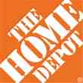

Data Breaches 2005-2015, by Number of Breaches and Records Exposed
# Data Breaches/Millions of Records Exposed
Millions
The 781 reported data breaches in 2015 was virtually unchanged form the record 783 reported in 2014. The number of exposed records soared to 169.1 million, and increase of 97.5%.
Source: Identity Theft Resource Center (updated as of Jan. 6, 2016);
http://www.idtheftcenter.org/images/breach/ITRCBreachReport2015.pdf

Slide 173
Data/Privacy Breach:
Many Potential Costs Can Be Insured
Data Breach Event
Costs of notifying affecting individuals
Defense and settlement costs
Lost customers and damaged reputation
Cyber extortion payments
Costs of notifying regulatory authorities
Regulatory fines at home & abroad
Business Income Loss
Forensic costs to discover cause
173

Slide 174
Estimated Cyber Insurance Premiums Written, 2014 – 2020F
Cyber insurance premiums written could more than triple to $7.5 billion by 2020
$ Billions
I.I.I.’s Cyber Risk paper issued Oct. 2015
Source: Advisen (2014 est.); PwC (2015, 2020); Insurance Information Institute.

Slide 175
THE SHARING (ON-DEMAND) ECONOMY
Area of Extreme Interest—And Insurers Are Providing Solutions for this Dynamic Economic Segment
175

Slide 176




Sharing/On-Demand/Peer-to-Peer Economy Impacts Many Lines of Insurance
The “On-Demand” Economy is or will impact many segments of the economy important to P/C insurers
  Auto (personal and commercial)
  Homeowners/Renters
  Many Liability Coverages
  Professional Liability
  Workers Comp
Many insurance questions have arisen
Insurance solutions are increasingly available to fill the many insurance gaps that arise
176
12/01/09 - 9pm
eSlide – P6466 – The Financial Crisis and the Future of the P/C
Notes:
176

Slide 177



Labor on Demand: Huge Implications for the US Economy, Workers & Insurers
Will YOUR job be reduced to an app?

Slide 178
Ridesharing Regulation/Legislation and Status of ISO Filings as of 9/30/15
Status Ride Sharing Legislation/Regulation
Status of ISO Filings
178
Source: ISO.

Slide 179
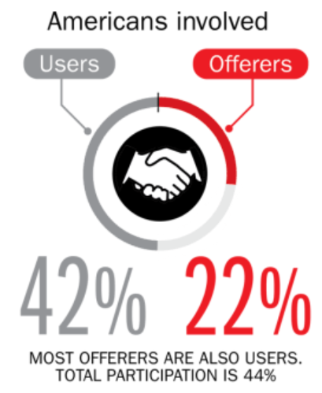
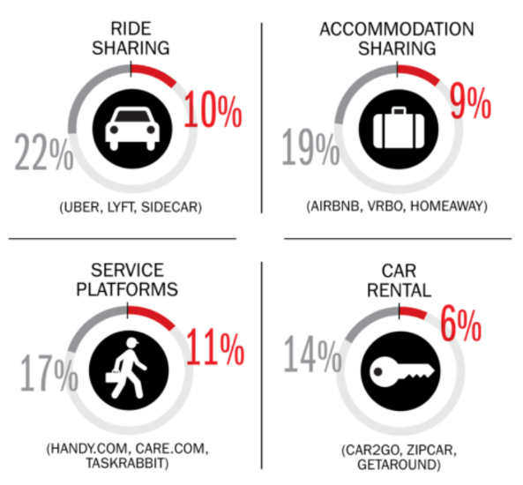
Percent of Americans Who Have Engaged in the “Gig/Sharing Economy” by Transaction
Drivers have significant WC exposures
Service platforms have the most direct link to WC; 11% of Americans have offered their services
About 22% of Americans have offered services in the sharing economy
Sources: The SelfEmployed.com accessed at https://www.theselfemployed.com/gig-economy/infographic-inside-the-new-economy/ based on a poll by Time magazine, Bursten-Marsteller and The Aspen Institute; Insurance Information Institute.

Slide 180
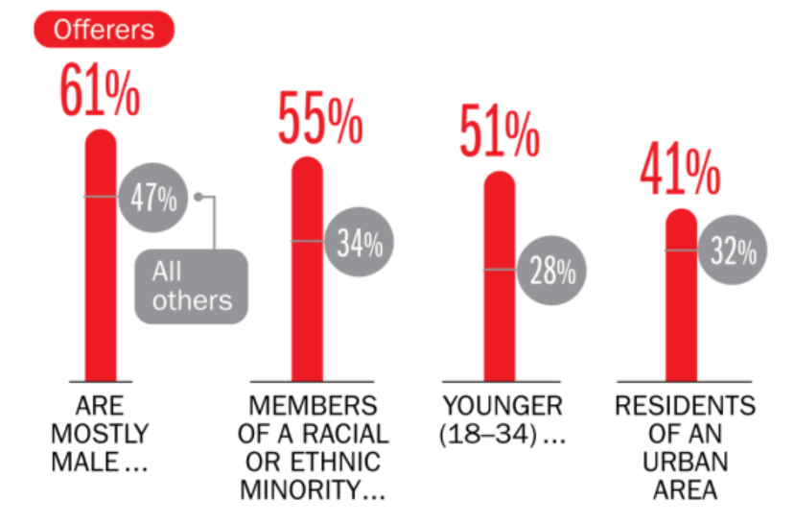
Americans Who Offer Services in the Sharing/Gig Economy Are Statistically More Prone to Workplace Injury
Young, Urban Minority Males Are the Most Likely to Offer their Services in the Sharing Economy
Sources: The SelfEmployed.com accessed at https://www.theselfemployed.com/gig-economy/infographic-inside-the-new-economy/ based on a poll by Time magazine, Bursten-Marsteller and The Aspen Institute; Insurance Information Institute.

Slide 181

The Sharing Economy Can’t Escape Politics and Regulation

Slide 182

Political Skepticism About the
‘Gig’ Economy
"Many Americans are making extra money renting out a spare room, designing a website ... even driving their own car. This on demand or so called 'gig' economy is creating exciting opportunities and unleashing innovation, but it's also raising hard questions about workplace protections and what a good job will look like in the future."
--Hillary Clinton,
July 13, 2015
182
12/01/09 - 9pm
eSlide – P6466 – The Financial Crisis and the Future of the P/C
Notes:
182

Slide 183
AUTO TECHNOLOGY &
THE FUTURE OF AUTO INSURANCE
Technology Promises Safer Cars and Highways, BUT Some Analysts, Media and Many in Silicon Valley Are Predicting Doom for Auto Insurers
183

Slide 184
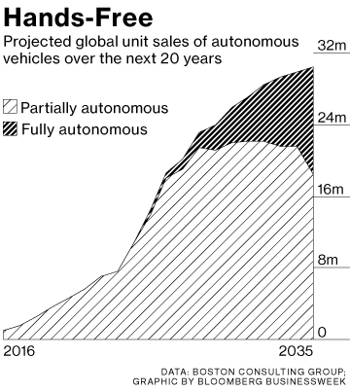
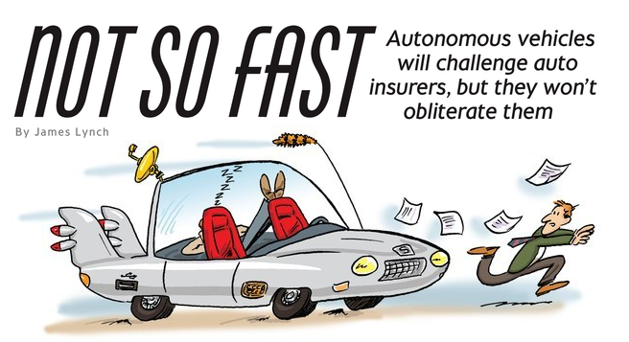

Media is Obsessed with Driverless Vehicles: Often Predicting the Demise of Auto Insurance
By 2035, it is estimated that 25% of new vehicle sales could be fully autonomous models
Questions
Are auto insurers monitoring these trends?
How are they reacting?
Will or Amazon or FinTech take over the industry? (cars/sales)
Will the number of auto insurers shrink?
How will liability shift?
Source: Boston Consulting Group; Insurance Information Institute.

Slide 185
I.I.I. Poll: Telematics
Q. I’m going to ask you a question about your opinion of insurance companies collecting information about how and when you drive in order to set your auto insurance premium. Please tell me which statement you agree with. Would you…¹
Don’t know
Would not allow
Allow if premium went down
Allow whether or not premium went down
More Than Half of Auto Policyholders Would Allow Their Insurer to Collect Their Driving Information In Order to Set Premiums.
¹Asked of those who auto insurance.
Source: Insurance Information Institute Annual Pulse Survey.

Slide 186


Send in the Drones: Potential Rapid
Adoption in Industry; Media Loves It
Drones or Unmanned Aerial Vehicle (UAV) technology is seeing rapid adoption rate in many industries, including insurance
FAA granting Section 333 exemptions for commercial use and testing of UAS
At least 5 insurers have received permission to test
Wide variety of applications: claims, pre-event property inspections…
Insurers partnering with construction industry to guide R&D and regulation of UAV use via Property Drone Consortium: www.propertydrone.org

Slide 187
THE ‘INTERNET OF THINGS’
Capturing Economic Value Amid a Shifting Insurer Value Chain
187

Slide 188
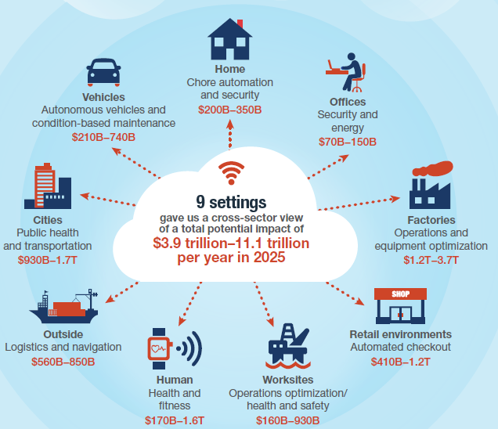
The Internet of Things and the Insurance Industry
The “Internet of Things” will create trillions in economic value throughout the global economy by 2025
What opportunities, challenges will this create for insurers?
What are the impact on the insurance industry “value chain”?
Sources: McKinsey Global Institute, The Internet of Things: Mapping the Value Beyond the Hype,
June 2015; Insurance Information Institute.
188
12/01/09 - 9pm
eSlide – P6466 – The Financial Crisis and the Future of the P/C
Notes:
188

Slide 189
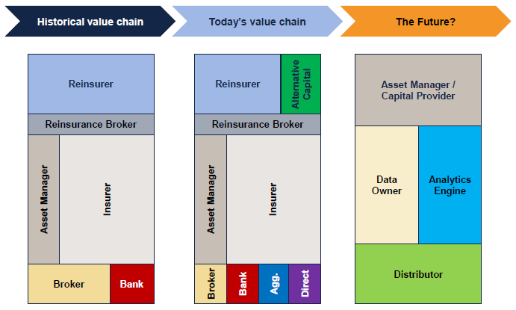
The Internet of Things and the Insurance Industry Value Chain
The Insurance Industry Value Chain Is Changing for Many Reasons
Source: Willis Capital Markets & Advisory; Insurance Information Institute.
189
12/01/09 - 9pm
eSlide – P6466 – The Financial Crisis and the Future of the P/C
Notes:
189

Slide 190
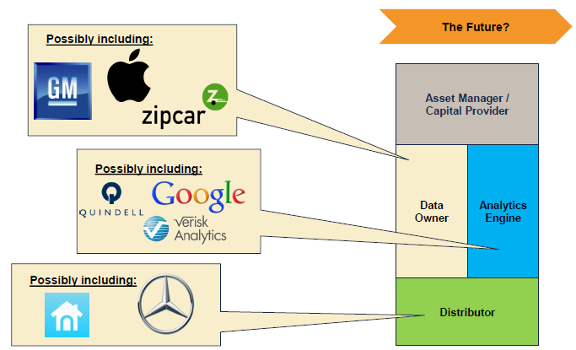
The Internet of Things and the Insurance Industry Value Chain
Who owns the data? Where does It flow? Who does the analytics? Who is the capital provider?
Source: Willis Capital Markets & Advisory; Insurance Information Institute.
190
12/01/09 - 9pm
eSlide – P6466 – The Financial Crisis and the Future of the P/C
Notes:
190

Slide 191

A NEST Case Study
Nest: A Leader in the “Internet of Things”
Collision Course or Cooperation with the Insurance Industry?
191

Slide 192



Telematics for Your Home:
The Internet of Things
The home is the next frontier for telematics
Rapidly becoming a crowded space
How and with whom will insurers partner?
Can control increasing array of household systems remotely
  Heat, A/C
  Fire, CO detection
  Security Systems
  Cameras/Monitors
  Appliances
  Lighting
Technology is adaptive
  Uses sensors and algorithms to learn about you
192
12/01/09 - 9pm
eSlide – P6466 – The Financial Crisis and the Future of the P/C
Notes:
192

Slide 193

Partnerships with Insurers: Selling Safety and Savings Simultaneously
Nest is actively seeking to partner with insurers. As of Jan. 10, 2016, Nest listed 2 insurance partners offering discounts in a number of states
Source: https://nest.com/insurance-partners/ accessed 1/10/16; Insurance Information Institute research.
193
12/01/09 - 9pm
eSlide – P6466 – The Financial Crisis and the Future of the P/C
Notes:
193

Slide 194
Shifting Legal Liability &
Tort Environment
Will the Tort Pendulum
Swing Against Insurers?
194

Slide 195
Average Personal Injury Jury Award,
2009 – 2013
Average awards in Personal Injury cases have increased by more than 1/3 in recent years
Source: Current Award Trends in Personal Injury, 54th Edition; Insurance Information Institute.

Slide 196
Business Leaders Ranking of Liability Systems in 2015
Best States
Delaware
Vermont
Nebraska
Iowa
New Hampshire
Idaho
North Carolina
Wyoming
South Dakota
Utah
Worst States
Arkansas
Missouri
Mississippi
Florida
New Mexico
Alabama
California
Illinois
Louisiana
West Virginia
New in 2015
Vermont
New Hampshire
North Carolina
South Dakota
Newly Notorious
Arkansas
Missouri
Drop-offs
Rising Above
Minnesota
Kansas
Virginia
North Dakota
Oklahoma
Montana
Source: US Chamber of Commerce 2015 State Liability Systems Ranking Study; Insurance Info. Institute.

Slide 197
The Nation’s Judicial “Hellholes”: 2014/2015
Watch List
Illinois
Madison County
West Virginia
Atlantic County, New Jersey
Mississippi Delta
Montana
Nevada
Newport News, Virginia
Philadelphia, Pennsylvania
California
Dishonorable Mention
Assignment of Benefits issue looms large in FL
New York City Asbestos Litigation
AL Supreme Court
PA Supreme Court
Volkswagen: Massive tort actions, fines, penalties certain. Are others vulnerable? Issue of cheating on environmental standards and liability looms large.
Florida
Source: American Tort Reform Association; Insurance Information Institute

Slide 198
Insurance Information Institute Online:
www.iii.org
Thank you for your time
and your attention!
Twitter: twitter.com/bob_Hartwig
Download at www.iii.org/presentations

