Slide 1
Overview & Outlook for the Commercial P/C Insurance Industry in 2016 & Beyond
Trends, Challenges & Opportunities
Insurance Information Institute
September 15, 2016
Robert P. Hartwig, Ph.D., CPCU, Special Consultant
Insurance Information Institute ♦ 110 William Street ♦ New York, NY 10038
Tel: 917.453.1885 ♦ bobh@iii.org ♦ www.iii.org

Slide 2
Insurance Industry:
Financial Update & Outlook
2015 Was a Reasonably Good Year and Similar to 2014
2016: Could Be Similar to 2015
2

Slide 3
P/C Industry Net Income After Taxes
1991–2016:Q1
$ Millions
2005 ROE*= 9.6%
2006 ROE = 12.7%
2007 ROE = 10.9%
2008 ROE = 0.1%
2009 ROE = 5.0%
2010 ROE = 6.6%
2011 ROAS¹ = 3.5%
2012 ROAS¹ = 5.9%
2013 ROAS¹ = 10.2%
2014 ROAS¹ = 8.4%
2015 ROAS = 8.4%
Net income in Q1:2016 on an annualized basis was on track to match full-year 2015
ROE figures are GAAP; ¹Return on avg. surplus. Excluding Mortgage & Financial Guaranty insurers yields a 8.2% ROAS in 2014, 9.8% ROAS in 2013, 6.2% ROAS in 2012, 4.7% ROAS for 2011, 7.6% for 2010 and 7.4% for 2009; 2015E is annualized figure based actual figure through Q3 of $44.0
Sources: A.M. Best, ISO; Insurance Information Institute

Slide 4
Profitability Peaks & Troughs in the P/C Insurance Industry, 1975 – 2015
ROE
1977:19.0%
History suggests next ROE peak will be in 2016-2017
1987:17.3%
10 Years
1997:11.6%
2006:12.7%
10 Years
2015: 8.4%
2013 9.8%
9 Years
2014 8.4%
1975: 2.4%
1984: 1.8%
1992: 4.5%
2001: -1.2%
*Profitability = P/C insurer ROEs. 2011-15 figures are estimates based on ROAS data. Note: Data for 2008-2014 exclude mortgage and financial guaranty insurers.
Source: Insurance Information Institute; NAIC, ISO, A.M. Best, Conning

Slide 5
ROE: Property/Casualty Insurance by Major Event, 1987–2015
(Percent)
P/C Profitability Is Both by
Cyclicality and Ordinary Volatility
Modestly higher CATs
Katrina, Rita, Wilma
Low CATs
Sept. 11
Hugo
Lowest CAT Losses in
15 Years
4 Hurricanes
Sandy
Andrew, Iniki
Record Tornado Losses
Northridge
Financial Crisis*
* Excludes Mortgage & Financial Guarantee in 2008 – 2014.
Sources: ISO, Fortune; Insurance Information Institute.

Slide 6
P/C Insurance Industry ROE: Magnitude of Cyclicality, Volatility Changes Over Time, 1950-2015
1950 - 1970
Low
Volatility
1971 - 1992
Extreme
Volatility
1993 - 2008
Moderate
Volatility
2009 - Present
Modest
Volatility
.
Source: Insurance Information Institute

Slide 7
Return on Equity by Financial Services Sector vs. Fortune 500, 2004-2015*
(Percent)
Average: 2004 - 2014
Fortune 500: 13.9% Commercial Banks: 9.8% Life: 8.2% P/C: 7.1%
Banks and Insurers Have Substantially Underperformed the Fortune 500 Since the Financial Crisis
*GAAP basis.
Sources: ISO, Fortune; Insurance Information Institute.
7
Notes:
7

Slide 8
RNW All Lines, 2005-2014 Average:
Highest 25 States
(Percent)
The most profitable states over the past decade are widely distributed geographically, though none are in the Gulf region
Profitability Benchmark: All P/C
US: 7.7%
Source: NAIC; Insurance Information Institute.

Slide 9
RNW All Lines, 2005-2014 Average:
Lowest 25 States
(Percent)
Some of the least profitable states over the past decade were hit hard by catastrophes
Source: NAIC; Insurance Information Institute.

Slide 10
RNW Commercial Auto,
2005-2014 Average: Highest 25 States
(Percent)
Sources: NAIC; Insurance Information Institute

Slide 11
RNW Commercial Auto,
2005-2014 Average: Lowest 25 States
(Percent)
Sources: NAIC; Insurance Information Institute

Slide 12
RNW Workers Compensation,
2005-2014 Average: Highest 25 States
(Percent)
Sources: NAIC; Insurance Information Institute

Slide 13
RNW Workers Compensation,
2005-2014 Average: Lowest 25 States
(Percent)
Sources: NAIC; Insurance Information Institute

Slide 14
P/C Insurance Industry
Combined Ratio, 2001–2016:Q1*
Heavy Use of Reinsurance Lowered Net Losses
Relatively Low CAT Losses, Reserve Releases
Higher CAT Losses, Shrinking Reserve Releases, Toll of Soft Market
As Recently as 2001, Insurers Paid Out Nearly $1.16 for Every $1 in Earned Premiums
Relatively Low CAT Losses, Reserve Releases
Avg. CAT Losses, More Reserve Releases
3 Consecutive Years of U/W Profits: First Time Since 1971-73
Sandy Impacts
Best Combined Ratio Since 1949 (87.6)
Cyclical Deterioration
Lower CAT Losses
Elevated CATs
* Excludes Mortgage & Financial Guaranty insurers 2008--2014. Including M&FG, 2008=105.1, 2009=100.7, 2010=102.4, 2011=108.1; 2012:=103.2; 2013: = 96.1; 2014: = 97.0.
Sources: A.M. Best, ISO (2014-2015); Figure for 2010-2013 is from A.M. Best P&C Review and Preview, Feb. 16, 2016.

Slide 15
P/C Insurance Loss Reserve Development, 1992 – 2017E*
Reserve releases are expected to gradually taper off slowly, but will continue to benefit the bottom line and combined ratio through at least 2017
Reserve Change
Source: A.M. Best; Barclays research for estimates.

Slide 16
NPW Premium Growth: Peaks & Troughs in the P/C Insurance Industry, 1926 – 2015
ROE
Post WW II Peak:
1947: 26.2%
1970-90: Peak premium growth was much higher in this period while troughs were comparable. Rapid inflation, economic volatility, high interest rates, tort environment all played roles
Start of WW II
1941: 15.8%
Economic Shocks, Inflation:
1976: 22.0%
Tort Crisis
1985/86: 22.2%
Post-9/11
2002:15.3%
1988-2000: Period of inter-cycle stability
2015 3.4%
1950-70: Extended period of stability in growth and profitability. Low interest rates, low inflation, “Bureau” rate regulation all played a role
2010-20XX? Post-recession period of stable growth?
Twin Recessions; Interest Rate Hikes
1987: 3.7%
Great Recession:2010: -4.9%
Great Depression
1932: -15.9% max drop
Note: Data through 1934 are based on stock companies only. Data include state funds beginning in 1998.
Source: A.M. Best; Insurance Information Institute.

Slide 17
Policyholder Surplus,
2006:Q4–2016:Q1
($ Billions)
2007:Q3
Pre-Crisis Peak
Drop due to near-record 2011 CAT losses
Surplus as of 3/31/16 stood at a record high $676.3B
The industry now has $1 of surplus for every $0.76 of NPW,
close to the strongest claims-paying status in its history.
2010:Q1 data includes $22.5B of paid-in capital from a holding company parent for one insurer’s investment in a non-insurance business .
The P/C insurance industry entered 2016
in very strong financial condition.
Sources: ISO, A.M .Best.
17
12/01/09 - 9pm
eSlide – P6466 – The Financial Crisis and the Future of the P/C
Notes:
17

Slide 18
Profitability & Politics
How Is Profitability Affected by the President’s Political Party?
18

Slide 19
P/C Insurance Industry ROE by Presidential Administration, 1950-2015*
OVERALL RECORD: 1950-2015*
Democrats 7.72%
Republicans 7.85%
Party of President has marginal bearing on profitability of P/C insurance industry
*Truman administration ROE of 6.97% based on 3 years only, 1950-52;.
Source: Insurance Information Institute

Slide 20
P/C insurance Industry ROE by Presidential Party Affiliation, 1950- 2015*
BLUE = Democratic President RED = Republican President
Nixon/Ford
Carter
Reagan/Bush I
Clinton
Bush II
Obama
Truman
Eisenhower
Kennedy/ Johnson
.
*2015 data is through Q3.
Source: Insurance Information Institute

Slide 21
Trump vs. Clinton:
Issues that Matter to P/C Insurers
Issue | Trump | Clinton
Economy | Supply Side-Like Philosophy: Lower taxes→Faster real GDP growth; Deficits likely grow as tax cuts are combined with targeted increased spending on Homeland Security, Defense, etc. | Keynesian Philosophy: More government spending on infrastructure, education, social services; Deficits likely increase as tax increases likely difficult to pass
Interest Rates | May trend higher with larger deficits; Shift from monetary policy to fiscal focus (tax cuts, government spending) | Status quo at the Fed; Net impact on interest rates unclear
Taxes | Favors lower tax rates for corporate and personal income tax rates; Tax code overhaul? | Unlikely to reduce taxes or embark on major overhaul of tax code
International Trade | Protectionist Tendencies (appeal primarily to manufacturing sector) | Has criticized Trans-Pacific Partnership but is a realist on international matters
Tort System | Doesn’t like trial lawyers but seems to like filing lawsuits | Status Quo
Energy | Laissez-faire; Less “green” | Status Quo

Slide 22
2015 Property and Casualty Insurance
Regulatory Report Card
C
AK
AL
A
WA
ME
C
MT
B
ND
C
VT
D
MN
D
NH
B
OR
ID
C+
C
NY
MA
= A
= B
= C
= D
= F
= NG
B
SD
B+
WI
MI
CT
RI C+
B
B
NJ
WY
PA
C
B
B+
IA
B
C-
A
C+
OH
MD
NV
NE
A-
IL
IN
DE
B+
WV
B
UT
B
C
VA
CO
C+
A
B
A
B
KS
MO
KY
CA
B
A
F
D
A-
TN
NC
C
AZ
NM
OK
C
AR
C
SC
Source: James Madison Institute, February 2008.
A-
D
HI
B
B
AL
B
MS
C
GA
LA
D+
TX
D
Not Graded: District of Columbia
FL
D
D
Source: R Street Insurance Regulation Report Card, December 2015

Slide 23
INVESTMENTS:
THE NEW REALITY
Investment Performance is a Key Driver of Profitability
Depressed Yields Will Necessarily Influence Underwriting & Pricing
23

Slide 24
Property/Casualty Insurance Industry Investment Income: 2000–2016:Q1¹
Investment earnings are still below their 2007 pre-crisis peak
($ Billions)
Due to persistently low interest rates, investment income fell in 2012, 2013 and 2014 but showed a small (1.9%) increase in 2015—another drop in 2016 seems likely.
*Annualized figure based on actual Q1:2016 net investment income earned of $10.893B.
¹ Investment gains consist primarily of interest and stock dividends. Sources: ISO; Insurance Information Institute.

Slide 25
U.S. Treasury Security Yields:
A Long Downward Trend, 1990–2016*
Yields on 10-Year U.S. Treasury Notes have been essentially below 5% for more than a decade.
Despite the Fed’s December 2015 rate hike, yields remain low though short-term yields have seen some gains; Yield curve is flattening.
Since roughly 80% of P/C bond/cash investments are in 10-year or shorter durations, most P/C insurer portfolios will have low-yielding bonds for years to come.
*Monthly, constant maturity, nominal rates, through August 2016.
Sources: Federal Reserve Bank at http://www.federalreserve.gov/releases/h15/data.htm. National Bureau of Economic Research (recession dates); Insurance Information Institute.
25
12/01/09 - 9pm
eSlide – P6466 – The Financial Crisis and the Future of the P/C
Notes:
25

Slide 26
Net Investment Yield on Property/ Casualty Insurance Invested Assets, 2007–2016P*
(Percent)
Estimated book yield in 2016 is down about 140 BP from pre-crisis levels
The yield on invested assets remains low relative to pre-crisis yields. The Fed’s plan to raise interest rates in late 2015 has pushed up some yields, albeit quite modestly.
Sources: A.M. Best; 2015E-2016P figures from A.M. Best P/C Review and Preview, Feb. 2016; Insurance Information Institute

Slide 27
Interest Rate Forecasts: 2016 – 2021F
Yield (%)
3-Month Treasury
10-Year Treasury
10-year yields are actually down in 2016
A full normalization of interest rates is unlikely until 2019, more than a decade after the onset of the financial crisis.
Sources: Blue Chip Economic Indicators (9/16 for 2016 and 2017; for 2018-2021 3/16 issue); Insurance Info. Institute.

Slide 28
Treasury Yield Curves:
Pre-Crisis (July 2007) vs. April 2016*
Treasury yield curve remains near its most depressed level in at least 45 years. Investment income is depressed as a result. Fed began to raise rates in Dec. 2015, but yields unlikely to return to pre-crisis levels anytime soon
The Fed Began to Raise Rates in Dec. 2015 but Market Volatility and Weakness Abroad Have Made Additional Hikes Difficult
*As of April 22, 2016.
Source: Federal Reserve Board of Governors: http://www.federalreserve.gov/releases/h15/data.htm; Insurance Information Institute.

Slide 29
Annual Inflation Rates, (CPI-U, %),
1990–2017F
Annual Inflation Rates (%)
Inflation peaked at 5.6% in August 2008 on high energy and commodity crisis. The recession and the collapse of the commodity bubble reduced inflationary pressures in 2009/10
Inflationary expectations have slipped (due in part to falling energy costs) allowing the Fed to maintain low interest rates
Slack in the U.S. economy and falling energy prices suggests that inflationary pressures should remain subdued for an extended period of times
Sources: US Bureau of Labor Statistics; Blue Chip Economic Indicators, 4/16 (forecasts).

Slide 30
P/C Insurer Net Realized
Capital Gains/Losses, 1990-2015
Realized capital gains rose sharply as equity markets rallied in 2013-14
($ Billions)
Insurers Posted Net Realized Capital Gains in 2010 - 2015 Following Two Years of Realized Losses During the Financial Crisis. Realized Capital Losses Were a Primary Cause of 2008/2009’s Large Drop in Profits and ROE.
Sources: A.M. Best, ISO; Insurance Information Institute.
30
12/01/09 - 9pm
eSlide – P6466 – The Financial Crisis and the Future of the P/C
Notes:
30

Slide 31
Property/Casualty Insurance Industry Investment Gain: 1994–2015¹
($ Billions)
Investment gains in 2015 were unchanged from 2014 and still well below the pre-crisis highs
Total Investment Gains Were Flat in 2015 as Investment Income Rose Marginally and Realized Capital Gains Fell Slightly
¹ Investment gains consist primarily of interest, stock dividends and realized capital gains and losses.
* 2005 figure includes special one-time dividend of $3.2B; 2015 figure is through Q3 2015.
Sources: ISO, SNL; Insurance Information Institute.

Slide 32
Reduction in Combined Ratio Necessary to Offset 1% Decline in Investment Yield to Maintain Constant ROE, by Line*
Lower Investment Earnings Place a Greater Burden on Underwriting and Pricing Discipline
*Based on 2008 Invested Assets and Earned Premiums
**US domestic reinsurance only
Source: A.M. Best; Insurance Information Institute.
32
12/01/09 - 9pm
eSlide – P6466 – The Financial Crisis and the Future of the P/C
Notes:
32

Slide 33
CAPITAL/CAPACITY
Capital Accumulation Has Multiple Impacts
Alternative Capital Impacts?
33

Slide 34
Policyholder Surplus,
2006:Q4–2016:Q1
($ Billions)
2007:Q3
Pre-Crisis Peak
Drop due to near-record 2011 CAT losses
Surplus as of 3/31/16 stood at a record high $676.3B
The industry now has $1 of surplus for every $0.76 of NPW,
close to the strongest claims-paying status in its history.
2010:Q1 data includes $22.5B of paid-in capital from a holding company parent for one insurer’s investment in a non-insurance business .
The P/C insurance industry entered 2016
in very strong financial condition.
Sources: ISO, A.M .Best.
34
12/01/09 - 9pm
eSlide – P6466 – The Financial Crisis and the Future of the P/C
Notes:
34

Slide 35
US Policyholder Surplus:
1975–2015*
($ Billions)
Surplus as of 12/31/15 was a near-record $673.7, down 0.2% from $675.2 of 12/31/14, and up 54.1% ($236.6B) from the crisis trough of $437.1B at 3/31/09
“Surplus” is a measure of underwriting capacity. It is analogous to “Owners Equity” or “Net Worth” in non-insurance organizations
The Premium-to-Surplus Ratio Stood at $0.76:$1 as of
12/31/15, a Near Record Low (at Least in Recent History)
* As of 12/31/15.
Source: A.M. Best, ISO, Insurance Information Institute.

Slide 36
Alternative Capital
New Investors Continue to Change the Reinsurance Landscape
First I.I.I. White Paper on Issue Was Released in March 2015
36

Slide 37
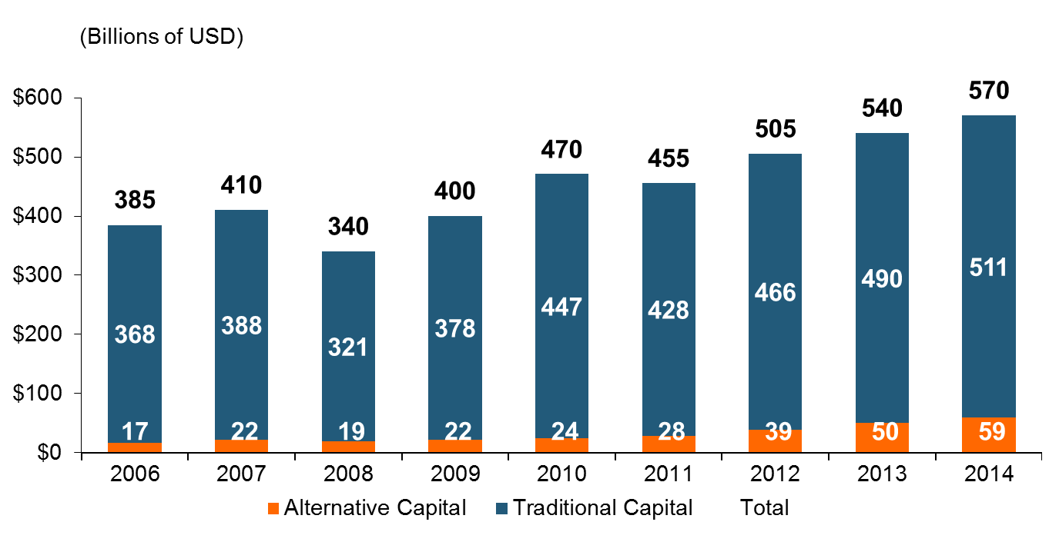
Global Reinsurance Capital (Traditional and Alternative), 2006 - 2014
Total reinsurance capital reached a record $570B in 2013, up 68% from 2008.
But alternative capacity has grown 210% since 2008, to $50B. It has more than doubled in the past three years.
2014 data is as of June 30, 2014.
Source: Aon Benfield Analytics; Insurance Information Institute.

Slide 38
Alternative Capital as a Percentage of Traditional Global Reinsurance Capital
Alternative Capital’s Share of Global Reinsurance Capital Has More Than Doubled Since 2010.
2014 data is as of June 30, 2014.
Source: Aon Benfield Analytics; Insurance Information Institute.

Slide 39
Catastrophe Bond Issuance and Outstanding: 1997-2015
Risk Capital Amount ($ Millions)
Cat Bond Issuance Declined Slightly in 2015 from 2014’s Record Pace. Lower Yields on Bonds Explain Some of the Contraction.
Source: Guy Carpenter, Artemis accessed at http://www.artemis.bm/deal_directory/cat_bonds_ils_issued_outstanding.html .

Slide 40
US Property CAT Rate on Line Index & Global Reinsurance ROE
US Property CAT ROL
Global Reinsurance ROE
Record traditional capacity, alternative capital and low CAT activity have pressured reinsurance prices; ROEs are own only very modestly
Source: Barclays PLC from Guy Carpenter; Insurance Information Institute.

Slide 41
GLOBAL M&A UPDATE:
A PATH TO GROWTH?
Are Capital Accumulation, Drive for Growth and Scale Stimulating M&A Activity?
41

Slide 42
U.S. INSURANCE MERGERS AND ACQUISITIONS,
P/C SECTOR, 1994-2015 (1)
M&A activity in the P/C sector in 2015 totaled $39.6B, its highest level since 2000
($ Millions)
(1) Includes transactions where a U.S. company was the acquirer and/or the target.
Source: Conning proprietary database.

Slide 43
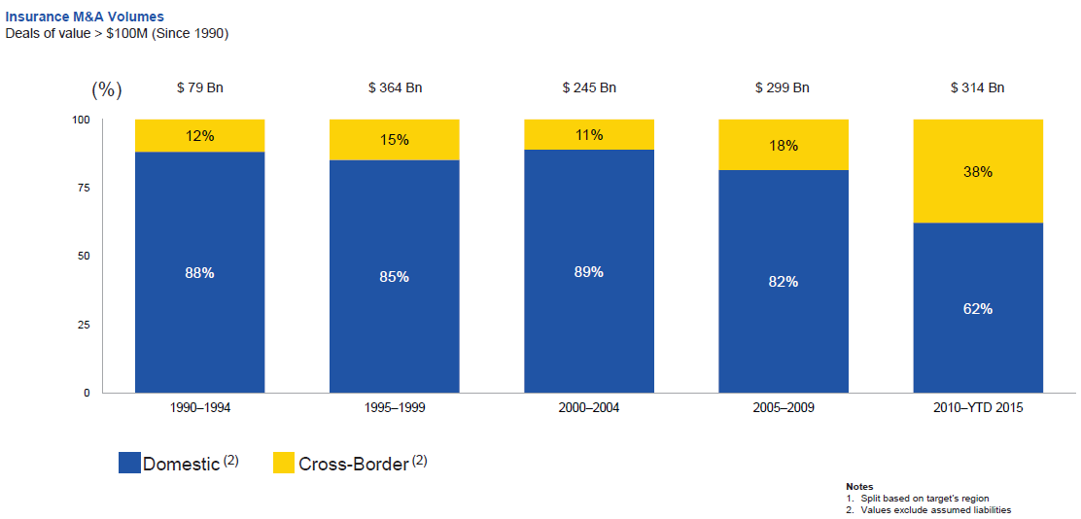
Huge Shift from Domestic M&A Activity to Cross-Border
The share of M&A deal volume that was cross-border more than doubled in 2015
.
Source: Thomson Reuters as of Oct. 2015 from Geneva Association Newsletter Insurance and Finance, Jan. 2016, presentation “Facts vs. Sentiment: Deals in the Insurance Sector,” by Aviva CEO Mark Wilson.

Slide 44
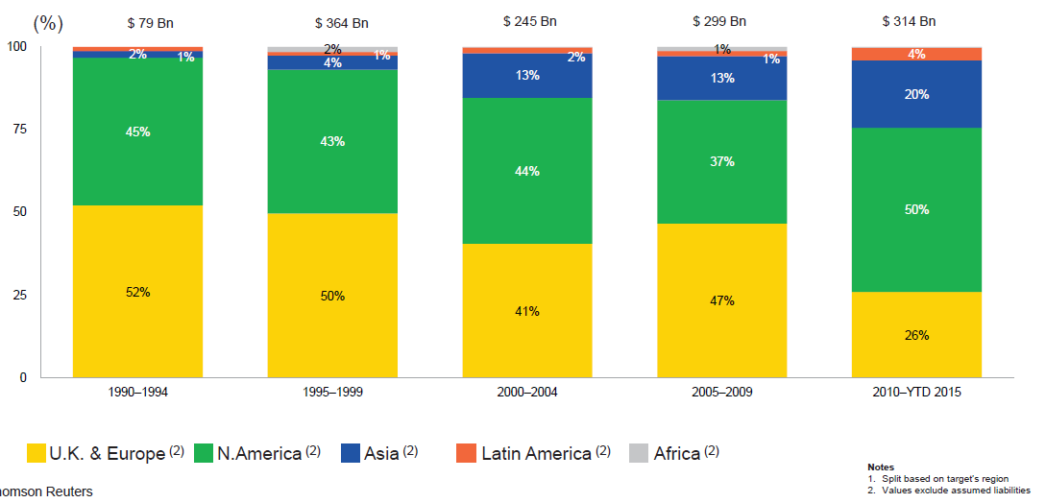
M&A Activity Has Shifted Away from Europe and Towards Asia and N. America
Asian, N. American deal volumes were up sharply in 2015
.
Source: Thomson Reuters as of Oct. 2015 from Geneva Association Newsletter Insurance and Finance, Jan. 2016, presentation “Facts vs. Sentiment: Deals in the Insurance Sector,” by Aviva CEO Mark Wilson.

Slide 45
Growth
Premium Growth Rates Vary Tremendously by State and Over Time, But…
45

Slide 46
Net Premium Growth (All P/C Lines): Annual Change, 1971—2016:Q1
(Percent)
1975-78
1984-87
2000-03
Net Written Premiums Fell 0.7% in 2007 (First Decline Since 1943) by 2.0% in 2008, and 4.2% in 2009, the First 3-Year Decline Since 1930-33.
2016 Q1: 3.2%
2015: 3.4%
2014: 4.2
2013: 4.4%
2012: +4.2%
Outlook
2016F: 3.2%
2017F: 3.0%
Shaded areas denote “hard market” periods
Sources: A.M. Best (1971-2013), ISO (2014-16).

Slide 47
NPW Premium Growth: Peaks & Troughs in the P/C Insurance Industry, 1926 – 2015
ROE
Post WW II Peak:
1947: 26.2%
1970-90: Peak premium growth was much higher in this period while troughs were comparable. Rapid inflation, economic volatility, high interest rates, tort environment all played roles
Start of WW II
1941: 15.8%
Economic Shocks, Inflation:
1976: 22.0%
Tort Crisis
1985/86: 22.2%
Post-9/11
2002:15.3%
1988-2000: Period of inter-cycle stability
2015 3.4%
1950-70: Extended period of stability in growth and profitability. Low interest rates, low inflation, “Bureau” rate regulation all played a role
2010-20XX? Post-recession period of stable growth?
Twin Recessions; Interest Rate Hikes
1987: 3.7%
Great Recession:2010: -4.9%
Great Depression
1932: -15.9% max drop
Note: Data through 1934 are based on stock companies only. Data include state funds beginning in 1998.
Source: A.M. Best; Insurance Information Institute.

Slide 48
Direct Premiums Written: Total P/C
Percent Change by State, 2007-2014
Top 25 States
North Dakota was the country’s growth leader over the past 7 years with premiums written expanding by 70.7%, fueled by the state’s energy boom
Growth Benchmarks: Total P/C
US: 13.0%
Sources: SNL Financial LC.; Insurance Information Institute.

Slide 49
Direct Premiums Written: Total P/C
Percent Change by State, 2007-2014
Bottom 25 States
Growth was negative in 4 states and DC between 2007 and 2014
Sources: SNL Financial LC.; Insurance Information Institute.

Slide 50
Commercial Lines Growth and Pricing Trends
Survey Results Suggest Commercial Pricing Has Flattened Out, with Impacts on Growth
50

Slide 51
Commercial Lines NPW Premium Growth:
1975 – 2015E
ROE
Commercial lines is prone to more cyclical volatility that personal lines. Recently, growth has stabilized in the 4% to 5% range.
Economic Shocks, Inflation:
1976: 22.2%
Tort Crisis
1986: 30.5%
Post-9/11
2002: 22.4%
Post-Hurricane Andrew Bump:
1993: 6.3%
1988-2000: Period of inter-cycle stability
Post Katrina Bump:
2006: 7.7%
2015E 3.3%
2010-20XX? Post-recession period of stable growth?
Recessions:
1982: 1.1%
Great Recession:2009: -9.0%
Note: Data include state funds beginning in 1998.
Source: A.M. Best; Insurance Information Institute.

Slide 52
Direct Premiums Written: Comm. Lines
Percent Change by State, 2007-2015
Top 25 States
44 states showed commercial lines growth from 2007 through 2015
Growth Benchmarks: Commercial
US: 9.0%
Sources: NAIC via SNL Financial; Insurance Information Institute.

Slide 53
Direct Premiums Written: Comm. Lines
Percent Change by State, 2007-2015
Bottom 25 States
Eight states write less commercial business than they did in 2007
Sources: NAIC via SNL Financial; Insurance Information Institute.

Slide 54
Commercial Auto Insurance
Net Written Premium, 2000–2015F
In contrast to positive PP Auto NPW growth, Commercial Auto premiums fell 21.3% between 2005 and 2011 due to soft market conditions in commercial lines and negative exposure trends, though growth resumed in 2012
$ Billion
Sources: A.M. Best (2000-2014); Conning (2015F); Insurance Information Institute.

Slide 55
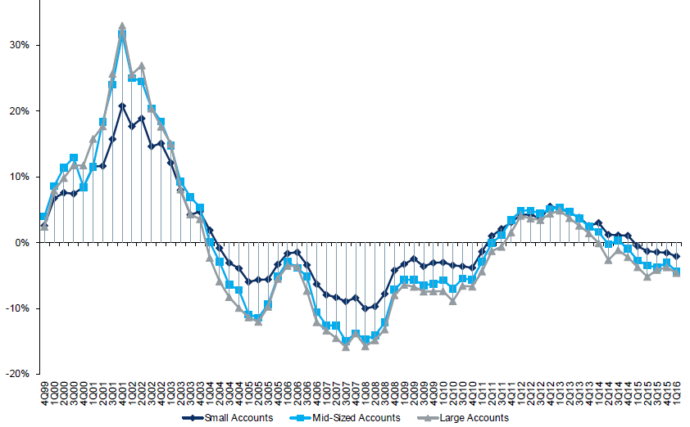
Change in Commercial Rate Renewals, by Account Size: 1999:Q4 to 2016:Q1
Percentage Change (%)
Peak = 2001:Q4 +28.5%
Pricing turned positive in Q3:2011, the first inrease in nearly 8 years; Q1:2015 renewals were down 2.8%; Some insurers posted stronger numbers.
Pricing Turned Negative in Early 2004 and Remained that way for 7 ½ years
Trough = 2007:Q3 -13.6%
KRW : No Lasting Impact
Source: Council of Insurance Agents and Brokers; Barclay’s Capital; Insurance Information Institute.
Note: CIAB data cited here are based on a survey. Rate changes earned by individual insurers can and do vary, potentially substantially.

Slide 56
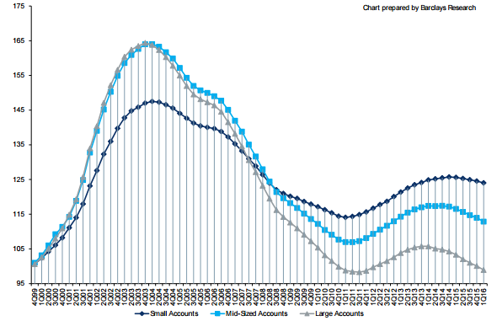
Cumulative Qtrly. Commercial Rate Changes, by Account Size: 1999:Q4 to 2016:Q1
1999:Q4 = 100
Pricing for smaller accounts has been more stable than for larger accounts
Note: CIAB data cited here are based on a survey. Rate changes earned by individual insurers can and do vary, potentially substantially.
Source: Council of Insurance Agents and Brokers; Barclay’s Capital; Insurance Information Institute.

Slide 57
CIAB: Average Commercial Rate Change, All Lines, (1Q:2004–2Q:2016)
(Percent)
Q2 2011 marked the last of 30th consecutive quarter of price declines
Pricing as of Q2:2016 remained somewhat negative
KRW Effect
Note: CIAB data cited here are based on a survey. Rate changes earned by individual insurers can and do vary, potentially substantially.
Source: Council of Insurance Agents & Brokers; Insurance Information Institute

Slide 58
Change in Commercial Rate Renewals, by Line: 2016:Q2
Percentage Change (%)
Commercial Auto rate increases are larger than any other line, followed by EPL
Major Commercial Lines Renewals Were Mixed to Down in Q2:2016; EPL and Commercial Auto Saw Gains
Note: CIAB data cited here are based on a survey. Rate changes earned by individual insurers can and do vary, potentially substantially.
Source: Council of Insurance Agents and Brokers; Insurance Information Institute.

Slide 59
Underwriting Performance
59
Notes:
59

Slide 60
Commercial Lines Combined Ratio, 1990-2017F*
Commercial lines underwriting performance improved in 2013/14 but higher cats, diminishing prior year reserves and rising loss cost trends in some lines could push combined ratios higher
*2007-2012 figures exclude mortgage and financial guaranty segments.
Source: A.M. Best (1990-2014); Conning (2015E-17F) Insurance Information Institute.

Slide 61
Commercial Property Combined Ratio:
2007–2017F
Commercial Property Underwriting Performance Has Improved in Recent Years, Largely Due to Diminished CAT Activity
Source: Conning Research and Consulting.

Slide 62
General Liability Combined Ratio:
2005–2017F
Commercial General Liability Underwriting Performance Has Been Volatile in Recent Years
Source: Conning Research and Consulting.

Slide 63
Commercial Auto Combined Ratio: 1993–2017F
Commercial Auto Results Are Challenged as Rate Gains Barely Have Yet to Offset Adverse Frequency and Severity Trends
Sources: A.M. Best (1990-2014);Conning (2015E-2017F); Insurance Information Institute.

Slide 64
Commercial Multi-Peril Combined Ratio: 1995–2017F
Commercial Multi-Peril Underwriting Performance is Expected to Deteriorate Slightly in the 2015 - 2017 Period Assuming Normal Catastrophe Loss Activity
*2015E-2017F figures are Conning figures for the combined liability and non-liability components.
Sources: A.M. Best; Conning; Insurance Information Institute.

Slide 65
Inland Marine Combined Ratio:
2004–2017F
Inland Marine Underwriting Performance Has Been Consistently Strong for Many Years
Source: A.M. Best (2004-2014); Conning Research and Consulting (2015F-2017F).

Slide 66
Medical Malpractice Combined Ratio vs. All Lines Combined Ratio, 1991-2017F
MPL insurers in 2015 paid out an estimated $1.04 in loss and expense for every $1 they earned in premiums
The dramatic improvement over the past decade has restored MPL’s viability, though some deterioration has occurred and is expected to continue
In 2001, med mal insurers paid out $1.55 for every dollar earned
Source: AM Best (1991-2014); Conning (2015-17F) Insurance Information Institute.

Slide 67
Workers Compensation Combined Ratio: 1994–2016F
WC results have improved markedly since 2011
Workers Comp Results Began to Improve in 2012. Underwriting Results Deteriorated Markedly from 2007-2010/11 and Were the Worst They Had Been in a Decade.
Sources: A.M. Best (1994-2009); NCCI (2010-2014P) and are for private carriers only; Insurance Information Institute (2015-16F).

Slide 68
Workers Compensation Operating Environment
Workers Comp Results Have Improved Substantially in Recent Years
68

Slide 69
Workers Compensation Premium:
Fifth Consecutive Year of Increase
Net Written Premium
$ Billions
p Preliminary
Source: NCCI from Annual Statement Data.
Includes state insurance fund data for the following states: AZ, CA, CO, HI, ID, KY, LA, MD, MO, MT, NM, OK, OR, RI, TX, UT.
Each calendar year total for State Funds includes all funds operating as a state fund that year.
Calendar Year

Slide 70
2015 Workers Compensation Direct Written Premium Growth, by State*
PRIVATE CARRIERS: Overall 2015 Growth = +4.3%
While growth rates varied widely, most states experienced modest positive growth in 2015
*Excludes monopolistic fund states (in gray): OH, ND, WA and WY.
Source: NCCI.

Slide 71
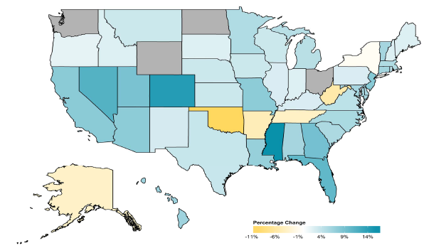
2014 Workers Compensation Direct Written Premium Growth, by State*
PRIVATE CARRIERS: Overall 2014 Growth = +4.6%
While growth rates varied widely, most states experienced positive growth in 2014
*Excludes monopolistic fund states (in gray): OH, ND, WA and WY.
Source: NCCI.

Slide 72
Workers Compensation Components of Written Premium Change, 2014 to 2015
Written Premium Change from 2014 to 2015
Net Written Premium—Countrywide | +2.9%
Direct Written Premium—Countrywide | +4.3%
Direct Written Premium—NCCI States | +2.5%
Components of DWP Change for NCCI States
Change in Carrier Estimated Payroll | +4.5%
Change in Bureau Loss Costs and Mix | -4.0%
Change in Carrier Discounting | -0.3%
Change in Other Factors | +2.2%
Combined Effect | +2.5%
Growth is now almost entirely payroll driven
Sources: Countrywide: Annual Statement data.
NCCI States: Annual Statement Statutory Page 14 for all states where NCCI provides ratemaking services.
Components: NCCI Policy data.

Slide 73
Workers Comp Approved Changes in Bureau Premium Level, 2000-2016p
Percent
Cumulative Change = –20.1%
(1994–2016p)
Accident Year
Note: Bureau premium level charges reflect approved changes in advisory rates, loss costs, assigned risk rates relative to those approved in NCCI states only IN and NC are filed in cooperation with state rating bureaus.
2016p: Preliminary based on data valued as of 4/15/2015.
Source: NCCI

Slide 74
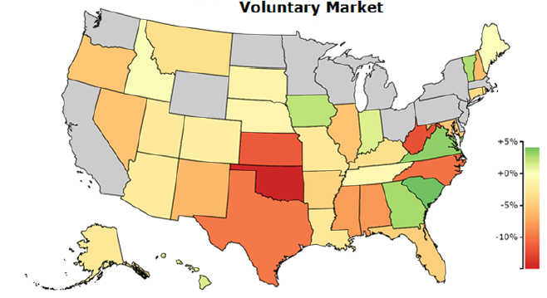
WC Approved or Filed and Pending Change in NCCI Premium Level by State*
Latest Change for Voluntary Market
Many states have seen rates rates drop recently
*As of 4/15/16. Excludes monopolistic fund states (in gray): OH, ND, WA and WY.
Source: NCCI.

Slide 75
WC Approved Changes in Bureau Premium Level (Rates/Loss Costs)
Percent
By Effective Date for Total Market
Cumulative 2000–2003
+17.1%
Cumulative 2011–2014
+11.8%
Cumulative 1994–1999
-27.8%
Cumulative 2004–2011
-30.8%
Cumulative
1990–1993
+36.3%
Approved rates/loss costs are down for the first time since 2010
Calendar Year
*States approved through 4/24/15.
Note: Bureau premium level changes are countrywide approved changes in advisory rates, loss costs and assigned risk rates as filed by applicable rating organization, relative to those previously approved.
Source: NCCI.

Slide 76
Workers Compensation Lost-Time
Claim Frequency Declined in 2015
Percent
Average Annual Change = –3.6%
(1994–2014)
*Adjustments primarily due to significant audit activity.
2015p: Preliminary based on data valued as of 12/31/2015.
Source: NCCI Financial Call data, developed to ultimate and adjusted to current wage an voluntary loss cost level; Excludes high deductible policies; 1994-2014: Based on data through 12/31/14. Data for all states where NCCI provides ratemaking services, excluding WV.
Frequency is the number of lost-time claims per $1M pure premium at current wage and voluntary loss cost level
Accident Year

Slide 77
Workers Comp Indemnity Claim Costs: Slight Increase in 2015
Average Indemnity Cost per Lost-Time Claim
Indemnity
Claim Cost ($ 000s)
Average indemnity costs per claim were up 1% in 2015 to $23,500
+1%
+1.5%
+2.9%
Cumulative Change = 140%
(1991-2015p)
Accident Year
2014p: Preliminary based on data valued as of 12/31/2014.
1991-2013: Based on data through 12/31/2013, developed to ultimate
Based on the states where NCCI provides ratemaking services including state funds, excluding WV; Excludes high deductible policies.
Notes:
77
Exhibit 11 of Article

Slide 78
WC Indemnity Severity vs. Wage Inflation, 1995 -2015p
Indemnity severities usually outpace wage gains
Annual Change 1994–2014
Indemnity Claim Sev.: +4.6
US Avg. Weekly Wage: +3.4%
WC indemnity severity turned positive again in 2011
2014p: Preliminary based on data valued as of 12/31/2014; 1991-2010: Based on data through 12/31/2010, developed to ultimate. Based on the states where NCCI provides ratemaking services. Excludes the effects of deductible policies. CPS = Current Population Survey.
Source: NCCI; Insurance Information Institute

Slide 79
Workers Compensation Medical Severity:
Small Decrease in 2015
Medical
Claim Cost ($000s)
Average Medical Cost per Lost-Time Claim
Medical severity for lost time claims was down 1% in 2015, the first decline in at least 20 years
Annual Change 1991–1993: +1.9%
Annual Change 1994–2001: +8.9%
Annual Change 2002–2010: +6.0%
Cumulative Change = 252%
(1991-2015p)
Accident Year
Accident Year
2015p: Preliminary based on data valued as of 12/31/2015.
1991-2013: Based on data through 12/31/2014, developed to ultimate
Based on the states where NCCI provides ratemaking services including state funds, excluding WV; Excludes high deductible policies.

Slide 80
Annual Inflation Rates, (CPI-U, %),
1990–2017F
Annual Inflation Rates (%)
Inflation peaked at 5.6% in August 2008 on high energy and commodity crisis. The recession and the collapse of the commodity bubble reduced inflationary pressures in 2009/10
Inflationary expectations have slipped (due in part to falling energy costs) allowing the Fed to maintain low interest rates
Slack in the U.S. economy and falling energy prices suggests that inflationary pressures should remain subdued for an extended period of times
Sources: US Bureau of Labor Statistics; Blue Chip Economic Indicators, 4/16 (forecasts).

Slide 81
Workers Compensation
Change in Medical Severity
Comparison to Change in Medical Consumer Price Index (CPI)
Percent Change
Average Annual Change: 1994—2015
Lost-Time Medical Severity: +5.9%
US Medical CPI: +3.6%
Year
2015p: Preliminary based on data valued as of 12/31/2015.
Sources: Severity: 995-2013: Based on data through 12/31/2014, developed to ultimate
Based on the states where NCCI provides ratemaking services including state funds, excluding WV; Excludes high deductible policies.
US Medical CPI: US Bureau of Labor Statistics.

Slide 82
WC Medical Severity Generally Outpaces the Medical CPI Rate
Average annual increase in WC medical severity from 1995 through 2015 was well above the medical CPI (5.9% vs. 3.6%), but the gap has narrowing. Lost-time medical severities appear to on the rise again.
Sources: Med CPI from US Bureau of Labor Statistics, WC med severity from NCCI based on NCCI states.

Slide 83
Medical Cost Inflation vs. Overall CPI, 1995 – 2014*
Though moderating, medical inflation will continue to exceed inflation in the overall economy
Average Annual Growth Average 1995 – 2013
Healthcare: 3.8%
Total Nonfarm: 2.4%
*July 2014 compared to July 2013.
Sources: Med CPI from US Bureau of Labor Statistics, WC med severity from NCCI based on NCCI states.

Slide 84
U.S. Health Care Expenditures,
1965–2022F
$ Billions
From 1965 through 2013, US health care expenditures had increased by 69 fold. Population growth over the same period increased by a factor of just 1.6. By 2022, health spending will have increased 119 fold.
U.S. health care expenditures have been on a relentless climb for most of the past half century, far outstripping population growth, inflation of GDP growth
Sources: Centers for Medicare & Medicaid Services, Office of the Actuary at http://www.cms.gov/Research-Statistics-Data-and-Systems/Statistics-Trends-and-Reports/NationalHealthExpendData/NationalHealthAccountsProjected.html accessed 3/14/14; Insurance Information Institute.

Slide 85
National Health Care Expenditures as a Share of GDP, 1965 – 2022F*
% of GDP
Health care expenditures as a share of GDP rose from 5.8% in 1965 to 18.0% in 2013 and are expected to reach 19.9% of GDP by 2022
2022 19.9%
2010: 17.9%
2000: 13.8%
1990: 12.5%
Since 2009, heath expenditures as a % of GDP have flattened out at about 18%--the question is why and will it last?
1980: 9.2%
1965 5.8%
Sources: Centers for Medicare & Medicaid Services, Office of the Actuary at http://www.cms.gov/Research-Statistics-Data-and-Systems/Statistics-Trends-and-Reports/NationalHealthExpendData/NationalHealthAccountsProjected.html accessed 3/14/14; Insurance Information Institute.

Slide 86
Insured Catastrophe Losses
2013-2015 Experienced Below Average CAT Activity After Very High CAT Losses in 2011/12
2016 Is On Track to Surpass Recent Years
86

Slide 87
U.S. Insured Catastrophe Losses
($ Billions, $ 2015)
2012 was the 3rd most expensive year ever for insured CAT losses
2013/14/15 Were Welcome Respites from 2011/12, among the Costliest Years for Insured Disaster Losses in US History. 2016 Is Off to a Costlier Start.
$11.0B in insured CAT losses though 6/30/16
*Through 6/30/16. 2016 figure stated in 2016 dollars.
Note: 2001 figure includes $20.3B for 9/11 losses reported through 12/31/01 ($25.9B 2011 dollars). Includes only business and personal property claims, business interruption and auto claims. Non-prop/BI losses = $12.2B ($15.6B in 2011 dollars.)
Sources: Property Claims Service/ISO; Insurance Information Institute.
87
12/01/09 - 9pm
eSlide – P6466 – The Financial Crisis and the Future of the P/C
Notes:
87

Slide 88
Combined Ratio Points Associated with Catastrophe Losses: 1960 – 2016F*
Avg. CAT Loss Component of the Combined Ratio by Decade
1960s: 1.04 1970s: 0.85 1980s: 1.31 1990s: 3.39 2000s: 3.52 2010s: 5.47*
Catastrophe losses as a share of all losses reached a record high in 2011
Combined Ratio Points
The Catastrophe Loss Component of Private Insurer Losses Has Increased Sharply in Recent Decades
*2010s represent 2010-2015.
Notes: Private carrier losses only. Excludes loss adjustment expenses and reinsurance reinstatement premiums. Figures are adjusted for losses ultimately paid by foreign insurers and reinsurers.
Source: ISO (1960-2009); A.M. Best (2010-16E) Insurance Information Institute.

Slide 89
Inflation Adjusted U.S. Catastrophe Losses by Cause of Loss, 1996–2015¹
Other Wind/Hail/Flood (3), $19.9
Fires (4), $7.3
Winter storm losses were much above average in 2014/15 pushing this share up
Other (5), $0.8
Insured cat losses from 1996-2015 totaled $404.1B, an average of $20.2B per year or $1.68B per month
Terrorism, $24.6
Winter Storms, $30.4
Hurricanes & Tropical Storms, $158.6
Tornado share of CAT losses is rising
Wind losses are by far cause the most catastrophe losses, even if hurricanes/TS are excluded.
Events Involving Tornadoes (2), $158.6
Catastrophes are defined as events causing direct insured losses to property of $25 million or more in 2015 dollars.
Excludes snow.
Does not include NFIP flood losses
Includes wildland fires
Includes civil disorders, water damage, utility disruptions and non-property losses such as those covered by workers compensation.
Source: ISO’s Property Claim Services Unit.

Slide 90
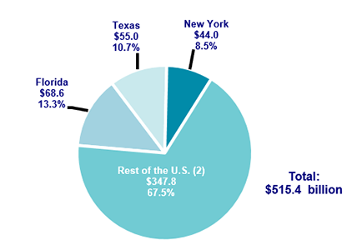
Top 3 States for Insured Catastrophe Losses, 1996-2005 (in 2015 Dollars)
Texas, Florida and New York lead the country in insured catastrophe losses over the past 20 years. These 3 states accounted for nearly 1/3 of all insured catastrophe losses over the past two decades
Source: PCS/Verisk for 2016 Insurance Fact Book, Insurance Information Institute.

Slide 91
Top 16 Most Costly Disasters in U.S. History—Katrina Still Ranks #1
(Insured Losses, 2014 Dollars, $ Billions)
Storm Sandy in 2012 was the last mega-CAT to hit the US
Includes Tuscaloosa, AL, tornado
Includes Joplin, MO, tornado
12 of the 16 Most Expensive Events in US History Have Occurred Since 2004
Sources: PCS; Insurance Information Institute inflation adjustments to 2014 dollars using the CPI.

Slide 92
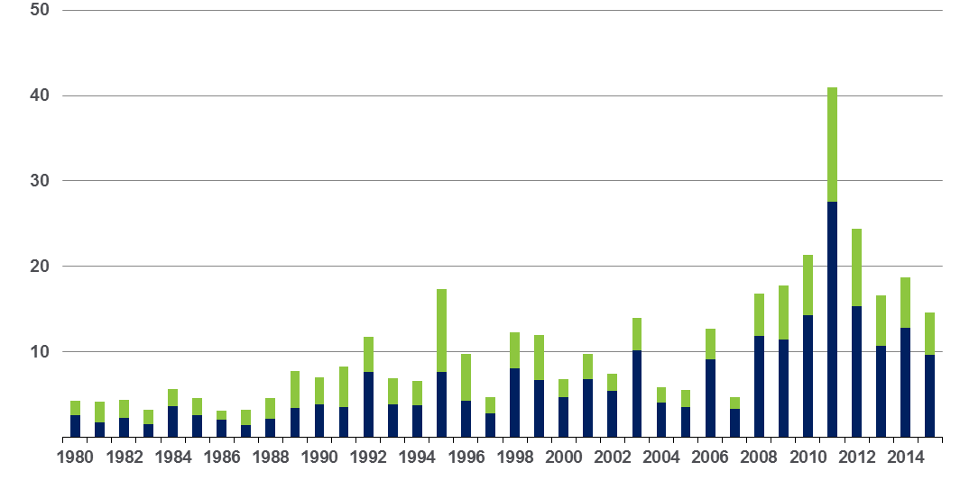
Convective Loss Events in the US
Overall and insured losses, 1980 – 2015
Overall losses
(in 2015 values)*
$ Billions
Insured losses
(in 2015 values)*
The period from 2008-2015 has been the most expensive on record for insured losses from “Convective Events” (severe thunderstorms, tornado, hail, lightning and flash flood)
*Losses adjusted to inflation based on CPI
Analysis contains:
severe storm, tornado, hail, flash flood and lightning
92
Source: Geo Risks Research, NatCatSERVICE

Slide 93
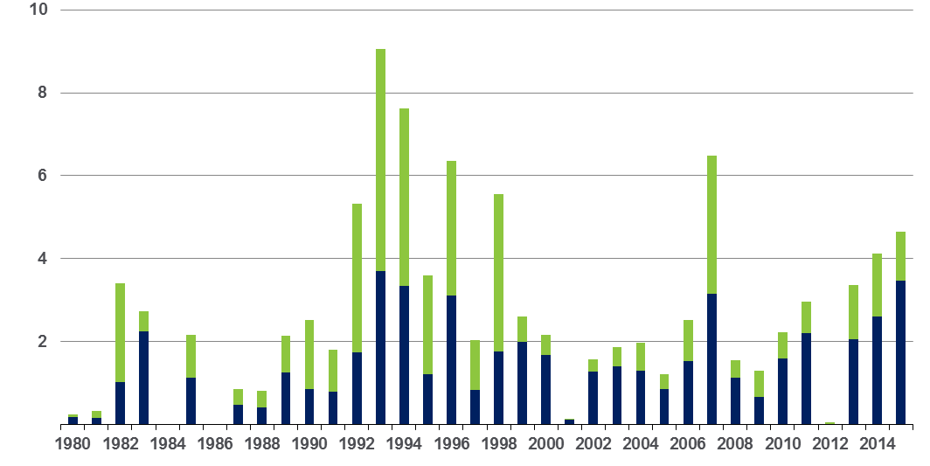
Winter Storm Losses in the US
1980 – 2015 (Overall and Insured Losses)*
$ Billions
Winter storm losses have been increasing rapidly in recent years
Overall losses
(in 2015 values)*
Insured losses
(in 2015 values)*
*Winter storms include also winter damages, blizzards and cold waves
*Losses adjusted to inflation based on CPI.
Source: Property Claim Services, MR NatCatSERVICE.
93

Slide 94
US Property CAT Rate on Line Index & Global Reinsurance ROE
US Property CAT ROL
Global Reinsurance ROE
Record traditional capacity, alternative capital and low CAT activity have pressured reinsurance prices; ROEs are own only very modestly
Source: Barclays PLC from Guy Carpenter; Insurance Information Institute.

Slide 95
THE ECONOMY
The Strength of the Economy Will Greatly Influence Insurer Exposure Base Across Most Lines
95

Slide 96
US Real GDP Growth*
The Q4:2008 decline was the steepest since the Q1:1982 drop of 6.8%
Real GDP Growth (%)
Recession began in Dec, 2007
Q1 2014/15 GDP data were hit hard by this year’s “Polar Vortex” and harsh winter
Demand for Energy Should Increase in 2016-17 as GDP Growth Continues at a Steady, Albeit Moderate Pace and Gradually Benefits the Economy Broadly
* Estimates/Forecasts from Blue Chip Economic Indicators.
Source: US Department of Commerce, Blue Economic Indicators 9/16; Insurance Information Institute.

Slide 97
US Unemployment Rate Forecast
Rising unemployment
eroded payrolls
and WC’s
exposure base.
Unemployment peaked at 10% in late 2009.
2007:Q1 to 2017:Q4F*
Jobless figures have been revised downwards for 2016
Unemployment forecasts have been revised modestly downwards. Optimistic scenarios put the unemployment as low as 4.4% by Q4 of 2016.
* = actual; = forecasts
Sources: US Bureau of Labor Statistics; Blue Chip Economic Indicators (9/16 edition); Insurance Information Institute.

Slide 98
Trucking Employment: 2006–2016*
(000)
Trucking employment is up by more than 200,000 or 16.8% since 2010
*Seasonally-adjusted monthly average through Aug 2016
Source: US Census Bureau; Insurance Information Institute.

Slide 99
Construction Employment,
Jan. 2010—Aug. 2016*
(Thousands)
Construction employment is +1.205 million above
Jan. 2011 (+22.2%) trough
Construction and manufacturing employment constitute 1/3 of all WC payroll exposure.
*Seasonally adjusted.
Sources: US Bureau of Labor Statistics at http://data.bls.gov; Insurance Information Institute.
99
12/01/09 - 9pm
eSlide – P6466 – The Financial Crisis and the Future of the P/C
Notes:
99

Slide 100
Employment in Oil & Gas Extraction,
Jan. 2010—Aug. 2016*
Employment peaked in Oct. 2014 at 201,500—its highest level since Dec. 1986.
(000)
Oil and gas extraction employment is down up 14.2% since Oct. 2014 as oil prices remain depressed
*Seasonally adjusted
Sources: US Bureau of Labor Statistics at http://data.bls.gov; Insurance Information Institute.
100
12/01/09 - 9pm
eSlide – P6466 – The Financial Crisis and the Future of the P/C
Notes:
100

Slide 101
CONSTRUCTION INDUSTRY OVERVIEW & OUTLOOK
The Construction Sector Is Critical to the Economy and the P/C Insurance Industry
101

Slide 102
Value of New Private Construction: Residential & Nonresidential, 2003-2016*
2016: Value of new pvt. construction hits $875.0 as of Jul. 2016, up 74.8% from the 2010 trough but still 4.0% below 2006 peak
New Construction peaks at $911.8. in 2006
Billions of Dollars
Trough in 2010 at $500.6B, after plunging 55.1% ($411.2B)
$613.7
$447.9
$298.1
$261.8
$398.3
$238.8
Private Construction Activity Is Moving in a Positive Direction though Remains Well Below Pre-Crisis Peak; Residential Dominates
*2016 figure is a seasonally adjusted annual rate as of July.
Sources: US Department of Commerce http://www.census.gov/construction/c30/c30index.html ; Insurance Information Institute.
102
12/01/09 - 9pm
eSlide – P6466 – The Financial Crisis and the Future of the P/C
Notes:
102

Slide 103
Value of Construction Put in Place, 2016 vs. 2015*
Growth (%)
Private: +1.0%
Public: -3.1%
Public sector construction activity is finally beginning to create less drag up after years of decline
Private sector construction activity is up in both the residential and nonresidential segments
Overall Construction Activity is Up Slighty, Having Decelrated from Early 2016; State/Local Sector Government Sector Was Recovering but Is Experienced Renewed Weakness
*seasonally adjusted data through July 2016.
Source: U.S. Census Bureau, http://www.census.gov/construction/c30/c30index.html ; Insurance Information Institute.

Slide 104
Value of Private Construction Put in Place, by Segment, 2016 vs. 2015*
Growth (%)
Construction activity has slowed in 2016, but led by the Office and Manufacturing segments, the sector continues to expand after plunging during the “Great Recession.”
Private Construction Activity is Up in Most Segments in the Second Half of 2016; Expansion Should Continue
*seasonally adjusted through Jul. 2016.
Source: U.S. Census Bureau, http://www.census.gov/construction/c30/c30index.html ; Insurance Information Institute.

Slide 105
New Private Housing Starts, 1990-2021F
Job growth, low inventories of existing homes, still-low mortgage rates and demographics should continue to stimulate new home construction for several more years
(Millions of Units)
New home starts plunged 72% from 2005-2009; A net annual decline of 1.49 million units, lowest since records began in 1959
Insurers Are Continue to See Meaningful Exposure Growth in the Wake of the “Great Recession” Associated with Home Construction: Construction Risk Exposure, Surety, Commercial Auto; Potent Driver of Workers Comp Exposure
Source: U.S. Department of Commerce; Blue Chip Economic Indicators (9/16 for 2016-17; 3/16 for 2018-21F; Insurance Information Institute.

Slide 106
Value of Public Construction Put in Place, by Segment, 2015 vs. 2016*
Growth (%)
Public sector construction activity slowed by mid-2016
Power, Commercial and Educations led declines in public sector construction
Public Construction Activity Surged in Early 2016 but Contracted Again by Mid-Year. A Resumption of the Recovery is Likely which Will Help Drive Demand in Many Commercial Insurance Lines
*seasonally adjusted through July 2016.
Source: U.S. Census Bureau, http://www.census.gov/construction/c30/c30index.html ; Insurance Information Institute.

Slide 107
Value of New Federal, State and Local Government Construction: 2003-2016*
Construction across all levels of government peaked at $314.9B in 2009
Austerity Reigns
Govt. construction has slowed in 2016; still down $36.7B or 11.7% since 2009 peak
($ Billions)
Government Construction Spending Peaked in 2009, Helped by Stimulus Spending, but Contracted As State/Local Governments Grappled with Deficits and Federal Sequestration; Only Now Recovering
*2016 figure is a seasonally adjusted annual rate as of July; http://www.census.gov/construction/c30/historical_data.html
Sources: US Department of Commerce; Insurance Information Institute.

Slide 108
Construction Employment,
Jan. 2003–Dec. 2015
(Thousands)
Construction employment as of Dec. 2015 totaled 6.538 million, an increase of 1.103MM jobs or 20.2% from the Jan. 2011 trough
Construction employment peaked at 7.726 million in April 2006
Gap between pre-recession construction peak and today: 1.19 million jobs
The “Great Recession” and housing bust destroyed 2.3 million constructions jobs
Construction employment troughed at 5.435 million in Jan. 2011, after a loss of 2.291 million jobs, a 29.7% plunge from the April 2006 peak
The Construction Sector Was a Growth Leader in 2014-15 as the Housing Market, Private Investment and Govt. Spending Recover. WC Insurers Will Benefit.
Note: Recession indicated by gray shaded column.
Sources: U.S. Bureau of Labor Statistics; Insurance Information Institute.
108
12/01/09 - 9pm
eSlide – P6466 – The Financial Crisis and the Future of the P/C
Notes:
108

Slide 109
MANUFACTURING SECTOR OVERVIEW & OUTLOOK
The U.S. Manufacturing Sector Is Being Buffeted by a High Dollar, Weak Export Markets and Plunging Oil Prices
109

Slide 110
Dollar Value* of Manufacturers’ Shipments Monthly, Jan. 1992—December 2015
$ Millions
The value of Manufacturing Shipments in Dec. 2015 was $467.0B—down 8% from the July 2014 record high of $508.1B
Monthly shipments in Nov. 2014 exceeded the pre-crisis (July 2008) peak but has declined in recent months. Weakness abroad, falling energy prices and a strong dollar are hurting the sector, especially exports. Manufacturing growth leads to gains in many commercial exposures: WC, Commercial Auto, Marine, Property, and various Liability Coverages.
* Seasonally adjusted; Data published Feb. 4, 2016.
Source: U.S. Census Bureau, Full Report on Manufacturers’ Shipments, Inventories, and Orders, http://www.census.gov/manufacturing/m3/
110
12/01/09 - 9pm
eSlide – P6466 – The Financial Crisis and the Future of the P/C
Notes:
110

Slide 111
ISM Manufacturing Index
(Values > 50 Indicate Expansion)
January 2010 through December 2015
Manufacturing began to contract in late 2015
The manufacturing sector expanded for 68 of the 72 months from Jan. 2010 through Dec. 2015. Manufacturing sector now appears to be in contraction due to weakness abroad, strong dollar and collapse in oil prices
Source: Institute for Supply Management at http://www.ism.ws/ismreport/mfgrob.cfm; Insurance Information Institute.

Slide 112
Manufacturing Growth for Selected Sectors, 2015 vs. 2014*
Growth (%)
Durables: +1.8%
Non-Durables: -9.6%
Manufacturing of non-durable goods is weaker than for durables
Manufacturing Is Contracting Across a Number of Sectors, Especially Petroleum. Adverse Exposure Impacts Are Likely for: WC, Commercial Property, Commercial Auto and Certain Liability Coverages
*Seasonally adjusted; Date are YTD comparing data through November 2015 to the same period in 2014.
Source: U.S. Census Bureau, Full Report on Manufacturers’ Shipments, Inventories, and Orders, http://www.census.gov/manufacturing/m3/

Slide 113
Manufacturing Employment,
Jan. 2003–December 2015
(Thousands)
Manufacturing employment hit a trough at 11.45 million in Feb. and Mar. 2010
Latest (Dec 2015) at 12.33 million
Manufacturing employment was declining, slowly, before the Great Recession
Manufacturing employment was growing slowly but steadily from 2010 through 2014 but has been flat in 2015. Automation, a slowing world economy, the strong dollar and other factors have held the growth rate down.
Note: Recession indicated by gray shaded column. Data are seasonally adjusted.
Sources: US Bureau of Labor Statistics; Insurance Information Institute.
113
12/01/09 - 9pm
eSlide – P6466 – The Financial Crisis and the Future of the P/C
Notes:
113

Slide 114
Manufacturing Employment,
Jan. 2010—December 2014*
(Thousands)
Since Jan 2010, manufacturing employment is up (+877,000 or +7.7%)
and still growing.
Manufacturing employment is a surprising source of strength in the economy. Employment in the sector is at a multi-year high.
*Seasonally adjusted.
Sources: US Bureau of Labor Statistics at http://data.bls.gov; Insurance Information Institute.
114
12/01/09 - 9pm
eSlide – P6466 – The Financial Crisis and the Future of the P/C
Notes:
114

Slide 115
Employment in Oil & Gas Extraction,
Jan. 2010—Aug. 2016*
Employment peaked in Oct. 2014 at 201,500—its highest level since Dec. 1986.
(000)
Oil and gas extraction employment is down up 14.2% since Oct. 2014 as oil prices remain depressed
*Seasonally adjusted
Sources: US Bureau of Labor Statistics at http://data.bls.gov; Insurance Information Institute.
115
12/01/09 - 9pm
eSlide – P6466 – The Financial Crisis and the Future of the P/C
Notes:
115

Slide 116
Trucking Employment: 2006–2016*
(000)
Trucking employment is up by more than 200,000 or 16.8% since 2010
*Seasonally-adjusted monthly average through Aug 2016
Source: US Census Bureau; Insurance Information Institute.

Slide 117
Index of Total Industrial Production:*
A Near Peak as of December 2014
Many economists expect business investment to rise in 2015
December 2014 Index at 106.5
Peak at 100.82 in December 2007 (officially the 1st month of the Great Recession)
Insurance exposures for industrial production will continue growing in 2015, and commercial insurance premium volume with them. Y-o-Y growth to December 2014 was 4.6%. Both production and premium volume growth for 2015 should exceed this.
*Monthly, seasonally adjusted, through December 2014 (which is preliminary). Index based on year 2007 = 100
Sources: Federal Reserve Board at http://www.federalreserve.gov/releases/g17/ipdisk/ip_sa.txt .
National Bureau of Economic Research (recession dates); Insurance Information Institute.
117
12/01/09 - 9pm
eSlide – P6466 – The Financial Crisis and the Future of the P/C
Notes:
117

Slide 118
Recovery in Capacity Utilization is a Positive Sign for Commercial Exposures
March 2001 through Dec. 2014
“Full Capacity”
The US operated at 79.7% of industrial capacity in Dec. 2014, well above the June 2009 low of 66.9% but is still below pre-recession levels.
Percent of Industrial Capacity
Hurricane Katrina
The closer the economy is to operating at “full capacity,” the greater the inflationary pressure
March 2001-November 2001 recession
December 2007-
June 2009 Recession
118
Source: Federal Reserve Board statistical releases at http://www.federalreserve.gov/releases/g17/Current/default.htm.
Notes:
118

Slide 119
TECHNOLOGY, DISRPTORS AND INSURANCE
Applications of Technology in P/C Insurance Have Gripped the Media as Have Industry Solutions
119

Slide 120
Interest in Technology Issues and Insurance Is Surging: Presents Opportunity
Insurers are at the intersection of many of the most important technological innovations of the early 21st century
  Problem→Solution→Opportunity
Industry is too often depicted as a technology laggard
I.I.I. is highlighting the industry as being on the technological cutting edge—an innovative, nimble industry with solutions for managing countless new risks of the current era:
  Sharing economy Cyber Auto Technology
  Supply Chain Climate Risk Drones
  Wearable devices The “Internet of Things”
Positions industry well with customers, investors, current and prospective workers/Millennials, regulators/legislators and (tech) media
120
12/01/09 - 9pm
eSlide – P6466 – The Financial Crisis and the Future of the P/C
Notes:
120

Slide 121
CYBER RISK AND INSURANCE
Cyber Risk is a Rapidly Emerging Exposure for Businesses Large and Small in Every Industry
121

Slide 122






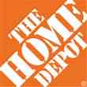

Data Breaches 2005-2015, by Number of Breaches and Records Exposed
# Data Breaches/Millions of Records Exposed
Millions
The 781 reported data breaches in 2015 was virtually unchanged form the record 783 reported in 2014. The number of exposed records soared to 169.1 million, and increase of 97.5%.
Source: Identity Theft Resource Center (updated as of Jan. 6, 2016);
http://www.idtheftcenter.org/images/breach/ITRCBreachReport2015.pdf

Slide 123
Data/Privacy Breach:
Many Potential Costs Can Be Insured
Data Breach Event
Costs of notifying affecting individuals
Defense and settlement costs
Lost customers and damaged reputation
Cyber extortion payments
Costs of notifying regulatory authorities
Regulatory fines at home & abroad
Business Income Loss
Forensic costs to discover cause
123

Slide 124
Estimated Cyber Insurance Premiums Written, 2014 – 2020F
Cyber insurance premiums written could more than triple to $7.5 billion by 2020
$ Billions
I.I.I.’s Cyber Risk paper issued Oct. 2015
Source: Advisen (2014 est.); PwC (2015, 2020); Insurance Information Institute.

Slide 125
THE SHARING (ON-DEMAND) ECONOMY
Area of Extreme Interest—And Insurers Are Providing Solutions for this Dynamic Economic Segment
125

Slide 126




Sharing/On-Demand/Peer-to-Peer Economy Impacts Many Lines of Insurance
The “On-Demand” Economy is or will impact many segments of the economy important to P/C insurers
  Auto (personal and commercial)
  Homeowners/Renters
  Many Liability Coverages
  Professional Liability
  Workers Comp
Many insurance questions have arisen
Insurance solutions are increasingly available to fill the many insurance gaps that arise
126
12/01/09 - 9pm
eSlide – P6466 – The Financial Crisis and the Future of the P/C
Notes:
126

Slide 127



Labor on Demand: Huge Implications for the US Economy, Workers & Insurers
Will YOUR job be reduced to an app?

Slide 128
Ridesharing Regulation/Legislation and Status of ISO Filings as of 9/30/15
Status Ride Sharing Legislation/Regulation
Status of ISO Filings
128
Source: ISO.

Slide 129
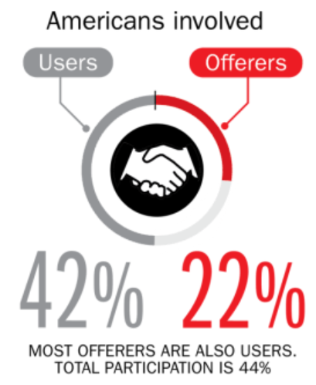
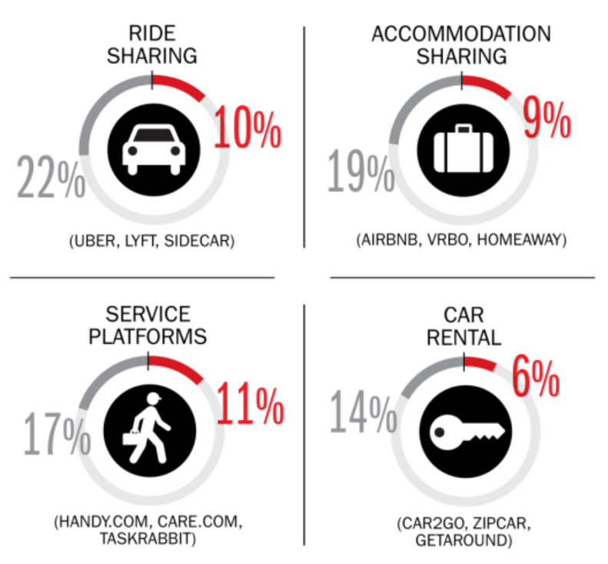
Percent of Americans Who Have Engaged in the “Gig/Sharing Economy” by Transaction
Drivers have significant WC exposures
Service platforms have the most direct link to WC; 11% of Americans have offered their services
About 22% of Americans have offered services in the sharing economy
Sources: The SelfEmployed.com accessed at https://www.theselfemployed.com/gig-economy/infographic-inside-the-new-economy/ based on a poll by Time magazine, Bursten-Marsteller and The Aspen Institute; Insurance Information Institute.

Slide 130
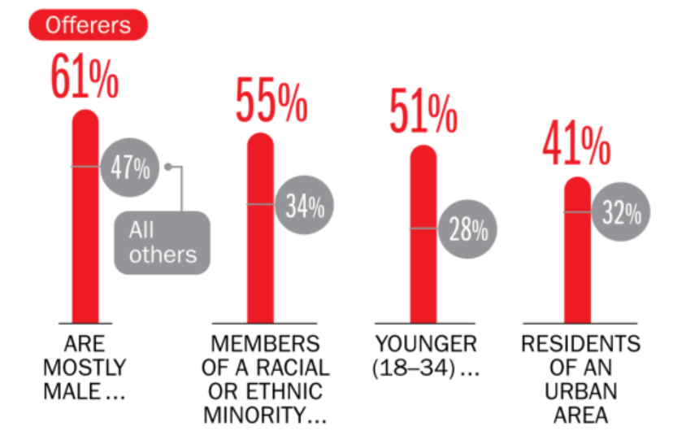
Americans Who Offer Services in the Sharing/Gig Economy Are Statistically More Prone to Workplace Injury
Young, Urban Minority Males Are the Most Likely to Offer their Services in the Sharing Economy
Sources: The SelfEmployed.com accessed at https://www.theselfemployed.com/gig-economy/infographic-inside-the-new-economy/ based on a poll by Time magazine, Bursten-Marsteller and The Aspen Institute; Insurance Information Institute.

Slide 131

The Sharing Economy Can’t Escape Politics and Regulation

Slide 132

Political Skepticism About the
‘Gig’ Economy
"Many Americans are making extra money renting out a spare room, designing a website ... even driving their own car. This on demand or so called 'gig' economy is creating exciting opportunities and unleashing innovation, but it's also raising hard questions about workplace protections and what a good job will look like in the future."
--Hillary Clinton,
July 13, 2015
132
12/01/09 - 9pm
eSlide – P6466 – The Financial Crisis and the Future of the P/C
Notes:
132

Slide 133
AUTO TECHNOLOGY &
THE FUTURE OF AUTO INSURANCE
Technology Promises Safer Cars and Highways, BUT Some Analysts, Media and Many in Silicon Valley Are Predicting Doom for Auto Insurers
133

Slide 134
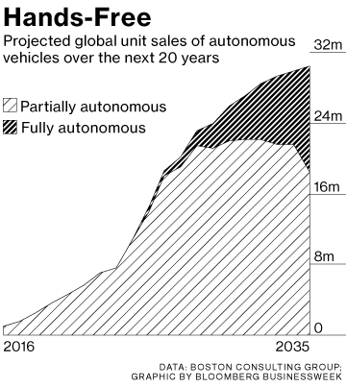
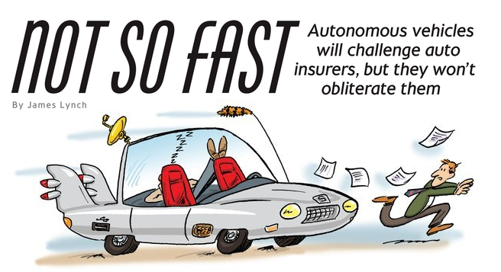

Media is Obsessed with Driverless Vehicles: Often Predicting the Demise of Auto Insurance
By 2035, it is estimated that 25% of new vehicle sales could be fully autonomous models
Questions
Are auto insurers monitoring these trends?
How are they reacting?
Will or Amazon or FinTech take over the industry? (cars/sales)
Will the number of auto insurers shrink?
How will liability shift?
Source: Boston Consulting Group; Insurance Information Institute.

Slide 135
I.I.I. Poll: Telematics
Q. I’m going to ask you a question about your opinion of insurance companies collecting information about how and when you drive in order to set your auto insurance premium. Please tell me which statement you agree with. Would you…¹
Don’t know
Would not allow
Allow if premium went down
Allow whether or not premium went down
More Than Half of Auto Policyholders Would Allow Their Insurer to Collect Their Driving Information In Order to Set Premiums.
¹Asked of those who auto insurance.
Source: Insurance Information Institute Annual Pulse Survey.

Slide 136
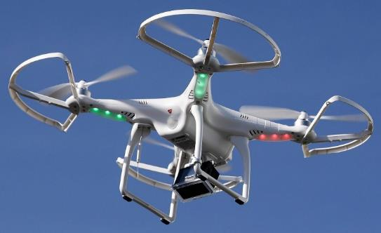

Send in the Drones: Potential Rapid
Adoption in Industry; Media Loves It
Drones or Unmanned Aerial Vehicle (UAV) technology is seeing rapid adoption rate in many industries, including insurance
FAA granting Section 333 exemptions for commercial use and testing of UAS
At least 5 insurers have received permission to test
Wide variety of applications: claims, pre-event property inspections…
Insurers partnering with construction industry to guide R&D and regulation of UAV use via Property Drone Consortium: www.propertydrone.org

Slide 137
THE ‘INTERNET OF THINGS’
Capturing Economic Value Amid a Shifting Insurer Value Chain
137

Slide 138
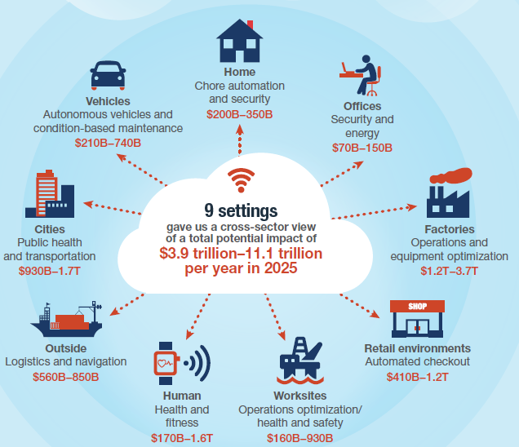
The Internet of Things and the Insurance Industry
The “Internet of Things” will create trillions in economic value throughout the global economy by 2025
What opportunities, challenges will this create for insurers?
What are the impact on the insurance industry “value chain”?
Sources: McKinsey Global Institute, The Internet of Things: Mapping the Value Beyond the Hype,
June 2015; Insurance Information Institute.
138
12/01/09 - 9pm
eSlide – P6466 – The Financial Crisis and the Future of the P/C
Notes:
138

Slide 139
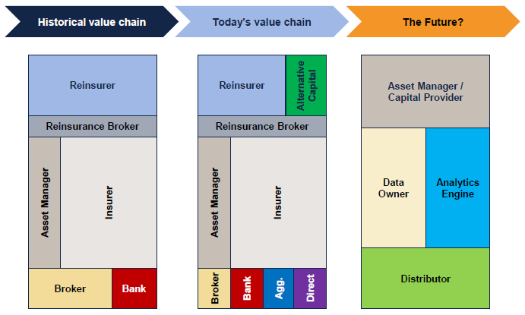
The Internet of Things and the Insurance Industry Value Chain
The Insurance Industry Value Chain Is Changing for Many Reasons
Source: Willis Capital Markets & Advisory; Insurance Information Institute.
139
12/01/09 - 9pm
eSlide – P6466 – The Financial Crisis and the Future of the P/C
Notes:
139

Slide 140
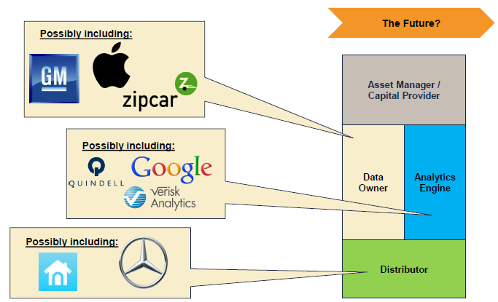
The Internet of Things and the Insurance Industry Value Chain
Who owns the data? Where does It flow? Who does the analytics? Who is the capital provider?
Source: Willis Capital Markets & Advisory; Insurance Information Institute.
140
12/01/09 - 9pm
eSlide – P6466 – The Financial Crisis and the Future of the P/C
Notes:
140

Slide 141

A NEST Case Study
Nest: A Leader in the “Internet of Things”
Collision Course or Cooperation with the Insurance Industry?
141

Slide 142



Telematics for Your Home:
The Internet of Things
The home is the next frontier for telematics
Rapidly becoming a crowded space
How and with whom will insurers partner?
Can control increasing array of household systems remotely
  Heat, A/C
  Fire, CO detection
  Security Systems
  Cameras/Monitors
  Appliances
  Lighting
Technology is adaptive
  Uses sensors and algorithms to learn about you
142
12/01/09 - 9pm
eSlide – P6466 – The Financial Crisis and the Future of the P/C
Notes:
142

Slide 143
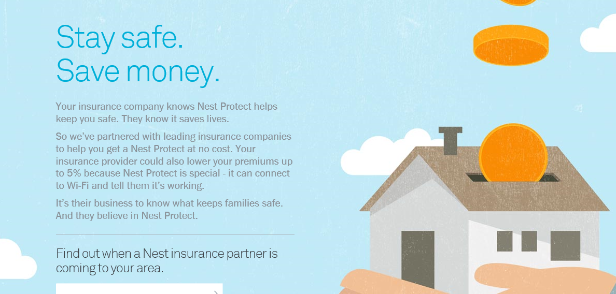
Partnerships with Insurers: Selling Safety and Savings Simultaneously
Nest is actively seeking to partner with insurers. As of Jan. 10, 2016, Nest listed 2 insurance partners offering discounts in a number of states
Source: https://nest.com/insurance-partners/ accessed 1/10/16; Insurance Information Institute research.
143
12/01/09 - 9pm
eSlide – P6466 – The Financial Crisis and the Future of the P/C
Notes:
143

Slide 144
Shifting Legal Liability &
Tort Environment
Will the Tort Pendulum
Swing Against Insurers?
144

Slide 145
Average Personal Injury Jury Award,
2009 – 2013
Average awards in Personal Injury cases have increased by more than 1/3 in recent years
Source: Current Award Trends in Personal Injury, 54th Edition; Insurance Information Institute.

Slide 146
Business Leaders Ranking of Liability Systems in 2015
Best States
Delaware
Vermont
Nebraska
Iowa
New Hampshire
Idaho
North Carolina
Wyoming
South Dakota
Utah
Worst States
Arkansas
Missouri
Mississippi
Florida
New Mexico
Alabama
California
Illinois
Louisiana
West Virginia
New in 2015
Vermont
New Hampshire
North Carolina
South Dakota
Newly Notorious
Arkansas
Missouri
Drop-offs
Rising Above
Minnesota
Kansas
Virginia
North Dakota
Oklahoma
Montana
Source: US Chamber of Commerce 2015 State Liability Systems Ranking Study; Insurance Info. Institute.

Slide 147
The Nation’s Judicial “Hellholes”: 2014/2015
Watch List
Illinois
Madison County
West Virginia
Atlantic County, New Jersey
Mississippi Delta
Montana
Nevada
Newport News, Virginia
Philadelphia, Pennsylvania
California
Dishonorable Mention
Assignment of Benefits issue looms large in FL
New York City Asbestos Litigation
AL Supreme Court
PA Supreme Court
Volkswagen: Massive tort actions, fines, penalties certain. Are others vulnerable? Issue of cheating on environmental standards and liability looms large.
Florida
Source: American Tort Reform Association; Insurance Information Institute

Slide 148
Insurance Information Institute Online:
www.iii.org
Thank you for your time
and your attention!
Twitter: twitter.com/bob_Hartwig
Download at www.iii.org/presentations

