Slide 1
Future Shock:
Challenges and Opportunities for the Global Insurance Industry in a Rapidly Changing World
Connecticut Insurance Market Forecast
Hartford, CT
November 20, 2014
Download at: www.iii.org/presentations
Robert P. Hartwig, Ph.D., CPCU, President & Economist
Insurance Information Institute ♦ 110 William Street ♦ New York, NY 10038
Tel: 212.346.5520 ♦ Cell: 917.453.1885 ♦ bobh@iii.org ♦ www.iii.org

Slide 2
Presentation Outline
Insurance: A Global Force
The Impact of the “Insurance Economy”
  Dollars and Jobs
Public Perceptions of the Insurance Industry
The Importance of Insurance:
  P/C
  Life
  Health
The Insurance Equation: Challenge = Opportunity
  Old & New: Challenges and Insurance Solutions
An Industry Built of Strength & Experience
Q&A

Slide 3
INSURANCE:
We Are a Global Force
Becoming More Global Is the Destiny of the Insurance Industry
3

Slide 4
Distribution of Global Insurance Premiums, 2013 ($ Trillions)
Total Premium Volume = $4.641 Trillion*
Life insurance accounted for 56.2% of global premium volume in 2013 vs. 43.8% for Non-Life
Source: Swiss Re, sigma, No. 3/2014; Insurance Information Institute.

Slide 5
Distribution of Nonlife Premium: Industrialized vs. Emerging Markets, 2013
Emerging market’s share of nonlife premiums increased to 19.5% in 2013, up from 17.3% in 2012 and 14.3% in 2009. The share of premiums written in the $2 trillion global nonlife market remains much larger (80.5%) but continues to shrink.
The financial crisis and sluggish recovery in the major insurance markets will accelerate the expansion of the emerging market sector
Premium Growth Facts
2013, $Billions
Industrialized Economies
$1, 653.0
Emerging Markets
$399.8
Developing markets now account for about 40% of global GDP but just under 20% of nonlife premiums
Sources: Swiss Re sigma No.4/2013; Insurance Information Institute research.

Slide 6
Tope 15 Insurance Markets in 2013,
Life and Property/Casualty
Global premium volume in 2013 = $4.641 Trillion
$ Billions
Countries in all parts of the world except Africa are now represented among the world’s largest insurance markets
Source: Swiss Re, sigma, No. 3/2014; Insurance Information Institute.

Slide 7
Premium Growth by Region, 2013
Latin America growth was the strongest in 2013
Growth in Advanced Asia (incl. China) markets decelerated in 2013
Strength in Africa,
Global Premium Volume Totaled $4.641 Trillion in 2013, up 1.4% from $4.599 Trillion in 2012. Global Growth Was Weighed Down by Slow Growth in N. America and W. Europe and Partially Offset by Emerging Markets
Source: Swiss Re, sigma, No. 3/2013.
7
Notes:
7

Slide 8
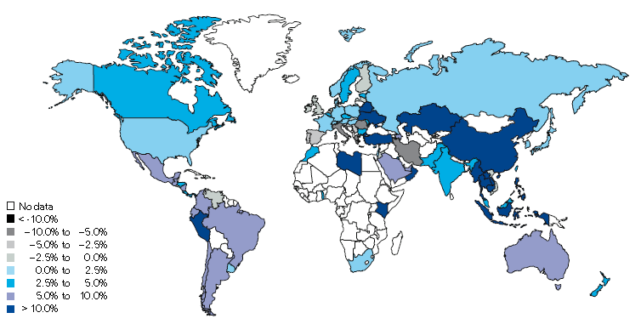
Non-Life Insurance: Global Real (Inflation Adjusted) Premium Growth, 2013
Real growth in non-life insurance premiums was faster in China and most of SE Asia than the US
Growth in Emerging markets is much faster than in Advanced markets
Market | Life | Non-Life | Total
Advanced | -0.2 | 1.1 | 0.3
Emerging | 6.4 | 8.3 | 7.4
World | 0.7 | 2.3 | 1.4
Source: Swiss Re, sigma, No. 3/2014.
8
12/01/09 - 9pm
eSlide – P6466 – The Financial Crisis and the Future of the P/C
Notes:
8

Slide 9
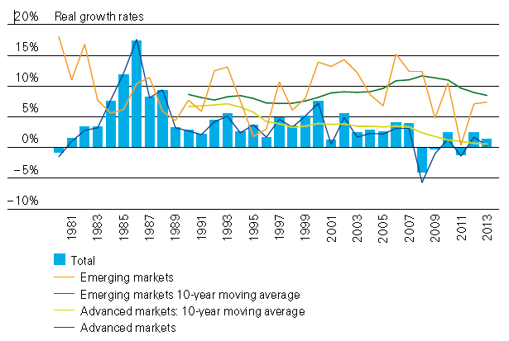
Global Real (Inflation Adjusted)
Premium Growth: 1980-2013
Premium growth is very erratic in part to inflation volatility in emerging markets as well as a lack of consistent cyclicality
Emerging market growth has exceeded that of industrialized countries in 30 of the past 34 years, including the entirety of the global financial crisis and subsequent recovery
Source: Swiss Re, sigma, No. 3/2014.
9
12/01/09 - 9pm
eSlide – P6466 – The Financial Crisis and the Future of the P/C
Notes:
9

Slide 10
GDP Growth: Advanced & Emerging Economies vs. World, 1970-2015F
Emerging economy growth rates are expected to ease to 4.4% in 2014 and 5.0% in 2015
GDP Growth (%)
World output is forecast to grow by 3.3% in 2014 and 3.8% in 2015. The world economy shrank by 0.6% in 2009 amid the global financial crisis
Advanced economies are expected to grow at a modest pace of 1.8% in 2014 and to 2.3% in 2015.
Source: International Monetary Fund, World Economic Outlook , October 2014; Insurance Information Institute.

Slide 11
Real GDP Growth Forecasts:
Major Economies: 2011 – 2015F
US growth should acceleratein 2015
Growth in China has slowed but outpaces the US and Europe
The Eurozone remains weak
Political turmoil in Latin America is hurting growth
Growth Prospects Vary Widely by Region but the Outlook for 2015 Has Dimmed Except in the US and UK
Sources: Blue Chip Economic Indicators (10/2014 issue); IMF (10/2014); Insurance Information Institute.
11
Notes:
11

Slide 12
Real GDP Growth Forecasts:
Selected Economies: 2011 – 2015F
Strong economies in smaller industrialized nations will bolster demand for products, services, international trade and insure
Growth in Russia is being hit hard by sanctions
Growth Is Expected Accelerate Modestly in Most of the World in 2014 and 2015
Sources: Blue Chip Economic Indicators (10/2014 issue); IMF (10/2104); Insurance Information Institute.
12
Notes:
12

Slide 13
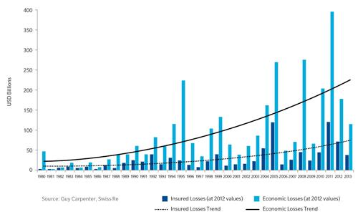
Gap Between Economic and Insured Losses: 1980—2013
The gap between economic and insured losses is growing—suggesting both a problem and an opportunity
Sources: Guy Carpenter, Swiss Re; Insurance Information Institute .
13
12/01/09 - 9pm
eSlide – P6466 – The Financial Crisis and the Future of the P/C
Notes:
13

Slide 14
Globalization:
The Global Economy Creates Opportunities & Risks
Globalization Is a Double Edged Sword—Creating Opportunity and Wealth But Potentially Creating and Amplifying Risk
Greater Reward → Greater Risk
14

Slide 15





5 Major Categories for External Global Risks, Uncertainties and Fears: Insurance Solutions
Economic Risks
Geopolitical Risks
Environmental Risks
Technological Risks
Societal Risks
While risks can be broadly categorized, none are mutually exclusive
Source: Adapted from World Economic Forum, Global Risks 2014; Insurance Information Institute.

Slide 16

Multitude of Exogenous Factors Influence Insurer Growth, Performance & Cyclicality
Economic Issues in US, Europe
Weakness in China/Emerging Economies
Political Upheaval in the Ukraine, Middle East
  Syria, Iraq, Thailand, Argentina, Venezuela
  →Trade sanctions (e.g., Iran, Russia)
Political Gridlock in the US, Europe, Japan
Fiscal/Monetary Imbalances/Low Interest Rates
Unemployment
Resurgent Terrorism Risk: ISIS & Other Groups
Cyber Attacks (theft, espionage, terrorism)
Ebola Crisis
Sabre Rattling (e.g., US-China, Russia-Ukraine)
Separatist Fever (UK/Scotland, Spain)
Severe Natural Disaster Losses
Climate Change/Sea Level Rise
Environmental Degradation
(Over)Regulation: Systemic Risk?
Are “Black Swans” everywhere or does it just seem that way?

Slide 17
The Economics of Connecticut’s Insurance Industry
Insurance Remains Key to Connecticut’s Economy
17

Slide 18
US Insurance and Related Activities as a Percent of US GDP, 1997-2012
Insurance activity accounts for about 2.5% of US GDP annually
Recessions and investment reverses (in 2001 and 2008) cut into the contribution of the Insurance Industry to U.S. GDP. In times of healthier economic growth, the industry contributes between 2.5% and 2.75% of U.S. GDP
Sources: U.S. Department of Commerce, Bureau of Economic Analysis; Insurance Information Institute.

Slide 19
Insurance and Related Activities in CT as a Percent of CT GDP, 1997-2012
Insurance activity accounts for 7% - 8% of Connecticut’s economy, three times that of the US overall
Recessions and investment reverses (in 2001 and 2008) cut into the contribution of the Insurance Industry to CT GDP. In times of healthier economic growth, the industry contributes between 7% and 9% (and sometimes more) of Connecticut’s state GDP
Sources: U.S. Department of Commerce, Bureau of Economic Analysis; Insurance Information Institute.

Slide 20
Insurance and Related Activities as a Percent of GDP, US vs. CT, 1997-2012
Insurance activity in CT is three times that of the US overall
Recessions and investment reverses (in 2001 and 2008) cut into the contribution of the Insurance Industry to GDP. In times of healthier economic growth, the industry contributes between 7% and 9% (and sometimes more) of Connecticut’s state GDP
Sources: U.S. Department of Commerce, Bureau of Economic Analysis; Insurance Information Institute.

Slide 21
INSURANCE INDUSTRY EMPLOYMENT TRENDS
A Big, Important Industry With Many Employment Crosscurrents
21

Slide 22
Insurance Industry Employment*
2000-2014F
Insurance industry employment is recovering and will likely reach a new record level of employment in early 2015
Annual Average, in Thousands
Insurance industry employment added nearly 185,000 jobs from 2000 to 2008, an increase 8.3%
Insurance industry employment fell by 2.9% during Great Recession
*Includes direct writers, claims adjusters, third-party administrators of insurance funds and other service personnel such as advisory and insurance ratemaking services.
Sources: U.S. Department of Labor, Bureau of Labor Statistics; Insurance Information Institute (2014 forecast).

Slide 23
Overview of Insurance Sector Employment Changes*
Insurance Subsector | August 2014 Employment | September 2014 Employment | Change
CARRIERS
P-C Direct | 534,300 | 535,000 | +700
Life Direct | 341,900 | 343,500 | +1,600
Health/Medical Direct | 496,200 | 498,300 | +2,100
Title & Other Direct | 73,500 | 73,100 | -400
Reinsurers | 27,400 | 27,400 | 0
OTHERS
Agents/Brokers | 689,800 | 692,000 | +2,200
3rd-Party Administration | 164,500 | 166,500 | +2,000
Claims Adjusters | 50,600 | 50,000 | -600
*Data are through September 2014 and are preliminary (i.e., subject to later revision); seasonally adjusted.
23
Notes:
23

Slide 24
Insurance Industry Employment Trends
Over the Past 25 Years, Each Industry Segment Has Had Different Employment Experiences
24

Slide 25
U.S. Employment in the Direct
P/C Insurance Industry: 1990–2014*
Thousands
P/C employment is recovering
The BLS occasionally reclassifies employment within industries. When this happens, the change is spread evenly over a 12-month period (in this case March 2010-March 2011.
*As of September 2014; not seasonally adjusted; Does not including agents & brokers.
Note: Recessions indicated by gray shaded columns.
Sources: U.S. Bureau of Labor Statistics; National Bureau of Economic Research (recession dates); Insurance Information Institute.
25
Notes:
25

Slide 26
U.S. Employment in the Direct
Life Insurance Industry: 1990–2014*
Thousands
Life employment is basically flat
Every 4-5 years BLS reconciles its data with census data; sometimes this reclassifies employment within industries. This drop, spread over March 2004-March 2005, moved some people to the Health/Medical Expense sector.
*As of September 2014; not seasonally adjusted; Does not including agents & brokers.
Note: Recessions indicated by gray shaded columns.
Sources: U.S. Bureau of Labor Statistics; National Bureau of Economic Research (recession dates); Insurance Information Institute.
26
Notes:
26

Slide 27
U.S. Employment in the Direct Health-
Medical Insurance Industry: 1990–2014*
Thousands
Employment in the Health-Medical insurance segment is seeing strong growth, as it has for most of the past 25 years.
*As of September 2014; not seasonally adjusted; Does not including agents & brokers.
Note: Recessions indicated by gray shaded columns.
Sources: U.S. Bureau of Labor Statistics; National Bureau of Economic Research (recession dates); Insurance Information Institute.
27
Notes:
27

Slide 28
U.S. Employment in the
Reinsurance Industry: 1990–2014*
Thousands
After a multi-decade decline, Reinsurance employment has shown some recent growth
*As of September 2014; not seasonally adjusted; Does not including agents & brokers.
Note: Recessions indicated by gray shaded columns.
Sources: U.S. Bureau of Labor Statistics; National Bureau of Economic Research (recession dates); Insurance Information Institute.
28
Notes:
28

Slide 29
U.S. Employment in Insurance
Agencies & Brokerages: 1990–2014*
Thousands
Agency/Brokerage employment is recovering despite consolidation
*As of September 2014; not seasonally adjusted. Includes all types of insurance.
Note: Recessions indicated by gray shaded columns.
Sources: U.S. Bureau of Labor Statistics; National Bureau of Economic Research (recession dates); Insurance Information Institute.
29
Notes:
29

Slide 30
U.S. Employment in Insurance
Claims Adjusting: 1990–2014*
Thousands
Claims adjusting is a profession in transition
*As of September 2014; not seasonally adjusted.
Note: Recessions indicated by gray shaded columns.
Sources: U.S. Bureau of Labor Statistics; National Bureau of Economic Research (recession dates); Insurance Information Institute.
30
Notes:
30

Slide 31
U.S. Employment in Third-Party Administration of Insurance Funds: 1990–2014*
Thousands
More work is being done by TPAs
*As of September 2014; not seasonally adjusted. Includes all types of insurance.
Note: Recessions indicated by gray shaded columns.
Sources: U.S. Bureau of Labor Statistics; National Bureau of Economic Research (recession dates); Insurance Information Institute.
31
Notes:
31

Slide 32
How Does the Public (and Prospective Employees) View the Industry?
I.I.I. Survey: Insurance Favorability Ratings Are Fairly Strong
32

Slide 33
I.I.I. Poll: Favorability
Percent of Public Rating Industry as Very or Mostly Favorable, 2013-2014
Auto/Home Insurers Achieved Their Highest Ranking in the 47-Year History of the Pulse Survey. Life insurers rank high as well.
Auto/Home Insurers Ranked Highest of Industries Surveyed.
Source: Insurance Information Institute Annual Pulse Survey.

Slide 34
I.I.I. Poll: Favorability
Percent of Public Rating Industry as Very or Mostly Favorable, 2014
Auto/Home Favorability outranks other key industries
Source: Insurance Information Institute Annual Pulse Survey.

Slide 35
I.I.I. Poll: Favorability
Percent of Public Rating Industry as Very or Mostly Favorable, 1968-2014
Auto/Home Favorability Has Outranked Banking Four Years in a Row.
Auto/Home Insurers Continue to Rank Higher Than Banking, Mutual Funds.
Source: Insurance Information Institute Annual Pulse Survey.

Slide 36
Insurance Market Overview:
A Segmented Industry
Property/Casualty
Life/Annuity
Health
36

Slide 37
Property/Casualty Insurance Industry Trends
Rich History, Poised to Manage the Risks and Seize the Opportunities of the Future
37

Slide 38
Cumulative Value of Inflation-Adjusted Claims Paid by P/C Insurers, 1925–2010E*
Adjusted for inflation, it took 36 years for the industry to pay its first $1 trillion in claims in the years since 1925. Today, the industry pays $1 trillion in claims every 2 to 3 years after adjusting for inflation.
$ Billions
3 years (2008)
3 years (2005)
2 years (2002)
4 years (2000)
3 years (1996)
3 years (1993)
4 years (1990)
4 years (1986)
5 years (1982)
7 years (1977)
9 years (1970)
36 years (1925 – 1961)
*1925 – 1934 stock companies only. Includes workers compensation state funds 1998-2006.
Sources: Insurance Information Institute research and calculations from A.M. Best data.
38
12/01/09 - 9pm
eSlide – P6466 – The Financial Crisis and the Future of the P/C
Notes:
38

Slide 39
P/C Industry Net Income After Taxes
1991–2014:H1
2005 ROE*= 9.6%
2006 ROE = 12.7%
2007 ROE = 10.9%
2008 ROE = 0.1%
2009 ROE = 5.0%
2010 ROE = 6.6%
2011 ROAS¹ = 3.5%
2012 ROAS¹ = 5.9%
2013 ROAS¹ = 10.3%
2014 ROAS¹ = 7.8%
Net income rose strongly (+81.9%) in 2013 vs. 2012 on lower cats, capital gains
$ Millions
2014 is off to a slower start
ROE figures are GAAP; ¹Return on avg. surplus. Excluding Mortgage & Financial Guaranty insurers yields a 7.7% ROAS through 2014:Q2, 9.8% ROAS in 2013, 6.2% ROAS in 2012, 4.7% ROAS for 2011, 7.6% for 2010 and 7.4% for 2009.
Sources: A.M. Best, ISO; Insurance Information Institute

Slide 40
Profitability Peaks & Troughs in the P/C Insurance Industry, 1975 – 2014:H1*
ROE
1977:19.0%
History suggests next ROE peak will be in 2016-2017
1987:17.3%
10 Years
2006:12.7%
1997:11.6%
10 Years
2013 10.4%
9 Years
2014:H1 7.7%
1975: 2.4%
1984: 1.8%
1992: 4.5%
2001: -1.2%
*Profitability = P/C insurer ROEs. 2011-14 figures are estimates based on ROAS data. Note: Data for 2008-2014 exclude mortgage and financial guaranty insurers.
Source: Insurance Information Institute; NAIC, ISO, A.M. Best.

Slide 41
Back to the Future: Profitability Peaks & Troughs in the P/C Insurance Industry, 1950 – 2014*
ROE
1970-90: Peak ROEs were much higher in this period while troughs were comparable. High interest rates, rapid inflation, economic volatility all played roles
1950-70: ROEs were lower in this period. Low interest rates, low inflation, “Bureau” rate regulation all played a role
1990-2010s: Déjà vu. Excluding mega-CATs, this period is very similar to the 1950-1970 period
1977:19.0%
1987:17.3%
2006:12.7%
1972:13.7%
1997:11.6%
2013 10.4%
1950:8.0%
1966-67: 5.5%
1959:6.8%
2014:H1 7.7%
1969: 3.9%
1957: 1.8%
1965: 2.2%
1975: 2.4%
1984: 1.8%
1992: 4.5%
2001: -1.2%
*Profitability = P/C insurer ROEs. 2011-14 figures are estimates based on ROAS data. Note: Data for 2008-2014 exclude mortgage and financial guaranty insurers. 2014 figure is through Q2.
Source: Insurance Information Institute; NAIC, ISO, A.M. Best.

Slide 42
ROE: Property/Casualty Insurance by Major Event, 1987–2014:H1
(Percent)
P/C Profitability Is Both by
Cyclicality and Ordinary Volatility
Katrina, Rita, Wilma
Low CATs
Sept. 11
Hugo
Lowest CAT Losses in
15 Years
4 Hurricanes
Sandy
Andrew
Record Tornado Losses
Northridge
Financial Crisis*
* Excludes Mortgage & Financial Guarantee in 2008 – 2014. 2014 figure is through H1:2014.
Sources: ISO, Fortune; Insurance Information Institute.

Slide 43
Policyholder Surplus,
2006:Q4–2014:H1
Drop due to near-record 2011 CAT losses
($ Billions)
2007:Q3
Pre-Crisis Peak
Surplus as of 6/30/14 stood at a record high $671.6B
The industry now has $1 of surplus for every $0.73 of NPW,
close to the strongest claims-paying status in its history.
2010:Q1 data includes $22.5B of paid-in capital from a holding company parent for one insurer’s investment in a non-insurance business .
The P/C insurance industry entered 2014
in very strong financial condition.
Sources: ISO, A.M .Best.
43
12/01/09 - 9pm
eSlide – P6466 – The Financial Crisis and the Future of the P/C
Notes:
43

Slide 44
US Policyholder Surplus:
1975–2014*
($ Billions)
Surplus as of 3/30/14 was a record $671.6, up 2.8% from $653.3 of 12/31/13, and up 53.6% ($234.5B) from the crisis trough of $437.1B at 3/31/09
“Surplus” is a measure of underwriting capacity. It is analogous to “Owners Equity” or “Net Worth” in non-insurance organizations
The Premium-to-Surplus Ratio Stood at $0.73:$1 as of
6/30/14, a Near Record Low (at Least in Recent History)
* As of 6/30/14.
Source: A.M. Best, ISO, Insurance Information Institute.

Slide 45
P/C Net Premium Growth: Annual Change,
1971—2014F
(Percent)
1975-78
1984-87
2000-03
Net Written Premiums Fell 0.7% in 2007 (First Decline Since 1943) by 2.0% in 2008, and 4.2% in 2009, the First 3-Year Decline Since 1930-33.
2014F: 4.0%
2013: 4.6%
2012: +4.3%
Shaded areas denote “hard market” periods
Sources: A.M. Best (historical and forecast), ISO, Insurance Information Institute.

Slide 46
Direct Premiums Written: Total P/C
Percent Change by State, 2007-2013
Top 25 States
North Dakota was the country’s growth leader over the past 6 years with premiums written expanding by 74.6%
Sources: SNL Financial LC.; Insurance Information Institute.

Slide 47
Direct Premiums Written: Total P/C
Percent Change by State, 2007-2013
Bottom 25 States
Growth was negative in 7 states and DC between 2007 and 2013
Sources: SNL Financial LC.; Insurance Information Institute.

Slide 48
Life Insurance Trends
Critical Sector, Key Products
What Don’t Millennials Understand?
48

Slide 49
Amount of Life Insurance Death Benefits Paid, 2005-2013
Millions
The amount of death benefits life insurers paid grew by 53.6%
in the 8 years since 2005 (averaging 5.5% growth per year).
Sources: NAIC, via SNL Financial; Insurance Information Institute.

Slide 50
Amount of Individual Life Insurance (Death Benefits) Issued, by Type of Policy, 2005-2013
Billions
The Great Recession negatively impacted life insurance sales
The amount of term life insurance (measured by death benefit amounts) issued yearly has slipped since 2008, from $1.35 billion to $1.05 billion, while the amount of permanent life insurance grew slightly.
Sources: NAIC, via SNL Financial; Insurance Information Institute.

Slide 51
Group Insurance Premiums (line)
Track Nonfarm Employment (bars)
The spike is mainly in Group Annuity premiums;
it represents “de-risking”
by a few giant DB plans
*Not seasonally adjusted. Group premiums = group life, group annuities, and group a&h
Sources: Bureau of Labor Statistics; NAIC Annual Statements, via SNL Financial; http://www.bls.gov/ces/; I.I.I.

Slide 52
Distribution of Premiums by
Major Line of Business, 1996-2013
Insurance
Annuities have been the main premium source for decades. Variable annuity premiums generally rise and fall with the stock market.
Source: NAIC, via SNL Financial; I.I.I.

Slide 53
Amount of Individual Life Insurance (Death
Benefits) & Number of Policies Issued, 2005-2013
Trillions
The Great Recession cut sharply into the number of policies and the amount of life insurance bought in subsequent years
Millions
Sources: NAIC, via SNL Financial; Insurance Information Institute.

Slide 54
Amount of Individual Life Insurance (Death Benefits) Issued, 2005-2013
Billions
The Great Recession cut sharply into the amount of life insurance bought in subsequent years
The Life/Annuity industry has produced steady (if unspectacular) profits,
except for years in which the industry’s investment results produced significant realized capital losses.
Sources: NAIC, via SNL Financial; Insurance Information Institute.

Slide 55
Healthcare Cost Trends
Healthcare Cost Will Move Up for the Indefinite Future
Health Insurers Will Grow and Adapt
55

Slide 56
U.S. Health Care Expenditures,
1965–2022F
$ Billions
From 1965 through 2013, US health care expenditures had increased by 69 fold. Population growth over the same period increased by a factor of just 1.6. By 2022, health spending will have increased 119 fold.
U.S. health care expenditures have been on a relentless climb for most of the past half century, far outstripping population growth, inflation of GDP growth
Sources: Centers for Medicare & Medicaid Services, Office of the Actuary at http://www.cms.gov/Research-Statistics-Data-and-Systems/Statistics-Trends-and-Reports/NationalHealthExpendData/NationalHealthAccountsProjected.html accessed 3/14/14; Insurance Information Institute.

Slide 57
National Health Care Expenditures as a Share of GDP, 1965 – 2022F*
% of GDP
Health care expenditures as a share of GDP rose from 5.8% in 1965 to 18.0% in 2013 and are expected to reach 19.9% of GDP by 2022
2022 19.9%
2010: 17.9%
2000: 13.8%
1990: 12.5%
Since 2009, heath expenditures as a % of GDP have flattened out at about 18%--the question is why and will it last?
1980: 9.2%
1965 5.8%
Sources: Centers for Medicare & Medicaid Services, Office of the Actuary at http://www.cms.gov/Research-Statistics-Data-and-Systems/Statistics-Trends-and-Reports/NationalHealthExpendData/NationalHealthAccountsProjected.html accessed 3/14/14; Insurance Information Institute.

Slide 58
Medical Cost Inflation vs. Overall CPI, 1995 – 2014*
Though moderating, medical inflation will continue to exceed inflation in the overall economy
Average Annual Growth Average 1995 – 2013
Healthcare: 3.8%
Total Nonfarm: 2.4%
*July 2014 compared to July 2013.
Sources: Med CPI from US Bureau of Labor Statistics, WC med severity from NCCI based on NCCI states.

Slide 59
Rate of Health Care Expenditure Increase Compared to Population, CPI and GDP
Accelerating business investment will be a potent driver of commercial property and liability insurance exposures and should drive employment and WC payroll exposures as well (with a lag)
1965: $42.0 Bill
2013: $2,914.7 Bill
1965: $719.1 Bill
2013: $16,797.5 Bill
1965: 194.3 Mill
2013: 317.0 Mill
Source: Insurance Information Institute research.

Slide 60
Reshaping the Insurance Industry:
Consolidation Trends
Merger & Acquisition Activity:
Will Slow Growth, Rising Capacity in Some Segments Lead to Consolidation?
60

Slide 61
U.S. INSURANCE MERGERS AND ACQUISITIONS, All Sectors, 1989-2013 (1)
M&A activity recovered to pre-crisis levels but deal values dropped sharply in 2013
($ Billions)
$165.4
(1) Includes transactions where a U.S. company was the acquirer and/or the target.
Source: Conning proprietary database.

Slide 62
U.S. INSURANCE MERGERS AND ACQUISITIONS,
P/C SECTOR, 2002-2013 (1)
M&A activity in the P/C sector remains below pre-crisis levels.
($ Millions)
(1) Includes transactions where a U.S. company was the acquirer and/or the target.
Source: Conning proprietary database.

Slide 63
U.S. INSURANCE MERGERS AND ACQUISITIONS,
LIFE/ANNUITY SECTOR, 2002-2013 (1)
Life/Annuity sector M&A activity is highly volatile
($ Millions)
(1) Includes transactions where a U.S. company was the acquirer and/or the target.
Source: Conning proprietary database.

Slide 64
Agent/Broker M&A Deals, 2000-2014:6M
Number of Deals
Agent/Broker activity is running at a record pace in 2014 with 314 deals announced through June 30.
Source: Optis Partners, “Agent-Broker Merger & Acquisition Statistics: The New Normal?”, August 2014; Insurance Information Institute.

Slide 65
Agent/Broker Consolidators by Type, 2011 – 2014:6M
Private Equity and Privately Owned agencies/brokers accounted for 68% of the 1,042 transactions from 2011 through mid-2014
Private Equity money flows in to finance deals, but also exits as ownership stakes are sold
Source: Optis Partners, “Agent-Broker Merger & Acquisition Statistics: The New Normal?”, August 2014, Insurance Information Institute.

Slide 66
Insurance Equation
Challenge = Opportunity
We Solve Problems: Old and New
66

Slide 67
Insurance in the Age of Mega-Disasters
Insurers and Reinsurers Worldwide Have Risen to the Challenge and Are Prepared for Increasing Variability and Volatility in the Climate
67

Slide 68
U.S. Insured Catastrophe Losses,
1989 – 2014E
The majority of the costliest disasters events have occurred over the past decade
($ Billions, $ 2013)
2013/14 Were Welcome Respites from 2011/12, among the Costliest Years for Insured Disaster Losses in US History. Longer-term Trend is for more—not fewer—Costly Events
Note: 2001 figure includes $20.3B for 9/11 losses reported through 12/31/01 ($25.9B 2011 dollars). Includes only business and personal property claims, business interruption and auto claims. Non-prop/BI losses = $12.2B ($15.6B in 2011 dollars.)
Sources: Property Claims Service/ISO; Insurance Information Institute.
68
12/01/09 - 9pm
eSlide – P6466 – The Financial Crisis and the Future of the P/C
Notes:
68

Slide 69
Inflation Adjusted U.S. Catastrophe Losses by Cause of Loss, 1994–2013¹
Wind/Hail/Flood (3), $14.6
Fires (4), $5.5
Other (5), $0.2
Insured cat losses from 1993-2012 totaled $386.7B, an average of $19.3B per year or $1.6B per month
Geological Events, $18.4
Terrorism, $24.8
Winter Storms, $24.7
Hurricanes & Tropical Storms, $159.1
Tornado share of CAT losses is rising
Wind losses are by far cause the most catastrophe losses, even if hurricanes/TS are excluded.
Events Involving Tornadoes (2), $139.3
Catastrophes are defined as events causing direct insured losses to property of $25 million or more in 2013 dollars.
Excludes snow.
Does not include NFIP flood losses
Includes wildland fires
Includes civil disorders, water damage, utility disruptions and non-property losses such as those covered by workers compensation.
Source: ISO’s Property Claim Services Unit.

Slide 70
Top 16 Most Costly Disasters in U.S. History
(Insured Losses, 2013 Dollars, $ Billions)
Superstorm Sandy in 2012 was the last mega-CAT to hit the US
Includes Tuscaloosa, AL, tornado
Includes Joplin, MO, tornado
12 of the 16 Most Expensive Events in US History Have Occurred Over the Past Decade
Sources: PCS; Insurance Information Institute inflation adjustments to 2013 dollars using the CPI.

Slide 71
Natural Disasters in the United States, 1980 – 2013
Number of Events (Annual Totals 1980 – 2013)
There were 128 natural disaster events in 2013
Number
22
19
81
6
Geophysical
(earthquake, tsunami,
volcanic activity)
Meteorological (storm)
Climatological
(temperature extremes,
drought, wildfire)
Hydrological
(flood, mass movement)
Source: MR NatCatSERVICE
71

Slide 72
Losses Due to Natural Disasters in the US, 1980–2013
(Overall and Insured Losses)
(2013 Dollars, $ Billions)
2013 CAT Losses
Overall : $21.8B
Insured: $12.8B
Indicates a great deal of losses are uninsured (~40%-50% in the US) = Growth Opportunity
Overall losses (in 2012 values)
Insured losses (in 2013 values)
Source: MR NatCatSERVICE
72

Slide 73
Total Value of Insured Coastal Exposure in 2012
(2012, $ Billions)
The value of insured coastal exposures in NY and FL lead the US.
In 2012, New York Ranked as the #1 Most
Exposed State to Hurricane Loss, Overtaking Florida with $2.862 Trillion. Texas is very exposed too, and ranked #3 with $1.175 Trillion
in insured coastal exposure
The Insured Value of All Coastal Property Was $10.6 Trillion in 2012 , Up 20% from $8.9 Trillion in 2007 and Up 48% from $7.2 Trillion in 2004
Source: AIR Worldwide

Slide 74
I.I.I. Poll: Homes Near Hazards
Q. If you were to purchase a home today, which of the following summarizes your views on that home’s risk of damage from natural disasters . . . and your decision to purchase that home?
Don’t Know
Willing to Accept Risk
Risk Not a Major Consideration
Risk a Significant Influence on Purchase
More Than Half of the Public Would Be Significantly Influenced by Risk of Damage from Natural Disasters. Close to a Third Do Not Regard Such a Risk To Be a Major Consideration.
Source: Insurance Information Institute Annual Pulse Survey.

Slide 75
Top 16 Most Costly World Insurance Losses, 1970-2014*
(Insured Losses, 2013 Dollars, $ Billions)
5 of the top 14 most expensive catastrophes in world history have occurred within the most recent 4 years (2010-2014)
Hurricane Sandy became the 6th costliest event in global insurance history
*Figures do not include federally insured flood losses.
Sources: Munich Re; Swiss Re; Insurance Information Institute research.

Slide 76
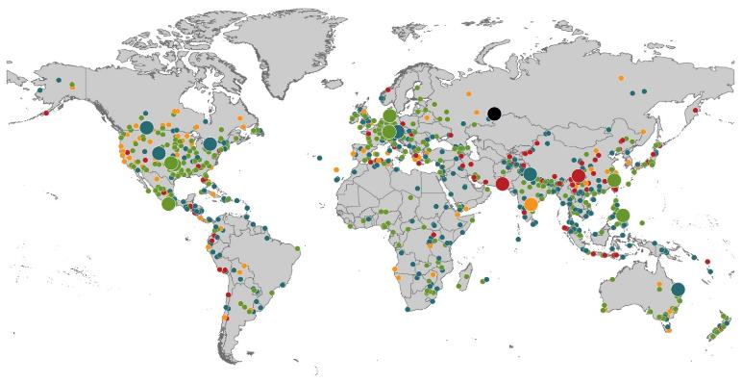
Natural Loss Events:
Full Year 2013
World Map
Winter Storm Christian (St. Jude)
Europe, 27–30 October
Floods
Europe,
30 May–19 June
Meteorite impact
Russian Federation, 15 February
Flash floods
Canada, 8–9 July
Floods
Canada, 19–24 June
Earthquake
China, 20 April
Hailstorms
Germany,
27–28 July
Floods
USA, 9–16 September
Typhoon Fitow
China, Japan,
5–9 October
Severe storms, tornadoes
USA, 18–22 May
Typhoon Haiyan
Philippines,
8–12 November
Severe storms, tornadoes
USA, 28–31 May
Floods
India, 14–30 June
Hurricanes Ingrid & Manuel
Mexico, 12–19 September
Floods
Australia,
21–31 January
880
Loss events
Earthquake (series)
Pakistan, 24–28 September
Heat wave
India, April–June
Geophysical events
(earthquake, tsunami, volcanic activity)
Hydrological events
(flood, mass movement)
Natural catastrophes
Geophysical events
(earthquake, tsunami, volcanic activity)
Hydrological events
(flood, mass movement)
Selection of significant
Natural catastrophes
Meteorological events
(storm)
Climatological events
(extreme temperature, drought, wildfire)
Meteorological events
(storm)
Climatological events
(extreme temperature, drought, wildfire)
Extraterrestrial events
(Meteorite impact)
Source: Munich Re Geo Risks Research, NatCatSERVICE – as of January 2014.
76

Slide 77
Natural Disasters Worldwide,
1980 – 2013 (Number of Events)
There were 880 natural disaster events globally in 2013 compared to 905 in 2012
Number
Geophysical
(earthquake, tsunami,
volcanic activity)
Meteorological (storm)
Climatological
(temperature extremes,
drought, wildfire)
Hydrological
(flood, mass movement)
Source: MR NatCatSERVICE
77

Slide 78
Losses Due to Natural Disasters Worldwide, 1980–2013 (Overall & Insured Losses)
(Overall and Insured Losses)
(2013 Dollars, $ Billions)
10-Yr. Avg. Losses
Overall : $184B
Insured: $56B
2013 Losses
Overall : $125B
Insured: $34B
There is a clear upward trend in both insured and overall losses over the past 30+ years
Overall losses (in 2013 values)
Insured losses (in 2013 values)
Source: MR NatCatSERVICE
78

Slide 79
The “Underinsurance” Gap
Why is So Much Loss Uninsured and How to Close the Gap
79

Slide 80
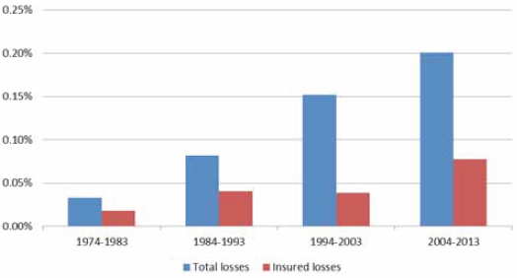
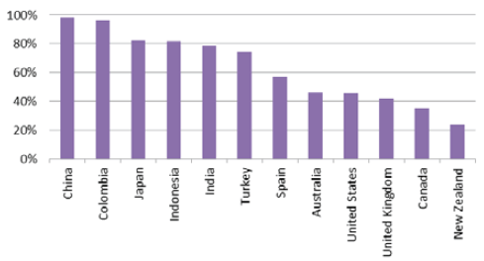
Even as Insurance Coverage Expands, the Insured Share of Losses Is Falling
Total Global vs. Insured Losses as % GDP (1974 – 2013)
Total and insured losses as a share of global GDP have both increased over the past 40 years, but insured losses as a share of total losses has shrunk
Natural Catastrophe Protection Gap (1974 – 2013)
Many emerging market nations have very large insurance gaps. In the US, the gap is about 50%.
Source: Swiss Re Economic Research & Consulting; Geneva Association; Insurance Information Institute.
80

Slide 81
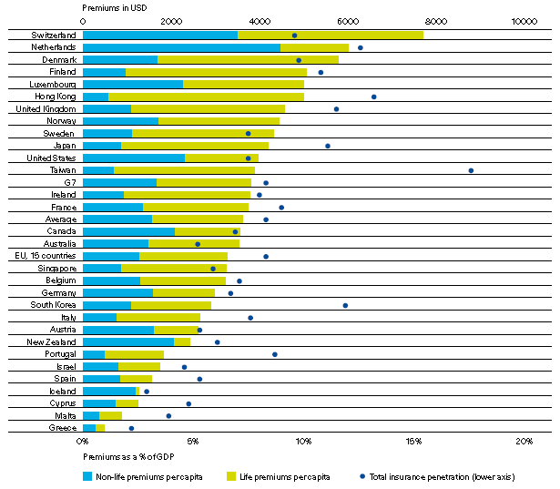
Insurance Density and Penetration in Advanced Markets, 2013
Western/Northern Europe, the US and Advanced Asia are relatively well insured, but many “Advanced” economies are not, especially Southern Europe
(Premiums per Capita in US $)
Spending on insurance fell 1% to $3,621 per capita in 2013. Penetration decreased too. Nonlife penetration is down from its from a high of 5.7% of GDP in 2000 to 4.7% in 2013.
Density = Premiums per capita
Penetration = Premiums as % of GDP
(Premiums as % of GDP)
Source: Swiss Re, sigma no. 3, 2014; Insurance Information Institute.
81

Slide 82
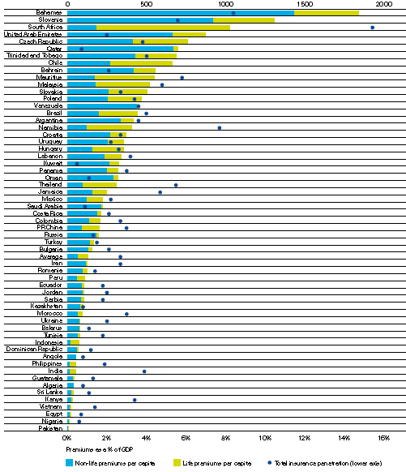
Insurance Density and Penetration in Emerging Markets, 2013
(Premiums per Capita in US $)
Although emerging markets posted growth of 7.4% in 2013 (Life: +6.4%; Nonlife: +8.3%), most emerging economies are poorly insured, representing growth opportunities for the insurance industry.
Spending on insurance in emerging markets increased to $129 per capita in 2013 from $121 in 2012. Penetration decreased was flat art 2.7% of GDP
Density = Premiums per capita
Penetration = Premiums as % of GDP
(Premiums as % of GDP)
Source: Swiss Re, sigma no. 3, 2014; Insurance Information Institute.
82

Slide 83
Causes of the Underinsurance Gap and Ways to Narrow/Close It
Contributing Factors to the
Underinsurance Gap
Solutions that Will Help Close the Underinsurance Gap
Compulsory Insurance
Create a Conducive Regulatory, Legal and Tax Environment
Build Public-Private Partnerships
Develop New Products
Microinsurance
Enhance Data Collection/Sharing
Foster a More Strategic Approach to Risk Among Businesses
Affordability
Lack of Awareness
Limits to Insurability
Regulatory Deficiencies
Source: Geneva Association; Insurance Information Institute.

Slide 84
CYBER RISK
Cyber Risk is a Rapidly Emerging Exposure for Businesses Large and Small in Every Industry
84

Slide 85






Data Breaches 2005-2013, by Number of Breaches and Records Exposed
# Data Breaches/Millions of Records Exposed
Millions
The Total Number of Data Breaches (+38%) and Number of Records Exposed (+408%) in 2013 Soared
85
* 2013 figures as of Jan. 1, 2014 from the ITRC updated to an additional 30 million records breached (Target) as disclosed in Jan. 2014.
Source: Identity Theft Resource Center.

Slide 86
Evolving Cyber Threats in Need of Insurance Solutions
State Sponsored Groups
Foreign government sponsored
Organized Cyber Criminals
Hacktivists
Politically-motivated hackers
Traditional organized crime groups
Loosely organized global hacker crews
Increasing capabilities
Sophisticated and well-funded
Insiders
Easy access to sensitive information
Difficult to detect
Terrorists
Destruction of physical and digital assets
86
Source: Price Waterhouse Cooper (PwC).

Slide 87
Worldwide Cybersecurity Spending, 2011- 2016F
($ Billions)
Cybersecurity spending is expected to increase by $5.2B in 2014, $5.8B in 2015 and $6.3B in 2016
Cybersecurity Spending Is Rising Sharply, Up by About 8%+ Annually through 2016—a Projected Increase of $12.1 Billion from 2014 to 2016
87
Source: Gartner Group; Insurance Information Institute; Adapted from Wall Street Journal: “Financial Firms Boost Cybersecurity Funds,” Nov. 17, 2014.

Slide 88
Worldwide Information Security Spending per Employee, by Industry, 2013
(Dollars per Employee)
Information Security Spending by Financial Services and Critical Infrastructure Industries (e.g., Utilities) Outpaces that of Other Industries
88
Source: Gartner Group; Insurance Information Institute; Adapted from Wall Street Journal: “Financial Firms Boost Cybersecurity Funds,” Nov. 17, 2014.
Notes:
88

Slide 89
2013 Data Breaches By Business Category, By Number of Breaches
The majority of the 614 data breaches in 2013 affected business and medical/healthcare organizations, according to the Identity Theft Resource Center.
Banking/Credit/Financial, 23 (3.7%)
Govt/Military, 56 (9.1%)
Business, 211 (34.4%)
Educational, 55 (9.0%)
Medical/Healthcare, 269 (43.8%)
Source: Identity Theft Resource Center, http://www.idtheftcenter.org/images/breach/2013/UpdatedITRCBreachStatsReport.pdf
89

Slide 90
External Cyber Crime Costs: Fiscal Year 2013
Information loss (43%) and business disruption or lost productivity (36%) account for the majority of external costs due to cyber crime.
Equipment damages
Information loss
Revenue loss
Business disruption
Other costs* 0%
* Other costs include direct and indirect costs that could not be allocated to a main external cost category
Source: 2013 Cost of Cyber Crime: United States, Ponemon Institute.
90

Slide 91
TYPICAL STRUCTURE OF INSURER CYBER RISK PRODUCTS
Insurers’ Product Offerings Are Increasingly Designed to Provide End-to-End Cyber Risk Management Solutions
91

Slide 92
The Three Basic Elements of Cyber Coverage: Prevention, Transfer, Response
Loss Prevention
Post-Breach Response
(Insurable)
Loss Transfer (Insurance)
Cyber risk management today involves three essential components, each designed to reduce, mitigate or avoid loss. An increasing number of cyber risk products offered by insurers today provide all three.
Source: Insurance Information Institute research.
92

Slide 93
Data/Privacy Breach:
Many Potential Costs Can Be Insured
Data Breach Event
Costs of notifying affecting individuals
Defense and settlement costs
Lost customers and damaged reputation
Cyber extortion payments
Costs of notifying regulatory authorities
Regulatory fines at home & abroad
Business Income Loss
Forensic costs to discover cause
Source: Zurich Insurance; Insurance Information Institute
93

Slide 94
Big Data and the Era of Predictive Analytics & Modelling
For Insurers, It’s Always Been About the Data
94

Slide 95
Percentage of Carriers Using Predictive Analytics by Major P/C Line, 2013
Predictive analytics is more like to be used in personal lines, but commercial lines use is growing
82% of insurers report using predicative analytics in at least one line. 18% do not use it all.
Benefits Cited
Drive Profitability: 85%
Reduce Risk: 55%
Grow Revenue: 52%
Improve Op. Efficiency: 39%
Source: ISO/Earnix Survey, September 2013; Insurance Information Institute.

Slide 96
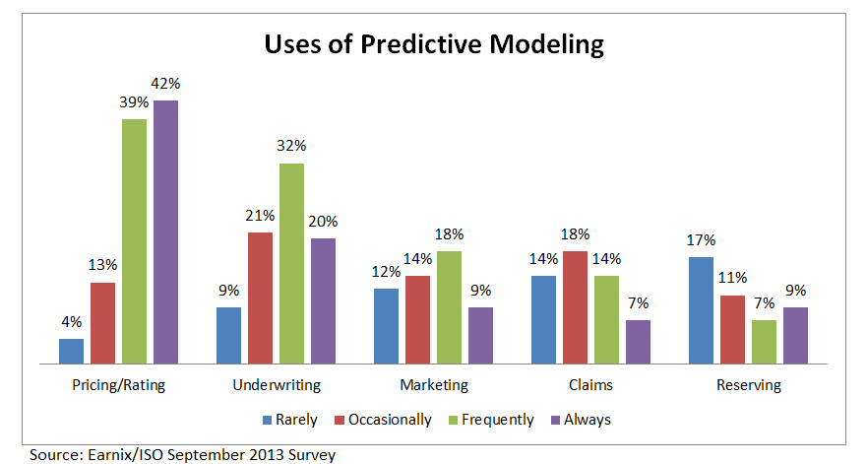
Uses of Predictive Analytics by Function
Pricing and Underwriting are the leading uses for predictive analytics

Slide 97
ALTERNATIVE CAPITAL & REINSURANCE MARKETS
Ample Capacity as Alternative Capital is Transforming Reinsurance Markets
97

Slide 98
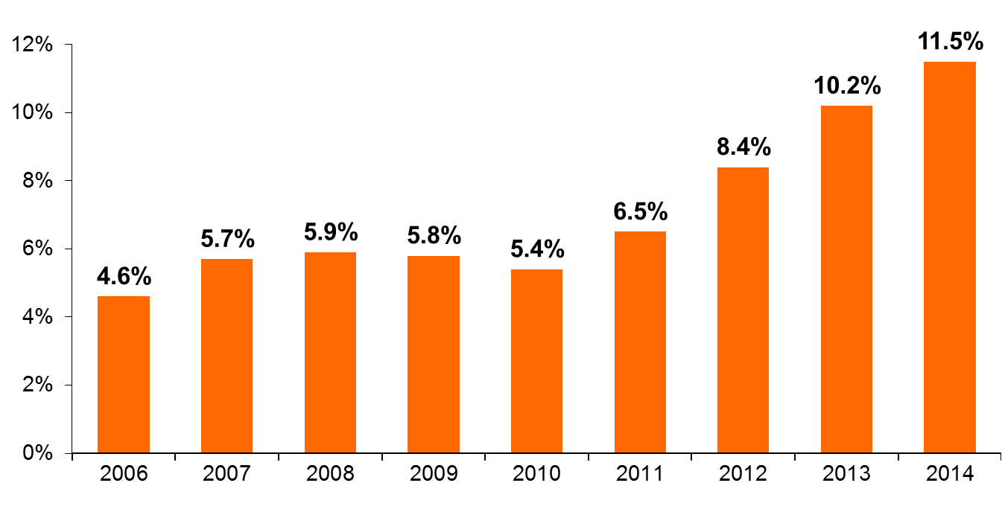
Alternative Capacity as a Percentage of Global Reinsurance Capital
(As of Year End)*
Alternative Capacity accounted for approximately 11.5% or $59 billion of the $511 in global reinsurance capital as of mid-2014
*As of June 30.
Source: Aon Benfield Analytics.

Slide 99
Investor by Category
Institutional investors are accounting for a larger share of alternative reinsurance investors
Years ended June 30.
Source: Aon Benfield Securities; Insurance Information Institute.

Slide 100
Catastrophe Bonds: Issuance and Outstanding, 1997- 2014:Q2
Risk Capital Amount ($ Millions)
Risk capital outstanding reached a record high in 2014
Financial crisis depressed issuance
CAT bond issuance reached a record high in 2013.
2014 Issuance Slowed Down Substantially; May Not Surpass 2013 Record
Sources: Guy Carpenter; Insurance Information Institute.

Slide 101
Terrorism Risk
Insurers Met the Challenge
But Politics Threaten to End a Successful Public/Private Partnership
101
Notes:
101

Slide 102
Loss Distribution by Type of Insurance from Sept. 11 Terrorist Attack ($ 2013)
($ Billions)
Total Insured Losses Estimate: $42.9B**
*Loss total does not include March 2010 New York City settlement of up to $657.5 million to compensate approximately 10,000 Ground Zero workers or any subsequent settlements.
**$32.5 billion in 2001 dollars.
Source: Insurance Information Institute.

Slide 103
Terrorism Insurance Take-up Rates,
By Year, 2003-2013
TRIA’s high take-up rates, availability and affordability have benefitted businesses, workers and the entire US economy since the program’s enactment
In 2003, the first year TRIA was in effect, the terrorism take-up rate was 27 percent. Since then, it has increased steadily, remaining in the low 60 percent range since 2009.
Source: Marsh Global Analytics, 2014 Terrorism Risk Insurance Report, April 2014 and earlier editions.
103
Notes:
103

Slide 104
Insurance:
A Financially Stable, Sound & Secure Industry
Very Different from Banks
Industry Impairment Rates Are Near Record Lows
104

Slide 105
P/C Insurer Impairments, 1969–2013
Impairments among P/C insurers remain infrequent
The Number of Impairments Varies Significantly Over the P/C Insurance Cycle, With Peaks Occurring Well into Hard Markets
Source: A.M. Best Special Report “U.S. P/C Impairments Down Sharply in 2013; Alternative Risk Players Faltered,” June 23, 2014; Insurance Information Institute.

Slide 106
P/C Insurer Impairment Frequency vs. Combined Ratio, 1969-2013
2013 impairment rate was 0.43%, down from 0.76% in 2012; the rate is lower than the 0.81% average since 1969
Impairment Rates Are Highly Correlated With Underwriting Performance and Reached Record Lows in 2007; Recent Increase Was Associated Primarily With Mortgage and Financial Guaranty Insurers and Not Representative of the Industry Overall
Source: A.M. Best; Insurance Information Institute

Slide 107
100+ Year Old Insurers as a Share of All P/C Insurers
About 12% of P/C insurance companies (fewer than 1-in-8) today (2013) are 100+ years old. This is a surprisingly high percentage.
Insurers at Least 100 Years Old, 12.3%
(287)
Insurers Less than 100 Years Old, 87.7%
(1,979)
Odds of a Human Living to 100
Born 1900: ~0.25% (1-in-400)
Born Today: ~2% (1-in-50)
Source: National Association of Insurance Commissioners (NAIC) Annual Statement Database, via Highline Data LLC; CDC

Slide 108
Number of Recessions Endured by P/C Insurers, by Number of Years in Operation
Number of Recessions Since 1860
Insurers that have made it to the age of 150 have endured 32 recessions over the years
Number of Years in Operation
Longevity Requires an Insurer to Overcome Extreme Economic Adversity of Every Sort
Sources: Insurance Information Institute research from National Bureau of Economic Research data.
108
12/01/09 - 9pm
eSlide – P6466 – The Financial Crisis and the Future of the P/C
Notes:
108

Slide 109
The Global Financial Crisis: The Pendulum Swings: Dodd-Frank & Systemic Risk
Dodd-Frank Act of 2010: The implosion of the housing bubble and virtual collapse of the US banking system, the seizure of credit markets and massive government bailouts of US financial institutions led to calls for sweeping regulatory reforms of the financial industry
Limiting Systemic Risk is at the Core of Dodd-Frank
Designation as a Systemically Important Financial Institutional (SIFI) Will Result in Greater Regulatory Scrutiny and Heightened Capital Requirements
Dodd-Frank Established Several Entities Impacting Insurers
  Federal Insurance Office
  Financial Stability Oversight Council
  Office of Financial Research
  Consumer Financial Protection Bureau

Slide 110
Global Financial Crises &
Global Systemic Risk
The Global Financial Crisis Prompted the G-20 Leaders to Request that the Financial Stability Board (FSB) Assess the Systemic Risks Associated with SIFIs, Global-SIFIs in Particular
In July 2013, the FSB Endorsed the International Association of Insurance Supervisors Methodology for Identifying Globally Systemically Important Insurers (G-SIIs)
For Each G-SII, the Following Will Be Required:
  (i) Recovery and resolution plans
  (ii) Enhanced group-wide supervision
  (iii) Higher loss absorbency (HLA) requirements
G-SIIs as Designated by the FSB as of July 2013:
  Allianz SE AIG Assicurazioni Generali
  Aviva Axa MetLife
  Ping An Prudential Financial Prudential plc

Slide 111
Summary
Insurance Remains an Essential Tool for Reducing Risk
The Industry’s Future Is Increasingly Global
Future Growth Will Incur More Risk
New Challenges Abound, But So Do Opportunities
Insurers Have Centuries of History Demonstrating their Ability to Major Through Era of Disruptive Risks
  Operational
  Economic
  Regulatory
Insurers Will Manage through Quantum Shifts and “Disruptor” Forces in the Decades Ahead

Slide 112
Insurance Information Institute Online:
www.iii.org
Thank you for your time
and your attention!
Twitter: twitter.com/bob_hartwig
Download at www.iii.org/presentations

