Slide 1
Triple-I Update Economic Briefing
Covid-19 Impact on PC Insurance Market: Business Interruption and Pandemics
Thursday, April 16, 2020
Dr. Steven Weisbart, Senior Vice President and Chief Economist ♦ Dr. Michel Leonard, CBE, Vice President and Senior Economist
Insurance Information Institute ♦ 110 William Street ♦ New York, NY 10038
stevenw@iii.org ♦ michell@iii.org ♦ www.iii.org
The Insurance Information Institute reserves the right to change, improve or correct the information, materials and descriptions in this presentation. The information contained herein is the work of Triple-I analysts and contains information from third party sources. Triple-I gives no guarantees, undertakings, or warranties concerning the accuracy, completeness, validity, or timeliness of the information provided. Independent confirmation of the accuracy of the information contained herein is recommended. Any dated information is published as of its date only.

Slide 2
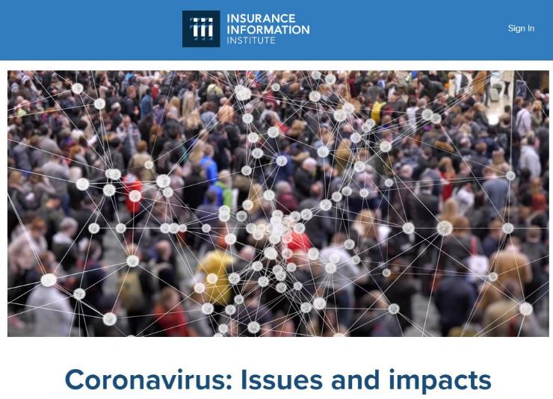
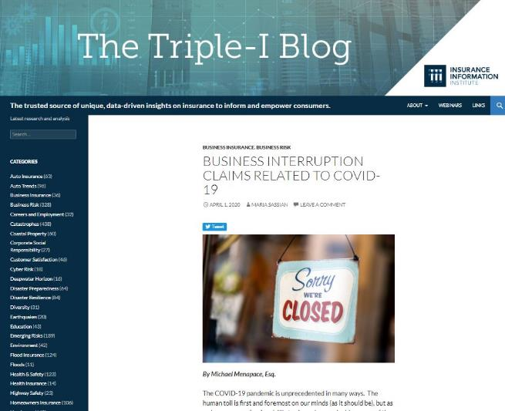
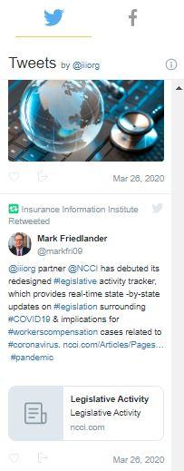
Triple-I Actively Supporting Members and the Industry
@iiiorg
Do not hesitate to reach out to Michael Barry, Head of Media and Public Affairs (michaelb@iii.org) or Sean Kevelighan, Chief Executive Officer (seank@iii.org).
Notes:
Sean will handle the intro and reference this slide.

Slide 3
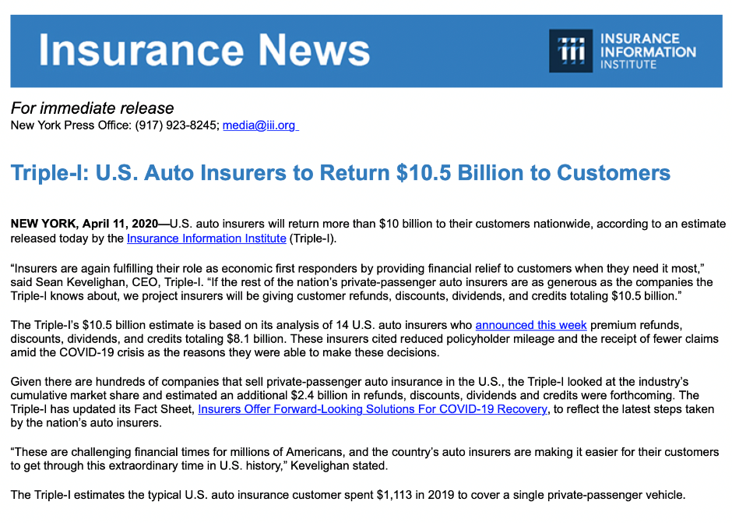
Economic Summary
US GDP likely to have contracted by as much as 40% in March. Year-to-date, this is the equivalent of a decrease of about 7% for the year
Insurance industry will experience decrease in profit, earnings, and returns on investments. Insurers doing their part to support economy including through voluntary refund and rebate for customers worth well over 10B collectively year-to-date
Claims will raise across most lines. Impact across lines can be summarized as follows:
High Impact: Workers Compensation, Health
Moderate Impact: Life, Liability, and D&O
Low Impact: Property, Auto
Economy unlikely to start recovering until Q4 of 2020 followed by slow growth in 2021

Slide 4
Understanding Insurance Surplus

Slide 5
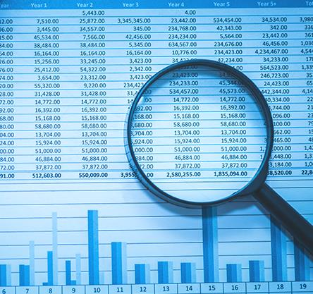
P/C Industry Capacity: What Is Surplus?
The industry prices coverage for expected claims, with surplus for unexpected claims, such as exceptionally severe hurricanes
By law and regulation, each insurer maintains an amount of “surplus” for use when claims and/or other expenses exceed allowances in premiums
The surplus backs up each line of insurance that each company writes
It is calculated as assets minus liabilities and rises and falls due to changes in asset values and claims
Drops in stock market valuations lower assets and surplus
Regulators set minimum levels and rating agencies downgrade insurers whose surplus levels fall too far
Notes:
Premiums for insurance in 2020 did not expect COVID-19 claims
Also, drops in investment income were not expected when 2020 premiums were set
As Surplus nears minimum levels, concern about the insurer’s health rises, in the same way concern rises when your car’s gas gauge nears the empty mark.

Slide 6
Risk Based Capital
State regulators use Risk-Based Capital (RBC) to indicate when a company has insufficient capital and surplus to operate safely
The RBC calculation covers several types of risks that are inherent in providing insurance:
Asset risk
Credit risk
Loss reserve risk
Premium and growth risk
The “Company Action Level” of RBC ratios is the level at which companies must report to regulators how they will raise their financial status to a safe level. For the industry as a whole, this is roughly $400 billion.
Source: NAIC, via S&P Global; Triple-I

Slide 7
Surplus Available for Unexpected Losses
After assumptions (at right), surplus available for unexpected losses is $317 billion.
Billions of dollars
Q1 capital loss is Triple-I estimate
Q2 capital gains/ losses assumed to be $0
Q2-Q3 assumes worst year of catastrophe claims above trend
Q2-Q4 U/W profits assumed to be $0
Critical Level
Below This Amount, Industry Imperiled
Sources: NAIC data sourced from S&P Global Market Intelligence; Insurance Information Institute.

Slide 8
Retroactive BI threatens other insurer promises
Loss estimates dwarf other black swan scenarios
Five Katrinas per Month
Source: Insurance Information Institute.

Slide 9
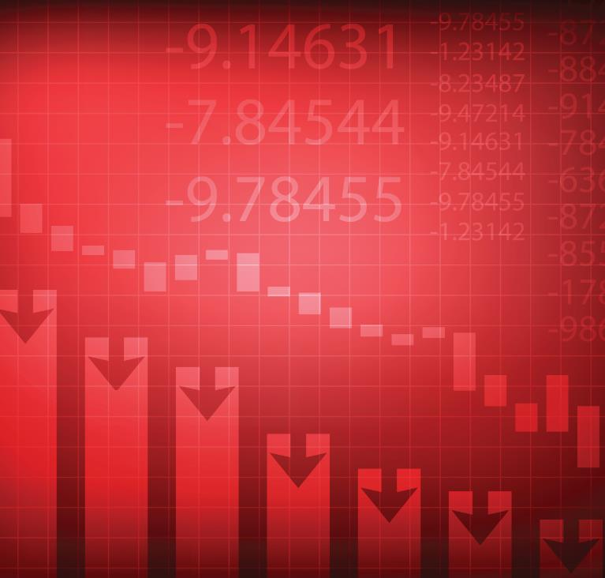
Can the P/C Industry Insure Losses Caused by a Pandemic?
No, not in policies widely available. Insurance works only if insurers can be confident that losses can be
Priced so that many independently-exposed units would buy the coverage, and
Total claims can, at most, be kept within limits of available capital.
Few businesses have bought this coverage, probably because the price is judged too high for the protection offered.
The policies that have been bought, like the one by the All England Lawn Tennis Association (which runs the Wimbledon tennis tournament) were uniquely negotiated. And claim payment was prompt.
Notes:
Mandating that all existing business interruption insurance policies cover losses caused by a pandemic could create a situation in which total claims would exceed available capital, thereby rendering the industry insolvent.
Even mandating that future business interruption policies cover losses caused by a pandemic would likely cause insurers to drastically reduce the number and limits of such policies they would sell (in order to limit the effect of claims on required capital) or, in the extreme, stop selling business interruption policies entirely.
This is what happened in 1992 in Florida after Hurricane Andrew and in 2001 after the terrorist attacks. In both cases government action was needed to restore a private market for these coverages.

Slide 10
Business Interruption Implications of retroactive and expanded coverage

Slide 11
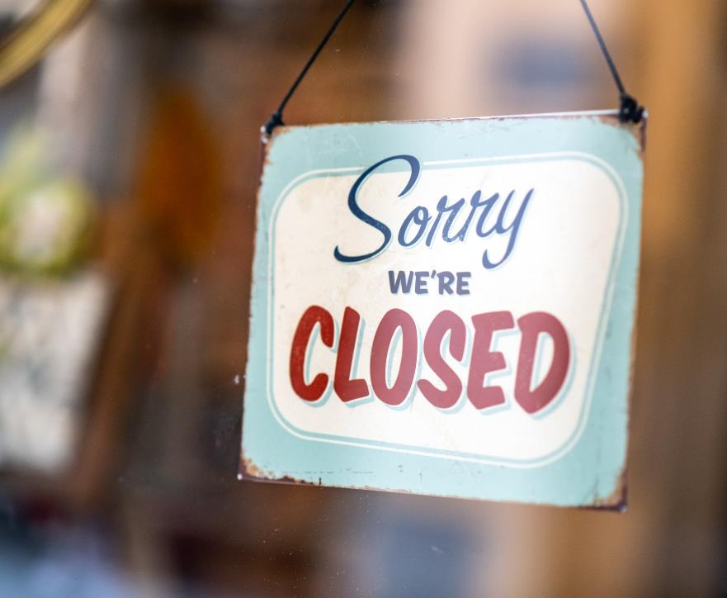
What is business interruption (BI) insurance?
Option added to property, businessowners or commercial multiperil policies
Typically covers
Profits
Payroll
Other expenses (rent)
Triggered by
Suspension of operations
Direct physical loss or damage
Covered cause of loss
Virus specifically excluded
Sources: American Property Casualty Insurance Association, Insurance Information Institute; Getty Images.
Notes:
This describes the situation for small business owners. Large business owners are much more likely to have policies with unique terms – like Wimbledon
Each of the three triggers must be tripped to warrant payment. The red type are the two triggers that don’t get ‘tripped’ to warrant payment.
Virus is excluded twice, when it is defined as one of several pollutants that are excluded and again in the mandatory endorsement called “Exclusion of Loss Due to Virus or Bacteria” (mandatory meaning that the insurer requires its underwriters to attach the endorsement to the policy)

Slide 12
Key Modeling Assumptions
Two BI scenarios and losses expressed on peak month and adjusted yearly basis
Macroeconomic Level
Policy Level
US GDP of $22T with SMEs representing 43.5% of this number
At peak business closures:
95% of businesses under some sort of business interruption
Average lost output across industries is 47%
Monthly loss to US economy as high as $700B and to SMEs $340B
Latest GDP estimates for 2020 point to yearly decrease between 4% and 6%
BI coverage for SME companies
Key loss and cost basis:
Lost compensation (est. 70% of revenues)
Lost profits (est. 7% of revenues)
Adjustment costs (est. 10% of insured loss)
T&C include 7 days waiting period and retained loss of 10% of total loss
Take-up rate of 40% for scenario one and 100% for scenario two

Slide 13
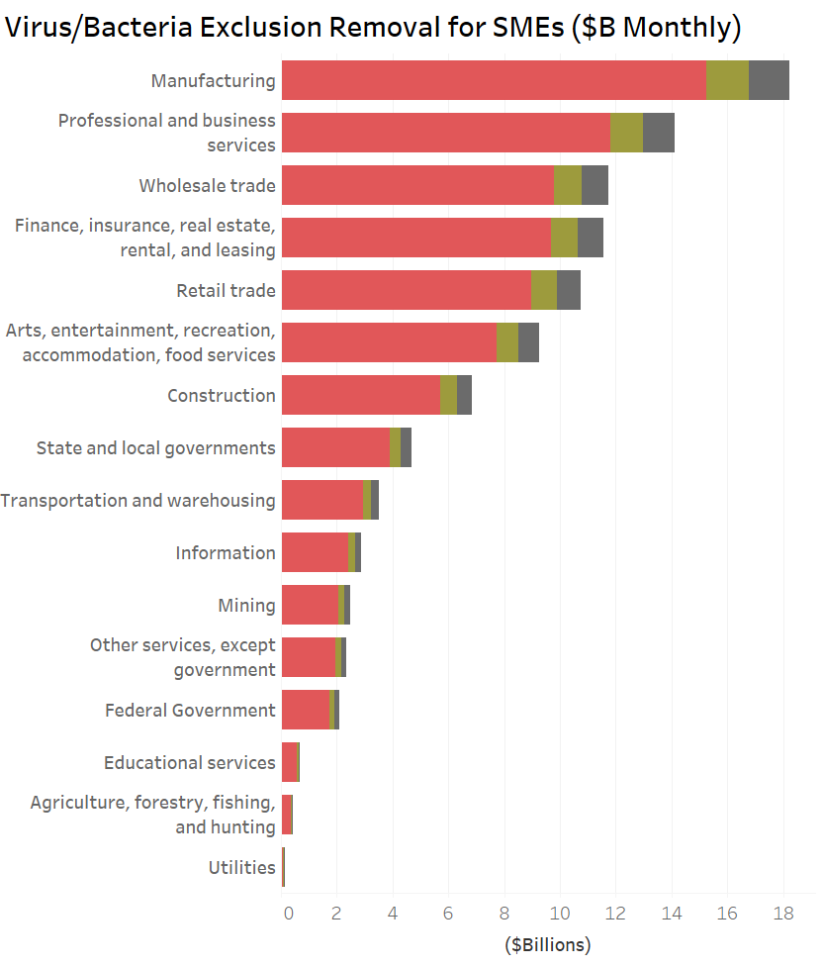
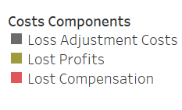
Virus/Bacteria Exclusion Removal
Monthly cost of BI coverage by sector ranges from roughly a billion for utilities to as much as $18B for manufacturing.
Median monthly estimate for cost of retroactive BI across all sectors is $100B

Slide 14
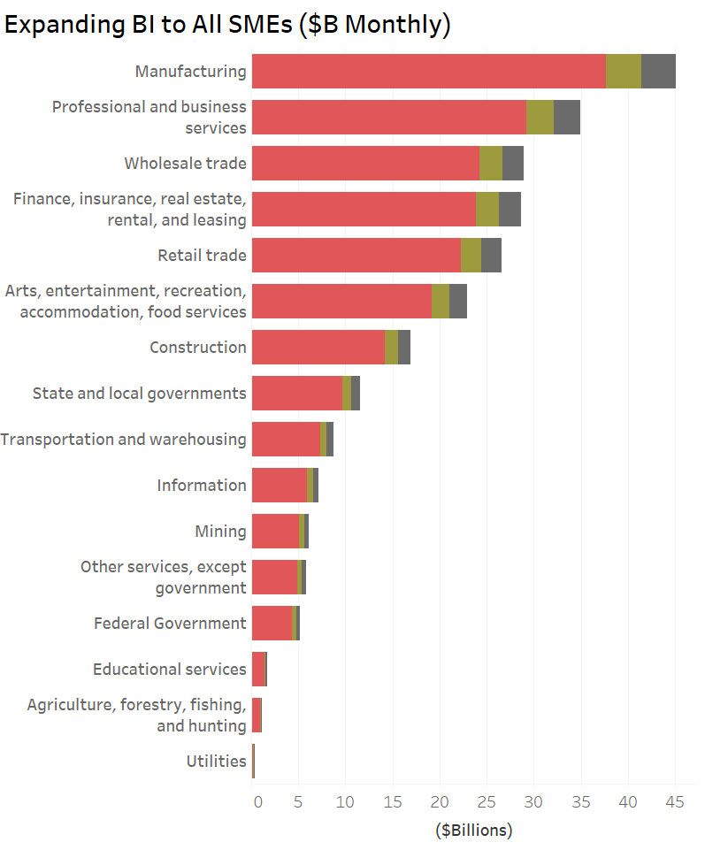
Expanding BI to All SMEs
Monthly cost of BI coverage by sector ranges from roughly $4B for utilities to as much as $46B for manufacturing.
Median monthly estimate for retroactive and expanded BI coverage across all sectors is $250B

Slide 15
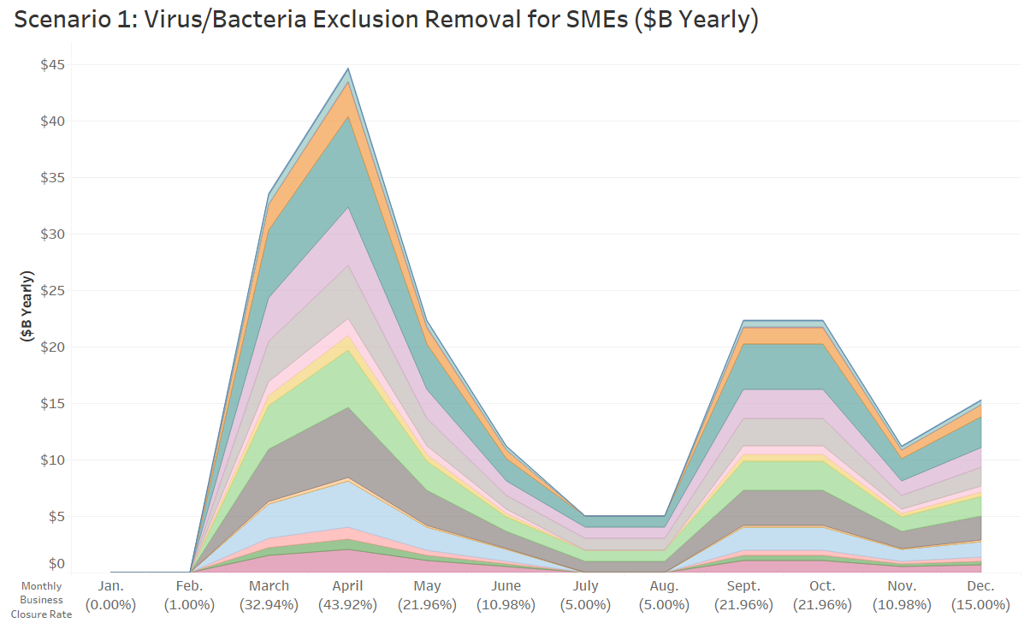
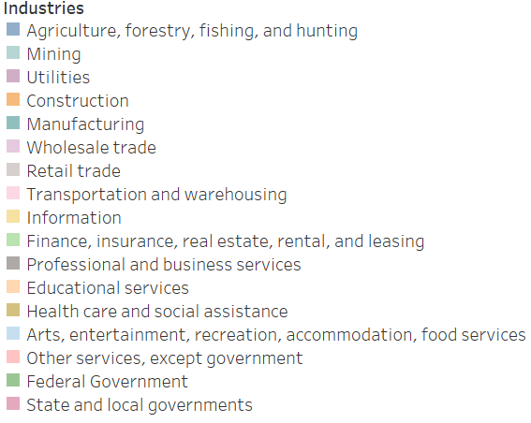
BI Losses Due to Covid-19 2020 Full Year Forecast
Adjusted for Sept/Dec waves losses could reach $270B for scenario one and $600B for scenario two.

Slide 16
Covid-19 Business Interruption Impact Scenarios
Retroactive changes could cost industry from roughly ~$150B to nearly as high as ~$380B
Notes:
Scenario 1: Take-up rate: 40%
Scenario 2: Take-up rate: 100%
Both:
Covered losses expressed as lost profits and total comp or 77% of total loss
Waiting period 7 days, retained loss 10%, and total loss adjustment costs 10%
We did not include considerations such as policy sub-limit capping BI loss

Slide 17
Effect on Surplus of Pandemic-Related BI Losses
Billions of dollars
Critical Level
Below This Amount, Industry Imperiled
Sources: NAIC data sourced from S&P Global Market Intelligence; American Property Casualty Insurance Association; Insurance Information Institute.

Slide 18
Conclusion
Severe economic drop as high as 40% of GDP for March and 8% of GDP for year
For insurance, highest impact will be on health, workers comp, and liability/D&O
The property/casualty industry has enough surplus to keep its promises to customers
Retroactive BI could cost industry from roughly $150B to nearly as high as $400B
Threatens insurance industry’s ability to meet contractual obligations
Would likely eliminate business interruption on all policies

Slide 19
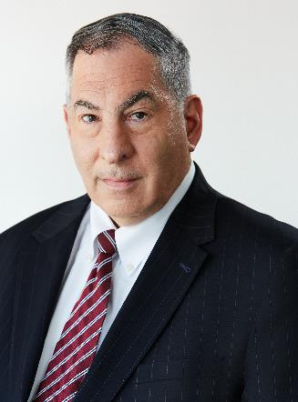
Dr. Steven Weisbart
stevenw@iii.org
Dr. Michel Leonard, CBE
michell@iii.org

