Slide 1
The P/C Insurance Industry and the U.S. Economy:
Issues & Outlook
Los Angeles Area CPCU All-Industry Day
Studio City, CA
October 18, 2016
Steven N. Weisbart, Ph.D., CLU, Senior Vice President & Chief Economist
Insurance Information Institute ♦ 110 William Street ♦ New York, NY 10038
Tel: 212.346.5540 ♦ Cell: 917.494.5945 ♦ stevenw@iii.org ♦ www.iii.org

Slide 2
First, the Good News about
the P/C Insurance Industry:
2013-15 Were
Three Good Years in a Row
But 2016 Could End this String
2

Slide 3
P/C Insurance Industry
Combined Ratio, 2001–2016:1H*
Insurers Paid Nearly $1.16 for Every $1 in Earned Premiums
Higher CAT Losses, Shrinking Reserve Releases, Toll of Soft Market
Doesn’t Reflect Hurricane Matthew
Best Combined Ratio Since 1949 (87.6)
Heavy Use of Reinsurance Lowered Net Losses
Excludes Mortgage & Financial Guaranty insurers 2008--2014. Including M&FG, 2008=105.1, 2009=100.7, 2010=102.4, 2011=108.1; 2012:=103.2; 2013: = 96.1; 2014: = 97.0. Note: 2015:1H combined ratio was 97.6
Sources: A.M. Best, ISO.

Slide 4
Net Written Premium Growth:
Annual Change, 1971—2016:1H
16 Years
16 Years?
1975-78
1984-87
2000-03
2016-19
Net Written Premiums Fell 0.7% in 2007 (First Decline Since 1943) by 2.0% in 2008, and 4.2% in 2009, the First 3-Year Decline Since 1930-33.
2016*: 3.0%
2015: 3.4%
2014: 4.2%
2013: 4.6%
2012: 4.3%
Shaded areas denote “hard market” periods *first half
Sources: A.M. Best (historical), ISO, Insurance Information Institute.

Slide 5
P/C Industry Net Income After Taxes
1991–2016:1H
$ Millions
2006 ROE = 12.7%
2007 ROE = 10.9%
2008 ROE = 0.1%
2009 ROE = 5.0%
2010 ROE = 6.6%
2011 ROAS¹ = 3.5%
2012 ROAS¹ = 5.9%
2013 ROAS¹ = 10.2%
2014 ROAS¹ = 8.4%
2015:ROAS = 8.4%
ROE figures are GAAP; ¹Return on avg. surplus. Excluding Mortgage & Financial Guaranty insurers yields a 8.2% ROAS in 2014, 9.8% ROAS in 2013, 6.2% ROAS in 2012, 4.7% ROAS for 2011, 7.6% for 2010 and 7.4% for 2009.
Sources: A.M. Best, ISO; Insurance Information Institute.

Slide 6
Profitability Peaks & Troughs in the P/C Insurance Industry, 1975 – 2016F
ROE
1977:19.0%
History suggests next ROE peak will be in 2016-2017, but that seems unlikely
1987:17.3%
10 Years
2006:12.7%
1997:11.6%
10 Years
2013 9.8%
9 Years
1975: 2.4%
2001: -1.2%
2016:1H 6.4%
1984: 1.8%
1992: 4.5%
*Profitability = P/C insurer ROEs. 2011-14 figures are estimates based on ROAS data. Note: Data for 2008-2014 exclude mortgage and financial guaranty insurers.
Source: Insurance Information Institute; NAIC, ISO, A.M. Best, Conning

Slide 7
Return on Net Worth (RNW)
Largest Lines: 2005-2014 Average
Over the 10 years ending 2014, virtually every P/C line in California has been more profitable than in the U.S. overall
Source: NAIC; Insurance Information Institute.

Slide 8
RNW All Lines, 2005-2014 Average, Vary Widely by State and Region
Southwest
Mountain
Far West
Great Lakes
Great Plains
Sources: NAIC; Insurance Information Institute
8
12/01/09 - 9pm
eSlide – P6466 – The Financial Crisis and the Future of the P/C
Notes:
8
In May for the first time in 2 years, Nevada overtook Michigan as the state with the highest unemployment rate

Slide 9
RNW All Lines, 2005-2014 Average, Vary Widely by State and Region
Southeast
Mid-Atlantic
New England
Sources: Sources: NAIC; Insurance Information Institute.
9
12/01/09 - 9pm
eSlide – P6466 – The Financial Crisis and the Future of the P/C
Notes:
9
This chart and the succeding one show that unemployment rates vary widely, not only by region, but within regions.

Slide 10
Policyholder Surplus,
2006:Q4–2016:1H
($ Billions)
2007:Q3
Pre-Crisis Peak
Drop due to near-record 2011 CAT losses
Surplus as of 6/30/16 stood at $680.6B
As of mid-year 2016, the industry had roughly $1.28 of surplus for every $1.00 of NPW, close to the strongest claims-paying status in its history.
2010:Q1 data includes $22.5B of paid-in capital from a holding company parent for one insurer’s investment in a non-insurance business.
The P/C insurance industry likely will enter 2017 in very strong financial condition.
Sources: ISO, A.M .Best.
10
12/01/09 - 9pm
eSlide – P6466 – The Financial Crisis and the Future of the P/C
Notes:
10

Slide 11
U.S. Employment in the Direct
P/C Insurance Industry: 1990–2016*
Sometimes the BLS Reclassifies Employment Within Industries.
When This Happens, the Change is Spread Evenly Over a 12-month Period (in This Case March 2010–March 2011)
*As of August 2016; not seasonally adjusted; Does not include agents & brokers.
Note: Recessions indicated by gray shaded columns.
Sources: U.S. Bureau of Labor Statistics; National Bureau of Economic Research (recession dates); Insurance Information Institute.
Notes:
11

Slide 12
LA-Long Beach-Anaheim Employment in the Direct Insurance Industry*: 1990–2016**
Aug 2016: 33,000 (preliminary)
*includes life and p/c **As of August 2016; not seasonally adjusted; Does not include agents & brokers.
Note: Recessions indicated by gray shaded columns.
Sources: U.S. Bureau of Labor Statistics; National Bureau of Economic Research (recession dates); Insurance Information Institute.
Notes:
12

Slide 13
U.S. Employment in Insurance
Agencies & Brokerages: 1990–2016*
*As of August 2016; not seasonally adjusted. Includes all types of insurance.
Note: Recessions indicated by gray shaded columns.
Sources: U.S. Bureau of Labor Statistics; National Bureau of Economic Research (recession dates); Insurance Information Institute.
Notes:
13

Slide 14
LA-Long Beach-Anaheim Agent/Broker
(& Related) Employment: 1990–2016*
Aug 2016: 42,500 (preliminary)
*As of August 2016; not seasonally adjusted; Does not include agents & brokers.
Note: Recessions indicated by gray shaded columns.
Sources: U.S. Bureau of Labor Statistics; National Bureau of Economic Research (recession dates); Insurance Information Institute.
Notes:
14

Slide 15
What’s Happening in
P/C Insurance in California?
Decreasing Profitability
in Many Lines of Business
15

Slide 16
RNW on Selected Lines of Business, California, 2005-2014
Homeowners
PP Auto
Workers Comp
Sources: NAIC; Insurance Information Institute
16
12/01/09 - 9pm
eSlide – P6466 – The Financial Crisis and the Future of the P/C
Notes:
16
In May for the first time in 2 years, Nevada overtook Michigan as the state with the highest unemployment rate

Slide 17
RNW on Selected Lines of Business, California, 2005-2014
Inland Marine
Commercial Auto
Commercial Multiple-Peril
Sources: NAIC; Insurance Information Institute
17
12/01/09 - 9pm
eSlide – P6466 – The Financial Crisis and the Future of the P/C
Notes:
17

Slide 18
RNW on Selected Lines of Business, California, 2005-2014
Fire
Allied Lines
Other Liability*
*excludes products liability, medical professional liability, and liability coverages in CMP, FarmMP, HO, and Auto coverages
Sources: NAIC; Insurance Information Institute
18
12/01/09 - 9pm
eSlide – P6466 – The Financial Crisis and the Future of the P/C
Notes:
18

Slide 19
Investment Performance:
A Key Driver of Profitability
Depressed Yields Will Continue
to Affect Underwriting & Pricing
19

Slide 20
US Treasury Note 10-Year Yields:
A Long Downward Trend, 2000–2016*
Yields on 10-Year US Treasury Notes have been below 3% for 5 years: bonds bought in 2006 at 5% will be reinvested at 1.5% for 10 more years
US Treasury yields plunged to historic lows in 2013, then rebounded but are sinking again
Since roughly 80% of P/C bond/cash investments are in 5-to-10-year durations, most P/C insurer portfolios will have low-yielding bonds for years to come.
*Monthly, constant maturity, nominal rates, through September 2016.
Sources: Federal Reserve Bank at http://www.federalreserve.gov/releases/h15/data.htm; National Bureau of Economic Research (recession dates); Insurance Information Institute.
20
12/01/09 - 9pm
eSlide – P6466 – The Financial Crisis and the Future of the P/C
Notes:
20

Slide 21
Property/Casualty Insurance Industry Net Investment Income: 2005–2016:1H
Investment Income
($ Billions)
Invested Assets
($ Billions)
Due mainly to persistently low interest rates,
investment income has not risen as invested assets grew.
Investment income consists primarily of bond interest and stock dividends.
Sources: SNL Financial; Insurance Information Institute

Slide 22
Distribution of Bond Maturities,
P/C Insurance Industry, 2006-2015
Two main shifts over these years. From 2008 to 2011-12, from bonds with longer maturities to bonds with shorter maturities. But beginning in 2013, the reverse. Note, however, that the percentages in bonds with maturities over 10 years continues to drop.
Sources: SNL Financial; Insurance Information Institute.

Slide 23
P/C Insurer Net Realized
Capital Gains/Losses, 2005-2016:1H
($ Billions)
Realized Capital losses were a main cause of 2008/2009’s large drop in profits and ROE
Insurers consistently posted 6 years of Net Realized Capital Gains
in 2010 - 2015 following the Financial Crisis.
If (when?) interest rates rise, this streak might end.
Sources: SNL Financial, Insurance Information Institute.
23
12/01/09 - 9pm
eSlide – P6466 – The Financial Crisis and the Future of the P/C
Notes:
23

Slide 24
P/C Insurer Portfolio Yields,
2005-2015
P/C carrier yields have been falling for over a decade, reflecting the long downtrend in prevailing interest rates. Even if prevailing rates rise in the next few years, portfolio yields are unlikely to rise quickly,
since low yields of recent years are “baked in” to future returns.
Sources: NAIC, via SNL Financial; Insurance Information Institute.

Slide 25
Forecasts of Avg. Yield of 10-Year US Treasury Notes
Yield (%)
Virtually every one of the 53 forecasts in the Blue Chip survey
anticipates that long-term interest rates
will stay at unusually low levels through 2017
Sources: Blue Chip Economic Indicators (10/16); Insurance Information Institute

Slide 26
The Strength of the Economy Will Influence P/C Insurer Growth Opportunities
Growth, Although Weak,
Will Expand Insurer Exposure Base Across Most Lines
26

Slide 27
Real U.S. Quarterly GDP Growth
Since the “Great Recession
“GDP now” estimate as of Oct. 14
Since the Great Recession ended, even 3% real growth (at an annual rate) in a quarter has been unusual. Through 2016:Q2, it happened only 7 times in 28 quarters—and not once in the most recent 7 quarters.
Data are quarterly changes at annualized rates.
Sources: US Department of Commerce, at http://www.bea.gov/national/index.htm#gdp ; Insurance Information Institute.

Slide 28
Quarterly US Real GDP for 2016-17:
October 2016 Forecasts
Real GDP
Growth Rate (%)
Virtually all of the 53 forecasts in the Blue Chip survey expect
steady growth in the next five quarters; they differ on the level of growth.
Sources: Blue Chip Economic Indicators (10/16); Insurance Information Institute

Slide 29
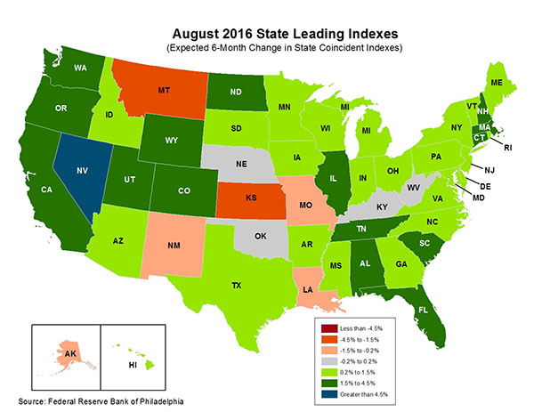
State-by-State Leading Indicators
through February 2017
Near-term growth forecasts vary widely by state.
Strongest
growth = blue (over 4.5%);
dark green
(1.5%-4.5%);
then light green;
then gray;
weakest = red
Sources: Federal Reserve Bank of Philadelphia at www.philadelphiafed.org/index.cfm , released August 29, 2016; Next release is September 30, 2016; Insurance Information Institute.

Slide 30
ISM Manufacturing Index (Values > 50
Indicate Expansion), Jan. 2010-Sept. 2016
Index
As of July,
5 Consecutive Months of Expansion
The Manufacturing Sector Expanded for 68 of the 72 Months
from January 2010 Through December 2015.
Manufacturing Contracted in 2015:Q4 and 2016:Q1
but was Expanding until August.
Sources: Institute for Supply Management; Insurance Information Institute.

Slide 31
ISM Non-Manufacturing Index (Values > 50
Indicate Expansion), January 2010-Sept. 2016
Index
The Non-Manufacturing (Services) Sector
Expanded in Every Month After January 2010. Compared to 2014-15,
the Pace of Expansion Has Slowed in 2016 But Not Ended.
Sources: Institute for Supply Management via https://research.stlouisfed.org/fred2/data/NMFCI.txt; Insurance Information Institute.

Slide 32
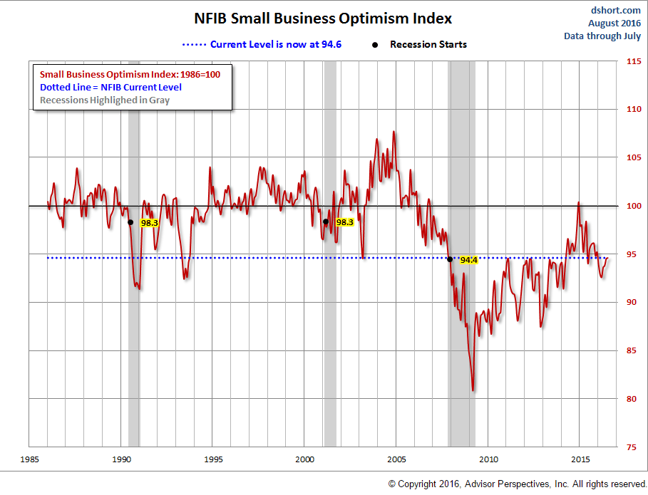
NFIB Small Business Optimism Index
January 1985 through July 2016
Growing pessimism in last 18 months
Source: National Federation of Independent Business at http://www.advisorperspectives.com/dshort/charts/indicators/Sentiment.html?NFIB-optimism-index.gif ; Insurance Information Institute.

Slide 33
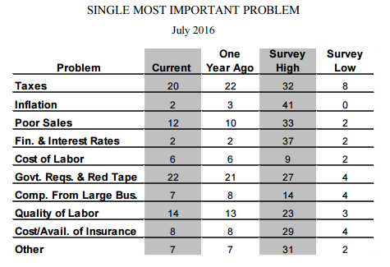
NFIB Small Business Survey: Single Most Important Problem, July 2016
Percent
Source: National Federation of Independent Business at http://www.advisorperspectives.com/dshort/charts/indicators/Sentiment.html?NFIB-optimism-index.gif ; Insurance Information Institute.

Slide 34
Business Bankruptcy Filings: Two Years at a Remarkably Low Level (1994:Q1 – 2016:Q2)
New Bankruptcy Law Takes Effect
(Thousands)
Recessions in orange
Below pre-recession level
Business bankruptcies in 2014-16 were below both the Great Recession levels and the 2003:Q3-2005:Q1 period (the best five-quarter stretch in the last 20 years). Bankruptcies restrict exposure growth in all commercial lines.
Sources: U.S. Courts at http://www.uscourts.gov/uscourts/Statistics/BankruptcyStatistics/BankruptcyFilings/2013/0913_f2q.pdf ; Insurance Information Institute
34
12/01/09 - 9pm
eSlide – P6466 – The Financial Crisis and the Future of the P/C
Notes:
34

Slide 35
Index of Total Industrial Production:*
A Peak in November 2014
Index
New Peak: November 2014 Index at 106.7
Peak at 105.73 in December 2007 (officially the 1st month of the Great Recession)
Some of the downturn in industrial production in 2015 and 2016 is due to slow growth in exports, thanks to the rise in the value of the U.S. dollar and slowing economies world-wide. Little relief is forecast for the near term.
*Monthly, seasonally adjusted, through July 2016 (which is preliminary). Index based on year 2012 = 100
Sources: Federal Reserve Board at http://www.federalreserve.gov/releases/g17/ipdisk/ip_sa.txt .
National Bureau of Economic Research (recession dates); Insurance Information Institute.
35
12/01/09 - 9pm
eSlide – P6466 – The Financial Crisis and the Future of the P/C
Notes:
35

Slide 36
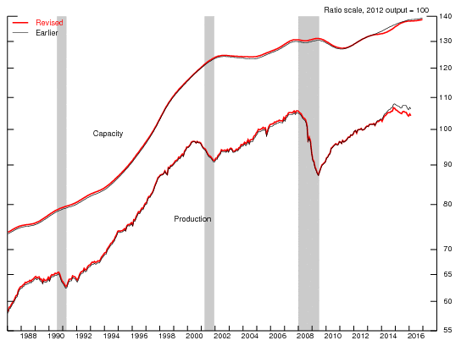
The Gap Between Industrial Production and Capacity Appears to be Widening
Even in boom times, we never use all of our industrial capacity, but lately the gap appears to be widening
Sources: Federal Reserve Board at http://www.federalreserve.gov/releases/g17/ipdisk/ip_sa.txt .
National Bureau of Economic Research (recession dates); Insurance Information Institute.

Slide 37
Labor Market Trends
We’re Now Gaining Jobs at a Good Pace,
but We’re Not at “Full Employment” Yet,
and There are Signs of Softening
37

Slide 38
Nonfarm Employment, Quarterly Change, 2011 – 2016*
Thousands
After a strong 2014-15, the pace of job growth has slowed somewhat.
*Seasonally adjusted; August and Sept 2016 data are preliminary
Sources: US Bureau of Labor Statistics; Insurance Information Institute

Slide 39
Unemployment and
Underemployment Rates: Still Falling
January 2000 through September 2016, Seasonally Adjusted (%)
U-6 went from 8.0%
in March 2007 to 17.5% in October 2009
For U-6, 8.0% to 9.5% is “normal.”
U-6 was 9.7% in Sept. 2016.
“Headline” unemployment was 5.0% in Sept. 2016. 4.5% to 5.5% is “normal.”
Based on the latest readings,
it appears that the job market is now close to “normal”
Source: US Bureau of Labor Statistics; Insurance Information Institute.
39
12/01/09 - 9pm
eSlide – P6466 – The Financial Crisis and the Future of the P/C
Notes:
39

Slide 40
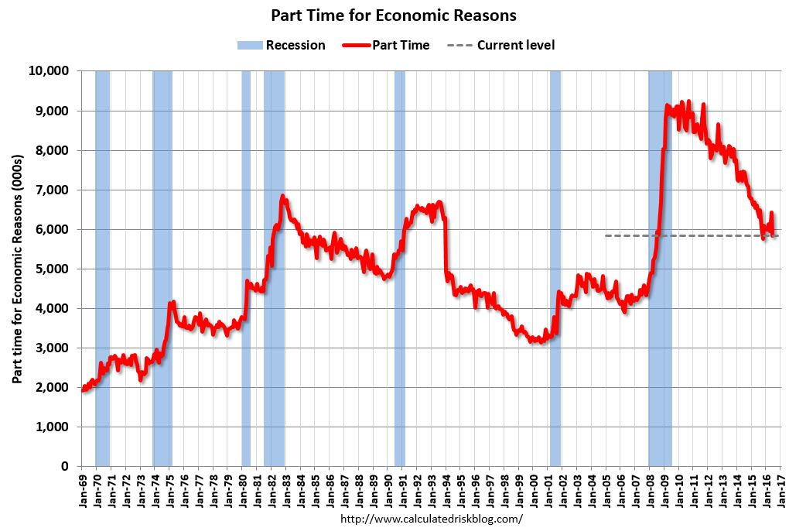
Labor Market Slack: Elevated Number of Involuntary Part-time Workers
Sep. 2016:
5.89 million
In less than 18 months, 4.5 million additional people were involuntarily working part time
The “normal” range
(since 1992)

Slide 41
Number of “Discouraged Workers”:
Elevated, but Dropping Jan. 1994 – Sept. 2016
Thousands
A “discouraged worker” in a month did not actively look for work in the prior month
for reasons such as
--thinks no work available,
--could not find work,
--lacks schooling or training,
--thinks employer thinks too young or old, and other types of discrimination.
Latest reading: 553,000
in Sept. 2016.
Normal
In recent good times, the number of discouraged workers ranged from 200,000-400,000 (1995-2000) or from 300,000-500,000 (2002-2007).
Notes: Recessions indicated by gray shaded columns. Data are seasonally adjusted.
Sources: Bureau of Labor Statistics; National Bureau of Economic Research (recession dates).
41
12/01/09 - 9pm
eSlide – P6466 – The Financial Crisis and the Future of the P/C
Notes:
41

Slide 42
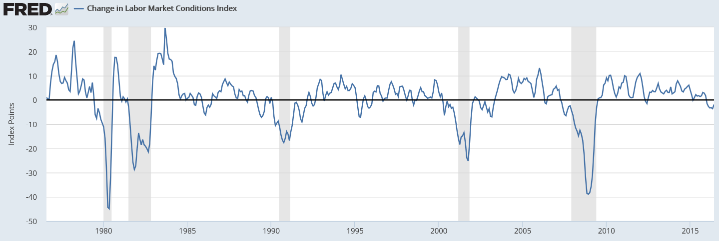
The Fed’s Labor Market Conditions Index
Combines 19 Labor Market Indicators
Since 1976, we’ve had a recession whenever the Index drops below -17.6.
As of June 2016 the Index was at -1.9 and appeared to be heading up.
Source: https://fred.stlouisfed.org/series/FRBLMCI#0

Slide 43
Labor Market Conditions Index
Since the Recession Ended
Index Value
Decline began in November 2015.
Based on history of the last 40 years, there’s no recession in sight.
Notes: Data are seasonally adjusted. The entire dataset is subject to revision, but that usually affects only the most recent 6 months.
Sources: https://research.stlouisfed.org/fred2/series/FRBLMCI
43
12/01/09 - 9pm
eSlide – P6466 – The Financial Crisis and the Future of the P/C
Notes:
43

Slide 44
Full-time vs. Part-time Employment,
Quarterly, 2003-2016:Q2
Full time, millions
Part-time, millions
Recession
New full-time peak
Pre-recession, most new jobs were full-time
Recession shifted employment growth from full-time to part-time
The Great Recession shifted employment from full-time to part-time.
Full-time employment is finally above its pre-recession peak,
but part-time hasn’t receded.
Data are seasonally-adjusted. Sources: US Bureau of Labor Statistics, US Department of Labor; Insurance Information Institute.

Slide 45
Nonfarm Payroll (Wages and Salaries):
Quarterly, 2005–2016:Q2
Billions
Latest (2016:Q2) was $8.06 trillion, a new peak--$1.83T above 2009 trough
Prior Peak was 2008:Q3 at $6.54 trillion
Y-o-Y Growth rates
2011:Q2 over 2010:Q2: 3.9%
2012:Q2 over 2011:Q2: 4.0%
2013:Q2 over 2012:Q2: 3.3%
2014:Q2 over 2013:Q2: 4.3%
2015:Q2 over 2014:Q2: 5.4%
2016:Q2 over 2015:Q2: 3.3%
Recent trough (2009:Q1) was $6.23 trillion, down 5.3% from prior peak
Note: Recession indicated by gray shaded column. Data are seasonally adjusted annual rates.
Sources: http://research.stlouisfed.org/fred2/series/WASCUR; National Bureau of Economic Research (recession dates); Insurance Information Institute.
45
12/01/09 - 9pm
eSlide – P6466 – The Financial Crisis and the Future of the P/C
Notes:
45

Slide 46
Average Weekly Hours Worked,*
Yearly, 2006—2015
The average work-week rose sharply in 2010-2012 and is now above levels prevailing before the Great Recession (which began in December 2007). Note that service-providing workers work a 7-hour shorter week than goods-producing workers.
*Seasonally adjusted. Data for 2016 are based on Jan-July; June and July are prelimnary
Note: Recessions indicated by gray shaded columns.
Sources: US Bureau of Labor Statistics at http://www.bls.gov/data/#employment;
National Bureau of Economic Research (recession dates); Insurance Information Institute.

Slide 47
Average Weekly Hours of All Private Workers, Mar. 2006—July 2016
Hours Worked*
The average hours worked per week was 34.5 in July 2016
Hours worked plunged during the recession, affecting payroll exposures
*Seasonally adjusted
Note: Recessions indicated by gray shaded columns.
Sources: US Bureau of Labor Statistics at http://www.bls.gov/data/#employment;
National Bureau of Economic Research (recession dates); Insurance Information Institute.
47
12/01/09 - 9pm
eSlide – P6466 – The Financial Crisis and the Future of the P/C
Notes:
47

Slide 48
Since 2012-13, Wages Have Grown Faster Than Inflation,* 2007-2016
Y-o-Y Change
Wage growth accelerating
The Fed raised rates for the first time in 7 years
*Seasonally adjusted; year-over-year; Shaded area indicates recession.
Sources: NBER (recessions); https://www.frbatlanta.org/chcs/wage-growth-tracker.aspx?panel=1 ; I.I.I.

Slide 49
U.S. Insured Catastrophe Loss Update
2014-15 Had Below-Average CAT Activity
49

Slide 50
U.S. Insured Catastrophe Losses
2012 was the 3rd most expensive year ever for insured CAT losses
($ Billions, $ 2015)
2013/14/15 were welcome respites from 2011/12—the latter being among the costliest years for insured disaster losses in US history. The longer-term trend is for more costly events.
Note: 2001 figure includes $20.3B for 9/11 losses reported through 12/31/01 ($25.9B 2011 dollars). Includes only business and personal property claims, business interruption and auto claims. Non-prop/BI losses = $12.2B ($15.6B in 2011 dollars.)
Sources: Property Claims Service/ISO; Insurance Information Institute.
50
12/01/09 - 9pm
eSlide – P6466 – The Financial Crisis and the Future of the P/C
Notes:
50

Slide 51
Combined Ratio Points Associated with Catastrophe Losses: 1960 – 2015E*
Avg. CAT Loss Component of the Combined Ratio by Decade
1960s: 1.04 1970s: 0.85 1980s: 1.31 1990s: 3.39 2000s: 3.52 2010s: 5.46*
Catastrophe losses as a share of all losses reached a record high in 2011
Combined Ratio Points
The Catastrophe Loss Component of Private Insurer Losses Has Increased Sharply in Recent Decades
*2010s represent 2010-2015E.
Notes: Private carrier losses only. Excludes loss adjustment expenses and reinsurance reinstatement premiums. Figures are adjusted for losses ultimately paid by foreign insurers and reinsurers.
Source: ISO (1960-2009); A.M. Best (2010-15E) Insurance Information Institute.

Slide 52
Growth of Homeowners/Renters Exposures
52

Slide 53
Forecast: Continued Growth in Private Housing Unit Starts, 1995-2019F
Rising mortgage rates could dampen the demand for new residential construction
(Millions of Units)
Housing unit starts plunged 72% from 2005-2009, down 1.49 million, to lowest level since records began in 1959
Housing starts are climbing slowly. Recently, the fastest growth is in multi-unit residences. Personal lines exposure will grow, and commercial insurers with Workers Comp, Construction risk exposure and Surety also benefit.
Sources: US Department of Commerce (history); Blue Chip Economic Indicators (10/2016), forecasts; Insurance Information Institute.

Slide 54
Number of Owner-Occupied & Renter-Occupied Housing Units, US, Quarterly, 1990:Q1-2016:Q2
Millions of Renter-Occupied Housing Units
Millions of Owner-Occupied Housing Units
Number of owner-occupied units has been stuck at
roughly 75 million units since 2005:Q4
Trough in 2004:Q2 at 32.61 million units.
Latest renter-occupied was 43.86 million units in 2016:Q2.
Since 2004 the number of renter-occupied housing units has grown
by over 11 million units (+34.5%), but there has been no growth in the number of owner-occupied housing units in 12 years. When will this end?
Sources: US Census Bureau at http://www.census.gov/housing/hvs/data/histtabs.html , Table 8; Insurance Information Institute.
54
12/01/09 - 9pm
eSlide – P6466 – The Financial Crisis and the Future of the P/C
Notes:
54

Slide 55
I.I.I. Poll: Renters Insurance
Percentage of Renters Who Have Renters Insurance, 2011-2015
Percentage Of Renters With Renters Insurance Continues to Increase.
Source: Insurance Information Institute Annual Pulse Survey.

Slide 56
Rental Vacancy Rates,
Quarterly, 1990-2016
Percent vacant
Peak vacancy rate 11.1% in 2009:Q3
Latest vacancy rate was 6.7% in 2016:Q2
Vacancy rate 10.4% in 2004:Q1
Before the 2001 recession, rental vacancy rates were 7.0-7.5%.
We’re below those levels now. => More multi-unit construction?
Sources: US Census Bureau, http://www.census.gov/housing/hvs/data/histtabs.html Table 1; Insurance Information Institute.
56
12/01/09 - 9pm
eSlide – P6466 – The Financial Crisis and the Future of the P/C
Notes:
56

Slide 57
US: Pct. Of Private Housing Unit Starts
In Multi-Unit Projects, 1990-2016*
Units in Multiple-Unit Projects
as Percent of Total
A NEW NORMAL?
In 6 of the last 8 years, over 30% of housing unit starts were in 5+-unit projects
For the U.S. as a whole, the trend toward multi-unit housing projects (vs. single-unit homes) is recent. Commercial insurers with Workers Comp, Construction risk exposure, and Surety benefit.
*data through August
Based on seasonally-adjusted data. Sources: U.S. Census Bureau; Insurance Information Institute calculations.

Slide 58
Giant Age Cohort (Millenials) Is Approaching Home-Buying Stage
Number of People in 2016 (Millions)
Average Age, 1st Time Homebuyer
Millennial Generation
Average Age, Repeat Homebuyer
If prior patterns hold, the number of homes bought by current renters, and the number of new homes built, will rise in coming years
Sources: Census Bureau; CoreLogic; Insurance Information Institute.

Slide 59
Growth in Number of Households
=> Increased Demand for Housing
Net Change in Number of Occupied Residences (Thousands)
A spike, not a trend
Housing bubble
Bubble burst
If prior patterns hold, the number of homes bought by current renters, and the number of new homes built, will rise in coming years
*2016:Q2-2015:Q4 Sources: Census Bureau; CoreLogic; Insurance Information Institute.

Slide 60
Insurance Information Institute Online:
www.iii.org
Thank you for your time
and your attention!

