Slide 1
Today’s Uncertain Economy:
Implications for P/C Insurance
Tri-State CPCUs
September 17, 2020
Steven N. Weisbart, Ph.D., CLU, Senior Vice President & Chief Economist
Insurance Information Institute ♦ 110 William Street ♦ New York, NY 10038
Tel: 212.346.5540 ♦ Cell: 917.494.5945 ♦ stevenw@iii.org ♦ www.iii.org

Slide 2
Economic Outlook
The Strength of the Economy
Will Influence the Insurance Environment
Notes:
Antitrust disclaimer – no one should express their individual plans or situation
With three major hurricanes, an earthquake and record wildfires in the third quarter of the year, following an above-average catastrophe first-half, there is talk about a “hard market” emerging.
How is a hard market defined?
A hard market occurs when insurance premiums grow substantially faster than the economy.
Premiums are measured by Net Written Premiums
The economy is measured by nominal GDP
The last hard market was 15 years ago. Are we due for another one?

Slide 3
July 29 Statement by the Federal Reserve Open Market Committee
The path of the economy will depend significantly on the course of the virus.
The ongoing public health crisis will weigh heavily on economic activity, employment, and inflation in the near term,
and [it] poses considerable risks to the economic outlook over the medium term.

Slide 4
The Economy Drives P/C Insurance Industry Premiums:
Nominal GDP: Annual Change, 1971-2021F
The U.S. economy’s annual growth—not adjusted for inflation—
has slowed over the last five decades.
Sources: U.S. Commerce Dept., Bureau of Economic Analysis; I.I.I. 2020 and 2021 are Blue Chip median forecasts (Sept. 2020 issue)

Slide 5
The Economy Drives P/C Insurance Industry Premiums:
Net Premium Growth (All P/C Lines) vs. Nominal GDP: Annual Change, 1971-2021
This isn’t a “hard market.” It’s driven by the tax law change.
Except for the three “hard markets” in this 50-year period,
Net Written Premiums track Nominal GDP—not year by year but fairly well.
Sources: A.M. Best (1971-2013), ISO (2014-19); U.S. Commerce Dept., Bureau of Economic Analysis; I.I.I. 2020 and 2021 are Blue Chip median forecasts, Sept. 2020 issue

Slide 6
U.S. Real GDP Growth,* Quarterly, 2010-2020
The rates of change here are quarterly change since the immediate prior quarter, but expressed at an annual rate. This assumes that a given quarterly change will persist for another three consecutive quarters.
Of course, this is a highly unlikely assumption.
In the last decade, the economy (as measured by real GDP) rarely grew faster than 3% (at an annual rate) in a calendar quarter.
*Seasonally adjusted at an annual rate
Sources: U.S. Department of Commerce; Insurance Information Institute.

Slide 7
Quarterly U.S. Real GDP Growth (at annual rates): Range of Forecasts, 2020-2021
Tough times ahead?
Forecasts expect U.S. growth to recover slowly through 2021.
Sources: Blue Chip Economic Indicators, Sept. 2020 issue; Insurance Information Institute.

Slide 8
Quarterly U.S. Real GDP: Actual and Forecasts, 2019-2021F
Tough times ahead? The economy is not forecast to reach its pre-recession (2019:Q4) level until the last quarter of 2021.
$ Billions
+5.5%
-9.1%
Sources: Blue Chip Economic Indicators, Sept. 2020 issue; Insurance Information Institute. Plot points for 2020:Q3 and later are estimates and forecasts.

Slide 9
U.S. Real GDP Growth (at annual rate): mid-September Range of Forecasts for 2020:Q3
With two weeks to go in the quarter, forecasts differ widely for U.S. growth in 2020:Q3, from a modest recovery (New York Fed) to a bonfire (Goldman Sachs).
Sources: Blue Chip Economic Indicators, Sept. 2020 issue; Calculated Risk on 9/11/2020; Insurance Information Institute.

Slide 10
Hiring Depends on People Having Income and Spending It*
$ Billions
Personal Saving as a % of DPI
Nov 2019: 7.9%
Dec. 2019: 7.2%
Jan. 2020: 7.6%
Feb 2020: 8.3%
Mar. 2020: 12.9%
Apr. 2020: 33.7%
May 2020: 24.6%
Jun. 2020: 19.2%
Jul. 2020: 17.8%
In 2020:Q2 we had the largest drop in credit card balances in history--$75 billion. Consumption (70% of the economy) is cautious.
*Data are seasonally adjusted at an annual rate
Sources: bea.gov, Personal Income and Outlays, published August 28, 2020, Table 1; Insurance Information Institute.

Slide 11
Growth in Non-Residential Fixed Investment: History and Range of Forecasts, 2020-2021
Year-over-Year percent change
Forecasts expect business investment (in structures, equipment, and software) to plunge this year and most see a recovery in 2021.
Sources: Blue Chip Economic Indicators, Sept. 2020 issue; Insurance Information Institute.

Slide 12
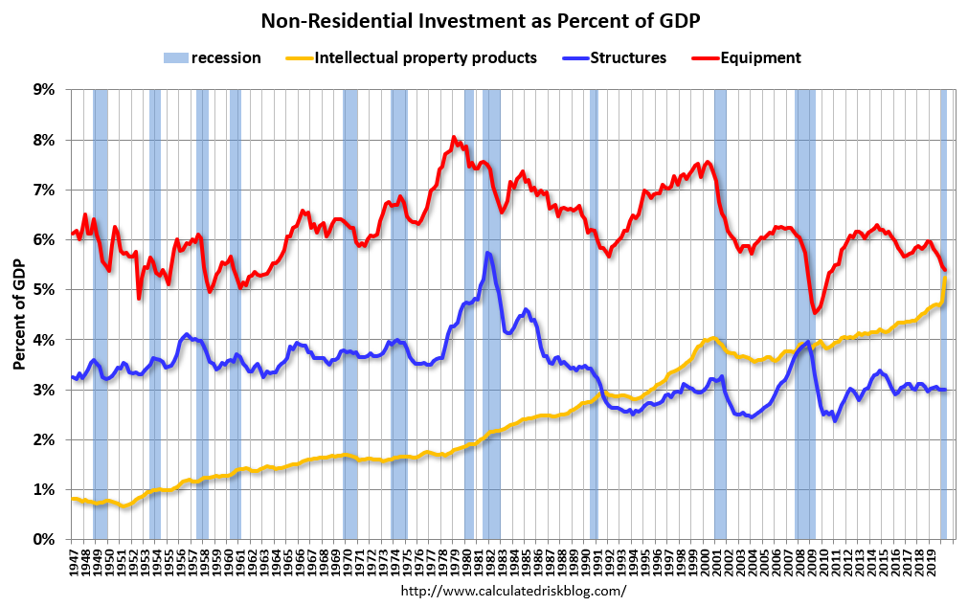
Investments in structures and equipment tend to plunge in recessions, but software investments keep rising

Slide 13
Where is the Stock Market Headed? Recent Corporate Profits History and Range of Forecasts
Year-over-Year percent change
Forecasts expect corporate profits to plunge this year
but most see a recovery in 2021.
Sources: Blue Chip Economic Indicators, Sept. 2020 issue; Insurance Information Institute.

Slide 14
Personal Consumption Expenditures:
Durable Goods subcategories, Quarterly
$ Billions
2020:Q2 vs. 2019:Q4: motor vehicles -10.7%;
furniture, major appliances, TVs, computers -0.4%
Data are seasonally-adjusted, annualized.
Sources: US Bureau of Economic Analysis, NIPA, Table 2.4.5U; Insurance Information Institute.

Slide 15
Personal Consumption Expenditures:
Durable Goods subcategories, Quarterly
$ Billions
2020:Q2 vs. 2019:Q4: recreational vehicles +15.1%;
jewelry, watches -25.4%; phones -25.1%
Data are seasonally-adjusted, annualized.
Sources: US Bureau of Economic Analysis, NIPA, Table 2.4.5U; Insurance Information Institute.

Slide 16
Personal Consumption Expenditures: Theaters,
Amusement Parks, Museums, Membership Clubs, etc., Quarterly
$ Billions
2020:Q2 vs. 2019:Q4: -78.1%
Data are seasonally-adjusted, annualized.
Sources: US Bureau of Economic Analysis, NIPA, Table 2.4.5U; Insurance Information Institute.

Slide 17
Total Business Revenue for Transportation and Warehousing vs. IM Direct Premiums, Quarterly
Percent Change from Prior Year
-6.6%
-31.0%
Sources: FRED https://fred.stlouisfed.org/series/REV4849YTAXABL144QNSA#0; S&P Global; Insurance Information Institute.

Slide 18
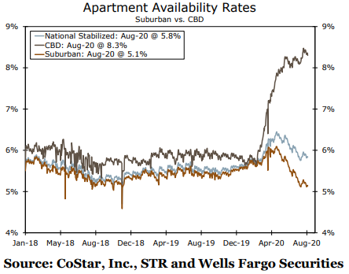
CBD Renters Moving to Suburban Apartments
Rising [inner-city] apartment vacancy [availability] rates
  a skyrocketing apartment availability rate in central business districts (CBD) mirrored by a declining rate for suburban properties
Source: https://image.mail1.wf.com/lib/fe8d13727664027a7c/m/4/89570e31-d1a4-46bd-8e6e-1599b995dc1a.pdf?utm_source=SFMC&utm_medium=email&utm_campaign=&utm_content=&utm_term=7230679&sid=44743

Slide 19
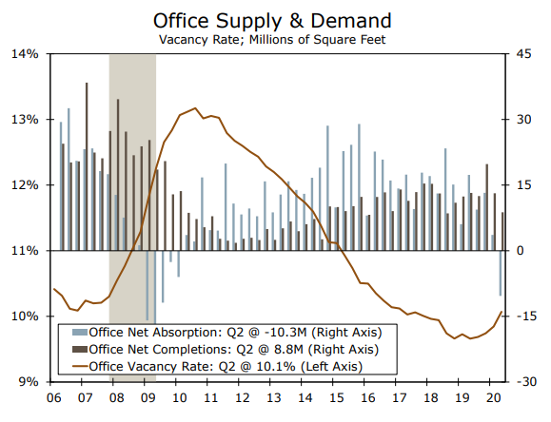
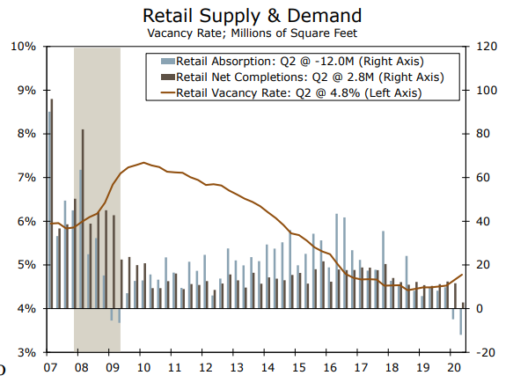
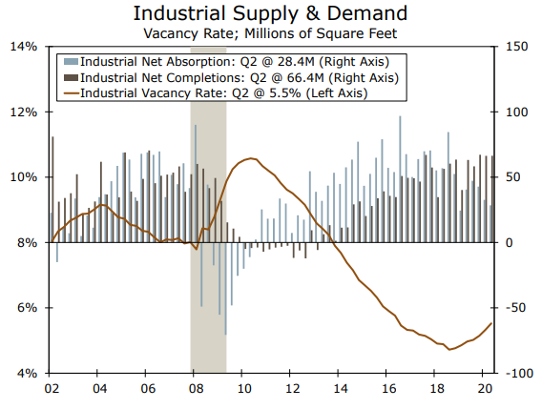
Property Insurance: Property Vacancies Rising
Rising vacancies mean potentially higher claim frequency and severity.
Source: https://image.mail1.wf.com/lib/fe8d13727664027a7c/m/4/89570e31-d1a4-46bd-8e6e-1599b995dc1a.pdf?utm_source=SFMC&utm_medium=email&utm_campaign=&utm_content=&utm_term=7230679&sid=44743

Slide 20
Labor Market Trends
Continuing Job Gains in the Private Sector

Slide 21
Nonfarm Employment, Quarterly Change*
Thousands
Trump
We have a steep employment hill to climb to get back to employment levels at the end of 2019.
*Seasonally adjusted; 2020:Q3 is estimated based on preliminary data
Sources: US Bureau of Labor Statistics; Insurance Information Institute

Slide 22
Unemployment and Underemployment Rates
January 2000 through latest month Seasonally Adjusted (%)
U-6 was 14.2% in August 2020.
“Headline” unemployment was 8.4% in August 2020.
4% or so is generally considered to be “full employment.”
Based on the latest readings, the job market is getting better,
but only slowly. Officially, 13 million are unemployed.
Sources: US Bureau of Labor Statistics; Insurance Information Institute.
22
12/01/09 - 9pm
eSlide – P6466 – The Financial Crisis and the Future of the P/C
Notes:
22

Slide 23
A Closer Look: Full-time vs. Part-time Employment, Quarterly, 2013:Q1-2020:Q2
Full time, millions
Part-time, millions
In one quarter, we went from 130 million employed full-time
to 116 million.
We went from 27 million employed part-time to 21 million.
The pandemic recession has affected both full-time and part-time together.
Data are seasonally-adjusted. Sources: US Bureau of Labor Statistics, US Department of Labor; Insurance Information Institute.

Slide 24
The Civilian Labor Force: A Closer Look
Jan. 2013 – August 2020
Millions
If you are unemployed but haven’t looked for work in the past four weeks, you are not counted as being in the labor force. So it ebbs and grows according to perceived job opportunities.
What happened? Maybe several million people retired, rather than go back to work (if their job still existed).
The workforce in April 2020 was about the same size as in October 2014.
A University of Chicago study found that the share of Americans who retired rather than remain in the labor force shot up 7 percentage points between January and April.
From February 2020 to April, the workforce shrank by 8.1 million,
but it regained 4.3 million by August, for a net drop of 3.8 million.
Notes: Recession indicated by gray shaded column. Data are seasonally adjusted.
Sources: Bureau of Labor Statistics; National Bureau of Economic Research (recession dates).
24
12/01/09 - 9pm
eSlide – P6466 – The Financial Crisis and the Future of the P/C
Notes:
24

Slide 25
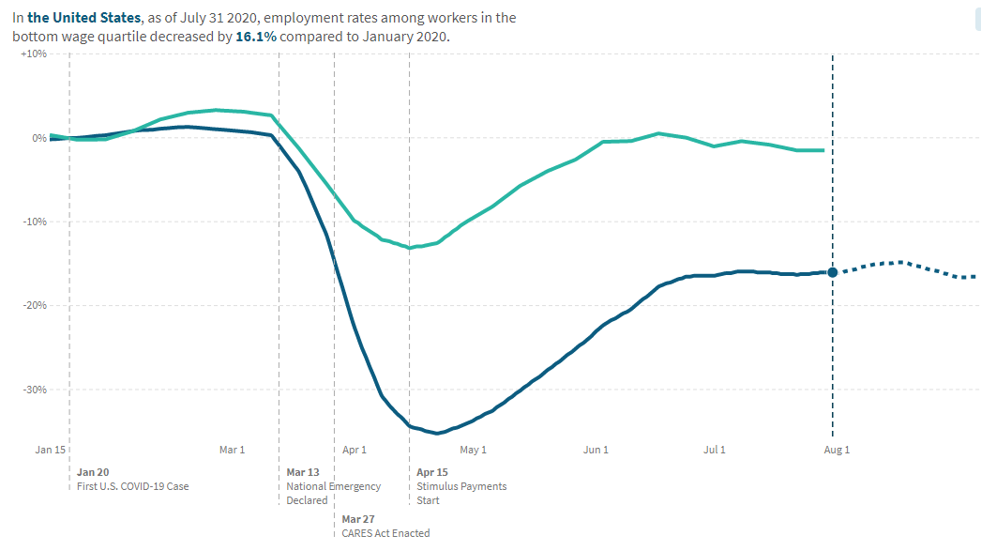
Two Economies: Employment Rates in 2020 Differ by Wage Levels
>$60K
-1.6%
<$27K
-16.1%
Source: https://tracktherecovery.org/

Slide 26
The Investment Story:
Lower for Longer
Depressed Yields Will Necessarily Influence Underwriting & Pricing

Slide 27
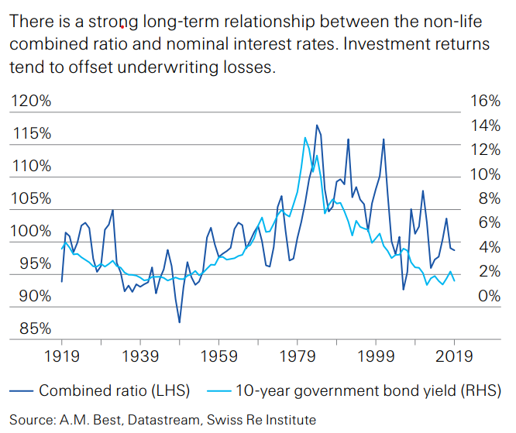
Why We Focus on Interest Rates

Slide 28
US Treasury Note 10-Year Yields*
Yields on 10-Year US Treasury Notes have been below 3% for over 8 years: 10-year U.S Treasury bonds bought in 2011 at 3.5% will be reinvested today at less than 1.0% for 10 more years
0.65%
Since nearly 50% of P/C bond/cash investments are in 5-year or longer maturities, most P/C insurer portfolios will have low-yielding bonds for years to come.
*Monthly, constant maturity, nominal rates, through August 2020.
Sources: Federal Reserve Bank at http://www.federalreserve.gov/releases/h15/data.htm; National Bureau of Economic Research (recession dates); Insurance Information Institute.
28
12/01/09 - 9pm
eSlide – P6466 – The Financial Crisis and the Future of the P/C
Notes:
28

Slide 29
BofA AA Corporate Index Effective Yields,*
2000–2020
The yield on these bonds has been lower than 3% for most of the last decade
1.42%
Since the yield on these bonds has been lower than 3% for most of the past decade, many P/C insurer portfolios will have low-yielding bonds for years to come.
*Monthly, not seasonally adjusted, through August 2020.
Sources: Federal Reserve Bank at http://www.federalreserve.gov/releases/h15/data.htm; National Bureau of Economic Research (recession dates); Insurance Information Institute.
29
12/01/09 - 9pm
eSlide – P6466 – The Financial Crisis and the Future of the P/C
Notes:
29

Slide 30
P/C Insurer Portfolio Yields,
2002-2020:Q2
P/C Carrier Yields Have Been Falling for Over a Decade, Reflecting the Long Downtrend in Prevailing Interest Rates.
Even if Rates Rise in the Next Few Years, Portfolio Yields Are Unlikely to Rise Quickly Since Low Yields of Recent Years Are “Baked In” to Future Returns.
Sources: NAIC data, sourced from S&P Global Market Intelligence; Insurance Information Institute.

Slide 31
August 2020: Quarterly Yield Forecasts for 10-Year US Treasury Bonds in 2020-21
Yield (%)
The forecasts in the Blue Chip survey see a common direction for the yield of 10-year T-bonds in 2021 but not much relief.
Sources: Blue Chip Economic Indicators (9/20); Insurance Information Institute

Slide 32
P/C Insurance Industry:
Financial Update
It’s Hard to Know Where We Stand
or Where We’re Going

Slide 33
Net Written Premium Growth (All P/C Lines):
Annual Change, 2008-2019
Net Written Premiums rose more in 2018 than in any year in the prior decade.
The spike was due largely to reinsurance changes driven by tax reform.
Sources: A.M. Best (2007-2013), ISO (2014-19).

Slide 34
U.S. Inflation-Adjusted Insured Cat Losses
Harvey, Irma, Maria
2019 – 11th worst year for U.S. Insured Catastrophe Losses. Average Insured Loss per Year for 1980-2019 is $20.1B.
*2020: Aon estimate through April.
2010s is average of 2010 to 2019. All losses are Direct.
Sources: Property Claims Service, a Verisk Analytics business; Aon; Insurance Information Institute.

Slide 35
P/C Insurance Industry
Combined Ratio, 2000-2018*
3 Consecutive Years of U/W Profits; 1st time since 1971-73
Heavy Use of Reinsurance Lowered Net Losses
Higher CAT Losses, Shrinking Reserve Releases, Toll of Soft Market
2nd worst combined ratio since 2002
Sandy
*Excludes Mortgage & Financial Guaranty insurers 2008-2014.
Including M&FG, 2008=105.1, 2009=100.7, 2010=102.4, 2011=108.1; 2012:=103.2; 2013: = 96.1; 2014: = 97.0.
Sources: A.M. Best; ISO, a Verisk Analytics® business; NAIC data from S&P Global Intelligence; I.I.I.

Slide 36
Net Underwriting Gains and Losses, 1st Quarters
Sources: NAIC data, sourced from S&P Global Market Intelligence, ISO/PCI. 2019
Notes:
Updated 7/25/18 – brent
http://www3.ambest.com/bestweekpdfs/sr577057119015afull.pdf

Slide 37
P/C industry operating ratios
Operating ratio = combined ratio (losses plus expenses as a percent of earned premiums) minus net investment income as a percent of earned premiums.
Operating ratio includes all insurance and investment operations except taxes and capital gains and losses.
Exceptional catastrophe years (2011, 2017) drove the operating ratio above 92. A "normal" range is 88-92.
Sources: NAIC data, sourced from S&P Global Market Intelligence; Insurance Information Institute.
Notes:
Updated 6/25/18 – lynch

Slide 38
Sources of investment gains
$ Billions
Steady Investment Income
but smaller realized capital gains in 2020:Q1.
Through First Quarter. Sources: NAIC data, sourced from S&P Global Market Intelligence; Insurance Information Institute.

Slide 39
Key sources of P/C insurer profits
$ Billions
Steady Investment Gains,
Good Underwriting Results Lifted Profits.
Through first quarter.
Data are before taxes and exclude extraordinary items.
Source: NAIC data, sourced from S&P Global Market Intelligence.

Slide 40
Policyholder Surplus, 2006–2019
Surplus as of 6/30/20 stood at $837.0B
($ Billions)
The industry now has $1 of surplus for every $0.79 of NPW,
near the strongest claims-paying status in its history.
The P/C insurance industry is in very strong financial condition.
Sources: ISO, A.M .Best.
40
12/01/09 - 9pm
eSlide – P6466 – The Financial Crisis and the Future of the P/C
Notes:
40

Slide 41
Commercial Insurance Premiums

Slide 42
Workers Comp Premiums, 2007–2020
Remarkably, total Workers Comp premiums have declined almost continually since 2007. From January 2007 to August 2020, -11.4%. This is even more remarkable given that total private employment rose by 14.7 million through February 2020 (+6.4 million through August 2020).
Index:
Jan 2007=100
Monthly, not seasonally adjusted, through August 2020.
Sources: U.S. Bureau of Labor Statistics, Producer Price Index (WC premiums Index) and private employment; National Bureau of Economic Research (recession dates); Insurance Information Institute.
42
12/01/09 - 9pm
eSlide – P6466 – The Financial Crisis and the Future of the P/C
Notes:
42

Slide 43
CMP and Liability Premiums, 2007–2020
Since 2007, total CMP premiums have risen about 14%. The “Great Recession” slowed this increase but not the current recession. Premium increases for liability insurance were slowed by both recessions but rose by about 10% overall.
Index:
Jan 2007=100
Monthly, not seasonally adjusted, through August 2020.
Sources: U.S. Bureau of Labor Statistics, Producer Price Index (CMP premiums Index) and private employment; National Bureau of Economic Research (recession dates); Insurance Information Institute.
43
12/01/09 - 9pm
eSlide – P6466 – The Financial Crisis and the Future of the P/C
Notes:
43

Slide 44
Questions?

Slide 45
Insurance Information Institute
www.iii.org
Thank you for your time
and your attention!
Notes:
45

