Slide 1
Insurance:
Leading Through Disruption
Sean Kevelighan, Chief Executive Officer
Insurance Information Institute  110 William Street  New York, NY 10038
212.346.5520  seank@iii.org  www.iii.org
Notes:
Introduction
Preliminary work and observations since starting with III
Disruption is everywhere and insurance is right in the middle of it
Relevant anecdote for audience

Slide 2
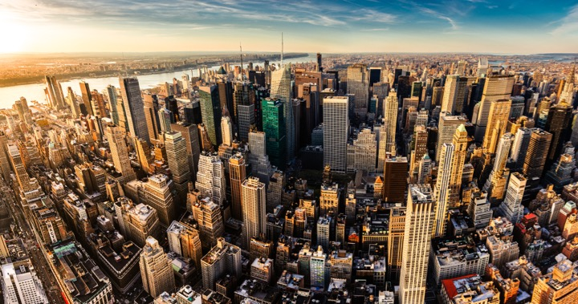
I.I.I. Mission Statement
Improving public understanding
of insurance...
…what it does and how it works
2

Slide 3
Disruption is Everywhere

Slide 4




Disruption is Everywhere
Catastrophes – Increases in frequency and severity
Natural Catastrophes
Water
Fire
2016 Flood Loss 6x Greater
2015: Record Year
Wind
Climate Change
8 of 10 costliest since 2004
367 Tornados Q1/17

Slide 5


Disruption is Everywhere
Catastrophes – Increases in frequency and severity
Man-Made Catastrophes
Autos
Cyber
“Induced”
Earthquakes
More cars on road
Distracted driving
$445 million/year
~950 3.0+
60% in OK

Slide 6



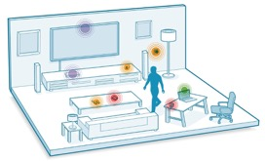

Technology / Digitalization
Sharing
Economy
The Internet of Things
Big Data
Notes:
All industries being impacted

Slide 7
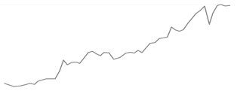
Economic Uncertainty
Global Growth...
US Growth...
  *Since 2008 we've had the longest period of relative trade stagnation since World War II...
  Investment
  Growth
  GDP
  1.6%
...Monetary vs. Fiscal Policy
  Monetary: Low interest rates mean insurers are struggling to meet interest rate guarantees for life insurance and annuities must diversify their investment portfolios
  Fiscal: Supply-side debate heating up, i.e., tax reform
* The Peterson Institute for International Economics
Notes:
GDP – Per Steve full year 2016 GDP is 1.6%

Slide 8




Globalization
Geopolitical Polarization
Rise of Nationalism
Regional
Tensions
Global Trends Impacting
Domestic Market
Regulatory Trends
"Conduct of Business"
TPP
Capital/Solvency
Dodd-Frank
* Mainland purchases of insurance and related investment policies in the nine months ended September 2016 surged to a record high.
Notes:
Elected Officials: "Rise of Nationalism" -- US, France, Germany
Neither US presidential candidate supports TPP
Regions: Europe (EU/Brexit/Russia), Asia (China/North-South Korea/Japan), Middle East (Syria/Iraq)
Global trends impacting domestic market
Regulatory trends:
"Conduct of Business"
Capital/Solvency
Climate Change

Slide 9
Geopolitics – US

Slide 10
P/C Insurance Industry ROE by Presidential Party Affiliation
1950-2016*
Truman
Eisenhower
Kennedy/ Johnson
Nixon/
Ford
Carter
Reagan/
Bush I
Clinton
Bush II
Obama
BLUE = Democratic President RED = Republican President
.
*2016 data is through Q3.
Source: Insurance Information Institute

Slide 11
But State Politics Drives Insurance
And Every State is Different
C-
WA
D
MT
D+
ND
A
ME
B+
OR
B
MN
A
ID
A-
WI
D+
NY
NH A-
VT A+
MA D-
RI C+
CT C+
NJ B-
DE D
MD C+
B-
SD
B
WY
C+
MI
B
NE
B+
IA
B-
PA
D
CA
B+
NV
B
OH
A
UT
A
IL
B
IN
C
CO
C
WV
B
VA
C
KS
B
MO
A-
KY
B- TN
F NC
A
AZ
B
NM
C
OK
C+
AR
B
SC
D
MS
C-
AL
C
GA
B-
TX
D
LA
= A
= B
= C
= D
= F
= NG
D-
AK
C
FL
D
HI
Not Graded: District of Columbia
Source: R Street Insurance Regulation Report Card, December 2016

Slide 12
Insurance Industry Snapshot

Slide 13

State of Insurance
Top Issues
Catastrophe Costs
Consolidation/M&A
Insurance-related Deals
Involving U.S. Firms²
Autonomous
Vehicles
P/C Payouts / Property Losses¹
564
+11.5%
$194B
+517%
P2P insurance
2015
2016
2015
$15.4B
$21.0B
Cybersecurity
DEALS
VALUE
506
2014
$38B
Sharing Economy
U.S. Insured Cat Losses
Workers Comp
Regulation
2016 Loss Up Modestly Compared With 10-YearAaverage $19.1B
$6.3B
(JAPAN)
(BERMUDA)
Politics
84
pending or completed M&As involving U.S. insurance companies (2016)³
Overcapitalization
(Reinsurance)
1. PCS; 2. Conning Research 3. S&P Financial
Notes:
According to the KPMG report called “The New Deal: Driving Insurance Transformation with Strategy-aligned M&A,” 84% of insurance companies plan to make between one and three acquisitions in 2017, while 94% plan at least one divestiture.

Slide 14
P/C Insurance Industry
Combined Ratio, 2001-2016*
3 Consecutive Years of U/W Profits; 1st time since 1971-73
An UW Loss, Actually.
*Excludes Mortgage & Financial Guaranty insurers 2008-2014. 2016 is first nine months
Including M&FG, 2008=105.1, 2009=100.7, 2010=102.4, 2011=108.1; 2012:=103.2; 2013: = 96.1; 2014: = 97.0.
Sources: A.M. Best; ISO, a Verisk Analytics company; 2010-2015E is from A.M. Best P&C Review and Preview, February 16, 2016.
Notes:
Drivers: Higher cats than older years
Development on Prior is trending the wrong way ($5B favorable is half what was posted last year; 2015 already trending higher)
2011 Tornados - Joplin Tuscaloosa
Joplin was biggest insurance event in Missouri history
2012 Super Storm Sandy
2001-2001 Interest Rates higher, but not the case since 2008/2009
99.5 – So close to 100 because earned and written premium

Slide 15
Commercial & Personal Lines NPW Growth:
1996-2016
5.7%
-1.3%
Commercial Lines is Prone to
Much More Cyclical Volatility Than Personal Lines.
Note: Data include state funds beginning in 1998.
Sources: A.M. Best; Insurance Information Institute.

Slide 16
P/C Insurer Portfolio Yields,
2002-2015
P/C Carrier Yields Have Been Falling for Over a Decade, Reflecting the Long Downtrend in Prevailing Interest Rates.
Even as Prevailing Rates Rise in the Next Few Years,
Portfolio Yields Are Unlikely to Rise Quickly,
Since Low Yields of Recent Years Are “Baked In” to Future Returns.
Sources: NAIC data, sourced from S&P Global Market Intelligence; Insurance Information Institute.
Notes:
Likely to be some time before industry gets any relief – yields continue to be declining.
70’s – 80’s investment yields were in the double digits.
Seeing some – but not a lot – where they are looking for higher, but can only do so much because of the liability cover issue AND regulatory scrutiny
Hedge funds
Pension funds

Slide 17
Rising Auto Costs
A force to be reckoned with…

Slide 18
Net Combined Ratio, 2005-2015
Loss Ratios Have Been Rising for a Decade.
2015 Return on Net Worth is Likely Close to Zero or Negative.
Source: National Association of Insurance Commissioners data, sourced from S&P Global Market Intelligence;
Insurance Information Institute.

Slide 19





Double Digit Loss Costs
Auto Insurance
Increase in Loss Costs, 2014:Q4–2016:Q4
Bodily Injury
14.2%
Property
Damage
15.3%
Personal Injury Protection
14.2%
Collision
13.6%
Comprehensive
20.7%
From 2014 to 2016, the cost of accidents
has risen dramatically. By contrast, consumer prices overall
rose 3.9 percent during 2014 and 2015.
Source: Fast Track Monitoring System.
Notes:
The amount of claim costs per vehicle insured - known as loss costs in the industry - is the primary cost in auto insurance rates. Those have been rising across all major coverages.

Slide 20
More People Working and Driving
=> More Collisions, 2006–2016
Number Employed,
Millions
Overall Collision Claims Per 100 Insured Vehicles
Recession
When people are out of work, they drive less. When they get jobs,
they drive to work, helping drive claim frequency higher.
Sources: Seasonally Adjusted Employed at end of each quarter, from Bureau of Labor Statistics; Rolling Four-Qtr Avg. Frequency from Insurance Services Office; Insurance Information Institute.
20
12/01/09 - 9pm
eSlide – P6466 – The Financial Crisis and the Future of the P/C
Notes:
20
A lot of attention – WSJ, ABC
Nutshell: More people working, more people driving, more cars, more accidents
Costs are going up across the board – AAA numbers!
Manufacturing – Purchase – And depreciation
Repair & maintenance
Gas
Insurance – in that order!
Chart provides only frequency – seeing that level off
For reasons above, we still expect the severity will continue to

Slide 21
Severity: Driving Fatalities Are Rising
Annual Change in Motor Vehicle Deaths
Seatbelt Use Rose to 62% of Drivers, From 49% in ‘90
Big Drop-off Due to the Great Recession
Driving Has Been Getting Safer for Decades, But Recent Trend is Discouraging—38,300 Deaths in 2015.
Sources: National Safety Council, Insurance Information Institute.
Notes:
Source: http://www.nsc.org/NewsDocuments/2017/12-month-estimates.pdf

Slide 22
Fixing a Bumper
. . . On an Entry-Level Luxury Car (~$35K)
2014 Cost vs. 2016 Cost
What Has Changed?
 | 2014 | 2016
Grille: Distance Sensor | $0 | $2,818
Headlamp Assembly | 394 | 918
Mechanical Labor | 0 | 108
Fewer Accidents, Higher Costs
Parts: 130% Higher
Labor: 18% Higher
Total cost: $1,705 higher
2016 vehicle has LED headlights and adaptive cruise control.
Source: Liberty Mutual Insurance.

Slide 23
Insurance: Leading Through Disruption

Slide 24
Insurance Leadership
Sustainable Business Model
Strong Jobs Pool/Provider
Economic Growth Promoter/Facilitator
2010
$450.3B
2.6%
US GDP³
Bank Failures: 157
2.5M Employed
Premium Taxes Paid⁴ $19.2B
Insurance Impairments¹: 8
Bond Investment⁵ $489B
Policyholder Surplus:
$700.9B
Need to Fill
400K+ by 2022
End
2016
Charity/Volunteerism⁶ 15%
Fundamentals Strong – but Still Susceptible to Disruption
1. Life/Health and P/C Insurance’ 2. PC 360 http://www.propertycasualty360.com/2013/04/17/insurance-industry-crisis-400000-positions-to-fill?slreturn=1476304299; 3. U.S. Bureau of Economic Analysis. 2014; 4. U.S. Department of Commerce, 2015; 5. Federal Reserve, 2015; 6. 2011–2014, Insurance Industry Charitable Foundation.

Slide 25
  Insurance Disruption
  Technology / Digitalization
Fundamental
Changes
Opportunities
Challenges
Future of Auto
Future of Reduced
Risk Pools
Automation / Efficiencies
New Product Lines (Cyber)
Emerging Technologies
Consumer Trust – Demonstrate the Societal Value
Big Data vs. Individual Privacy
New Market Entrants “Uber of Insurance”?
Regulatory Opportunities/Threats
Lemonade
  Approved in NY and CA
Barrier to Entry
US vs. Other Less Regulated Regions
Trust Pull-back – the Sandbox Approach
Notes:
Insurance Disruption
Technology / Digitalization
Fundamental changes
Future of auto insurance
Autonomous vehicles -- reduction of accidents
Future of reduced risk pools
Disparate Impact
Opportunities
Automation and efficiencies -- claims, underwriting, filings (?)
New product lines -- cyber, sharing economy
Emerging technologies -- cognitive computing, predictive analytics
Challenges
Consumer trust will be key -- demonstrate the societal value
Big data vs. personal/information privacy
New market entrants -- "Uber of Insurance"
Lemonade: Approved in State of New York
Regulatory -- Opportunity / Threat
Barrier to entry (for potential disrupters)
US -- 50+ individual regulatory bodies
Taxi vs. Insurance Regulator: One can put you in jail…
Pull back / curb
Consumer trust will play key role
Sandbox approach
US vs. other global regions with less regulatory burden
[TBD] Audience Relevance Section

Slide 26
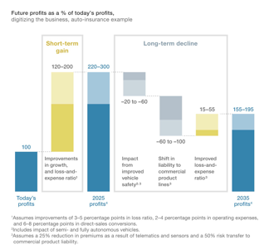
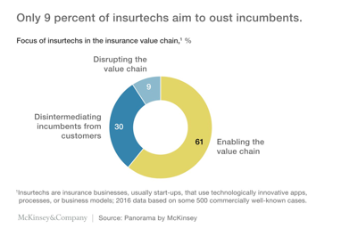
InsurTech Disruption: Threat or Opportunity?
Automation efficiencies can have powerful impact on industry

Slide 27









InsurTech Startups Have Broad Range… BUT…
Risk
Health
Insurance Marketplace
Digital Brokers
Peer to Peer
Health Navigators
Micro-duration Coverage
Telematics
Notes:
Based on our most recent count we are tracking over 500+ InsurTech Companies. Just a year ago that number was about half that. We are tracking companies across Risk and Health in a variety of themes. For us its more about business concepts than it is about individual companies.

Slide 28









…With Broad Incumbent Support
$205M
$57M
$37M
$21M
$4M
Note; Total funding
Notes:
Some examples of insurance company investments in InsurTech…. As you can see it is across a variety of themes or business concepts….
Metromile – Telematics
CoverHound and Policy Genius- Insurance Marketplaces
One Inc. – Cloud Based IT Platform and
Slice - Micro-Duration Coverage.
These investments create an opportunity to accelerate growth, improve efficiency, enhance the customer experience and “Speed to Market” for new products in emerging risk.

Slide 29







Successful Digital Transformation → Holistic Approach
Notes:
All industries being impacted

Slide 30

Notes:
Mission: Improving public understanding of insurance -- what it is and how it works
Key stakeholders: industry (businesses/trades), consumers, government, media)

Slide 31

“Surround Sound” Approach
Consumers
Consumers
Industry
Policymakers
Media
Relevant
Experts
Relevant
Experts
Industry
Media
Policymakers
Public Affairs Channels
Messaging & Engagement

Slide 32
Campaign Framework
Proactively Position the Insurance Industry
as an Economic Imperative
Pillar:
Financial & Community Resilience
Pillar:
Talent Recruitment & Retention
Pillar:
Innovation & Technology
Campaign 1:
A Day in the Life of Risk
Campaign 2:
Insurance Information Institute
of Innovation
Actuary in Action
Conquering Life’s Obstacles
On-Air Actuary
Innovation Sessions
Insure-Tech Hackathon
Incubator

Slide 33
A Day in the Life of Risk
Concept
  People usually don’t understand risk or the economic value of insurance until something bad happens to them or someone they know. They also don’t understand the humanity of the insurance industry until they have a live person helping them sort out their situation.
  The I.I.I. will construct a scalable, multi-tier campaign aimed at building community resilience and talent recruitment that tastefully and authentically raises awareness of the critical importance of insurance by personifying risk and giving it tangible, touchable, and experiential factors.
Actuary in Action
Conquering Life’s Obstacles
On-Air Actuary
Irreverent Video Testimonials
Social Media
National Media Event
Campus Tour
Media Partnership
“Honorary Actuary” Celeb-Hosted Podcast

Slide 34
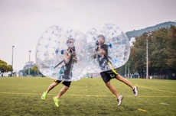

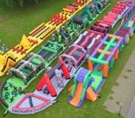
A Day in the Life of Risk
Conquering Life’s Obstacles
Phase 1
Phase 2
Invite press to experience the I.I.I. Obstacle Course as a kick-off event that reintroduces the industry and shakes off outdated insurance sentiments; offer executive interviews on thought leadership and institutional authority.
Take the show on the road.
  Hold events at college campuses nationwide where students can participate in the obstacle course, get information on careers in the industry and learn more about why they need the product at this stage of their life.
  Potentially engage celebrity (ex: comedian Chris Hardwick) to host competitive sessions between teams (fraternities, sororities, study groups).
Notes:
Life comes at you fast, but there’s a whole industry built on helping you get out of the way.
I.I.I. will create a fun, physical experience that introduces risk-related concepts and careers that articulate the social and economic value of insurance.

Slide 35
Insurance Information Institute of Innovation (I-4)
Concept
  Embrace disruption and new technologies to ensure relevance and address potential challenges technology can manifest by launching the I-4 campaign: the Insurance Information Institute of Innovation.
  It begins with a focus on:
    Driving conversations around technology and its implications – both positive and negative – to business and personal insurance.
    Shining a light on the current innovators in the industry while supporting and celebrating new development and technology breakthroughs.
    Promoting contemporary and technology-focused career opportunities within the insurance industry on college campuses.
Innovation Sessions
InsureTech Hacks
I-4 Incubator
Salon Dinner Series
1:1 Editor Meetings
Speaking & Panel Opps
I-4 Hackathon
Course-Based Challenge
Incubator

Slide 36




I-4 InsurTech Hacks
Phase 1
Phase 2
Participate with informational POV in stories of innovation, such as:
  Sharing Economy: Gather members for a “State of the Gig Economy” review and discussion.
  entrepreneurs who are just starting their joInsurance for Start Ups: Partner with leading VCs and incubators to offer webinars and how-to’s for urney into fundraising and how to protect themselves; consider a session at this fall’s TechCrunch Hackathon in SF.
i-4 Hackathon: Increase I.I.I.’s presence at these hackathons – like SXSW next spring – by building out an InsurTech track and stacking the judging panel with industry leaders.
  Solicit problems/parameters from member companies to solve at the hackathon; drive a discussion around STANDARDS.
  Engage universities in each city to participate by inviting engineering students, insurance majors and their professors.
  Note that Axis held one at University of Illinois at CU and Zurich Insurance in Germany.
Notes:
To continue to serve as the trusted voice of the industry, l.I.I. can lead the public narrative by participating in relevant stories and speaking opportunities– addressing industry trends and showing how the industry drives social value.

Slide 37
Summary
Disruption Causing Insurance Industry Inflection Point
Opportunity/Risk: Define or Be Defined...
I.I.I. @ Catalyst – Responsiveness to Proactive Driver

Slide 38
Thank You!

Slide 39
Insurance:
Leading Through Disruption
Q&A
Notes:
Introduction
Preliminary work and observations since starting with III
Disruption is everywhere and insurance in right in the middle of it
Relevant anecdote for audience

