Slide 1
Industry Update: Yesterday, Today and Tomorrow
Central States Actuarial Forum
Grinnell, Iowa
October 15, 2019
James Lynch, FCAS MAAA, Chief Actuary
Insurance Information Institute  110 William Street  New York, NY 10038 Tel: 212.346.5533  jamesl@iii.org  www.iii.org

Slide 2

I.I.I. Mission Statement
Improving public understanding of insurance...
…what it does and how it works.
2

Slide 3










How Insurance Drives Economic Growth
Safety/
Security
Economic/ Financial Stability
Development
Insurers are financial first responders
Insurers are capital protectors
Insurance is a partner in social policy
Insurers are community builders
Insurance enables infrastructure improvements
Insurers are risk mitigators
Insurance sustains the supply chain
Insurers are capital infusers
Insurers are innovation catalysts
Insurers are credit facilitators
Notes:
3

Slide 4
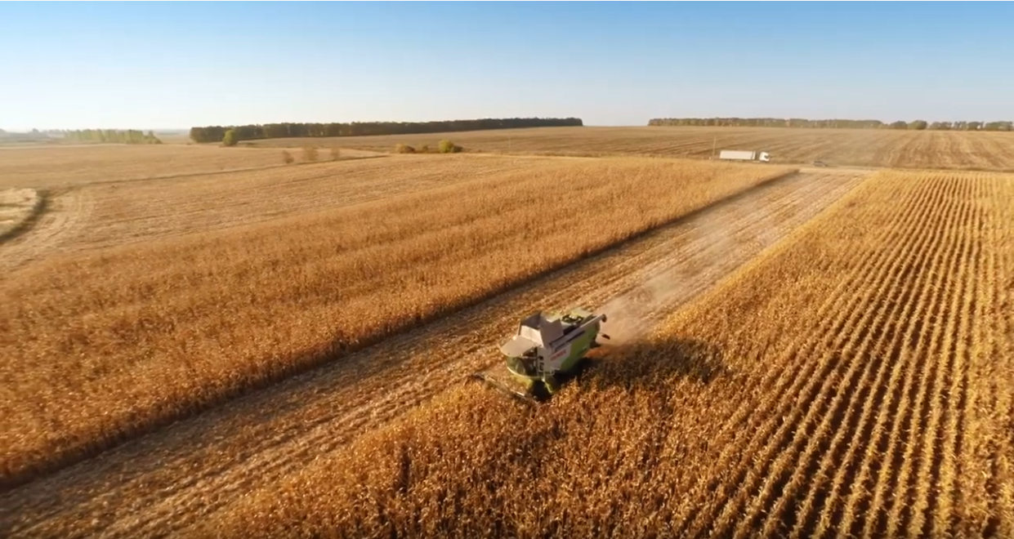
Insurance and Agriculture
I.I.I. Video: Insurance and Agriculture

Slide 5
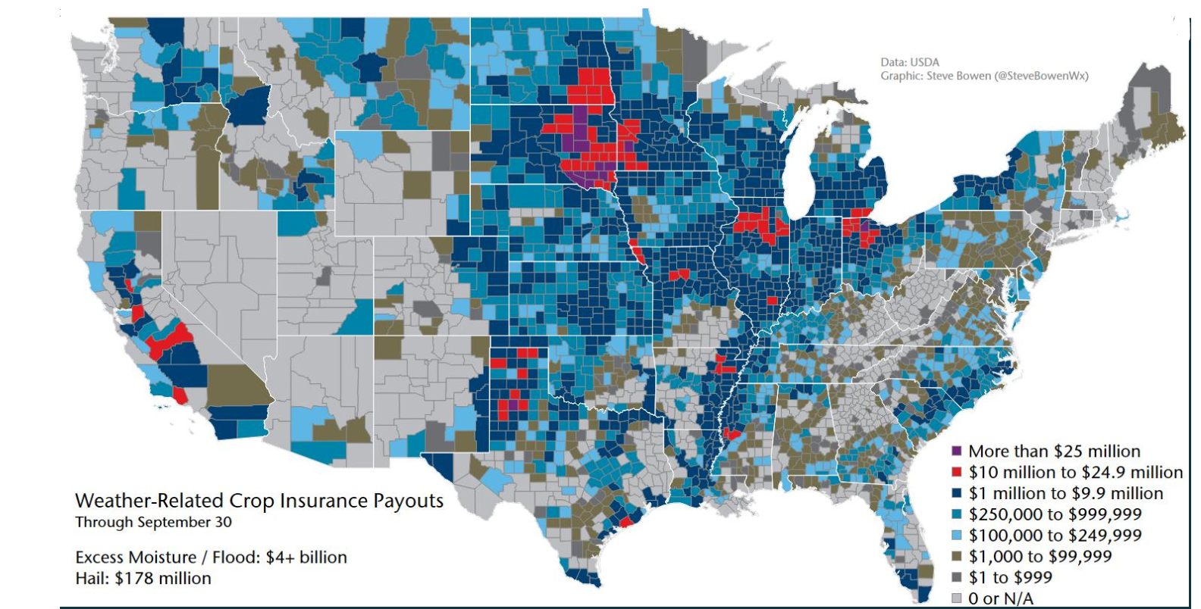
Protecting America’s Farms
Source: USDA, Aon (Steve Bowen).

Slide 6
Catastrophes
Extreme Weather Threatens Union

Slide 7
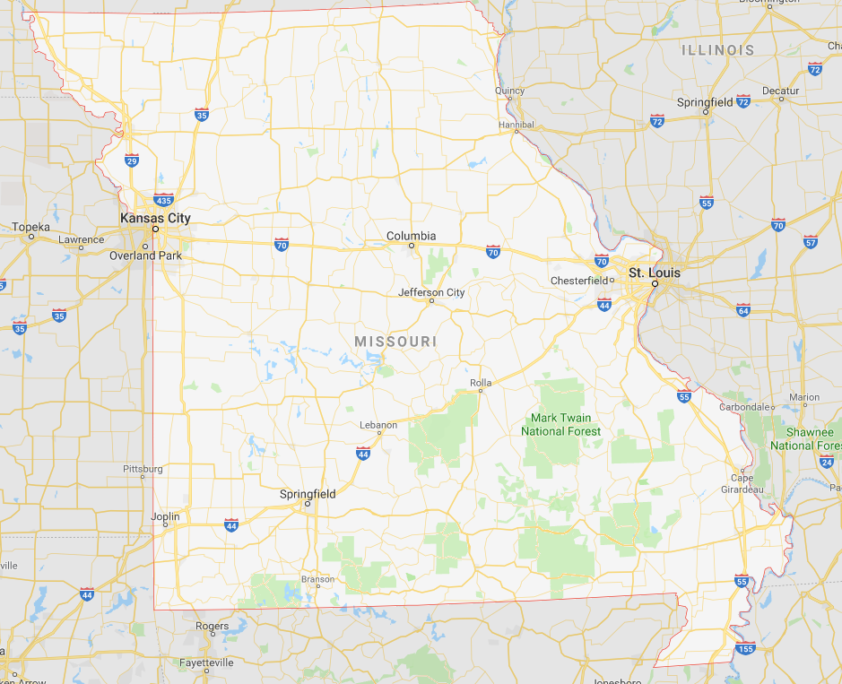
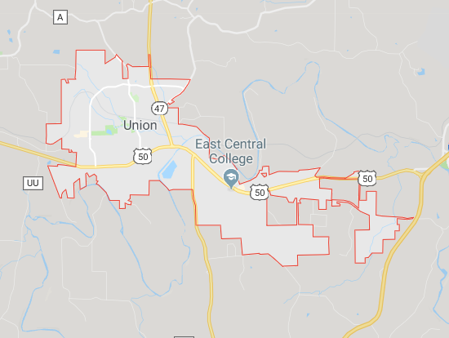
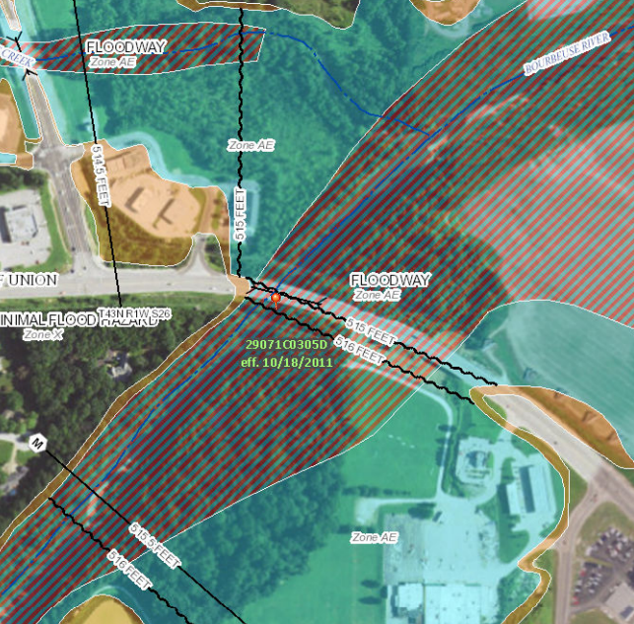
A Small Town in Missouri

Slide 8
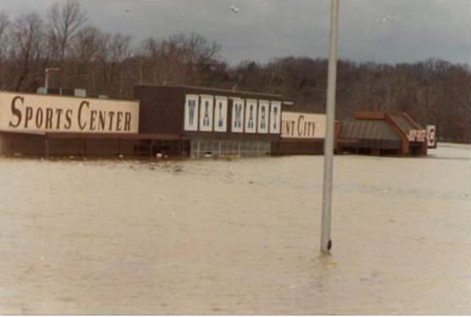
1982 Union, Missouri, Flood
A Storm for the Ages
Bourbeuse River
Record Crest
33.8 feet
12/5/1982
Source: Fox2News.com, @BoxxRadio.

Slide 9
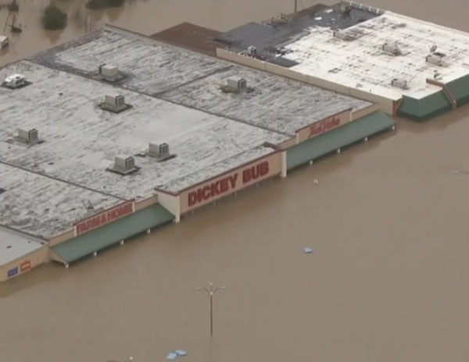
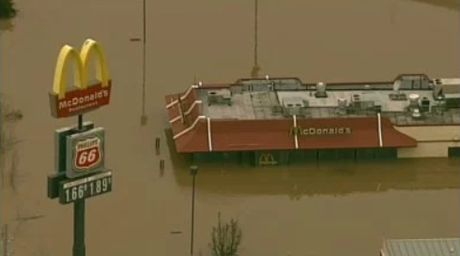
2015 Union, Missouri, Flood
A Storm for the Ages
Bourbeuse River
Record Crest
34.3 feet
12/29/2015
Sources: CBSnews.com; fox2news.com

Slide 10
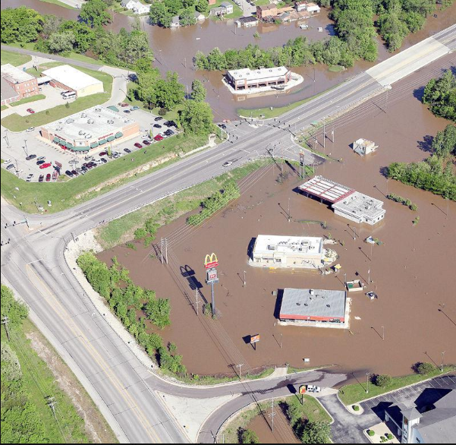
2017 Union, Missouri, Flood
Bourbeuse River
Crest
29.4 feet
May 2-3, 2017
“Unfortunately, it’s a river and Mother Nature.
And we can’t control her.”
 | Crest (feet) | Year
1 | 34.31 | 2015
2 | 33.80 | 1982
3 | 29.38 | 2017
4 | 28.50 | 1915
5 | 27.77 | 1994
6 | 26.37 | 1993
7 | 25.89 | 2008
8 | 24.53 | 2000
9 | 24.44 | 1957
10 | 23.89 | 2005
 | Crest (feet) | Year
1 | 0.40 | 1936
2 | 0.40 | 1948
3 | 0.40 | 1948
4 | 0.50 | 1976
5 | 0.55 | 2014
6 | 0.64 | 2012
7 | 0.68 | 2000
8 | 0.78 | 2001
9 | 0.80 | 1996
10 | 1.14 | 2007
Source: eMissourian.com, National Weather Service.

Slide 11
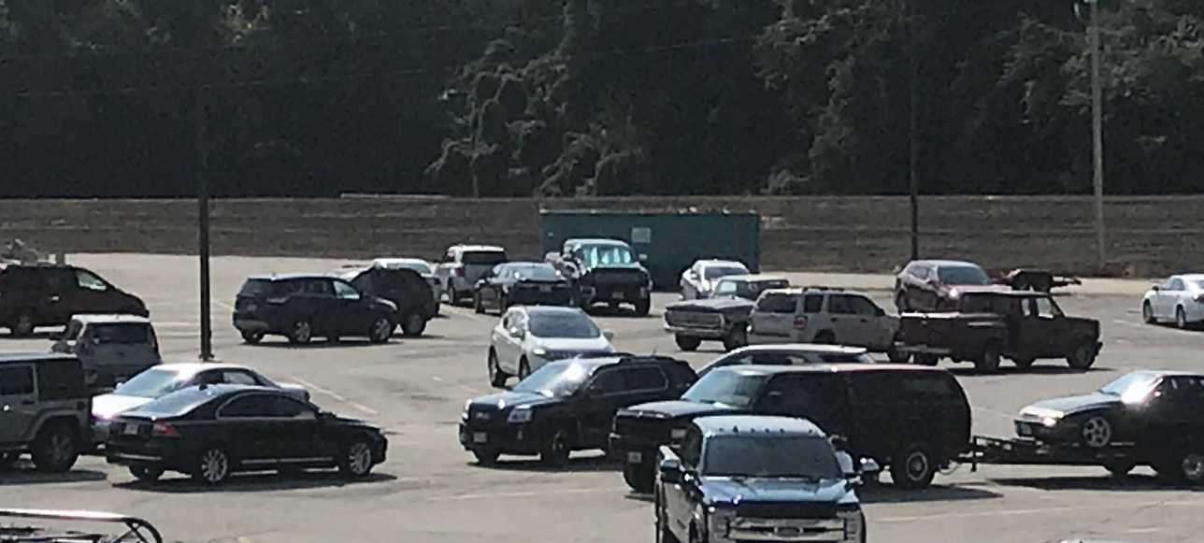


2019: Union, Missouri, Embraces Resilience
Community Hardening
Dickey Bub Berm
Shopping on One Side
Park on the Other

Slide 12
U.S. Inflation-Adjusted Cat Losses
Harvey, Irma, Maria
2018 – Third worst year for U.S. Insured Catastrophe Losses. Average Insured Loss per Year for 1980-2018 is $19.3 B.
*2018: Inflation-adjusted estimate, subject to change. 2010s is average of 2010 to 2018. All losses are Direct.
Sources: Property Claims Service, a Verisk Analytics business; Insurance Information Institute.

Slide 13
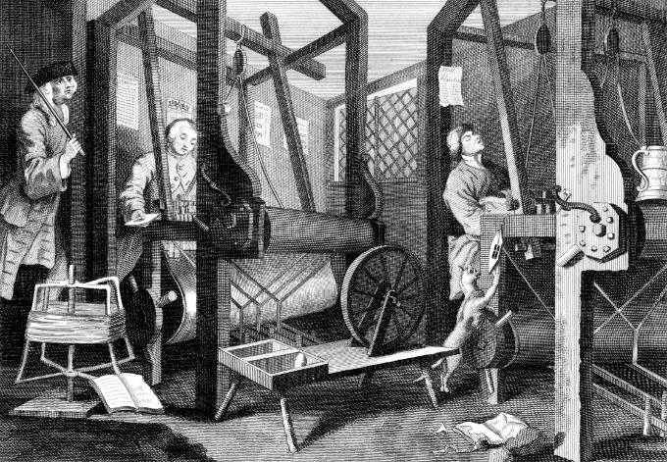
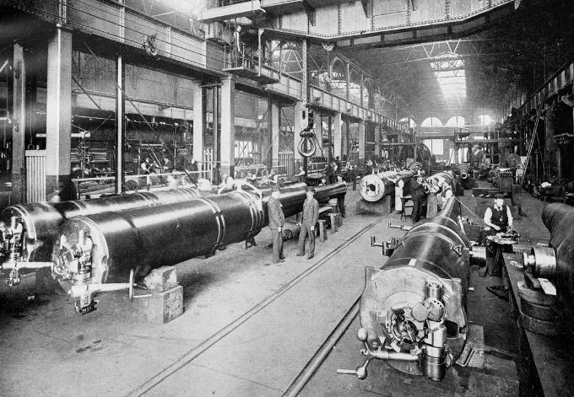
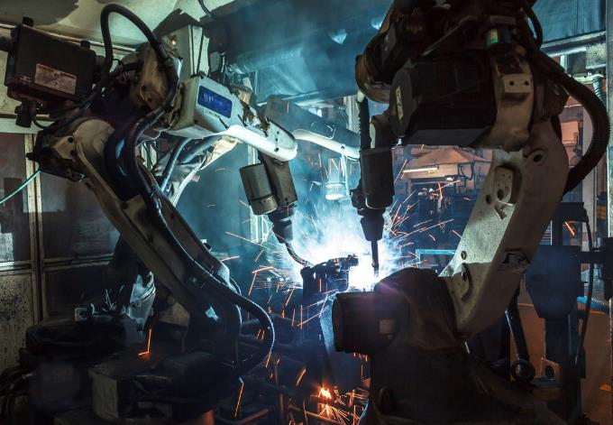

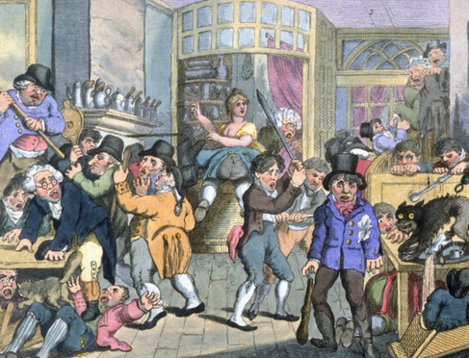
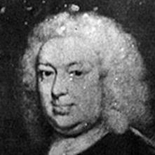
Insurance Leading Throughout History
???
1969
1870
1784
1648
Edward Lloyd’s Coffee House
Steam, Water, Mechanical Production
Division of Labor, Electricity, Mass Production
Electronics, IT, Automated Production
Cyber-Physical Systems

Slide 14
Yesterday: Industry Results
Higher Rates, Moderating Claim Rates Buoy Results

Slide 15
Are Insurers Growing?
Rising Auto Rates Driving Premium Growth - $337B at Second Quarter.
All data through second quarter.
SOURCES:NAIC data sourced through S&P Global Intelligence, Bureau of Economic Affairs, Insurance Information Institute.

Slide 16
Are Insurers Making Money?
Billions
Through first quarter. Adjusted for inflation using the BLS CPI calculator. Sources: ISO/APCI.

Slide 17
Policyholder Surplus By Quarter
Amount of Surplus
Change from Prior Quarter
($ Billions)
Surplus Has Rebounded from Q4 Decline Caused by Stocks. 78 Cents of Premium per Dollar of Surplus.
17
Sources: ISO, A.M .Best.
12/01/09 - 9pm
eSlide – P6466 – The Financial Crisis and the Future of the P/C
Notes:
17

Slide 18
P/C Insurance Industry Combined Ratio*
3 Consecutive Years of U/W Profits; 1st time since 1971-73
Higher CAT Losses, Shrinking Reserve Releases, Toll of Soft Market
Hurricanes, Wildfires Drive CR Higher.
Best Combined Ratio Since 1949 (87.6)
Sandy
Through Q2.
*Excludes Mortgage & Financial Guaranty insurers 2008-2014. Including M&FG, 2008=105.1, 2009=100.7, 2010=102.4, 2011=108.1; 2012:=103.2; 2013: = 96.1; 2014: = 97.0.
Sources: A.M. Best; ISO, a Verisk Analytics company.

Slide 19
Catastrophe Claims, by Season
Catastrophe Claims as % of Total Claims
Catastrophe Claims Hit Hardest in Second and Third Quarters.
Losses are net of reinsurance but include Loss Adjustment Expenses Sources: ISO PCS; Insurance Information Institute calculations.

Slide 20
Key sources of P/C insurer profits
$ Billions
Strong Capital Gains, Underwriting Result Lifted Profits.
Through second quarter. Not adjusted for inflation.
Data are before taxes and exclude extraordinary items.
Source: NAIC data, sourced from S&P Global Market Intelligence.

Slide 21
Sources of investment gains
$ Billions
Investment Gains Running Behind of 2018 So Far.
Through Second Quarter. Sources: NAIC data, sourced from S&P Global Market Intelligence; Insurance Information Institute.

Slide 22
P/C Insurer Portfolio Yields
Yields Have Been Under 4 Percent Since 2009.
Source: NAIC data, sourced from S&P Global Market Intelligence, ISO/PCI.

Slide 23
Auto Net Combined Ratio
Personal Auto Has Returned to Underwriting Profitability. In Commercial Auto the Fever May Have Broken.
Source: NAIC data, sourced from S&P Global Market Intelligence.

Slide 24
Loss Costs Have Tapered Off the Past 2 Years
After Several Years of Steep Increases the Cost of Accidents has Tapered Off. Consumer Prices Overall Rose 6.6 Percent from 2016 to 2018.
Source: Fast Track Monitoring System.

Slide 25
Auto Repair: Complexity Grows
More Cool Stuff to Fix
More Parts, More Labor: Higher Costs
Electronics Add to Cost, Complexity
150
28% Increase!
Electronics: 40-50% of cost of vehicle
Pre-repair scan: $63
Post-repair scan: $93
Calibration labor: sublet at $150
OEM: 98% of camera/sensors
* Property Damage Only.
SOURCES: “2019 Crash Course,” CCC Information Services; Ford Motor Co.;

Slide 26
Workers Comp: Soft Market Offsetting Exposure Growth
Private Carriers: Tax Law Changes Boosted Net Premiums.
Source: NCCI.

Slide 27
Workers Comp Net Combined Ratio
Favorable Loss Trends Let Private Carriers Post Lowest C.R. Since 1930s.
Source: NCCI..

Slide 28
Focus on Iowa
Growth and Profitability

Slide 29
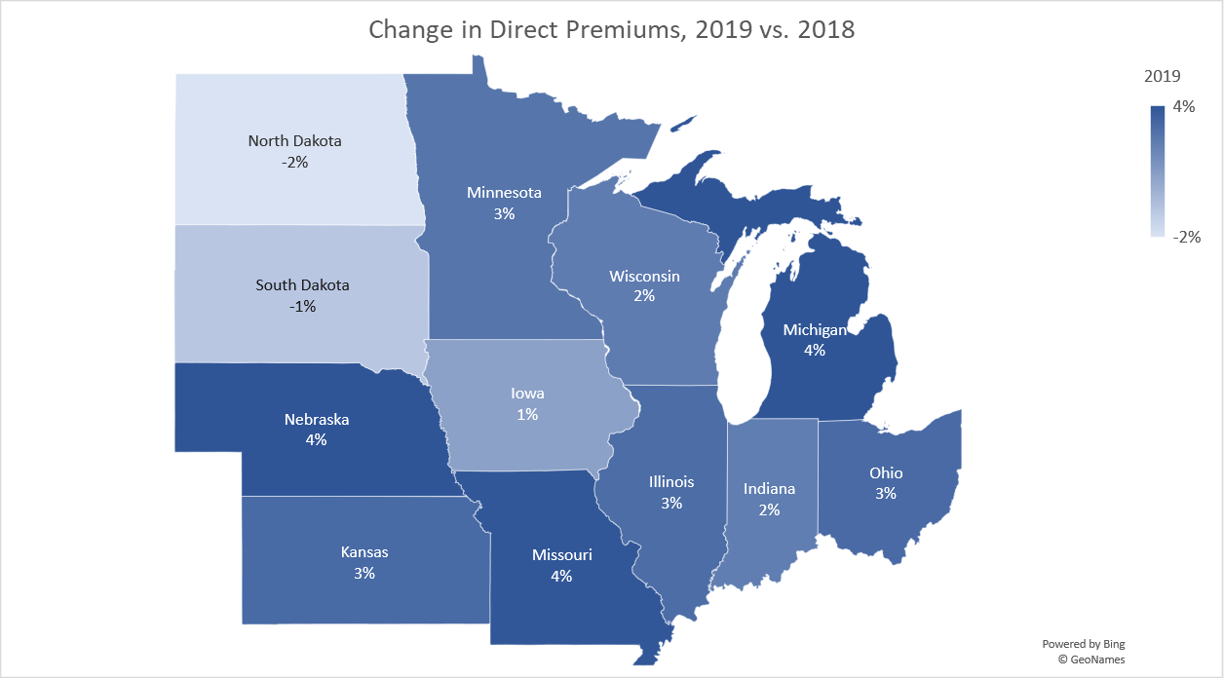
2019: Tepid Growth in the Midwest
Source: S&P Global Intelligence, sourced from NAIC data.

Slide 30
Return on Net Worth and Direct Premiums Written All Lines
Iowa vs. USA
Premium Growth
Return on Net Worth
Annual % change
Sources: NAIC data sourced from S&P Market Intelligence; NAIC Profitability Report.

Slide 31
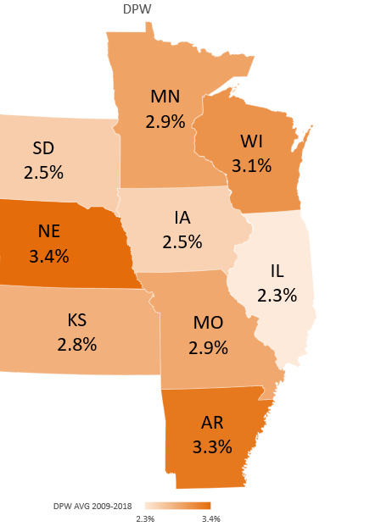
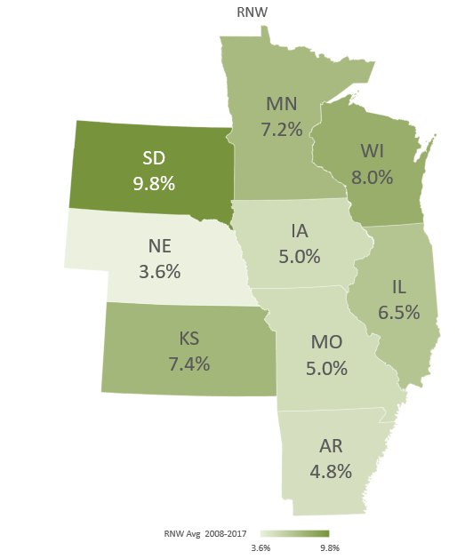
All Lines: 10-Year Average DPW Growth and Return on Net Worth
Sources: NAIC data sourced from S&P Market Intelligence; NAIC Profitability Report

Slide 32
Return on Net Worth and Direct Premiums Written PP Auto
Iowa vs. USA
Premium Growth
Return on Net Worth
Annual % change
Sources: NAIC data sourced from S&P Market Intelligence; NAIC Profitability Report.

Slide 33
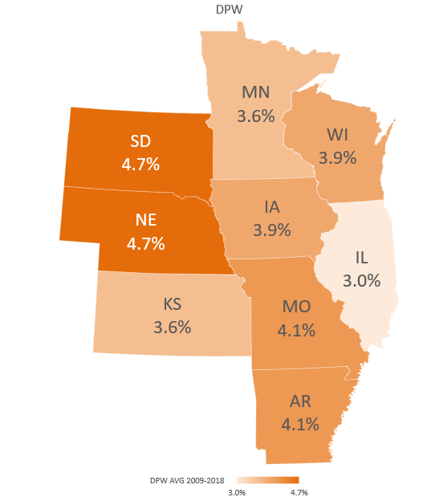
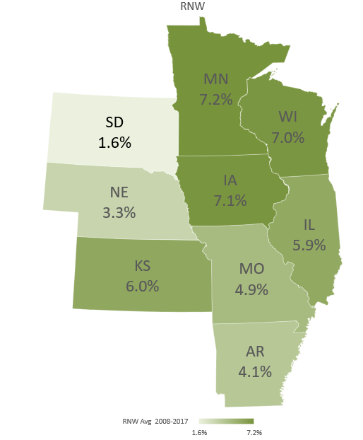
PP Auto: 10-Year Average DPW Growth and Return on Net Worth
Sources: NAIC data sourced from S&P Market Intelligence; NAIC Profitability Report

Slide 34
Return on Net Worth and Direct Premiums Written Commercial Auto
Iowa vs. USA
Premium Growth
Return on Net Worth
Annual % change
Sources: NAIC data sourced from S&P Market Intelligence; NAIC Profitability Report.

Slide 35
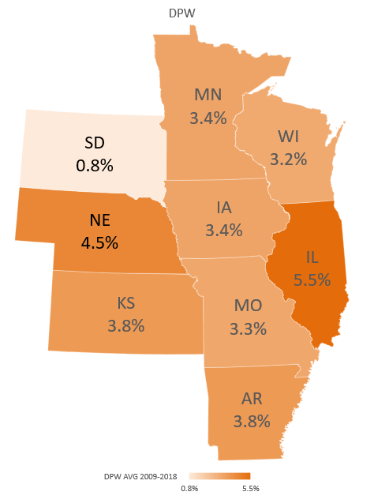
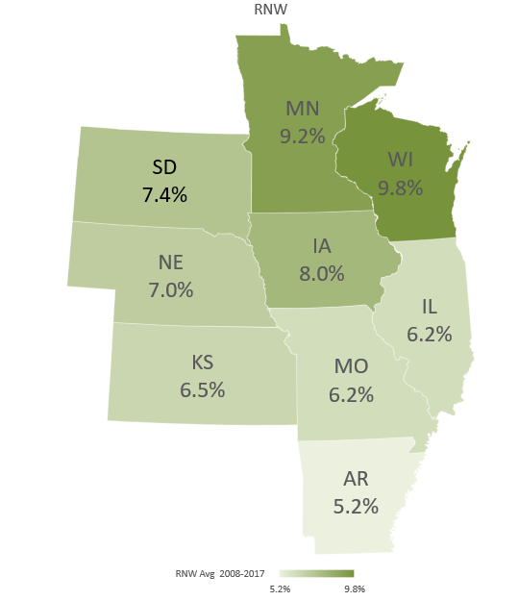
Comm. Auto: 10-Year Average DPW Growth and Return on Net Worth
Sources: NAIC data sourced from S&P Market Intelligence; NAIC Profitability Report

Slide 36
Return on Net Worth and Direct Premiums Written Workers Comp
Iowa vs. USA
Premium Growth
Return on Net Worth
Annual % change
Sources: NAIC data sourced from S&P Market Intelligence; NAIC Profitability Report.

Slide 37
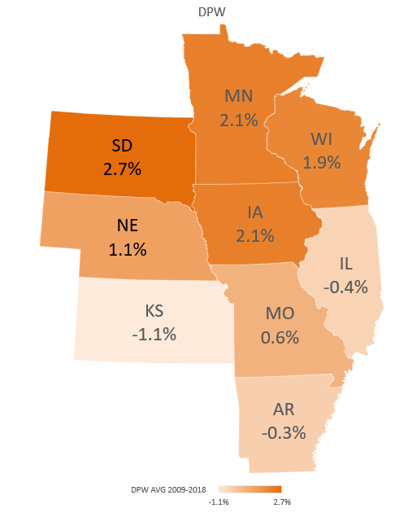
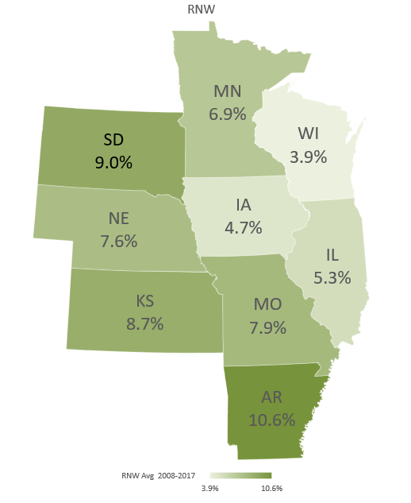
Workers Comp: 10-Year Average DPW Growth and Return on Net Worth
Sources: NAIC data sourced from S&P Market Intelligence; NAIC Profitability Report

Slide 38
Tomorrow
Is Recession Lurking?

Slide 39
Outlook: The Economy
Real GDP Growth Forecasts
Most Forecasters Predict Slow Growth Through 2020.
39
Source: Blue Chip Economic Indicators, September 2019.
Source: Blue Chip

Slide 40
A Cloud: Interest Rates
Worries About Economy Have Sent Investors Into Treasuries.
Source: Federal Reserve Bank of St. Louis (FRED)

Slide 41
Today: Marijuana and Insurance

Slide 42
Support for Legalization Grows
% Saying Yes
“Do You Think the Use of Marijuana Should Be Made Legal, Or Not?”
No survey in years where no data appears.
SOURCES: Gallup Poll Social Series, http://news.gallup.com/file/poll/221027/171025Marijuana.pdf.

Slide 43
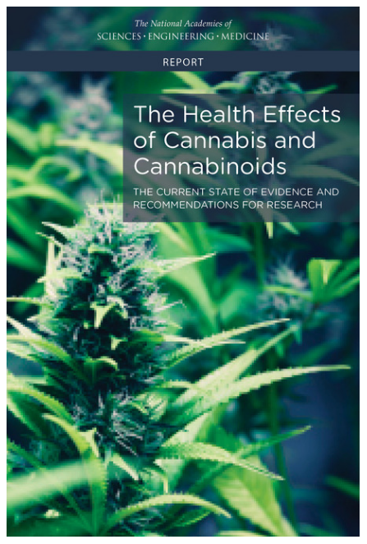
Cannabis & Insurance
The Science
Review of Literature
Conclusive evidence
Improves the lot of adults in chronic pain.
Substantial evidence
Increases the risk of motor vehicle crashes.
SOURCE: National Academy of Sciences, https://www.nap.edu/catalog/24625/the-health-effects-of-cannabis-and-cannabinoids-the-current-state

Slide 44
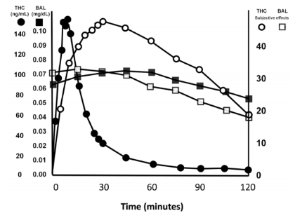
THC Levels not an Accurate Indication of Impairment
BAC and ‘feeling drunk’ rise and fall in lockstep
THC levels in blood and ‘feeling high’ rise and fall at different rates
Source: Sewell, Poling, Sofuoglu, “The Effect of Cannabis Compared with Alcohol on Driving,” American Journal on Addictions, 2009.

Slide 45
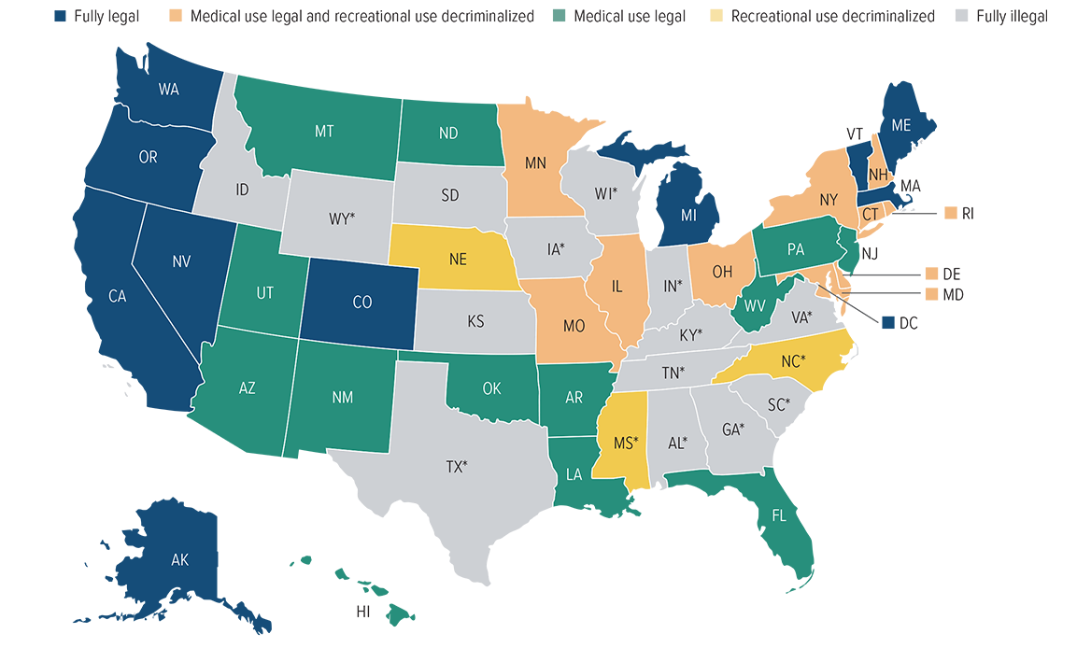
Current marijuana laws by state
*CBD/Low THC medical program.
Source: National Journal; Ballotpedia, 2019.

Slide 46
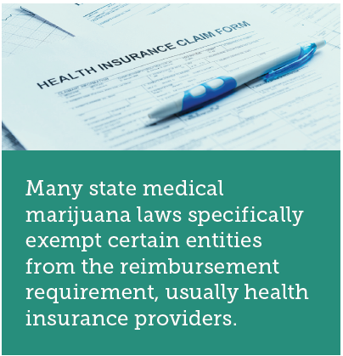
Is Medical Marijuana Covered by Comp?
Reimbursable in a handful of states
Unclear whether reimbursable in many states
Reimbursement not required
Reimbursement prohibited or ineligible

Slide 47
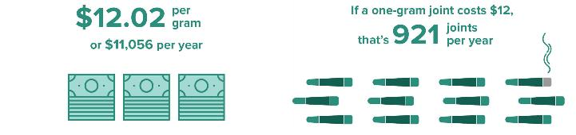
New Mexico is the Only State That Provides a Fee Schedule for Medical Marijuana¹
Maximum reimbursable amount
In context
¹“Healthcare Provider Fee Schedule and Billing Instructions,” State of New Mexico Workers’ Compensation Administration.

Slide 48
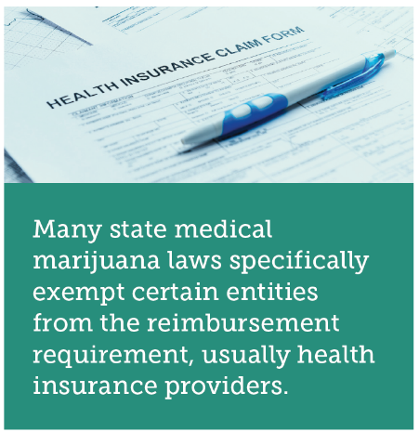
Reimbursement Complications
Cash-only business
Proper dosages poorly understood, non-standardized
No standardized “serving” of marijuana. Potency levels non-standardized
Expenses can vary widely

Slide 49
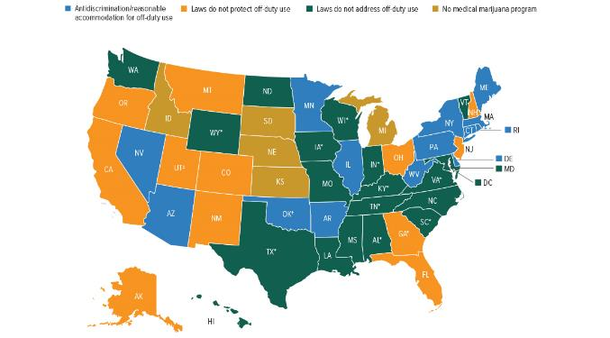
Workers Comp Issues: Can You Get Fired?
Only 13 states have anti-discrimination/reasonable accommodation for off-duty marijuana use
*CBD/Low THC medical program. †Oklahoma has not yet released its final medical marijuana rules. ‡Provides limited protections to state employees.
Source: Insurance Information Institute, 2019.

Slide 50
Summary
Insurance Industry Leads Through Disruption
Iowa Results Resemble the Rest of USA
2019 Results Promising, With Long-Awaited Improvement in Auto Lines and Workers Comp Setting Records
Economic Growth Steady – How Long Will it Last?
Marijuana: New Challenges for Insurers

Slide 51
Thank you for your time and your attention!

