Slide 1
Future Shock: 2020 & Beyond Insurance Industry Trends, Challenges and Opportunities
Center for Insurance Studies
California State University Fullerton
Fullerton, CA
May 9, 2016
Download at www.iii.org/presentations
Robert P. Hartwig, Ph.D., CPCU, President & Economist
Insurance Information Institute ♦ 110 William Street ♦ New York, NY 10038
Tel: 212.346.5520 ♦ Cell: 917.453.1885 ♦ bobh@iii.org ♦ www.iii.org

Slide 2
Risk & Insurance
U.S. and Global Perspective
The Global (Re)Insurance Industry is Very Sensitive to Economic and Geopolitical and Regulatory Environments
2

Slide 3
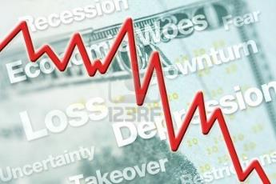




5 Major Categories for External Global Risks, Uncertainties and Fears: Insurance Solutions
Economic Risks
Geopolitical Risks
Environmental Risks
Technological Risks
Societal Risks
While risks can be broadly categorized, none are mutually exclusive
Source: Adapted from World Economic Forum, Global Risks 2014; Insurance Information Institute.

Slide 4

Multitude of Exogenous Factors Influence Growth, Performance & Cyclicality
Tepid growth in US, Europe
Weakness in China/Emerging Economies
Political uncertainty in the US, Brazil, Argentina
UK “Brexit” concern
Low/Negative Interest Rates
Resurgent Terrorism Risk: ISIS & Other Groups
Cyber Attacks
Sabre Rattling (e.g., US-China, Russia)
Severe Natural Disaster Losses→Supply Chain
Nationalism
International trade deals under siege
(Over)Regulation: Systemic Risk?
Strong dollar/Currency manipulation
Are “Black Swans” everywhere or does it just seem that way?

Slide 5
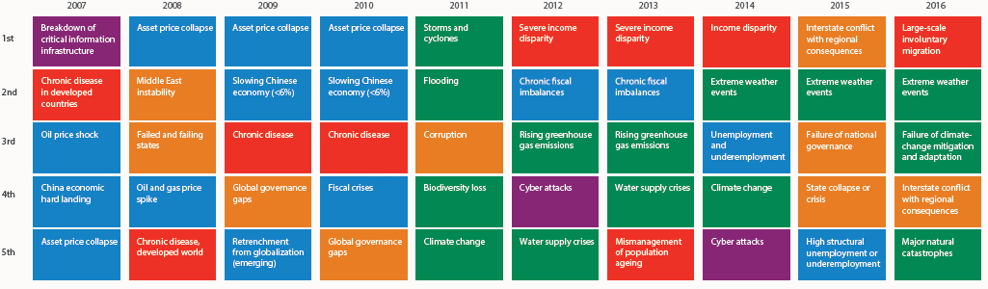
Top 5 Global Risks in Terms of Likelihood, 2007—2016: Insurance Can Help With Most
In 2016, societal and environ-mental issues dominated frequency concerns
Concerns Shift Considerably Over Short Spans of Time. 2016 Includes a Mix of Environmental Economic, Social and Environmental Risks
Source: World Economic Forum, Global Risks 2016; Insurance Information Institute.
5
12/01/09 - 9pm
eSlide – P6466 – The Financial Crisis and the Future of the P/C
Notes:
5

Slide 6
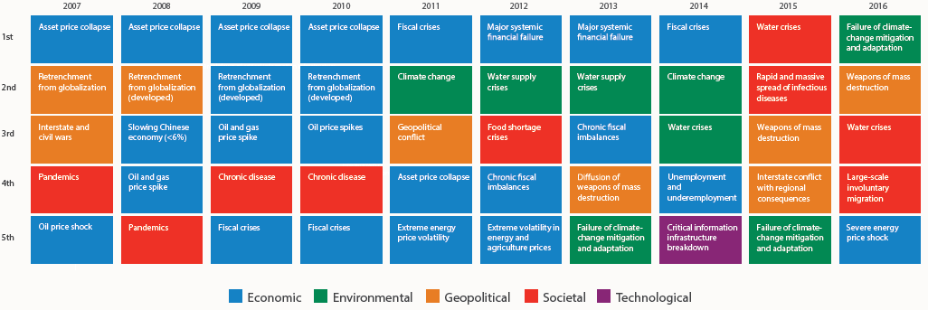
Top 5 Global Risks in Terms of Impact, 2007—2016: Insurance Can Help With Most
In 2016, societal issues dominated severity concerns
Concerns Over the Impacts of Societal Risks Remained High in 2016, but Economic, Environment and Geopolitical Risks Also Loom Large
Source: World Economic Forum, Global Risks 2016; Insurance Information Institute.
6
12/01/09 - 9pm
eSlide – P6466 – The Financial Crisis and the Future of the P/C
Notes:
6

Slide 7
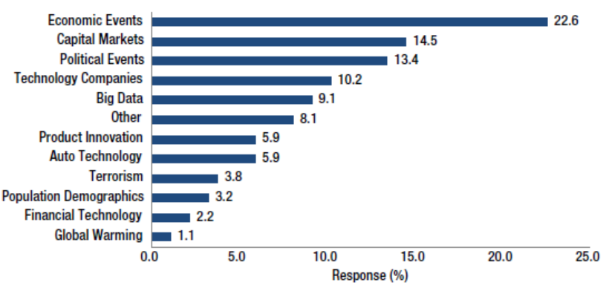
Leading Disruptive Forces for the Insurance Industry Over the Next 5 Years
Commercial Lines
$282.5B/51%
Economic and political concerns are overwhelmingly viewed as the most likely to be disruptive to insurers; Concerns over technology disruptions lag
Homeowners
$86.1B/15%
Pvt. Pass Auto
$190.3B/34%
Concerns 20-25 Years Ago: Out of Control Tort System, Asbestos, MegaCats (Hugo, Andrew, Northridge); Hillary Care; Exploding Residual Markets; Reinsurance Price/Availability; Banks & Insurance
Sources: A.M. Best Winter 2015/2016 Insurance Industry Survey, March 2016; Insurance Information Institute.

Slide 8
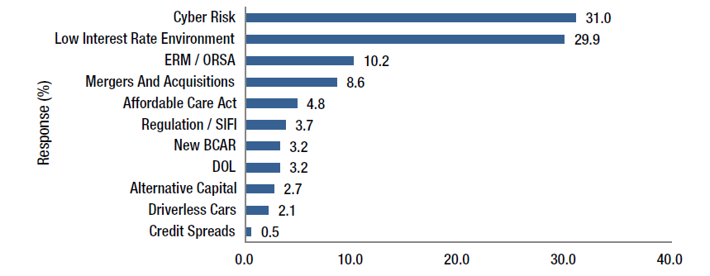
A.M. Best Survey: Top Insurance Industry Concerns
Cyber risk and the low interest rates dominate industry concerns today
Commercial Lines
$282.5B/51%
Homeowners
$86.1B/15%
Pvt. Pass Auto
$190.3B/34%
Concerns 20-25 Years Ago: Out of Control Tort System, Asbestos, MegaCats (Hugo, Andrew, Northridge); Hillary Care; Exploding Residual Markets; Grumbling over Glass-Steagall→GLB
Sources: A.M. Best Winter 2015/2016 Insurance Industry Survey, March 2016; Insurance Information Institute.

Slide 9
Globalization: The Global Economy Creates and Transmits Cycles & Risks
Globalization Is a Double Edged Sword—Creating Opportunity and Wealth But Potentially Creating and Amplifying Risk
Emerging vs. “Advanced” Economies
9

Slide 10
GDP Growth: Advanced & Emerging Economies vs. World, 1970-2016F
Emerging economy growth rates are expected to increase to 4.3% in 2016 and 4.7% in 2017
GDP Growth (%)
World output is forecast to grow by 3.4% in 2016 and 3.6% in 2017. The world economy shrank by 0.6% in 2009 amid the global financial crisis
Advanced economies are expected to grow at a modest pace of 2.1% in 2016 and 2017.
Source: International Monetary Fund, World Economic Outlook, Jan. 2016; Insurance Information Institute.

Slide 11
Real GDP Growth Forecasts: Major Economies: 2014 – 2017F
US growth should acceleratein 2016
The Eurozone remains weak but should improve
Growth in China has slowed but outpaces the US and Europe
“Brexit” impact will be negative
Growth in the UK is stronger than in the Eurozone
Germany’s growth mirrors the Eurozone overall
Growth Prospects Vary Widely by Region; US and the UK Lead the Advanced Economies; Germany Leads in the Euro Area; China Has Slowed
Sources: Blue Chip Economic Indicators (2/2016 issue); IMF ( Jan. 2016); Insurance Information Institute.
11
Notes:
11

Slide 12
World Trade Volume Growth*, 2012 – 2017F
World trade volume growth is expected to accelerate modestly by 2017 after dipping in 2015, 2016
*Goods and services.
Source: International Monetary Fund, World Economic Outlook, April 2016; Insurance Information Institute.

Slide 13
World Trade Volume: IMPORTS 2010 – 2017F
Growth (%)
Advanced Economies
Emerging Economies
Import growth in Advanced Economies is expected to decelerate in 2016
Import growth in emerging economies outpaces Advanced Economies has been hit hard
Sources: IMF World Economic Outlook (April 2016 ); Insurance Information Institute.

Slide 14
World Trade Volume: EXPORTS 2010 – 2017F
Growth (%)
Advanced Economies
Emerging Economies
Export growth in emerging economies has struggled but should improve in 2016-17
Export growth in advanced economies is expected to decelerate in 2016 before accelerating in 2017
Sources: IMF World Economic Outlook (April 2016); Insurance Information Institute.

Slide 15
Global Insurance Premium Growth Trends
Growth Is Uneven Across Regions and Market Segments
15

Slide 16
Distribution of Global Insurance Premiums, 2012 ($ Trillions)
Total Premium Volume = $4.613 Trillion*
Life insurance accounted for nearly 57% of global premium volume in 2012 vs. 43% for Non-Life
Source: Swiss Re, sigma, No. 3/2013; Insurance Information Institute.

Slide 17
Non-Life Insurance: Global Real (Inflation Adjusted) Premium Growth, 2014
Real nonlife premium growth was stronger in the US in 2014 than in most of Europe
Market | Life | Non-Life | Total
Advanced | 3.8 | 1.8 | 2.9
Emerging | 6.9 | 8.0 | 7.4
World | 4.3 | 2.9 | 3.7
Source: Swiss Re, sigma, No. 4/2015.
17
12/01/09 - 9pm
eSlide – P6466 – The Financial Crisis and the Future of the P/C
Notes:
17

Slide 18
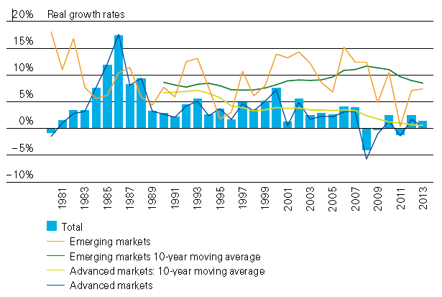
Global Real (Inflation Adjusted) Premium Growth: 1980-2013
Premium growth is very erratic in part to inflation volatility in emerging markets as well as a lack of consistent cyclicality
Emerging market growth has exceeded that of industrialized countries in 30 of the past 34 years, including the entirety of the global financial crisis and subsequent recovery
Source: Swiss Re, sigma, No. 3/2014.
18
12/01/09 - 9pm
eSlide – P6466 – The Financial Crisis and the Future of the P/C
Notes:
18

Slide 19
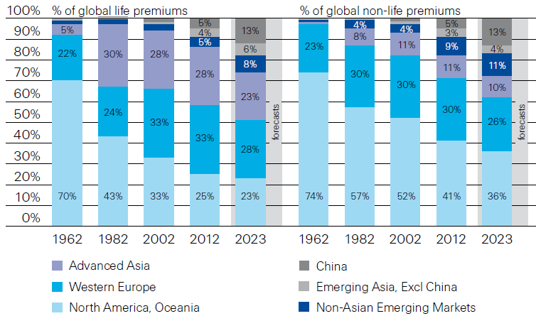
Premiums Written in Life and Non-Life, by Region: 1962-2023F
Emerging market shares rose rapidly over the past 50 years
Source: Swiss Re, sigma, No. 3/2013.
19
12/01/09 - 9pm
eSlide – P6466 – The Financial Crisis and the Future of the P/C
Notes:
19

Slide 20
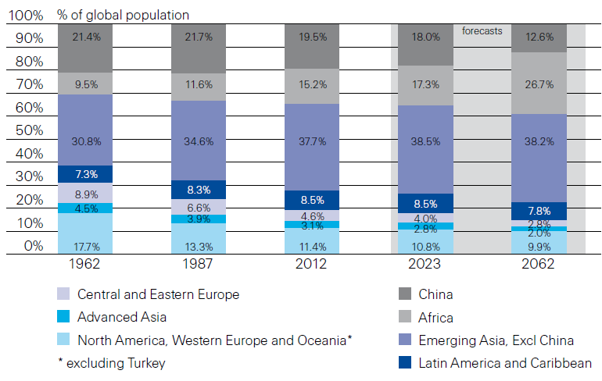
Population Distribution, by Region: 1962-2062F
Enormous population shifts will impact insurance demand over the next half century
Africa is expected to be the fastest population growth over the next 50 years, but no expectation now of Asia-like growth in economies or insurance demand
Source: Swiss Re, sigma, No. 3/2013 from United Nations Department of Economic and Social Affairs, Population Division.
20
12/01/09 - 9pm
eSlide – P6466 – The Financial Crisis and the Future of the P/C
Notes:
20

Slide 21
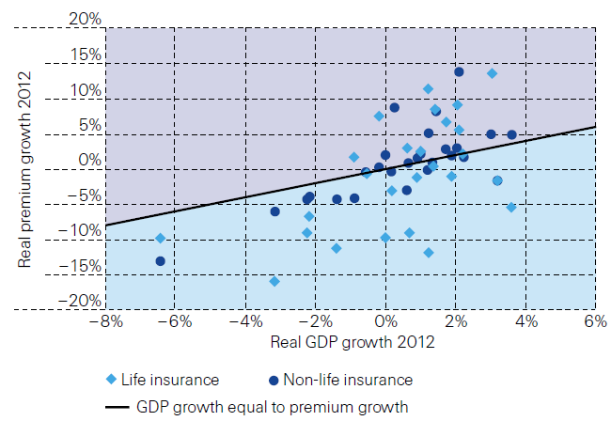
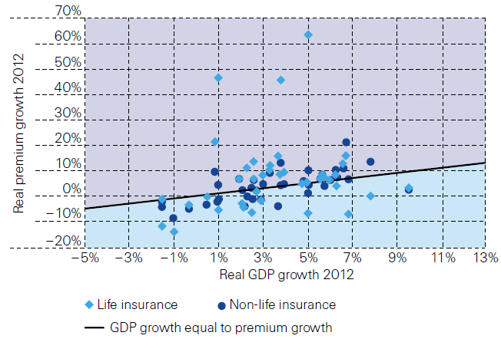
Relationship Between Real GDP and Real Life and Non-Life Premium Growth, 2012
Advanced Markets
Emerging Markets
The was a clear but highly relationship between real GDP growth and real premium growth in advance markets in 2012
The correlation between real GDP growth and real premium growth in emerging markets was much stronger than in advanced markets in 2012
Source: Swiss Re, sigma, No. 3/2013.
21
12/01/09 - 9pm
eSlide – P6466 – The Financial Crisis and the Future of the P/C
Notes:
21

Slide 22
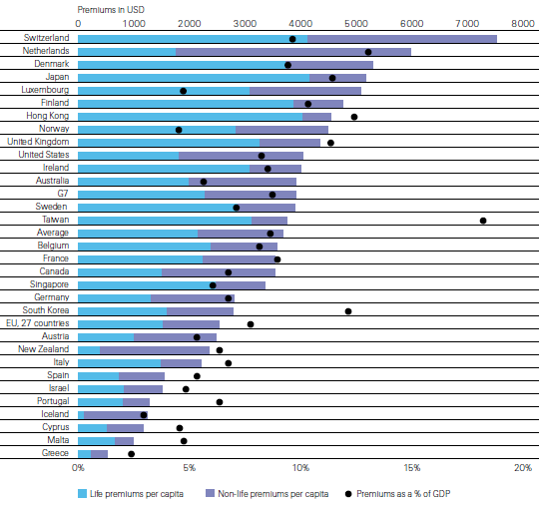
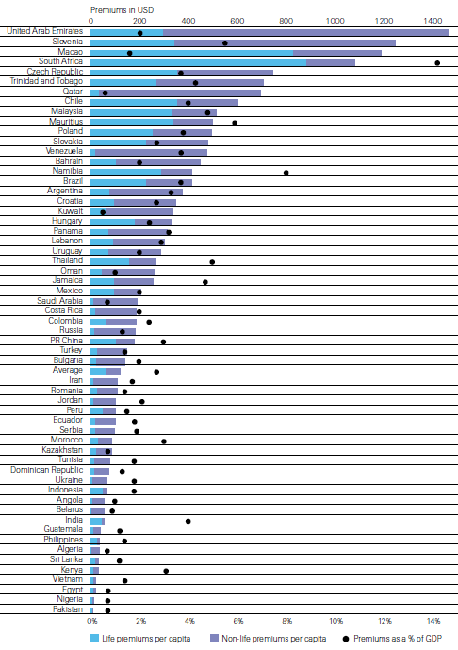
Insurance Density and Penetration for Advanced and Emerging Markets, 2012
Advanced Markets
Emerging Markets
Spending and penetration are generally much higher in advanced markets, though growth is fastest in emerging markets
Chinese spending on insurance is very similar to Russia, but Russian spending is mostly non-life and in China the majority is life
Source: Swiss Re, sigma, No. 3/2013.
22
12/01/09 - 9pm
eSlide – P6466 – The Financial Crisis and the Future of the P/C
Notes:
22

Slide 23
The Unfortunate Nexus: Opportunity, Risk & Instability
Most of the Global Economy’s Future Gains Will be Fraught with Much Greater Risk and Uncertainty than in the Past
23

Slide 24
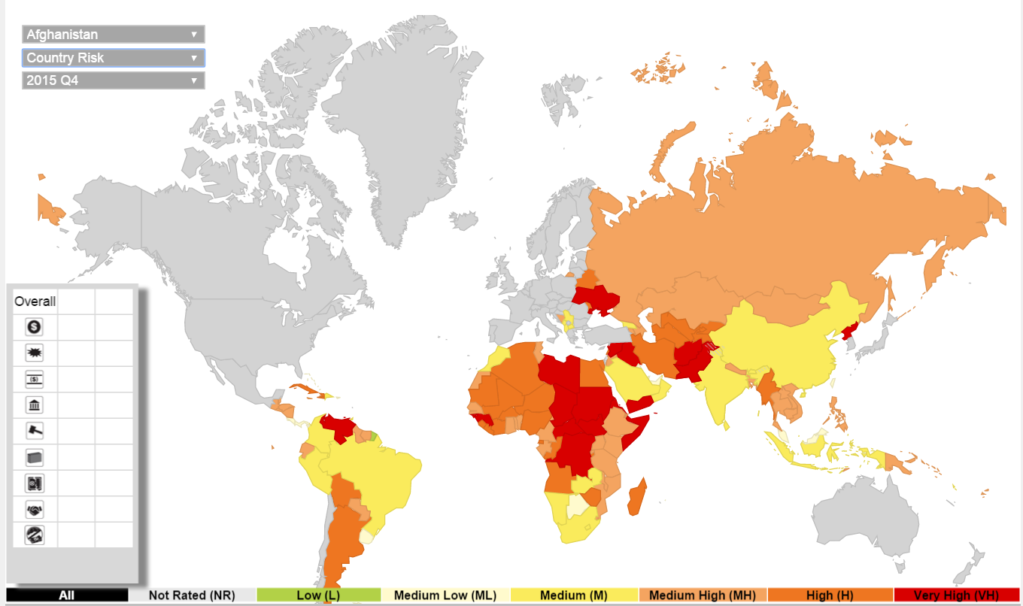
Political Risk: Greatest Opportunities Often in Risky Nations
As of 2015:Q4
Latin and South America have modest terrorist threats though Brazil is elevated
Terrorism remains a greater concern in the Middle East, Africa and South Asia
Source: Aon PLC; Insurance Information Institute.

Slide 25
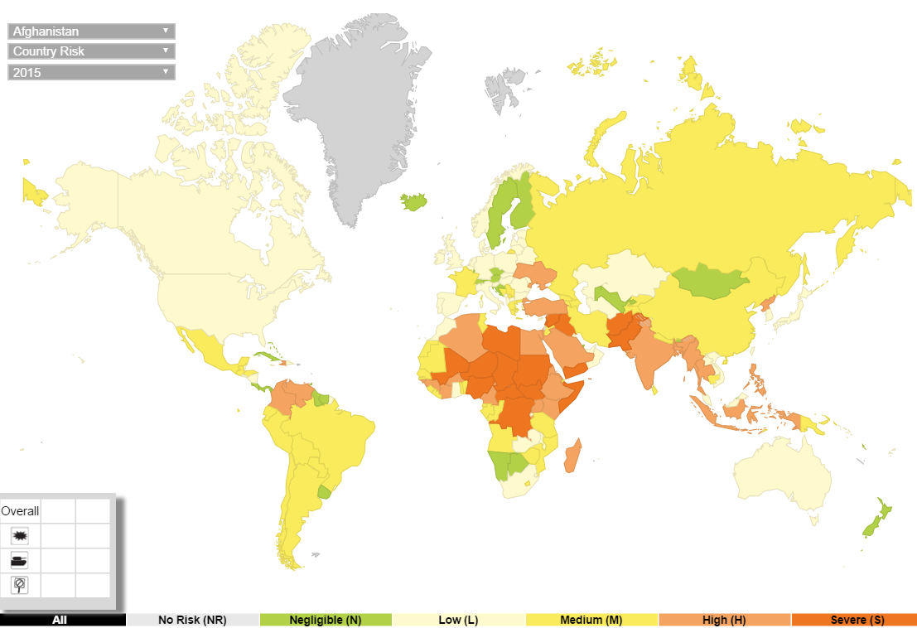
Terrorism Risk: Greatest Opportunities Are Often in Risky Nations
As of 2015:Q4
Problems in the Ukraine will intensify political risk in several former Soviet republics
Latin and South America also present insurers with growth opportunities but political instability has increased markedly
The fastest growing markets are generally also among the politically riskiest, including East and South Asia and Africa
Source: Aon PLC; Insurance Information Institute.

Slide 26
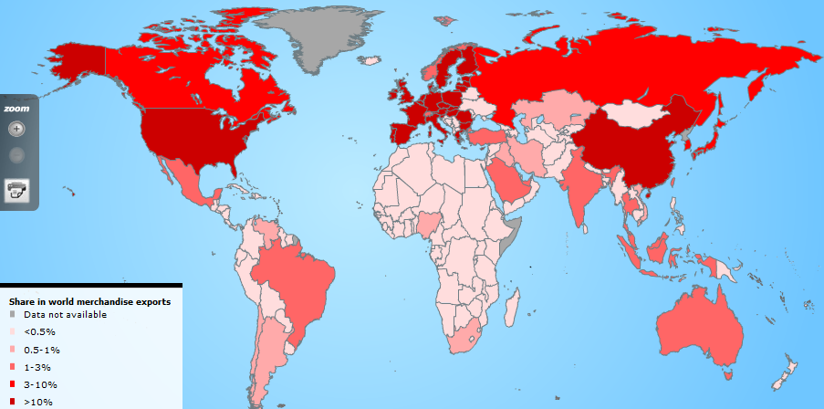
Country Shares of World Merchandise Exports
The US, China, Japan and Western Europe lead the world in merchandise exports
Source: World Trade Organization accessed 4/30/14 at: http://www.wto.org/english/res_e/statis_e/statis_e.htm ; Insurance Information Institute.
26
12/01/09 - 9pm
eSlide – P6466 – The Financial Crisis and the Future of the P/C
Notes:
26

Slide 27
Growth in US Insurance Markets
Investment Performance is a Key Driver of Profitability
Depressed Yields Will Necessarily Influence Underwriting & Pricing
27

Slide 28
Net Premium Growth (All P/C Lines): Annual Change, 1971—2015
(Percent)
1975-78
1984-87
2000-03
Net Written Premiums Fell 0.7% in 2007 (First Decline Since 1943) by 2.0% in 2008, and 4.2% in 2009, the First 3-Year Decline Since 1930-33.
Outlook
2016F: 3.9%
2017F: 3.8%
2015: 3.4%
2014: 4.2%
2013: 4.4%
2012: +4.2%
Shaded areas denote “hard market” periods
Sources: A.M. Best (1971-2013), ISO (2014-15).

Slide 29
NPW Premium Growth: Peaks & Troughs in the P/C Insurance Industry, 1926 – 2015
ROE
Post WW II Peak:
1947: 26.2%
1970-90: Peak premium growth was much higher in this period while troughs were comparable. Rapid inflation, economic volatility, high interest rates, tort environment all played roles
Start of WW II
1941: 15.8%
Economic Shocks, Inflation:
1976: 22.0%
Tort Crisis
1985/86: 22.2%
Post-9/11
2002:15.3%
1988-2000: Period of inter-cycle stability
2015 3.4%
1950-70: Extended period of stability in growth and profitability. Low interest rates, low inflation, “Bureau” rate regulation all played a role
2010-20XX? Post-recession period of stable growth?
Twin Recessions; Interest Rate Hikes
1987: 3.7%
Great Recession:2010: -4.9%
Great Depression
1932: -15.9% max drop
Note: Data through 1934 are based on stock companies only. Data include state funds beginning in 1998.
Source: A.M. Best; Insurance Information Institute.

Slide 30
Direct Premiums Written: Total P/C Percent Change by State, 2007-2014
Top 25 States
North Dakota was the country’s growth leader over the past 7 years with premiums written expanding by 70.7%, fueled by the state’s energy boom
Growth Benchmarks: Total P/C
US: 13.0%
Sources: SNL Financial LC.; Insurance Information Institute.

Slide 31
Direct Premiums Written: Total P/C Percent Change by State, 2007-2014
Bottom 25 States
P/C premium growth in California has lagged behind the nation as a whole
Growth was negative in 4 states and DC between 2007 and 2014
Sources: SNL Financial LC.; Insurance Information Institute.

Slide 32
Direct Premiums Written: PP Auto Percent Change by State, 2007-2014
Top 25 States
Growth Benchmarks: PPA
US: 16.4%
Sources: SNL Financial LC.; Insurance Information Institute.

Slide 33
Direct Premiums Written: PP Auto Percent Change by State, 2007-2014
Bottom 25 States
Pvt. Passenger Auto premium growth in CA was among the slowest in the country between 2007 and 2014 as the Great Recession took its toll
Sources: SNL Financial LC.; Insurance Information Institute.

Slide 34
Direct Premiums Written: Comm. Lines Percent Change by State, 2007-2015
Top 25 States
44 states showed commercial lines growth from 2007 through 2015
Growth Benchmarks: Commercial
US: 9.0%
Sources: NAIC via SNL Financial; Insurance Information Institute.

Slide 35
Direct Premiums Written: Comm. Lines Percent Change by State, 2007-2015
Bottom 25 States
Eight states still write less commercial business than they did in 2007
Sources: NAIC via SNL Financial; Insurance Information Institute.

Slide 36
Direct Premiums Written: Workers’ Comp Percent Change by State, 2007-2015*
Top 25 States
27 states showed positive growth in the workers comp line from 2007 – 2015 (up from 13 through 2013 and 5 through 2012).
*Excludes monopolistic fund states: ND, OH, WA, WY as well as WV, which transitioned to a competitive structure during this period.
Sources: NAIC data, sourced from S&P Global Market Intelligence; Insurance Information Institute.

Slide 37
Direct Premiums Written: Worker’s Comp Percent Change by State, 2007-2015*
Bottom 25 States
States with the poorest performing economies also produced some of the most negative net change in premiums of the past 8 years
*Excludes monopolistic fund states: ND, OH, WA, WY as well as WV, which transitioned to a competitive structure during this period.
Sources: NAIC data, sourced from S&P Global Market Intelligence; Insurance Information Institute.

Slide 38
INVESTMENTS: THE NEW REALITY
Investment Performance is a Key Driver of Profitability
Depressed Yields Will Necessarily Influence Underwriting & Pricing
38

Slide 39
U.S. Treasury Security Yields: A Long Downward Trend, 1990–2016*
Yields on 10-Year U.S. Treasury Notes have been essentially below 5% for more than a decade.
Despite the Fed’s December 2015 rate hike, yield remain low though short-term yields have seen some gains
Since roughly 80% of P/C bond/cash investments are in 10-year or shorter durations, most P/C insurer portfolios will have low-yielding bonds for years to come.
*Monthly, constant maturity, nominal rates, through March 2016.
Sources: Federal Reserve Bank at http://www.federalreserve.gov/releases/h15/data.htm. National Bureau of Economic Research (recession dates); Insurance Information Institute.
39
12/01/09 - 9pm
eSlide – P6466 – The Financial Crisis and the Future of the P/C
Notes:
39

Slide 40
Net Investment Yield on Property/ Casualty Insurance Invested Assets, 2007–2016P*
(Percent)
Estimated book yield in 2016 is down about 140 BP from pre-crisis levels
The yield on invested assets remains low relative to pre-crisis yields. The Fed’s plan to raise interest rates in late 2015 has pushed up some yields, albeit quite modestly.
Sources: A.M. Best; 2015E-2016P figures from A.M. Best P/C Review and Preview, Feb. 2016; Insurance Information Institute

Slide 41
Property/Casualty Insurance Industry Investment Income: 2000–2015¹
Investment earnings are still below their 2007 pre-crisis peak
($ Billions)
Due to persistently low interest rates, investment income fell in 2012, 2013 and 2014 but showed a small (1.9%) increase in 2015—a trend that may continue.
¹ Investment gains consist primarily of interest and stock dividends. Sources: ISO; Insurance Information Institute.

Slide 42
Interest Rate Forecasts: 2016 – 2021
Yield (%)
3-Month Treasury
10-Year Treasury
The end of the Fed’s QE program in 2014 and a stronger economy have yet to push longer-term yields much higher
A full normalization of interest rates is unlikely until 2019, more than a decade after the onset of the financial crisis.
Sources: Blue Chip Economic Indicators (4/16 for 2016 and 2017; for 2018-2021 3/16 issue); Insurance Info. Institute.

Slide 43
Reduction in Combined Ratio Necessary to Offset 1% Decline in Investment Yield to Maintain Constant ROE, by Line*
Lower Investment Earnings Place a Greater Burden on Underwriting and Pricing Discipline
*Based on 2008 Invested Assets and Earned Premiums
**US domestic reinsurance only
Source: A.M. Best; Insurance Information Institute.
43
12/01/09 - 9pm
eSlide – P6466 – The Financial Crisis and the Future of the P/C
Notes:
43
This shows the drop in Combined Ratio for each line of business that would be needed to maintain a constant ROE, given a 1-percentage-point drop in investment yield

Slide 44
P/C Insurance Industry Profitability Trends
2015: Second-Best Year in the Post-Crisis Era but Low Interest Rates Weigh Heavily
44

Slide 45
P/C Industry Net Income After Taxes 1991–2015
$ Millions
2005 ROE*= 9.6%
2006 ROE = 12.7%
2007 ROE = 10.9%
2008 ROE = 0.1%
2009 ROE = 5.0%
2010 ROE = 6.6%
2011 ROAS¹ = 3.5%
2012 ROAS¹ = 5.9%
2013 ROAS¹ = 10.2%
2014 ROAS¹ = 8.4%
2015 ROAS = 8.4%
Net income in 2015 was on par with 2014; ROE unchanged at 8.4%
ROE figures are GAAP; ¹Return on avg. surplus. Excluding Mortgage & Financial Guaranty insurers yields a 8.2% ROAS in 2014, 9.8% ROAS in 2013, 6.2% ROAS in 2012, 4.7% ROAS for 2011, 7.6% for 2010 and 7.4% for 2009; 2015E is annualized figure based actual figure through Q3 of $44.0
Sources: A.M. Best, ISO; Insurance Information Institute

Slide 46
Profitability Peaks & Troughs in the P/C Insurance Industry, 1975 – 2015
ROE
1977:19.0%
History suggests next ROE peak will be in 2016-2017
1987:17.3%
10 Years
1997:11.6%
2006:12.7%
10 Years
2015: 8.4%
2013 9.8%
9 Years
2014 8.4%
1975: 2.4%
1984: 1.8%
1992: 4.5%
2001: -1.2%
*Profitability = P/C insurer ROEs. 2011-15 figures are estimates based on ROAS data. Note: Data for 2008-2014 exclude mortgage and financial guaranty insurers.
Source: Insurance Information Institute; NAIC, ISO, A.M. Best, Conning

Slide 47
P/C Insurance Industry Combined Ratio, 2001–2015*
Heavy Use of Reinsurance Lowered Net Losses
Relatively Low CAT Losses, Reserve Releases
Higher CAT Losses, Shrinking Reserve Releases, Toll of Soft Market
As Recently as 2001, Insurers Paid Out Nearly $1.16 for Every $1 in Earned Premiums
Relatively Low CAT Losses, Reserve Releases
Avg. CAT Losses, More Reserve Releases
3 Consecutive Years of U/W Profits: First Time Since 1971-73
Best Combined Ratio Since 1949 (87.6)
Sandy Impacts
Cyclical Deterioration
Lower CAT Losses
* Excludes Mortgage & Financial Guaranty insurers 2008--2014. Including M&FG, 2008=105.1, 2009=100.7, 2010=102.4, 2011=108.1; 2012:=103.2; 2013: = 96.1; 2014: = 97.0.
Sources: A.M. Best, ISO (2014-2015); Figure for 2010-2013 is from A.M. Best P&C Review and Preview, Feb. 16, 2016.

Slide 48
Profitability & Politics
How Is Profitability Affected by the President’s Political Party?
48

Slide 49
P/C Insurance Industry ROE by Presidential Administration, 1950-2015*
OVERALL RECORD: 1950-2015*
Democrats 7.72%
Republicans 7.85%
Party of President has marginal bearing on profitability of P/C insurance industry
*Truman administration ROE of 6.97% based on 3 years only, 1950-52;.
Source: Insurance Information Institute

Slide 50
Trump vs. Clinton: Issues that Matter to P/C Insurers
Issue | Trump | Clinton
Economy | Supply Side-Like Philosophy: Lower taxes→Faster real GDP growth; Deficits likely grow as tax cuts are combined with targeted increased spending on Homeland Security, Defense, etc. | Keynesian Philosophy: More government spending on infrastructure, education, social services; Deficits likely increase as tax increases likely difficult to pass
Interest Rates | May trend higher with larger deficits; Shift from monetary policy to fiscal focus (tax cuts, government spending) | Status quo at the Fed; Net impact on interest rates unclear
Taxes | Favors lower tax rates for corporate and personal income tax rates; Tax code overhaul? | Unlikely to reduce taxes or embark on major overhaul of tax code
International Trade | Protectionist Tendencies (appeal primarily to manufacturing sector) | Has criticized Trans-Pacific Partnership but is a realist on international matters
Tort System | Doesn’t like trial lawyers but seems to like filing lawsuits | Status Quo
Health Care | ACA should be repealed & replaced | Incremental Change

Slide 51
2015 Property and Casualty Insurance Regulatory Report Card
C
AK
AL
A
WA
ME
C
MT
B
ND
C
VT
D
MN
D
NH
B
OR
ID
C+
C
NY
MA
= A
= B
= C
= D
= F
= NG
B
SD
B+
WI
MI
CT
RI C+
B
B
NJ
WY
PA
C
B
B+
IA
B
C-
A
C+
OH
MD
NV
NE
A-
IL
IN
DE
B+
WV
B
UT
B
C
VA
CO
C+
A
B
A
B
KS
MO
KY
CA
B
A
F
D
A-
TN
NC
C
AZ
NM
OK
C
AR
C
SC
Source: James Madison Institute, February 2008.
A-
D
HI
B
B
AL
B
MS
C
GA
LA
D+
TX
D
Not Graded: District of Columbia
FL
D
D
Source: R Street Insurance Regulation Report Card, December 2015

Slide 52
GLOBAL M&A UPDATE: A PATH TO GROWTH & PROFIT?
Are Capital Accumulation, Drive for Growth and Scale Stimulating M&A Activity?
52

Slide 53
U.S. INSURANCE MERGERS AND ACQUISITIONS, P/C SECTOR, 1994-2015E (1)
M&A activity in 2015 will likely reach its highest level since 1998. Globally, across all sectors, M&A activity exceeded $200B
($ Millions)
M&A activity in the P/C sector was up sharply in 2015
(1) Includes transactions where a U.S. company was the acquirer and/or the target.
Source: Conning proprietary database; 2015 I.I.I. estimate.

Slide 54
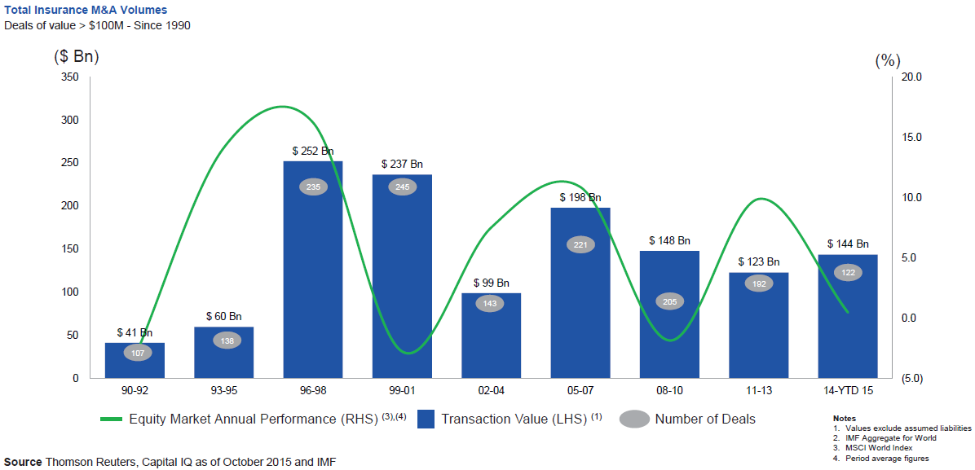
Global M&A Activity Tends to Follow Equity Market Performance
The number and volume of insurance M&A deals was up globally in 2015
.
Source: Thomson Reuters, Capital IQ as of Oct. 2015 and IMF from Geneva Association Newsletter Insurance and Finance, Jan. 2016, presentation “Facts vs. Sentiment: Deals in the Insurance Sector,” by Aviva CEO Mark Wilson.

Slide 55
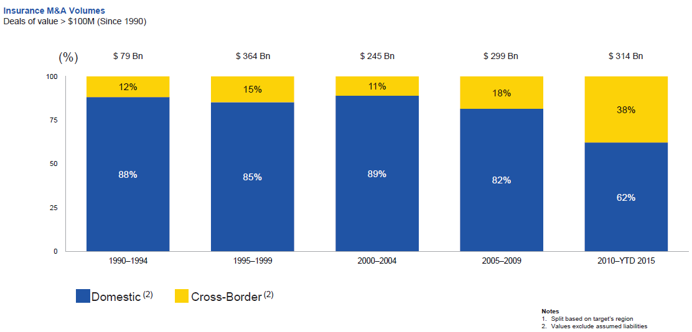
Huge Shift from Domestic M&A Activity to Cross-Border
The share of M&A deal volume that was cross-border more than doubled in 2015
.
Source: Thomson Reuters as of Oct. 2015 from Geneva Association Newsletter Insurance and Finance, Jan. 2016, presentation “Facts vs. Sentiment: Deals in the Insurance Sector,” by Aviva CEO Mark Wilson.

Slide 56
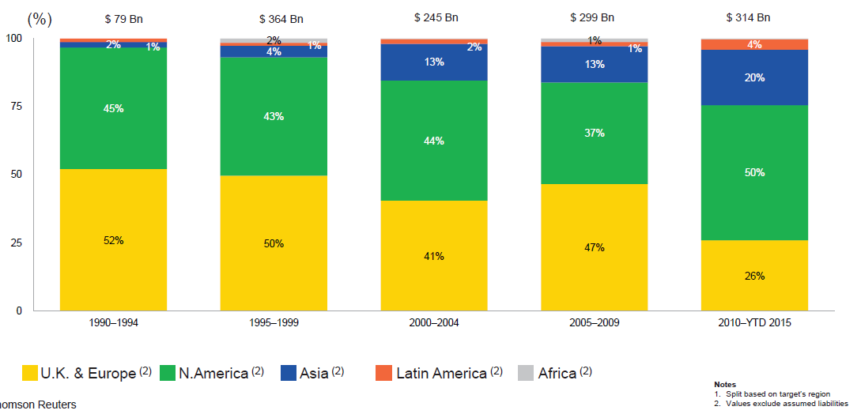
M&A Activity Has Shifted Away from Europe and Towards Asia and N. America
Asian, N. American deal volumes were up sharply in 2015
.
Source: Thomson Reuters as of Oct. 2015 from Geneva Association Newsletter Insurance and Finance, Jan. 2016, presentation “Facts vs. Sentiment: Deals in the Insurance Sector,” by Aviva CEO Mark Wilson.

Slide 57
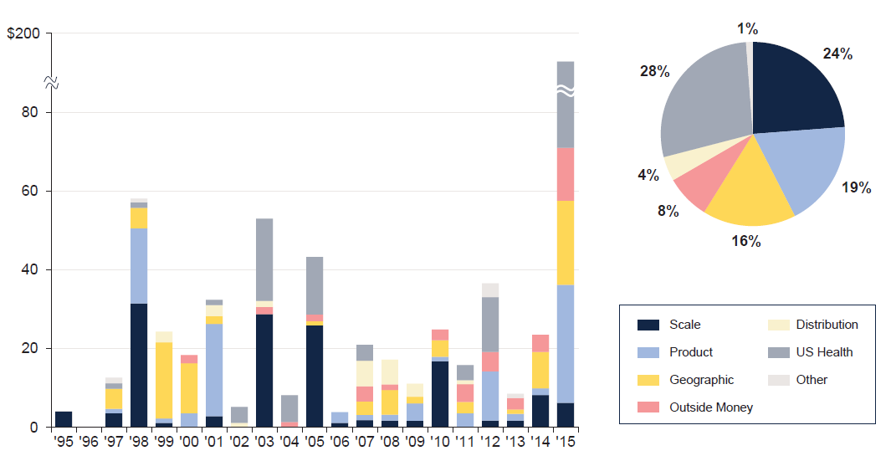
M&A: Deal Rationale by Dollar Amount
Scale drives most deals (excluding health sector)
Source: SNL Financial and WCMA estimates from Geneva Association Newsletter Insurance and Finance, Jan. 2016, presentation “What is the Logic Behind Consolidation? And Does It Create Value? A View from Outside,” by Brian Shea, Head of Willis Capital Markets & Advisory Europe (WCMA).
.

Slide 58
TECHNOLOGY, DISRPTORS AND INSURANCE
The Insurance Industry Is on the Cutting Edge of Providing Technology-Driven Risk Management and Insurance Solutions
58

Slide 59
Interest in Technology Issues and Insurance Is Surging: Presents Opportunity
Insurers are at the intersection of many of the most important technological innovations of the early 21st century
Problem→Solution→Opportunity
Industry is too often depicted as a technology laggard
I.I.I. is highlighting the industry as being on the technological cutting edge—an innovative, nimble industry with solutions for managing countless new risks of the current era:
Sharing economy Cyber Auto Technology
Supply Chain Climate Risk Drones
Wearable devices The “Internet of Things”
Positions industry well with customers, investors, current and prospective workers/Millennials, regulators/legislators and (tech) media
59
12/01/09 - 9pm
eSlide – P6466 – The Financial Crisis and the Future of the P/C
Notes:
59

Slide 60
CYBER RISK AND INSURANCE
Cyber Risk is a Rapidly Emerging Exposure for Businesses Large and Small in Every Industry
60

Slide 61








Data Breaches 2005-2015, by Number of Breaches and Records Exposed
# Data Breaches/Millions of Records Exposed
Millions
The 781 reported data breaches in 2015 was virtually unchanged form the record 783 reported in 2014. The number of exposed records soared to 169.1 million, and increase of 97.5%.
Source: Identity Theft Resource Center (updated as of Jan. 6, 2016);
http://www.idtheftcenter.org/images/breach/ITRCBreachReport2015.pdf

Slide 62
Data/Privacy Breach: Many Potential Costs Can Be Insured
Data Breach Event
Costs of notifying affecting individuals
Defense and settlement costs
Lost customers and damaged reputation
Cyber extortion payments
Costs of notifying regulatory authorities
Regulatory fines at home & abroad
Business Income Loss
Forensic costs to discover cause
62

Slide 63
The Three Basic Elements of Cyber Coverage: Prevention, Transfer, Response
Loss Prevention
Post-Breach Response
(Insurable)
Loss Transfer (Insurance)
Cyber risk management today involves three essential components, each designed to reduce, mitigate or avoid loss. An increasing number of cyber risk products offered by insurers today provide all three.
Source: Insurance Information Institute research.
63

Slide 64
Estimated Cyber Insurance Premiums Written, 2014 – 2020F
Cyber insurance premiums written could more than triple to $7.5 billion by 2020
$ Billions
I.I.I.’s Cyber Risk paper issued Oct. 2015
Source: Advisen (2014 est.); PwC (2015, 2020); Insurance Information Institute.

Slide 65
INDUSTRY DISRUPTORS
Technology, Society and the Economy Are All Changing at a Rapid Pace
Thoughts on the Future
65

Slide 66
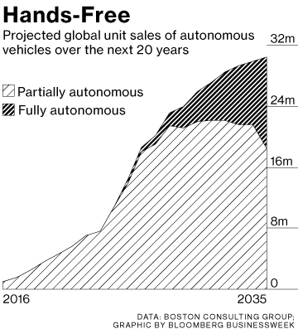
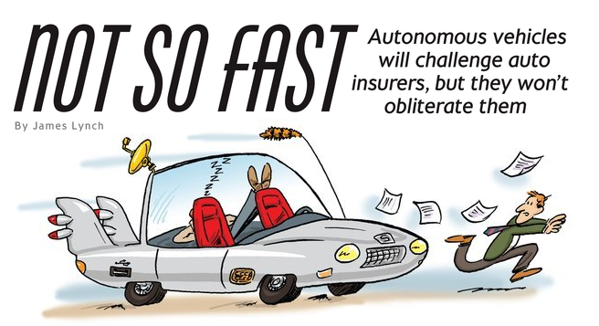
Media is Obsessed with Driverless Vehicles: Often Predicting the Demise of Auto Insurance
By 2035, it is estimated that 25% of new vehicle sales could be fully autonomous models
Questions
Are auto insurers monitoring these trends?
How are they reacting?
Will Google take over the industry?
Will the number of auto insurers shrink?
How will liability shift?
Source: Boston Consulting Group.

Slide 67




On-Demand/Sharing/Peer-to-Peer Economy Impacts Many Lines of Insurance
The “On-Demand” Economy is or will impact many segments of the economy important to P/C insurers
Auto (personal and commercial)
Homeowners/Renters
Many Liability Coverages
Professional Liability
Workers Comp
Many unanswered insurance questions
Insurance solutions are increasingly available to fill the many insurance gaps that arise
67
12/01/09 - 9pm
eSlide – P6466 – The Financial Crisis and the Future of the P/C
Notes:
67

Slide 68
Ridesharing Regulation/Legislation and Status of ISO Filings as of 9/30/15
Status Ride Sharing Legislation/Regulation
Status of ISO Filings
68
Source: ISO.

Slide 69
The Sharing Economy: An Update
The On-Demand Economy Will Transform the American Workforce and the P/C Insurance Industry Too
69

Slide 70

The Sharing Economy Has Grown— And Attracted Political Scrutiny

Slide 71

Political Skepticism About the ‘Gig’ Economy
"Many Americans are making extra money renting out a spare room, designing a website ... even driving their own car. This on demand or so called 'gig' economy is creating exciting opportunities and unleashing innovation, but it's also raising hard questions about workplace protections and what a good job will look like in the future."
--Hillary Clinton,
July 13, 2015
71
12/01/09 - 9pm
eSlide – P6466 – The Financial Crisis and the Future of the P/C
Notes:
71

Slide 72


Regulatory Issues Abound as Well, With Implications for Insurance Coverages
A driver for Uber is an employee, not a
contractor, according to a California
Ruling that eventually could push up costs
‘for the smartphone-based ride hailing service
and hurt the closely watched start-up's valuation.
The California Labor Commissioner's decision could ripple through the burgeoning industry of providing services via smartphones, with potential implications for other “crowdsourced” services such as Uber rival Lyft, chore service TaskRabbit, and cleaning service Homejoy.
--Reuters, June 18, 2015
72
12/01/09 - 9pm
eSlide – P6466 – The Financial Crisis and the Future of the P/C
Notes:
72

Slide 73
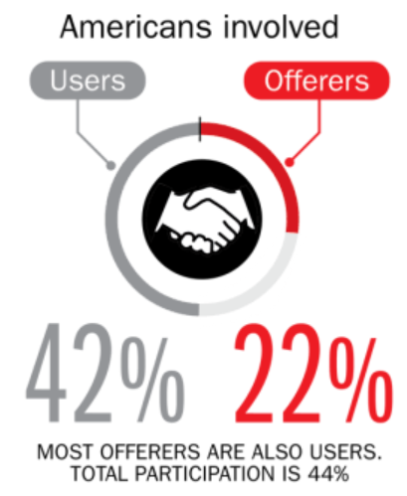
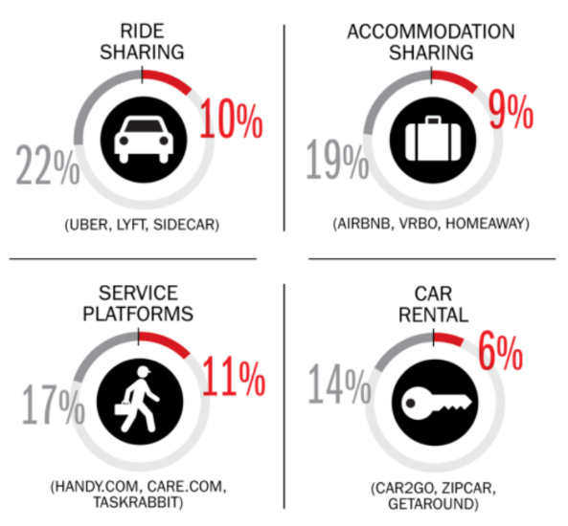
Percent of Americans Who Have Engaged in the “Gig/Sharing Economy” by Transaction
Drivers have significant WC exposures
Service platforms have the most direct link to WC; 11% of Americans have offered their services
About 22% of Americans have offered services in the sharing economy.
Sources: The SelfEmployed.com accessed at https://www.theselfemployed.com/gig-economy/infographic-inside-the-new-economy/ based on a poll by Time magazine, Bursten-Marsteller and The Aspen Institute; Insurance Information Institute.

Slide 74
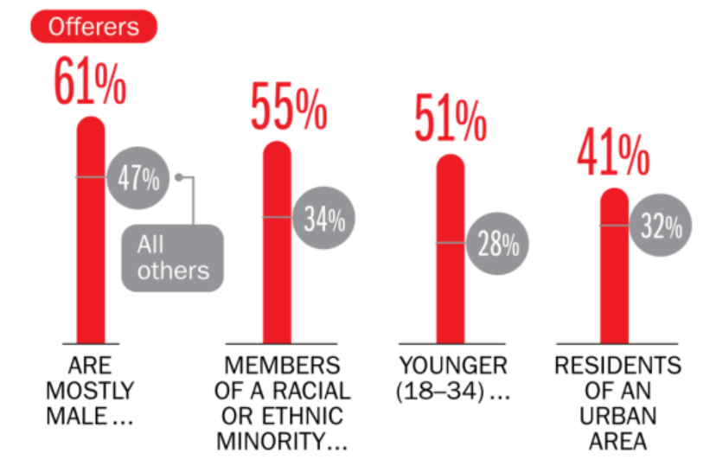
Americans Who Offer Services in the Sharing/Gig Economy Are Statistically More Prone to Workplace Injury
Young, urban minority males are the most likely to offer their services in the sharing economy.
Sources: The SelfEmployed.com accessed at https://www.theselfemployed.com/gig-economy/infographic-inside-the-new-economy/ based on a poll by Time magazine, Bursten-Marsteller and The Aspen Institute; Insurance Information Institute.

Slide 75
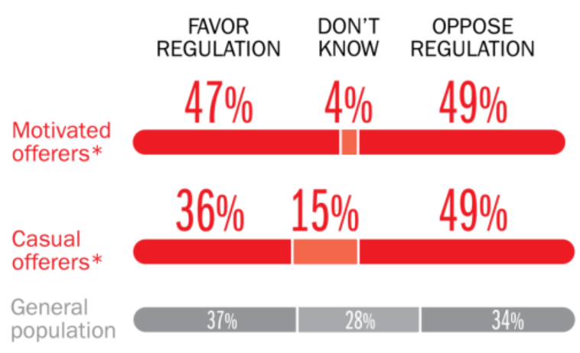
Opinions Are Split on Whether the Sharing Economy Needs More Regulation
The most frequent offerers of services though online platforms are equally divided over the need for more regulation
Sources: The SelfEmployed.com accessed at https://www.theselfemployed.com/gig-economy/infographic-inside-the-new-economy/ based on a poll by Time magazine, Bursten-Marsteller and The Aspen Institute; Insurance Information Institute.

Slide 76
THE ‘INTERNET OF THINGS’
Capturing Economic Value Amid a Shifting Insurer Value Chain
76

Slide 77
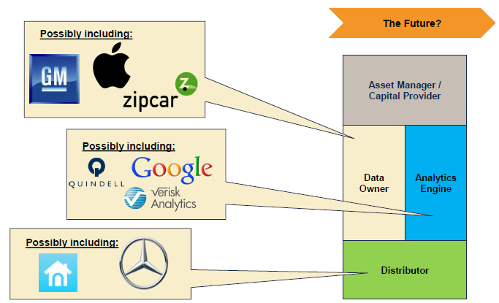

The Internet of Things and the Insurance Industry Value Chain
Who owns the data? Where does It flow? Who does the analytics? Who is the capital provider?
Source: Willis Capital Markets & Advisory; Insurance Information Institute.
77
12/01/09 - 9pm
eSlide – P6466 – The Financial Crisis and the Future of the P/C
Notes:
77

Slide 78
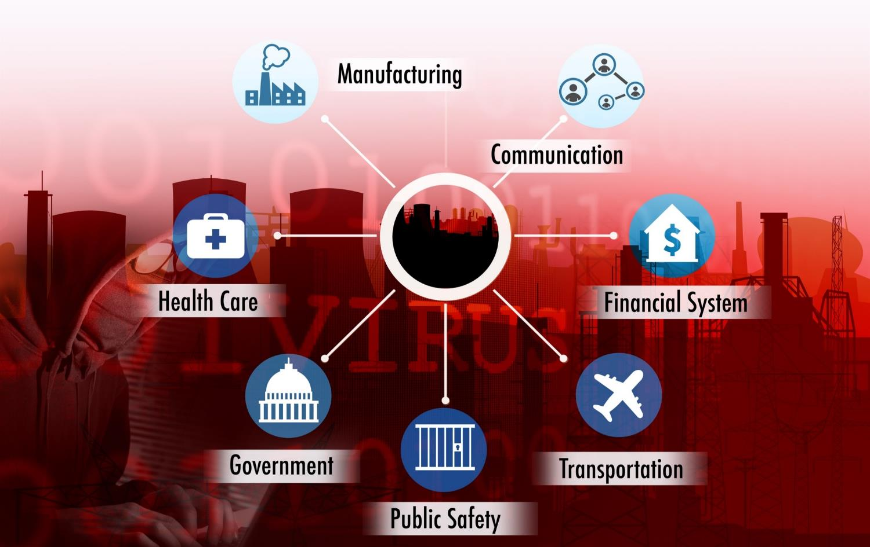
The ‘Internet of Things’ and ‘The Insurance-Net of Things’

Slide 79
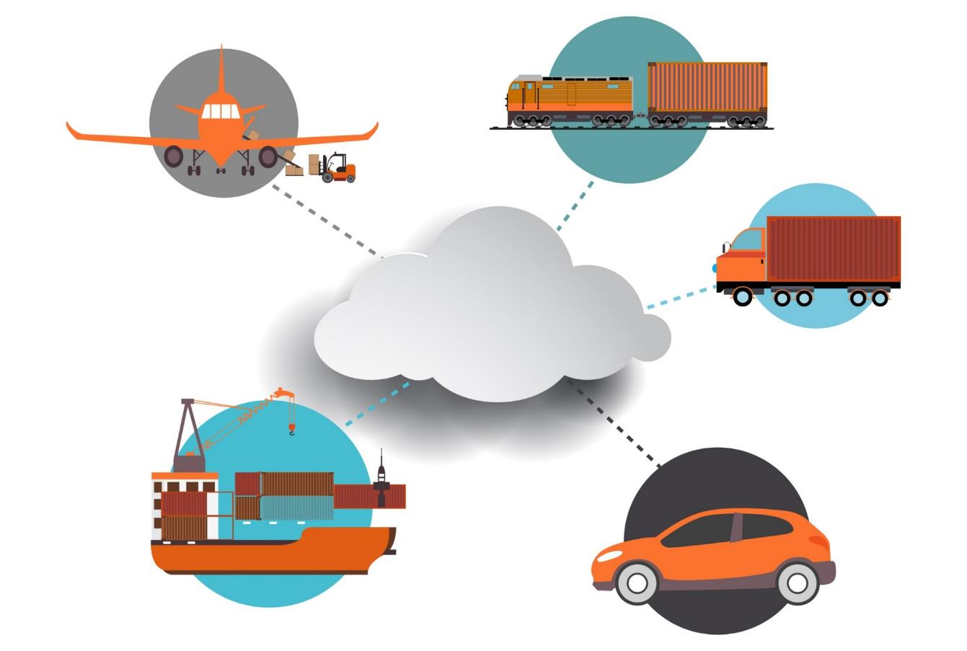
The Insurance Industry’s Future Is in the Cloud…
Rail & Public
Transport
Aviation
The Cloud
Trucking & Fleet Vehicles
Marine Transport
Private Motor Vehicles

Slide 80

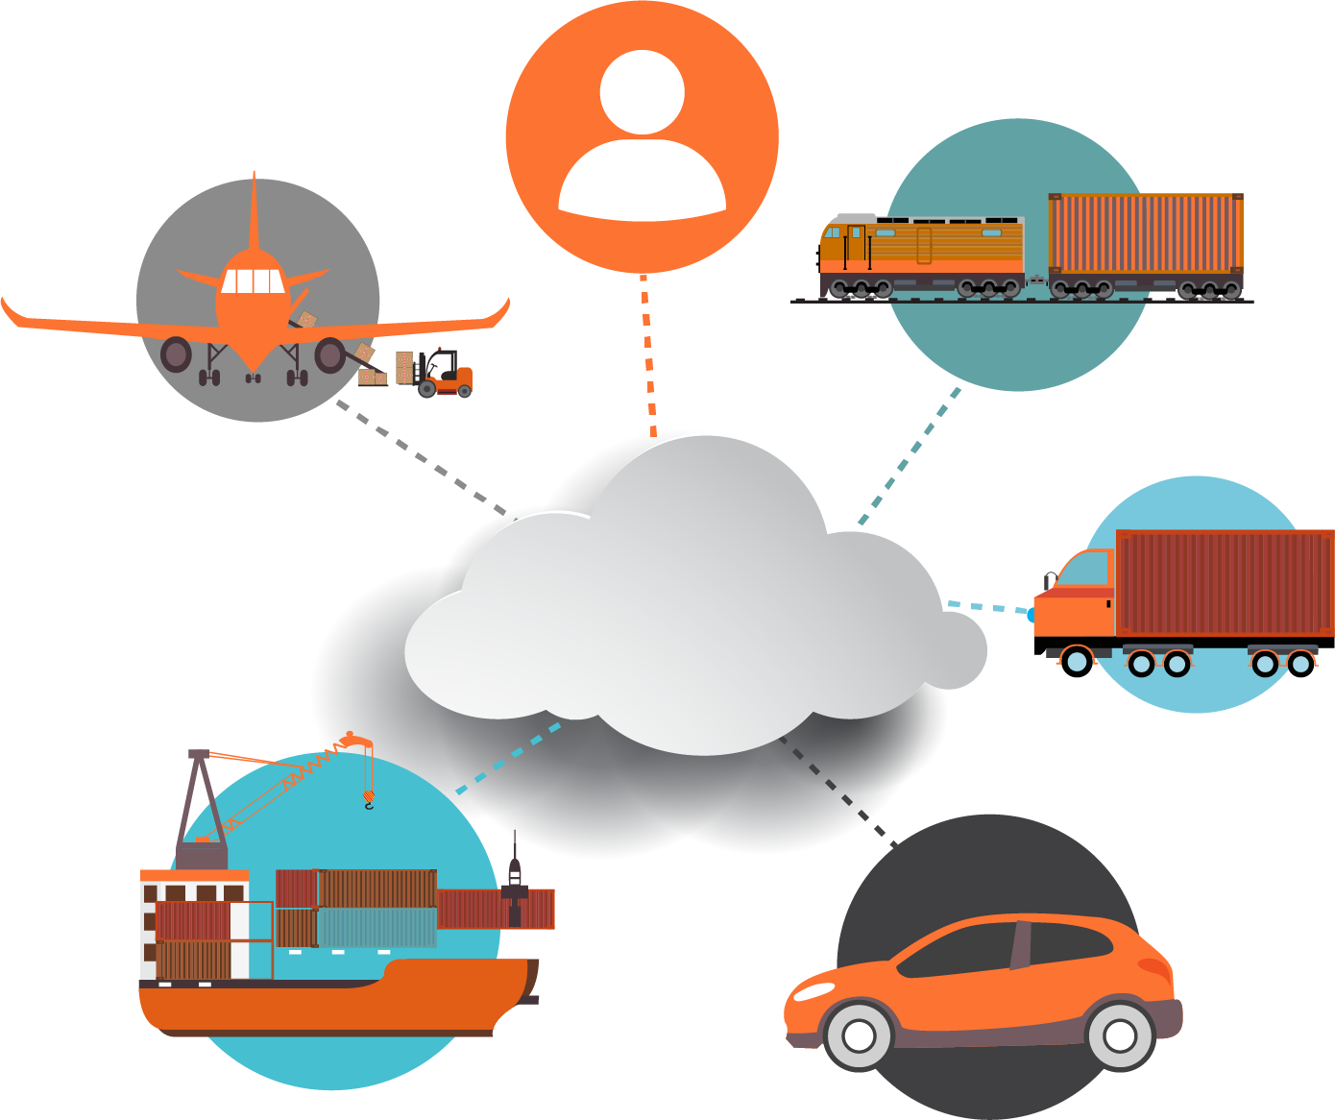
The Insurance Industry’s Future Is in the Cloud…
Human Beings
Rail & Public
Transport
Aviation
Trucking & Fleet Vehicles
The Cloud
Marine Transport
Private Motor Vehicles

Slide 81

#RiskyRide
SXSW
March 13, 2016, Austin, TX

Slide 82
INSURANCE TECHNOLOGY:
FIN TECH ZEROES IN
Number and Value of Deals Is Increasing
In Search of the Elusive Insurance ‘Unicorn’
82

Slide 83
Insurance Technology Financing Trend: Change Is Coming
Insurance tech deals reached a new record in 2016:Q1
($ Millions)
Investment in insurance tech is rising
Source: CB Insights at https://www.cbinsights.com/blog/insurance-tech-overview-q1-2016/; Insurance Information Institute.

Slide 84
Insurance Tech Activity by Area of Interest, 2013 – 2016:Q1
With the ACA in the rear view window, non-health insurance tech accounts for the majority of investment
(Percent)
Silicon Valley and the venture capital community have the insurance industry in their sights. Most will fail. Some will succeed.
Source: CB Insights at https://www.cbinsights.com/blog/insurance-tech-overview-q1-2016/; Insurance Information Institute.

Slide 85


Thank You and…
Hasta La Vista, Baby
I’ll Be Back
85
12/01/09 - 9pm
eSlide – P6466 – The Financial Crisis and the Future of the P/C
Notes:
85

Slide 86
Insurance Information Institute Online:
www.iii.org
Thank you for your time and your attention!
Twitter: twitter.com/bob_Hartwig
Download at www.iii.org/presentations

