Slide 1
Cyberrisk: Threat And Opportunity
Insurance Information Institute  110 William Street  New York, NY 10038 212.346.5500  info@iii.org  www.iii.org

Slide 2
Number Of Data Breaches And Records Exposed
Number of Data Breaches
Millions of Records Exposed*
Both the number of data breaches and records exposed by breaches continues to grow.
*Figures as of July 7, 2016.
Source: Identity Theft Resource Center.
Notes:
This chart doesn't include the 2014 Yahoo! Breach of more than 500 million records that was announced in recent weeks.

Slide 3
Who Gets Attacked The Most?
2015 Data Breaches By Business Category, By Number of Breaches
Medical And Healthcare Records Were More Than Half Of All Records Stolen
Banking/Credit/Financial
5.1 MM
Educational
58
Educational
759,600
Govt./Military
63
Business
16.2 MM
0.4%
Banking/ Credit/Financial
71
Business
312
Govt./ Military
34.2 MM
Medical/ Healthcare
121.6 MM
Medical/ Healthcare
277
Businesses are breached most frequently, but more medical records are exposed.
Total may not equal 100% due to rounding.
Source: Identity Theft Resource Center.

Slide 4
Cyber Incidents Are The No. 3 Global Business Risk
Cyber incidents moved to No. 3 in the Allianz Risk Barometer Survey, up from No. 5 a year earlier.
*From social media
Source: Allianz Risk Barometer on Business Risks 2016.
Notes:
Cyber incidents also ranked as the top long-term risk, according to the survey.

Slide 5
What Were The Most Costly Crimes?
Percentage of Average Cost
Malicious coding, denial of service and phishing make up more than half of the average cost of cyber crimes.
Total may not equal 100% due to rounding.
Source: 2015 Cost of Cyber Crime: United States, Ponemon Institute.

Slide 6
Breach Costs Are Rising
The average breach in the U.S. cost $7.0 million in 2016.*
*The 2016 study examines the costs incurred by 383 companies across 16 industries representing 12 countries, including 64 U.S. case studies. Total breach costs include: lost business resulting from diminished trust or confidence of customers; costs related to detection, escalation, and notification of the breach; and ex-post response activities, such as credit report monitoring.
Source: Ponemon Institute.

Slide 7

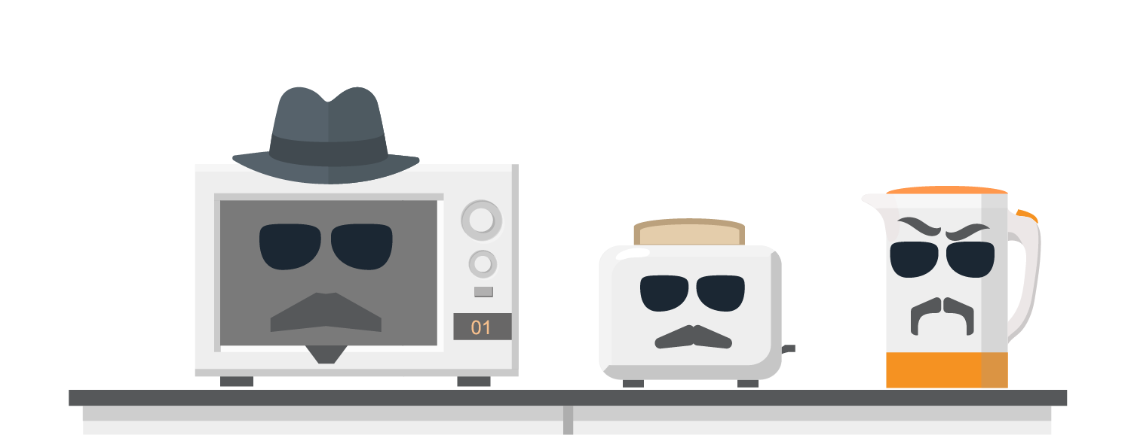
Billions Of Internet-connected Devices Could Be Vulnerable To Attack, Compromising Users’ Personal Data
2016
6.4 billion
connected devices
2020
20.8 billion
connected devices
Source: Symantec, 2016 Internet Security Threat Report, Volume 21, April 2016; Gartner, press release, November 10, 2015.

Slide 8
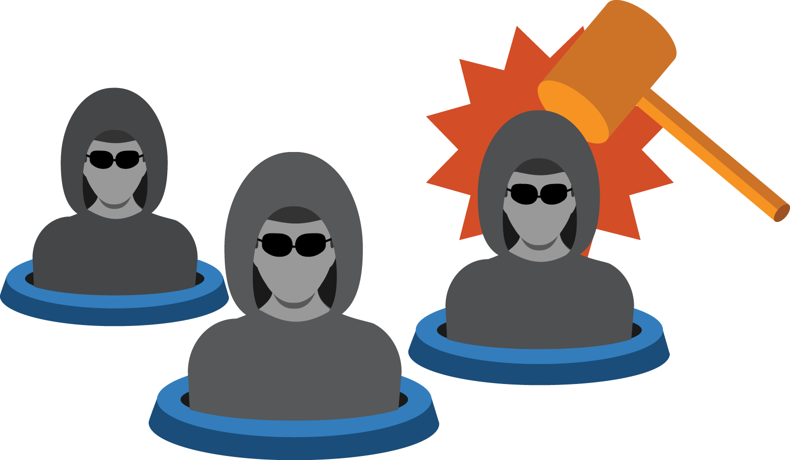
As Quickly As Insurers Develop Cyber Policies, New Risks Pop Up
40%
of businesses
attacked using
ransomware
$740 million
social engineering
(business email compromise)
losses since 2013
62%
of all breaches target
small and midsized
businesses
Source: Malwarebytes™, press release, August 3, 2016; Federal Bureau of Investigation, Business Email Compromise: An Emerging Global Threat, August, 28, 2015; Rosalie Donlon, “Small, mid-sized businesses hit by 62% of all cyber attacks,”Propertycasualty360.com, May 27, 2015.

Slide 9
Who Is Buying Cyber Coverage?
Stand-alone Policies Grew By More Than 25 Percent Among Marsh Clients
Growth is fastest among manufacturers and communications companies.
Source: Benchmarking Trends: As Cyber Concerns Broaden, Insurance Purchases Rise, Marsh Risk Management Research Briefing, March 2015.
Notes:
Infrastructure industries, in particular chemical, communications, energy, health care and transportation, are particularly interested in business interruption coverage.

Slide 10

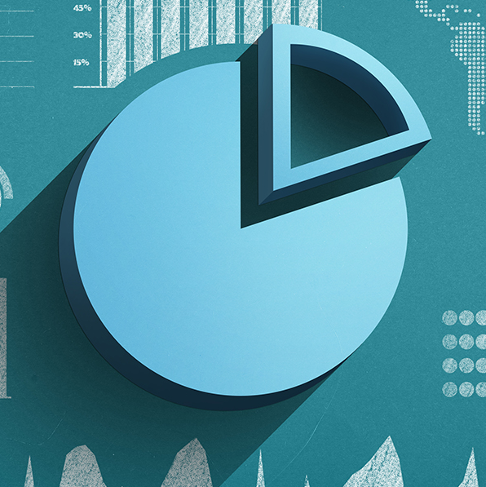
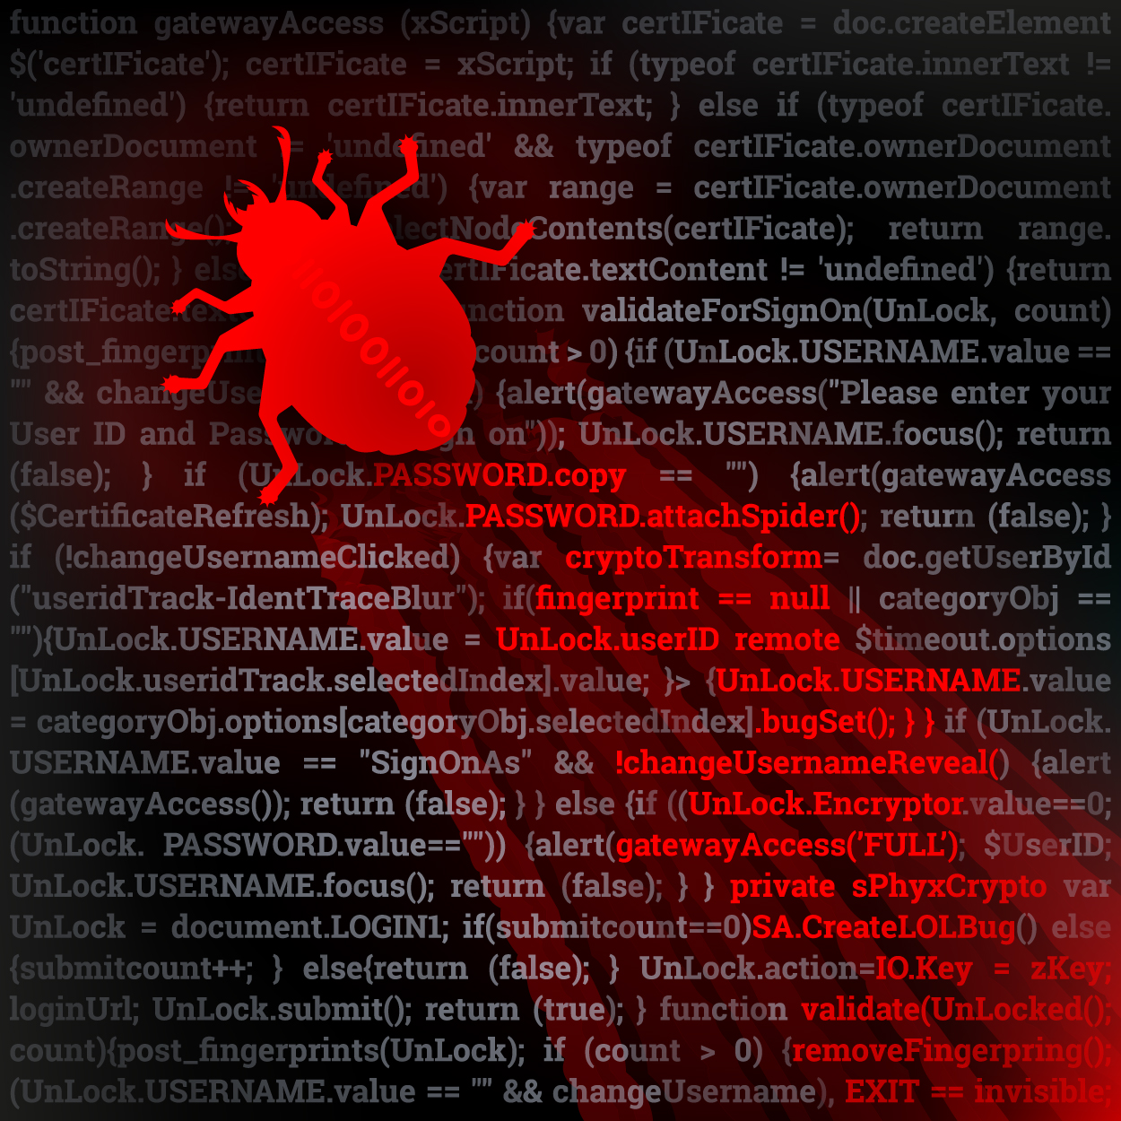
Major Difficulties In Writing Cyber Coverage
Complexity of risk
Lack of historical data
Risk accumulation
Threats are becoming more sophisticated.
Executives, boards, cyber experts, insurers and others struggle to keep up.
New coverages lack historical data, making pricing difficult.
Several insurers are developing common data requirements.
Cyberattacks could be massive. A 'cyber hurricane' could cause thousands of claims.
Some insurers worry that cyber is too big for private sector to handle alone.

Slide 11
Summary
Cyberattacks are proliferating.
Insurance has an important role in risk-mitigation.
Insuring cyberrisk is a unique challenge.
The cast of perpetrators and targets constantly changes.
Lack of data makes pricing difficult.
It is hard to monitor the accumulation of risk.

