Slide 1
Disruptors in the P/C Insurance Industry:
Trends, Challenges and Opportunities
Insurance Information Institute
June 30, 2016
Robert P. Hartwig, Ph.D., CPCU, President & Economist
Insurance Information Institute ♦ 110 William Street ♦ New York, NY 10038
Tel: 212.346.5520 ♦ Cell: 917.453.1885 ♦ bobh@iii.org ♦ www.iii.org

Slide 2
Outline
The Economy: Major Factors Influencing Growth and Profitability
“Old School” Disruptors
Insurance, Technology and 21st Century Disruptors
  Auto/Driving Technology
  Cyber
  Sharing Economy
  The Internet of Things: Personal and Commercial Lines Applications
    Wearables and Beyond
  InsureTech (Venture Capital, Start-Ups and Insurance)
Distribution Trends and Challenges
Millennials
  As consumers
  As employees
2
12/01/09 - 9pm
eSlide – P6466 – The Financial Crisis and the Future of the P/C
Notes:
2

Slide 3
THE ECONOMY
The Strength of the Economy Will Greatly Influence Insurer Exposure Base Across Most Lines
3

Slide 4
US Real GDP Growth*
The Q4:2008 decline was the steepest since the Q1:1982 drop of 6.8%
Real GDP Growth (%)
Recession began in Dec, 2007
Q1 2014/15 GDP data were hit hard by this year’s “Polar Vortex” and harsh winter
Demand for Insurance Should Increase in 2016 as GDP Growth Continues at a Steady, Albeit Moderate Pace and Gradually Benefits the Economy Broadly
* Estimates/Forecasts from Blue Chip Economic Indicators.
Source: US Department of Commerce, Blue Economic Indicators 6/16; Insurance Information Institute.

Slide 5
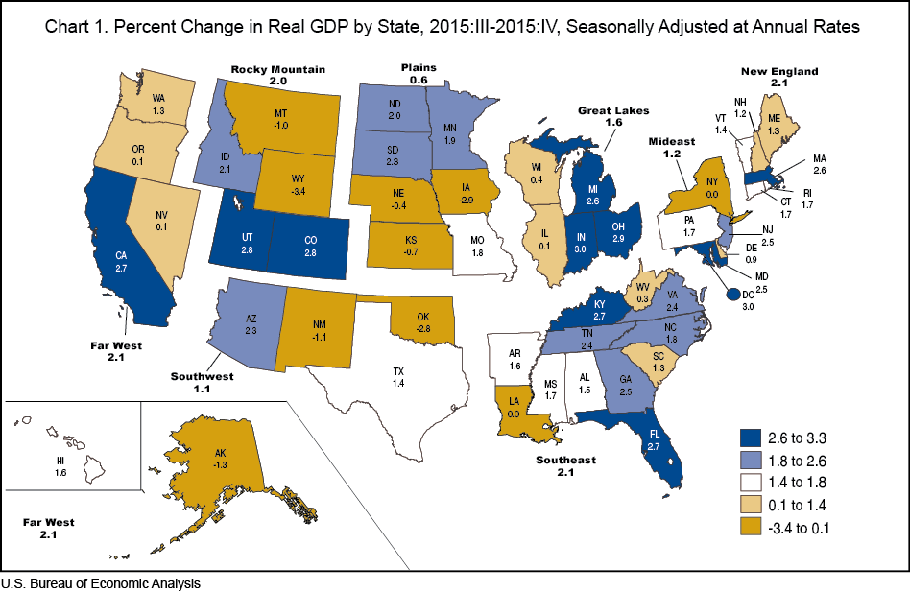
Real GDP Growth by State:
2015:III - 2015:IV
5

Slide 6
US Unemployment Rate Forecast
Rising unemployment
eroded payrolls
and WC’s
exposure base.
Unemployment peaked at 10% in late 2009.
2007:Q1 to 2017:Q4F*
Jobless figures have been revised downwards for 2016
Unemployment forecasts have been revised modestly downwards. Optimistic scenarios put the unemployment as low as 4.4% by Q4 of 2016.
* = actual; = forecasts
Sources: US Bureau of Labor Statistics; Blue Chip Economic Indicators (6/16 edition); Insurance Information Institute.

Slide 7
Unemployment Rates by State, May 2016:
Highest 25 States*
In May, unemployment rates were significantly higher in 5 states, lower in 4 states and the District of Columbia, and stable in 41 states.
Weak economies are keeping unemployment relatively high in several states; Low energy prices play a role in some.
*Provisional figures for May 2016, seasonally adjusted.
Sources: US Bureau of Labor Statistics; Insurance Information Institute.

Slide 8
Unemployment Rates by State, May 2016:
Lowest 25 States*
In May, unemployment rates were significantly higher in 5 states, lower in 4 states and the District of Columbia, and stable in 41 states.
15 states have unemployment rates under 4%
*Provisional figures for May 2016, seasonally adjusted.
Sources: US Bureau of Labor Statistics; Insurance Information Institute.

Slide 9

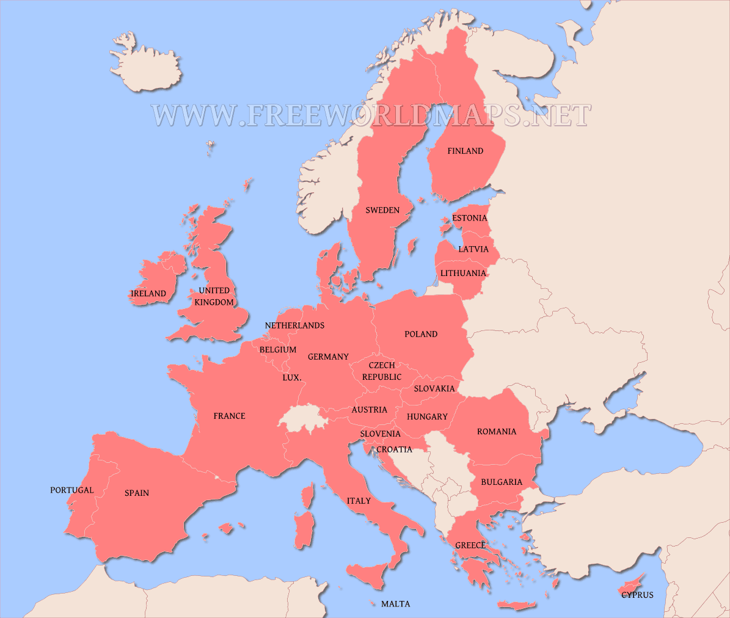
Brexit: Potential Impacts on the Global (Re)Insurance Industry
Brexit is a net negative for the global (re)insurance industry
Fundamentally, Brexit is a protectionist measure and antithetical to free trade; Economic negatives:
  Dollar appreciates weakening US exports
  Delays Fed rate hikes
  Uncertainty
Free flow of financial capital, human capital and coordinated regulatory policy across EU states is on net good for Europe’s economy
Concern that UK’s action could initiate a domino effect
Economic integration is the cornerstone of keeping (most of) Europe free of war
Does Brexit weaken Solvency II and efforts to implement European-like regulations in the US?
9
12/01/09 - 9pm
eSlide – P6466 – The Financial Crisis and the Future of the P/C
Notes:
9

Slide 10
CONSTRUCTION INDUSTRY OVERVIEW & OUTLOOK
The Construction Sector Is Critical to the Economy and the P/C Insurance Industry
10

Slide 11
Value of New Private Construction: Residential & Nonresidential, 2003-2016*
2016: Value of new pvt. construction hits $843.1B as of Apr. 2016, up 68.4% from the 2010 trough but still 7.5% below 2006 peak
New Construction peaks at $911.8. in 2006
Billions of Dollars
Trough in 2010 at $500.6B, after plunging 55.1% ($411.2B)
$613.7
$439.7
$298.1
$261.8
$403.5
$238.8
Private Construction Activity Is Moving in a Positive Direction though Remains Well Below Pre-Crisis Peak; Residential Dominates
*2016 figure is a seasonally adjusted annual rate as of April.
Sources: US Department of Commerce http://www.census.gov/construction/c30/c30index.html ; Insurance Information Institute.
11
12/01/09 - 9pm
eSlide – P6466 – The Financial Crisis and the Future of the P/C
Notes:
11

Slide 12
Value of Construction Put in Place, 2016 vs. 2015*
Growth (%)
Private: +5.7%
Public: +1.2%
Public sector construction activity is finally beginning to create less drag up after years of decline
Private sector construction activity is up in both the residential and nonresidential segments
Overall Construction Activity is Up Again After Languishing in Early 2015; State/Local Sector Government Sector May Be Recovering as Budget Woes Ease in Some Jurisdictions
*seasonally adjusted data through April 2016.
Source: U.S. Census Bureau, http://www.census.gov/construction/c30/c30index.html ; Insurance Information Institute.

Slide 13
Value of New Federal, State and Local Government Construction: 2003-2016*
Construction across all levels of government peaked at $314.9B in 2009
Austerity Reigns
Govt. construction MAY finally be turning around; still down $24.1B or 7.7% since 2009 peak
($ Billions)
Government Construction Spending Peaked in 2009, Helped by Stimulus Spending, but Contracted As State/Local Governments Grappled with Deficits and Federal Sequestration; Only Now Recovering
*2016 figure is a seasonally adjusted annual rate as of April; http://www.census.gov/construction/c30/historical_data.html
Sources: US Department of Commerce; Insurance Information Institute.

Slide 14
PERSONAL LINES EXPOSURE BASE IS EXPANDING
Top Line Growth for Personal Lines Exceeds Commercial Lines:
Exposure and Rate Contribute
14

Slide 15
New Private Housing Starts, 1990-2021F
Job growth, low inventories of existing homes, still-low mortgage rates and demographics should continue to stimulate new home construction for several more years
(Millions of Units)
New home starts plunged 72% from 2005-2009; A net annual decline of 1.49 million units, lowest since records began in 1959
Insurers Are Continue to See Meaningful Exposure Growth in the Wake of the “Great Recession” Associated with Home Construction: Construction Risk Exposure, Surety, Commercial Auto; Potent Driver of Workers Comp Exposure
Source: U.S. Department of Commerce; Blue Chip Economic Indicators (5/16 for 2016-17; 3/16 for 2018-21F; Insurance Information Institute.

Slide 16
Homeowners Insurance
Net Written Premium, 2000–2016F
$ Billions
Homeowners insurance NWP continues to rise (up 150% 2000-2015F) despite very little unit growth during the real estate crash. Reasons include rate increases, especially in coastal zones, ITV endorsements (e.g., “inflation guards”), compulsory for mortgaged properties and resumption of home building activity
The Homeowners line will generate about $4B in new premiums annually through 2016
Sources: A.M. Best; Insurance Information Institute.

Slide 17
I.I.I. Poll: Renter’s Insurance
Q. Do you have renters insurance? ¹
Americans are increasingly choosing to rent, but are slow to understand the need to insure, exacerbating the underinsurance gap
The Percentage of Renters Who Have Renters Insurance Has Been Rising Since 2011.
¹Asked of those who rent their home.
Source: Insurance Information Institute Annual Pulse Survey.

Slide 18
Auto/Light Truck Sales, 1999-2021F
Job growth and improved credit market conditions will boost auto sales in 2015 and beyond
Sales have returned to pre-crisis levels
(Millions of Units)
New auto/light truck sales fell to the lowest level since the late 1960s. Forecast for 2014-15 is still below 1999-2007 average of 17 million units, but a robust recovery is well underway.
Truck, SUV purchases by contractors are especially strong
Yearly car/light truck sales will likely continue at current levels, in part replacing cars that were held onto in 2008-12. PP Auto premium might grow by 3.5% - 5%.
Source: U.S. Department of Commerce; Blue Chip Economic Indicators (5/16 for 2016-17; 3/16 for 2018-21F; Insurance Information Institute.

Slide 19
Average Expenditures* on Auto Insurance, 1994-2015E
Annual Pct Changes
2001: 5.2%
2002: 8.6%
2003: 5.6%
2004: 1.5%
2005: -1.3%
2006: -1.8%
2007: -2.1%
2008: -1.0%
2009: -0.5%
2010: 0.6%
2011: 0.6%
2012: 2.3%
2013: 3.3%
The average expenditure on auto insurance now finally exceeds the pre-crisis high of $842 recorded in 2004, taking a full decade to recover, but on an inflation-adjusted basis premiums are still below 2004 levels
Across the U.S., auto insurance expenditures fell by 0.8% in 2008
and 0.5% in 2009 but rose 0.5% in 2010, 0.8% in 2011, 2.3% in 2012 and 3.3% in 2013; I.I.I. estimate is for +3.4% in 2014 and 2015.
* The NAIC data are per-vehicle (actually, per insured car-year)
Sources: NAIC for 1994-2013; Insurance Information Institute estimates for 2014-2015 based on CPI and other data.

Slide 20
Private Passenger Auto Insurance
Net Written Premium, 2000–2017F
PP Auto premiums written continue to recover from a period of flat growth attributable to the weak economy impacting new vehicle sales, car choice, and increased price sensitivity among consumers
PPA will generate $6B - $8B in new premiums annually through 2017
$ Billion
PPA NWP volume in 2014 was up $26.3B or 16.7% since the 2009 trough; By 2017 the gain is expected to be $46.8B or 29.7%
Sources: A.M. Best (1990-2014); Conning (2015-17F); Insurance Information Institute.

Slide 21
Monthly Change in Auto Insurance Prices, 1991–2015*
Cyclical peaks in PP Auto tend to occur roughly every 10 years (early 1990s, early 2000s and likely the early 2010s)
Pricing peak occurred in late 2010 at 5.3%, falling to 2.8% by Mar. 2012
“Hard” markets tend to occur during recessionary periods
Dec. 2015 reading of 5.5% is up from 4.7%
a year earlier
*Percentage change from same month in prior year; through Dec. 2015; seasonally adjusted
Note: Recessions indicated by gray shaded columns.
Sources: US Bureau of Labor Statistics; National Bureau of Economic Research (recession dates); Insurance Information Institutes.
21
12/01/09 - 9pm
eSlide – P6466 – The Financial Crisis and the Future of the P/C
Notes:
21

Slide 22
Claim Trends in Private Passenger Auto Insurance
Rising Frequencies and Severities in Many Coverages
A More Immediate Challenge
22

Slide 23
Auto Severity & Frequency by Coverage: Trending Up in 2015
Annual Change, 2015 Over 2014
Frequency and Severity Were Up Across Most Coverage Types in 2015; A Trend Likely to Continue in 2016
Source: ISO/PCI Fast Track data; Insurance Information Institute

Slide 24
Collision Coverage: Severity & Frequency Trends Are Both Higher in 2015
Annual Change, 2005 through 2015
The Recession, High Fuel Prices Helped Temper Frequency and Severity, But this Trend Has Clearly Reversed, Consistent with Experience from Past Recoveries
Source: ISO/PCI Fast Track data; Insurance Information Institute

Slide 25
Collision Loss Ratio Trending Upward:
Private Passenger Auto, 2010 – 2015
Loss Ratio
Collision Loss Ratios are Trending Steadily Upward
Source: ISO/PCI Fast Track data; Insurance Information Institute

Slide 26
Bodily Injury: Severity Trend Is Up, Frequency Decline Has Ended—Rising?
Annual Change, 2005 through 2015
Cost Pressures Will Increase if BI Frequency and Severity Trends Persist
Source: ISO/PCI Fast Track data; Insurance Information Institute

Slide 27
Property Damage Liability: Severity and Frequency Are Up
Annual Change, 2005 through 2015
Severity/Frequency Trends Have Been Volatile, But Rising Severity since 2011 Is a Concern
Source: ISO/PCI Fast Track data; Insurance Information Institute

Slide 28
Comprehensive Coverage: Frequency and Severity Trends Are Volatile
Severe weather is a principal cause of the spikes in both frequency and severity
Annual Change, 2005 through 2015
Weather Creates Volatility for Comprehensive Coverage
Source: ISO/PCI Fast Track data; Insurance Information Institute

Slide 29
A Few Factors Driving Adverse Private Passenger Auto Loss Trends
More People Driving, Lower Gas Prices, Higher Speed Limits…
29

Slide 30
Why Are People
Driving More Miles? Jobs?
Billions of Miles Driven in Prior Year
Millions Employed
Recession
People Drive To and From Work and Drive to Entertainment. Out of Work, They Curtail Their Movement.
Sources: Federal Highway Administration (http://www.fhwa.dot.gov/policyinformation/travel_monitoring/tvt.cfm ); Seasonally Adjusted Employed from Bureau of Labor Statistics; Insurance Institute for Highway Safety; Insurance Information Institute.
30
12/01/09 - 9pm
eSlide – P6466 – The Financial Crisis and the Future of the P/C
Notes:
30

Slide 31
More People Working and Driving
=> More Collisions, 2006-2016
Overall Collision Claims Per 100 Insured Vehicles
Number Employed,
Millions
Recession
When people are out of work, they drive less. When they get jobs,
they drive to work, helping drive claim frequency higher.
Sources: Seasonally Adjusted Employed from Bureau of Labor Statistics; Rolling Four-Qtr Avg. Frequency from Insurance Services Office; Insurance Information Institute.
31
12/01/09 - 9pm
eSlide – P6466 – The Financial Crisis and the Future of the P/C
Notes:
31

Slide 32
Change in Auto Fatalities by State: Especially Severe in Georgia
GA’s auto fatality rate has increased at a pace nearly 3 times that of the US overall and far in excess of any other state in the region
2015 vs. 2014
Fatalities in Southeast Rising Faster Than USA as a Whole
SOURCE: Estimates from National Safety Council.

Slide 33
TECHNOLOGY, DISRUPTORS AND INSURANCE
The Insurance Industry Is on the Cutting Edge of Providing Technology-Driven Risk Management and Insurance Solutions
33

Slide 34
I.I.I. Media Index, P/C, First Five Months 2015 vs. First Five Months* 2016¹
Percent Increase/Decrease from Previous Year
*Through May 15.
¹Based on a search of Meltwater News

Slide 35
Interest in Technology Issues and Insurance Is Surging: Presents Opportunity
Insurers are at the intersection of many of the most important technological innovations of the early 21st century
  Problem→Solution→Opportunity
Industry is too often depicted as a technology laggard
I.I.I. is highlighting the industry as being on the technological cutting edge—an innovative, nimble industry with solutions for managing countless new risks of the current era:
  Sharing economy Cyber Auto Technology
  Supply Chain Climate Risk Drones
  Wearable devices The “Internet of Things”
Positions industry well with customers, investors, current and prospective workers/Millennials, regulators/legislators and (tech) media
35
12/01/09 - 9pm
eSlide – P6466 – The Financial Crisis and the Future of the P/C
Notes:
35

Slide 36
CYBER RISK AND INSURANCE
Cyber Risk is a Rapidly Emerging Exposure for Businesses Large and Small in Every Industry
36

Slide 37






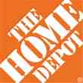

Data Breaches 2005-2015, by Number of Breaches and Records Exposed
# Data Breaches/Millions of Records Exposed
Millions
The 781 reported data breaches in 2015 was virtually unchanged form the record 783 reported in 2014. The number of exposed records soared to 169.1 million, and increase of 97.5%.
Source: Identity Theft Resource Center (updated as of Jan. 6, 2016);
http://www.idtheftcenter.org/images/breach/ITRCBreachReport2015.pdf

Slide 38
Data/Privacy Breach:
Many Potential Costs Can Be Insured
Data Breach Event
Costs of notifying affecting individuals
Defense and settlement costs
Lost customers and damaged reputation
Cyber extortion payments
Costs of notifying regulatory authorities
Regulatory fines at home & abroad
Business Income Loss
Forensic costs to discover cause
38

Slide 39
Estimated Cyber Insurance Premiums Written, 2014 – 2020F
Cyber insurance premiums written could more than triple to $7.5 billion by 2020
$ Billions
I.I.I.’s Cyber Risk paper issued Oct. 2015
Source: Advisen (2014 est.); PwC (2015, 2020); Insurance Information Institute.

Slide 40
AUTO TECHNOLOGY &
THE FUTURE OF AUTO INSURANCE
The Road to Fully Autonomous Vehicles: Long, Dark and Full of Potholes
Tales of the Death of Auto Insurance Are Greatly Exaggerated
40

Slide 41
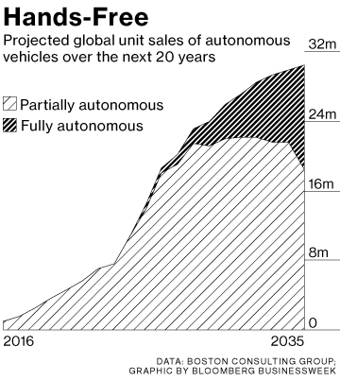
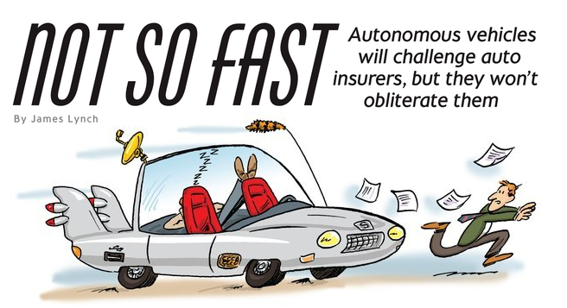
Media is Obsessed with Driverless Vehicles: Often Predicting the Demise of Auto Insurance
By 2035, it is estimated that 25% of new vehicle sales could be fully autonomous models
Questions
Are auto insurers monitoring these trends?
How are they reacting?
Will Google take over the industry?
Will the number of auto insurers shrink?
How will liability shift?
Source: Boston Consulting Group.

Slide 42
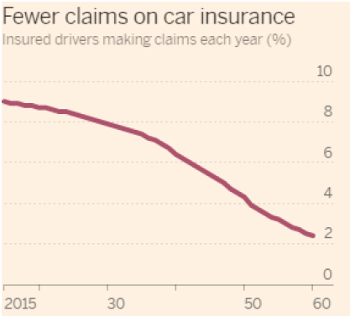
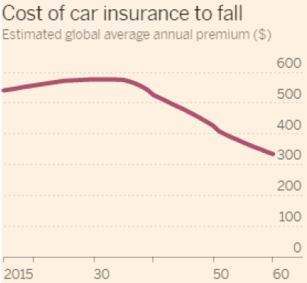
Media is Obsessed with Driverless Vehicles: Often Predicting the Demise of Auto Insurance
Some are predicting that the rise of autonomous vehicles will reduce claim frequency by 75% or more…
,,,and that this technology will cause average auto insurance premiums to plunge
Source: Autonomous Consulting as cited in the Financial Times: “Cost of Car Insurance to Plunge With Rise of Driverless Vehicles, June 28, 2016.

Slide 43
I.I.I. Poll: Auto Insurance
Q. Would you be willing to ride in a driverless car?
May 2015
May 2016
Don’t Know
Don’t Know
Yes
Yes
No
No
The Percentage Willing to Ride in a Driverless Car Rose Slightly.
71 Percent of People Over 64 Were Unwilling to Ride.
The Percentage Willing to Ride in a Driverless Car Rose Slightly;
71% of People Over 64 Were Unwilling to Ride.
Source: Insurance Information Institute Annual Pulse Survey.

Slide 44
I.I.I. Poll: Driverless Cars
Q. Would you be willing to ride in a driverless car?
The Percentage Willing to Ride in a Driverless Car Remains at 43%;
71% of People Over 64 Were Unwilling to Ride.
Source: Insurance Information Institute Annual Pulse Survey

Slide 45
I.I.I. Poll: Driverless Cars
Q. Would you be willing to ride in a driverless car?
The Percentage Willing to Ride in a Driverless Car Remains at 43%;
71% of People Over 64 Were Unwilling to Ride.
Source: Insurance Information Institute Annual Pulse Survey.

Slide 46
I.I.I. Poll: Driverless Cars
Why Americans Would Not Want to Ride in a Driverless Car,
May 2016¹
Safety Concerns Are Paramount Among Those Who Would Avoid Driverless Cars.
¹ Based on those who would not ride in a driverless car. Respondents could give more than one answer.
Source: Insurance Information Institute Annual Pulse Survey.

Slide 47
I.I.I. Poll: Telematics—
Consumers Still Hesitant
Q
Would you allow your auto insurer to collect information about how and when you drive in order to set your auto insurance premium?
Don’t Know
Allow if Premium Went Down
Not
Allow
Allow Whether or Not Premium Went Down
More Than Half of Auto Policyholders Would Allow Their Insurer to
Collect Their Driving Information in Order to Set Premiums.
¹Asked of those who have auto insurance.
Source: Insurance Information Institute Annual Pulse Survey.

Slide 48
The Sharing Economy
The On-Demand Economy Will Transform the American Workforce and the P/C Insurance Industry Too
48

Slide 49




On-Demand/Sharing/Peer-to-Peer Economy Impacts Many Lines of Insurance
The “On-Demand” Economy is or will impact many segments of the economy important to P/C insurers
  Auto (personal and commercial)
  Homeowners/Renters
  Many Liability Coverages
  Professional Liability
  Workers Comp
Many unanswered insurance questions
Insurance solutions are increasingly available to fill the many insurance gaps that arise
49
12/01/09 - 9pm
eSlide – P6466 – The Financial Crisis and the Future of the P/C
Notes:
49

Slide 50
TNC Ridesharing Arrangements: Insurance Applicability
The concern was that TNCs were seeking to offload risk on to personal auto insurers. An increasing number of personal auto insurers have developed solutions to ensure that coverage gaps are minimized
*From publically available sources as of June 2, 2015.
Source: ISO/Verisk.
50

Slide 51
Ridesharing Regulation/Legislation and Status of ISO Filings as of 9/30/15
Status Ride Sharing Legislation/Regulation
Status of ISO Filings
51
Source: ISO.

Slide 52
Homesharing Arrangements: Potential Host Exposure Concerns (Receives Rental Income)
Source: ISO/Verisk.
52

Slide 53
Homesharing Arrangements: Potential Traveler Exposure Concerns
.
Source: ISO/Verisk.
53

Slide 54
Homesharing: ISO’s Proposed Changes*
.
*As of Oct. 6, 2015.
Source: ISO/Verisk.
54

Slide 55
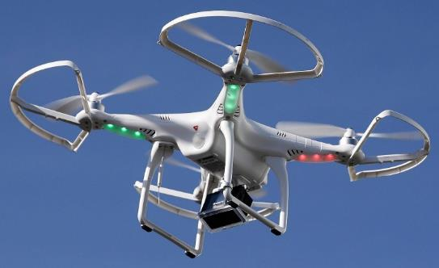
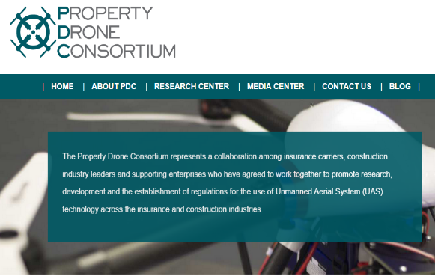
Send in the Drones: Potential Rapid
Adoption in Industry; Media Loves It
Drones or Unmanned Aerial Vehicle (UAV) technology is seeing rapid adoption rate in many industries, including insurance
~700,000 drones in US by year-end
FAA granting Section 333 exemptions for commercial use and testing of UAS
FAA will require most drones to be registered by year-end 2015.
At least 5 insurers have received permission to test
Wide variety of applications: claims, pre-event property inspections…
Insurers partnering with construction industry to guide R&D and regulation of UAV use via Property Drone Consortium: www.propertydrone.org

Slide 56

The Sharing Economy Has Grown— And Attracted Political Scrutiny

Slide 57

Political Skepticism About the
‘Gig’ Economy
"Many Americans are making extra money renting out a spare room, designing a website ... even driving their own car. This on demand or so called 'gig' economy is creating exciting opportunities and unleashing innovation, but it's also raising hard questions about workplace protections and what a good job will look like in the future."
--Hillary Clinton,
July 13, 2015
57
12/01/09 - 9pm
eSlide – P6466 – The Financial Crisis and the Future of the P/C
Notes:
57

Slide 58
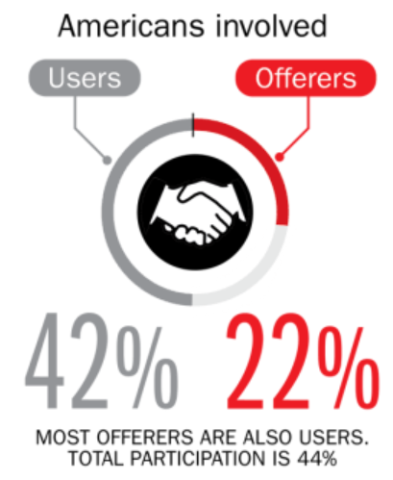
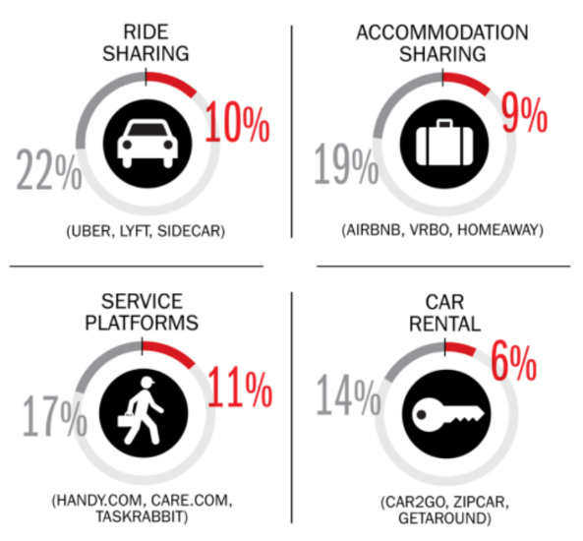
Percent of Americans Who Have Engaged in the “Gig/Sharing Economy” by Transaction
Drivers have significant WC exposures
Service platforms have the most direct link to WC; 11% of Americans have offered their services
About 22% of Americans have offered services in the sharing economy.
Sources: The SelfEmployed.com accessed at https://www.theselfemployed.com/gig-economy/infographic-inside-the-new-economy/ based on a poll by Time magazine, Bursten-Marsteller and The Aspen Institute; Insurance Information Institute.

Slide 59
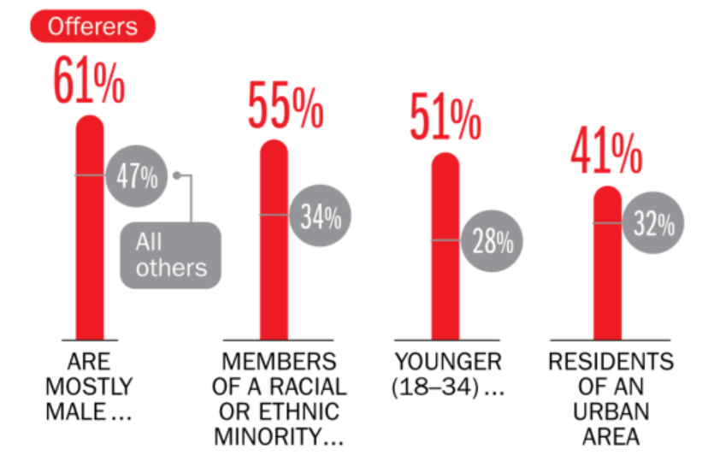
Americans Who Offer Services in the Sharing/Gig Economy Are Statistically More Prone to Workplace Injury
Young, urban minority males are the most likely to offer their services in the sharing economy.
Sources: The SelfEmployed.com accessed at https://www.theselfemployed.com/gig-economy/infographic-inside-the-new-economy/ based on a poll by Time magazine, Bursten-Marsteller and The Aspen Institute; Insurance Information Institute.

Slide 60
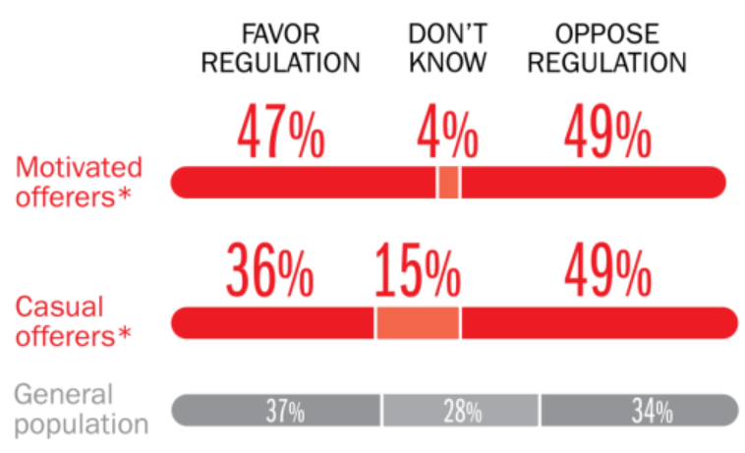
Opinions Are Split on Whether the Sharing Economy Needs More Regulation
The most frequent offerers of services though online platforms are equally divided over the need for more regulation
Sources: The SelfEmployed.com accessed at https://www.theselfemployed.com/gig-economy/infographic-inside-the-new-economy/ based on a poll by Time magazine, Bursten-Marsteller and The Aspen Institute; Insurance Information Institute.

Slide 61
THE ‘INTERNET OF THINGS’
Capturing Economic Value Amid a Shifting Insurer Value Chain
61

Slide 62
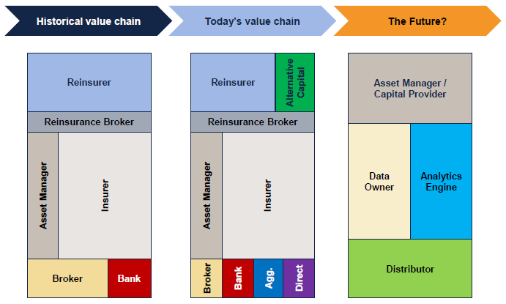
The Internet of Things and the Insurance Industry Value Chain
The Insurance Industry Value Chain Is Changing for Many Reasons
Source: Willis Capital Markets & Advisory; Insurance Information Institute.
62
12/01/09 - 9pm
eSlide – P6466 – The Financial Crisis and the Future of the P/C
Notes:
62

Slide 63
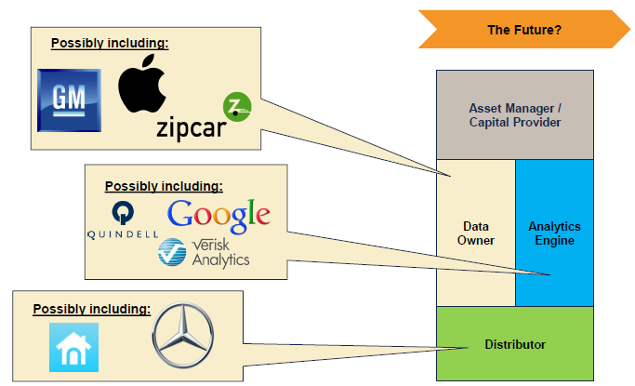

The Internet of Things and the Insurance Industry Value Chain
Who owns the data? Where does It flow? Who does the analytics? Who is the capital provider?
Source: Willis Capital Markets & Advisory; Insurance Information Institute.
63
12/01/09 - 9pm
eSlide – P6466 – The Financial Crisis and the Future of the P/C
Notes:
63

Slide 64
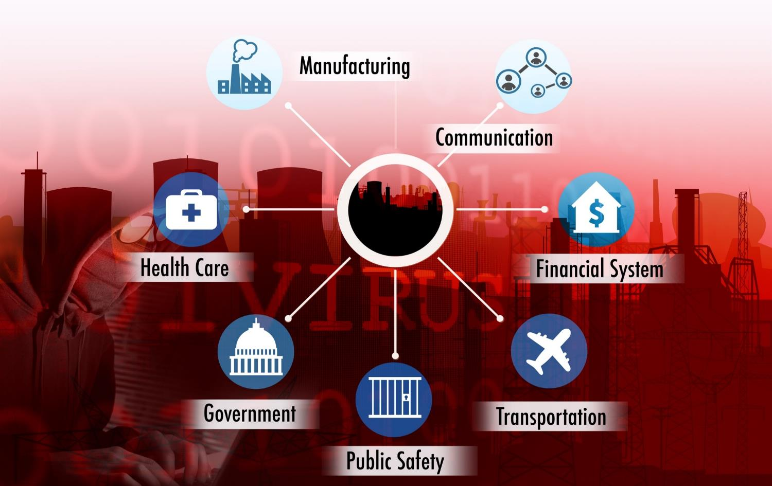
The ‘Internet of Things’ and ‘The Insurance-Net of Things’

Slide 65
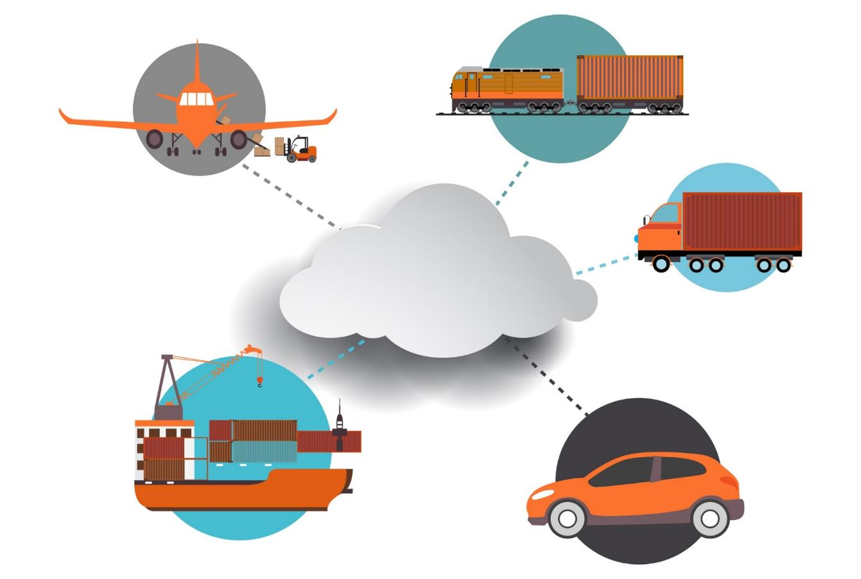
The Insurance Industry’s Future Is in the Cloud…
Rail & Public
Transport
Aviation
The Cloud
Trucking & Fleet Vehicles
Marine Transport
Private Motor Vehicles

Slide 66

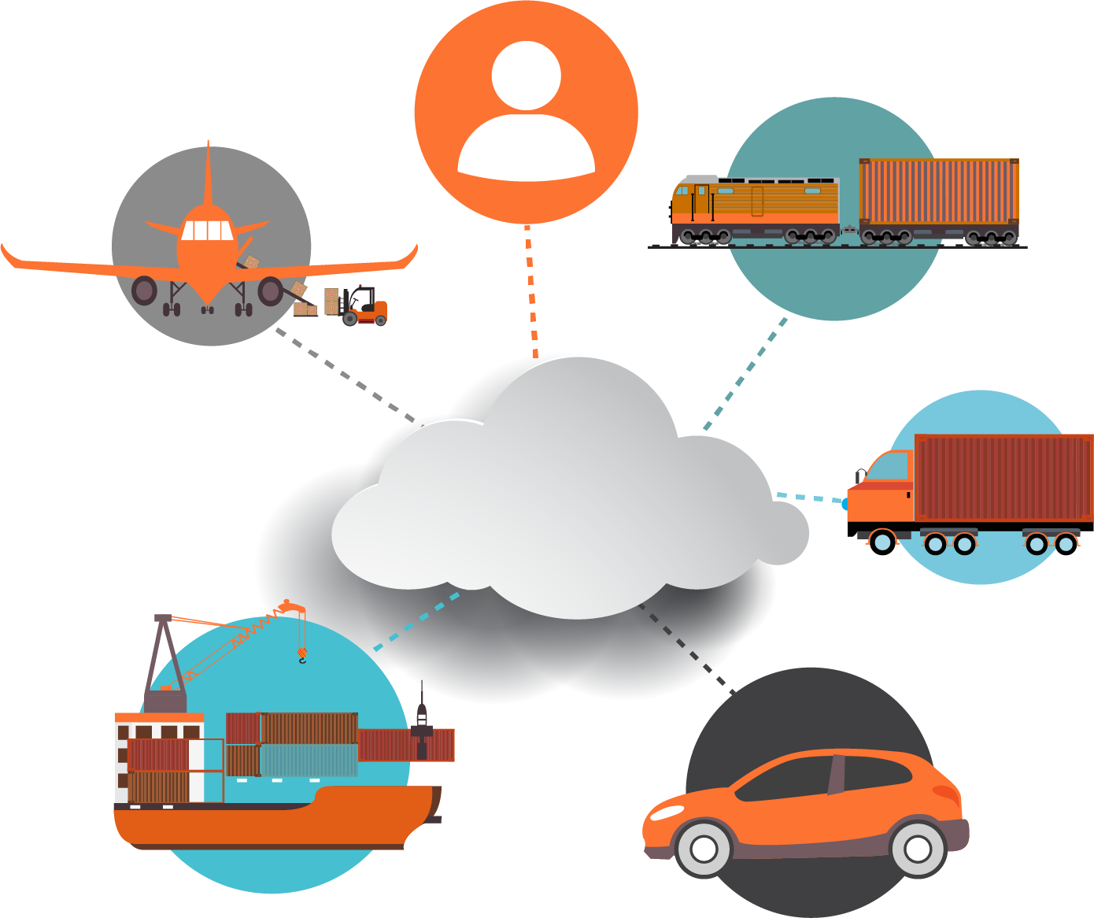
The Insurance Industry’s Future Is in the Cloud…
Human Beings
Rail & Public
Transport
Aviation
Trucking & Fleet Vehicles
The Cloud
Marine Transport
Private Motor Vehicles

Slide 67
Wearables and Beyond…
Where The Internet of Things
Meets Health, Disability and Workers Compensation Insurance
67

Slide 68
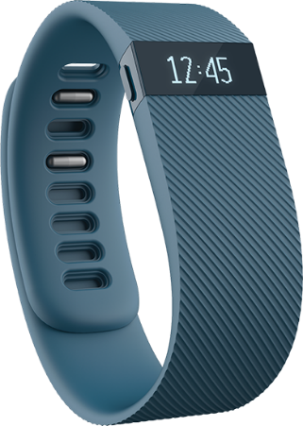
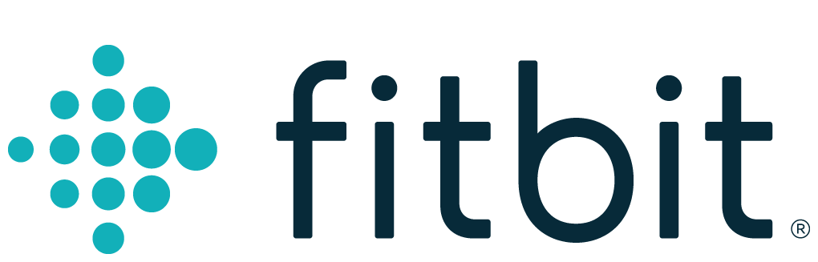
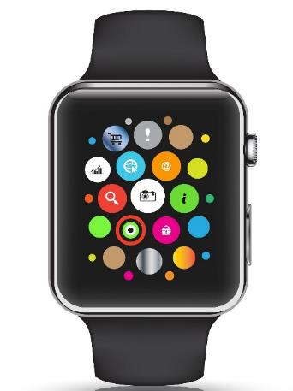

Wearables Show Significant Potential to Reduce Workplace Injury, Death
Wearables Today Can Monitor:
  Location
  Heart rate
  Temperature
  Steps/Exertion
  Sweat
  Sleep
In the Near Future Could Monitor:
  Glucose level
  Oxygen levels
  Pain
  Nausea
68
12/01/09 - 9pm
eSlide – P6466 – The Financial Crisis and the Future of the P/C
Notes:
68

Slide 69
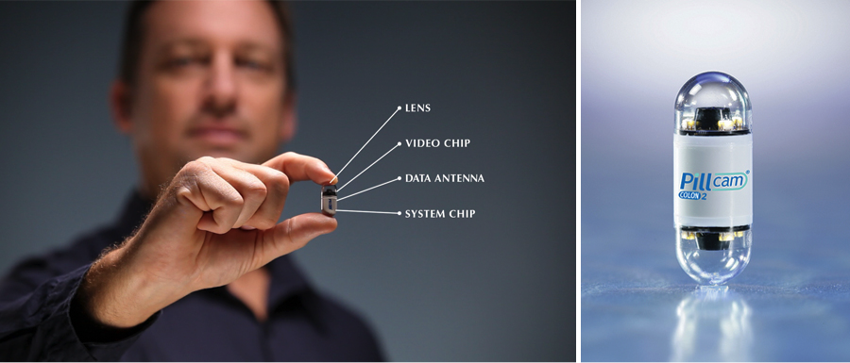
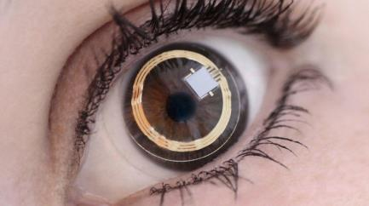
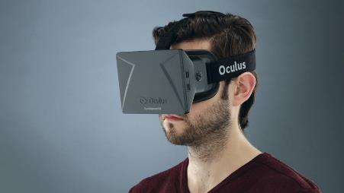
Beyond Wearables: Ingestibles and Implantables, VR Could Have Big Impacts Too
Ingestibles:
  Body chemistry
  View malignancies
  Detect diseases
  Medication adherence
Implantables
Smart Fabrics
Virtual Reality
  Computer simulated reality
Augmented Reality
  Real world environment supplemented by computer generated inputs
69
12/01/09 - 9pm
eSlide – P6466 – The Financial Crisis and the Future of the P/C
Notes:
69

Slide 70
A Few Outstanding Issues (Among Many)
Worker Status
  Are workers independent contractors or employees?
Privacy
  Where is the dividing line between data that is useful or necessary for the conduct of business and truly private information?
Security
  How will data be protected?
  How will the inevitable breaches be managed?
Data Ownership and Portability
  Who owns the data? Is the data portable?
Insurance
  Need for evolving property and liability coverages
  Concern over disintermediation
70
12/01/09 - 9pm
eSlide – P6466 – The Financial Crisis and the Future of the P/C
Notes:
70

Slide 71

A NEST Case Study
Nest: A Leader in the “Internet of Things”
Collision Course or Cooperation with the Insurance Industry?
71

Slide 72


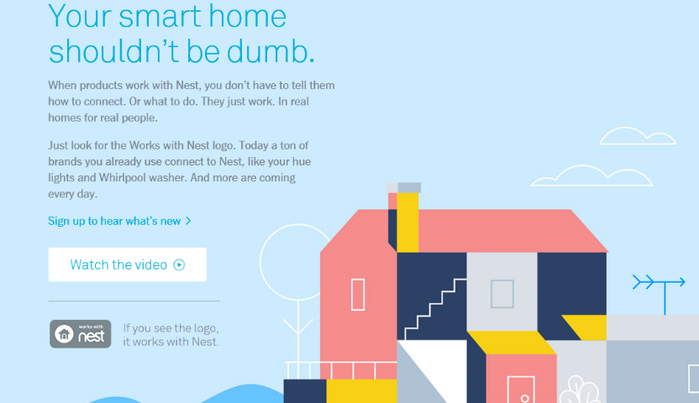
Telematics for Your Home:
The Internet of Things
The home is the next frontier for telematics
Rapidly becoming a crowded space
How and with whom will insurers partner?
Can control increasing array of household systems remotely
  Heat, A/C
  Fire, CO detection
  Security Systems
  Cameras/Monitors
  Appliances
  Lighting
Technology is adaptive
  Uses sensors and algorithms to learn about you
72
12/01/09 - 9pm
eSlide – P6466 – The Financial Crisis and the Future of the P/C
Notes:
72

Slide 73
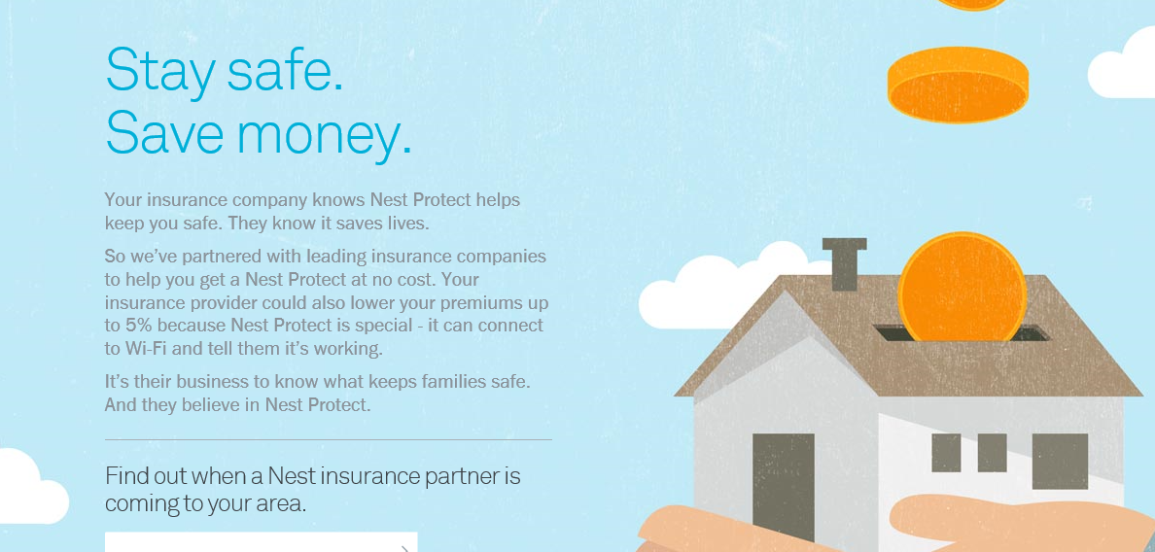
Partnerships with Insurers: Selling Safety and Savings Simultaneously
Nest is actively seeking to partner with insurers. As of Jan. 10, 2016, Nest listed 2 insurance partners offering discounts in a number of states
Source: https://nest.com/insurance-partners/ accessed 1/10/16; Insurance Information Institute research.
73
12/01/09 - 9pm
eSlide – P6466 – The Financial Crisis and the Future of the P/C
Notes:
73

Slide 74
INSURANCE TECHNOLOGY:
FIN TECH ZEROES IN
Number and Value of Deals Is Increasing
In Search of the Elusive Insurance ‘Unicorn’
74

Slide 75
Insurance Technology Financing Trend: Change Is Coming
Insurance tech deals reached a new record in 2016:Q1
($ Millions)
Investment in insurance tech is rising
Source: CB Insights at https://www.cbinsights.com/blog/insurance-tech-overview-q1-2016/; Insurance Information Institute.

Slide 76
Insurance Tech Activity by Area of Interest, 2013 – 2016:Q1
With the ACA in the rear view window, non-health insurance tech accounts for the majority of investment
(Percent)
Silicon Valley and the venture capital community have the insurance industry in their sights. Most will fail. Some will succeed.
Source: CB Insights at https://www.cbinsights.com/blog/insurance-tech-overview-q1-2016/; Insurance Information Institute.

Slide 77
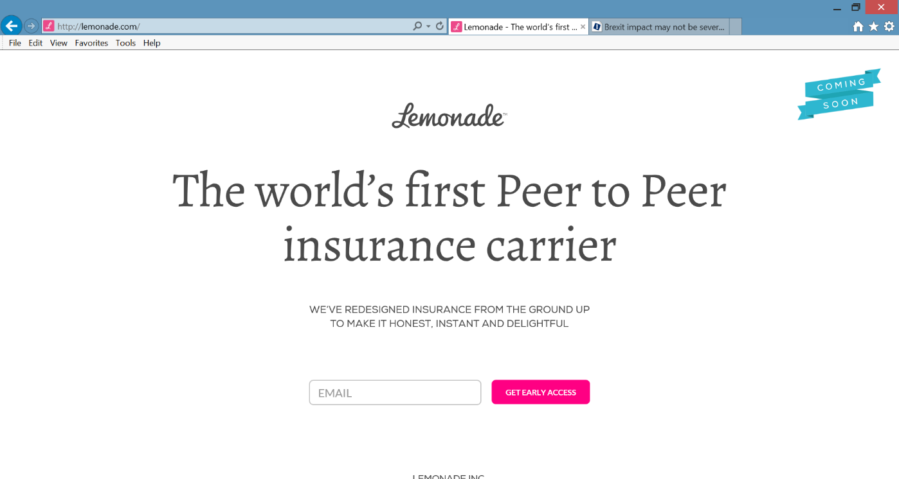
Lemonade: Peer-to-Peer (P2P) Insurance
Source: Lemonade.com accessed June 24, 2016.
77

Slide 78
Lemonade: Sour Words About Insurance
Daniel Schreiber here, with updates from Lemonade.
I’m thrilled to report that a few days ago, by unanimous vote of our board and shareholders, Lemonade became a Public Benefit Corporation, and was also awarded provisional ‘B-Corp’ certification. Both are firsts for an insurance carrier, and are points of tremendous pride for our team.
Rebuilding insurance as a social good, rather than a necessary evil, is now part of our legal mission. Our Chief Behavioral Officer, Professor Dan Ariely, says that “If you tried to create a system to bring out the worst in humans, it would look a lot like the insurance of today.” Working in partnership with nonprofits, and baking giving-back into our business model, holds the promise of a better insurance experience, and a more valuable insurance company.
In other news, I’m happy to say that we’re putting finishing touches on our product and will be ready to launch in New York within weeks. The final step is for us to get our license, and if all goes to plan, we’ll have that shortly.
Be sure to follow us on Twitter, Facebook, and LinkedIn to stay in the know.
Until next time,
Daniel
@daschreiber
78
Source: Email from Lemonade CEO Danieal Schreibeir, May 17, 2016.

Slide 79
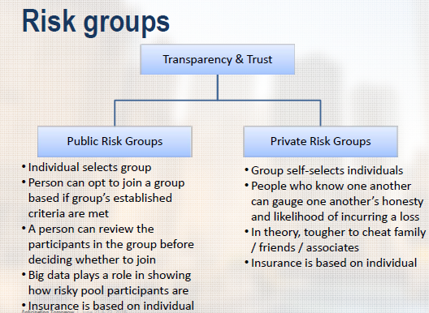
Risk Groups in P2P Structures
P2P model is predicated in part that view that individuals who know one another are less likely to commit fraud, etc.
Source: “UberX-ing Insurance : Is Peer-to-Peer Insurance Viable?”, presentation by Jay Sarzen, Aite Group at DrinkerBiddle Insurance Conference, June 21, 2016.
79

Slide 80
Distribution Trends
Distribution by Channel Type Continues to Evolve Around the World
80

Slide 81
All P/C Lines Distribution Channels,
Direct vs. Independent Agents, 1983-2014
Independent agents steadily lost market share from the early 1980s through the early 2000s across all P/C lines, made some games in the mid-2000s, but then lost share again in the late 2000s. Loss rate has slowed in in the 2010s. Direct channels include exclusive agency companies, direct marketers and direct sales (e.g., internet)
Source: Insurance Information Institute; based on data from Conning and A.M. Best.

Slide 82
Personal Lines Distribution Channels, Direct vs. Independent Agents, 1972-2014
Independent agents have lost significant personal lines market share since the early 1970s. Although the trend slowed from 2000-2007, it may be accelerating again.
Source: Insurance Information Institute; based on data from Conning and A.M. Best.

Slide 83
Millennials and Insurance
Actively Disengaged or the Vanity of Youth?
83

Slide 84
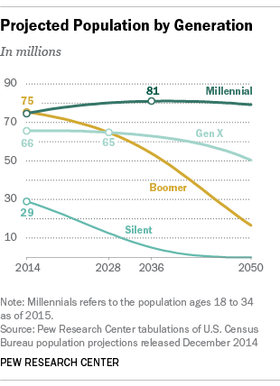
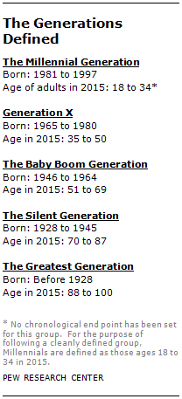
2015: Millennials Overtook Baby Boomers as the Largest Generation
There were 75.3 million Millennials in 2015, overtaking for the first time the Baby Boomers who totaled 74.9 million
Source: “This Year Millennials Will Overtake Baby Boomers,” Pew Research Center, January 15, 2015 accessed at http://www.pewresearch.org/fact-tank/2015/01/16/this-year-millennials-will-overtake-baby-boomers/ .

Slide 85
Channel Preference for Home/Rental Insurance, by Age Category
2/3 of Millennials purchase dwelling coverage directly from the company
How much of this is a generational preference vs. having very simple insurance needs?
Sources: “5 Reasons Millennials Aren’t Buying Insurance from Local Agents,” Eric Narisco, Sept. 16, 2015 from PropertyCasualty360.com based on a study by Effective Coverage and performed by ORC International.

Slide 86
Insurance Customers: Engagement
by Generation
Millennials are the least likely to be engaged with their insurer
Millennials are more twice as likely to buy online
Millennial’s families influence their choice in insurers
Sources: Gallup: “Insurance Companies Have a Big Problem with Millennials,” Daniela Yu and Chris Portera, March 5, 2015.

Slide 87
Insurance Customers: Key Drivers of Engagement for Millennials
Data security and ease of making coverage changes are keys to successful engagement with Millennial insurance buyers
Sources: Gallup: “Insurance Companies Have a Big Problem with Millennials,” Daniela Yu and Chris Portera, March 5, 2015

Slide 88
Millennials as Employees
A Talent Gap Looms
Insurance Industry Employees Are Older than in Most Industries
88

Slide 89

The Economy, Millennials and Careers in the Insurance Industry
Some 400,000 job openings in the insurance industry through 2020 will need to be filled, mostly by Millennials
The number of professionals 55 and older is 30 percent higher in the insurance industry than the rest of the economy
The number of insurance professionals over 55 has risen 74 percent during the past 10 years.
I.I.I. created a video featuring actual Millennials who work for I.I.I. member organizations
Also created individual videos profiling each person featured
Free for you to use!
89
12/01/09 - 9pm
eSlide – P6466 – The Financial Crisis and the Future of the P/C
Notes:
89

Slide 90
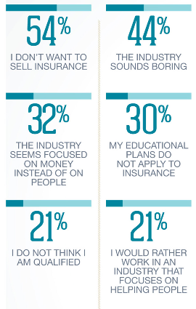
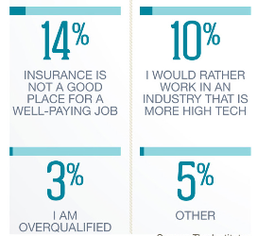
Reasons Millennials Give for Not Wanting to Work in the Insurance Industry
Let’s Change Their Mind!
Sources: The Institutes.
90
12/01/09 - 9pm
eSlide – P6466 – The Financial Crisis and the Future of the P/C
Notes:
90

Slide 91
Insurance Information Institute Online:
www.iii.org
Thank you for your time
and your attention!
Twitter: twitter.com/bob_Hartwig

