Slide 1
Insurance Industry Overview and Outlook:
Trends, Challenges and Opportunities
2016 Coastal Risk Retreat
East Carolina University
April 6, 2016
Download at www.iii.org/presentations
James Lynch, FCAS MAAA, Vice President & Chief Actuary
Insurance Information Institute ♦ 110 William Street ♦ New York, NY 10038
Tel: 212.346.5533 ♦ Cell: 917.359.3908 ♦ jamesl@iii.org ♦ www.iii.org

Slide 2
Insurance Industry:
Financial Update & Outlook
2015 Was a Reasonably Good Year and Similar to 2014
2016: Could Be Similar to 2015
2

Slide 3
P/C Industry Net Income After Taxes
1991–2015E
$ Millions
2005 ROE*= 9.6%
2006 ROE = 12.7%
2007 ROE = 10.9%
2008 ROE = 0.1%
2009 ROE = 5.0%
2010 ROE = 6.6%
2011 ROAS¹ = 3.5%
2012 ROAS¹ = 5.9%
2013 ROAS¹ = 10.2%
2014 ROAS¹ = 8.4%
2015E ROAS = 8.8%
Net income in 2015 is on par with 2014
ROE figures are GAAP; ¹Return on avg. surplus. Excluding Mortgage & Financial Guaranty insurers yields a 8.2% ROAS in 2014, 9.8% ROAS in 2013, 6.2% ROAS in 2012, 4.7% ROAS for 2011, 7.6% for 2010 and 7.4% for 2009; 2015E is annualized figure based actual figure through Q3 of $44.0
Sources: A.M. Best, ISO; Insurance Information Institute

Slide 4
Profitability Peaks & Troughs in the P/C Insurance Industry, 1975 – 2015E
ROE
1977:19.0%
History suggests next ROE peak will be in 2016-2017
1987:17.3%
10 Years
1997:11.6%
2006:12.7%
10 Years
2015E: 8.8%
2013 9.8%
9 Years
2014 8.2%
1975: 2.4%
1984: 1.8%
1992: 4.5%
2001: -1.2%
*Profitability = P/C insurer ROEs. 2011-14 figures are estimates based on ROAS data. Note: Data for 2008-2014 exclude mortgage and financial guaranty insurers.
Source: Insurance Information Institute; NAIC, ISO, A.M. Best, Conning

Slide 5
ROE: Property/Casualty Insurance by Major Event, 1987–2015E
(Percent)
P/C Profitability Is Both by
Cyclicality and Ordinary Volatility
Modestly higher CATs
Katrina, Rita, Wilma
Low CATs
Sept. 11
Hugo
Lowest CAT Losses in
15 Years
4 Hurricanes
Sandy
Andrew
Record Tornado Losses
Northridge
Financial Crisis*
* Excludes Mortgage & Financial Guarantee in 2008 – 2014.
Sources: ISO, Fortune; Insurance Information Institute.

Slide 6
Insured Catastrophe Losses
2013/14 and 2015 Experienced Below Average CAT Activity After Very High CAT Losses in 2011/12
Winter Storm Losses Far Above Average in 2014 and 2015
6

Slide 7
U.S. Insured Catastrophe Losses
($ Billions, $ 2015)
2012 was the 3rd most expensive year ever for insured CAT losses
2013/14/15 Were Welcome Respites from 2011/12, among the Costliest Years for Insured Disaster Losses in US History. Longer-term Trend is for more—not fewer—Costly Events
$15B in insured CAT losses though 12/31/15 (est.)
*Estimate through 12/31/15 in 2015 dollars.
Note: 2001 figure includes $20.3B for 9/11 losses reported through 12/31/01 ($25.9B 2011 dollars). Includes only business and personal property claims, business interruption and auto claims. Non-prop/BI losses = $12.2B ($15.6B in 2011 dollars.)
Sources: Property Claims Service/ISO; Insurance Information Institute.
7
12/01/09 - 9pm
eSlide – P6466 – The Financial Crisis and the Future of the P/C
Notes:
7

Slide 8
Combined Ratio Points Associated with Catastrophe Losses: 1960 – 2015E*
Avg. CAT Loss Component of the Combined Ratio by Decade
1960s: 1.04 1970s: 0.85 1980s: 1.31 1990s: 3.39 2000s: 3.52 2010s: 5.46*
Catastrophe losses as a share of all losses reached a record high in 2011
Combined Ratio Points
The Catastrophe Loss Component of Private Insurer Losses Has Increased Sharply in Recent Decades
*2010s represent 2010-2015E.
Notes: Private carrier losses only. Excludes loss adjustment expenses and reinsurance reinstatement premiums. Figures are adjusted for losses ultimately paid by foreign insurers and reinsurers.
Source: ISO (1960-2009); A.M. Best (2010-15E) Insurance Information Institute.

Slide 9
Top 16 Most Costly Disasters in U.S. History—Katrina Still Ranks #1
(Insured Losses, 2014 Dollars, $ Billions)
Storm Sandy in 2012 was the last mega-CAT to hit the US
Includes Tuscaloosa, AL, tornado
Includes Joplin, MO, tornado
12 of the 16 Most Expensive Events in US History Have Occurred Since 2004
Sources: PCS; Insurance Information Institute inflation adjustments to 2014 dollars using the CPI.

Slide 10
Inflation Adjusted U.S. Catastrophe Losses by Cause of Loss, 1995–2014¹
Wind/Hail/Flood (3), $21.4
Fires (4), $6.0
Winter storm losses were much above average in 2014/15 are will push this share up
Other (5), $0.2
Insured cat losses from 1995-2014 totaled $395.6B, an average of $19.8B per year or $1.65B per month
Geological Events, $0.5
Terrorism, $24.5
Winter Storms, $26.9
Hurricanes & Tropical Storms, $161.2
Tornado share of CAT losses is rising
Wind losses are by far cause the most catastrophe losses, even if hurricanes/TS are excluded.
Events Involving Tornadoes (2), $154.9
Catastrophes are defined as events causing direct insured losses to property of $25 million or more in 2014 dollars.
Excludes snow.
Does not include NFIP flood losses
Includes wildland fires
Includes civil disorders, water damage, utility disruptions and non-property losses such as those covered by workers compensation.
Source: ISO’s Property Claim Services Unit.

Slide 11
Number of National Flood Insurance Program Policies in Force at Year-End, 1980-2015*
(millions)
The number of NFIP policies in force has plunged by 549,000 or 9.6% since 2009, even as coastal development surges and sea levels rise
Source: National Flood Insurance Program.
* As of July, 2015

Slide 12
Take-Up Rates for Various Types of Insurance in the U.S.
Take-Up Rate
Take-up rates vary widely by type of coverage
Sources: CA Earthquake (WSJ, http://www.wsj.com/articles/california-pushes-homeowners-to-insure-against-earthquakes-1440980138 ); Flood and Renters (I.I.I. June 2015 Pulse Survey); Cyber (Advisen, 2015); Terrorism (Marsh Global Analytics, 2014 Terrorism Risk Insurance Report, April 2014; data for 2013); Pvt. Passenger Auto (Insurance Research Council, Uninsured Motorists, 2014 Edition, data for 2012); Home and Workers Comp (I.I.I. estimates); Insurance Information Institute research.

Slide 13
Policyholder Surplus,
2006:Q4–2015:Q4E
($ Billions)
2007:Q3
Pre-Crisis Peak
Drop due to near-record 2011 CAT losses
Surplus as of 12/31/15 stood at a near-record high $670B
The industry now has $1 of surplus for every $0.73 of NPW,
close to the strongest claims-paying status in its history.
2010:Q1 data includes $22.5B of paid-in capital from a holding company parent for one insurer’s investment in a non-insurance business .
The P/C insurance industry entered 2016
in very strong financial condition.
Sources: ISO, A.M .Best.
13
12/01/09 - 9pm
eSlide – P6466 – The Financial Crisis and the Future of the P/C
Notes:
13

Slide 14
Net Premium Growth (All P/C Lines): Annual Change, 1971-2016
(Percent)
1975-78
1984-87
2000-03
Hard Market: Prices Rise Faster Than Economic Growth.
Nominal GDP Growth
In Soft Market, Premium Grows Slower Than Economy.
2015E: 2.7%
2014: 4.3%
2013: 4.4%
2012: +4.4%
2015E: Estimate; 2015F: Forecast. Shaded areas denote “hard market” periods
Sources: A.M. Best, St. Louis Federal Reserve (Fred), Blue Chip Economic Indicators (January 2016).

Slide 15
P/C Insurance Industry
Combined Ratio, 2001–2015 (Est.)*
Heavy Use of Reinsurance Lowered Net Losses
Relatively Low CAT Losses, Reserve Releases
Higher CAT Losses, Shrinking Reserve Releases, Toll of Soft Market
As Recently as 2001, Insurers Paid Out Nearly $1.16 for Every $1 in Earned Premiums
Loss Trends Outstrip Rate Changes
Relatively Low CAT Losses, Reserve Releases
Avg. CAT Losses, More Reserve Releases
Sandy Impacts
Best Combined Ratio Since 1949 (87.6)
Cyclical Deterioration
Lower CAT Losses
* Excludes Mortgage & Financial Guaranty insurers 2008--2014. Including M&FG, 2008=105.1, 2009=100.7, 2010=102.4, 2011=108.1; 2012:=103.2; 2013: = 96.1; 2014: = 97.0.
Sources: A.M. Best, ISO; Figure for 2010-2015E is from A.M. Best P&C Review and Preview, Feb. 16, 2016.

Slide 16
A 100 Combined Ratio Isn’t What It
Once Was: Investment Impact on ROEs
A combined ratio of about 100 generates an ROE of ~7.0% in 2012/13, ~7.5% ROE in 2009/10,
10% in 2005 and 16% in 1979
Combined Ratio / ROE
Lower CATs helped ROEs in 2013
Combined Ratios Must Be Lower in Today’s Depressed
Investment Environment to Generate Risk Appropriate ROEs
* 2008 -2015 figures are return on average surplus and exclude mortgage and financial guaranty insurers. 2014 combined ratio including M&FG insurers is 97.0; 2013 = 96.1; 2012 =103.2, 2011 = 108.1, ROAS = 3.5%.
Source: Insurance Information Institute from A.M. Best and ISO Verisk Analytics data.

Slide 17
RNW All Lines, 2005-2014 Average:
Highest 25 States
(Percent)
The most profitable states over the past decade are widely distributed geographically, though none are in the Gulf region
Profitability Benchmark: All P/C
US: 7.7%
Source: NAIC; Insurance Information Institute.

Slide 18
RNW All Lines, 2005-2014 Average:
Lowest 25 States
(Percent)
Some of the least profitable states over the past decade were hit hard by catastrophes
Source: NAIC; Insurance Information Institute.

Slide 19
INVESTMENTS:
THE NEW REALITY
Investment Performance is a Key Driver of Profitability
Depressed Yields Will Necessarily Influence Underwriting & Pricing
19

Slide 20
S&P 500 Index Returns, 1950 – 2016*
Annual Return
Stock market is off to its worst start in years but volatility is endemic to stock markets—and may be increasing—but there is no persistent downward trend over long periods of time
Fed Raises Rate
Tech Bubble Implosion
2016*:
+0.14%
Energy Crisis
Financial Crisis
*Through March 28, 2016.
Source: NYU Stern School of Business: http://pages.stern.nyu.edu/~adamodar/New_Home_Page/datafile/histretSP.html Ins. Info. Inst.

Slide 21
Property/Casualty Insurance Industry Investment Income: 2000-2015E¹
Investment earnings are still below their 2007 pre-crisis peak
($ Billions)
Due to persistently low interest rates,
investment income fell in 2012, 2013 and 2014.
¹ Investment gains consist primarily of interest and stock dividends. *2015 figure is estimated based on annualized data through Q3.
Sources: ISO; Insurance Information Institute.

Slide 22
Distribution of Invested Assets: P/C Insurance Industry, 2014
Total Invested Assets = $1.5 Trillion
Source: Insurance Information Institute Fact Book 2016, A.M. Best.

Slide 23
U.S. Treasury Security Yields:
A Long Downward Trend, 1990-2016*
Yields on 10-Year U.S. Treasury Notes have been essentially below 5% for a full decade.
Despite the Fed’s December 2015 rate hike, yield remain low though short-term yields have seen some gains
Since roughly 80% of P/C bond/cash investments are in 10-year or shorter durations, most P/C insurer portfolios will have low-yielding bonds for years to come.
*Monthly, constant maturity, nominal rates, through February 2016.
Sources: Federal Reserve Bank at http://www.federalreserve.gov/releases/h15/data.htm. National Bureau of Economic Research (recession dates); Insurance Information Institute.
23
12/01/09 - 9pm
eSlide – P6466 – The Financial Crisis and the Future of the P/C
Notes:
23

Slide 24
Interest Rate Forecasts: 2015-2021
Yield (%)
3-Month Treasury
10-Year Treasury
The end of the Fed’s QE program in 2014 and its first rate increase in Dec. 2015 have yet to push longer-term yields much higher
A full normalization of interest rates is unlikely until 2019, more than a decade after the onset of the financial crisis.
Sources: Blue Chip Economic Indicators (3/16 for 2016 and 2017; for 2018-2021 10/15 issue); Insurance Info. Institute.

Slide 25
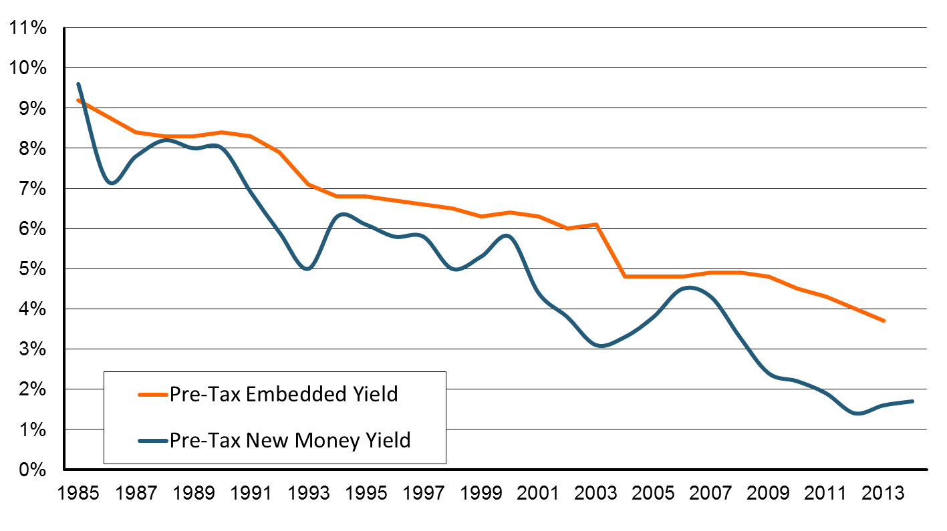
The Falling Investment Curve
What Insurers Earn on Current Portfolio.
What Insurers Earn on the Next Dollar They Invest
The Long, Slow Decline In Rates Will Continue to Drag on Investment Portfolios Even After Rates Start Rising.
Source: National Council on Compensation Insurance.
25
12/01/09 - 9pm
eSlide – P6466 – The Financial Crisis and the Future of the P/C
Notes:
25

Slide 26
Loss and Inflation Trends
Frequency/Severity, Long Dormant, May Be Returning
26
Notes:
26

Slide 27
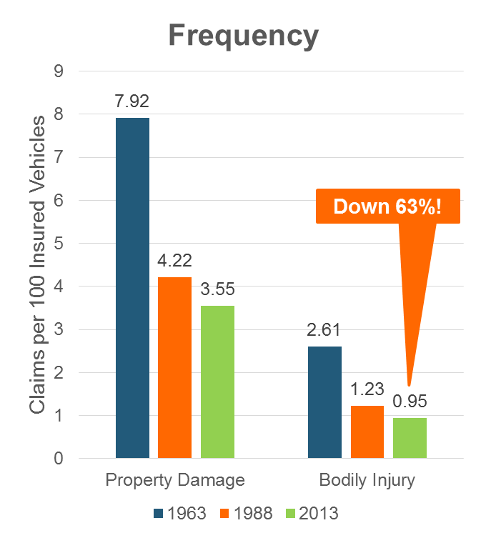
The Norm in Auto Insurance:
Frequency Falls, Severity Rises
Safer Cars . . . .
. . . That Cost More to Repair.
Down 55%!
Sources: Insurance Institute for Highway Safety, Insurance Services Office, Insurance Information Institute.

Slide 28
Collision Coverage: Severity & Frequency Trends Are Both Higher in 2015*
Annual Change, 2005 through 2015*
The Recession, High Fuel Prices Helped Temper Frequency and Severity, But this Trend Has Clearly Reversed, Consistent with Experience from Past Recoveries
*2015 figure is for the 4 quarters ending with 2015:Q3.
Source: ISO/PCI Fast Track data; Insurance Information Institute

Slide 29
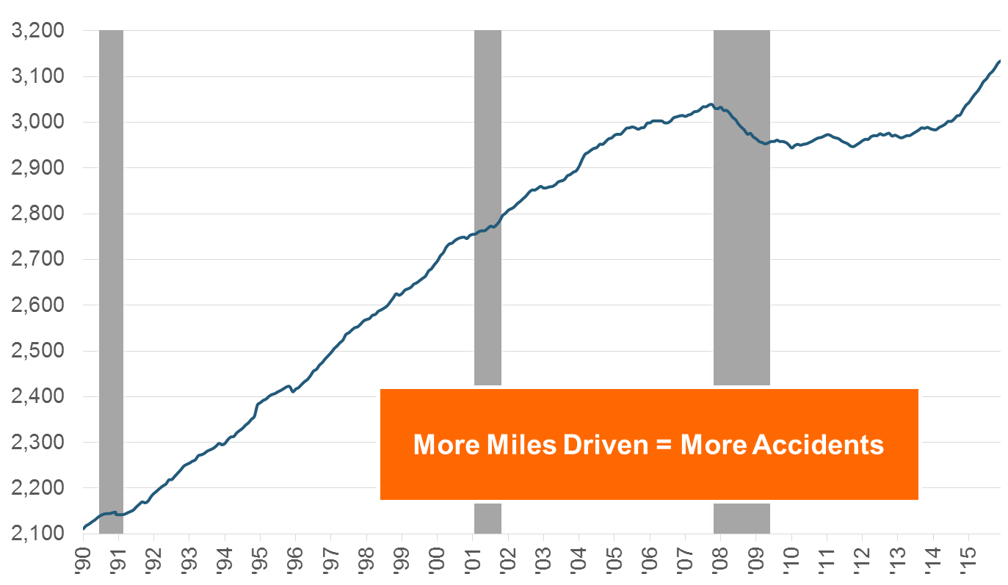
Frequency: Miles Driven is Climbing
Billions of Miles
In Past 18 Months, Miles Driven Have Soared – More Accidents, More Exposures
*Moving 12-month total. Data through July 2015.
Note: Recessions indicated by gray shaded columns.
Sources: Federal Highway Administration (http://www.fhwa.dot.gov/policyinformation/travel_monitoring/tvt.cfm);
National Bureau of Economic Research (recession dates); Insurance Information Institute.
29
12/01/09 - 9pm
eSlide – P6466 – The Financial Crisis and the Future of the P/C
Notes:
29

Slide 30
Frequency: As More People Work,
They Get in More Accidents
Overall Collision Claims Per 100 Insured Vehicles
Number Employed,
Millions
Recession
When people are out of work, they drive less. When they get jobs,
they drive to work, helping drive claim frequency higher.
Sources: Seasonally Adjusted Employed from Bureau of Labor Statistics; Rolling Four-Qtr Avg. Frequency from Insurance Services Office; Insurance Institute for Highway Safety; Insurance Information Institute.
30
12/01/09 - 9pm
eSlide – P6466 – The Financial Crisis and the Future of the P/C
Notes:
30

Slide 31
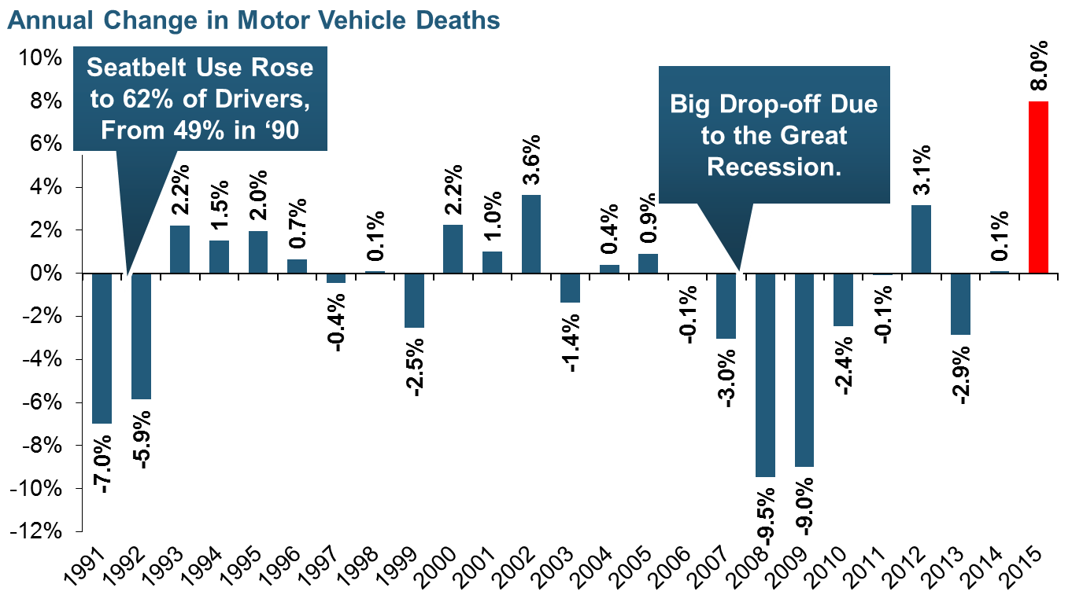
Severity: Driving Fatalities Are Rising
Driving Has Been Getting Safer For Decades, But Recent Trend Is Discouraging—38,300 Deaths in 2015
Sources: National Safety Council, Insurance Information Institute.

Slide 32
Severity: Chg in Auto Fatalities by State
2015 vs. 2014
Fatalities in Southeast Rising Faster Than USA as a Whole
SOURCE: Estimates from National Safety Council.

Slide 33
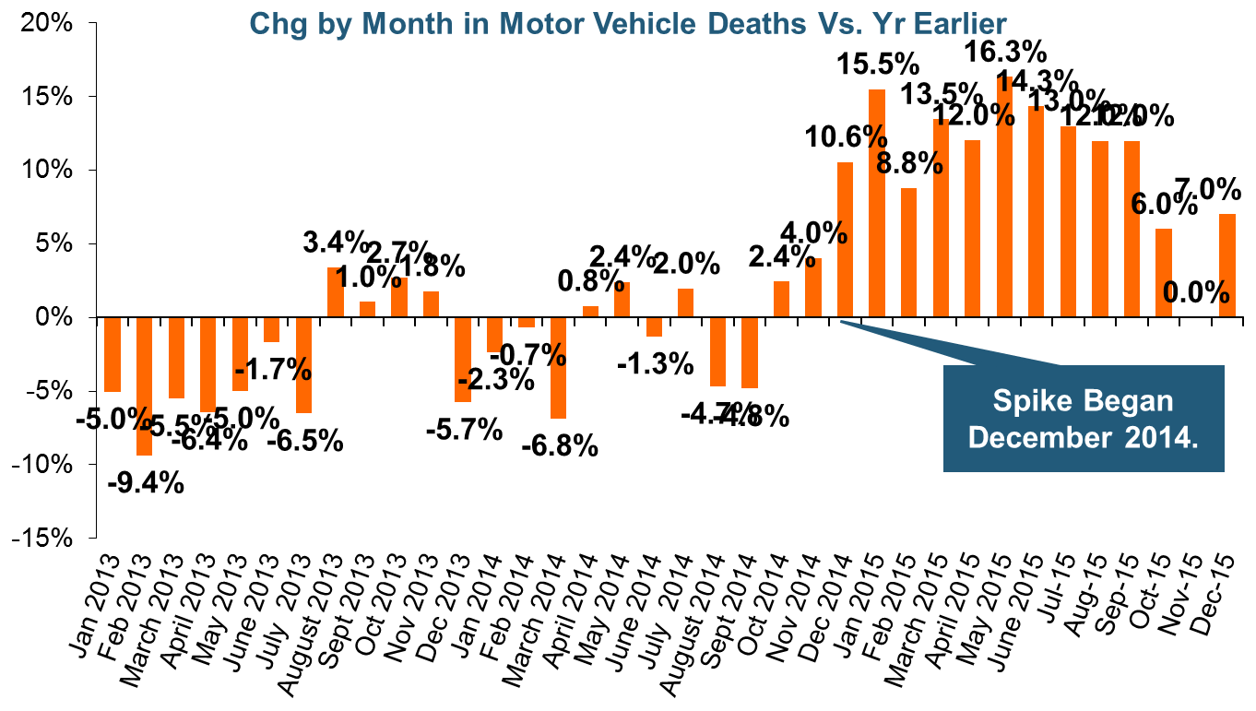
Severity: Driving Fatalities Are Rising
On Track for Most Auto Fatalities Since 2007.
Sources: National Safety Council, Insurance Information Institute.

Slide 34
Severity: Loss Trend vs. Inflation
Annual Change, 2005 through 2014
Trend, CPI Converged Around 2011. . .
Normally Trend > CPI
. . . And Starting to Diverge Again
If Loss Trends Return to the Norm, Upward Pressure Will Be Applied to Loss Costs.
Source: Towers Watson Claim Cost Index, Insurance Information Institute.

Slide 35
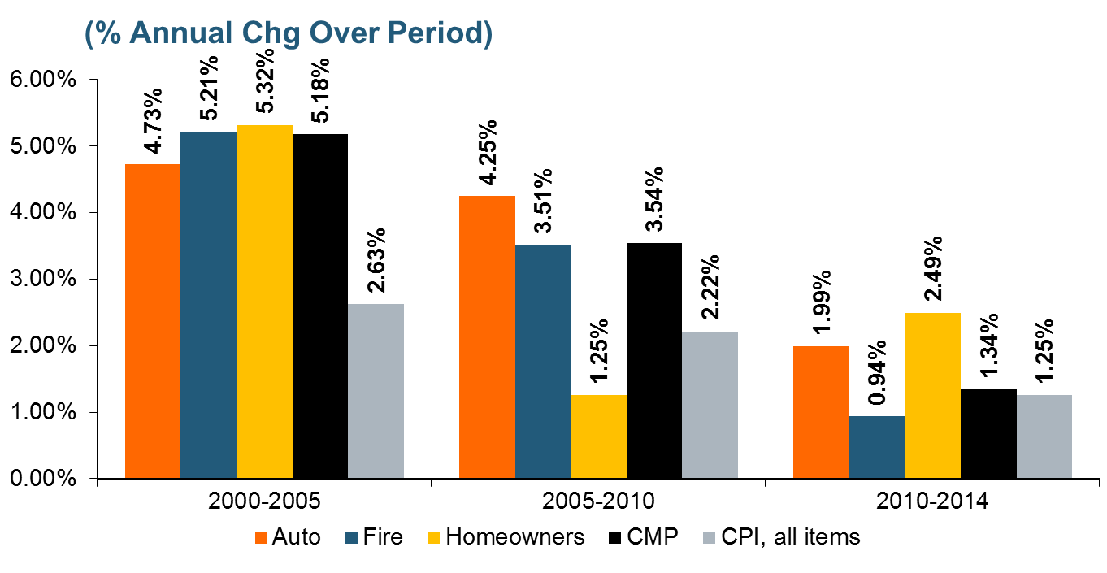
Loss Trends vs. CPI: Not Just Auto
In Recent Years, Claim Costs Have Risen at About the Inflation Rate. If We Return to the Norm, Claim Costs Will Rise.
Source: Insurance Information Institute calculation from Towers Watson data.

Slide 36
RATES & LOSS TRENDS
Commercial Lines Roughly Flat; Personal Auto Rates Feeling Upward Pressure
36

Slide 37
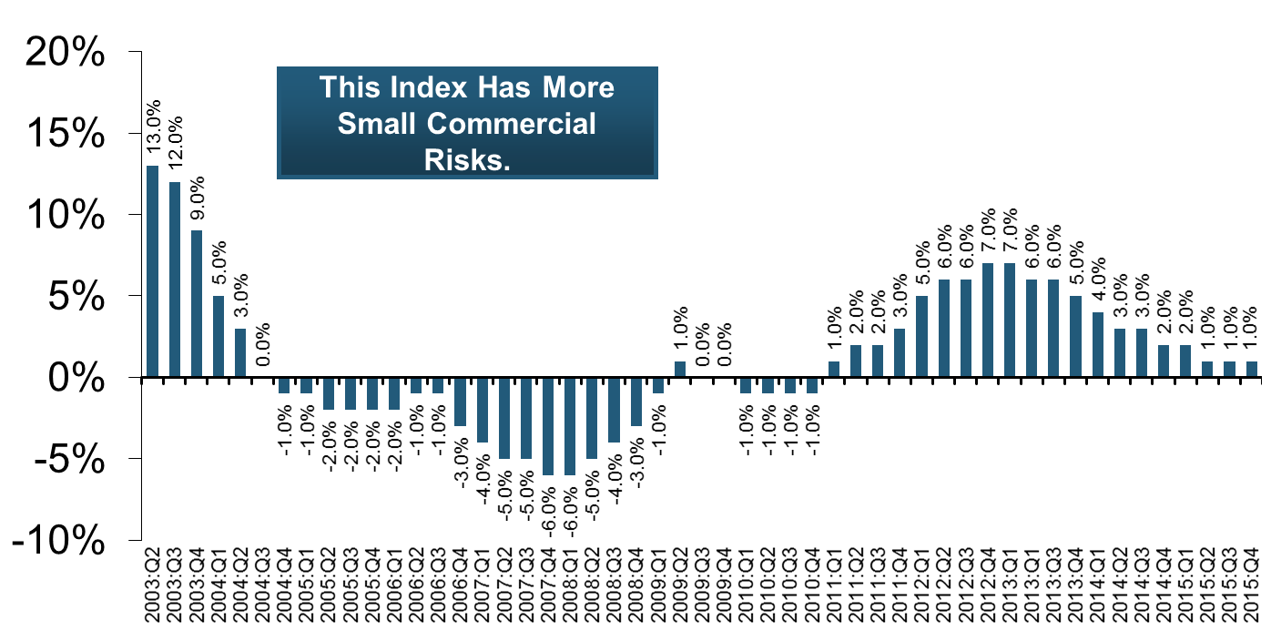
Commercial Lines Rate Change by Qtr (vs. Year Earlier)
20 consecutive quarters of rate increases
Decreases: WC, Property, D&O. ‘Meaningful’ Increases: Commercial Auto.
Sources: Towers Watson Commercial Lines Insurance Pricing Survey, Insurance Information Institute.
37
12/01/09 - 9pm
eSlide – P6466 – The Financial Crisis and the Future of the P/C
Notes:
37

Slide 38
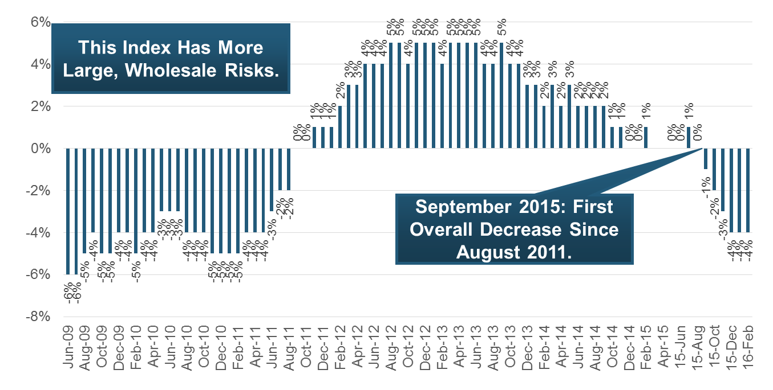
Commercial Lines Rate Change by Month (vs. Year Earlier) Since 6/09
Rate Decline Has Leveled Off a Bit. Decreases in All Lines But EPLI (Flat) – Even Commercial Auto.
SOURCE: MarketScout, Insurance Information Institute.

Slide 39
Rates in The Southeast, Q4 2015*
By Account Size
This Survey is Based on Agent Estimates.
 | Down > 10% | Down 1-10% | No Change | Up 1-10% | Up > 10% | N/A
Small (<25K) | 0.00% | 43.75% | 43.75% | 6.25% | 0.00% | 6.25%
Medium (25-100K) | 0.00% | 62.50% | 18.75% | 12.50% | 0.00% | 6.25%
Large (100K+) | 0.00% | 75.00% | 6.25% | 12.50% | 0.00% | 6.25%
By Line of Business
 | Down > 10% | Down 1-10% | No Change | Up 1-10% | Up > 10% | N/A
Commercial Auto | 0.00% | 0.00% | 25.00% | 68.75% | 6.25% | 0.00%
Commercial Property | 12.50% | 68.75% | 18.75% | 0.00% | 0.00% | 0.00%
D&O | 0.00% | 12.50% | 81.25% | 6.25% | 0.00% | 0.00%
Flood Insurance | 0.00% | 12.50% | 75.00% | 6.25% | 6.25% | 0.00%
General Liability | 6.25% | 68.75% | 25.00% | 0.00% | 0.00% | 0.00%
Terrorism | 0.00% | 12.50% | 75.00% | 0.00% | 0.00% | 12.50%
Umbrella | 0.00% | 62.50% | 25.00% | 12.50% | 0.00% | 0.00%
Workers Compensation | 6.25% | 62.50% | 25.00% | 6.25% | 0.00% | 0.00%
Rates Can Vary Significantly Within States, Lines of Business or Individual Markets.
* AL, FL, GA, KY, LA, MS, NC, SC, TN, VA, WV.
SOURCE: Council of Insurance Agents & Brokers.

Slide 40
Profitability and Growth in North Carolina P/C Insurance Markets
Analysis by Line and Nearby State Comparisons
40

Slide 41
All Lines DWP Growth: NC vs. U.S., 2005-2014
Average 2005-2014
US: 1.9%
NC: 2.6%
(Percent)
NC Has Lagged U.S. in Recent Years
Source: SNL Financial.
41
Notes:
41

Slide 42
Comm. Lines DWP Growth:
NC vs. U.S., 2005-2014
(Percent)
Average 2005-2014
US: 1.4%
NC: 1.9%
Source: SNL Financial.
42
Notes:
42

Slide 43
Personal Lines DWP Growth:
NC vs. U.S., 2005-2014
(Percent)
Average 2005-2014
US: 2.6%
NC: 3.4%
Source: SNL Financial.
43
Notes:
43

Slide 44
Private Passenger Auto DWP Growth:
NC vs. U.S., 2005-2014
(Percent)
Average 2005-2014
US: 1.6%
NC: 2.5%
Exposures Fall: Weak Economy
Source: SNL Financial.
44
Notes:
44

Slide 45
Homeowner’s MP DWP Growth: NC vs. U.S., 2005-2014
Reaction to 2011 Catastrophes (filed, OKd in 2012)
(Percent)
Average 2005-2014
US: 4.8%
NC: 5.6%
Source: SNL Financial.
45
Notes:
45

Slide 46
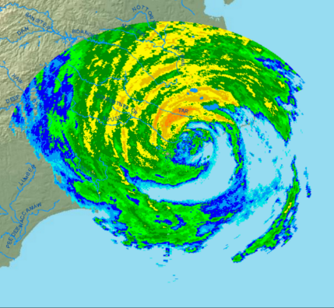
RNW All Lines: NC vs. U.S., 2005-2014
P/C Insurer profitability in NC is above that of the US overall over the past decade
US: 7.7%
NC: 11.1%
(Percent)
Hurricane Irene, Tornadoes
Hurricane Irene Over NC.
Sources: NAIC.
46
Notes:
46

Slide 47
RNW Comm. Auto: NC vs. U.S.,
2005-2014
(Percent)
Commercial Auto profitability in NC is generally above the US average
Average 2005-2014
US: 8.1%
NC: 11.4%
Sources: NAIC.
47
Notes:
47

Slide 48
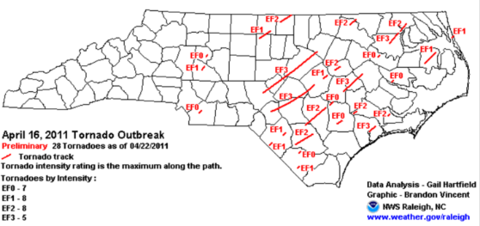
RNW Comm. Multi-Peril: NC vs. U.S.,
2005-2014
(Percent)
Average 2005-2014
US: 8.9%
NC: 15.4%
Irene, 6 Tornadoes of EF-3 or Higher
Sources: NAIC.
48
Notes:
48

Slide 49
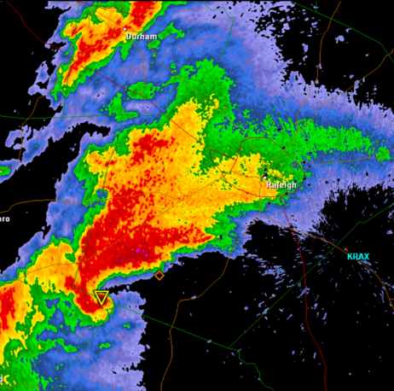
RNW Homeowners: NC vs. U.S.,
2005-2014
Average 2005-2014
US: 7.6%
NC: 11.5%
(Percent)
6 Tornadoes of EF-3 or Higher
Ike, Financial Crisis
Katrina, Rita, Wilma
Tornado Approaches Raleigh.
Sources: NAIC.
49
Notes:
49

Slide 50
RNW Workers Comp: NC vs. U.S.,
2005-2014
(Percent)
Average 2005-2014
US: 6.8%
NC: 5.1%
HB79 passed--Caps TT Benefits at 500 Weeks, Tightens Def. of Suitable Employment
Growing Hospital Costs Drive Profitability Down
Sources: NAIC.
50
Notes:
50

Slide 51
All Lines: 10-Year Average RNW NC & Nearby States
2005-2014
North Carolina All Lines profitability is above the US and regional averages
Source: NAIC, Insurance Information Institute

Slide 52
Comm. Auto: 10-Year Average RNW NC & Nearby States
2005-2014
North Carolina Comm. Auto profitability is above the US and regional averages
Source: NAIC, Insurance Information Institute

Slide 53
Comm. M-P: 10-Year Average RNW NC & Nearby States
2005-2014
North Carolina Comm. M-P profitability is above the US and regional averages
Source: NAIC, Insurance Information Institute

Slide 54
Homeowners: 10-Year Average RNW NC & Nearby States
2005-2014
North Carolina Homeowners profitability is above the US and regional averages
Mid-South States Hurt by Tornado/Hail 2008-2012
Source: NAIC, Insurance Information Institute

Slide 55
Top Ten Most Expensive And Least Expensive States For Homeowners Insurance, 2013 (1)
North Carolina ranked as the 23rd most expensive state for homeowners insurance in 2013, with an average expenditure of $1,008.
Rank | Most expensive states | HO average premium | Rank | Least expensive states | HO average premium
1 | Florida | $2,115 | 1 | Idaho | 561
2 | Texas (2) | 1,837 | 2 | Oregon | 568
3 | Louisiana | 1,822 | 3 | Utah | 609
4 | Oklahoma | 1,654 | 4 | Wisconsin | 665
5 | Mississippi | 1,395 | 5 | Washington | 676
6 | Kansas | 1,343 | 6 | Nevada | 687
7 | Rhode Island | 1,334 | 7 | Delaware | 709
8 | Alabama | 1,323 | 8 | Arizona | 724
9 | Connecticut | 1,274 | 9 | Ohio | 763
10 | Massachusetts | 1,263 | 10 | Maine | 776
Includes policies written by Citizens Property Insurance Corp. (Florida) and Citizens Property Insurance Corp. (Louisiana), Alabama Insurance Underwriting Association, Mississippi Windstorm Underwriting Association, North Carolina Joint Underwriting Association and South Carolina Wind and Hail Underwriting Association. Other southeastern states have wind pools in operation and their data may not be included in this chart. Based on the HO-3 homeowner package policy for owner-occupied dwellings, 1 to 4 family units. Provides “all risks” coverage (except those specifically excluded in the policy) on buildings and broad named-peril coverage on personal property, and is the most common package written.
The Texas Department of Insurance developed home insurance policy forms that are similar but not identical to the standard forms. In addition, due to the Texas Windstorm Association (which writes wind-only policies) classifying HO-1, 2 and 5 premiums as HO-3, the average premium for homeowners insurance is artificially high.
Note: Average premium=Premiums/exposure per house years. A house year is equal to 365 days of insured coverage for a single dwelling. The NAIC does not rank state average expenditures and does not endorse any conclusions drawn from this data.
Source: ©2016 National Association of Insurance Commissioners (NAIC). Reprinted with permission. Further reprint or distribution strictly prohibited without written permission of NAIC.

Slide 56
Workers Comp.: 10-Year Average RNW NC & Nearby States
2005-2014
North Carolina Workers Comp profitability is below the US and regional averages
Source: NAIC, Insurance Information Institute

Slide 57
2015 Property and Casualty Insurance
Regulatory Report Card
R Street Institute is “A Free-Market Think Tank” on the Political Right.
C
AK
AL
A
WA
ME
C
MT
B
ND
C
VT
D
MN
D
NH
B
OR
ID
C+
C
NY
MA
= A
= B
= C
= D
= F
= NG
B
SD
B+
WI
MI
CT
RI C+
B
B
NJ
WY
PA
C
B
B+
IA
B
C-
A
C+
OH
MD
NV
NE
A-
IL
IN
DE
B+
WV
B
UT
B
C
VA
CO
C+
A
B
A
B
KS
MO
KY
CA
B
A
F
D
A-
TN
NC
C
AZ
NM
OK
C
AR
C
SC
Source: James Madison Institute, February 2008.
A-
D
HI
B
B
AL
B
MS
C
GA
LA
D+
Rated Worst Regulatory Environment
TX
D
D
Not Graded: District of Columbia
FL
D
Source: R Street Insurance Regulation Report Card, December 2015

Slide 58
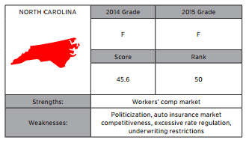
About North Carolina’s Regulatory Grade
Cons
  Elected Insurance Commissioner
  Huge Auto Residual Market
  Growing Property Residual Market
  Lack of Flexibility
    Regulatory
    Ratemaking
    Product Design
Pros
  Competitive Workers Comp Market
  Transparent Rule-Making Process
Source: R Street Insurance Regulation Report Card, December 2015

Slide 59
NORTH CAROLINA AUTO INSURANCE
A Look at the State and Its Reinsurance Facility, the Nation’s Largest Residual Market
59

Slide 60
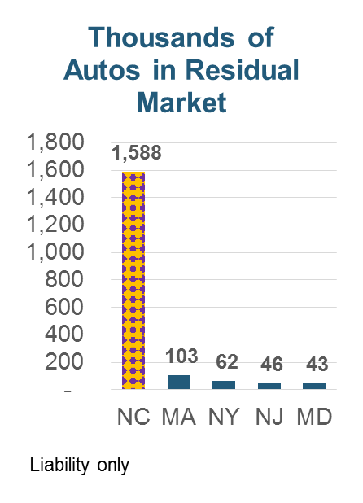
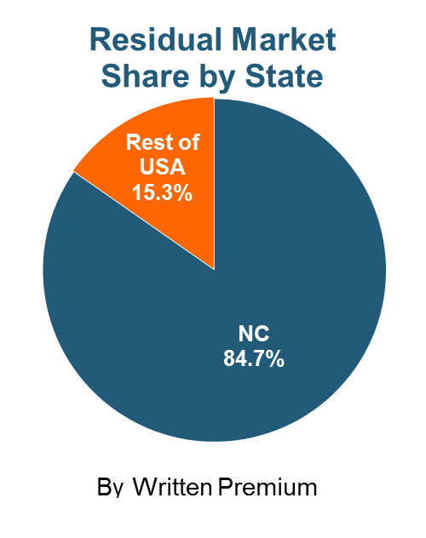
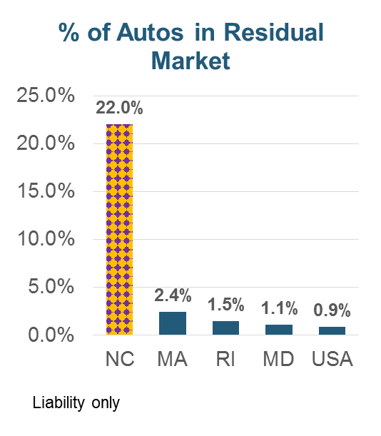
How Big Is NC Personal Auto
Residual Market?
North Carolina Has More Autos and A Greater Percentage of Autos in Residual Market Than Any Other State.
All data as of 2012, excludes commercial exposures.
Source: AIPSO.

Slide 61
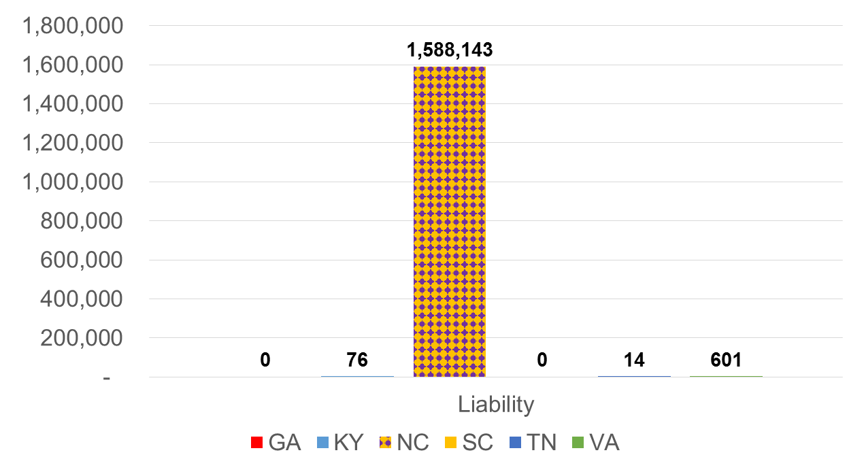
Personal Auto: Size of Residual Market
(Written Car Years)
North Carolina’s Residual Market is 2,000 Times Larger Than All Surrounding States Combined.
Liability coverage only.
Source: AIPSO.
61
Notes:
61

Slide 62
Number of Autos in Residual Market, 1994-2012
(Thousands of Written Car-Years)
U.S. Residual Market Has Shrunk As Regulators Remove Subsidies, Allow More Dynamic Pricing
Rest of Nation is Shrinking Their Residual Markets. NC Market is Slowly Growing.
Source: AIPSO.
62
Notes:
62

Slide 63
Top Ten Most Expensive And Least Expensive States For Automobile Insurance, 2013 (1)
Rank | Most expensive states | Average expenditure | Rank | Least expensive states | Average expenditure
1 | New Jersey | $1,254.10 | 1 | Idaho | $553.38
2 | D.C. | 1,187.49 | 2 | Iowa | 572.14
3 | New York | 1,181.86 | 3 | South Dakota | 580.99
4 | Louisiana | 1,146.29 | 4 | Maine | 592.82
5 | Florida | 1,143.83 | 5 | North Dakota | 604.58
6 | Michigan | 1,131.40 | 6 | Wisconsin | 621.05
7 | Delaware | 1,101.12 | 7 | Indiana | 621.71
8 | Rhode Island | 1,066.25 | 8 | North Carolina | 624.76
9 | Connecticut | 1,011.27 | 9 | Nebraska | 638.74
10 | Massachusetts | 1,007.98 | 10 | Wyoming | 639.71
North Carolina ranked 8th as the least expensive state in 2013, with an average expenditure for auto insurance of $624.76.
Based on average automobile insurance expenditures.
Source: © 2016 National Association of Insurance Commissioners.

Slide 64
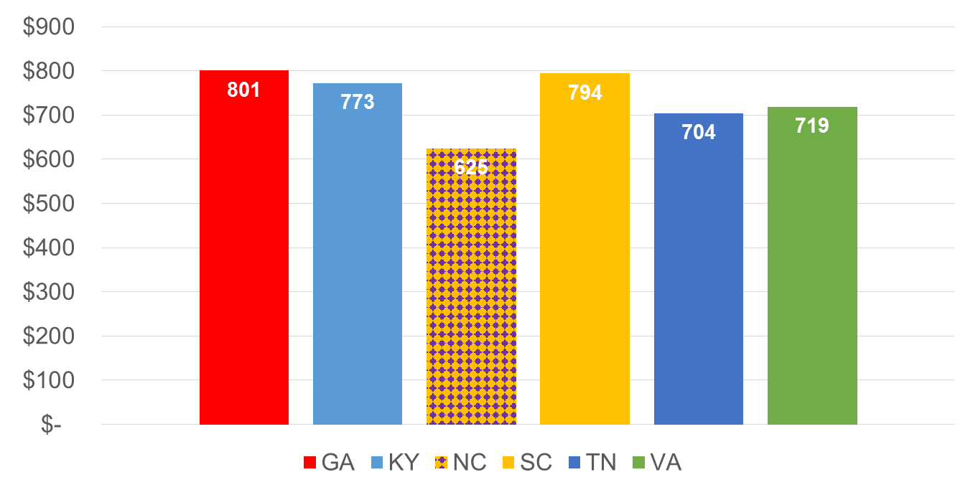
Personal Auto Premiums, 2013
Does Regulatory Market Keep Rates Lower?
(Average Expenditure)
North Carolina’s Has Lowest Expenditure of Surrounding States, About 11 Percent Lower Than Any Other.
Source: National Association of Insurance Commissioners, Insurance Information Institute.
64
Notes:
64

Slide 65
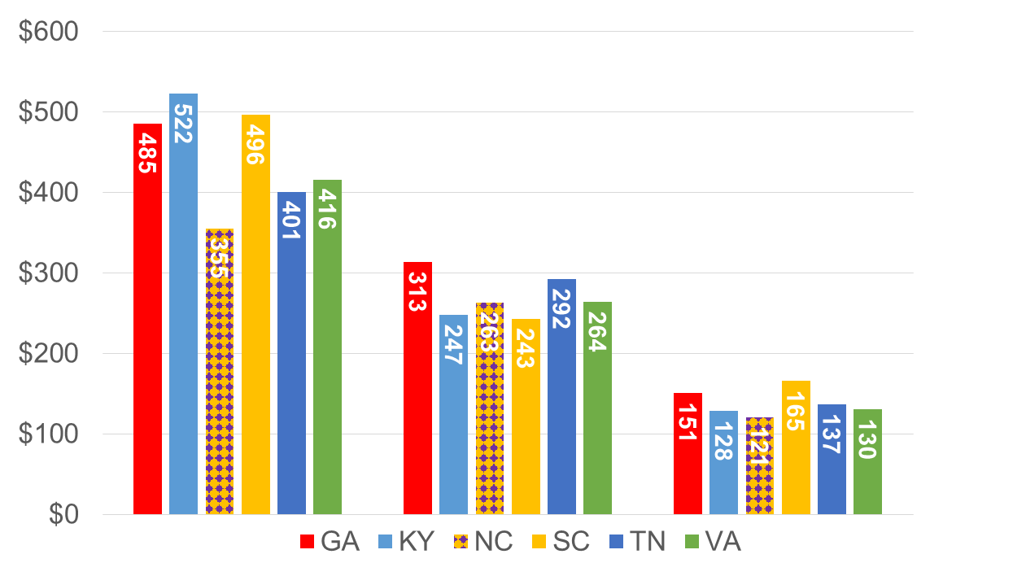
Personal Auto: Average Premium by Coverage, 2013
(Average Premium)
Strong Rate Regulation or Contributory Negligence Rule?
North Carolina’s Liability Rates, Based on State’s Rates, Are Much Lower Than Neighboring States. (NCRF Only Covers Liability.)
Source: National Association of Insurance Commissioners.
65
Notes:
65

Slide 66
RNW PP Auto: NC vs. U.S., 2005-2014
NC Slightly More Profitable Than Rest of USA
Average 2005-2014
US: 6.2%
NC: 6.4%
Irene, 6 Tornadoes of EF-3 or Higher
Source: National Association of Insurance Commissioners.
66
Notes:
66

Slide 67
PP Auto: 10-Year Average RNW NC & Nearby States
2005-2014
North Carolina PP Auto profitability is above the US and regional averages
Reinsurance Facility Doesn’t Appear to Reduce Profitability.
Source: NAIC, Insurance Information Institute

Slide 68
RNW PP Auto Liability: NC vs. U.S., 2005-2014
Average 2005-2014
US: 4.9%
NC: 3.7%
Liability Less Profitable Than Rest of USA
Source: National Association of Insurance Commissioners.
68
Notes:
68

Slide 69
RNW PP Auto PhysDam: NC vs. U.S., 2005-2014
Physical Damage More Profitable Than Rest of USA
Average 2005-2014
US: 9.5%
NC: 11.4%
Physical Damage Tends to Be More Profitable Everywhere Because of Catastrophe Risk. More Risk→Greater Return.
Source: National Association of Insurance Commissioners.
69
Notes:
69

Slide 70
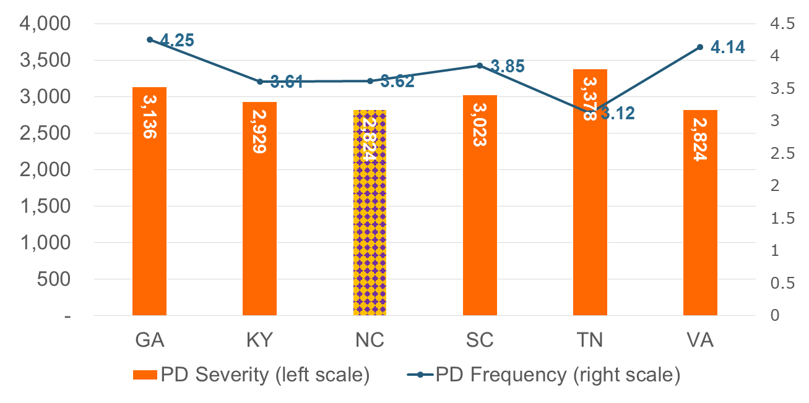
Personal Auto: Property Damage, 2012
(Severity [Claim Size] $$$)
(Frequency [Claim/100 Car-Yr])
Average of Neighbors
Freq: 3.77
Severity: $3,019
NC Property Damage Liability Is Similar to Nearby States in Claim Size and Claim Frequency. System Doesn’t Prevent Accidents or Make Them Less Severe.
Source: National Association of Insurance Commissioners.
70
Notes:
70

Slide 71
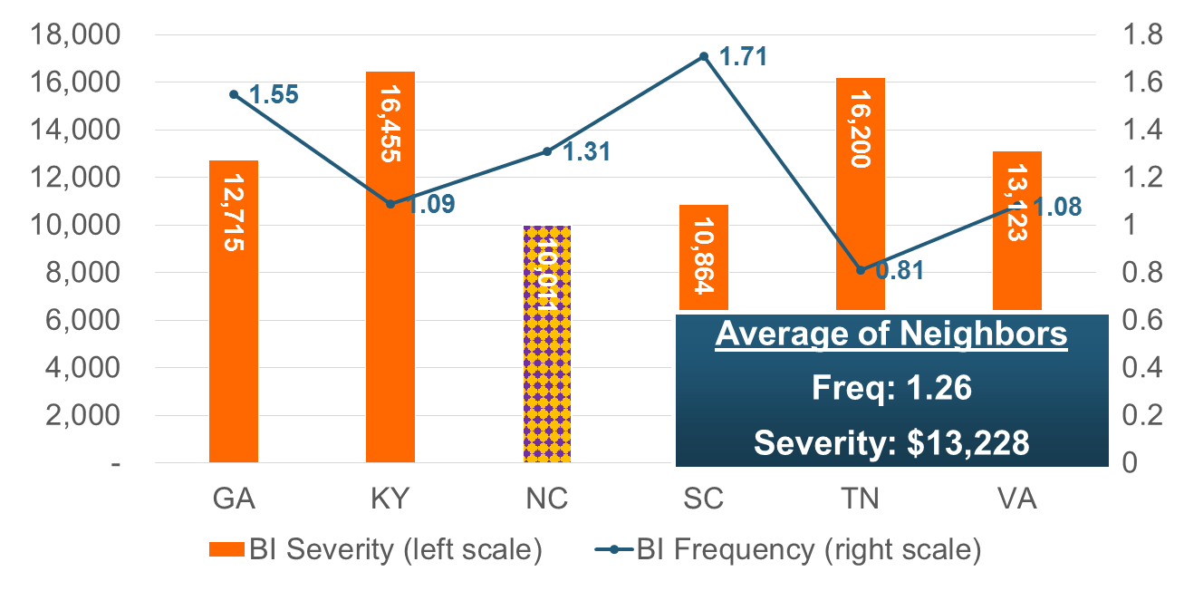
Personal Auto: Bodily Injury, 2012
(Severity [Claim Size] $$$)
(Frequency [Claim/100 Car-Yr])
NC Bodily Injury Frequency is Close to That of Neighbors, But It Has Lowest Claim Size.
Source: National Association of Insurance Commissioners.
71
Notes:
71

Slide 72
FLOOD INSURANCE
The South Carolina Deluge; Is Anyone Buying?
72

Slide 73
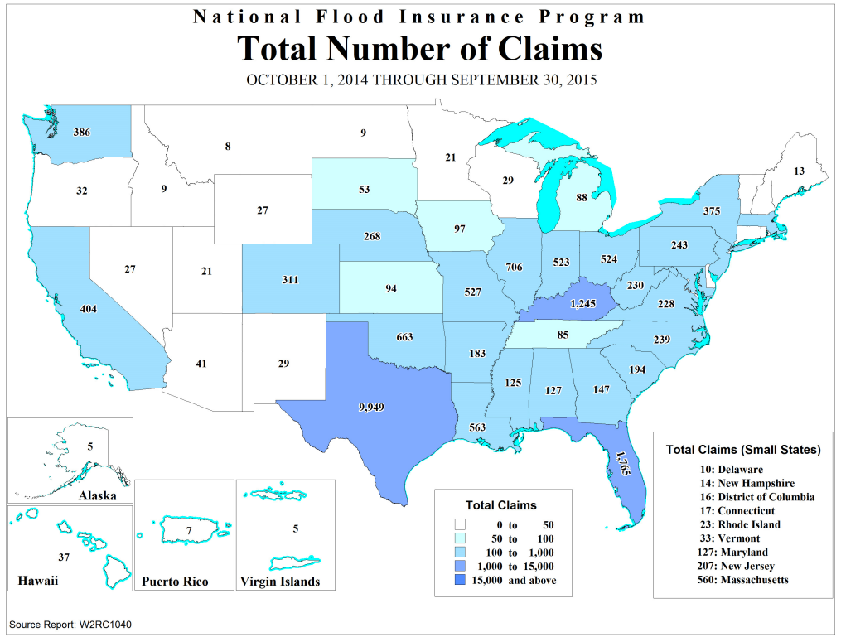
Flood Insurance Claims by State, FY2015
SOURCE: National Flood Insurance Program.

Slide 74
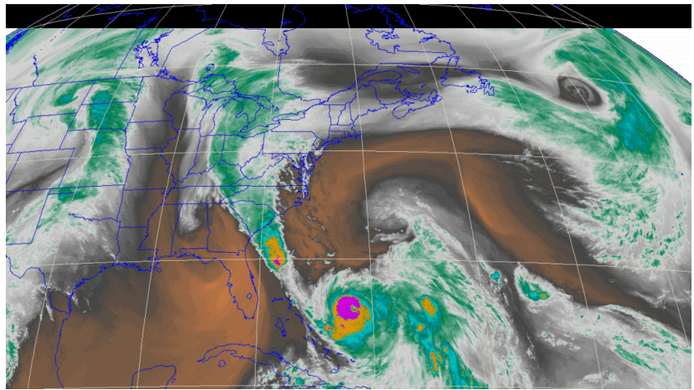
‘An Atmospheric River’
Low Pressure Over Florida Got Stuck, Funneling Incredibly Moist Air Over South Carolina—Again and Again.

Slide 75
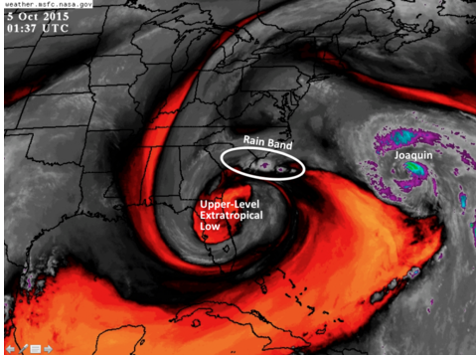
Epic Rains Cause Epic Floods
SOURCE: NASA, via The Washington Post.

Slide 76
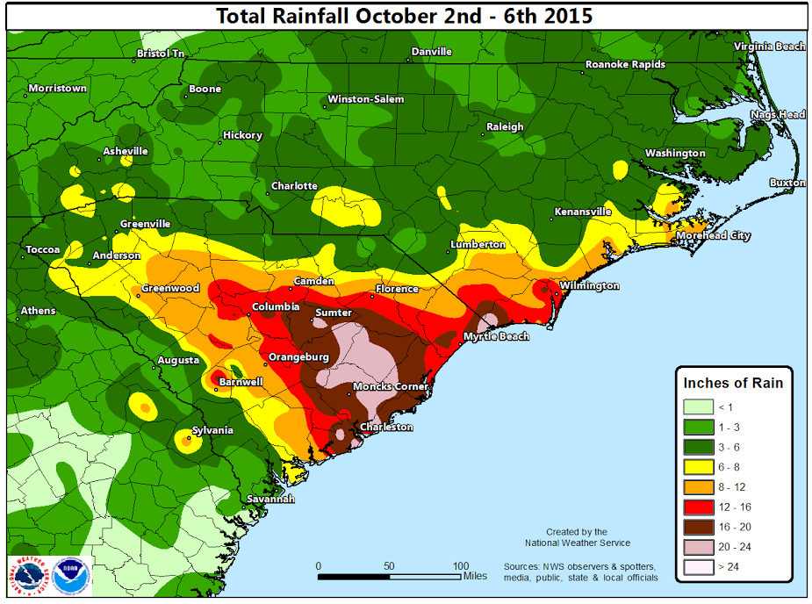
Epic Rains Cause Epic Floods
A 1,000-Year Event
  (Katrina was a 500-Year Event)
$1.5 billion total damages
$300 million insured loss, including
  3,521 Flood Claims
  $115.0 Million in Paid Flood Losses
  $32,676 per Claim
SOURCES: Image--National Weather Service, via blog.weatherflow.com. Likelihood of event from NWS and nola.com. Flood loss statistics from National Flood Insurance Program. Other data from Swiss Re sigma 1/2016.

Slide 77
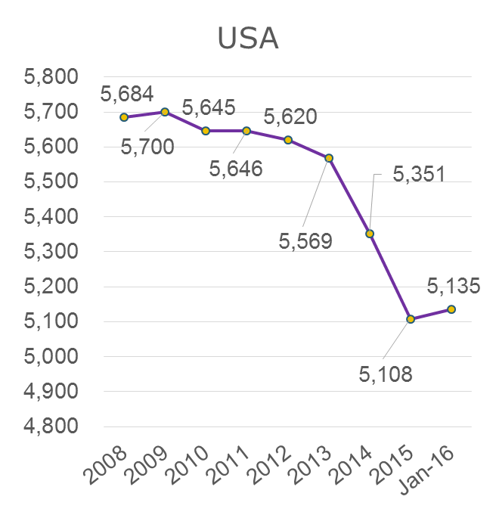
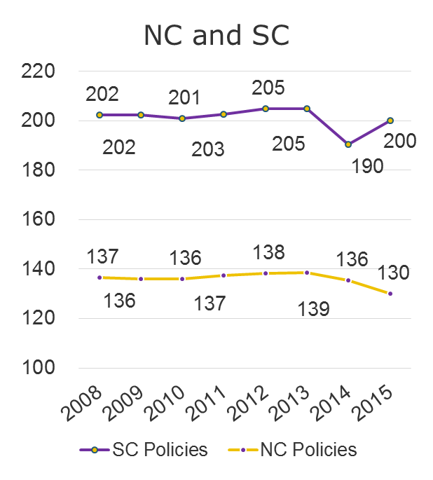
Flood Insurance Exposures, by Year
(Thousands of Policies in Force)
Slight Spike: El Niño Initiative in CA
Changes to Flood Insurance Program Have Driven Policy Counts Down, Both in Carolinas and Rest of USA.
Source: National Flood Insurance Program, Insurance Information Institute.
77
Notes:
77

Slide 78
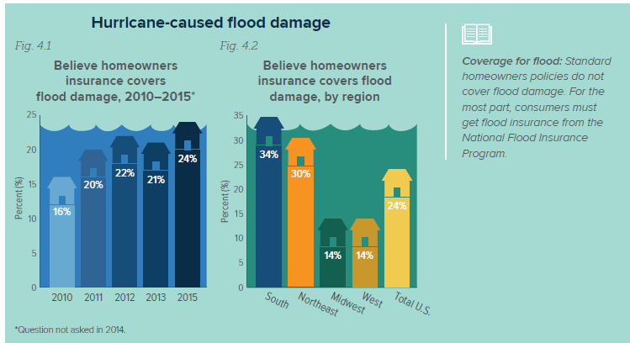
Public Understanding of Flood Insurance
Nearly One Quarter of Homeowners Incorrectly Thought Homeowners Policy Covers Flood Damage.
SOURCE: Insurance Information Institute.

Slide 79
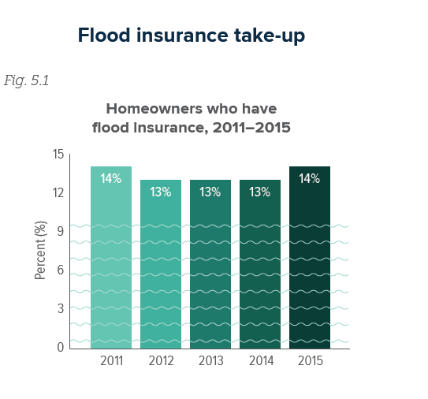
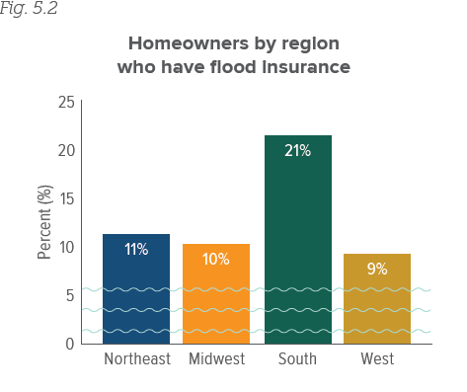
Flood Insurance Take-up Rates
The percentage of homeowners purchasing Flood insurance has remained consistent
The South Has the Highest Proportion of Homeowners with Flood Insurance
SOURCE: Insurance Information Institute.

Slide 80
National Flood Insurance Reforms
2012: Biggert-Waters Flood Insurance Reform Act:
  Eliminated Many Rate Subsidies (Discounts) that Many Property-Owners in High-Risk Areas Receive
  Attempted to Make Program Self-Sufficient
2014: Bigger-Waters Recalibrated:
  Many Rate Increases Rescinded.
  Annual Increases Capped: 25% (subsidized) 18% (other).
  Surcharges Policyholders to Help Pay for Subsidies
    $25 Primary homeowners
    $250 Vacation homes and nonresidential property

Slide 81
April 2016 Changes
Updated Premium Rates (Year 2 of Increases) – 9% on Average (excluding surcharges)
25% Increase for subsidized non-residential businesses in many high-risk areas
Eliminate subsidy for certain policies that lapsed and are reinstated in many high-risk areas
Details at: http://nfipiservice.com/Stakeholder/FEMA7/W-15046.html

Slide 82
On the Horizon
Current Authorization Expires in 2017
  Last Time: 17 Extensions, 4 Lapses, Took 4 Years
  This Time: Smoother Sailing?
Proposals
  Flood Insurance Market Parity and Modernization Act (HR 2901)
    Encourages Private Market (Lets Lenders Recognize Private Insurance for Mortgages)
    Passed Financial Services Committee
  Are Private Insurers Entering the Market

Slide 83
TECHNOLOGY, DISRPTORS AND INSURANCE
Applications of Technology in P/C Insurance Have Gripped the Media as Have Industry Solutions
83

Slide 84
Interest in Technology Issues and Insurance Is Surging: Presents Opportunity
Insurers are at the intersection of many of the most important technological innovations of the early 21st century
  Problem→Solution→Opportunity
Industry is too often depicted as a technology laggard
I.I.I. is highlighting the industry as being on the technological cutting edge—an innovative, nimble industry with solutions for managing countless new risks of the current era:
  Sharing economy Cyber Auto Technology
  Supply Chain Climate Risk Drones
  Wearable devices The “Internet of Things”
84
12/01/09 - 9pm
eSlide – P6466 – The Financial Crisis and the Future of the P/C
Notes:
84

Slide 85
CYBER RISK AND INSURANCE
Cyber Risk is a Rapidly Emerging Exposure for Businesses Large and Small in Every Industry
85

Slide 86






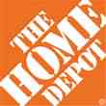

Data Breaches 2005-2015, by Number of Breaches and Records Exposed
# Data Breaches/Millions of Records Exposed
Millions
The 781 reported data breaches in 2015 was virtually unchanged form the record 783 reported in 2014. The number of exposed records soared to 169.1 million, and increase of 97.5%.
Source: Identity Theft Resource Center (updated as of Jan. 6, 2016);
http://www.idtheftcenter.org/images/breach/ITRCBreachReport2015.pdf

Slide 87
Data/Privacy Breach:
Many Potential Costs Can Be Insured
Costs of notifying affecting individuals
Costs of notifying regulatory authorities
Defense and settlement costs
Data Breach Event
Regulatory fines at home & abroad
Lost customers and damaged reputation
Forensic costs to discover cause
Cyber extortion payments
Business Income Loss
Source: Zurich Insurance; Insurance Information Institute
87

Slide 88
Estimated Cyber Insurance Premiums Written, 2014 – 2020F
Cyber insurance premiums written could more than triple to $7.5 billion by 2020
$ Billions
I.I.I.’s Cyber Risk paper issued Oct. 2015
Source: Advisen (2014 est.); PwC (2015, 2020); Insurance Information Institute.

Slide 89
THE SHARING (ON-DEMAND) ECONOMY
Area of Extreme Interest—And Insurers Are Providing Solutions for this Dynamic Economic Segment
89

Slide 90
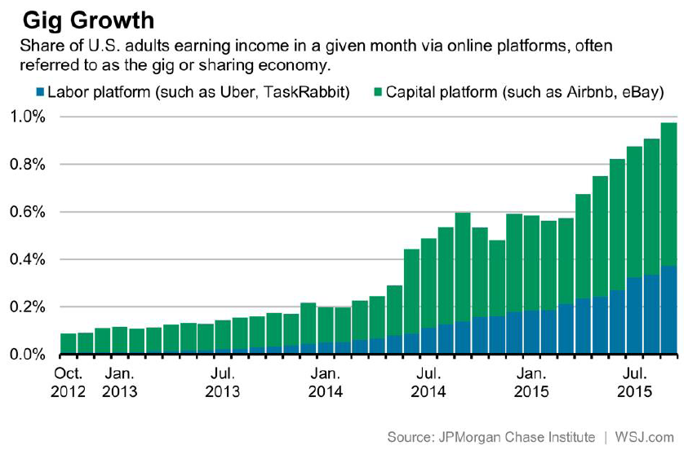
Tiny, but Growing

Slide 91




Sharing/On-Demand/Peer-to-Peer Economy Impacts Many Lines of Insurance
The “On-Demand” Economy is or will impact many segments of the economy important to P/C insurers
  Auto (personal and commercial)
  Homeowners/Renters
  Many Liability Coverages
  Professional Liability
  Workers Comp
Many insurance questions have arisen
Insurance solutions are increasingly available to fill the many insurance gaps that arise
91
12/01/09 - 9pm
eSlide – P6466 – The Financial Crisis and the Future of the P/C
Notes:
91

Slide 92



Labor on Demand: Huge Implications for the US Economy, Workers & Insurers
Will YOUR job be reduced to an app?

Slide 93
Ridesharing Regulation/Legislation and Status of ISO Filings as of 9/30/15
Status Ride Sharing Legislation/Regulation
Status of ISO Filings
TNC: Transportation Network Companies.
93
Source: ISO.

Slide 94
AUTO TECHNOLOGY &
THE FUTURE OF AUTO INSURANCE
Technology Promises Safer Cars and Highways, BUT Some Analysts, Media and Many in Silicon Valley Are Predicting Doom for Auto Insurers
94

Slide 95

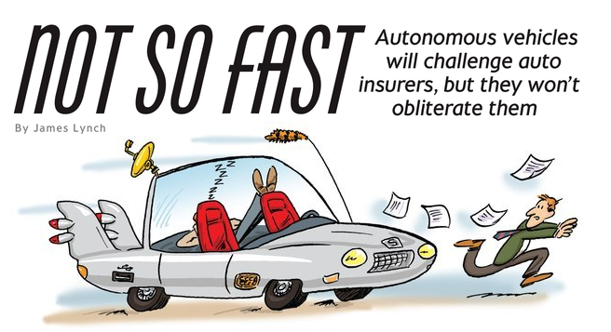
When Computers Take the Wheel . . .

Slide 96
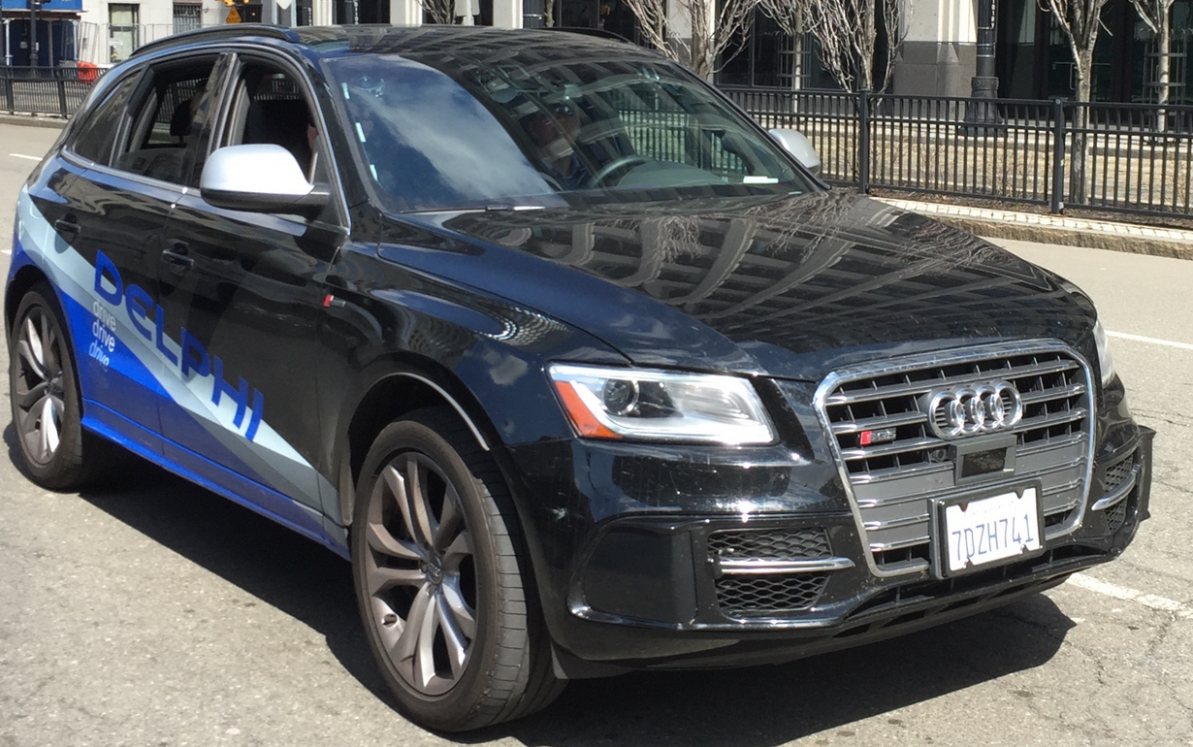
This is a Test . . . On the Street
Delphi prototype “Road-runner”
SF to NYC in Nine Days (4/2015)
3,400 Miles – All but 50 Autonomous
Issues: ‘Unmarked Lanes, Heavy Roadworks,’ When Sun Was Low in Sky
All Major Manufacturers Are Developing These Safety Devices. Autopilot Features Are Imminent.

Slide 97
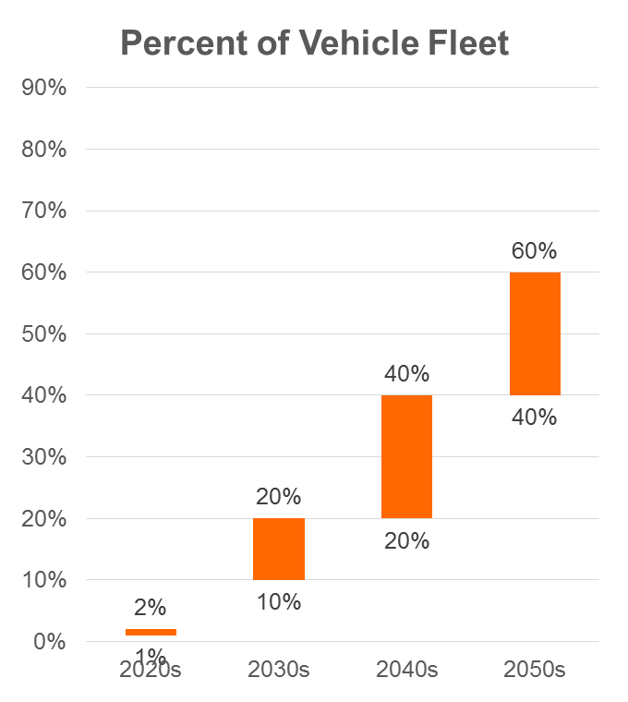
When Will This Happen?
Standard Equipment
Minimal Price
Expensive
Expensive
SOURCE: Autonomous Vehicle Implementation Predictions, Victoria Transport Policy Institute, 2015.

Slide 98
Why Will It Take So Long?
Average Light Vehicle
Age (Years)
Recession Hangover – People Struggling to Afford Major Purchase; Cars Are Built Better, Last Longer.
Sources: U.S. Department of Transportation, Polk, January 2015 Survey, IHS Automotive July 2015; Insurance Information Institute.
98
12/01/09 - 9pm
eSlide – P6466 – The Financial Crisis and the Future of the P/C
Notes:
98

Slide 99
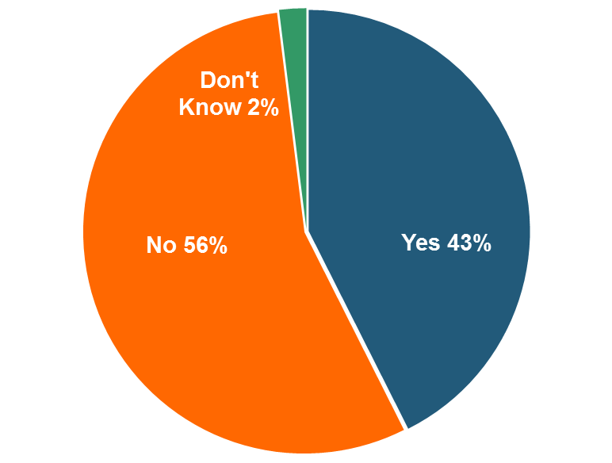
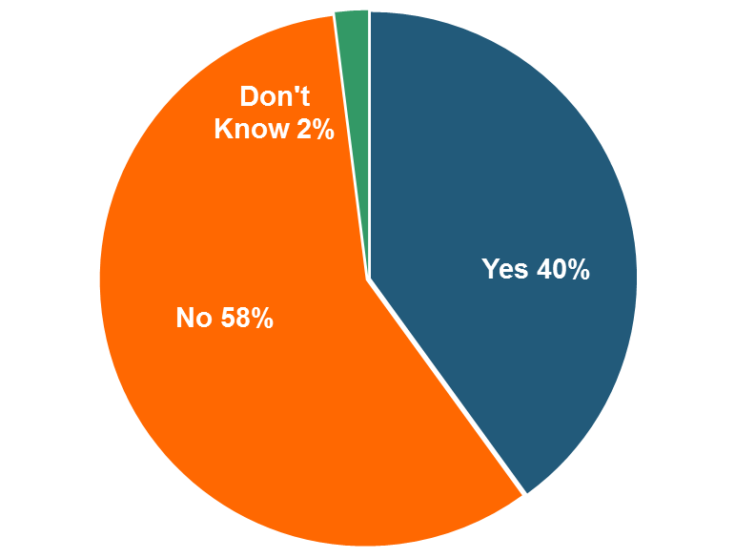
Why Will It Take So Long?
Q. Would you be willing to ride in a driverless car?
November 2015
May 2015
The Percentage Willing to Ride in a Driverless Car Rose Slightly. 69 Percent of People Over 64 Were Unwilling to Ride.
Source: Insurance Information Institute Annual Pulse Survey.

Slide 100
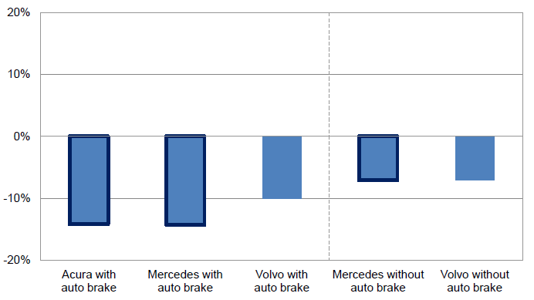
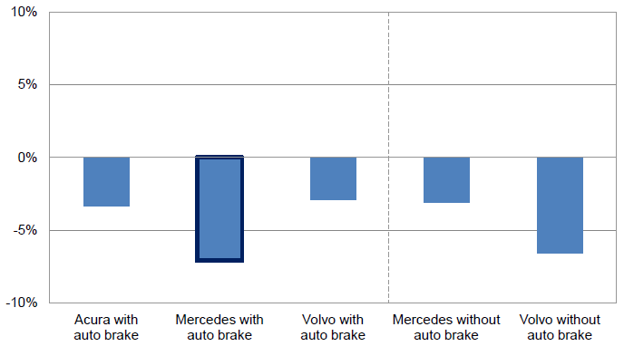
Meanwhile, Other Important Tech Improvements Are Coming to Autos
Forward collision warning systems have a material impact on PD liability claim frequency, especially when paired with auto braking
Property Damage Liability Claim Frequency by Manufacturer
Collision Claim Frequency by Manufacturer
Collision frequency falls as well
Source: Highway Loss Data Institute and Insurance Institute for Highway Safety presentation by Matthew Moore, Measuring Crash Avoidance System Effectiveness with Insurance Data,” January 30 2013; Insurance Information Institute.
100

Slide 101
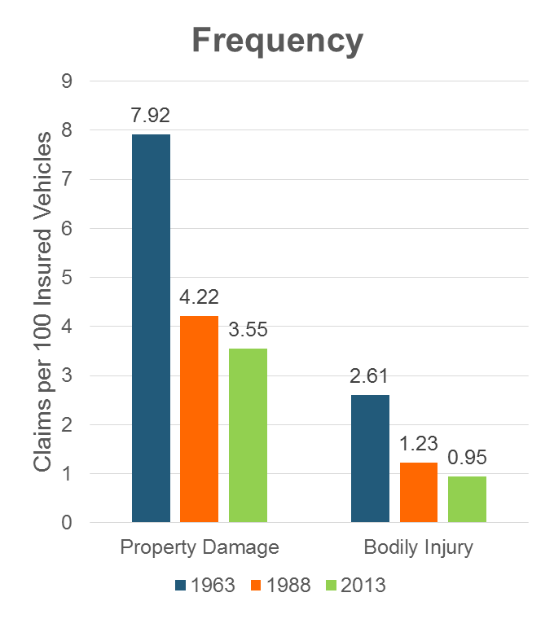
Auto Insurance: Frequency vs. Severity
Sources: Insurance Institute for Highway Safety, Insurance Services Office, Insurance Information Institute.

Slide 102
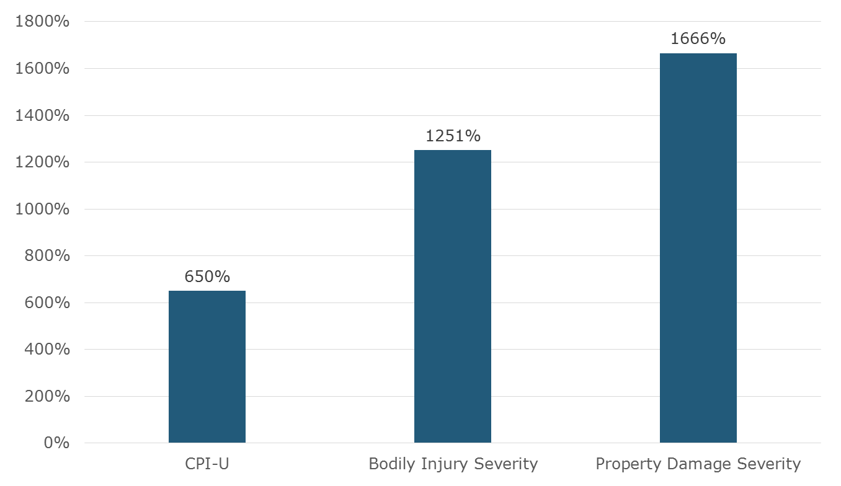
Auto Claims Have Grown Faster Than Inflation for 50 Years
Percentage Change, 1963-2013

Slide 103
Who Is Responsible?
Q. Who should be responsible if an accident occurred involving a driverless car?
Don’t Know
Car’s Occupant
Car’s Insurer
Car’s Manufacturer
Car’s Owner
Half of Respondents Think a Driverless Car’s Manufacturer Should Bear Responsibility in Case of an Accident.
Source: Insurance Information Institute Annual Pulse Survey.

Slide 104
Who Is Responsible?
Q. Would you be willing to pay more for your car to cover the manufacturer’s liability in case of an accident?
Don’t Know
Yes
No
Only a Quarter of Americans Would Be Willing to Pay More for a Driverless Car to Cover the Manufacturer’s Liability in Case of an Accident.
Source: Insurance Information Institute Annual Pulse Survey.

Slide 105
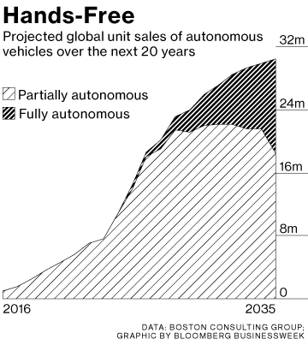

Media is Obsessed with Driverless Vehicles: Often Predicting the Demise of Auto Insurance
By 2035, it is estimated that 25% of new vehicle sales could be fully autonomous models
Questions
Are auto insurers monitoring these trends?
How are they reacting?
Will take over the industry? (cars/sales)
Will the number of auto insurers shrink?
How will liability shift?
Source: Boston Consulting Group; Insurance Information Institute.

Slide 106
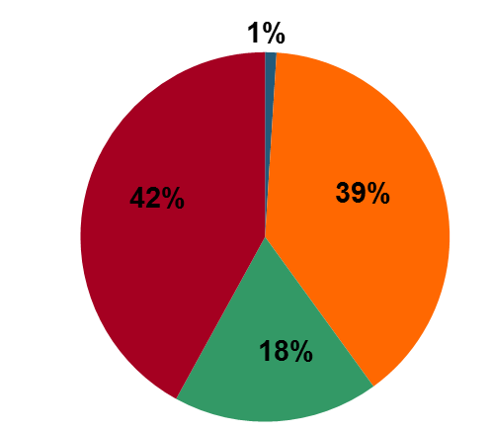
I.I.I. Poll: Telematics
Q. I’m going to ask you a question about your opinion of insurance companies collecting information about how and when you drive in order to set your auto insurance premium. Please tell me which statement you agree with. Would you…¹
Don’t know
Would not allow
Allow if premium went down
Allow whether or not premium went down
More Than Half of Auto Policyholders Would Allow Their Insurer to Collect Their Driving Information In Order to Set Premiums.
¹Asked of those who auto insurance.
Source: Insurance Information Institute Annual Pulse Survey.

Slide 107
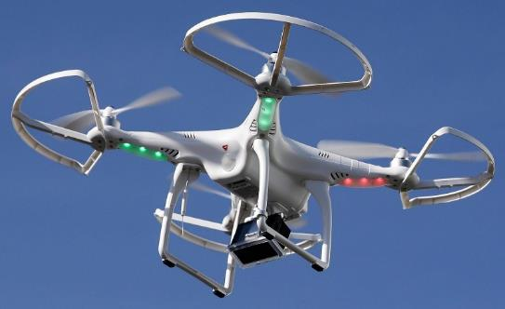

Send in the Drones: Potential Rapid
Adoption in Industry; Media Loves It
Drones or Unmanned Aerial Vehicle (UAV) technology is seeing rapid adoption rate in many industries, including insurance
FAA granting Section 333 exemptions for commercial use and testing of UAS
At least 5 insurers have received permission to test
Wide variety of applications: claims, pre-event property inspections…
Insurers partnering with construction industry to guide R&D and regulation of UAV use via Property Drone Consortium: www.propertydrone.org

Slide 108
Summary
2015 Was Profitable for the P/C Industry
Low Interest Rates Present a Challenge
Rate Changes Flat, Perhaps Lower
Loss Trends Accelerating, Especially in Auto
NC Mirrors Most U.S. Trends (except Residual Market)
Flood Insurance: Is Anyone Buying?
Disruptors Loom, but Industry Appears Ready

Slide 109
Insurance Information Institute Online:
www.iii.org
Thank you for your time
and your attention!
Twitter: twitter.com/III_Research
Download at www.iii.org/presentations

