Slide 1
Insurance Market Trends and More
Sean Kevelighan
Chief Executive Officer
Insurance Information Institute  Washington, DC  New York, NY
212.346.5520  seank@iii.org  www.iii.org
Notes:
Talk about what’s happening in the world in terms of what we are hearing a lot of lately – disruption.
But also why insurance is an industry well-poised to lead through it
Also, look at some industry trends.
At the end, will circle back to insurance leading through disruption.

Slide 2
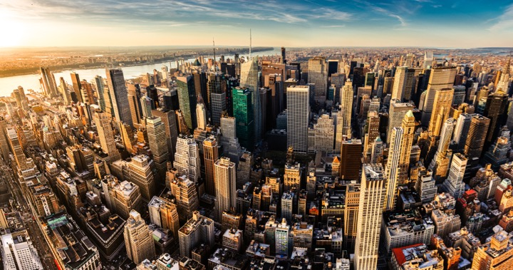
I.I.I. Mission Statement
Improving public understanding
of insurance...
…what it does and how it works.
2

Slide 3
Over The Past 18 Months, However, Insurance Coverage Has Focused On…
Insurance Lawsuits
Travel & Pet Insurance
3%
Mortgage & Title Insurance
3%
18% on other P/C and life products
Crop Insurance
3%
Life Insurance & Long-Term Care
Auto Insurance
Wildfires
2%
Flood & Storms
Homeowner Insurance
28% on Nat Cat risks
NFIP
Cyber Insurance
30% on cyber insurance and digital trends
InsurTech
Count
Source: Quid, HPS Analysis, Excludes Health Insurance And Company Performance

Slide 4
Social Media Focuses More On NatCat Than Cyber, Auto and InsurTech
Traditional Media Coverage vs Social Shares
NFIP
Flood & Storms
Homeowner Insurance
Average Social Share
Travel Insurance
Insurance Lawsuits
Wildfires
Life Insurance & Long-Term Care
Crop Insurance
Cyber Insurance
Auto Insurance
InsurTech
Publisher Count

Slide 5
2018 I.I.I. Issue Focus Areas
Mapping Where Our Issues Stand As We Approach Q3
Inform
Own
Audiences
High
Insurance As Economic Capital
B2B
Nat Cat Resilience
B2C
Life
Cyber Risk
B2G
Pandemic Risk
Auto
Strategic Initiative
InsurTech
Public Discussion
To Begin 2H 2018
Manage
Elevate
Home/Rental
Political Risk
Terror
Low
Fraud
Industry Talent
Low
I.I.I. Opp/Risk
High

Slide 6

Disruptive Forces in the World – The New Norm
Catastrophes
Economics
Geopolitical
Technology

Slide 7
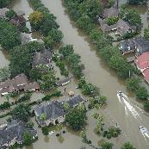
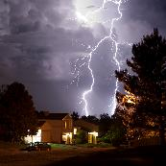

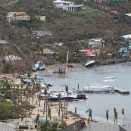

Catastrophes
Flooding events spurred 73% of federal disaster declarations
Thunderstorm related losses 2nd highest ever in U.S.
$14B insured wildfire losses; California estimated ~$11B
N.A. hurricane season record-breaking insured & economic losses; disasters affected >25 million Americans
Auto: Reaching epidemic proportions
Cyber: Risk continuing to increase

Slide 8
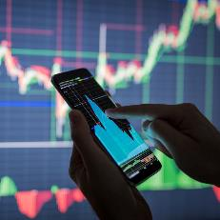

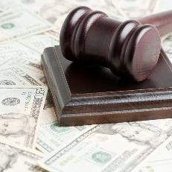
Economics
Strengthening Fundamentals:
All OECD economies growing – 1st in 10 yrs.
Tepid monetary policies; keeping interest rates at historical lows — moving slow...
Fiscal policies, i.e. tax reform and deregulation surfacing.

Slide 9



Geopolitical
Rise in Nationalism: Brexit, U.S. – Populist vote in Europe tripled since 2000*.
Political gridlock in Congress, with 2018 election lurking.
“Major conflict threat greatest since WWII“ – US Intelligence Report to Congress
* Source: Harvard University, Tony Blair Institute

Slide 10
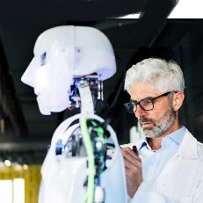

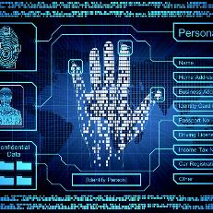
Technology
Robotics
Artificial Intelligence
“The Fourth Industrial Revolution”
Cyber meets Physical
Big Data
Internet of Things
Social Economy

Slide 11
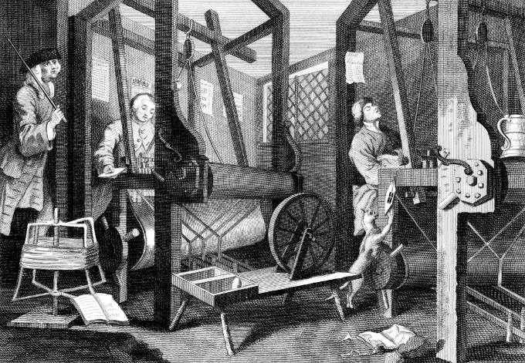
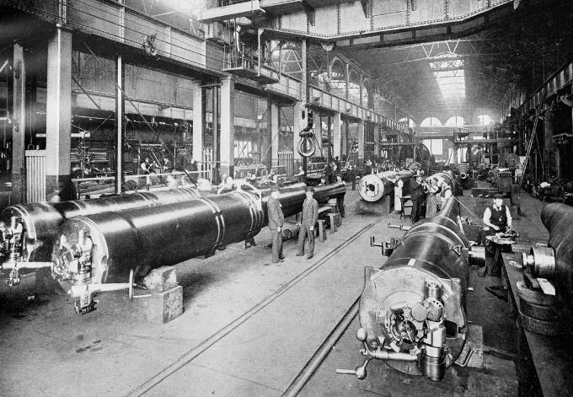
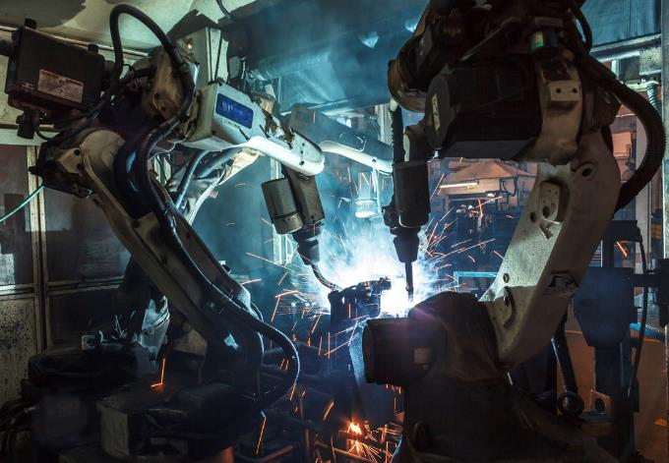

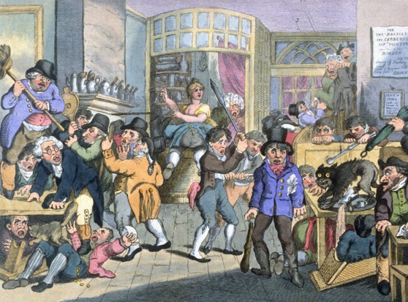
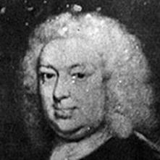
Insurance Leading Throughout History
???
1969
1870
1784
1648
Edward Lloyd’s Coffee House
Steam, Water, Mechanical Production
Division of Labor, Electricity, Mass Production
Electronics, IT, Automated Production
Cyber-Physical Systems
Notes:
We only need to look back at history to find the answer…
History shows that insurance has been helping individuals, businesses and communities look around the corner for more than 300 years – dating back to Edward Lloyd’s coffee house, which once was a center for shipping news and information, that evolved into the modern marketplace.
That marketplace was used as a tool for innovation, manufacturing and modernization.
Look at all of the three industrial revolutions:
Utilization of steam engine.
Electricity
Electronics
Insurance is what’s driving growth.
In fact we have studied this at I.I.I. and I will illustrate later that in order to have a developed economy, you need insurance
And now we find ourselves in what many are calling the Fourth Industrial Revolution – with the merging of cyber and physical systems, e.g. AI, IoT,
This will be interesting, I think most exciting for insurance.
Beyond helping the customer innovate, our own industry must look inwardly and embrace the changes that will be taking place in how we do business. This is an exciting time, no doubt.

Slide 12
Insurance Industry Economic Trends
Notes:
Will circle to this later, but first thought I would go through some of macro economic trends we are seeing for the industry at I.I.I.
Part of new product we are putting out quarterly at I.I.I.

Slide 13
U.S. Insured Catastrophe Losses, 1989–2017
($ billions, 2016 dollars)
2017 was one of the costliest years for insured disaster losses on record.
Longer-term trend is for more costly events.
*PCS estimate, subject to change
Note: 2001 figure includes $20.3B for 9/11 losses reported through 12/31/01 ($25.9B 2011 dollars). Includes only business and personal property claims, business interruption and auto claims. Non-prop/BI losses = $12.2B ($15.6B in 2011 dollars).
Sources: Property Claims Service, a Verisk Analytics business; Insurance Information Institute.
Notes:
PCS estimate for 2017 is $93B, adjusted to 2016 dollars becomes 90.7

Slide 14
Inflation Adjusted U.S. Catastrophe Losses by Cause of Loss, 1997–2016¹
Terrorism, $25.0
Fires (3), $8.4
Other (4), $0.8
Winter Storms, $28.2
Wind/Hail/Flood, $29.7
Events Including Tornadoes (2), $168.1
Hurricanes & Tropical Storms, $161.1
(1) Adjusted for inflation through 2016 by ISO using the GDP implicit price deflator. Excludes catastrophes causing direct losses less than $25 million
in 1997 dollars. Does not include flood damage covered by the federally administered National Flood Insurance Program.
(2) Includes other wind, hail, and/or flood losses associated with catastrophes involving tornadoes.
(3) Includes wildland fires.
(4) Includes losses from civil disorders, water damage, utility service disruptions, and any workers compensation catastrophes generating losses
in excess of PCS's threshold after adjusting for inflation.
Source: Property Claim Services (PCS)®, a unit of ISO®,a Verisk Analytics® business.

Slide 15
P/C Insurance Industry
Combined Ratio, 2001–2019*
Heavy Use of Reinsurance Lowered Net Losses.
Higher CAT Losses, Shrinking Reserve Releases, Toll of Soft Market
3 Consecutive Years of U/W Profits; 1st Time Since 1971–73
Best Combined Ratio Since 1949 (87.6)
HIM, Fires Drove UW Loss
Sandy
*2017-2019 I.I.I. Estimate and Forecast
*Excludes Mortgage & Financial Guaranty insurers 2008-2014.
Including M&FG, 2008=105.1, 2009=100.7, 2010=102.4, 2011=108.1; 2012:=103.2; 2013: = 96.1; 2014: = 97.0.
Sources: A.M. Best; ISO, a Verisk Analytics company; I.I.I.
Notes:
Updated 2017 result (had been 104, now 103.7
Illustrates the up and down trends of the how insurance perform in terms of what’s going out and what’s coming it.
Goal is always to get below 100.
2017 was a big year – tornados, hurricanes, wildfires.
Also saw commercial auto as a big driver.
We do see 18 and 19 as potentially lower due to cat losses lowering.
And we are beginning to see signs of flattening and even decreasing frequency and severity in auto.

Slide 16
Industry Surplus
(Billions)
Industry Remains Strong: $1.30 in surplus stands behind every dollar of premium written
Decline in Stock Market Pushed Surplus Down Slightly.
Sources: ISO, A.M. Best.
Notes:
Updated 6/25/18 – lynch

Slide 17
Net Premium Growth, Annual Change
$157 Billion
Tax Reform Led to Spike in Net Written Premium in 2018.
Through first quarter.
SOURCES: A.M. Best (2007-2013), ISO (2014-present), Insurance Information Institute.
Notes:
Updated 6/25 - lynch

Slide 18
Commercial & Personal Lines NPW Growth:
1996-2017
6.7%
3.3%
Commercial Lines is Prone to
Much More Cyclical Volatility Than Personal Lines.
Note: Data include state funds beginning in 1998.
Sources: A.M. Best; Insurance Information Institute.

Slide 19
P/C Industry Net income After Taxes
Billions, 2018 dollars
Catastrophes Hurt 2017 Results. 2018 So Far: Higher Auto Rates, Lack of Cats.
Through first quarter. Adjusted for inflation using the BLS CPI calculator.
Sources: NAIC data, sourced from S&P Global Market Intelligence; Insurance Information Institute.
Notes:
Updated 6/25/18 – lynch

Slide 20
The Changing Mix of Invested Assets,
P/C Industry, 2008-2017
From 2008 to 2017, P/C portfolios shifted out of bonds (74% of invested assets in 2008 to 65% in 2017) into common stock (up from 12% to 22%).
The U.S. economy now hovers near full employment, and inflation and interest rates are rising slowly. It would not be surprising to see the decade-long shift out of bonds begin to reverse.
Sources: NAIC data, sourced from S&P Global Market Intelligence; Insurance Information Institute.

Slide 21
Consolidation / M&A
Insurance-Related Deals
Involving U.S. Firms
499
$22B
2016
DEALS
VALUE
597
+20%
$107B
+386%
2017
1. PCS; 2. Conning Research 3. S&P Financial 4. Insurance Journal
Notes:
According to the KPMG report called “The New Deal: Driving Insurance Transformation with Strategy-aligned M&A,” 84% of insurance companies plan to make between one and three acquisitions in 2017, while 94% plan at least one divestiture.
In 2015 Anthem’s announced purchase of Cigna, and Aetna’s planned purchase of Humana together totaled $83 billion, according to S&P Global Market Intelligence. The continued scrutiny of these two deals may have dampened merger activity in this sector in 2016.

Slide 22

Commercial Lines Trends

Slide 23
Property Premiums* Grow as Investment Does
23
% change from same quarter, prior year
Investment in structures, equipment and software is expected to grow at least partly due to the provisions of the Tax Cuts and Jobs Act.
Premiums for commercial property insurance should grow nicely due to an expanding exposure base.
8.1%**
6.1%
*Commercial property direct premiums written (fire, allied lines, CMP, inland marine, burglary and theft); business fixed investment (structures, equipment, and software). **Preliminary.
Note: Recession indicated by gray shaded column. Data are seasonally adjusted annual rates.
Sources: https://fred.stlouisfed.org/series/PNFI#0; National Bureau of Economic Research (recession dates); Insurance Information Institute.

Slide 24
As Hiring Goes, Exposures Follow
(000) at quarter-end
Of these industries, construction is enjoying the fastest growth. This is expected to continue for at least the short-term.
At the end of 2018:Q1, employment in these three industries that are the heart of workers composition exposure, at 20.5 million, was not quite back to the level reached before the Great Recession.
Sources: U.S. Bureau of Labor Statistics; Insurance Information Institute.
Sources: U.S. Department of Commerce, Census Bureau; Insurance Information Institute.

Slide 25
Hospital Costs Forecast Injury Costs
Price change
For the past five years, prices for hospital services grew more moderately than before, lately at rates ranging between 3% and 6%.
Even with these more modest increases, prices for hospital care rose on average several percentage points faster than inflation generally.
4.5%
*Percentage change from same month in prior year through May 2018; seasonally adjusted.
Sources: US Bureau of Labor Statistics; National Bureau of Economic Research (recession dates); Insurance Information Institute.

Slide 26

Personal Lines Trends

Slide 27
Results by Line
LOB | 2018 | 2017 | Change From Year Earlier
Personal Auto Liab | 65 | 69
Homeowners | 57 | 61
PhysDam (PA, CA) | 58 | 64
GL (incl Products) | 56 | 51
WC | 51 | 55
Fire & Allied Lines | 49 | 46
CMP | 52 | 52
Comm Auto Liab | 67 | 65
Other | 39 | 47
Total | 56 | 59
Positive Number =
Bad News
Through Q1. Differences may not add up due to rounding.
Sources: NAIC data from S&P Global Intelligence, Insurance Information Institute.

Slide 28
Driving Patterns Predict Claim Frequency
Billions of miles driven in prior year
Overall collision claims per 100 insured vehicles
The sharp rise in collision frequency in 2014-2016 appears to have peaked in the last year. However, claim severity will likely continue to rise as 2018 will see another 17 million new cars on the road.
The only force that could derail the relationship between miles driven and frequency would be a sharp and persistent rise in the cost of gasoline.
3,215
Recession
6.06
Sources: Federal Highway Administration; Rolling four-quarter average frequency from Fast Track Monitoring System; Insurance Institute for Highway Safety; Insurance Information Institute.

Slide 29





Rising Accident Costs
All Coverages Affected
Increase in Loss Costs, 2016:Q1–2018:Q1
Bodily Injury
9.0%
Property
Damage
6.6%
Personal Injury Protection
2.6%
Collision
6.1%
Comprehensive
27.6%
From 2016 to 2018, the cost of accidents
has risen dramatically. By contrast, consumer prices overall
rose 4.8 percent during 2015 and 2017.
Source: Fast Track Monitoring System.
Notes:
The amount of claim costs per vehicle insured - known as loss costs in the industry - is the primary cost in auto insurance rates. Those have been rising across all major coverages.

Slide 30
To rent or to buy?
Millions of renter-occupied housing units
Millions of owner-occupied housing units
77
From 2004 to 2016:Q4, the number of renter-occupied housing units grew by about 10.5 million units (+34%), but there was no growth in the number of owner-occupied housing units for 12 years. This streak appears to have ended in 2016:Q4. This is good news for homeowners insurance premium growth.
43
Sources: U.S. Census Bureau at http://www.census.gov/housing/hvs/data/histtabs.html, Table 8; Insurance Information Institute.

Slide 31
Insurance Industry and Innovation

Slide 32
Insurance Disruption: Technology / Digitalization
Fundamental
Changes
Opportunities
Challenges
Future of Auto
Future of Reduced
Risk Pools
Automation / Efficiencies
New Product Lines (Cyber)
Emerging Technologies
Consumer Trust – Demonstrate the Societal Value
Big Data vs. Individual Privacy
New Market Entrants “Uber of Insurance”?
Regulatory Opportunities/Threats
Lemonade
  Offered in CA, GA, IL, NJ, NV, NY, OH, PA, TX
Barrier to Entry
US vs. Other Less Regulated Regions
Trust Pull-back – the Sandbox Approach
Notes:
Insurance Disruption
Technology / Digitalization
Fundamental changes
Future of auto insurance
Autonomous vehicles -- reduction of accidents
Future of reduced risk pools
Disparate Impact
Opportunities
Automation and efficiencies -- claims, underwriting, filings (?)
New product lines -- cyber, sharing economy
Emerging technologies -- cognitive computing, predictive analytics
Challenges
Consumer trust will be key -- demonstrate the societal value
Big data vs. personal/information privacy
New market entrants -- "Uber of Insurance"
Lemonade: Approved in State of New York
Regulatory -- Opportunity / Threat
Barrier to entry (for potential disrupters)
US -- 50+ individual regulatory bodies
Taxi vs. Insurance Regulator: One can put you in jail…
Pull back / curb
Consumer trust will play key role
Sandbox approach
US vs. other global regions with less regulatory burden
[TBD] Audience Relevance Section

Slide 33
InsurTech Disruption: Threat or Opportunity?
Automation efficiencies can have powerful impact on industry
Focus of InsurTech in the insurance value chain¹, %
Future profits as a % of
today’s profits
Only nine percent of InsurTechs
aim to oust incumbents
Digitizing the business,
auto insurance example
Disrupting the value chain
Short-term gain
Long-term decline
120-200
220-300
-20 to -60
15-55
155-195
Disintermediating incumbents from customers
100
-60 to -100
Improvements in growth, and loss-and-expense ratio²
Impact from improved vehicle safety³⁻⁴
Shift in liability to commercial product lines⁴
Improved loss-and-expense ratio⁴
Enabling the value chain
Today’s profits
2025 profits
2035 profits⁵
¹Insurtechs are insurance businesses, usually startups, that use technologically innovative apps, processes, or business models; 2016 data based on some 500 commercially well-known cases. ²Assumes a 3 to 5 percentage point improvement in loss ratio, a 2 to 4 percentage point improvement in operating expenses, and a 6 to 8 percentage point improvement in direct sales conversions. ³Includes growth in investment income as well premiums. Investment income modeled as a ﬂat percentage of premium in each year. ⁴Includes impact of semi- and fully autonomous vehicles. ⁵Assumes a
25 percent reduction in premiums as a result of telematics and sensors and a 50 percent risk transfer to commercial product liability.
Source: Panorama by McKinsey; Digital and Auto Insurers Value at Stake Analysis, McKinsey, 2016.

Slide 34
















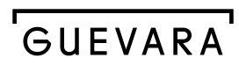
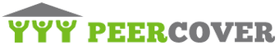










InsurTech Startups Have Broad Range…BUT…
Risk
Health
Insurance Marketplace
Digital Brokers
Peer to Peer
Health Navigators
Micro-duration Coverage
Telematics
Source: Aon.
Notes:
Based on our most recent count we are tracking over 500+ InsurTech Companies. Just a year ago that number was about half that. We are tracking companies across Risk and Health in a variety of themes. For us its more about business concepts than it is about individual companies.

Slide 35










…With Broad Incumbent Support
$205M
$57M
$37M
$21M
$4M
Note: Total funding.
Source: Aon.
Notes:
Some examples of insurance company investments in InsurTech…. As you can see it is across a variety of themes or business concepts….
Metromile – Telematics
CoverHound and Policy Genius – Insurance Marketplaces
One Inc. – Cloud Based IT Platform and
Slice – Micro-Duration Coverage.
These investments create an opportunity to accelerate growth, improve efficiency, enhance the customer experience and “Speed to Market” for new products in emerging risk.

Slide 36




Four Main Effects on Insurance in the
Fourth Industrial Revolution
Customer Expectations
  Amazon raises the bar
  AI and robotics
Product Enhancement
More personalized and/or digitally-enhanced
Value focus on risk mitigation and resilience
Collaborative innovation
  Speed of innovation requires new forms of collaboration to keep up
Organizational forms
  Talent, culture, and organizational forms will have to be rethought
Source: https://www.weforum.org/agenda/2016/01/the-fourth-industrial-revolution-what-it-means-and-how-to-respond/

Slide 37





Challenges the Insurance Industry Faces in Innovation
Sources: PricewaterhouseCoopers, Global Insurtech Report - 2017
Notes:
https://www.pwc.es/es/publicaciones/seguros/fintech-seguros-junio-2017%20.pdf

Slide 38

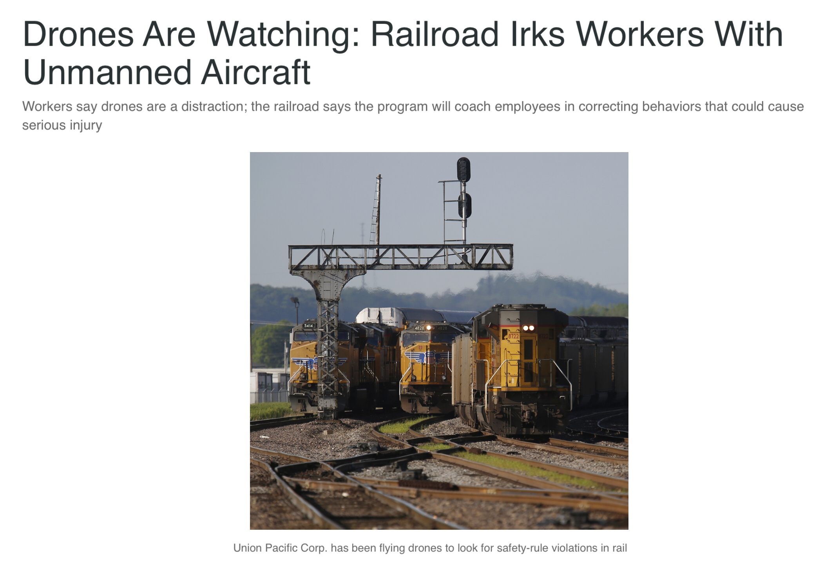
Transparent Communications Will Be Critical…

Slide 39
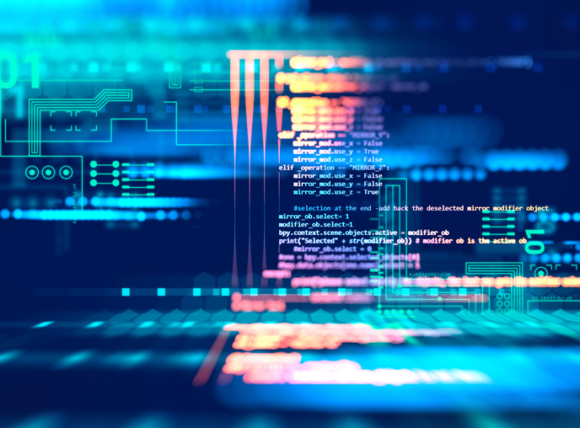






Successful Digital Transformation
→ Holistic Approach
Notes:
All industries being impacted

Slide 40
Insurance Leadership in Economics

Slide 41
Insurance & Economic Leadership
Sustainable Business Model
Strong Jobs Pool/Provider
Economic Growth Promoter/Facilitator
2010
$612B
3.1%
US GDP³
Bank Failures: 157
2.8M Employed
Premium Taxes Paid⁴ $19.2B
Insurance Impairments¹: 8
Bond Investment⁵ $489B
Policyholder Surplus:
~$750B
End
Q1/18
Need to Fill
400K+ by 2022²
Charity/Volunteerism⁶ 15%
¹Life/Health and P/C Insurance; ²PC 360 http://www.propertycasualty360.com/2013/04/17/insurance-industry-crisis-400000-positions-to-fill?slreturn=1476304299; ³U.S. Bureau of Economic Analysis, 2016; ⁴U.S. Department of Commerce, 2015;
⁵Federal Reserve, 2015; ⁶2011–2014, Insurance Industry Charitable Foundation.
Notes:
2.8 million jobs, with many becoming available
400k to retire by 2020
Actuaries: 18% increase 2014-2024
Risk Managers: 6% increase by 2020
Diversity in the industry – Not always a beacon, but improving
Women
61% insurance workforce 2007-2016
1.7 million in 2016: 60.9%
Wide variety of roles:
Sales: 630k
Claims: 622k
Underwriters: 100k
Actuaries: 14k
IICF Women in Insurance Conference – One of the most successful
20 programs / initiatives
Leaders Surfacing to top
Inga Beale: Lloyd’s
Kathleen Savio: Zurich
Pina Albo: Hamilton Group

Slide 42










How Insurance Drives Economic Growth
Safety/
Security
Economic/
Financial Stability
Development
Insurers are financial first responders
Insurers are capital protectors
Insurance is a partner in social policy
Insurers are community builders
Insurance enables infrastructure improvements
Insurers
are risk mitigators
Insurance sustains the supply chain
Insurers are capital infusers
Insurers are innovation catalysts
Insurers are credit facilitators
Notes:
42
Importance to educate people on the value of insurance
shows that in 2012, 8 percent answered yes, and another 27 percent did not know, meaning that more than one person in three could incorrectly expect government support where none would be forthcoming.2

Slide 43
Since 2015, the Insurance Industry’s Contribution to GDP Exceeds That of Banks
Recession
3.1%
2.9%
Sources: US Bureau of Economic Analysis https://www.bea.gov/iTable/iTable.cfm?ReqID=51&step=1#reqid=51&step=51&isuri=1&5114=a&5102=5 ;
Insurance Information Institute.

Slide 45
Thank you!
www.iii.org

