Slide 1
Energy Infrastructure and Vulnerabilities Insurance Market Perspectives
U.S. Department of Energy
Quadrennial Energy Review Public Meeting
Washington, DC
April 11, 2014
Download at www.iii.org/presentations
Robert P. Hartwig, Ph.D., CPCU, President & Economist
Insurance Information Institute ♦ 110 William Street ♦ New York, NY 10038
Tel: 212.346.5520 ♦ Cell: 917.453.1885 ♦ bobh@iii.org ♦ www.iii.org

Slide 2
Energy Is a Very Large and Very Challenging Business for Insurers Worldwide
Energy is One of the Few Major Markets/Industries With Clear Long-Term Growth Trends
2

Slide 3
Energy Insurance Market Summary
Energy is Among the Insurance Industry’s Largest Industry Sectors
Insurers Have Extensive Experience Offering Comprehensive Solutions Across the Entire Spectrum of Energy Industry Property and Liability Exposures
Extraction (on/offshore)
Refining and Storage
Transportation (marine, rail, truck)
Generation (Electricity)
Renewables
Workers Compensation
Management Liability (D&O)

Slide 4
Energy Insurance: Market Summary (cont’d)
Multi-Billion Dollar Limits Are Available in Most Segments
Property and liability exposures
Risks are rewarded for superior experience
Results Can Be Volatile
Insurers Work Closely With Client Risk Managers
Price of Coverage is Both Event Driven and Cyclical
Market is Truly Global
Substantial share of underwriting capacity originates abroad
History of Working Closely to Reduce Loss, Enhance Resilience
Major losses stimulate innovative risk management
Price (premium/rate) is a powerful signal about risk; Motivates

Slide 5
World Primary Energy Consumption, 1990-2040P
Quadrillion BTUs
Growth in worldwide energy consumption will create more risk and vulnerabilities (natural and manmade); Innovations in risk management and insurance are needed.
Between 2010 and 2040, energy consumption in projected to increase by 56.4% worldwide
Source: Energy Information Administration, 2013 International Energy Outlook, Insurance Information Institute.

Slide 6
Cumulative Projected Investment in Global Energy Infrastructure, 2011-2035 ($ Trill.)
Projected energy infrastructure investment through 2035 total $38 trillion; Implies substantial incurrence of risk.
Source: International Energy Agency, World Energy Outlook 2011.

Slide 7
US Electric Power Generation by Fuel Source, 2010-2035F (Billions of Kilowatt Hours)
4,279
4,427
3,937
4,118
3,806
3,796
Demand for Electricity Is Expected to Grow at a 0.6% Annual Rate Through 2035. Renewables and Natural Gas Will Account for an Increasing Share of Fuel Source
Source: US Energy Information Administration, Annual Energy Outlook 2012, Appendix A7.
7
12/01/09 - 9pm
eSlide – P6466 – The Financial Crisis and the Future of the P/C
Notes:
7

Slide 8
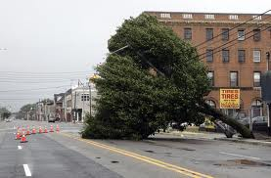
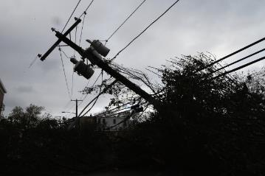
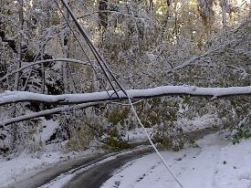
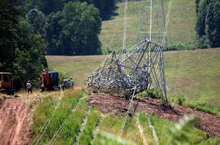
The Past Few Years Have Not Been Kind to Insurers or Utilities
Hurricane Irene: Aug. 27-29, 2011
Insured Losses: $4.3 Billion
Customers w/o Power: 5 Million
“Snowtober” Blizzard: Oct. 29, 2011
Insured Losses: ~$1 Billion
Customers w/o Power: 2.7 Million
Derecho: June 29, 2012
Insured Losses: ~$1+ Billion
Customers w/o Power: 3.7 Million
Superstorm Sandy: Oct. 29-30, 2012
Insured Losses: $18.8 Billion Customers w/o Power: 8.1 Million
Source: Insurance Information Institute research.

Slide 9
U.S. Insured Catastrophe Losses
($ Billions, $ 2012)
2012 was the third most expensive year ever for insured CAT losses
2012 Was the 3rd Highest Year on Record for Insured Losses in U.S. History on an Inflation-Adj. Basis. 2011 Losses Were the 6th Highest. YTD 2013 Running Well Below 2011 and 2012 YTD Totals.
Record tornado losses caused 2011 CAT losses to surge
*Through 12/31/13.
Note: 2001 figure includes $20.3B for 9/11 losses reported through 12/31/01 ($25.9B 2011 dollars). Includes only business and personal property claims, business interruption and auto claims. Non-prop/BI losses = $12.2B ($15.6B in 2011 dollars.)
Sources: Property Claims Service/ISO; Insurance Information Institute.
9
12/01/09 - 9pm
eSlide – P6466 – The Financial Crisis and the Future of the P/C
Notes:
9

Slide 10
Inflation Adjusted U.S. Catastrophe Losses by Cause of Loss, 1993–2012¹
Wind/Hail/Flood (3), $14.9
Fires (4), $6.5
Other (5), $0.2
Insured cat losses from 1993-2012 totaled $391.7B, an average of $19.6B per year or $1.6B per month
Geological Events, $18.4
Terrorism, $24.8
Winter Storms, $27.8
Hurricanes & Tropical Storms, $158.2
Tornado share of CAT losses is rising
Wind losses are by far cause the most catastrophe losses, even if hurricanes/TS are excluded.
Tornadoes (2), $140.9
Catastrophes are defined as events causing direct insured losses to property of $25 million or more in 2012 dollars.
Excludes snow.
Does not include NFIP flood losses
Includes wildland fires
Includes civil disorders, water damage, utility disruptions and non-property losses such as those covered by workers compensation.
Source: ISO’s Property Claim Services Unit.

Slide 11
Top 16 Most Costly Disasters in U.S. History
(Insured Losses, 2012 Dollars, $ Billions)
Hurricane Sandy became the 5th costliest event in US insurance history
Includes Tuscaloosa, AL, tornado
Includes Joplin, MO, tornado
Hurricane Irene became the 12th most expense hurricane in US history in 2011
12 of the 16 Most Expensive Events in US History Have Occurred Over the Past Decade
*PCS estimate as of 4/12/13.
Sources: PCS; Insurance Information Institute inflation adjustments to 2012 dollars using the CPI.

Slide 12
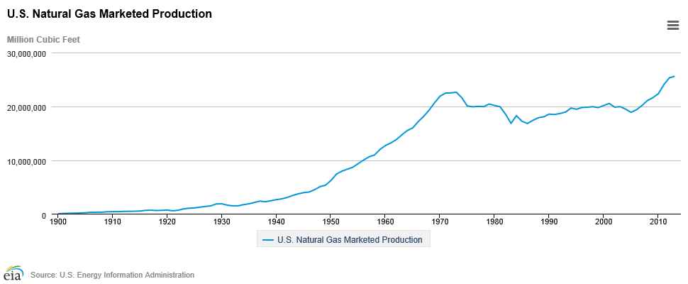
U.S. Natural Gas Marketed Production,
1900 - 2013
Million Cubic Feet
Hydraulic fracturing (fracking) has pushed US natural gas productions to record levels. The U.S. is now the world’s largest NG producer.
Source: U.S. Energy Information Administration, accessed 4/10/14 at http://www.eia.gov/dnav/ng/hist/n9050us2a.htm
12

Slide 13
U.S. Natural Has Imports and Exports, 1990 - 2040
Trillions of Cubic Feet
The US is now the largest gas producer in the world, though Russia is the largest exporter. The US needs to invest in its pipeline and LNG infrastructure and expedite regulatory approval to realize its full export potential
Sources: US Energy Information Administration, Annual Energy Outlook 2014 Early Release Overview; ;Insurance Information Institute.

Slide 14
U.S. Crude Oil Production, 2005-2015P
Millions of Barrels per Day
Crude oil production in the U.S. is expected to increase by 82.6% from 2008 through 2015
Source: Energy Information Administration, Short-Term Energy Outlook (April 8, 2014) , Insurance Information Institute.

Slide 15
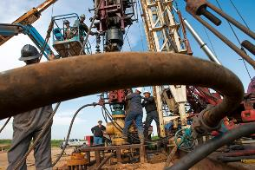
Oil & Gas Extraction Employment, Jan. 2010—March 2014*
Oil and gas extraction employment is up 33.1% since Jan. 2010 as the energy sector booms. Domestic energy production is essential to any robust economic recovery in the US.
Highest since Aug. 1986
(Thousands)
*Seasonally adjusted
Sources: US Bureau of Labor Statistics at http://data.bls.gov; Insurance Information Institute.
15
12/01/09 - 9pm
eSlide – P6466 – The Financial Crisis and the Future of the P/C
Notes:
15

Slide 16
Insurance Industry Concerns Related to Energy Infrastructure
Grid Vulnerability to Physical (Terrorist) Attack
April 2013 attack on PG&E substation in Metcalf, CA
Question of public disclosure of such events per DOE IG report
Expiration of Terrorism Risk Insurance Act 12/31/14
Pipeline Risks
Pollution/Environmental risks
Offshore
Remains a concern post-Deepwater Horizon
Vulnerable to manmade and natural disaster risks
Arctic Pollution
New frontier
Rail Transportation
Concerns in the wake of several major, costly explosions
Cyber
“Data” policies available (protects value of digital assets)
Management liability coverage (D&O) increasingly available
Broad property and liability is not commonly available
Source: Insurance Information Institute research and Willis 2014 Energy Market Review.

Slide 17
The Spectrum of Political Violence Including Terrorism
DISTURBING FACTS
In the US, 40% of all cyber attacks on critical infrastructure assets in 2012 occurred against the energy sector
Globally, it’s estimated that cyber attacks against oil and gas infrastructure will cost oil and gas companies $1.87 billion by 2018
The UK govt. estimates that oil and gas companies in the UK already lose ~GBP400 million per year as a result of cyber attacks
Sources: ICS-CERT; ABI; KPMG
The view is that eventually terrorism risk could be managed within the spectrum of Political Violence risks, which are a constant concern in the global energy sector
Sources: 2014 Willis Energy Review, p.25.

Slide 18
Insurance Information Institute Online:
www.iii.org
Thank you for your time and your attention!
Twitter: twitter.com/bob_hartwig
Download at www.iii.org/presentations

