Slide 1
Premium Trends
Claim Trends
Investment Trends
Profitability Trends
So far, 2019 Looks Like a Good Year

Slide 2
Net Premium Written Growth, Annual Change
The tax reform act at the end of 2017 led to the spike in net written premium in 2018 - $314B at Second Quarter.
The 1.1% growth in 2019:1H is distorted by the spike the previous year.
As a general rule, net written premium growth tracks nominal GDP growth.
All data through second quarter.
SOURCES: NAIC data sourced through S&P Global Intelligence, Bureau of Economic Affairs, Insurance Information Institute.
Notes:
Updated 6/25 – lynch
Updated 9/13 lynch

Slide 3
Net Underwriting Gains & Losses,
1st Halves of Each Year, 2008-2019
$ Millions
Second-highest first-half U/W gains in last dozen years
Net underwriting results in the first half of the year
have been quite variable, but mostly losses.
Sources: ISO/PCI; Insurance Information Institute.

Slide 4
Net Investment Gains Vary Mainly With Realized Capital Gains/Losses, 1st Halves, 2007-2019
$ Billions
In the first half of the year, net investment income has been steady but realized capital gains/losses have been variable.
Sources: ISO/PCI; Insurance Information Institute.

Slide 5
Sources of Profit (before taxes), 1st Halves, 2007-2019
$ Billions
Second-Highest first-half profit in last dozen years
In the first half of 2018 and 2019, net investment gains alone
were higher than total profits in prior years.
Sources: ISO/APCIA; Insurance Information Institute.

Slide 6
P/C Industry Net Income After Taxes*,
1st Halves, 2007-2019
$ Billions, 2018 dollars
In the first half of the year, net income varied.
2019 was the third-highest profit in the last dozen years.
*adjusted for inflation using the BLS CPI calculator, to 2018 dollars
Sources: ISO, a Verisk Analytics company; Insurance Information Institute.

Slide 7
Policyholder Surplus, 2006–2019
Surplus as of 6/30/19 stood at $802.2B
($ Billions)
The industry now has $1 of surplus for every $0.77 of NPW,
near the strongest claims-paying status in its history.
The P/C insurance industry is in very strong financial condition.
Sources: ISO, A.M .Best.
7
12/01/09 - 9pm
eSlide – P6466 – The Financial Crisis and the Future of the P/C
Notes:
7

Slide 8
Six Insurance Industry Challenges
Severe Weather Trends
The “Protection Gap”
Financial Illiteracy and Innumeracy
Behavioral Economic Biases
“Big Data”
Attracting Top and Diverse Talent
Notes:
Antitrust disclaimer – no one should express their individual plans or situation
With three major hurricanes, an earthquake and record wildfires in the third quarter of the year, following an above-average catastrophe first-half, there is talk about a “hard market” emerging.
How is a hard market defined?
A hard market occurs when insurance premiums grow substantially faster than the economy.
Premiums are measured by Net Written Premiums
The economy is measured by nominal GDP
The last hard market was 15 years ago. Are we due for another one?

Slide 9
Severe Weather

Slide 10
Storms Coming at “Warp Speed”
From The New York Times
[Hurricane] Imelda …, which struck two years and two weeks after [Hurricane] Harvey, means Harris County has now suffered one 500-year rainfall event and two 100-year events since 2016.
Source: Christopher Flavelle, “In Houston, A Rash of Storms Tests the Limits of Coping with Climate Change,” New York Times, October 2, 2019.

Slide 11
U.S. Inflation-Adjusted Cat Losses
Harvey, Irma, Maria
2018 – Third worst year for U.S. Insured Catastrophe Losses. Average Insured Loss per Year for 1980-2018 is $19.3 B.
*2018: Inflation-adjusted estimate, subject to change. 2010s is average of 2010 to 2018. All losses are Direct.
Sources: Property Claims Service, a Verisk Analytics business; Insurance Information Institute.

Slide 12
Post 2005, NFIP Payouts Have Spiked (to the Few Americans With Flood Insurance)
NFIP Payouts (000) in 2018 $
2005:
Hurricanes KRW
Oct 2012:
Superstorm
Sandy
2017: Hurricanes HIM
Source: FEMA NFIP
Year

Slide 13
The “Protection Gap”
It’s Getting Worse

Slide 14
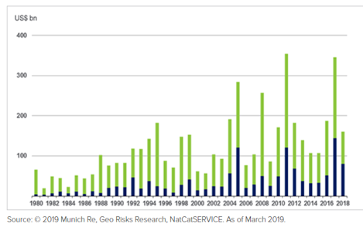
The Protection Gap:
Total Uninsured Property Losses
World Natural Catastrophes By Insured (Blue) and Overall (Green) Losses, 1980–2018
The “Protection Gap”

Slide 15
Understanding the Concept, and its Flaws
Broadly, it assumes that the goal is insurance sufficient to cover all losses that are likely to occur
  Anything less than full loss reimbursement leaves the policyholder undercompensated and unable to fully recover
  Typically, when this happens, the insurance industry is blamed for the product’s failure to restore the policyholder to pre-loss condition
Sources: Swiss Re Institute, Sigma No. 5/2019, “Indexing Resilience: a primer for insurance markets and economies”; I.I.I.

Slide 16
Understanding the Concept, and its Flaws
Of course, only insuring against trend losses doesn’t assure that policyholders will have full (or nearly full) insurance because
  Future extreme events could be more frequent and/or more violent and cause more damage
  The graphs ignore flood damage/coverage and all perils not currently insured in the private market. Counting these would make the protection gap wider (and tougher to close).
Sources: Swiss Re Institute, Sigma No. 5/2019, “Indexing Resilience: a primer for insurance markets and economies”; I.I.I.

Slide 17
Understanding the Concept, and its Flaws
Even with it’s flaws, the concept has merit. If we shrink the Protection Gap,
  More insureds would recover more quickly and more fully from natural disasters
  People would have a more favorable (or less hostile) view of insurance
  Insurers’ premium income would rise and stay higher
Sources: Swiss Re Institute, Sigma No. 5/2019, “Indexing Resilience: a primer for insurance markets and economies”; I.I.I.

Slide 18

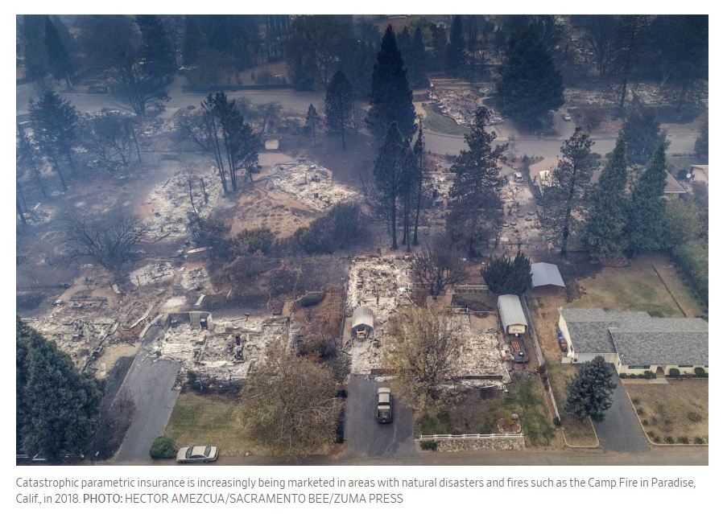
One of a homeowner’s worst nightmares is learning that major expenses resulting from a natural disaster aren’t covered by their insurance policy.
As hurricanes, wildfires and other natural disasters have increased in recent years, so has marketing of insurance products designed to offer policyholders more coverage than typical homeowners policies give.
One type of policy consumers are seeing more of is catastrophic parametric insurance. Unlike traditional indemnity benefits, parametric policies pay a predetermined amount of money when a trigger is met—such as a named storm, certain wind speeds, geological readings, waterlines, flood depths, or burned acreage.
Source: Lisa Ward, “Insurers Aim to Fill In the Disaster Gap,” Wall Street Journal, Oct. 21, 2019

Slide 19
Many Renters Have a Large Protection Gap (Because They Have No Renters Insurance At All)
Percent of Renters Who Have Renters Insurance
Source: I.I.I. public opinion poll taken November 8-11, 2018

Slide 20
Financial Illiteracy and Innumeracy
(Nobody Understands Insurance or anything else financial)

Slide 21
Financial Literacy:
A 3-Question Test
This test has been administered world-wide to provide a rough indicator of financial literacy
among many populations.
21
Notes:
21

Slide 22
The First Financial Literacy Question
If you had $100 in a savings account with an interest rate of 2 percent per year, after 5 years, how much do you think you would have in the account if you left the money to grow?
More than $102
Exactly $102
Less than $102
Don’t know
Refuse to answer

Slide 23
The Second Financial Literacy Question
If the interest rate on your savings account was 1 percent per year and inflation was 2 percent per year, after 1 year with the money in this account would you be able to buy
More than today
Exactly the same as today
Less than today
Don’t know
Refuse to answer

Slide 24
The Third Financial Literacy Question
“Buying a single company stock usually provides a safer return than a stock mutual fund.” This statement is
True
False
Don’t know
Refuse to answer

Slide 25
Financial Literacy by Age Group and Education
Percent answering all three questions correctly
*The questions ask about interest rates, inflation, and risk diversification (comparing individual stocks vs. stock mutual funds). The details are on page 10 of the cited article and in other articles cited by the authors.
Source: Lusardi and Mitchell, “The Economic Importance of Financial Literacy: Theory and Evidence,” Journal of Economic Literature, 2014 (pp. 5-44).

Slide 26
Why Is This Important?
To make good decisions regarding the types and amounts of P/C insurance to buy, consumers should understand
The types of losses/claims that they might sustain
The likelihood/probability of those various kinds of losses/claims—what we call “frequency”
The potential severity of those losses

Slide 27
Behavioral Economic Biases:
Why Don’t People Buy Insurance or Take Protective Measures?

Slide 28
Decision-making is generally poor when dealing with problems that are
  Unfamiliar
  Complex
  In the future
And we often use instinct instead of reason.

Slide 29
6 Biases That Lead to Bad Insurance Decisions
Myopia – focusing on immediate costs (premiums, preventive measures) and ignoring future benefits
Amnesia – forgetting past disasters
Optimism – “it won’t happen to me”
Inertia – tendency to not act in the face of uncertainty
Simplification – tendency to focus on a subset rather than all relevant factors
Herding – tendency to do what others are doing
Source: Meyer and Kunreuther, The Ostrich Paradox: Why We Underprepare for Disasters, Wharton School Press, 2017.

Slide 30
“Big Data”

Slide 31
“Big Data” Definition
Data that contains greater variety arriving in increasing volumes and with ever-higher velocity (the three Vs).
Big data is
larger, more complex data sets, especially from new data sources.
These data sets are so voluminous that traditional data processing software just can’t manage them.
These massive volumes of data can be used to address business problems you wouldn’t have been able to tackle before.
Source: https://www.oracle.com/big-data/guide/what-is-big-data.html

Slide 32
Some tough challenges involving Big Data
Maintaining Compliance with a plethora of laws and regulations.
  All 50 states have some sort of data protection regulation, with the strictest data laws in California and Vermont.
  It is vital that insurers utilize a data system that is flexible and scalable, so they can stay in compliance as laws and regulations continue to change over time.
Convincing regulators that new rating variables, from Big Data, are acceptable
Source: https://www.duckcreek.com/blog/insurance-big-data-analytics-trends/

Slide 33
Attracting Top and Diverse Talent:
It’s Going to be Tougher than Ever

Slide 34
Unemployment Rates, Bachelor’s Degree vs. All
January 2000 through Sept. 2019 Seasonally Adjusted (%)
10.1%
5.0%
3.5%
2.0%
Even in the worst of the “Great Recession,” the unemployment ate for people with a Bachelor’s degree or higher never rose above 5%.
Sources: US Bureau of Labor Statistics; Insurance Information Institute.
34
12/01/09 - 9pm
eSlide – P6466 – The Financial Crisis and the Future of the P/C
Notes:
34

Slide 35
Over 42,000 Employed in Computer Occupations at P/C Insurance Carriers
Thousands
Virtually every aspect of insurance activity now involves computers in some way, so these totals can be expected to grow.
Sources: Bureau of Labor Statistics; I.I.I.

Slide 36
Over 150,000 Employed in Traditional Insurance Occupations at P/C Carriers
Thousands
These are occupations that one expects to find at a P/C insurance carrier. Increasingly, routine tasks are being automated and so the work-product relies more on judgment and experience.
Sources: Bureau of Labor Statistics; I.I.I.

Slide 37
Employment Cost Growth,
Insurance Carrier Employees
Percent change from same quarter, prior year Not seasonally-adjusted
Employment cost (wages + benefits) have generally risen faster than inflation
by roughly 1 percentage point per year.
Sources: U.S. Bureau of Labor Statistics; Insurance Information Institute.

Slide 38
Thank you

